Slide 1

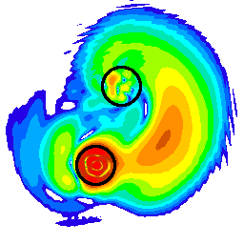
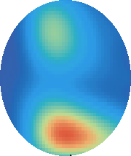
Neutron-proton pairs in the self-conjugate nuclei of the fp-shell through two-nucleon transfer reactions
M. Assié, IJCLab Orsay, assie@ijclab.in2p3.fr

Slide 2
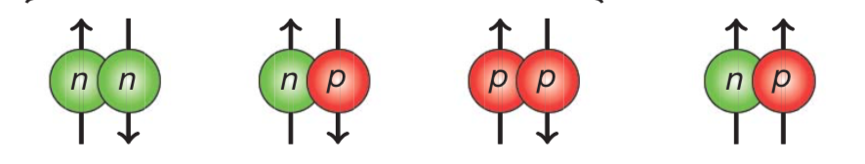
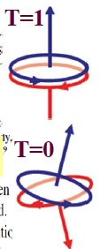
Neutron-proton pairing : generalities
T=1,S=0
T=0,S=1
np pairing occurs in 2 different states:
-T=1 (isovector)
-T=0 (isoscalar) <-- unique in np pairs
Manifestations of np pairing
deuteron : only mass-2 nucleus to be bound
overbinding of N=Z nuclei --> effect of shells
Where to search for np pairing ?
- N=Z nuclei
- stronger in high-j orbitals --> fp shell
The question is whether or not the T=0 pairing can create a correlated state in analogy with the BCS superfluid phase.
J=0
T=0 J=1
How to probe neutron-proton pairing experimentally ?
2

Slide 3
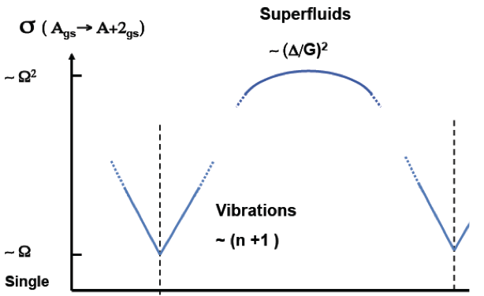
Transposition for np-transfer reactions
If pairing is important, the 2N transfer probability should be enhanced, particularly at mid-shell and will sign the onset of a superfluid phase:
Enhencemnet factor :
- 25 for nn pairs Brink & Broglia, Nuclear superfluidity
- 2.5 for np pairs Fröbrich, Phys. Lett. (1971)
S. Frauendorf, Prog. in Part. and Nucl. Phys. (2014)
mid shell
closed shell
A
closed shell
reaction | selectivity
(p,³He) | ΔT=0,1
(³He,p) | ΔT=0,1
(d,α)(α,⁶Li) | ΔT=0
(α,d)(⁶Li, α) | ΔT=0
ΔL=0,2
deuteron-like
ΔT=0
1⁺,T=0
Transfer can take place in
  T=0,J=1 state (deuteron transfer)
  T=1,J=0 state (analog to 2n or 2p transfer)
The (p,³He) and (³He,p) transfer reactions allow both channels ΔT = 0,1.
0⁺,T=1
0⁺,T=0
ΔT=1
^{2(Z±1)}(Z±1)
^{2Z}Z
ΔL=0
The usual observable for np transfer is the ratio σ (0⁺)/σ (1⁺) that gives the relative strength of T=1/T=0 pairing.
3

Slide 4
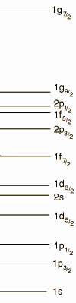
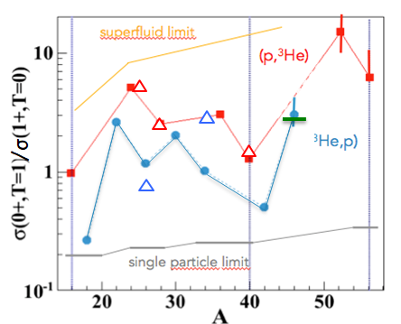

State-of-the-art of the search for np pairing
sd-shell
?
sd-shell systematic measurement (stable nuclei)
    From litterature & ENSDF:
- max of cross-section (lowest angle measured)
+ no error bars
- first 0+ and first 1+ states taken into account
(no centroid)
    Recent consistent remeasurement : Y. Ayyad et al, PRC 96 (2017) (open triangles)
50
(p,³He)
28
20
(³He,p)
8
60
70
A
Overall ~ agreement with parabolic shape

Slide 5
State-of-the-art of the search for np pairing
sd-shell
fp-shell
fp shell measurements (inverse kinematics):
    ⁴⁴Ti(³He,p)⁴⁶V @ Argonne
    (A.O. Macchiavelli et al)
    ⁵⁶Ni, ⁵²Fe(p,³He)⁵⁴Co,⁵⁰Mn @ LISE
    (B. Le Crom M. A. et al)
    ⁴⁸Cr(p,³He)⁴⁶V : @ LISE
    (H. Jacob, M. A. et al)
50
(p,³He)
28
20
(³He,p)
8
60
A

Slide 6
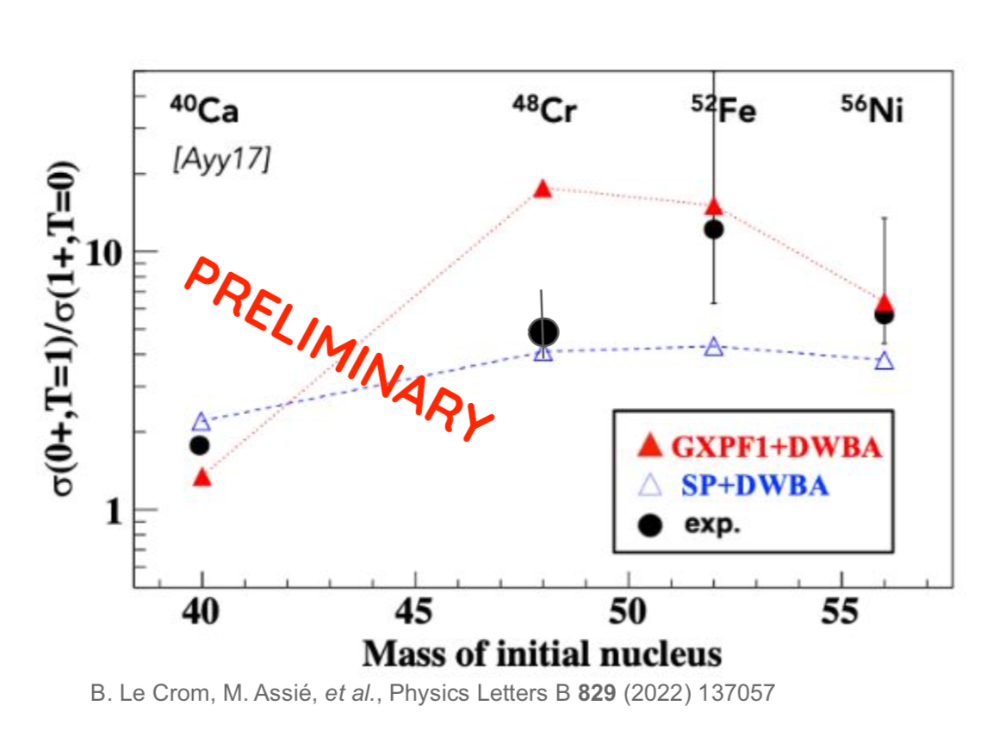
State-of-the-art of the search for np pairing : f-shell
50
T=1 (1f_{7/2})² & (1f_{5/2})²
T=0 (1f_{7/2})² & (1f_{5/2})² &(1f_{7/2})(1f_{5/2})
28
20
8
Good agreement between exp and DWBA+pairing (although with large error bars)
T=1 ~ superfluid
T=0 very weak due to the effect of spin-orbit that hinders T=0 pairing in the fp-shell.
Except for ⁴⁸Cr : interplay between pairing and deformation ? --> still under investigation

Slide 7
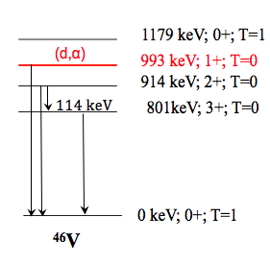
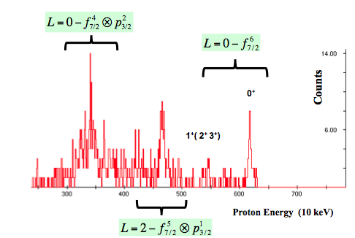
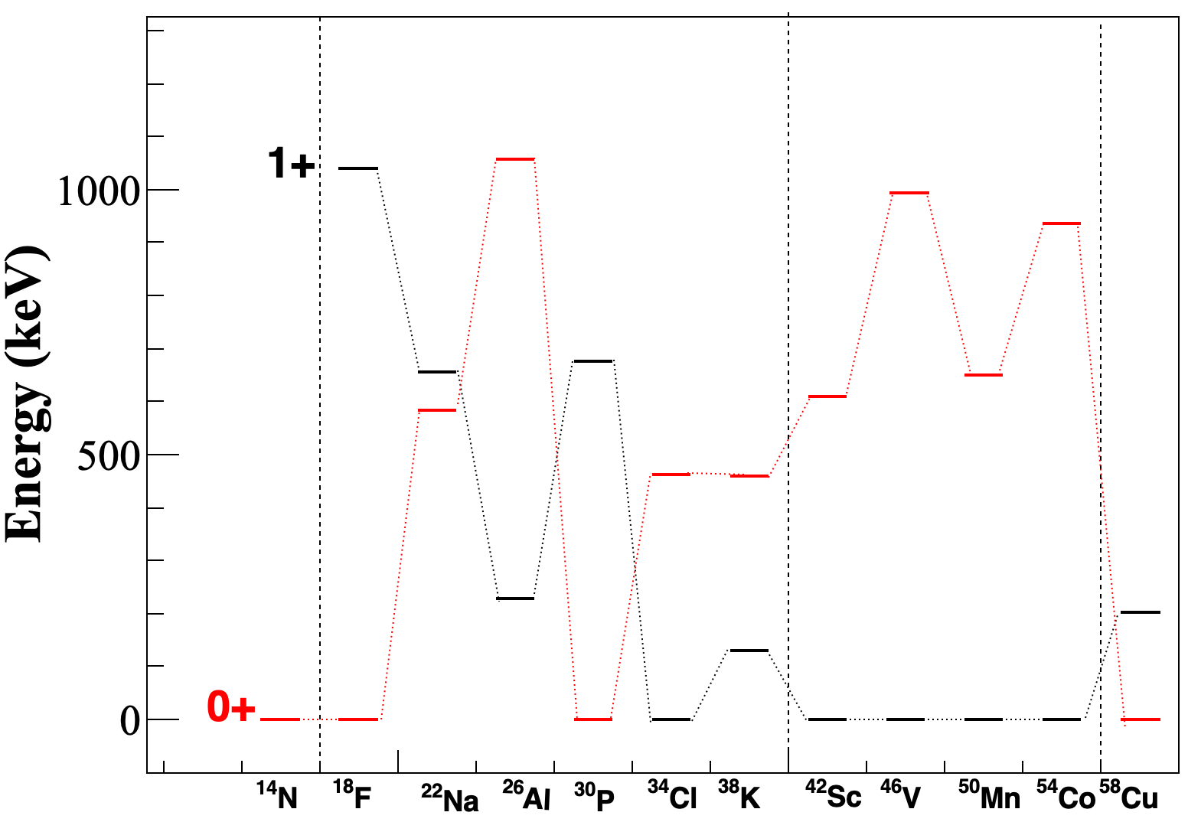
np paring in the fp-shell : further studies
⁴⁴Ti(³He,p)⁴⁶V for re-measurement given that the first low lying
states could not be disentangled in the Argonne experiment.
--> particle-gamma coincidences are crucial
50
28
20
0+
8
⁵⁶Ni(³He,p)⁵⁸Cu : ⁵⁸Cu is the only fp shell odd-odd nucleus with g.s. T=0
Spin-orbit effect reduced in this nucleus ?
1+

Slide 8
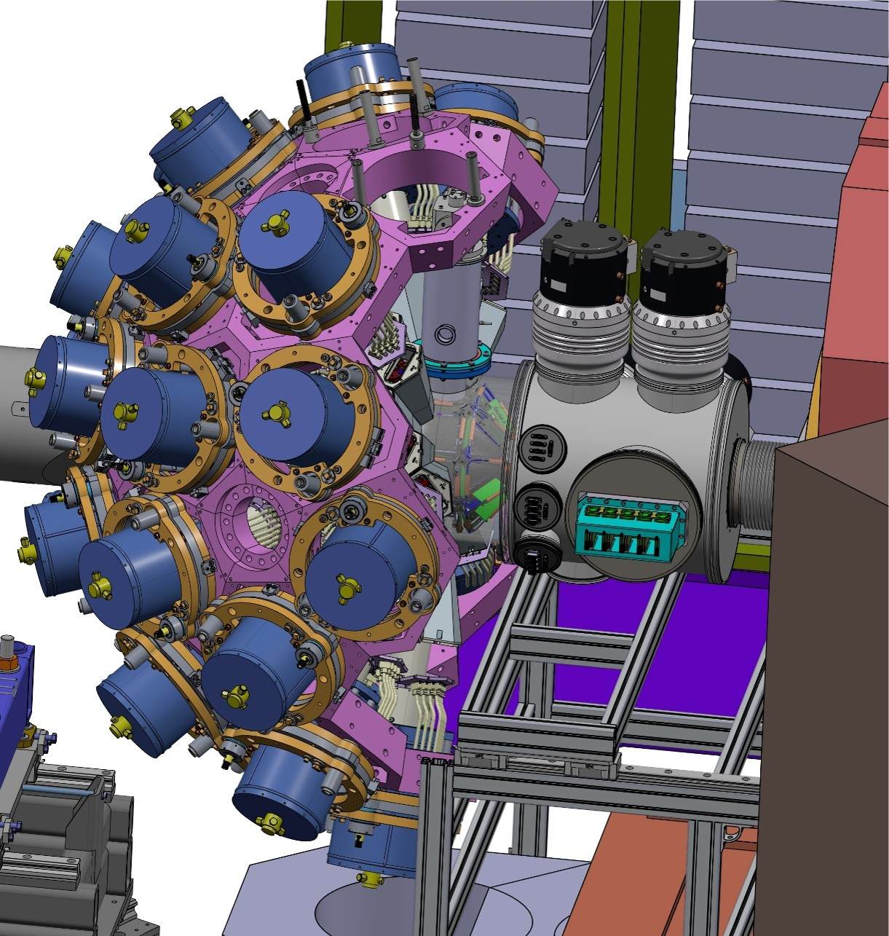

Experimental set-up
. GRIT phase 0 (not full array)
. ATRACT : after the experience with
HecTOr during the MUGAST-AGATA-VAMOS campaign a new design is under investigation (funded by ANR ATRACT):
- based on cryocooler
- thinner windows
- de-icing protocol

Slide 9
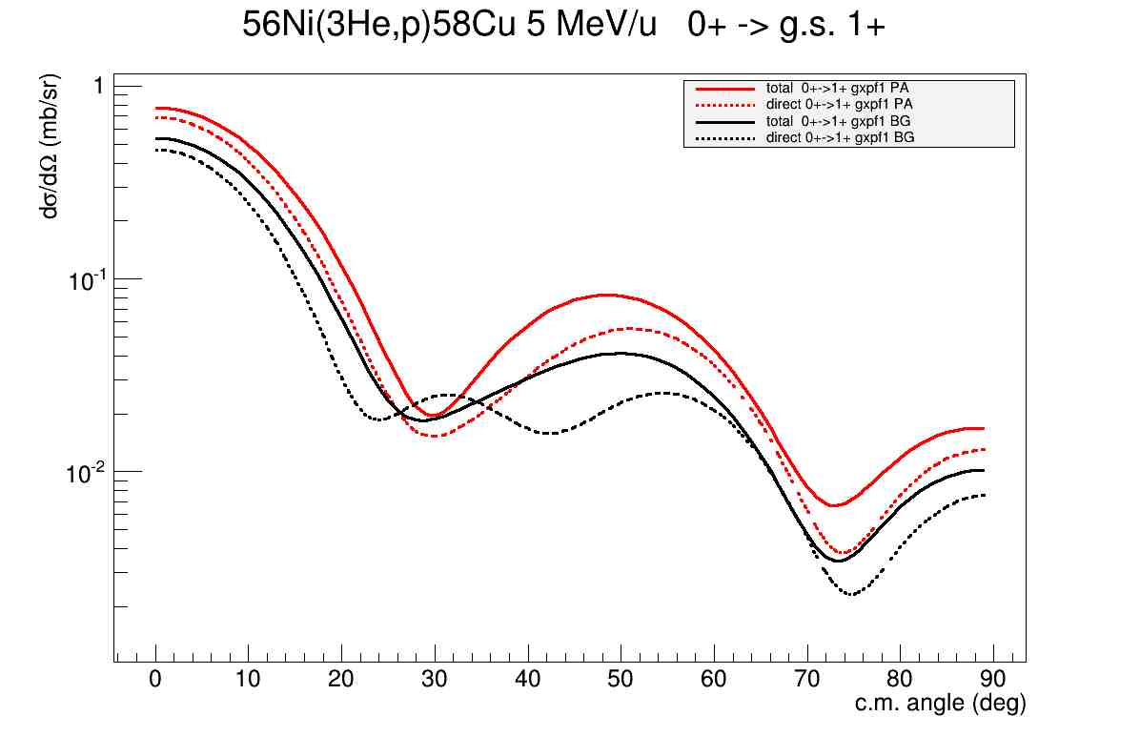
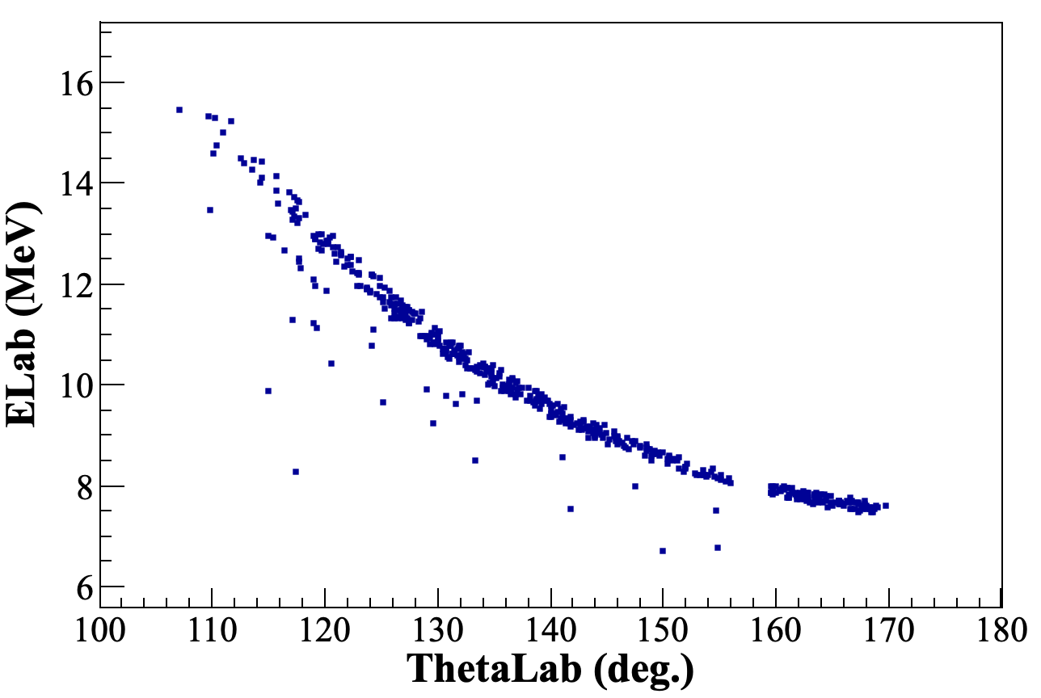
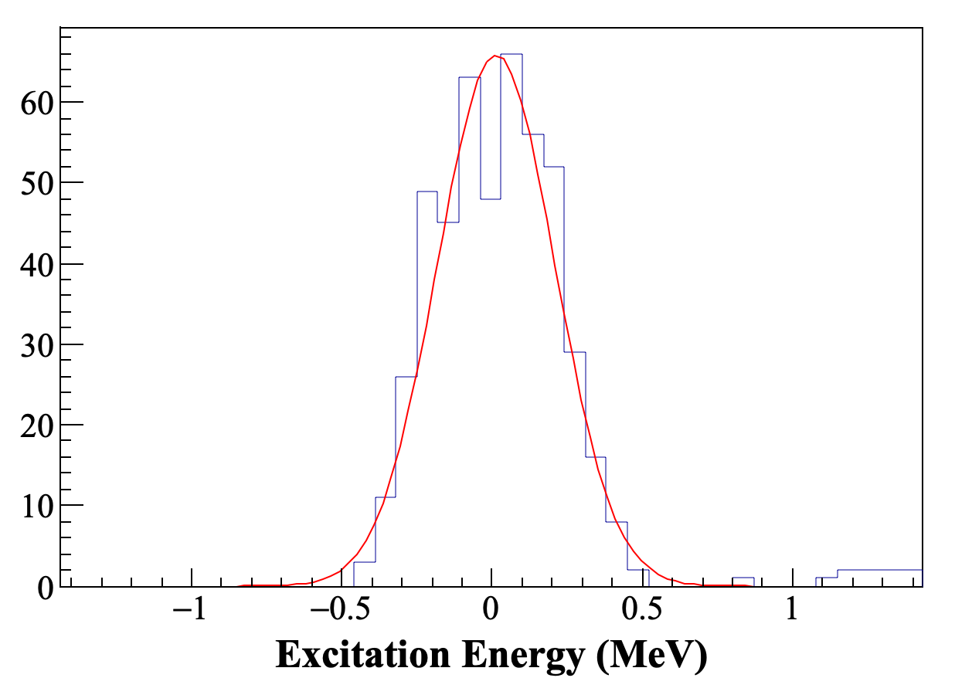
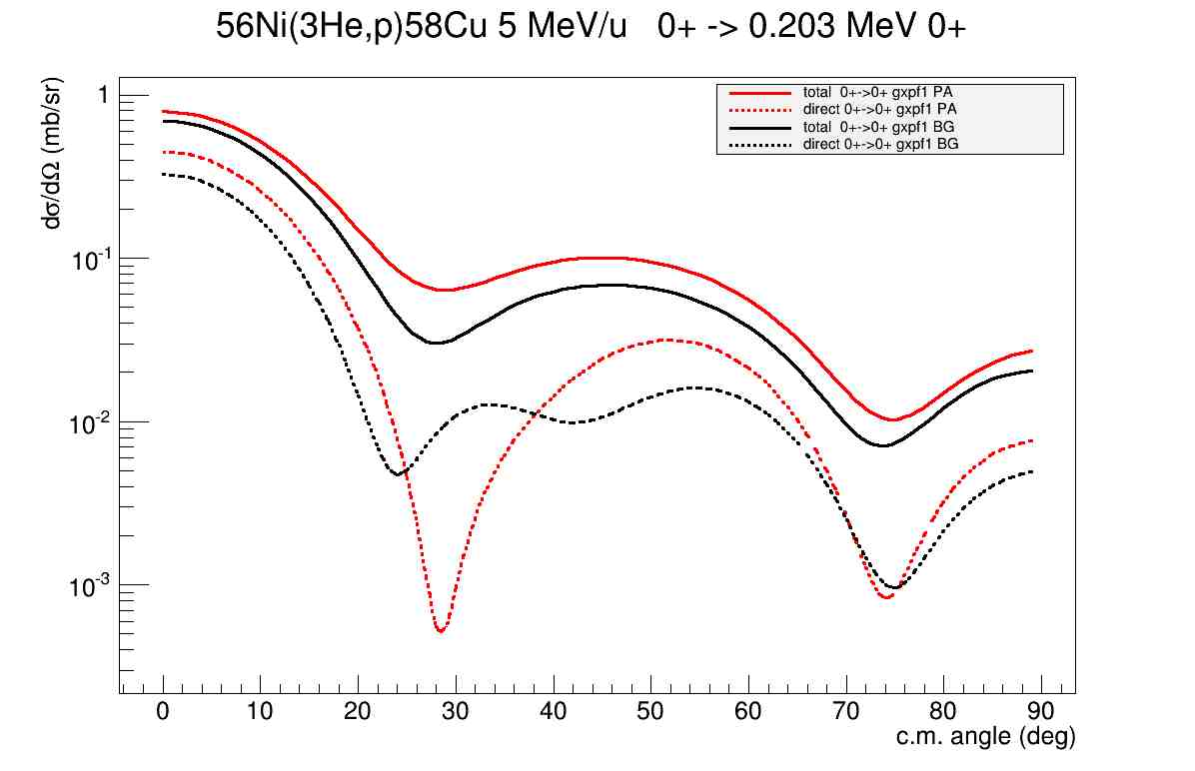
Experimental conditions
⁵⁶Ni(³He,p)⁵⁸Cu @ 10 MeV/u
. target thickness 2 mg/cm² (deformation included)
. 4 um of Toray Aramid windows
. ⁵⁶Ni Spiral1 beam : intensity ? Contaminants ?
--> difficulty with charge states in VAMOS
Excitation energy resolution : 460 keV
. For 100 ub cross-section : 700 counts (particle) /level
~100 counts (gamma)
4⁺ 1549 keV T=0
2⁺ 1427 keV T=0
1⁺ 1051 keV T=0
3+, 443 keV T=0
0+ 203 keV T=1
1⁺ g.s. (T=0)
⁵⁸Cu

