Slide 1
VAMOS Data Flow
Diego Ramos
Antoine Lemasson
GRIT AGATA VAMOS MEETING 12/06/2025, Caen

Slide 2
VAMOS DATA FLOW SCHEME
NUMEXO2
NUMEXO2
NUMEXO2
NUMEXO2
MTDC
VTC (TS)
(VME)
MFM
MFM
MFM
MFM
RECEIVER
MFM
TRANSMITTER
MFM
MERGER
(TS)
NARVAL
ONLINE ANALYSIS
STORAGE

Slide 3
VAMOS DATA FLOW SCHEME
GTS
NUMEXO2
NUMEXO2
NUMEXO2
NUMEXO2
MTDC
VTC (TS)
(VME)
BEAST
MFM
MFM
MFM
MFM
RECEIVER
MFM
TRANSMITTER
MFM
MERGER
(TS)
NARVAL
ONLINE ANALYSIS
NO COMMON DEADTIME READOUT
- NUMEXO: Trigger-less readout (External validation)
- MTDC: External Trigger
STORAGE

Slide 4
VAMOS DATA TREATMENT
MFM libraries
https://gitlab.in2p3.fr/ganilanalysis/ganalysis.git
GAnalysis Software
Detectors Configuration
Calibration Files
MFM
MERGED FRAMES
UNPACKER
L1 ANALYSIS
RawData
L2 ANALYSIS
Calibrated Data
L3 ANALYSIS
Brho Reconstruction
Identification
- Online Analysis and Offline Analysis work similarly (SAME SOFTWARE)
ROOT FILE
Raw Branches
ROOT FILE
POSITIONS
TIMES
(Raw Branches)
ROOT FILE
Z,A,Q,v
(Raw Branches)

Slide 5
VAMOS DATA TREATMENT
MFM libraries
https://gitlab.in2p3.fr/ganilanalysis/ganalysis.git
GAnalysis Software
Detectors Configuration
Calibration Files
MFM
MERGED FRAMES
UNPACKER
L1 ANALYSIS
RawData
L2 ANALYSIS
Calibrated Data
L3 ANALYSIS
Brho Reconstruction
Identification
- Online Analysis and Offline Analysis work similarly (SAME SOFTWARE)
ROOT FILE
Raw Branches
ROOT FILE
POSITIONS
TIMES
(Raw Branches)
ROOT FILE
Z,A,Q,v
(Raw Branches)
- Posibility to Process Single Levels from previous-level RootFiles

Slide 6
VAMOS DATA TREATMENT
MFM libraries
https://gitlab.in2p3.fr/ganilanalysis/ganalysis.git
GAnalysis Software
Detectors Configuration
Calibration Files
MFM
MERGED FRAMES
UNPACKER
L1 ANALYSIS
RawData
L2 ANALYSIS
Calibrated Data
L3 ANALYSIS
Brho Reconstruction
Identification
- Online Analysis and Offline Analysis work similarly (SAME SOFTWARE)
ROOT FILE
Raw Branches
ROOT FILE
POSITIONS
TIMES
(Raw Branches)
ROOT FILE
Z,A,Q,v
(Raw Branches)
- Posibility to Process Single Levels from previous-level RootFiles
Data Quality Control

Slide 7
VAMOS DATA TREATMENT
MFM libraries
https://gitlab.in2p3.fr/ganilanalysis/ganalysis.git
GAnalysis Software
Detectors Configuration
Calibration Files
MFM
MERGED FRAMES
UNPACKER
L1 ANALYSIS
RawData
L2 ANALYSIS
Calibrated Data
L3 ANALYSIS
Brho Reconstruction
Identification
- Online Analysis and Offline Analysis work similarly (SAME SOFTWARE)
ROOT FILE
Raw Branches
ROOT FILE
POSITIONS
TIMES
(Raw Branches)
ROOT FILE
Z,A,Q,v
(Raw Branches)
- Posibility to Process Single Levels from previous-level RootFiles
POSTPROCESSING
REQUIRED
ONLINE DELIVERABLE DATA

Slide 8
VAMOS DATA TREATMENT
METADATA STORAGE
MFM libraries
https://gitlab.in2p3.fr/ganilanalysis/ganalysis.git
GAnalysis Software
Detectors Configuration
Calibration Files
MFM
MERGED FRAMES
UNPACKER
L1 ANALYSIS
RawData
L2 ANALYSIS
Calibrated Data
L3 ANALYSIS
Brho Reconstruction
Identification
- Online Analysis and Offline Analysis work similarly (SAME SOFTWARE)
ROOT FILE
Raw Branches
ROOT FILE
POSITIONS
TIMES
(Raw Branches)
ROOT FILE
Z,A,Q,v
(Raw Branches)
- Posibility to Process Single Levels from previous-level RootFiles
POSTPROCESSING
REQUIRED
ONLINE DELIVERABLE DATA

Slide 9
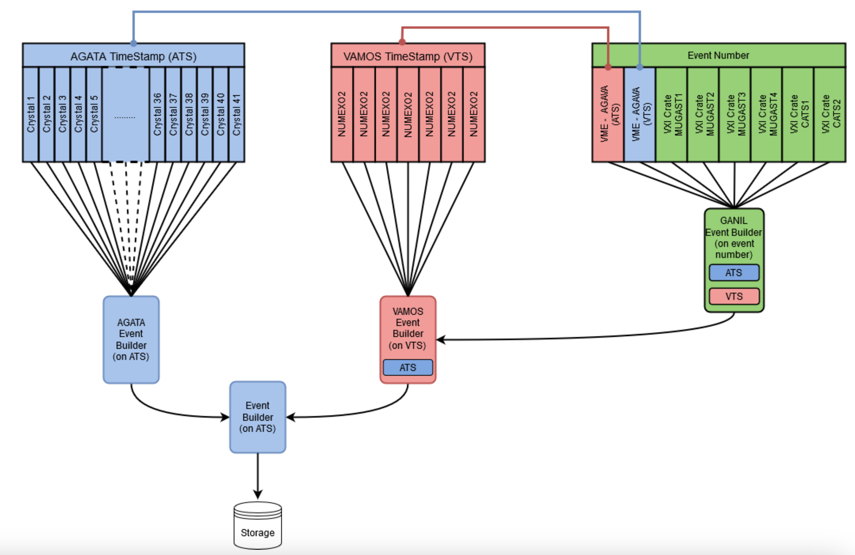
AGATA-MUGAST-VAMOS DATA
PROBLEMs:
- Difficult to ReProcess
- Lost of the version of each software
- Crazy loops in the analysis dependences

Slide 10
AN IDEA FOR AGATA-GRIT-VAMOS DATA
ADVANTAGES:
- Parallel analysis
- Full compatibility
RISKS:
- Lost of versioning
- Latency in
data quality checks
- Lost of run index
synchronization
- Individual Analysis Process (versioning)
PSA
GAna
nptool
- RootFiles without specific libraries dependences
RootFile
(TS Branch)
RootFile
(TS Branch)
RootFile
(TS Branch)
Merged RootFile
- Automatic Merge Process

