Slide 2
SMART + GANIL coupling
How to synchronize and label events across different detectors ?

Slide 3
Outline
This talk is not about…
Time-of-flight or timing measurements (TAC, etc.)
Computing/dataflow architecture
Acquisition software integration
But about…
The process of assigning global (absolute) timestamps to physical events
Hardware synchronization across different detectors
Enabling coherent event correlation in distributed setups
Notes:
Timestamping = synchronizing and labeling events across different detectors
Goal : Enabling us to correlate data in a distributed setup.

Slide 4
From challenges to solutions: The timeline of Timestamping at GANIL
This presentation aims to shed light on the following key questions:
Where are we today at GANIL ?
Current state-of-the-art solutions and methods we use
What are the main challenges we face ?
Challenges that pushed us to proposed something new
How does the SMART system address future challenges ?
Key concepts and how it addresses our specific requirements
How are we deploying it in practice ?
Our phased development and deployment strategy
What else ?
Future questions to solve over coffee
Notes:
A few key questions that structure both our work and this presentation 1 : Overview of where we stand today
2 : Dive into the main challenges that pushed us to develop new solutions 3: I’ll introduce the SMART system, how it tackles these challenges 4: Following a phased deployment and development strategy 5 :I’ll leave you with some open questions

Slide 5
I. Where are we today at GANIL?
Four representative setups to illustrate the state-of–art of timestamping in GANIL
INDRA/FAZIA
MESYTEC VME DAQ modules with CENTRUM (Clock Event Number Transmitter Receiver Universal Module) and TGV (Trigger Generique VME)
EXOGAM–MEDLEY–PPAC
GANIL NUMEXO2 DAQ modules with GTS (Global Trigger and Synchronization)
ACTAR
GET (Generic Electronics for TPCs) µTCA DAC with MUTANT (MUtiplicity, Trigger ANd Time)
LISE 2024 (MUGAST/CATS/EXOGAM/ZDD)
GANIL VXI DAQ modules with CENTRUM coupled with NUMEXO2 modules with GTS thanks to AGAVA (AGATA VME Adapter) & TGV gateway
“48-bit timestamp @ 10 ns & 32-bit event number: The universal backbone ensuring time correlation across all systems”
Notes:
Even if each system comes with its own technology and acronyms, they all rely on the same backbone:
- 48-bit timestamp at 10 ns precision
- 32-bit event number for identification.

Slide 6
II. What are the main challenges we face?
Aging Standards (VXI)
Maintaining aging standards like VXI is increasingly difficult
Obsolescence (TGV, AGAVA and GTS mezzanines) and Increasing Demand
Modules such as TGV and AGAVA and GTS mezzanines are now obsolete. At the same time, our experimental needs require an ever-growing number of these modules.
Heterogeneity and Integration Issues
Coupling and timestamping schemes vary significantly between experiments. This drives the need for reliable gateways and interface modules.
Operational Stability and Documentation Gaps
Ensuring the long-term stability and robustness of systems like GTS is challenging, especially given the lack of comprehensive technical documentation and support

Slide 7
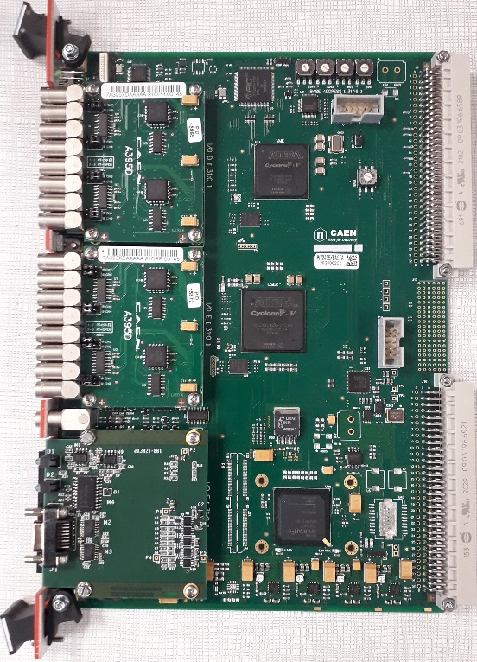
II.1. A VTC* in response of the lack of TGV
Trigger inputs
VME interface
IO signals
USER FPGA
Inspection lines
CENTRUM interface
*VTC stands for VME Trigger Centrum
Notes:
VTC stands for "VME Trigger Centrum,”
CAEN commercial module with CENTRUM daughterboard
Drop-in replacement module for earlier TGV Full compatible with MESYTEC acquisition modules

Slide 8
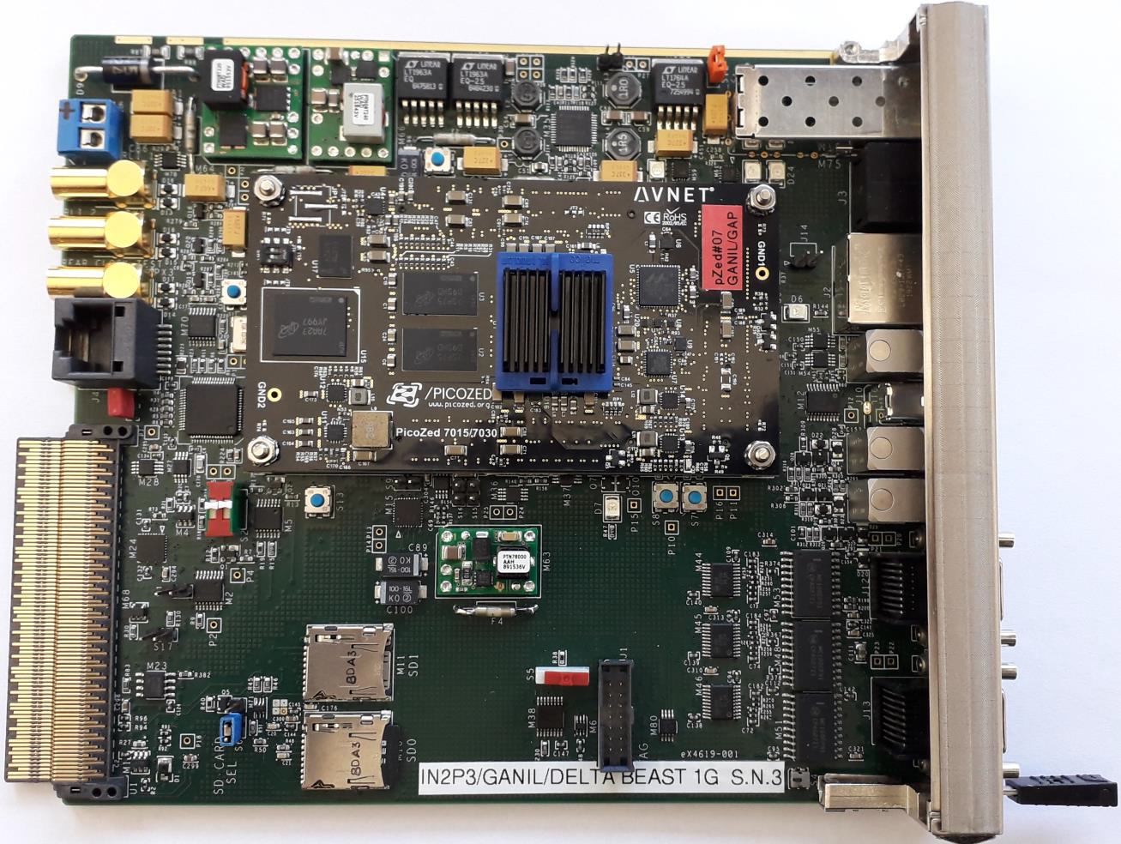
II.2. The beauty of the BEAST
SELF_SYNC mode
GTS_SYNC mode
MIXED_SYNC mode
MUTANT_SYNC mode
Optical interface GTS or SMART
MUTANT µTCA interface
CENTRUM interface

Slide 9
II.2. The beauty of the BEAST
SELF_SYNC mode
GTS_SYNC mode
MIXED_SYNC mode
MUTANT_SYNC mode
Internal TS
Internal EN
TS to CENTRUM RX
EN to CENTRUM RX
Notes:
Ideal, drop-in replacement solution for VXI CENTRUM master module
Within a modern µTCA standard.

Slide 10
II.2. The beauty of the BEAST
SELF_SYNC mode
GTS_SYNC mode
MIXED_SYNC mode
MUTANT_SYNC mode
TS From GTS or SMART
TS to CENTRUM RX
Notes:
BEAST is seen as a GTS leaf, so this module is part of the GTS tree

Slide 11
II.2. The beauty of the BEAST
SELF_SYNC mode
GTS_SYNC mode
MIXED_SYNC mode
MUTANT_SYNC mode
TS From GTS or SMART
Master Trigger Input
Internal EN
TS to CENTRUM RX
EN to CENTRUM RX
Notes:
This mode is the one that we use to replace the AGAVA when we need to couple GTS based systems with CENTRUM based system.
Like today in VAMOS to couple GTS modules with MESYTEC solution

Slide 12
II.2. The beauty of the BEAST
SELF_SYNC mode
GTS_SYNC mode
MIXED_SYNC mode
MUTANT_SYNC mode
TS to CENTRUM RX
TS & EN from MUTANT
EN to CENTRUM RX

Slide 13
III. 1. How does the SMART system address future challenges ?
GANIL needs more GTS boards, and it’s obsolete
More than 40 GTS boards on 12 NIM Carrier on use today
More than 20 GTS boards out of work
1 working GTS mezzanine for hardware spare
SMART propose an up to date hardware solution
The GTS tree needs too much nodes
For example : 13 GTS nodes for 24 NUMEXO2 in EXOGAM setup
SMART_AMC_ROUTER node can address 15 endpoints ; 3 modules are needed for EXOGAM setup
The GTS is seen at GANIL as a black box
=> SMART will be developed, supported and documented by GANIL local team

Slide 14
III. 2. The SMART project
Sfp connectivity and Microtca for Advanced RemoteTrigger
Phase 1 : SMART_AMC
Phase 2 : SMART_MCH
Phase 3 : SMART_TRIGGER
A minimum of 6 people in GANIL acquisition group involved in the project:
Project leader, global architecture, firmware, software, CAD :…………………………..... Gilles Wittwer
PCB Routing, component ordering, manufacturing follow-up : ………………………...... Maria Blaizot
SMART IP in NUMEXO2, SMART production tests : ………......................................... Matthieu Bezard/Alexis Duval
Embedded software (Linux OS, slow control, automatic alignment): …………….….… Sébastien Coudert/Frédéric Saillant
“More or less two Full-Time Employees for GANIL acquisition group”

Slide 15
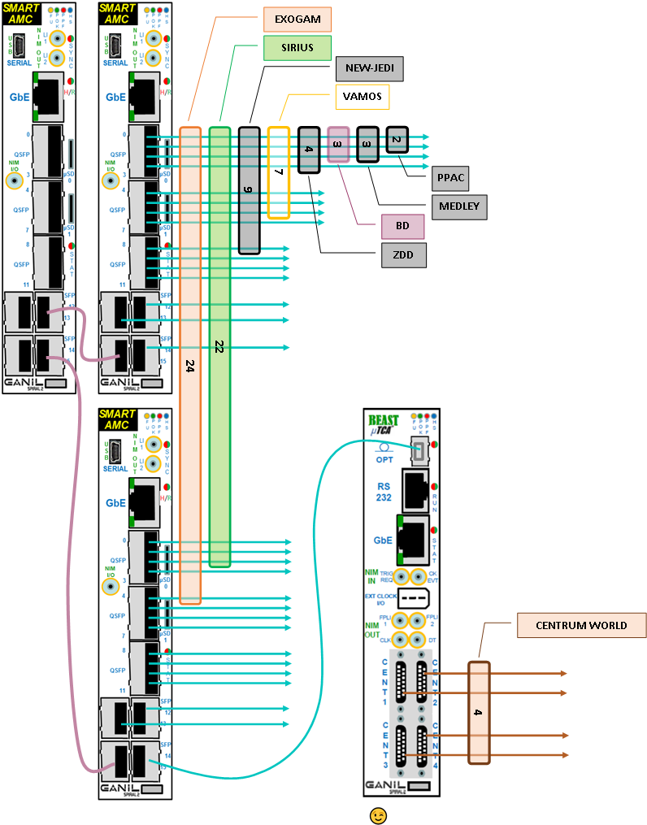
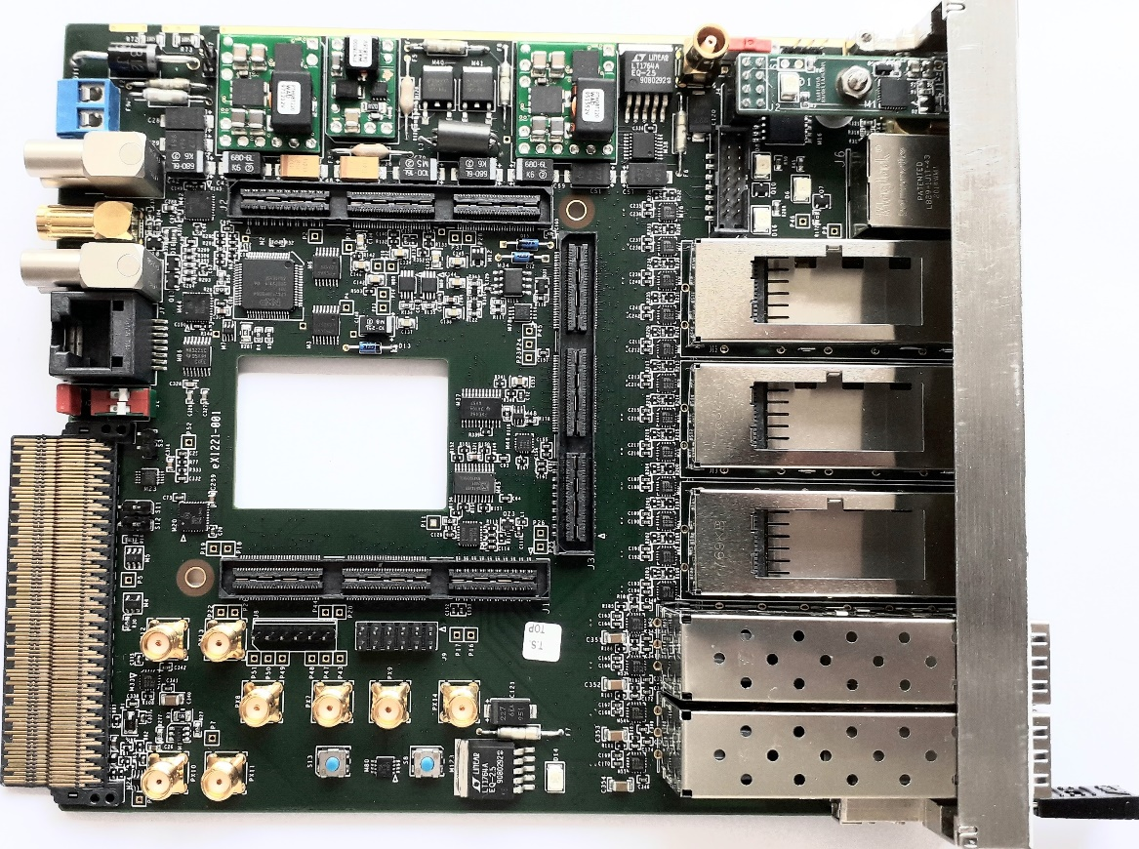
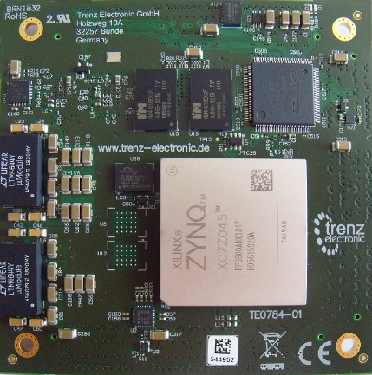
III. 3. The SMART_AMC phase
Up to 240 digitizers or boards synchronized by 17 AMC’s (1 HUB & 16 ROUTERS) housed in 2 µTCA shelves.
3 SMART_AMC modules (1 HUB + 2 ROUTER) can synchronize up to 30 endpoints. It’s equivalent to 14 GTS Mezzanines in 5 GTS NIM Carrier
Notes:
Key benefits of the SMART_AMC module: integration.

Slide 16
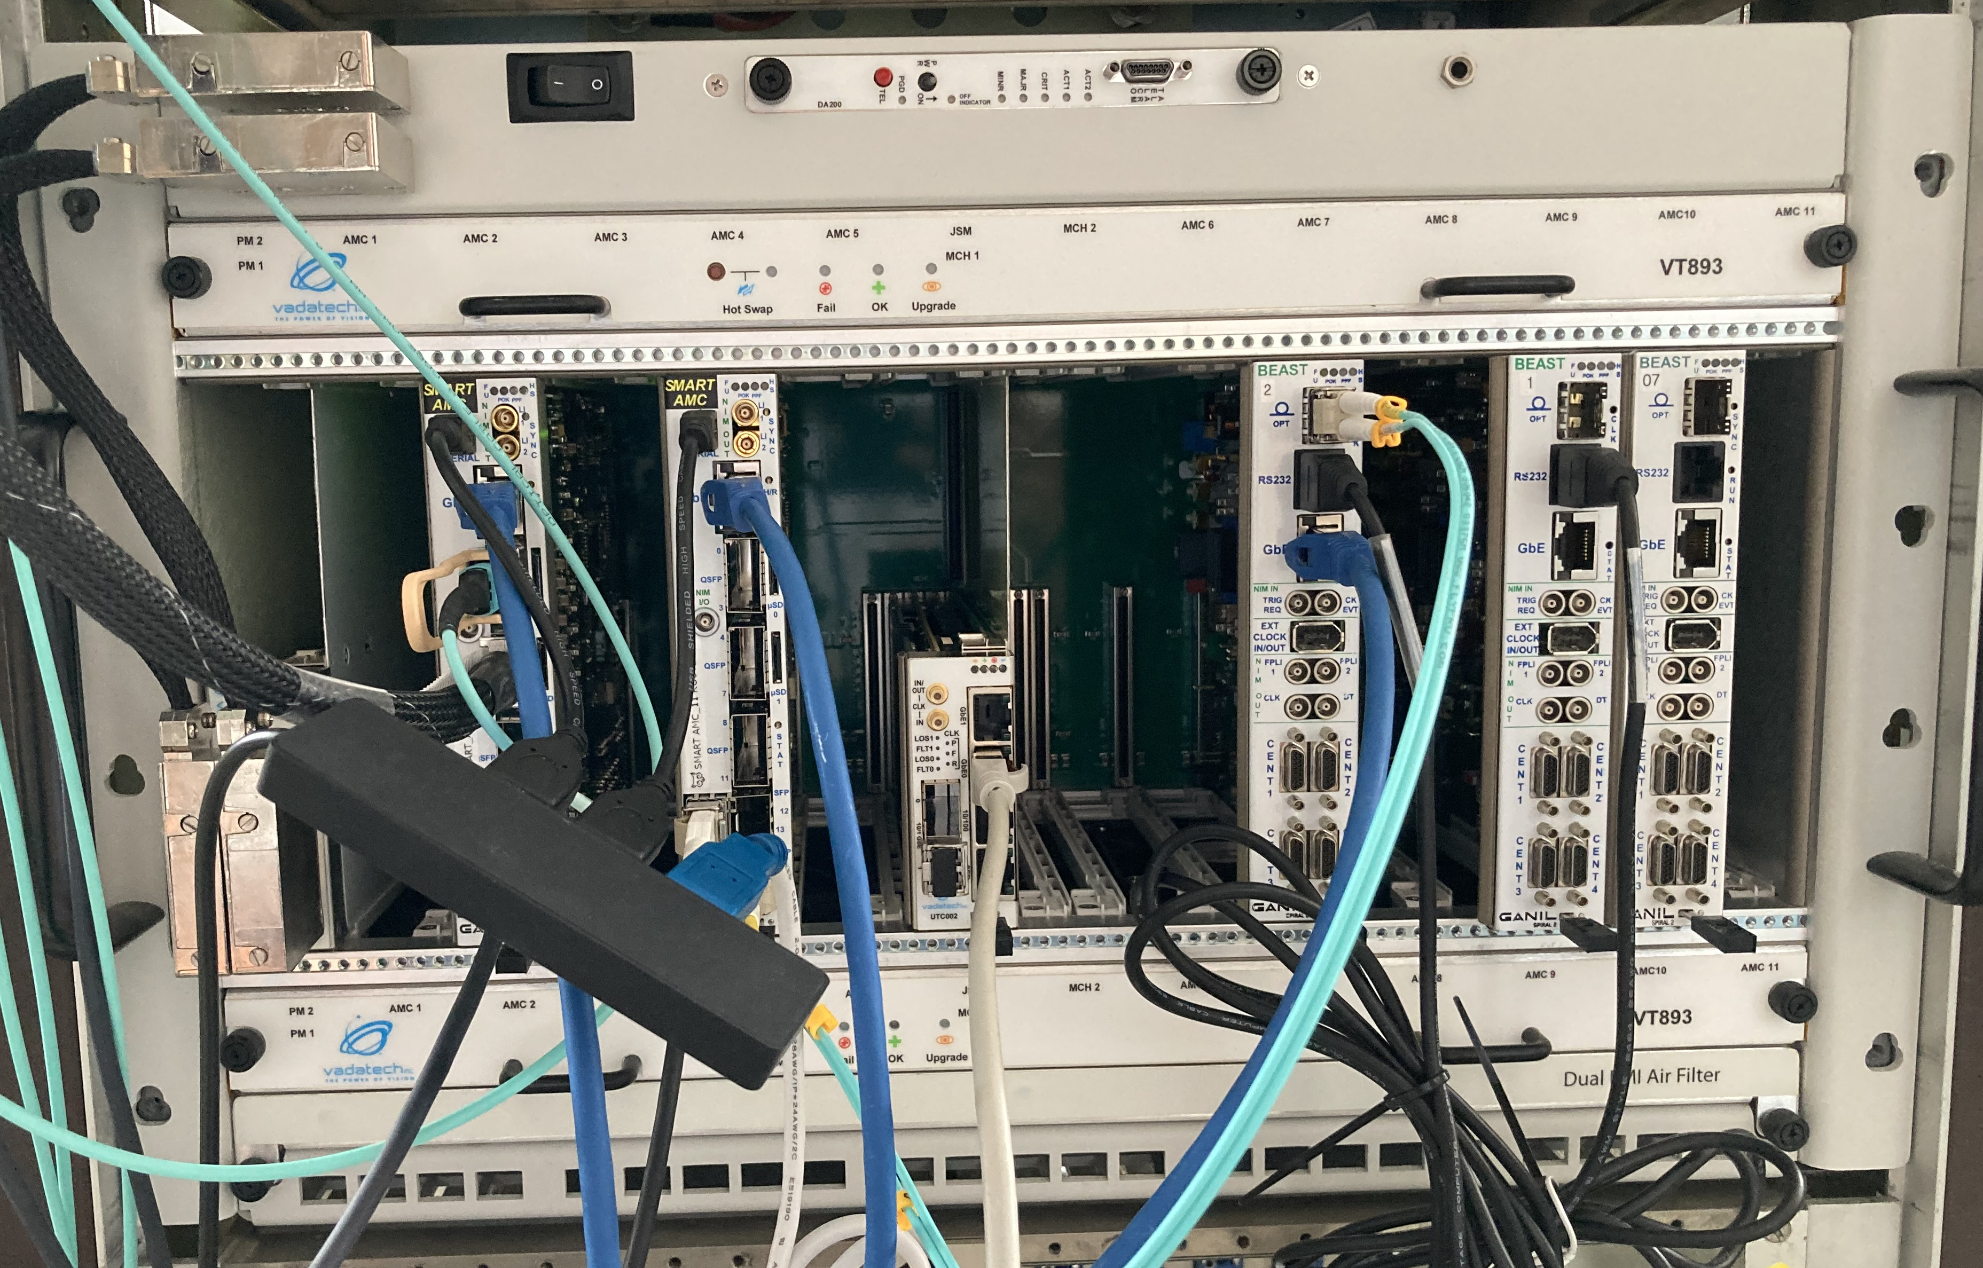
III. 4. What is on the shelf ?
3 tests benches : with in each 1 SMART_AMC HUB + 1 SMART_AMC ROUTER + up to 3 BEAST
26 SMART_AMC modules ready to deploy (1st production batch)

Slide 17
III. 4. What is on the shelf ?
AGATA
3 tests benches : with in each 1 SMART_AMC HUB + 1 SMART_AMC ROUTER + up to 3 BEAST
26 SMART_AMC modules ready to deploy (1st production batch)
AGATA

Slide 18
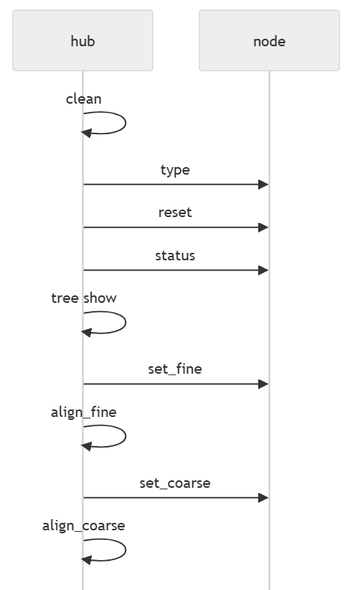
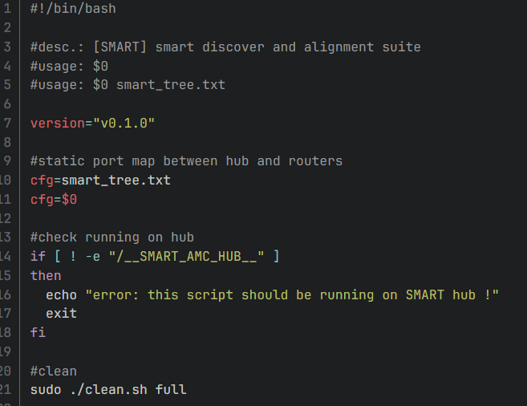
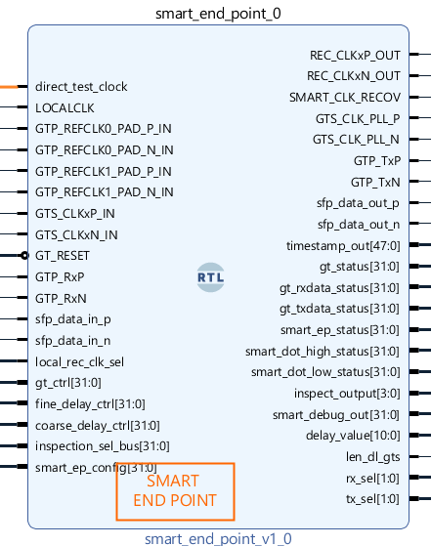
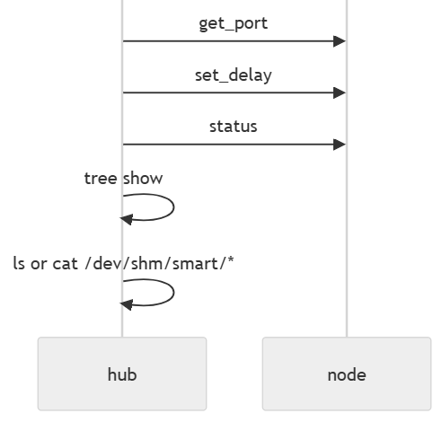
III. 5. What is on the shelf ?
SMARTree : the alignment software
SMART_ENPOINT : the firmware
Autonomous system
Executed on SMART_AMC_HUB
Setup via ssh on nodes
Based on shell scripts
POC validated with BEAST
ENDPOINT firmware IP supported by GTA
Documentation to make implementation easier
POC validated in BEAST module
Under tests on NUMEXO2_REA
On implementation on MASTER (FASTER interface with SMART)

Slide 19
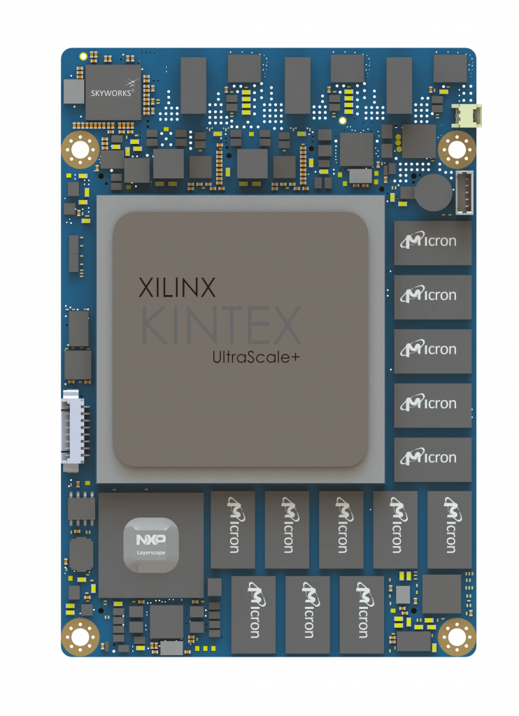
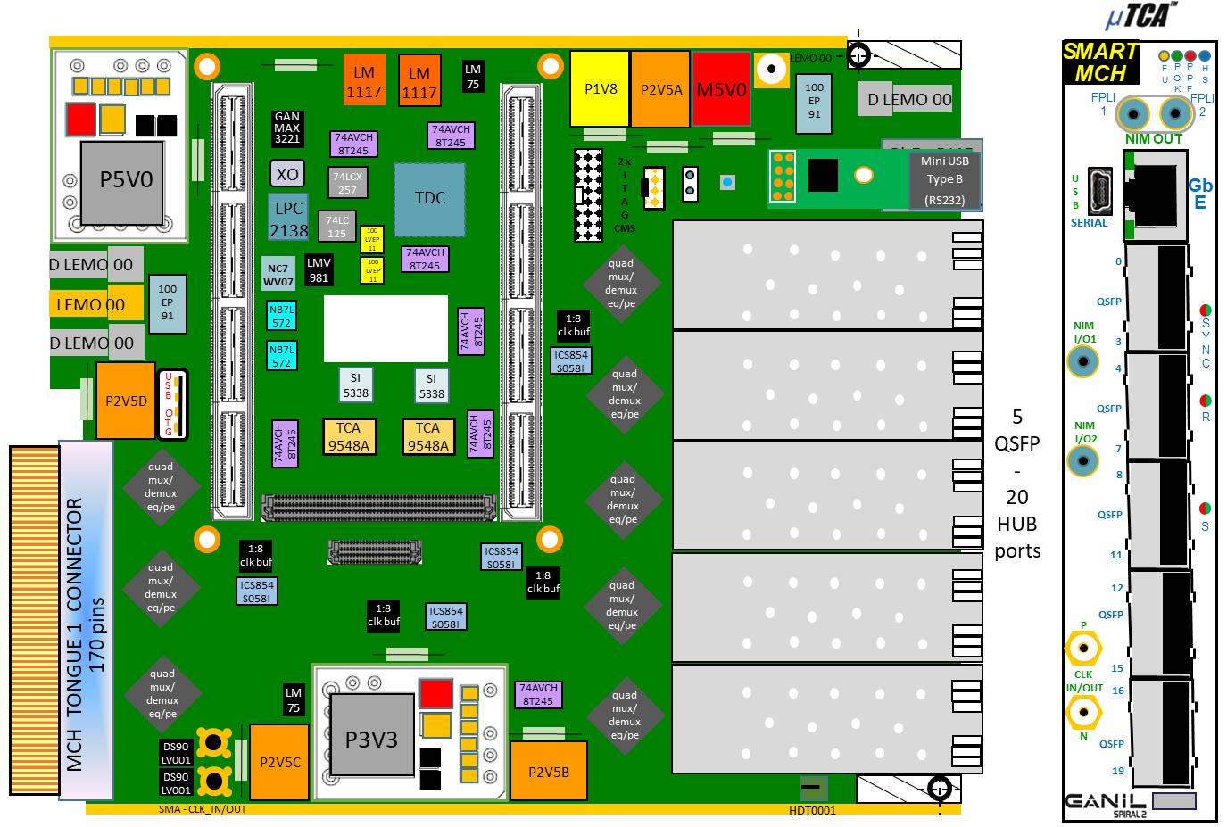
III. 6. The SMART_MCH phase
From 240 to 480 End Points synchronized by 32 SMART_AMC_ROUTER modules and 1 SMART_MCH housed in 3 µTCA shelves
SMART_TRIGGER will be implemented in this module for AGATA needs
ToDo list (Q1/2026 milestone):
SMART MCH prototype assembly
SMART MCH prototype for tests (hardware, firmware, software)
SMART MCH prototype to production update (schematics, routing, …)
SMART MCH ready to use (automatic alignment + first trigger version)
Memory and Bandwidth
Enhanced FPGA

Slide 20
IV. How are we deploying it in practice?
SMART_AMC deployment strategy
Milestone 1 : Q3/2025 : An experimental setup with NUMEXO2_REA
Validation of the SMARTree software and SMART_ENPOINT on NUMEXO2
Milestone 2 : Q3/2025 : A experimental setup with FASTER and NUMEXO2_REA
Validation of SMART_ENDPOINT in FASTER coupled with NUMEXO2 for TAS experiment
Milestone 3 : Q1/2026 : Deploy SMART in VAMOS-EXOGAM setup
Validation of a setup with NUMEXO2 and BEAST/VTC as gateway towards MESYTEC VME modules
Milestone 4 : Q2/2026 : Integration of SMART_ENPOINT in AGATA PACE module
Validation of the last endpoint implementation for AGATA-GRIT-VAMOS

Slide 21
V. What else?
This presentation hasn’t covered the full scope of our ongoing work, nor all the open questions to keep exploring together:
SMART_TRIGGER definition for AGATA
We have to write the functional description of the Trigger for AGATA needs
SMART_AMC production batch 2 & SMART_MCH production batch
We have to plan the production of SMART modules to satisfied all expressed needs
SMART_ENDPOINT for MESYTEC modules
We have to see if the BEAST & VTC gateway fulfill the needs or if we have to go further
Other timestamping systems (e.g., White Rabbit)
Exploring compatibility and potential integration pathways for even broader system interoperability.
Plenty still on our plate—let's keep the discussion going!

Slide 22
Thank you for your attention

Slide 23
 | SMART_AMC ROUTER | SMART_AMC HUB | SMART_MCH
PCB (14 layers) | 640+150(VAT) | 640+150(VAT) | ~1000(estimation)
Front panel kit + Drilling + Silkscreen | 20 50 70 | 20 50 70 | 20 50 70
Assembly + Passive components | 850 | 850 | 900
Active components (provided) | 600 | 600 | 700
SOM | 2300 | 2600 | 9000
UART2USB board | 120 | 120 | 120
Price/Unit (€) | 4800 | 5100 | 11860

