Slide 1

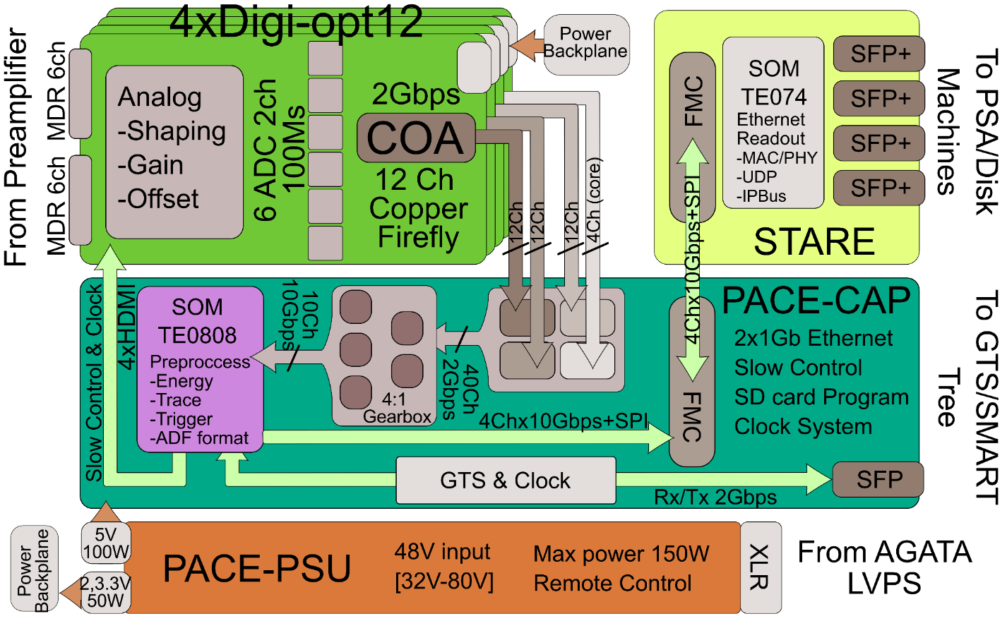
Introduction to the AGATA Phase 2 Front-end Electronics
A. Gadea (IFIC-CSIC), E.Clement (GANIL)
GRIT AGATA VAMOS 2029-2030 Campaign
June 11-13, 2025, GANIL Caen, France
Notes:
Introduction
Overview of the system
Physics outcomes from this meeting important
define physics case
experimental constraints
range of experiments
key experiments demonstrator/full array
meeting
Key design parameters Before too late
120/180 decision

Slide 2
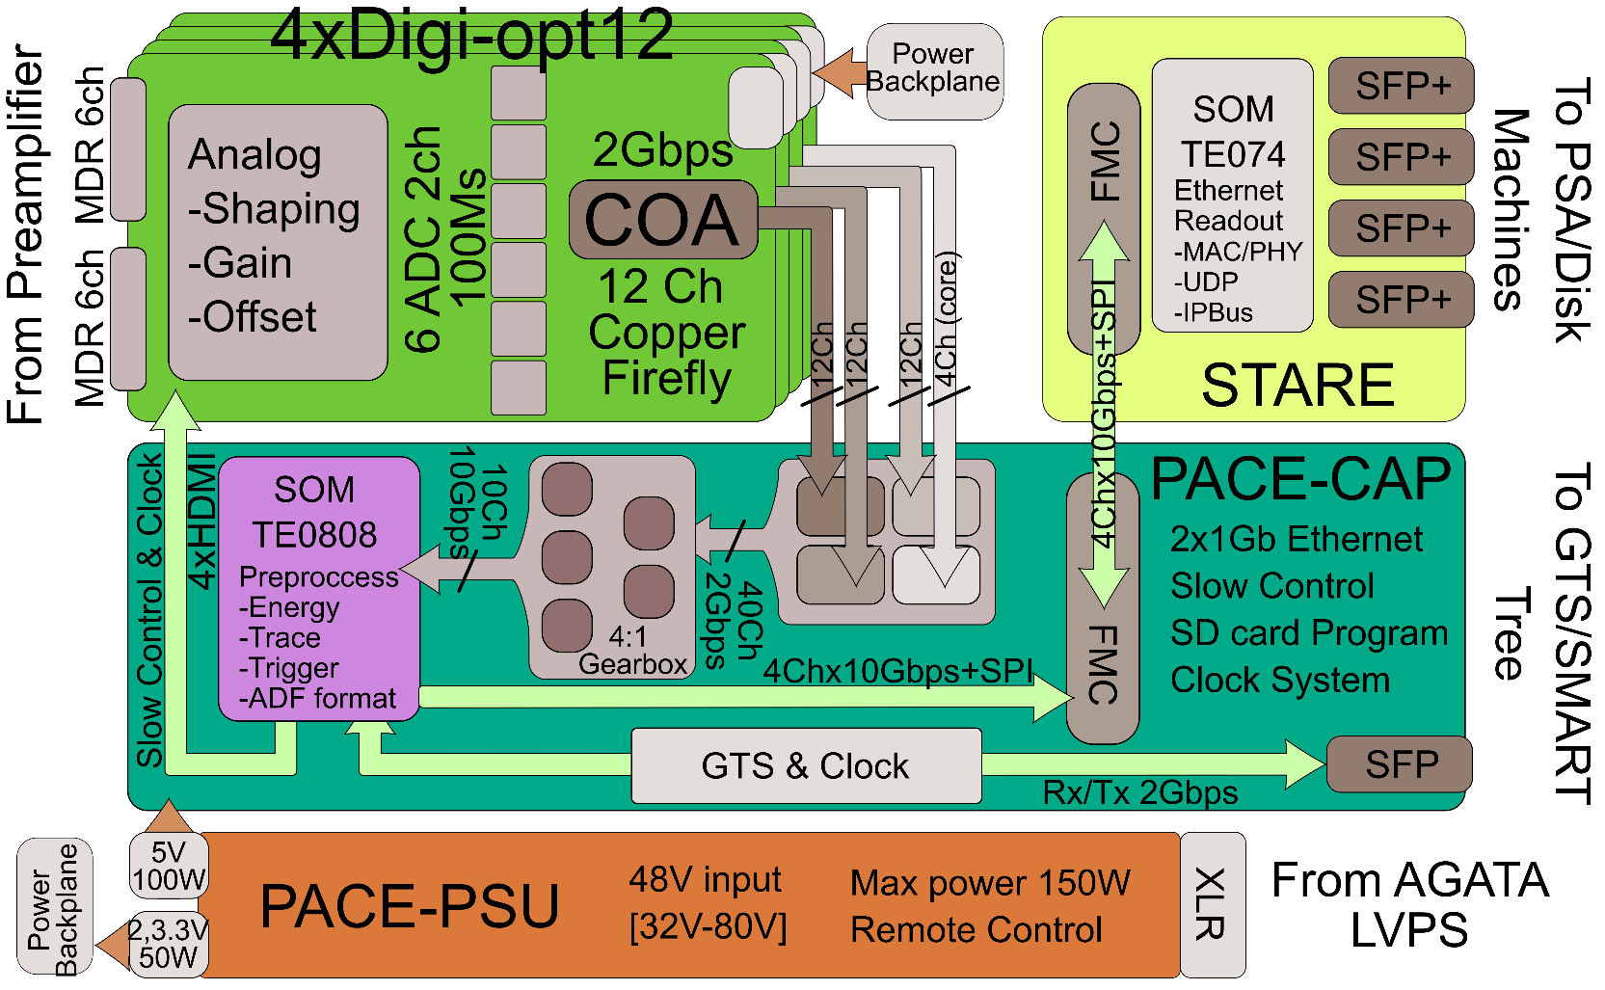
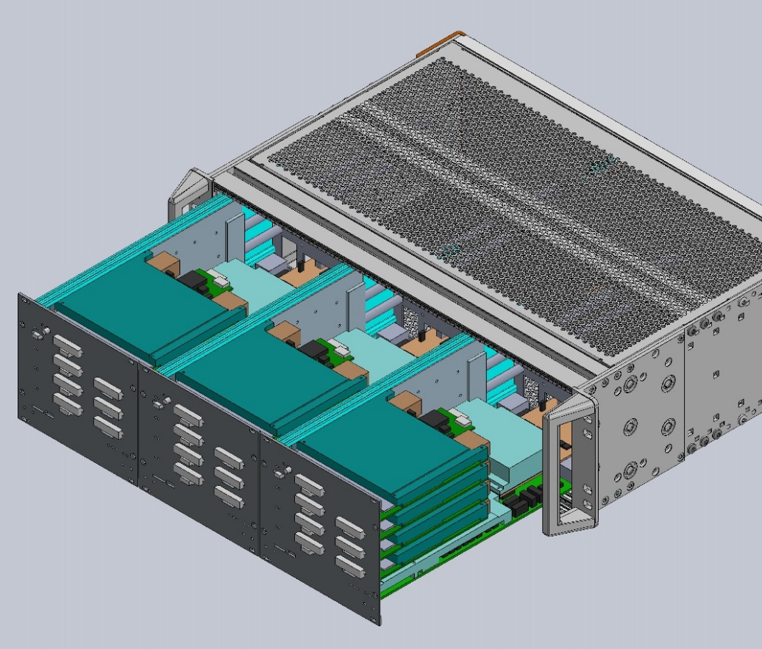
Phase 2 Electronics
AGATA phase 2 advancements in front-end electronics. European Physical Journal A, 59 (2023) 133.
Follows the principles of the previous AGATA front-end electronics: Independent digitizer and pre-processing electronics
for each capsule, only “connected” through the Global Trigger and Synchronization system.
Notes:
Introduction
Overview of the system
Physics outcomes from this meeting important
define physics case
experimental constraints
range of experiments
key experiments demonstrator/full array
meeting
Key design parameters Before too late
120/180 decision

Slide 3
The motivation to design a new electronics
In the earlier versions of the AGATA electronics the samples transfer done with several (7 for phase 0 and 4 for Phase 1) 60 m to 100 m long 12-fold optical fibers.
Obsolete critical components in the previous versions of the pre-processing electronics will not be present.
The introduction of commercial mezzanines as main building blocks, improves production yield, reduces development time and facilitates maintenance.
Avoiding customized point-to point data transfer after pre-processing: avoids customized interfaces and allows flexibility in the architecture of the Data Flow and processing server farms improving the rate capabilities.
Improvements in the data transmission rates will allow the implementation software triggers in addition to the hardware GTS and SMART Trigger Processors.
Pre-processing FPGA resources, presently used at < 50% level (except for the memory blocks, used at ≈ 80% level), allowing improvements in the preprocessing algorithms.
The new Digi-Opt12 sampling board include improvements in the signal-to-noise quality and remove obsolete fundamental components and reduce power consumption.
Extended monitoring for the input samples and for the pre-processing signals.
Notes:
Introduction
Overview of the system
Physics outcomes from this meeting important
define physics case
experimental constraints
range of experiments
key experiments demonstrator/full array
meeting
Key design parameters Before too late
120/180 decision

Slide 4
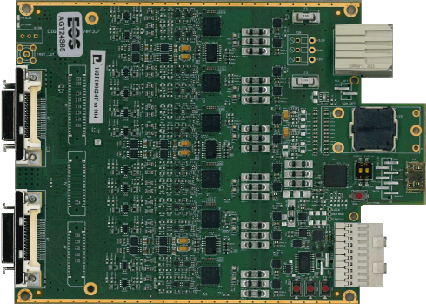
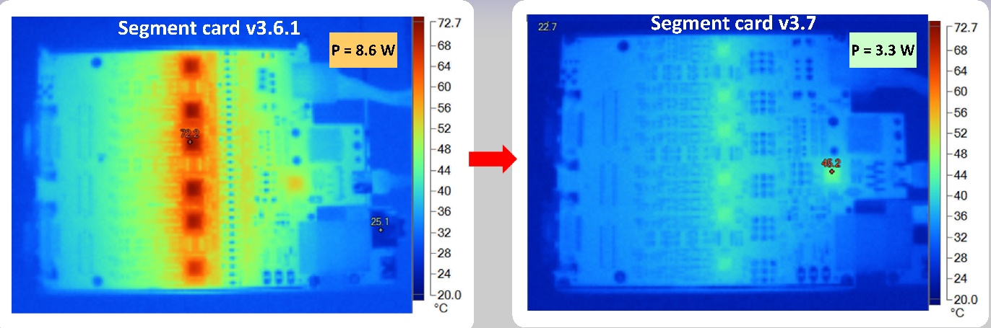
Implementation: DIGI-OPT12 v3.7
Alberto Pullia and Stefano Capra, INFN - Milano University of Milano
Card redesign for ADC32J44 Dual-Channel, 14-Bit, 100-MSPS ADC’s with JESD204B Interface.
Two boards Segment & Core versions
New design of signal conditioning stage
Production yield: 94.6% after repairs 100%
~50% lower power consumption
Includes as well low noise LTC6247 opamp that allows to reach σ = 1.5 LSB i.e. ENOB = 11.6
Input from pre-amplifiers by 10m MDR cables
Requires 1 backplane with power distribution and 1 backplane with the 100 MHz clock distribution.
FireFly copper cable readout at 2Gbps
Notes:
Introduction
Overview of the system
Physics outcomes from this meeting important
define physics case
experimental constraints
range of experiments
key experiments demonstrator/full array
meeting
Key design parameters Before too late
120/180 decision

Slide 5
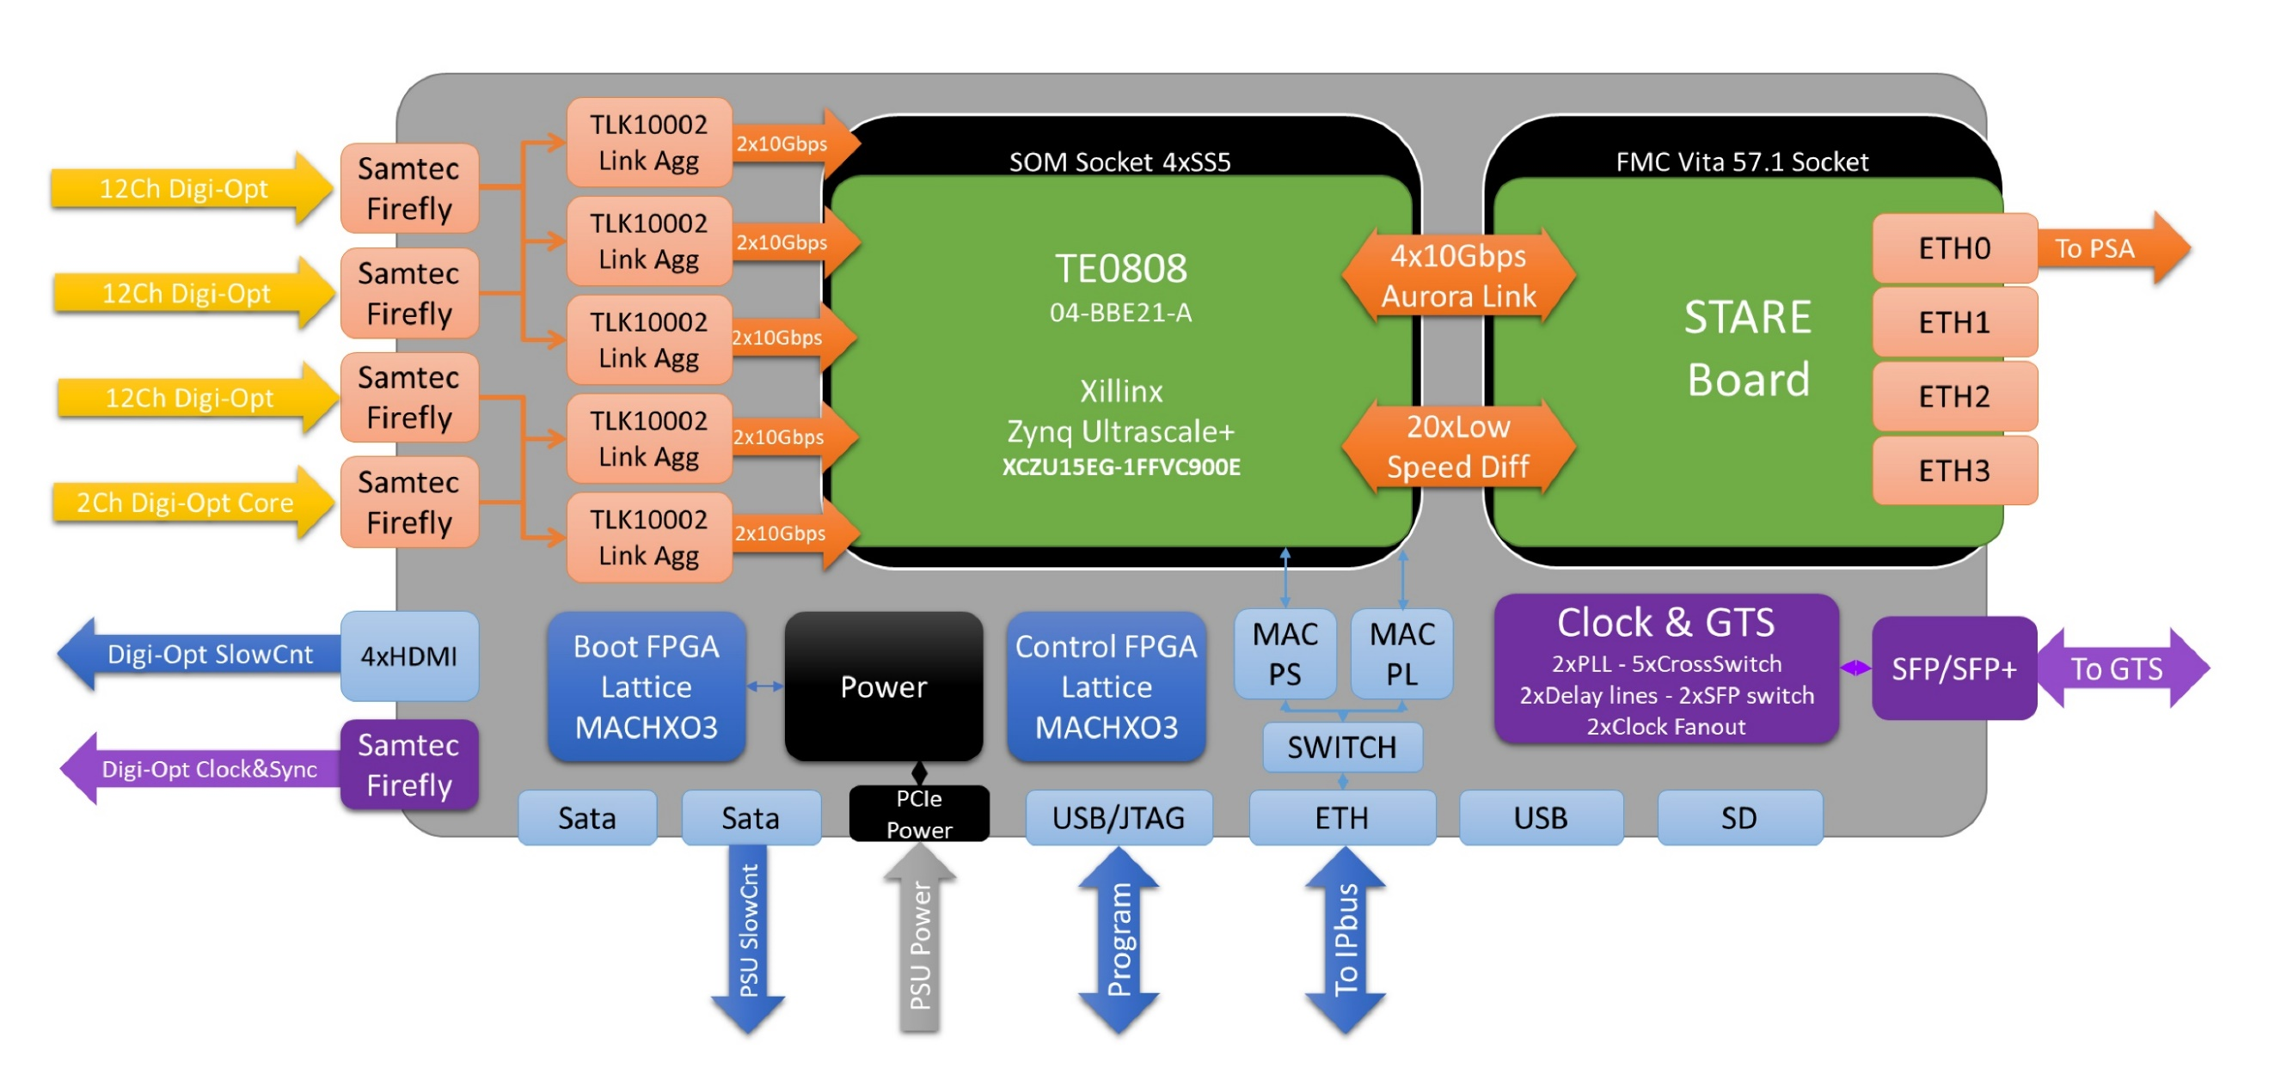
Pre-processing block diagram
J.Collado, V.Gonzalez, IFIC – CSIC and ETSE University of Valencia
N. Karkour X. Lafay et al., IJCLab, Orsay France and the AGATA FEE W.G.
Slow Control & monitoring Scope Ch. Bonnin, IPHC Strasbourg
Proof-of-Concept: 2019
Production: 2024
Notes:
Introduction
Overview of the system
Physics outcomes from this meeting important
define physics case
experimental constraints
range of experiments
key experiments demonstrator/full array
meeting
Key design parameters Before too late
120/180 decision

Slide 6
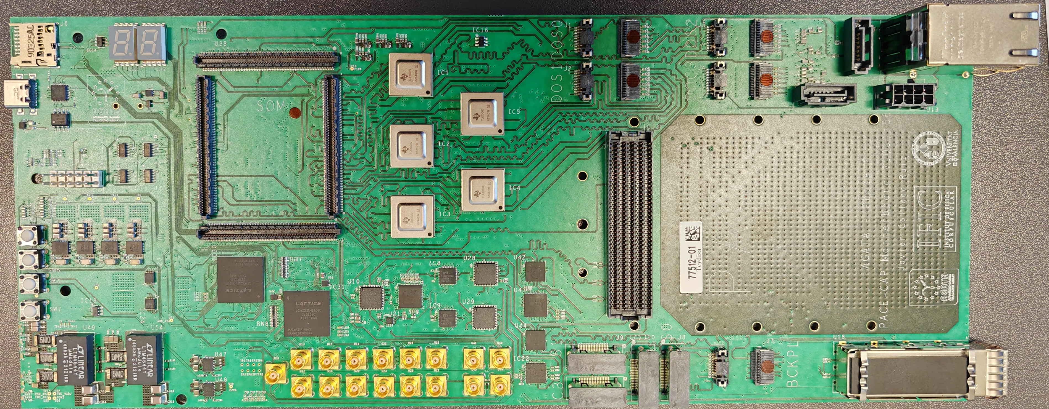
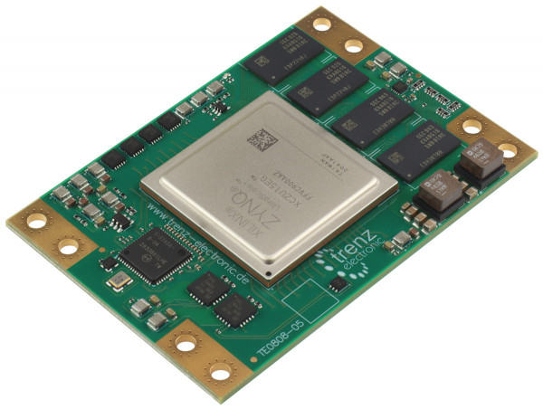
Implementation: Pre-processing board PACE
J.Collado, V.Gonzalez, IFIC – CSIC and ETSE University of Valencia
Read-out the DIGI-OPT12 boards through FireFly
Time Domain Multiplexing link aggregation (IDM) concept built in the receiver section implemented with TLK10002 (TI).
IDM allows to use more efficiently the FPGA Transceivers .
Global Trigger and Synchronization is fully supported (GTS or SMART).
The link provides a common clock to all the system that is cleaned and fine-tuned during the alignment protocol in the PACE Clock & GTS hardware section.
Following the pre-processing on the SOM FPGA, all the events validated by the GTS second level trigger, are readout via the Ethernet STARE board, plugged into the FMC Vita 57.1
With a SoM TE0808-05-BBE81-E
by Trenz Electronics based on the
AMD Zynq™ UltraScale+™
XCZU15EG-1FFVC900E
(746,550 Logic Cells and 24 transceivers)
with 4 GByte DDR4
Notes:
Introduction
Overview of the system
Physics outcomes from this meeting important
define physics case
experimental constraints
range of experiments
key experiments demonstrator/full array
meeting
Key design parameters Before too late
120/180 decision

Slide 7
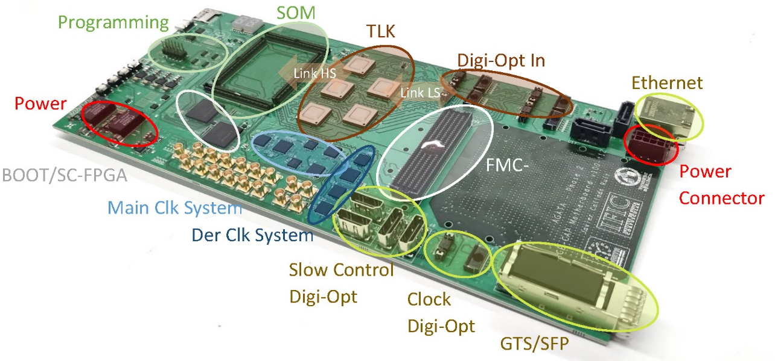
Implementation: Pre-processing board PACE
J.Collado, V.Gonzalez, IFIC – CSIC and ETSE University of Valencia
Read-out the DIGI-OPT12 boards through FireFly
Time Domain Multiplexing link aggregation (IDM) concept built in the receiver section implemented with TLK10002 (TI).
IDM allows to use more efficiently the FPGA Transceivers .
Global Trigger and Synchronization is fully supported (GTS or SMART).
The link provides a common clock to all the system that is cleaned and fine-tuned during the alignment protocol in the PACE Clock & GTS hardware section.
Following the pre-processing on the SOM FPGA, all the events validated by the GTS second level trigger, are readout via the Ethernet STARE board, plugged into the FMC Vita 57.1
With a SoM TE0808-05-BBE81-E
by Trenz Electronics based on the
AMD Zynq™ UltraScale+™
XCZU15EG-1FFVC900E
(746,550 Logic Cells and 24 transceivers)
with 4 GByte DDR4
Notes:
Introduction
Overview of the system
Physics outcomes from this meeting important
define physics case
experimental constraints
range of experiments
key experiments demonstrator/full array
meeting
Key design parameters Before too late
120/180 decision

Slide 8
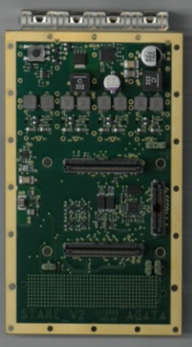
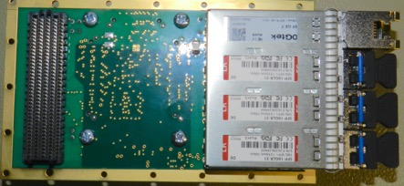
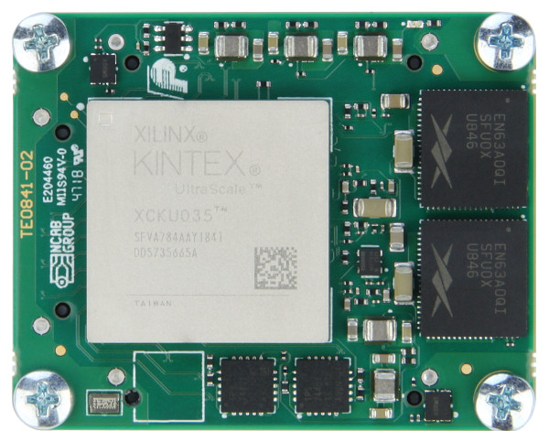
Implementation: Ethernet board STARE
N. Karkour X. Lafay et al., IJCLab, Orsay France
The STARE board is a FMC mezzanine to be mounted on PACE pre-processing
Its function is to do the readout using fast Ethernet protocol at high bandwidth.
The STARE mezzanine compiles the generated data from the PACE over a Xilinx AXI stream AURORA interface, using up to 4 independent 10 Gbps transceiver lines.
Each line data is formatted to be transferred through 4 independent 10 Gbps transceivers to servers or computer farm using UDP protocol. Each of the 4 UDP channels can send data to several different servers.
The STARE module is equipped with external memory to allow re-transmission of any packages not correctly received by the HTC server farm.
SoM
Ethernet
Optical
Trnasceivers
With a SoM TE0841-03-41I31-A
by Trenz Electronics based on the
AMD Kintex™ UltraScale™
XCKU040-1SFVA784I FPGA (530,250 Logic Cells and 8 transceivers)
with 4 GByte DDR4
Notes:
Introduction
Overview of the system
Physics outcomes from this meeting important
define physics case
experimental constraints
range of experiments
key experiments demonstrator/full array
meeting
Key design parameters Before too late
120/180 decision

Slide 9
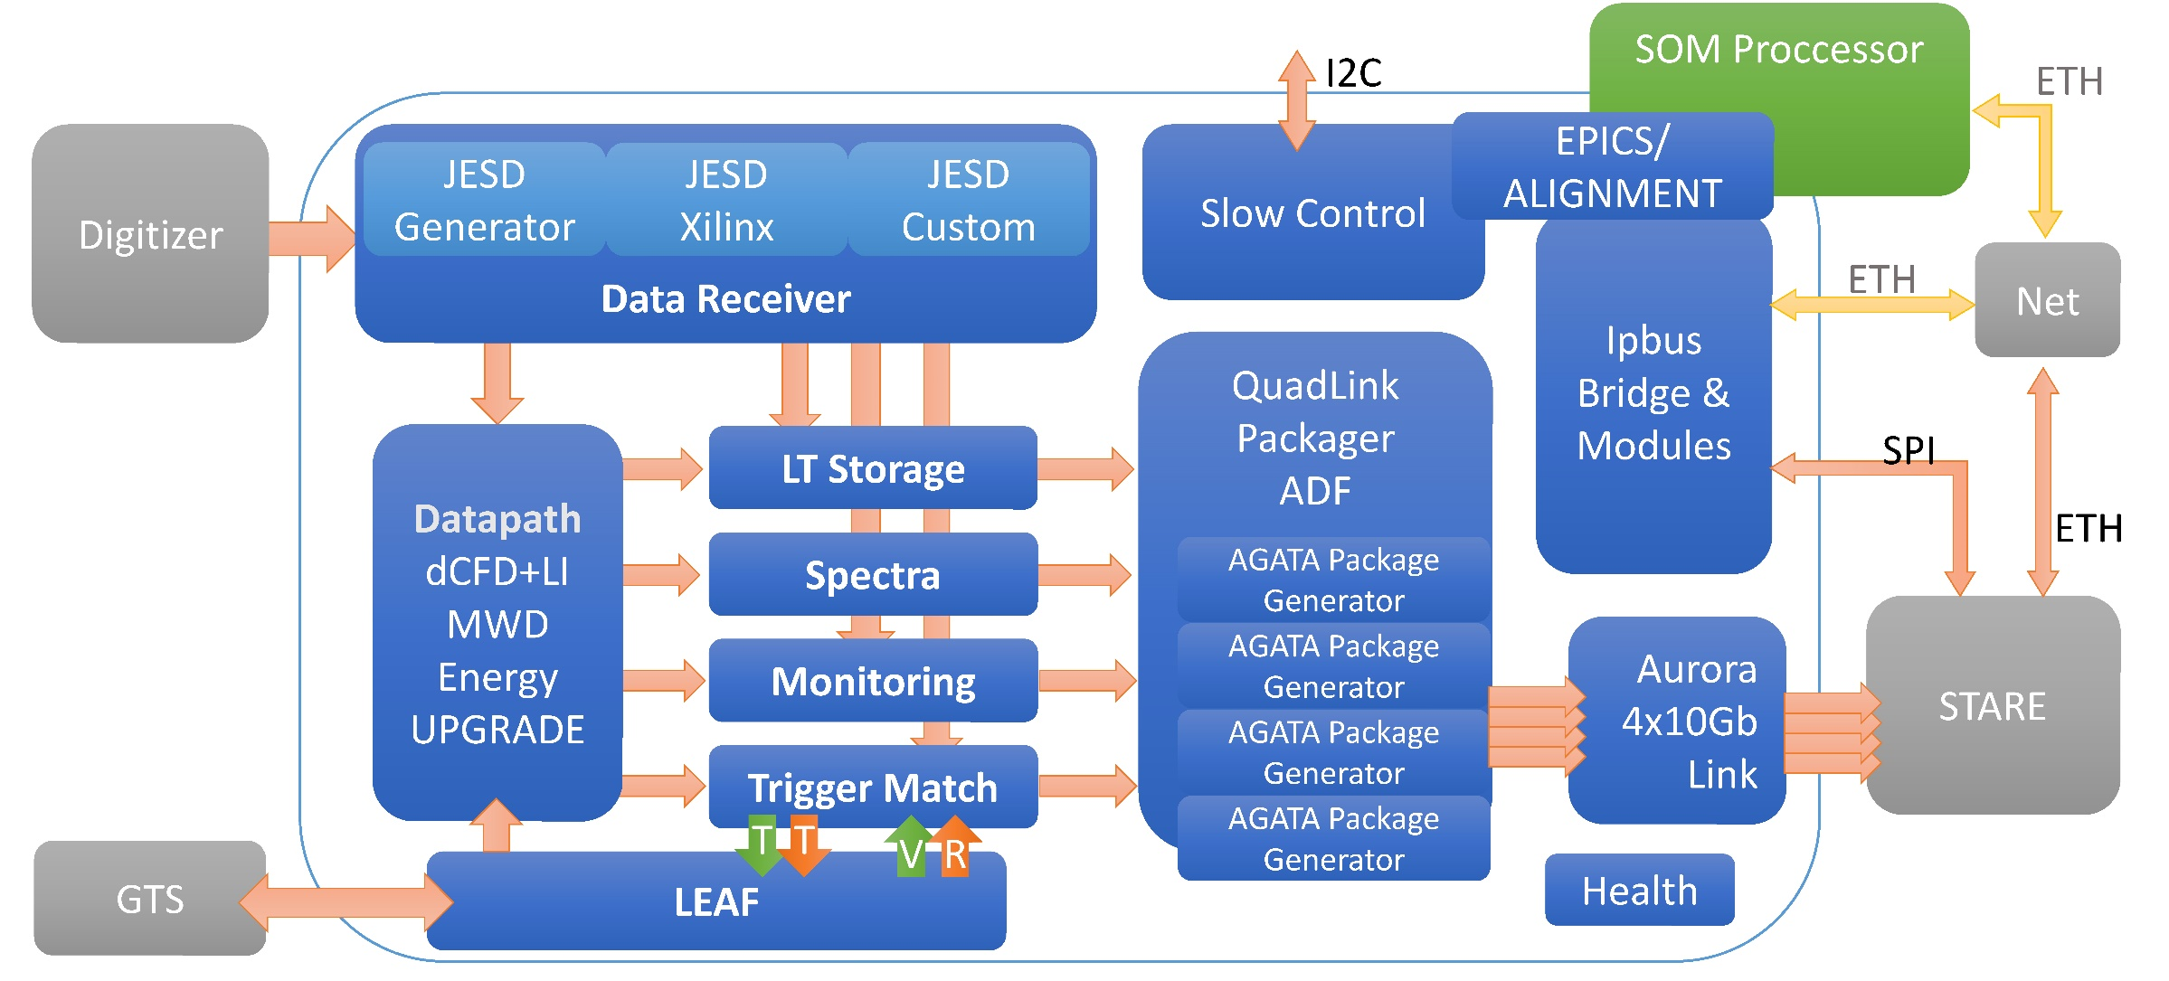
Firmware for the Pre-processing board PACE
J.Collado, V.Gonzalez, IFIC – CSIC and ETSE University of Valencia, Spain
All firmware modules existing. Required revision of the GTS Leaf, and the AGATA Package generator.
Migration to the Global Trigger and Synchronization SMART system foreseen in Phase 2.
New Energy evaluation algorithm developed by M. Kogimtzis, STFC, UK
Notes:
Introduction
Overview of the system
Physics outcomes from this meeting important
define physics case
experimental constraints
range of experiments
key experiments demonstrator/full array
meeting
Key design parameters Before too late
120/180 decision

Slide 10
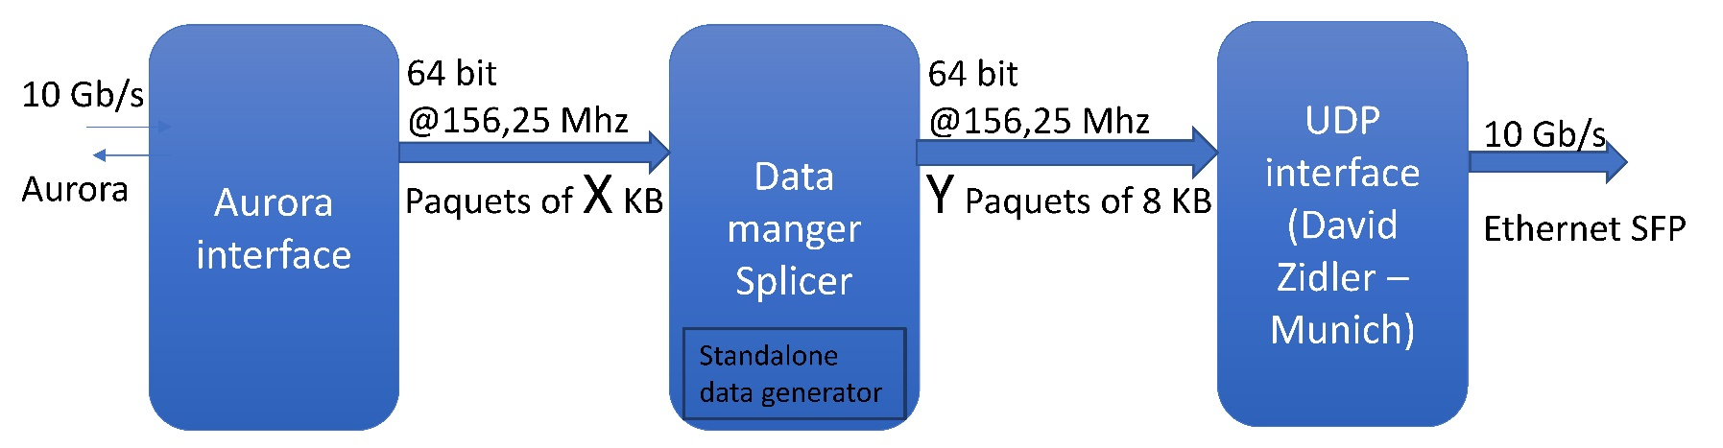
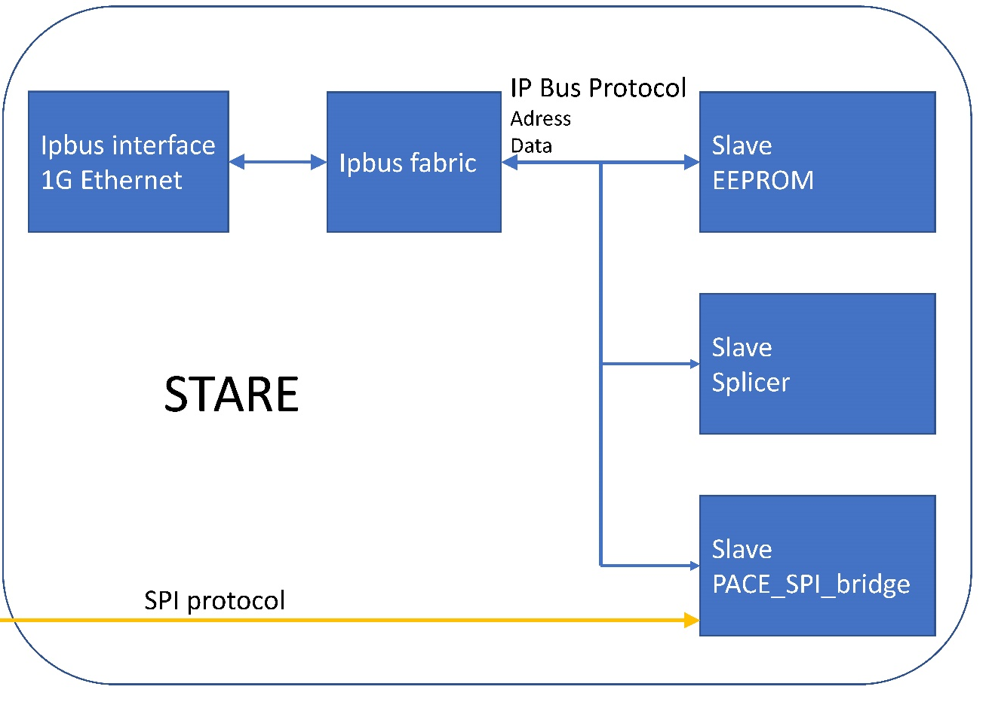

Firmware for the Ethernet board STARE
N. Karkour X. Lafay et al., IJCLab, Orsay France
Data Path Firmware with UDP in the future RUDP
IPbus Master/Slave Firmware. Presently IPbus control performed through STARE
IP_Bus SlowControl (CERN & LPSC Grenoble)
Notes:
Introduction
Overview of the system
Physics outcomes from this meeting important
define physics case
experimental constraints
range of experiments
key experiments demonstrator/full array
meeting
Key design parameters Before too late
120/180 decision

Slide 11
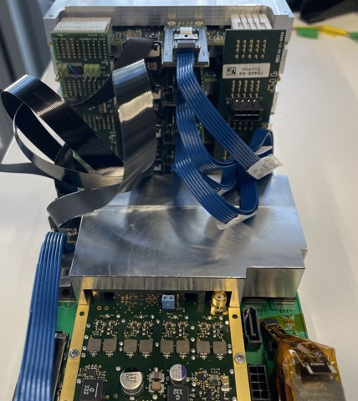
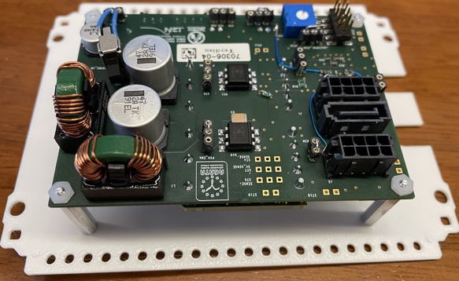
Implementation: mechanics and PSU
V.Gonzalez, ETSE University of Valencia
Clock
Bckplane
Power
Bckplane
FireFly
HDMI
DIGI-OPT12
Slow Control
PSU
Notes:
Introduction
Overview of the system
Physics outcomes from this meeting important
define physics case
experimental constraints
range of experiments
key experiments demonstrator/full array
meeting
Key design parameters Before too late
120/180 decision

Slide 12
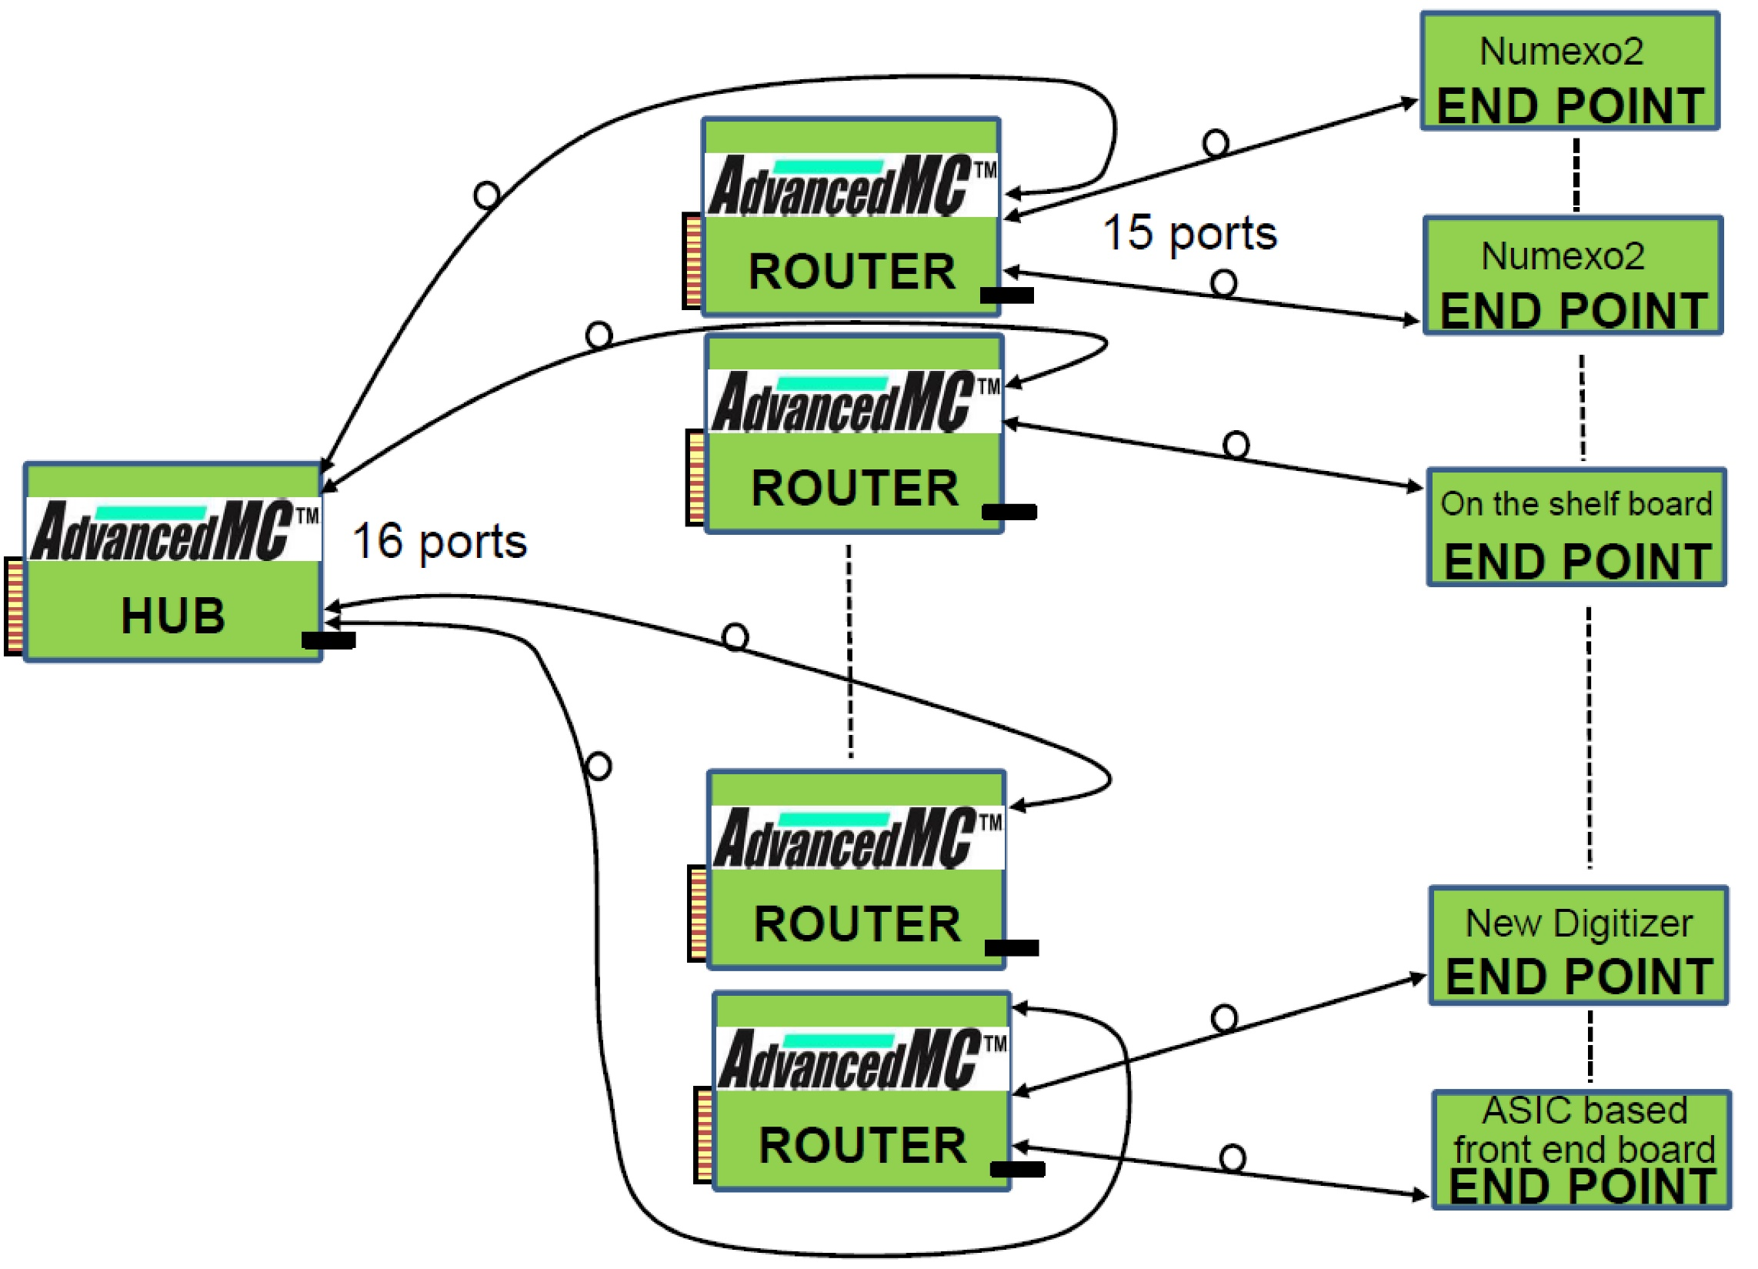
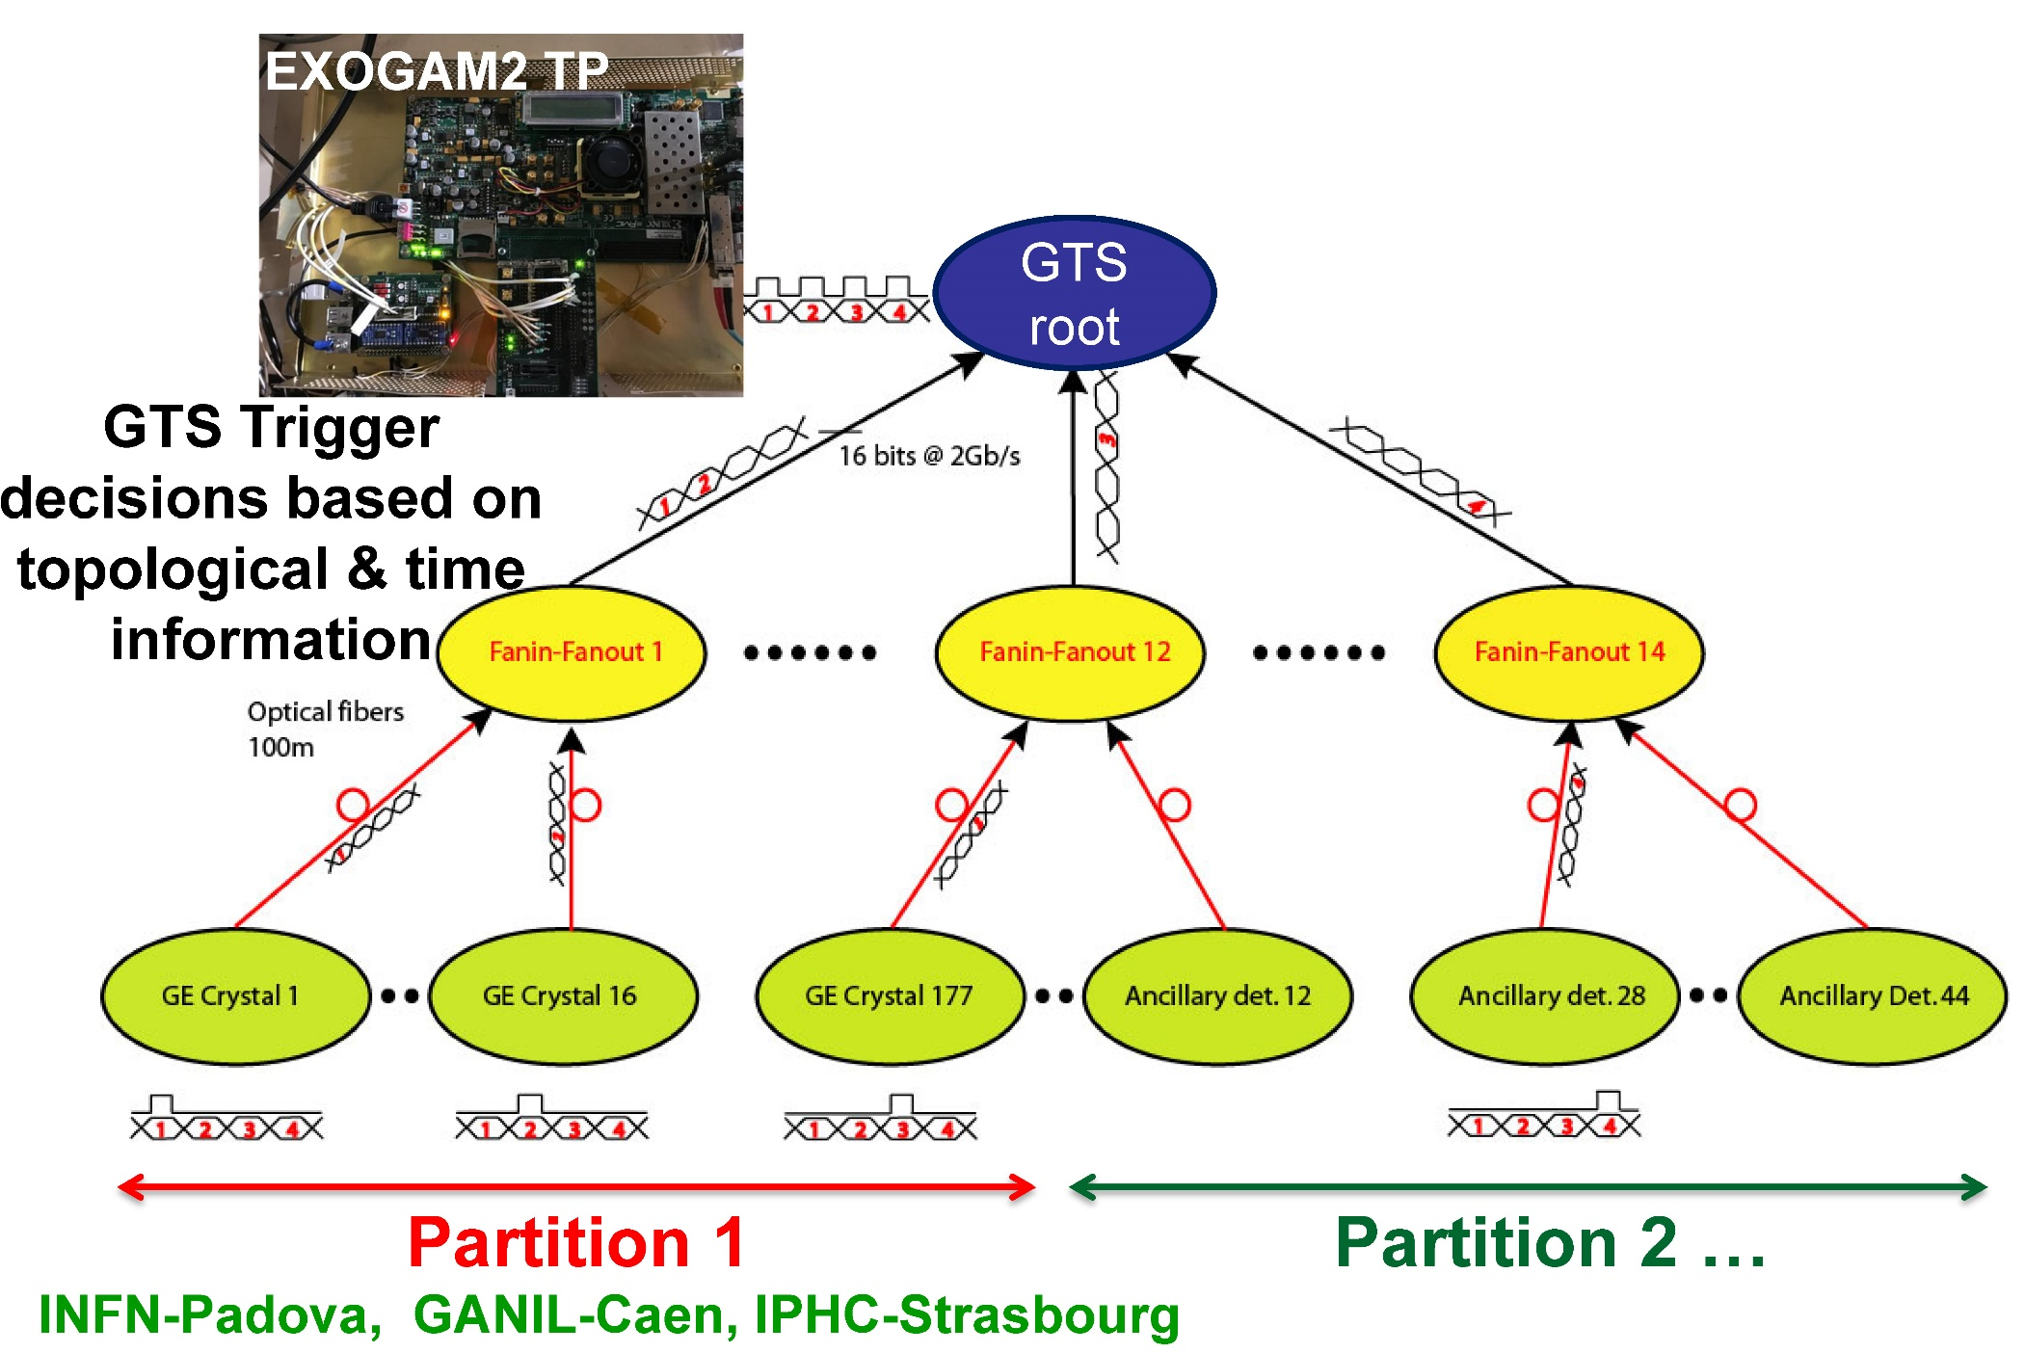
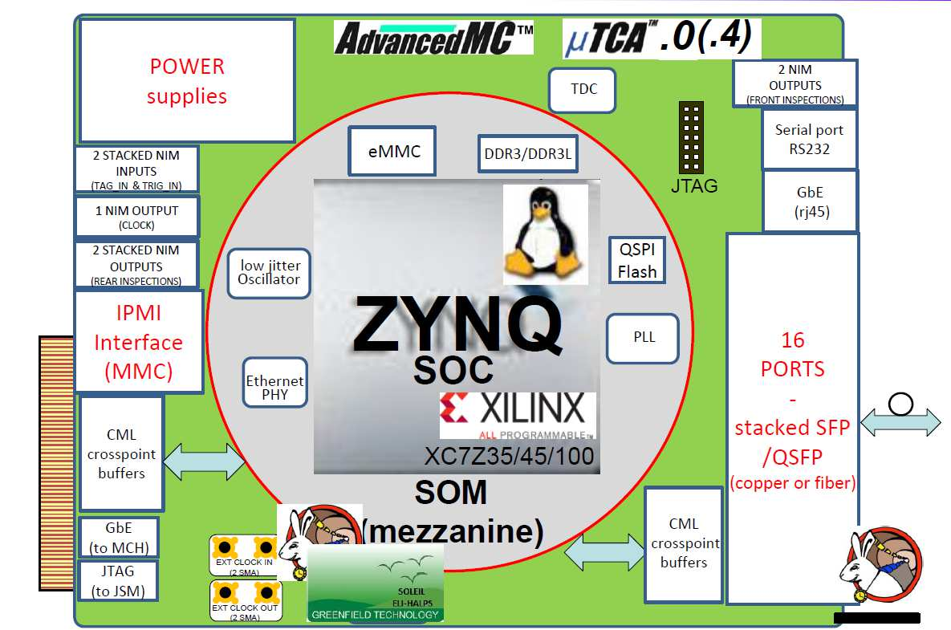
AGATA Coupling with Complementary Instrumentation from GTS to SMART
Presently AGATA and the Complementary Instrumentation Synchronized/Triggered via the GTS system + EXOGAM2 Trigger Processor
From 2026 Expected to be available the GANIL SMART Trigger and Synchronization system. The HUB contains a new Trigger Processor.
Issue:
limited number
of channels &
Obsolescence
See Matthieu Bezard
contribution
Already available the AMC board that can work as HUB or ROUTER
Prototyping the MCH board necessary for the AGATA requirements.
VAMOS++ electronics based in NUMEXO2 and GRIT final electronics
Complementary Instrumentation Synchronized and participating in the Trigger via the VME AGAVA Interface
Notes:
Introduction
Overview of the system
Physics outcomes from this meeting important
define physics case
experimental constraints
range of experiments
key experiments demonstrator/full array
meeting
Key design parameters Before too late
120/180 decision

Slide 13
External Trigger for the Pre-processing board PACE
Presently due to Trigger Rate limitations in the AGATA system, a external triggering is necessary in the AGATA pre-processing board. The implementation of such trigger in PACE is scheduled.
A.Goasduff (INFN-LNL)
GTS or
SMART
External Gate
Blocking the Trigger Request
J.Collado, V.Gonzalez, IFIC – CSIC and ETSE University of Valencia, Spain
Notes:
Introduction
Overview of the system
Physics outcomes from this meeting important
define physics case
experimental constraints
range of experiments
key experiments demonstrator/full array
meeting
Key design parameters Before too late
120/180 decision

Slide 14
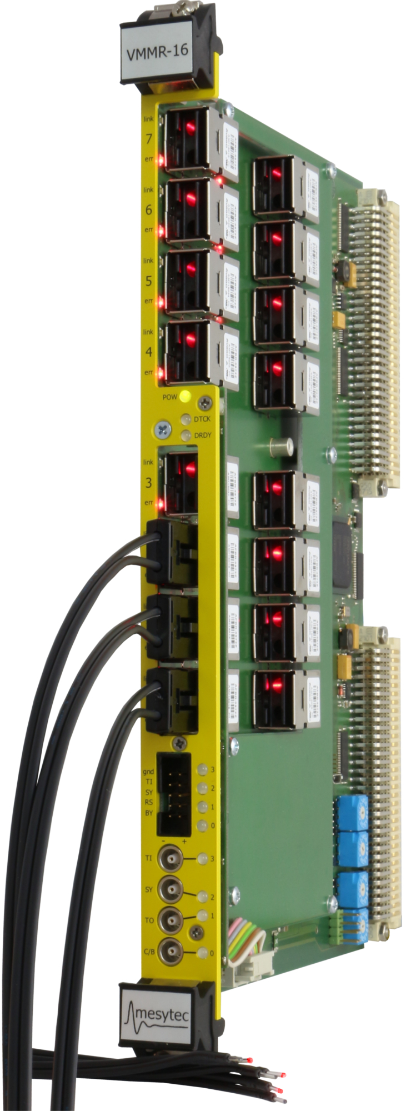
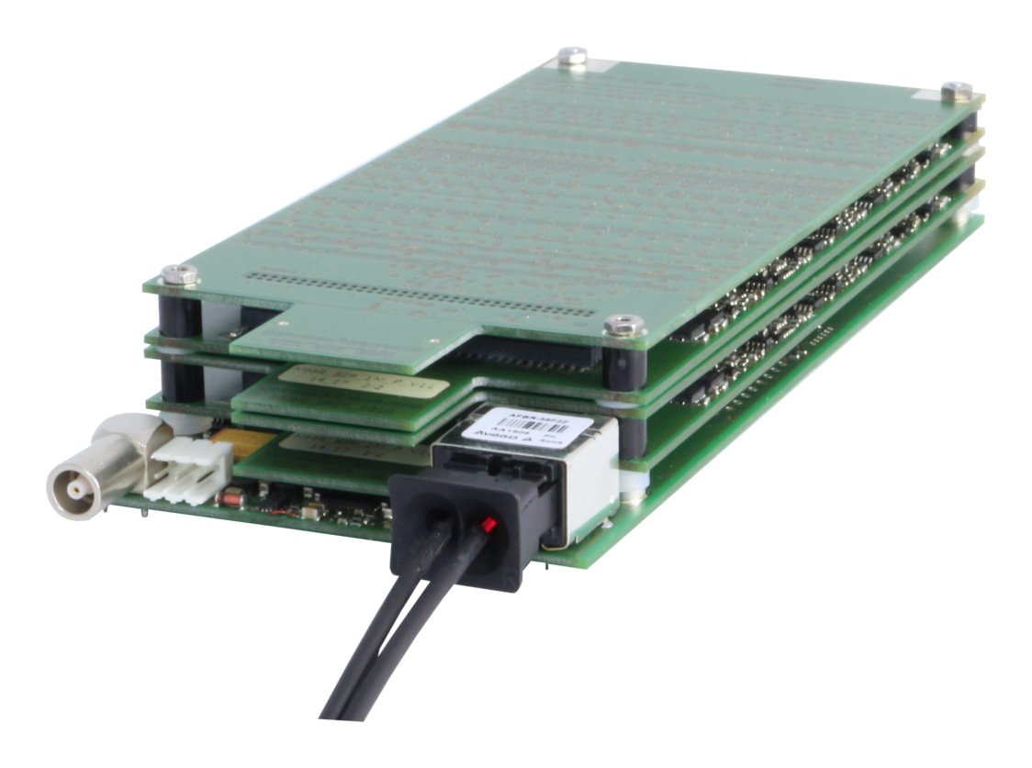
GRIT Phase 0 BEE Contingency Plan
The primary goal for the GRIT BEE is to have ready for 2029 the PLASV3 + FASTER + SMART Electronics
A contingency plan has been discussed, aiming to use the Mesytec Multiplexed Readout system MMR +
VMMR, based in the VME bus.
While the SMART HUB can accept logical signals to participate in the Trigger decision, a way to synchronize the TImeStamps will be necessary.
VMMR
Provides Trigger Output ~750 ns delay.
Accepts Trigger inputs
MMR
Amplifier, filter and digitization on front end
Notes:
Introduction
Overview of the system
Physics outcomes from this meeting important
define physics case
experimental constraints
range of experiments
key experiments demonstrator/full array
meeting
Key design parameters Before too late
120/180 decision

Slide 15

Schedule for the Completion and Production of the Phase 2 Electronics
DIGIOPT12 (V3.6, V3.7, V3.71)
90 channels (3 Segments + 1 Core) produced
STARE Ethernet Interface board
135 STARE boards + Spares Already produced
PACE Pre-Processing Board
90 PACE Ordered, 15 delivered, completion scheduled June 2025
PACE Pre-processing firmware
95% completed ongoing final formatting and GTS still to test
STARE Data transfer Firmware
Completed a production version with UDP protocol working stable
RUDP version under discussion
Notes:
Introduction
Overview of the system
Physics outcomes from this meeting important
define physics case
experimental constraints
range of experiments
key experiments demonstrator/full array
meeting
Key design parameters Before too late
120/180 decision

Slide 16


Acknowledgements
Thanks to the AGATA Front-End Electronics Working Group
&
the Data Processing Working Group (Data Acquisition and Control)
The new Global Trigger and Synchronization System SMART is being developed by G. Wittwer, M. Bezard et al., GANIL, France
MICINN, AIE and Generalitat Valenciana, Spain under Grants PID2020-118265GB-C4, PID2023-150056NB-C4 CEX2023-001292-S, ASFAE/2022/031 CIPROM/2022/54, and by the EU NextGenerationEU and FEDER funds
Notes:
Introduction
Overview of the system
Physics outcomes from this meeting important
define physics case
experimental constraints
range of experiments
key experiments demonstrator/full array
meeting
Key design parameters Before too late
120/180 decision

