Slide 1
GRIT BEE
Granularity, Resolution, Identification, Transparency
D.Etasse@LPC Caen, CNRS/IN2P3

Slide 2
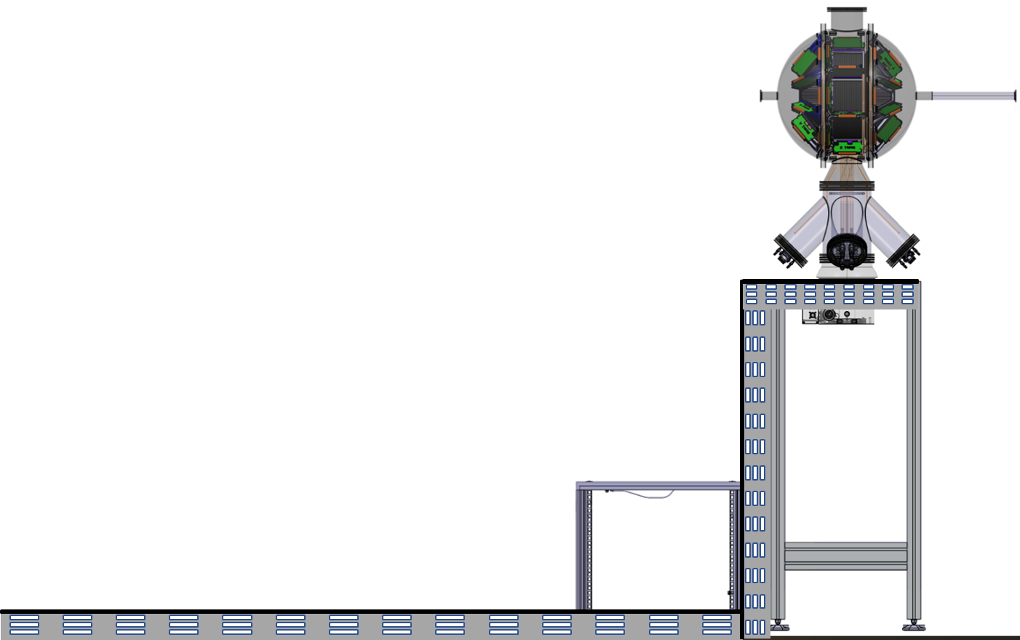
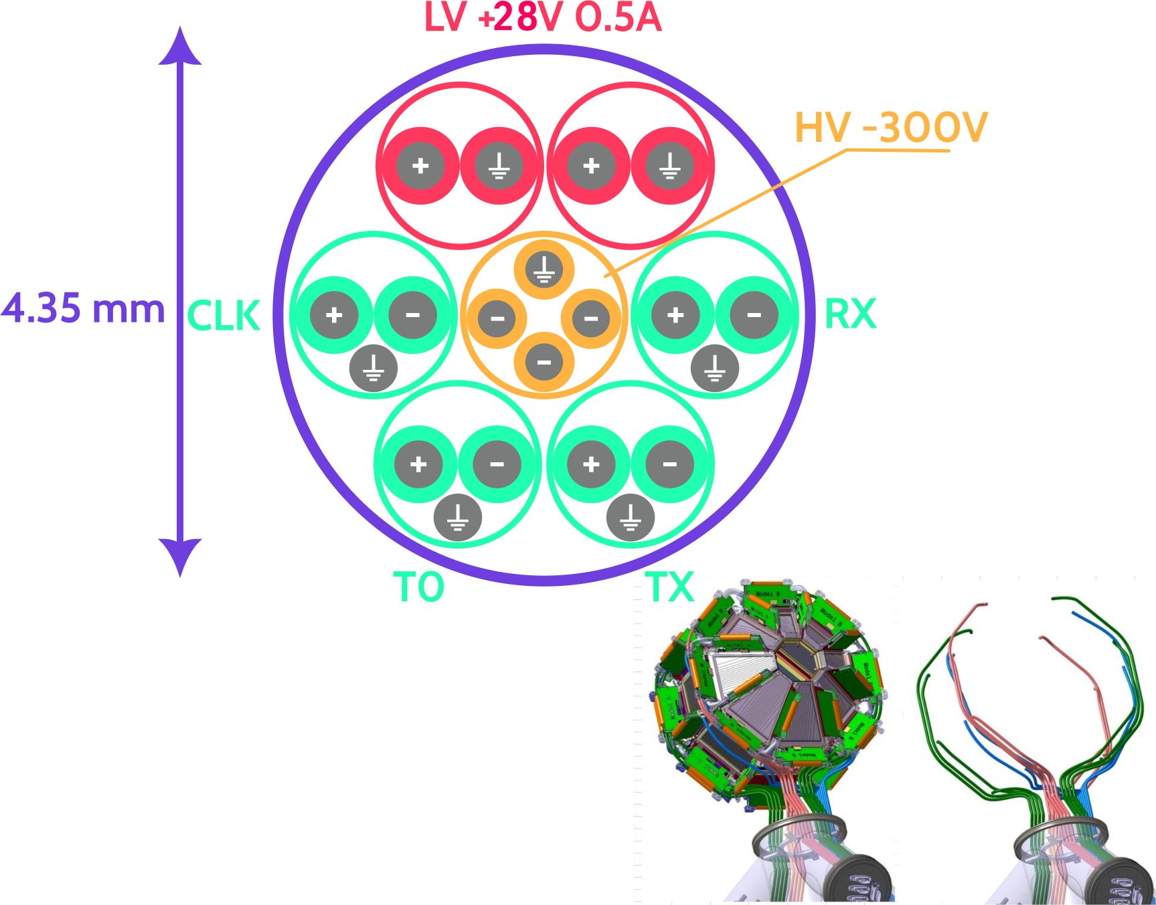
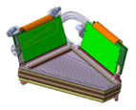
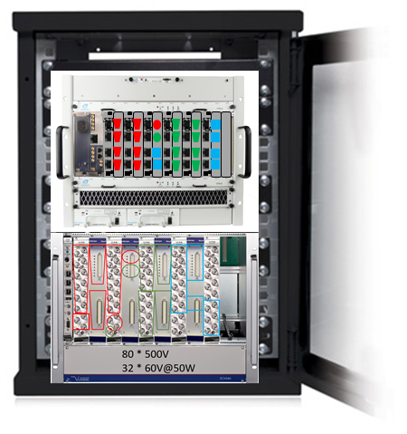
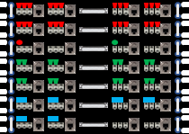
GRIT BEE → Overview
SLOW CONTROL
DATA PROCESSING
MONITORING
FRONT END
VERSIONING
PLAS
PLAS
PLAS
PLAS
PCIe Gen4 128Gb/s
ETHERNET 1/25Gb/s
DATABASE
GPIO
SYNCHRO
PLAS
PLAS
CPLD
FRONT END
Optical Fiber
TIMESTAMP
DAQ / SYNC
PROTOCOL
PLAS
PROTOCOL
MANDATORY
OPTIONAL
Back-End
Front-End
AGATA-GRIT-VAMOS@2025-06-13 Caen, David Etasse

Slide 3
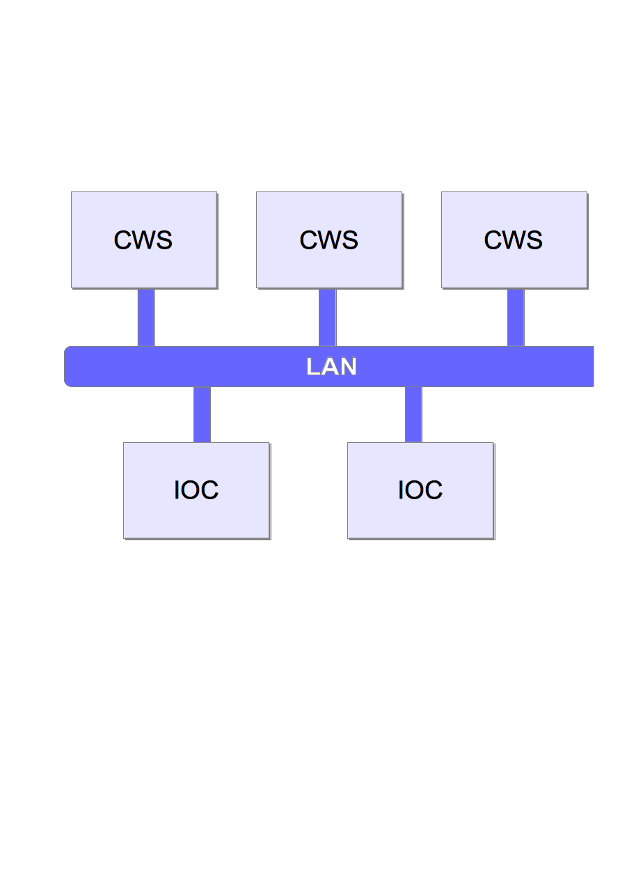
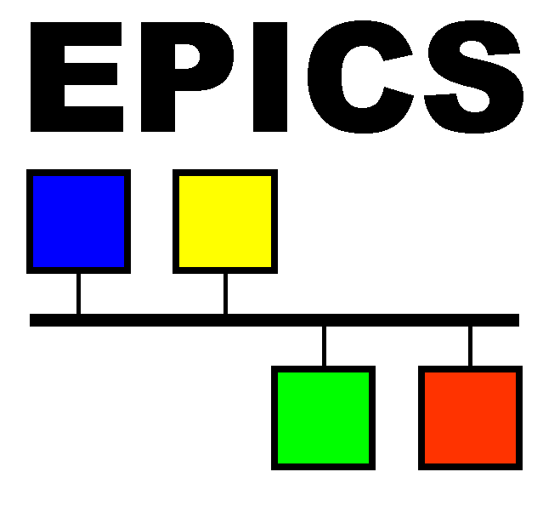
GRIT BEE → Slow Control
SLOW CONTROL
DATA PROCESSING
A simple EPICS control system can be composed of one or more IOCs
and Client WorkStations that communicate over a LAN
MONITORING
PCIe Gen4 128Gb/s
VERSIONING
Client WorkStation
ETHERNET 1/25Gb/s
DATABASE
SYNCHRO
Local Area Network
Optical Fiber
Input/Output
Controller
MANDATORY
OPTIONAL
https://epics-controls.org/
AGATA-GRIT-VAMOS@2025-06-13 Caen, David Etasse

Slide 4
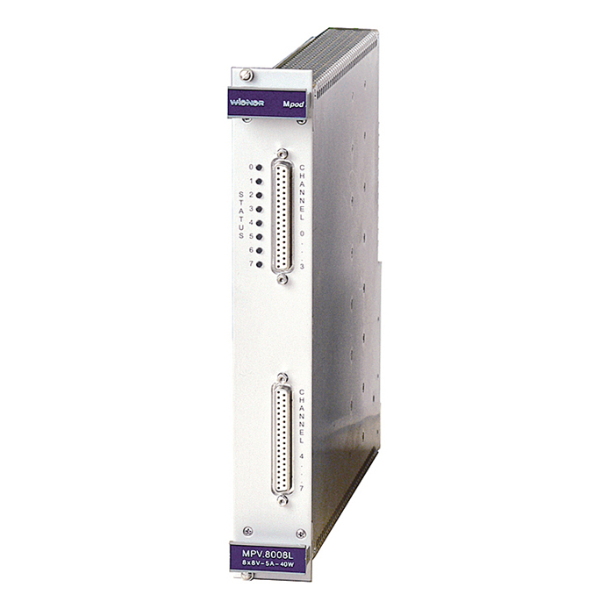
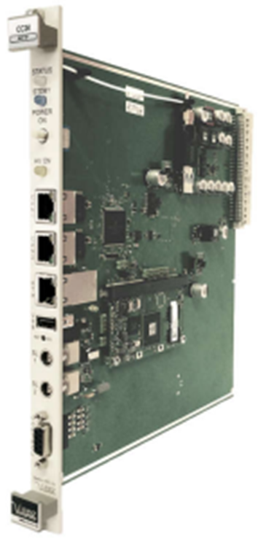
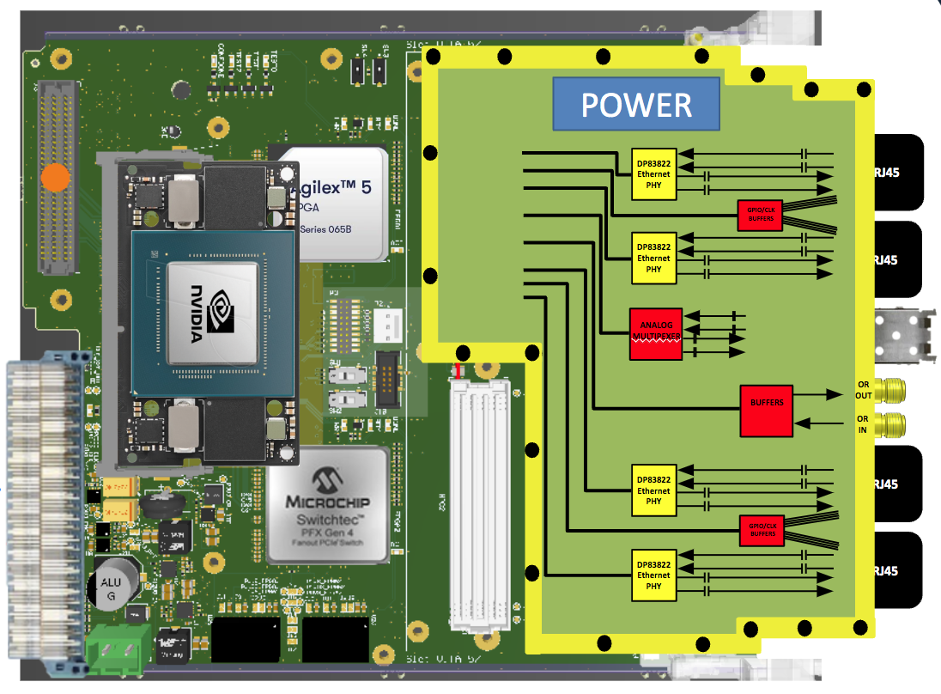
GRIT BEE → Slow Control
SLOW CONTROL
EHS F4 05n
DATA PROCESSING
MPV 8060H
CC24 Controller
uTCA GRIT MODULE
MONITORING
PCIe Gen4 128Gb/s
VERSIONING
ETHERNET 1/25Gb/s
DATABASE
SYNCHRO
CHANNEL ACCESS
16 Channels
500 V
10 mA
neg
Ethernet
Epics compatible
8 Channels
60 V
1 A
pos
Optical Fiber
MANDATORY
VACUUM CONTROL
SYSTEM
OPTIONAL
AGATA-GRIT-VAMOS@2025-06-13 Caen, David Etasse

Slide 5
GRIT BEE → Data Processing
SLOW CONTROL
GRIT BEE
DATA PROCESSING
SMART
Slow Control
FASTERv3
GRIT Daughter-board
MONITORING
PCIe Gen4 128Gb/s
VERSIONING
ETHERNET 1/25Gb/s
ML processing, Data exchange and storage
Data acquisition and
synchronisation
User Algorithms
DATABASE
SYNCHRO
SINAPSE
SImulateur Numérique pour l'Apprentissage Profond sur Système Embarqué
Digital SImulator for Deep Learning on Embedded Systems
Optical Fiber
Board Design, Firmware,
VHDL Algorithms, Synchronisation
ML or Traditional Algorithms
MANDATORY
OPTIONAL
→ 4 LPC Caen, 1 CDD SINAPSE, 2 years,
150K€
→ 5 LPC Caen, 1 CDD SAGA, X years, FASTERv2 funding
→ LPC Caen or
other laboratories
AGATA-GRIT-VAMOS@2025-06-13 Caen, David Etasse

Slide 6
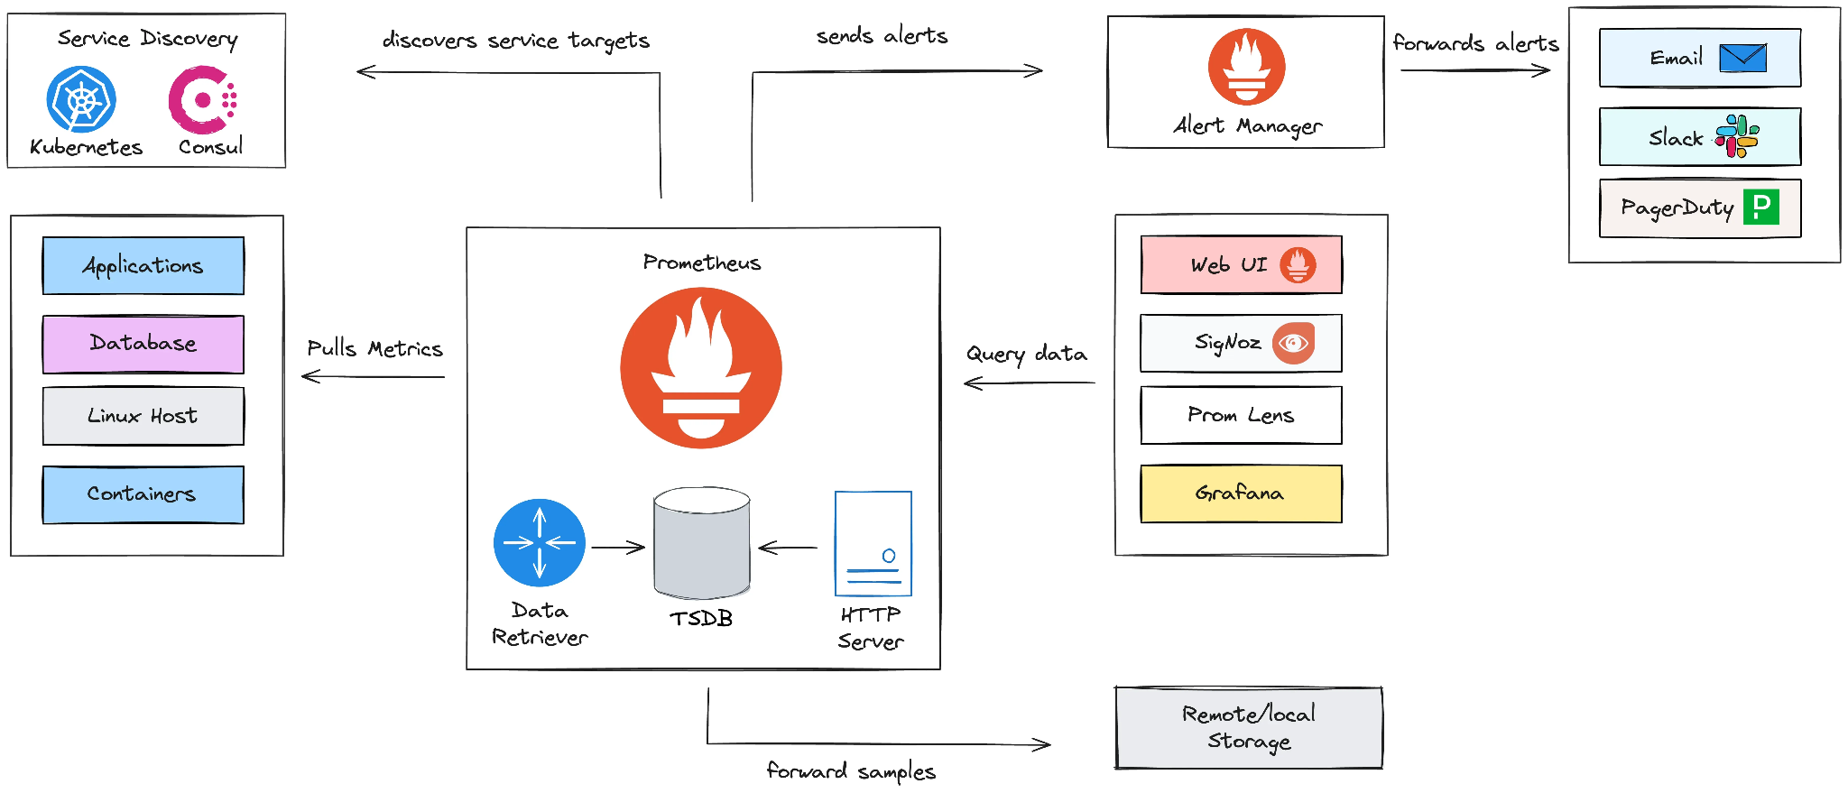
GRIT BEE → Monitoring
SLOW CONTROL
The following diagram shows an overview of the overall Prometheus system architecture.
DATA PROCESSING
MONITORING
PCIe Gen4 128Gb/s
VERSIONING
ETHERNET 1/25Gb/s
DATABASE
SYNCHRO
Optical Fiber
MANDATORY
OPTIONAL
AGATA-GRIT-VAMOS@2025-06-13 Caen, David Etasse

Slide 7
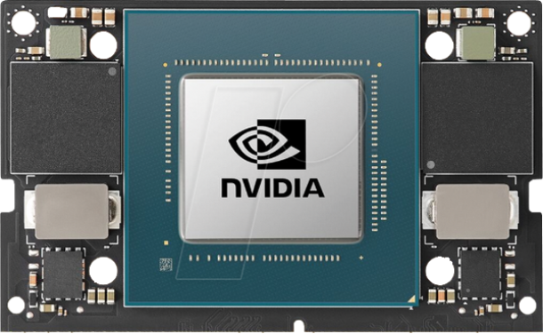
GRIT BEE → Versioning/DATAbase
SLOW CONTROL
Git for the versioning
Redis for the DATAbase
DATA PROCESSING
MONITORING
VERSIONING
Channel Access
PCIe Gen4 128Gb/s
ETHERNET 1/25Gb/s
DATABASE
CA SERVER
EPICS
IOC
Export
RUNTIME DATAbase
SYNCHRO
DEVICE SUPPORT
Import
4 x
Ethernet 100 Mb
DEVICE DRIVER
GPIO Signal
Optical Fiber
CLK Signal
Hardware Control
Exporter
UTCA MODULE 1
MANDATORY
OPTIONAL
AGATA-GRIT-VAMOS@2025-06-13 Caen, David Etasse

Slide 8
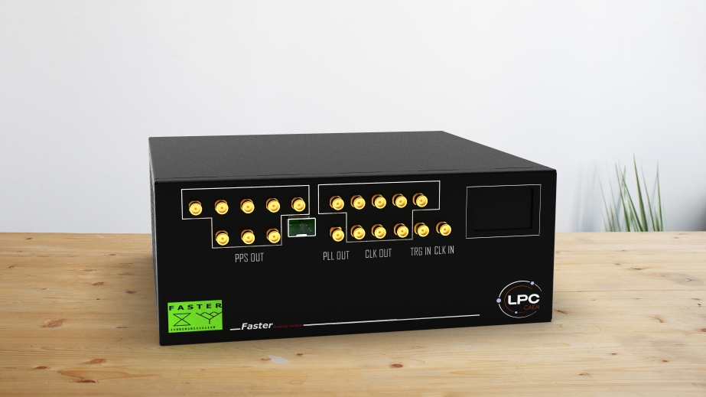
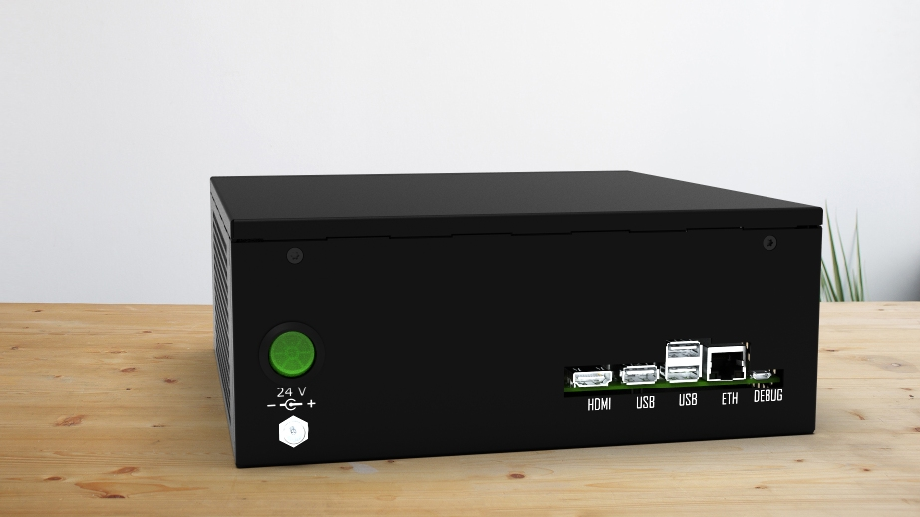
GRIT BEE → Synchro
SLOW CONTROL
DATA PROCESSING
MASTER_A10 Box
FASTERV2/SMART bridge
2 timestamps in a FASTERv2 UDP frame
Test of WHITE Rabbit
MONITORING
PCIe Gen4 128Gb/s
VERSIONING
ETHERNET 1/25Gb/s
DATABASE
SYNCHRO
FASTERv3
uTCA FASTERv2/WR bridge
utCA FASTERv2/SMART bridge
For other uTCA boards in a FASTERV3 system → Either a SMART or a WR End Point
Optical Fiber
MANDATORY
OPTIONAL
AGATA-GRIT-VAMOS@2025-06-13 Caen, David Etasse

Slide 9
GRIT BEE → Synchro → GPIO Signal
GRIT BEE → Synchro
SLOW CONTROL
DATA PROCESSING
MONITORING
PCIe Gen4 128Gb/s
VERSIONING
GPIO
ETHERNET 1/25Gb/s
DATABASE
SYNCHRO
GPIO → General-Purpose Input-Output Signal
If DAQ is not running (Output Signal)
CS → Common Start
TU → Update timestamp registers in CPLD front end boards
PP → Ping Pong (Cable Measurement length, Output/Input)
If DAQ is running (Input signal)
TRIG → Trigger signal from all PLAS devices of the front end boards
Optical Fiber
MANDATORY
OPTIONAL
AGATA-GRIT-VAMOS@2025-06-13 Caen, David Etasse

Slide 10
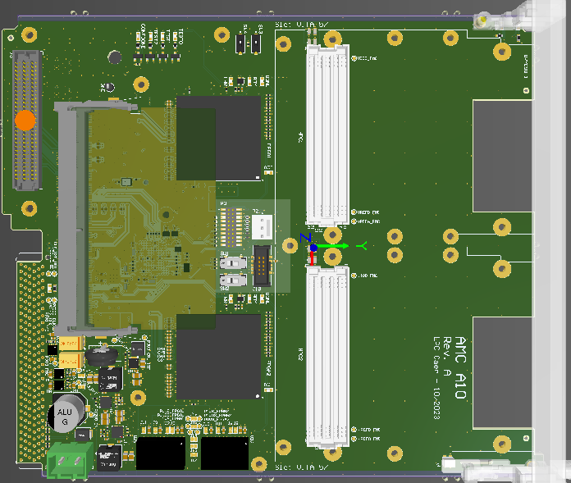
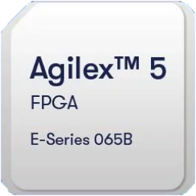
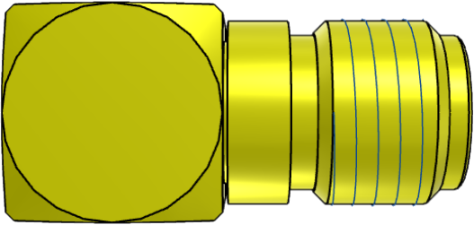
GRIT BEE → Synchro → GRIT Daughter-Board
SLOW CONTROL
DATA PROCESSING
POWER
Ethernet 100 Mb
MONITORING
DP83822
Ethernet
PHY
RJ45
GPIO Signal
CLK Signal
VERSIONING
GPIO/CLK
BUFFERS
Ethernet 100 Mb
PCIe Gen4 128Gb/s
RJ45
GPIO Signal
ETHERNET 1/25Gb/s
DP83822
Ethernet
PHY
CLK Signal
DATABASE
ANALOG
MULTIPEXER
SMART
(Optical fiber)
SYNCHRO
OR
OUT
TO ADJACENT MODULE OR
AGATA DAQ
BUFFERS
OR
IN
Optical Fiber
FROM ADJACENT MODULE
RJ45
Ethernet 100 Mb
GPIO Signal
DP83822
Ethernet
PHY
CLK Signal
MANDATORY
GPIO/CLK
BUFFERS
Ethernet 100 Mb
OPTIONAL
RJ45
GPIO Signal
DP83822
Ethernet
PHY
CLK Signal
AGATA-GRIT-VAMOS@2025-06-13 Caen, David Etasse

Slide 11
GRIT BEE → Standalone VS AGATA-GRIT- VAMOS mode
SLOW CONTROL
DATA PROCESSING
MONITORING
PCIe Gen4 128Gb/s
VERSIONING
ETHERNET 1/25Gb/s
DATABASE
SYNCHRO
Optical Fiber
MANDATORY
OPTIONAL
AGATA-GRIT-VAMOS@2025-06-13 Caen, David Etasse

Slide 12
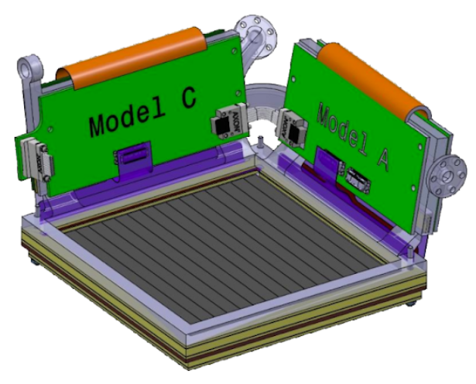
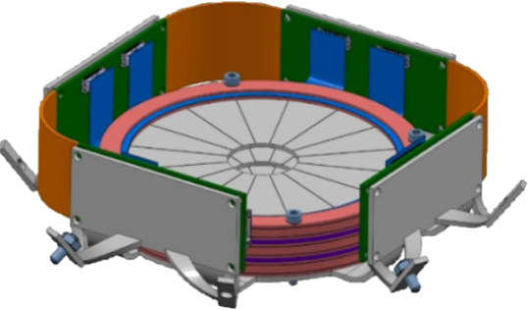
GRIT BEE → Standalone mode
 | Module | CRATE
Mandatory | 1/10Gbe | 2x 1/25Gbe
Eth (Opt1) | 40Gbe | 2x 100Gbe
PCIe (Opt2) | 64Gb/s | 2x 128Gb/s
4 x
Ethernet 100 Mb
EPICS IOC
Exporter(s)
GPIO Signal
CLK Signal
GPIO1
GPIO1 Monitoring
UTCA MODULE 1
4 x
Ethernet 100 Mb
EPICS IOC
Exporter(s)
GPIO Signal
CLK Signal
GRIT SERVER
GPIO2
GPIO2 Monitoring
UTCA MODULE 2
4 x
Ethernet 100 Mb
EPICS IOC
Exporter(s)
25Gbe/s
GPIO Signal
CLK Signal
GPIO3
GPIO3 Monitoring
UTCA MODULE 3
4 x
MERGER DATA ^{100%}
Ethernet 100 Mb
EPICS IOC
Exporter(s)
GPIO Signal
CLK Signal
Data Processing → ML, Algorithm,
Software Trigger/Merger, etc.)
GPIO4
GPIO4 Monitoring
UTCA MODULE 4
ONLINE DATA ^{≤100%}
(Merger, oscillo, single) …
4 x
Ethernet 100 Mb
EPICS IOC
Exporter(s)
GPIO Signal
CLK Signal
ETH
1/25Gb/s
2 x
GPIO5
GPIO5 Monitoring
UTCA MODULE 5
Ethernet 100 Mb
EPICS IOC
Exporter(s)
WHITE RABBIT (Optical fiber)
2 x
GPIO Signal
CLK Signal
GPIO6
GPIO6 Monitoring
UTCA MODULE 6
GPIO 1-6
PPS
1-6
PPS (NIM)
AGATA-GRIT-VAMOS@2025-06-13 Caen, David Etasse

Slide 13
GRIT BEE → AGATA-GRIT-VAMOS mode
4 x
Ethernet 100 Mb
EPICS IOC
Exporter(s)
GPIO Signal
Smart.sh(s)
CLK Signal
GPIO1
GPIO1 Monitoring
UTCA MODULE 1
Command SSH
(Ethernet)
MASTER
DAQ
4 x
Ethernet 100 Mb
EPICS IOC
Exporter(s)
GPIO Signal
Smart.sh(s)
CLK Signal
GRIT SERVER
Command SSH
(Ethernet)
GPIO2
GPIO2 Monitoring
UTCA MODULE 2
Daq_Start.sh
Daq_Stop.sh
4 x
Ethernet 100 Mb
EPICS IOC
Exporter(s)
GPIO Signal
Smart.sh(s)
25Gb/s
Grafana Query
(Ethernet)
CLK Signal
GPIO3
GPIO3 Monitoring
UTCA MODULE 3
4 x
MERGER DATA ^{100%}
(Ethernet)
Ethernet 100 Mb
EPICS IOC
Exporter(s)
GPIO Signal
Smart.sh(s)
CLK Signal
Data Processing → ML, Algorithm,
Software Trigger/Merger, etc.)
GPIO4
GPIO4 Monitoring
UTCA MODULE 4
HISTOGRAM
(Ethernet)
4 x
Ethernet 100 Mb
EPICS IOC
Exporter(s)
GPIO Signal
Smart.sh(s)
CLK Signal
ETH
1/25Gb/s
2 x
GPIO5
GPIO5 Monitoring
UTCA MODULE 5
Ethernet 100 Mb
EPICS IOC
Exporter(s)
SMART (Optical fiber)
2 x
GPIO Signal
Smart.sh(s)
CLK Signal
GPIO6
GPIO6 Monitoring
UTCA MODULE 6
GPIO 1-6
Trigger (NIM)
AGATA-GRIT-VAMOS@2025-06-13 Caen, David Etasse
CLOCK NETWORK
MANDATORY
OPTIONAL

Slide 14
GRIT BEE → Calendar
SLOW CONTROL
GRIT BEE
DATA PROCESSING
SMART
Slow Control
FASTERv3
GRIT Daughter-board
MONITORING
2026
2027
2023 …
2026..
PCIe Gen4 128Gb/s
VERSIONING
ETHERNET 1/25Gb/s
AI processing, Data exchange and storage
Data acquisition and
synchronisation
User Algorithms
DATABASE
SYNCHRO
SINAPSE
SImulateur Numérique pour l'Apprentissage Profond sur Système Embarqué
Digital SImulator for Deep Learning on Embedded Systems
Optical Fiber
2025 → 2027
2023 → ~2030
Board Design, Firmware,
VHDL Algorithms, Synchronisation
AI or Traditional Algorithms
MANDATORY
OPTIONAL
→ 4 LPC Caen, 1 CDD SINAPSE, 2 years,
150K€
→ 5 LPC Caen, 1 CDD, X years, FASTERv2 funding
→ LPC Caen or
other laboratories
AGATA-GRIT-VAMOS@2025-06-13 Caen, David Etasse

Slide 15
GRIT BEE
SLOW CONTROL
DATA PROCESSING
MONITORING
Thank you
for your attention
PCIe Gen4 128Gb/s
VERSIONING
ETHERNET 1/25Gb/s
DATABASE
SYNCHRO
Optical Fiber
MANDATORY
OPTIONAL
AGATA-GRIT-VAMOS@2025-06-13 Caen, David Etasse

