Slide 1
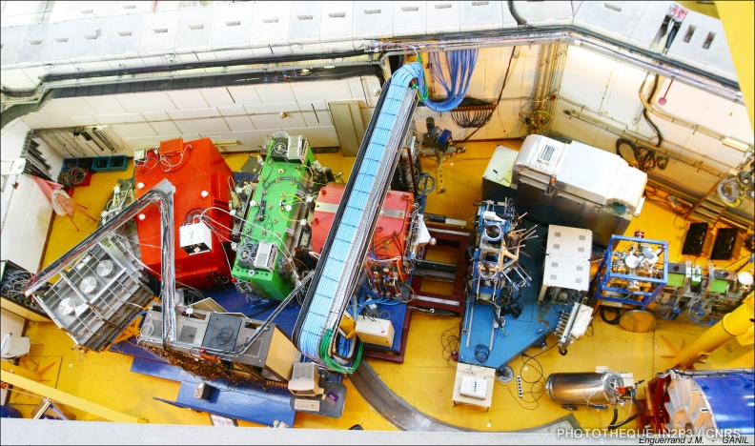
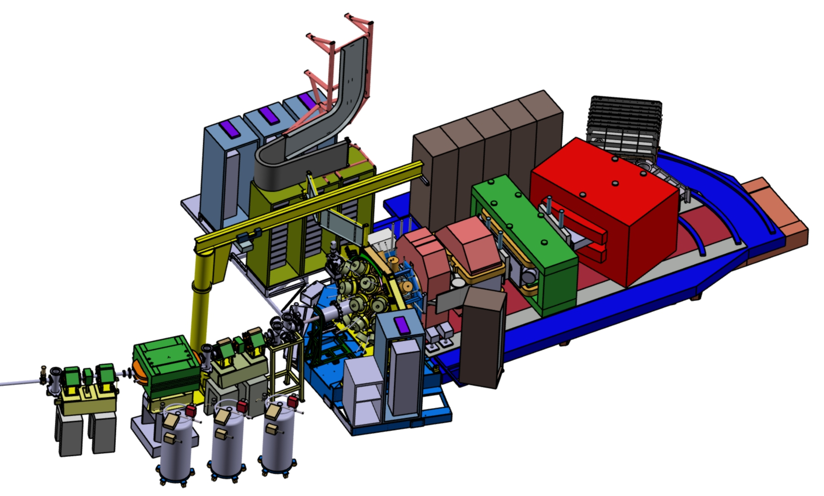
AGATA-2 @ GANIL, Mechanical integration
Gamma ray in VAMOS: A bit of history
~ 2003, coupling Vamos-Exogam: 12 detectors max
2014-2021 Agata 15 detectors max
& Exogam 8 detectors max
Optic fibers
Agata electronics plateform
Agata
VAMOS
Target
Exogam
Exogam

Slide 2
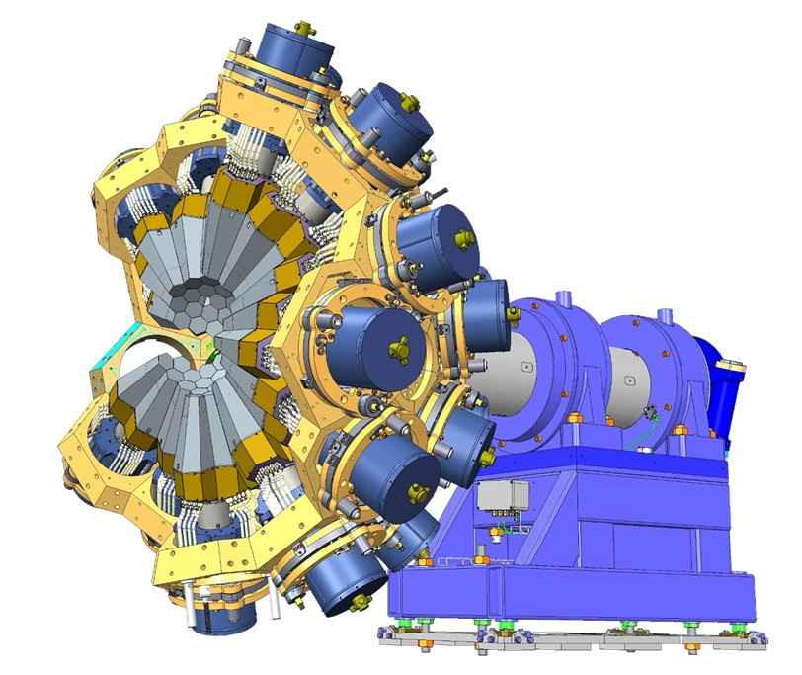
AGATA-2 @ GANIL, Mechanical integration
THE CHALLENGE: - Mount half of a complete AGATA (30 Detectors) around the Vamos target, (7500Kg)
2028-20.. - Use VAMOS at 0 and 28 degrees
- Keep an access to the target chamber
- Don’t move the magnets
- Keep the diag box and it’s diagnostics before the target - AGATA comes with its full shaft
It’s so big and
Vamos so small
Emmanuel
Half AGATA
Complete AGATA

Slide 3
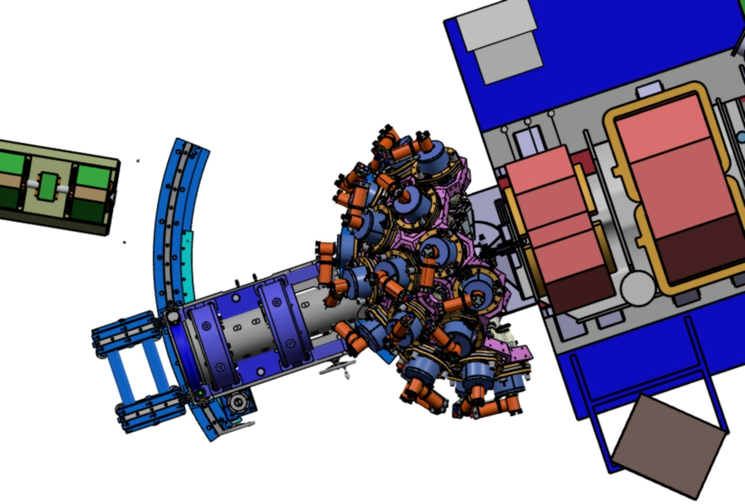
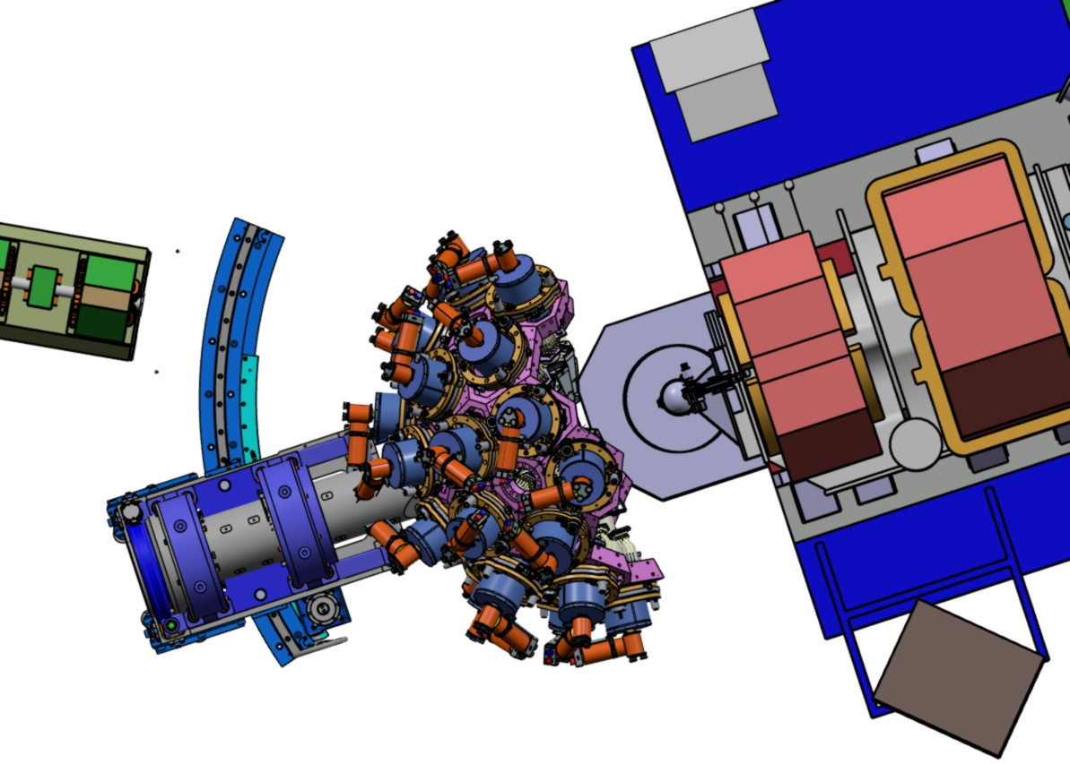
AGATA-2 @ GANIL, Mechanical integration
Beam throught a hole of a détector off
IMPLANTATION OF AGATA
- kept the actual base under the shaft with the adjustments X-Y-Z.
- install on the ground 2 rails for rotating -1° to 29 °.
- At 28°, we will have a back stand to move back Agata. Target chamber access 550mm.
- The translation and rotation of AGATA will be done manually.
- The rotation of AGATA on the beam axle remains motorized.
Beam
Vamos Agata at 28°
Agata bearings and base
550mm
Beam
Beam
Vamos Agata at 0°
New stands and curve rails
Access target chamber

Slide 4
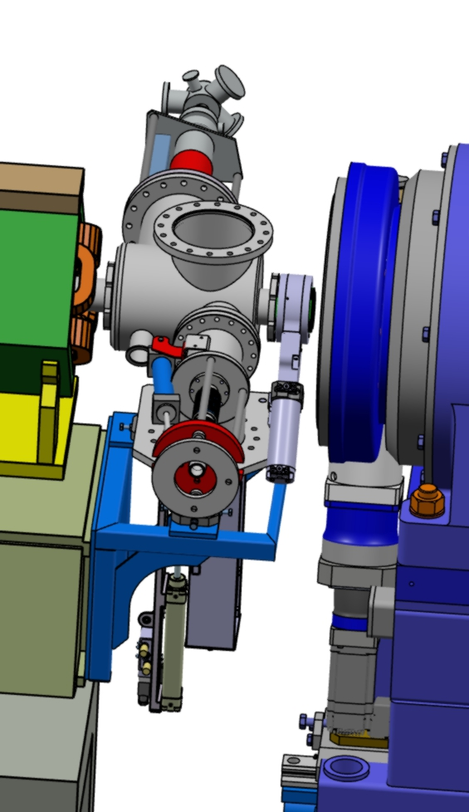
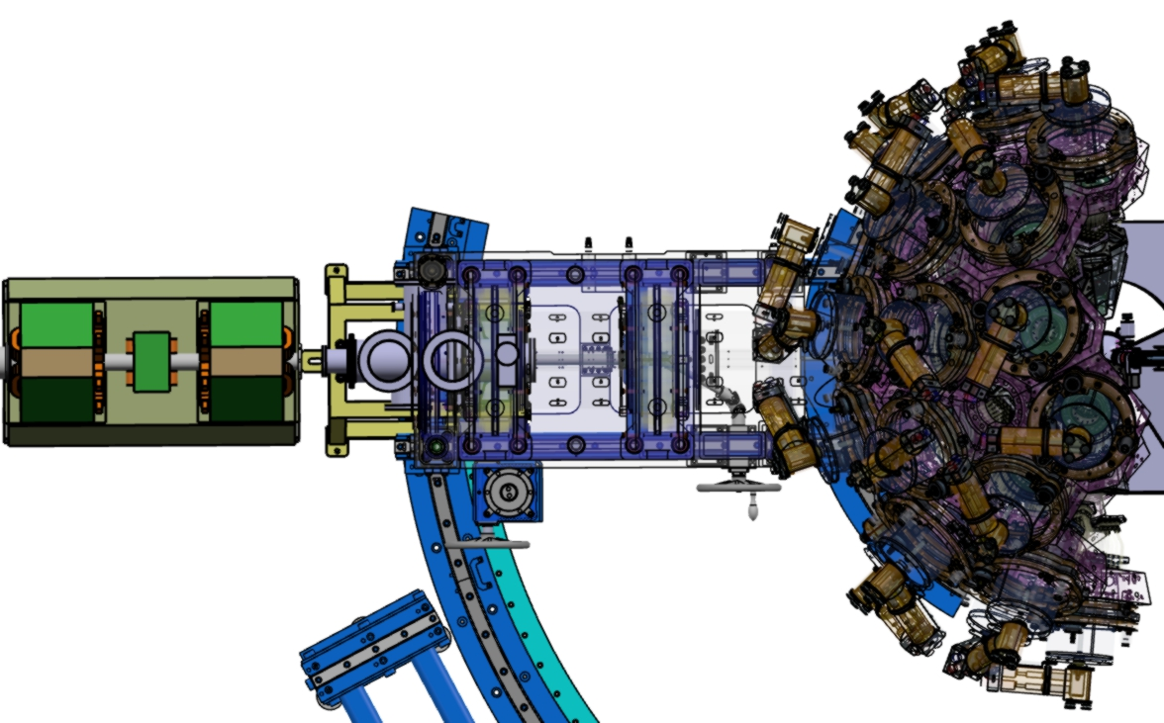
AGATA-2 @ GANIL, Mechanical integration
EMS Profilor
Reduce pipe
Turbo pump
DIAGNOSTIC BOX
- The implantation of AGATA requires to make a new diagnostics box and frame.
- Into the 375mm gap : A bellow, an isolated valve, an EMS beam profil,
a faraday cup, a turbo pump and keep a DN160 free flange for a tracking detector.
- The bellow will be inside the AGATA shaft.
Valve
Bellow
Vamos diag box
Agata stand
THE CLASH!
Frame
Tracking detector

Slide 5
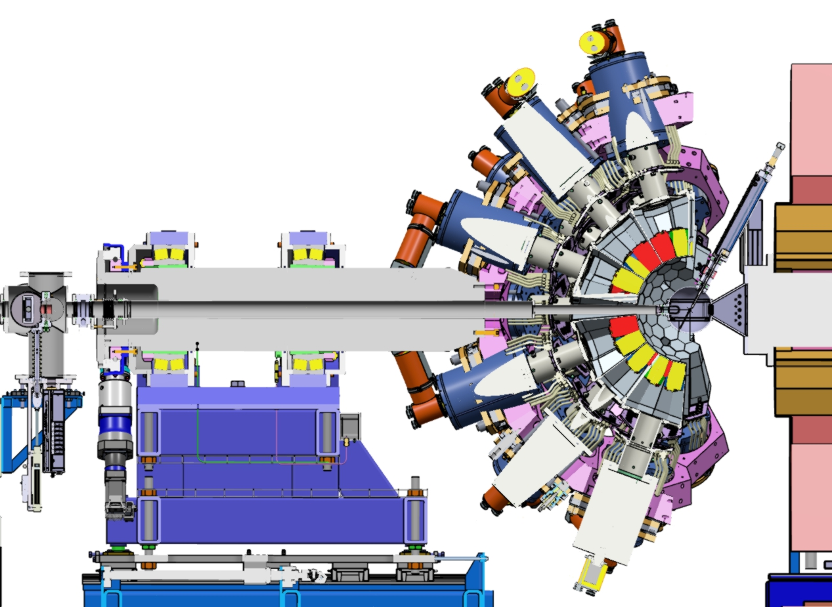
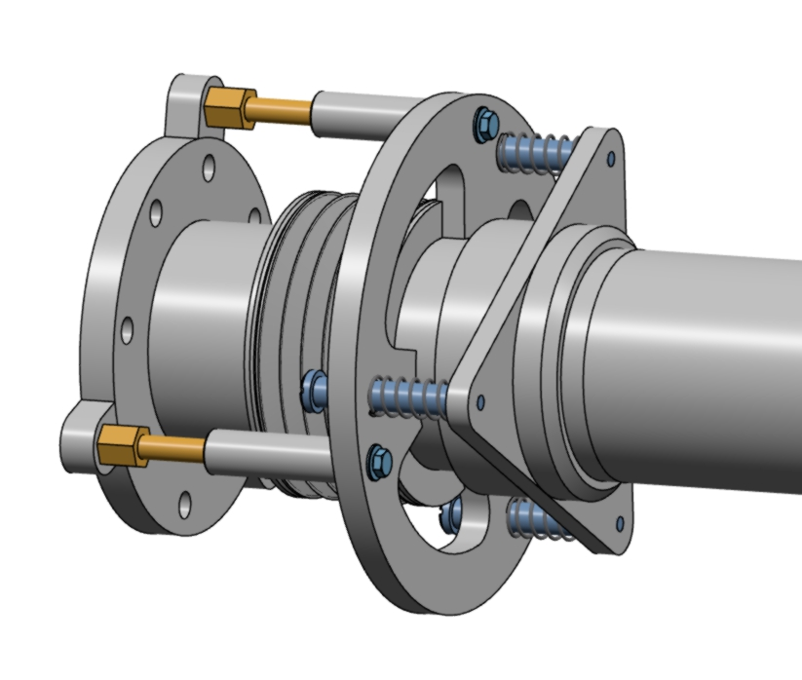
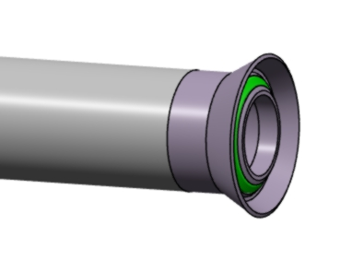
AGATA-2 @ GANIL, Mechanical integration
VACUUM PIPE
- The vacuum pipe (2,58m) will pass through the AGATA shaft.
- It will be connected to the diag box (DN100) and the target chamber.
- We have only one access: Diag box side, and only few cm to operate.
To close the line, just turn the 3 brass bolts to extend the bellow and the pressure
of the 3 springs will press the O-ring. Go back to open the line.
+/2mm clearance
Pipe/Agata Axel
Centering cone
Ball end
brass bolts
Springs
O-ring

Slide 6
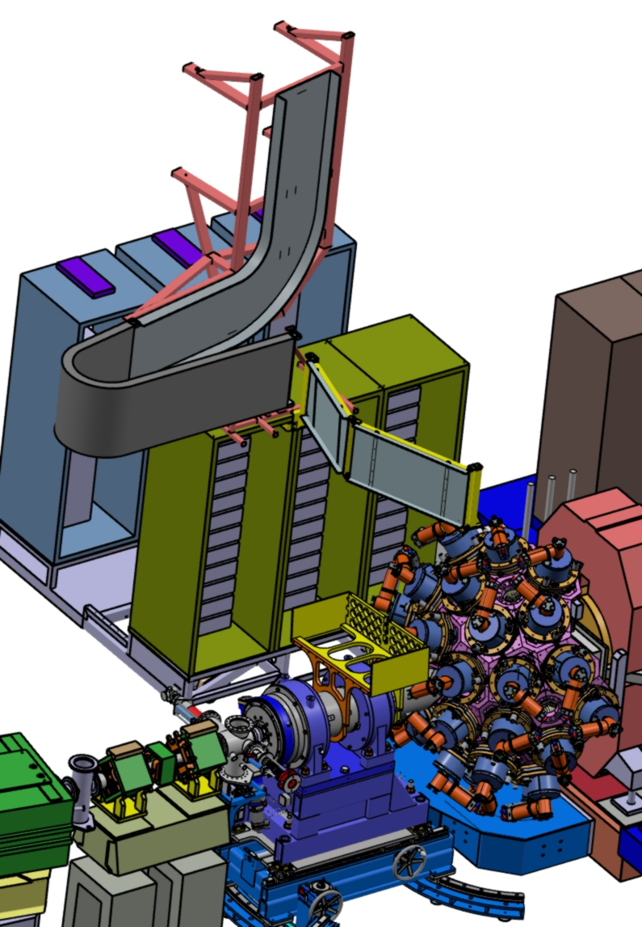
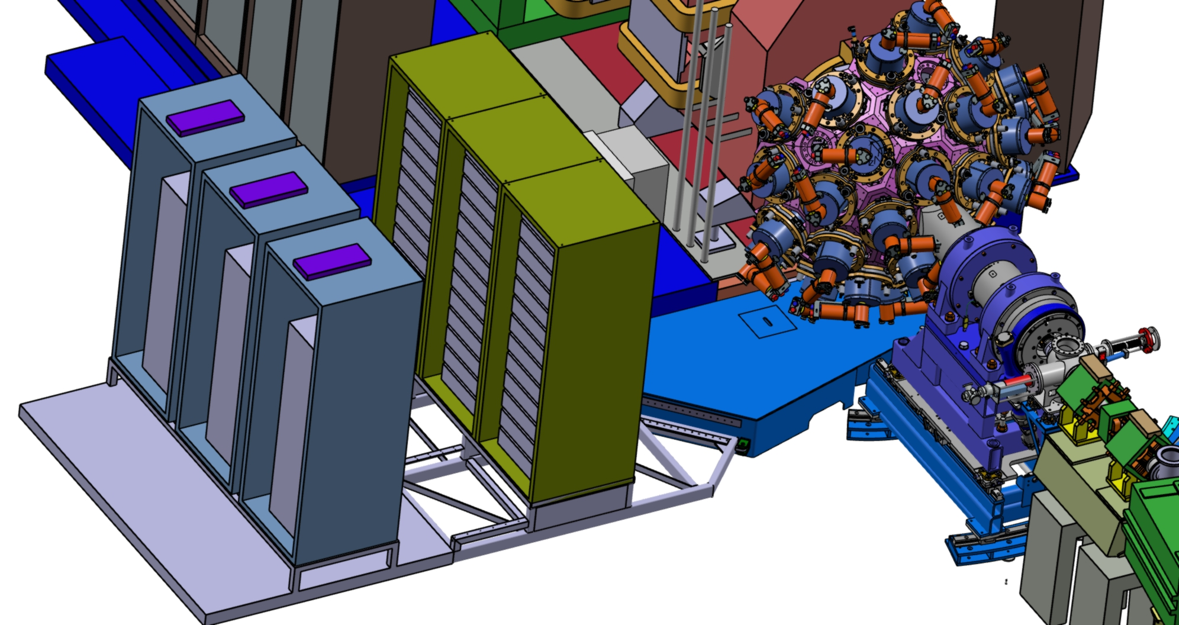
AGATA-2 @ GANIL, Mechanical integration
ELECTRONIC PLATEFORM, CABLES & CEM
- The AGATA electronic platform used for Agata-1 will be kept.
- The interface frame will be designed to be smaller and less higher.
- The 2x CEM copper link between the platform and Vamos will be kept.
- Possibility to put a copper plane under AGATA rails (installed in first).
- The upper half of the cables, will used the top cable tray. - AGATA cable tray has been moved, (for lower cables) to not damage the diagnostics.
Optic fibers
Top cable tray
Possibility to put a copper
surface under Agata stand
Agata cable tray
Copper link
Agata electronic plateform
Interface frame

Slide 7
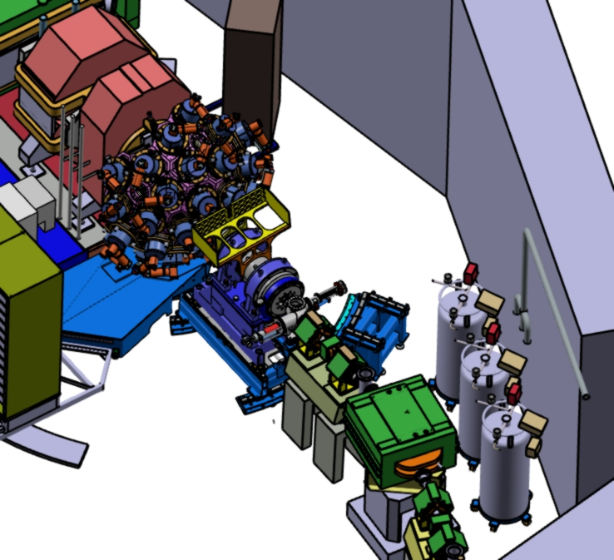
AGATA-2 @ GANIL, Mechanical integration
NITROGEN DISTRIBUTION (Should be discussed and studied)
- We could use the 3 Dewars going to 3 manifolds (10 ways each).
- The manifolds can be mounted on a gantry, fixed on the interface frame (60 small pipes in rotation)
or directly on the honeycomb (6 big pipes in rotation), but there is not enough place between the honeycomb and the interface frame…
As you have seen, the implantation of AGATA in VAMOS is extremely
constrained.
Each action on AGATA will require time and extreme attention.
It will be necessary to set up scenaris and to program them in advance,
To be continued with Mr Guillaume BRUNET (Brunet@ganil.fr),...
Interface frame
Nitrogene
3x Deware

