Slide 1
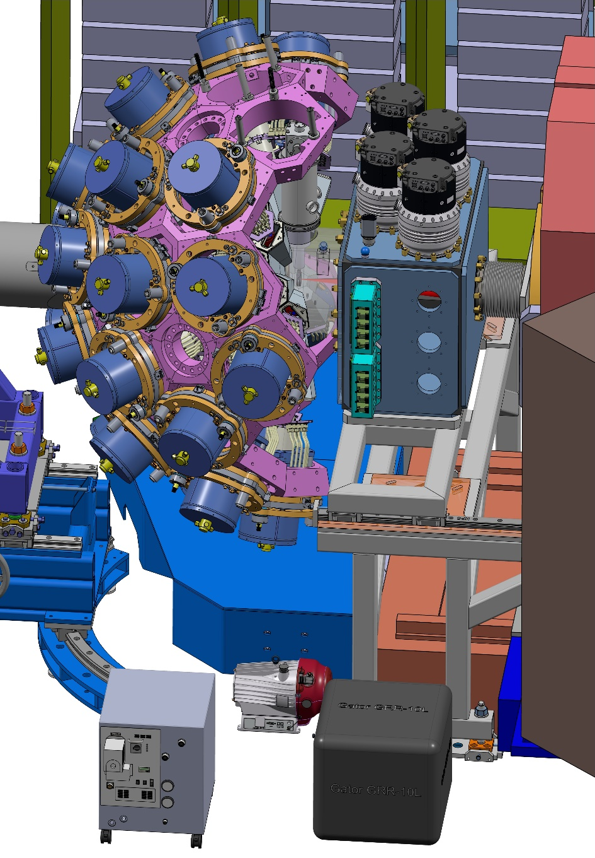
Mechanical integration of GRIT into AGATA-VAMOS
Yann Peinaud, IJCLab
Marlène Assié, IJCLab
Notes:
I will talk about mechanics

Slide 2
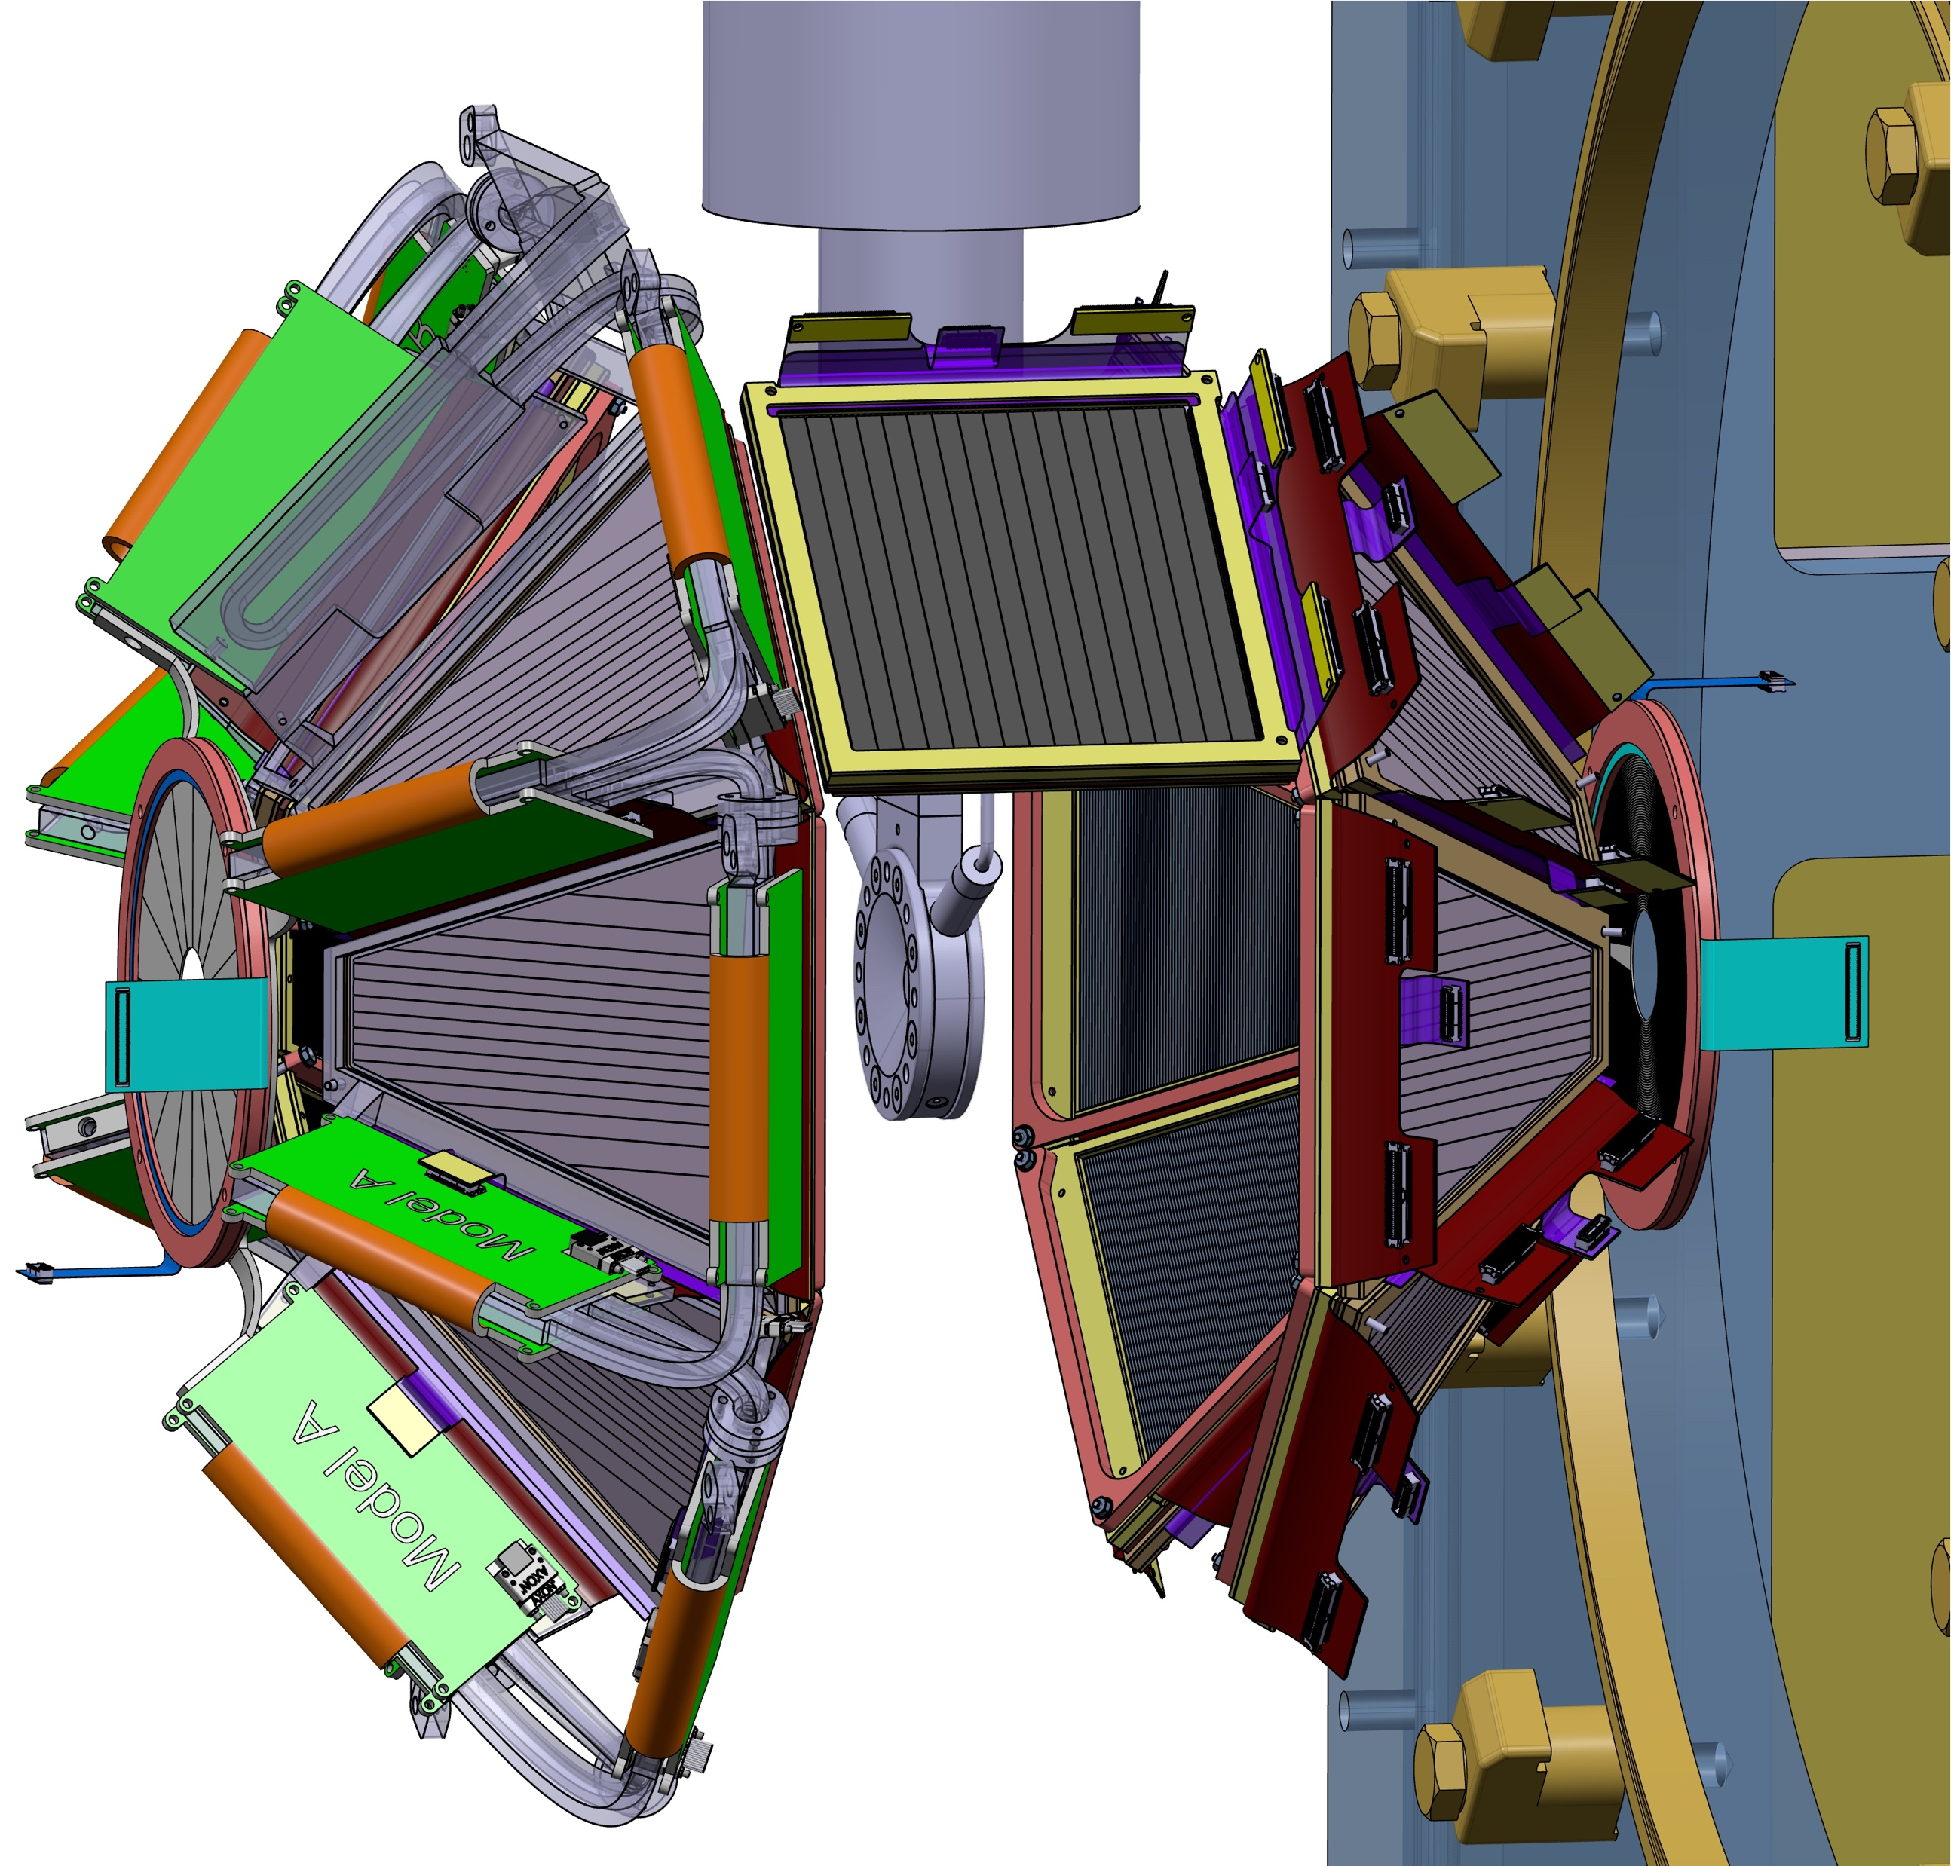
GRIT Phase 0 configuration
UPSTREAM (AGATA side)
90 degrees
DOWNSTREAM (VAMOS side)
1 square detector (1 or 2 stages ?)
read by Mesytec
Depending on Physics cases !
6 trapezoidal detectors (2 stages)
read by GRIT electronics (PLAS)
+ 1 annular detector (1stage)
read by Mesytec
6 trapezoidal detectors (2 stages)
read by Mesytec
+ 1 annular detector ? (1 stage ?)
read by Mesytec
Total : ~ 4300 strips (1920 read by GRIT electronics)

Slide 3
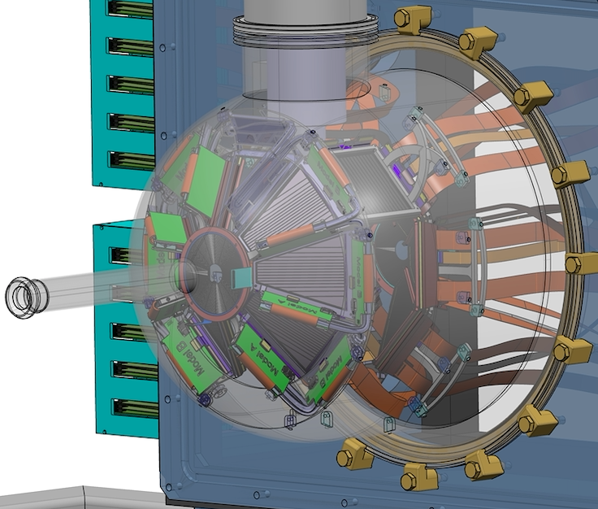
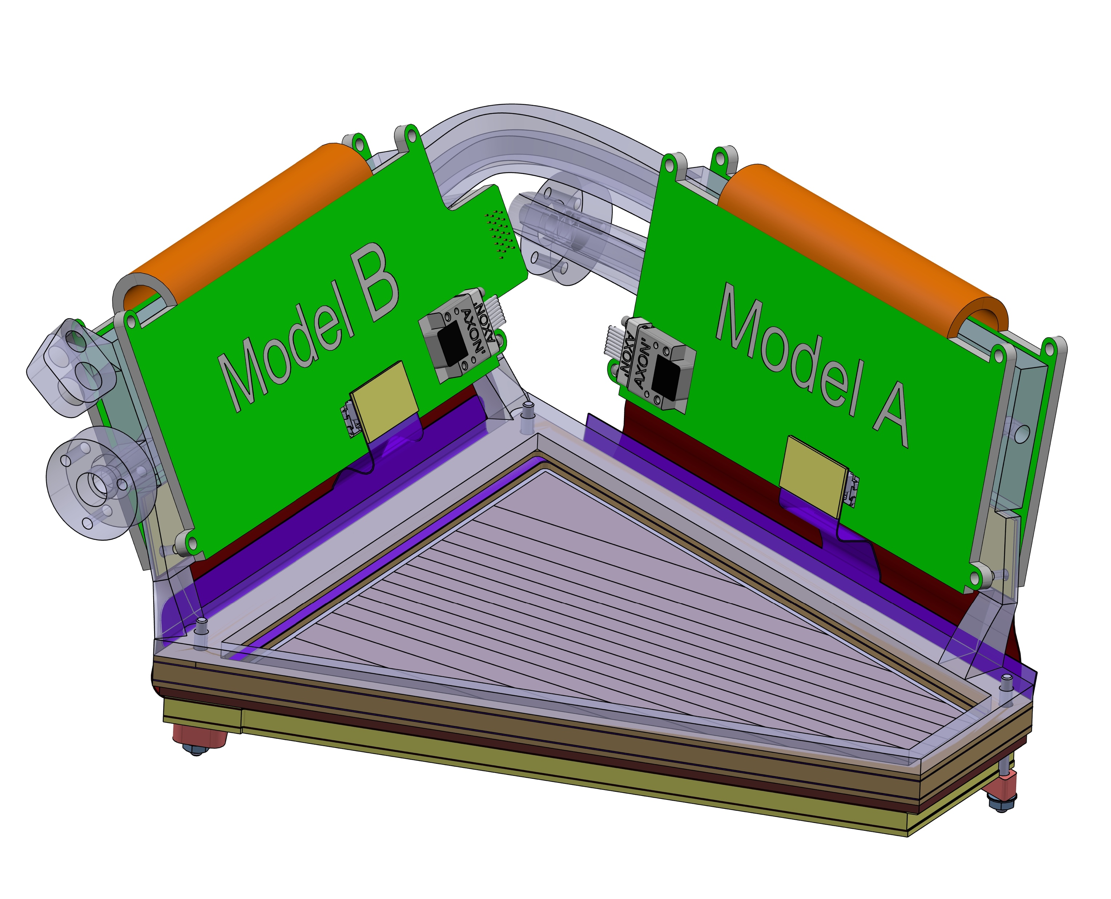
Mechanics inside the reaction chamber
UPSTREAM (AGATA side)
90 degrees
New support designed
DOWNSTREAM (VAMOS side)
New support designed
Trapezoidal + annular detectors hold by GRIT cooling blocks attached to the reaction chamber
3

Slide 4
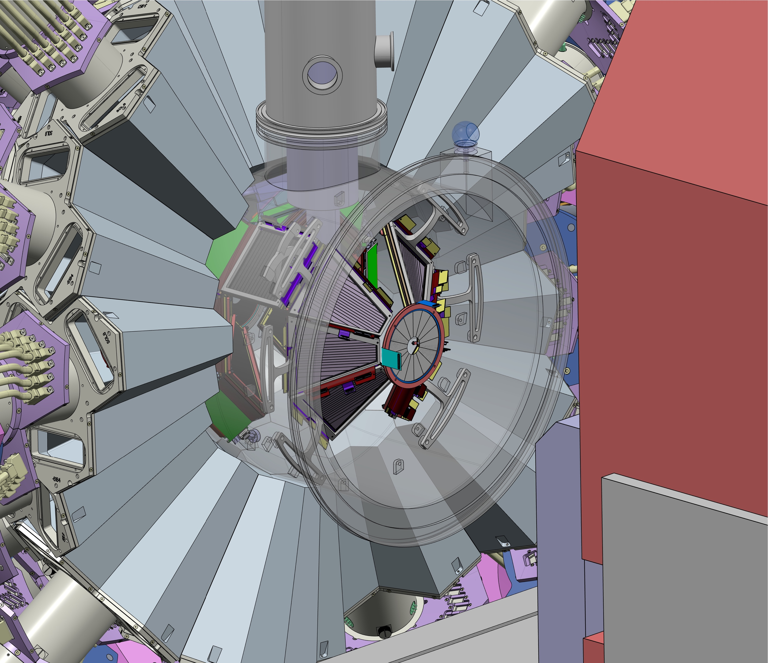
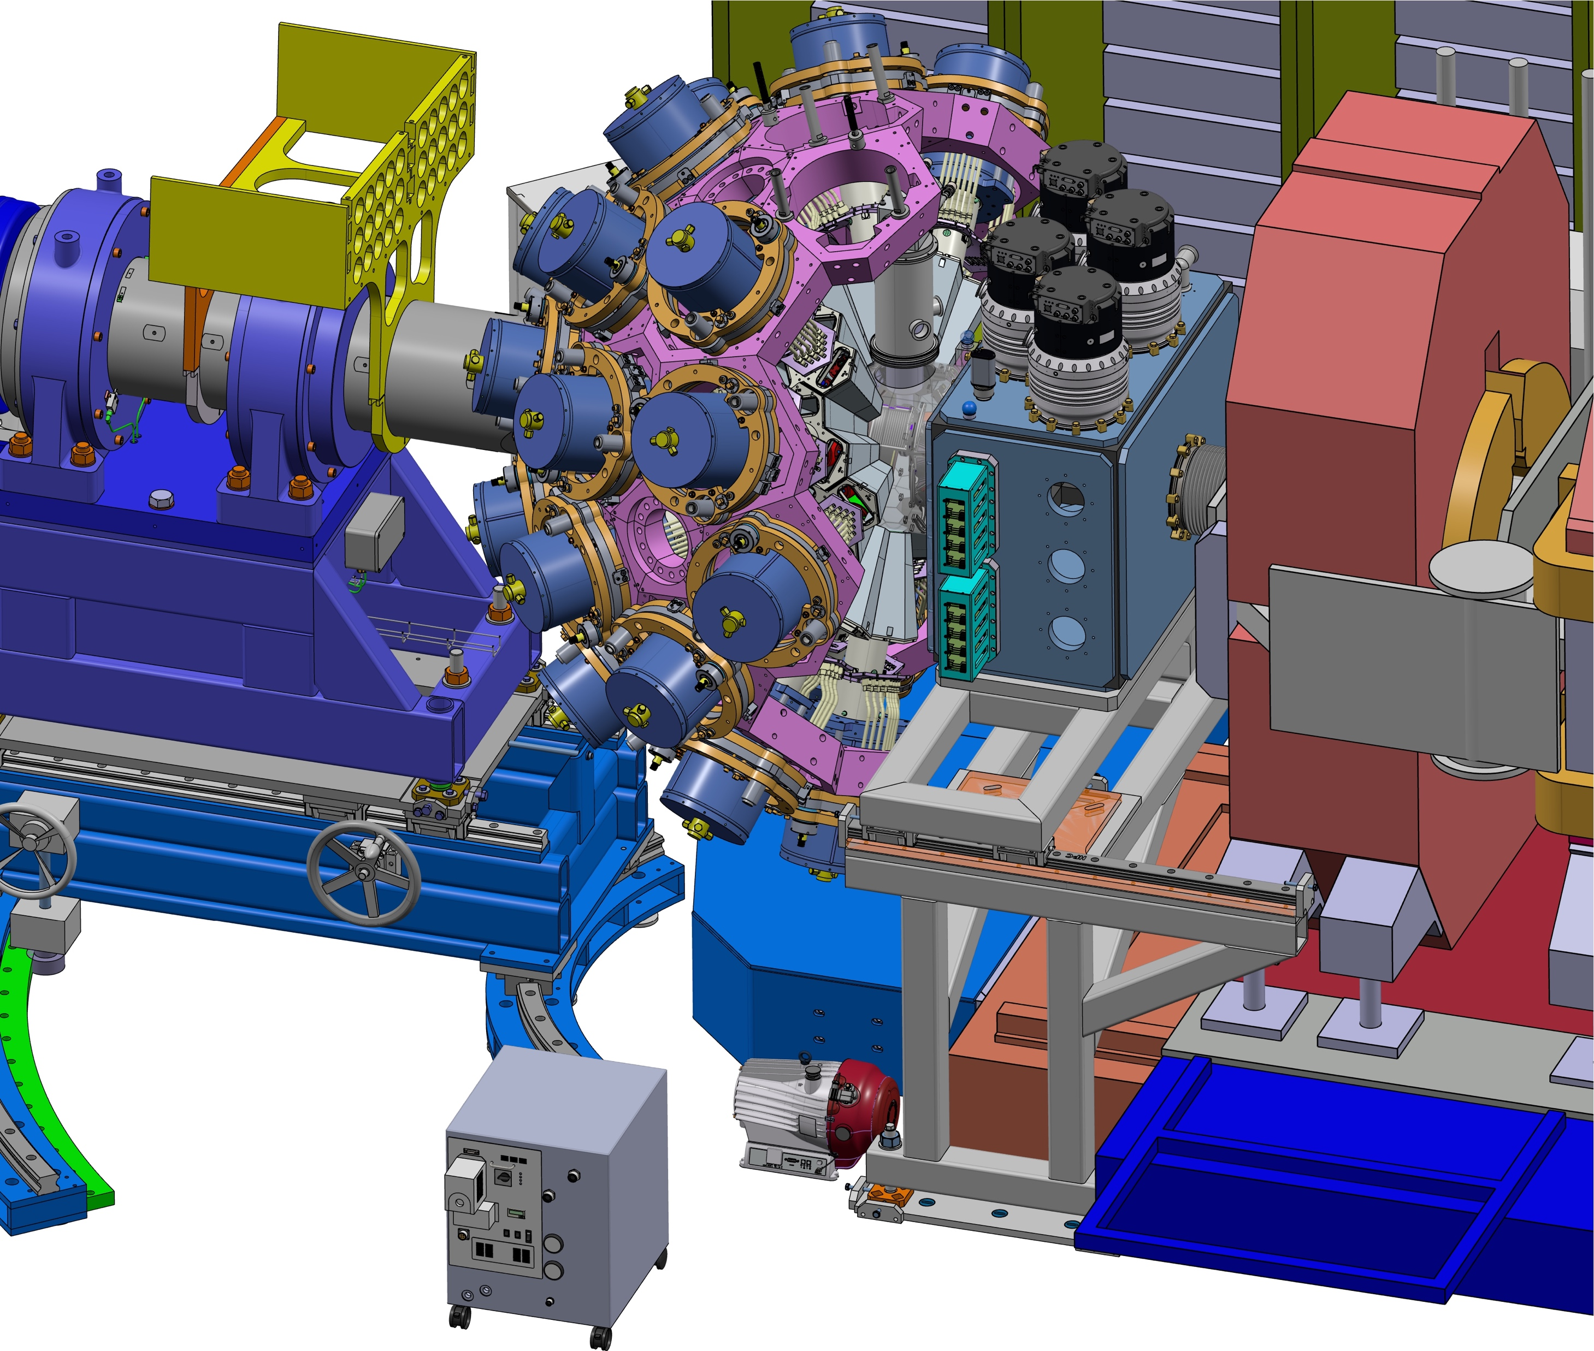
General view
Main constraint =
Integration of the cryogenic ³He target (CTADIR and ATRACT)
in DN150

Slide 5
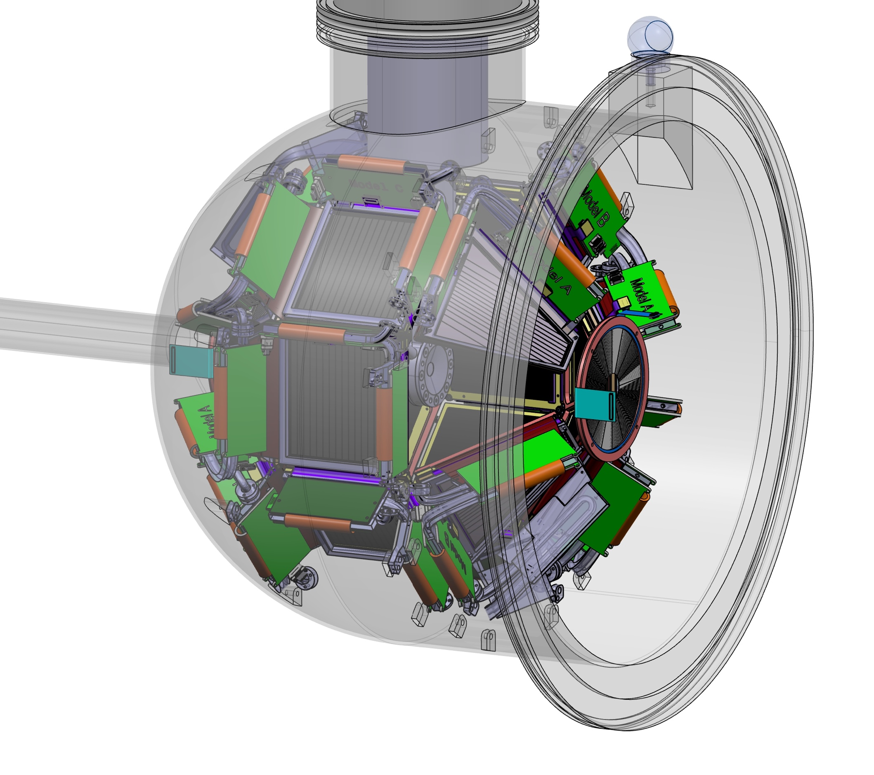
General view - Main reaction chamber
Main reaction chamber (3 mm Al)
GRIT detectors will be mounted inside the reaction
chamber in the LAB and brought all together in
the experimental room.

Slide 6
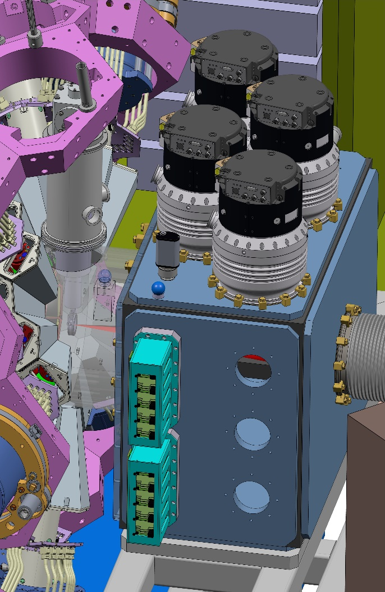
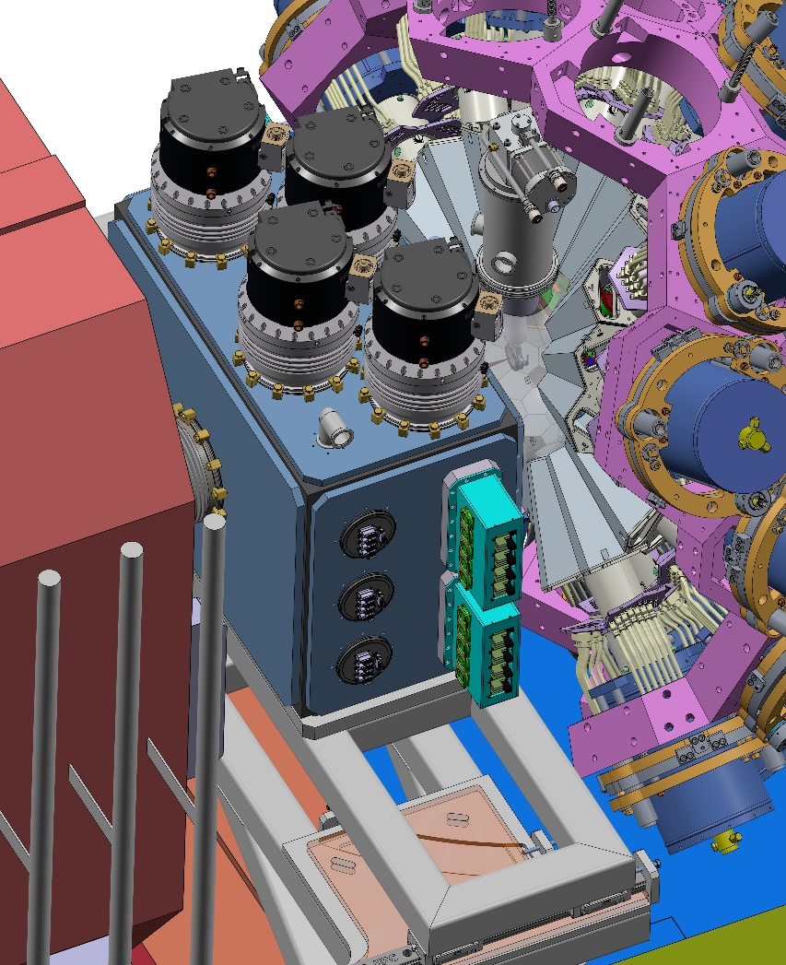
General view - Chamber with all utilities
Pumping needs :
Vacuum tests were performe for GRIT
Main contributions :
detectors packaging
FEB
Need to reach few 10⁻⁷ mbar for cryogenic target
2x DN200 turbo-pumps
1x DN40 gauge
Electronics/ Connectics :
3x brides AXON for GRIT electronics
4x brides PISTA for plan B (Mesytec)
Cooling system (only for GRIT) :
3x flanges for cooling

Slide 7
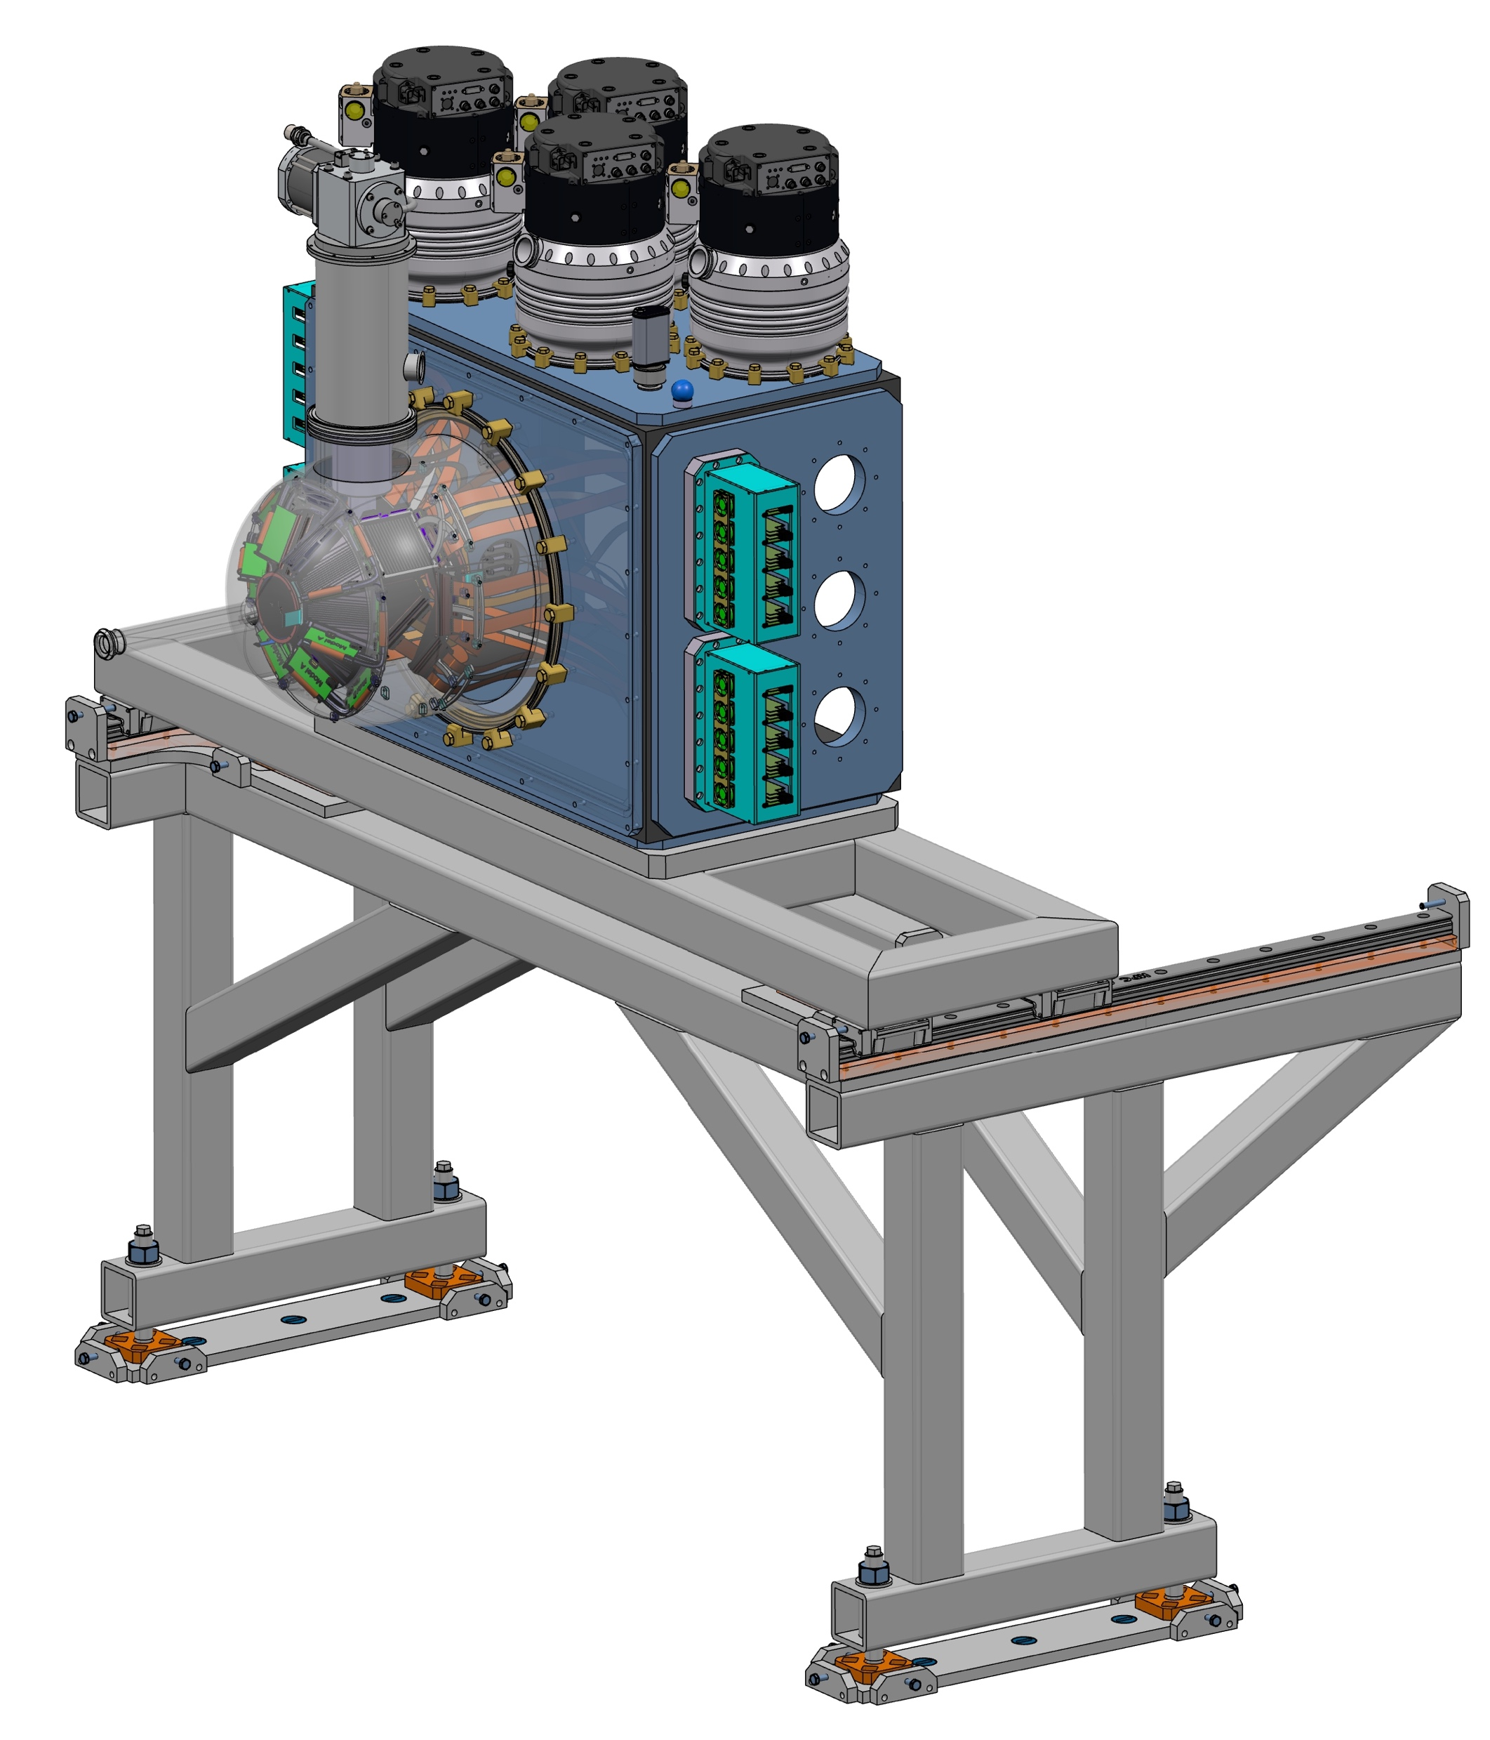
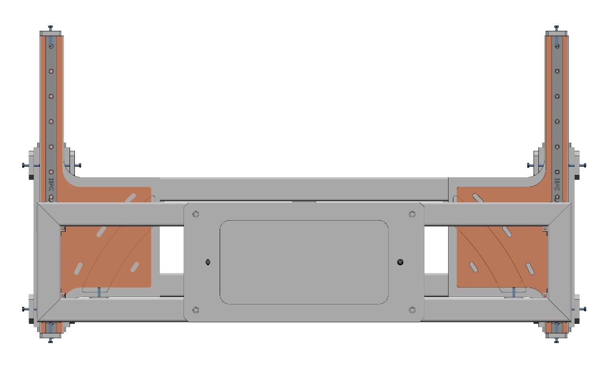
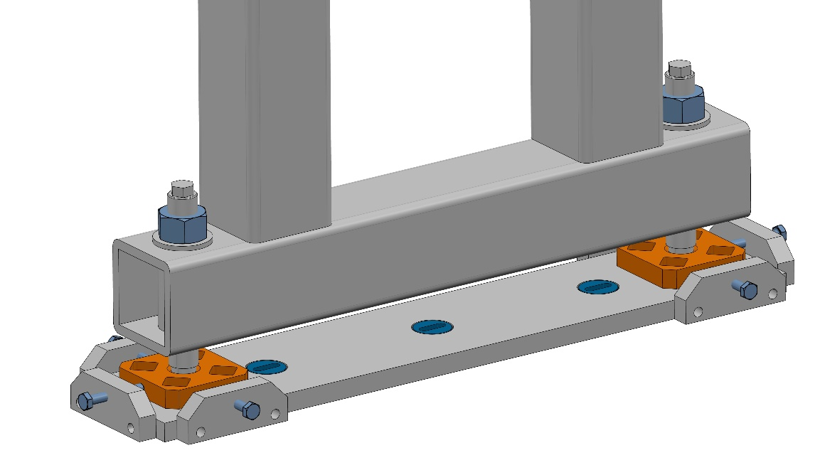
Frame and adjustement/ surveyor measurement
In the LAB :
Detector mounted and measured
Reference points will be taken on the chamber and used to adjust the reaction chamber
Measurement of the shape of the reaction chamber (Al)
Installation of the Al chamber
Installation of chamber with all utilities
Adjustement with laser tracker
Connection between chambers
Insertion into AGATA
Welded frame
At GANIL :
X/Y/Z translation
+ Rx/Ry rotation
Rotation Rz
Notes:
slide 7 sur la vue du dessus c'est le réglage en rotation autour de l'axe vertical (Rz) et sur la vue des réglages au niveau des pieds c'est pour régler les 3 translations (Tx Ty Tz) ainsi que le réglage de l'assiette (Rx Ry)

Slide 8
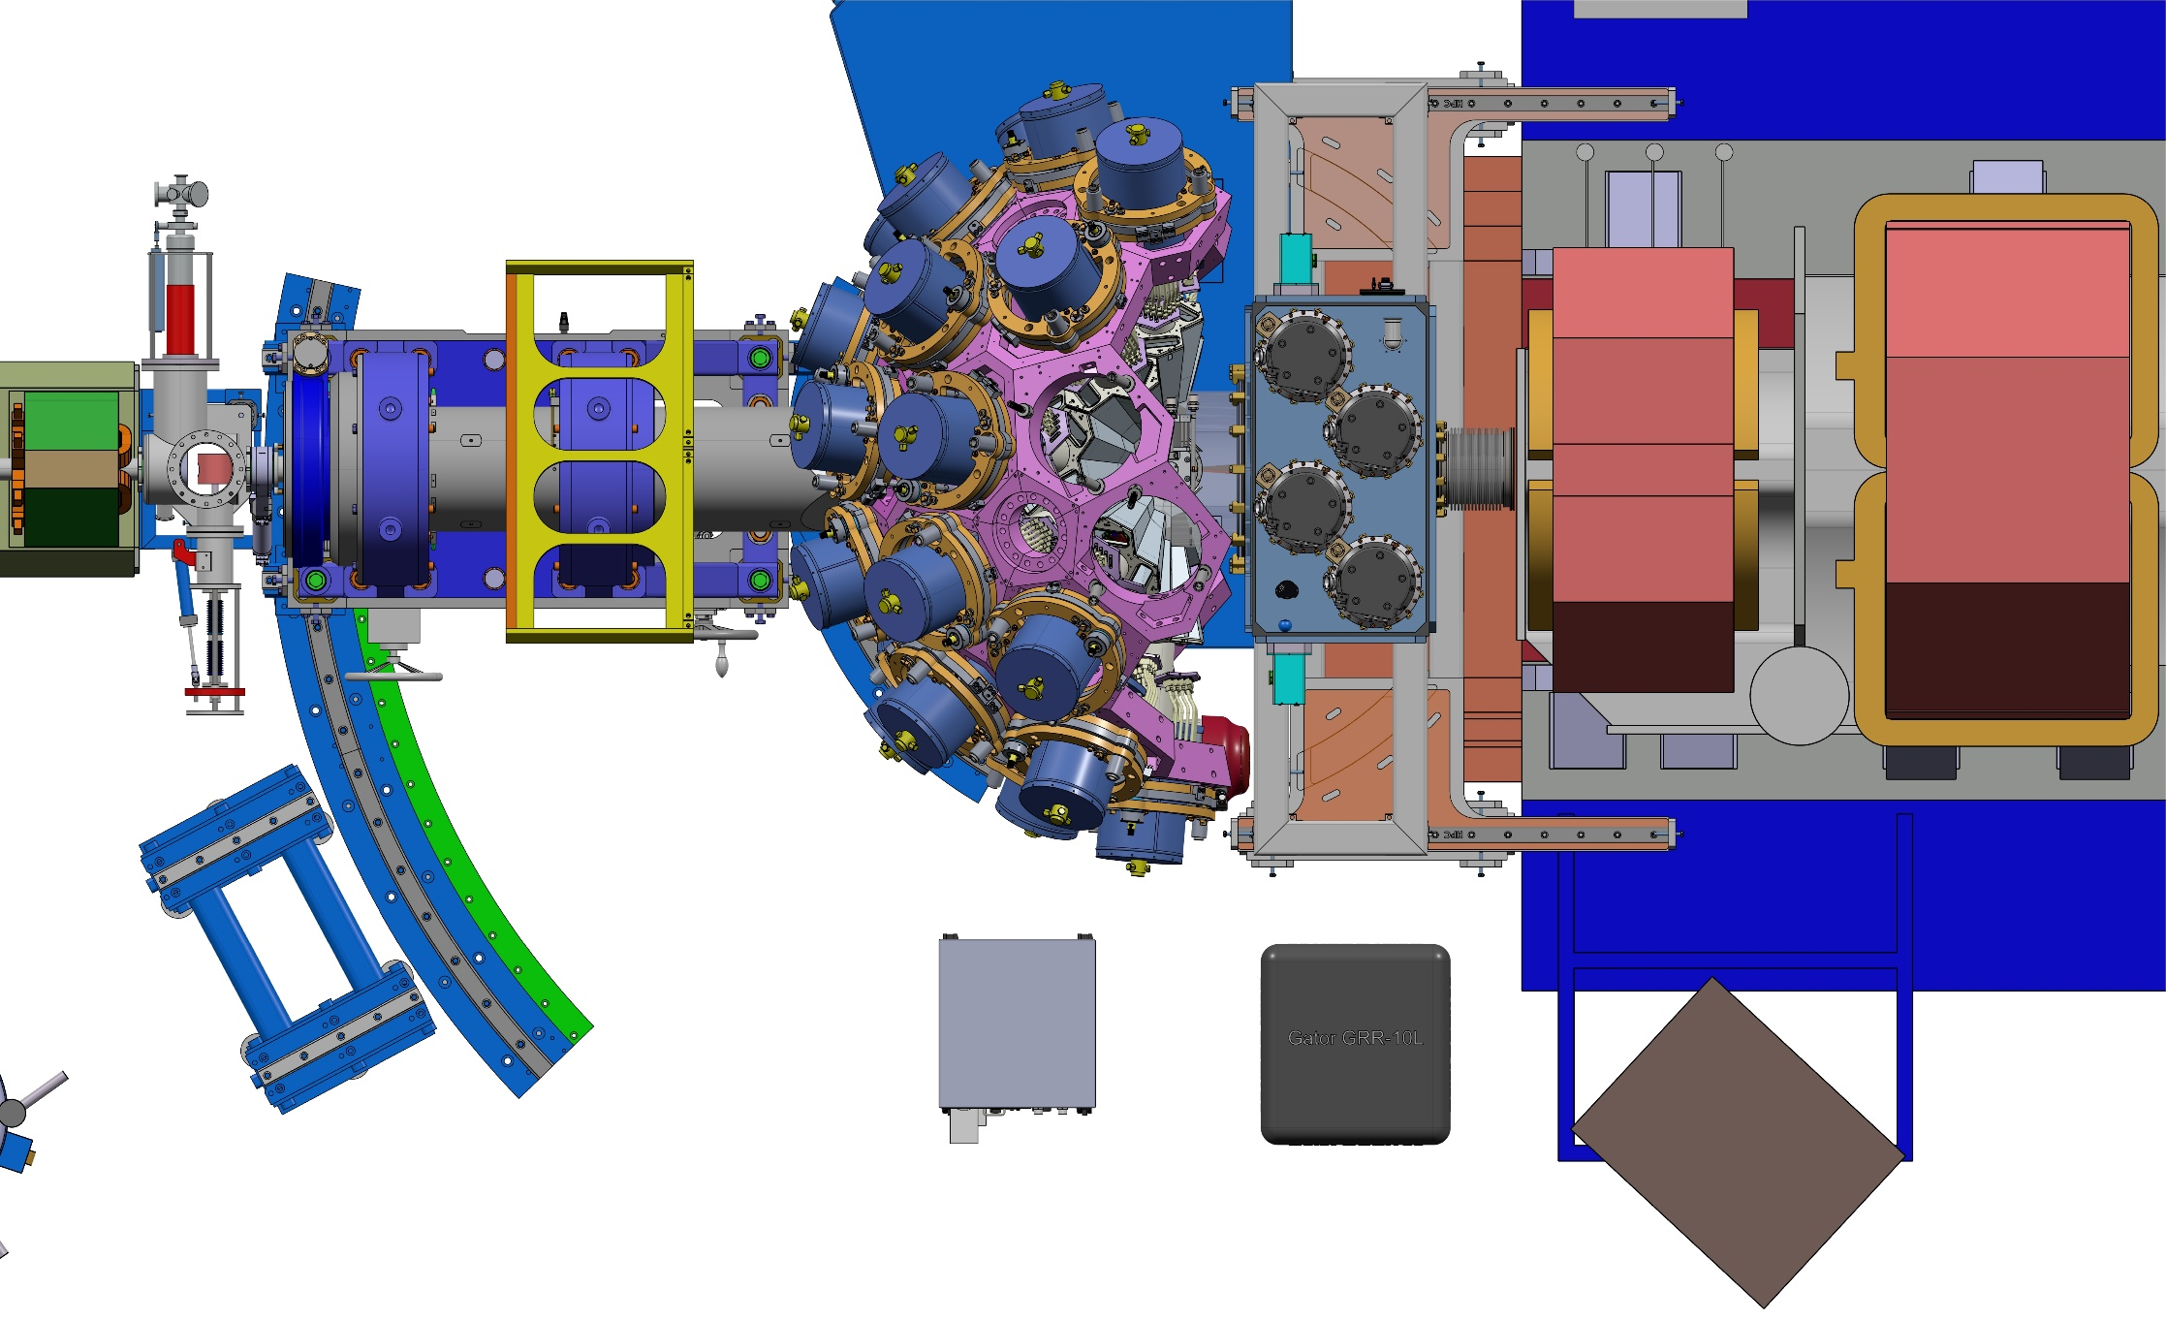
General design for GRIT integration
Agata 2𝜋 with 2 modules removed from the top (for target purposes) and put on the sides
Vamos -650 mm at 0 degree (+/- 5 deg.)
GRIT Phase 0 is already mounted in the lab into the reaction chamber

Slide 9
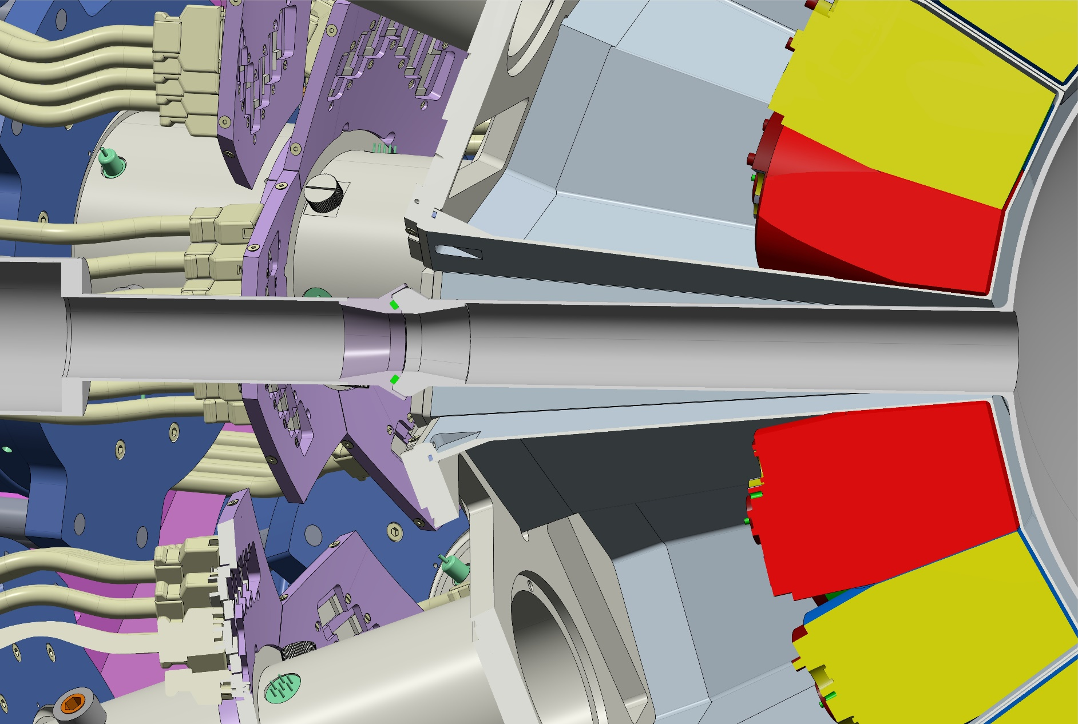
Connection of reaction chamber with beam pipe
Beam Pipe designed by Patrice Gangnant)
( see slide 5 of his presentation) :
Same design but shorter (-400 mm)

Slide 10
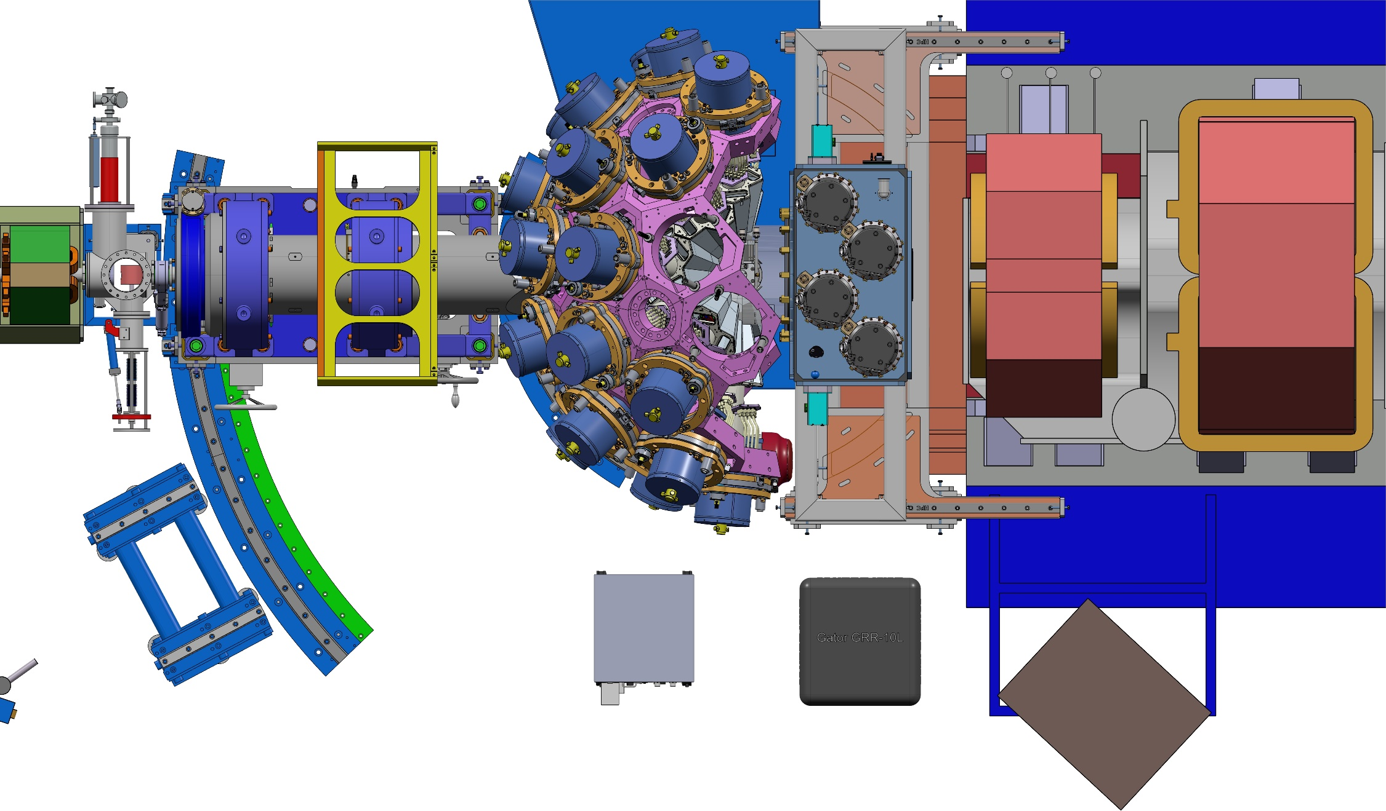
Mechanical mounting of the GRIT chamber
Remove the mechanical bellows (length=200 mm)

Slide 11
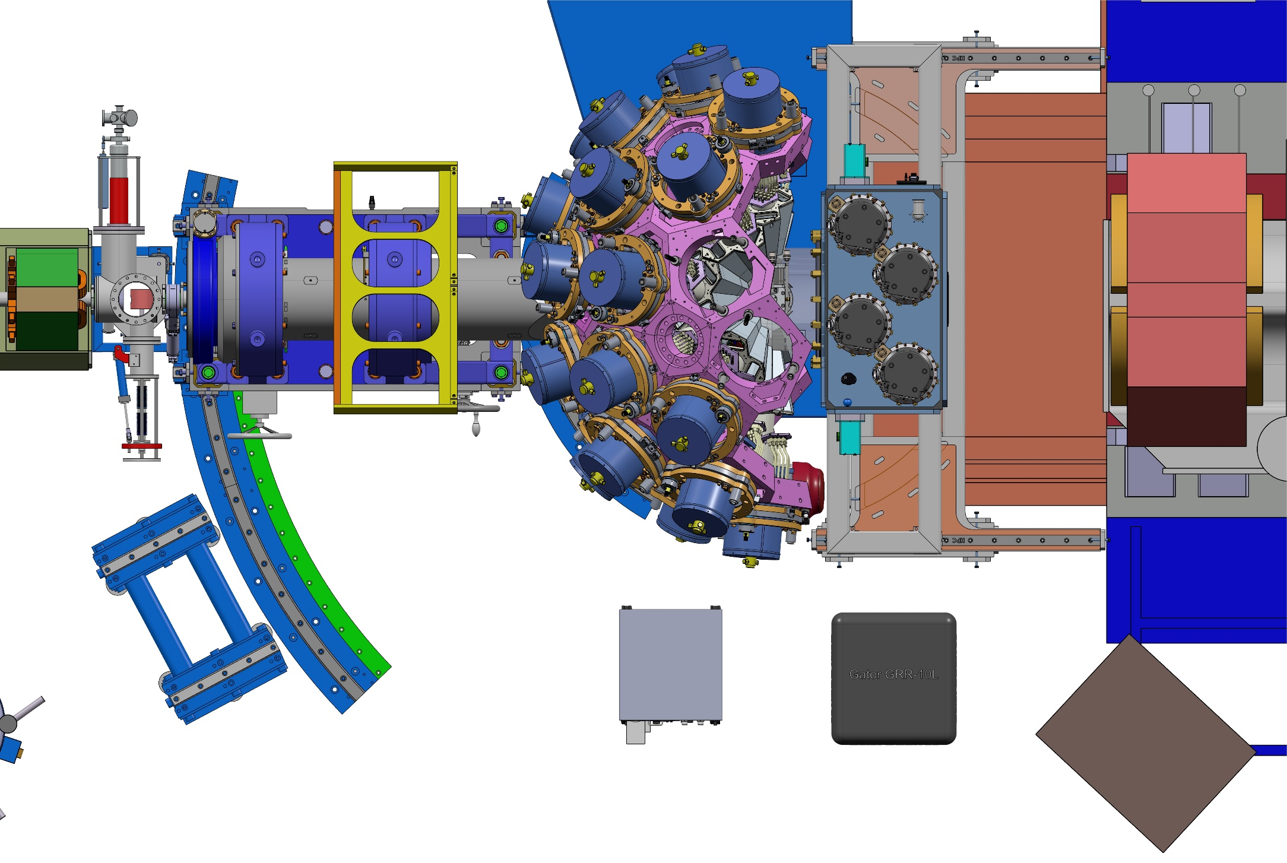
Mechanical mounting of the GRIT chamber
Move Vamos back -1100 mm

Slide 12
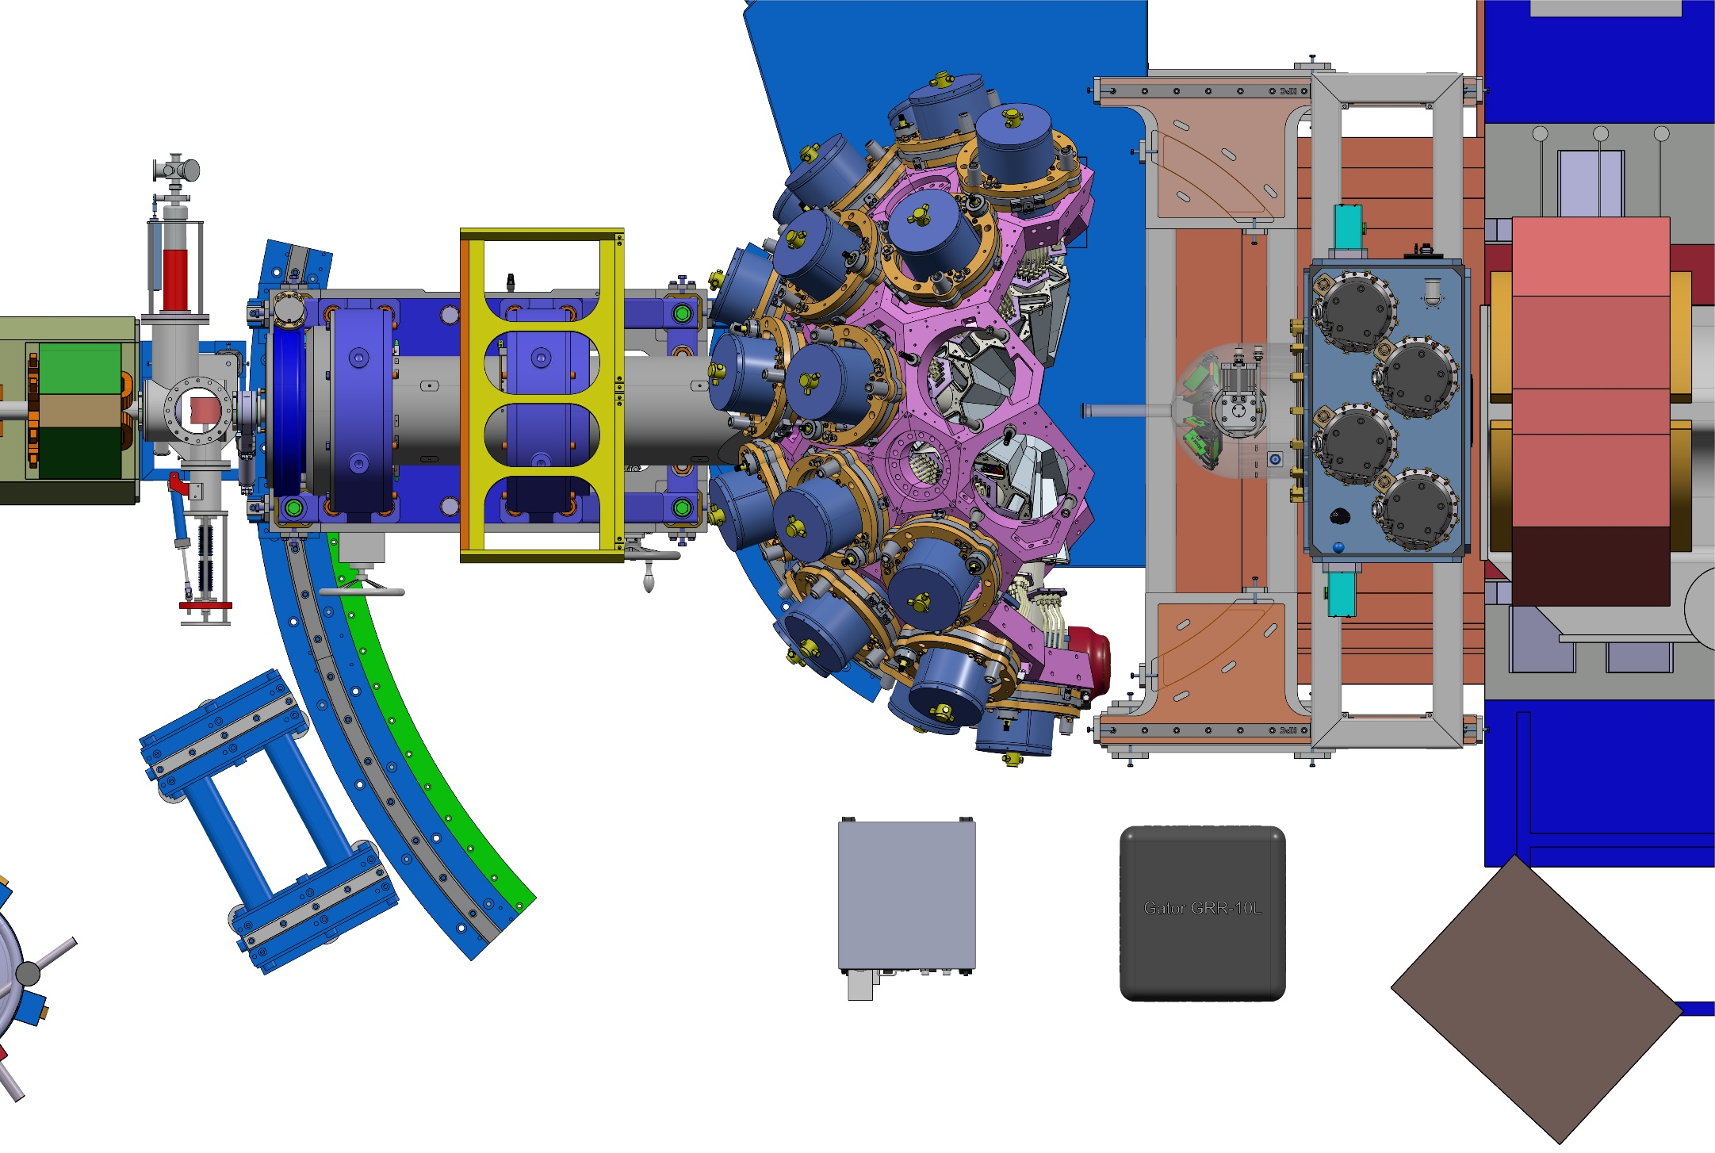
Mechanical mounting of the GRIT chamber
Move GRIT back -650 mm (200+450 mm)

Slide 13
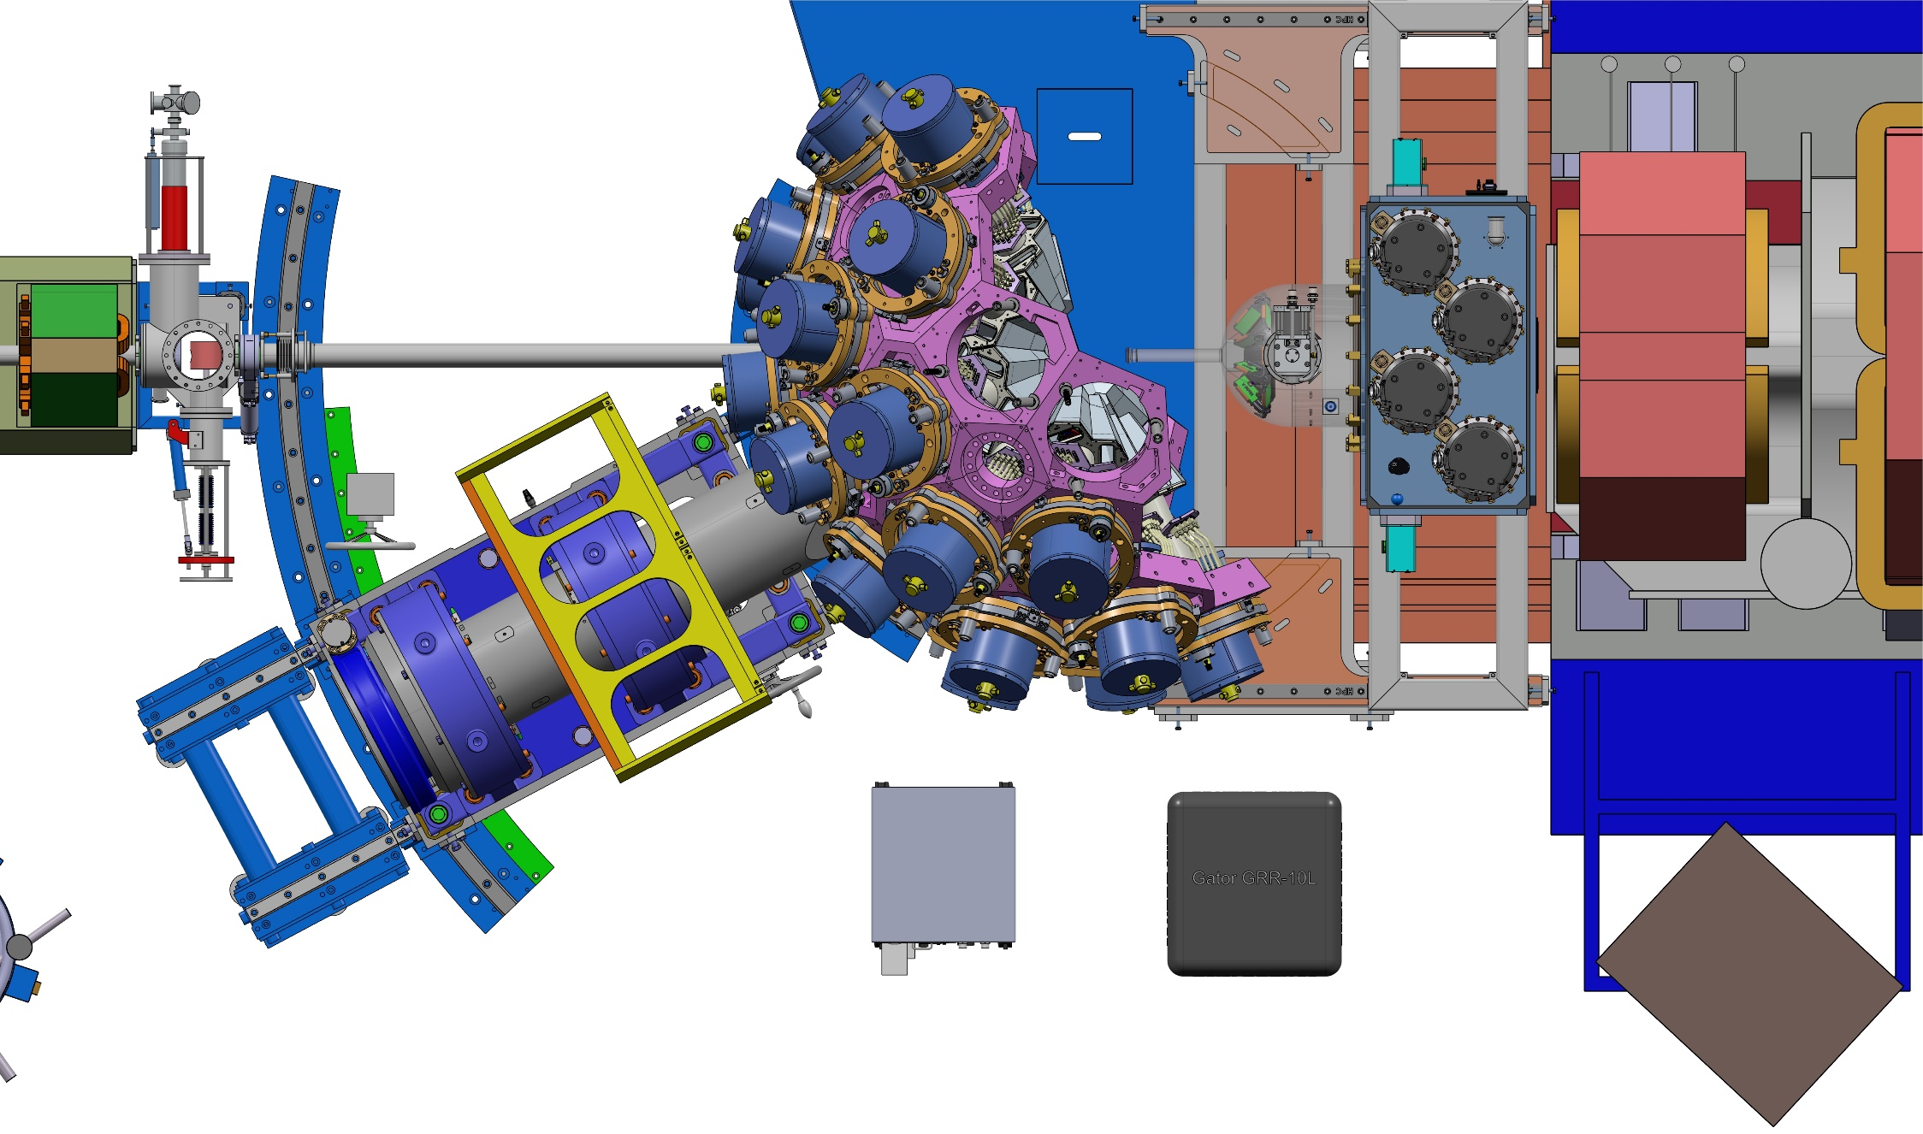
Mechanical mounting of the GRIT chamber
Uncoupling of beam pipe /
reaction chamber pipe
+ Rotation
The pipe stays into the
shaft

Slide 14
Mechanical mounting of the GRIT chamber
Agata is now rotated at
-28 deg.

Slide 15
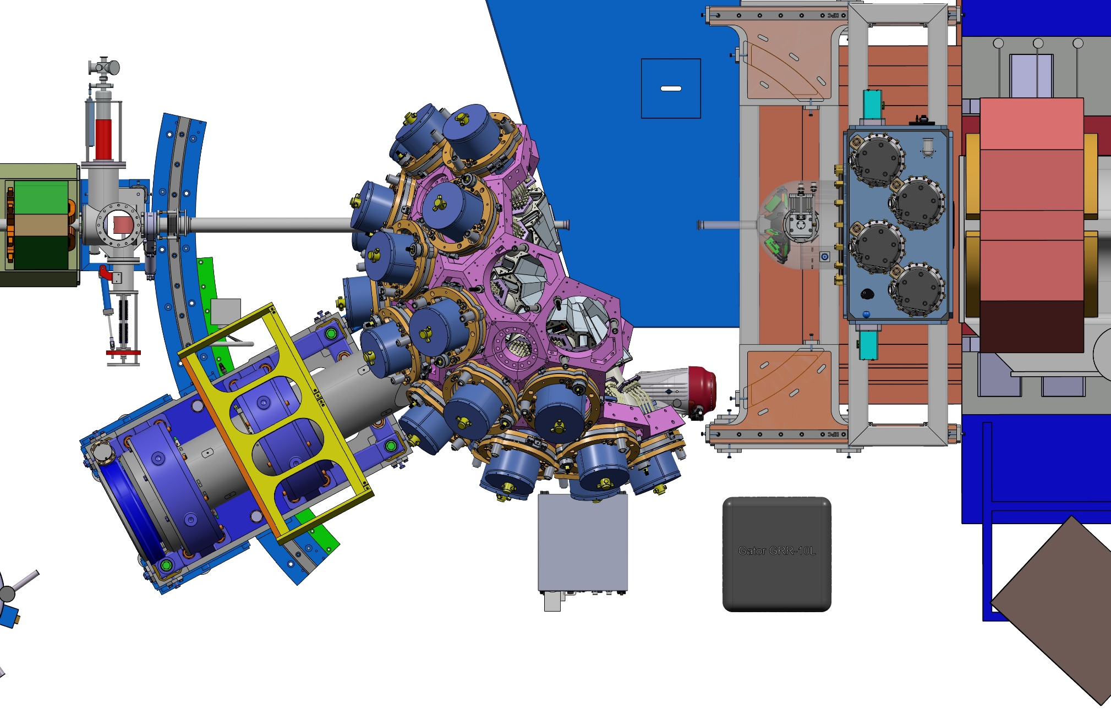
Mechanical mounting of the GRIT chamber
… AGATA can be moved back to operate it

Slide 16
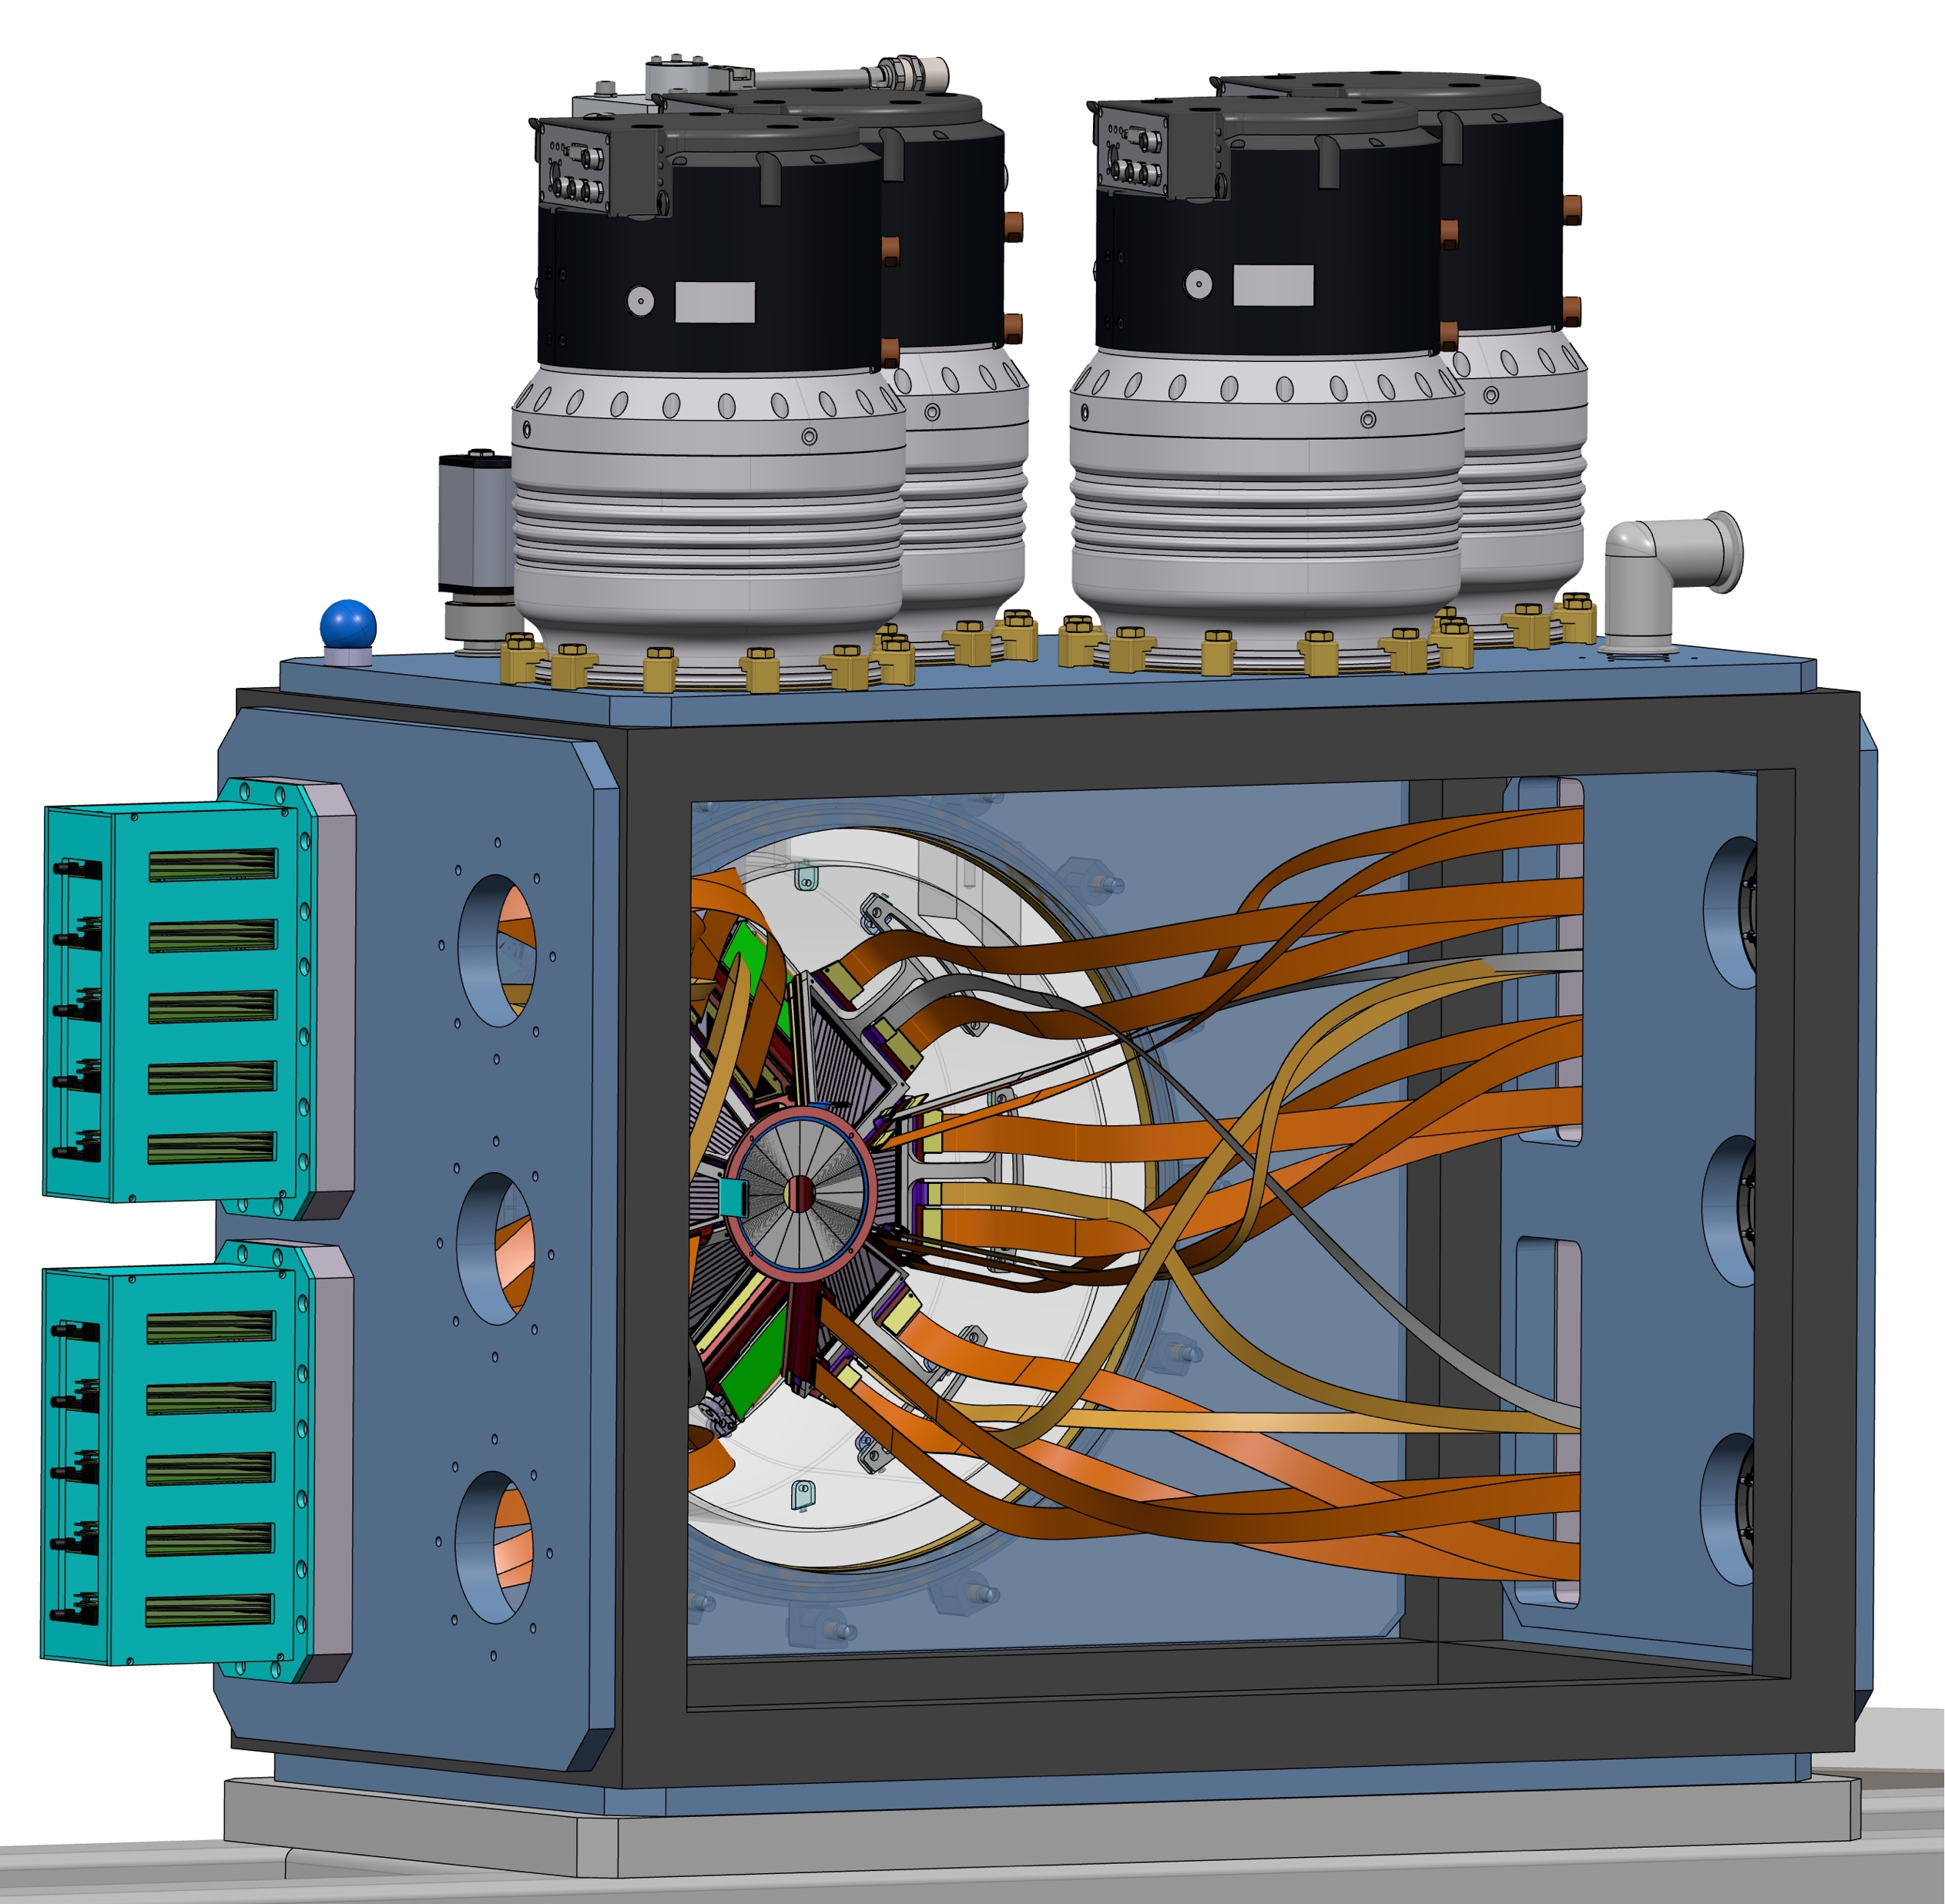
Conclusion
Reaction chambers almost finalised
--> frame fixing points to be checked
Internal design for detectors to be finalised (supports, kaptons…)

