Slide 1
SPIRAL1 beams from AGATA
Pierre Delahaye for the Target/Ion-source group

Slide 2
Outline
SPIRAL1 and its limitations
  Beam production : sources
  Beam purity
Beam requests
Conclusion
Experimental areas
SPIRAL1
Historic GANIL

Slide 3
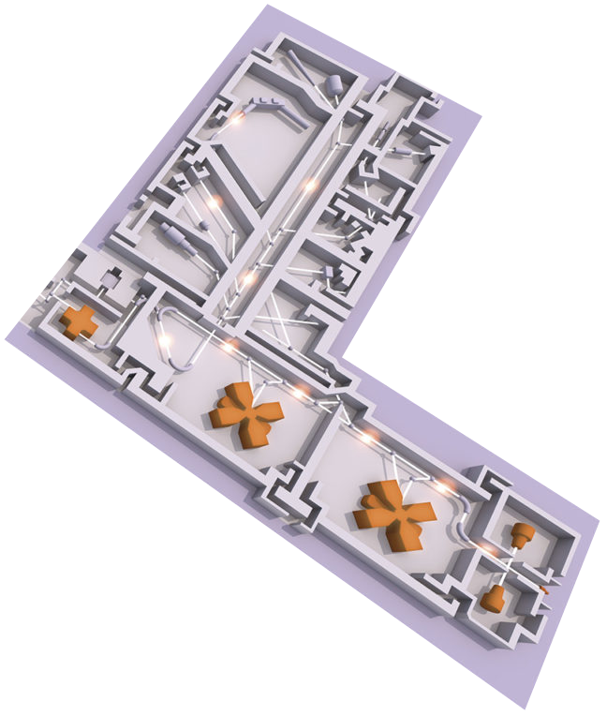
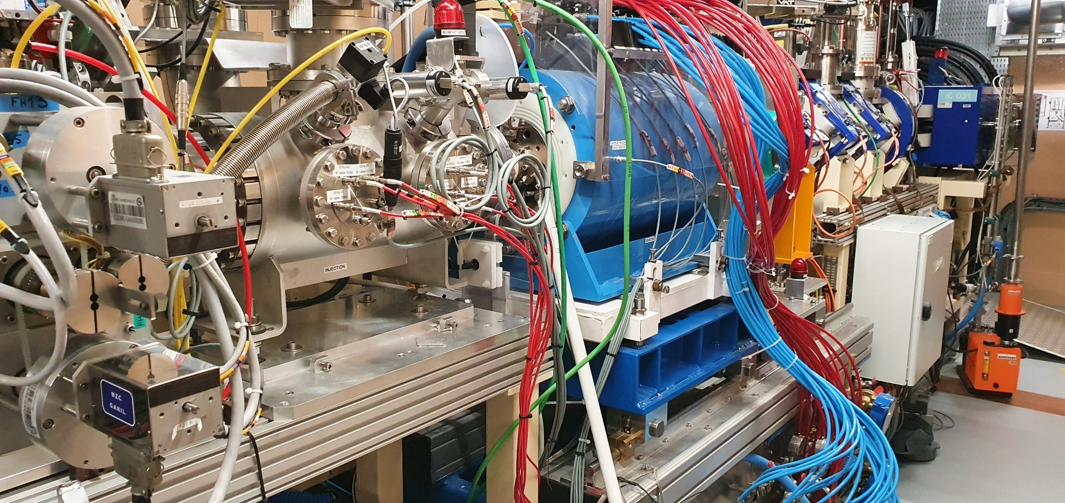
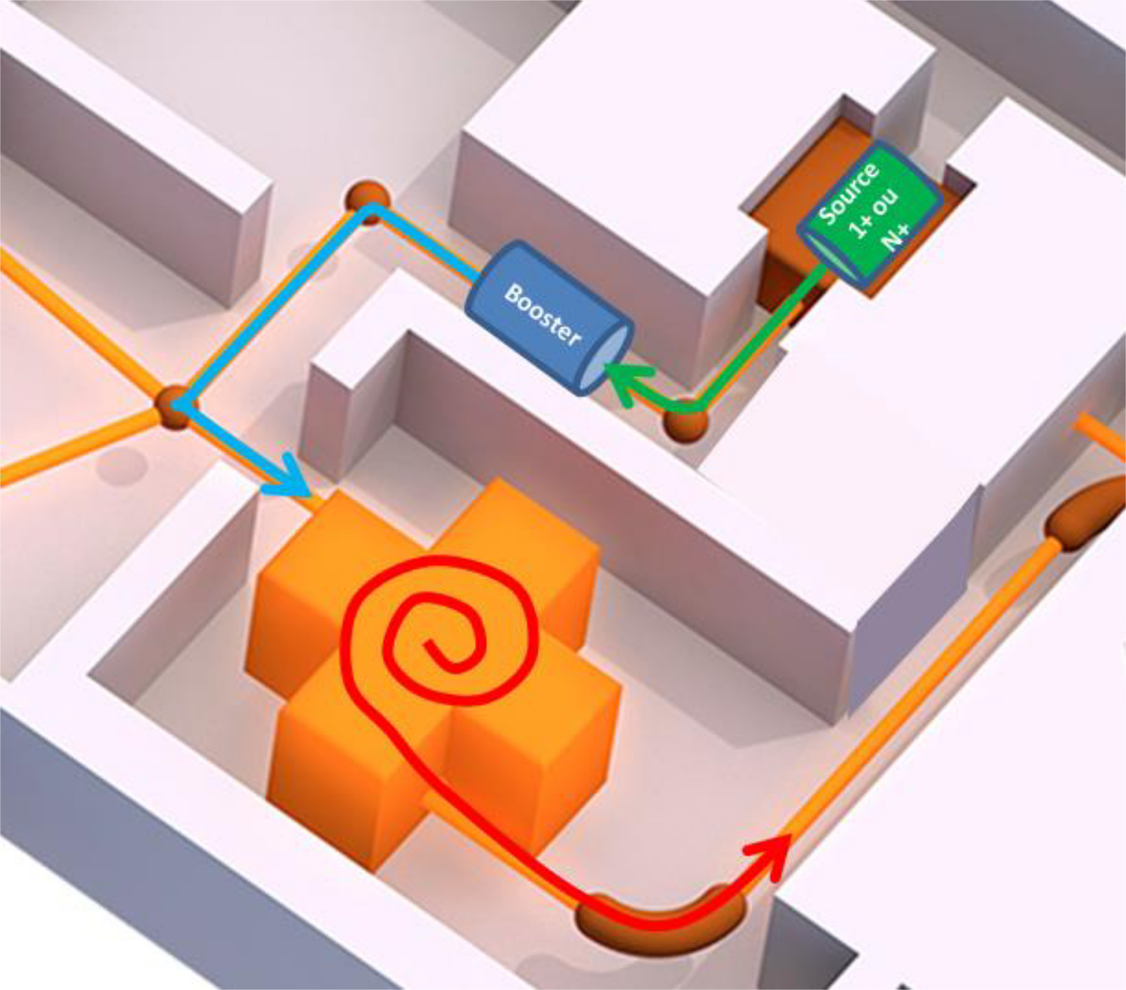
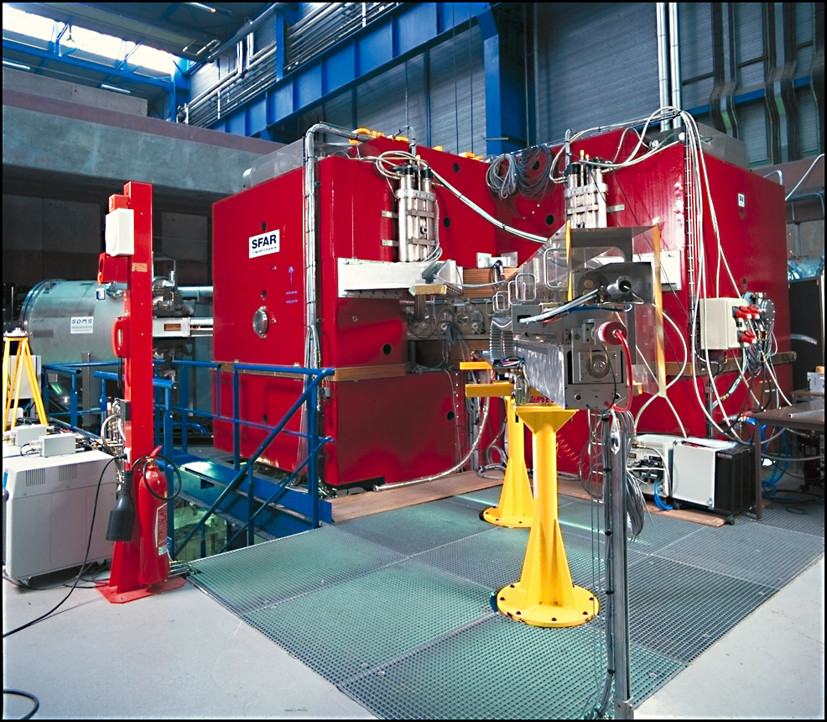
Introduction – SPIRAL
Charge breeder
TISS
To LIRAT/ DESIR
To IBE
To CIME

Slide 4
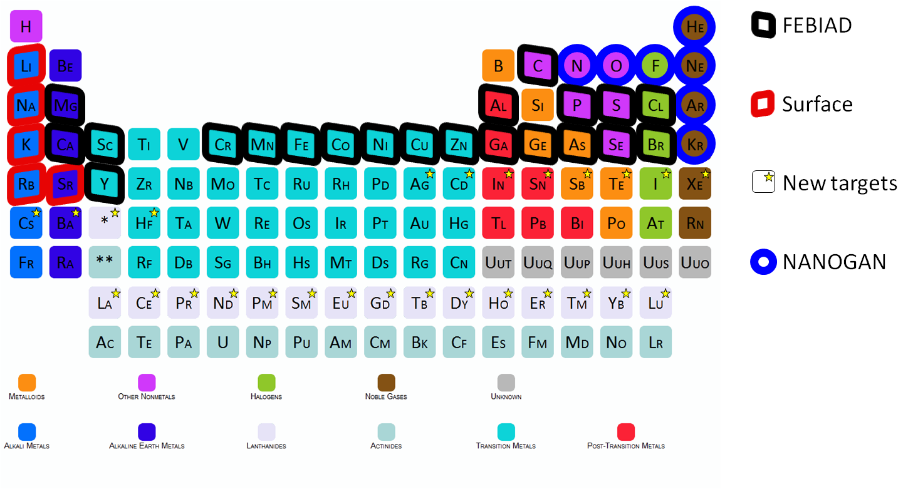
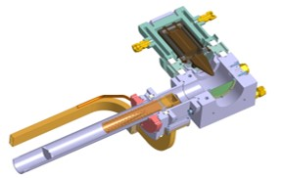
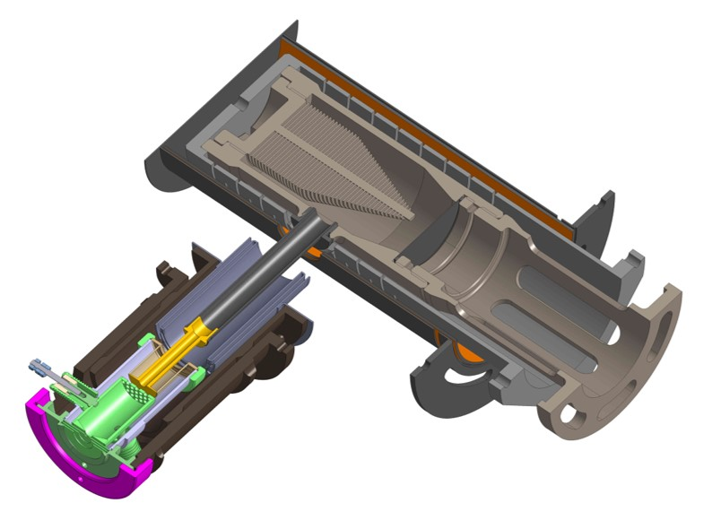
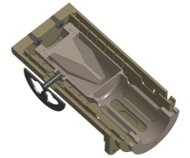
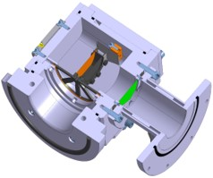
Beam production
58 primary beams from ¹²C to ²³⁸U
Graphite target (so far)
4 ion sources
The ISOL technique
Primary beam
Target/stopper
Ion source
Separator
TISS
To user/
acceleration
N+
1+
1+
Nanogan
For gaz
FEBIAD
For condensable
TULIP(-FEBIAD)
For proton-rich isotopes
MonoNaKe
For alkaline

Slide 5
Beam production
58 primary beams from ¹²C to ²³⁸U
Graphite target (so far)
4 ion sources
The ISOL technique
Primary beam
Target/stopper
Ion source
Separator
TISS
To user/
acceleration
N+
1+
1+
Advantages
Intensity (directly N+ beam)
Purity (gases only)
Disadvantages
Lower charge states (and energy)
Gases only
Advantages
Intensity (high efficiency for most alkali)
Purity (low ionisation energies only)
Disadvantages
Only a few elements
Advantages
Broadband
Disadvantages
Non selective
Advantages
Very fast release
Disadvantages
Rather low in-target production
Nanogan
For gaz
FEBIAD
For condensable
TULIP(-FEBIAD)
For proton-rich isotopes
MonoNaKe
For alkaline

Slide 6
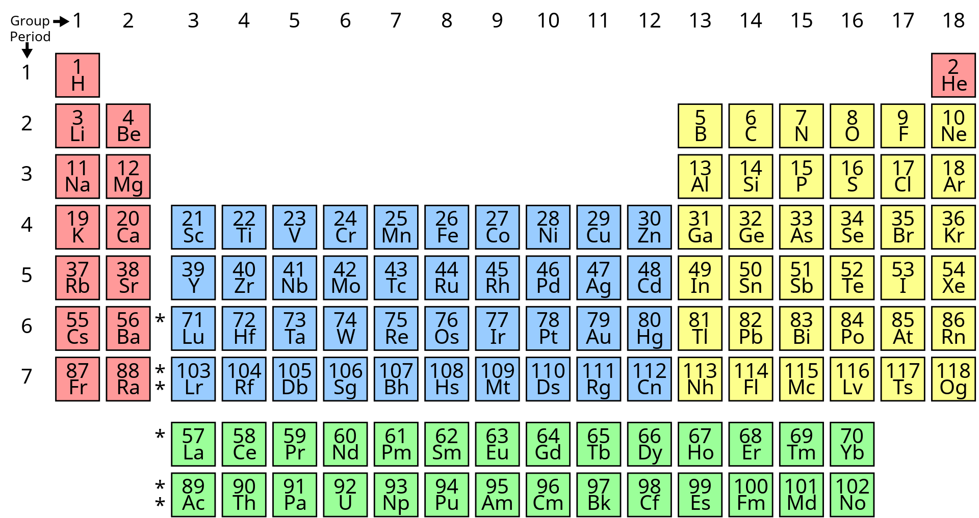
Focus on the FEBIAD
Before 2023
July 2024 (58Ni)
April 2023 (50Cr)
September 2024
(129Xe)
Objective: production of radioactive metallic ions
Since 2021
Irradiated with ⁴⁸Ca (2021), ³⁶Ar, ⁸⁴Kr (2022), ⁵⁰Cr (2023), ⁵⁸Ni (2024),¹²⁹Xe (2024)
100+ radioactive isotopes/isomers seen, including around 60 at post-accelerable intensities (>1E5pps).
^{48,49}Cr produced for the first time in 2023
Fe/Co/Ni beams produced for the first time in 2024
« Heavy » ions produced in 09/2024
Future
Post acceleration of 56Ni in 2025.
On-going development of target-ion source systems for Fe-Co-Ni beams (PhD work of Erwan Le Villain) and target fragmentation (Postdoc work of Sophie Hurier)

Slide 7
Contamination & Purification
Source
D1P
Charge Breeder
D3P
CIME
Stripping

Slide 8
Contamination & Purification
Source
D1P
Charge Breeder
D3P
CIME
Stripping
>
>
MonoNaKe
For alkaline
Nanogan
For gaz
FEBIAD
For everything
The best is to have a pure beam from the source

Slide 9
Contamination & Purification
Source
D1P
Charge Breeder
D3P
CIME
Stripping
R≈200
Keeps isobars of the ion on interest

Slide 10
Contamination & Purification
Source
D1P
Charge Breeder
D3P
CIME
Stripping
Increase the CS of both the ion of interest and its contaminants
Re-introduce stable contamination
  Gases (100 nA-10µA)
  Metals (< 100 pA)

Slide 11
Contamination & Purification
Source
D1P
Charge Breeder
D3P
CIME
Stripping
R≈200
Keeps N+ isobars and ions of similar A/Q as the ion of interest

Slide 12
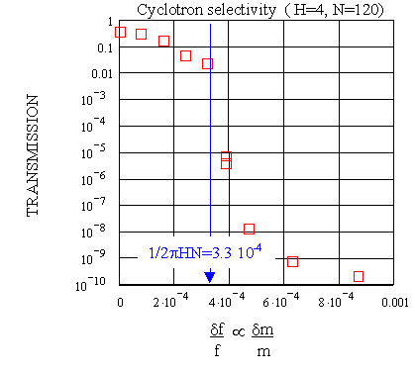

Contamination & Purification
Source
D1P
Charge Breeder
D3P
CIME
Stripping
$$\frac{δm}{m}=\frac{1}{2πHN}$$
CIME can be used as a mass spectrometer
R = 2000-3000
Example for H=4 (Energy range 2.7-5.8 MeV/A)
Possible to detune CIME to get less contamination at the cost of lower intensity for the ion of interest
credit: B. Jacquot

Slide 13
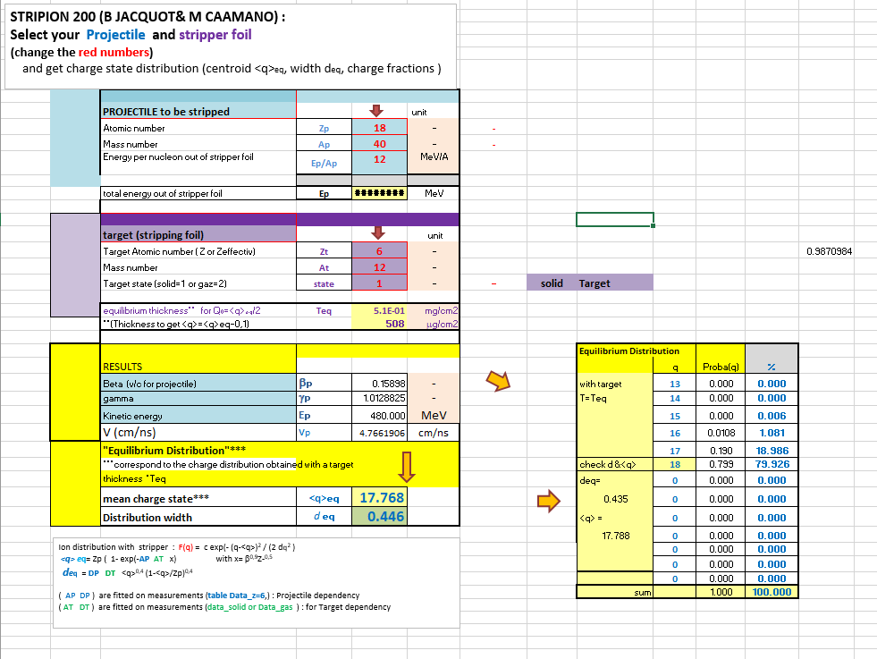
Contamination & Purification
Source
D1P
Charge Breeder
D3P
CIME
Stripping
credit: B. Jacquot
Full stripping at high energy
n-deficient only
The higher the energy, the higher the efficiency (typically >12 AMeV)
Model, not measurement

Slide 14
Beam requests
This Workshop:
¹³O, ⁶²Zn, ⁴⁴Ti, ⁵⁵Co, ⁵⁶Ni, ⁵⁷Ni
Rate on target > 1E5 pps
Purity > 50%
Energy > 8 AMeV
Last Workshop:
Rate on target > 1E4 pps
Max rate : 1E6 pps (limited by VAMOS 0°)
Purity > 1%

Slide 15
¹³O
Never done, never seen
1E8 pps in-target production, but estimated 1E4 pps ¹³O⁴⁺ at the source (very short T_{1/2} = 8ms)
Estimated 1.6E3 pps in post-accelerated beam, no real contamination problem
Improving the release efficiency is possible but very unlikely to reach 1E5 pps
 | Intensity (pps) | Energy (AMeV) | Purity
Request | 1E5 | > 8 | 50%
TGT - Nanogan | 1.6E3 | 7 - 19 | ≈100%
Conclusion : not feasible at the required rate. R&D necessary to increase the rate

Slide 16
⁴⁴Ti
Ti does not diffuse in the target : not possible to produce in SPIRAL1
Has to be produced in batch mode. A sample of 5-10 MBq should be sufficient for a 2-week experiment at the required post-accelerated rate (already done by PSI for ISOLDE)
Test with stable Ti necessary to estimate the release time and the source efficiency.
Unknown difficulties with procuring the sample and safety regulations
 | Intensity (pps) | Energy (AMeV) | Purity
Request | 1E5 | > 8 | 50%
TGT – FEBIAD + CIME detuning | 1E5? | 7 - 18 | ≈50%
TGT – FEBIAD + stripping | 1E5? | 7 - 18 | 100%
Conclusion : probably feasible, but to be confirmed

Slide 17
⁶²Zn
Estimated post accelerated rate is sufficient, but strongly contaminated with ⁶²Cu (radioactive) and ⁶²Ni (stable)
Purification by CIME or stripping possible but not while keeping the 1E5 pps rate goal
Contaminants could perhaps be « frozen » at the source if the target is cold enough, but this has to be tested offline AND online
 | Intensity (pps) | Energy (AMeV) | Purity
Request | 1E5 | > 8 | 50%
TGT – FEBIAD | 1.1e5 | 6 - 17 | 0.5%
TGT – FEBIAD + CIME detuning | 1.5E4 | 6 - 17 | ≈30%
TGT – FEBIAD + stripping | Max 2.2E4 | 14 - 17 | 100%
Conclusion : feasibility uncertain at required rate and purity. Online test necessary

Slide 18
⁵⁶Ni
Estimated post accelerated rate is already below the 1E5 pps mark, without any purification
After stripping at max energy, the rate will be ≈ 1E4 pps
End-of-year experiment will confirm feasability of full stripping for ⁵⁶Ni but also for ⁵⁷Ni and ⁵⁵Co
 | Intensity (pps) | Energy (AMeV) | Purity
Request | 1E5 | > 8 | 50%
TGT – FEBIAD | 4.7E4 | 6 – 16.5 | 0.002%
TGT – FEBIAD + CIME detuning | 3.0E3 | 6 – 16.5 | ≈50%
TGT – FEBIAD + stripping | Max 1.2E4 | 13 – 16.5 | ≈100%
Conclusion : not feasible at the required rate.

Slide 19
⁵⁵Co
Estimated post-acceleration rate sufficient, but strongly contaminated with ⁵⁵Fe (radioactive) and ⁵⁵Mn (stable)
Contamination can be reduced with CIME or stripping.
The 1E5 pps rate goal is still achievable after stripping, but only for the highest energies
If the ⁵⁶Ni stripping experiment is succesful, ⁵⁵Co purification by stripping will be confirmed
 | Intensity (pps) | Energy (AMeV) | Purity
Request | 1E5 | > 8 | 50%
TGT – FEBIAD | 4.8E5 | 7 – 18 | 0.8%
TGT – FEBIAD + CIME detuning | 4E4 | 7 – 18 | ≈99%
TGT – FEBIAD + stripping | Max 1.8E5 | 12 – 18 | 100%
Conclusion : Most likely feasible. Confirmation expected at the end of the year

Slide 20
⁵⁷Ni
Estimated post-acceleration rate sufficient, but strongly contaminated with ⁵⁷Co (radioactive) and ⁵⁷Fe (stable)
Contamination can be reduced with CIME or stripping.
The 1E5 pps rate goal is still achievable after stripping, but only for the highest energies
If the ⁵⁶Ni stripping experiment is succesful, ⁵⁷Ni purification by stripping will be confirmed
 | Intensity (pps) | Energy (AMeV) | Purity
Request | 1E5 | > 8 | 50%
TGT – FEBIAD | 5.6E5 | 6 – 17 | 0.3%
TGT – FEBIAD + CIME detuning | 6.1e4 | 6 – 17 | ≈80%
TGT – FEBIAD + stripping | Max 1.6E5 | 13 – 17 | ≈100%
Conclusion : Most likely feasible. Confirmation expected at the end of the year

Slide 21
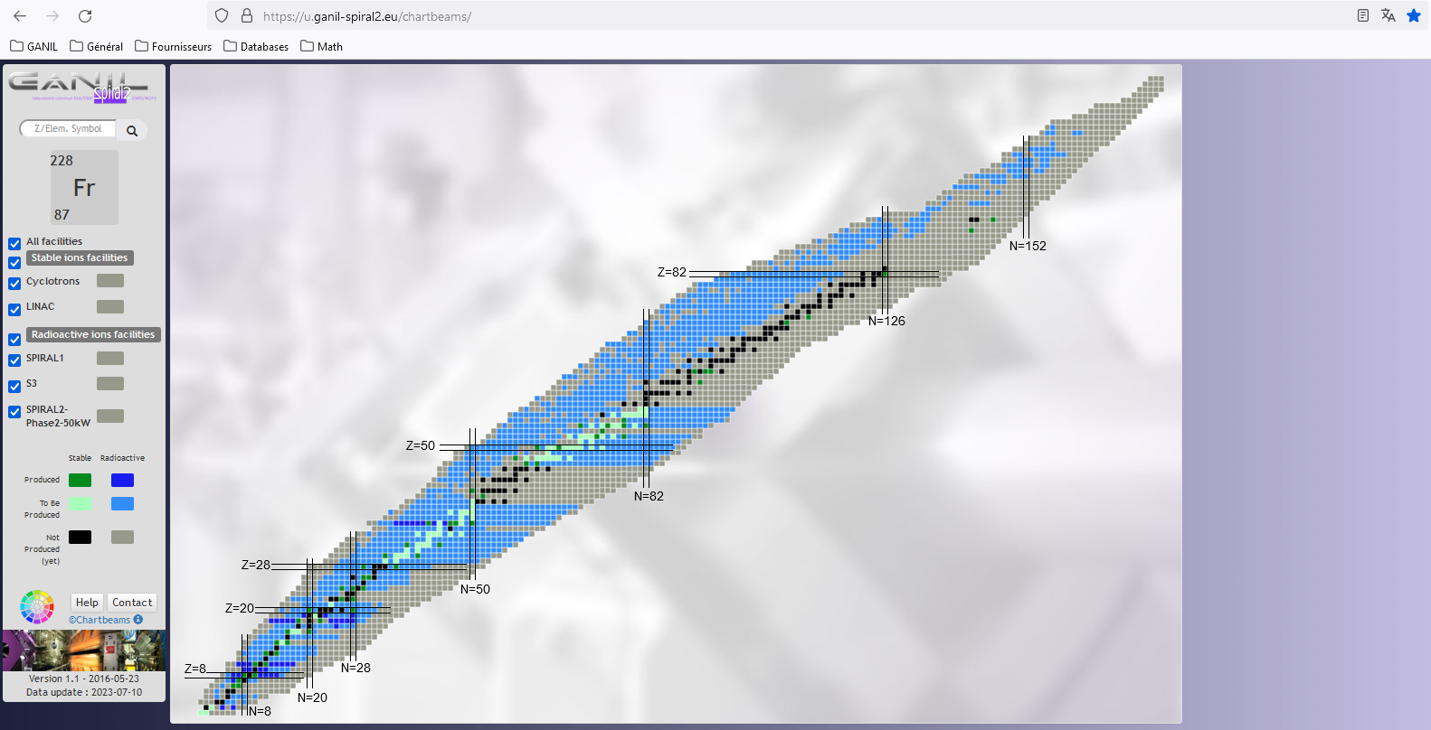
Takeway messages
Basic information on beams: https://u.ganil-spiral2.eu/chartbeams/
⁵⁵Co, ⁵⁷Ni and ⁴⁴Ti probably technically feasible
⁵⁶Ni and ⁶²Zn not feasible at the 1E5 pps rate goal without contamination
⁵⁵Co, ^{56,57}Ni are being developed, others have to be supported by LoI, proposals, etc (otherwise no development)
Laser ionization would help all of those beams but ¹³O to exploit the full post-accelerated rate.
More beam could be feasible
  Check the possible rates on the beam chart
  Keep sending us requests with minimum purity, minimum rate and energy
inquiries to be sent at chartbeams-spiral1@ganil.fr

Slide 22
Thank you for your attention

Slide 23
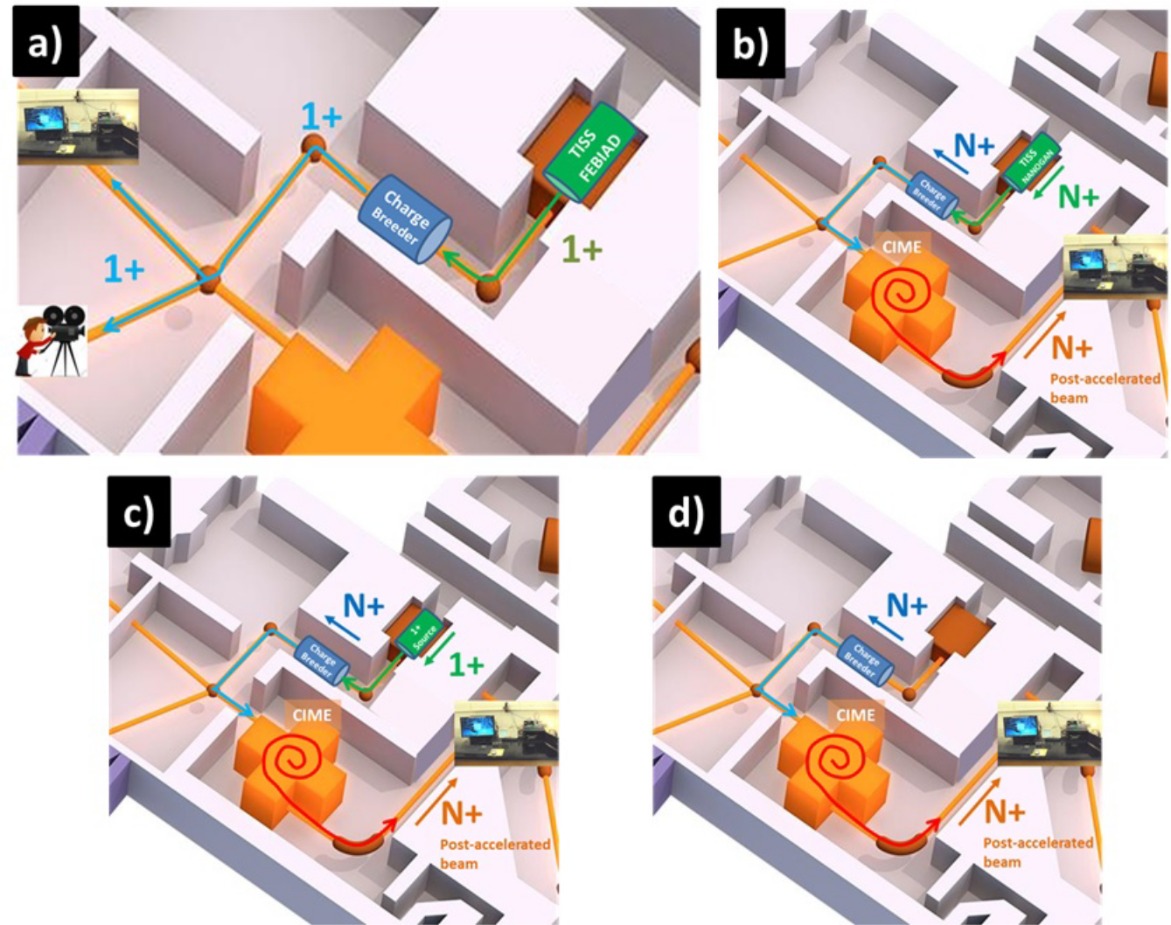
Operating modes
1+ shooting through, for identification, low energy (10-20 keV) physics in LIRAT and since 2024, low energy (2 MeV/u) post-acceleration of very light ions (up to A≈12)
N+ shooting through for post-acceleration (up to 24 MeV/A)
1+/N+ for post-acceleration
SP1CB as a source for post-acceleration tuning or experiments with stable or long-lived isotope beams (gaz only)
Using a 1+ TISS without primary beam as a source for stable beams (to tune CIME) or long-lived isotopes (batch mode)
L. Maunoury et al, 2018 JINST 13 C12022

Slide 24
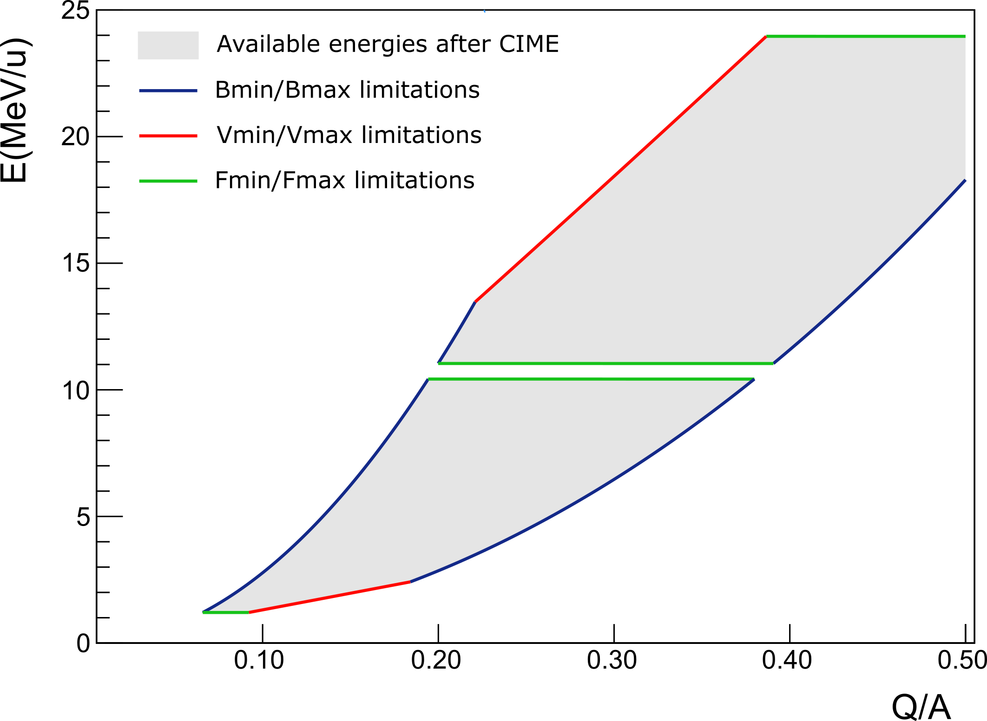
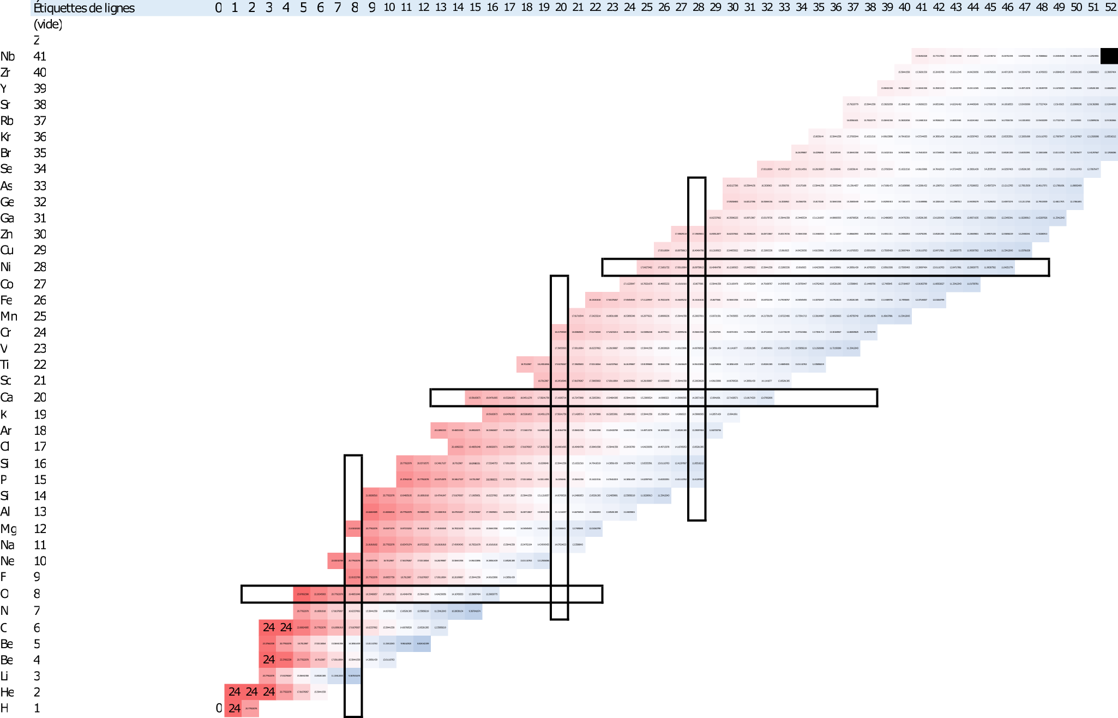
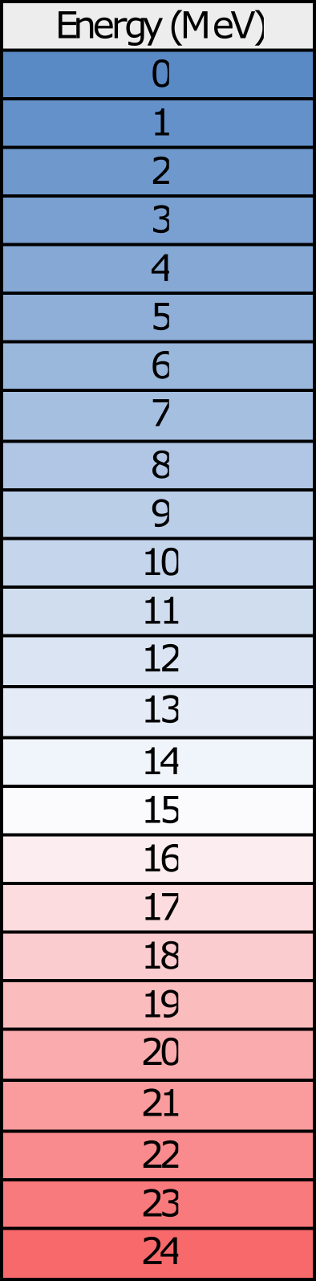
Acceleration
Up to 24 MeV/u, limited by:
charge state distribution at the output of the charge breeder
platform limitations
Emax

Slide 25
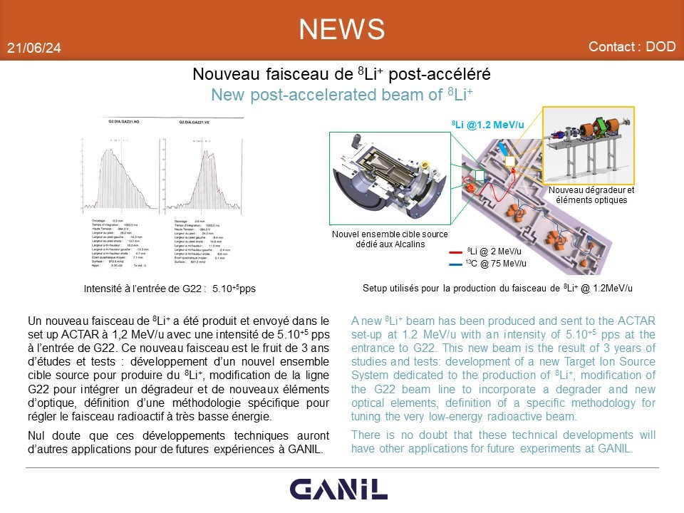
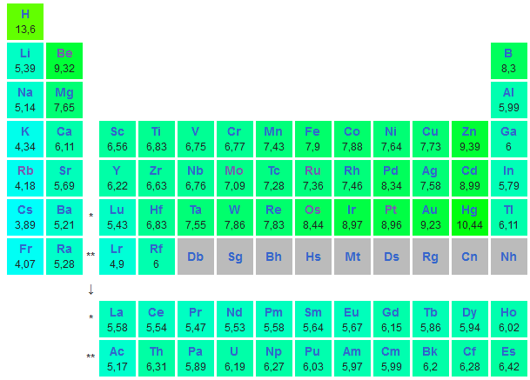
MonoNaKe (credit P. Jardin) Thick target + SIS
Low ionization potential atom
+
High work function surface
= Surface ionization
Designed and tested in 2006
Recently, interest for Li beams
Successful production test of ⁸Li (2e7pps) and ⁹Li (1e5pps) at low energy in 03/2024
Successful experiment with post-acc. ⁸Li (5e5pps at 1.2MeV/A) in 06/2024
In the future
Development and tests with Re ionizer to enable other elements

Slide 26
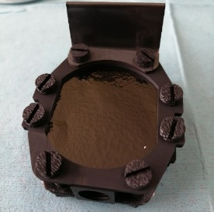
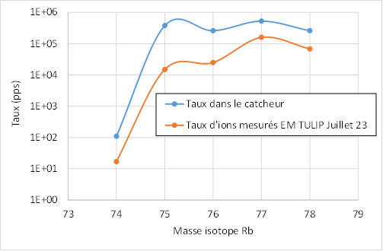
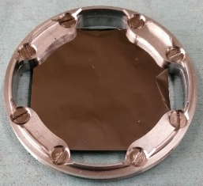
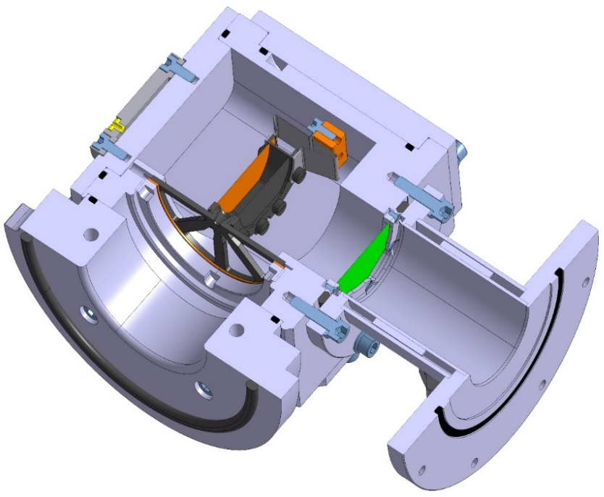
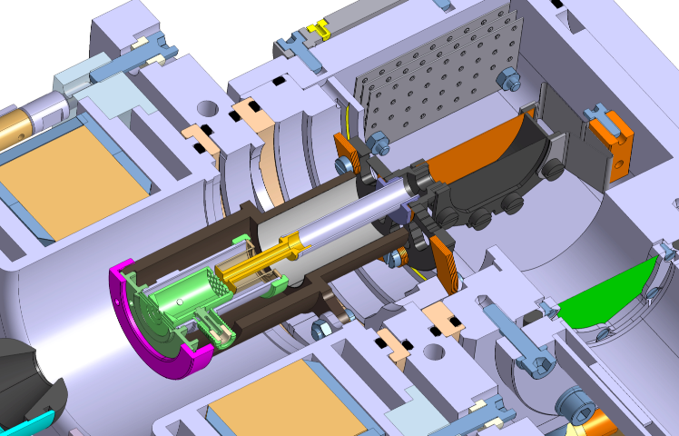
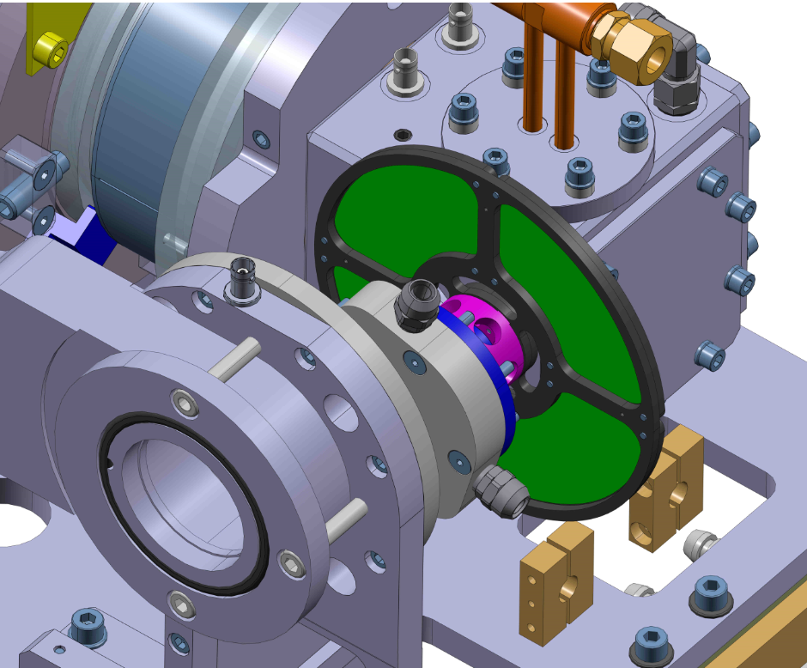
TULIP (credit P. Jardin) Thin ⁵⁸Ni target + SIS
On-line test 2023: production of ⁷⁴⁻⁷⁸Rb⁺ ions (≈10%)
Ongoing
Off-line test of the TULIP-FEBIAD coupling (metallic ions) + rotating wheel (production x7)
In the future
Off line test of Re ionizer
On-line production of ⁷⁴Rb (2025?)
On-line test of the TULIP-FEBIAD with a ⁵⁴Fe
target and a ¹⁴N beam (2026?)
Isotope mass
LE rate
Production rate (calculated PACE4)
Measured rate
DLC window
TULIP cavity
Mo-Ni-Mo target
(fusion-evaporation)
Graphite catcher
60 mm
²⁰Ne Primary beam
Radioactive ion beam
Rotating wheel

Slide 27
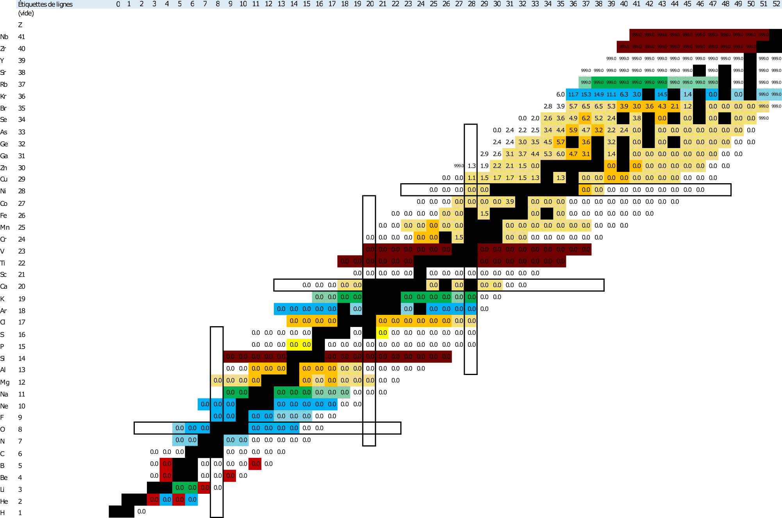
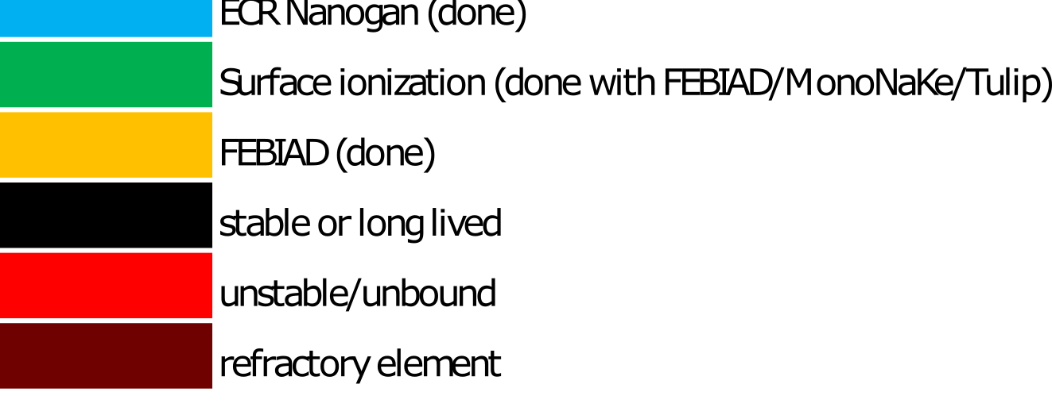

Production summary
All beams >1E3pps at low energy
n-deficient Rb isotopes
^{48,49}Cr, ⁵⁰Mn, ^{53m/g}Fe ⁵⁵Co, ^{56,57}Ni, Cs isotopes down to A=117,
Other isotopes (ongoing analysis)
We can/could do many exotic beams !
(Operational limit at 1 TISS/month)
^{8,9}Li

Slide 28
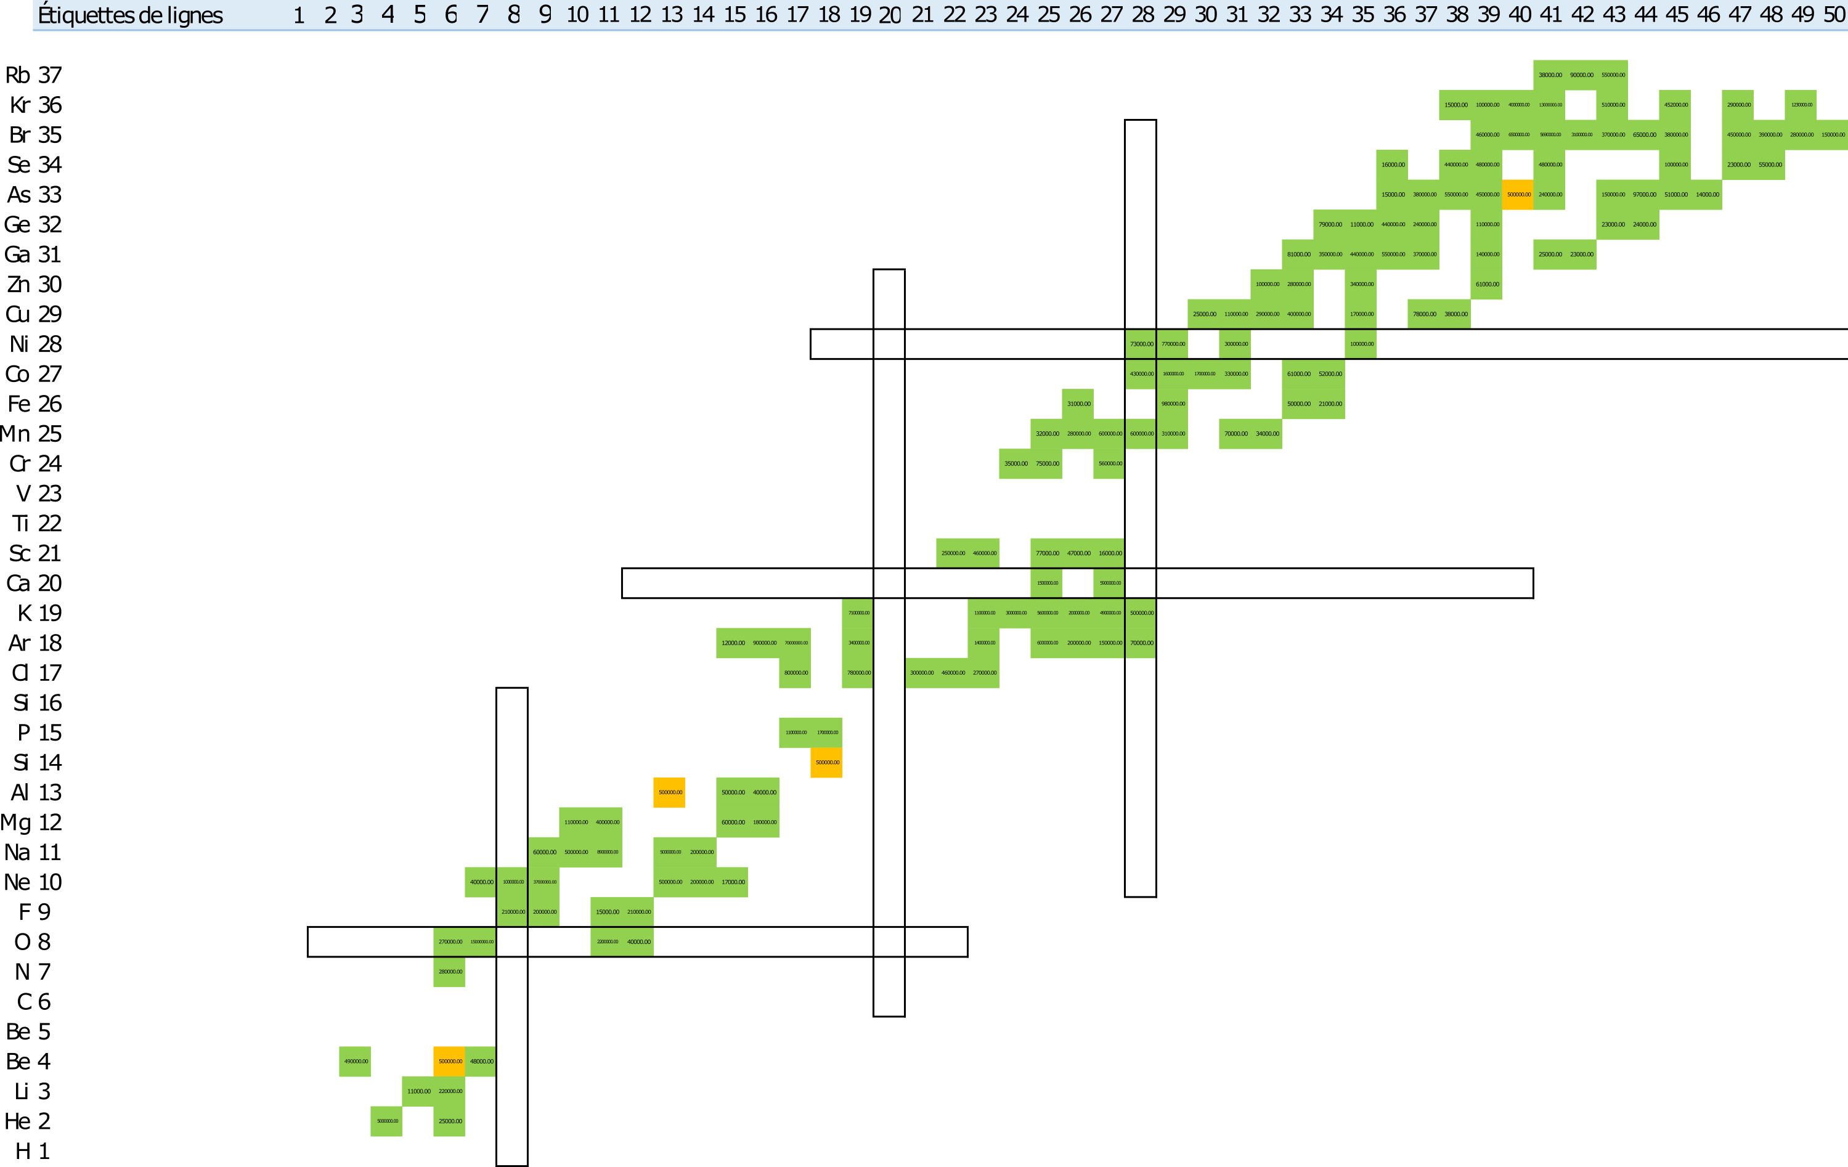
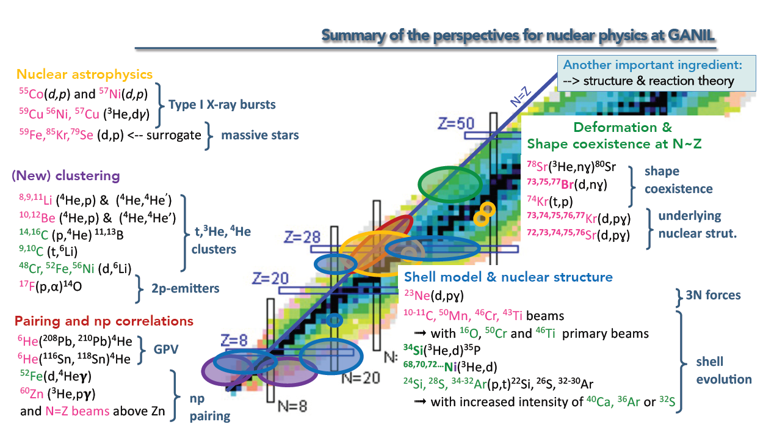
Post accelerated FEBIAD beams - intensity
All radioactive beams > 10^4 pps after acceleration
Direct measurements (19, mostly Nanogan)
Extrapolation from direct measurements (46)
Estimates (107, FEBIAD only)
172 isotopes + possible batchmode beams
M. Assié, WS Cible-Source, 09/2023

Slide 29
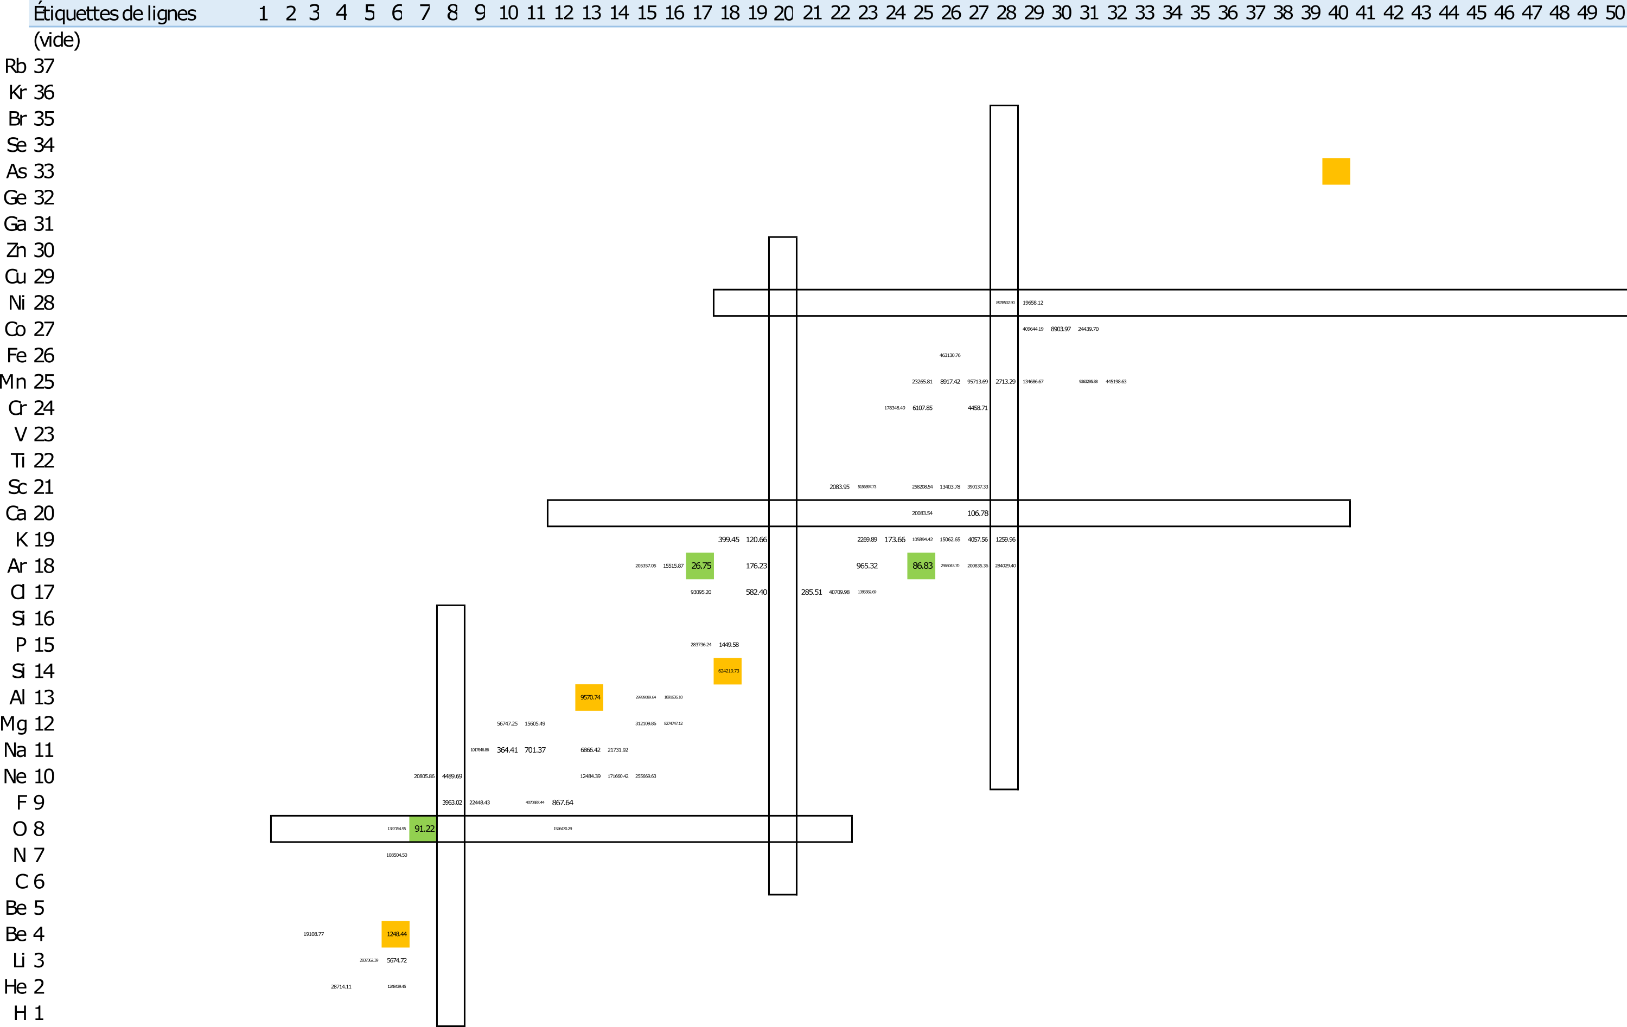
Post accelerated FEBIAD beams - purity
Requirements
Min rate : 1E4 pps
Max rate : 1E6 pps (limite VAMOS 0°)
IoI/contaminant > 1/100
Disclaimer
contaminants not measured for A>57
Contaminants not formally identified
Other possible contaminants
Usable without any purification
172 isotopes
3 isotopes

Slide 30
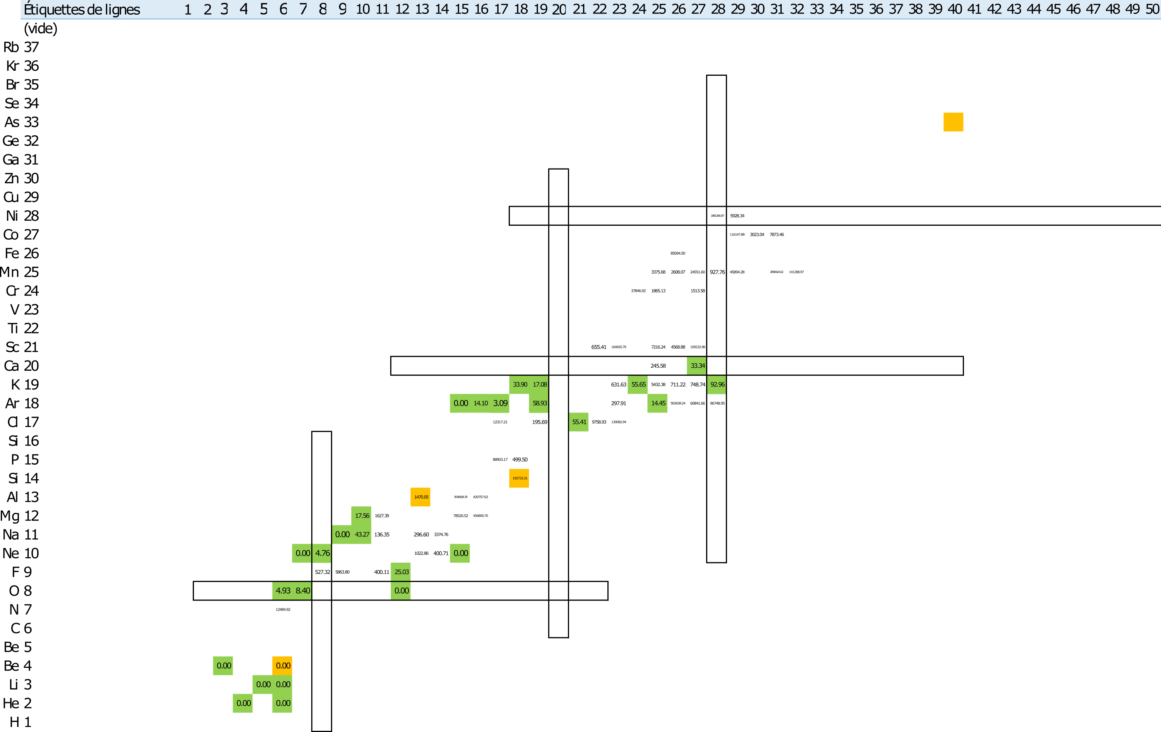
Post accelerated FEBIAD beams - purity
Requirements
Min rate : 1E4 pps
Max rate : 1E6 pps (limite VAMOS 0°)
IoI/contaminant > 1/100
Disclaimer
contaminants not measured for A>57
Contaminants not formally identified
Other possible contaminants
Using CIME as a mass spectrometer
Usable after mass separation in CIME
172 isotopes
26 isotopes

Slide 31
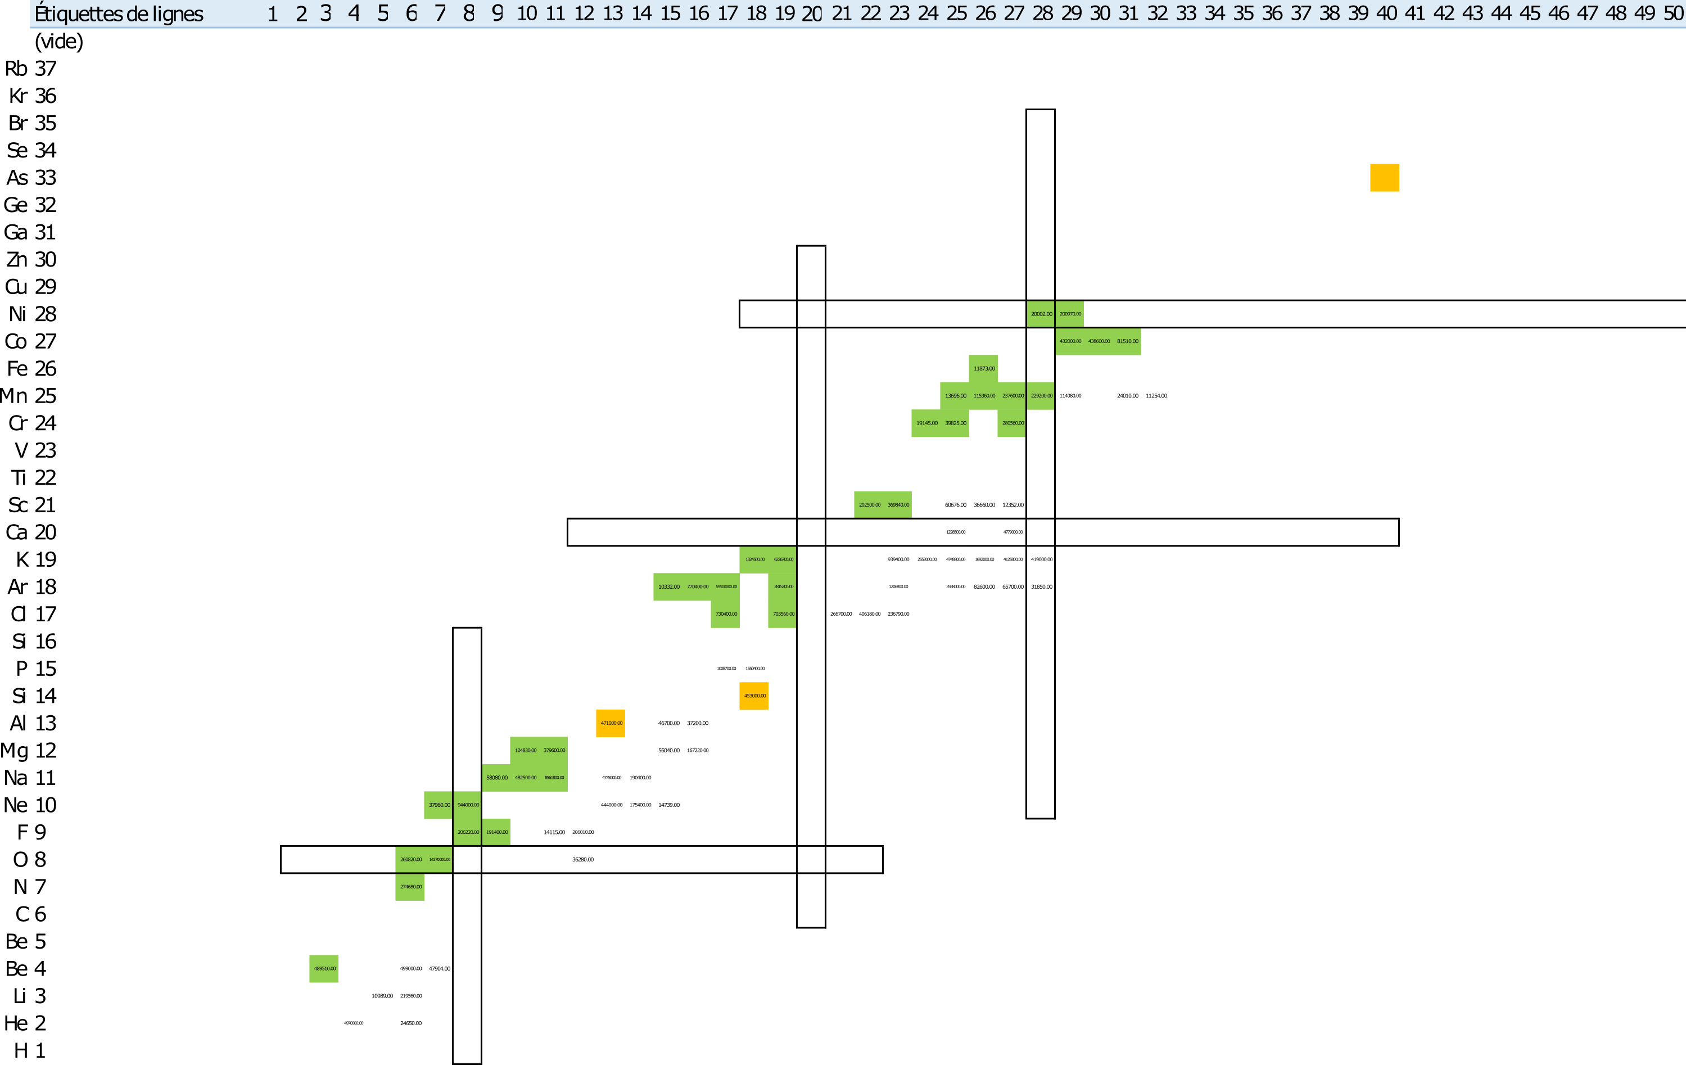
Post accelerated FEBIAD beams - purity
Requirements
Min rate : 1E4 pps
Max rate : 1E6 pps (limite VAMOS 0°)
IoI/contaminant > 1/100
Disclaimer
contaminants not measured for A>57
Contaminants not formally identified
Other possible contaminants
With full stripping
Usable after stripping at max E
172 isotopes
36 isotopes

