Slide 1

Project Manager Report
2025
Emmanuel Clément (GANIL)
on behalf of the AMB, LNL and Padova local team
June 2025

Slide 2

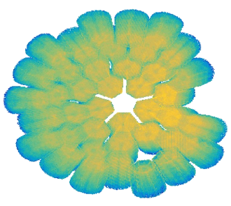
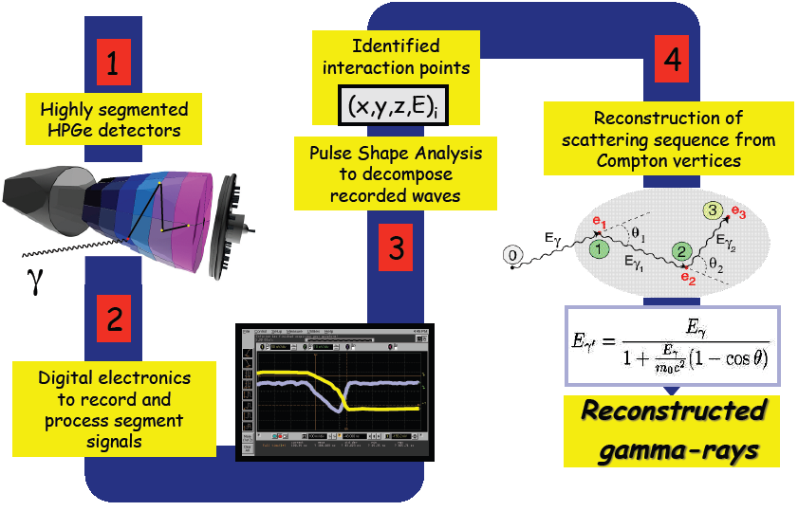
AGATA : PBS
6
Doppler Correction
Complementary Detectors
5
β, θ, φ, E*

Slide 3
2020- 2024 achievements
ASC’s courtezy

Slide 4
ASC’s courtezy

Slide 5
ASC’s courtezy

Slide 6
AGATA MoU Phase 2
2026-2030
39 capsules
7,7 M€
2021
120 capsules
2009-2020
57 capsules
2021-2025
(MoU is 39 capsules)
24 capsules
10 cryostats 2,0 M€
CTT/MIRION
2026-2030
54 capsules
9,1 M€
10 cryostats CTT
135 capsules
15 cryostats 2,9 M€
CTT/MIRION
MoU Phase 2
Mid-term review 22 apr. 2025
by AGATA Ressource Board
ASC/AMB/ACC document : ATRIUM-1080389
No objection for the 135 scenario
ASC members to go to their respective instituts to get the amendment signature

Slide 7
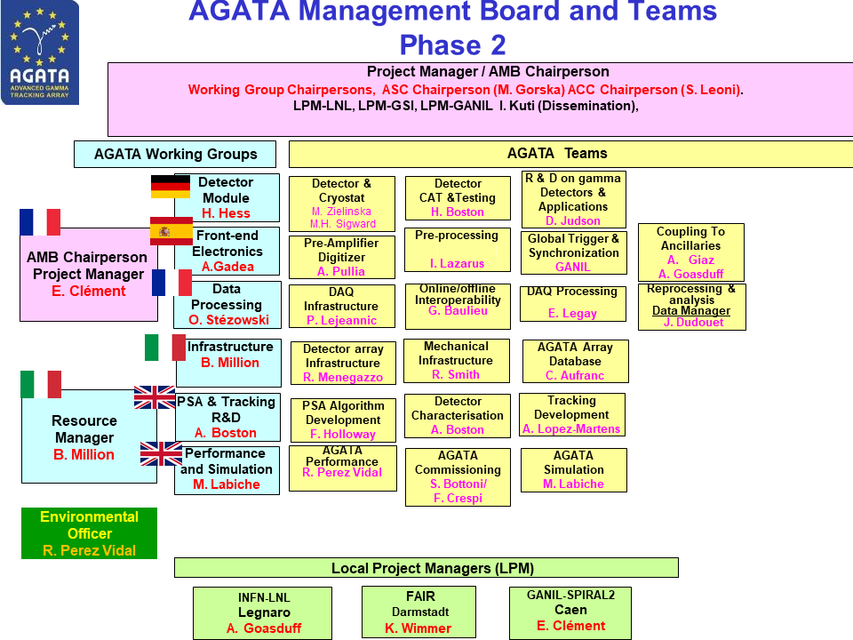
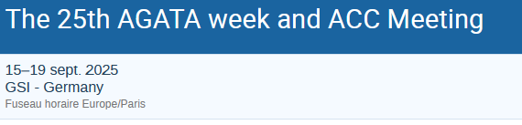
AGATA : WBS
1
The AMB meets every month by zoom
Excellent stability and smooth evolutions of the board
One AMB meeting per year in presence
3 AMB meetings per year include all team leaders.
The AMB organises the annual AGATA week
The next one is in GSI
2,5
3,5,6
1,2
3,4
6
Most likely the 2026 AW will be proposed to Poland

Slide 8
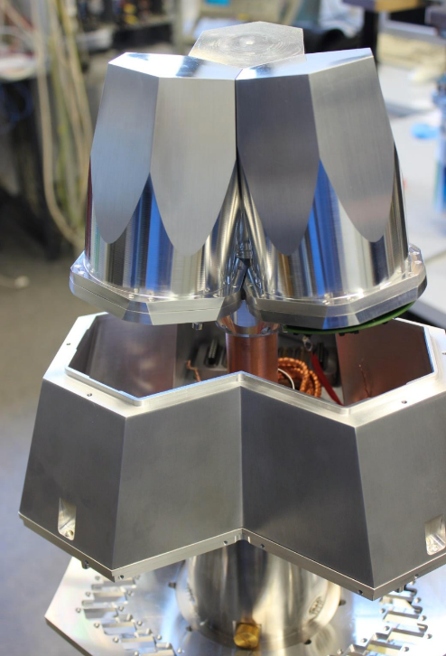
Detector status (April 2025)
Detector procurement
The total number of delivered AGATA asym-capsules is 71
+ 1 DEGAS ATC completed in IKP
+ 1 ORTEC prototype, not functional
+ 3 symmetric capsules
3 x encapsulated HPGe crystal from MIRION®
Open Orders: 6 capsules
4 x Owner (Italy) delivery expected in 2025 and 2026
2 x Owner (France) delivery expected 2025
1 x cryostat from CTT®
Cluster Assembly
ATC24 (GSI) delivered
ATC25 (GANIL) in progress
ATC16 (conversion of ADC03 - GANIL): completed
Test cryostats refurbishment done
AGATA Triple Cluster (ATC)
Maintenance
A 4 years contract (1.6 M€) between GANIL and MIRION for new orders/ annealing / repairs has been signed using the OC located in the GANIL common account. Started in January 2025

Slide 9
Phase 0 + 1 = 53 caps
+ 1 DEGAS Triple available to the collaboration
+ 1 ORTEC prototype – non functional
---------------------------------------------------------------57 capsules
Phase 0+1
B025
CEA Saclay
+ Fr(2) GANIL : B024, C025, (2025)
+ INFN(4) : A025, C024 (2025) , 2 orders in March 2025 → 2026 delivery

Slide 10
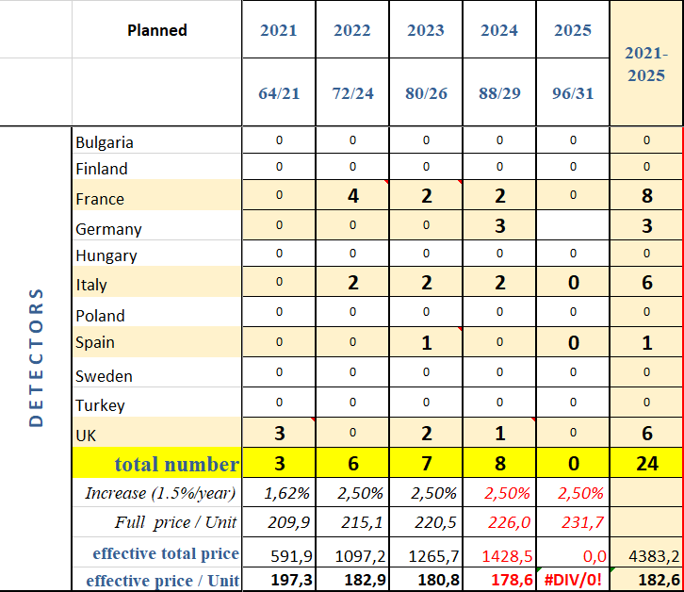
Phase 0 + 1 = 53 caps
+ 1 DEGAS Triple available to the collaboration
+ 1 ORTEC prototype – non functional
---------------------------------------------------------------57 capsules
Phase 2, ½ = +39 (according to MoU) → 24 achieved
Phase 2 ^{2/2} = +39 (according to Mou)
Phase 0+1
B025
CEA Saclay
+ Fr(2) GANIL : B024, C025, (2025)
+ INFN(4) : A025, C024 (2025) , 2 orders in March 2025 → 2026 delivery
Total funded so far = 57 + 24 = 81 capsules

Slide 11
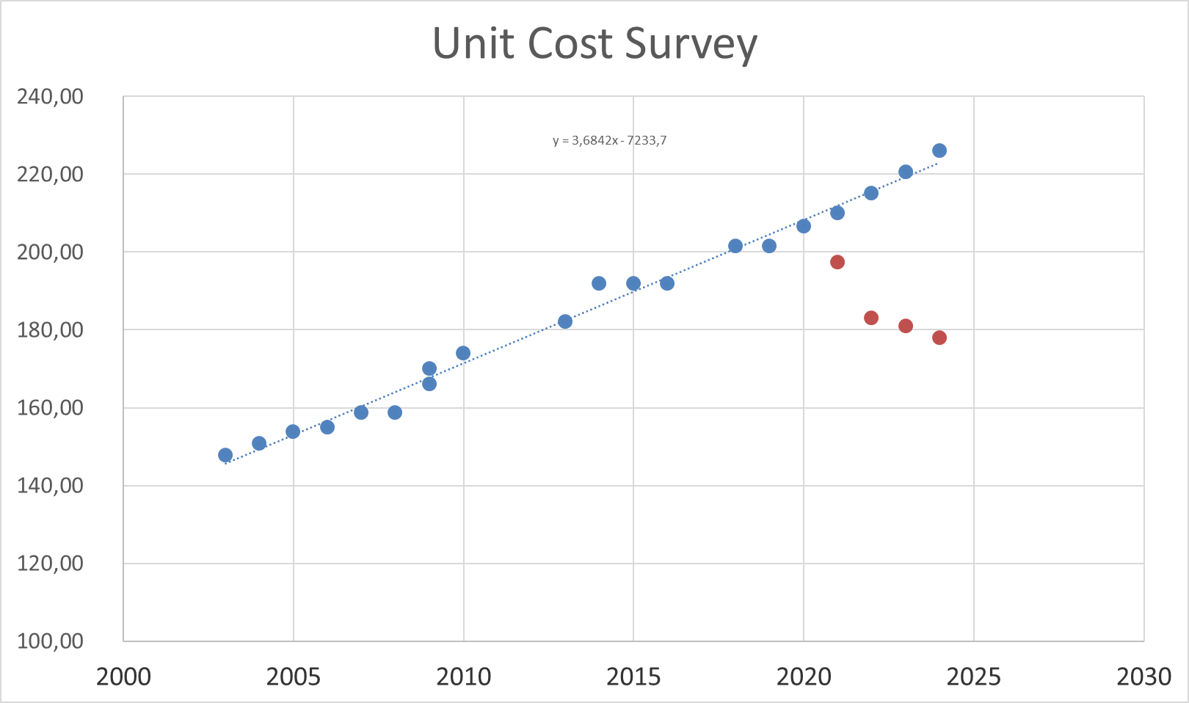
Detector status ; Project Definition
Procurements :
Capsules procurement at 2025 milestone will be 85% of the objective [2010-2025]
Cryostat procurement at 2025 milestone will be 100% of the objective
Improvements :
Improving the vacuum in the cryostat by new getter → done
Survey of obsolete component for the preamps → done
R&D :
-ORTEC option → went far thanks to the UK investment
- p-type design, electric cooling, ASIC preamps → to be continue in the second part of the decade
Cost optimisation :
Efforts :
Based on the involvement of Univ. of Cologne, Univ. of Liverpool, IRFU Saclay, IPHC Strasbourg, Host Lab’s.
The detector laboratories are committed to pursue their activity for AGATA with perspectives of acquiring more knowhow
Toward a GRETA business model with the CTT-MIRION agreement
→ [2021-2024] 890k€ saved (17%) thanks to the coordination effort

Slide 12
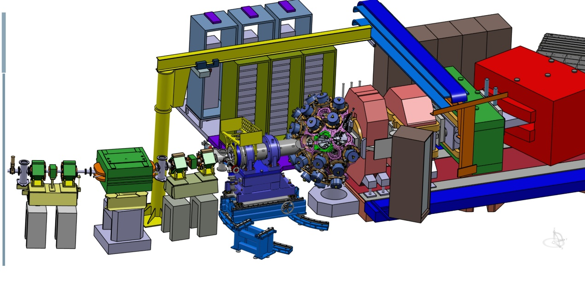
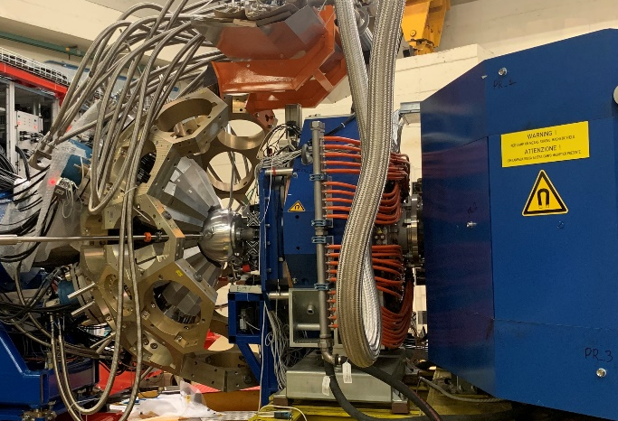
Infrastructures
Mechanics (STFC, LNL, GANIL) :
Involved in LNL campaign (STFC- LNL – PD)
Involved in the next Host Lab discussion
EMC (IJCLab)
Detector Support System (CEA)
Phase 2 LVPS designed (CEA) and 2π delivered, operational at LNL
HV replacement funded. Done.
LN2 system for phase 2 designed (CEA), delivered and operation at LNL
Design of the mechanical support completed, 2π delivered (STFC)
The 2π solid angle is covered

Slide 13
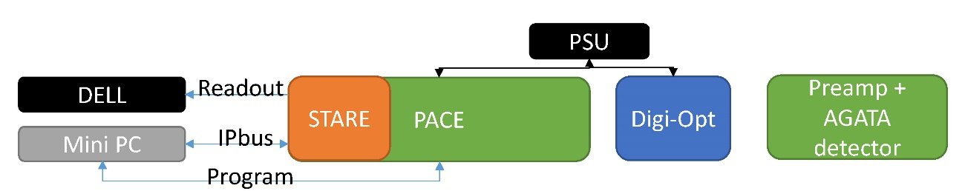

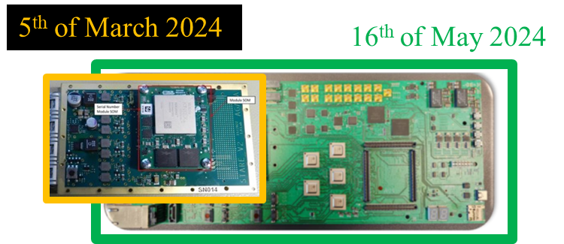
Phase 2 FEBEE ; evaluation status
The most challenging R&D of phase 2
Mass production has started for all hardware parts in 2024. Procurement delays are > 12 months
The critical path is the integration at the firmware level in the existing system (GTS, network, flow, RUDP etc…) due to human resource availability
The ASC approved to charge the OC at GANIL for the maintenance of the firmware with the ZeptoNova company contract (52 k€)
→ Signed by GANIL on February 2025
Present schedule
DIGOPT mass production is on time
3 years delay in the mass production of PACE/STARE boards due to difficulties now resolved
75 x complete chains are now ordered and to be delivered by summer 2025
Integration work to coupled with phase 1 (> 100 channels)
Expected delivery end of 2025
2026- 2030 period, extending the system to cover the full AGATA solid angle

Slide 14
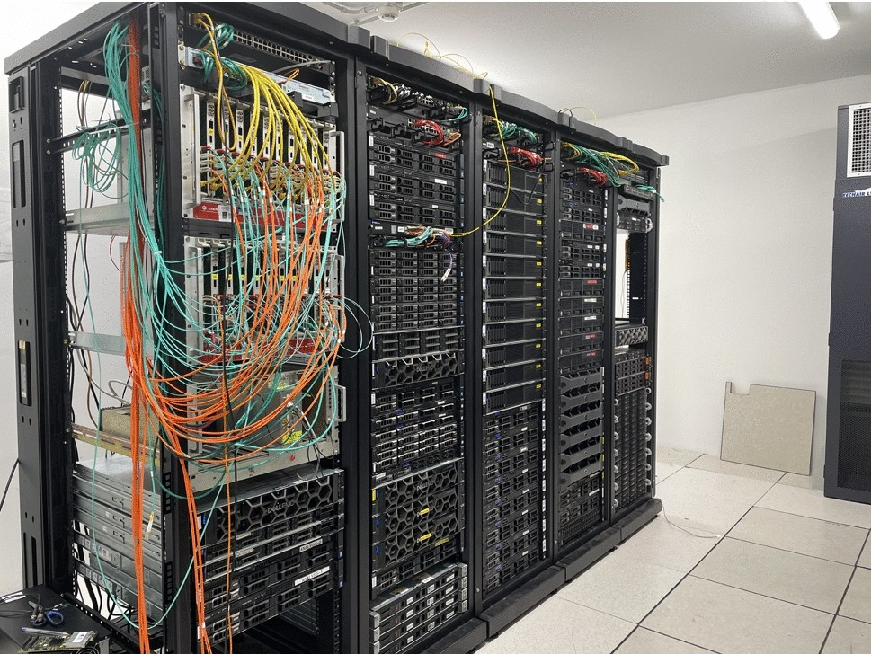
Data flow and Acquisition status
Maintaining the present system with upgrades
The phase 2 data pipe line is ready
Software Slow Control installed in LNL
Performances are testes using an V2 emulator and real data taken in LNL
Preparing the migration to new PSA including the use of GPU
Mini daq box for data flow R&D setup in Orsay to validate the most recent technologies (PSA > 20 kHz reached on recent technologies)
Improvements in accessing the data from GRID and maintaining the identification process
The investment remained low in 2020-2025 due to a constant number of channel to be instrumented
After V2 implementation, due to the rapid increase of the number of detector, a massive investment will be needed in 2026 -2030 (0.9M€) with savings possible thanks to the CNRS accord cadre
DAQbox at LNL

Slide 15
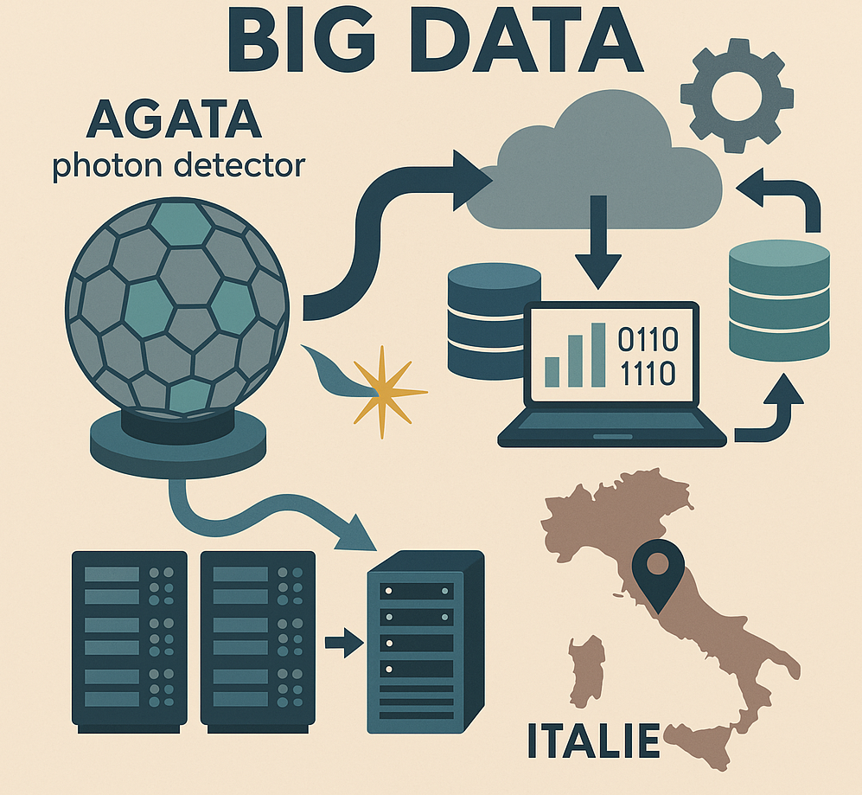
Data flow and Acquisition status
Next 5 years objectives
The monitoring will be extensively benchmarked to correct for weaknesses
  It will be extended also to all processing nodes
The processing of few tens of emulated crystals will be tested
  At high/low rates, possibly including new PSA/Tracking
  The data transfer through the UDP (RUDP) protocol should be mastered to avoid loss
A new scalable reprocessing environment will be tested and validated
Advanced data & metadata management tools (solutions such as ami/rucio) will be tested
Software triggers are to be developed to allow PSA to be performed only on the most interesting events in order to speed up the global processing rates
In the host laboratories (LNL and then GANIL)
The server farm will be modified to handle new v2 electronic boards
  At a first step with a coexistence with old v1 boards then with only v2
The new processing will be implemented up to the global level
  A commissioning at high/low rates, possibly including new PSA/Tracking, is to be done

Slide 16
Performances and Simulations ; status
Neutron damage : the Performance team monitors the resolution of the array after the neutron damage following the high luminosity.
18 capsules are already being annealed by MIRION in 2024
Operation Cost are fundamental for this operation.
High energy gamma ray benchmark for the future campaigns in SPIRAL1 and SPES
The AGATA package is maintained following the GEANT4 releases → done
Including new ancillaries → done
Event generators :Integration of the FAIR MOCADI frameworks → done
The improve characterization of the crystal geometry or sensitivity relies on the systematic study of the measured efficiency and performances as well as the scanning data in tomography mode
→ to be completed in this second half of the MoU

Slide 17
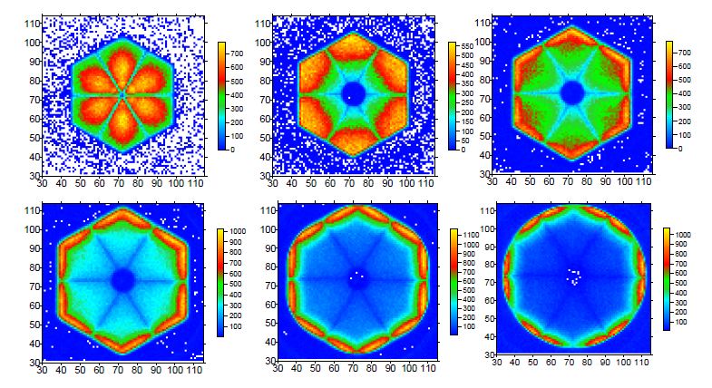
PSA-Tracking R&D ; status
New simulation package, AGATAGeFEM
→ J. Ljungvall, EPJA 57, 198 (2021) 10.1140/epja/s10050-021-00512-w
→ Dependencies investigation
→ Improved geometries
Characterization with IPHC scanning table and elsewhere (Salamanca and GSI)
Ip2i involvement in the analysis
Implementation of the multi-interaction PSA grid search using the GRETINA approach : This has been fully implemented in AGAPRO and works (Univ. Liverpool)
workshops
OASIS AGATA AI workshop 2024, 13th of May
AGATA – GRETINA in ANL (Nov. 2024)
https://indico.in2p3.fr/event/32594/overview
Tracking
Investigation into how tracking behaves when the proper position & energy dependent uncertainties are used to estimate the error on the Compton scattered energies

Slide 18
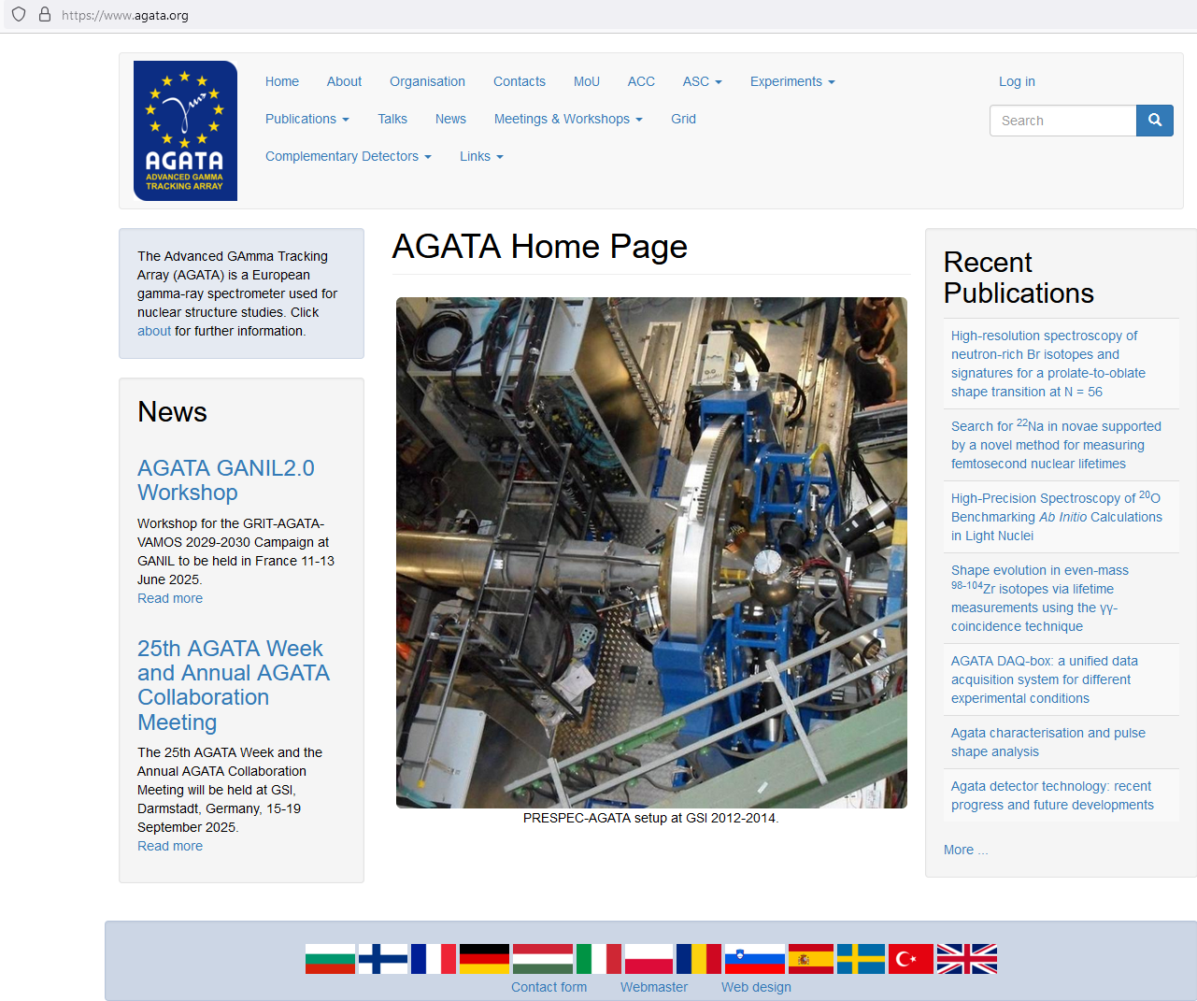
Dissemination
J. Nyberg → I. Kuti

Slide 19
Thanks to all AGATA contributors
The local team LNL/PD

