Slide 1
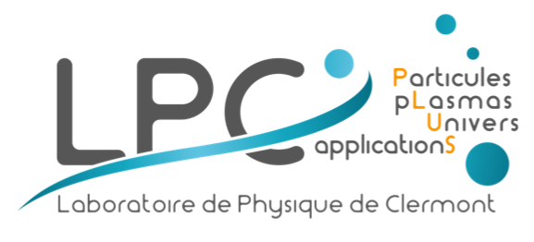
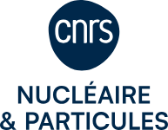
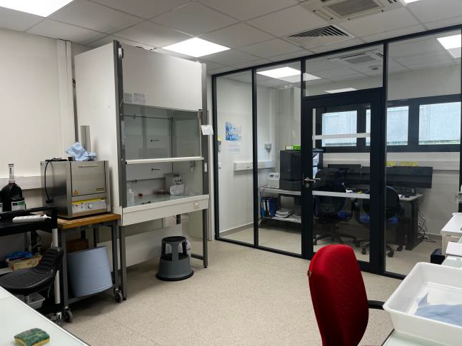
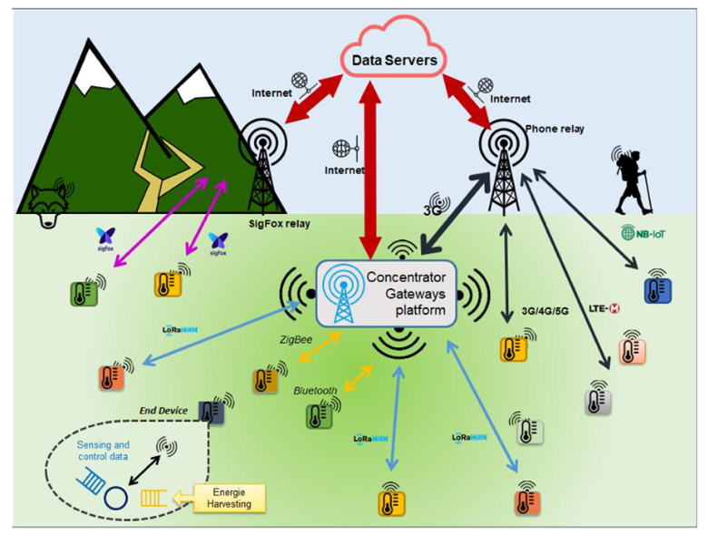
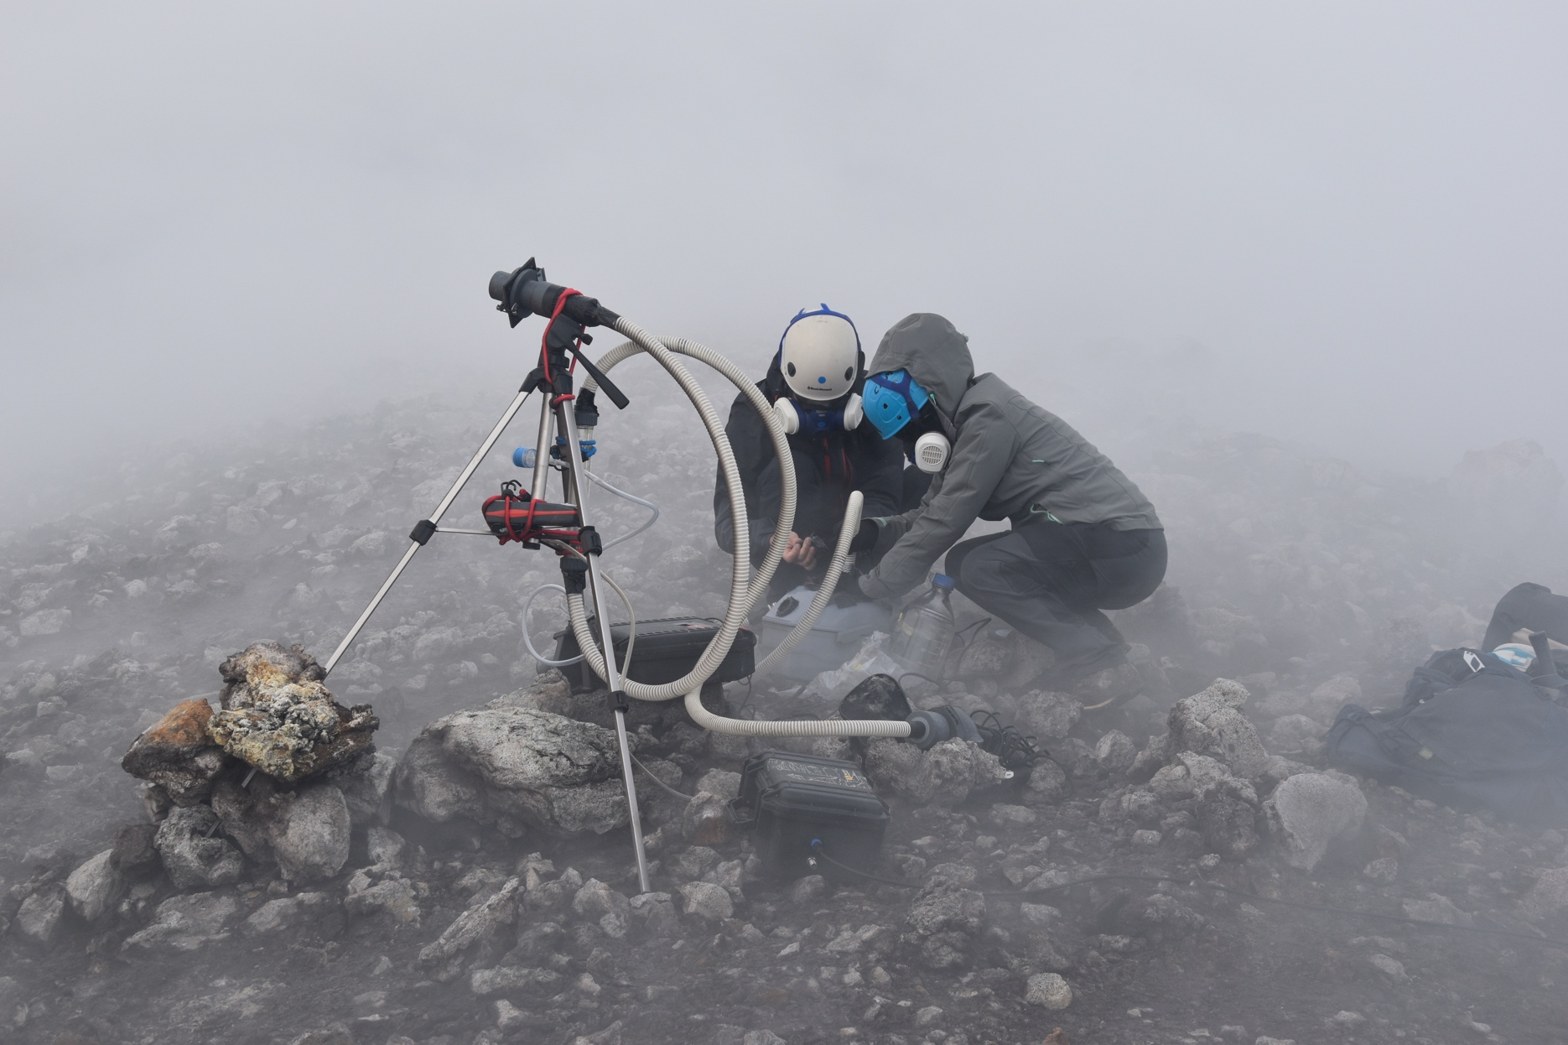
The 4 pillars of LPCA environment team
Basic science for society
Irradiation / nuclear characterization
Simulation
Innovative detector design
Big data, from sensor to cloud
Radiological analysis of environmental samples
17 full time staff
1 post-doc
5 PhD student
11 FTE
Monte-Carlo simulation from micro to nano-scale of naturally radiative ecosystems
IN2P3
2 infinis
Deployment of sensor networks
radon monitoring in extreme environments

Slide 2
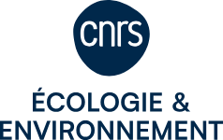
Our main research projects …
2024 – 2028: Thermalism and
Radioactivity (ZATU)
Basic science for society
Irradiation / nuclear characterization
Simulation
Innovative detector design
Big data, from sensor to cloud
Impact of ultralow radioactivity
on biological systems @LSM
2025-2030: Monitoring the environmental impact of nuclear power plants
Led by Réseau
Becquerel
2023 – 2028 Deploying intelligent
sensors to monitor water resources
(CPER IDEAL)
2024 - 2028 : natural and anthropic
radioactivity in deep ocean (NODSSUM, RADIOCEAN)
2021-2029 Deploying Anthropocene in situ observatories
(Equipex+ TERRA FORMA)
2023- : Labcom IOTAE
2012- : Inverse Monte-Carlo, from
muon tomography to radon
monitoring of active volcanoes
Our current main platforms:
- PAVIRMA @LPCA
- Mesocentre Clermont-Auvergne @UCA
- Réseau Becquerel (IPHC, LP2I, Subatech)
- Modane Underground Laboratory
2023-2028: Innovative instruments for radon monitoring in extreme environments (ANR SPAGHETTI)

