Slide 1
Batch Mode Ion Source (BMIS) Rare Isotope Production and Acceleration at FRIB
Antonio Villari
Facility for Rare Isotope Beams / MSU
villari@frib.msu.edu
March 2025

Slide 2
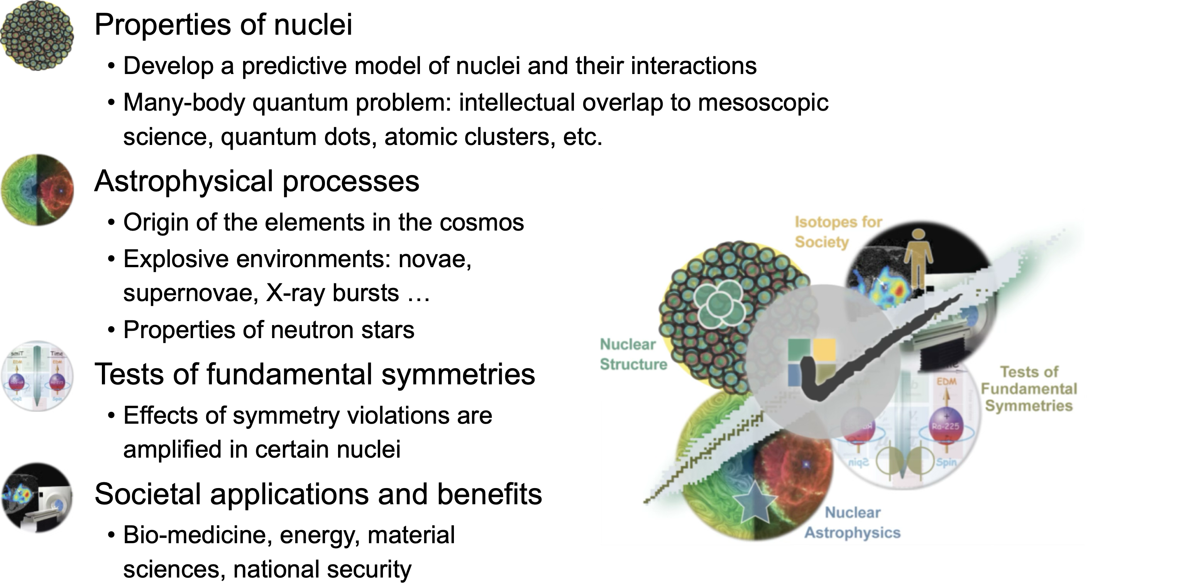
The Facility for Rare Isotope Beams Science

Slide 3
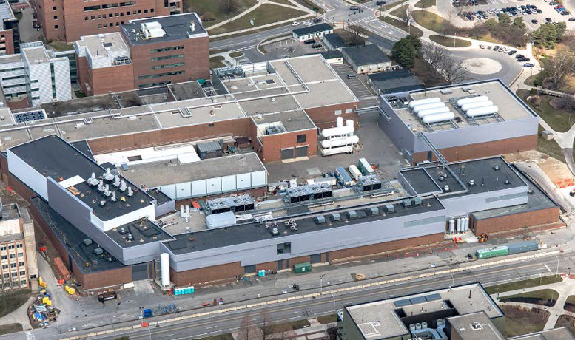
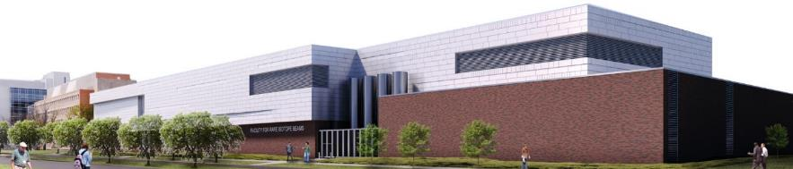
Facility for Rare Isotope Beams – FRIB
User Operation Started
FRIB is a scientific user facility funded by
the US Department of Energy Office of
Science (DOE-SC), Michigan State
University, and the State of Michigan
  FRIB serves as a DOE-SC user facility open
  to researchers from around the world
During FRIB construction NSCL
delivered NSF-funded pre-FRIB science
ReA stand-alone program in 2021 and
early 2022 during phase of connecting FRIB
beam line to NSCL facilities
  Stopped and reaccelerated beam experiments with long-lived and stable isotopes
The FRIB scientific user program with fast beams started in May 2022
  Start with 1 kW beam power, today 20 kW
  Ramp up towards 400 kW in next years
Notes:
Remark here: Scientific program started in May 2022, three experiments performed, two in FRIB Decay Station initiator and one in S800

Slide 4
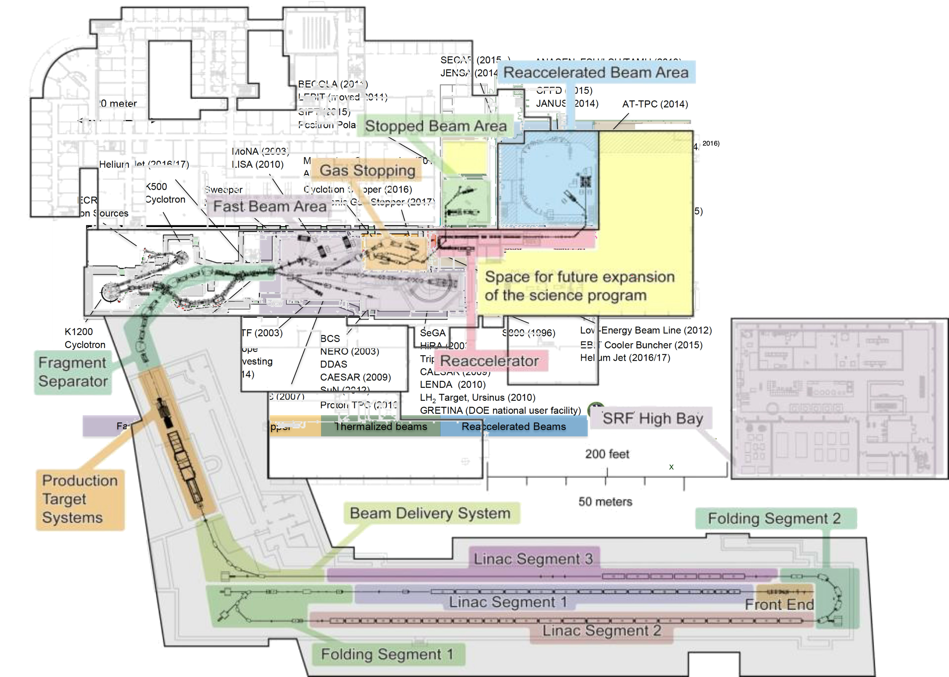
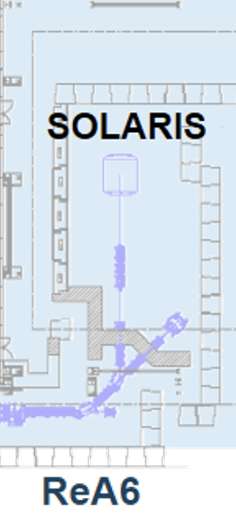
History (Why): Moving NSCL Program to FRIB (May 2022) Without Interruption of the Science Program
Construction of the Batch Mode Ion Source (BMIS), providing rare isotopes of relatively long half-life during the connection of the new LINAC and ARIS separator to the existing experimental areas
Construction of ReA6 (May 2019 to April 2021) with less than 3 months interruption of ReA3 program
Also, refurbishment of the fast beam experimental areas (S800 – first, Sweeper and new FDSi dedicated vault)
Connection
ReA6 (2021)

Slide 5
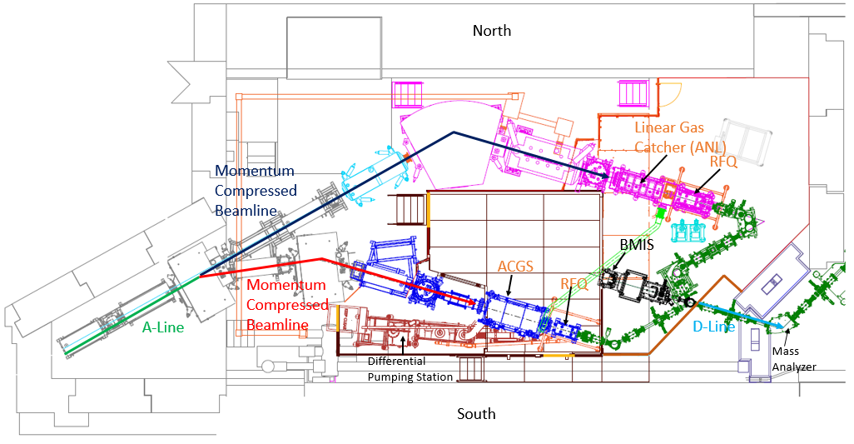
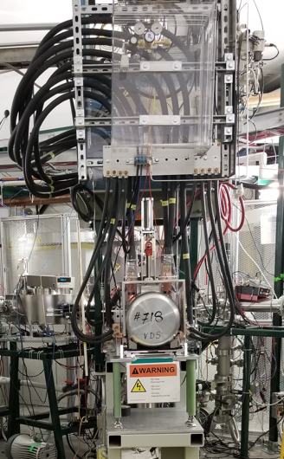
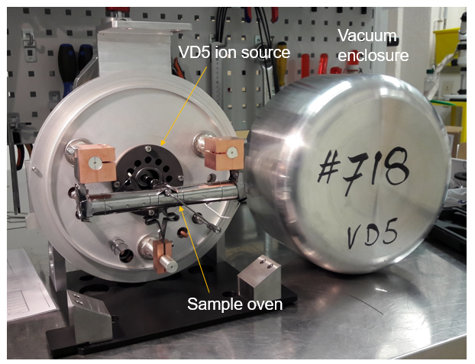
Successful Stand-Alone Operation
During Transition to FRIB
N4 vault
BMIS provides beams of stable and long-lived isotopes for experiments in stopped and reaccelerated areas
  ISOLDE collaboration provided initial ion source modules, design input and chemical recipe for Be and other beams
    ISOLDE sources are ideal, as it can be changed completely minimizing hands-on on the most contaminated portion of the system
  FRIB radiochemistry group supports making samples for beam production
Stand-alone program continues during FRIB operation
  Presently, BMIS beams can be delivered in parallel to FRIB fast beams
Have delivered about 20 beams (stable and radioactive) for experiments in stopped and reaccelerated areas
BMIS
VD5 ion source
Batch Mode Ion Source (BMIS) setup

Slide 6
Process for Choosing Beams First to be Developed for the Stand-Alone Transition
Call for Letters of Intent issued via NSCL/FRIB User Community
About 50 isotopes were proposed, with half-lives spanning from 6 days to 1E+6 years
Amongst those isotopes, first preference was given based on a “mix” between science impact, number of proposals with the same isotope, forecasted feasibility, availability and radioactive dose impact
  A committee with Brad Sherrill, Dave Morrissey, Greg Severin and AV (all FRIB) studied each case
The conclusion of this study is shown in the next slide for the final cases

Slide 7
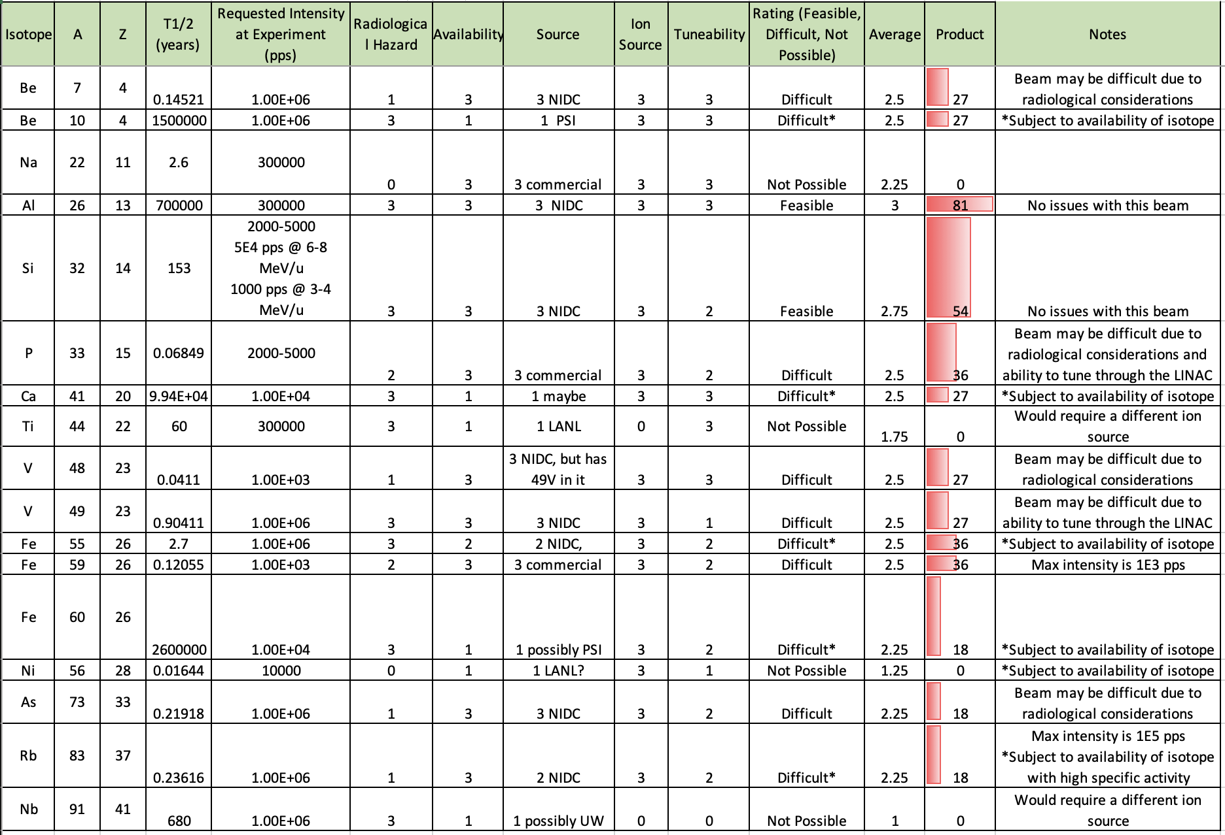

Slide 8
After PAC, a Detailed Analysis of Beam Losses all Long the Injection, Linac and Experimental Areas Were Performed
Self-goal was to allow hands-on work of parts of the accelerator
  The injector (outside the BMIS source and closed-by elements) as well as EBIT and ReA were not built for tele-manipulation
Components of the analysis
  Definition of each position where the beam is potentially lost (efficiency of transport for each step)
  Assumption that the MINIMUM quantity of isotope is purchased and injected in the source
    The quantity is estimated (including R&D and tuning) taken into account efficiencies
    Even though, the quantities to be injected in the source are of the order of 10-100 ng depending on the isotope
    The maximum activity in the source: 73As => 250 μCi
    No rare isotope beam is provided with more than 1E+6 pps after acceleration

Slide 9
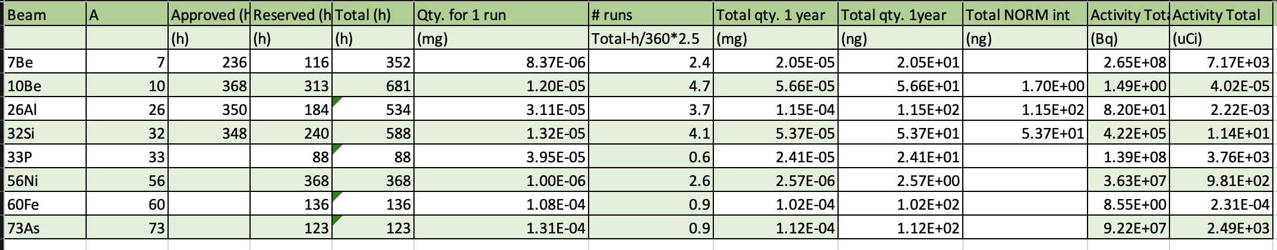
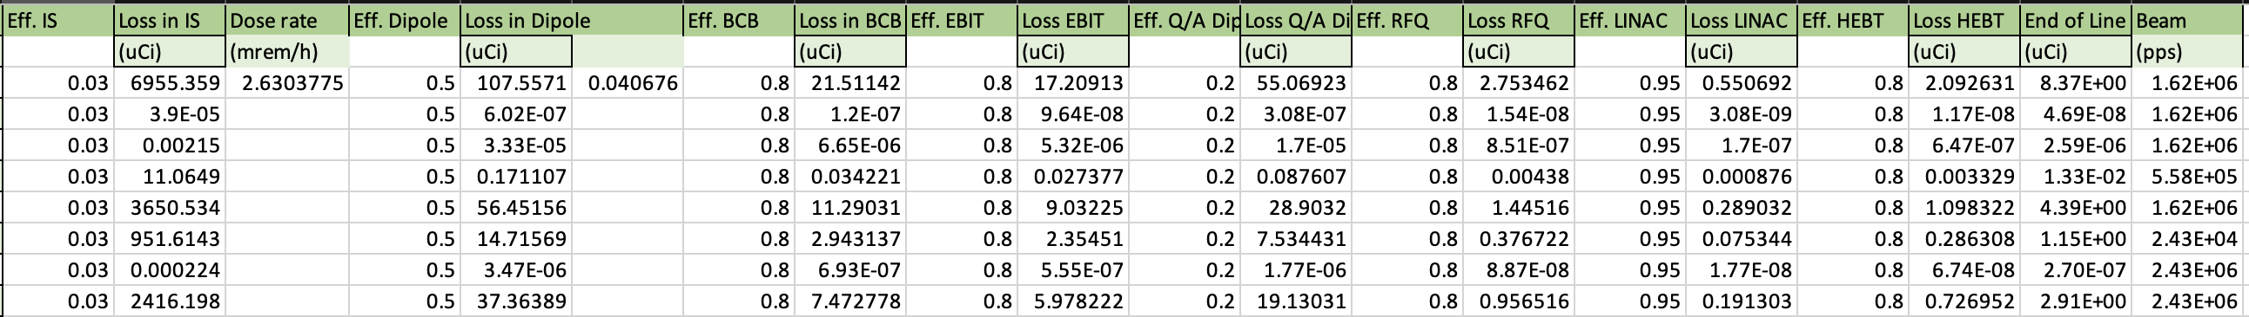
Selected Portions of the Analysis for Selected Isotopes

Slide 10
General Comments
This exercise took 2 months of intense work of the task force
Intense R&D for each beam was performed, first with stable isotopes
  This could involve LEBIT and ReA, depending on the case
One experiment fail and one didn’t run
  56Ni was highly contaminated by 56Fe and cleanup with stripper in ReA was not enough
  60Fe didn’t run
Not always the projected molecule to inject in the source was used
  Tests with stable isotopes were used to define the best choice in terms of feasibility, consumption and contamination in the same mass of the rare isotope
For reaccelerated beams, stripping at high energy was also used to clean-up beams
  Including developments to measure the content of the beam with a simple operation method

Slide 11
Successful Experiments with BMIS Beams
Beam | Half-Life | Expt # | Beamline | Hours Run
¹⁰Be | 1.5E6 y | 20009 | ReA6/SOLARIS/AT-TPC | 174
 |  | 20021 | ReA6/SOLARIS/Si array | 224
 |  | 20026 | ReA3/BTS33 GPBL | 151
 |  | 22502 | ReA6/SOLARIS/AT-TPC | 130
⁷Be | 53 d | 20007 | ReA6/GPBL | 259
 |  | 20025 | LEBIT | 387
³²Si | 153 y | 20002 | BECOLA | 44
 |  | 20010 | ReA6/SOLARIS/Si array | 123
 |  | 20014 | ReA6/SOLARIS/Si array | 137
 |  | 20015 | ReA6/GPBL/JANUS/SeGA | 168
 |  | 20022 | ReA3/BTS33 GPBL | 334 (include 30,28Si)
²⁶Al | 7.2E5 y | 20027 | ReA3/SECAR/SuperORRUBA | 372
 |  | 23060 | BECOLA | 30
⁷³As | 80 d | 22505 | ReA/GPBL/SUN | 144
²³²Th | 1.4e10 y | 23080 | BECOLA | 54
²²⁹Th | 2932 y | 23080 | BECOLA | 48 (includes 232,229Th)
Stable Beams
^{28,30}Si
⁵⁰Cr
⁵⁸Fe
⁸⁶Kr
¹²⁰Sn
²⁷Al
^{58,61}Ni
⁷⁵As
⁴⁰Ca
³⁵Cl
^{20,22}Ne
¹²⁰Te
Variety of beams have been developed and delivered for successful user experiments
BMIS beams boost FRIB scientific output by providing unique, high-rate beams
Total ~2800 hours of long-lived radioactive beams delivered to experiments

Slide 12
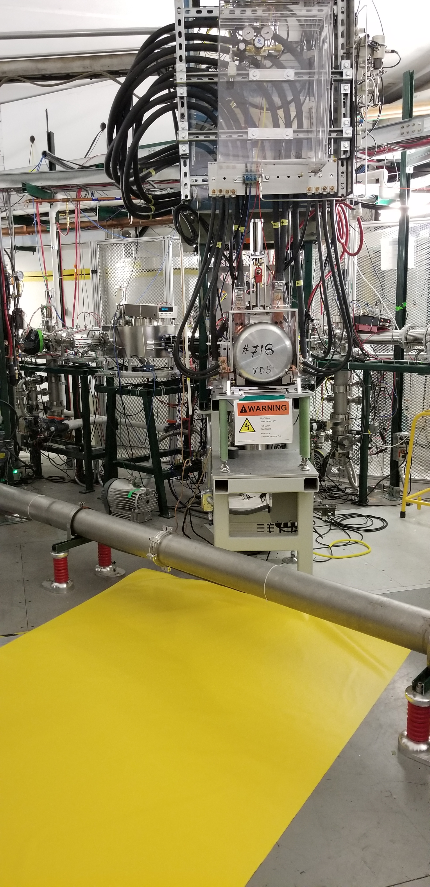
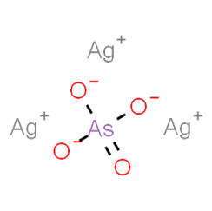
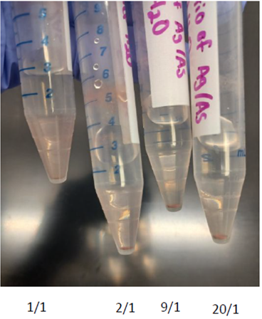
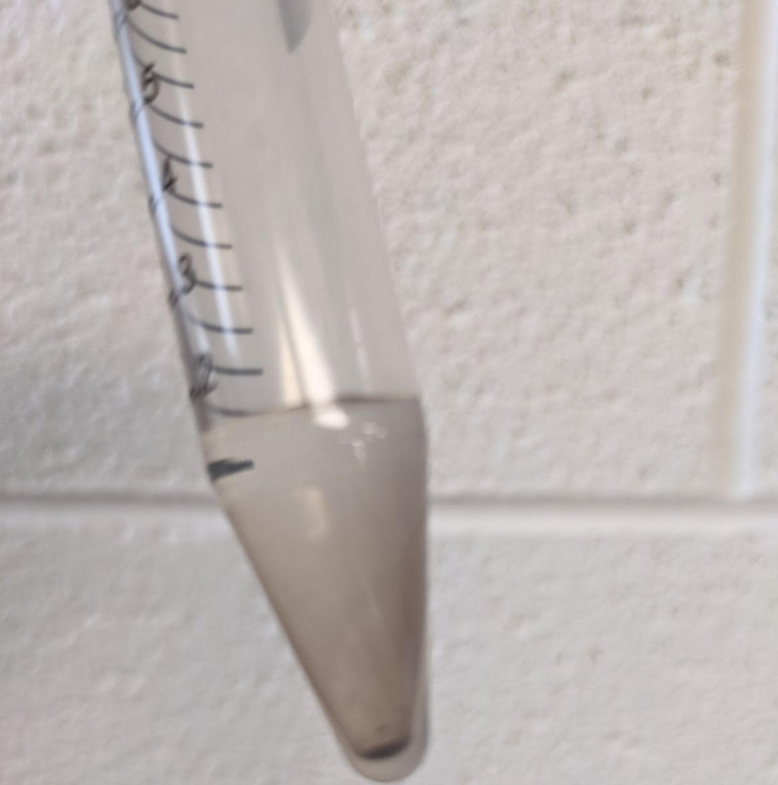
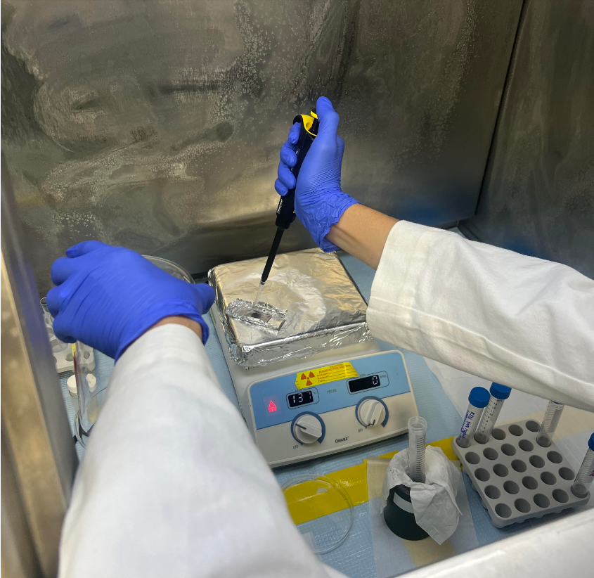
Example of Complexity: ⁷³As Beam Delivered for User
Batch-mode Ion Source and ReA to provide ⁷³As (T_{1/2}=80 days) beam for Exp 22505
  Beam development constrains
    ⁷³As radioactivity limit by NRC regulations: 1.8 mCi of ⁷³As allowed
    Arsenic chemical toxicity limit by OSHA: max of 400 μg allowed
BMIS located in N4 vault delivery the beam
  Initial beam development was done with ⁷⁵As (stable)
Source preparation in Chemistry was critical in producing quality beam
  Arsenic compound (silver arsenite) was selected based on chemical and physical properties
  Arsenic sample from NIDC convert to silver arsenite by reacting with silver nitrate (AgNO₃)
Silver arsenite precipitate: Optimize chemical process before make radioactive sample
Radioactive silver arsenite sample preparation
Silver arsenite

Slide 13
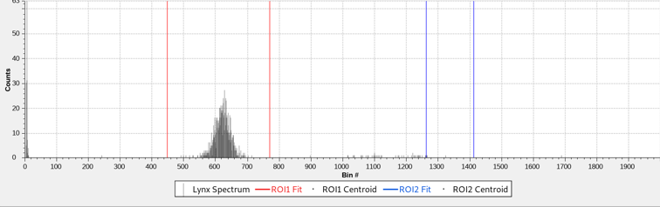
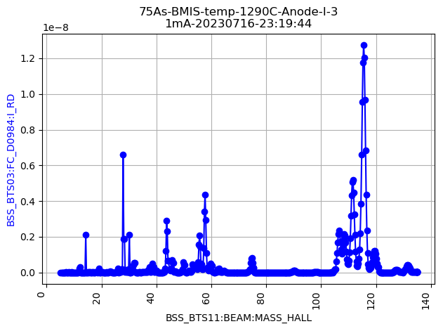
⁷³As Beam Delivered for Users in ReA
Beam delivered: 07/19 -07/27 (8 day)
  Beam “come out” of the source as bare arsenic ion. (No molecular fragments)
  Average rate at ReA: 5E+5 pps
  ReA rate within last 24 hrs of experiment: 3E6 pps
Deliver high purity beam to ReA experiment
  Purity of ⁷³As beam is close to 100%
  No radioactive daughter of ⁷³As (73Ge) was observed.
Beam composition measured using Si-detector after reacceleration and Al foil
Mass scan of ⁷⁵As beam
⁷⁵As

Slide 14
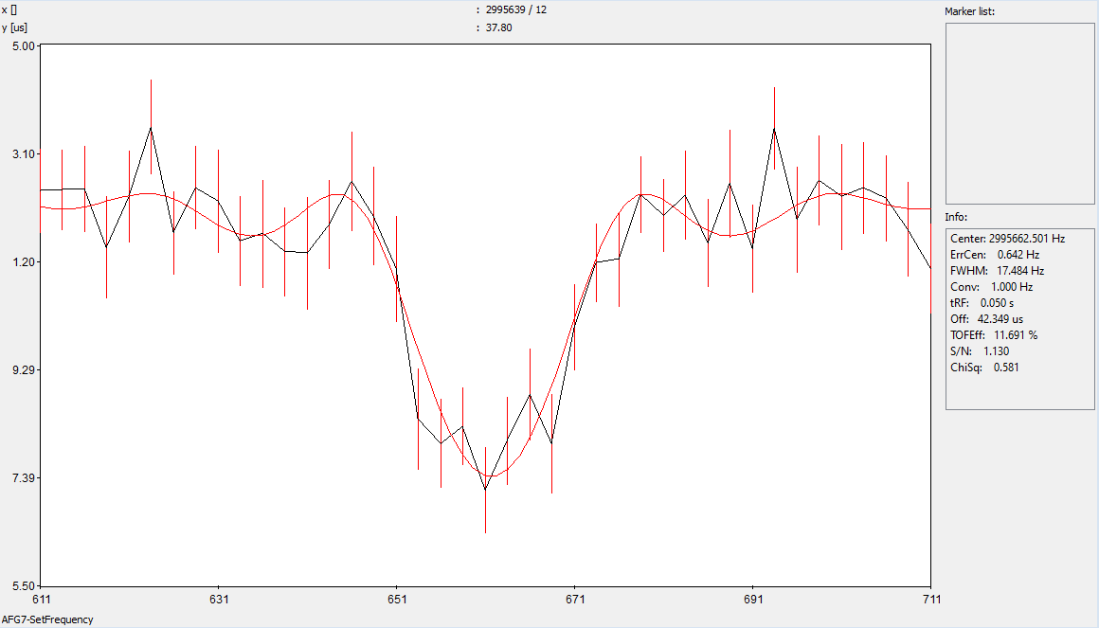
Titanium Development: Ongoing
After several attempts, the only that worked was to have FeTiO3 Ilmenite compound on a Zr foil inserted in the oven of BMIS (+He gas)
  Tests were performed with stable 48Ti
    Radioactive 44Ti is next step
~50 pA seen at mass 48 after increasing temp to 1800 C and anode current to 24 mA
~7 pA seen at mass 48
Sent to LEBIT, confirmed ~75% is ⁴⁸Ti⁺ (remainder not ID’d)
Note: Similar rates of ⁴⁸Ti⁺ seen and confirmed by LEBIT with TiO₂ on Zr foil w/ He gas the next week. Used a different BMIS module for those tests (OIS03) which had higher rates of background at mass 48 (³²Si¹⁶O⁺ remaining from earlier experiments).

Slide 15
Team
C.S. Sumithrarachchiª , Y. Liuª , S.N. Rogersª , S. Schwarzª , G. Bollenª , N. Gamageª , A. Henriquesª, A. Lapierreª , R. Ringleª, C.Izzoª, X.Chenª,A.C.C. Villariª, K.A. Domnanich ^{b}, S. Satija ^{b}, G.W. Severin ª ^{b}, M. Au ^{c} , J. Ballof ^{c}, Y.N. Vila Garcia ^{c}, M. Owen ^{c}, E. Reis ^{c}, S. Rothe ^{c}, S. Stegemann ^{c}
a) Facility for Rare Isotope Beams, Michigan State University
b) Department of Chemistry, Michigan State University
c) CERN, Accelerator Systems Department

Slide 16
Selected Technical References
Chandana Sumithrarachchi et al. NIM 541 (2023), 301
Katharina A. Domnanich et al., Applied Radiation and Isotopes 200 (2023) 110958
Samridhi Satija, Applied Radiation and Isotopes 211 (2024) 111382
Andrew C. Candia, Applied Radiation and Isotopes 217 (2025) 111642
A. Henriques et al., Rev. Sci. Instrum. 94 (2023) 103306

Slide 17
Summary
BMIS is a successful program in FRIB, providing beams for science at intensities compatible with experiment both at stopped and reaccelerated beams
Presently FRIB is building parts of BMIS
Important points during this development
  Collaboration with ISOLDE
  Collaboration with a very strong Chemistry team in FRIB
  Possibility to have beam-time in parallel for testing production and cleanliness prior to the experiment

