Slide 1

«Mass» & Z selection of post accelerated beams in SPIRAL1
Bertrand Jacquot, GANIL

Slide 2
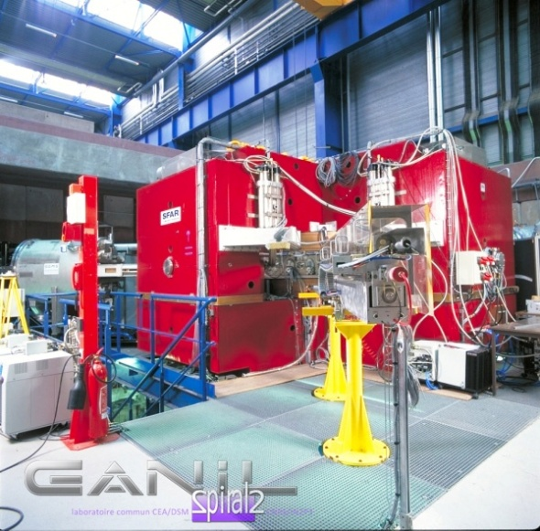
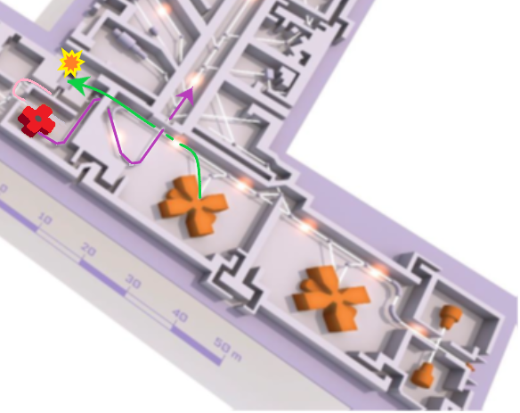
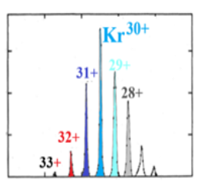
Summary : M & Z selection of post-accelerated beams
Introduction (SPIRAL1 & CIME)
Cyclotron selectivity: M/Q selection
Ion Stripping: Z selection at high energy
Exemples: ⁵⁶Ni* and ²⁰O*

Slide 3
Introduction : Post accelerated beams in SPIRAL1
- RIB purety is of utmost importance for many scientific cases
typical stable ion intensity : 10⁸⁻¹³ pps
Radioactive beams intensity for reaction study : 10⁴⁻⁷ pps
Final Selectivity is a result of
(production + ionization+ acceleration & transport + detection)
Focus on the 2 methods used after RIB production
a) M/Q selection in the Cyclotron CIME
b) Z selection with Stripping and Brho selection in Z-spectrometer

Slide 4
SPIRAL1 Facility: selection with cyclotron and/or stripping (for a given ion source)
introduction of SPIRAL1 : M/Q & Z selectivity
-SPIRAL1 CIME
RIB
-Stripping
Stripper
Zspectrometer
1 compact cyclo Kb =265
For radioactive ions
2 Separated Sectors cyclotrons Kb =380 MeV
4

Slide 5
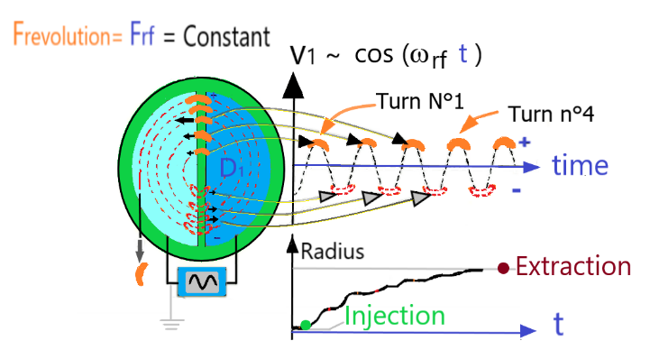

Synchronise ions with acceleration (Efinal => FRF = H. Frevolution)
Cyclotron theory : How to get a beam accelerated
Frevolution ~ function (M/Q , B)
FRF =H. Frevolution
R$ayon R =$Bρ ${/B}_{}$
(field B, Mass M, charge Q) gives Frevolution
FRF= H. Frevolution
H=integer called « harmonic »

Slide 6
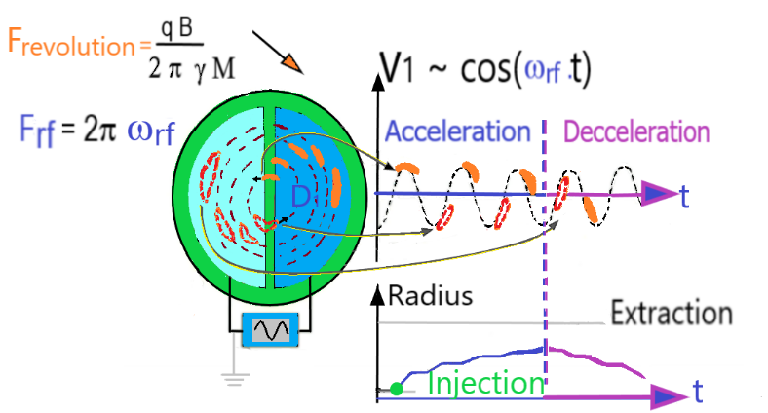
What happen if B not ajusted to M/Q : M/Q selection
If B field is adjusted for given ion (M1,q1) H. Frevolution= FHF
good transmission
.
For a contiminant (M2,Q2) FHF ≠ H. Frevolution
zero transmission
if FRF≠ H Frevolution
Ion revolution not synchronized with RF cavity : ion Deceleration
Contaminants are eliminated

Slide 7
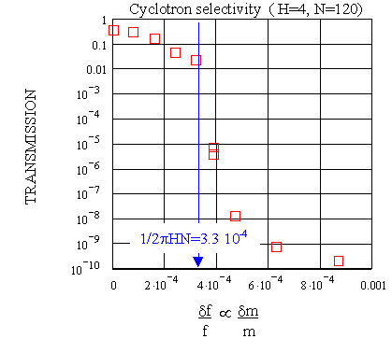
Cyclotron resolution R=1/ (2π H Nturn)
1) For an ion of interest M1,Q1 tune B1 at given FRF
2) A small δB reduces strongly the cyclo. transmission
FRF=H.Frevolution/ ~ Q. B1 / M
selection not sufficient
Very clean selection (many turns )
δB/B1
∼ δ M/Q
Ion of interest

Slide 8
RIB purification at SPIRAL1 : is CIME sufficient ?
Light beams (He, N,O,Ne, Ar): Purety possible with CIME
Large isobar mass difference good for Cime cyclotron
ex: ¹⁷Ne – ¹⁷O dM /M= 8 . 10⁻⁴
Fwe can get fully stripped ion, even at relatively low energy
Heavy beams :
very small isobar mass difference ex: 56Ni*- 56Co* δM/M= 3 . 10⁻⁵
56Ni*- 56Fe δM/M= 1.2 10⁻⁴
~ Mass selection not sufficient in Cime
⁻ Stripping at high energy is needed

Slide 9
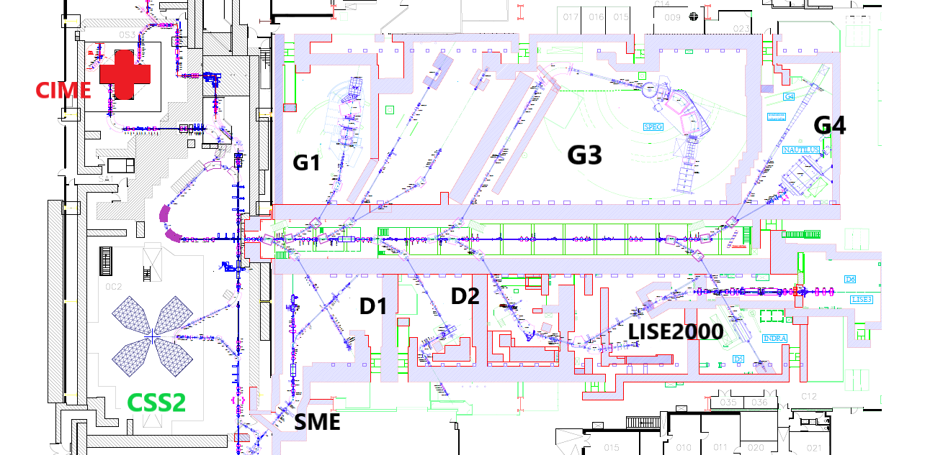
Stripping for RIB purification at SPIRAL1
Stripping and Bρ selection in the « Z-spectrometer »
- Stripper foil
Zspectrometer
Bρ= γ M v /q
Brho selection
Velocity determined by Cyclotron acceleration
Q~ F(Z,E) if Q=Z (fully stripped ions) easy selection

Slide 10
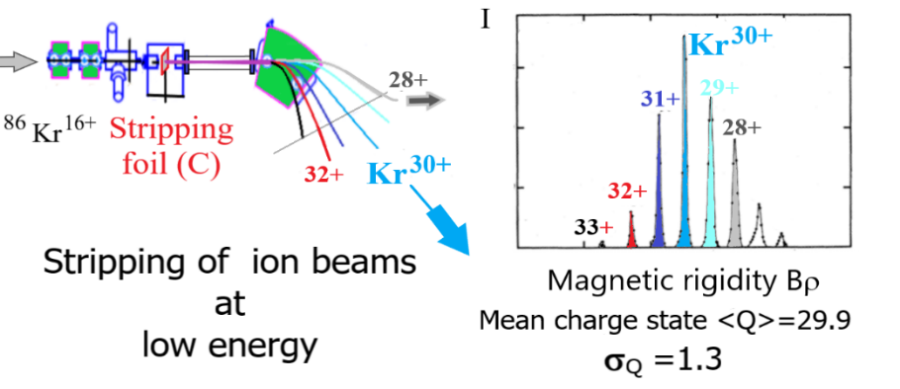
Stripping for RIB purification at SPIRAL1
Stripping with carbon foils
Fully stripped beam is desirable Q=Z , but « high energy » is needed
What is the energy required for 50% efficiency ? (F(Q=Z)>50%
  O E> 2.7 MeV/A
  Ar E> 9.1 MeV/A
  Ni E>22,5 MeV/A
  (no possibility at SPIRAL1)
Stripping is a Z selective process
Charge distribution is centered at <Q> = F1(Energy, Zbeam)
Charge distribution width σq= f2(E, Z)
At large energy <Q> = Z ( fully stripped beam )
What is the energy required for 20%
efficiency ? ? (F(Q=Z)>20%
  O E>1.6 MeV/A
  Ar E> 5.4 MeV/A
  Ni E>15 MeV/A

Slide 11
56Nickel* purification at SPIRAL1
Heavy beam purification : only a possiblity at high energy with stripping
For Ni*, very small isobar mass difference ex: 5⁵⁶Ni*- ⁵⁶Co* δM/M= 3 . 10⁻⁵
⁵⁶Ni*- ⁵⁶Fe δM/M= 1.2 10⁻⁴
-No mass selection in Cime cyclotron
⁻ Stripping at 15 Me/A can be envisaged
Acceleration in ⁵⁶Ni¹⁴⁺ (10⁵pps) polluted by ⁵⁶Co¹⁴⁺ (10(⁵⁻⁶pps)
polluted ⁵⁶Fe¹⁴⁺ (10⁹pps) (febiad+booster)
Downstream a C stripper we have ⁵⁶Ni^{28+,27+,26+} ⁵⁶Co^{,27+,26+,25+} ⁵⁶Fe^{26+ ,25+,24+}
Selection by Brho of (A=26 Q= 28 +) 20% efficiency …
Q=27+ Co+Ni
Q=26+
Fe +Co
+ Ni
Charge state Q=28+, Nickel is pure
but only 20% remaining :
    F(Ni, Q=28+) =20%
    F(Ni, Q=27+ )=52%
    F(Ni, Q=26+) =19%
Q=28+
Ni
Βρ

Slide 12
RIB purification at SPIRAL1 : one light exemple
Purification of ²⁰O3+ with ⁴⁰Ar 6+ , ²⁰Ne3+, ²⁰F3+ at 3.0 MeV/A
with M/Q selection (no stripping)
Transmission as a function of M/Q ~ Bcyclo : ajusting Bcyclo (Frf fixed)
Elimination of
All contaminants is possible
But ²⁰F3+ tricky
⁴⁰Ar
²⁰Ne
²⁰O
²⁰F
²⁰O2+ was polluted by molecules (not identified) , Q=3+ better

Slide 13
Conclusion : purification of post-accelerated beams
Light beams can be purified most of time (A<40) :
Avoid stable beams at δM/Q< 0.001 , think to standard contaminants
Heavy beams purification : CIME cyclotron is not sufficient
Only a possiblity at high energy with stripping
  (but low efficiency at low energy limit strongly, the applicability of the method : ex for Nickel*, no solution under 15MeV/A
Source selectivity is always desirable
Nanogan : select only gazeous atomes or molecules
1+// N+ with (febiad +ECR booster) produces many contaminants
Stable contaminants are very dangerous because of their intensity

Slide 14
Additive slides
CIME Properties
Typical pollutions induced by the charge booster // Febiad // Nanogan
Improving resolution in Cime : slight gains are possible

Slide 15
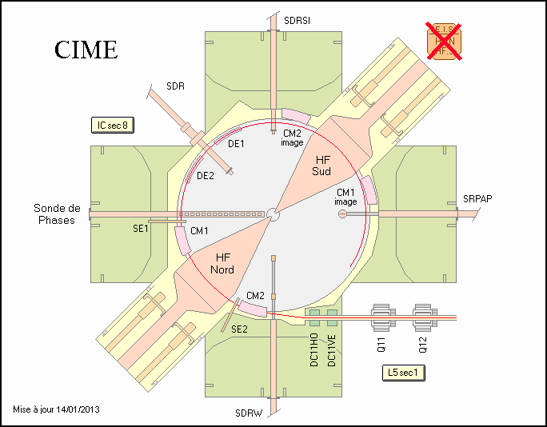
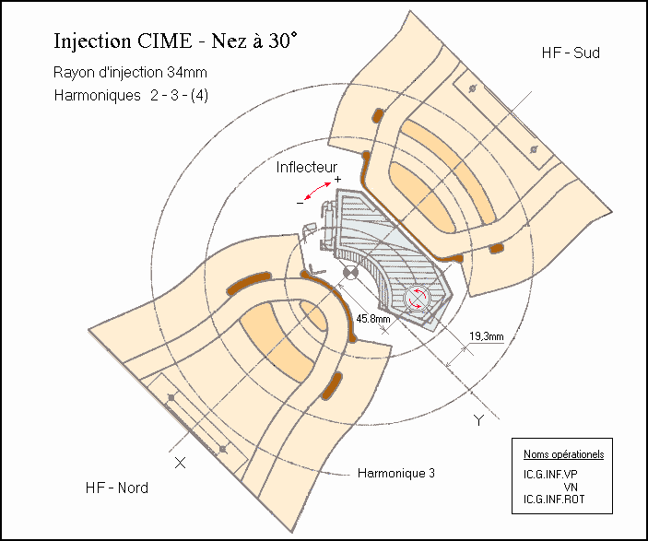
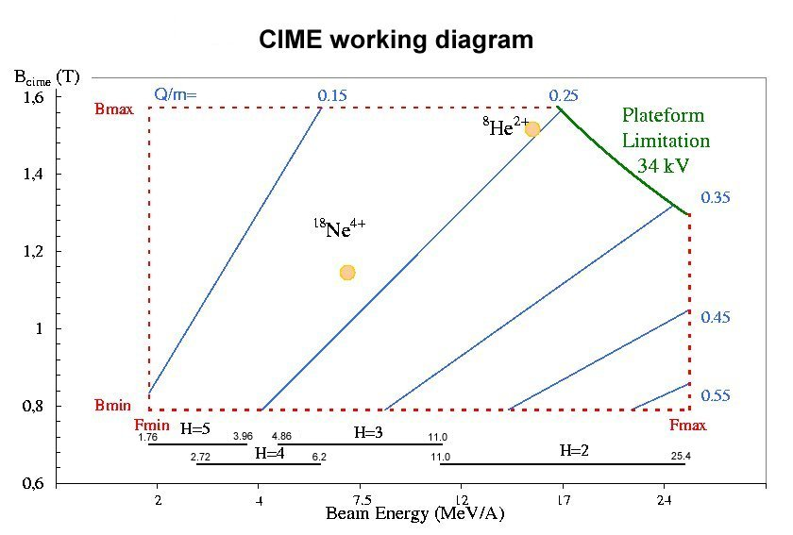
Energy limit : K=265 MeV
Bρmax = 2.4 T.m
Emax 8He1+= 4.3MeV/A
20O3+= 6.2MeV/A
20O4+= 11.0MeV/A
CIME CYCLOTRON (H=2,3,4,5 marginally H=6)
M/q resolution function(Nturn, Harmonic)
CIME CYCLOTRON
cyclotron CIME Bro_{max}#2.4 T.m
Harmonique et inflecteur |  | Energies en MeV/A | Nombre de tours Nt (Nominal) | Résolution Nominale 1/2pHNtour
H=6 | r = 45mm | [ 1.20 , 1.70] | 80 (low transmission) | 3.3 10⁻⁴
H=5 | r = 45 mm | [ 1.70 , 3.93] | 101 | 3.1 10⁻⁴
H=4 | r=45 ou 34 | [ 2.72, 6.20] | 121 | 3.2 10⁻⁴
H=3 | r=45 ou 34 | [ 4.85 , 11.0] | 280 | 1.8 10⁻⁴
H=2 | r=34mm | [ 11.0 , 25.0] | 330 | 2.2 10⁻⁴
1 compact cyclo Kb =265
For radioactive ions
2 Separated Sectors cyclotrons Kb =380 MeV
15

Slide 16
Selection of Radioactive ions not sufficient : many stable contaminants
  Metalic chamber : 56Fe , 58Ni, 60Ni, 48Ti , 52,53,54Cr, Mo (Febiad)
  Alumium chamber : 26Al (Booster) Fluorin: 19F (Nanogan)
  Copper : 63,65Cu (waveguide of ECR Nanogan , Booster)
  « Natural gases » 14,15N //20,21,22 Ne // 40, 36Ar // 86,….,78Kr // 129,…Xe// 4He Water : 16O, 17O, 18O
CYCLOTRON: typical pollution with sources
Residual beams Measured with ECR booster | Intensity, typical
¹⁴N⁴⁺ ¹⁶O⁴⁺ ⁺ ¹²C³⁺ | 10¹²pps
¹⁵N⁴⁺ ¹³C³⁺ ¹⁸O³⁺ | 10⁷⁻⁹pps
⁸⁴Kr¹⁹⁺ | 10⁷pps
⁵⁶Fe¹⁵⁺ | 10⁵pps (booster), 10⁸pps (febiad)
²²Ne⁵⁺ intéret ? | I_{max}=10⁵pps
⁴⁰Ar⁹⁺ | I_{max}=10⁸pps
¹²⁹Xe²⁹⁺ | 10⁵pps
⁵⁸Ni¹³⁺ ⁴⁸Ni¹²⁺ | I_{max}= 10⁵pps
^{63,65}Cu¹⁴⁺ | I_{max}=10⁶pps
²⁷Al⁷⁺ | I_{max}=10⁶pps
Efforts on source
selectivity are
very importants

Slide 17
Increasing turn number & Cyclotron resolution)
Cyclotron resolution R=1/ (2π H Nturn)
Transmisison is sharper
With 130 turns than 112
Doubling the turn number
not possible:Transmission =0%
(Problem at injection)
Selectivity can be increased
Increasing the turn number by 20%
Nturn =112
Nturn= 130

