Slide 1
MNT with Spiral 1?
Workshop on R&D for new ISOL beams (SPIRAL 1 and ALTO)
I. Stefan IJCLab

Slide 2
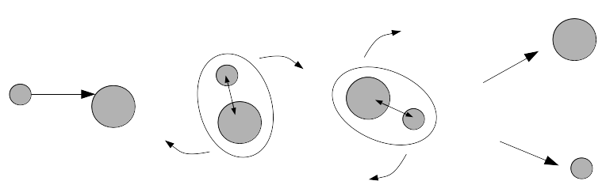
MNT with Spiral1?
Energies from Vc (5 MeV/A to 15 MeV/A)
Projectile
Quasi-target (QT)
Target
Quasi-projectile (QP)
N/Z equilibrium
I. Stefan Workshop on R&D for new ISOL beams (SPIRAL 1 and ALTO)

Slide 3
MNT with Spiral1?
Energies from Vc (5 MeV/A to 15 MeV/A)
Projectile
Quasi-target (QT)
Target
Quasi-projectile (QP)
N/Z equilibrium
MultiNucleon Transfer (MNT) Reactions
Orbiting phenomenon
N/Z equilibration
Evaporation
I. Stefan Workshop on R&D for new ISOL beams (SPIRAL 1 and ALTO)

Slide 4
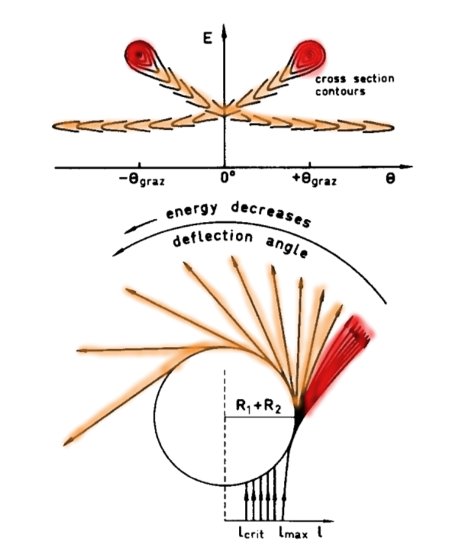
MNT with Spiral1?
Energies from Vc (5 MeV/A to 15 MeV/A)
Projectile
Quasi-target (QT)
Target
Quasi-projectile (QP)
N/Z equilibrium
MultiNucleon Transfer (MNT) Reactions
Orbiting phenomenon
N/Z equilibration
Evaporation
I. Stefan Workshop on R&D for new ISOL beams (SPIRAL 1 and ALTO)

Slide 5
MNT with Spiral1?
Energies from Vc (5 MeV/A to 15 MeV/A)
Projectile
Quasi-target (QT)
Target
Quasi-projectile (QP)
N/Z equilibrium
Z
Neutron-deficient
126
Neutron-rich
82
82
N
I. Stefan Workshop on R&D for new ISOL beams (SPIRAL 1 and ALTO)

Slide 6
MNT with Spiral1?
Energies from Vc (5 MeV/A to 15 MeV/A)
Projectile
Quasi-target (QT)
Target
Quasi-projectile (QP)
N/Z equilibrium
Z
Neutron-deficient
126
MNT
Neutron-rich
82
82
N
I. Stefan Workshop on R&D for new ISOL beams (SPIRAL 1 and ALTO)

Slide 7
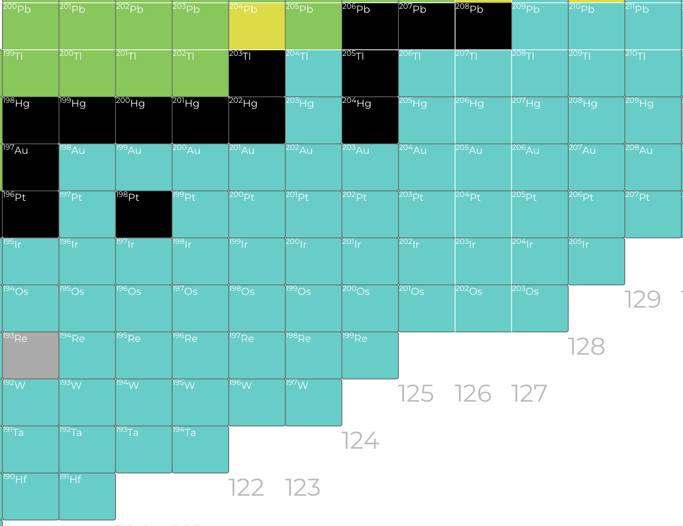
MNT with Spiral1?
Energies from Vc (5 MeV/A to 15 MeV/A)
Projectile
Quasi-target (QT)
Target
Quasi-projectile (QP)
N/Z equilibrium
Z=82
N=126
I. Stefan Workshop on R&D for new ISOL beams (SPIRAL 1 and ALTO)

Slide 8
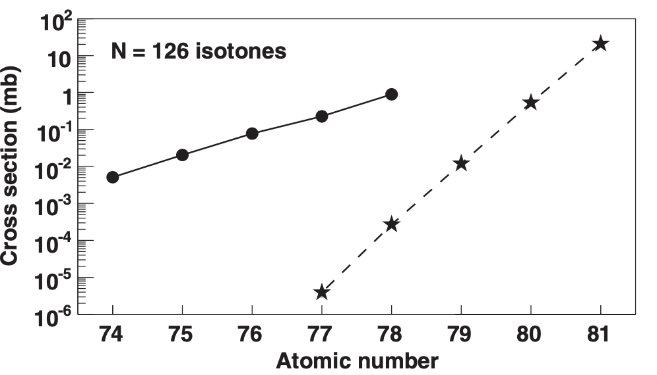
MNT with Spiral1?
Energies from Vc (5 MeV/A to 15 MeV/A)
Projectile
Quasi-target (QT)
Target
Quasi-projectile (QP)
N/Z equilibrium
Z=82
²⁰⁴Pt
²⁰⁰W
Unique opportunity
N=126
Y. X. Watanabe, PRL 115, 172503 (2015)
I. Stefan Workshop on R&D for new ISOL beams (SPIRAL 1 and ALTO)

Slide 9
MNT with Spiral1?
Relevant parameters:
Beam energy: Energies from Vc (5 MeV/A to 15 MeV/A)
N/Z equilibration: most neutron-rich target-beam combination for n-rich nuclei
The most neutron-deficient target-beam combination for n-deficient nuclei
¹²C bad for n-rich nuclei
not so bad for n-deficient nuclei
How much represents MNT from what has been already measured with Spiral1?
      (light and medium mass)
Are there cases where MNT mechanism has been dominant?
What seems like the best-case scenario for a measurement?
I. Stefan Workshop on R&D for new ISOL beams (SPIRAL 1 and ALTO)

Slide 10
MNT with Spiral1?
Relevant parameters:
Beam energy: Energies from Vc (5 MeV/A to 15 MeV/A)
N/Z equilibration: most neutron-rich target-beam combination for n-rich nuclei
The most neutron-deficient target-beam combination for n-deficient nuclei
¹²C bad for n-rich nuclei
not so bad for n-deficient nuclei
https://u.ganil-spiral2.eu/chartbeams/
²⁰Ne @ 95 MeV/A I=5e+12 pps
Fragmentation
5.5 mm
MNT
0.2 mm
¹⁵O 𝜎 fragmentation 2 mb
𝜎 MNT 4 mb
¹⁵O from MNT represents 8% of all the ¹⁵O produced
MNT in 4% of the effective target
I. Stefan Workshop on R&D for new ISOL beams (SPIRAL 1 and ALTO)

Slide 11
MNT with Spiral1?
Relevant parameters:
Beam energy: Energies from Vc (5 MeV/A to 15 MeV/A)
N/Z equilibration: most neutron-rich target-beam combination for n-rich nuclei
The most neutron-deficient target-beam combination for n-deficient nuclei
¹²C bad for n-rich nuclei
not so bad for n-deficient nuclei
https://u.ganil-spiral2.eu/chartbeams/
²²Ne @ 95 MeV/A I=5e+12 pps
Fragmentation
5.5 mm
MNT
0.2 mm
²⁰O 𝜎 fragmentation 1 mb
𝜎 MNT 1 mb
²⁰O from MNT represents 4% of all the ²⁰O produced
MNT in 4% of the effective target
I. Stefan Workshop on R&D for new ISOL beams (SPIRAL 1 and ALTO)

Slide 12
MNT with Spiral1?
Relevant parameters:
Beam energy: Energies from Vc (5 MeV/A to 15 MeV/A)
N/Z equilibration: most neutron-rich target-beam combination for n-rich nuclei
The most neutron-deficient target-beam combination for n-deficient nuclei
⁷⁸Kr @ 70.3 MeV/A 1e+12
https://u.ganil-spiral2.eu/chartbeams/
MNT in 10% of the effective target
Fragmentation
MNT
1.3 mm
0.13 mm
⁷⁵Kr 𝜎 fragmentation 2.3 mb
𝜎 MNT 7 mb
⁷⁵Kr from MNT represents 30% of all the ⁷⁵Kr produced
I. Stefan Workshop on R&D for new ISOL beams (SPIRAL 1 and ALTO)

Slide 13
MNT with Spiral1?
Relevant parameters:
Beam energy: Energies from Vc (5 MeV/A to 15 MeV/A)
N/Z equilibration: most neutron-rich target-beam combination for n-rich nuclei
The most neutron-deficient target-beam combination for n-deficient nuclei
⁷⁸Kr @ 70.3 MeV/A 1e+12
https://u.ganil-spiral2.eu/chartbeams/
MNT in 10% of the effective target
Fragmentation
MNT
1.3 mm
0.13 mm
⁷⁵Kr 𝜎 fragmentation 2.3 mb
𝜎 MNT 7 mb
⁷⁵Kr from MNT represents 30% of all the ⁷⁵Kr produced
⁷⁴Kr 𝜎 fragmentation 0.3 mb
𝜎 MNT 0.6 mb
⁷⁴Kr from MNT represents 20% of all the ⁷⁴Kr produced
I. Stefan Workshop on R&D for new ISOL beams (SPIRAL 1 and ALTO)

Slide 14
MNT with Spiral1?
Relevant parameters:
Beam energy: Energies from Vc (5 MeV/A to 15 MeV/A)
N/Z equilibration: most neutron-rich target-beam combination for n-rich nuclei
The most neutron-deficient target-beam combination for n-deficient nuclei
⁷⁸Kr @ 70.3 MeV/A 1e+12
https://u.ganil-spiral2.eu/chartbeams/
MNT in 10% of the effective target
Fragmentation
MNT
1.3 mm
0.13 mm
⁷⁵Kr 𝜎 fragmentation 2.3 mb
𝜎 MNT 7 mb
⁷⁵Kr from MNT represents 30% of all the ⁷⁵Kr produced
⁸¹Kr 𝜎 fragmentation 5e-7 mb
𝜎 MNT 0.1 mb
⁸¹Kr from MNT represents 100% of all the ⁸¹Kr produced
⁷⁴Kr 𝜎 fragmentation 0.3 mb
𝜎 MNT 0.6 mb
⁷⁴Kr from MNT represents 20% of all the ⁷⁴Kr produced
I. Stefan Workshop on R&D for new ISOL beams (SPIRAL 1 and ALTO)

Slide 15
MNT with Spiral1?
Relevant parameters:
Beam energy: Energies from Vc (5 MeV/A to 15 MeV/A)
N/Z equilibration: most neutron-rich target-beam combination for n-rich nuclei
The most neutron-deficient target-beam combination for n-deficient nuclei
⁷⁸Kr @ 70.3 MeV/A 1e+12
https://u.ganil-spiral2.eu/chartbeams/
MNT in 10% of the effective target
Fragmentation
MNT
1.3 mm
0.13 mm
⁷⁵Kr 𝜎 fragmentation 2.3 mb
𝜎 MNT 7 mb 9e+7 pps @1.2 kW
⁷⁵Kr from MNT represents 30% of all the ⁷⁵Kr produced
⁸¹Kr 𝜎 fragmentation 5e-7 mb
𝜎 MNT 0.1 mb 2e+5 pps @1.1 kW
⁸¹Kr from MNT represents 100% of all the ⁸¹Kr produced
⁷⁴Kr 𝜎 fragmentation 0.3 mb
𝜎 MNT 0.6 mb 1.5e+5 pps @1.1 kW
⁷⁴Kr from MNT represents 20% of all the ⁷⁴Kr produced
I. Stefan Workshop on R&D for new ISOL beams (SPIRAL 1 and ALTO)

Slide 16
MNT with Spiral1?
How to see mostly MNT? Reduce beam energy at < 15 MeV/A for any beam used with Spiral1
If we use heavier beams, MNT will be the main production mechanism
⁷⁸Kr @ 70.3 MeV/A 1e+12
https://u.ganil-spiral2.eu/chartbeams/
MNT in 10% of the effective target
Fragmentation
MNT
1.3 mm
0.13 mm
⁷⁵Kr 𝜎 fragmentation 2.3 mb
𝜎 MNT 7 mb 9e+7 pps @1.2 kW
⁷⁵Kr from MNT represents 30% of all the ⁷⁵Kr produced
⁸¹Kr 𝜎 fragmentation 5e-7 mb
𝜎 MNT 0.1 mb 2e+5 pps @1.1 kW
⁸¹Kr from MNT represents 100% of all the ⁸¹Kr produced
⁷⁴Kr 𝜎 fragmentation 0.3 mb
𝜎 MNT 0.6 mb 1.5e+5 pps @1.1 kW
⁷⁴Kr from MNT represents 20% of all the ⁷⁴Kr produced
I. Stefan Workshop on R&D for new ISOL beams (SPIRAL 1 and ALTO)

Slide 17
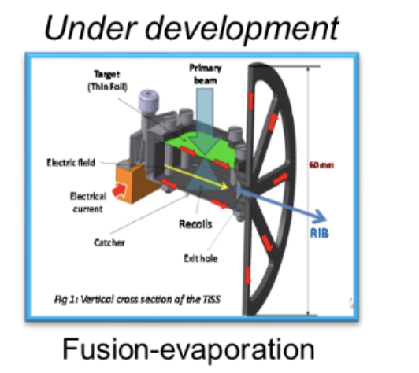
MNT with Spiral1?
Best Case?
Pt target of 50 mg/cm2
15 MeV/A ¹³⁶Xe beam & 1.6 puA (2 kW)
²⁰⁴Pt
²⁰³Ir
²⁰¹Re
²⁰²Os
1e+7pps
²⁰⁰W
3e+6pps
1e+6 pps
2e+5 pps
4e+3 pps
Y. X. Watanabe, PRL 115, 172503 (2015)
I. Stefan Workshop on R&D for new ISOL beams (SPIRAL 1 and ALTO)

Slide 18
MNT with Spiral1?
MNT is already present in Spiral 1 data summed with fragmentation (5% for light nuclei, 30% for heavier nuclei)
In heavier beams the MNT should dominate
⁸¹Kr seems to be produced mainly by MNT from ⁷⁸Kr (+3n) and is compatible with the estimation
𝜎 MNT 0.1 mb 2e+5 pps @1.1 kW
Best way to isolate MNT? Decrease beam energy to < 15 MeV/A
Measure toward n-reach nuclei to avoid fussion-evaporation
¹²C is not the best of targets for MNT (not a big nucleon reservoir and N/Z low)
Best MNT target at Spiral1?
Tulipe target: 50 mg/cm2 Pt 15 MeV/A ¹³⁶Xe
²⁰⁴Pt
²⁰³Ir
²⁰¹Re
²⁰²Os
1e+7pps
²⁰⁰W
3e+6pps
1e+6 pps
2e+5 pps
4e+3 pps
Y. X. Watanabe, PRL 115, 172503 (2015)
I. Stefan Workshop on R&D for new ISOL beams (SPIRAL 1 and ALTO)

