Slide 1
The benefit of laser ionization for SPIRAL1

Slide 2
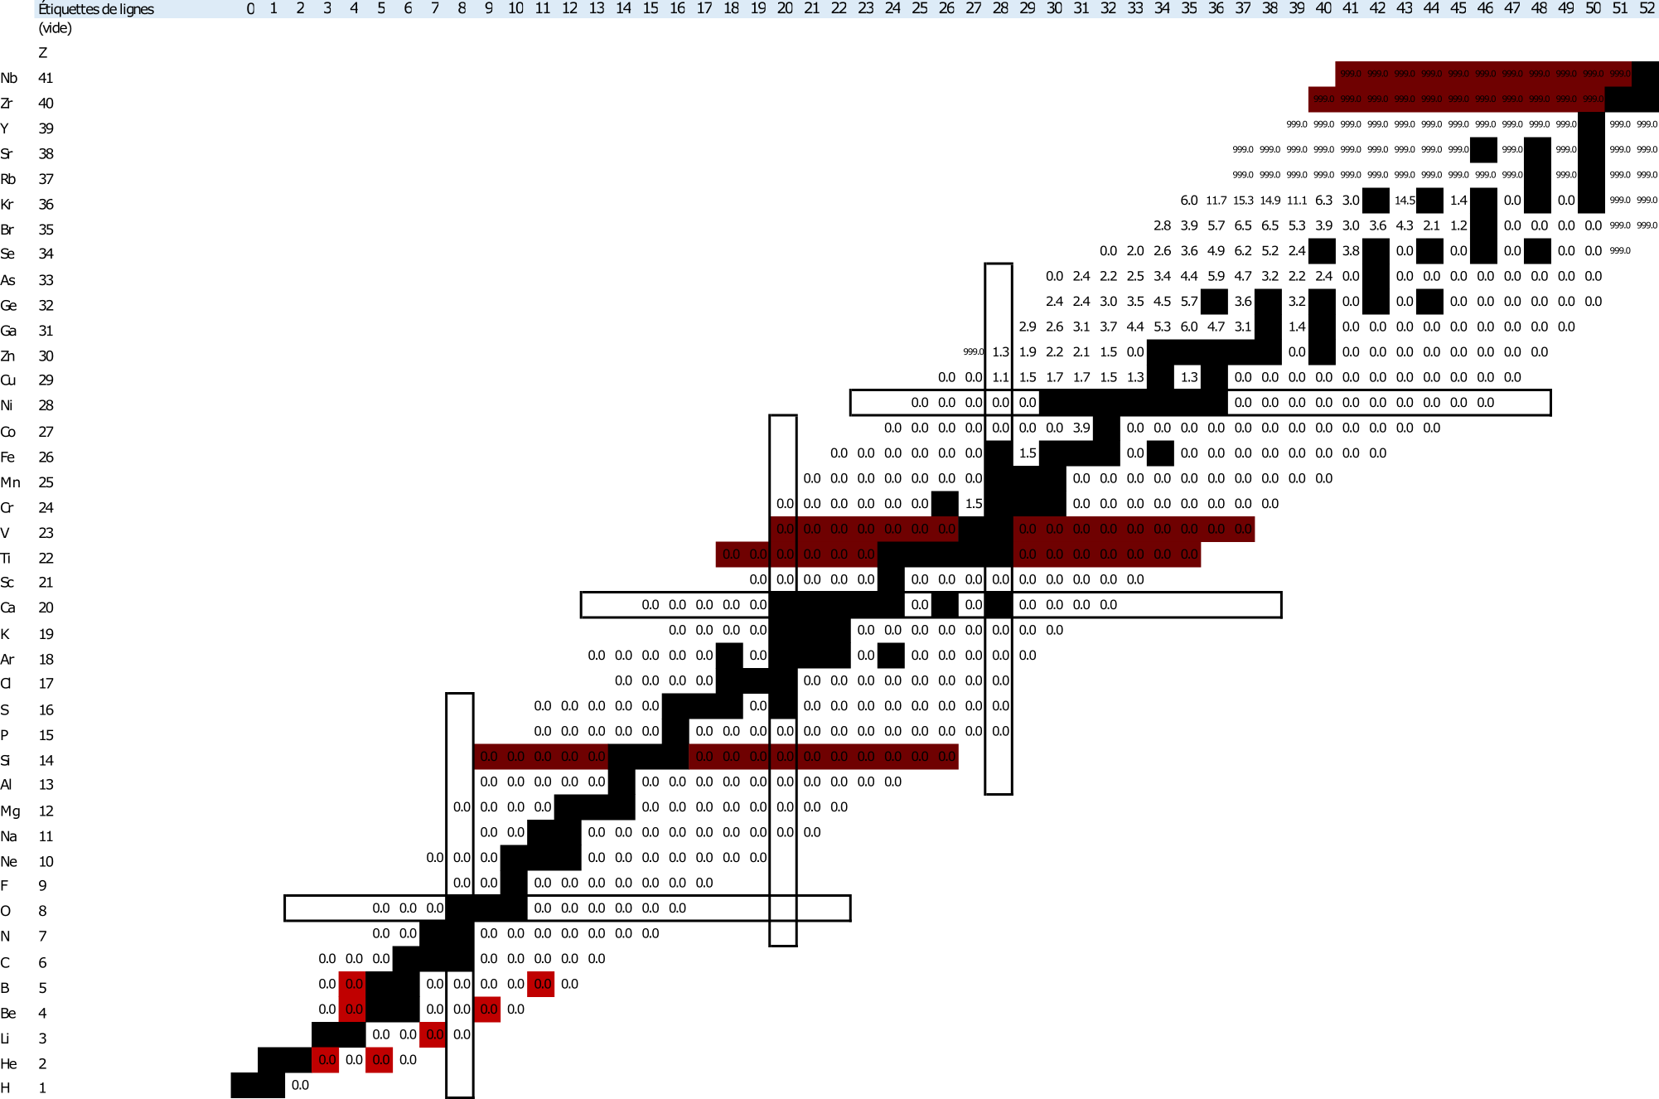
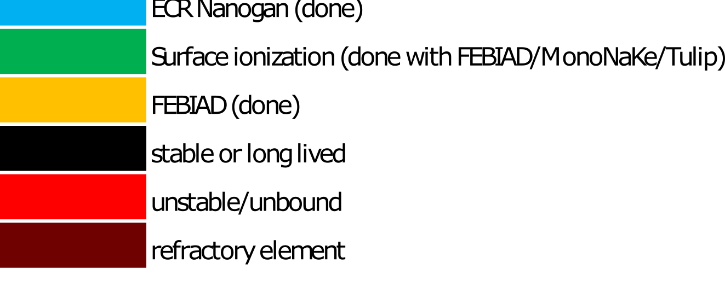
Why it’s better for many beams
Fragmentation : no selectivity on production
Fusion evaporation somewhat selective
Dipole magnet at low energy : low resolution (R=200) : A selection

Slide 3
Why it’s better for many beams
Fragmentation : no selectivity on production
Fusion evaporation somewhat selective
Dipole magnet at low energy : low resolution (R=200) : A selection
High resolution mass selection (R>20000)

Slide 4
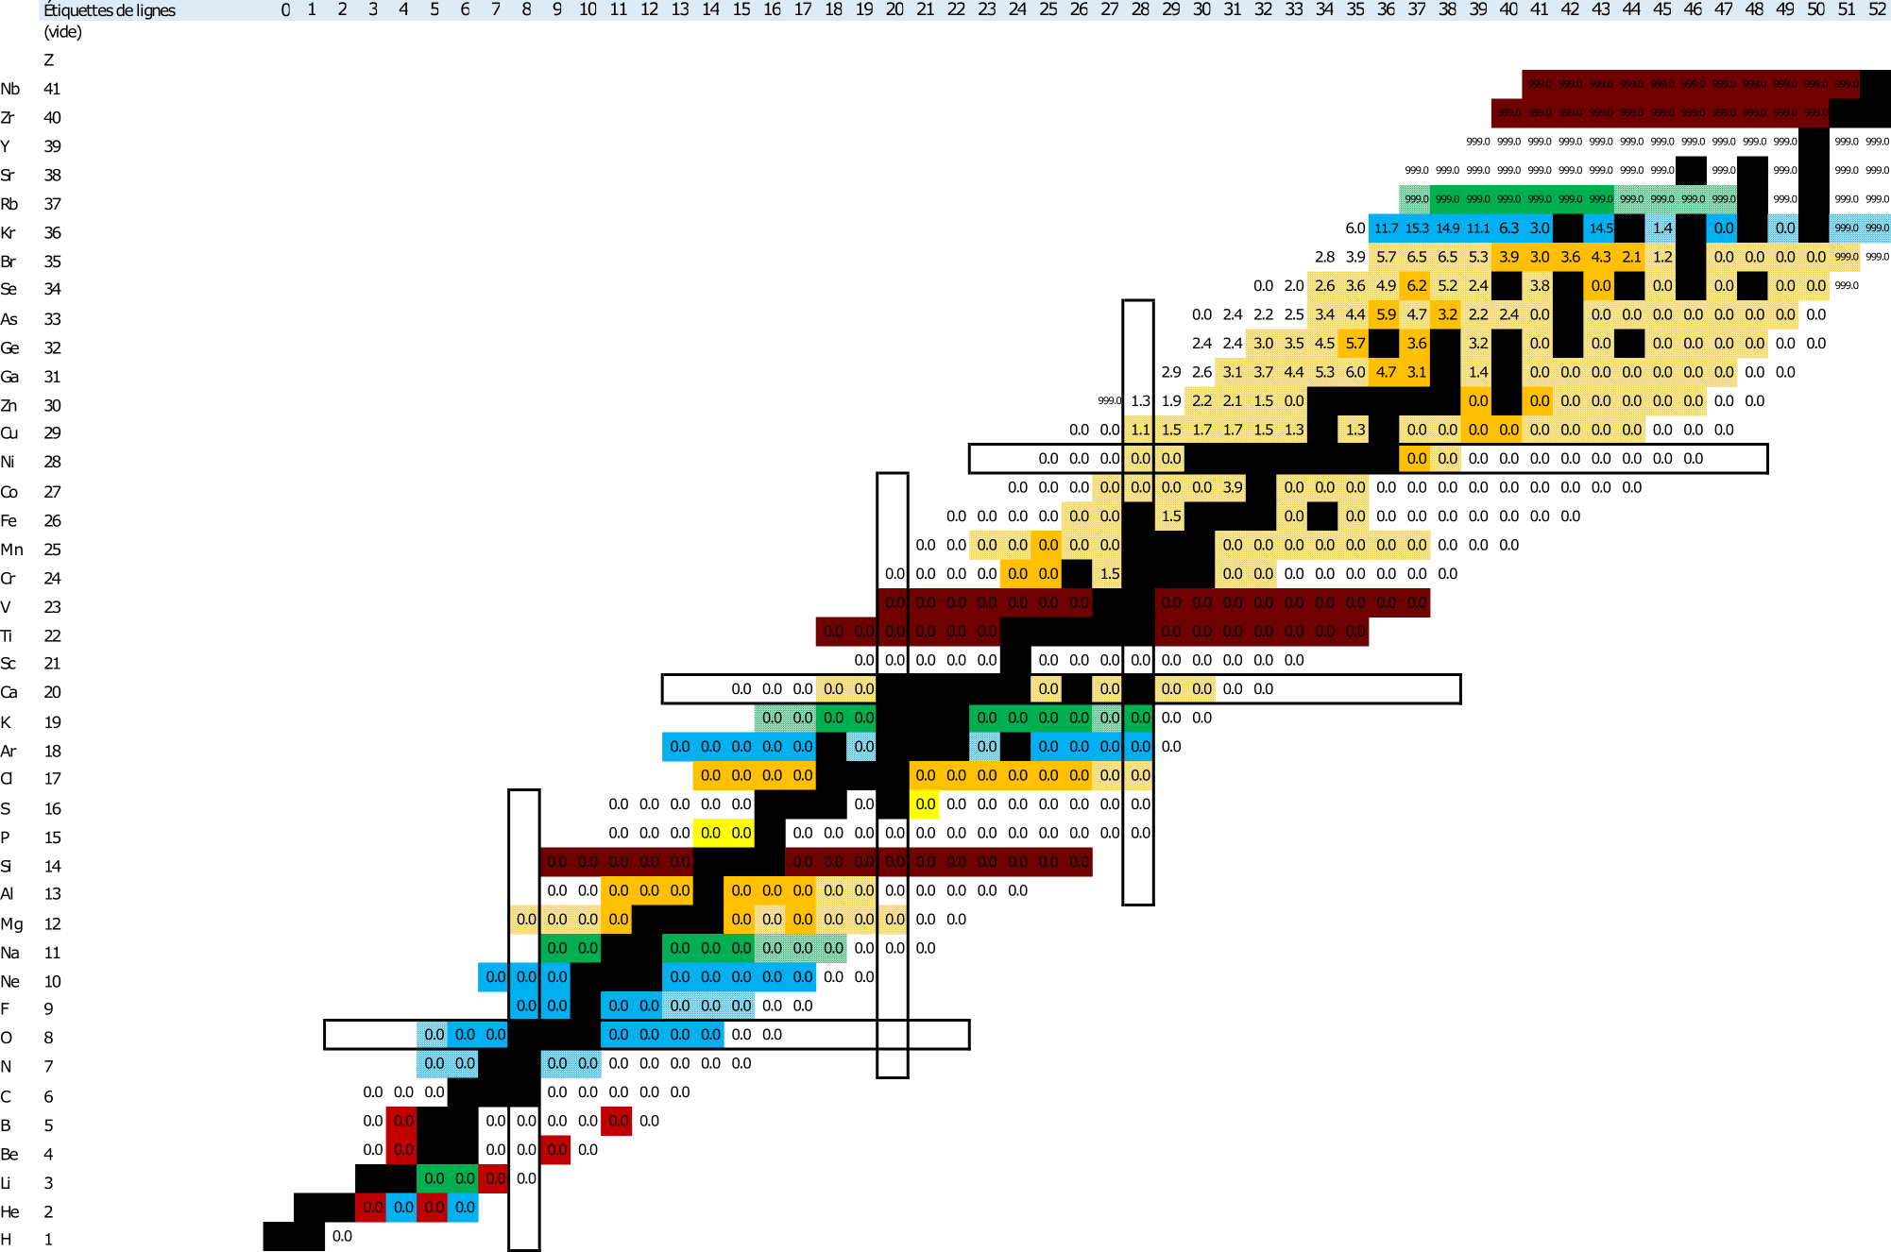
Why it’s better for many beams
Fragmentation : no selectivity on production
Fusion evaporation somewhat selective
Dipole magnet at low energy : low resolution (R=200) : A selection
High resolution mass selection (R>20000)
Element selection : gaz, SIS, laser

Slide 5
Why it’s better for many beams
Fragmentation : no selectivity on production
Fusion evaporation somewhat selective
Dipole magnet at low energy : low resolution (R=200) : A selection
High resolution mass selection (R>20000)
Element selection : gaz, SIS, laser

Slide 6
Outline
A laser ion source for the future of SPIRAL1 beams?
Review of the requests for low energy beams at DESIR
Review of the requests for post-accelerated beams
Requirements for a laser system at SPIRAL1

Slide 7
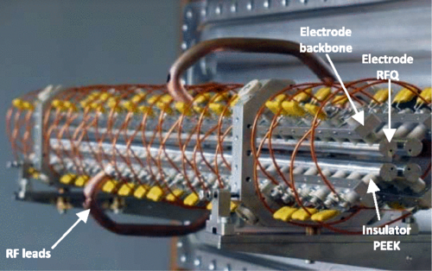
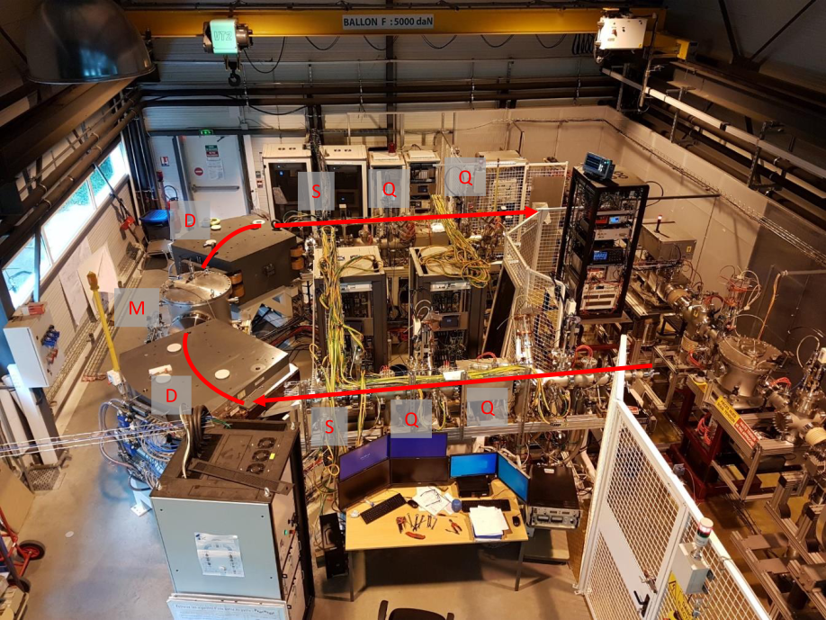
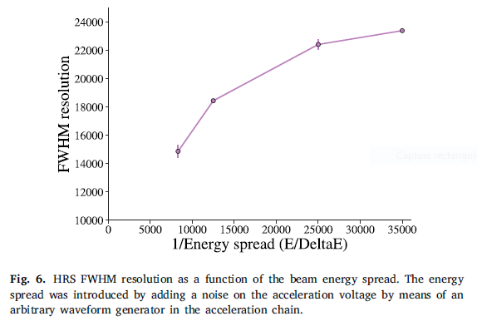
Low energy beams at DESIR
Contamination estimates before/after HRS
Assumptions:
Before HRS: R_{FWHM} = 200
HRS: R_{FWHM} = 20000
Perfectly gaussian E (or m) distributions
All masses from AME2020
m_{cut} at +/- 2σ around the mass of the ion of interest.
Radioactive ion rates from measurements or estimates
Stable ion rates from measurements or assumed to be 50pA when not seen
R. Boussaid, Phys. Rev. ST Accel. Beams 18, 072802
  Expectations:
  SHIRAC: ΔE down to 1eV
  HRS: R_{FWHM} up to 24000
J. Michaud et al, NIMB 541 (2023) 161-164

Slide 8
HRS estimates (laser spectroscopy)
Requirements
I > 1E3pps
Cont/IOI <1000
Comments
Most isotopes feasible on paper
Some Zn isotopes are too contaminated (existing laser scheme)
Some P isotopes are contaminated (no laser scheme found)
Zr isotopes require a new target if feasible at all. They will be contaminated (existing laser scheme)
O and Cl isotopes okay

Slide 9
HRS estimates (mass measurement)
Requirements
I > 0.1pps
Cont/IOI <10%
Comments
Most isotopes are very exotic, feasibility to be studied (N,O,F,P isotopes)
^{46,47}Cl and ^{49,50}Ar probably not feasible (in-target production in pps)

Slide 10
HRS estimates (mass measurement)
Requirements
I > 0.1pps
Cont/IOI <10%
Comments
Most isotopes are very exotic, feasibility to be studied (N,O,F,P isotopes)
^{46,47}Cl and ^{49,50}Ar probably not feasible (in-target production in pps)
Isotopes in the N=Z=50 region are all laser-ionizable and heavily contaminated before the HRS
Contamination rates after HRS should be 0 but very model dependant

Slide 11
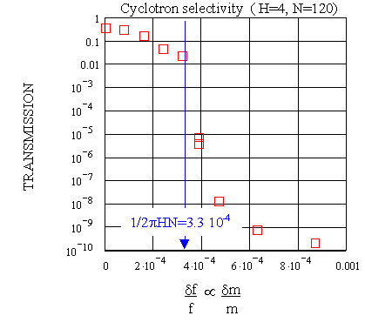
HRS estimates (mass measurement)
Requirements
I > 0.1pps
Cont/IOI <10%
Comments
Most isotopes are very exotic, feasibility to be studied (N,O,F,P isotopes)
^{46,47}Cl and ^{49,50}Ar probably not feasible (in-target production in pps)
Isotopes in the N=Z=50 region are all laser-ionizable and heavily contaminated before the HRS
Contamination rates after HRS should be 0 but very model dependant

Slide 12
HRS estimates (other cases)
Comments
SEASON beams: very exotic. ⁴³Cr probably not feasible. New targets necessary for ^{35,39}Ca and ²³Si if feasible
Most isotopes can be purified by HRS in theory but also have high contamination rates (>1E8pps)
(NA)2STARS
WISARD
MORA
β decay
SEASON β2p

Slide 13
HRS estimates (other cases)
Comments
SEASON beams: very exotic. ⁴³Cr probably not feasible. New targets necessary for ^{35,39}Ca and ²³Si if feasible
Most isotopes can be purified by HRS in theory but also have high contamination rates (>1E8pps)
Several elements have laser ionization schemes ->
(NA)2STARS
WISARD
MORA
β decay
SEASON β2p

Slide 14

Post-accelerated beams
$$\frac{δm}{m}=\frac{1}{2πHN}$$
Using CIME as a mass spectrometer
Not even close to the R of the HRS
Example for H=4 (Energy range 2.7-5.8 MeV/A)
Higher energies possible at the cost of more contamination
Less contamination possible at the cost of lower intensity

Slide 15
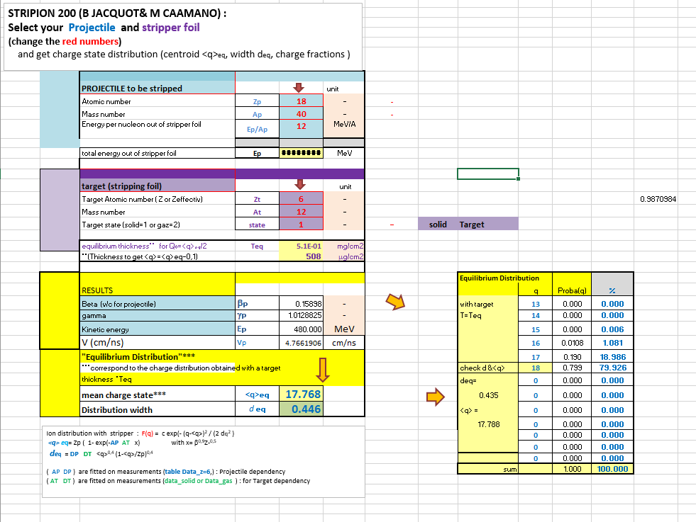
Post-accelerated beams
$$\frac{δm}{m}=\frac{1}{2πHN}$$
Using CIME as a mass spectrometer
Not even close to the R of the HRS
Example for H=4 (Energy range 2.7-5.8 MeV/A)
Higher energies possible at the cost of more contamination
Less contamination possible at the cost of lower intensity
Stripping at high energy
n-deficient only
Max energy mandatory (12-16 MeV/A)
Model, not measurement
Low energy tail of the contaminant not accounted for

Slide 16
Contamination estimates
Comments
Gaseous beams to be done with Nanogan
  Kr beams mostly done already
  ³²Ar done at LE but rate = request/10
Be beams never done, but ^{12,14}Be will be contaminated by gases from charge breeder
Metallic beams heavily contaminated
  ⁶⁸Se, ⁶⁶Ge at 20AMeV could be stripped but Eff = 8%/16%
  ⁴⁸Cr at 10 AMeV could be stripped at 16% eff
  Other metalic beams at 10AMeV have terrible stripping efficiencies (1%)
A LIS would unable the full potential of SPIRAL1 for metalic beams

Slide 17
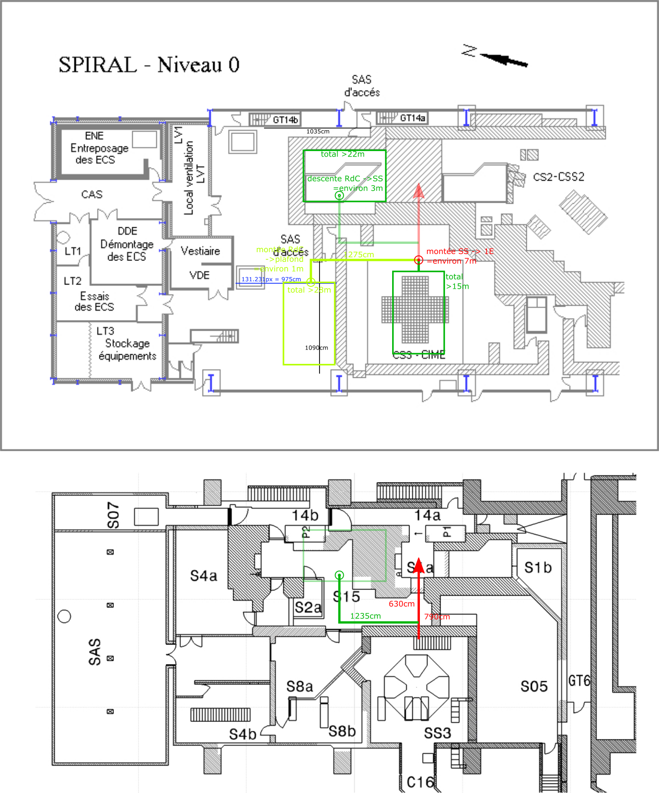
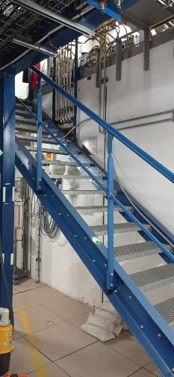
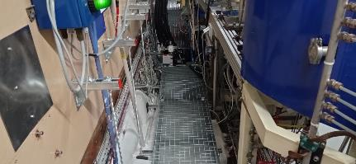
Laser room implantation
D1P

Slide 18
Laser room costs
Money : 500k€ - 1M€
  Mostly the room and the lasers
Time : 4-6 years
  Mostly study, ANR green light and laser manufacturing (for TiS:Sa)
HR : minimum 1IR (laser specialist) + 1IE (laser experienced) full time + help from the GCS team
What kind of lasers ?
  Ti:Sa good enough for most elements
  Would be nice to have Dye for specific wavelength but safety issue

Slide 19
Conclusion
At DESIR, lasers are necessary for a few isotopes but add purification layer for highly contaminated beams
For post accelerated beams, lasers are necessary for most metallic isotopes to use the full intensity of the RIB at any energy
Thank you for your attention!

