Slide 1
ISOLDE RILIS on-line operation capabilities
Katerina Chrysalidis

Slide 2
Resonance laser ionization Early days

Slide 3
Tunable lasers and spectroscopy
Invention of the LASER
(A. Schawlow & C. Townes)
Development of pulsed TiSa lasers
NB tunable dye laser (T. Hänsch)
Development of first widely tunable dye laser (M. Spaeth)
1990s
First (CW) TiSa laser
1958
1966
1970
1971
1972
1974
1980
1985
1990
1980s
Laser ion source at IRIS, Gatchina
USSR: 2-step laser ionization of Rb (R. Ambartsumyan, V. Letokhov)
Development of Resonance Ionization Mass Spectroscopy RIMS
Absorption laser spectroscopy with tunable lasers (T. Hänsch)
USA: resonance ionization spectroscopy of He (G. Hurst)
Proposal to use laser ion source at ISOLDE

Slide 4
The ISOLDE Resonance Ionization Laser Ion Source

Slide 5
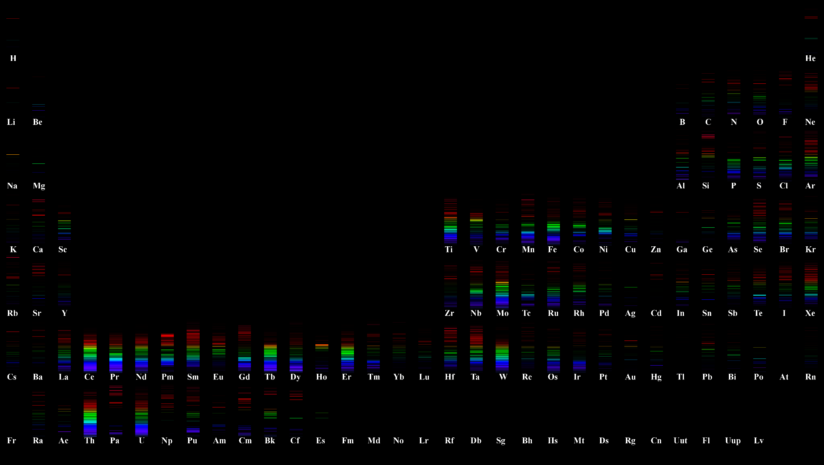
“Fingerprints”
solarsystem.nasa.gov
By Julie Gagnon (C) 2007, 2013. CC-BY-SA 4.0

Slide 6
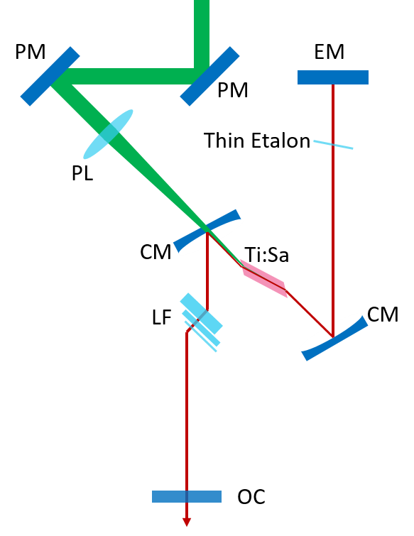
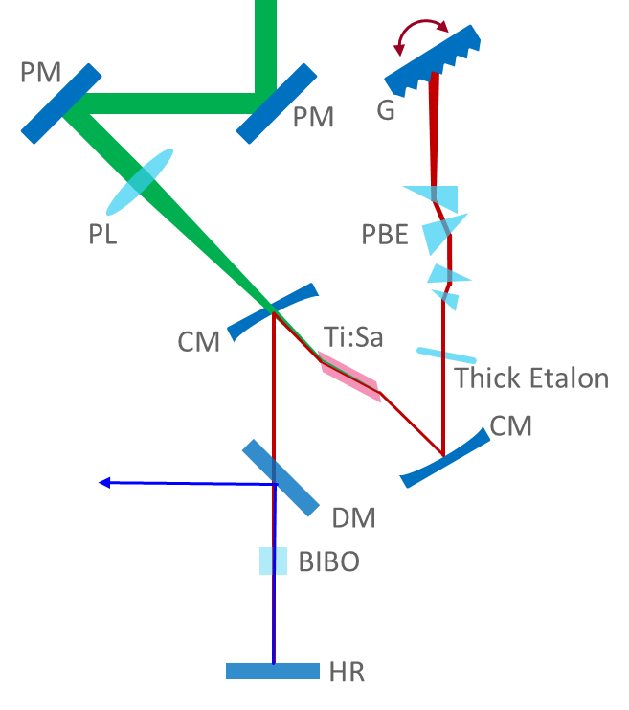
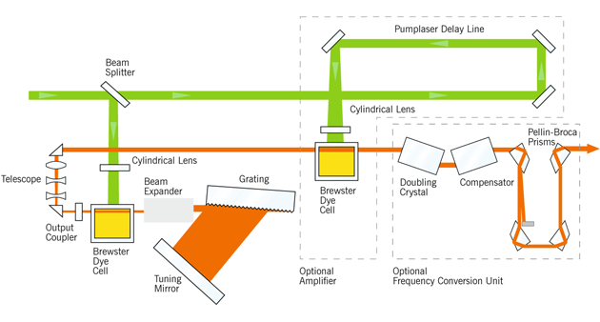
RILIS principle
IP
Stepwise excitation and subsequent ionization
Element specific due to electronic structure of the atoms
Advantages of RILIS:
Selectivity and efficiency
Energy (eV scale)
Tunable dye lasers, currently we are commissioning 2 new dye lasers from Lioptec
Tunable Titanium:Sapphire (solid state) lasers in different configuration
4ω Ti:Sa
210-230 nm
4ω Ti:Sa
210-230 nm
3ω Ti:Sa
230-270 nm
3ω Ti:Sa
230-270 nm
2ω Dye
300-350 nm
2ω Ti:Sa
350-475 nm
2ω Ti:Sa
350-475 nm
UV pumped Dye
475-550 nm
Ti:Sa
700-950 nm
Dye
550-700 nm
Ti:Sa
700-950 nm
Ideal RILIS spectral range
532 nm
532 nm
532 nm
950 nm
950 nm
210 nm
950 nm
210 nm
210 nm

Slide 7
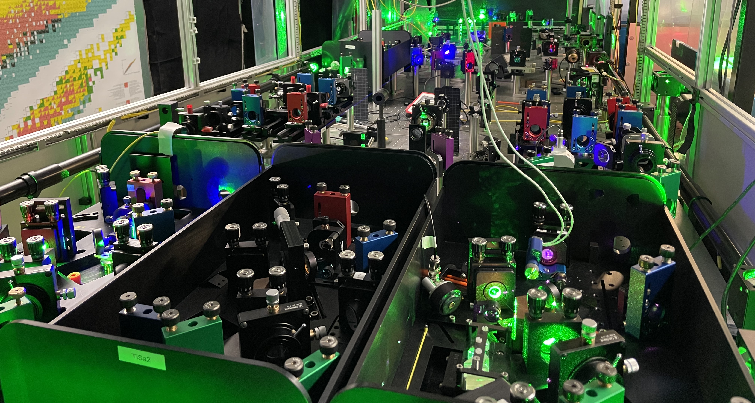
Real life RILIS

Slide 8
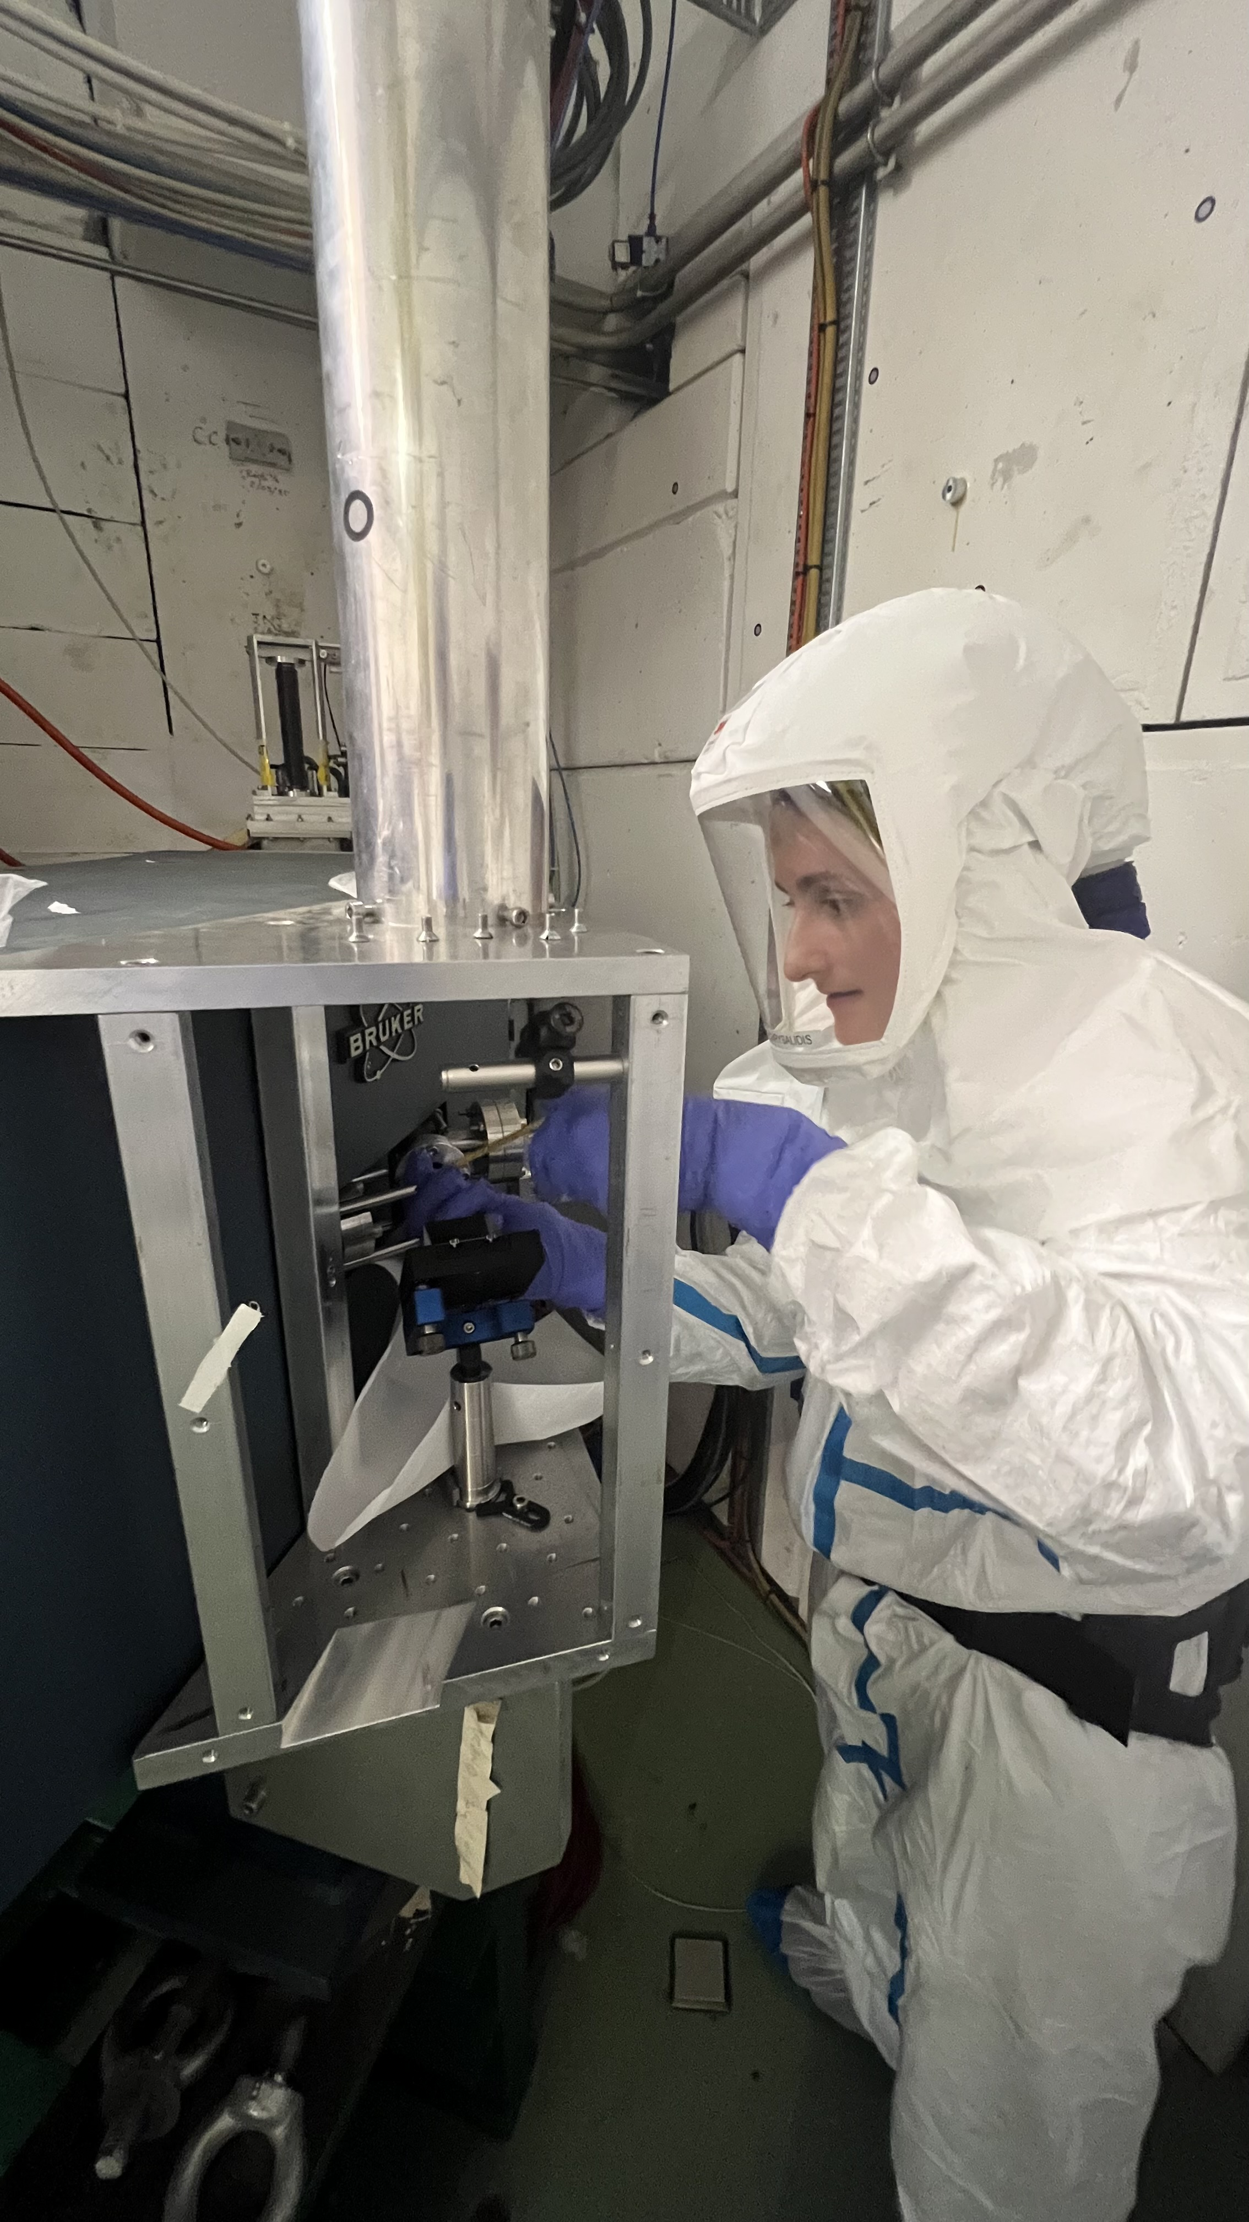
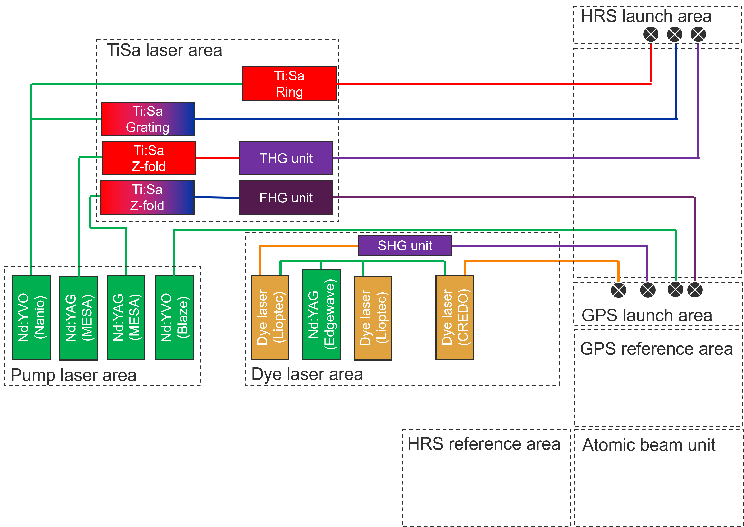
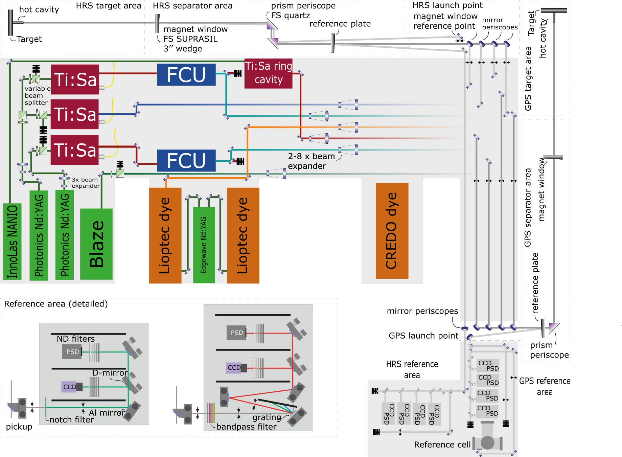
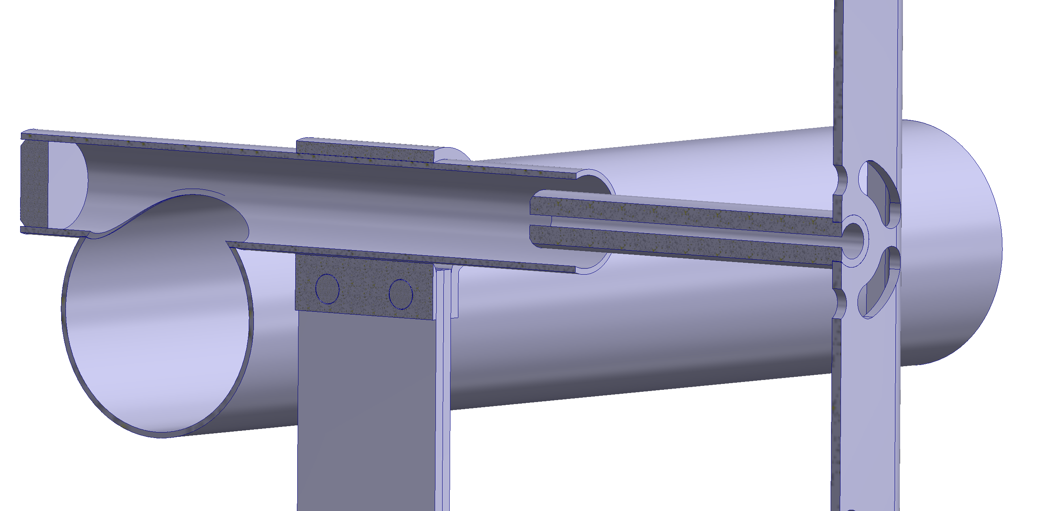
RILIS laser system

Slide 9
RILIS through the years

Slide 10
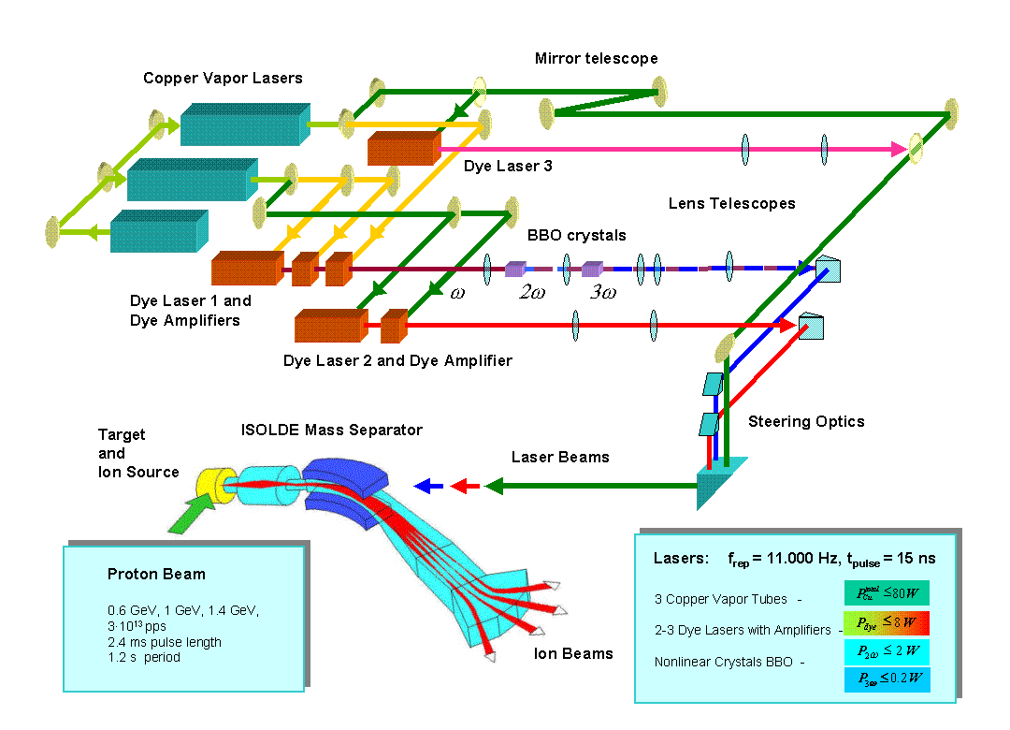
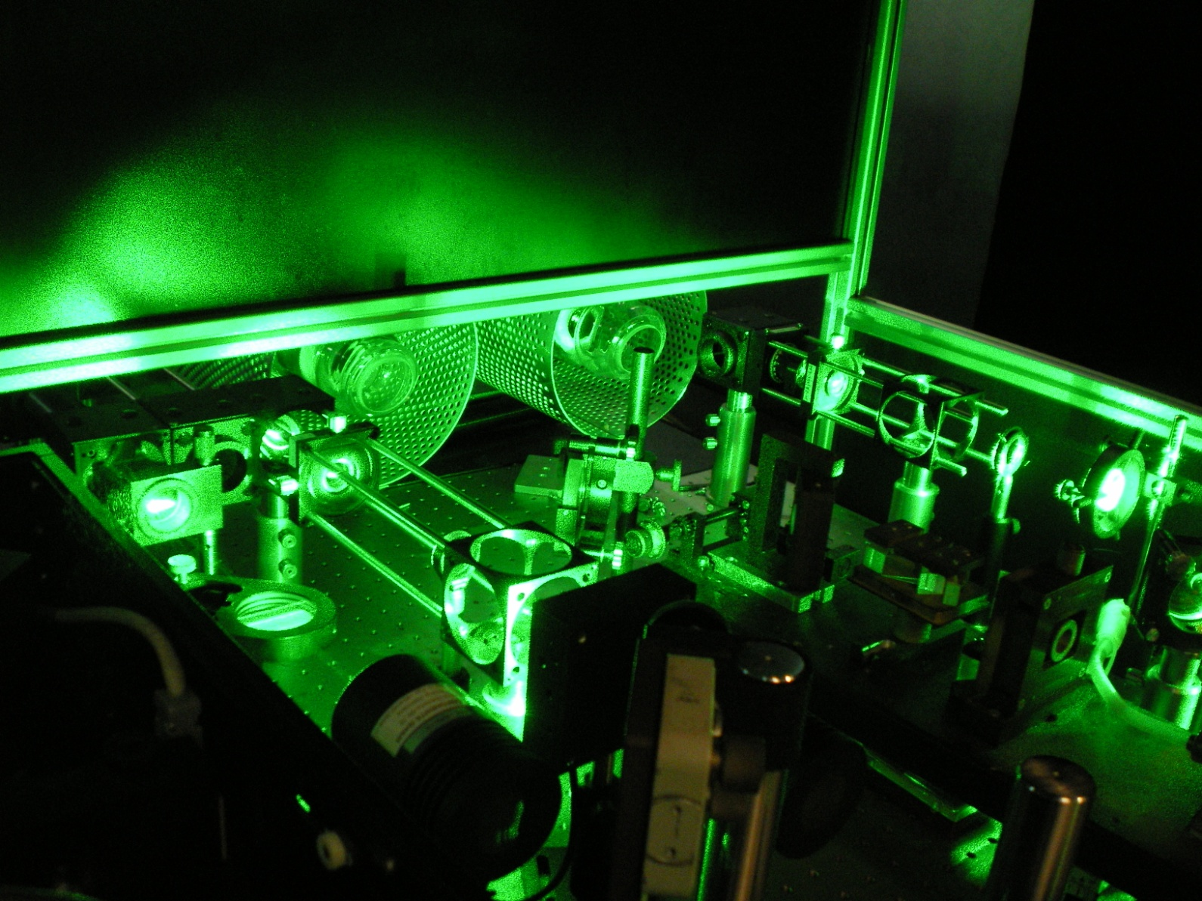
Laser installation in the 90s and early 2000s
Copper Vapor lasers for pumping of dye lasers and harmonic generation > 15 years old in 2007
Dye lasers > 15 years old in 2007
Operation requires 24/7 supervision in “shift” mode to prevent critical failures
Wavelength tuning range:
Fundamental (ω)
530 - 850 nm
2nd harmonic (2ω)
265 - 425 nm
3rd harmonic (3ω)
214 - 235 nm

Slide 11
Capabilities in 2004
High ionization efficiency
Proven isomer selectivity for several elements
Proven in-source spectroscopy capabilities
→ Rising demand for RILIS
Directions are being set for the future of RILIS:
Implementation of solid state lasers
Laser beam diagnostics and computer control systems
Surface ion suppression
Continued ionization scheme development

Slide 12
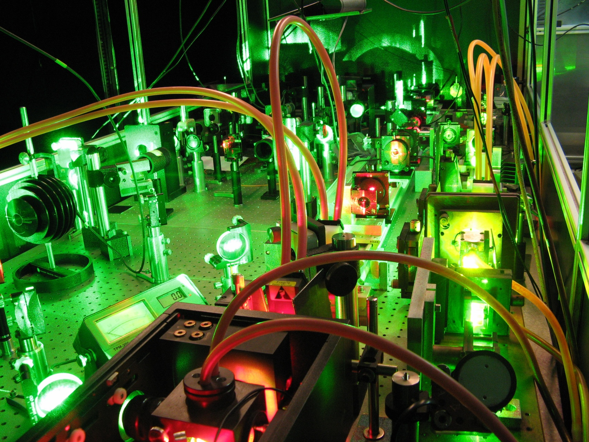
Operation from 1994-2007
With annual running times of over 2000h (corresponding to ~84 days non-stop) hands-off operation is becoming a necessity!

Slide 13
RILIS roadmap suggested in 2007
Installation of solid state (DPSS) lasers for dye laser pumping. Keeping CVL lasers at RILIS as backup until reliable SSL performance is reached.
Market survey for high pulse rate dye lasers.
Purchasing of new dye lasers.
Providing conditions for remote control of key RILIS parameters
Including RILIS operation in the ISOLDE separator courses
Switching RILIS running from “shift” to “on-call” operation mode
Installation of Ti:Sapphire lasers in addition to dye lasers
Availability of RILIS for parallel running at GPS and HRS
2008
2009
2010
→ Total expenses planned: 1.55 Mio chf

Slide 14

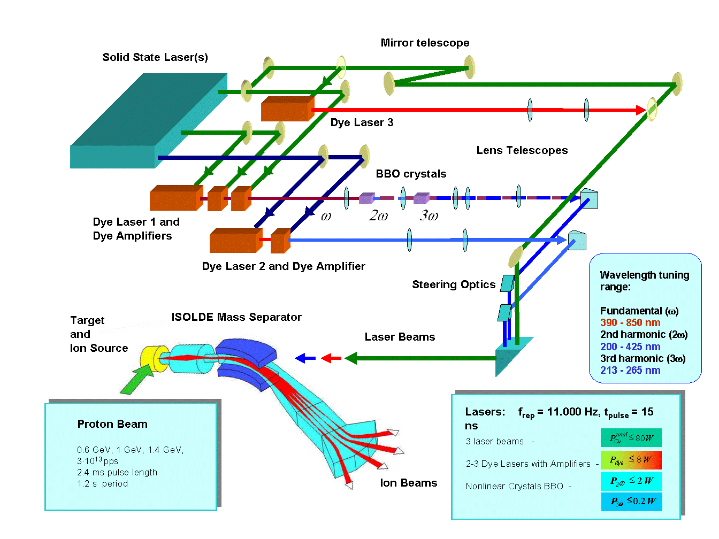
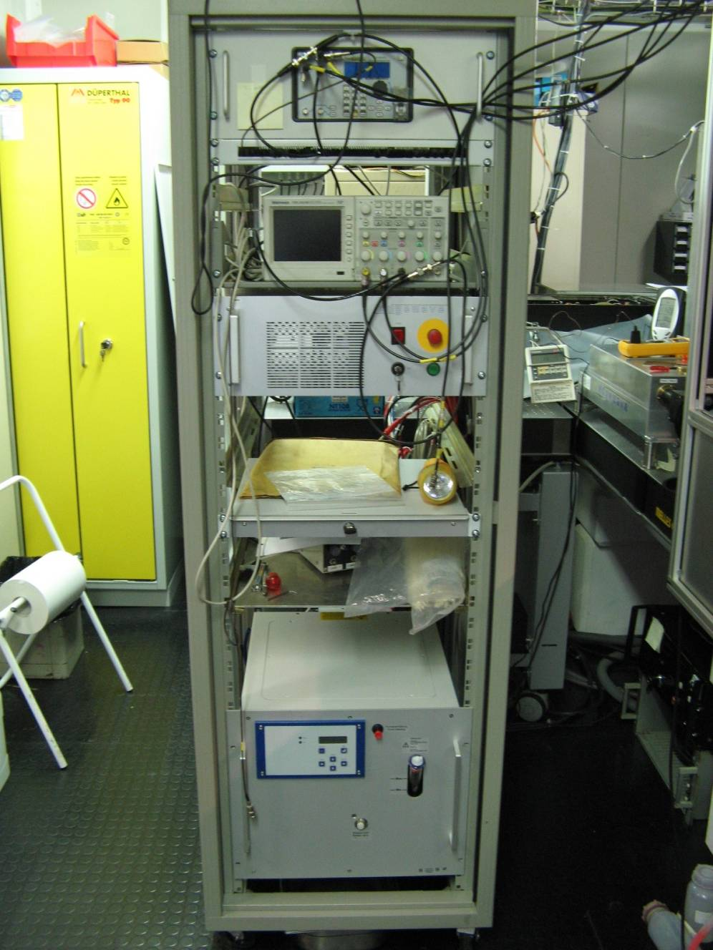
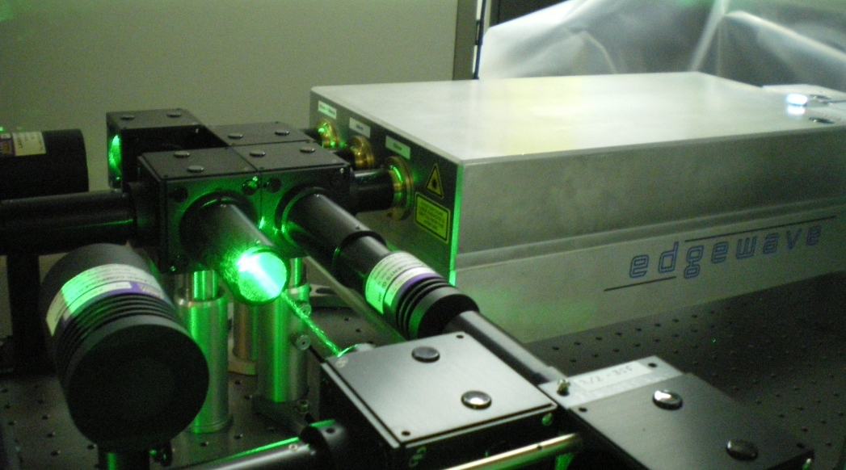
DPSS pump lasers 2008/2009
RILIS gets its first DPSS pump laser (Edgewave)
Overall the team is happy BUT: dye lasers still require supervision
CVL running foreseen until end of 2009 to confirm reliability of DPSS laser
Call for implementation of dual system with Ti:Sa lasers pumped by DPSS and commercial dye lasers
Wavelength tuning range:
Fundamental (ω)
390 - 850 nm
2nd harmonic (2ω)
210 - 425 nm
3rd harmonic (3ω)
213 - 265 nm
New RILIS laser layout

Slide 15
2010 – new beginnings
demand
Limit reached for existing laser resources
Limit reached: RILIS needs more lasers, hands-off operation and DPSS pump lasers to meet rising demands

Slide 16
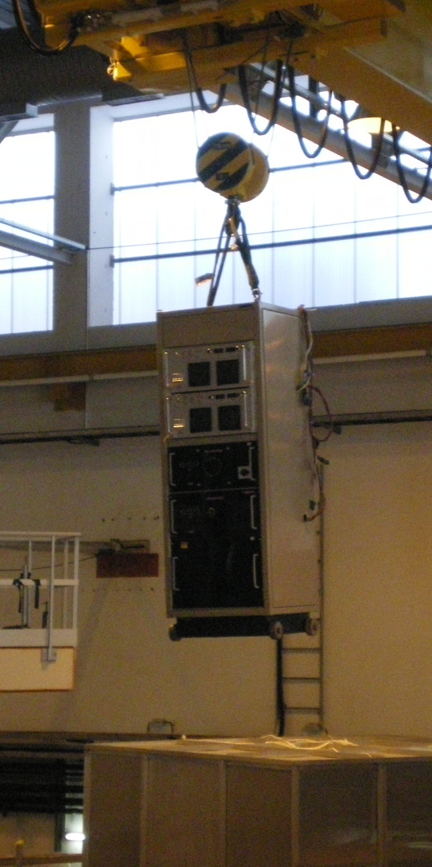
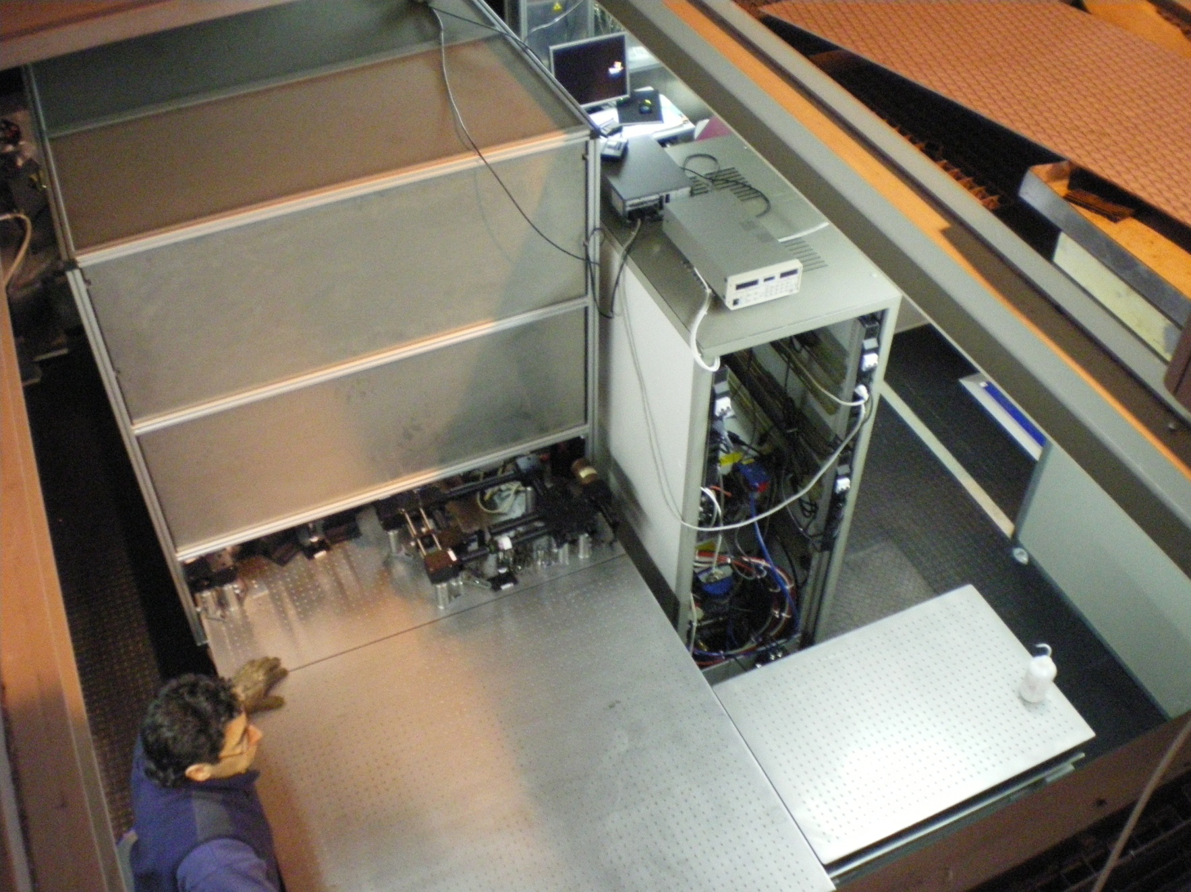
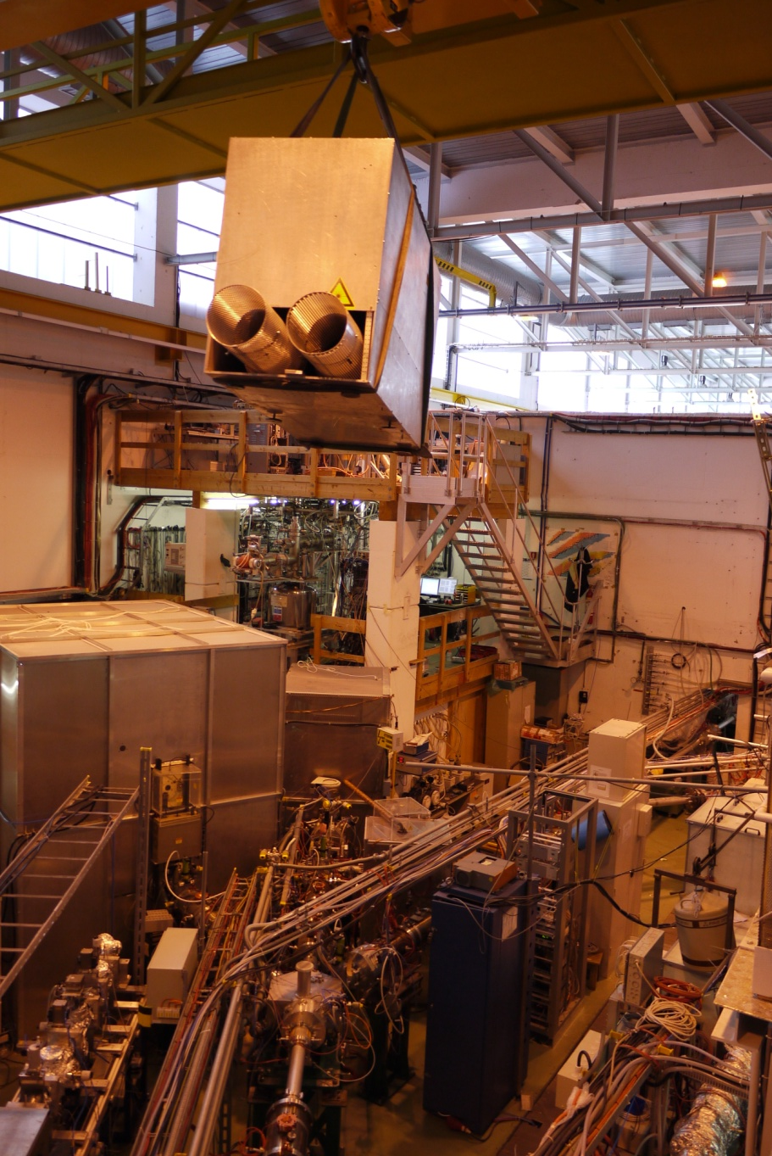
2010 – new beginnings
Bye, bye Copper Vapor lasers!

Slide 17
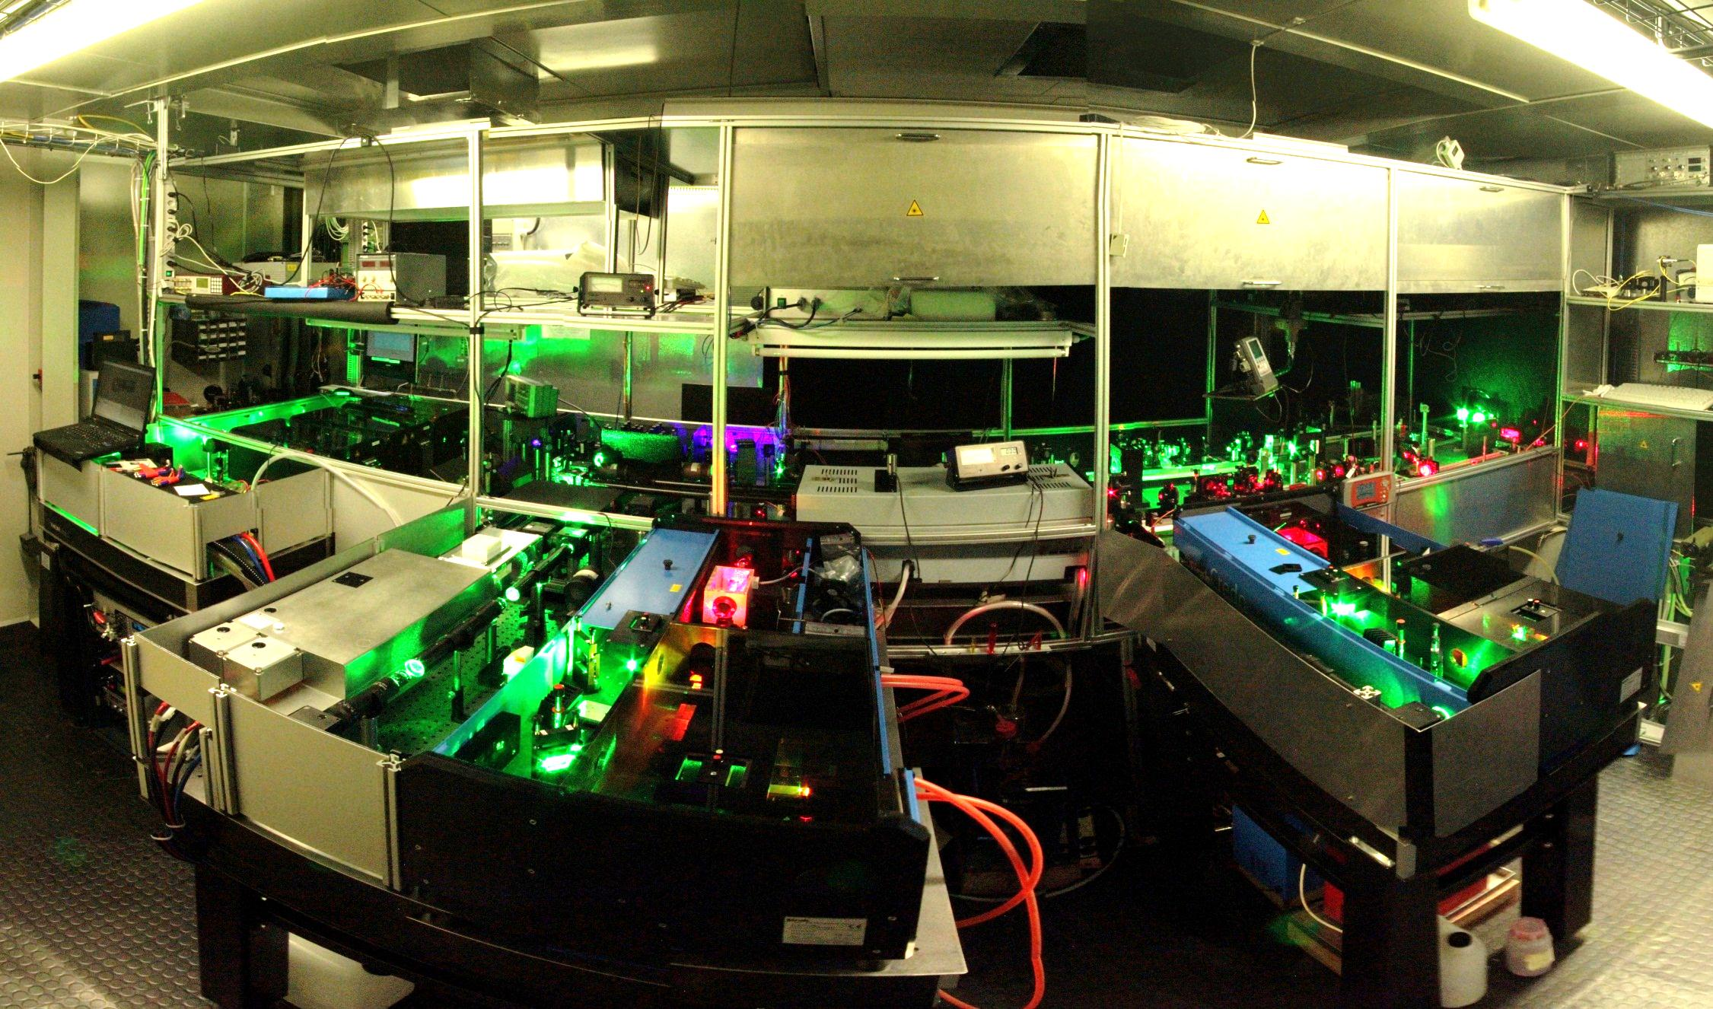
2010 – new beginnings
Hello Credo dye and Ti:Sa lasers!
→ Space is becoming an issue…

Slide 18
2012 - increased RILIS operation time after upgrades
31 different elements have been ionized with RILIS by 2012
Implementation of dual system
Plans for the future:
Automated protection and remote monitoring of installation
NEW schemes
Extension of the laser cabin
Dedicated laser for non-resonant ionization
2012 highlight: First on-line LIST run for polonium
→ 2013: CERN LS1 – (1st?) RILIS cabin extension

Slide 19
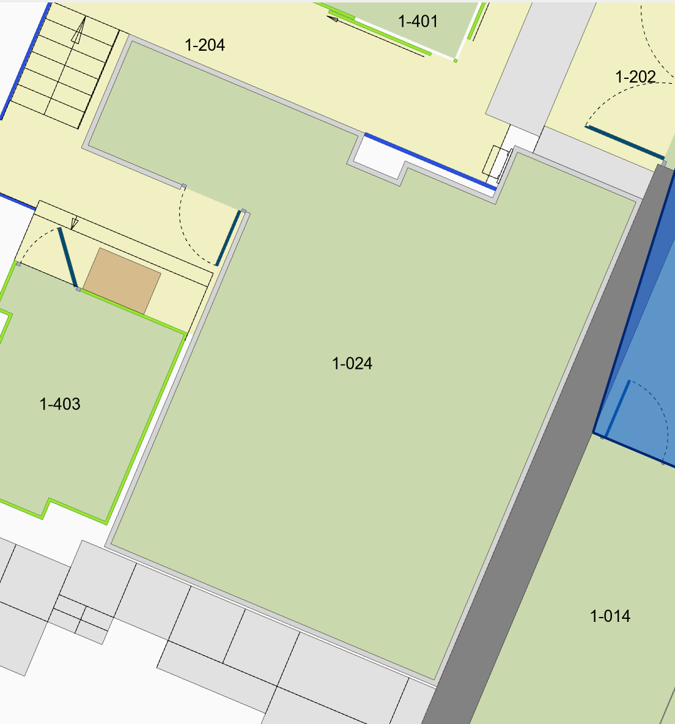
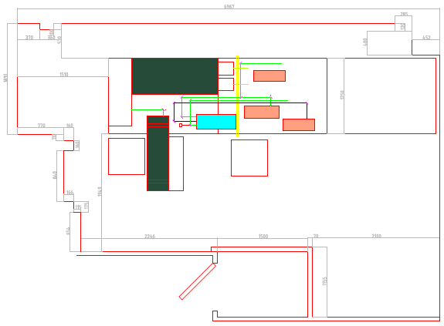
More space
34.5 m²
Added ~9m² of extra surface

Slide 20
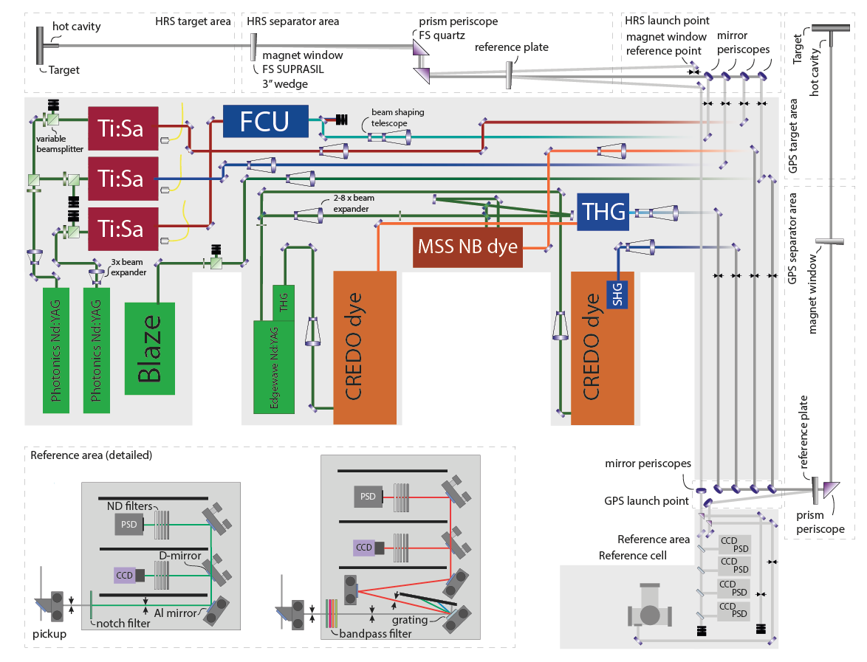
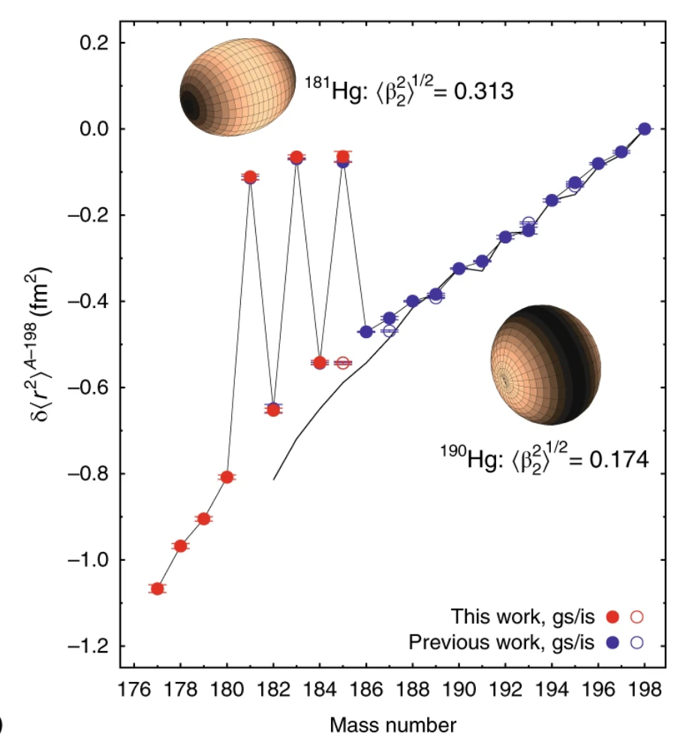
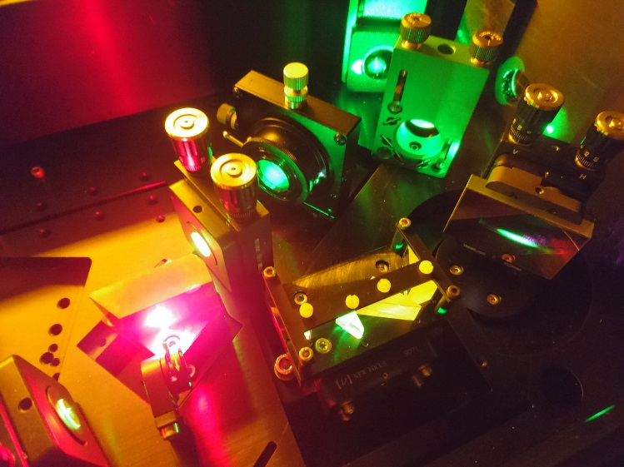
2014 onwards – RILIS goes to “on-call” mode
Machine protection system installed early 2014
RILIS goes fully on-call in 2015
New laser for non-resonant ionization (Blaze, the laser to rule them all)
Installation of “Reference Area”: automated laser beam stabilization and beam parameter observation published online
Grating Ti:Sa laser installation in 2015
2015 highlight: VAD(L)IS used for in-source spectroscopy → Hg odd-even staggering end determined
Marsh, B.A., Day Goodacre, T., Sels, S. et al. Nature Phys 14, 1163–1167 (2018)

Slide 21
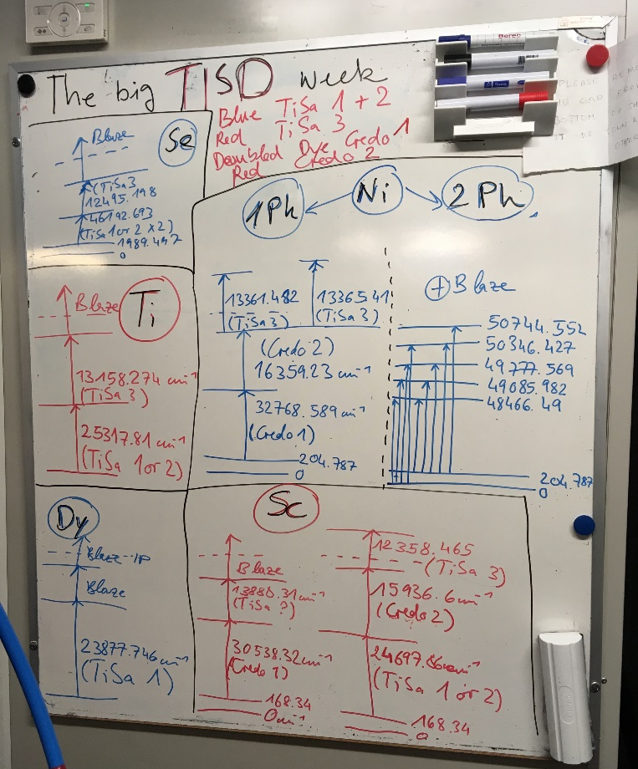
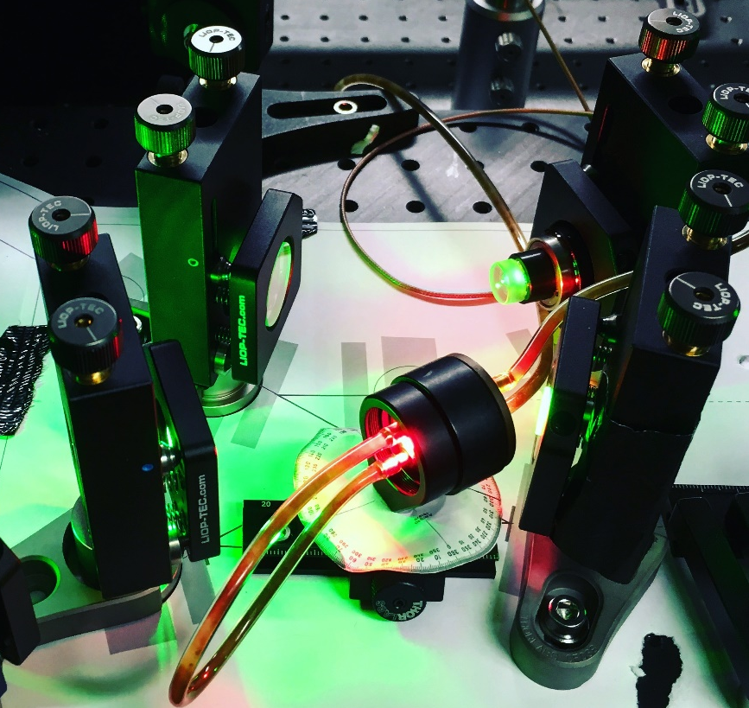
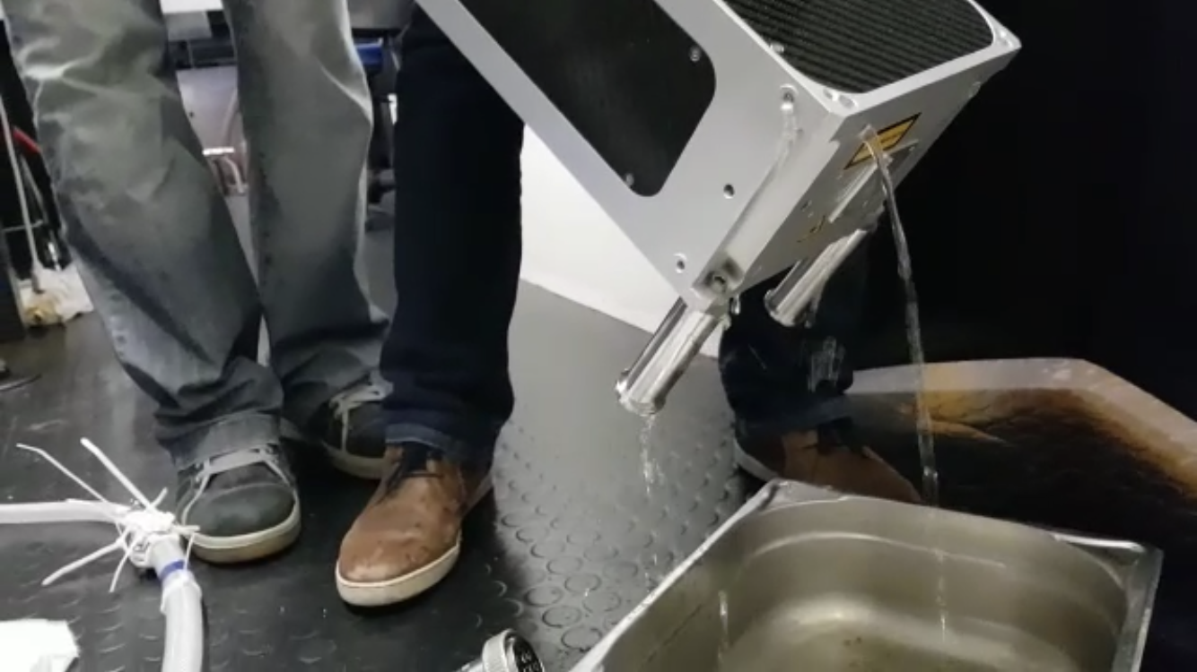
RILIS until LS2
Consistently providing >50% of all ISOLDE beams
On-call is the stablished method
Elements ionized with RILIS: 35
In-source laser spectroscopy on Au, At, Po, Hg, Bi, Dy
New Edgewave laser (2017)
Installation of seeded ring cavity for high-resolution spectroscopy in 2018
New Ti:Sa pump lasers (2018) with water feature
Scheme development for faster switches and more Ti:Sa schemes
Making laser fountains…
2018 highlight: First Ac beam at ISOLDE → creation of LISA Marie Curie training network followed

Slide 22
RILIS post LS2
2 new dye lasers (Liopstar) to replace 1 Credo
Construction of new frequency mixing unit to remove setup constraints in UV
New, independent reference area for HRS
2021 (June-November): > 1600h of RILIS (excluding setup time)
2022: >2600h (excluding setup time)
2023: > 1100h (and counting…)
New beams: Pu, Np (above target mass!)

Slide 23
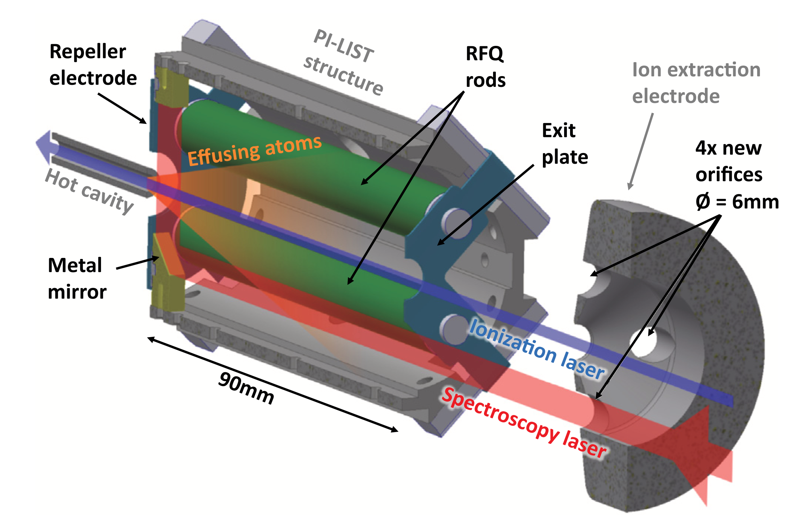
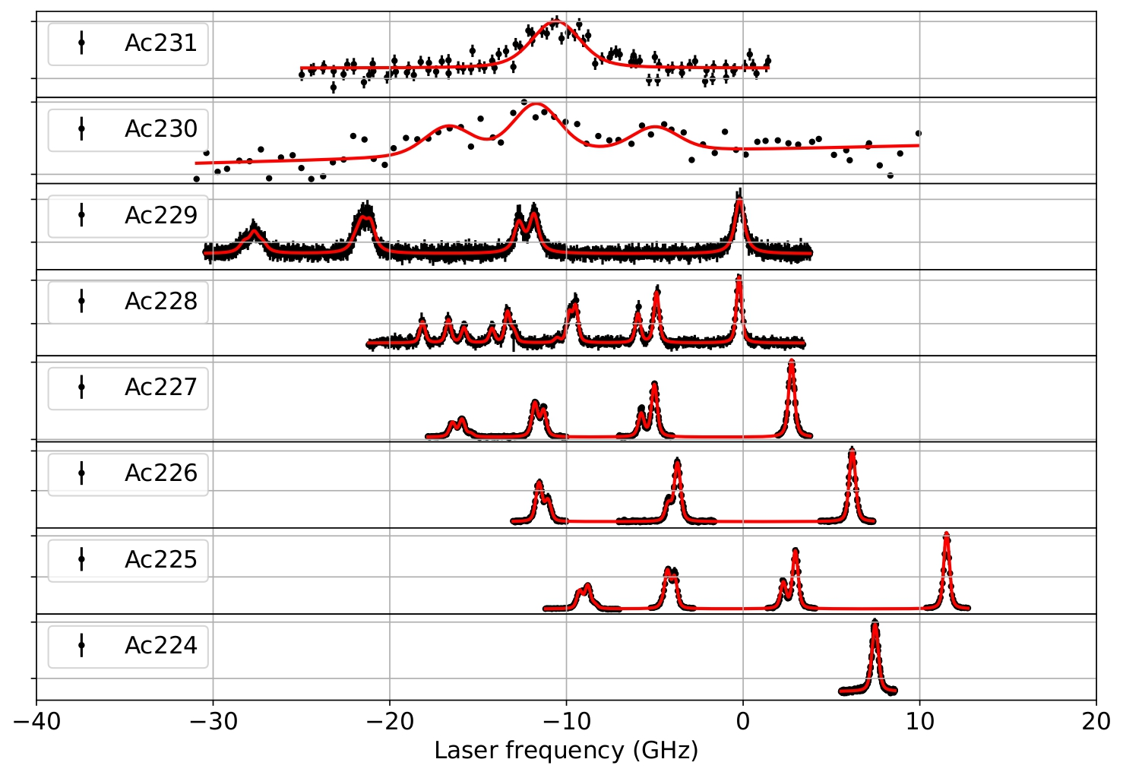
RILIS going ”really” high resolution
2022: First on-line run with PI-LIST for Ac
Seeded Ti:Sa ring cavity used (cw light provided by CRIS)
Measurement of Ac up to 231
Technique well suited for studies of low-yield isotopes (ions/s detection)
Dual ethalon laser (800MHz++)
2023: campaign launched for yield determination of lanthanides
Rich physics program foreseen in this region
RILIS can selectively ionize: elements, isotopes & isomers!*
Ring laser
* If you don’t care that you loose yield…

Slide 24

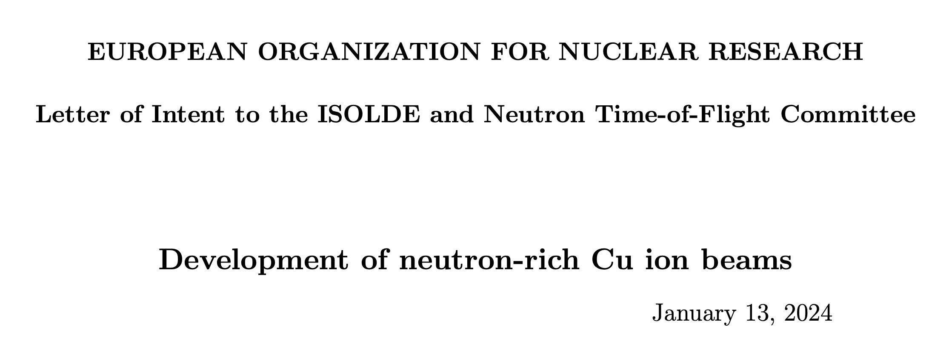
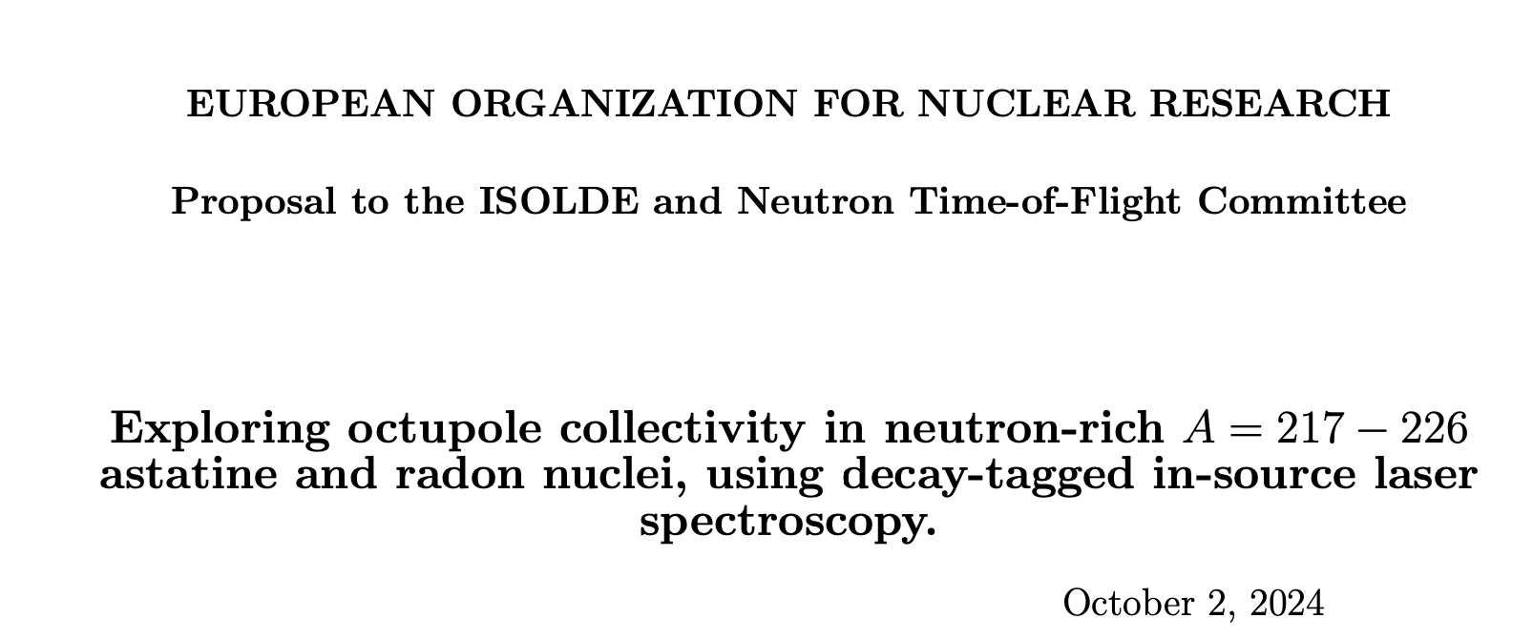
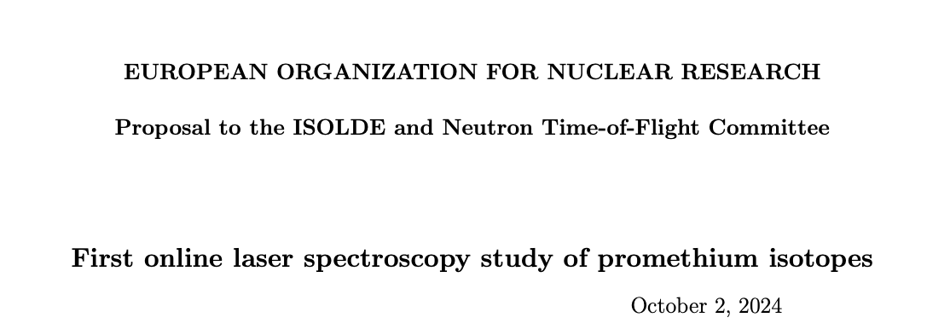
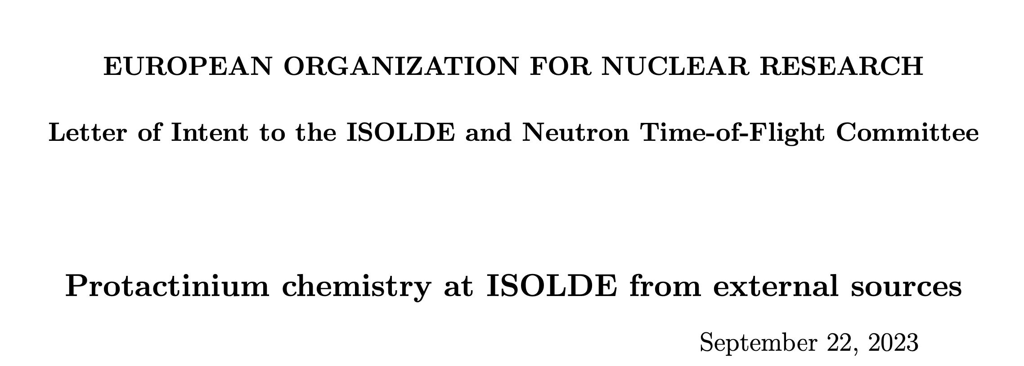
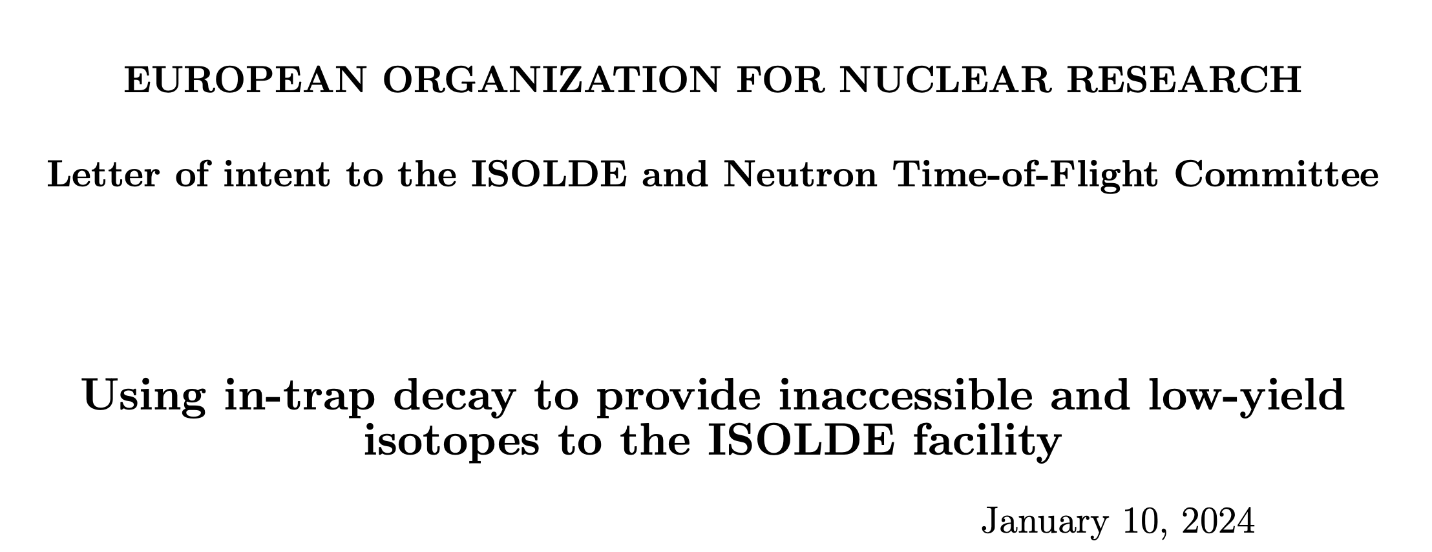
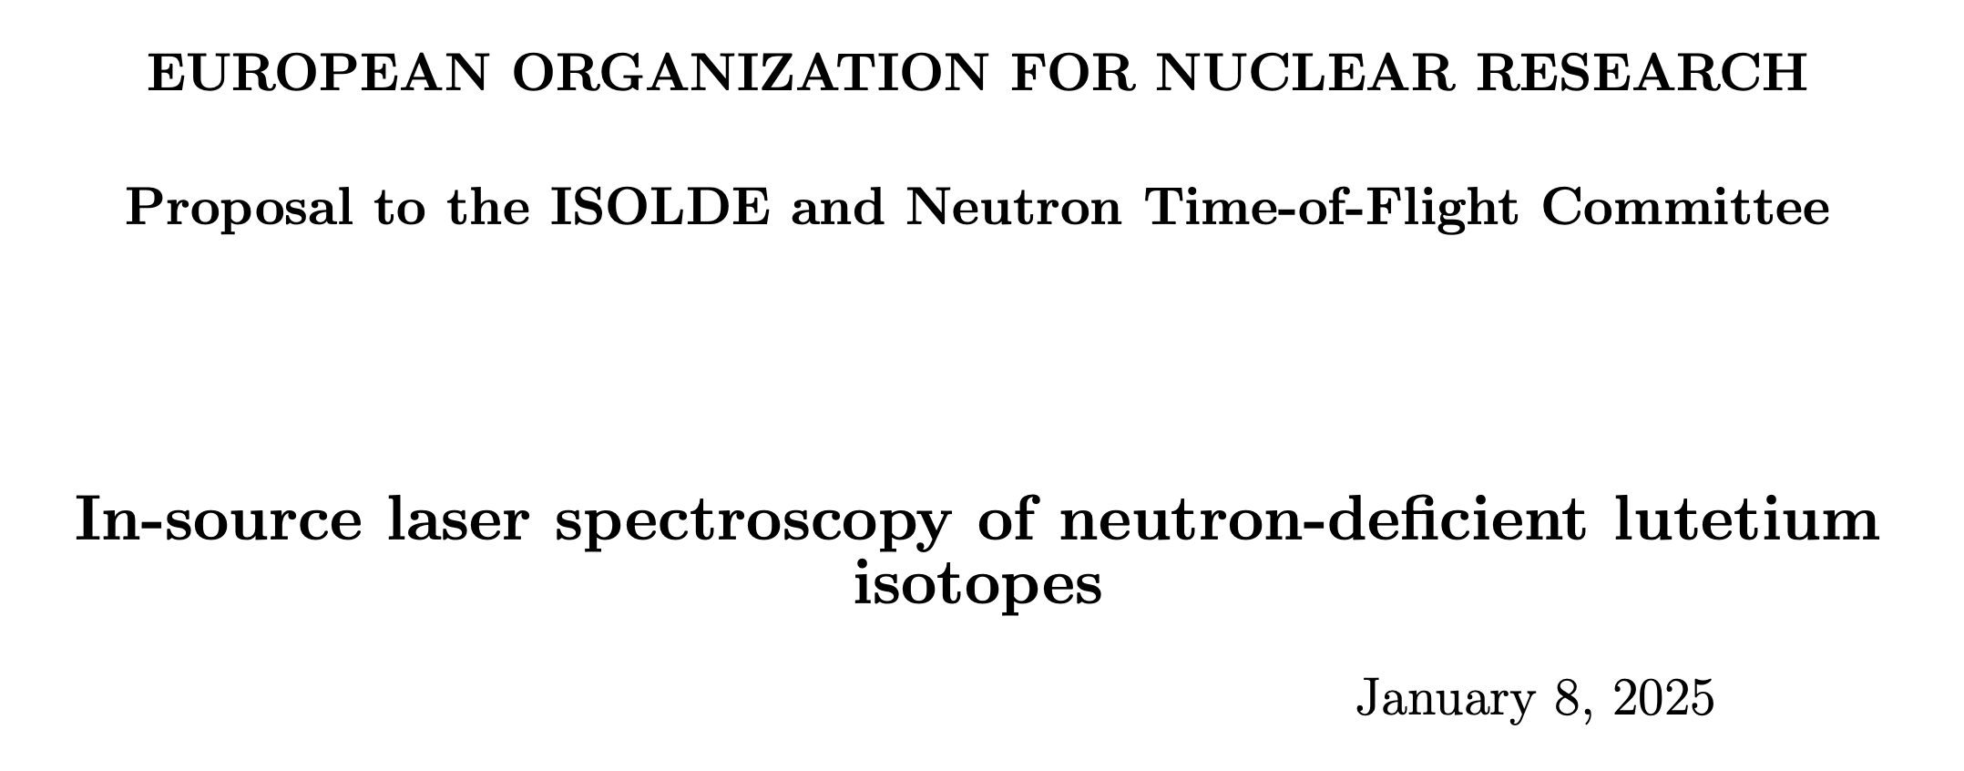
RILIS pre and post LS3
2024 – a year unlike any before
New methods for ion beam delivery (molecular dissociation, state preparation, in-trap decay and molecular formation, …)
TISD – multiple campaigns, many working towards new physics proposals
CERN’s Physics Beyond Colliders→ tasked to develop new beams (new collaboration in the making “FunSy”)
Restructured section, taking over full ISOLDE ion source development and ion beam manipulation with YOL2
More people, more responsibility, more opportunities!

Slide 25
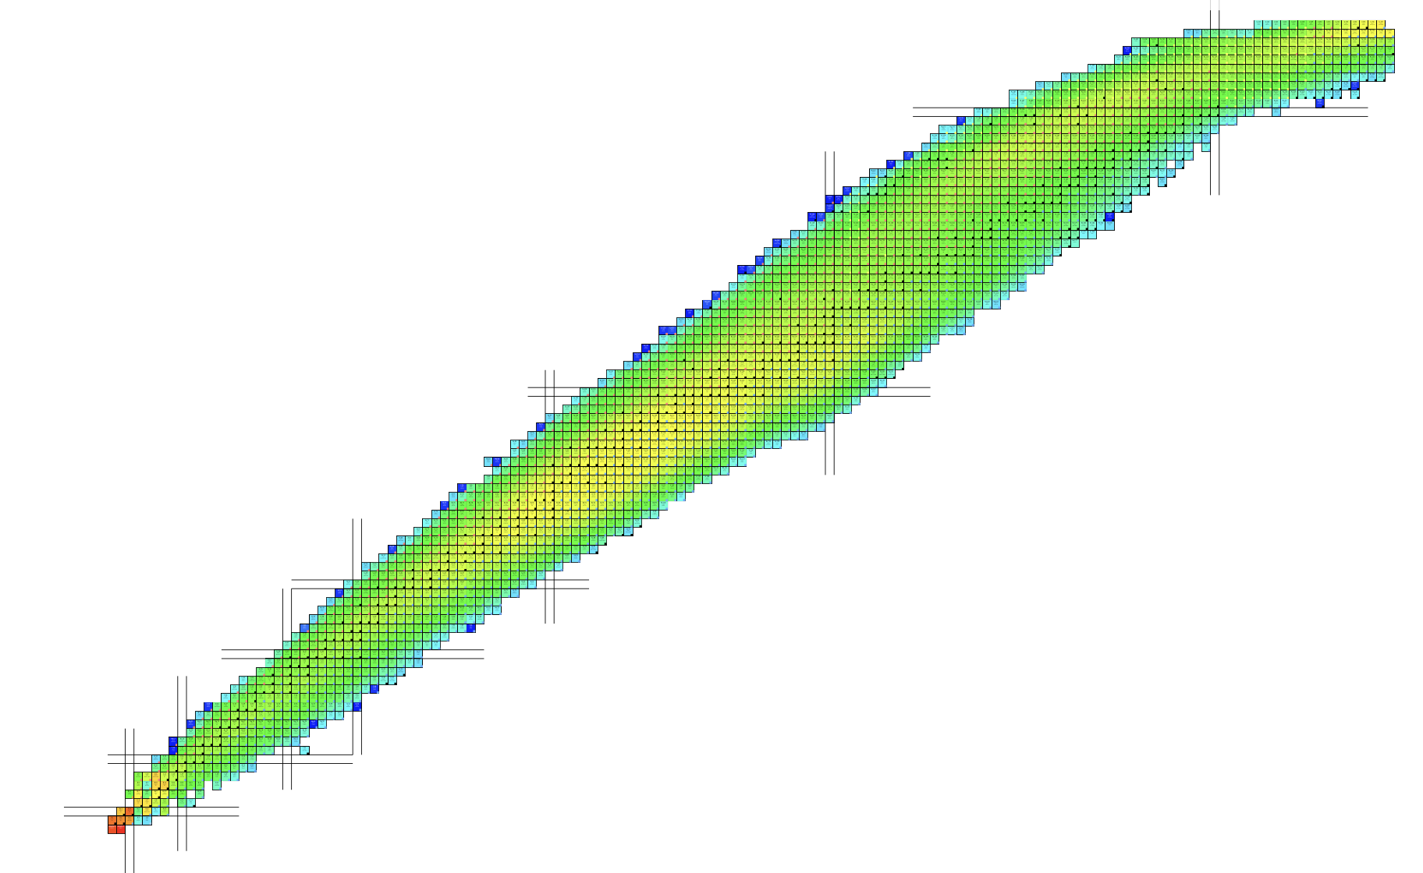
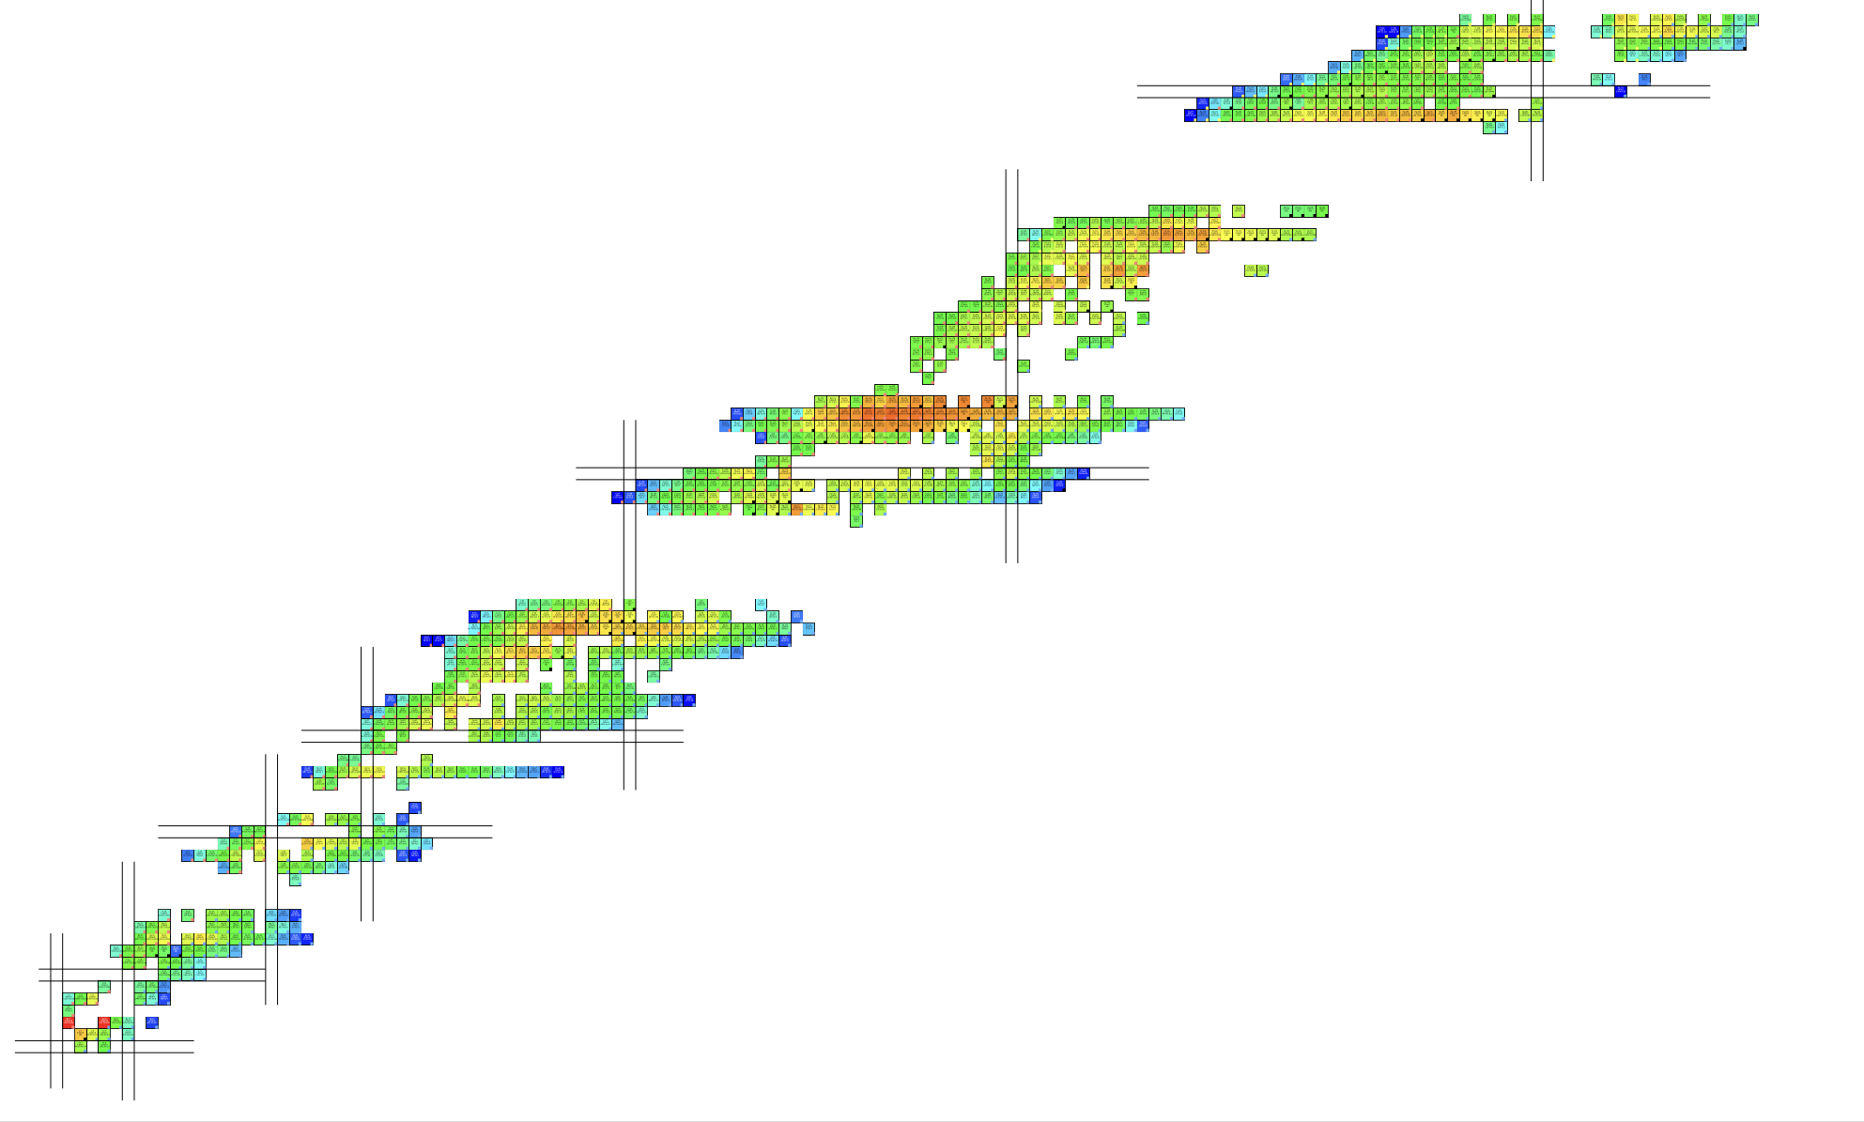
ISOLDE production & beams
Producing isotopes does NOT always mean we can also extract them
Laser schemes (often) exist anyway – we can develop schemes with stable samples…

Slide 26
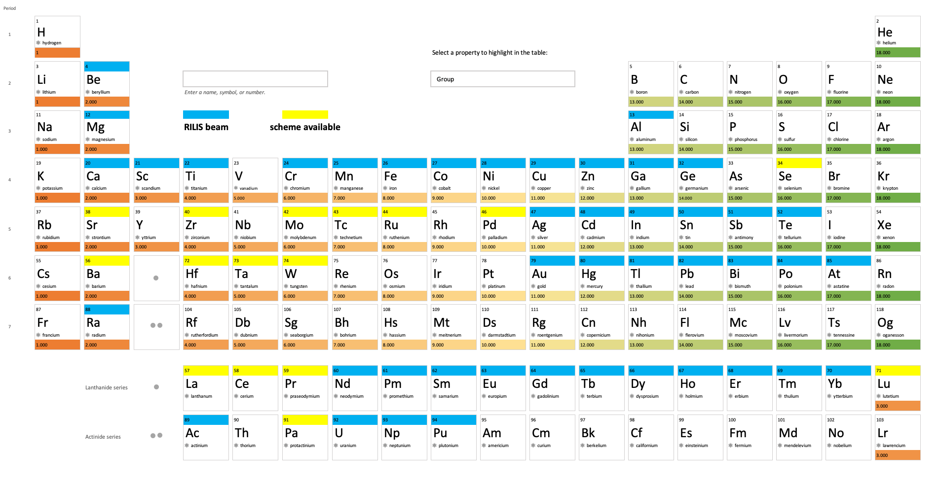
RILIS beams (for now)
44 Elements

Slide 27

New scheme database – please contribute!
New online database for laser ionisation schemes!
Found here: https://rims-code.github.io
Or use the QR code!

Slide 28
RILIS operation

Slide 29
A typical RILIS run - theory
Setup of tunable lasers (wavelength, power, stabilization)
setup of optical beam paths to separators
setup of observation system
optimization of laser position, timing and overlap on ion signal
handover
on-call mode starts
1-3 days depending on the wavelengths and lasers used in previous run
½ -1 day depending on the element and ion beam setup status

Slide 30
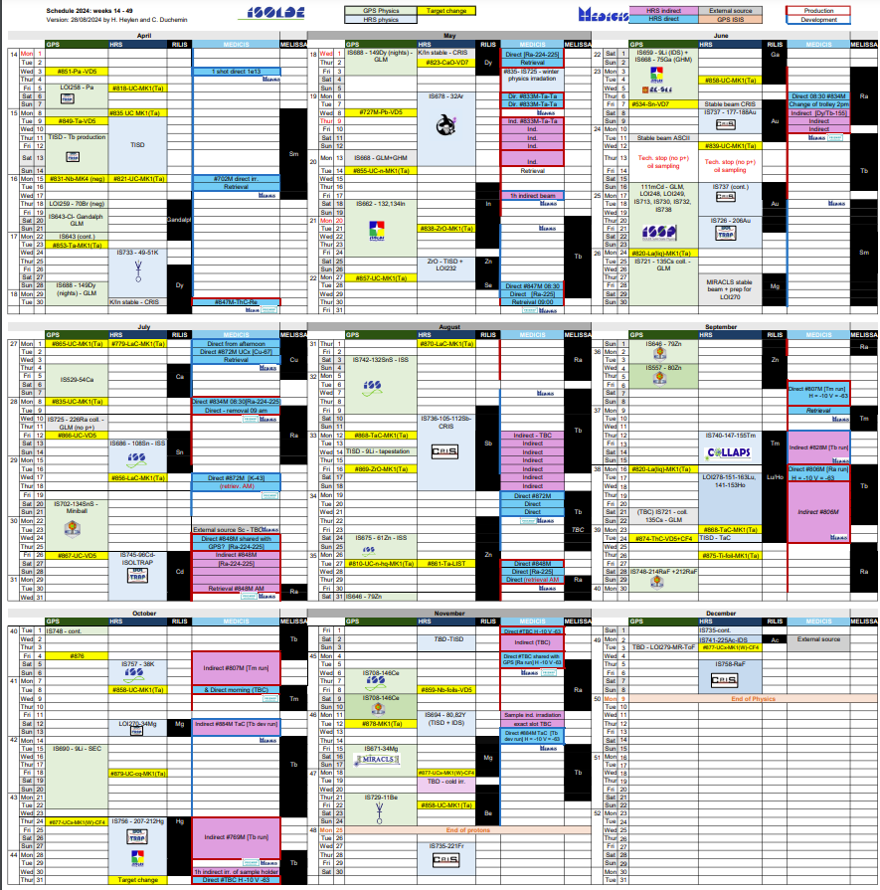
A typical RILIS run – real life 2024
22 experiments requiring laser ionized species at ISOLDE
20 collections at MELISSA (medical isotopes)
60% of campaigns throughout the running period and winter physics
Cl, Dy, In, Zn, Se, Ga, Au, Mg, Ca, Sn, Cd, Sb, Tm, Lu, Ho, Hg, Sr, Al, Be, Ac
1 x 3:00 am Chiller substitution
1 x LIST/PI-LIST campaign (Tm/Lu)
1 x 12-hour LIST target construction and change
1 x In-source spectroscopy campaign (Hg)
Many collaborative efforts with TISD/ISOLTRAP/IDS

Slide 31
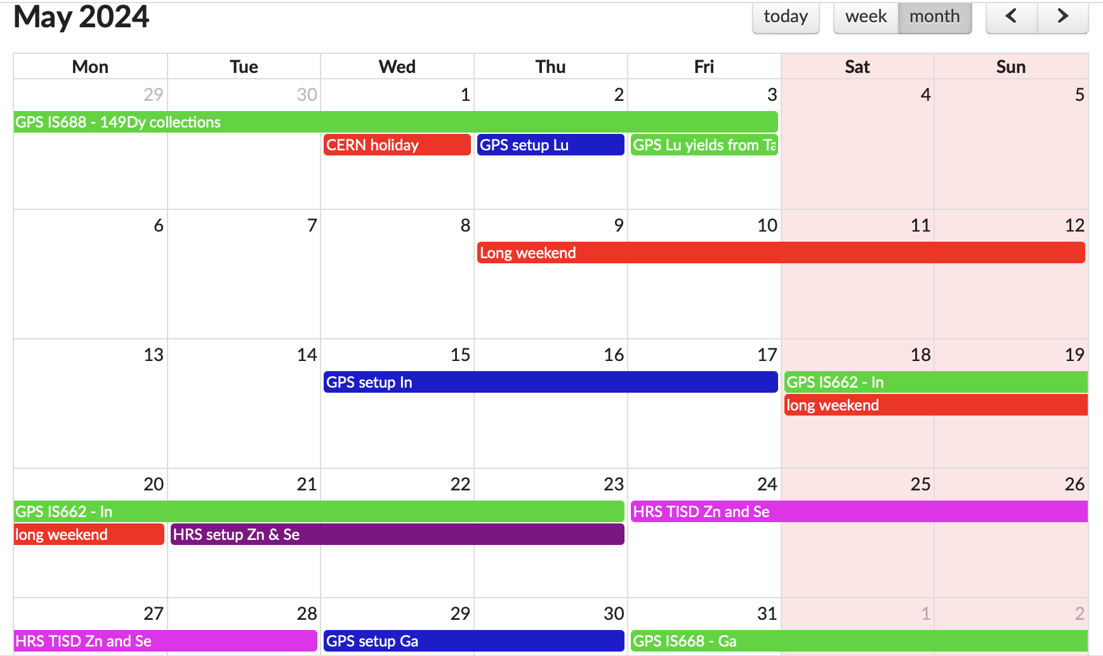
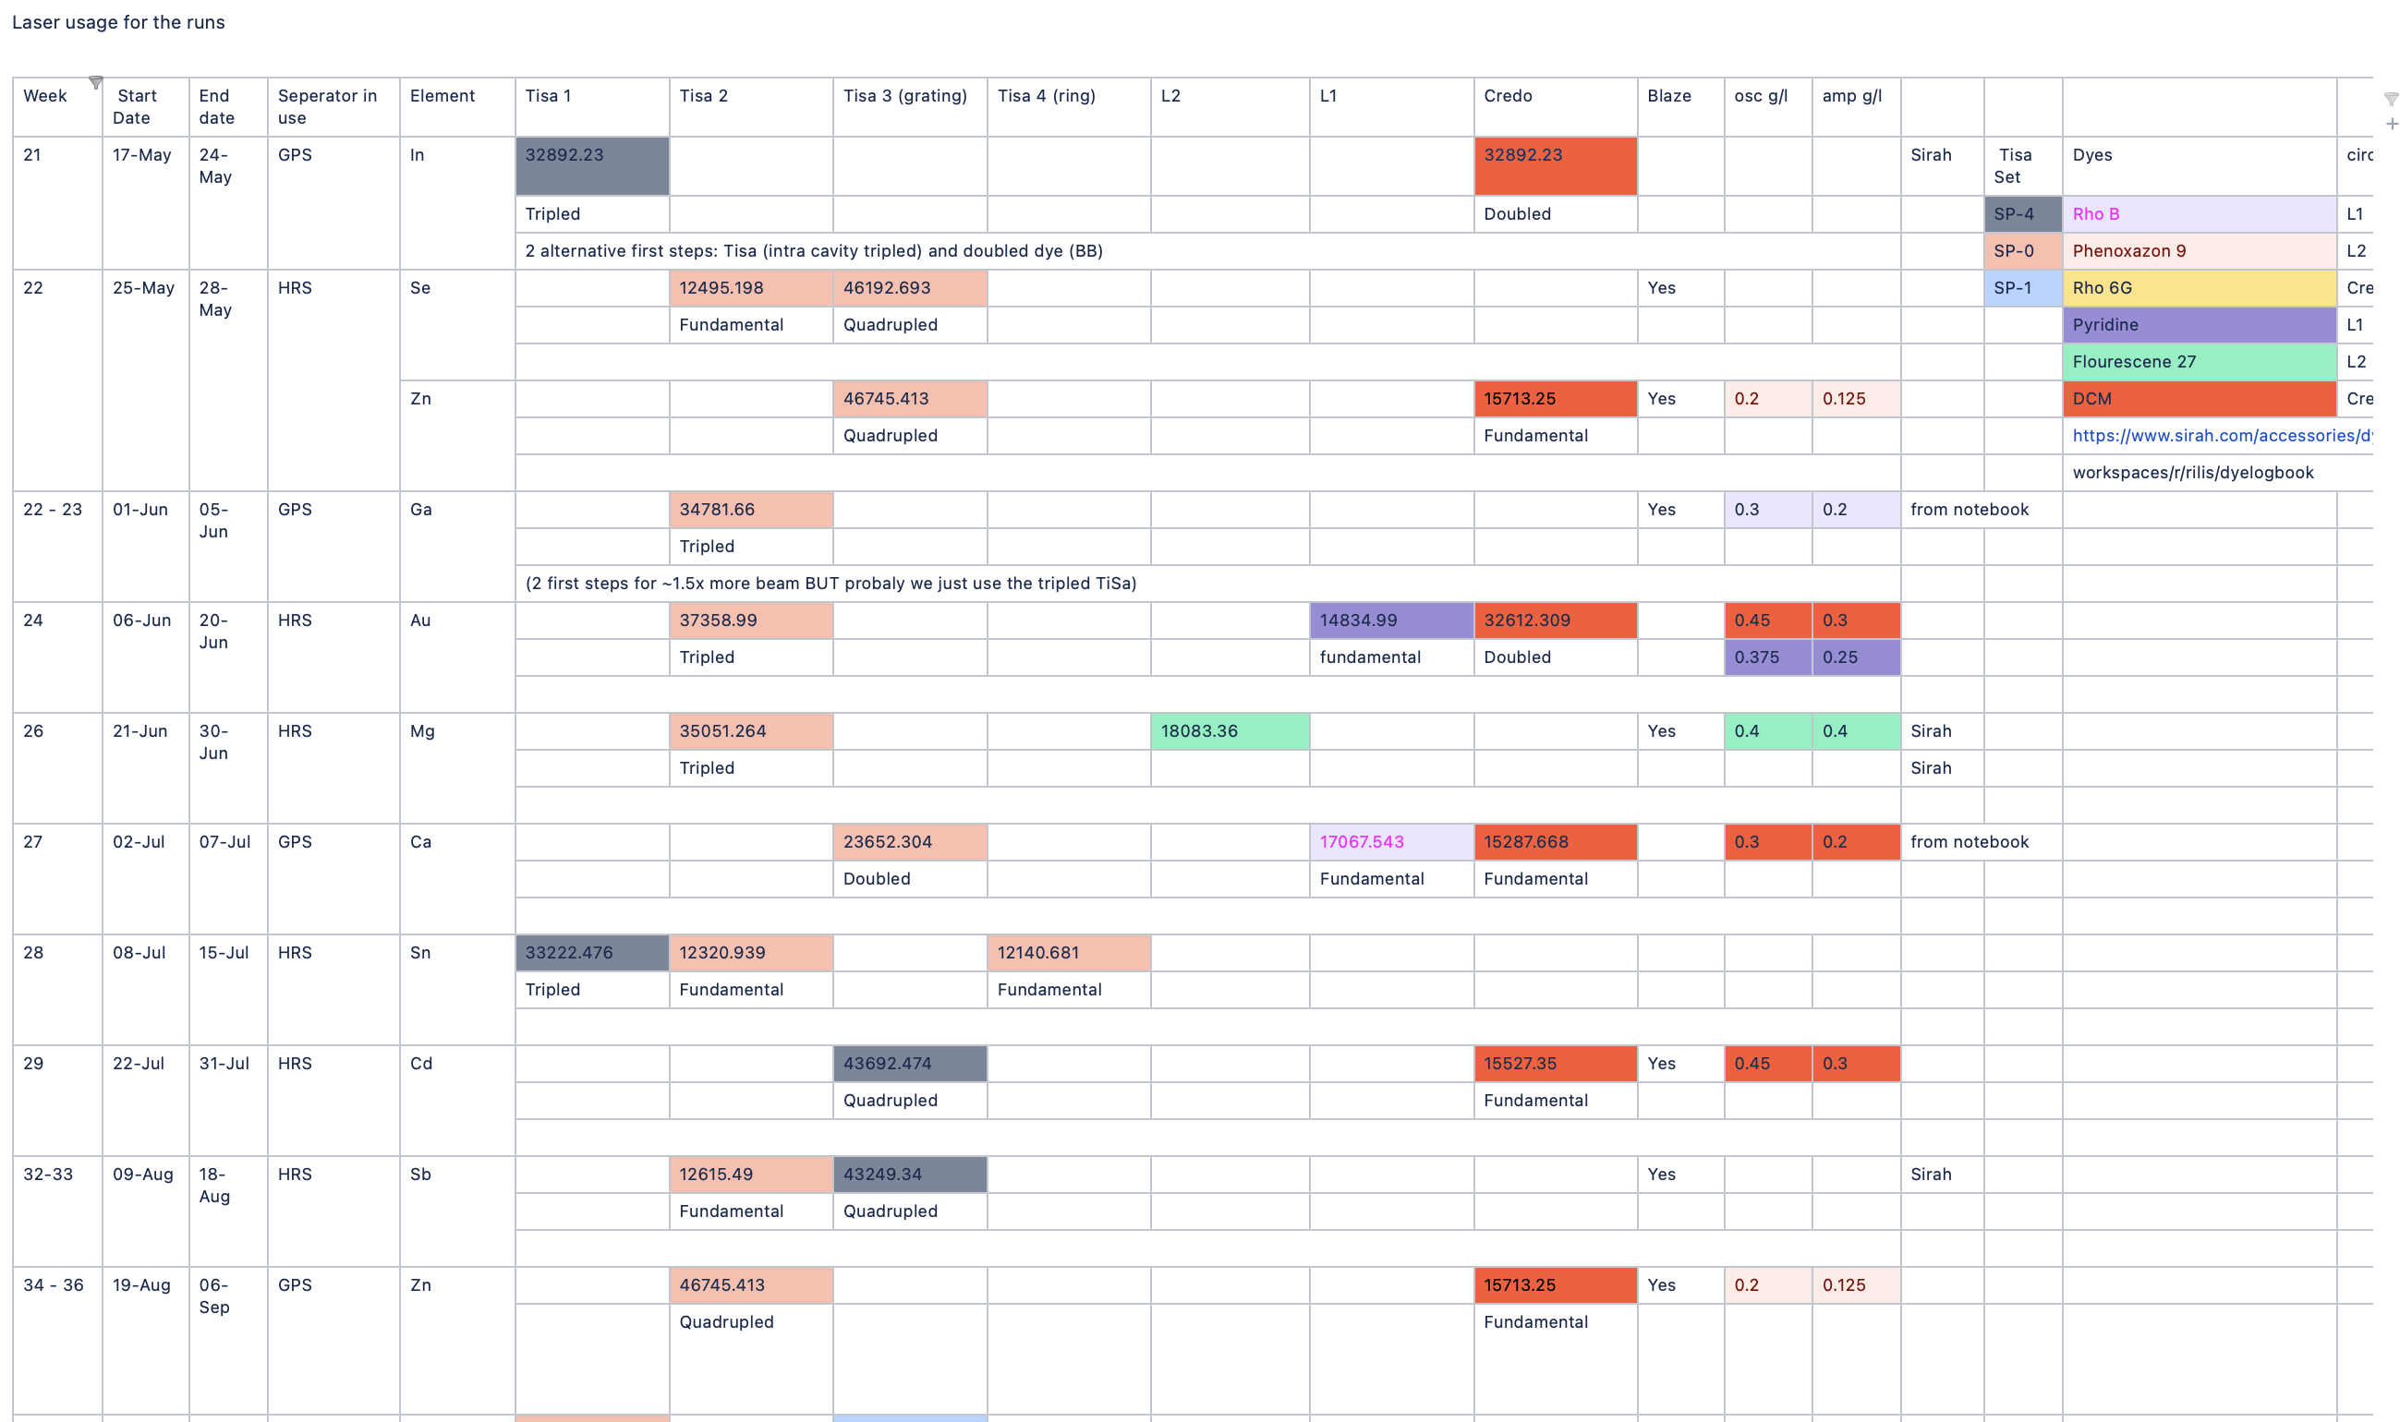
A typical RILIS run – real life 2024
Many parallel setups as schedule rarely takes into account the fact that RILIS is needed already for initial tuning
Development time (TISD) usually scheduled on weekends and holidays (when nobody else wants the beam)
Laser planning crucial to reduce setup time
There is (almost) no room for failure

Slide 32
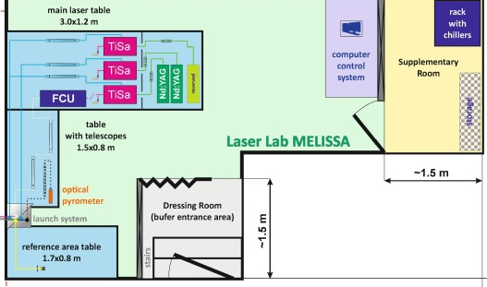
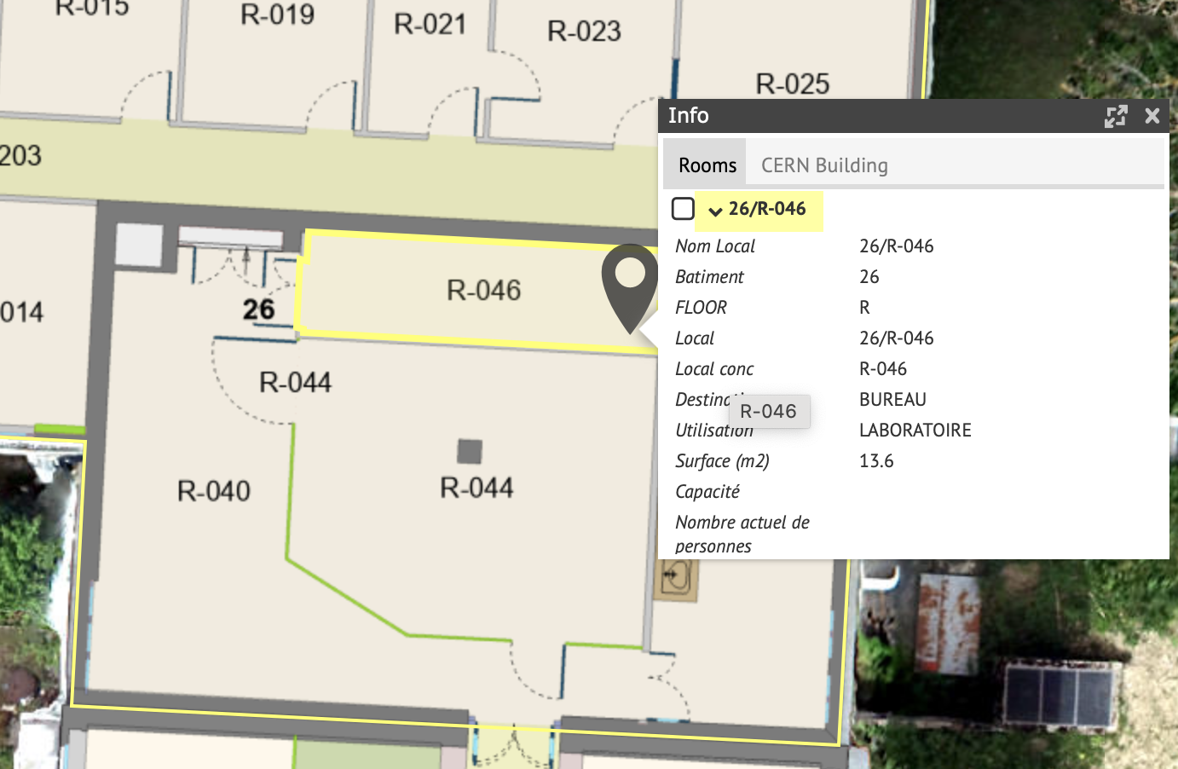
Backup lasers with chillers
3 x Photonics (varying performance)
4 x Ti:Sa cavities
1x Edgewave: > 8 years old (no warranty)
2 x CW diode lasers
1x CW TiSa with CW 10W Millennia pump
MEDICIS MELISSA:
2 x InnoLas Nanio: >5 years old (no warranty)
1 x Photonics laser (belonging to RILIS)
3 x Ti:Sa cavities

Slide 33
What’s the cost?

Slide 34
Lasers, optics, optomechanics, …
Assuming a 3-step scheme we need
  2-3 tunable frequency lasers (dye or solid state) prices vary from → 10k€ up to 70k€ per laser
  2 Pump lasers for the tunable lasers (with room for failure of one of them) → 80-120k€ per laser
  Ideally: 1 laser for non-resonant ionization → 100k€
  Wavemeter to read out the wavelengths → 20k€ (prices ~doubled over the last 10 years) + spare fibers (depends strongly on length, range, …)
  Each beam path needs:
    1 telescope,
    optics to align into it and out of it
    ~2.5k€ (with NO backup optics)
  Frequency conversion crystals to cover the UV&blue ~500€ per crystal + 1.5k€ for mixing unit
Ideally: spare chillers in case of failure (and they are the most likely point of failure) 3-7k€ depending on laser

Slide 35
Operating costs
Ethanol for the dye lasers → depending on run, dye, pump power used will be min 4Liters but can be much more
Dye → cheap 1€/g (everything used also in biology) up to expensive 200€/g
Other consumables like optics, optomechanics, …
Stabilization → spatial laser beam stabilization (needed with ion source >10m away from lasers) is 20k€ for 3 laser beams
remote stabilization of wavelength
  optoelectronics (varying prices depending on the quality)
  Software!
Software for logging, control, … needs development and maintenance (depends highly on chosen platform and person power allocated)
Person power: it depends… student, post doc, long-term laser user?
Covering on-call outside working hours (rota required depending on how often)
Developments
… many more things to consider here

Slide 36
Safety
  PPE for laser operators → 2-3k€ per person if everyone gets their own glasses e.g.
  Laser access interlock (not sure about price, CERN does it’s own thing with extra cost for installation)
  Chemical safety in case of dye lasers → at ISOLDE we use system developed to detect alcohol leaks and reduction in ethanol flow (100k€ worth of person and hardware costs to build and maintain)
  Handling of (possibly carcinogenic) dyes → fumehoods required, good ventilation, …
  Working without daylight, in radiation areas, ….

Slide 37
Why use a LIS?

Slide 38
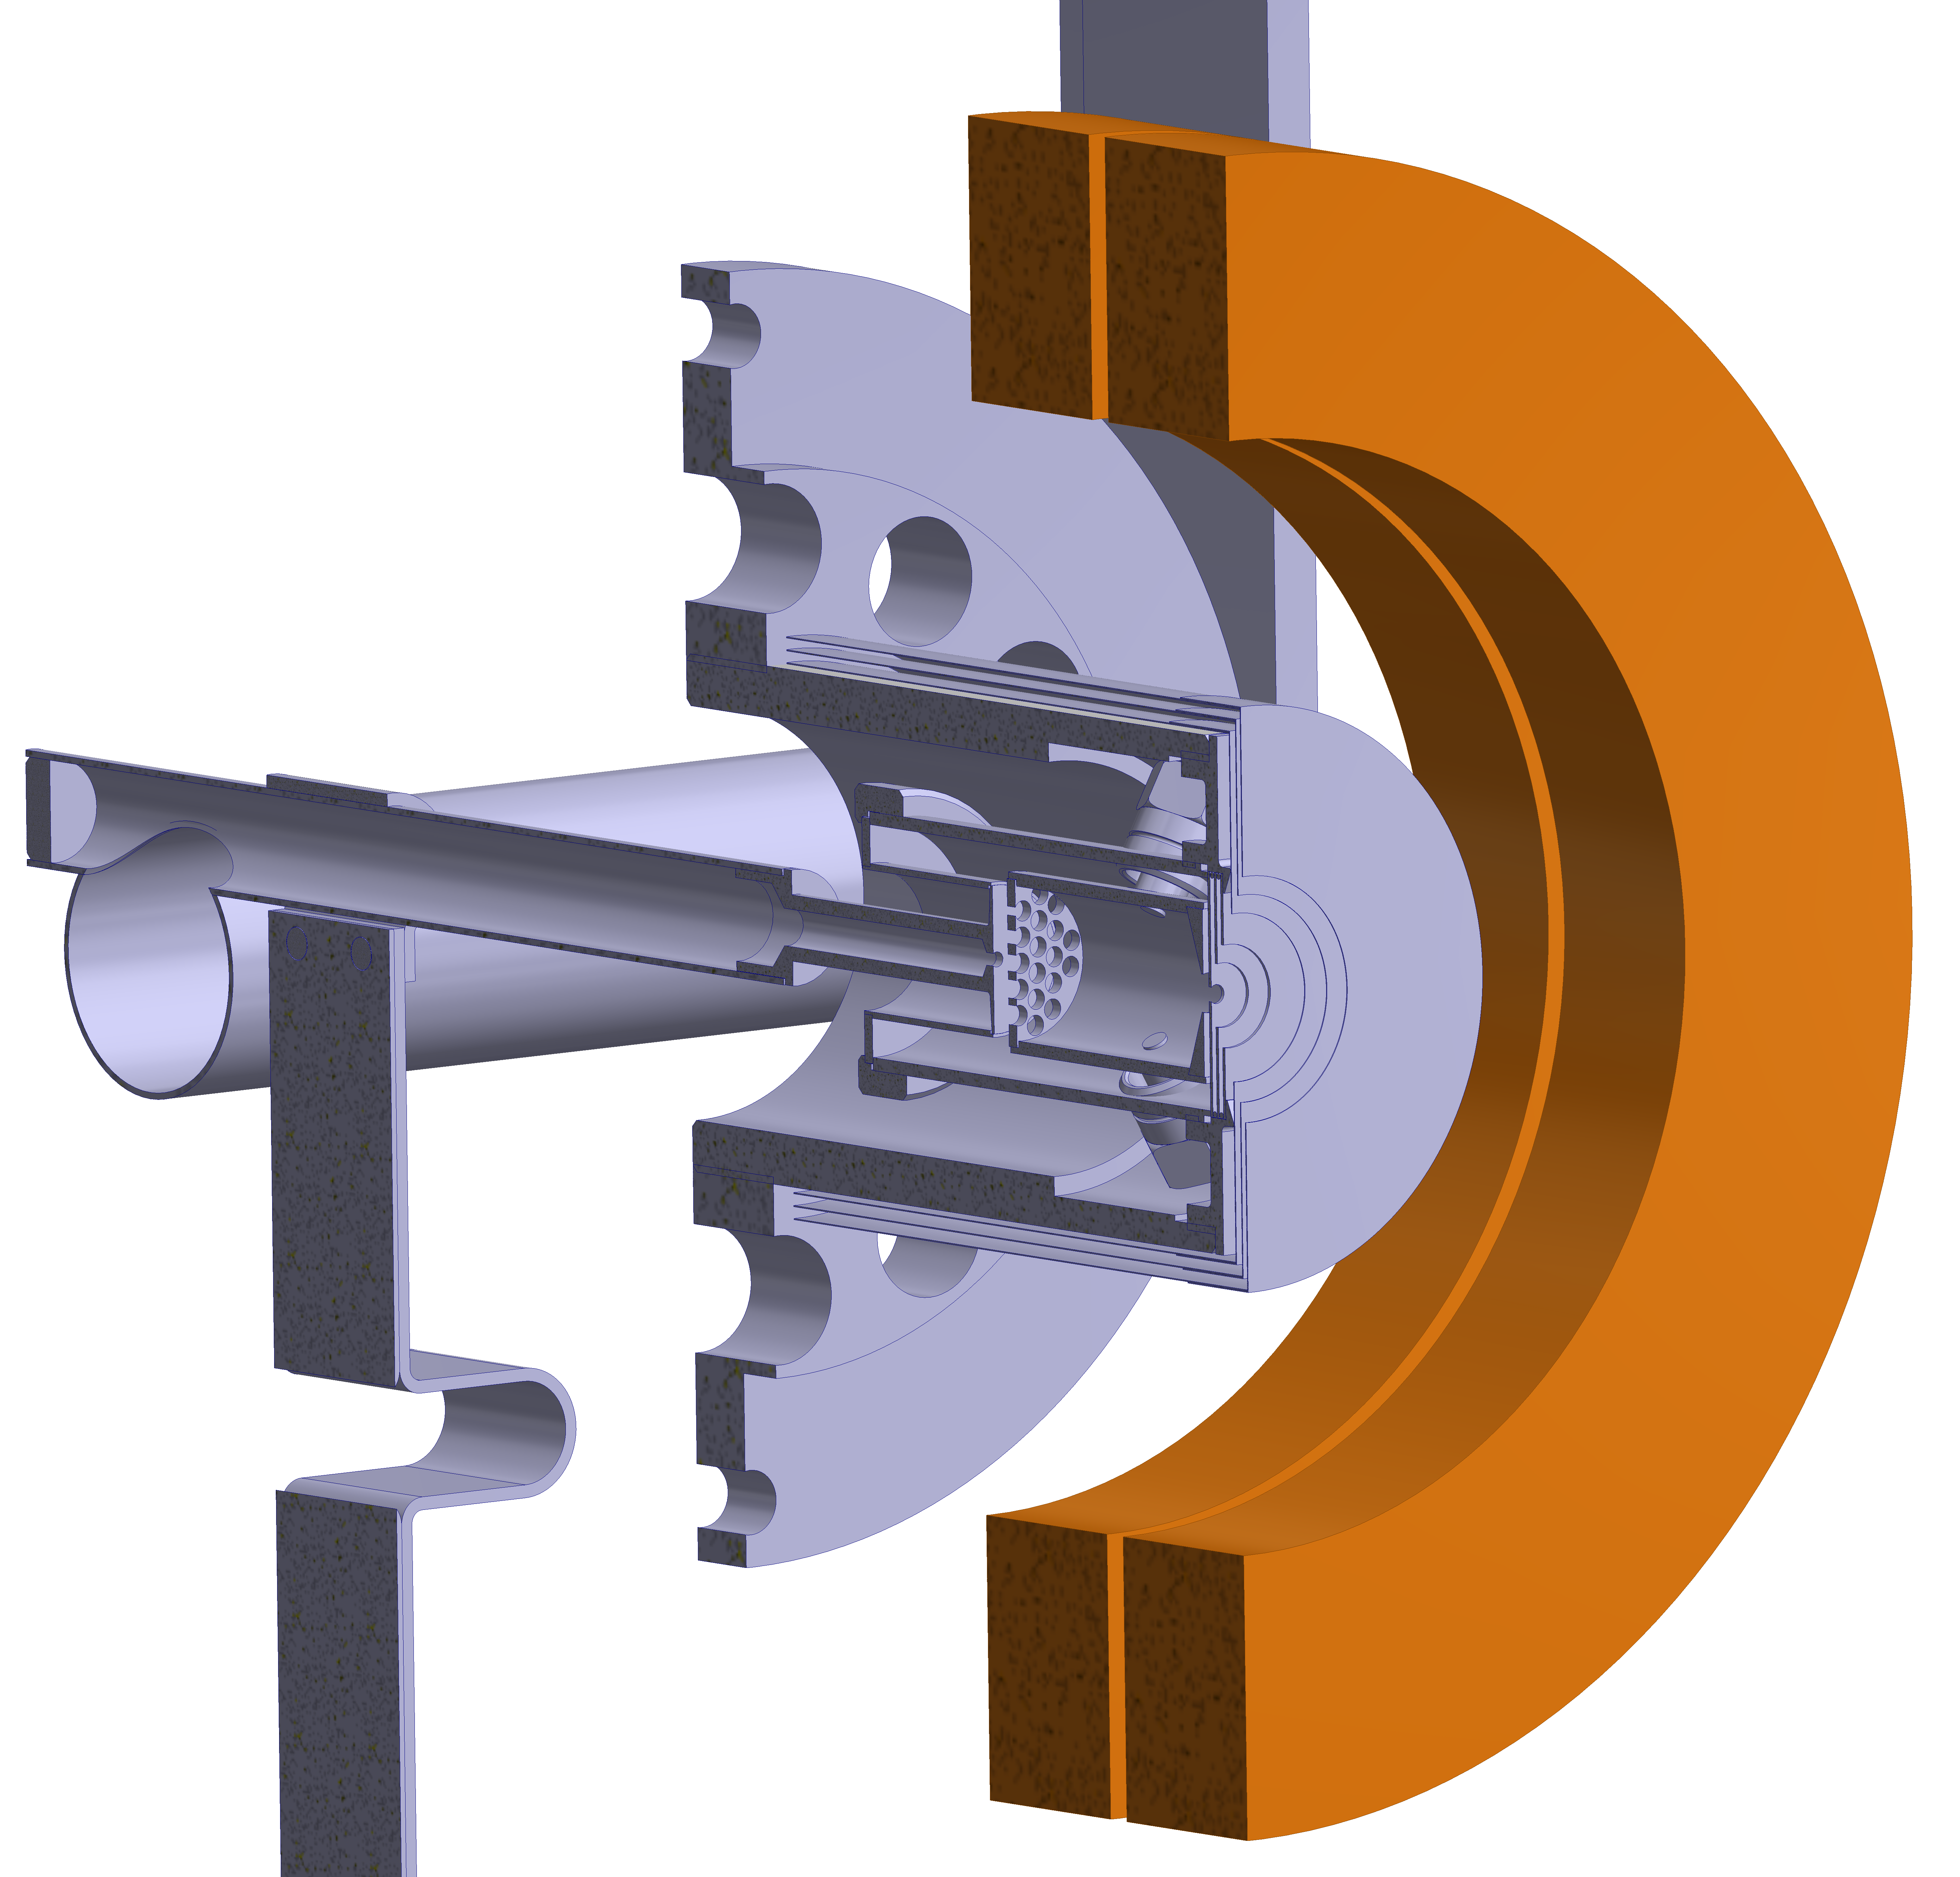
ISOLDE - Ion sources
Principle for ALL ion sources: apply energy > ionization potential (IP)
Plasma ionization
For all IP
Can break up & ionize molecules
Surface ionization
Hot cavity (line, up to 2400°C) of W or Ta
For low (< 6.5 eV) IP elements
Resonance laser ionization
For (nearly) all IP
Intrinsically element selective
Efficiency
*
Selectivity
Reliability
Universality
Simplicity
* Relative scale
12

Slide 39
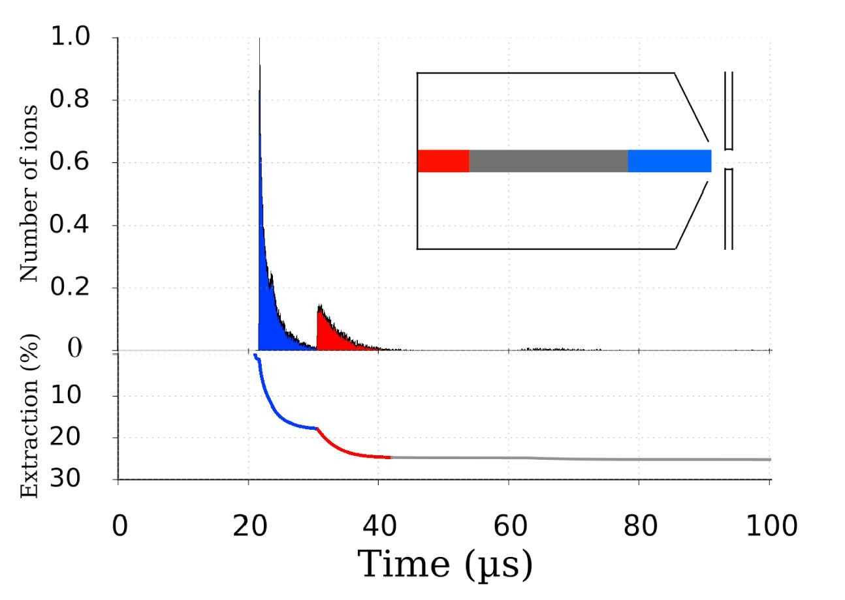
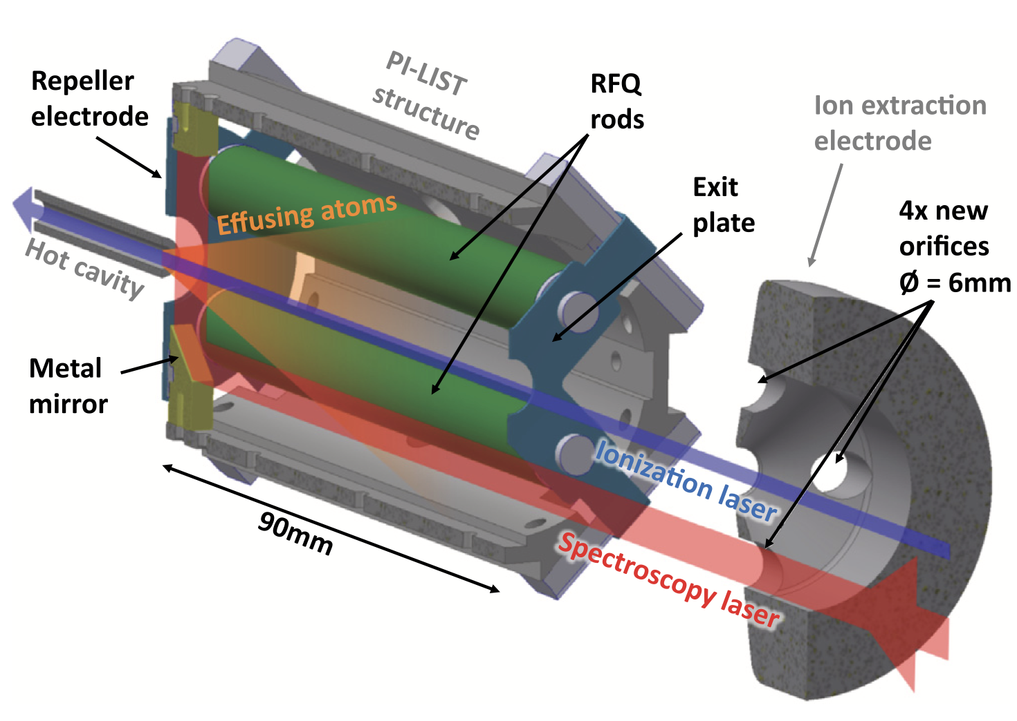
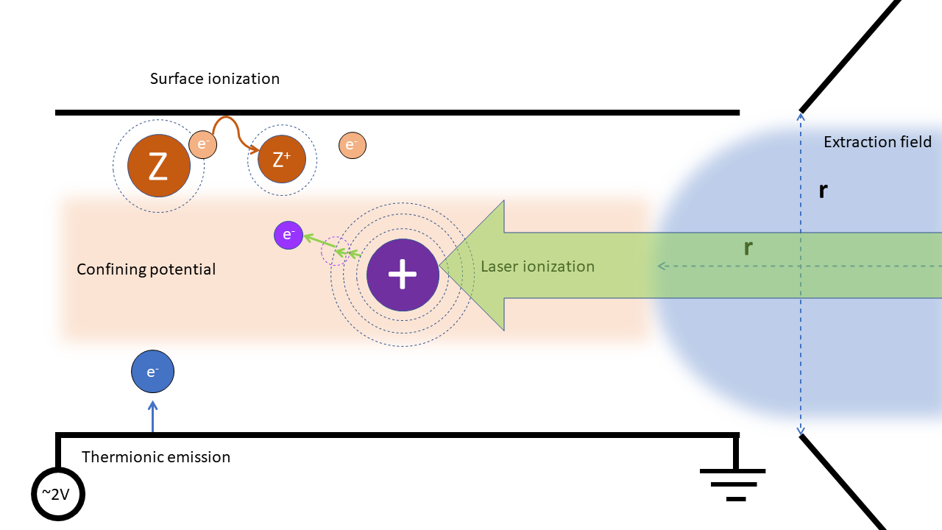
Other pros
  already HIGHLY selective “out of the box”
  Laser ionization offers ways to improve selectivity “at the source”
    Isomer selectivity through use of narrow(ish) linewidth lasers
    Isobar suppression through
      LIST (laser ion source and trap with surface ion suppression)
      Beam gating on laser ion time structure
      Use of appropriate materials (that’s another full hour talk…)
  Combination with FEBIAD type sources is possible → VAD(L)IS
  Great way to check beam composition through “laser on – off” measurements
  Best emittance of the ”standard” low RIB ion sources
Most demanded by ISOLDE users
Y. Martinez et al NIM B 431 (2018)
R. Heinke et al NIM B 541 (2023)
Figure courtesy of R. Mancheva

Slide 40
RILIS future (?)

Slide 41
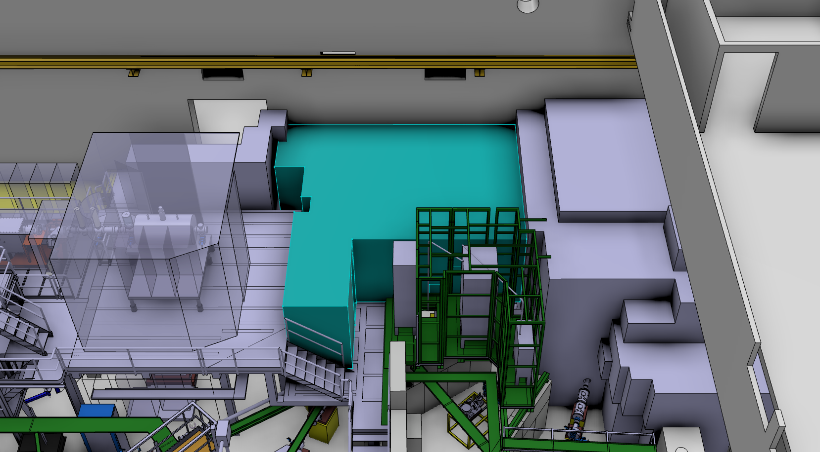
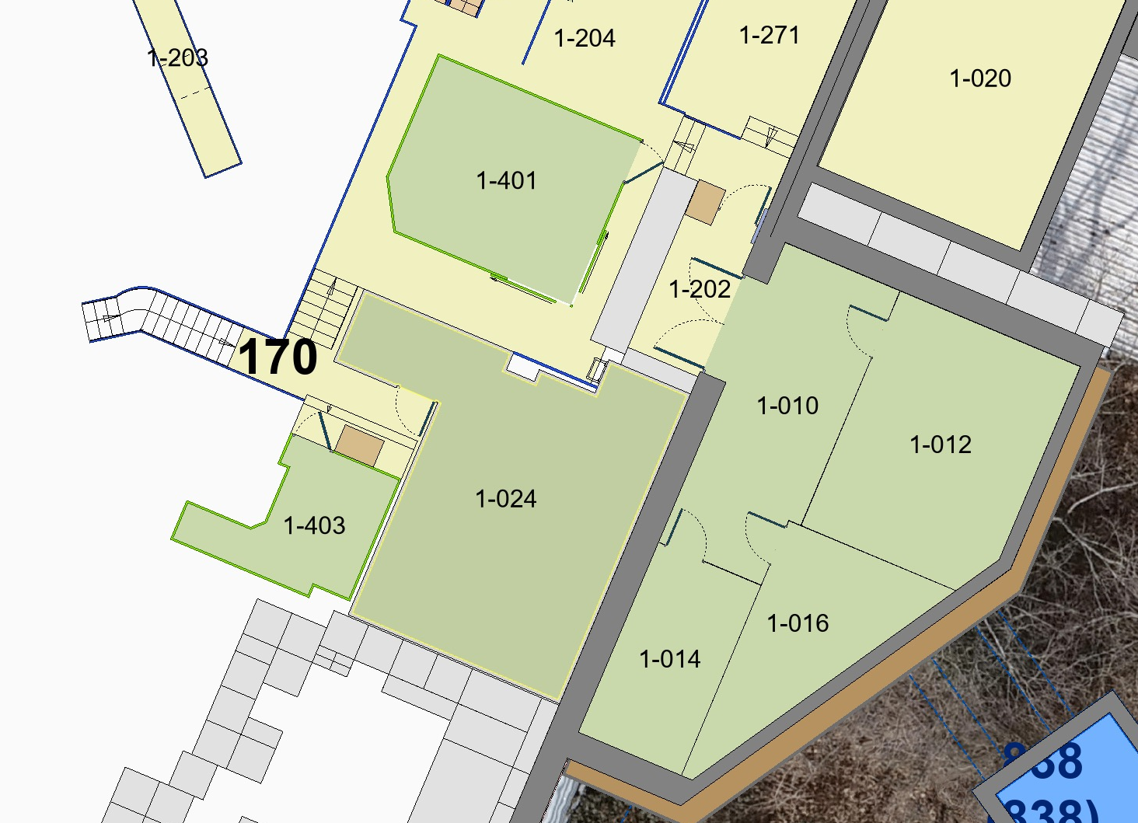
Current layout and proposed space increase
RILIS lab
Proposed increase
HV Faraday cage EBIS
34.5m²
HV Faraday cage ISCOOL
+6m²
HV Faraday cages GPS & HRS
+10m²
RILIS lab
Option 1 → up to edge of first extension from LS1
Option 2 → up to edge of the platform holding EBIS cage
Layout of RILIS lab and surrounding rooms

Slide 42
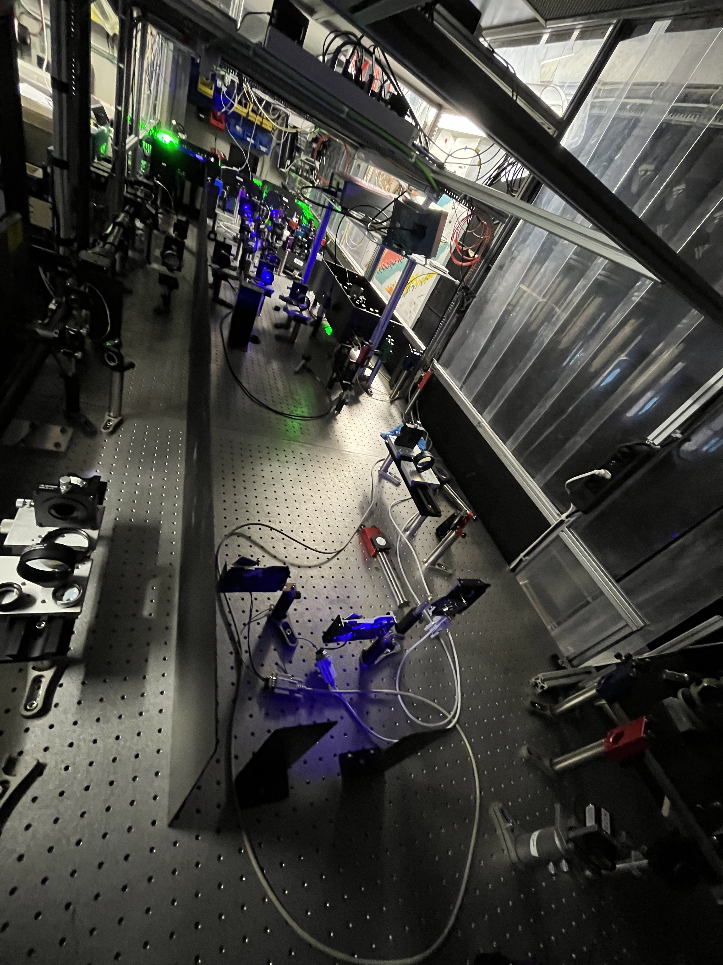
Placement inside the lab
HRS launch
HRS laser tables
HRS ref area
~ 1 Mio CHF allocated by CERN for the upgrade during LS3
GPS launch
SAS
GPS laser tables
GPS ref area
SAS
Possible new layout:
Tables separated for GPS and HRS
Launch and reference areas allow (if needed) crossing from one to the other table
Current layout
With 3 big laser tables, pump laser and dye tables & launch and reference areas

Slide 43
Thank you for your attention!

Slide 44
RILIS R&D
RILIS has been in operation since early 90’s
Started with CVL pumped dye lasers
Now a dual solid-state/dye system
Implementation of online monitoring and control during the past decade
increases system availability but also requires more training for operation
Ongoing developments:
  Raman laser for increased wavelength coverage and linewidth reduction for high resolution applications
  Time of flight laser ion source (ToF LIS) (pulsed heating, beamgating, ion source material)
  Laser Ion Source and Trap (LIST)
  2-photon ionization
  Laser ionization scheme development
  RILIS control system upgrades and developments
  …

Slide 45
On-call operation and what it means
Providing up to 80% of ISOLDE beams is time-consuming but possible if we do not have to “babysit” the laser system at all times
Setup is done during working hours (Mon-Fri, 8:30-17:30), everyone from the RILIS team helps out with this
  If anything happens during the working hours, RILIS operator can be called and will be there within a short time
  The team will give support
On-call operation is everything outside working hours
  One person is assigned to be on-call and available to come to CERN within ~1 hour
  One person is on backup → can be called for help but does not need to be available to come to CERN
  Three possible scenarios in case there really is a RILIS problem:
  Problem is easy to fix: the RILIS operator will do so
  Problem requires a second person: backup can be called and, if (s)he is available may come in to help (but does not have to if unavailable!)
  Problem cannot be fixed by operator (& backup): Laser system is brought into safe state and we will fix the problem during working hours

Slide 46

“If there's somethin' strange in your neighborhood
Who ya gonna call?”

Slide 47
Who ya gonna call?
Similarities between ghosts and problems at ISOLDE:
Just like ghosts, problems like to appear during the night or on weekends
They need to be categorized in order to be solved in an adequate way
With the right people there, they should be gone soon!
RILIS is just one of many parts required to provide an ion beam to your setup
Before you call the RILIS operator, please make sure that the problem really is laser related!
→ So, the easy answer to “who ya gonna call” is “the ISOLDE operator in charge!”

Slide 48
Identifying RILIS related problems
We provide multiple observables to identify if there are RILIS problems:
Website with published images and wavelengths of the laser beams
  All laser beams are there? → call the ISOLDE OP
  A laser beam disappeared (and you’re sure the the shutter is open) → call RILIS
  The wavelength is not what it should be? → call RILIS
Laser shutter for users (recently upgraded to give even more information!)
  please check laser on/off ratio on a FC with stable beam
  Does this work? Yes → call the ISOLDE OP (can’t be a RILIS problem), No → call the ISOLDE OP (very likely still not a RILIS problem)
  Laser on/off (now possible with up to 3 laser steps!) shows nothing? → call the ISOLDE OP
”Who ya gonna call” → The ISOLDE OP (with very few exceptions!)

Slide 49

Surface vs laser ions
For some elements laser ionization provides an enhancement over the surface ionization
For some laser (or plasma) ionization is the only path (so there is no ion beam without lasers)
Depending on the laser ionization scheme, there is signal when e.g. 2 out of 3 laser beams go into the ion source
Image extracted 04.05.2021, 19:05 https://en.m.wikipedia.org/wiki/File:First_Ionization_Energy.svg

Slide 50


The RILIS laser shutter(s)
There used to be 1 laser shutter in the control room BUT: no feedback if open/closed
Upgraded the shutter hardware: recycling old hard drives → now up to 6 shutters in use
NEW: software to control the shutters with feedback on status (open/closed)
“user mode”: simple laser on/off measurements (e.g. background estimation)
“expert mode” for RILIS team: more detailed measurements for laser performance
Guide on proper usage will be made available for the online period → please make sure visitors know about this!

Slide 51



The RILIS laser shutter(s): ion beam examples
1) Beam with surface ions & laser enhancement
2) Beam with laser ions only and signal generated by partial scheme
3) Beam with laser ions only and signal generated by full scheme
1st step only
1st step only
Full scheme
Lasers OFF
(surface only)
Full scheme
2nd step only
(no laser ions!)
1st & 2nd step
No signal:
No laser
Any laser combination that’s not the full scheme
Ion beam signal
Ion beam signal
Full scheme
NOTE: The enhancement factor is given ONLY for stable beam (on other masses there can be isobaric contamination!)
No signal:
No laser
2nd step only
2nd & 3rd step
3rd step only
Ion beam signal

Slide 52


RILIS status viewer
Set wavelength
Wavelength deviation
Reference → if all shutters are open, this is what you should see
Proportional power reading
Laser in use

Slide 53
Identifying RILIS related problems
Symptoms | (possible) cause | Check | Call RILIS?
Sudden loss of ion beam | FC left inside ion beam, valve closed, HV tripped, no protons, wrong mass, complete laser failure | Nothing in the beam line? HV on? Right mass? Laser on/off with MM on stable mass (to identify if there is something wrong with radioactive beam only) | No
Slow and steady decrease of ion beam | Target degradation Steady loss of laser power/wavelength drift | All laser beams visible? Same intensity/shape of laser profile? Correct wavelength? | Yes (if you can certainly answer “No” to any point in the check list)

Slide 54

A quick look at the schedule
With a 1-week exception, RILIS will run non-stop
First dual-separator operation
In-source spectroscopy (with shift work)

Slide 55
RILIS team

Slide 56
The SY-STI-LP section and our mandates
SY(stems)-S(ources)T(argets)I(nteractions)-L(asers)P(hotocathodes) section mandates:
laser installations and optical beam lines used to produce charged particle beams in the CERN accelerator complex and research facilities
ISOLDE-RILIS
ISOLDE-OFFLINE2
MEDICIS-MELISSA
Photoemission Laboratory
AWAKE
CLEAR
Development and implementation of novel lasers and photonic methods for production of ions, electrons and plasma
LISA ITN training network

