Slide 1
Physics program with
beams
• The low-energy RIBs at ALTO : photofission implemented in ISOL-production mode
→ intermediate-mass, neutron rich nuclei
• A quick glance in the rearview mirror (since ASN’s license to run: 2012)
→ the advent of BEDO (2012), TETRA (2015) and COeCO (2022) → focus on the beta-delayed spectroscopy tools
+ perspectives with MLL-Trap
- perspectives for POLAREX (still in “refinement” process, for ALTO and SPIRAL1 post-POLAREX dry device at DESIR)
• new physics avenues
→ structure nearby and above the neutron separation threshold
→ E0 strength measurement and the investigation of shape coexistence

Slide 2
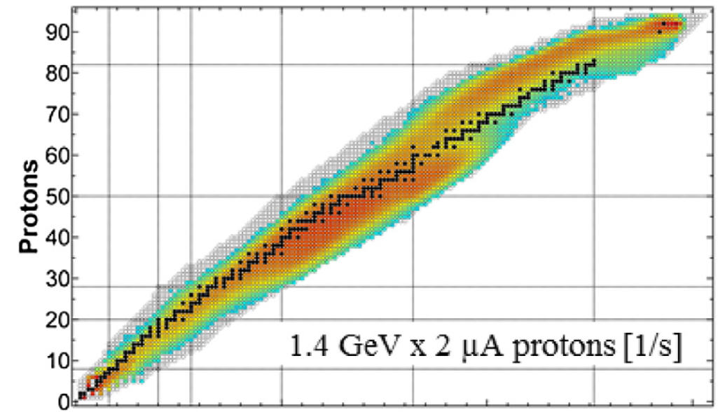
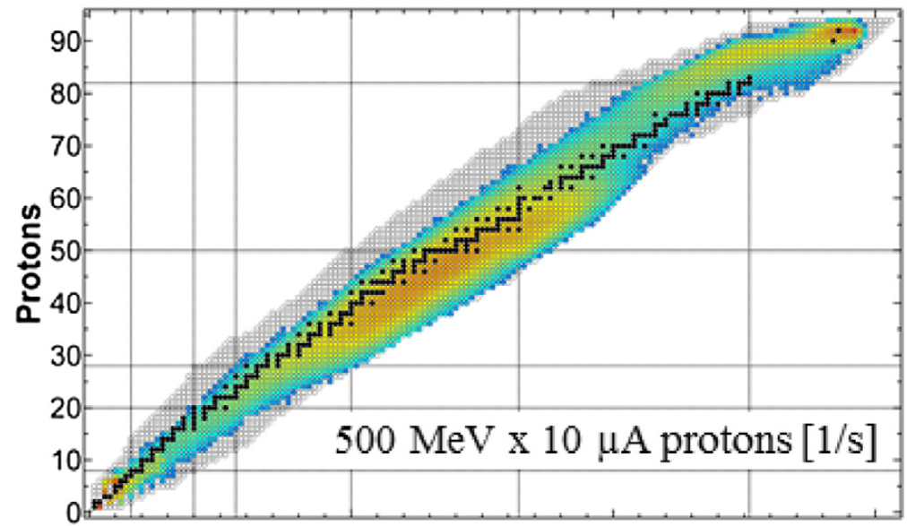
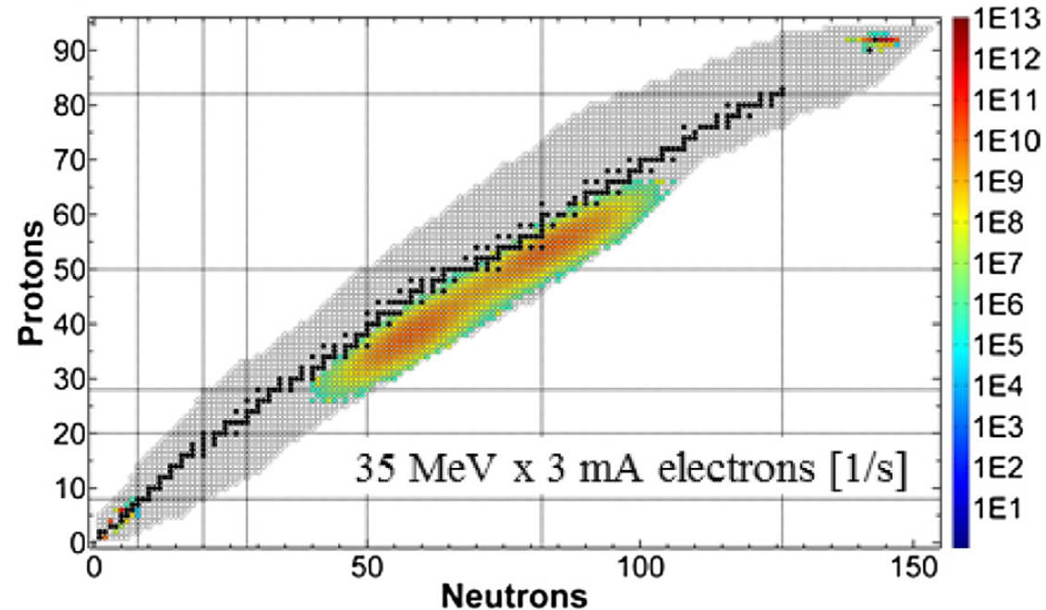
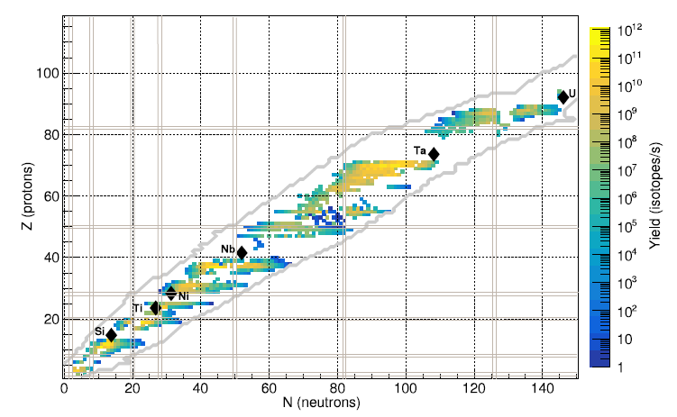
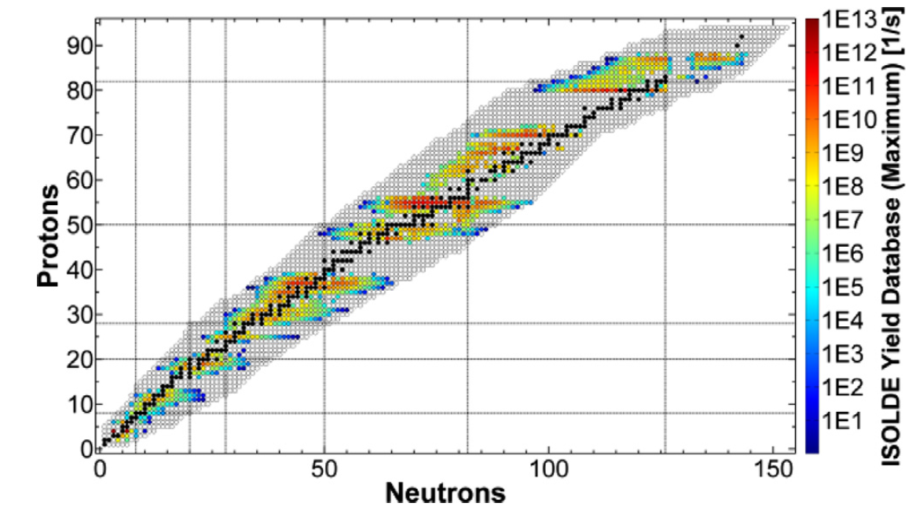
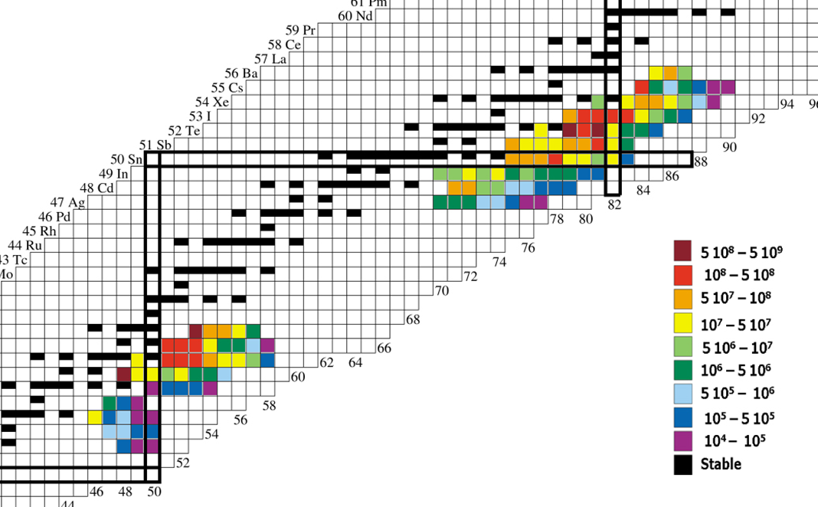
Low-energy RIBs at ALTO (in the global landscape)
A. Gottberg NIMB 376 (2016) 8–15
ISOLDE
ISAC/TRIUMF
ARIEL 3 mA (ALTO 10 µA)
spallation component
spallation component
× {extraction & ionization} efficiencies
measured in 2006 (ALTO commissioning phase)
hot plasma ion source
“best data-base yields”
“best data-base yields”
NIMB B (2023) 117
NIMB 376 (2016) 8
refractory gaps
refractory gaps
refractory gaps

Slide 3
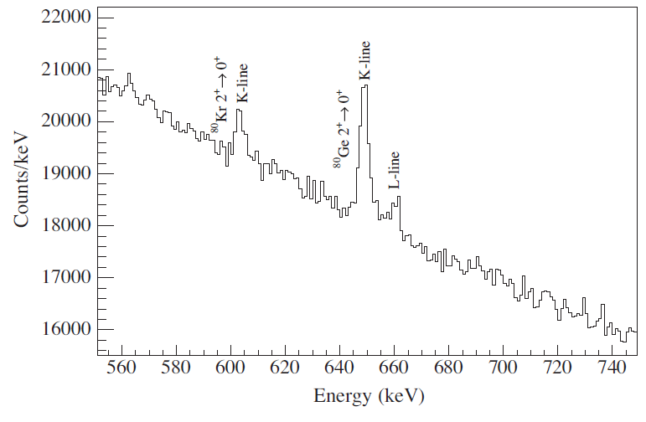
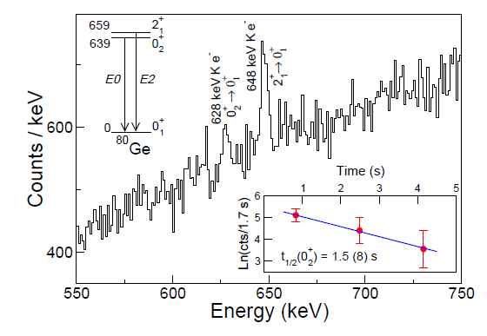
Low-energy RIBs at ALTO (in the global landscape)
A=80
A=80
Rb (surface ionization)
Rb (surface ionization)
⁸⁰Ga
⁸⁰Ga
p (500 MeV) induced fission
photofission
example of ⁸⁰Ga→⁸⁰Ge decay-spectroscopy study
ALTO: PRC 87, 054307 (2013) ⁸⁰Ga yield ≈10⁴ pps ; 0% ⁸⁰Rb contaminant
ALTO: PRL 118 182501 (2016) ⁸⁰Ga yield ≈10⁴ pps ; 0% ⁸⁰Rb contaminant ϵ_{γ}(1.3 MeV): 0.7% ; 1 Si(Li)
ISAC/TRIUMF : PRL 125, 172501 (2020) ⁸⁰Ga yield ≈10⁴ pps ; 78% ⁸⁰Rb contaminant*; ϵ_{γ}(1.3 MeV): 8% ; 5 Si(Li)
ALTO: PRC 111, 034303 (2025) ⁸⁰Ga yield ≈10⁴ pps ; 0% ⁸⁰Rb contaminant
*Fatima H. Garcia (SFU) presentation at Winter Nuclear and Particle Physics Conference (Feb 2025)
→The quality of an ISOL facility is determined by :
the diversity of the beams,
their purity,
and the availability of instrumentation suited to the physics program, enabling access to a consistent set of observables.

Slide 4
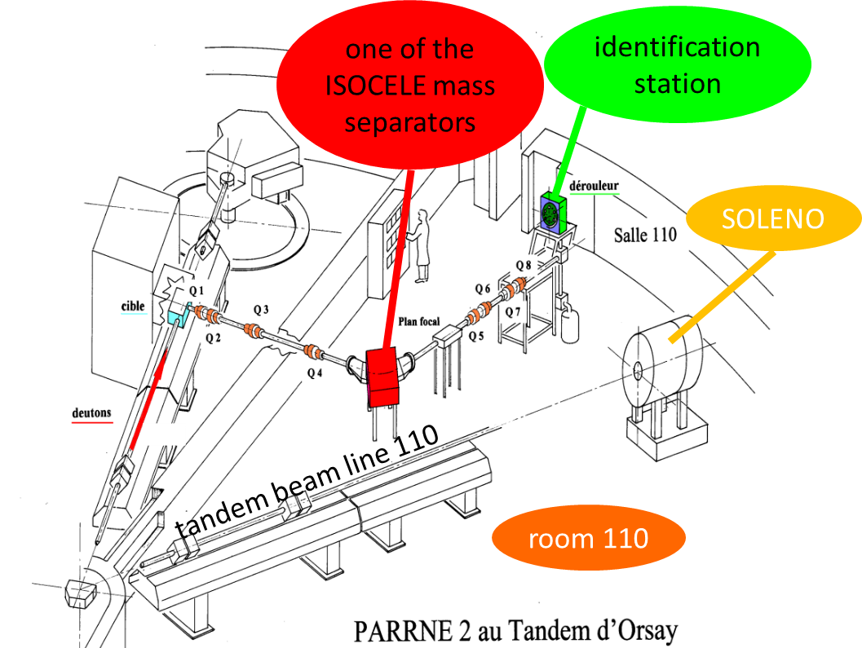
A quick glance in the rearview mirror
Exploratory (pioneering) experiments with the Tandem-driven PARRNe R&D device
PARRNe « Production d’Atomes Radioactifs Riches en Neutrons »
2001
within the framework of the SPIRAL2 project
state of the art of structure knowledge, 2000’s beginning
Zr90
Zr91
Z=40
β-decay
Y89
(d,3He)
Sr84
Sr86
Sr87
Sr88
Zendel et al
Inorg Nucl Chem
42, 1387 (1980)
Rb85
Rb87
(t,p)
Kratz et al
Nucl Phys A
250, 13 (1975)
Chimical separation
Kr78
Kr80
Kr82
Kr83
Kr84
Kr85
Kr86
Br79
Br81
Br85
fission
Del Marmol et al
Nucl Phys A
194, 140 (1972)
Se74
Se75
Se76
Se77
Se78
Se79
Se80
Se81
Se82
Se83
Se84
As75
As83
Hoff -Fogelberg
Nucl Phys A
368, 210 (1981)
OSIRIS /Studsvik
Ge70
Ge72
Ge73
Ge74
Ge76
fragmentation
Ge82
Ge83
Ge83
On-line mass separation
Ga69
Ga71
Ga79
Ga80
Ga81
Ga83
Winger et al
Phys Rev C
36, 758 (1987)
TRISTAN /Ames
Ga81
Zn66
Zn67
Zn68
Zn70
Zn75
Zn76
Zn77
Zn78
Zn80
Zn81
β-delayed spectroscopy at PARRNe : 2001-2003
Cu65
Cu74
Cu79
Ni64
Ni65
Ni66
Ni67
Ni68
Ni69
Ni70
Ni71
Ni72
Ni73
Ni74
Ni75
Ni76
Ni77
Ni78
28
N=40
50
isomeric decay: LISE-GANIL
frontier of knowledge

Slide 5
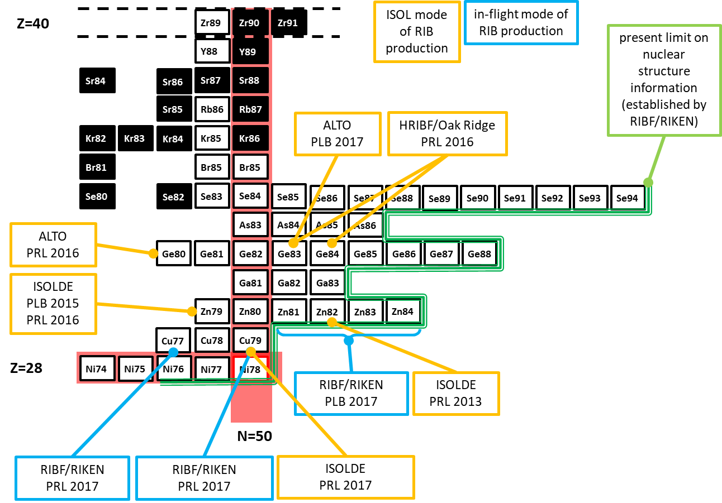
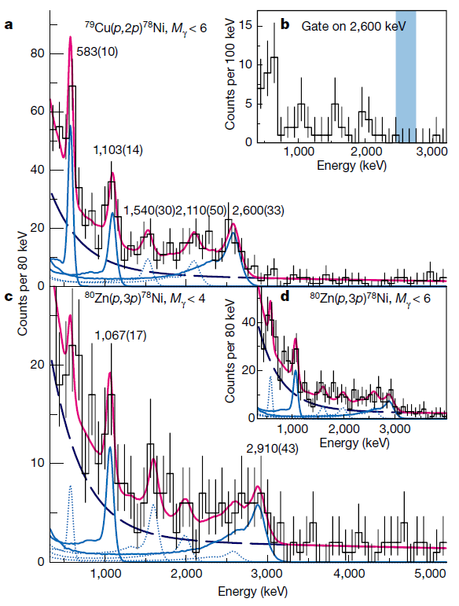
A quick glance in the rearview mirror
Overview presented at ISPUN 2017
→ During the second half of the 2010s, the ISOL method remained competitive despite the rise of next-generation in-flight facilities like RIBF/RIKEN.
2017
First spectroscopy of doubly-magic ⁷⁸Ni obtained at RIBF/RIKEN [Nature 569 (2019)]
→ poor spectral quality -- too many lines ?
→ The interpretation of the spectra required invoking the concept of shape coexistence in the ⁷⁸Ni region, which had already been introduced and discussed based on results obtained using the ISOL method (notably at ALTO)

Slide 6
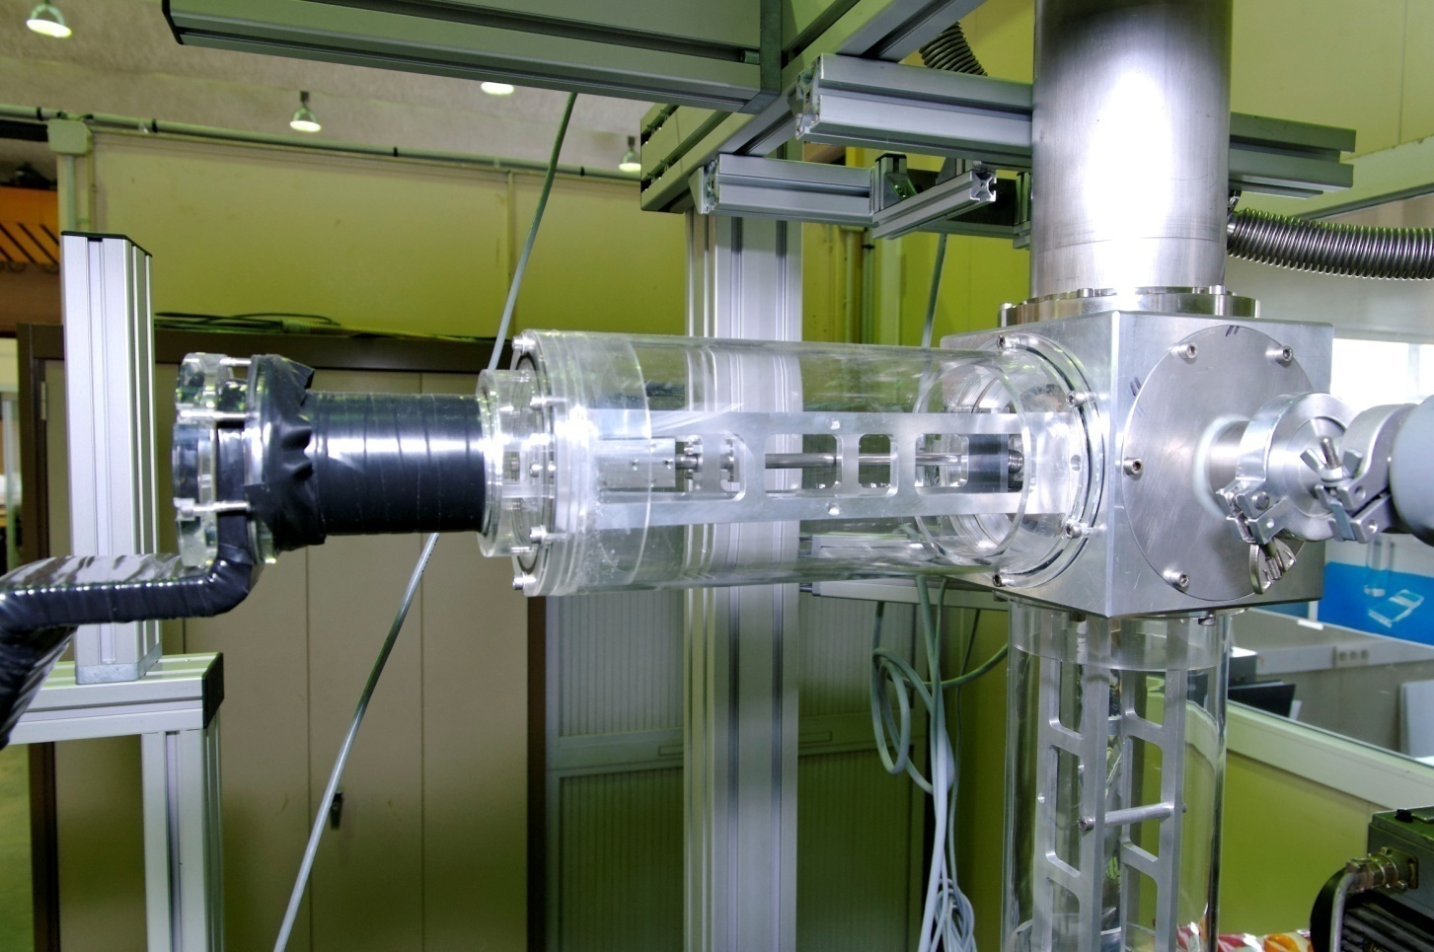
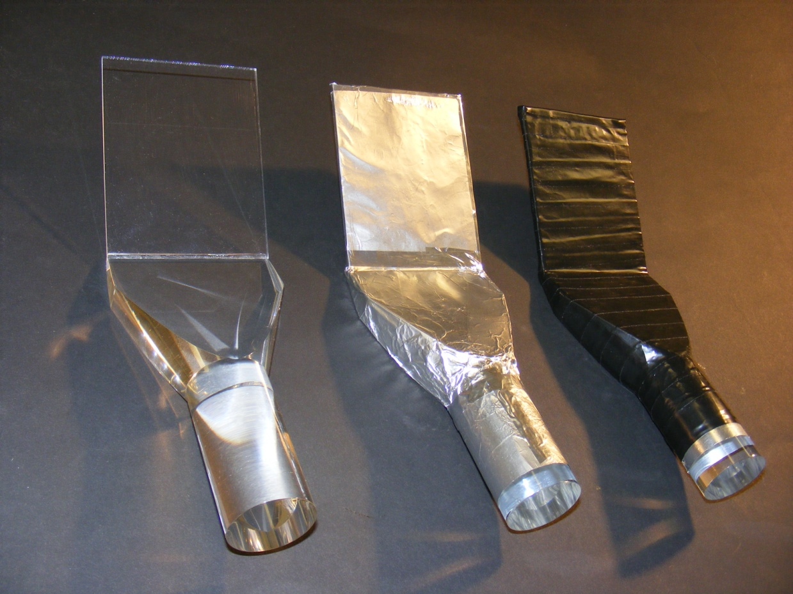
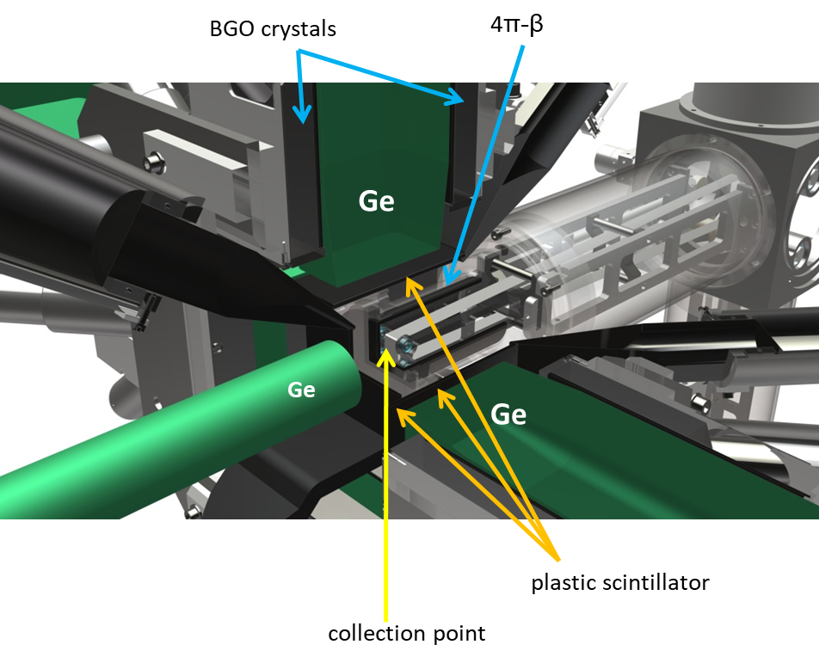
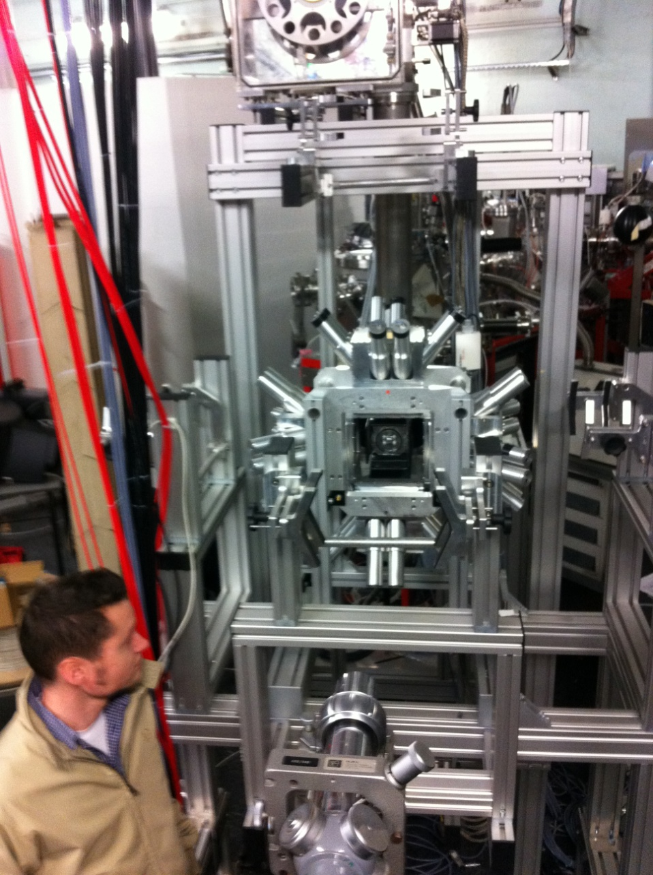
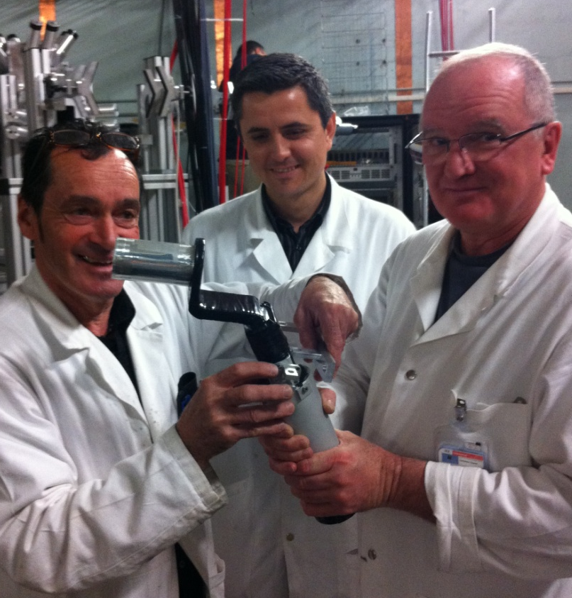
instrumentation of ALTO since ANR’s license to run (2012) : BEDO
the BEDO concept
Maximum space for detectors around the collection point
Compact geometry (max γ efficiency)
γ background suppression
modularity
2012
5 HPGe detectors
Source-cap distance = 5 cm
ε_{γ (1 MeV)} ≈ 4-5 %
Many things were home made
J. Bettane, A. Maroni, M. Imre, C. Thenau, B. Gajewski, B. Geoffroy, B. Mathon, L. Vatrinet, and M. Josselin
from the R&D Detection Department of IPN

Slide 7
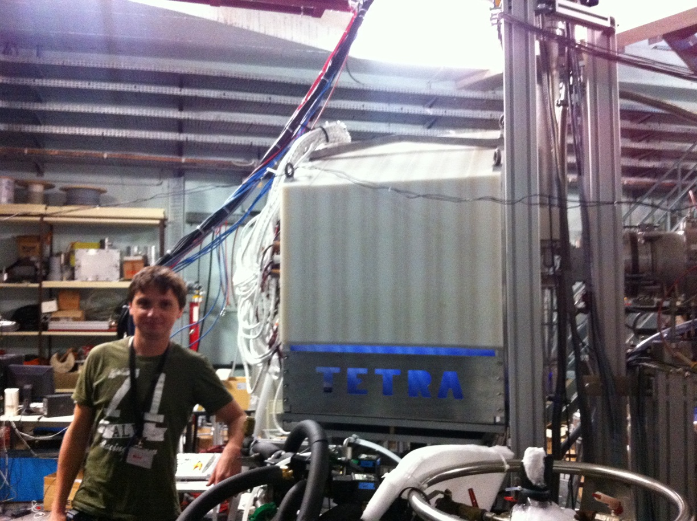
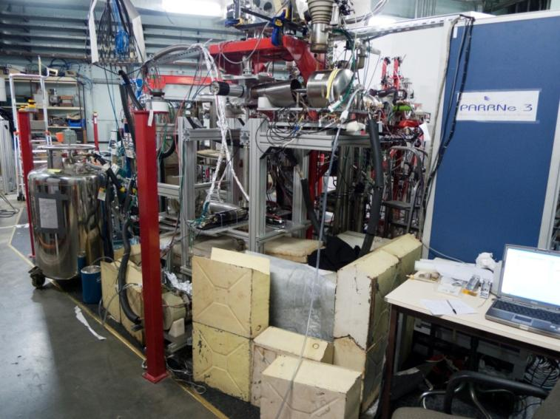
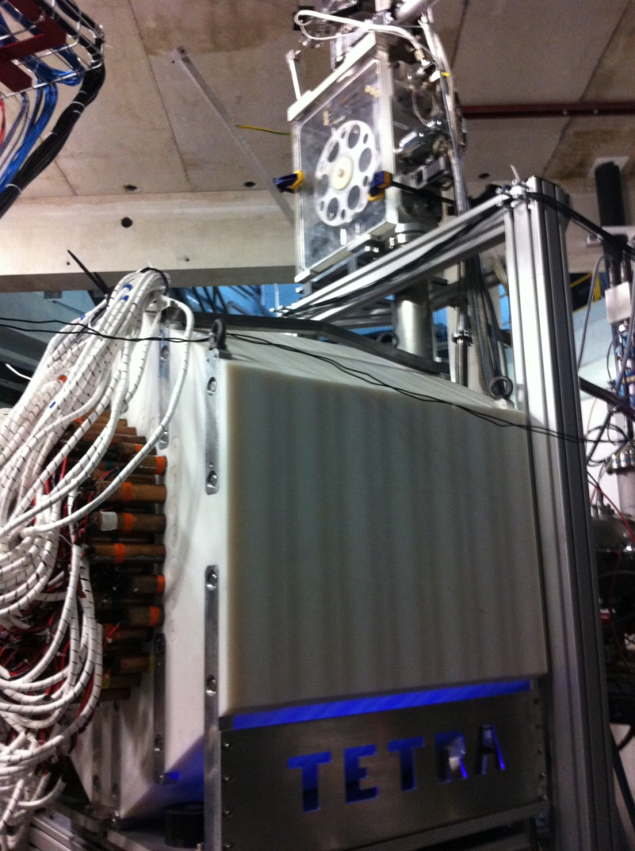
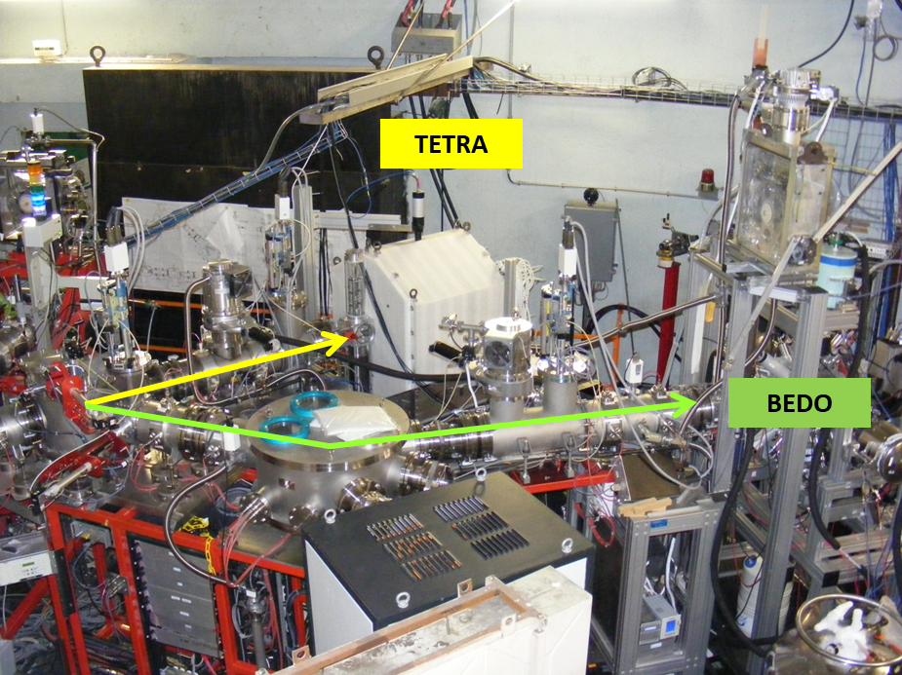
instrumentation of ALTO since ANR’s license to run (2012) : TETRA
the β-delayed neutron detection program
Dubna neutron counter TETRA
PhD D. Testov 2014
2015
TETRA@BEDO
2015 : dedicated beam line for TETRA
before 2012
three major experimental difficulties
Febiad source: beam purity
complex geometry of the detector
⇒ large uncertainties on ε_{n}
counting position far from implantation spot
~80 ³He tubes
borated polyethylene shielding

Slide 8
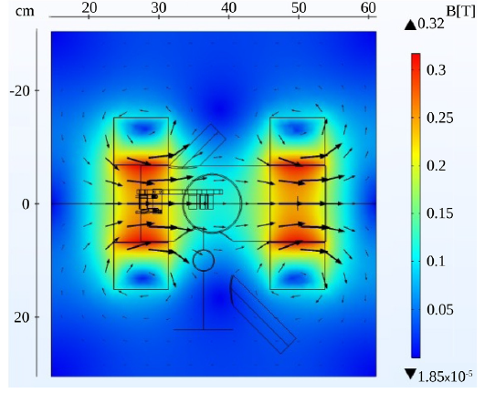
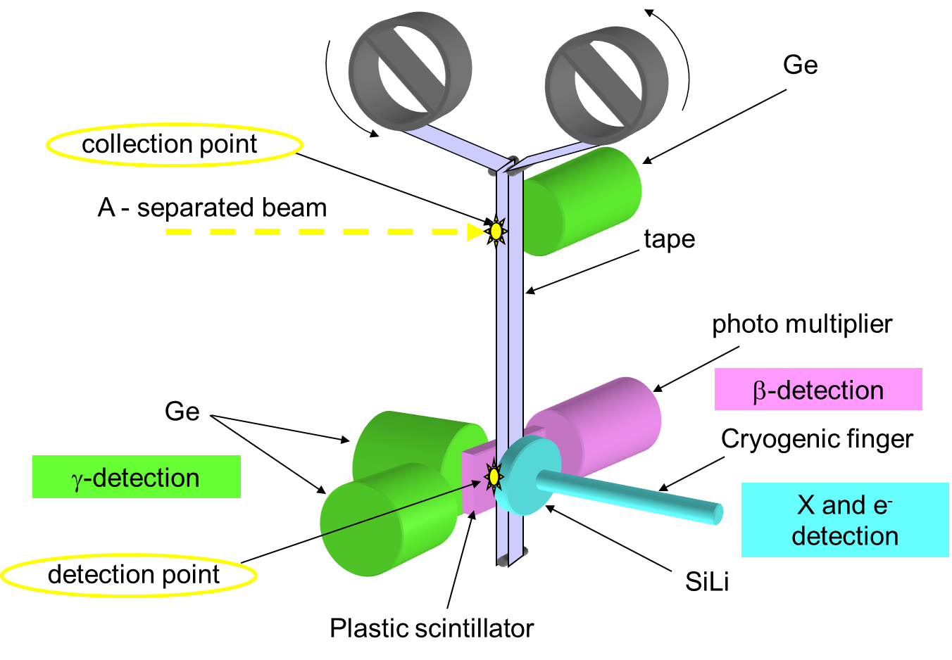
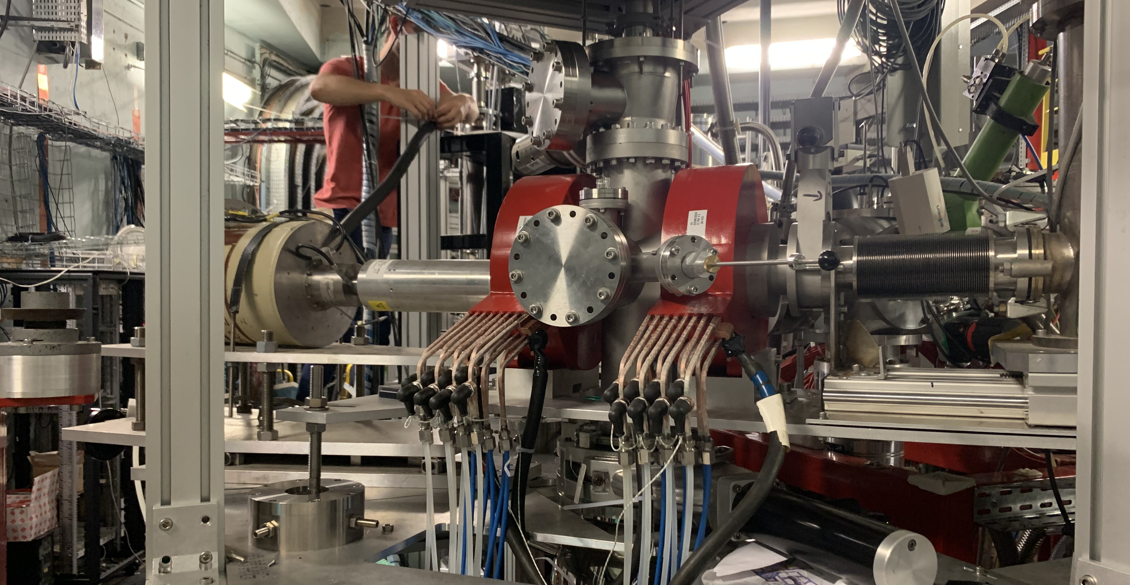
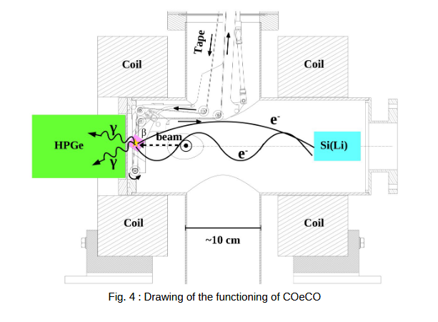
instrumentation of ALTO since ANR’s license to run (2012) : COeCO
the β-delayed conversion-electron spectroscopy program
2022
Tocabens et al NIM A 1064 (2024) 169345
magnetic electron transporter
2 coils in Helmholtz configuration
before 2022
two major experimental difficulties
Compton background ⇒ poor P/B ratio
counting position far from implantation spot (T_{1/2} limitations)

Slide 9
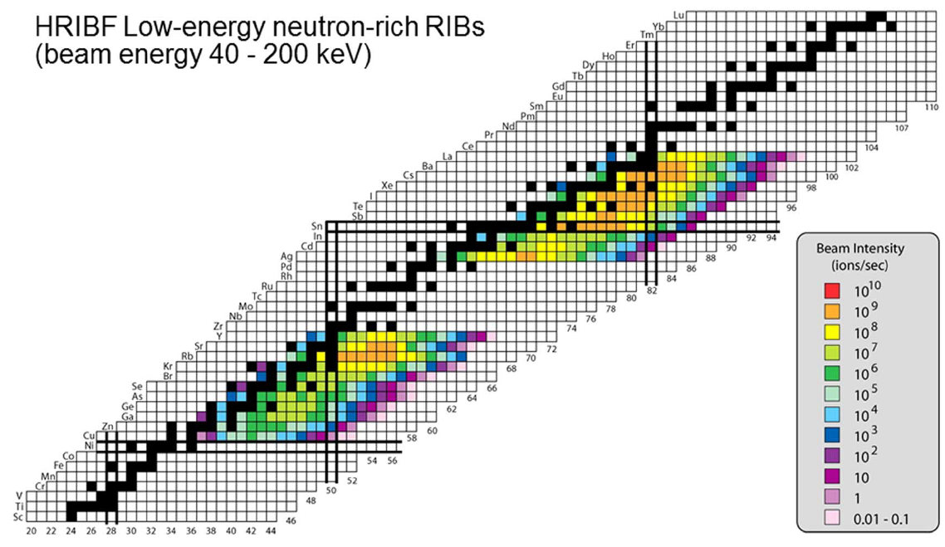
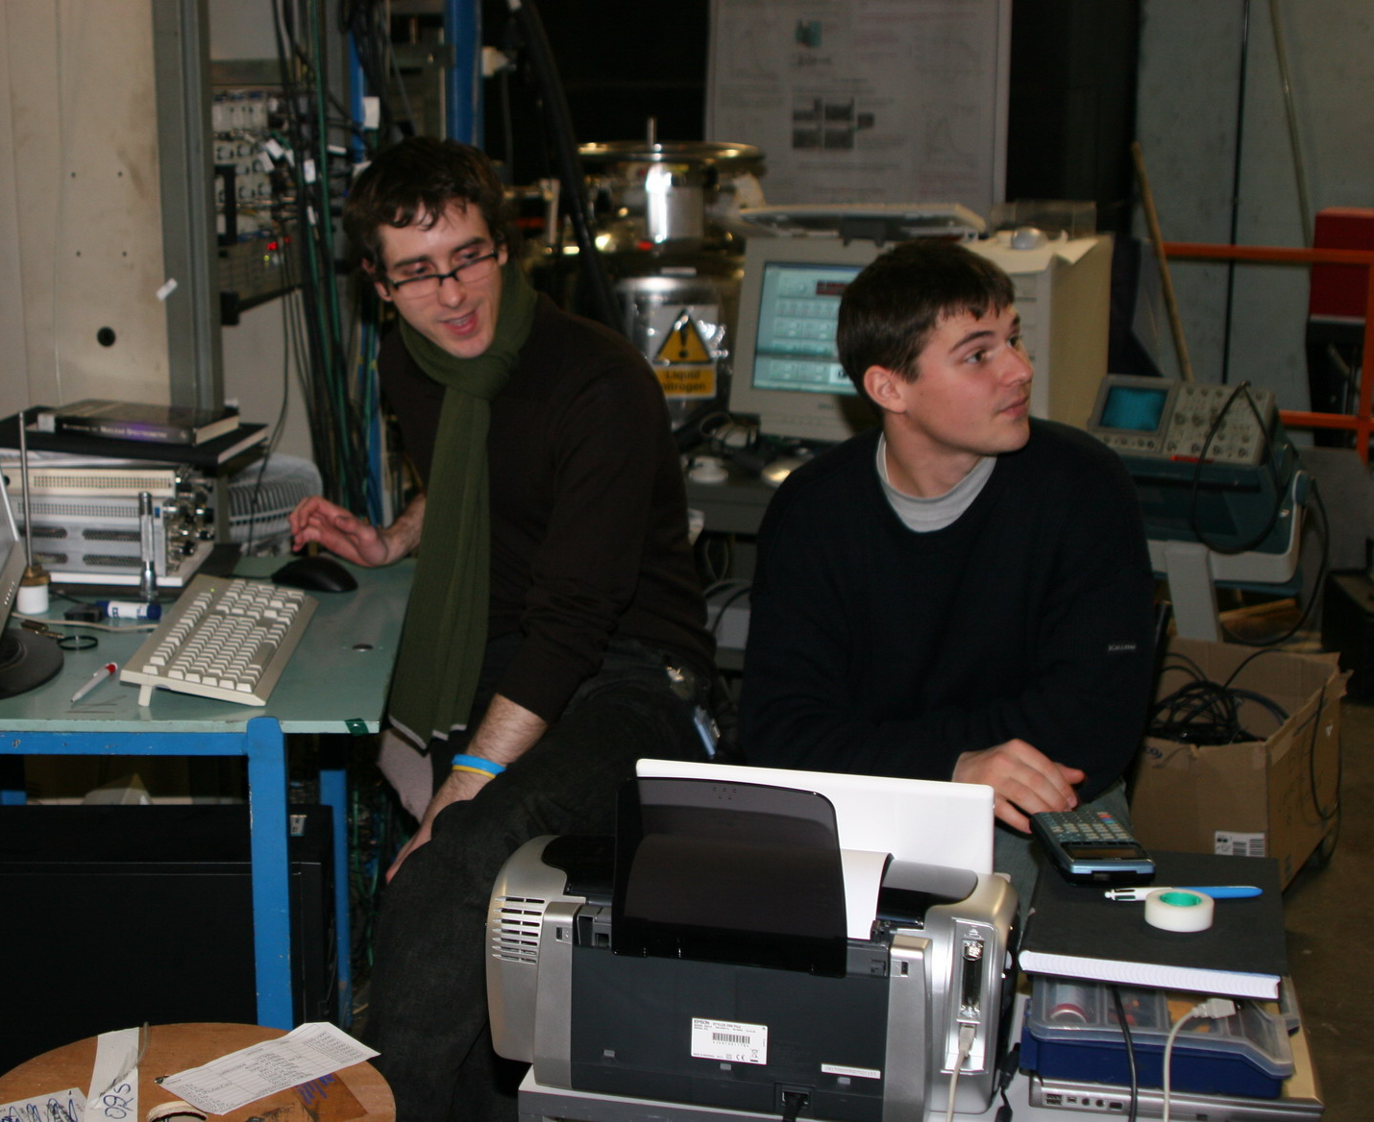
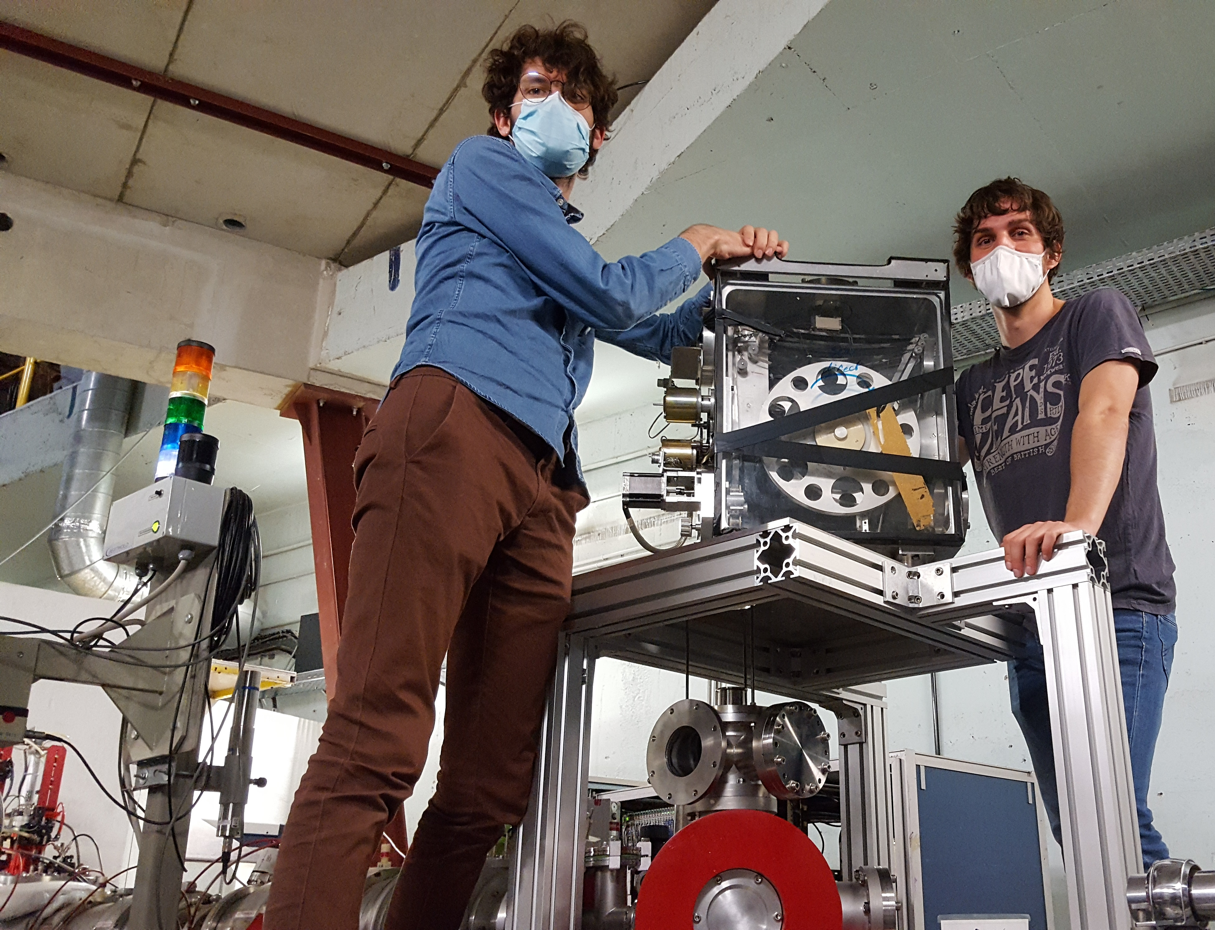
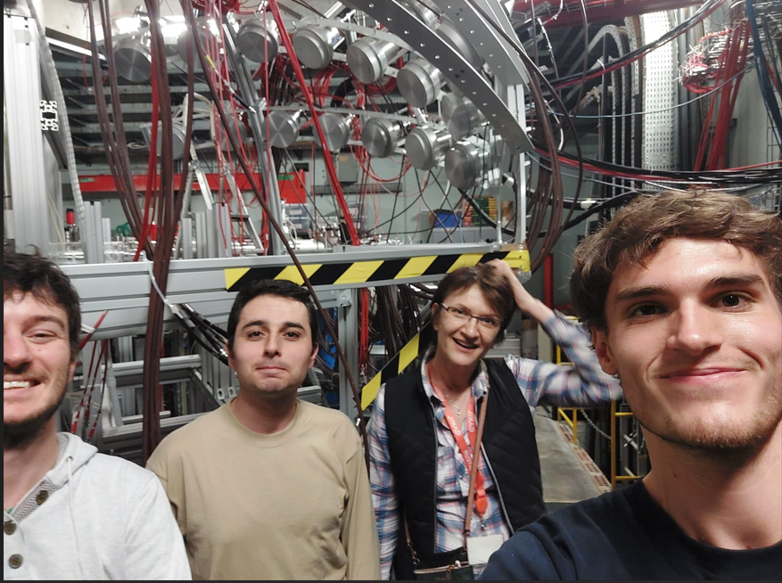
hot plasma ionization
(1 µA deuteron primary beam)
•O. Perru PhD –2004
Eur. Phys. J. A 28, 307 (2006)
PRC 76 054312 (2007)
(7 µA electron primary beam)
•A. Etilé PhD CSNSM –2014
PRC 91 064317 (2015)
surface ionization
(2-4 µA electron primary beam)
•M. Lebois PhD –2008
PRC 80, 044308 (2009)
•P.V Cuong PhD –2009
•B. Tastet PhD –2011
PRC 87, 054307 (2013)
•C. Delafosse PhD –2018
PRL 118 182501 (2016)
Phys. Lett. B 772 359 (2017)
D. Testov
L. Sagui
B. Tastet
M. Lebois
K. Kolos
hot plasma ionization
Cardona et al.
PRC 103, 034308 (2021)
Testov et al.
Eur. Phys. J. A 57 (2021)
laser ionization
(10 µA electron primary beam)
•K. Kolos PhD –2012
PRC 88, 047301 (2013)
•D. Testov PhD –2014
NIM A815, 96 (2016)
PRC 95 054320 (2017)
•G. Tocabens PhD – 2022
NIM A1064 169345 (2024)
PRC 111, 034306 (2025)
•R. Li PhD – 2022
PRC 111, 034303 (2025)
•L. Al Ayoubi PhD – 2023
•E. Cantacuzène PhD – ongoing
•E. Nseir PhD – ongoing
G. Tocabens
C. Delafosse
L. Plagnol
E. Cantacuzène
post-docs : L. Sagui, M. Babo, A. Gottardo, C. Delafosse, L. Plagnol
I. Matea
E. Nseir
L. Al Ayoubi

Slide 10
new physics avenues with ALTO beams
• β-delayed spectroscopy programme
→ structure nearby and above the neutron separation threshold
→ E0 strength measurement and the investigation of shape coexistence

Slide 11
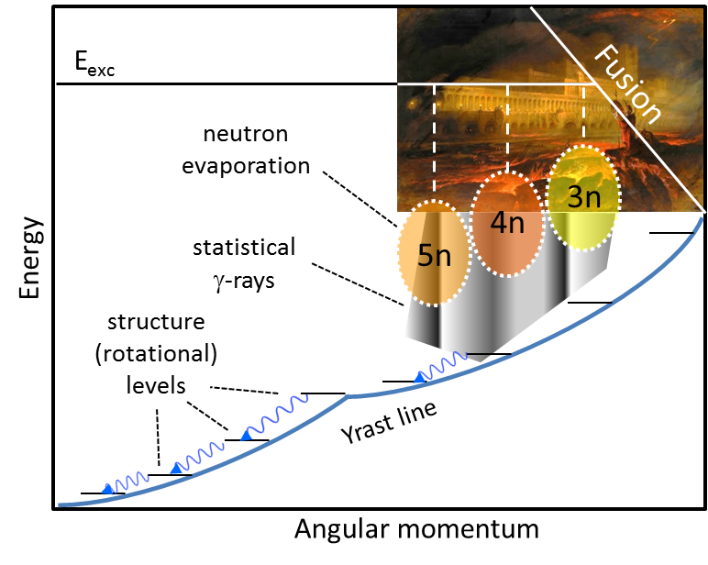
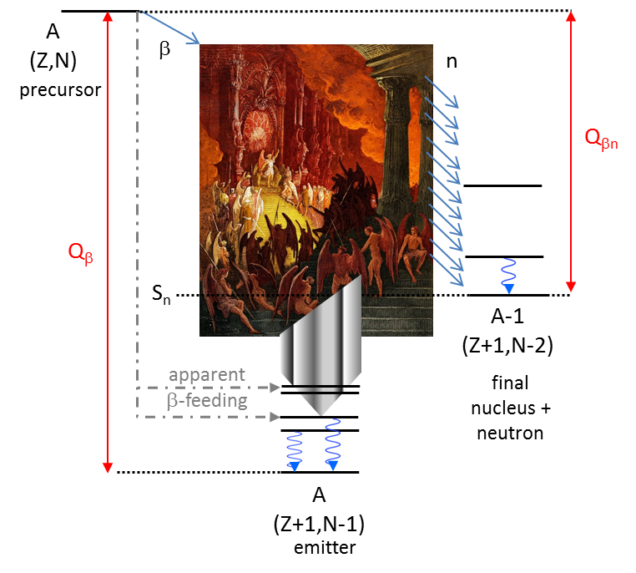
structure nearby and above the neutron separation threshold
Pandemonium* vs structure in β-decay properties
the old bogey of “Pandemonium effect” has since then been raised systematically in the context of β-decay studies
(Total Absorption Spectroscopy techniques introduced as an answer)
*concept introduced by Hardy PLB 71, 307 (1977)
"dire was the noise of conflict; overhead the dismal hiss of fiery darts in flaming volleys flew, and flying vaulted either host with fire" (J. Milton, Paradise Lost Book 6)
“hot” unstructured system
Bohr’s compound nucleus
[Nature 137, 344 (1936)]
“cool” structured system

Slide 12
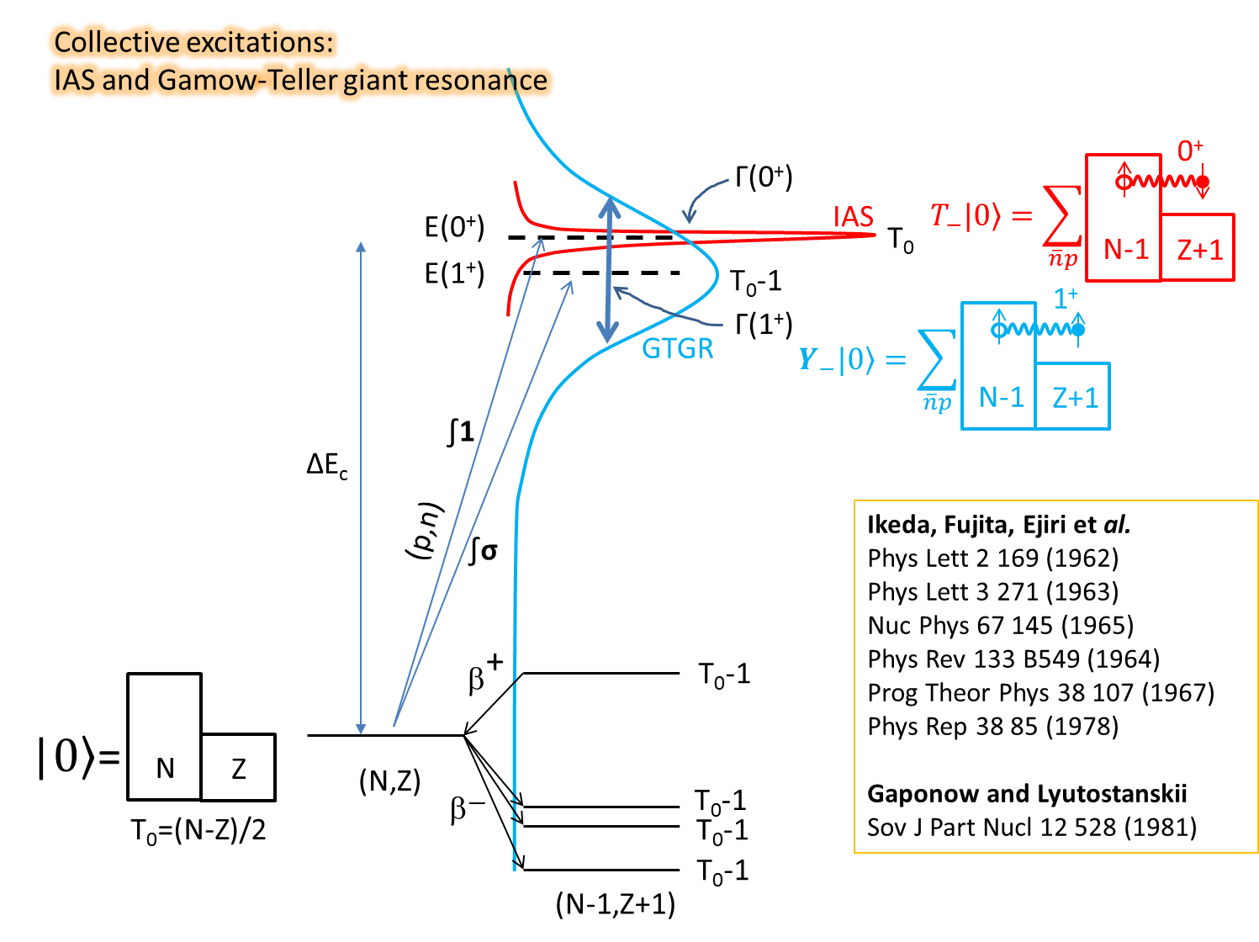
structure nearby and above the neutron separation threshold
Klapdor
Progr. Part. Nucl. Phys, 10, 131-225 (1983)

Slide 13
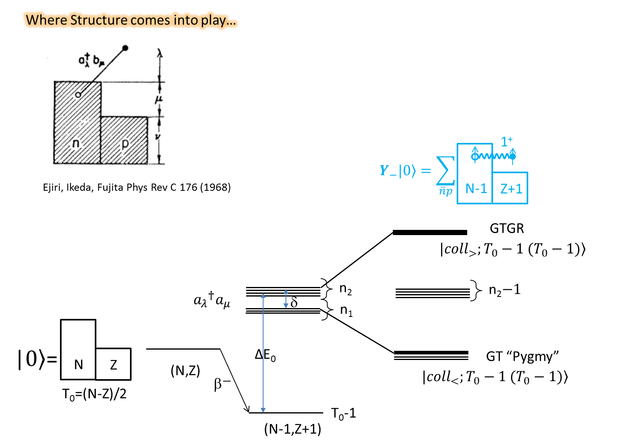
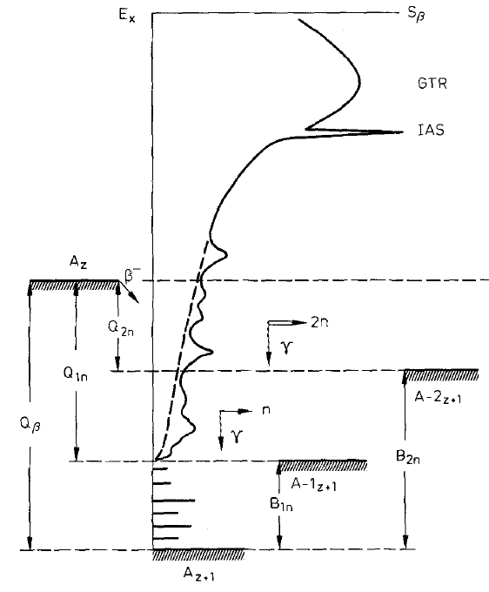
structure nearby and above the neutron separation threshold
V_{pn}

Slide 14
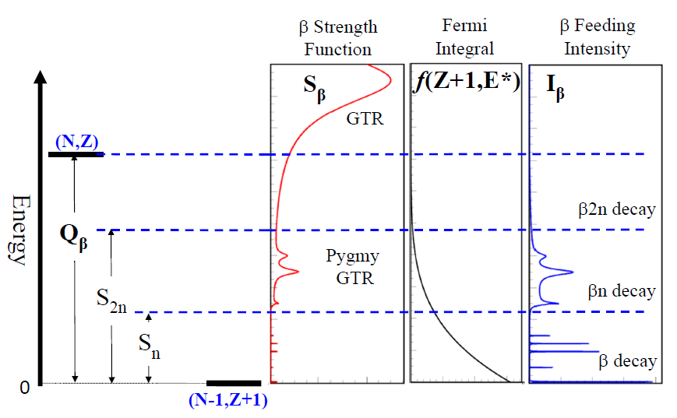
structure nearby and above the neutron separation threshold
principle of a beta-decay spectroscopy measurement
β-decay products
to be detected
What can be measured
A
(Z,N)
β
n
precursor
S_{n}
Q_{β}
A-1
(Z+1,N-2)
final nucleus + neutron
γ
A
(Z+1,N-1)
emitter
ideally the radioactive source should be as pure as possible (need elaborated selection devices e.g. at DESIR, or “natural” selection e.g. ALTO)
ultimately, the source can be “prepared” e.g. oriented (LTNO: eg POLAREX, laser induced orientation e.g. LINO etc…)
P_{1n} value gives information on the integral β-feeding of states above Sn

Slide 15
structure nearby and above the neutron separation threshold
What is inside a beta strength function ?
the example of an integrated quantity: P_{n}
A
(Z,N)
β
n
precursor
β-decay products
to be detected
S_{n}
Q_{β}
A-1
(Z+1,N-2)
What can be measured
final nucleus + neutron
γ
A
(Z+1,N-1)
emitter
transition (GT, ff etc)
matrix element
level density
≈1
S_{β}
Fermi function
$$P_{n}=\frac{\int_{S_{n}}^{Q_{β}}{\frac{Γ_{n}}{Γ_{n}+Γ_{γ}}{\left|M\right|}^{2}ρ\left(E\right)f\left(Z+1,Q_{β}−E\right)dE}}{\int_{0}^{Q_{β}}{{\left|M\right|}^{2}ρ\left(E\right)f\left(Z+1,Q_{β}−E\right)dE}}$$
P_{n}

Slide 16
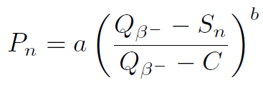
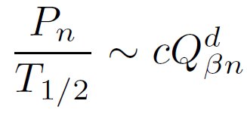
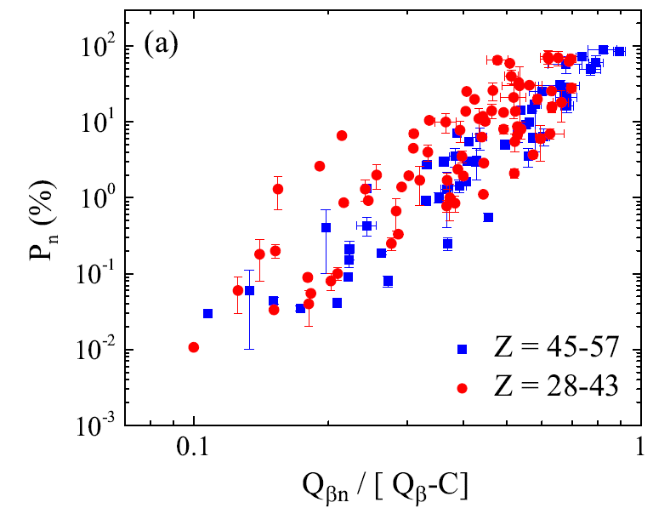
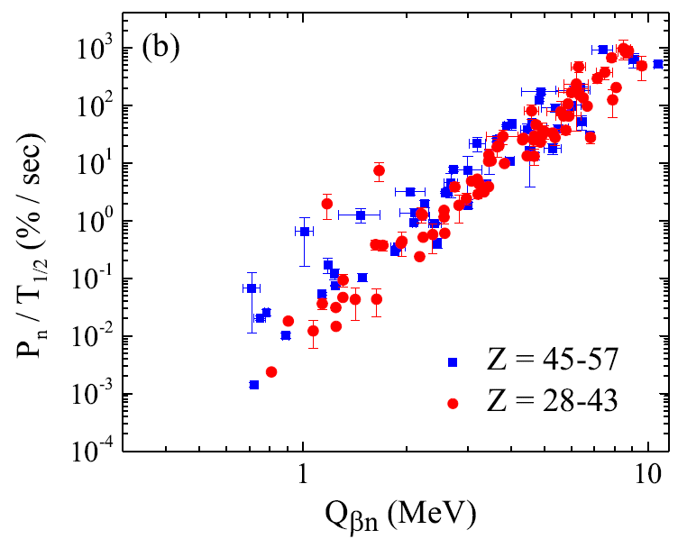
structure nearby and above the neutron separation threshold
P_{n} empirical formulas where early introduced neglecting explicitly any possible structure in the beta strength function (inspired by earlier works by Pappas and others)
≈const.
≈const. !
$$≈const.{(Q_{β}−E)}^{n}$$
with $n≈5$
≈1
S_{β}
Fermi function
$$P_{n}=\frac{\int_{S_{n}}^{Q_{β}}{\frac{Γ_{n}}{Γ_{n}+Γ_{γ}}{\left|M\right|}^{2}ρ\left(E\right)f\left(Z+1,Q_{β}−E\right)dE}}{\int_{0}^{Q_{β}}{{\left|M\right|}^{2}ρ\left(E\right)f\left(Z+1,Q_{β}−E\right)dE}}$$
the “Kratz-Herrmann formula”
[Z. Phys. 263, 435 (1973)]
the “McCutchan-et al formula”
[PRC 86, 041305 (2012)]

Slide 17
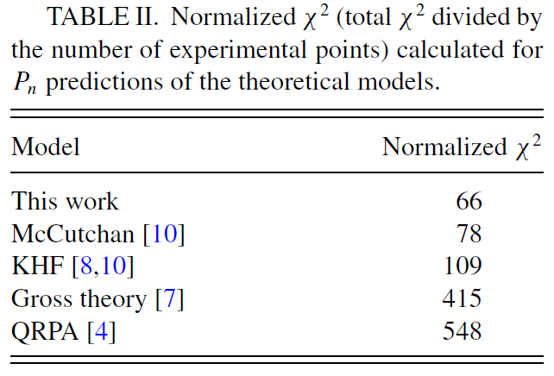
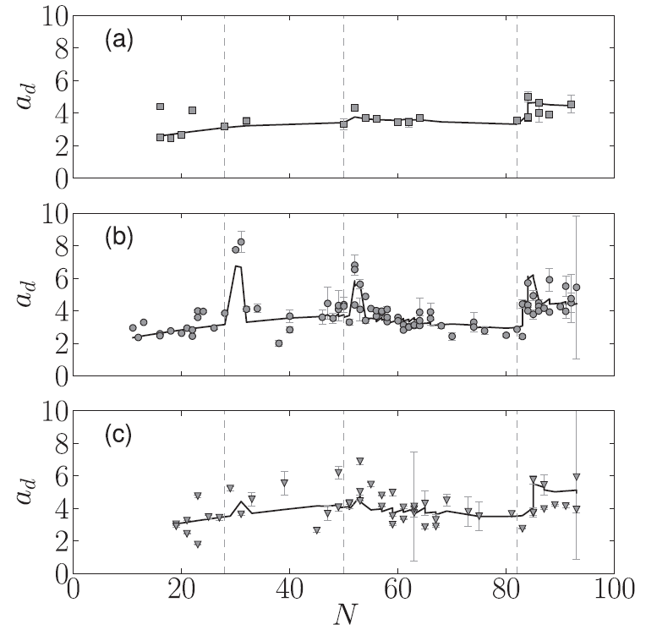
structure nearby and above the neutron separation threshold
≈const.
(Fermi gas)
another try for improvement:
….but still with a structureless β-strength function
≈1
S_{β}
Fermi function
$$P_{n}=\frac{\int_{S_{n}}^{Q_{β}}{\frac{Γ_{n}}{Γ_{n}+Γ_{γ}}{\left|M\right|}^{2}ρ\left(E\right)f\left(Z+1,Q_{β}−E\right)dE}}{\int_{0}^{Q_{β}}{{\left|M\right|}^{2}ρ\left(E\right)f\left(Z+1,Q_{β}−E\right)dE}}$$
Miernik level density parameterization
[PRC 88 041301(R) (2013)]
structure effects at shell closures ?
or just a trivial level density issue ?

Slide 18
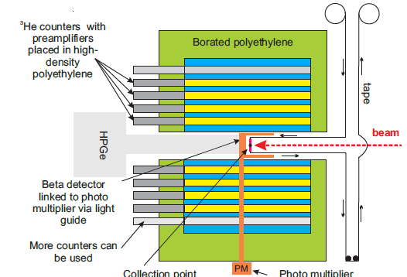
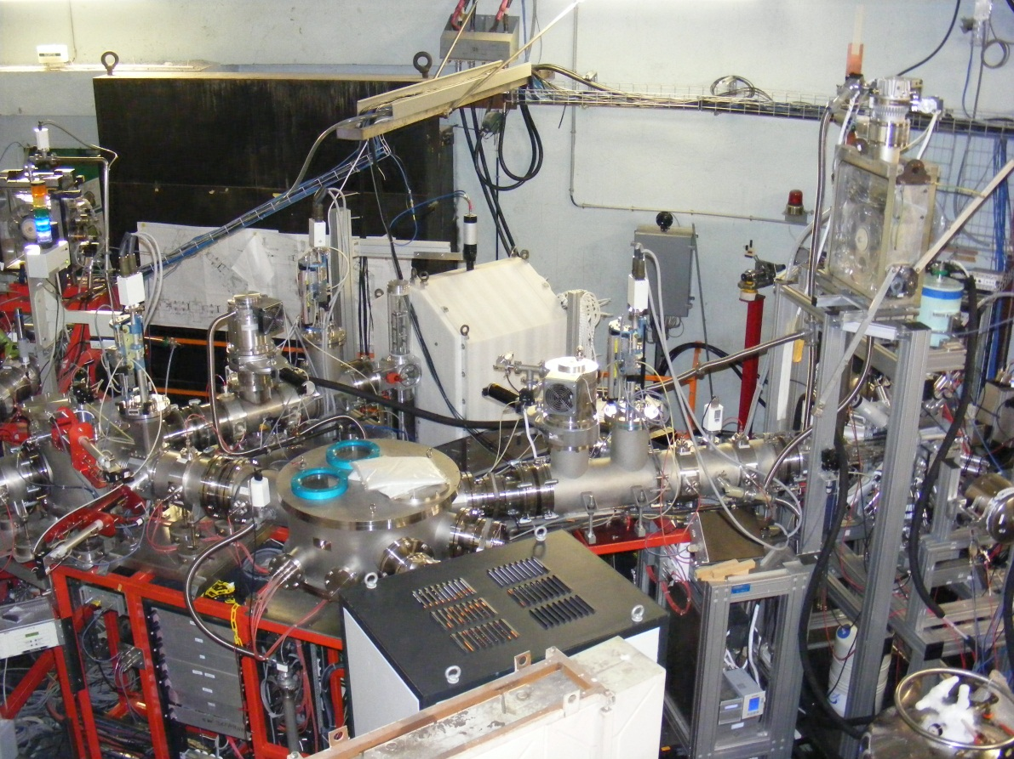
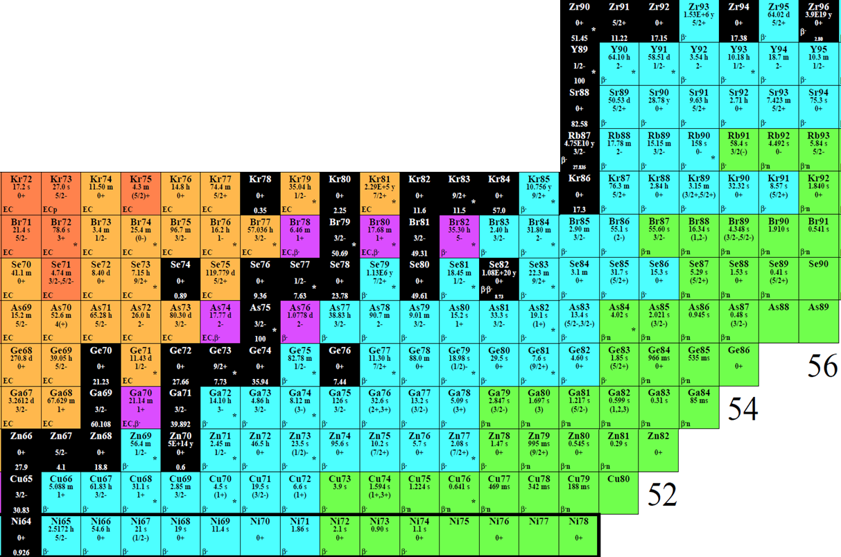
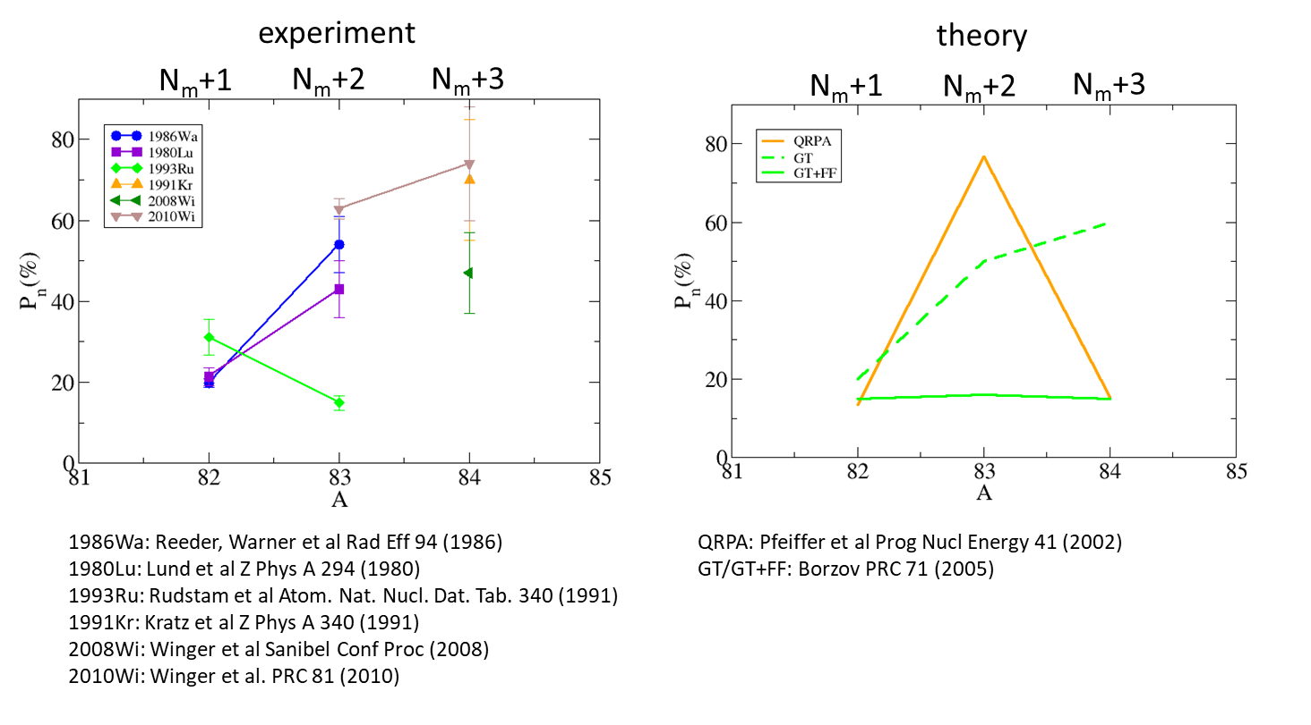
structure nearby and above the neutron separation threshold
The case of Ga (Z=31) precursors: ⁸²Ga (N_{m}+1); ⁸³Ga (N_{m}+2) ; ⁸⁴Ga (N_{m}+3)
TETRA
BEDO
The situation before our experiment:

Slide 19
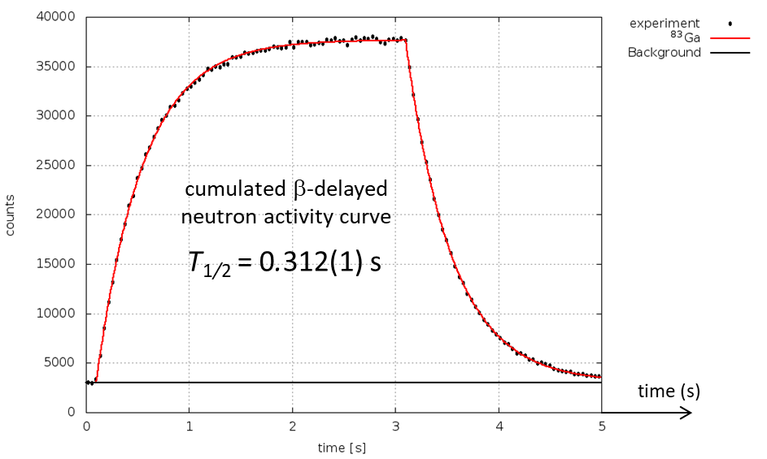
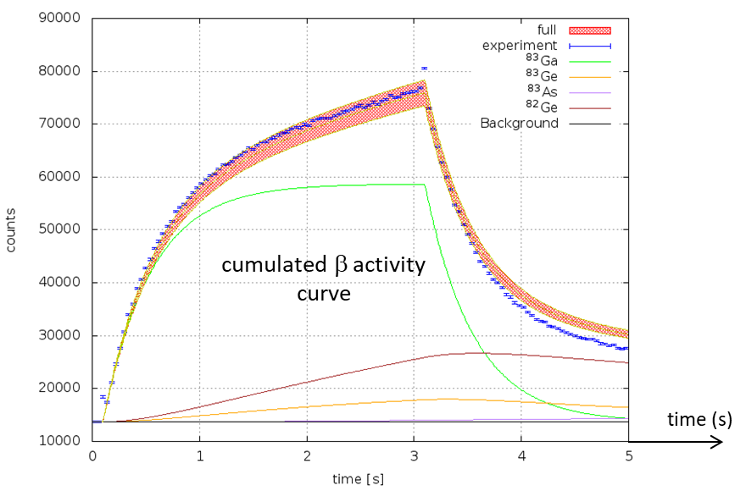
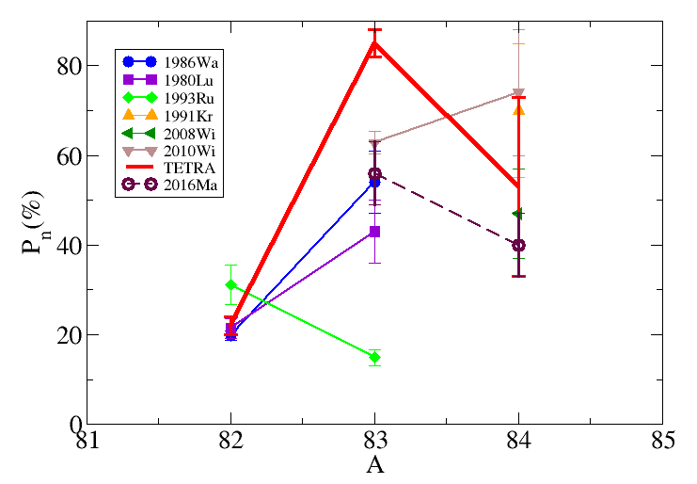
structure nearby and above the neutron separation threshold
n,β,γ activities recorded simultaneously
β-n, β-γ, β-γ-n coinc data
⇒ ε_{β}, ε_{n}
beam on
beam off
beam on
beam off
The key quantities to be determined from the comparison of the neutron and β activity curves:
φ: the number of incident ions per second
P_{n}: the β-delayed neutron emission probability
TETRA
Results:
⁸²Ga (N_{m}+1) → P_{n}= 22(2)% (test case -- Testov et al. NIM A 815 (2016) 96)
⁸³Ga (N_{m}+2) → P_{n}= 85(4)%
⁸⁴Ga (N_{m}+3) → P_{n}= 53(20)%
VANDLE
1986Wa: Reeder, Warner et al Rad Eff 94 (1986)
1980Lu: Lund et al Z Phys A 294 (1980)
1993Ru: Rudstam et al Atom. Nat. Nucl. Dat. Tab. 340 (1991)
1991Kr: Kratz et al Z Phys A 340 (1991)
2008Wi: Winger et al Sanibel Conf Proc (2008)
2010Wi: Winger et al. PRC 81 (2010)
2016Ma: Madurga et al. PRL 117 (2016)

Slide 20
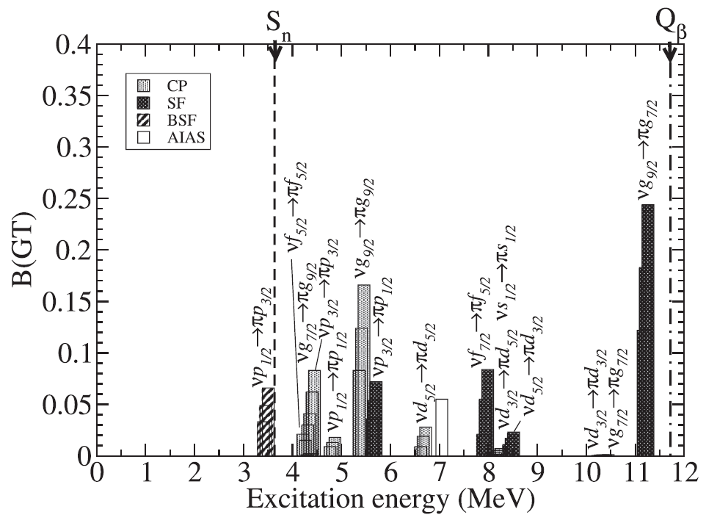
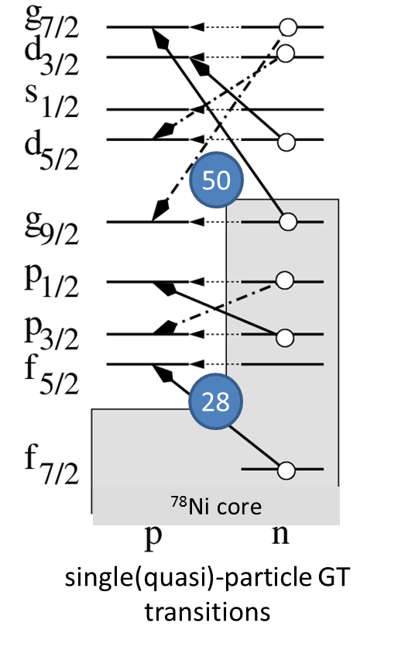
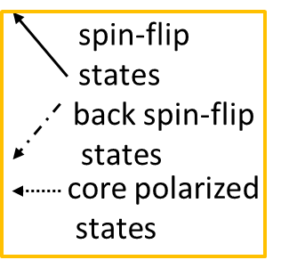
structure nearby and above the neutron separation threshold
A first attempt towards a structure interpretation of the strong P_{n} oscillation
(83)
S_{n}(84)
this was quite a pioneering work !
BRIKEN data collected at HRIBF RIKEN confirm that the Pn oscillation extends beyond A=84 ! [PRC 108, 064307 (2023)]
P_{1n}(⁸⁴Ga)=37.0(12)%
P_{1n}(⁸⁵Ga)=76(3)%
P_{1n}(⁸⁶Ga)=60(3)%
if this interpretation is correct :
γ-decay from high-lying (around 4.5 MeV) states in ⁸⁴Ga→⁸⁴Ge should be observed.
Unfortunately no large-statics data on this decay have been obtained so far…
SF
BSF
CP

Slide 21
structure nearby and above the neutron separation threshold
TETRA
BEDO
C. Delafosse
32
30
⁸³Ge (Z=32, N=51)
A. Gottardo
⁸⁰Ge (Z=32, N=48)
28

Slide 22
structure nearby and above the neutron separation threshold
At the beginning everything looked normal
⁸³Ge
β-gated HP-Ge γ-spectrum
β-gated LaBr₃
low-energy γ-spectrum
1092 keV
655 keV
1348 keV
1238 keV
data collected within the PhD program of C. Delafosse
(β-decay at ALTO, as a non-Yrast supplement to the AGATA+plunger+VAMOS data)

Slide 23
structure nearby and above the neutron separation threshold
A true serendipity !
generally taken as ≈1 !
S_{β}
Fermi function
$$P_{n}=\frac{\int_{S_{n}}^{Q_{β}}{\frac{Γ_{n}}{Γ_{n}+Γ_{γ}}{\left|M\right|}^{2}ρ\left(E\right)f\left(Z+1,Q_{β}−E\right)dE}}{\int_{0}^{Q_{β}}{{\left|M\right|}^{2}ρ\left(E\right)f\left(Z+1,Q_{β}−E\right)dE}}$$
comparison of ⁸⁰Ge vs ⁸³Ge spectra (below vs above N=50) up to ≈Q_{β}
one order of magnitude !

Slide 24
structure nearby and above the neutron separation threshold
A true serendipity !
pandemonium in troubles ?
γ rays between 4.5 – 6 MeV in coincidence with ⁸³Ge 1238 keV line
!!
Conclusion:
Low-energy states in ⁸³Ge are fed by β decay
via the GT population of high-energy (5-7 MeV) states
→ descrete ?
LaBr3 spectrum
γ rays in coincidence with ⁸²Ge 1348 keV line (2⁺→0⁺)

Slide 25
structure nearby and above the neutron separation threshold
A true serendipity !
pandemonium unveiled ?
Response function + energy linearity of LaBr3 detector fully characterized up to 11 MeV
using ²⁷Al(p,γ)²⁸Si reaction at the ARAMIS accelerator (CSNSM in Orsay)
LaBr₃ de-convoluted γ-spectrum
(intensity spectrum)
LaBr₃ re-convoluted spectrum
experimental γ-spectrum
structures appear above the neutron threshold
16(4) % of the β decay strength above n-threshold and followed by γ-emission
β-n branching measured with TETRA= 85(4)%

Slide 26
structure nearby and above the neutron separation threshold
Strongly competing n/γ-decays of states lying far above the neutron threshold
from β population:
the record was held by ⁷⁰Co→⁷⁰Ni
A. Spyrou et al. PRL 117, 142701 (2016)
→ one needs very strong B(E1) to compete with neutron emission at this altitude – what can it be ?

Slide 27
structure nearby and above the neutron separation threshold
(seriously) strengthening BEDO’s measurement system
3 PARIS clusters
R. Li et al. PRC 111, 034303 (2025)
beam direction
HPGe
1 CLOVER
1 Coax
TETRA
BEDO
Lama Al Ayoubi and Ren Li’s PhD works
These works have inspired further studies
the term "doorway decay" is gradually gaining traction in the literature to describe what could very well be a new facet of radioactivity—or at the very least, the end of the dominance of the nuclear Pandemonium concept.
see recent VANDLE results :
Heideman et al PRC 108, 024311 (2023)
‘Evidence of nonstatistical neutron emission following β decay near doubly magic ¹³²Sn’
L. Al Ayoubi
Io

Slide 28
structure nearby and above the neutron separation threshold
(seriously) strengthening BEDO’s measurement system with
MONSTER
(time-of-flight neutron spectrometer)
TETRA
BEDO
Emile Cantacuzene’s PhD works
part of Leo Plagnol’s post-doc work
the experiment took place last month
to be continued…
These works have inspired further studies
the term "doorway decay" is gradually gaining traction in the literature to describe what could very well be a new facet of radioactivity—or at the very least, the end of the dominance of the nuclear Pandemonium concept.
see recent VANDLE results :
Heideman et al PRC 108, 024311 (2023)
‘Evidence of nonstatistical neutron emission following β decay near doubly magic ¹³²Sn’

Slide 29
new physics avenues with ALTO beams
• β-delayed spectroscopy programme
→ structure nearby and above the neutron separation threshold
→ very small Q_{βn} windows and threshold effects
→ large Q_{βn} windows and marked shell effects

Slide 30
E0 strength measurement and the investigation of shape coexistence
N=20
_{(zone C)}
Heyde & Wood Rev. Mod. Phys. 83 (2011) 1467
Z=50 (zone J)
N=Z
?
⁷⁸Ni
first investigation with COeCO
PRC 111, 034306 (2025)
first investigation with « old » system
PRL 118 182501 (2016)
historical case N=20 (³²Mg region)
Klapisch PRL 31 118 (1973)
Thibault PRC 12 644 (1975)
Détraz PRC 19 164 (1979)
N=28 (⁴²Si region)
Bastin PRL 99 022503 (2007)
Force PRL 105 102501 (2010)
GANIL

Slide 31
E0 strength measurement and the investigation of shape coexistence
COeCO
electron spectrometer
COeCO
TETRA
BEDO
Shape coexistence in Zr isotopes investigated through the β decay of isotopically purified beams of ⁹⁸Rb and ¹⁰⁰Rb
δ<r²> from laser spectroscopy
Tocabens et al. PRC 111, 034306 (2025)
interpreted with the extreme schematic 2-state model
Guillem Tocabens’ PhD works
part of C. Delafosse’s post-doc work
G. Tocabens
854.1 keV E0 transition in ⁹⁸Zr
C. Delafosse
δ<r²> from ρ²(E0)
(COeCO)
taken from coulex data
854.1 keV E0 transition
in ¹⁰⁰Zr

Slide 32
new physics avenues with ALTO beams
→ E0 strength measurement and the investigation of shape coexistence

Slide 33
MLLTRAP @ ALTO : mass measurements
PDT
Emittancemètre
RFQCB
Manipulation
Photofission
Ag (Z=47) →masse > 125 still missing (+ isomers)
Ag masses in the vicinity of N = 82 → impact r-process abundances in neutron star merger event
ISOLTRAP : V. Manea et al., Phys. Rev. Lett. 124 (2020) 092502
JYFLTRAP : A. Kankainen et al., Hyperfine Interact. 241 (2020) 43 J. Ruotsalainen et al., 2024, arxiv.org/abs/2408.14181
Other opportunities for mass measurements at ALTO around N = 50

Slide 34
conclusions
requested developments :
laser ionized Zn (scheme already developed) Ge and Cd (scheme to be developed) with suppression of surface ionized Ga and In
more complicated : negative Br (1-) ions ; molecular As ions ?
surface ionized but we don’t care
surface ionized
→ structure nearby and above the neutron separation threshold
→ E0 strength measurement and the investigation of shape coexistence
surface ionized but we don’t care
surface ionized
fission fragments are badly needed at GANIL
it would be fantastic to have them available for DESIR
it is the necessary condition to pursue this program there

