Slide 1
AGATA@GANIL.2
M. Assié, E. Clément
SPIRAL1 2025 workshop
GRC - 2019

Slide 2
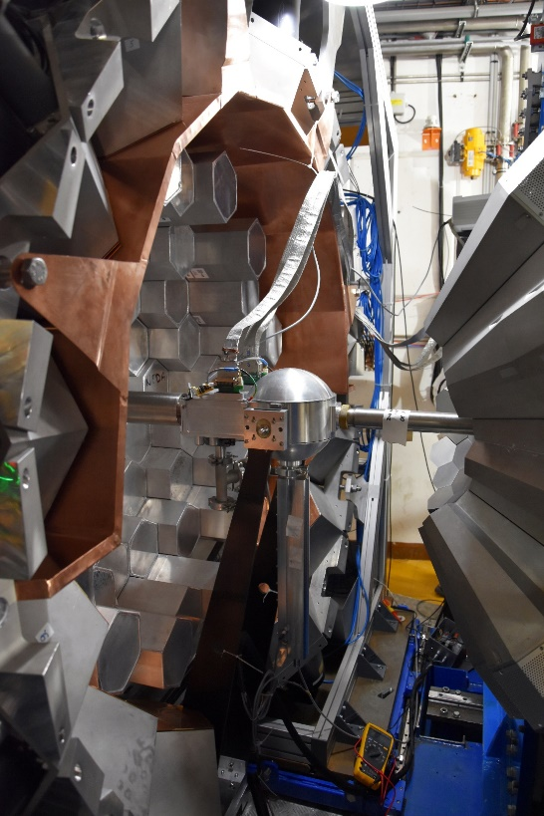
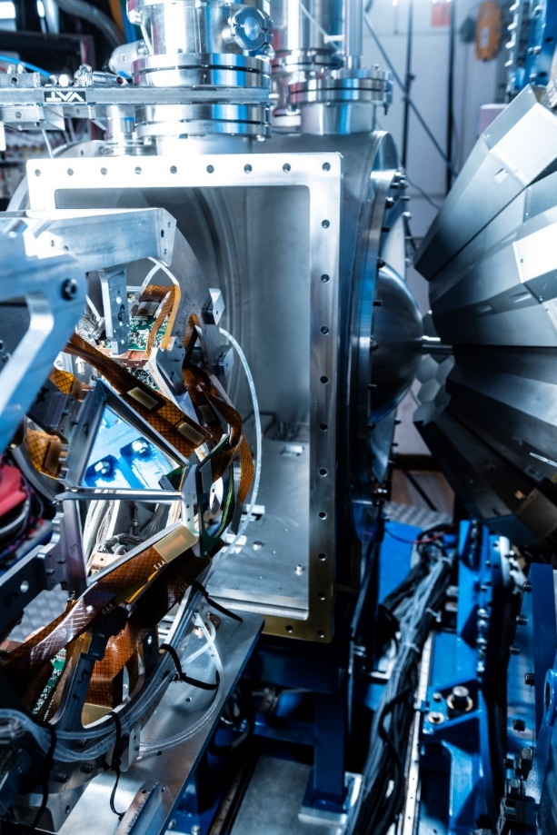
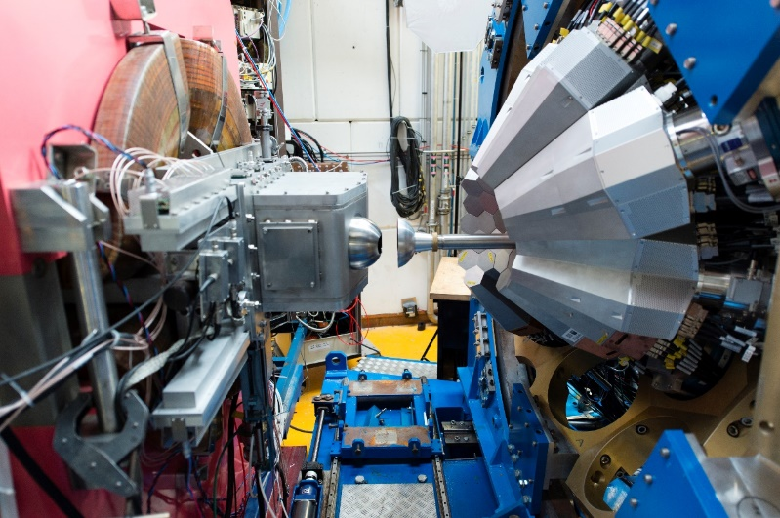
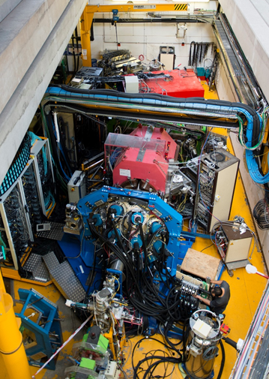
AGATA@GANIL.1 were many sub-campaigns
2018
2019-2021
2015-2017
2021
24-34 capsules
AGATA coupled to VAMOS, FATIMA, PARIS
36 capsules
40-41 capsules
Exotic nuclei spectroscopy by MNT transfer and fission reaction
AGATA coupled to NEDA- DIAMANT
N~Z nuclei spectroscopy by fusion evaporation
AGATA coupled to VAMOS MUGAST
40-41 capsules
AGATA coupled to VAMOS, EXOGAM, 2nd Arm, LEPS
40-41 capsules
927 UT have been approved
821 UT have been performed over 29 experiments ( 90 % done)
Exotic nuclei spectroscopy by transfer reaction using RIB
Exotic nuclei spectroscopy by MNT transfer

Slide 3
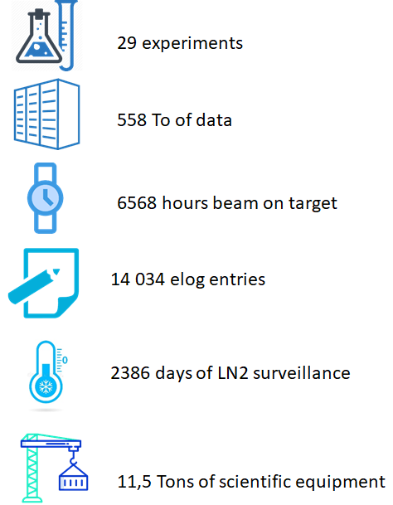
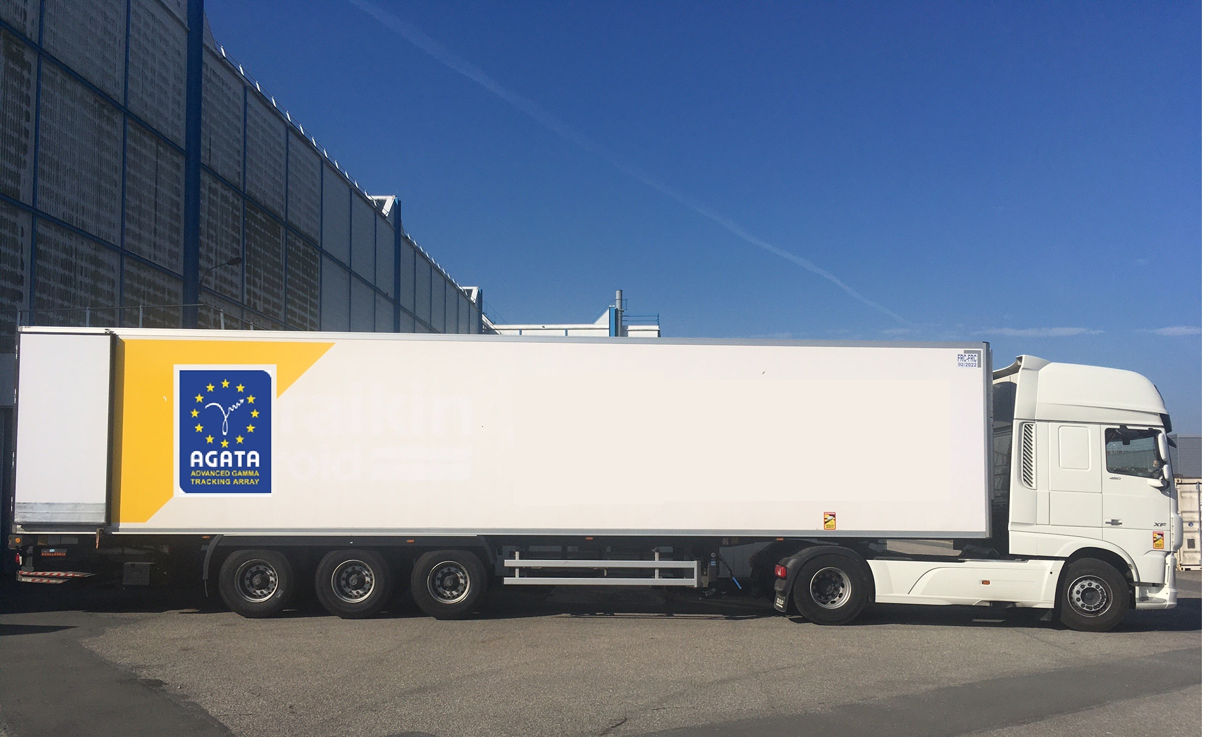
AGATA campaign #1 at GANIL
After 7 years [2014-2021], the AGATA@GANIL campaign was completed

Slide 4
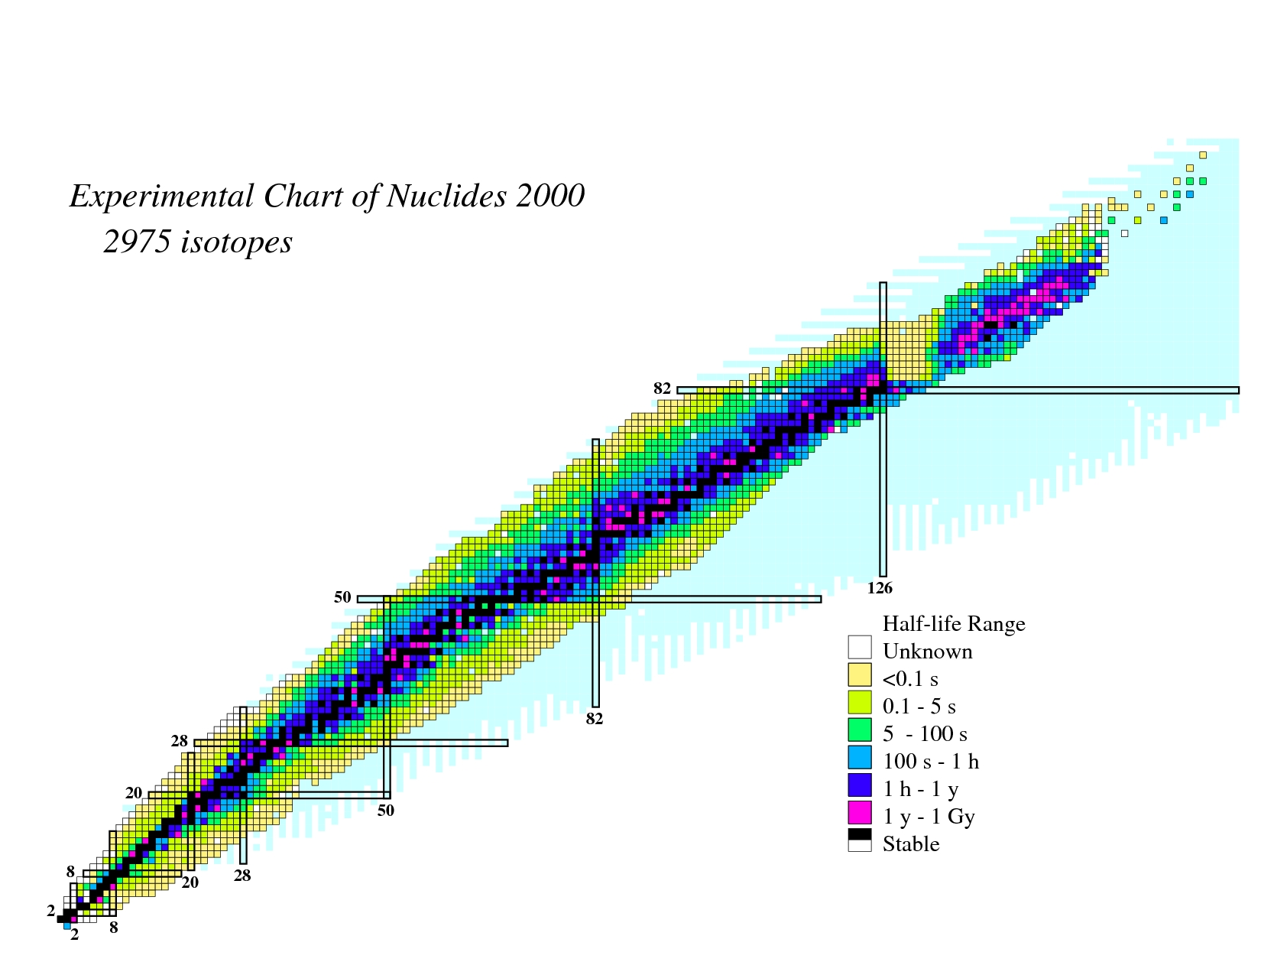
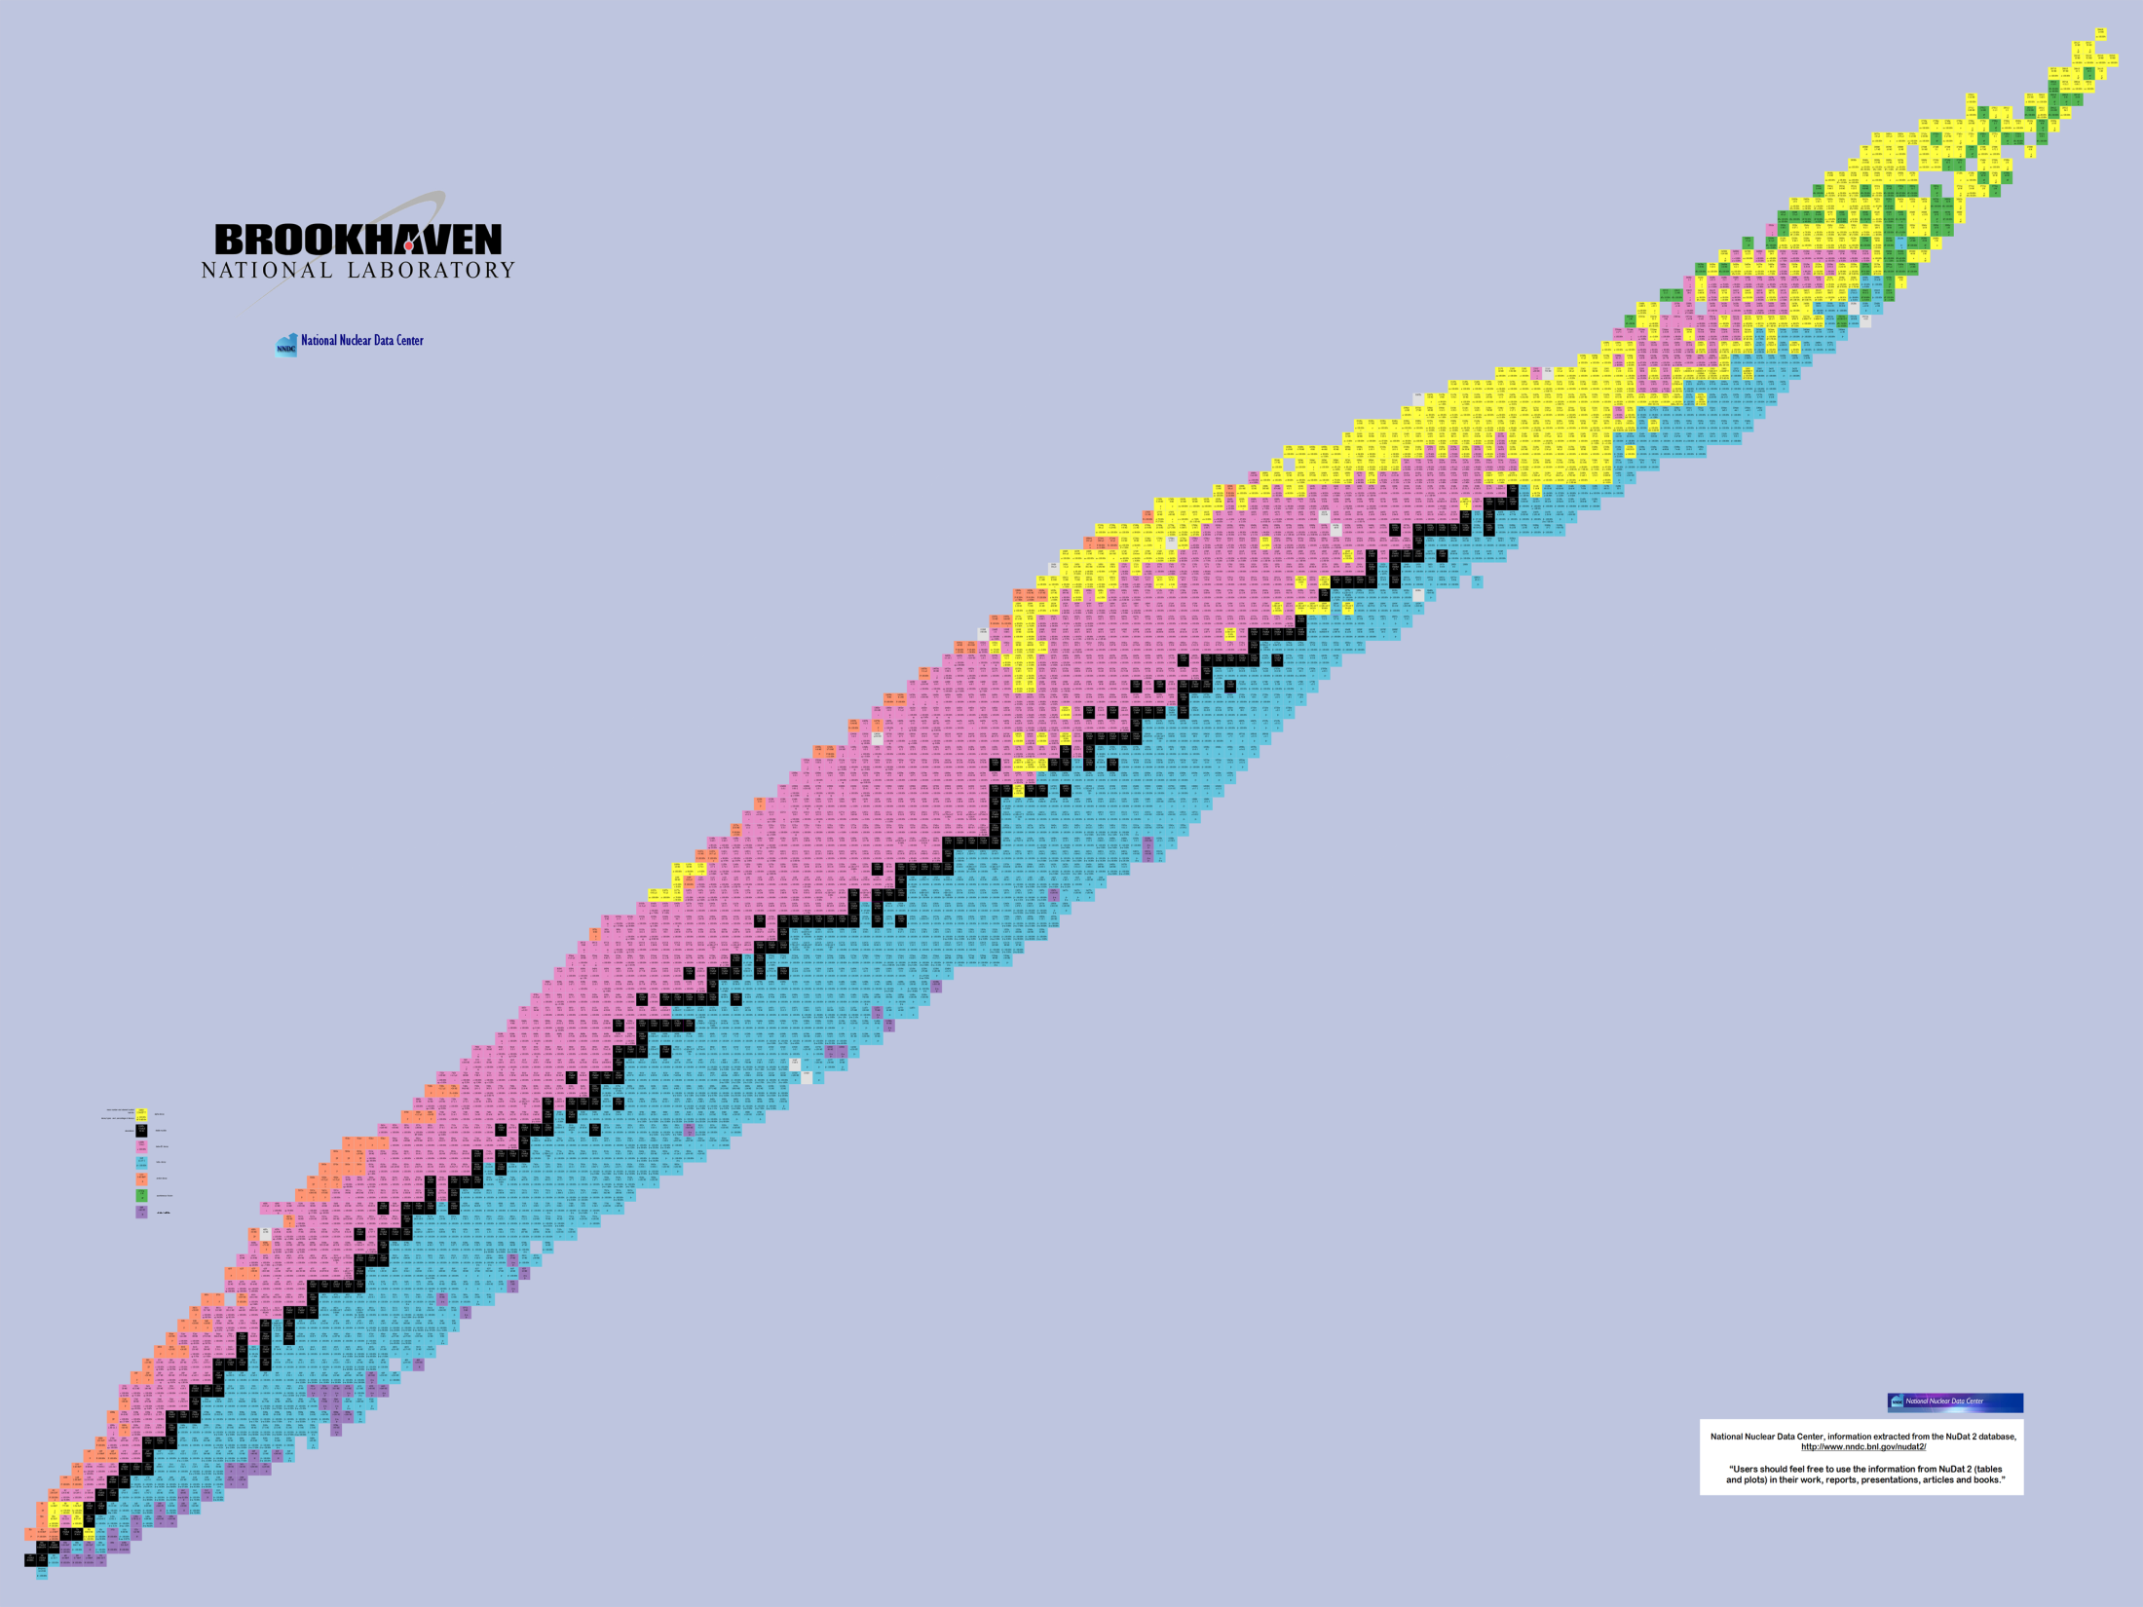
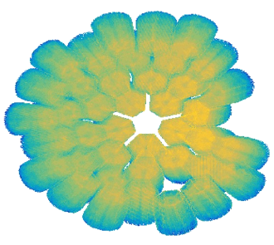
Experiments performed in 2015-2021 at GANIL with AGATA
RIB
with MUGAST
SHE Cross section ²³⁸U+²³⁸U in MNT
Search for Double Gamma decay in ¹³⁷Cs source
Reaction mechanism : Fission of Light Hg
Octupole – Quadrupole correlation in ¹¹²Xe
²⁰⁸Pb
Studies of excited states in ^{102,103}Sn
Octupole correlation in ²⁰⁷Pb
Evolution of collectivity around N=50: lifetime measurements ^{104,106}Sn
Exploration of alpha-cluster : the unique case of ²¹²Po (²⁰⁸Pb + α)
N=126 Xe+Pt spectroscopy after MNT
Evolution of collectivity around N=50: lifetime measurements ⁹⁴Ru
Shape transition in the neutron-rich W isotopes
Search for isoscalar pairing in the N=Z nucleus ⁸⁸Ru
Transition Quadrupole Moments in ^{166,168}Dy.
¹⁰⁰Sn
i_{13/2} single particle state in ¹³³Sn and high spin in ¹⁰⁸Zr
Isospin Symmetry Breaking in the A=63,71 mirror nuclei
¹³²Sn
Shape evolution in neutron rich fission fragments in the mass A~100 region
Above barrier narrow resonances in ¹⁵F
⁶⁸Ni
⁷⁸Ni
Shell evolution around N=50: ⁸¹Ga spectroscopy
Deter. the α+¹⁵O radiative capture rate
Evolution of collectivity around N=52: lifetime measurements in ^{83,84}Ge
Evolution of collectivity around N=40: lifetime measurements in ^{73,75}Ga
Evolution of collectivity around N=40: lifetime measurements in ⁶⁴Fe
⁴⁸Ca
Proton-neutron interactions across the N = 28 shell closure via ⁴⁷K(d,p)⁴⁸K
Lifetime measurements of excited states in neutron-rich C and O isotopes
Evolution of the shell structure in the region of neutron-rich Ti isotopes
The lifetime in ²³Mg as a probe for classical novae models
3-body contribution in ²⁰O structure
Is there a problem with protons in N=28 nucleus ⁴⁶Ar ?

Slide 5
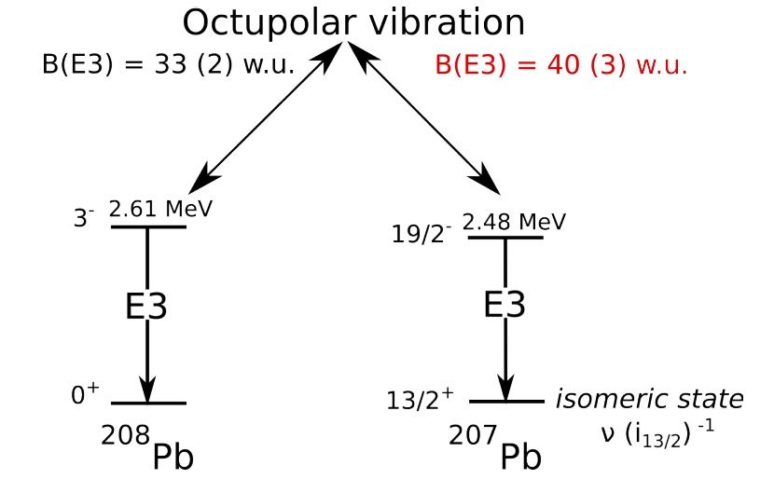
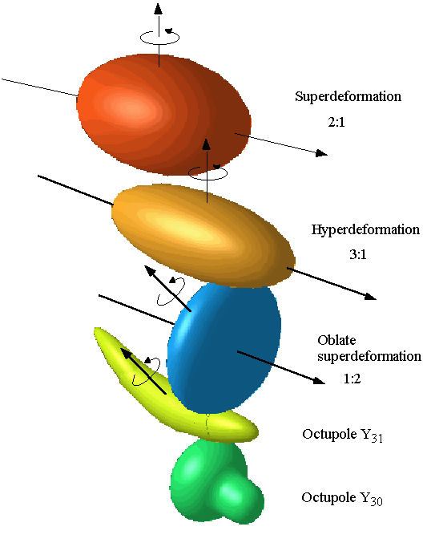
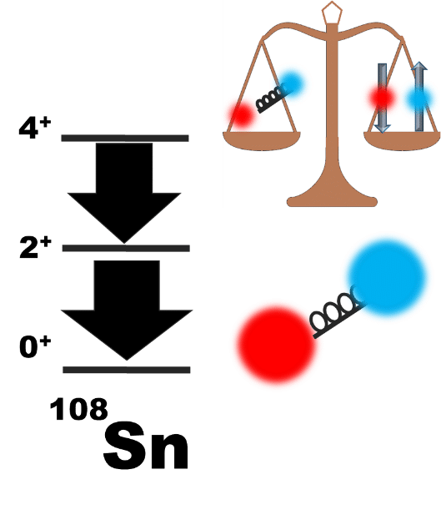
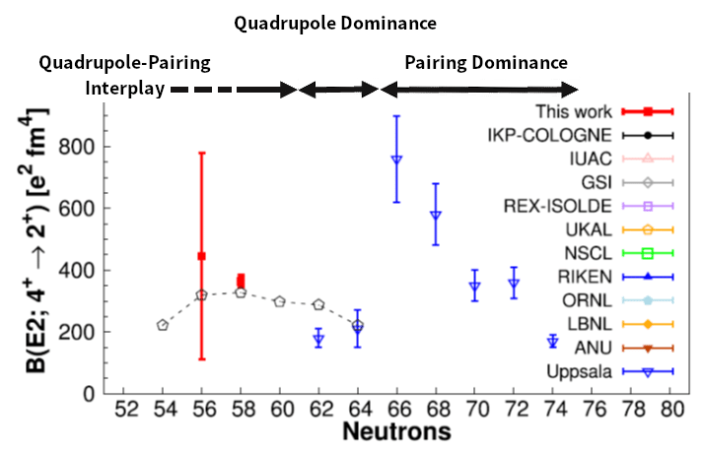
Some highlights of AGATA@GANIL.1
Evidence of octupole-phonon at high spin in ²⁰⁷Pb : Study of the octupole phonon in the ²⁰⁸Pb region.
Constraining the ²²Na(p, γ)²³Mg reaction from the spectroscopy of the 7785.0(7) keV resonance in ²³Mg.
Direct observation of a “delayed” rotational alignment in a deformed N = Z nucleus (⁸⁸Ru), in agreement with theoretical predictions related to the presence of strong isoscalar neutron-proton pair correlations.
B(E3) = 40 (8) w.u.
Ch. Fougère et al Nature Communications volume 14, 4536 (2023)
B. Cederwall et al, Phys. Rev. Lett. 124,062501 (2020)
D. Ralet et al Phys. Lett. B 797, 134797 (2019),
results agree well with predictions from ab initio VS-IMSRG for ²⁰O, showing that 3N interactions are needed to accurately describe electromagnetic observables
More accurate and holistic description from MUGAST-AGATA data, Phys. Rev. Lett. 131, 262501 (2023), I. Zanon, E. Clément, et al.
M.Siciliano et al, Physics Letters B 806 (2020) 135474
2⁺ wave function is dominated by the p-n quadrupole interaction
4+ wave function is a balance between p-n quadrupole and pairing interactions
Revisit our predictions on the ¹⁰⁰Sn structure to be investigated at S3
M. Ciemala et al, Phys. Rev. C101, 021303(R) (2020)
Investigation of the Seniority Conservation in the πg_{9/2} shell
R.M. Pérez-Vidal et al, Phys. Rev. Lett 129, 112501 (2022)
Notes:
More accurate and holystique description from MUGAST-AGATA data,
Phys. Rev. Lett. 131, 262501 (2023), I. Zanon, E. Clément, et al.

Slide 6
AGATA opportunities @GANIL :
SUMMARY
Very successful previous campaign with high-impact publications
GANIL staff trained and operational on AGATA duties
Most of the campaign#1 infrastructures are still available
High-quality and new RIB from SPIRAL1
High-intensity and high-quality stable heavy-ion beams
State-of-the-art spectrometer and instrumentation
Surrounding collaborations with active and cryogenic targets (ATRACT) or particle detectors (MUGAST/GRIT)
Commitment of the GANIL management to dedicate at least 50% of the CYCLOTRON beam-time (when approved by PAC) : ~ 100 UT yearly : 2500 hours of beam on target !
Notes:
Lettres : 7/13 letters

Slide 7
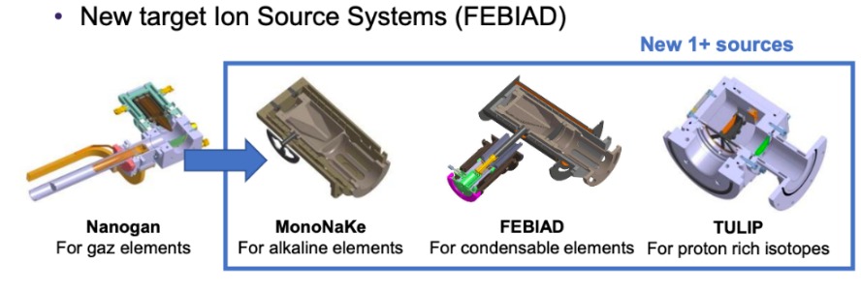
AGATA@GANIL.2 Proposal : 0° degree campaign using the SPIRAL1 beams with GRIT and VAMOS
  SPIRAL1 experiments have a strong impact (1 PRL and 1 Nature Comm. with AGATA+MUGAST under referee procedure at the moment)
  He, Ne, Ar, Kr, O, N, F, K beams are operational. Several tests have been performed in 2021-2023 leading to a list of 50 new isomers/isotopes with intensities suitable for acceleration using CIME
  SPEFICITIES of the combination of GRIT-AGATA-VAMOS
  AGATA: - high resolution and P/T ratio
  - high efficiency
  - high resolving power
  On-going developments on cryogenic targets at IJCLab (He): ATRACT (see talk tomorrow) (F. Galtarossa et al, NIMA 108 (2021), 165830)
  https://www.ganil-spiral2.eu/scientists/ganil-spiral-2-facilities/available-beams/
2π simulation at 23 cm
Tracked ε@1.3 MeV ⁶⁰Co = 13%, P/T = 42% (EXOGAM -12 clovers same distance ~3%)
Resolving power of AGATA 2π is order of magnitude better than EXOGAM in singles and without comparison at higher energies or for DSAM measurement
  GRIT: - High granularity --> Doppler correction from 2-body kinematics (Resolution 7 keV)
  --> Improved excitation energy resolution at the level of ISS (depending on reaction kinematics)
  - PSA for particle identification (upstream particularly)
  VAMOS: - full background rejection
  --> “uniqueness” experiments using transfer reactions in the fields of nuclear structure, astrophysics and dynamic.

Slide 8
C.J. Paxman et al https://arxiv.org/abs/2409.12594- submitted to PRL
Courtesy D. Ramos

Slide 9
I. Zanon, E. Clément, et al. Phys. Rev. Lett. 131, 262501 (2023),
Courtesy D. Ramos

Slide 10
V. Girard-Alcindor et al Phys. Rev. C 105, L051301 – Published 11 May, 2022
Courtesy D. Ramos

Slide 11
Courtesy D. Ramos

Slide 12
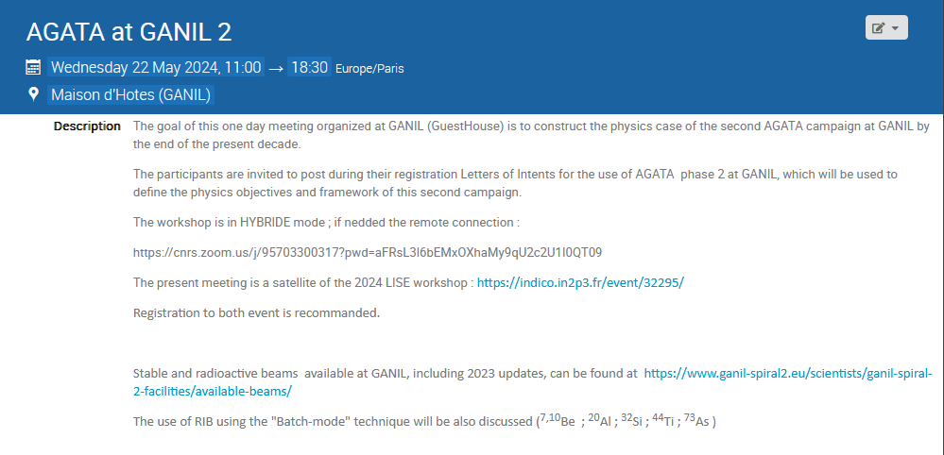
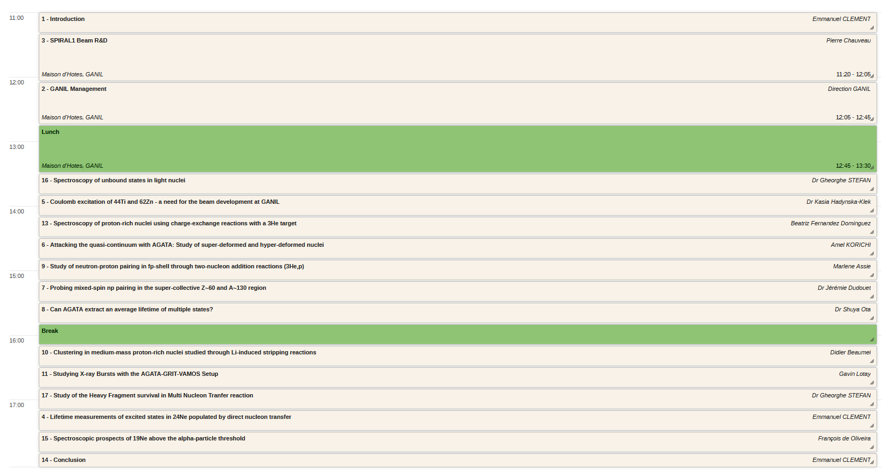
Workshop AGATA at GANIL 2
https://indico.in2p3.fr/event/32436/

Slide 13
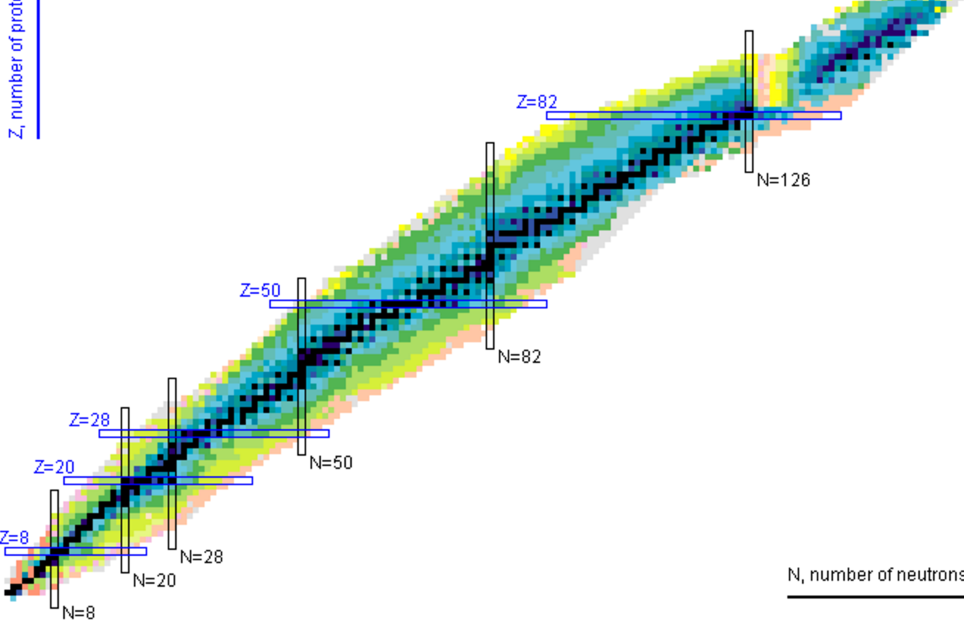
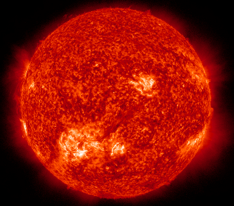
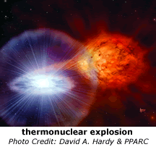
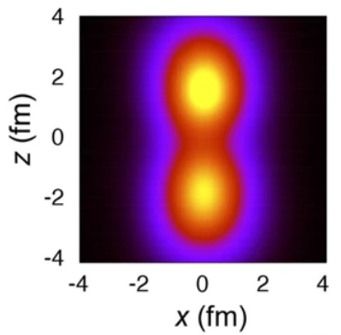
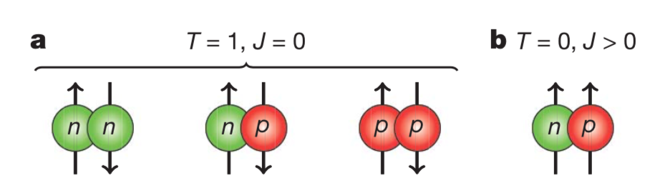
Overview of the perspectives with AGATA-GRIT-VAMOS @GANIL-Spiral1
Nuclear astrophysics
Studying X-ray Bursts with the AGATA-GRIT-VAMOS Setup G. Lotay et al
N=Z
(New) clustering and pairing
Probing mixed-spin np pairing in the super-collective Z~60 and A~130 region, J. Dudouet et al
Neutron-proton pairs in the self-conjugate nuclei (Ti,Ni) of the fp-shell through two-nucleon transfer, M. Assié, et al
Clustering in medium-mass proton-rich nuclei (Ar) studied through Li-induced stripping reactions, D. Beaumel et al
Shell model & collectivity
Ab-Initio test ²³Ne(d,p)²⁴Ne by DSAM on the 2⁺_{2,} E. Clément et al
Coulomb excitation of ⁴⁴Ti and ⁶²Zn, K. Hadynska-Klek et al
Can AGATA extract an average lifetime of multiple states? S. Ota et al
Hyper-Deformation
Unbound nuclei
Attacking the quasi-continuum & the entry distribution with AGATA hyperdeformation hunting Superdeformation revisiting, A. Korichi et al
Spectroscopic prospects for ¹⁹Ne above the a-particle threshold, F. De Oliveira et al
Spectroscopy of unbound states in light nuclei. I Stefan et al
Spectroscopy of proton-rich nuclei using charge-exchange reactions and proton adding with a ³He target, B. Fernandez-Dominguez et al.,
Study of the Heavy Fragment survival in Multi Nucleon Transfer reaction
I. Stefan et al

Slide 14

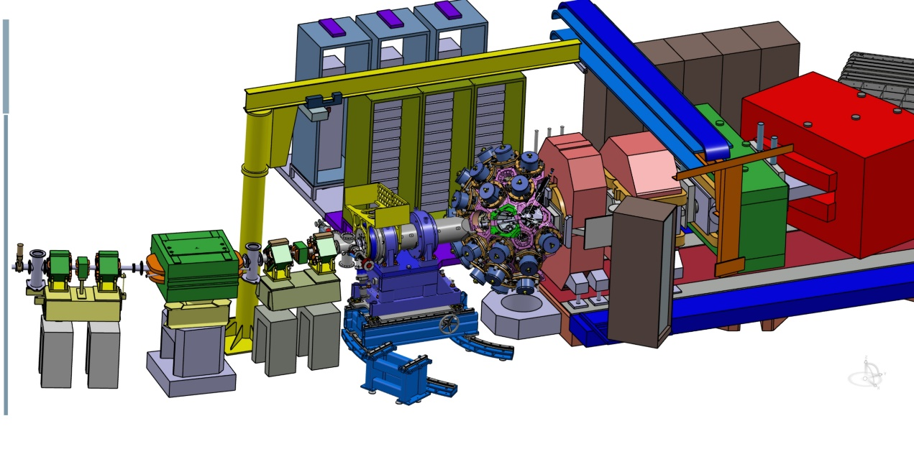
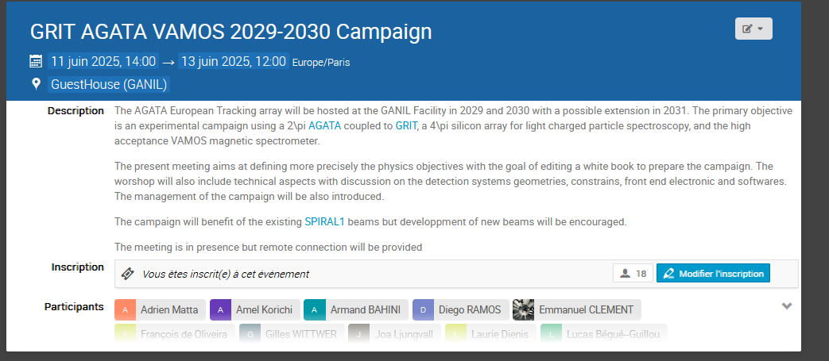
AGATA (2π) – GRIT – VAMOS – SPIRAL1
2nd of October 2024 – ASC meeting
Next steps :
    coming back in front of the community see our presentation in the GCM meeting
    Preparing a more detailed white book detailing the precise needs in term of detection geometry to constrain the implementation and SPIRAL1 beams requiring development. 2
    Organizing this new collaboration in term of workload, PBS, milestone and collaboration between the partners→ Host Agreement in progress
    Particular focus on the Data Management Plan
    Already on-going,
      CAD design and integration (IJCLab- GANIL)
      FEBEE coupling (LPC-Caen, GANIL)- PACE-FASTER via SMART
      DAQ and software (LPC-Caen, IJClab, IP2i, GANIL) DCOD-FASTER
      Analysis soft (AGAPRO-NPTool-GAna)
      ++ AGATA and GRIT collaborations, VAMOS Local team

Slide 15
Conclusions
The physics cases cover wide areas :
Resonance and near threshold spectroscopy including cluster
Ab-initio testing
Nuclear astrophysics spectroscopy
Study of nuclear deformation
Clustering and pairing in nuclei
SHE and hyper-deformation
with various experimental methods
one-nucleon and two-nucleon transfer
charge exchange reactions
surrogate methods
DSAM + transfer
coulex or fusion
N=Z
GRIT is covering almost all the requests coupled to AGATA and VAMOS (direct and fusion reaction)
SD and HD if solid angle when AGATA is there, is meaningful
Most of beams requested from SPIRAL1 are already available.
Improvements of the Kr, Ne beams identified
Development of new beams : ⁴⁴Ti, ⁶²Zn, ¹³O, ⁵⁵Co, ^{56,57}Ni
A cryo He target is needed (ATRACT ANR)
A key feature will be also to increase the beam energy event for the “nanogan”-like beams (~8 – 10 MeV/u)

Slide 16
Come and join !

Slide 17
Overview of the perspectives with AGATA-GRIT-VAMOS @GANIL-Spiral1
Nuclear astrophysics
Studying X-ray Bursts with the AGATA-GRIT-VAMOS Setup G. Lotay et al
N=Z
(New) clustering and pairing
Probing mixed-spin np pairing in the super-collective Z~60 and A~130 region, J. Dudouet et al
Neutron-proton pairs in the self-conjugate nuclei (Ti,Ni) of the fp-shell through two-nucleon transfer, M. Assié, et al
Clustering in medium-mass proton-rich nuclei (Ar) studied through Li-induced stripping reactions, D. Beaumel et al
Shell model & collectivity
Ab-Initio test ²³Ne(d,p)²⁴Ne by DSAM on the 2⁺_{2,} E. Clément et al
Coulomb excitation of ⁴⁴Ti and ⁶²Zn, K. Hadynska-Klek et al
Can AGATA extract an average lifetime of multiple states? S. Ota et al
Hyper-Deformation
Unbound nuclei
Attacking the quasi-continuum & the entry distribution with AGATA hyperdeformation hunting Superdeformation revisiting, A. Korichi et al
Spectroscopic prospects for ¹⁹Ne above the a-particle threshold, F. De Oliveira et al
Spectroscopy of unbound states in light nuclei. I Stefan et al
Spectroscopy of proton-rich nuclei using charge-exchange reactions and proton adding with a ³He target, B. Fernandez-Dominguez et al.,
Study of the Heavy Fragment survival in Multi Nucleon Transfer reaction
I. Stefan et al
Selected cases

Slide 18
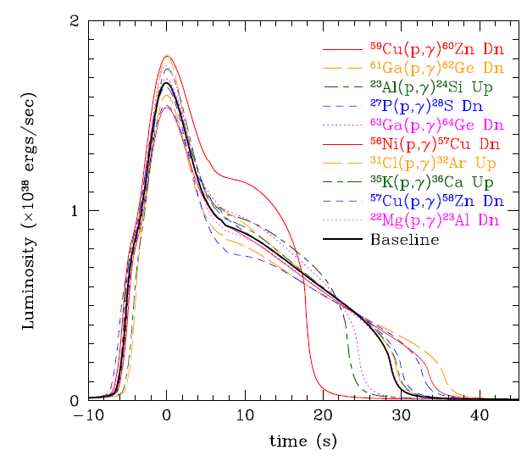
Nuclear astrophysics @ AGATA-GRIT-VAMOS
Studying X-ray Bursts with the AGATA-GRIT-VAMOS set-up, G. Lotay et al
N=Z
-- Type I X-ray bursts
. Sensitive study --> few tens of reactions play an important role
➟ (α,p) process: (α,p)(p,γ) up to A<60
➟ rp-process: (p,γ) reactions & β+ decay
Most important effect on the light curve : ⁵⁹Cu(p,γ)⁶⁰Zn, ⁵⁶Ni(p, γ)⁵⁷Cu and ⁵⁷Cu(p, γ)⁵⁸Zn
    Probing the ⁵⁶Ni waiting point via ⁵⁵Co(d,p) and ⁵⁷Ni(d,p) transfer (mirror reactions)
    Determination of reaction rate for ⁵⁹Cu(p,γ) via ⁵⁹Cu(³He,dγ)
Assets of AGATA-GRIT-VAMOS
High energy gamma-rays efficiency and P/T
Triple coincidence
³He cryogenic target
Energy thresholds

Slide 19
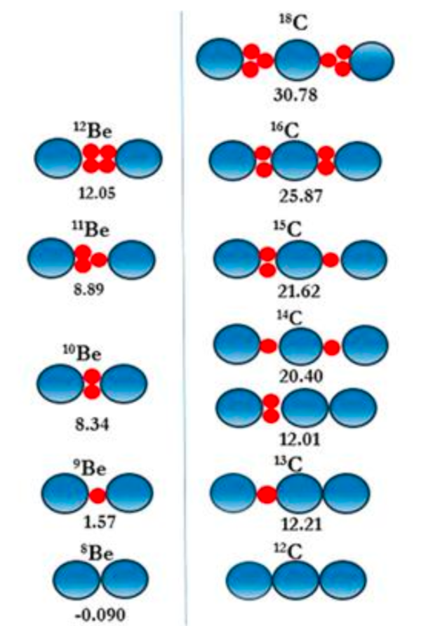
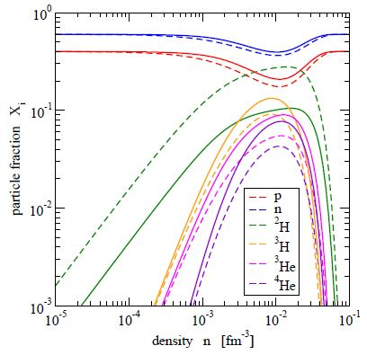
New Clustering @ AGATA-GRIT-VAMOS
Clustering in medium-mass proton-rich nuclei (Ar) studied through Li-induced stripping reactions, D. Beaumel et al
N=Z
Theory: All kind of clusters should be formed at low density
Triton clustering in Be observed @ RIKEN via QFS (D. Beaumel et al)
further investigation by transfer (p,alpha) on Be (experiment performed in 2024 with MUGAST-EXOGAM-LISE)
Hint for ³He clustering in N=2 isotones
(S. Koyama et al)
Further experimental program: heavier nuclei (Ar) and ³He clustering (proton-rich)
S.Typel, J.Phys.Conf.Ser.420,012078(2013)
Assets from AGATA-GRIT-VAMOS
Triple coincidence
Study of clustering in excited states
low CS --> efficiencies

Slide 20
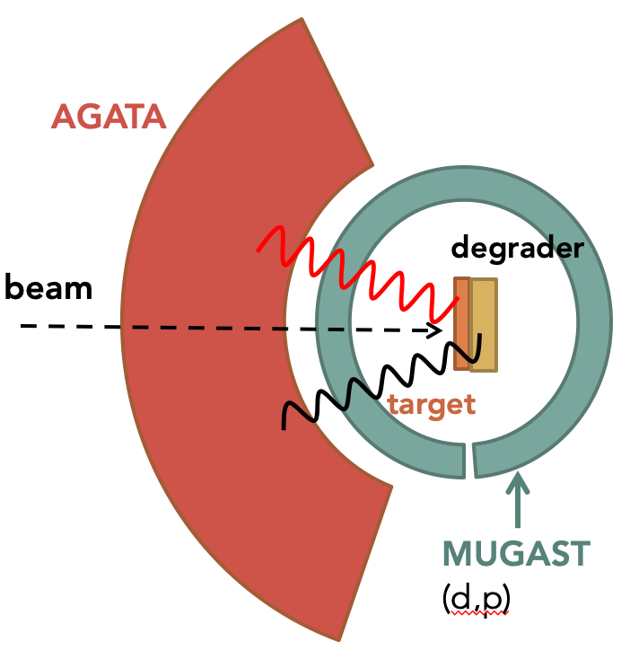
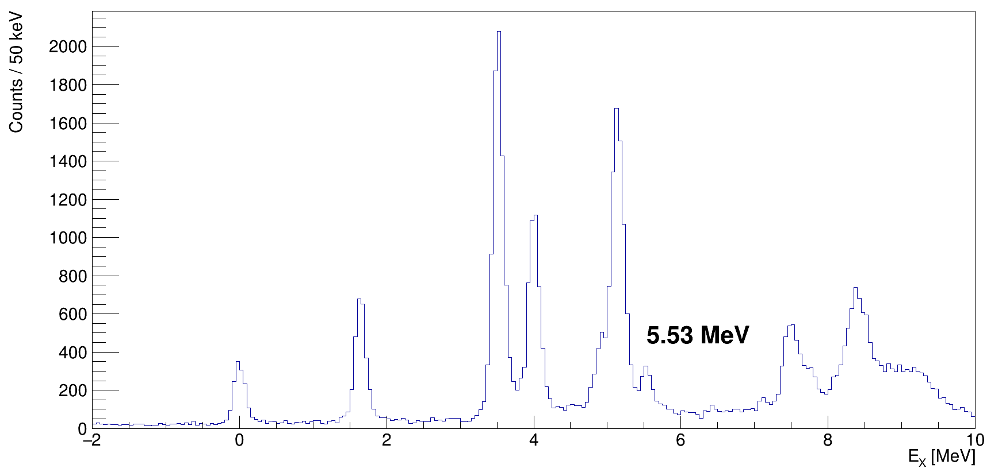
3N forces with AGATA-GRIT-VAMOS
Ab-Initio test ²³Ne(d,p)²⁴Ne by DSAM on the 2⁺_{2,} E. Clément et al
N=Z
-- 3N forces
. ²⁴O is the last bound isotopes : striking anomaly !
➟ need for 3N forces to understand it
--> Constraining ab-initio models towards the dripline:
¹⁹O(d,pɣ)_{DSAM}measured at GANIL (I. Zanon, et al. Phys. Rev. Lett. 131, 262501 (2023))
²³Ne(d,pɣ) to be measured !
GRIT
(d,p)
Assets from AGATA-GRIT-VAMOS
Triple coincidence
Resolving power of AGATA
Entry point control (GRIT)
T. Otsuka et al, PRL 104, 012501 (2010)
3⁺₁
2⁺₂
I. Zanon et al, PRL(2023)

Slide 21
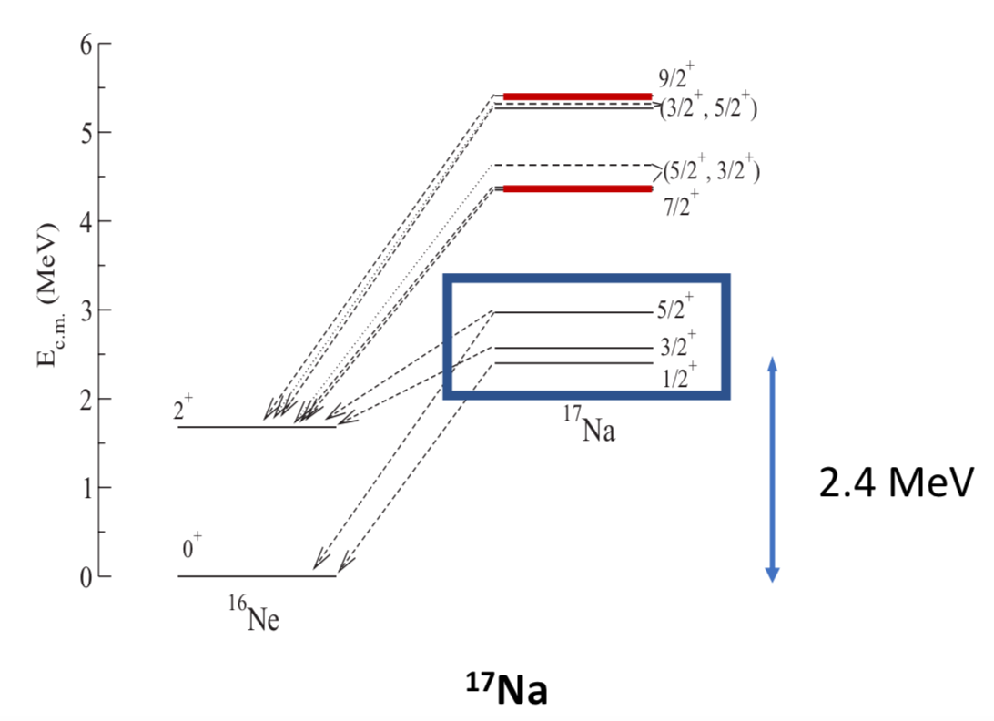
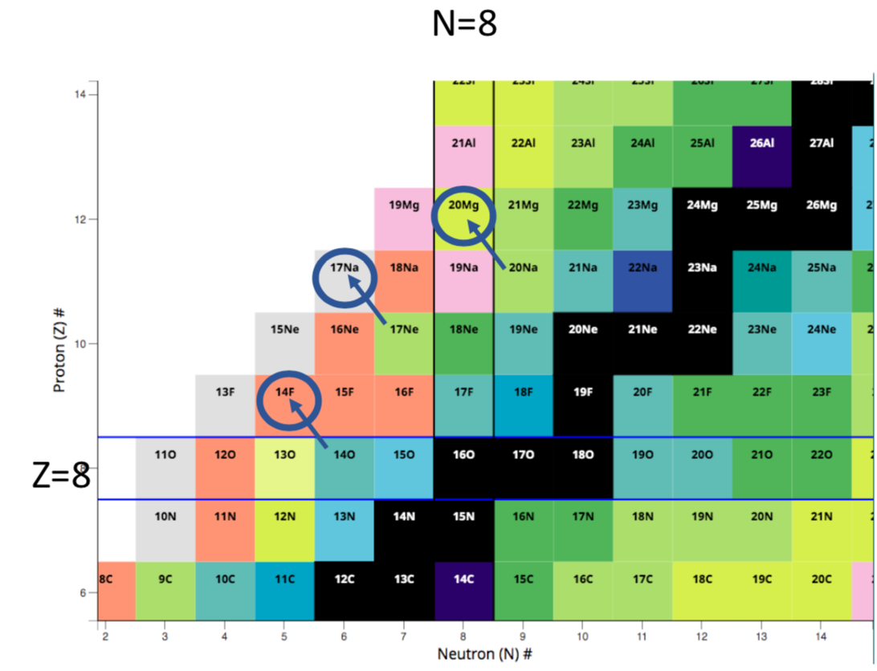
Unbound nuclei at the proton dripline with GRIT-AGATA-VAMOS
Spectroscopy of proton-rich nuclei using charge-exchange reactions and proton adding with a ³He target, B. Fernandez-Dominguez et al.,
N=Z
¹⁷Na predicted levels
Nuclei at the confluence of shell gaps between standard Z=8, N=8
- sd- space with intruder presence
- Effects of 3N-body forces
- Influence of the continuum
- Test of INC- Hamiltonians in the sd-shell
Timofeyuk, Descouvemont, PRC (2010)
GOAL : proton-rich nuclei and 1p emitters: ¹⁴F, ¹⁷Na,²⁰Mg by (³He,t) charge exchange reactions
+ 3p emitter to ¹⁴O
Assets from AGATA-GRIT-VAMOS
Triple coincidence
³He cryogenic target
Granularity : 3p decay
background rejection (¹⁵O)
Gamma decay from unbound states
Notes:
MCAS multichannel algebraic scattering, MCM microscopic cluster model

Slide 22
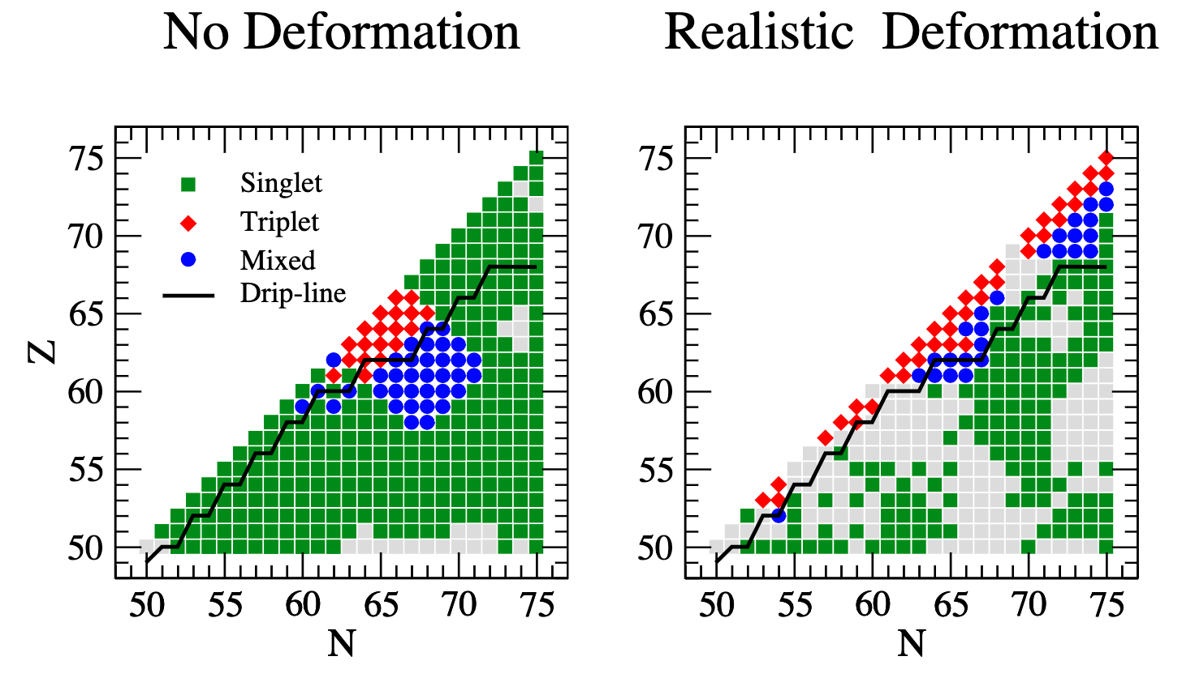
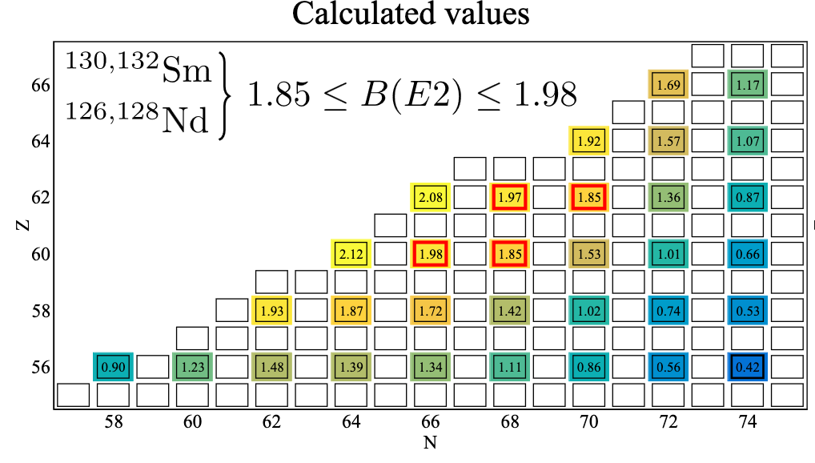
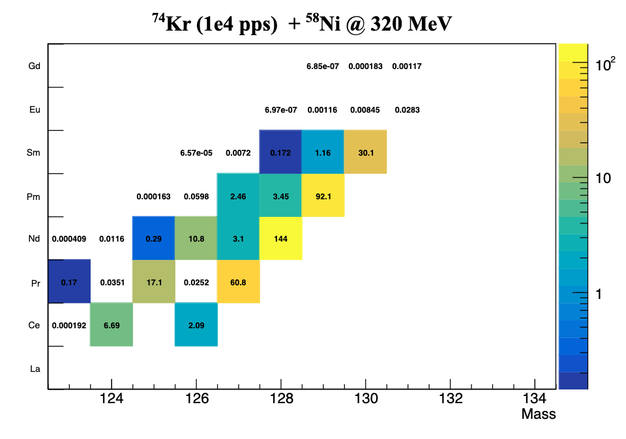
Mixed np pairing and super-cllecitivty by fusion evaporation with radioactive beams
Probing mixed-spin np pairing in the super-collective Z~60 and A~130 region, J. Dudouet et al
N=Z
Mixed pairing candidates :
np pairing + realistic deformation
Super-collectivity candidates :
Z~60 and A~130, B(E2) ~2
measured
Method: fusion-evaporation with radioactive beam ⁷⁴Kr + ⁵⁸Ni
G. Palkanoglou ,A. Gezerlis, arXiv (2024)
predicted
CS in mb as from HIVAP
Assets from AGATA-GRIT-VAMOS
Triple coincidence
Vamos resolution
Combined Efficiencies
AGATA resolving power
Focused on nuclei of interest

