Slide 1
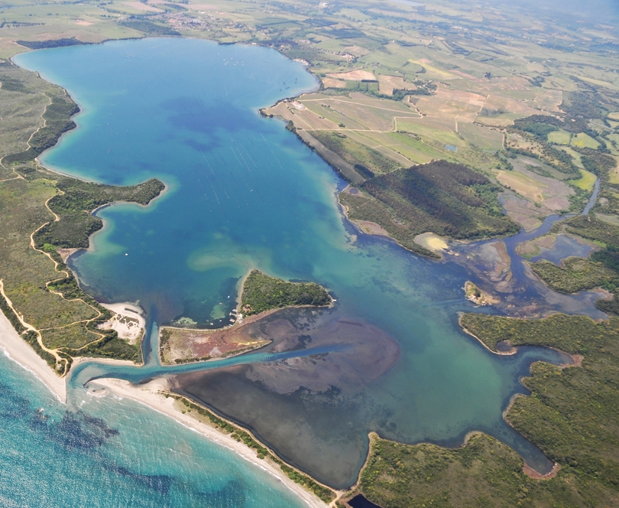


Le ²²²Rn comme traceur des apports d’eau souterraine vers les zones humides méditerranéennes : vers une standardisation des mesures et une aide à la gestion de ces espaces naturels
Rencontre Scientifique interdisciplinaire sur le Radon
14-16 Mai 2025
Université Aix-Marseille, Campus Saint Charles
Sébastien Santoni^{1,2}, P.-A. Guisiano^{1,2}, A. Guerin^{1,2}, D. Orticoni^{1,2} E. Garel^{1,2}, T. Leydier^{1,2}, F. Huneau^{1,2}
1 Université de Corse Pascal Paoli, Département d'Hydrogéologie, 20250 Corte, France
2 CNRS, UMR 6134 SPE, 20250 Corte, France
^{santoni_s@univ-corse.fr}
Diana lagoon, Corsica Island, France

Slide 2
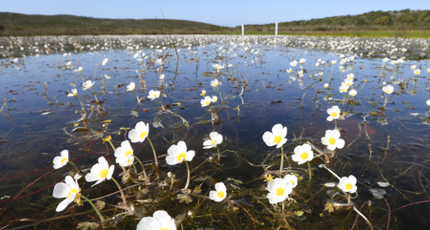
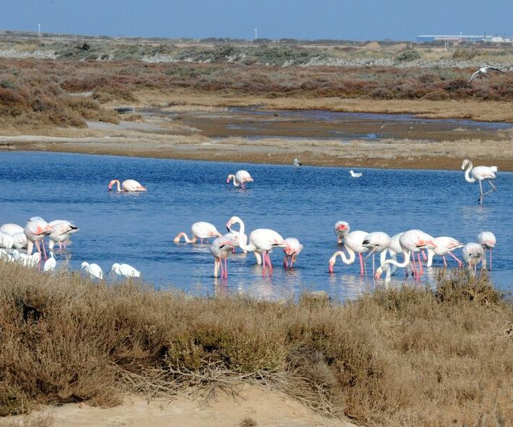
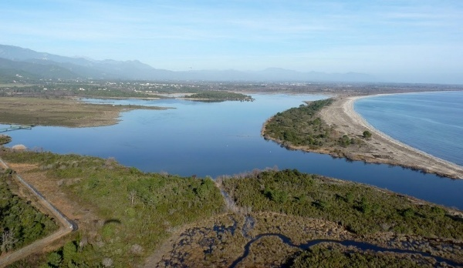
Rencontre Scientifique interdisciplinaire sur le Radon
14-16 Mai 2025
Université Aix-Marseille, Campus Saint Charles
Introduction
Mediterranean Wetlands
Pink flamingo, Corsica, France
Temporary pond of Tre Paduli, Corsica, France
Pink flamingo, Corsica, France
Palo lagoon, Corsica, France
provide
Food security
Climate change mitigation
Wetlands are essential for humankind
ecosystem services: water regulation, biodiversity conservation
Groundwater ensure part or total needs of human societies and sustainability of wetlands
High seasonality of hydroclimatic conditions in Mediterranean areas
Coastal lagoons, alluvial wetlands, river banks and mouths, temporary ponds, low and high altitude peatlands.

Slide 3
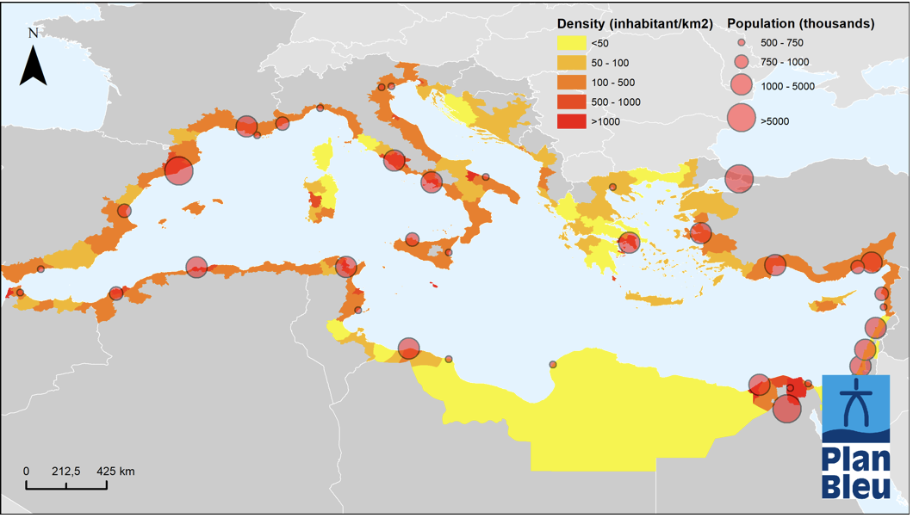
Rencontre Scientifique interdisciplinaire sur le Radon
14-16 Mai 2025
Université Aix-Marseille, Campus Saint Charles
Introduction
Mediterranean Wetlands
Since 1970 : area of wetland worldwide decreased by 35%
Mediterranean : 48%
Mainly attributed to :
Population growth
Water withdrawal
Agricultural land extension
Climate change
Lack in functioning knowledge
Population density of coastal regions and large coastal cities (over 500,000 inhabitants).
Source : UN - Barcelona Convention - Mediterranean 2017 Quality Status report
https://www.medqsr.org/fr/node/233c
Only 6% are in good conservation status (2013 - 2018).
41% of emblematic sites have seen their environment deteriorate (2010 -2020).
Notes:
État de conservation des habitats humides d’intérêt communautaire : Seuls 6 % sont en bon état selon les évaluations de 2013 à 2018.
Évolution de l’état général des zones humides : 41 % des sites emblématiques ont vu leurs milieux se dégrader entre 2010 et 2020.
https://naturefrance.fr/indicateurs/etat-de-conservation-des-milieux-humides-naturels
https://www.statistiques.developpement-durable.gouv.fr/les-zones-humides-en-france-synthese-des-connaissances-en-2021?

Slide 4
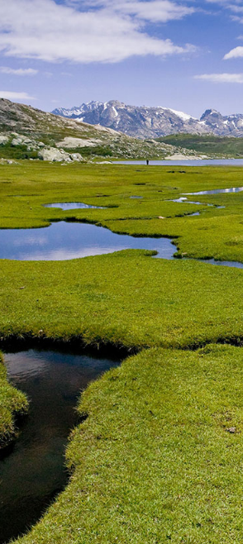
Rencontre Scientifique interdisciplinaire sur le Radon
14-16 Mai 2025
Université Aix-Marseille, Campus Saint Charles
Introduction
Mediterranean Wetlands
Little is known about Mediterranean wetlands hydrogeology
→ Especially their connectivity to groundwater.
Our main objectives using ²²²Rn:
Are all small Mediterranean wetlands dependent on groundwater? Insights from ²²²Rn as a tracer of groundwater-wetland interactions.
Discussing challenges in measurement protocols and related uncertainties
Exploring ways to integrate radon into wetland management strategies, particularly in defining "Hydrogeological watershed-scale management area”.
High elevation peatlands « pozzines » of Corsica, FR

Slide 5
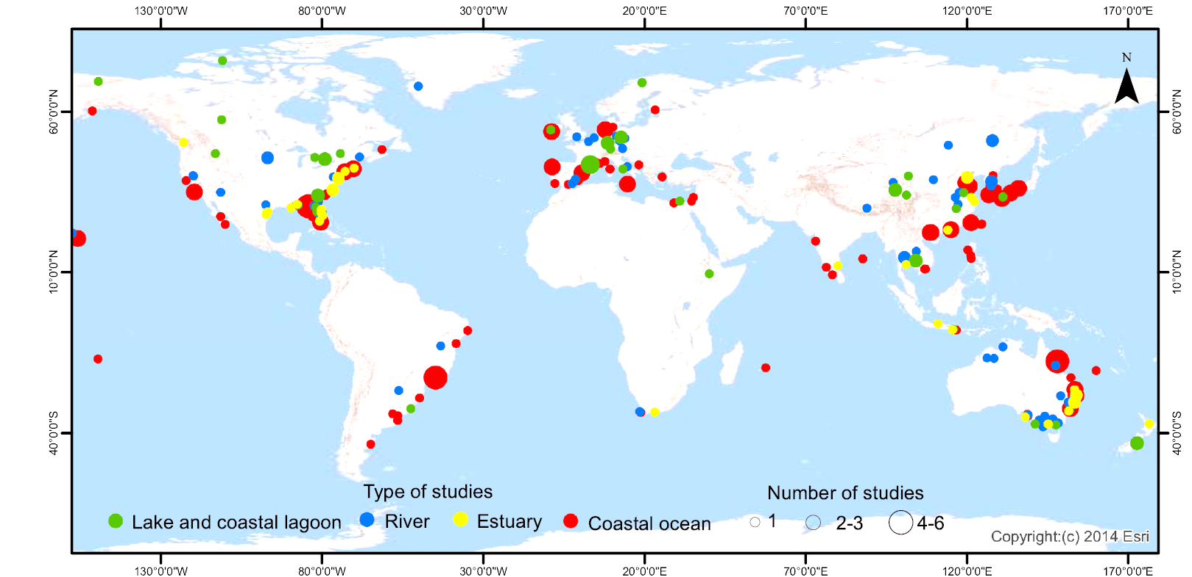
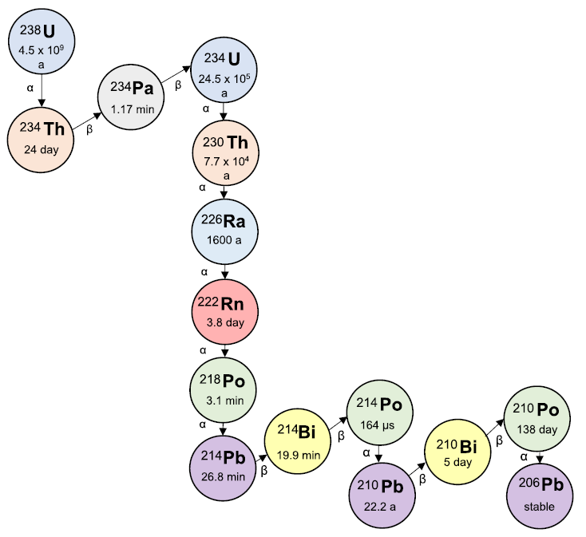
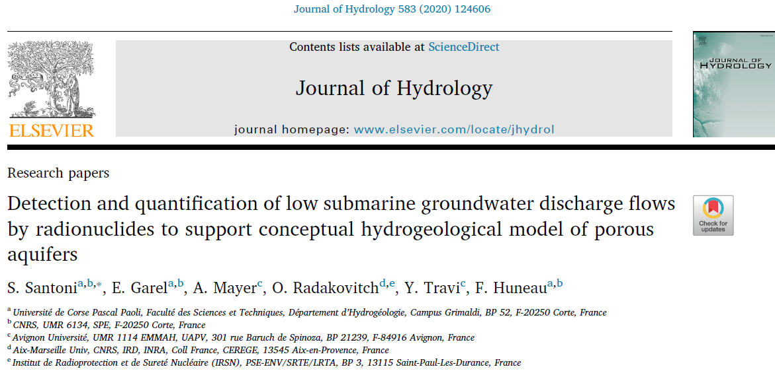
Rencontre Scientifique interdisciplinaire sur le Radon
14-16 Mai 2025
Université Aix-Marseille, Campus Saint Charles
Introduction
Radon-222 as a Groundwater Discharge Tracer in Mediterranean Wetlands
Combined with other tracers such as temperature (T), electrical conductivity (EC), and Radium isotopes,
²²²Rn has proven effective tracer in detecting and quantifying significant groundwater fluxes to large continental and transitional wetlands or at coastal aquifer outlets in the sea.
²²²Rn is an interesting tracer of GW discharge because :
  Short half-life (3.8 days)
  Chemically inert nature
  Significant enrichment in GW
      (≈ 3 orders of magnitude)
Map of worldwide publications dealing with GW discharge using ²²²Rn to coastal oceans, rivers, lakes (incl. lagoons and ponds), and coastal oceans
(1996 – 2021 period, n = 336, in Adyasari et al., 2023).
In contrast, low and diffuse GW fluxes remain understudied, despite their role in sustaining the rich and threatened biodiversity of smaller, numerous, and scattered wetlands, as seen in the Mediterranean area.

Slide 6
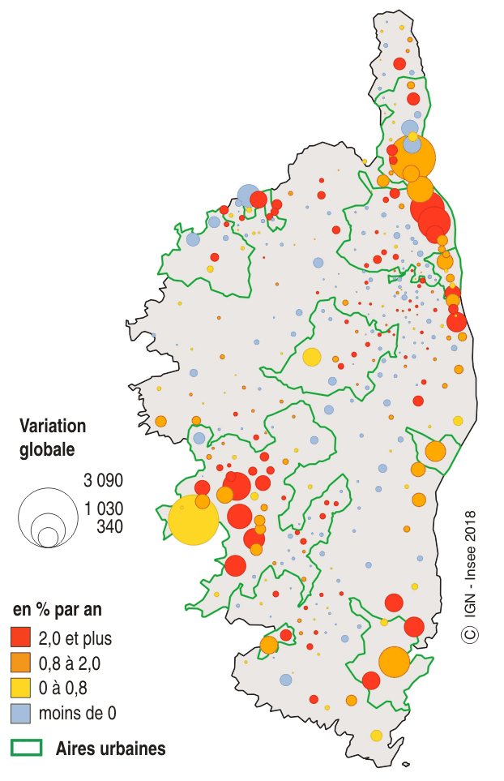
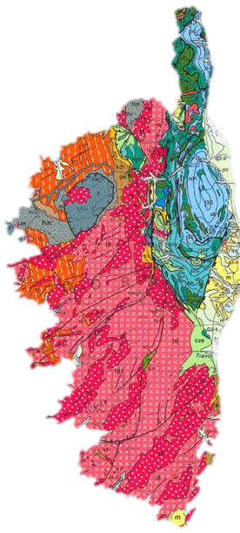
Rencontre Scientifique interdisciplinaire sur le Radon
14-16 Mai 2025
Université Aix-Marseille, Campus Saint Charles
Introduction
The Corsica Island (FR), an observatory of Mediterranean Wetlands
All the compartment of the continental water cycle
↗ pressure from : climate change, population growth, agriculture and tourism.
High geology diversity, including hercynian granites = high uranium content
Wetlands of national and international interest (RAMSAR…).
France
Corsica
Mediterranean Sea
Representative of the Mediterranean conditions with lots of ²²²Rn sources
Rate of population growth in Corsica (%/year) :
Geology
Wetlands
and more
Less than 0
Urban areas
Source : initiative PIM pour les îles de Méditerranée
Source : www. Insee.fr
Source : www. Infoterre.fr

Slide 7
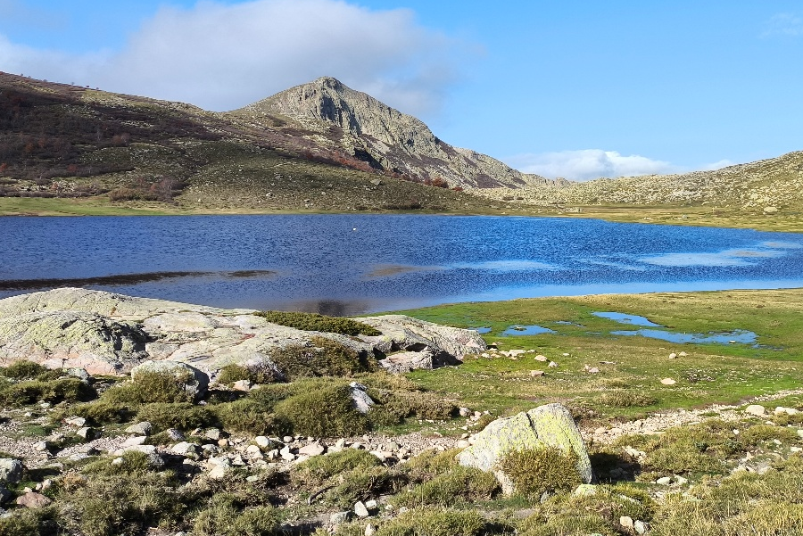
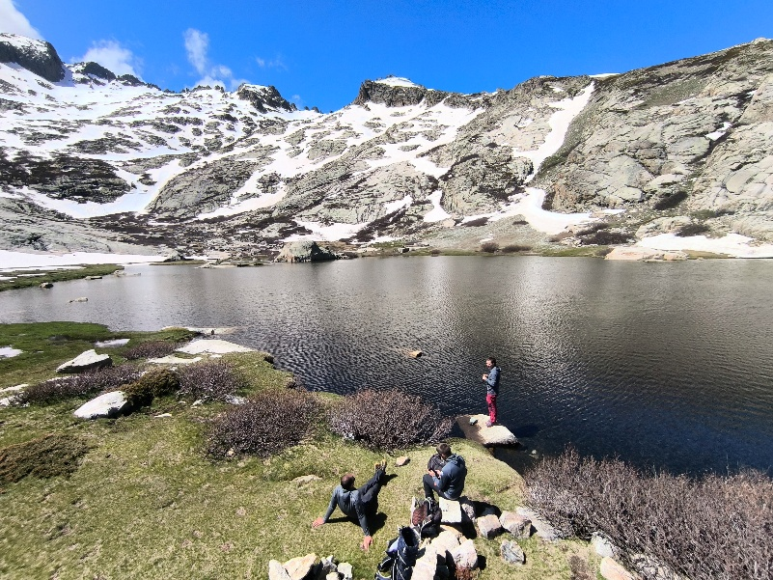
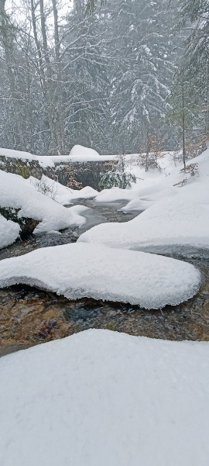
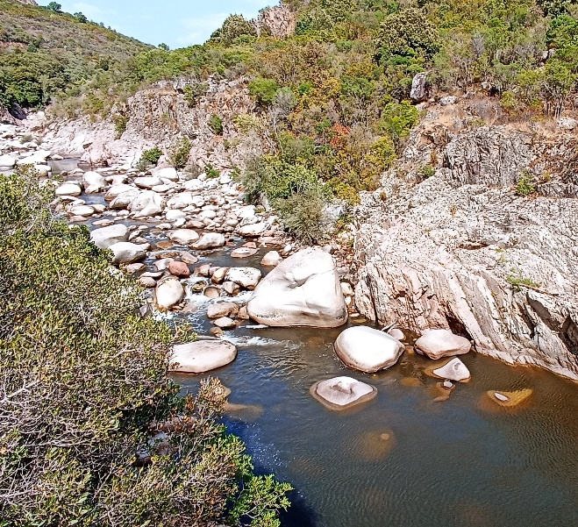
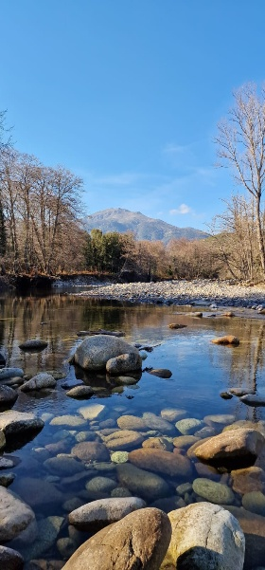
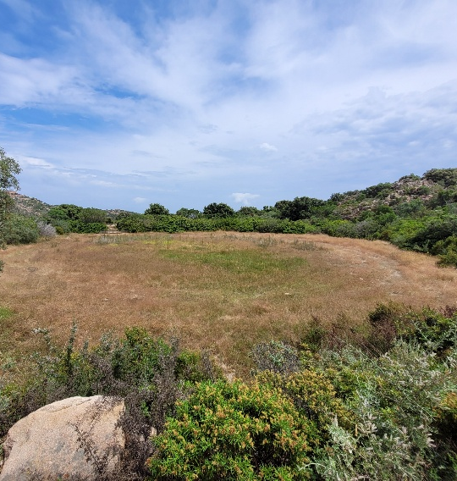
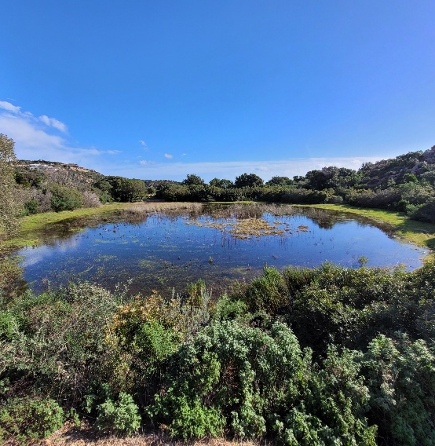
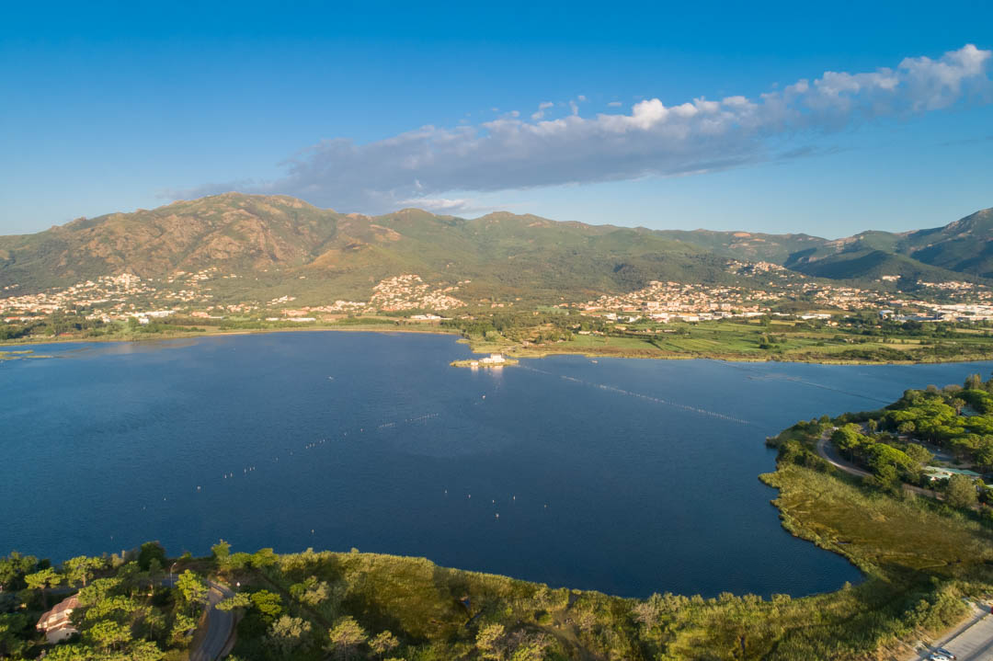
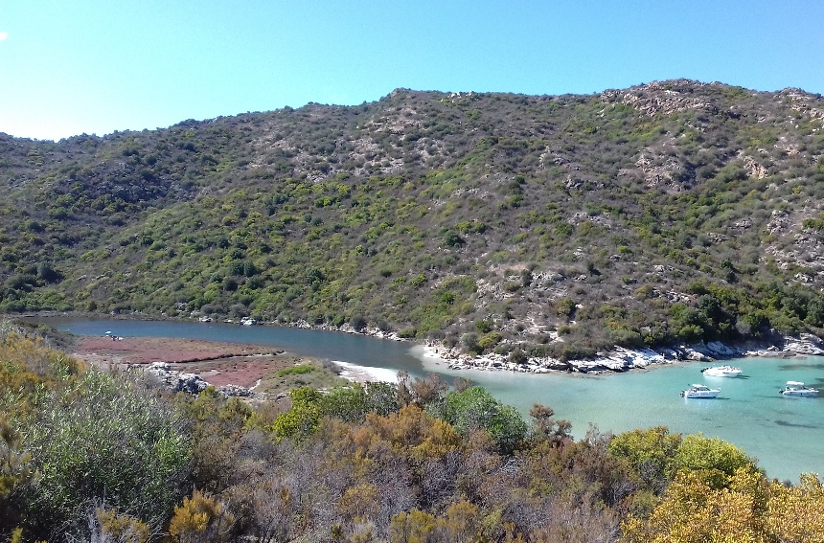
Rencontre Scientifique interdisciplinaire sur le Radon
14-16 Mai 2025
Université Aix-Marseille, Campus Saint Charles
Introduction
The Corsica Island (FR), an observatory of the diversity of Mediterranean Wetlands
Mountain lakes
Rivers and streams
Ninu lake, Corsica (1709 m a.s.l)
Oriente lake, Corsica (2062 m a.s.l)
Taravu
Gravona
Ascu
Temporary ponds
Coastal lagoons / estuary
Padullelu, Bonifacio
Biguglia coastal lagoon, Bastia
Fiume Santu micro-estuary

Slide 8
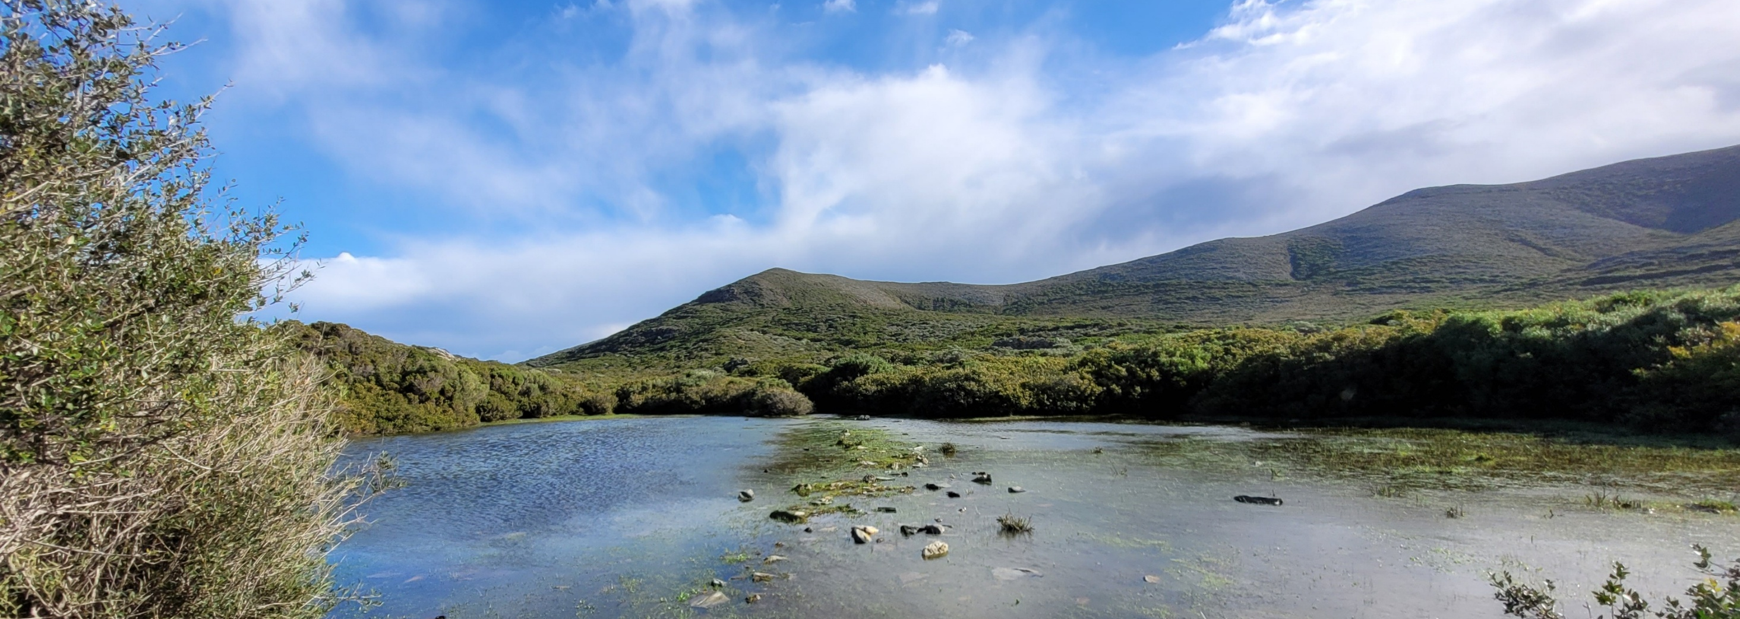
Rencontre Scientifique interdisciplinaire sur le Radon
14-16 Mai 2025
Université Aix-Marseille, Campus Saint Charles
1. Are all small Mediterranean wetlands dependent on groundwater? Insights from ²²²Rn

Slide 9
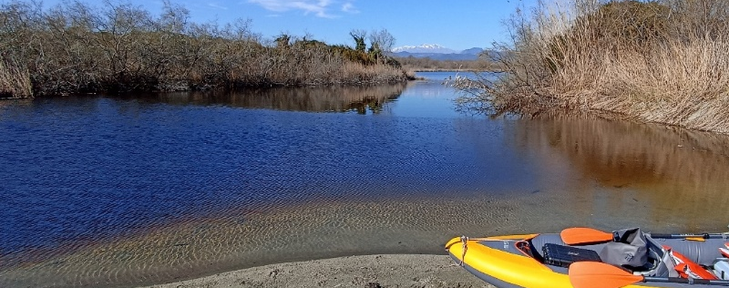
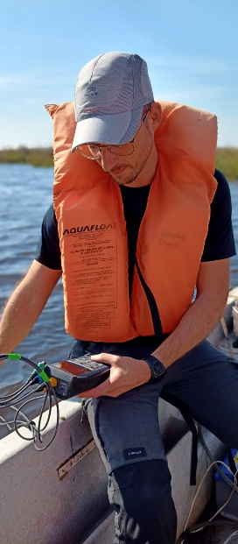
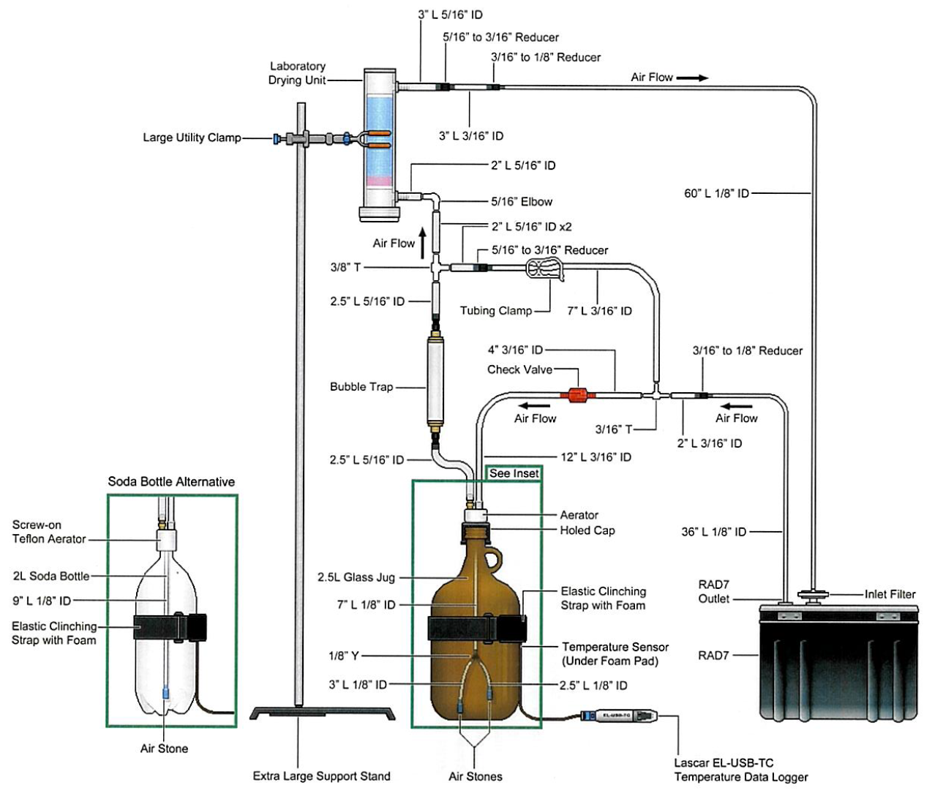
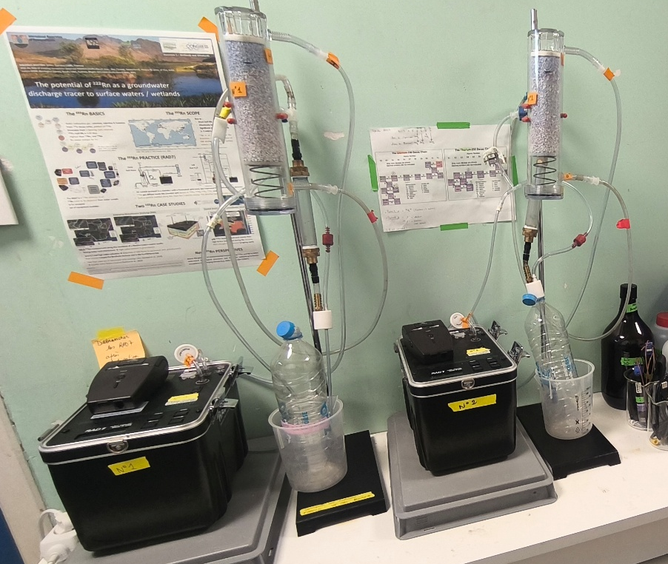

Rencontre Scientifique interdisciplinaire sur le Radon
14-16 Mai 2025
Université Aix-Marseille, Campus Saint Charles
1. Are all small Mediterranean wetlands dependent on groundwater? Insights from ²²²Rn
2 RAD7 Durridge® with accessories
“Soda Bottle setup”
Methodology
(remote areas)
Collect 1.5 l plastic bottles of surface water and groundwater potential end-members (if accessible).
Run the analysis for 5 minutes, six to eight times
(total: 30 to 40 minutes).
Discard the first 10 minutes during data post-processing (equilibration).

Slide 10
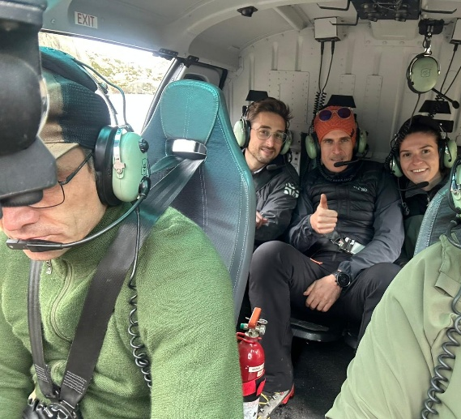
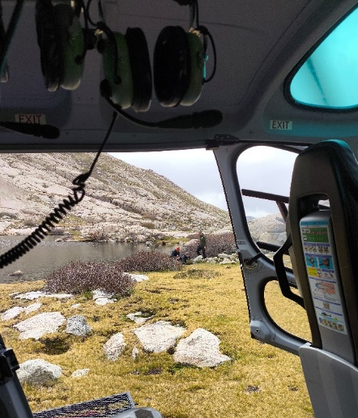
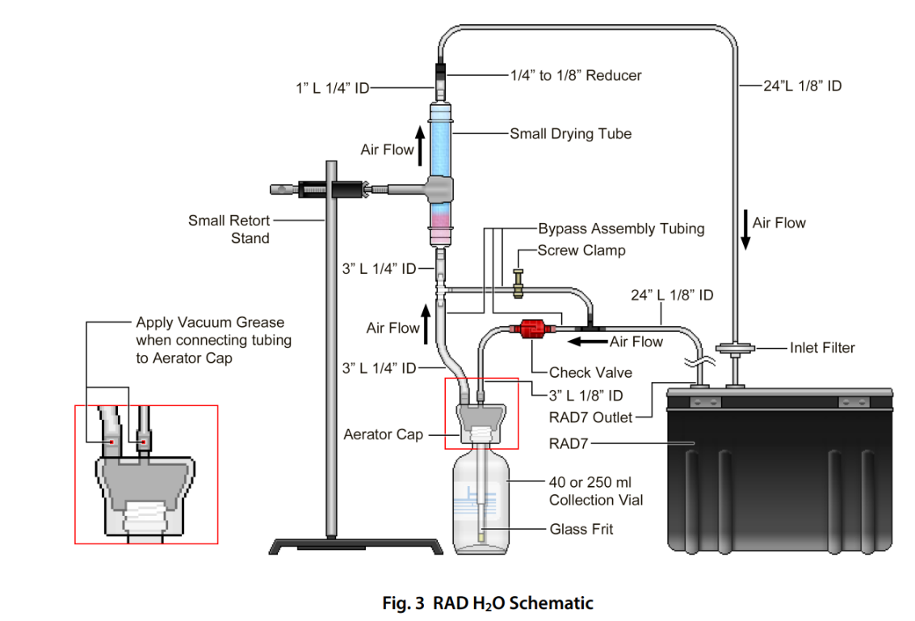
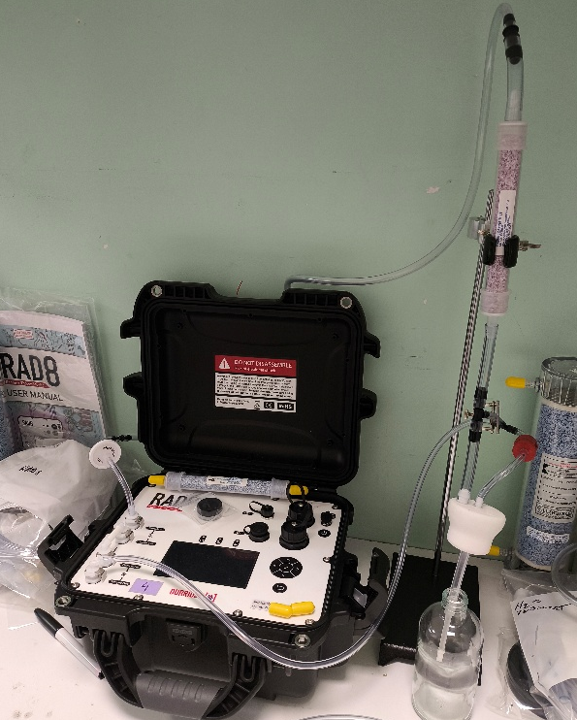
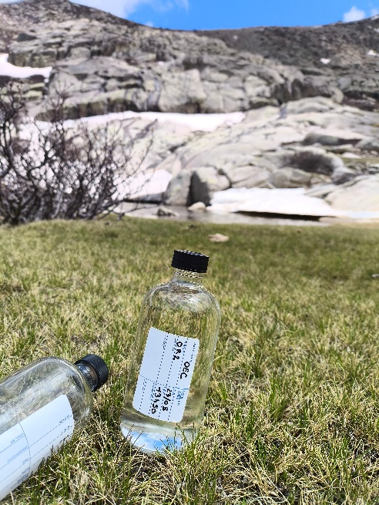
Rencontre Scientifique interdisciplinaire sur le Radon
14-16 Mai 2025
Université Aix-Marseille, Campus Saint Charles
1. Are all small Mediterranean wetlands dependent on groundwater? Insights from ²²²Rn
2 RAD8 Durridge® with accessories
“wat250 setup”
Methodology
(remote areas)
Collect 250 ml glass vials of surface water and groundwater potential end-members (if accessible).
Run the analysis for 5 minutes, six to eight times
(total: 30 to 40 minutes).
Discard the first 10 minutes during data post-processing (equilibration).

Slide 11
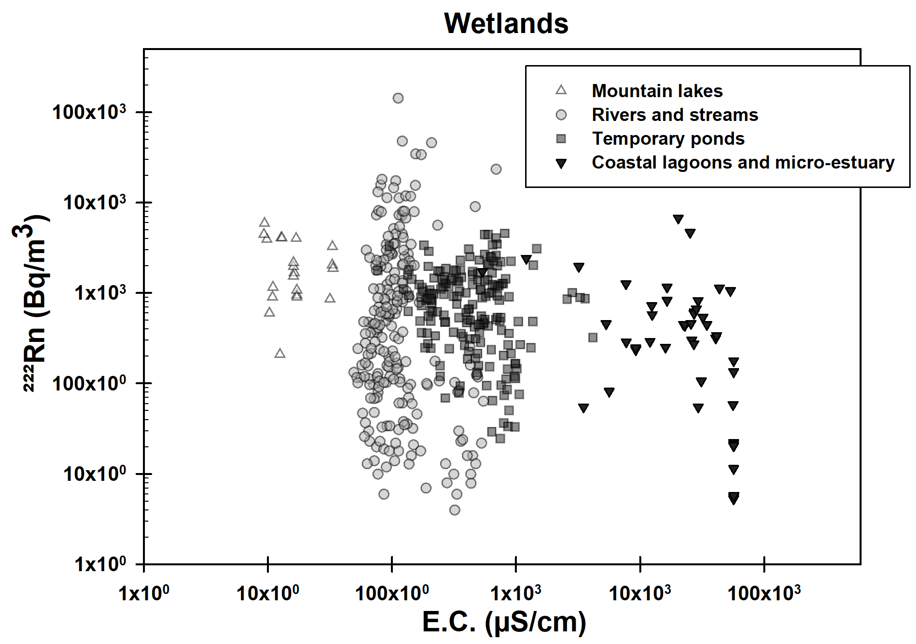
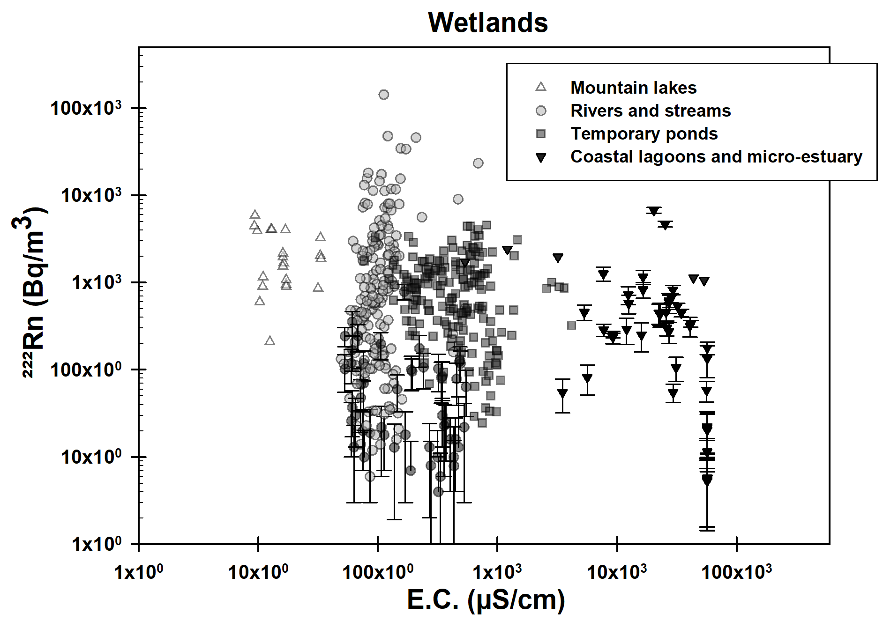
Rencontre Scientifique interdisciplinaire sur le Radon
14-16 Mai 2025
Université Aix-Marseille, Campus Saint Charles
1. Are all small Mediterranean wetlands dependent on groundwater? Insights from ²²²Rn
Results and discussion
Since 2022, we performed ²²²Rn analysis on 493 water samples from Mediterranean wetlands
²²²Rn activity clearly detected for 91% of the samples (n = 449 / 493)
→ Evidence of groundwater input.
²²²Rn activities with std. dev. close to zero for 9% of the samples (n = 44 / 493)
→ There is no evidence of groundwater input, although this cannot be excluded.
Most of Mediterranean wetlands investigated here can be considered as GDEs

Slide 12
Rencontre Scientifique interdisciplinaire sur le Radon
14-16 Mai 2025
Université Aix-Marseille, Campus Saint Charles
1. Are all small Mediterranean wetlands dependent on groundwater? Insights from ²²²Rn
Results and discussion
Upstream
Downstream
There is an upstream-downstream evolution of EC in wetlands
Rivers and temporary ponds
Alpine lakes
Coastal Lagoon
Estuary
Distance to the sea
Rain and snow influence (recharge area)
Groundwater contribution
Seawater

Slide 13
Rencontre Scientifique interdisciplinaire sur le Radon
14-16 Mai 2025
Université Aix-Marseille, Campus Saint Charles
1. Are all small Mediterranean wetlands dependent on groundwater? Insights from ²²²Rn
Results and discussion
²²²Rn and EC “correlated”
= GW dilution with seawater
Coastal Lagoon
Estuary
Distance to the sea
Mixing processes

Slide 14
Rencontre Scientifique interdisciplinaire sur le Radon
14-16 Mai 2025
Université Aix-Marseille, Campus Saint Charles
1. Are all small Mediterranean wetlands dependent on groundwater? Insights from ²²²Rn
Results and discussion
²²²Rn and EC
“NOT correlated”
= Decay and degassing
Rivers and temporary ponds
Alpine lakes
Distance to the sea
Mixing processes
²²²Rn signal loose

Slide 15
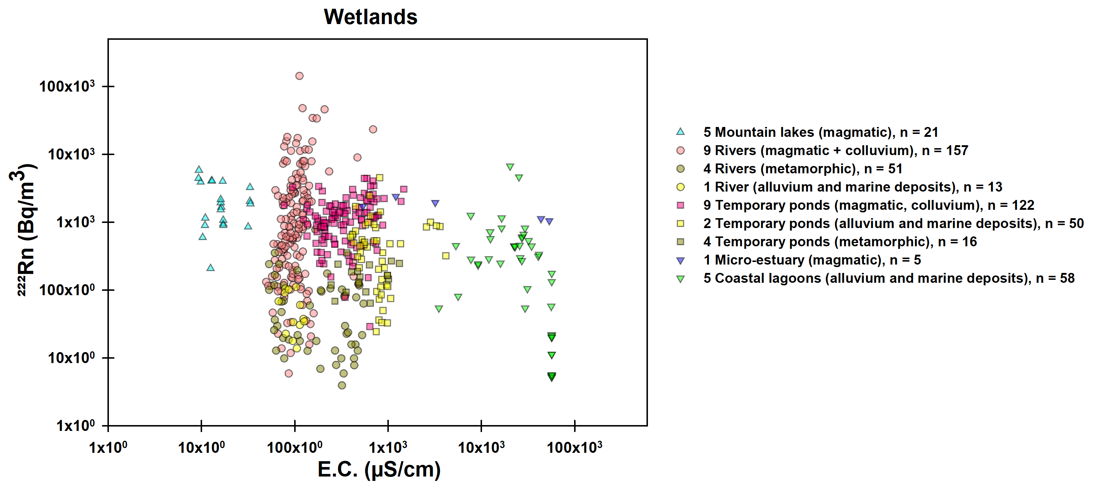
Rencontre Scientifique interdisciplinaire sur le Radon
14-16 Mai 2025
Université Aix-Marseille, Campus Saint Charles
1. Are all small Mediterranean wetlands dependent on groundwater? Insights from ²²²Rn
Results and discussion
There is a clear influence of the lithology of the underlying rocks on the ²²²Rn signature
Calcarenites
Metamorphic rocks
Weathering products of granites
High U-bearing minerals
Magmatic rocks
granites
Distance to the sea
Mixing processes
Low U-bearing minerals
Metamorphic rocks
Calcite
²²²Rn signal loose
Water-rock interactions

Slide 16
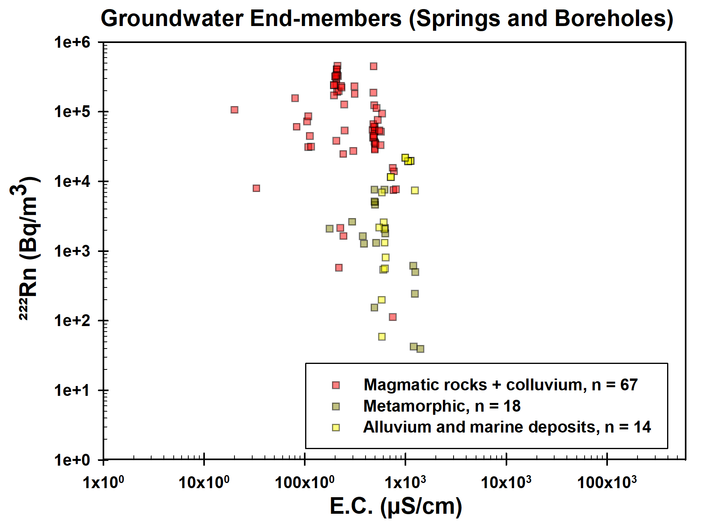
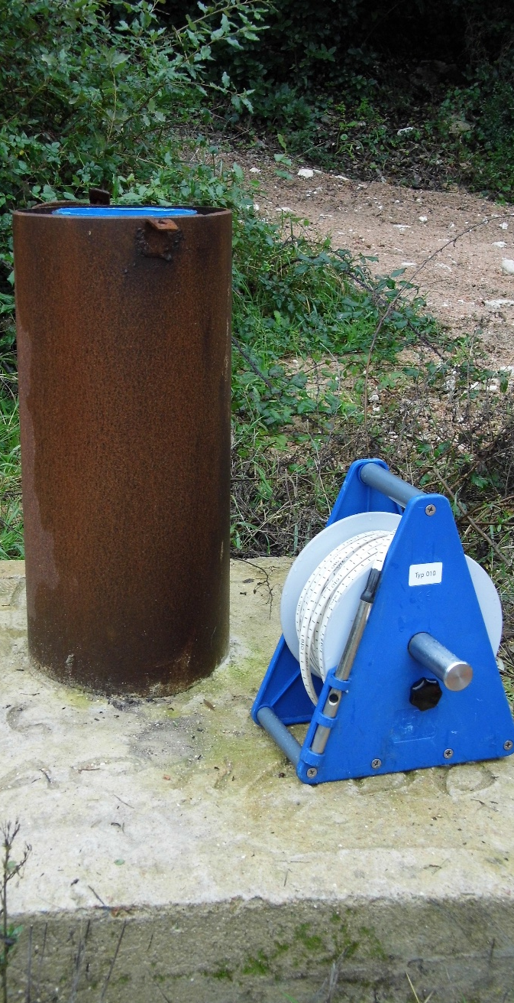
Rencontre Scientifique interdisciplinaire sur le Radon
14-16 Mai 2025
Université Aix-Marseille, Campus Saint Charles
1. Are all small Mediterranean wetlands dependent on groundwater? Insights from ²²²Rn
Focus on GW end-members
Results and discussion
EC values in GW ranges from 20 to 1400 µS/cm
²²²Rn activities in GW ranges from 39±15 to 460,000 ±13,150 Bq/m³
²²²Rn activities are 1 to 3 orders of magnitude higher in magmatic rocks
End members displays a wide range of EC and ²²²Rn contents, with more or less strong contrasts in between GW and surface water
Notes:
1400 - One thousand four hundred
460 000 - four hundred and sixty thousand

Slide 17
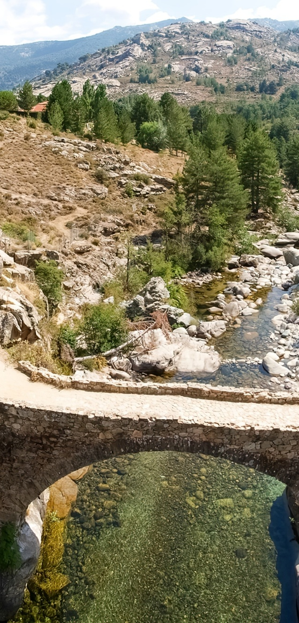
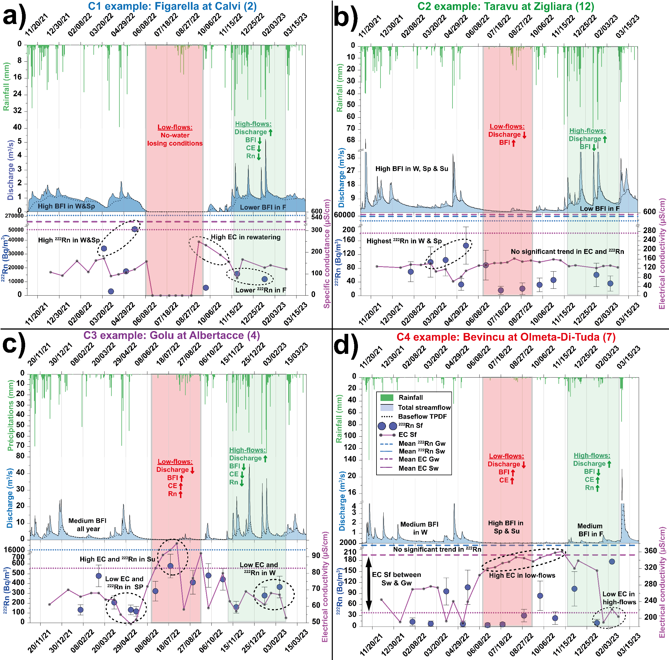
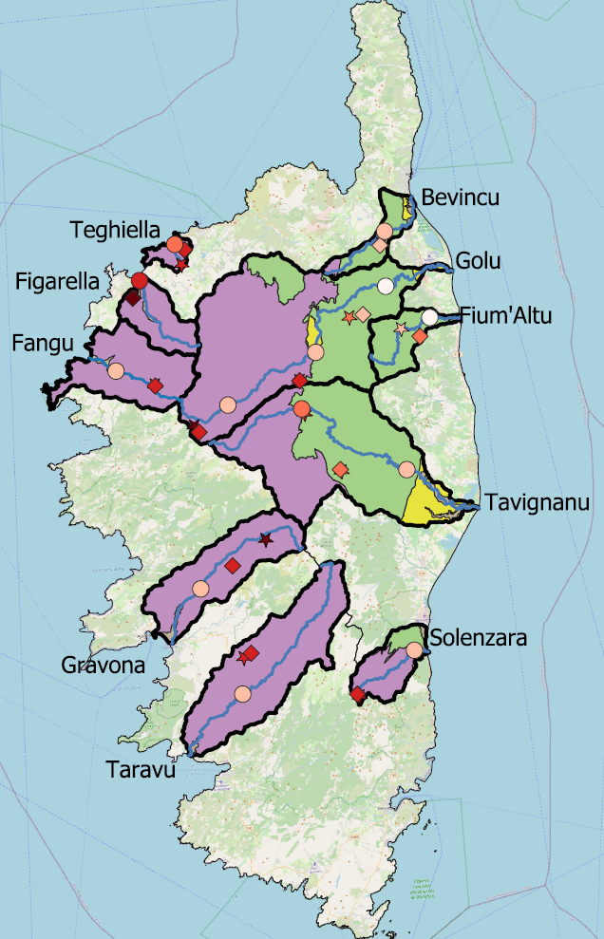
Rencontre Scientifique interdisciplinaire sur le Radon
14-16 Mai 2025
Université Aix-Marseille, Campus Saint Charles
1. Are all small Mediterranean wetlands dependent on groundwater? Insights from ²²²Rn
Focus on Rivers
Results and discussion
Magmatic context
(high U)
Guisiano et al.
Baseflow index (%GW/total river discharge) and ²²²Rn activity display same trend
Good potential of ²²²Rn to trace GW flows to the river system

Slide 18
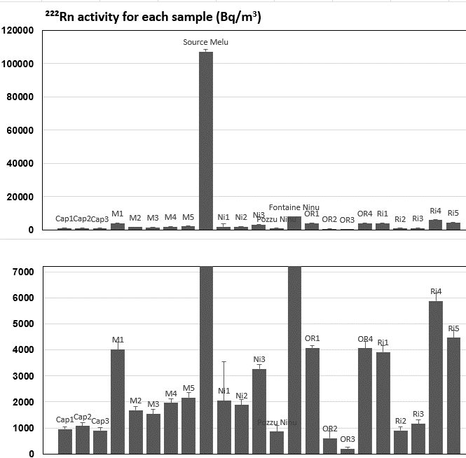
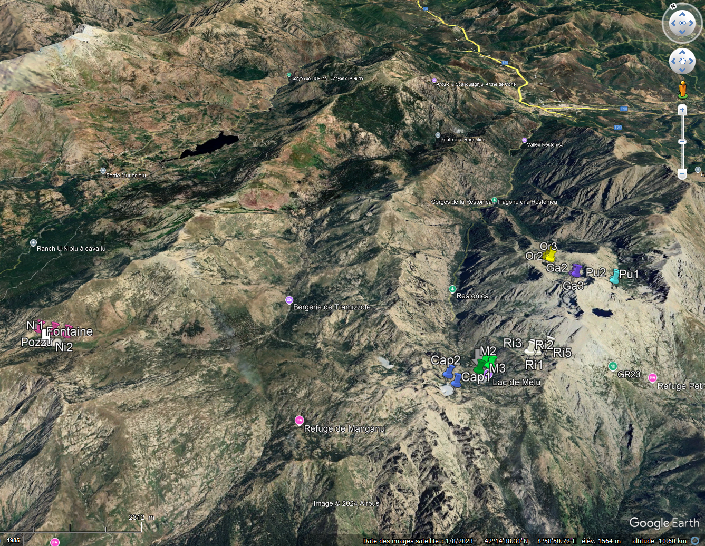
Rencontre Scientifique interdisciplinaire sur le Radon
14-16 Mai 2025
Université Aix-Marseille, Campus Saint Charles
1. Are all small Mediterranean wetlands dependent on groundwater? Insights from ²²²Rn
Focus on alpine lakes : RINOSU (2066 and 2083 m asl)
Focus on Alpine lakes
Results and discussion
Despite their mountain-top location, all these alpine lakes are GW-dependent.
Corte city (400 m asl)
Oriente Lake (2062 m asl)
Ninu Lake (1709 m asl)
Rinosu Lake (2083 m asl)
Capitellu Lake (1930 m asl)
Melu Lake (1746 m asl)
Capitellu Lake
Melu Lake
Ninu Lake
Oriente
Lake
Rinosu Lake
Notes:
we looked for radon in the water of 5 Alpine mountain lakes and obtained values between one and six thousand Bq/m3

Slide 19
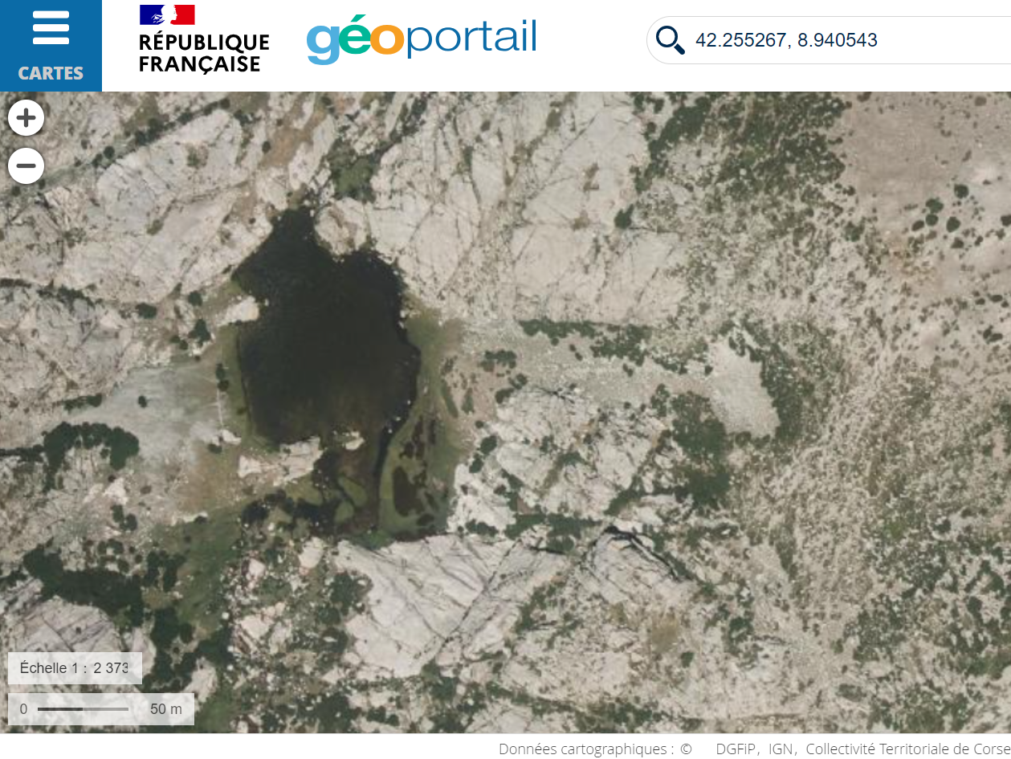
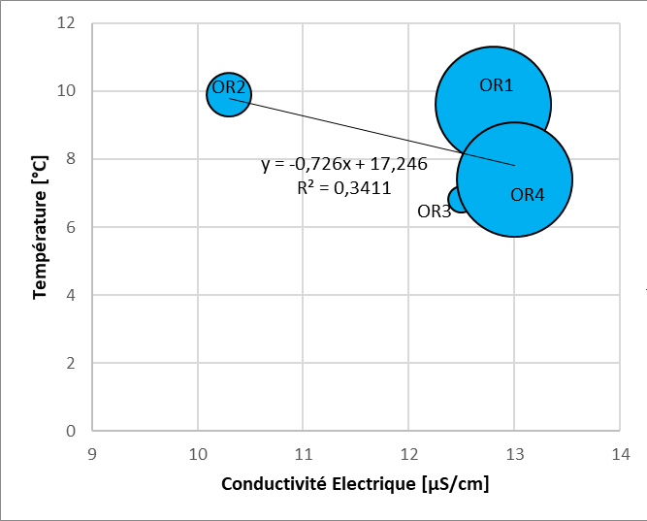
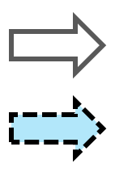
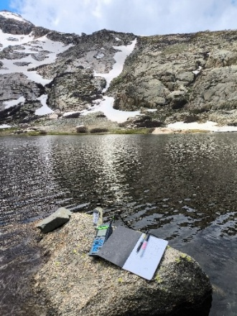
Rencontre Scientifique interdisciplinaire sur le Radon
14-16 Mai 2025
Université Aix-Marseille, Campus Saint Charles
1. Are all small Mediterranean wetlands dependent on groundwater? Insights from ²²²Rn
Focus on Alpine lakes
Oriente Lake (2062 m asl)
Results and discussion
The correlation between T, EC, and ²²²Rn is not clear.
T and EC are also likely affected by snow patches near the lake in some areas.
Maximum ²²²Rn values agree with clearly visible NE-SW oriented lineaments in the surrounding granite basement (OR1 & OR4).
Surface water
Groundwater
4076 Bq/m³
Or1
Or4
601 Bq/m³
4063 Bq/m³
Or2
Or3
210 Bq/m³
Clear input of radon-rich groundwater into the Oriente lake
4

Slide 20
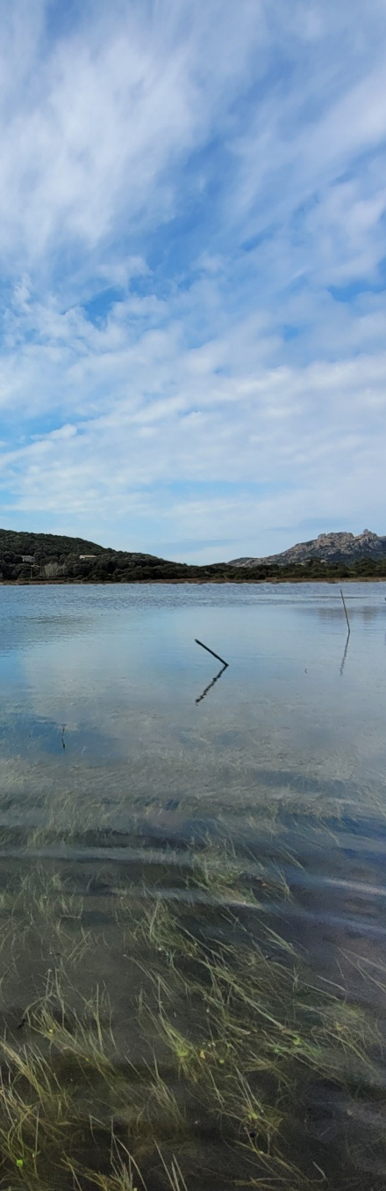
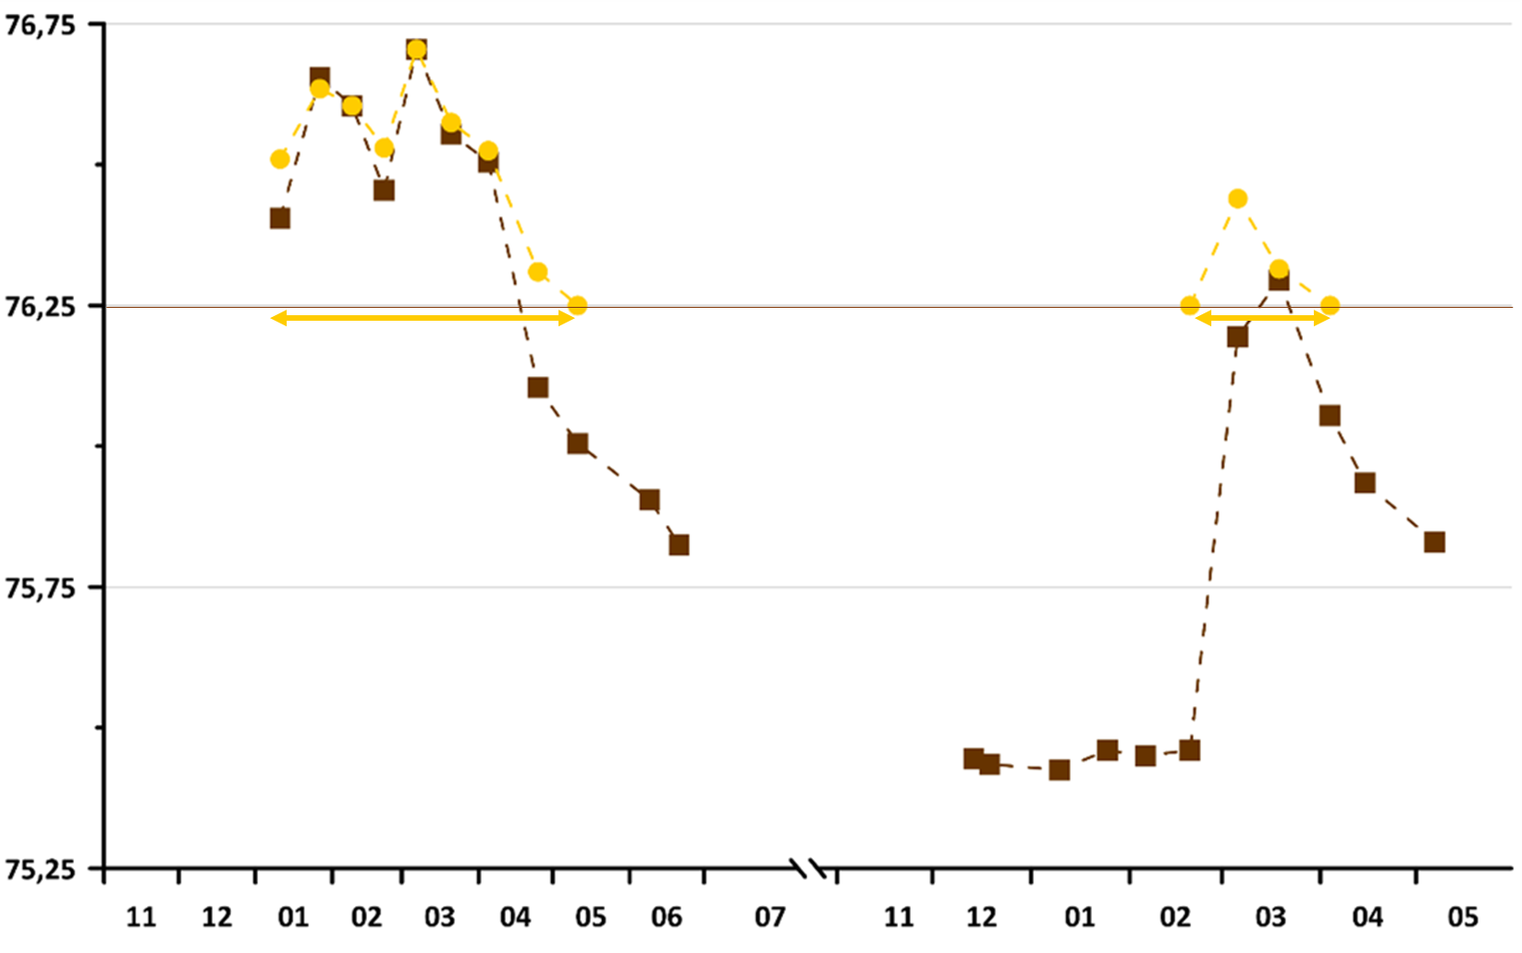
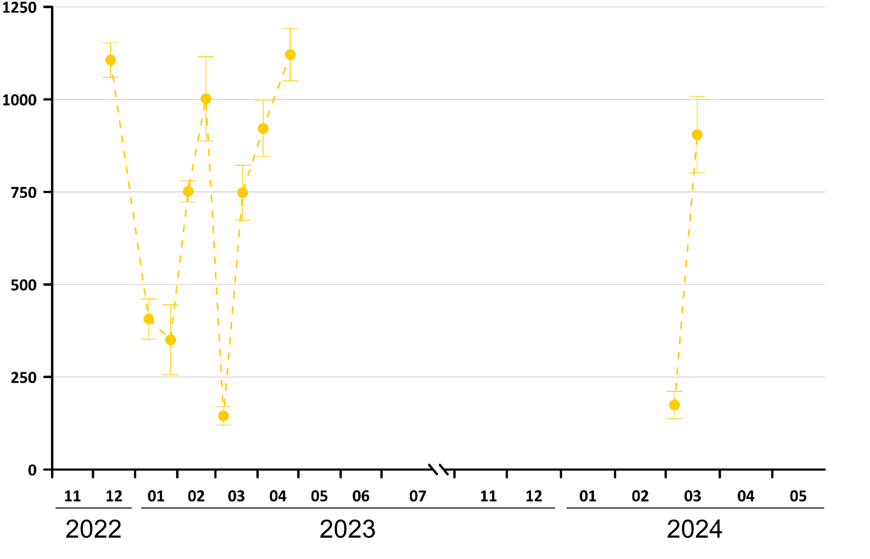
Rencontre Scientifique interdisciplinaire sur le Radon
14-16 Mai 2025
Université Aix-Marseille, Campus Saint Charles
1. Are all small Mediterranean wetlands dependent on groundwater? Insights from ²²²Rn
Results and discussion
Focus on temporary ponds
Padulu (Bonifacio calcarenites)
Ground level
Water Level (m asl)
5 months
2 months
The water level in the pond varies with the seasons.
During high-water periods, low ²²²Rn activity follows rainfall events.
The rest of the time, ²²²Rn activity is high, indicating groundwater input, especially during low-water periods and drying phases.
GW contribution
²²²Rn activity (Bq/m³)
Temporary ponds are GDE.
The GW contribution extends the hydroperiod.
Rain contribution

Slide 21
Rencontre Scientifique interdisciplinaire sur le Radon
14-16 Mai 2025
Université Aix-Marseille, Campus Saint Charles
1. Are all small Mediterranean wetlands dependent on groundwater? Insights from ²²²Rn
Focus on coastal lagoons : spatial trend
Results and discussion
EC (µS.m⁻¹)
Rainfall (surface water input)
April (14/04/2022)
S1
Strong spatial variations in ²²²Rn activity, and thus in GW inputs.
S2
S3
S4
S5
NO Rainfall (GW input ?)
May (13/05/2022)
S1
Maximum ²²²Rn activity detected in S2 and S1 → Indicates lateral and upstream GW inputs.
S2
S3
S4
S5
Decrease in ²²²Rn activity towards the sea channel.
Increase in ²²²Rn as low-water periods approaches
Sediment influence on the lowest ²²²Rn activity levels?
Guerin et al.

Slide 22
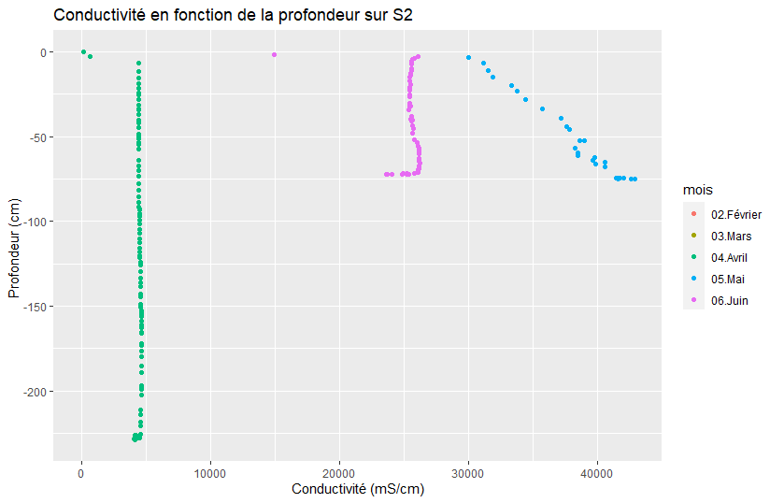

Rencontre Scientifique interdisciplinaire sur le Radon
14-16 Mai 2025
Université Aix-Marseille, Campus Saint Charles
1. Are all small Mediterranean wetlands dependent on groundwater? Insights from ²²²Rn
Focus on coastal lagoons : depth heterogeneity
Results and discussion
EC (µS.m⁻¹)
Rainfall (surface water input)
April (14/04/2022)
S2
Consider the sampling depth !
NO Rainfall (GW input ?)
May (13/05/2022)
S2
Low depth GW inputs : fresh water is less dense than brackish water
Bottom-up flows: groundwater inputs by artesianism? (seepage flows)
Guerin et al.

Slide 23
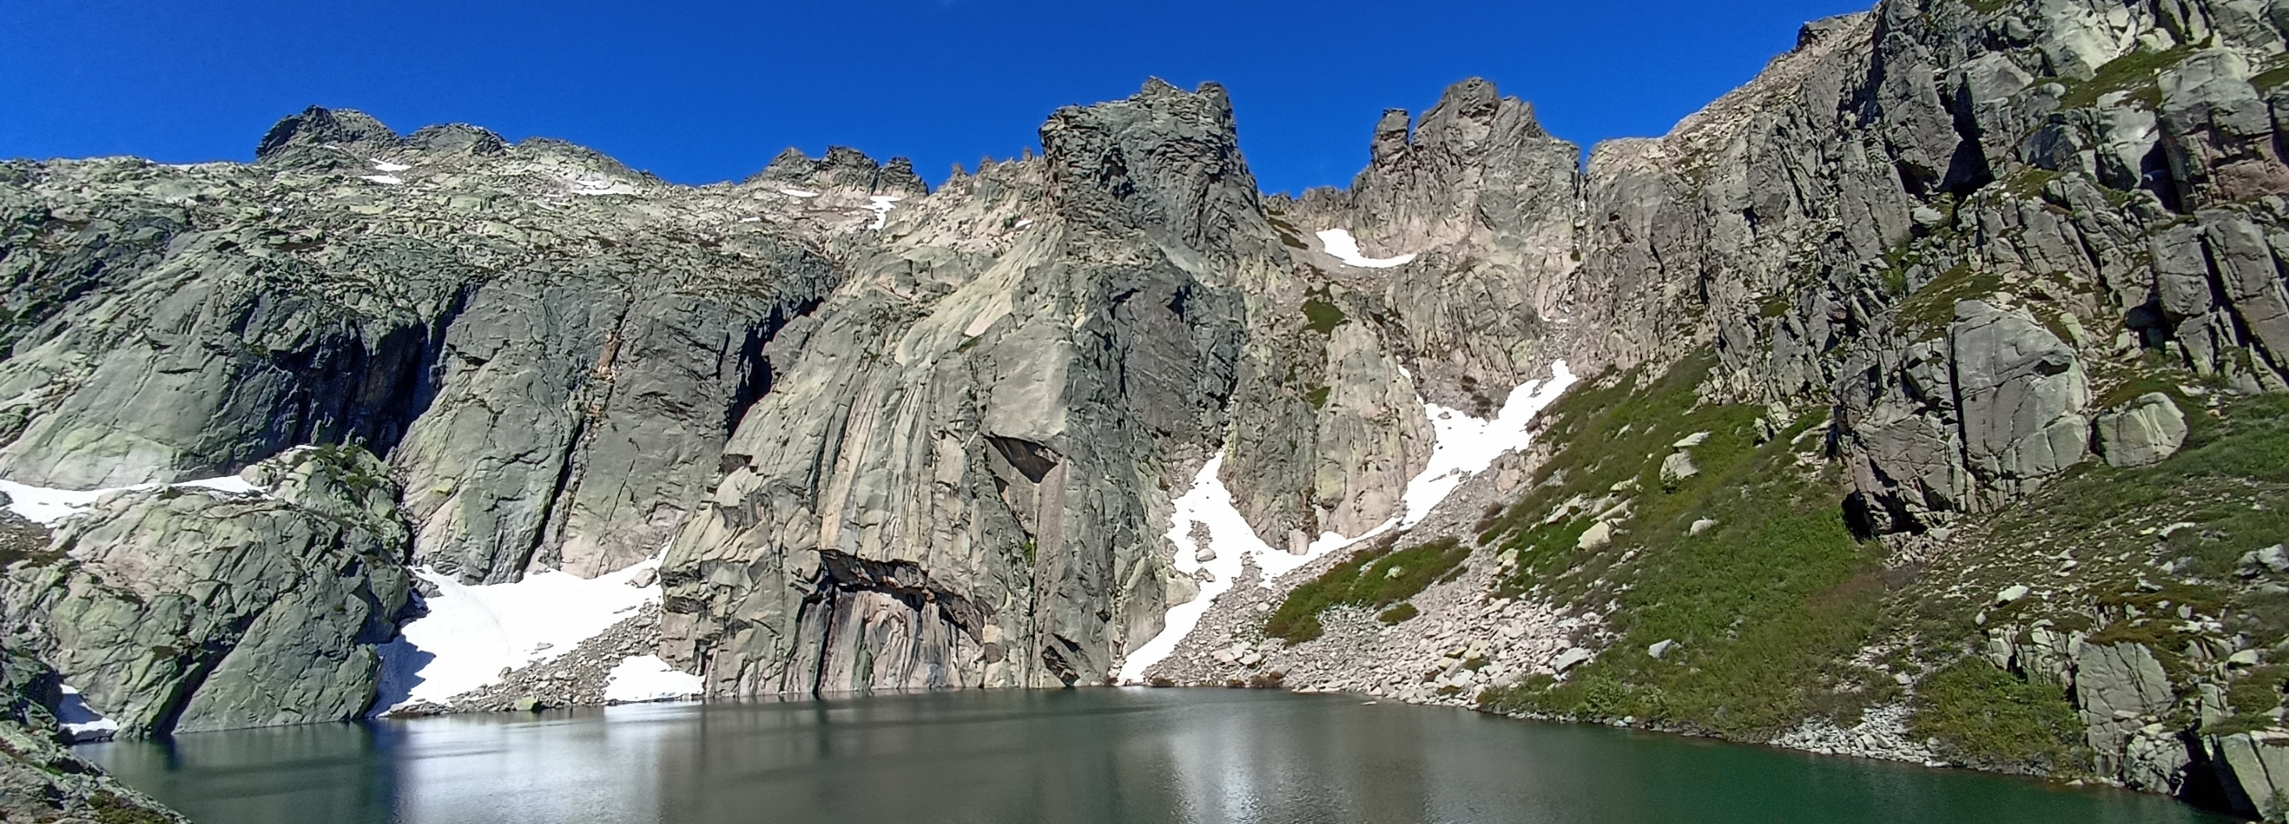
Rencontre Scientifique interdisciplinaire sur le Radon
14-16 Mai 2025
Université Aix-Marseille, Campus Saint Charles
2. Challenges in Standardizing ²²²Rn Measurement Protocols for Highlighting GW-Wetland Connectivity

Slide 24
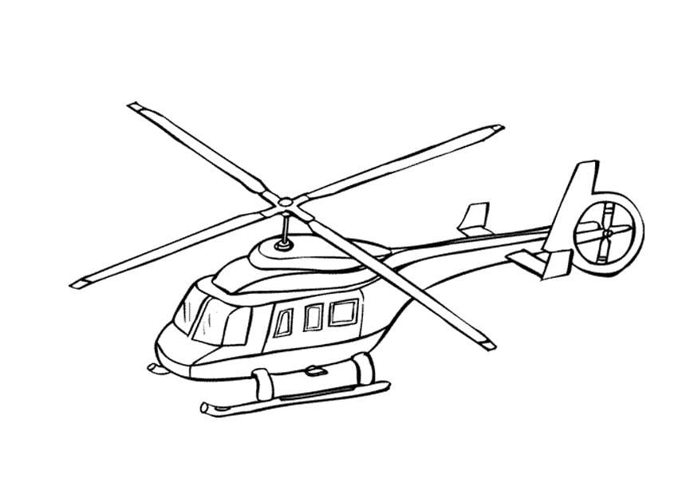



Rencontre Scientifique interdisciplinaire sur le Radon
14-16 Mai 2025
Université Aix-Marseille, Campus Saint Charles
2. Challenges in Standardizing ²²²Rn Measurement Protocols for Highlighting GW-Wetland Connectivity
Some suggestions / recommendations
To highlight GW-wetland connectivity, In situ ²²²Rn measurement is always preferable. However, given the low and diffuse GW fluxes in the Mediterranean smaller, numerous, remote, and scattered wetlands, sampling remains an interesting alternative to save time, money, energy and gain resolution in space and time.
Before sampling
During sampling
When possible, identify groundwater sampling points (springs, wells, and boreholes) to establish the local ²²²Rn baseline.
About bottles
  Note date and TIME (decay).
  Avoid any head-space
  Prefer glass jugs with a septum (to prevent the glass bottle from exploding due to altitude variations).
  Otherwise, use plastic bottles not to loose the sample, even if not perfectly gas-tight.
  1 liter for RAD7, 250 ml for RAD8
Try to gather hydrogeological framework information (topographic, geological, and piezometric maps…) to target wetland sampling areas.
Take into account :
  Seasonality : e.g. Δ GW discharge dynamics.
  GW input depth : i.e. make an EC profile.

Slide 25
Rencontre Scientifique interdisciplinaire sur le Radon
14-16 Mai 2025
Université Aix-Marseille, Campus Saint Charles
2. Challenges in Standardizing ²²²Rn Measurement Protocols for Highlighting GW-Wetland Connectivity
Some suggestions / recommendations
To highlight GW-wetland connectivity, In situ ²²²Rn measurement is always preferable. However, given the low and diffuse GW fluxes in the Mediterranean smaller, numerous, remote, and scattered wetlands, sampling remains an interesting alternative to save time, money, energy and gain resolution in space and time.
During lab analysis
During data interpretation
Match the number of samples taken in the field to the analysis time, to avoid losing the signal due to radioactive decay.
Increase analysis time or prefer RAD8 to RAD7 for water samples from wetlands (low ²²²Rn levels). “RAD8 boosts sensitivity 70% higher than RAD7, significantly reducing data uncertainty.”
Running the analysis for 5 minutes, six to eight times
(total: 30 to 40 minutes) on Mediterranean wetland samples gave good results with acceptable std. dev.
Data post-treatment : remove the two first 5 min of measurement due to equilibration.
Consider the ²²²Rn activity may be impacted by :
  Sampling distance to GW source, aquifers heterogeneity
  Physical parameters : permeability, decay, diffusion, dispersion, degassing, turbulence, stratification …
  Waterbodies mixing processes
  Rocks lithology (Uranium abundance)
  Potential ²²²Rn source from sediments
The presence of ²²²Rn can be enough to SIMPLY highlight connectivity with GW, which is of particular interest to Wetland’s manager.

Slide 26

Rencontre Scientifique interdisciplinaire sur le Radon
14-16 Mai 2025
Université Aix-Marseille, Campus Saint Charles
3. Exploring ways to integrate ²²²Rn into wetland management strategies

Slide 27
Rencontre Scientifique interdisciplinaire sur le Radon
14-16 Mai 2025
Université Aix-Marseille, Campus Saint Charles
3. Exploring ways to integrate ²²²Rn into wetland management strategies
Challenges in Managing Small Mediterranean Wetlands
Lack of Adequate Management Framework
  Wetlands smaller than 50 ha often fall outside the European Water Framework Directive (WFD).
  As a result, they are rarely included in local water management plans.
Decision-Making Challenges for Local Authorities
  Management relies then on local authorities with limited scientific data and expertise.
  Decisions are driven by compromises between ecosystem preservation and socio-economic development.
  Protection measures are mostly limited to existing legal frameworks, which may not be adequate because limited to the strict wetland limits, excluding recharge areas.
Increasing Human Pressure & Low Visibility of small wetlands
  These wetlands suffer from low public awareness and poor communication about their ecological value.
  Growing anthropogenic pressure is observed, particularly in coastal and/or urban areas.
Most Mediterranean wetlands are groundwater-dependent ecosystems (GDEs)
  Better resilience to drought and CC.
  Closely connected to the watershed (surface and groundwater), making them vulnerable to human-induced pressures (e.g., land use changes, water abstraction).

Slide 28


Rencontre Scientifique interdisciplinaire sur le Radon
14-16 Mai 2025
Université Aix-Marseille, Campus Saint Charles
3. Exploring ways to integrate ²²²Rn into wetland management strategies
Towards Improved Management of Small Mediterranean Wetlands
Define an ‘Hydrogeological watershed’ / Espace de bon fonctionnement
As scientifically defined hydrosystem-scale area with limited human activities, ensuring wetland sustainability. This requires :
  Considering surface & groundwater fluxes at regional scale.
  Using ²²²Rn as Relevant and SIMPLE indicator of GW-wetland connectivity
Implementing Scientifically Piloted Management
  Balancing socio-economic needs with ecological integrity.
  Improved stakeholder coordination
Towards a Science-Based Protection Framework
  Small GDEs could be included in the European Water Framework Directive (WFD).
  Local authorities require effective financial and regulatory tools for conservation.

Slide 29

Conclusion
This study highlights a clear spatial and temporal hierarchy in the dependence of Mediterranean wetlands on groundwater availability.
While this connection enhances resilience to drought, it also increases vulnerability to human pressures across the entire watershed.
In this context, ²²²Rn could become a key indicator for defining the Hydrogeological watershed management area of wetlands.
Integrating ²²²Rn into management strategies would help ensure long-term preservation, if a simple and reliable measurement/interpretation protocol is established.

Slide 30
Le ²²²Rn comme traceur des apports d’eau souterraine vers les zones humides méditerranéennes : vers une standardisation des mesures et une aide à la gestion de ces espaces naturels
Rencontre Scientifique interdisciplinaire sur le Radon
14-16 Mai 2025
Université Aix-Marseille, Campus Saint Charles
Sébastien Santoni^{1,2}, P.-A. Guisiano^{1,2}, A. Guerin^{1,2}, D. Orticoni^{1,2} E. Garel^{1,2}, T. Leydier^{1,2}, F. Huneau^{1,2}
1 Université de Corse Pascal Paoli, Département d'Hydrogéologie, 20250 Corte, France
2 CNRS, UMR 6134 SPE, 20250 Corte, France
^{santoni_s@univ-corse.fr}
Diana lagoon, Corsica Island, France

Slide 32

1. Are all small Mediterranean wetlands dependent on groundwater? Insights from ²²²Rn
Focus on Rivers
Results and discussion
Metamorphic context
(low U)
Guisiano et al.
Baseflow index (%GW/total river discharge) and ²²²Rn activity display a complex trend
The ²²²Rn signal is weaker (low U in rocks), and altered by degassing and decay

Slide 33


1. Are all small Mediterranean wetlands dependent on groundwater? Insights from ²²²Rn
Focus on alpine lakes : RINOSU (2066 and 2083 m asl)
Focus on Alpine lakes
Rinosu Lake (2083 m asl)
Results and discussion
Low temperatures associated with low EC and high ²²²Rn activity
Knowledge:
GW temperature is close to the annual atmospheric average of the area
Groundwater is weakly mineralized and ²²²Rn-rich
Surface water
Groundwater
Despite their mountain-top location, all these alpine lakes are GW-dependent.
904 Bq/m³
Ri2
Ri3
1161 Bq/m³
Ri1
Ri5
3913 Bq/m³
Clear input of cold, weakly mineralized, and radon-rich groundwater into the Rinosu lakes
4463 Bq/m³
Ri4
5887 Bq/m³
8

Slide 34






Rencontre Scientifique interdisciplinaire sur le Radon
14-16 Mai 2025
Université Aix-Marseille, Campus Saint Charles
1. Are all small Mediterranean wetlands dependent on groundwater? Insights from ²²²Rn
Focus on coastal lagoons : seasonal trend
Results and discussion
Rainfall (surface water input)
Rainfall (surface water input)
Rainfall (surface water input)
EC (µS.m⁻¹)
Hydroclimatic conditions strongly influence the hydrology of this small coastal lagoon :
After rainfall via runoff (February and March)
During low-water periods via groundwater input (June).
February (17/02/2022)
March (09/03/2022)
March (15/03/2022)
NO Rainfall (GW input ?)
Sea Channel Opening
NO Rainfall (GW input ?)
Guerin et al.
April (14/04/2022)
May (13/05/2022)
June (16/06/2022)
These maps spatialize EC data using kriging and homogeneous EC scale.
Lower EC values in February and March followed rainfall events.
Higher EC values in May campaign took place after a mechanical opening of the sea channel, which quickly closed before the June campaign experiencing a decrease in EC.

Slide 35


Rencontre Scientifique interdisciplinaire sur le Radon
14-16 Mai 2025
Université Aix-Marseille, Campus Saint Charles
2. Discussing protocols challenges
Sampling volume experiment with Durridge® RAD7
Tests on 36 radon-222 measurements (8 sites with 4 replicates each) to compare 1.5, and 1 liter plastic water bottles with in situ rad Aqua (reference)
RAD7
Cycle : 5 minutes
Recycle : 6 times (12 for RadAqua)
Total: 30 minutes (60 for RadAqua).
Data still in validation process
²²²Rn activities
²²²Rn std. dev.
p(same) = 1
Radon in situ seems display a better sensitivity to low ²²²Rn levels
p(same) = 0.999
p(same) = 0.978
After normality and variance tests, we performed 1-Way ANOVAs to compare the obtained values :
p(same) = 0.998
p(same) = 0.591
p(same) = 0.466
On ²²²Rn activities, in the end, no significant differences in between the three methods
..but…
the ²²²Rn std. dev. is higher for 1.5 l plastic bottles, and comparable in between in situ RadAqua and 1 l plastic bottles !
 | Radon 1L (Bq/m3) | Radon 1.5L (Bq/m3) | Radon in situ (Bq/m3)
Min | 10 | 0 | 240
Median | 826 | 870 | 1063
Max | 6180 | 6683 | 6449
 | Radon 1L (Bq/m3) | Radon 1.5L (Bq/m3) | Radon in situ (Bq/m3)
Min | 3 | 3 | 3
Median | 61 | 71 | 40
Max | 356 | 670 | 770

