Slide 1



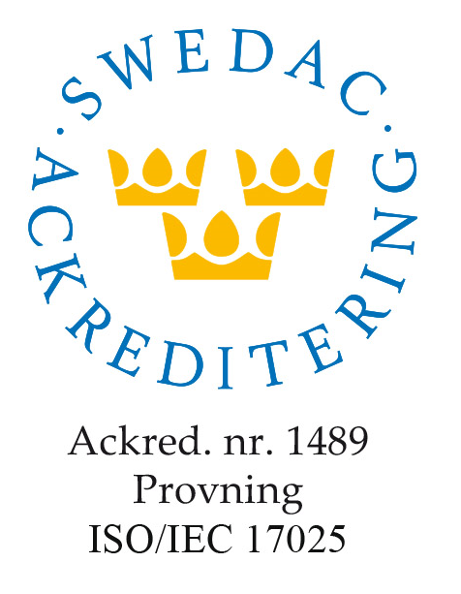
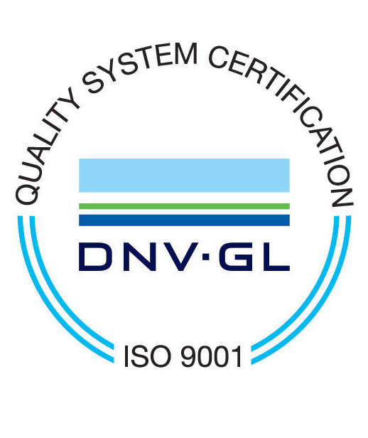
The global leader in radon measurement
Head office in Uppsala with a large laboratory, production of radon detectors and instruments, and a development department with a focus on radon measurement.
Uppsala, Sweden
Accredited measurement services in accordance with ISO 17025 and certified in accordance with ISO 9001 and ISO14001 as well as about 20 national approvals in Europe and North America
Bristol, UK
Warzaw, Poland
Member and active in several standardization committees and radon associations around the world
Neuss, Germany
La Rochelle, France
Chicago, USA
More than 20 million detectors and instruments sold
Measurements carried out in more than 80 countries

Slide 2
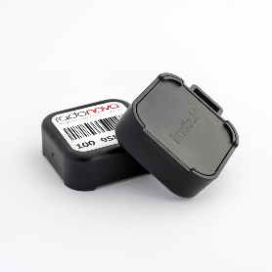
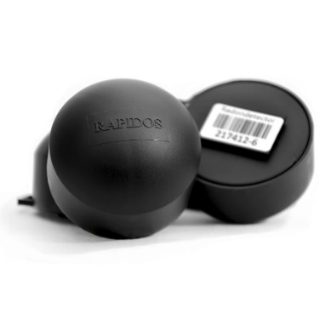
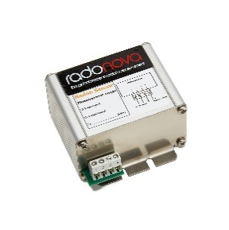
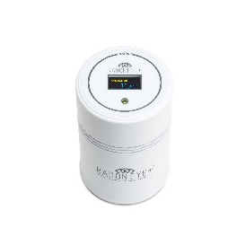


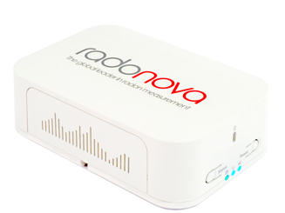
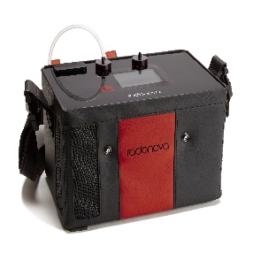
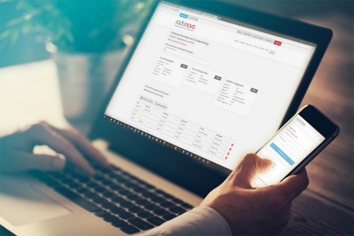
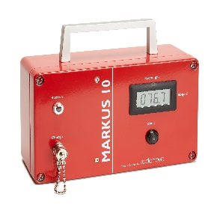
Our most important products
All our measurement services are
ISO 17025 accredited
Radtrak³®
LONG term measurement service with passive detector
Exposure time: from 2 months
Rapidos®
SHORT term measurement service with passive detector
Exposure time: from 7 days
SPIRIT® logger and sensor
Radon LOGGER for follow-up measurements
Radon SENSOR for optimization of ventilation
Calibrated, inexpensive and connected
Best for monitoring and discriminating radon level
ROBIN®
ATMOS®
Radon SENSOR
Simple and Sensitive
Best for controlling ventilation systems following radon levels
SNIFFER AND LOGGER
Fast and very accurate
Best for searching radon sources and air radon measurements
MARKUS®
SOIL radon measurement
Robust and Reliable
Best for measuring high radon concentrations in soil and air
My Pages

Slide 3
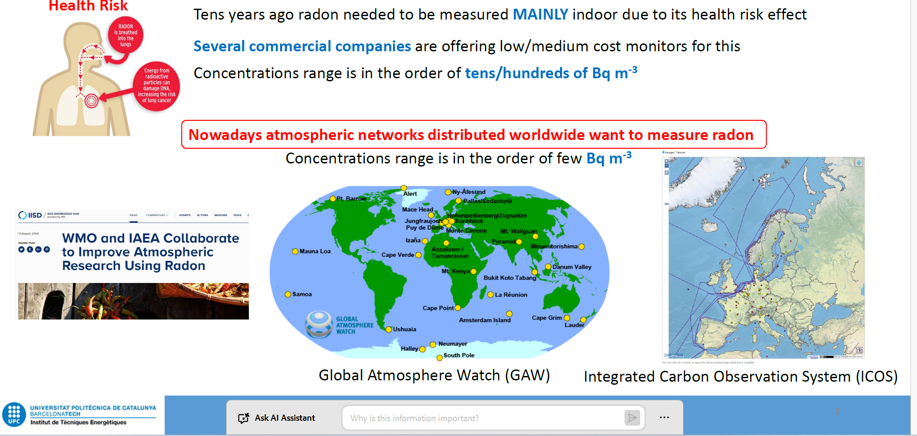
Atmospheric Radon monitor

Slide 4
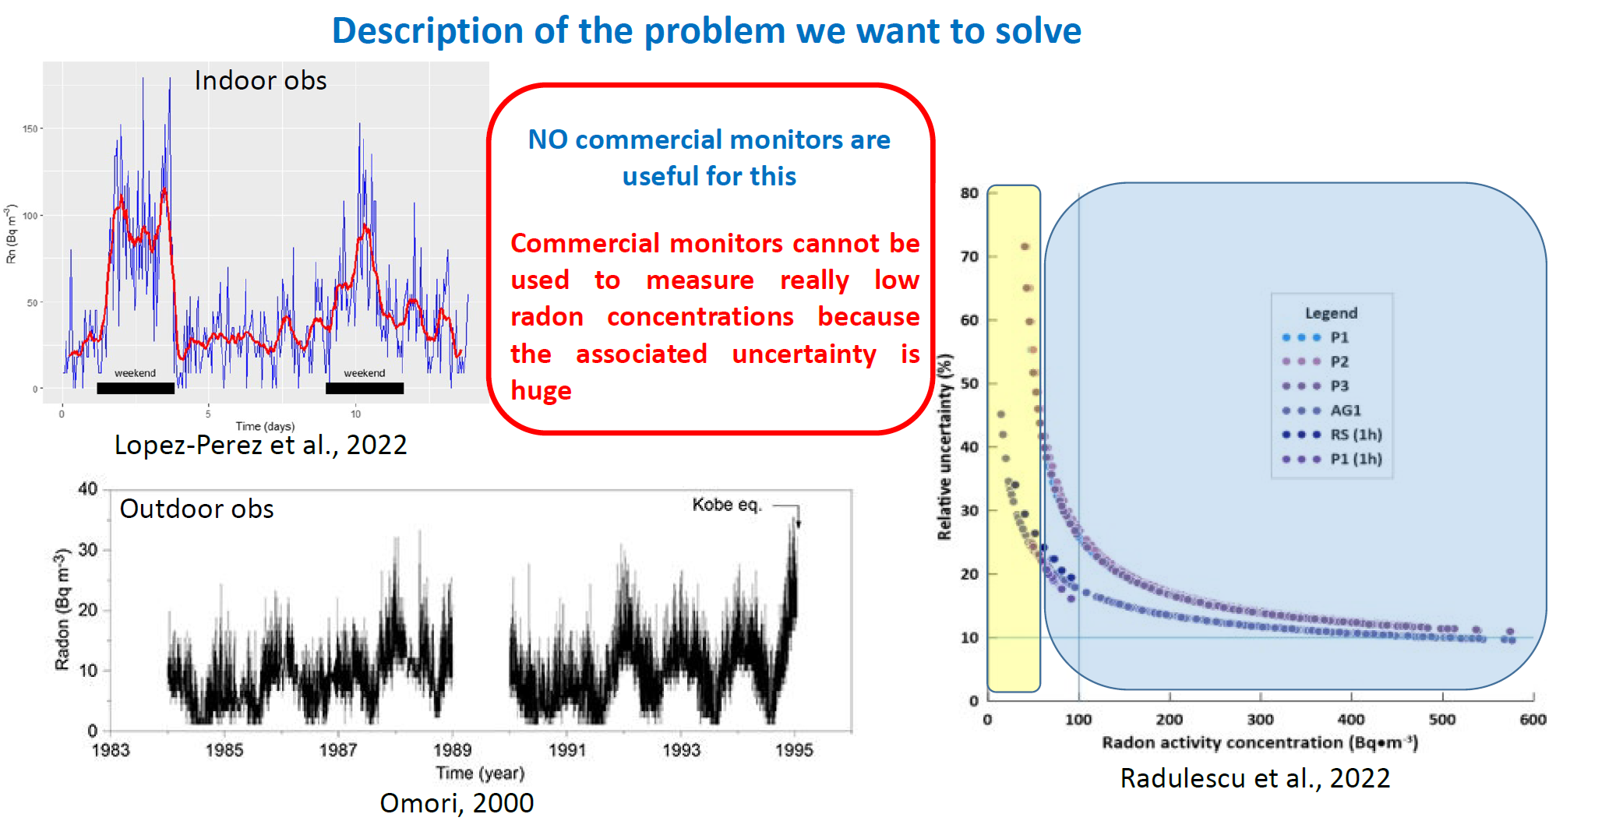
Atmospheric Radon MONitor

Slide 5
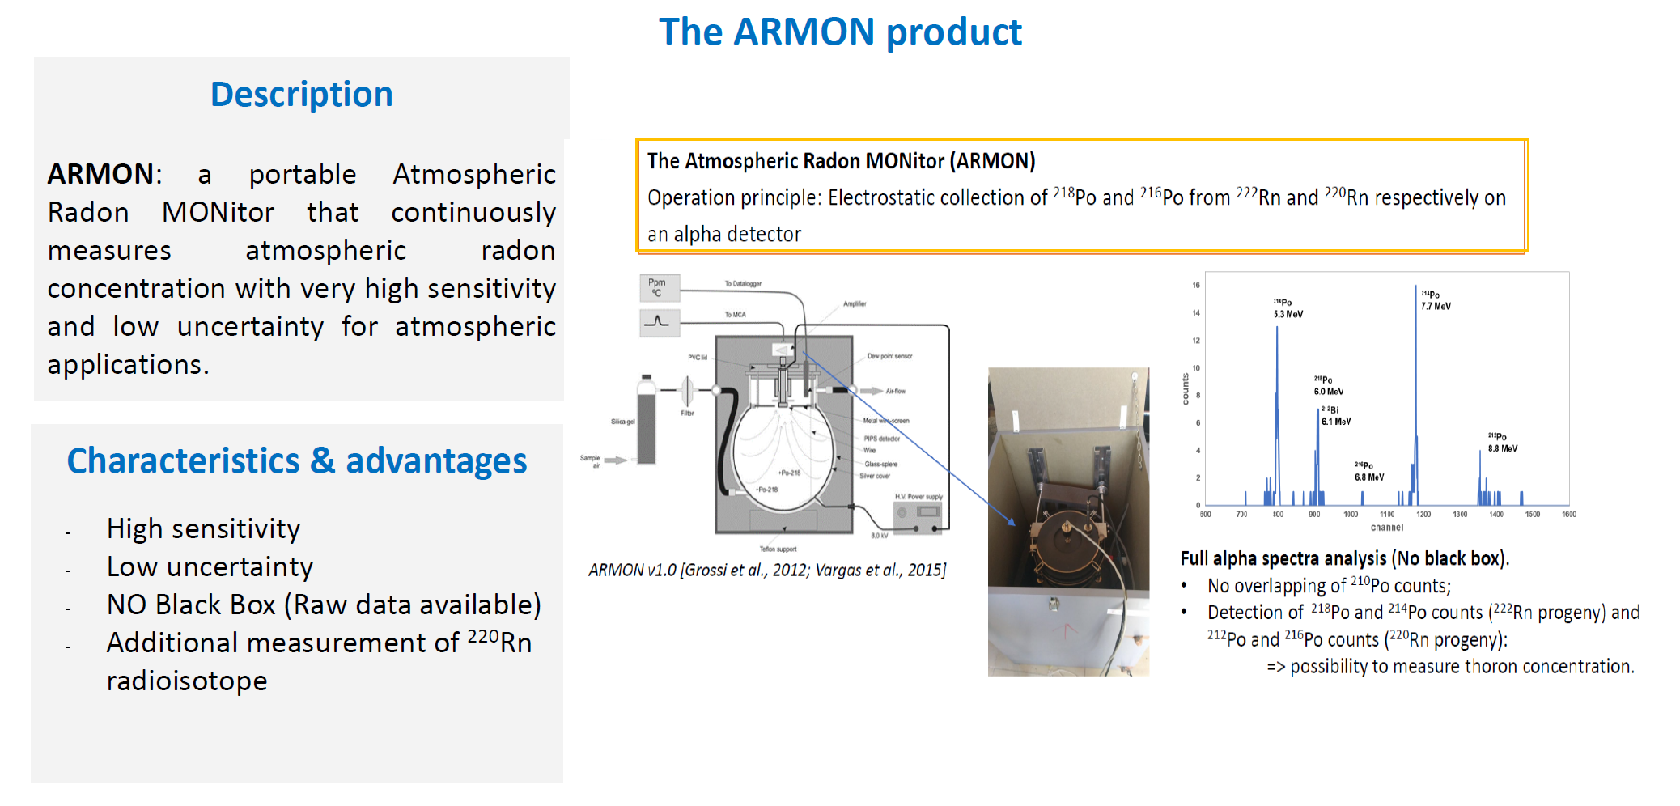
Atmospheric Radon MONitor

Slide 6
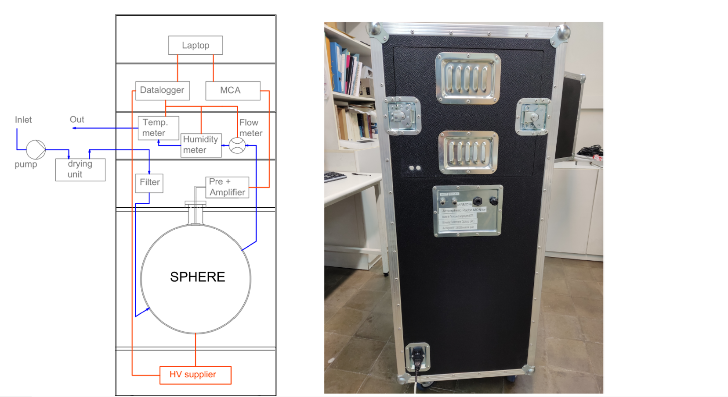
Atmospheric Radon MONitor

Slide 7
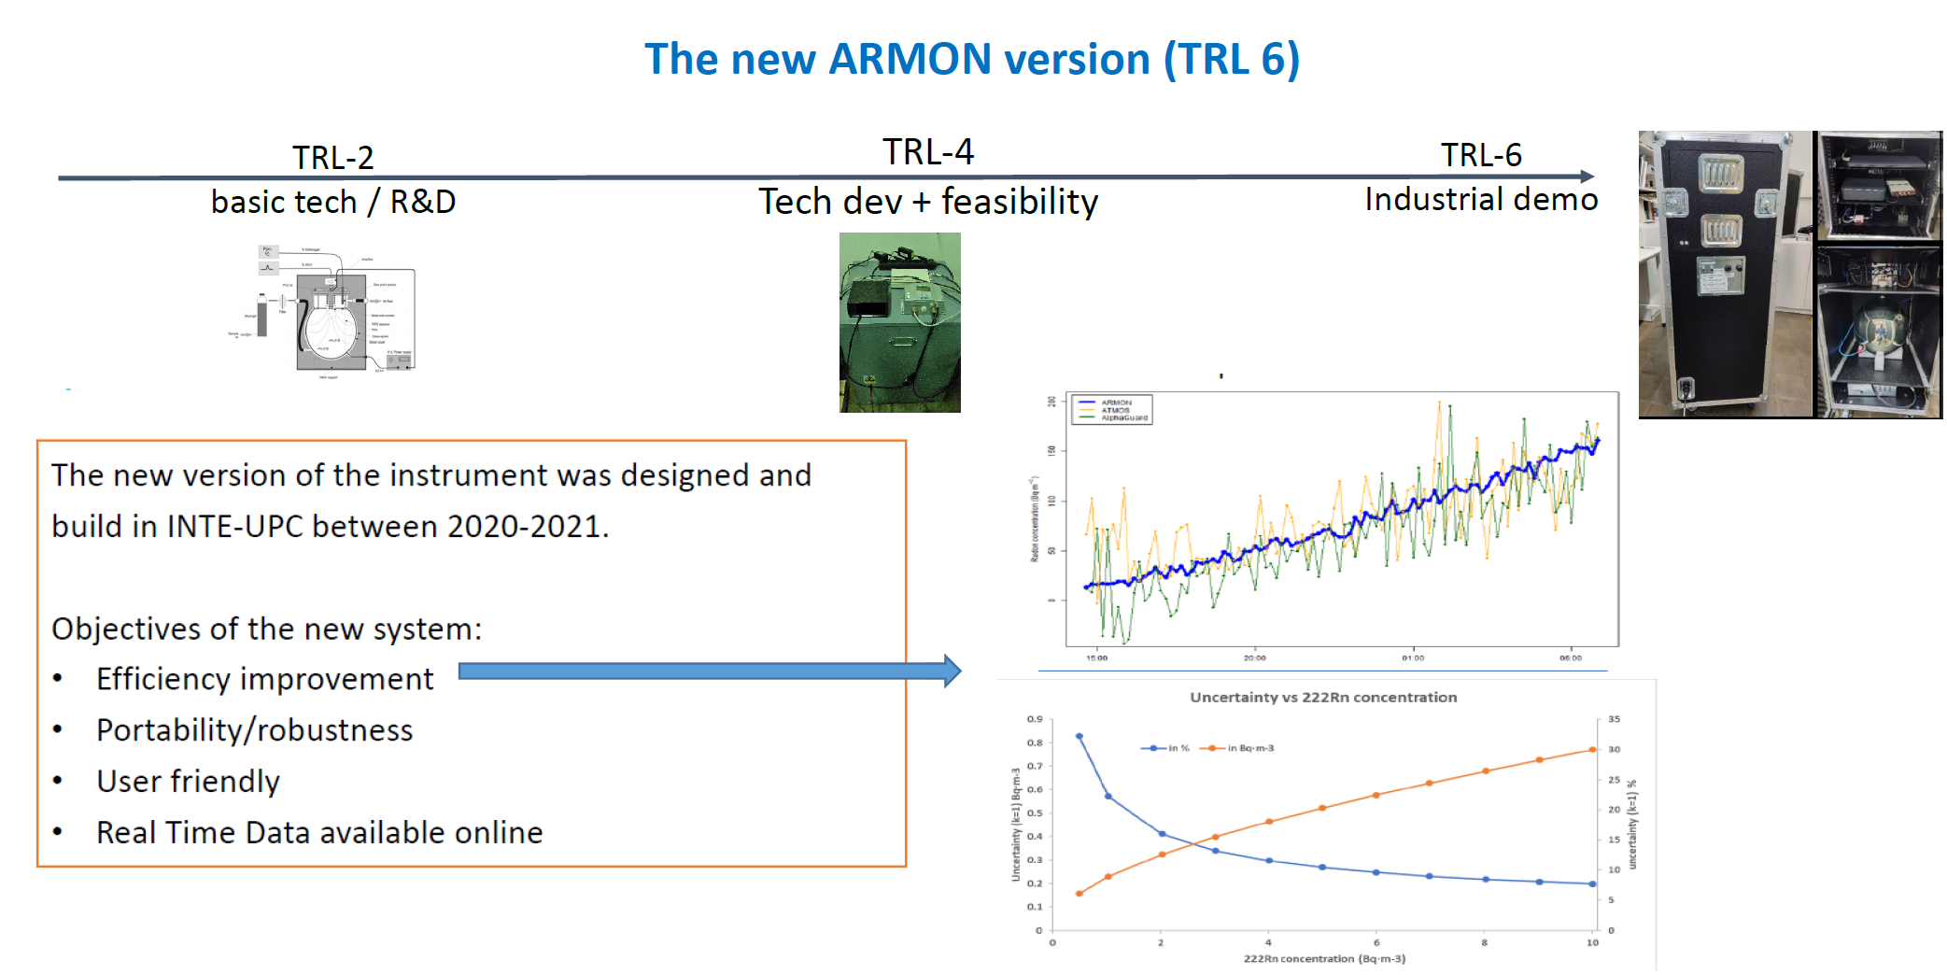
Atmospheric Radon MONitor

Slide 8
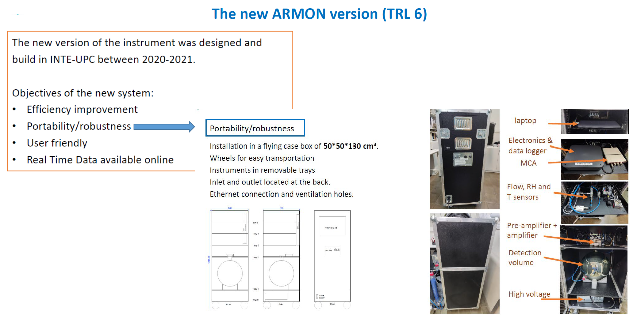
Atmospheric Radon MONitor

Slide 9
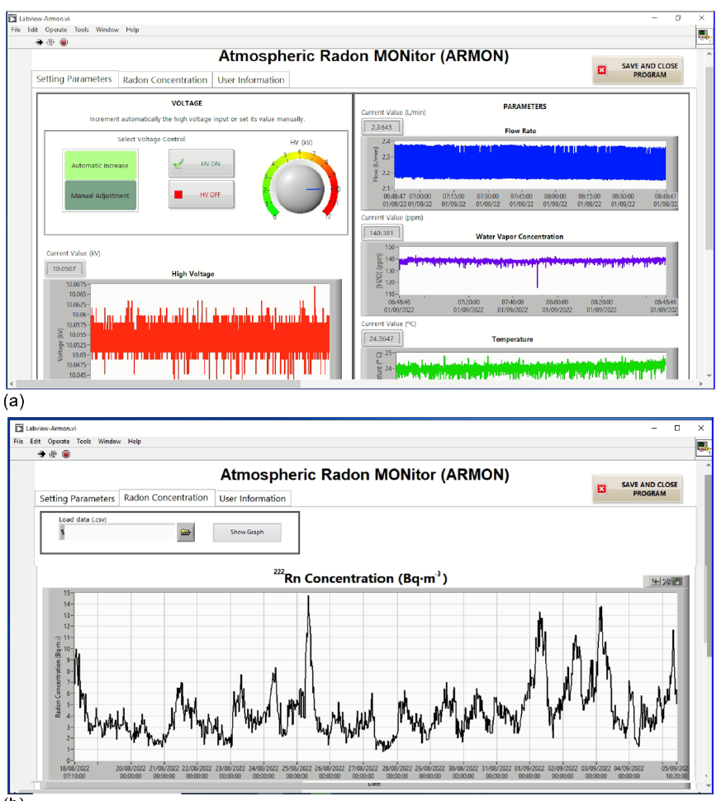

Slide 10
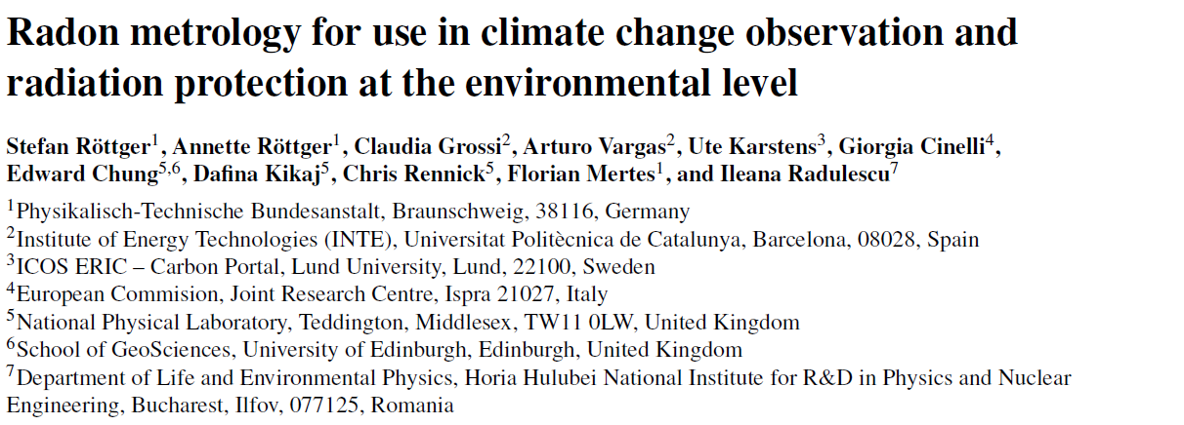
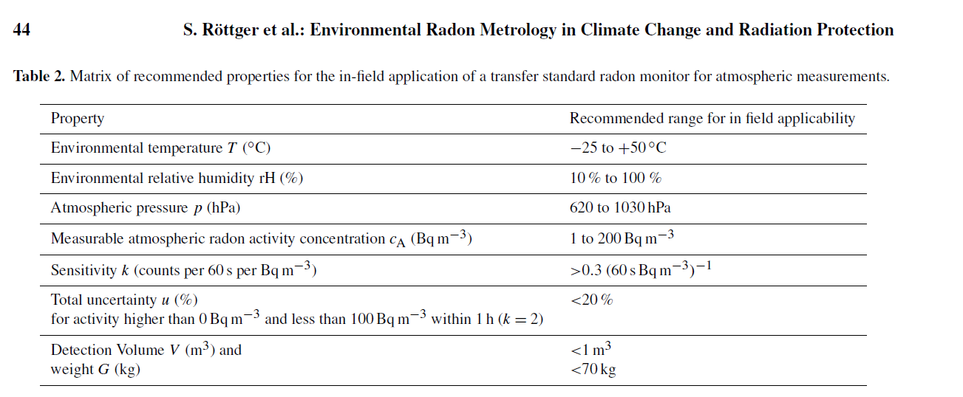

Slide 11
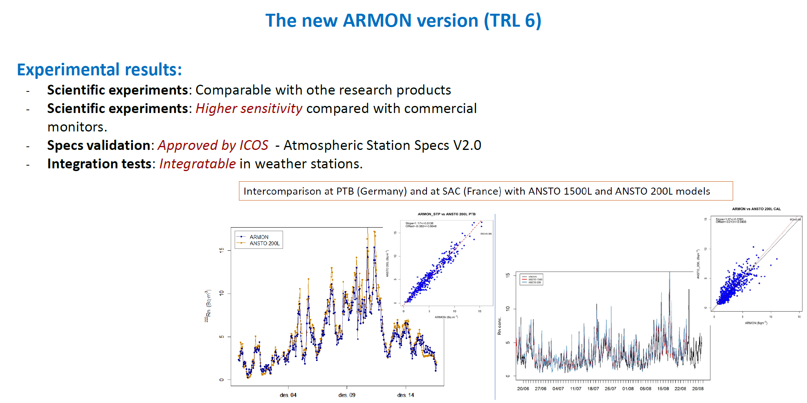
Atmospheric Radon MONitor

Slide 12
