Slide 1
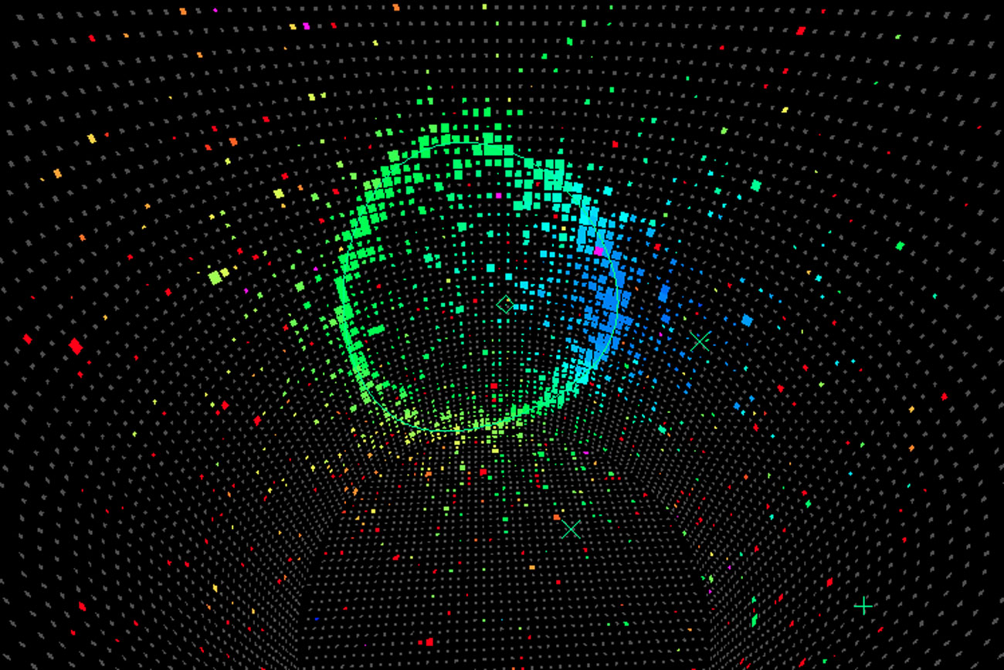
Enhanced Event Reconstruction at Hyper-Kamiokande using Graph Neural Networks at High Energy
Christine QUACH – Laboratoire Leprince-Rinquet & ILANCE
Notes:
Hi everyone, I’m Christine,, and today I am going to present, the Enhanced Event Reconstruction at Hyper-Kamiokande using Graph Neural Networks at High Energy!

Slide 2
1
How does the detection work in HK
Notes:
SO FIRST, Hyper-Kamiokande (HK) is the next-generation neutrino detector in Japan, designed to push the boundaries of neutrino physics, especially CP violation in the lepton sector. With a larger target volume, enhanced photodetectors, and better calibration, HK aims for unprecedented precision.
In this context, machine learning, particularly graph neural networks (GNNs), can help exploit HK’s full potential by providing faster and more precise event reconstruction.

Slide 3
1
How does the detection work in HK
Parameters to reconstruct
Flavor
Direction
Energy
Vertex
Notes:
To better constrain neutrino physics, the key parameters to reconstruct are flavor, direction, energy, and vertex.

Slide 4
1
How does the detection work in HK
a) Principle of event detection
b) Event reconstruction key points
Neutrino oscillation
Two flavor approximation in vacuum
Parameters to reconstruct
Flavor (PID)
Direction
Energy
Notes:
Indeed For neutrino oscillation, we need a robust particle identification (PID) algorithm to reconstruct flavor.

Slide 5
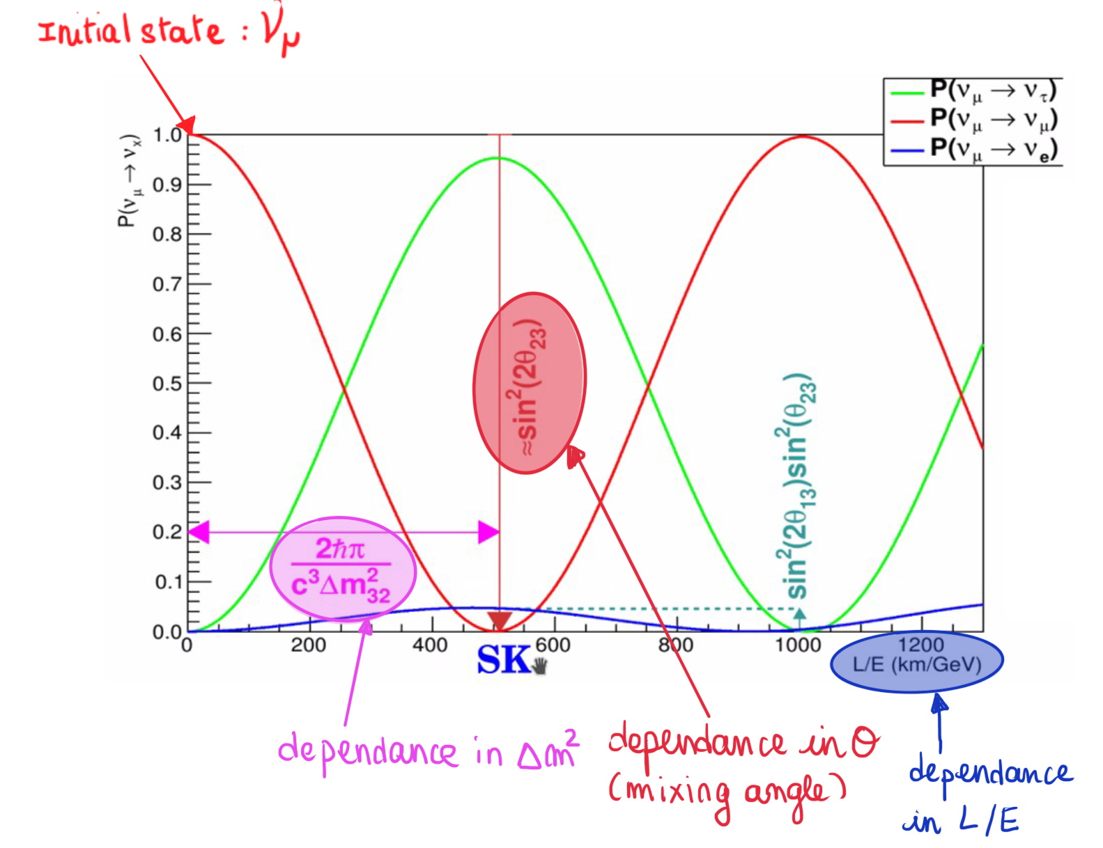
1
How does the detection work in HK
a) Principle of event detection
b) Event reconstruction key points
Neutrino oscillation
Two flavor approximation in vacuum
Parameters to reconstruct
Flavor (PID)
Direction
Energy
Accelerator neutrino
HK
Notes:
For accelerator-based neutrinos, oscillation depends on solely the energy since the length of the beamline is fixed

Slide 6
1
How does the detection work in HK
a) Principle of event detection
b) Event reconstruction key points
Neutrino oscillation
Two flavor approximation in vacuum
Parameters to reconstruct
Flavor (PID)
Direction
Energy
Notes:
while for atmospheric neutrinos, direction also plays a role due to varying distances traveled.

Slide 7
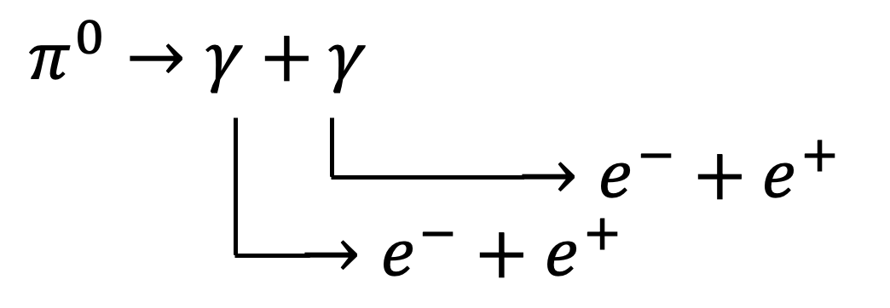
1
How does the detection work in HK
a) Principle of event detection
b) Event reconstruction key points
Cosmic rays muon background
Pi0 background
Pi0 decays like an electron ! :
Reconstructed vertex of cosmic ray muons
Parameters to reconstruct
PID
Flavor
e/pi0
vtx
Direction
direction
At high momentum, the 2 gammas decay are very boosted and the rings of e+/e- overlap, giving a 2 e-like rings.
Energy
Vertex
In some cases, the 2 e-like rings overlap.
Notes:
Additionally, we must address background noise. at high energy in HK, cosmic ray muons interacting near the tank walls and π0 events from neutral current interactions are the two major background.s So Precise vertex reconstruction and Accurate electron/pi0 separation is essential to differentiate neutrino events from backgrounds.

Slide 8
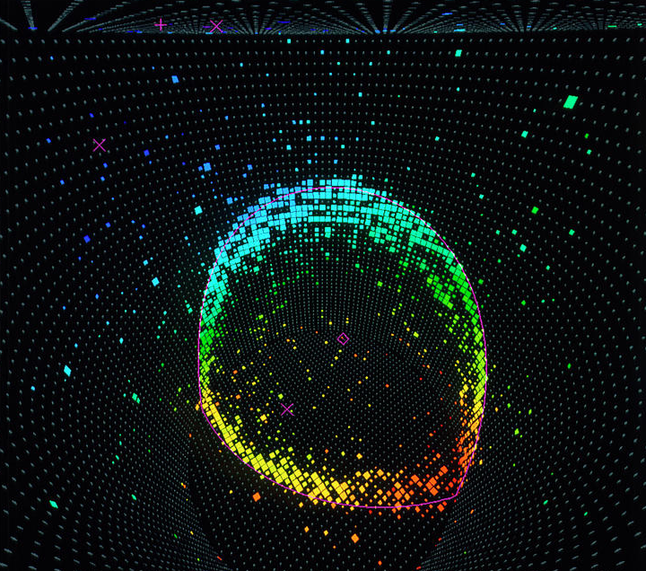
2
GNN : Machine Learning based algorithm for reconstruction
Notes:
But how do we go from this muonic event display to a graph?

Slide 9
2
GRANT : Machine Learning based algorithm for reconstruction
Notes:
well it’s as simple as that ! ☺

Slide 10
2
GRANT : Machine Learning based algorithm for reconstruction
Node : Hit PMT
Notes:
Here, each node represents a hit PMT.

Slide 11
2
GRANT : Machine Learning based algorithm for reconstruction
Node : Hit PMT
Hit coordinates (x, y, z)
Charge (Q)
Hit time (t)
Features.
Notes:
with features like hit coordinates, charge, and time.

Slide 12
2
GRANT : Machine Learning based algorithm for reconstruction
Node : Hit PMT 3
Hit coordinates (x, y, z)
Charge (Q)
Hit time (t)
Features.
Node : Hit PMT 2
Hit coordinates (x, y, z)
Charge (Q)
Hit time (t)
Features.
Node : Hit PMT 4
Node : Hit PMT 1
Hit coordinates (x, y, z)
Charge (Q)
Hit time (t)
Features.
Hit coordinates (x, y, z)
Charge (Q)
Hit time (t)
Features.
Notes:
then Edges connect those PMT nodes based on proximity in charge, time or space.

Slide 13
2
GRANT : Machine Learning based algorithm for reconstruction
Aggregation
Node : Hit PMT 3
Hit coordinates (x, y, z)
Charge (Q)
Hit time (t)
Features.
Node : Hit PMT 2
Hit coordinates (x, y, z)
Charge (Q)
Hit time (t)
Features.
Node : Hit PMT 4
Node : Hit PMT 1
Hit coordinates (x, y, z)
Charge (Q)
Hit time (t)
Features.
Features.
Notes:
after this, the PMTs "exchange" information, with its PMT's neighbors : this is called the aggregation step
each node aggregates data from its neighbors,

Slide 14
2
GRANT : Machine Learning based algorithm for reconstruction
Embedding
Hit PMT 3
Features.
Hit PMT 2
Hit PMT 4
Hit PMT 1
Features.
Notes:
and doing that multiple times will refining each PMT features layer by layer through what is called **embedding**.

Slide 15
2
GRANT : Machine Learning based algorithm for reconstruction
Convolutional layer
Aggregates and transforms information from neighboring nodes to update each node's feature. Reflecting local graph structures
Problem dependant !
Notes:
And now, if we look at our entire graph,

Slide 16
2
GRANT : Machine Learning based algorithm for reconstruction
Pooling
1D
(1D, #nodes)
# of convolutional layers
Notes:
In the end, the graph is reduced to a 1D vector,

Slide 17
2
GRANT : Machine Learning based algorithm for reconstruction
$$a_{1}$$
$$a_{1}$$
$$a_{1}$$
$$x_{1}$$
$$x_{2}$$
$$a_{2}$$
$$a_{2}$$
$$a_{2}$$
$$x_{n}$$
$$y_{1}$$
$$μ^{−}$$
$$x_{n}$$
…
$$x_{n}$$
$$0.9$$
$$1$$
$$x_{n}$$
$$x_{n}$$
$$y_{2}$$
$$e^{−}$$
$$x_{n}$$
$$x_{n}$$
$$0.2$$
$$0$$
$$x_{n}$$
Loss function :
$$\frac{1}{n}Σ{\left(y_{i}−\hat{y_{i}}\right)}^{2}$$
$$x_{n}$$
$$a_{p}$$
$$a_{q}$$
$$a_{r}$$
INPUT
(Graph representation as 1D vector)
NEURONS
NEURONS
NEURONS
# of hidden layers
Notes:
which is passed through a multi-layer perceptron to classify the event,

Slide 18
2
GRANT : Machine Learning based algorithm for reconstruction
$$a_{1}$$
$$a_{1}$$
$$a_{1}$$
$$x_{1}$$
$$x_{2}$$
$$a_{2}$$
$$a_{2}$$
$$a_{2}$$
$$x_{n}$$
$$y_{1}$$
$$μ^{−}$$
$$x_{n}$$
…
$$x_{n}$$
$$0.9$$
$$1$$
$$x_{n}$$
$$x_{n}$$
$$y_{2}$$
$$e^{−}$$
$$x_{n}$$
$$x_{n}$$
$$0.2$$
$$0$$
Loss function :
$$\frac{1}{n}Σ{\left(y_{i}−\hat{y_{i}}\right)}^{2}$$
$$x_{n}$$
Loss function :
$$\frac{1}{n}Σ{\left(y_{i}−\hat{y_{i}}\right)}^{2}$$
$$x_{n}$$
$$a_{p}$$
$$a_{q}$$
$$a_{r}$$
Minimization of the loss function !
INPUT
(Graph representation as 1D vector)
NEURONS
NEURONS
NEURONS
# of hidden layers
Notes:
by minimizing the loss function to match the output to the true label

Slide 19
2
GRANT : Machine Learning based algorithm for reconstruction
$$a_{1}$$
$$a_{1}$$
$$a_{1}$$
$$x_{1}$$
$$x_{2}$$
$$a_{2}$$
$$a_{2}$$
$$a_{2}$$
$$y_{1}$$
…
$$0.9$$
$$y_{2}$$
$$0.2$$
$$x_{n}$$
$$a_{p}$$
$$a_{p}$$
$$a_{p}$$
OUTPUT
INPUT
(Graph representation as 1D vector)
NEURONS
NEURONS
# of convolutional layers
# of hidden layers
Notes:
And this is how we go from event to graph classification.

Slide 20
3
Performance comparation: GNN vs existing software
 | GRANT | Existing software
e/mu
e/pi0
Energy reconstruction for e & mu (1D)
Vertex reconstruction for e & mu (3D)
Notes:
Let’s evaluate our GNN software, compared to the existing likelihood-based software.

Slide 21
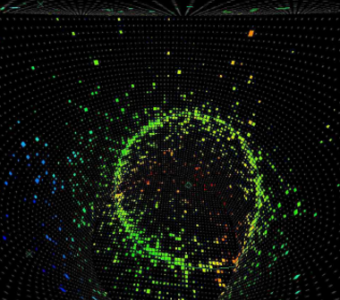
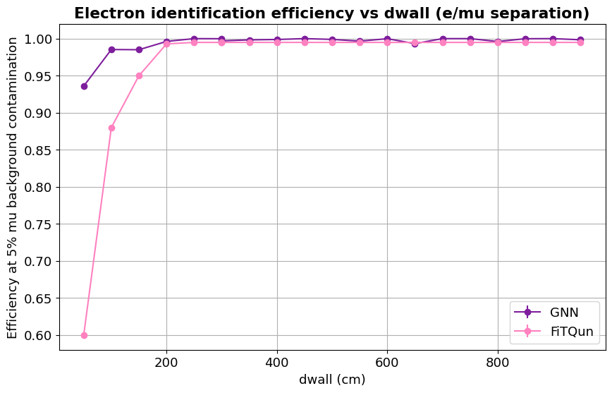
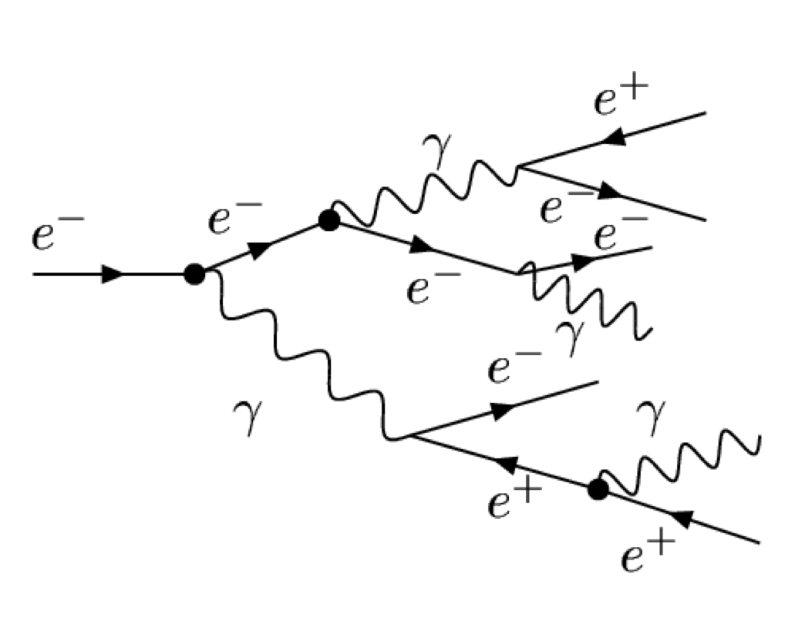
3
Performance comparation: GNN vs existing software
 | GRANT | Existing software
e/mu | 99% electron efficiency at 5% muon bg acceptance, Dwall, towall analysis: After 2 m, efficiency above 99.4% ! | 99% electron efficiency at 5% muon bg acceptance,
direction
vtx
Sharp ring
Fuzzy ring
Muon
Electron
- : GNN
- : Existing software
$$μ^{−}$$
For events close to the wall : GNN > existing software => potentially increase FV
21
Notes:
- **e/μ Separation**: Both perform well, but the GNN shows an advantage near the tank walls, potentially allowing an expansion of the fiducial volume, meaning that we could eventually reduce the statistical error.

Slide 22
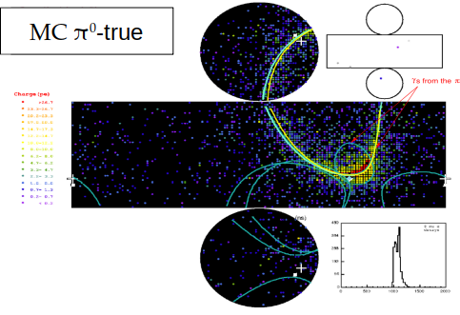
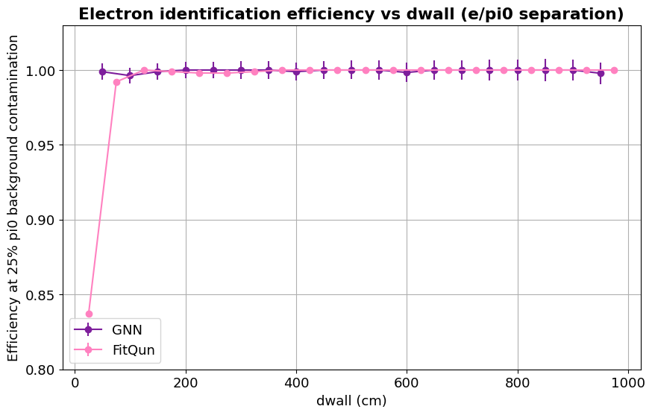
3
Performance comparation: GNN vs existing software
 | GRANT | Existing software
e/pi0 | 99% electron efficiency at 25% pi0 bg acceptance Dwall, towall analysis: After 2 m, efficiency above 99% ! | 94% electron efficiency at 25% pi0 bg acceptance
direction
vtx
Fuzzy ring
Fuzzy ring
Pi0
Electron
- : GNN
- : Existing software
For events close to the wall : GNN > Existing software => potentially increase FV
22
Notes:
**e/π0 Separation**: the GNN achieves 99% signal efficiency at 25% π0 background acceptance, compared to 94% for the existing software, again showing better performance near the tank walls, implying again the reduction of statistical error.

Slide 23
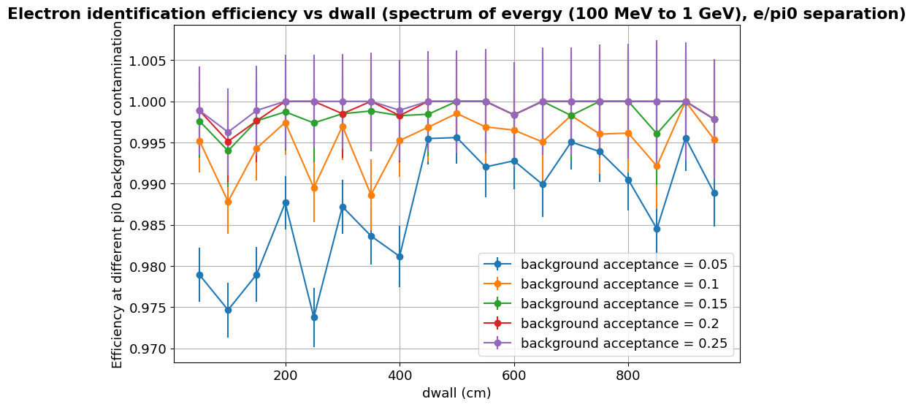
3
Performance comparation: GNN vs existing software
 | GRANT | Existing software
e/pi0 | 99% electron efficiency at 25% pi0 bg acceptance Dwall, towall analysis: After 2 m, efficiency above 99% ! | 94% electron efficiency at 25% pi0 bg acceptance
Fuzzy ring
Fuzzy ring
Pi0
Electron
Decrease pi0 background acceptance => reduce systematic errors!
Notes:
Moreover, the background acceptance can be reduced to 10% without reducing the 99% signal efficiency using our software : this could potentially mean decrease of the systematic error.

Slide 24
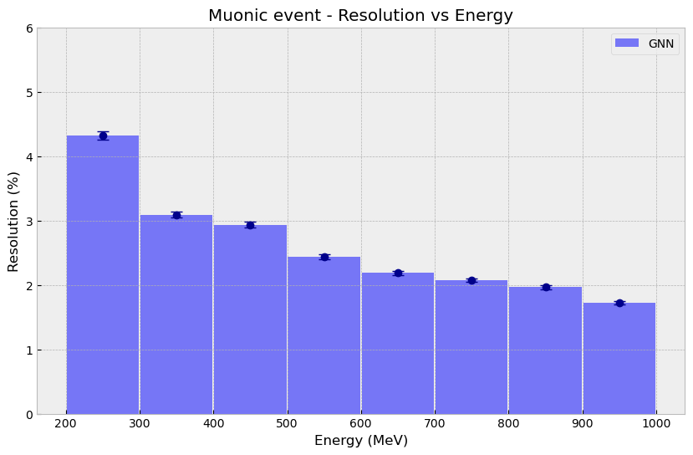
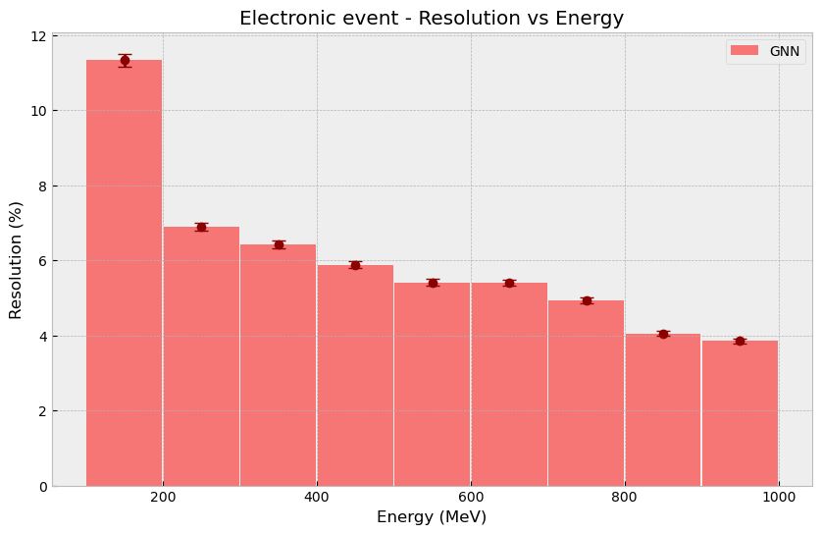
3
Performance comparation: GNN vs existing software
 | GNN | Existing software
Energy reconstruction for e & mu (1D) | Electron : 5.5% resolution at 500 MeV, energy bias at ~1.5% Muon : 2.5% resolution at 500 MeV, energy bias at ~0.5% | Electron : 7% resolution at 500 MeV, energy bias at ~0% Muon : 6% resolution at 500 MeV, energy bias at ~0%
- : GNN
Existing software : 7%
- : GNN
Existing software : 5%
GNN : 2.5% at 500 MeV,
BUT : the GNN has a biais ☹
(1.5% electron, 0.5% muon at 500 MeV)
GNN : 5.5% at 500 MeV,
0.06 s per event (GNN)
1min30 (Existing software)
Existing software : 0% biais !
Notes:
- **Energy Reconstruction**: At 500 MeV, the GNN achieves 5.5% resolution versus 7% for the existing software, though it introduces a 1.5% bias that needs further investigation.

Slide 25
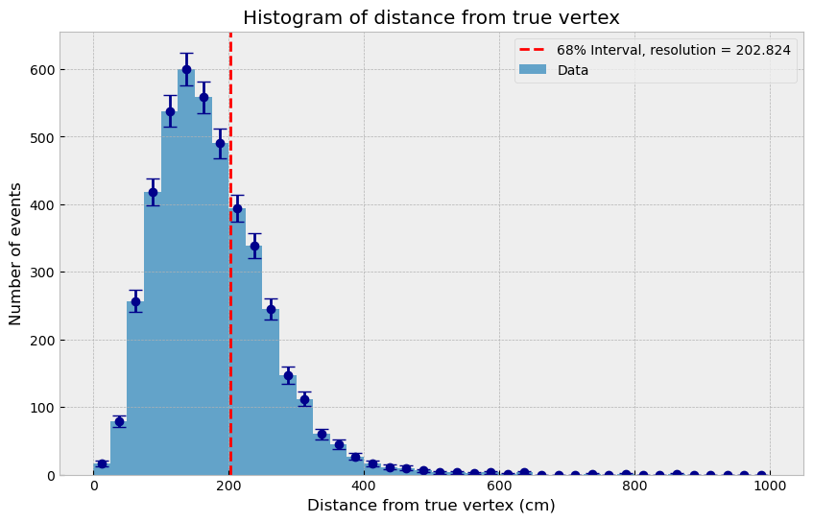
3
Performance comparation: GRANT vs existing software
 | GNN | Existing software
Vertex reconstruction for e & mu (3D) | Electron : 203 cm Muon: None | Electron : 22 cm Muon : 28 cm
GNN : 203 cm resolution
(Existing software : 22 cm)
0.07 s per event (GNN)
1min30 (Existing software)
Notes:
- **Vertex Reconstruction**: because it is a multi dimensionnanl reconstruction, the GNN still lags behind, with a resolution of 203 cm compared to 22 cm for the existing software. But it is obviously still a work in progress.

Slide 26
3
Performance comparation: GRANT vs existing software
 | GNN | FitQun
e/mu | 99% electron efficiency at 5% muon bg acceptance, | 99% electron efficiency at 5% muon bg acceptance,
e/pi0 | 99% electron efficiency at 25% pi0 bg acceptance | 94% electron efficiency at 25% pi0 bg acceptance
Energy reconstruction for e & mu (1D) | Electron : 5.5% resolution at 500 MeV, energy bias at ~1.5% Muon : 2.5% resolution at 500 MeV, energy bias at ~0.5% | Electron : 7% resolution at 500 MeV, energy bias at ~0% Muon : 6% resolution at 500 MeV, energy bias at ~0%
Vertex reconstruction for e & mu (3D) | Electron : 203 cm Muon: None | Electron : 22 cm Muon : 28 cm
0.1 s per event (GNN)
1min30 (Existing software)
Notes:
Now overall our GNN delivers superior results for particle identification and energy reconstruction, but vertex reconstruction still needs improvement.
on top of this our GNN also exhibits computationnal pros as It processes 1 events in 0.1 seconds only, compared to 1 minute 30 seconds for the existing software.
---
And now , The next BIG step IS to test our GNN on well-controlled data, which we plan to do at the Water Cherenkov Test Experiment (WCTE), a proof of technology for Hyper-Kamiokande.

Slide 27
Conclusion.
Hyper-Kamiokande is the next-generation neutrino detector, designed with unparalleled precision.
To fully exploit its potential, we need to push our reconstruction techniques to the next level.
That’s why we’re relying on machine learning, which is proving to be a powerful tool for enhancing precision and unlocking HK’s full potential for groundbreaking discoveries in neutrino physics.
Notes:
To conclude, what I want you to take away from this talk is that Hyper-Kamiokande is the next-generation neutrino detector, designed with unparalleled precision. To fully exploit its potential, we need to push our reconstruction techniques to the next level. That’s why we’re relying on machine learning, which is proving to be a powerful tool for enhancing precision and unlocking HK’s full potential for groundbreaking discoveries in neutrino physics.

Slide 28
Conclusion.
Hyper-Kamiokande is the next-generation neutrino detector, designed with unparalleled precision.
To fully exploit its potential, we need to push our reconstruction techniques to the next level.
That’s why we’re relying on machine learning, which is proving to be a powerful tool for enhancing precision and unlocking HK’s full potential for groundbreaking discoveries in neutrino physics.
Thank you for your attention !! ☺
Notes:
Thank you every one for listening

