Slide 1
SiPM board EIC calorimetry
Frederic DULUCQ – Pierrick DINAUCOURT
July 22 2024

Slide 2
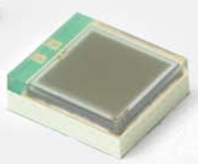
Boards with 16 3x3 mm SiPM
Stacking based on 2 boards:
SiPM board with an array of 16 SiPMs (3x3 mm² reference S14160-3015PS)
Daughter boards to set the SiPM configurations /arrangements
1 SiPM board | 3 daughter boards | Description
16 fully independent 3x3 mm SiPMs | Name: v_ind Independent | Independent SiPM but common HV
 | Name: v_4p Grouped by 4 (in parallel: 4p) | 4 groups of 4 SiPMs
 | Name: v_2s Grouped by 2 (2 series): 4 groups with variant 1 4 groups with variant 2 | 8 groups of 2 SiPMs
Dimension extended to 18.4 mm in one direction (in the other if needed)
(due to SiPM footprint size in X)

Slide 3
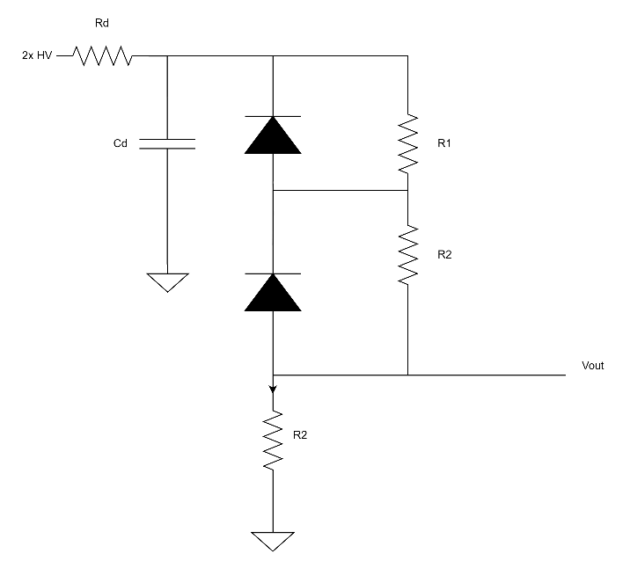
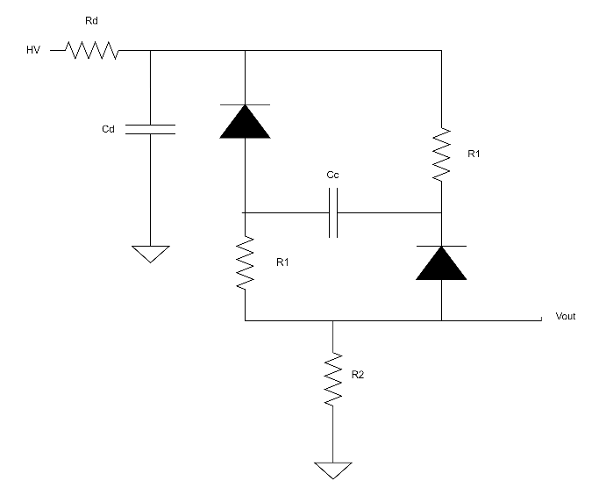
Daughter boards configurations
V_2s
V_ind
(HV filter not shown)
V_4p
(HV filter not shown)
2x HV
HV
+ HV
+ HV
Vout
Vout
If not possible to have 8 groups of 2 SiPMs
➔ Move to only 2 groups (1 for each variant)
NTC resistor connected to pin 1-2 of first connector
If possible LED connecter to pin 1-2 of second connector (then remove the 2-pin dedicated connector)
HV filtering done on daughter board (for ILCLab board, 1 per connector)

Slide 4
Panel
If easier
Baseline
If possible
(16 // new)
16 //
2s
2s
2s
16 //
16 //
16 //
2s
4 //
4 //
4 //
Vind
Vind
Vind
SIPM
SIPM
SIPM

Slide 5
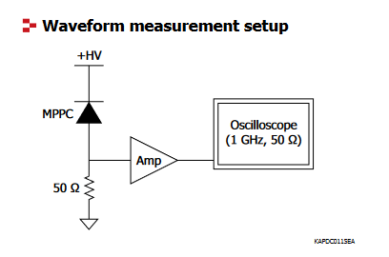
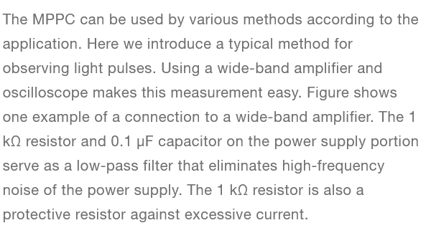
Hamamatsu schematics
HV filtering ( < 100 volts)

Slide 6
Open questions (meeting July 19 2024)
Remove LED connector ? use pin 1-2 of first connector
See slide 3
NTC resistor use 1-2 pin of the second connector
See slide 3
Size 18.4 mm on 1 dimension or 2 dimensions ?
See slide 2
V_2s2p only for 1 group ? other not used
Sees slide 3
Perpendicular connection to daughter board 2s2p ?
Remove daughter board in this case ? Still open

Slide 7
Links for specs
Links
SiPM board spec: https://cernbox.cern.ch/s/vt5BTljNIVfUQJK
Daughter boards: https://cernbox.cern.ch/s/mCTOspGW7W6wDcl

