Slide 1
Comparison of single, parallel and series SiPM
Pedro Pablo Dumas Ziehlmann

Slide 2
Nomenclature
SiPM capacitance | $$C$$
Capacitance seen by the front end | $$C_{in}$$
Charge created a uniform diode | $$Q$$
Charge seen by the front end for a single photoelectron | $$Q_{in}$$
Voltage seen by the front end | $$V_{in}$$
Dynamic range (in photons) of the front end using a single SiPM (max/min detectable signal) | $$DR$$
Signal to noise ratio of the front end using a single SiPM | $$SNR$$
Jitter of the front end using a single SiPM | $$J$$
Surface of detection for a single SiPM | $$S$$

Slide 3
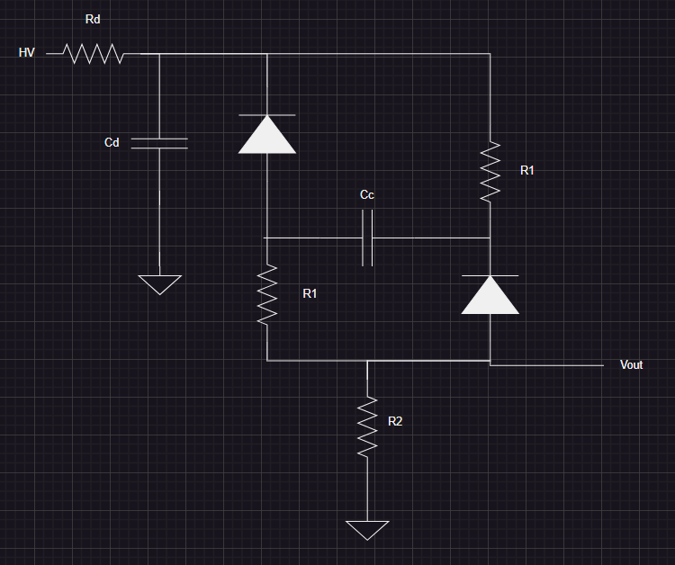
2 SiPM in series (2s SiPM)

Slide 4
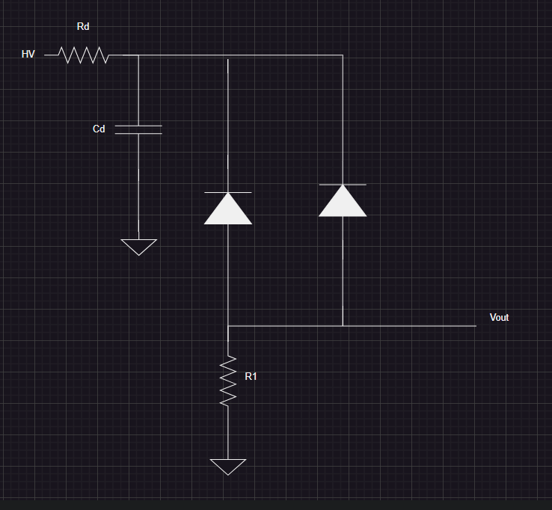
2 SiPM in parallel (2p SiPM)

Slide 5
 | Single SiPM | 2s SiPM | 2p SiPM
$$C_{in}$$ | $$C$$ | $$\frac{C}{2}$$ | $$2C$$
$$Q_{in}$$ | $$Q$$ | $$Q$$ | $$2Q$$
$$V_{in}$$ | $$\frac{Q}{C}$$ | $$2\frac{Q}{C}$$ | $$\frac{Q}{C}$$
Dynamic range (max - min) | $$DR$$ | $$DR$$ | $$DR$$
Signal to noise ratio | $$SNR$$ | $$SNR$$ | $$\frac{SNR}{2}$$
Jitter | $$J$$ | $$J$$ | $$2J$$
Surface of detection | $$S$$ | $$2S$$ | $$2S$$

