Slide 1
Synchrotron Data: Services, Software and AI
Bellachehab Anass
Groupe Réduction Analyse de Données Exp. de SOLEIL (GRADES)

Slide 2

GRADES Deployment Overview
Data Reduction and Analysis Group (GRADES) - Created in 2020, 5 active members+1 student.
576 CPU threads
4 TB mem
~200 TB disk
17 GPU’s
Our current resources are dimensioned for up to ~50 simultaneous users.
Our rationale: search for simple solutions, against complexity
SOLEIL:
2 PB in 2023

Slide 3

Importance of AI in Modern Scientific Facilities
Denoising (remove Poisson-noise), help further data treatment and compression.
Chatbot to help scientists at 3 am, and provide tips for on-going experiments as well as retrieval augmented generation for accelerator team
ML/AI beased optimal control for the accelerator Anomaly detection, predictive model control.

Slide 4
Problem Context

Slide 5
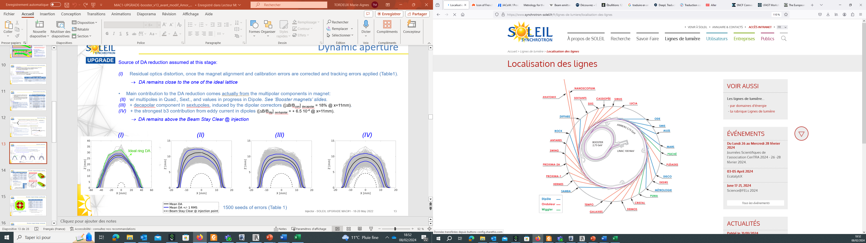
Injection System Overview
Due to the limited lifetime of the beam stored in the ring, the SOLEIL injector (LINAC, transfer lines, Booster) is called upon every ~3 minutes.
The efficiency of this injector impacts the quality of the stored beam (frequency of injections, transparency of the injection, quality of the injected beam). (can't go beneath 40%)
In the SOLEIL II project, the requirement for injector reliability will be increased.​

Slide 6

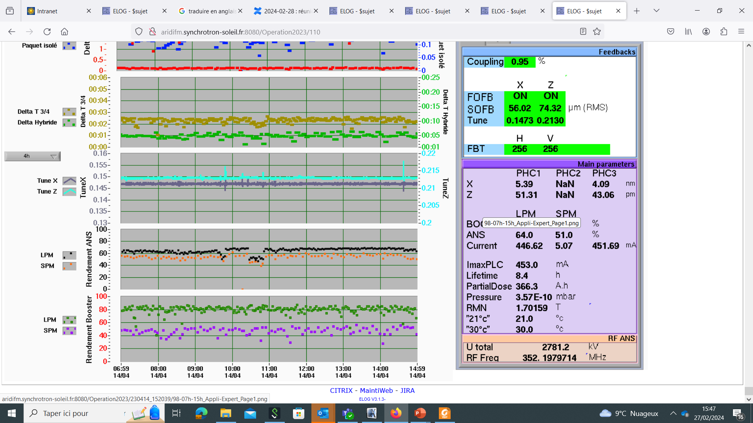
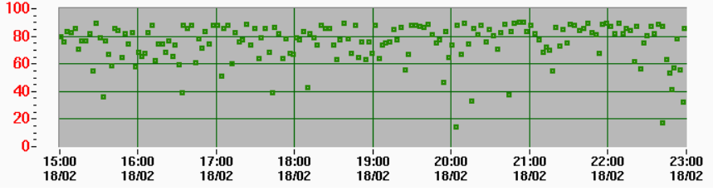
Efficiency Impact on Beam Quality
We are particularly interested in the injection of the LINAC beam into the booster:
The yield of this injection regularly fluctuates and requires careful adjustment on the part of the operators.
The source of these fluctuations is not always clear.
Such fluctuations will not be acceptable on SOLEIL II.
First request: Help establish correlations between parameters​
2nd request : machine learning for automatic optimization of injection into the booster​
Example of degraded LINAC-booster injection efficiency
Injection rate in booster
Stable
Fluctuating Long Pulse Mode injection rate

Slide 7
Data Description

Slide 8
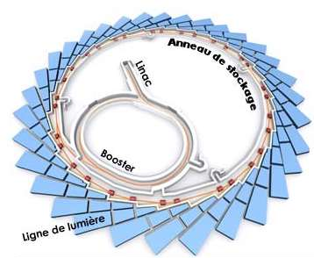
Overview of LINAC - booster Data
Problem: Optimizing synchrotron operations and data analysis
Data Source: Injection measurements from various devices
Key Metric: Injection efficiency (measured as a percentage)
Complexity: Multi-dimensional, multi-scale time series data

Slide 9

Data Collection and Organization
Yield Device:
  Aggregates and aligns measurements from different devices
Measurement Types:
  Single shot measurements
  Burst shot measurements (multiple shots collected)

Slide 10

Data Attributes and Structure
Spectrum Attributes:
  Contain data points for each shot in the last burst
  Example: charge measurements for each shot
Scalar Attributes:
  Derived from spectrum attributes
  Suffixes: _min (minimum), _max (maximum)
Efficiency Attributes:
  Ratios between different measurements

Slide 11
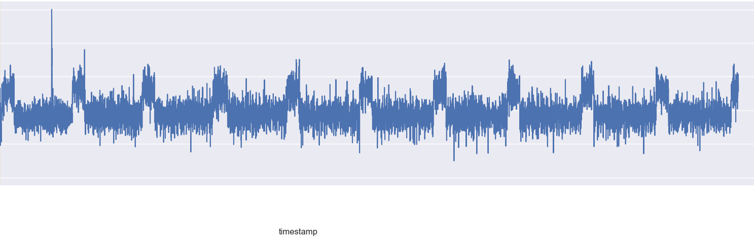
Time Series Characteristics
Variable:
Pression_retour
Characteristics:
  High-frequency oscillations
  Clear periodic patterns
  Occasional sharp spikes and dips
Challenges:
  Multiple timescales of behavior
    Potential anomalies in extreme values

Slide 12
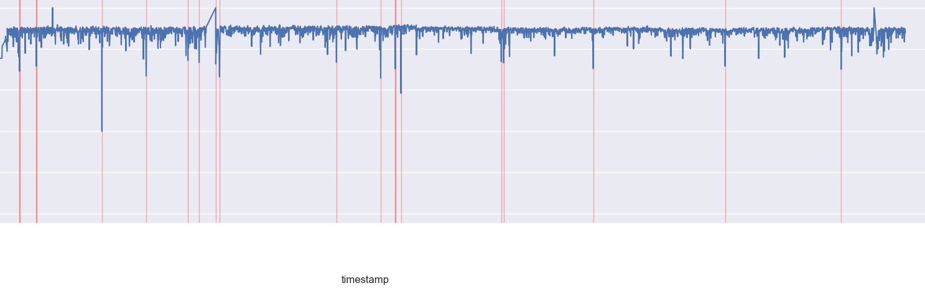
Efficiency Measurements
Variable:
ANS/IO/RENDEMENT/efficiency*t_lpm_arch
Key Features:
Efficiency values mostly between 0.6 and 1.0
Frequent sharp drops in efficiency
Red markers indicating potential anomalies or issues
Challenges:
Identifying true anomalies vs. normal fluctuations
Understanding causes of efficiency drops

Slide 13
Initial Approach: Anomaly Detection

Slide 14
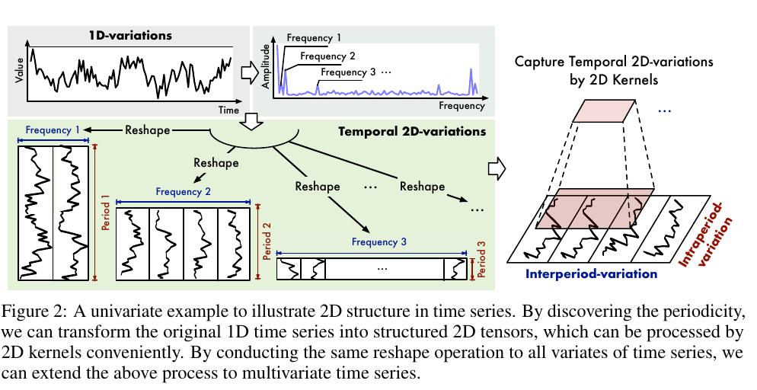
TimesNet Architecture
Input:
1D time series data
Process:
Discover periodicities using Frequency analysis
Reshape 1D series into multiple 2D tensors based on discovered frequencies
Output: Structured 2D tensors capturing temporal patterns
Benefit: Enables use of powerful 2D convolutional operations

Slide 15
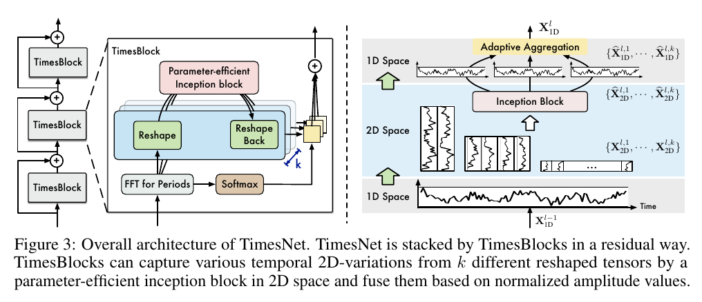
TimesNet complete architecture
Core component:
TimesBlock
Structure:
Multiple TimesBlocks stacked in a residual manner
Key operations within TimesBlock:
  FFT for period discovery
  Reshape to 2D
  Parameter-efficient inception block for feature extraction
  Reshape back to 1D
  Adaptive aggregation of multiple frequency representations

Slide 16
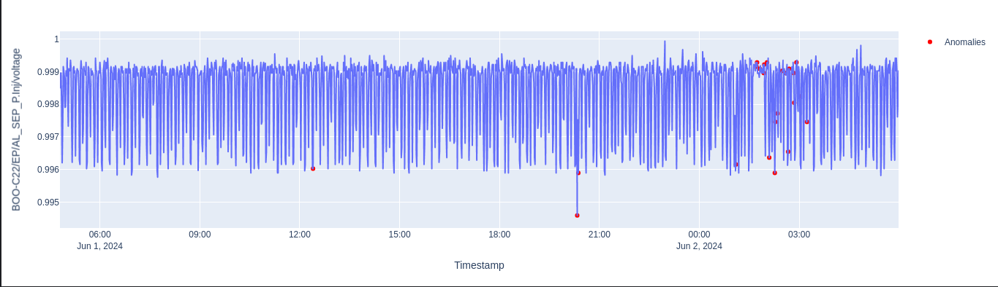
Anomaly Detection Results and Challenges
Time Range: June 1-2, 2024 (24 hours)
Key Observations:
Clear periodic pattern in voltage measurements
Anomalies (red dots) detected primarily in voltage peaks and troughs
Most anomalies clustered in the latter half of the time series
Majority of the data points classified as normal
Potential Insights:
TimesNet successfully captures the underlying periodic structure
Detected anomalies may indicate unusual voltage fluctuations
Increased anomaly frequency towards the end might suggest evolving system behavior

Slide 17
Evolution of Approach

Slide 18
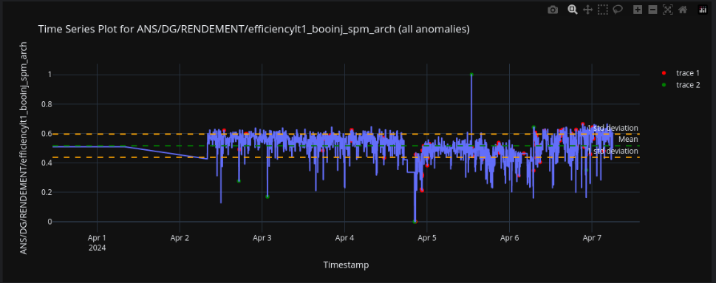
Limitations of Current Approach: Conceptual Challenges
Binary Classification is Too Simplistic
Efficiency issues exist on a spectrum
Not all "anomalies" require the same response
Missing temporal context in decisions
Complex Pattern Recognition
  Efficiency drops can be:
  Sudden and severe (rare)
  Gradual degradation (more common)
    Part of normal operation
  Need to understand patterns, not just detect them

Slide 19

Limitations of Current Approach: Practical Challenges
Operational Requirements
                Operators need predictive warnings
            Want to prevent efficiency drops, not just detect them
            Need guidance on corrective actions
Limited Actionability
  Detection alone doesn't suggest corrections
  No quantification of prediction uncertainty
  Difficult to integrate with control systems

Slide 20
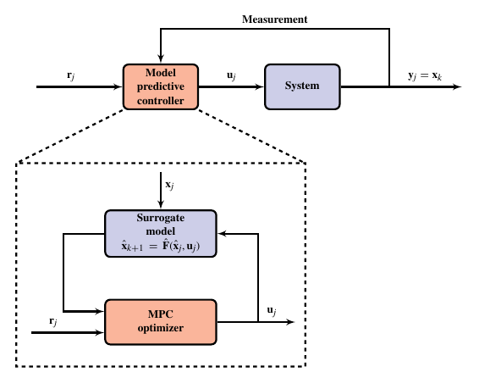
Reformulating the Problem: From Detection to Prediction
Key Shift:
Before: "Is this point anomalous?"
Now: "What will efficiency be, and how certain are we?"
Gaussian Process Regression
Provides uncertainty estimates
Use sparse GPs for better explainability
Uncertainty can be used to quantify stability
Model predictive control (in progress)
Predicts system behavior
Optimizes control actions
Handles constraints naturally

Slide 21
Future Perspectives: Beyond Initial Implementation
Phased Implementation Approach
            Controlled testing in parallel with existing systems
            Gradual transition to real-time operation
            Careful monitoring and performance assessment
Operational Integration
  Development of operator interface
  Real-time visualization tools
  Integration with existing control systems
  Automated reporting and diagnostics
  Research Opportunities
Machine Learning Advances
  Exploration of models combining physics insights with ML
  Investigation of transfer learning between different operation modes
  Development of interpretable AI techniques for operator trust

Slide 22


