Slide 1
Instrumentation Challenges and Computational Challenges
Developments since EPPSU 2020
- a (hopefully not too) personal selection -
Roman Pöschl
Supported by
R.P. Is indebted to a number of distinguished colleagues in particular Marc Winter, Paul Colas and David Rousseau for having provided input to this talk
IRN Terascale/GT01 Meeting – October 2024

Slide 2
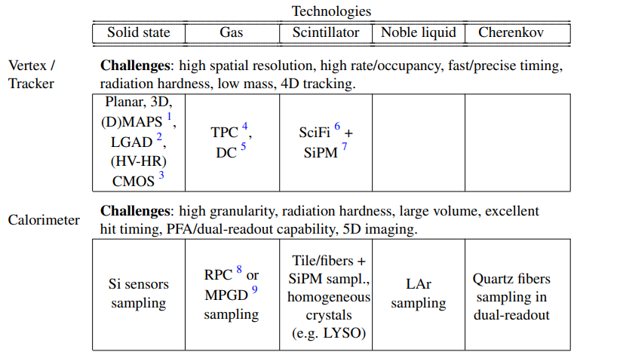
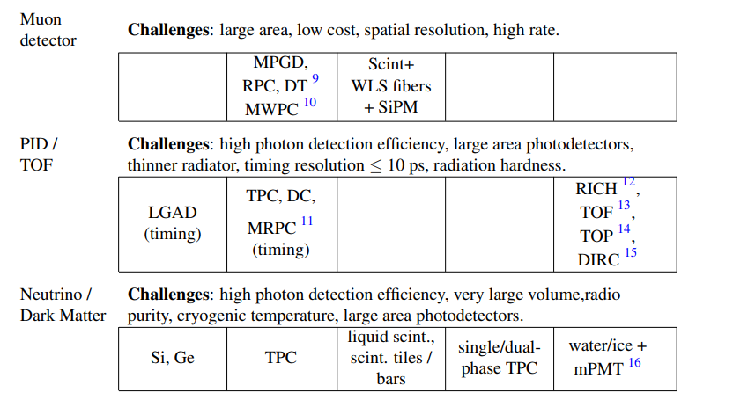
EPPSU 2020 – Brief recap
From Briefing Book EPPSU 2020
The EPPSU charged ECFA to develop an R&D Detector Roadmap

Slide 3
The Roadmap Document(s)
ECFA R&D Roadmap
CERN-ESU-017 https://cds.cern.ch/record/2784893
248 pages full text and 8 page synopsis
Endorsed by ECFA and presented to CERN Council in December 2021
The Roadmap has identified
General Strategic Recommendations (GSR)
Detector R&D Themes (DRDT)
Concrete R&D Tasks
Timescale of projects as approved by European Lab Director Group (LDG)
Guiding principle: Project realisation must not be delayed by detectors

Slide 4
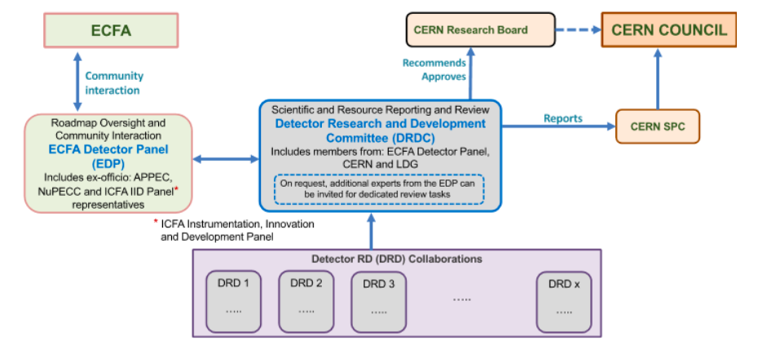
Future Organisation of Detector R&D (in Europe)
Detector R&D
Collaborations
DRDs are hosted by CERN and are therefore legally CERN collaborations
World wide collaborations!
The progress and the R&D will be overseen by a DRDC that is assisted by ECFA
https://committees.web.cern.ch/drdc
Chair Thomas Bergauer of ÖAW/Austria
The funding will come from national resources (plus eventually supranational projects)

Slide 5
Future Organisation of Detector R&D - The DRDs
Thomas Bergauer, June '24

Slide 6
Liquid Detectors - Science Directions
J.R. Monroe,
DRD 2 talk,
DRDC Meeting,
March '24

Slide 7
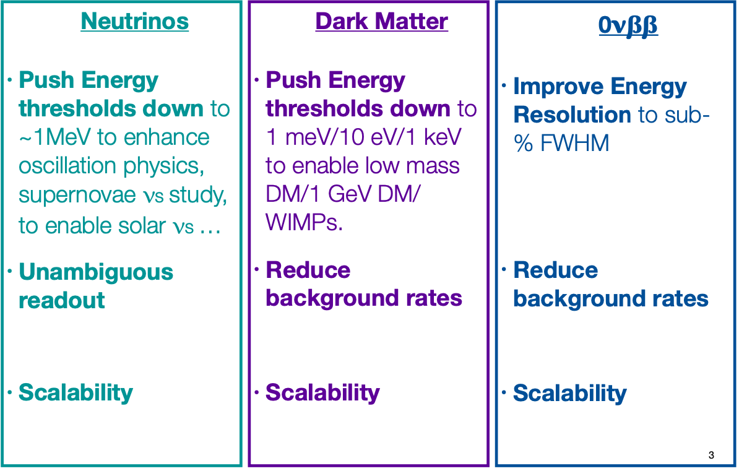
Liquid Detectors - Requirements
J.R. Monroe,
DRD 2 talk,
DRDC Meeting,
March '24

Slide 8
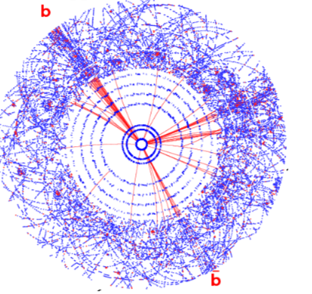
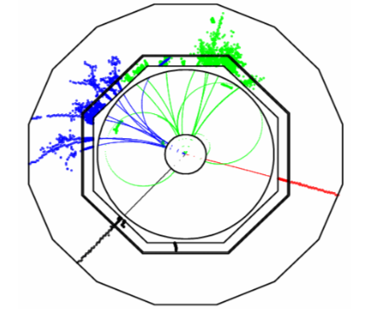
(Rough) Comparison – Hadron collisions ↔ e⁺e⁻ collisions
Hadron-hadron collisions e.g. LHC
e⁺e⁻-collisions
Picture Y. Sirois
Busy events
Require hardware and software triggers
High radiation levels
Clean events
No trigger
Full event reconstruction

Slide 9
(Rough) Comparison – Hadron collisions ↔ e⁺e⁻ collisions
Hadron-hadron collisions e.g. LHC
e⁺e⁻-collisions
Picture Y. Sirois
EPPSU 2020 named clearly an e+e- Higgs factory as priority after LHC
Therefore many R&D activities have been targeted into this direction (and sets the priorities for this talk)
However, community keeps an eye on future hadron and muon colliders

Slide 10
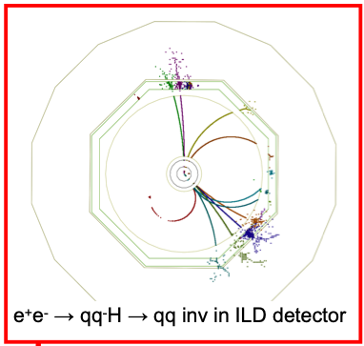
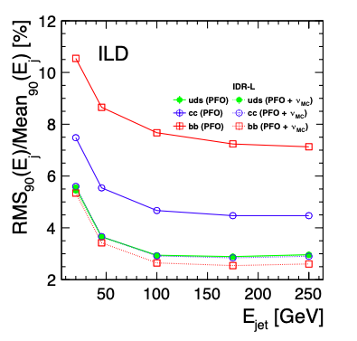
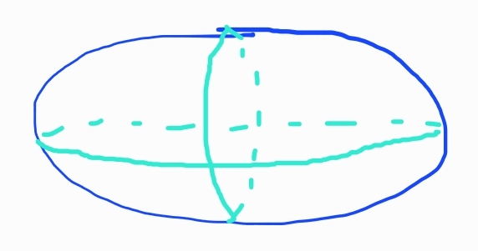
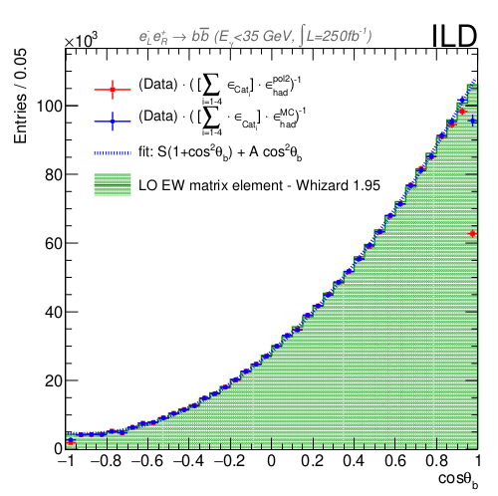
Detector Hermeticity
Invisible Higgs decays
Hermeticity = Acceptance
down to the beam pipe and
no acceptance holes!
Missing Energy
Rich events:
Heavy Quark asymmetries
Detector Hermeticity requires is team effort
Vertex Detectors, Central Tracking and
Calorimeters

Slide 11
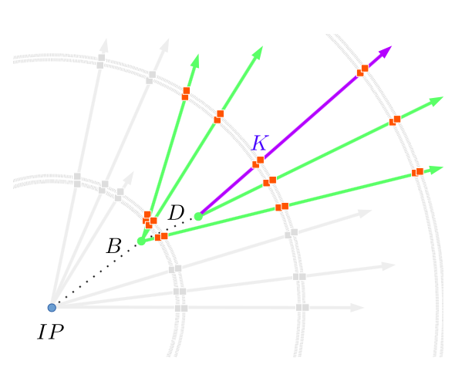
Vertexing and Tracking
Determination of primary vertex
Flavor tagging
Indispensable for analyses with final state quarks
Quark charge measurement
Important for top quark studies,
indispensable for ee->bb, cc, ss, ...
Control of migrations:
Correct measurement of vertex charge
Kaon identification by dE/dx (and more)
Future detectors can base the entire measurements on
double tagging and vertex charge
LEP/SLC had to include single tags and
semi-leptonic events
PhD thesis: S. Bilokin
A. Irles

Slide 12
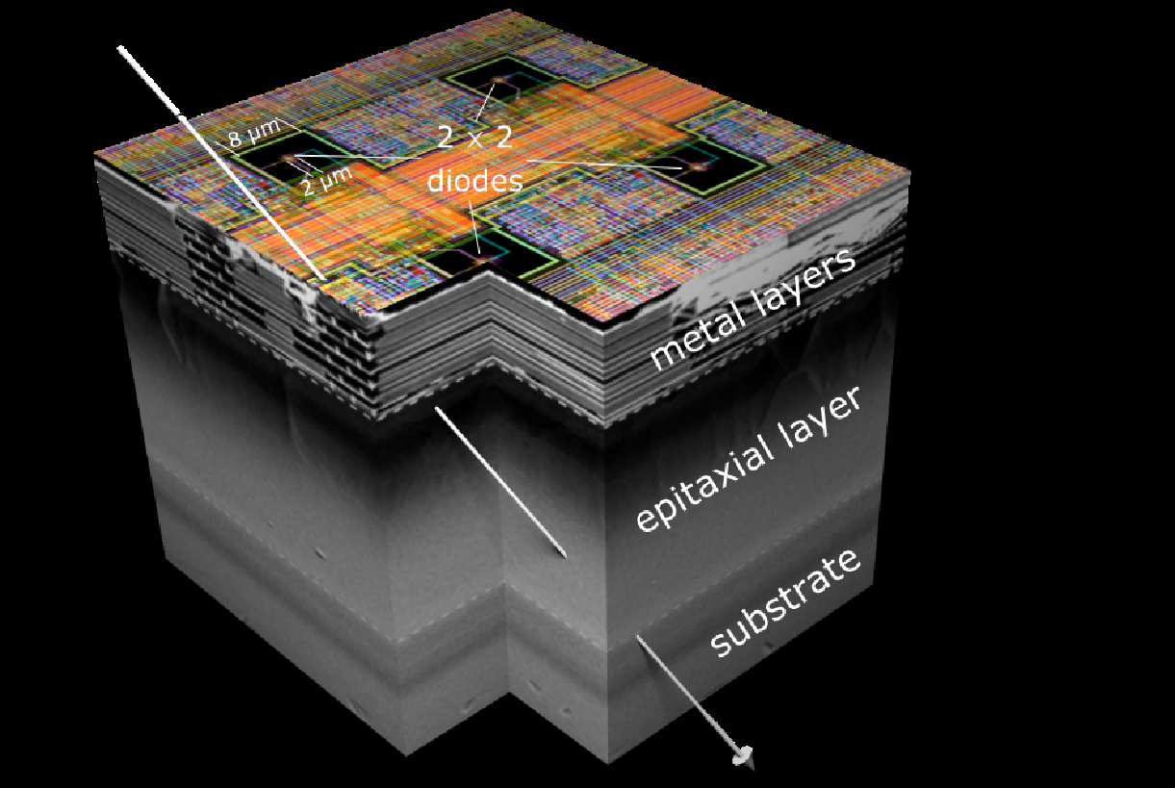
CMOS Sensors Silicon Tracking
Main asset: µ-circuits (steering, r.o., slow control) integrated on thin sensing substrate → Monolithic & Thin (& Troom)
Numerous developments of custom design CMOS Pixel Sensors (CPS) on-going for vertexing and tracking devices foreseen to equip experiments at existing infrastructures (LHC, KEK, PSI, …) and future colliders (eIC, FAIR, FCCee/hh, CEPC, ILC, C3, …)
Some R&D for ECAL
Optimisation imposes hierarchising conflicting requirements:
Spatial resol. / Timing / Mat. budget (power) / Rad. Tol. / Hit rate
- Dependence on CMOS process (foundry) characteristics
Frameworks: CERN-EP, DRD, ITS3 (main driver for Higgs
factories: 65 nm techno with stitched curved sensors)
3 predominent foundries: TJsc, TPSCo, L Foundry
System Integration is crucial for realistic detector optimisation:
. Air cooling at which price ?
. Services → impact on FW region ?
. Impact on choice of sensor technology and design ?
Courtesy of Marc Winter

Slide 13
Ambitioned Performances
Spatial and pointing resolution : < 3 µm and Rin ≤ 15 mm
Time stamping :
- Z pole running: << 1 µs ?
- for > 200 GeV : O(1) µs
Material budget / single layer: ≤ 0.15 % Xo
→ no active cooling inside sensitive volume (air flow only ?)
Remarks:
- minimise beam pipe material budget and radius
- exploit at best low radiation levels and backgrounds
(as compared to LHC)
- system optimisation should minimise bulk of services (end-caps !)
- Z-pole and H-top operations could involve two different vertex detectors
Application dependent Trade-off
Courtesy of Marc Winter

Slide 14
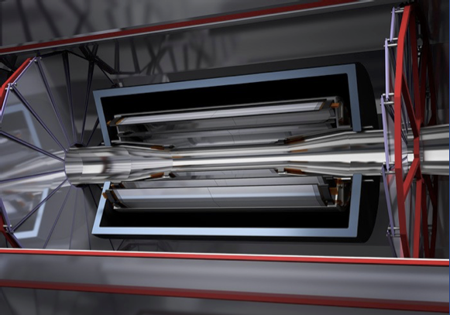
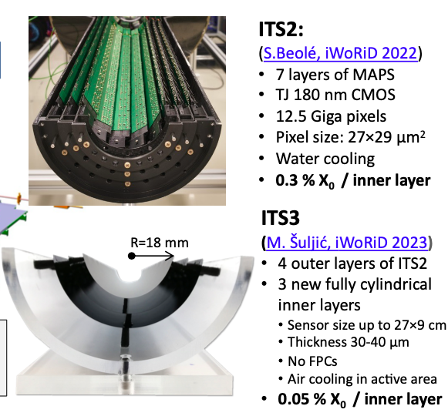
Vertex Tracking for Higgs Factories
Low material budget is overall challenge
Major step through ALICE upgrade
Big question: Radius of beam pipe
Considerable material reduction by application of
bent layers
=> No carrier structures

Slide 15
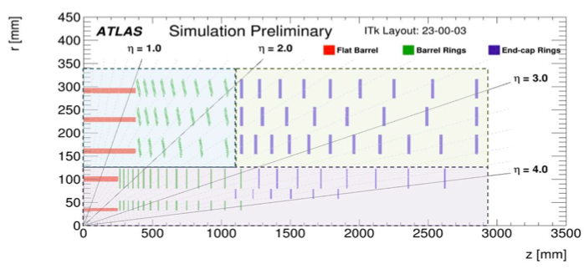
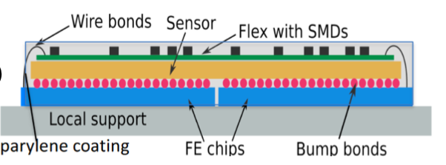
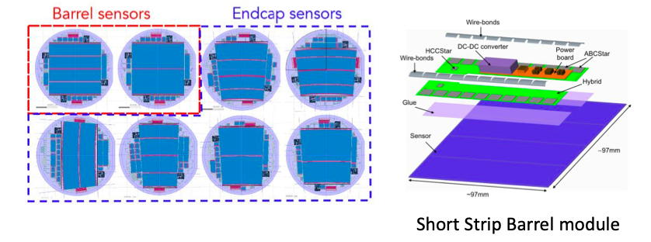
Central Tracking With Silicon – Example ATLAS ITK
Pixel Detectors
Structure of ITK Pixel Module
Silicon tracking yield excellent single point resolution
Typically O(few μm)
Less measurement points than gaseous tracking
LHC Detectors feature large silicon tracking
... that undergo currently a major upgrade
Many proposals for future detectors will also feature a large silicon tracking volume
Strip Detectors

Slide 16
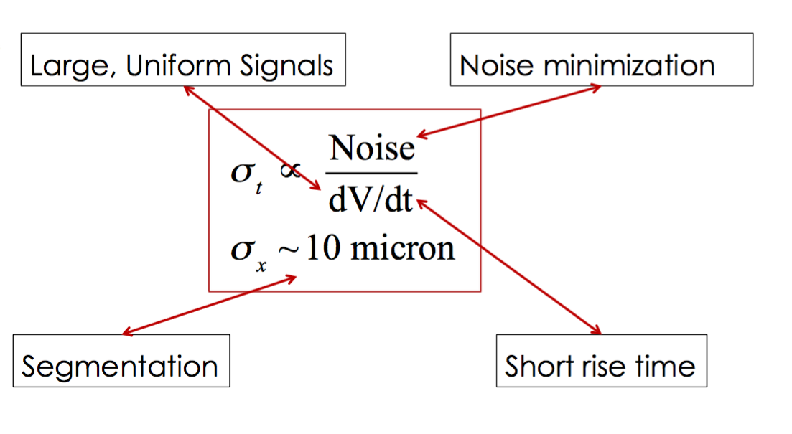
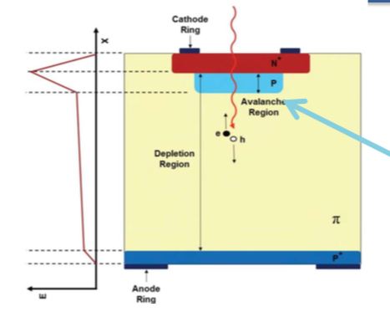
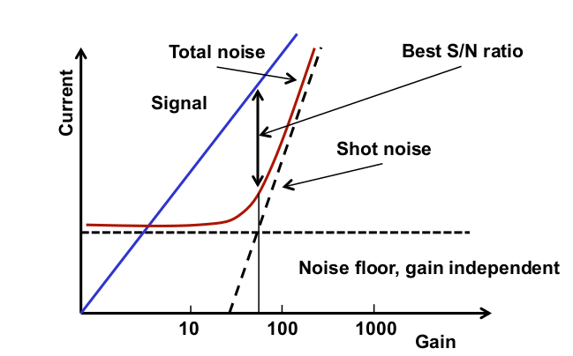
Timing (not only) for Tracking
Pioneered by LHC Experiments, timing detectors may require adaptation for Higgs Factory Experiments
Working horse LGAD
Better dV/dt by “active” Si diodes ? => Low Gain Avalanche Detectors
LGADs applied for ATLAS HGTD and CMS ETD
Expect time resolution σ_{t} ~ 30-50ps
Combining LGADs with tracking devices is current major R&D topic
=> 4D tracking

Slide 17
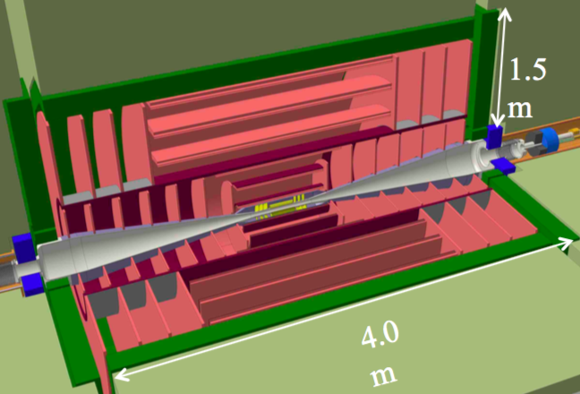
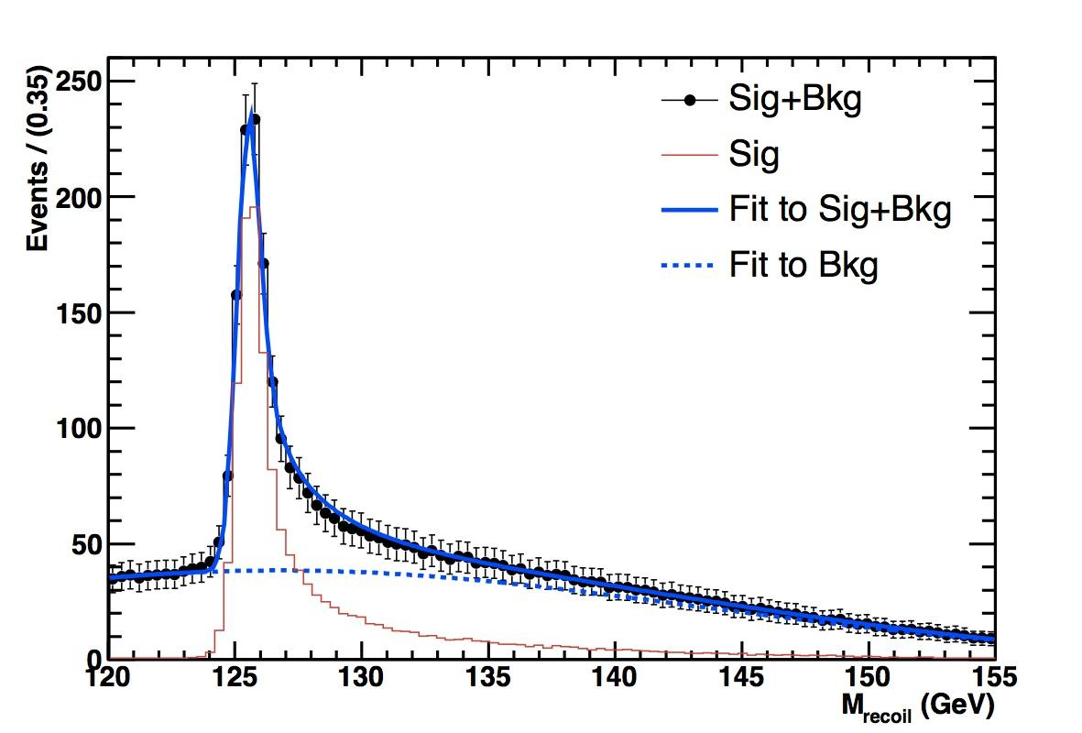
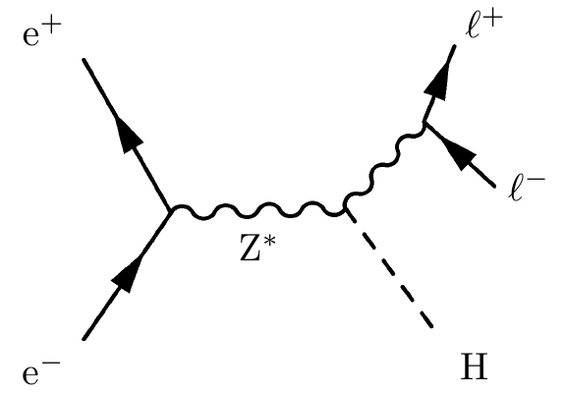
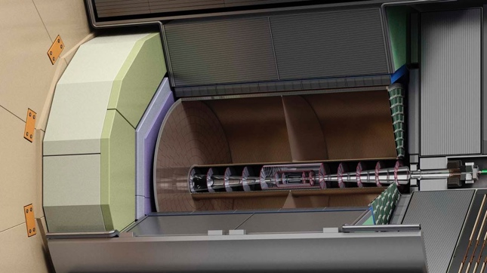
Central Tracking
“Royal” task of central tracking system
Precise measurement of charged particles in e.g.
Option 1: All silicon tracking
Gluckstern Formula:
Option 2: Gaseous tracking
Relates track momentum resolution with
single point resolution σ with Number of hits and track length L and magnetic Field B

Slide 18
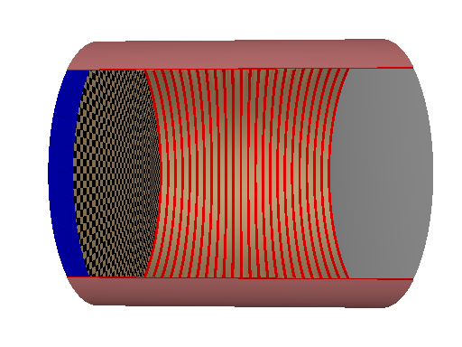
Gaseous Tracking Systems at Future Colliders
R&D for LC TPC is organised in Collaboration
Fieldcage
Gasvolume
B, E Field
Readout Layer
Gas Amplification
Cathode
Charged particle ionizes Gas
Electron cloud drifts to Anode (Readout layer)
Transversal diffusion is largely suppressed since E || B
z Coordinate: z = v_{d} · t_{d} (vd, td drift velocity and drifttime,respectively
rφ Coordinate by segmented Readout layer

Slide 19
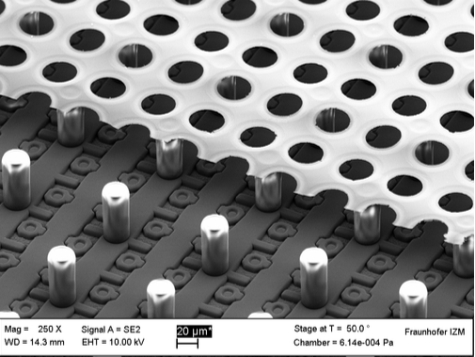
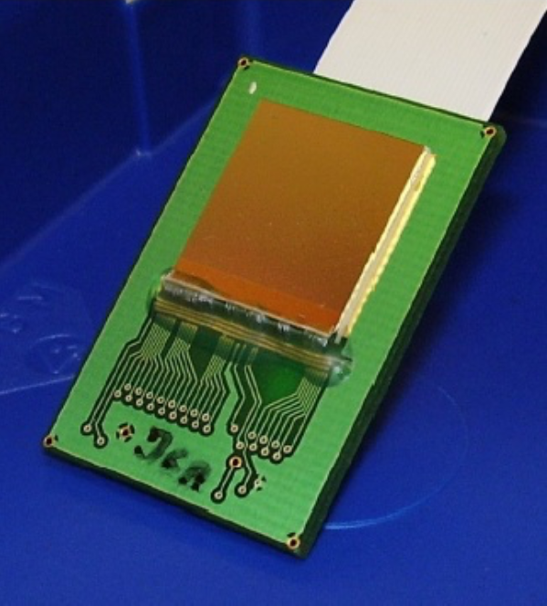
Central Tracking – Gaseous Tracking - TPC
Micropattern Gas Detectors - Pads :
T2K/ND280 (near detector at JPARC neutrino oscillation experiment) started in 2023-24
using a technology envisaged for a pad TPC : resistive Micromegas. This allows developments relevant for a Higgs factory TPC : long term stability, algorithms for dE/dx measurements, gain calibration and charge spreading studies.
Pixels : Performance studies going on using DESY 2021 test beam data and simulations. dE/dx, dN/dx, resolution, chip alignment, distortions.
Ion backflow and distortions from space charge (common to all readout options) : R&D necessary and in progress for TPC application at circular colliders, especially at the TeraZ. Here the ALICE Pb-Pb data are also useful. This also requires intense beam background simulations.
Paul Colas

Slide 20
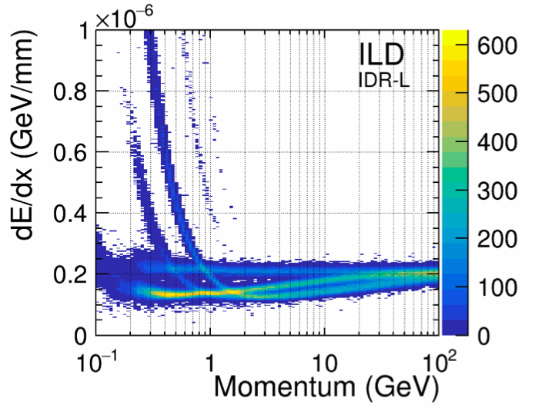
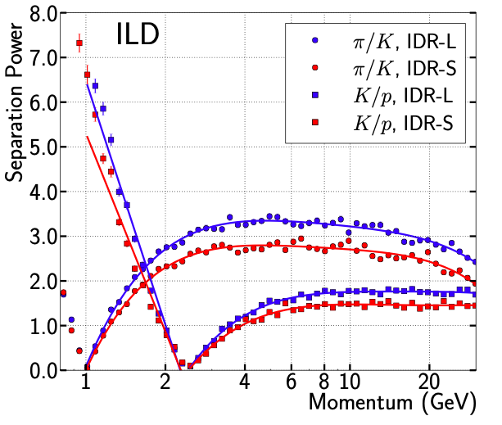
Gaseous Tracking – dE/dx in ILD
Up to 220 points for dE/dx in ILD
ILD targets resolution of at least 5% on dE/dx,
Fine pixels avoid ambiguities
=> most of the time all 220 Hits are available
Test beam results are encouraging
Applications of dE/dx:
Kaon identification in ee->tt, ee->bb, ee->cc, ee->ss
Supplementary to vertex charge measurement for heavy quarks
Increases statistics by a factor of two
Backbone of ee->ss
Separation of W->ud and W->cs
Separation power pi/K 2-3 sigma at momenta above 2 GeV
Degradation towards higher momenta

Slide 21
dE/dx → dN/dx – Cluster counting

Slide 22
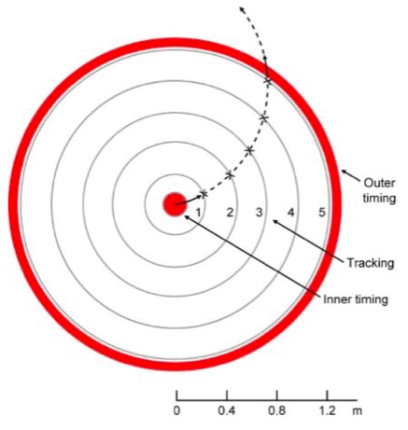
In absence of gaseous tracking
Two options (not mutually exclusive)
ToF System
Cerenkov Detector
Three options:
DIRC: 6- 7 GeV/c
Focusing Aerogel RICH: 9-10 GeV/c
Gaseous RICH: 10-30 GeV/c
à la J. Vavra
Gaseous RICH looked at for SiD:
K. Stefanov,
Pixel tracker for SiD
LCWS 2021
ToF and Cherenkov are options for PiD systems
Cherenkov most likely needed to go to high momenta
Both lead to ”compressed” tracking systems
Ongoing R&D to minimise this compression
(With two closed eyes)
ToF systems might work
up to 10 GeV

Slide 23
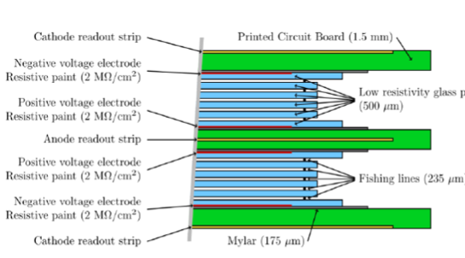
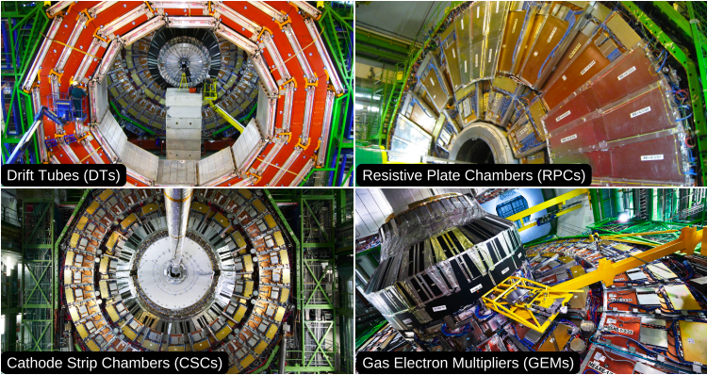
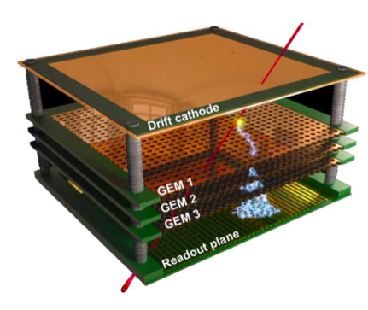
(Large scale) gas detectors
Example CMS Muon System
https://cms.cern/detector/detecting-muons
Trend: Multi Layer Chambers
Gas chambers are also options for calorimetry

Slide 24
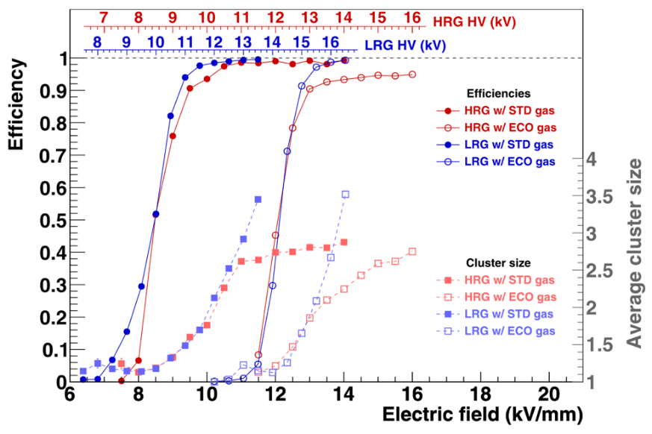
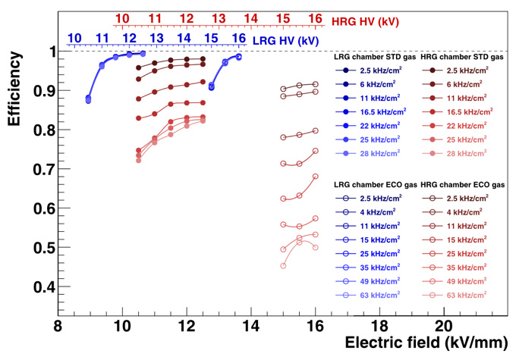
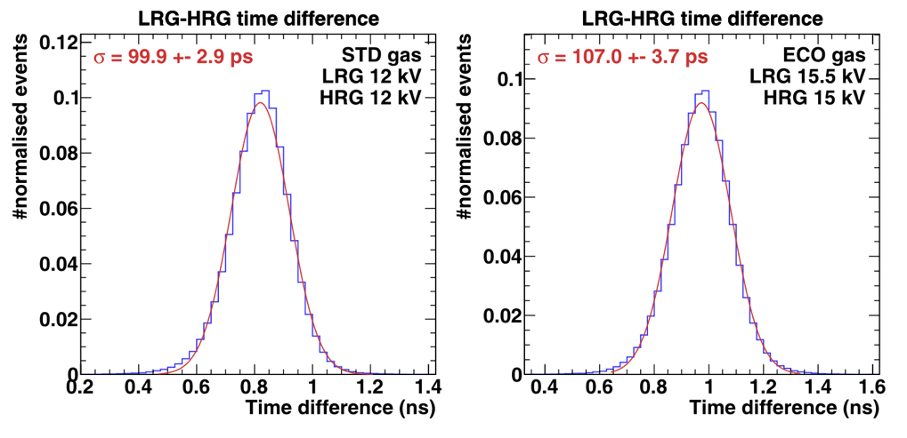
MRPCs for fast timing
MRPC developments for fast timing (D7.2):
- MRPC with 10 layers and 230μm gaps.
- Glass sheets with low-resistivity (LRG ~10⁹ Ωcm),
and high-resistivity glass (HRG ~10¹² Ωcm) used.
- Standard (98% C₂H₂F₄ 2% SF₆ GWP 2040) and ECO
(100% HFO1234ze GWP 6) gas mixtures were used.
Good performance of LRG, even with ECO gas, but
at much higher voltage (+4kV).
Rate performance with beam spot of 4 cm²
Time resolutions measure: ~100ps
B. Schmidt,
AIDAinnova Midterm Review

Slide 25
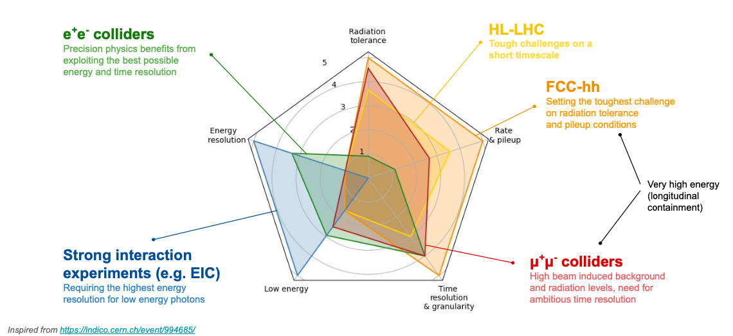
Requirements for calorimetry at future colliders
M. T. Lucchini, 1st Calo Community Meeting

Slide 26
Jet energy resolution – Different approaches
High pixelisation to exploit tracking as much as possible
Optimise for hadronic
energy resolution
Optimise for electromagnetic
energy resolution

Slide 27
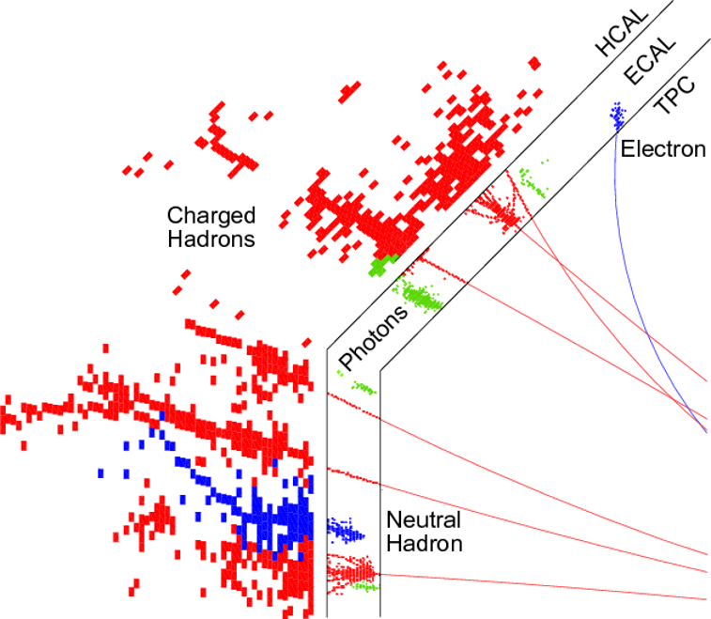
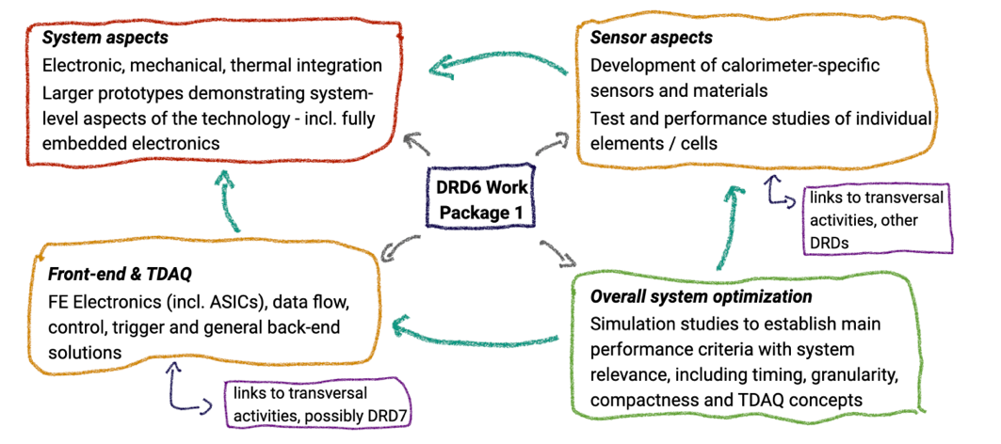
Imaging calorimeters
Challenges:
High pixelisation, 4pi hermetic -> little room for services
Detector integration plays a crucial role
New strategic R&D issues
Detector module integration
Timing
High rate e+e- collider (such as FCCee)
Imaging calorimeters provide the high separation power for Particle Flow

Slide 28
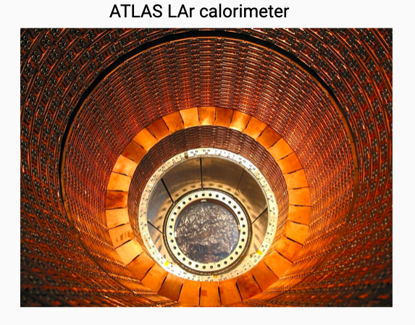
Future Noble Gas Calorimeters
LAr Calorimetry is proven technology since a few decades
ATLAS, H1, DO, NA31
Challenge is to make the technology “fit” for
future hadron and lepton machines
Design is driven by particle flow
ATLAS Jet-Energy resolution based on PFA
~24% at 20 GeV and 6% at 300 GeV
=> Increase of granularity
Goal: Factor ~10 w.r.t. ATLAS LAr Calorimeter
220 kCells -> ~2 MCells

Slide 29
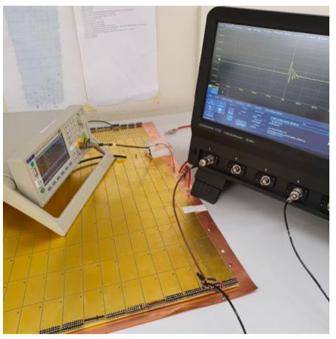
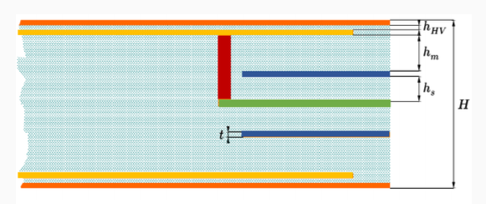
Future Noble Gas Calorimeters – How to increase the granularity
Development of a multilayer PCB
HV Layer on both sides
Readout layer on both sides
Connected to signal trace
One signal trace is economical solution
to reduce signal traces
Pick-up of signal from both sides increases S/N
Challenges:
Control number of signal traces
Big number of capacitances => Noise
Goal is 300 keV Noise for 200 pF cell (S/N > 5)
FCCee allows for higher integration times
Cold electronics?

Slide 30
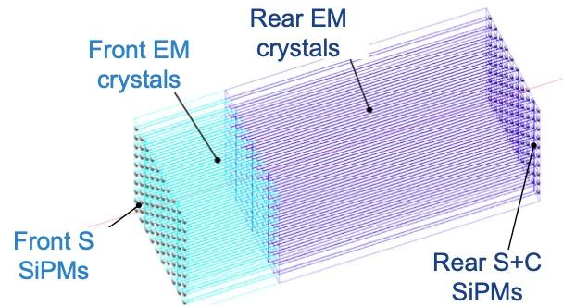
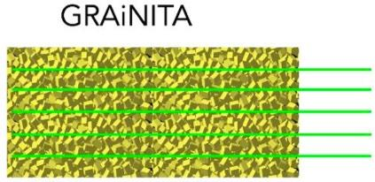
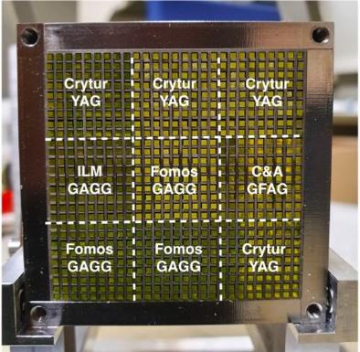
Optical calorimeters
MaxiCC
More than e.g. imaging calorimeters optical calorimeters put emphasis
on the electromagnetic energy resolution
(Liquid Noble) interpolates a bit between these two cases
Elm. resolutions down to 1-2%/√E are envisaged
Advantegeous for Higgs Factory, indispensable for Heavy Flavour
SpaCal
Main challenges
Find the good optical material
Find the adequate photosensor
Move from table top to system
First project to fully make this step is SpaCal (LHCb)

Slide 31
Novel optical materials
Radiation hard optical materials with
ultrafast timing response are required for
new detectors in HEP, nuclear medicine and
industry
A time resolution below 30 ps or even in the
sub ps domain requires a better understanding
of the fast signal production mechanisms in
detection materials
Innovative test suites required for the combination
of fast timing and radiation tolerance will be
developed for the characterisation and
classification of materials
Scalable and cost effective production techniques for the novel
materials have to be explored together with the industrial partners

Slide 32
(Nano) Materials for optical calorimeters
V. Sola
AIDAinnova Meeting
Valencia
R&D on material has
Overlap with DRD 5

Slide 33
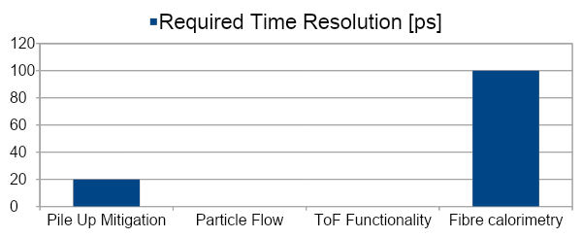
Timing ?
Timing is a wide field
A look to 2030 make resolutions between 20ps and 100ps at system level realistic assumptions
At which level: 1 MIP or Multi-MIP?
For which purpose ?
Mitigation of pile-up (basically all high rate experiments)
Support of PFA – unchartered territory
Calorimeters with ToF functionality in first layers?
Might be needed if no other PiD detectors are available
(rate, technology or space requirements)
In this case 20ps (at MIP level) would be maybe not enough
Longitudinally unsegmented fibre calorimeters
A topic on which calorimetry has to make up its mind
Remember also that time resolution comes at a price -> High(er) power consumption and (maybe)
higher noise levels
?
?

Slide 34
Calorimetry- Match Irradiation/Beam test Facilities Detector Needs
 | Energy | Irradiation
Higgs Factory CMS energy 90-1 TeV Radiation <= 10¹⁴ n_{eq/}cm² | ✓ | ✓
HL-LHC CMS energy 14 TeV (shared by partons) Radiation ~10¹⁶ n_{eq}/cm² | (✓) | ✓
Muon Collider CMS energy 3-10 TeV Radiation ~HL-LHC | x | ✓
Future Hadron Collider CMS energy 100 TeV (shared by partons) Radiation up to ~10¹⁸ n_{eq}/cm² | x | x
Message:
Beam test infrastructure is of vital need
for detector R&D
High quality detectors at future machines
need sustained support of
beam test facilities by lab managements
This costs money!

Slide 35
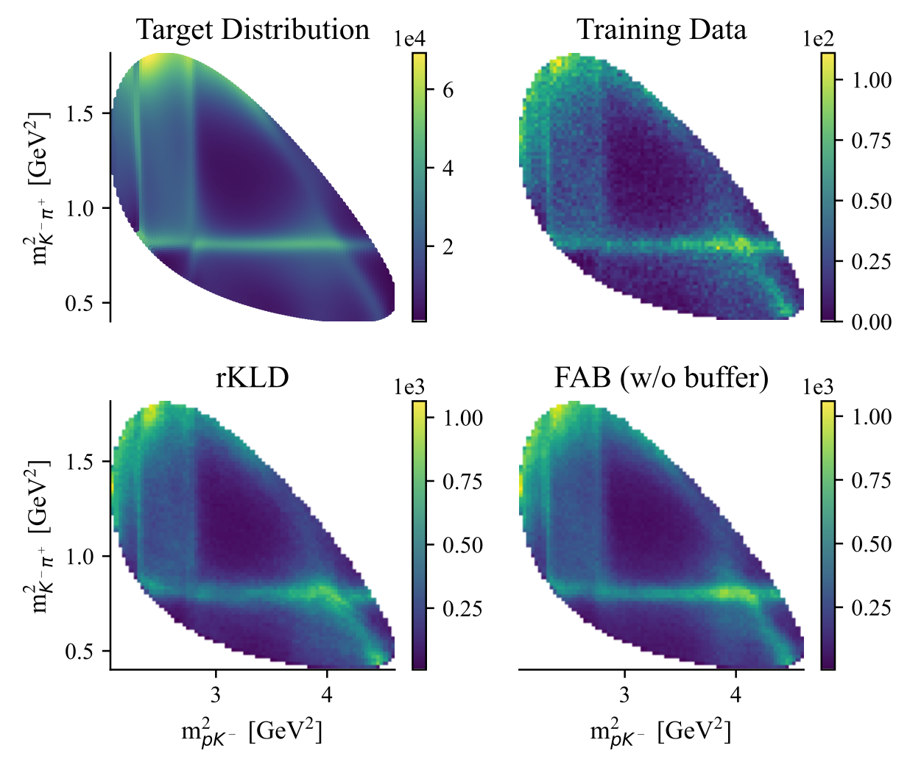
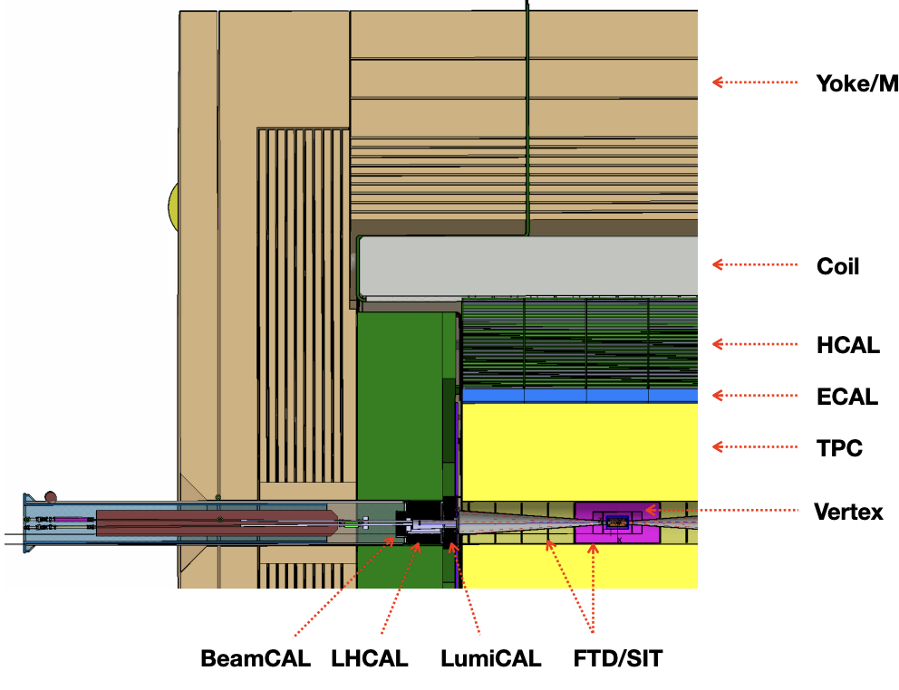
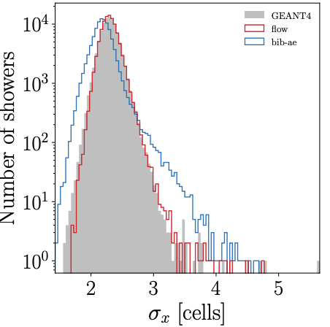
Simulation
Simulation needs ~ typically 50% ofcomputation need
Detector simulation (Geant4) but also event generation N^{(p)}LO
More data, precision physics🡺need for even more simulation
Generative models to emulate event generator and detector simulation
Physics simulator are still needed (keep them alive) to provide training data
Several orders of magnitude speed-up, but accuracy ?
Flow Annealed Bootstrap Meets Differentiable Particle Physics
Emulation of Matrix Elements for : Λ_{c}🡺p⁺K⁻π⁺
Convolutional L2Flows : Generating Accurate Showers in Highly Granular Calorimeters
Using Normalizing Flows
David Rousseau

Slide 36
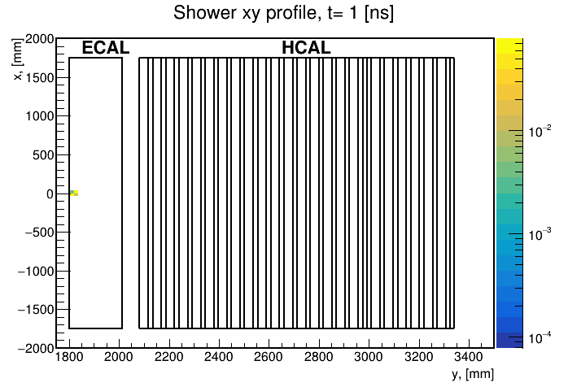
Event Reconstruction
From static pictures
to movies
Y. Padniuk, Master student
Technical University of Kiyv
Raw reconstruction (raw signals to energy deposition) : NN on FPGA (hls4ml), GPU
AI in pattern recognition with timing as additional variable
Jet tagging, particle identification
Event identification
Data Quality Monitoring
David Rousseau + R.P.

Slide 37
Experiment design
LHC experiments designed in the nineties, will take data well into thirties
AI used more and more in the full pipeline data taking, reconstruction, simulation
Can AI be used to design experiment ?
Key ingredient : auto-differentiation, to obtain the gradients of the figure-of-merits wrt experiment design parameter
Key difficulty (being overcome) inherent stochasticity of HEP detectors
Active development, see in particular Mode workshops
David Rousseau

Slide 38
Dataset
Persistent Dataset size challenge : AI can also be used for “intelligent” data compressing (allowing for losses).
(g)zip : no loss compression
mp3 : allow for losses that are inaudible to the human hear
lossy compression for example Baler: Auto-encoder-based compression of scientific datasets
To be tuned for almost zero impact on downstream physics analysis (which might not exist yet)
David Rousseau

Slide 39
Summary and outlook
EPPSU 2020 is about to be implemented
R&D needs and objectives have been summarised in the ECFA Detector Roadmap
The execution of the R&D programme will be (mainly) organised within DRDs
CERN Collaborations with worldwide participation
Goal is to achieve sustained funding for Detector R&D
An incomplete) overview on the concrete implementation has been given in this talk
Current focus is on Higgs factories
Benefit from HL-LHC upgrades (e.g. vertex detectors and ALICE ITS3)
But HL-LHC LS4 in view (e.g. LHCb SpaCal)
Should also mention CMS-HGCAL for granular calorimeters
Integrate engineering from the beginning in the R&D cycles
Next years will see the full implementation of timing in many types of detectors
Novel materials (Quantum Dots) will enter the game
AI will play an ever increasing role
Simulation, reconstruction and even detector design
Not covered but input for discussion
Instrumentation and computing should offer attractive career paths for ECR
Personal remark on AI:
It’s really fascinating but have to be careful to form physicists and not “machine learners”

Slide 40
Backup

Slide 41
Categories of R&D
F. Sefkow, CALICE Meeting and ECFA Higgs/top/EW Factory Meeting

Slide 42
Future direction of R&D - Impact of event rates
High energy e+e- colliders:
Physics rate is governed by strong variation
of cross section and instantaneous luminosity
Ranges from 100 kHz at Z-Pole (FCC-ee)
to few Hz above Z-Pole
(Extreme) rates at pole may require other
solutions than rates above pole
Event and data rates have to looked at differentially
In terms of running scenarios and differential cross sections
Optimisation is more challenging for collider with strongly varying event rates
Z-pole running must not compromise precision Higgs physics

Slide 43
Particle Flow Detector Layout
Jet energy measurement by measurement of individual particles
Maximal exploitation of precise tracking measurement
Large radius and length
to separate the particles
Large magnetic field
to sweep out charged tracks
“no” material in front of calorimeters
stay inside coil (the puristic viewpoint)
see later discussion
Minimize shower overlap
Small Molière radius of calorimeters
high granularity of calorimeters
to separate overlapping showers

Slide 44
Gaseous Tracking Systems at future colliders
Experiment / Timescale | Application Domain | Gas Detector Technology | Total detector size / Single module size | Operation Characteristics / Performance | Special Requirements/ Remarks
ILC TPC DETECTOR: STARTt: > 2035 | e+e- Collider Tracking + dE/dx | MM, GEM (pads) InGrid (pixels) | Total area: ~ 20 m2 Single unit detect: ~ 400 cm2 (pads) ~ 130 cm² (pixels) | Max. rate: < 1 kHz Spatial res.: <150µm Time res.: ~ 15 ns dE/dx: 5 % | Si + TPC Momentum resolution : dp/p < 9*10-5 1/GeV Power-pulsing
CEPC TPC DETECTOR START: > 2030 | e+e- Collider Tracking + dE/dx | MM, GEM (pads) InGrid (pixels) | Total area: ~ 2x10 m2 Single unit detect: up to 0.04 m2 | Max.rate:>100 kHz/cm2 Spatial res.: ~100µm Time res.: ~ 100 ns dE/dx: <5% | - Higgs run - Z pole run - Continues readout - Low IBF and dE/dx
FCC-ee and/or CEPC IDEA CENTRAL TRACKER START: >2030 | e+e- Collider Tracking/ Triggering | He based Drift Chamber | Total volume: 50 m3 Single unit detect: (12 m2 X 4 m) | Max. rate: < 25 kHz/cm2 Spatial res.: <100 µm Time res.: 1 ns Rad. Hard.: NA | Particle sepration with cluster counting at 2% level
SUPER-CHARM TAU FACTORY START: > 2025 | e+e- Collider Main Tracker | Drift Chamber | Total volume: ~ 3.6 m3 | Max. rate: 1 kHz/cm2 Spatial res.: ~100 µm Time res.: ~ 100 ns Rad. Hard.: ~ 1 C/cm
SUPER-CHARM TAU FACTORY START: > 2025 | e+e- Collider Inner Tracker | Inner Tracker / (cylindrical μRWELL, or TPC / MPDG read. | Total area: ~ 2 - 4 m2 Single unit detect: 0.5 m2 | Max. rate: 50-100 kHz/cm2 Spatial res.: ~<100 µm Time res.: ~ 5 -10 ns Rad. Hard.: ~ 0.1-1 C/cm2 | Challenging mechanics & mat. budget < 1% X0
ELECTRON-ION COLLIDER (EIC) START: > 2025 | Electron-Ion Collider Tracking | Barrel: cylindrical MM, μRWELL Endcap: GEM, MM, μRWELL | Total area: ~ 25 m2 | Luminosity (e-p): 1033 Spatial res.: ~ 50- 100 um Max. rate: ~ kHz/cm2 | Barrel technical challenges: low mass, large area Endcap: moderate technical challenges

Slide 45
CMOS Sensors in use or development
Name | Expt | Sub-syst | Area | Δ Pos., Time | Power (fid.) | Technology | Comment
ALPIDE | ALICE-ITS2 | Vx & In. Trkr | 10 m² | 5 µm, ≤ 10 µs | ≤ 50 mW/cm² | TJsc 180 nm EPI | In operation
MOSAIX | ALICE-ITS3 | Vx only | 0.12 m² | 5 µm, 2-10 µs | ≤ 40 mW/cm² ? | TPSco 65 nm EPI | Wafer scale CPS
FASTPIX | → HL-LHC | Demonstr. |  | ≥ 1 µm, ≤ 100 ps | +++ | TJsc 180 nm EPI | Timing & Rad. Tol.
MonoPix | → ATLAS | ITk | few m² | < 10 µm, ≤ 20 ns | > 0.5 W/cm² | TJsc 180 nm EPI | Not retained
CACTUS | FCC, eIC, … | Timing det. | few m² | < 100 ps | < 300 mW/cm² | LF 150 nm | Proto., 1 mm² pixels
MALTA | HL-LHC, … | Fast det. | few m² | 36x40 µm², 25 ns | > 100 mW/cm² | TJsc 180 nm EPI | 512x512 pixels
MIMOSIS | CBM/FAIR | Vx & In. Trkr | 0.16 m² | 5 µm, 5 µs | < 100 mW/cm² | TJsc 180 nm EPI | Fixed target HI expt
TaichuPix | CEPC | Vx & In. Trkr |  | ≤ 5 µm | 90-160 mW/cm² | TJsc 180 nm EPI | 8x8 µm² n-well
NAPA | SiD/C3 | Trkr, (calo.) |  | 7µm pitch, O(ns) | 20 mW/cm² | TPSCo 65 nm EPI | Target values
ARCADIA | IDEA/FCCee | Vx & In. Trkr |  | 10-50 µm |  | LF 110 nm | Working horse
CLICpix | CLICdp | Vx & In. Trkr |  | 25 µm pitch, 10 ns |  | TPSCo 65 nm EPI | Follows TimePix
OBELIX | Belle-II | Vx (7 layers) | O(1) m² | ≤ 10 µm, ≤ 100 ns | ≈ 200 mW/cm² | TJsc 180 nm EPI | Follows MonoPix
MuPix | Mu3e expt | Vx & Trkr |  | ≤ 30 µm, ≤ 20 ns | ≤ 350 mW/cm² | HV TJsc 180 nm | Fixed target expt
Courtesy of Marc Winter

Slide 46
A TPC at FCCee?
Count number of primary ions (that stay in TPC for long time, ~0.44s)
Main source of background: Beamstrahlung many low energy e+e- pairs due to quadropole
moment of beam => focusing effect
Per bunch crossing more for more (more focusses) Linear Collider, here ILC
Accumulation due to high repetition frequency at circular colliders
MDI for FCC increase background significantly compared to MDI for ILC
Daniel Jeans
Preliminary results

