Slide 1
GATE Simulation for Sub-0.5 mm Resolution PET
2024 IEEE NSS/MIC in Tampa
GATE User Meeting
Han Gyu Kang¹, Hideaki Tashima¹, and Taiga Yamaya¹
1. National Institutes for Quantum Science and Technology (QST), Japan
kang.hangyu@qst.go.jp
Date: Thursday, 31-Oct-2024
Time: 12:15-12:30 (12 min presentation + 3 min Q&A)
Place: 105&106
Session: GATE User Meeting
Notes:
Good afternoon. I’m Han Gyu Kang, a researcher at QST in Japan.
It is my great pleasure to present my research works in this session.
The title of my presentation is “GATE Simulation for sub-0.5 mm resolution PET”.

Slide 2
Outline
Factors affecting PET resolution
Optimal design of a sub-0.5 mm resolution PET
Preliminary experimental results
Front-end electronics
PET gantry design
Conclusions
Notes:
Here is the outline.
First, I’ll explain the factors affecting PET resolution.
Second, I’ll present the optimal design of a sub-0.5 mm resolution PET.
Third, I’ll be presenting the preliminary experiment results such as front-end electronics and PET gantry design.
Lastly, I’ll summarize my presentation and discuss the future plan

Slide 3
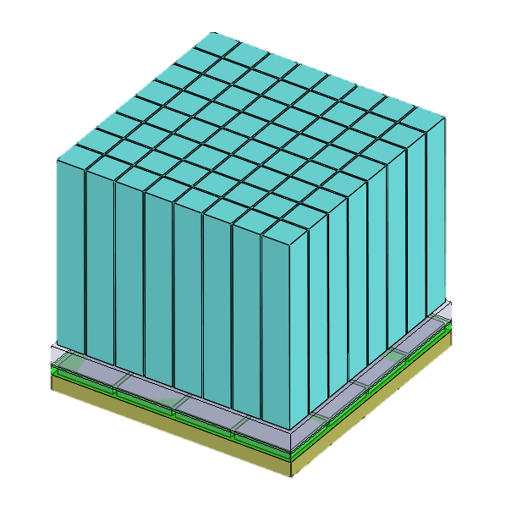
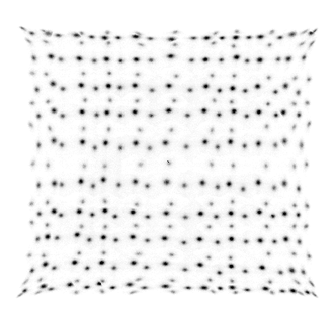
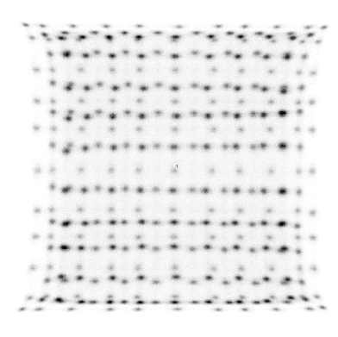
Factors affecting the PET resolution^{[1]}
Photo sensor
② Acollinearity
Crystal
Scintillation detector
④ Crystal pitch
③ Parallax error
⑤ Block effect
ESR
Crystal
BaSO₄
Ring diameter
β⁺
e⁻
① Positron range
Photo sensor
β⁺
Positron
e⁻
Multiplexing
Electron
Annihilation（511 keV）
A PET scanner that considered these factors
$$Resolution=1.25\sqrt{{\left(Positron range\right)}^{2}+{\left(Acollinearity\right)}^{2}+{(Parallax error)}^{2}+ {\left(Crystal pitch/2\right)}^{2}+{\left(block effect\right)}^{2}}$$
¹⁸F
Small ring diameter
(e.g. <50 mm)
Depth encoding
(e.g. 3-layer)
Fine crystal pitch
(e.g. <1 mm)
Opaque reflector
(e.g. BaSO₄)
Solution>
0.1 mm FWHM
[1] Moses 2010 NIMA
Notes:
This slide illustrates the factors affecting the PET resolution.
PET resolution is defined as a convolution of several different factors as shown in this equation.
The first factor is the positron range which has about 0.1 mm in full width at half maximum for F-18.
The second factor is acollinearity which can be reduced by using small ring diameter of less than 50 mm.
The third factor is parallax error, in which the radial resolution is blurred at the periphery of a PET FOV.
The parallax error can be reduced by using depth encoding detectors such as staggered 3-layer configuration.
The most important factor is the crystal pitch, which dominates the overall PET resolution.
The PET resolution can be substantially enhanced by using fine crystal pitch of 1 mm or even smaller.
To encode a large amount of finely pixelated crystal array, multiplexing readout is commonly used.
However, for multiplexing readout, the block effect arises thereby degrading the crystal decoding accuracy.
The block effect can be effectively reduced by using optically opaque reflector such as barium sulfate powder rather than using the ESR film.
Last year, we developed a PET scanner that addressed these issues to achieve submillimeter-resolution.

Slide 4
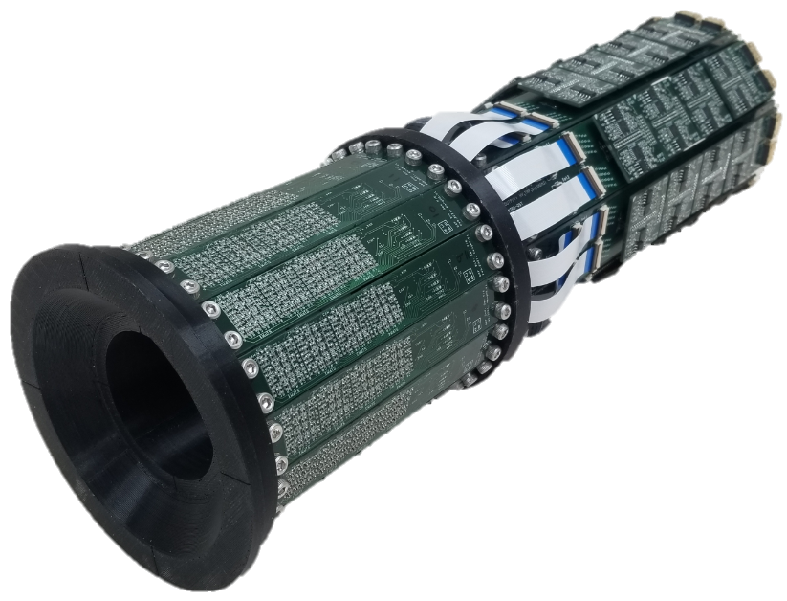
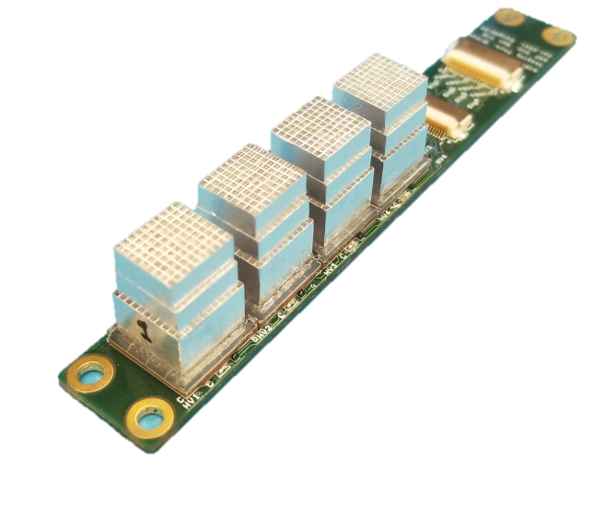
SR-PET achieved 0.55 mm resolution (2022 MIC)
PET image
SR-PET (Submillimeter-Resolution PET)^{[2]}
0.8
Goal: Design of a Sub-0.5 mm Resolution PET
0.75
0.85
Pitch=1 mm
1st layer
2nd layer
0.55
0.45
3rd layer
Axial FOV
=51.5 mm
0.5
SR-PET achieved the 0.55 mm resolution
Sub-0.5 mm resolution was NOT achieved due to
Large crystal pitch
Unoptimized crystal layer
[2] Kang et al., 2023 Journal of Nuclear Medicine
Crystal pitch = 1 mm
Crystal layer = 4+4+7 mm (1st+2nd+3rd)-> DOI
Notes:
The submillimeter-resolution PET, which is named as SR-PET has a 1 mm crystal pitch.
The 3-layer LYSO crystal arrays were stacked with staggered configuration to encode DOI information.
With the SR-PET, a resolution approaching 0.5 mm was achieved in a phantom study.
However, sub-0.5 mm resolution was not achieved due to the large crystal pitch and unoptimized crystal layer.
Therefore, the goal of this study is to design a sub-0.5 mm resolution PET by optimizing the crystal pitch and crystal layer configuration.

Slide 5
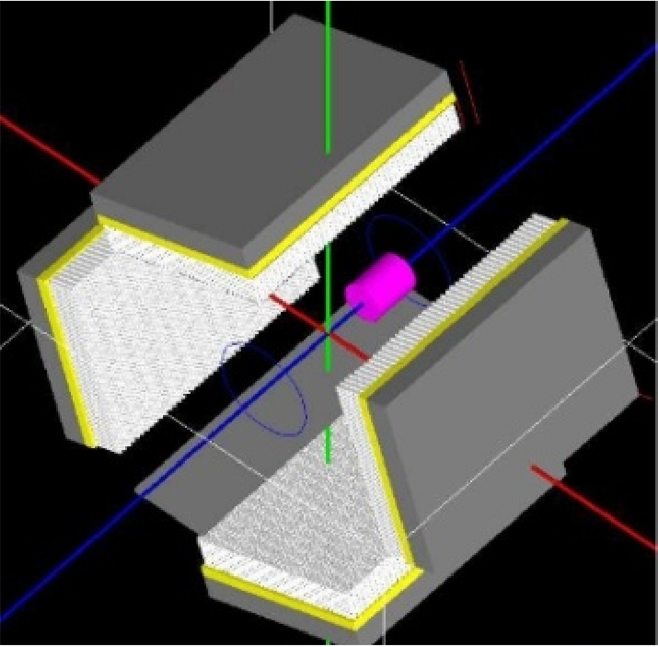
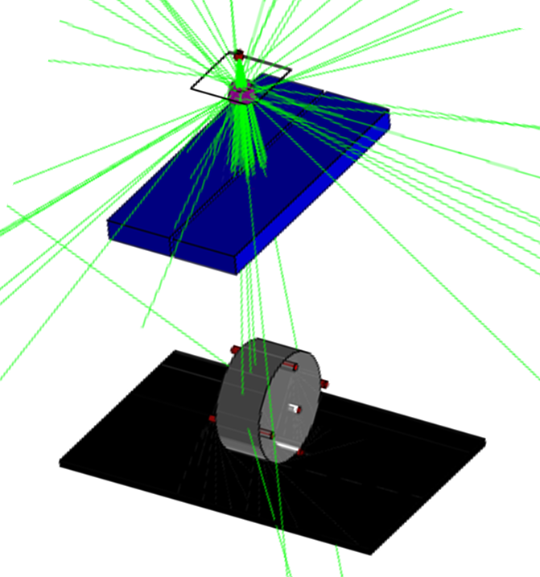
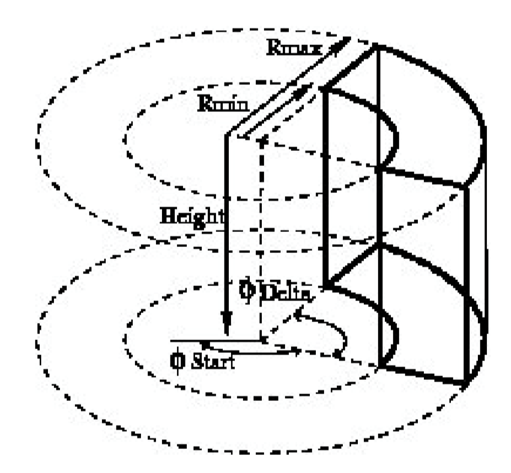
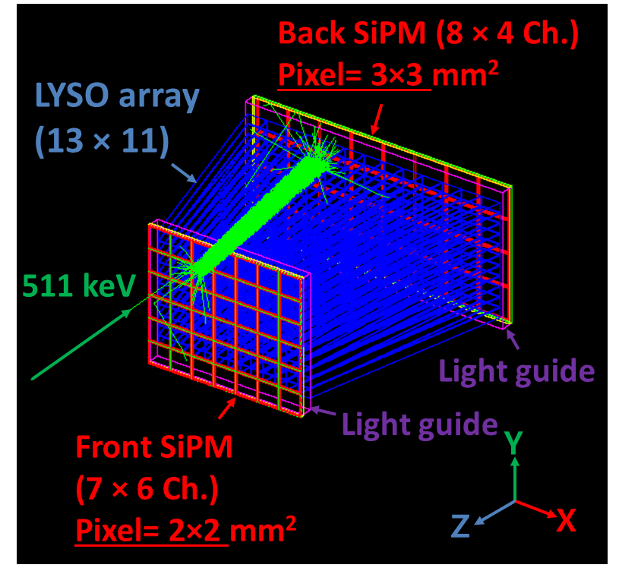
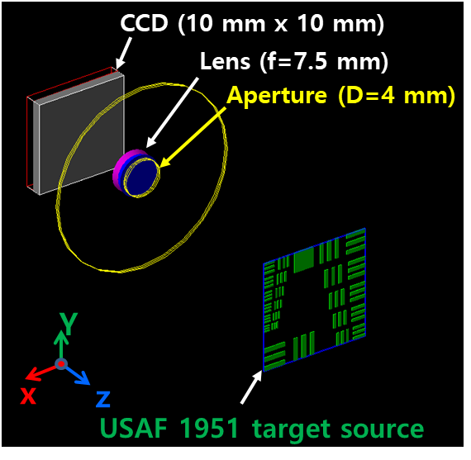
Predefined PET systems in GATE
SPECThead
ECAT
CylindricalPET
PETscanner
CTscanner
Scanner
Optical System
SPECThead
ecat
cylindricalPET
PETscanner
CTscanner
scanner
OpticalSystem
crystal
block
rsector
level1
module
level1
crystal
pixel
crystal
module
level2
cluster
level2
pixel
crystal
level3
pixel
level3
layer0
level4
level4
layer1
level5
level5
No DOI
2-layer DOI
3-layer DOI
Notes:
GATE provides various types of predefined PET systems such as ECAT, CylindricalPET and PET scanner.

Slide 6
Predefined PET systems in GATE
SPECThead
ECAT
CylindricalPET
PETscanner
CTscanner
Scanner
Optical System
SPECThead
ecat
cylindricalPET
PETscanner
CTscanner
scanner
OpticalSystem
crystal
block
rsector
level1
module
level1
crystal
pixel
crystal
module
level2
cluster
level2
pixel
crystal
level3
pixel
level3
layer0
level4
level4
layer1
level5
level5
PETscanner was used for 3-layer DOI PET
Notes:
Here, we used the “PETscanner” for the simulation of the 3-layer DOI PET scanner.

Slide 7
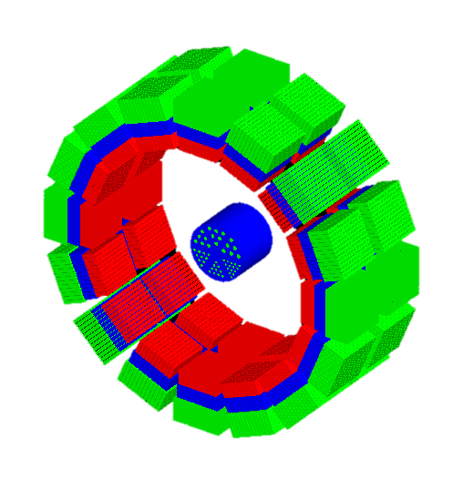
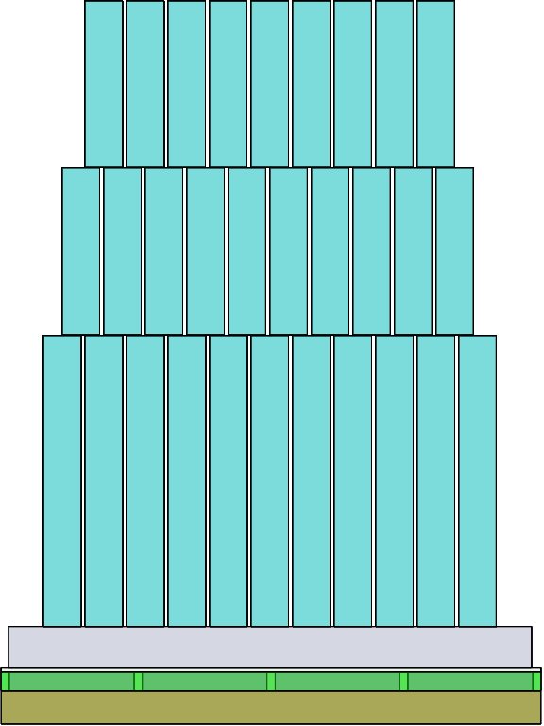
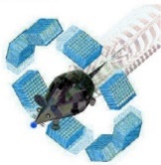
From GATE simulation to image reconstruction
Goal: Optimization of a DOI PET geometry
GATE PET simulation
Block (level1ID)
1st (level2ID)
2nd (level3ID)
Image Reconstruction
(In house software*)
3rd (level4ID)
Reconstructed PET image
10 mm
ROOT output
0.8
0.75
0.85
List-mode data
Block ID
Crystal ID
DOI ID
0.55
0.45 mm
0.5
Custom-written code
E.W=440-560 keV
GATEv9.1
*Developed by Dr. Hideaki Tashima (QST)
Notes:
This slide shows the procedure from the GATE simulation to image reconstruction.
First, we conducted the GATE PET simulation with 3-layer DOI detector configuration.
Second, the ROOT output file was imported by using a custom-written ROOT code to generate list-mode data.
An energy window of 440 to 560 keV was used.
Lastly, the list-mode data were reconstructed by using an in-house software developed in our lab.

Slide 8
Sub-0.5 mm resolution PET design
Notes:
First, let me describe PET design.

Slide 9
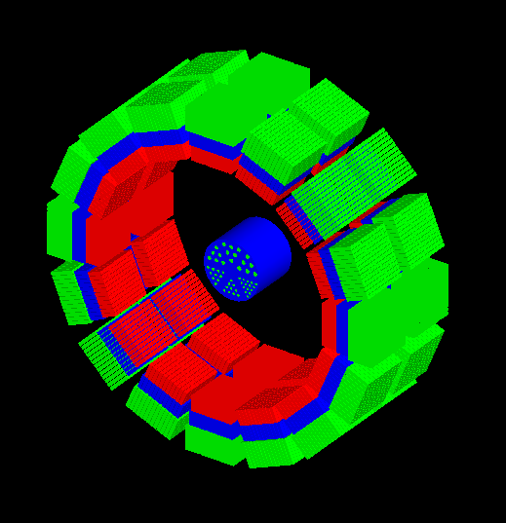
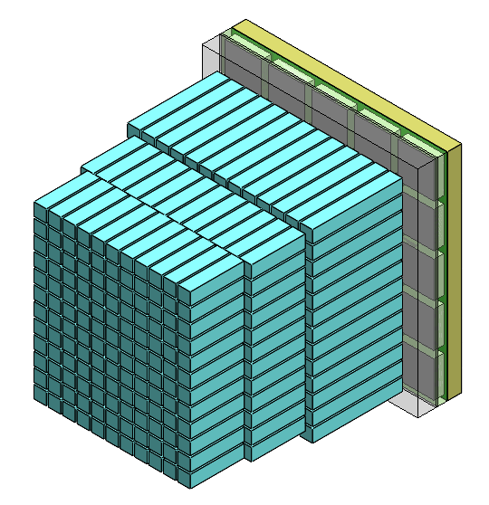
Sub-0.5 mm resolution PET
<3D view of the PET>
<Staggered 3-layer DOI detector>
SiPM (5 × 5 array)
Lightguide
2.4 mm
14×14
13×13
Phantom
13×12
LYSO array
3rd layer
Crystal pitch
=0.8 mm
2nd layer
ID=48 mm
23.4 mm
1st layer
Notes:
The PET scanner has an inner diameter of 48 mm and axial coverage of 23.4 mm.
The PET scanner has two rings, each of which has 16 DOI detectors.
Each DOI detector consists of 3-layer LYSO crystal array to encode DOI information.
The crystal pitch was 0.8 mm to achieve sub-0.5 mm resolution.
The 3-layer LYSO array was optically coupled to an SiPM 5x5 array with a pitch of 2.4 mm.
A 1 mm thick lightguide was inserted between the crystal and SiPM.

Slide 10
Crystal layer designs
(A) 4+4+7 mm
(B) 3+4+4 mm
(C) 3+3+5 mm
1st layer
4 mm
15 mm
1st layer
1st layer
2nd layer
4 mm
3 mm
3 mm
11 mm
11 mm
2nd layer
4 mm
2nd layer
3 mm
3rd layer
7 mm
3rd layer
4 mm
3rd layer
5 mm
SiPM 5×5 array
SiPM 5×5 array
SiPM 5×5 array
Notes:
We used three different crystal layer designs.
The first design-A has the crystal thickness of 4, 4 and 7 mm for the 1st, 2nd, and 3rd layers thereby resulting a total thickness of 15 mm.
The second design-B has the crystal thickness of 3, 4 and 4 mm, resulting in a total thickness of 11 mm.
The design-C has the crystal thickness of 3, 3 and 5 mm for the 1st, 2nd, and 3rd layers.
The relatively short crystal thickness was used for the design B and C to improve the DOI resolution at the expense of sensitivity.
The crystal thickness of each layer was chosen to make a uniform detection efficiency for each layer.

Slide 11
Spatial resolution
Notes:
Let me move on to spatial resolution

Slide 12
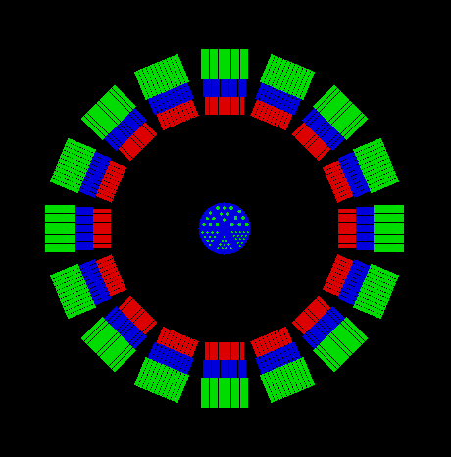
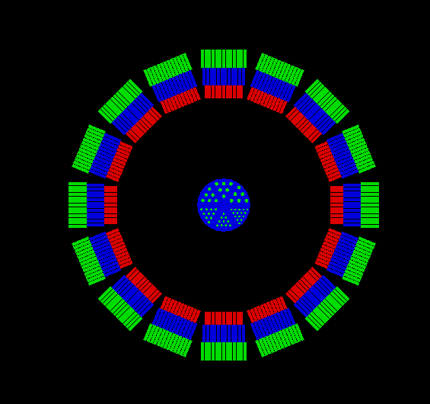
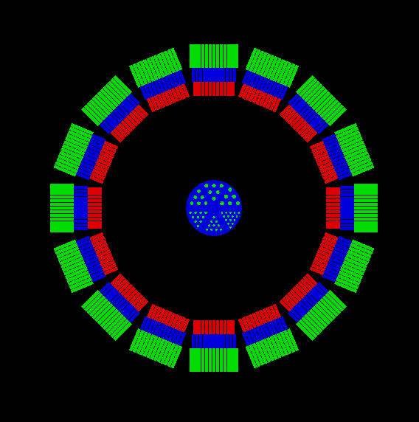
Spatial resolution with the NEMA ²²Na sources
(A) 4+4+7 mm
(B) 3+4+4 mm
(C) 3+3+5 mm
5 mm
²²Na source
²²Na source
²²Na
15 mm
15 mm
15 mm
11 mm
48 mm
11 mm
48 mm
15 mm
52.5 mm
Sensitivity
5.34%
3.99%
4.07%
E.W=440-560 keV
Notes:
The spatial resolution was evaluated by using a NEMA Na-22 source with a diameter was 0.25 mm.
The Na-22 sources were placed from the center to radial offset position of 15 mm with a spacing of 5 mm.
The spatial resolution was evaluated for three different crystal layer designs of A, B, and C.

Slide 13
Spatial resolution (FBP)
(a) NEMA ²²Na sources images
(b) Radial resolution with FBP
Rad. Offset [mm]
0
5
10
15
(A) 4+4+7 mm
(A)
(B) 3+4+4 mm
(B)
(C)
(C) 3+3+5 mm
1D Line profiles
FWHM
The design (C) resulted in the best spatial resolution of 0.72 mm at radial offset of 5 mm
Voxel size = 0.2×0.2×0.2 mm³
Notes:
The PET images were reconstructed with FBP algorithm for three different crystal layer designs.
A line profile was extracted from the FBP images. Then, full width at half maximum was calculated from the line profiles.
The right figure shows the radial resolution as a function of radial offset.
The design-C resulted in the best spatial resolution over the design-A and –B.
The spatial resolution was 0.72 mm at the radial offset of 5 mm.
Therefore, we chose the design-C as the optimal crystal layer design.

Slide 14
Resolution Phantom with Design (C) 3+3+5 mm
<3D view of the PET>
Phantom dimension
0.8
0.75
0.85
Phantom
10 mm
0.55
11.9 mm
0.45 mm
11.9 mm
0.5
ID=48 mm
23.4 mm
Total activity of ¹⁸F= 0.95 MBq
Acquisition time = 10 min
Notes:
To evaluate imaging performance with the design-C, a resolution phantom was placed at the center of the FOV.
The phantom has an outer diameter of 11.9 mm, and axial length of 10 mm.
The resolution phantom has 6 different sections, and the smallest rod diameter was 0.45 mm.
All the rods of the phantom were filled with 18F of 0.95 MBq.
The acquisition time was 10 min.

Slide 15
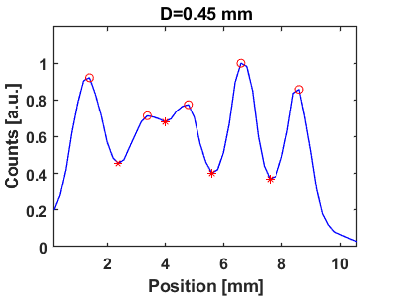
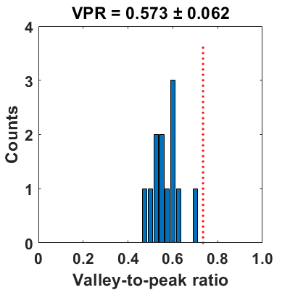
Resolution Phantom with Design (C) 3+3+5 mm
Reconstructed PET image
Line profiles (D=0.45 mm)
VPR histogram
10 mm
Reyleigh criterion (i.e. VPR=0.735)
0.8
Peak
12
0
0.85
Resolvability = 100%
0.75
0.55
Valley
0.45
0.5
Valley-to-peak ratio (VPR) = 0.543
VPR=0.573±0.062
Well below the 0.735 (Rayleigh criterion^{[3]})
Subset=8
Iterations=50
[3] Hellen et al., 2020 PMB
Notes:
PET images were reconstructed by using OSEM algorithm with 8 subsets and 50 iterations.
In the reconstructed PET image, all the rods can be clearly identified.
For quantitative evaluation of spatial resolution, a line profile was extracted for the 0.45 mm rod diameter.
The valley-to-peak ratio was 0.543, which was well below the Rayleigh criterion.
If the valley-to-peak ratio is under the Rayleigh criterion, the line profile is resolvable.
The line profiles were obtained for all rods in three different orientations and valley-to-peak ratio histogram was obtained.
As you can see, all the 12 line profiles can be resolved with an average valley-to-peak ratio of 0.573 thereby resulting in a 100% resolvability.
Iteration = 50
3+3+5 mm (P=0.8 mm)
PET Mouse Phantom (F-18), 10 min

Slide 16
Preliminary experimental results
Notes:
Based on the simulation results, we recently started to develop a prototype PET scanner.

Slide 17
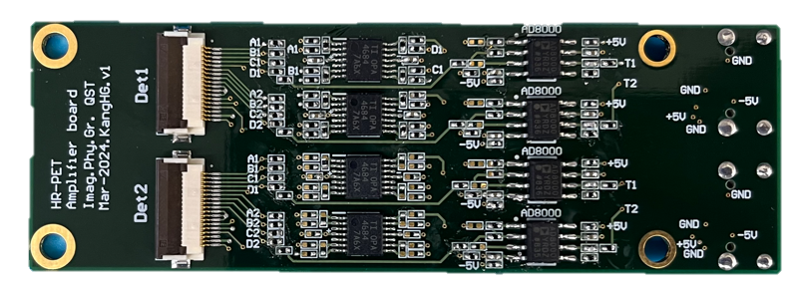
Front-end electronics
Amplifier board
miniHDMI
Front-end board
Flexible Flat Cable
2.4 mm
DAQ
Power
Top
14 mm
SiPM5×5
SiPM5×5
Resistive network
SiPM biasing
A
Anode 25 Ch
B
Cathode (+HV)
Position
4×4=16 ch
Timing
4×1=4 ch
Bottom
SiPM
Anode (Signal)
Pole-zero-cancellation circuit
D
C
Rf
Rpz
Timing signal
Rg
-
Output
Input
+
50Ω
200 mV
AD8000
Cpz
200 ns
<150ns
Notes:
The front-end board has SiPM5x5 array with a pitch of 2.4 mm.
The SiPM bias was applied to a common cathode and signals were extracted from anode.
The 25 anode signals were multiplexed into 4 positional signals by using a resistive network.
The multiplexed signals were transferred to an amplifier board via flexible flat cable.
The position signals were amplified with quad channel amplifiers.
The timing signals were amplified by using a fast amplifier followed by a pole-zero-cancellation circuit to obtain fast decay time of less than 150 ns.
The amplified signals were transferred to a DAQ via miniHDMI cables.
The power lines were supplied by using the same cables.

Slide 18
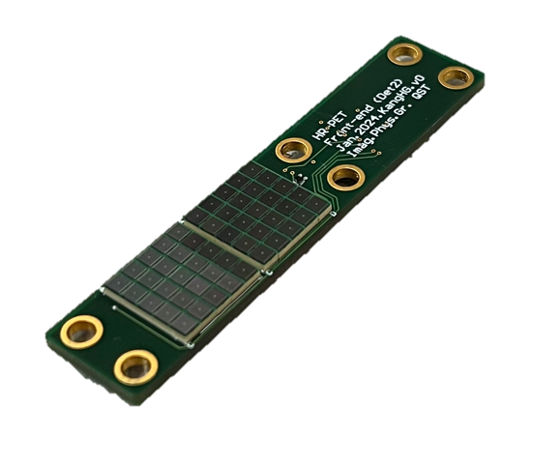
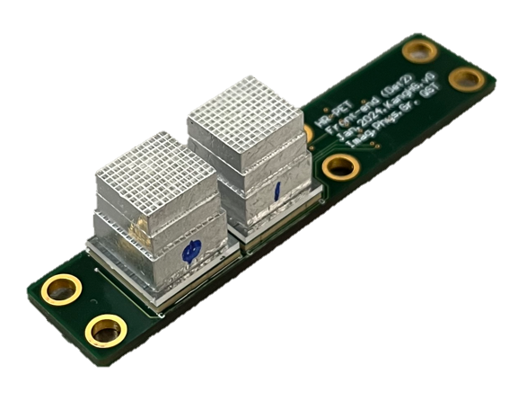
Staggered 3-layer DOI detector
<SiPM with front-end board>
<Staggered 3-layer DOI detector>
LYSO 3-layer
SiPM
5×5
Pitch=0.8 mm
Pitch=
2.4 mm
1st layer
2nd layer
3rd layer
12.5 mm
14 mm
Acrylic lightguide
(12.2×12.2×1 mm³)
Notes:
Two LYSO 3-layer arrays were mounted on top of the SiPM.
A 1 mm thick lightguide was inserted between the crystal and SiPM.

Slide 19
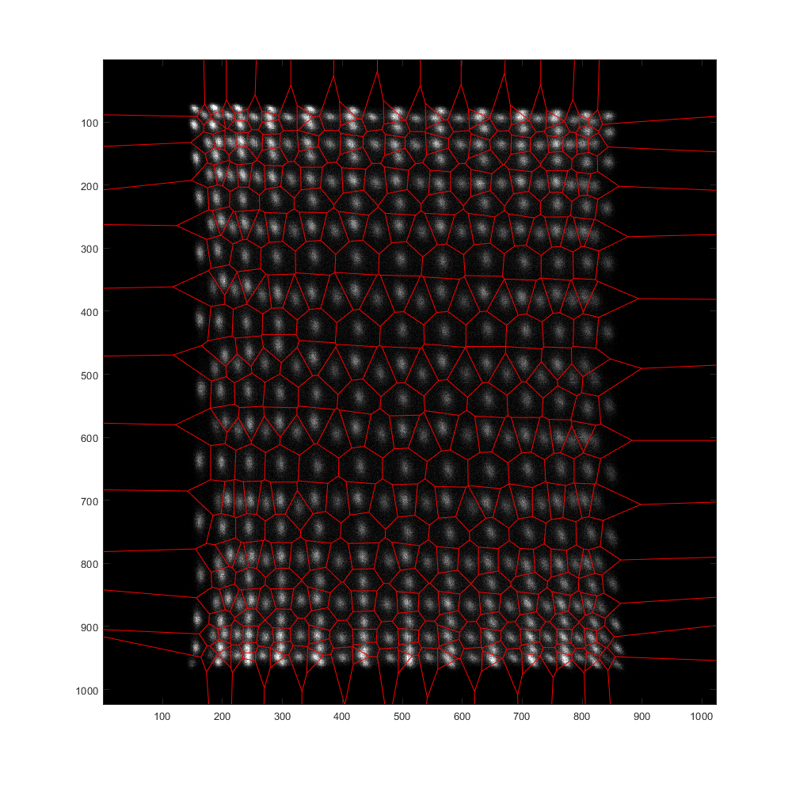
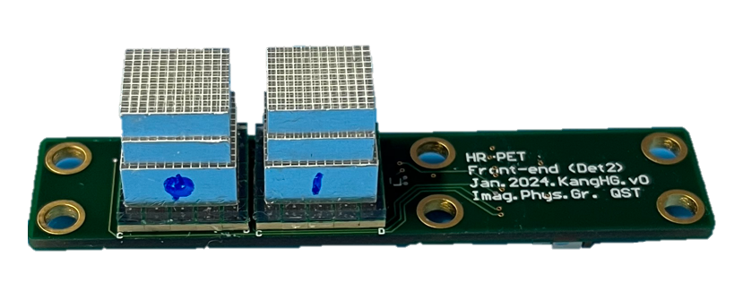
Crystal map (Experiment)
²²Na
Crystal map
511 keV
Pitch=0.8 mm
1st layer
3rd layer
2nd layer
3rd layer
2nd layer
1st layer
Front-end
The crystal map of a 3-layer LYSO crystal array with 0.8 mm pitch was well identified.
Notes:
Currently, the front-end electronics are under development.
We plan to develop a full-ring PET system within this year.

Slide 20
Conclusions
The optimal design of sub-0.5 mm resolution PET was investigated
The design (C) 3+3+5 mm resulted in the best spatial resolution
The 0.45 mm rod structure can be resolved clearly
Design (C)
Phantom image
1st layer
3 mm
0.8
2nd layer
3 mm
0.75
0.85
3rd layer
5 mm
0.55
0.45
0.5
Notes:
Let me summarize my presentation.
The optimal design of sub-0.5 mm resolution PET was investigated.
The design-C resulted in the best spatial resolution.
The 0.45 mm rod structure can be resolved clearly with the optimized design-C.

Slide 21
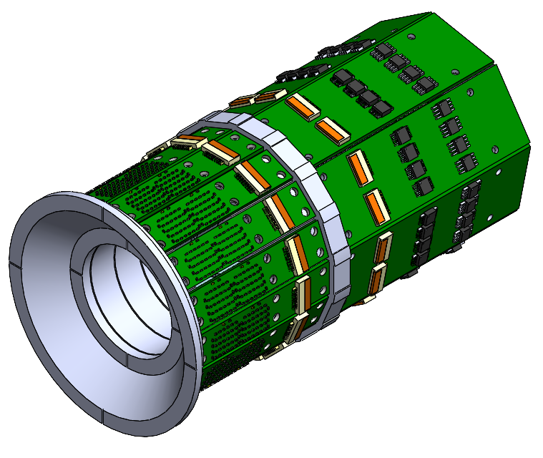
Progress of the PET development
GATE simulation
Front-end development
3D CAD gantry design
Amplifier
Front-end
Phantom
ID=48 mm
23.4 mm
Optimize the crystal layer
Optimize the PET detector
Notes:
Based on the GATE simulation, a PET detector was developed and gantry design was finished.
Next year, I would like to show you the imaging performance of the proposed PET scanner.

Slide 22
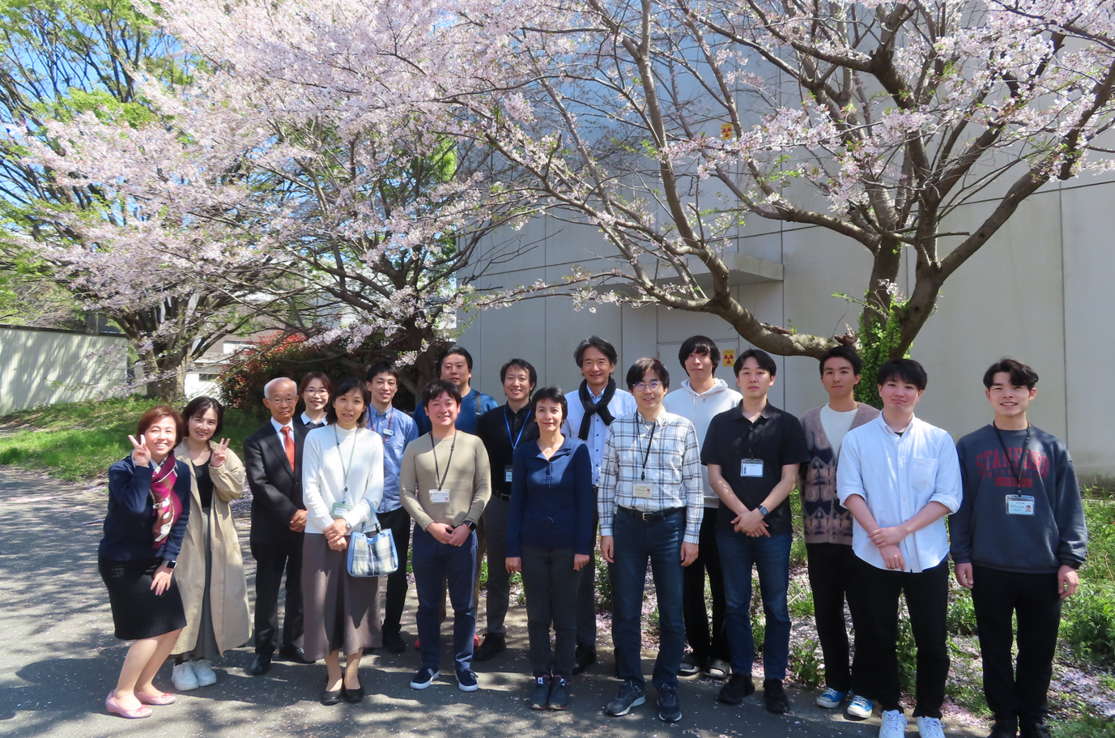
Thank you for your kind attention!
April-2024 in QST
2024 Imaging Physics Group
Yamaya
Tashima
HanGyu
17/17
Notes:
This is end of my presentation.
Thank you for your kind attention.

Slide 23
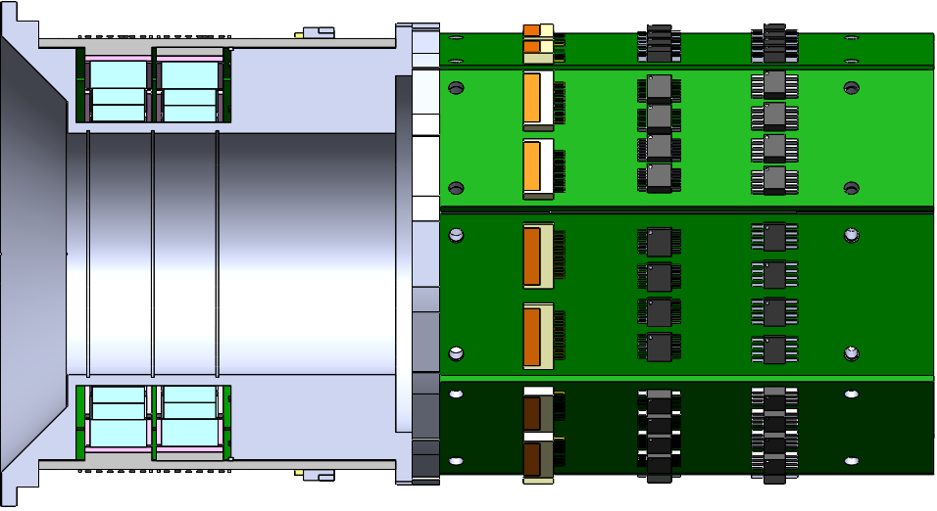
Design of the HR-PET
(a) Front view
Signal (18 pin)
(b) Cutaway side views
HV&TMP(18 pin)
Front-end board
Amplifier board
LYSO
FOV
44 mm
OD=92 mm
1
2
48 mm
23.4 mm
3D printed jig
OP-AMP
Mini-HDMI
Notes:
The SR-PET scanner has an inner diameter of 52.5 mm, and the crystal thickness of 15 mm.
The number of blocks is 16, each of which consists of 3-layer LYSO array.
The number of rings is 4, thereby resulting in an axial FOV of 51.5 mm.
The bore diameter is 48 mm, and the outer diameter is 107 mm.
The PET scanner consists of front-end board and amplifier board.
The SiPM signals and power lines were transferred by using flexible flat cables.

