Slide 1


A Digital Twin of the Biograph Vision Quadra Long Axial Field of View PET/CT:
Monte Carlo Simulation, Image Reconstruction Framework and Clinical Applications
Wenhong Lan¹, Ezzat Elmoujarkach², Christian Pommranz^{3,4}, Hong Phuc Vo², Jorge Cabello⁵, Pia Linder¹,
Julia Mannheim⁴, Andrea Santangelo³, Maurizio Conti⁵, Christian la Fougère^{1,6}, Magdalena Rafecas², Fabian Schmidt^{1,4}
¹ Department of Nuclear Medicine and Clinical Molecular Imaging, University Hospital Tübingen, Germany; ² Institute of Medical Engineering, University of Lübeck, Germany; ³ Institute for Astronomy and Astrophysics, University of Tübingen; ⁴ Werner Siemens Imaging Center, Department of Preclinical Imaging and Radiopharmacy, University of Tübingen; ⁵ Siemens Medical Solutions USA, Inc., Knoxville, TN, USA; ⁶ Cluster of Excellence iFIT (EXC 2180) “Image Guided and Functionally Instructed Tumor Therapies”, University of Tübingen;

Slide 2
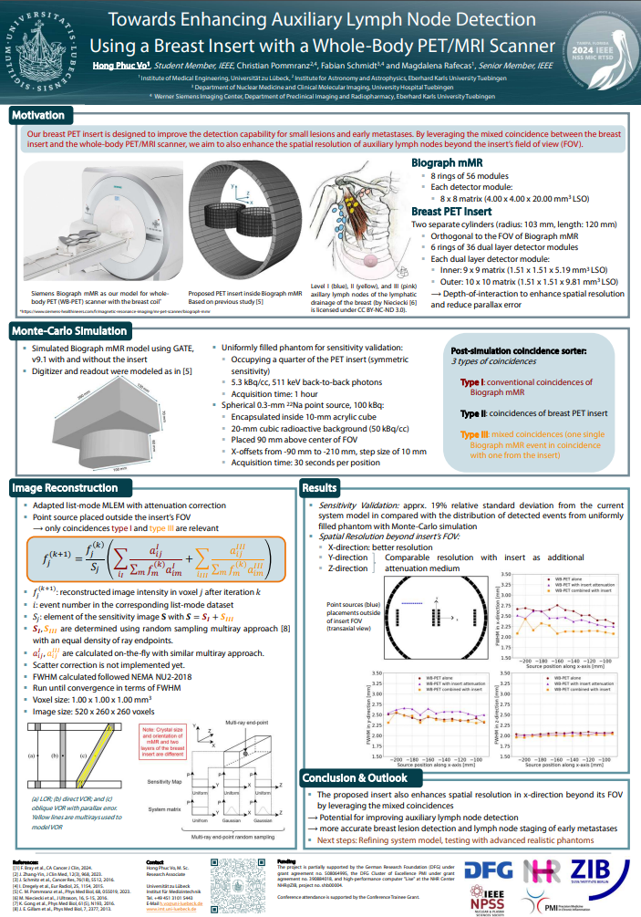
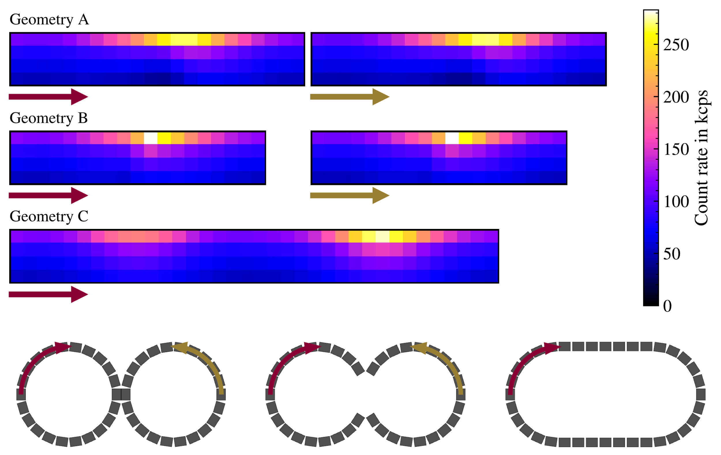
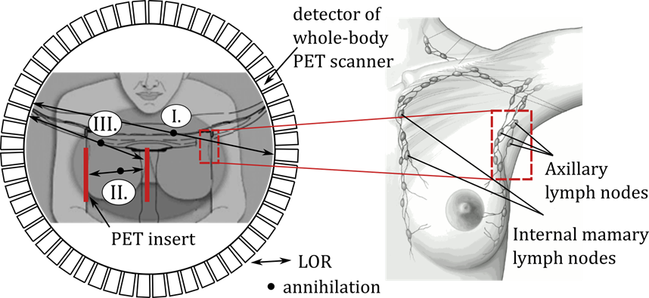
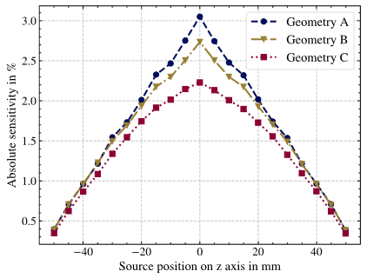
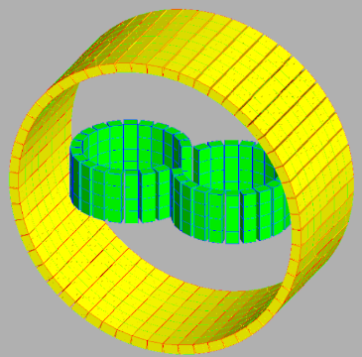
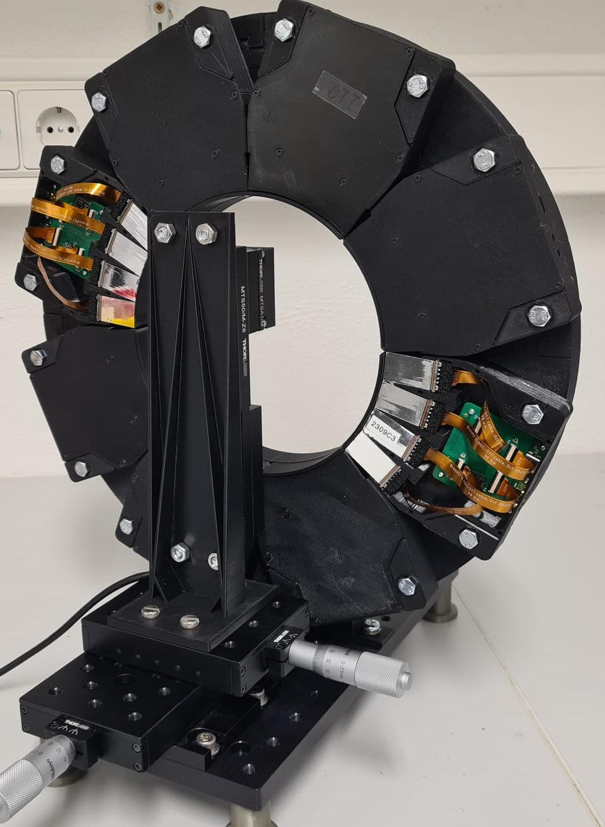

Motivation
Simulation scenario A) Development of new systems (predict behaviour)
More Details, Please visit us (H. P. Vo) ☺
Session: M-03, MIC Poster Session
Date & Time: Wednesday, 30.10.2024 - 14:00
Poster Number: M-03-058
Location: East / Central Hall
Pommranz, PMB 2023
Notes:
Add wsic + UZL logo + Hong Poster number and presentation time

Slide 3
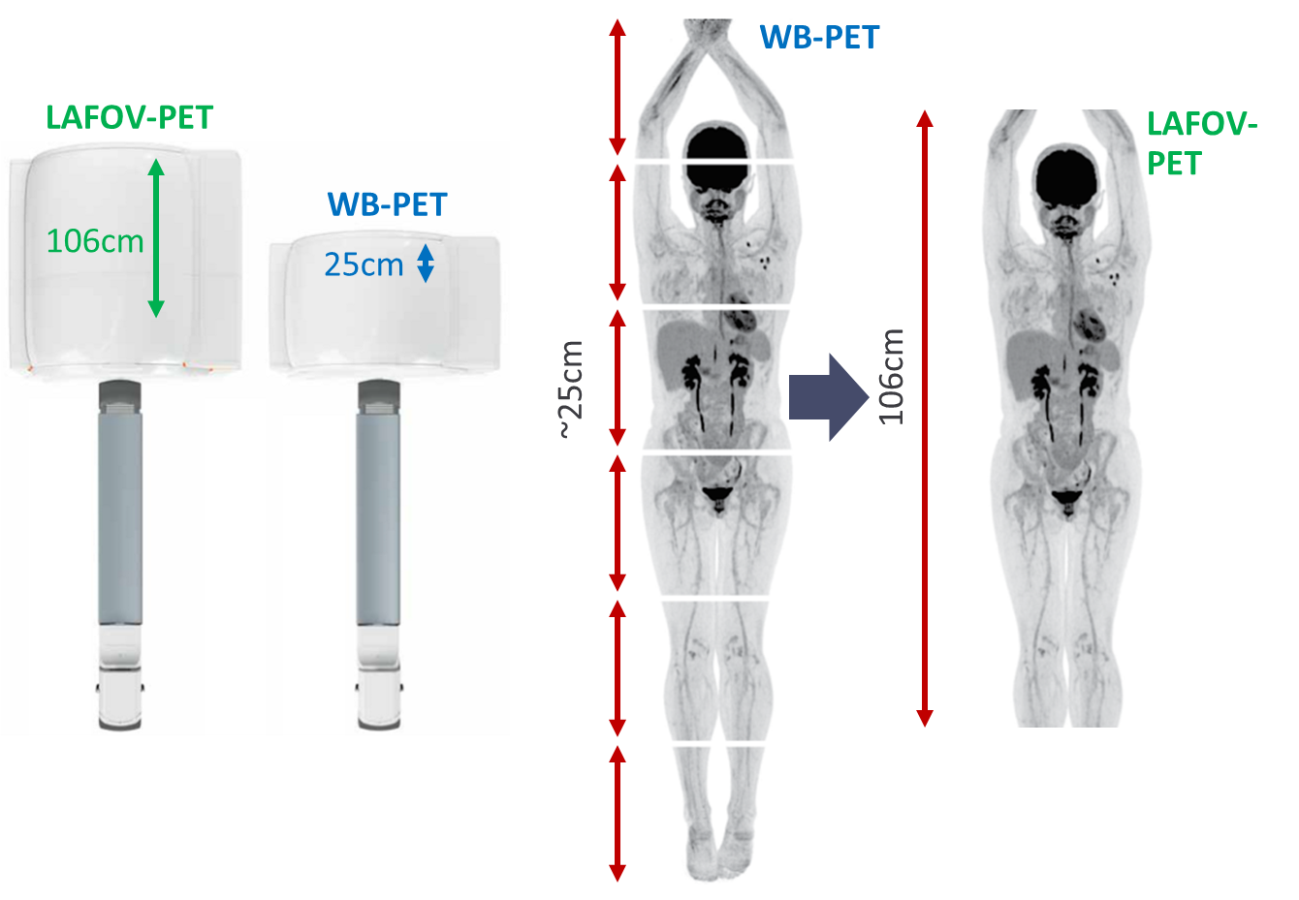
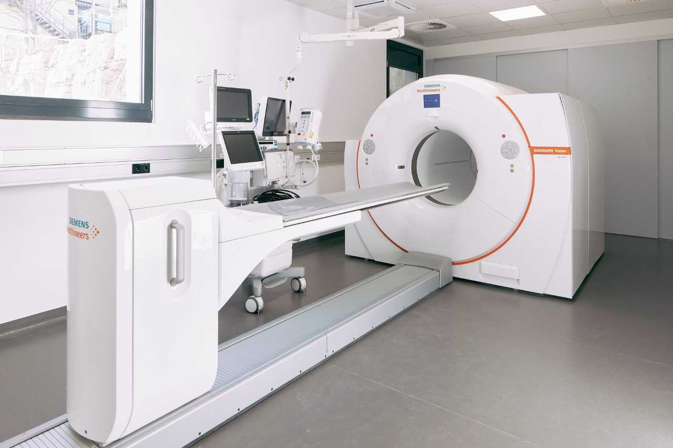
Motivation
B) Accurate Model of existing system (mimic behaviour)
Biograph Vision Quadra LAFOV PET/CT
at University Hospital Tuebingen
axial FOV: 106 cm
Sensitivity: 176 kcps/MBq
Timing Resolution: 230 ps

Slide 4
Motivation
B) Accurate model of existing system (mimic behaviour)
Overcome limitation of real patient examinations (e.g. repetitions, dose, examination time)
Provide "non-measurable" ground truth information (e.g. event characteristic, motion free reference, dose deposition)
Biograph Vision Quadra LAFOV PET/CT
at University Hospital Tuebingen

Slide 5
Digital Twin + Validation

Slide 6

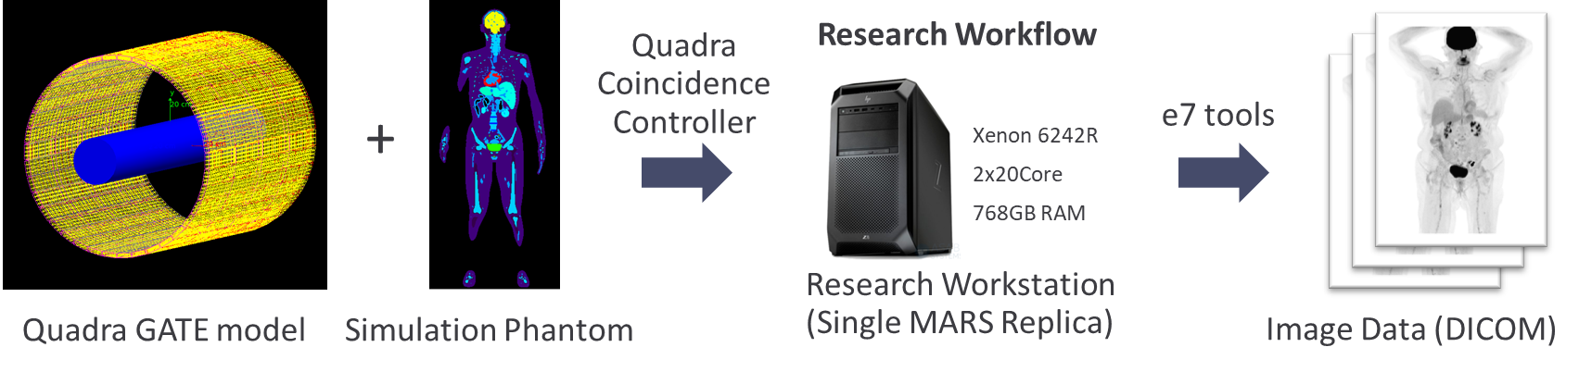


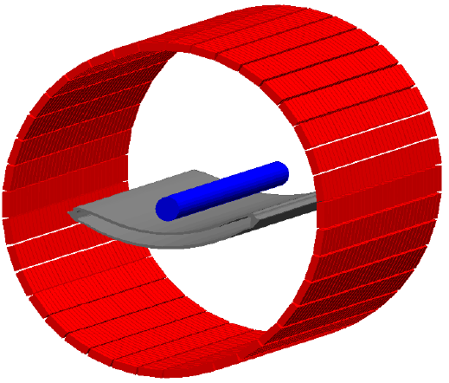

Concept Digital Twin Biograph Vision Quadra
Image reconstruction
Listmode data
e7 tools*
Patient
PET/CT scanner
Image Data
Listmode data
(proprietary)
e7 tools*
GATE model
Root2lm
Patient Simulation Model
Image Data
* Vendor specific image reconstruction software
Notes:
Please add pictogram fro listmode, e7 tools, rootfile, patient

Slide 7
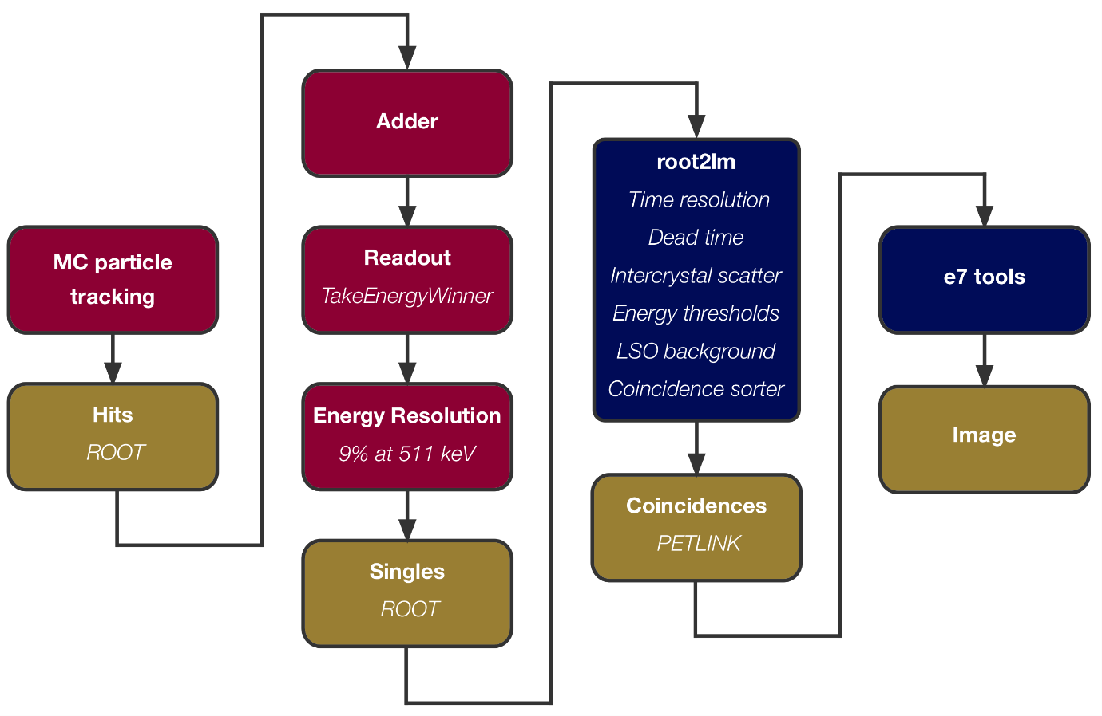
Simulation + Image Reconstruction Workflow
Listmode data
(proprietary)
e7 tools*
Root2lm
Image Data
Patient Simulation Model
GATE model
root2lm (Siemens Healthineers)
Notes:
This slide will be a zoomed in region of the

Slide 8
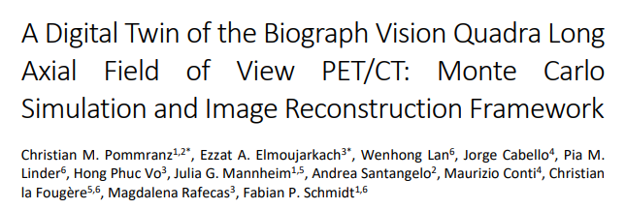




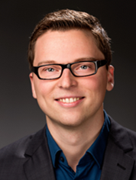
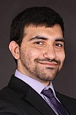


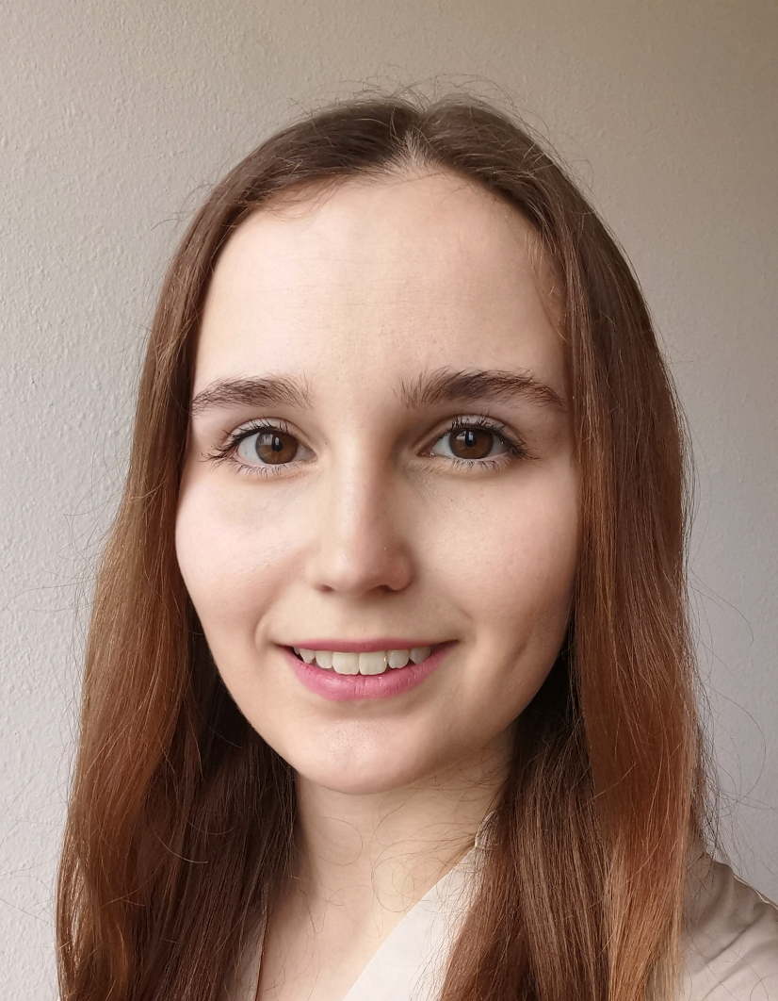

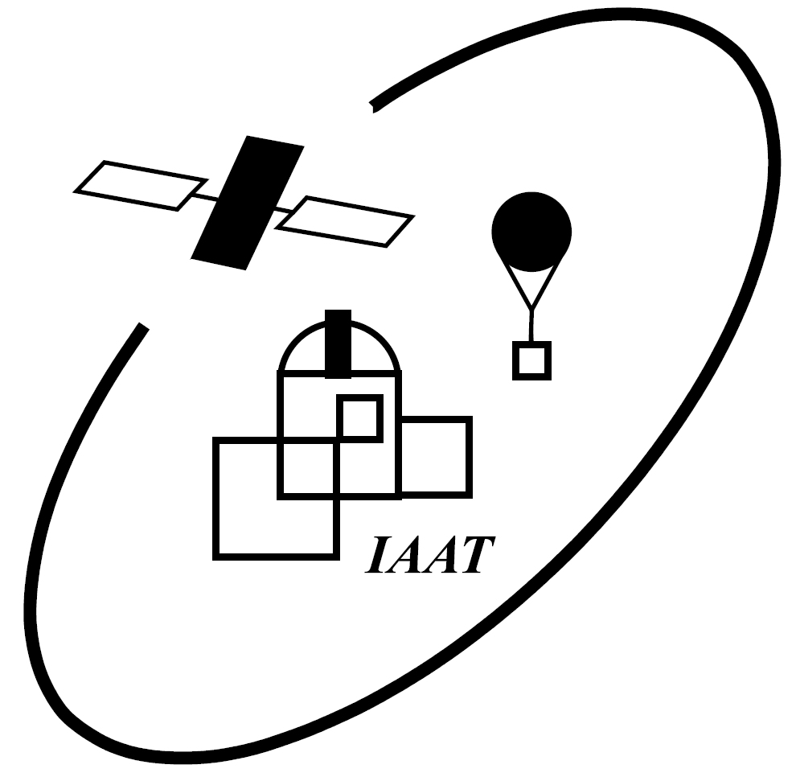
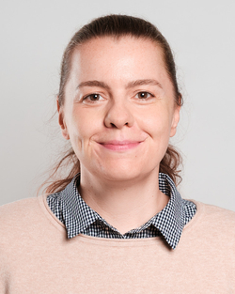
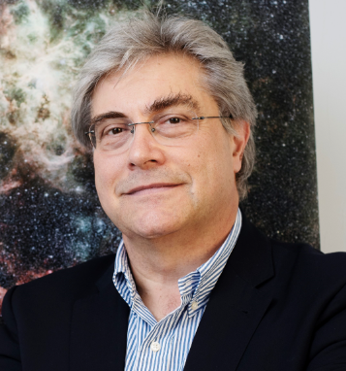
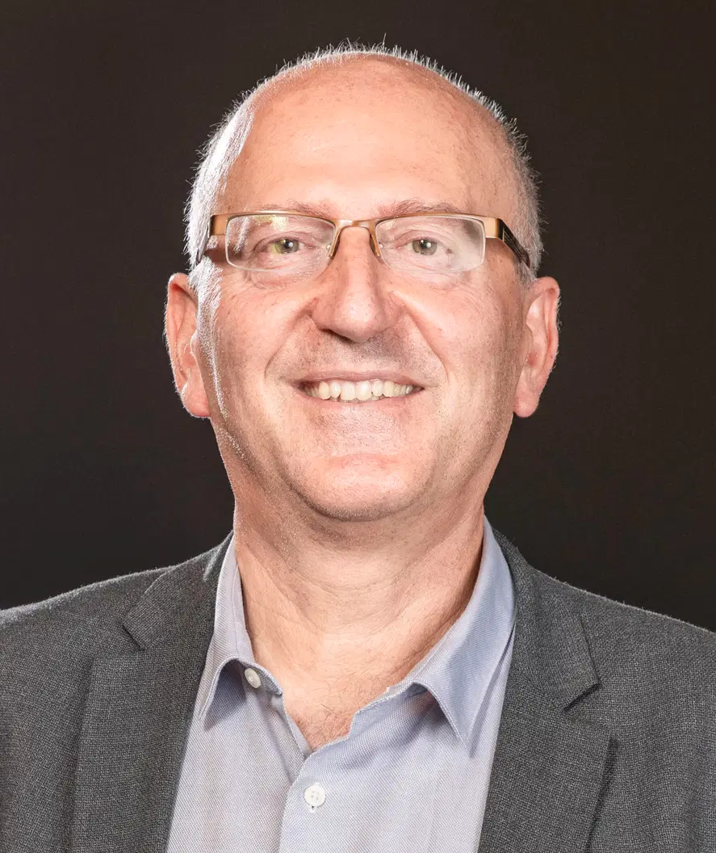
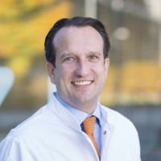
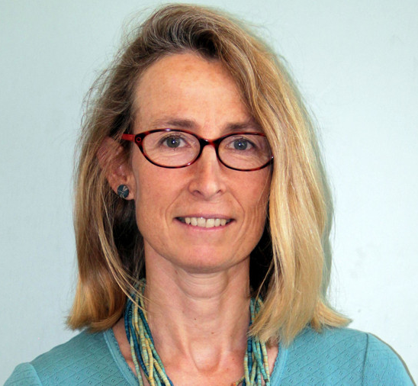


Quadra Digital Twin - Collaboration
Industry
In submission
Hospital
Christian Pommranz
Ezzat Elmoujarkach
Wenhong Lan
Jorge Cabello
Pia Linder
H. P. Vo
University
Julia Mannheim
Andrea Santangelo
Maurizio Conti
Christian la Fougère
Magdalena Rafecas
Fabian Schmidt
Notes:
Add picture of all people + logo WSIC, Uniklinik, Astrophysics, Siemens Healthineers, UZL
Add pictograms for university hosptiel and industry

Slide 9
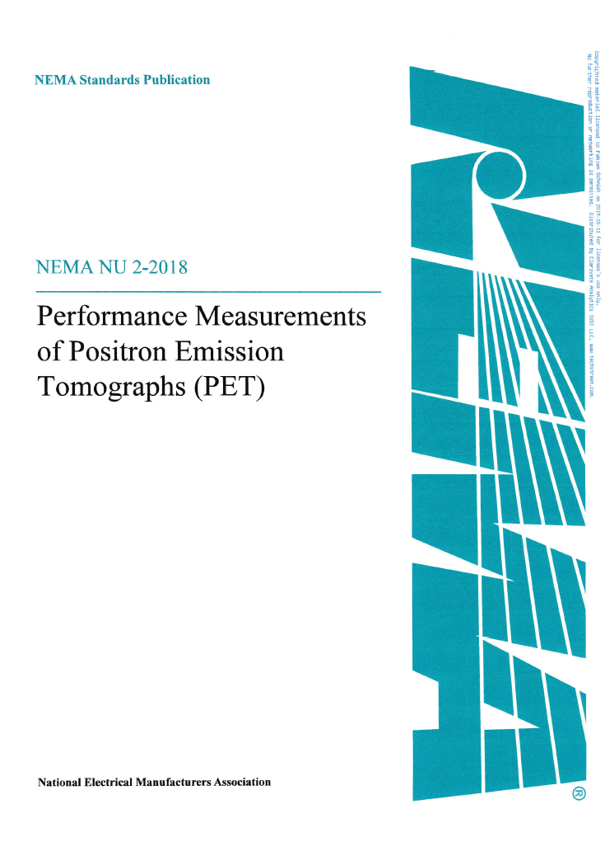
Validation: NEMA NU 2-2018
Replicate NEMA NU 2- 2018 experiments in silico
→ Comparison of (real) experimental and simulation derived metrics

Slide 10
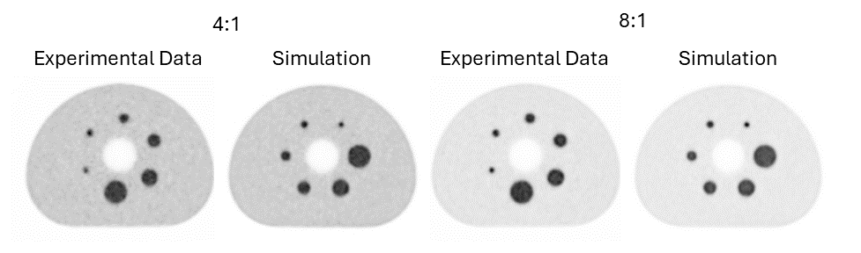
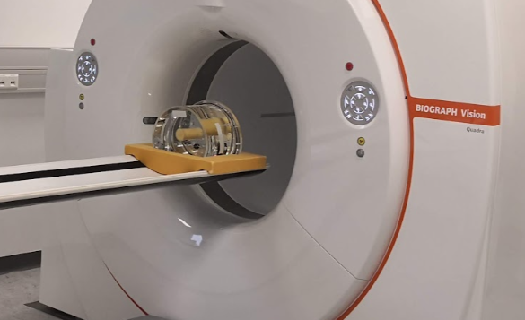
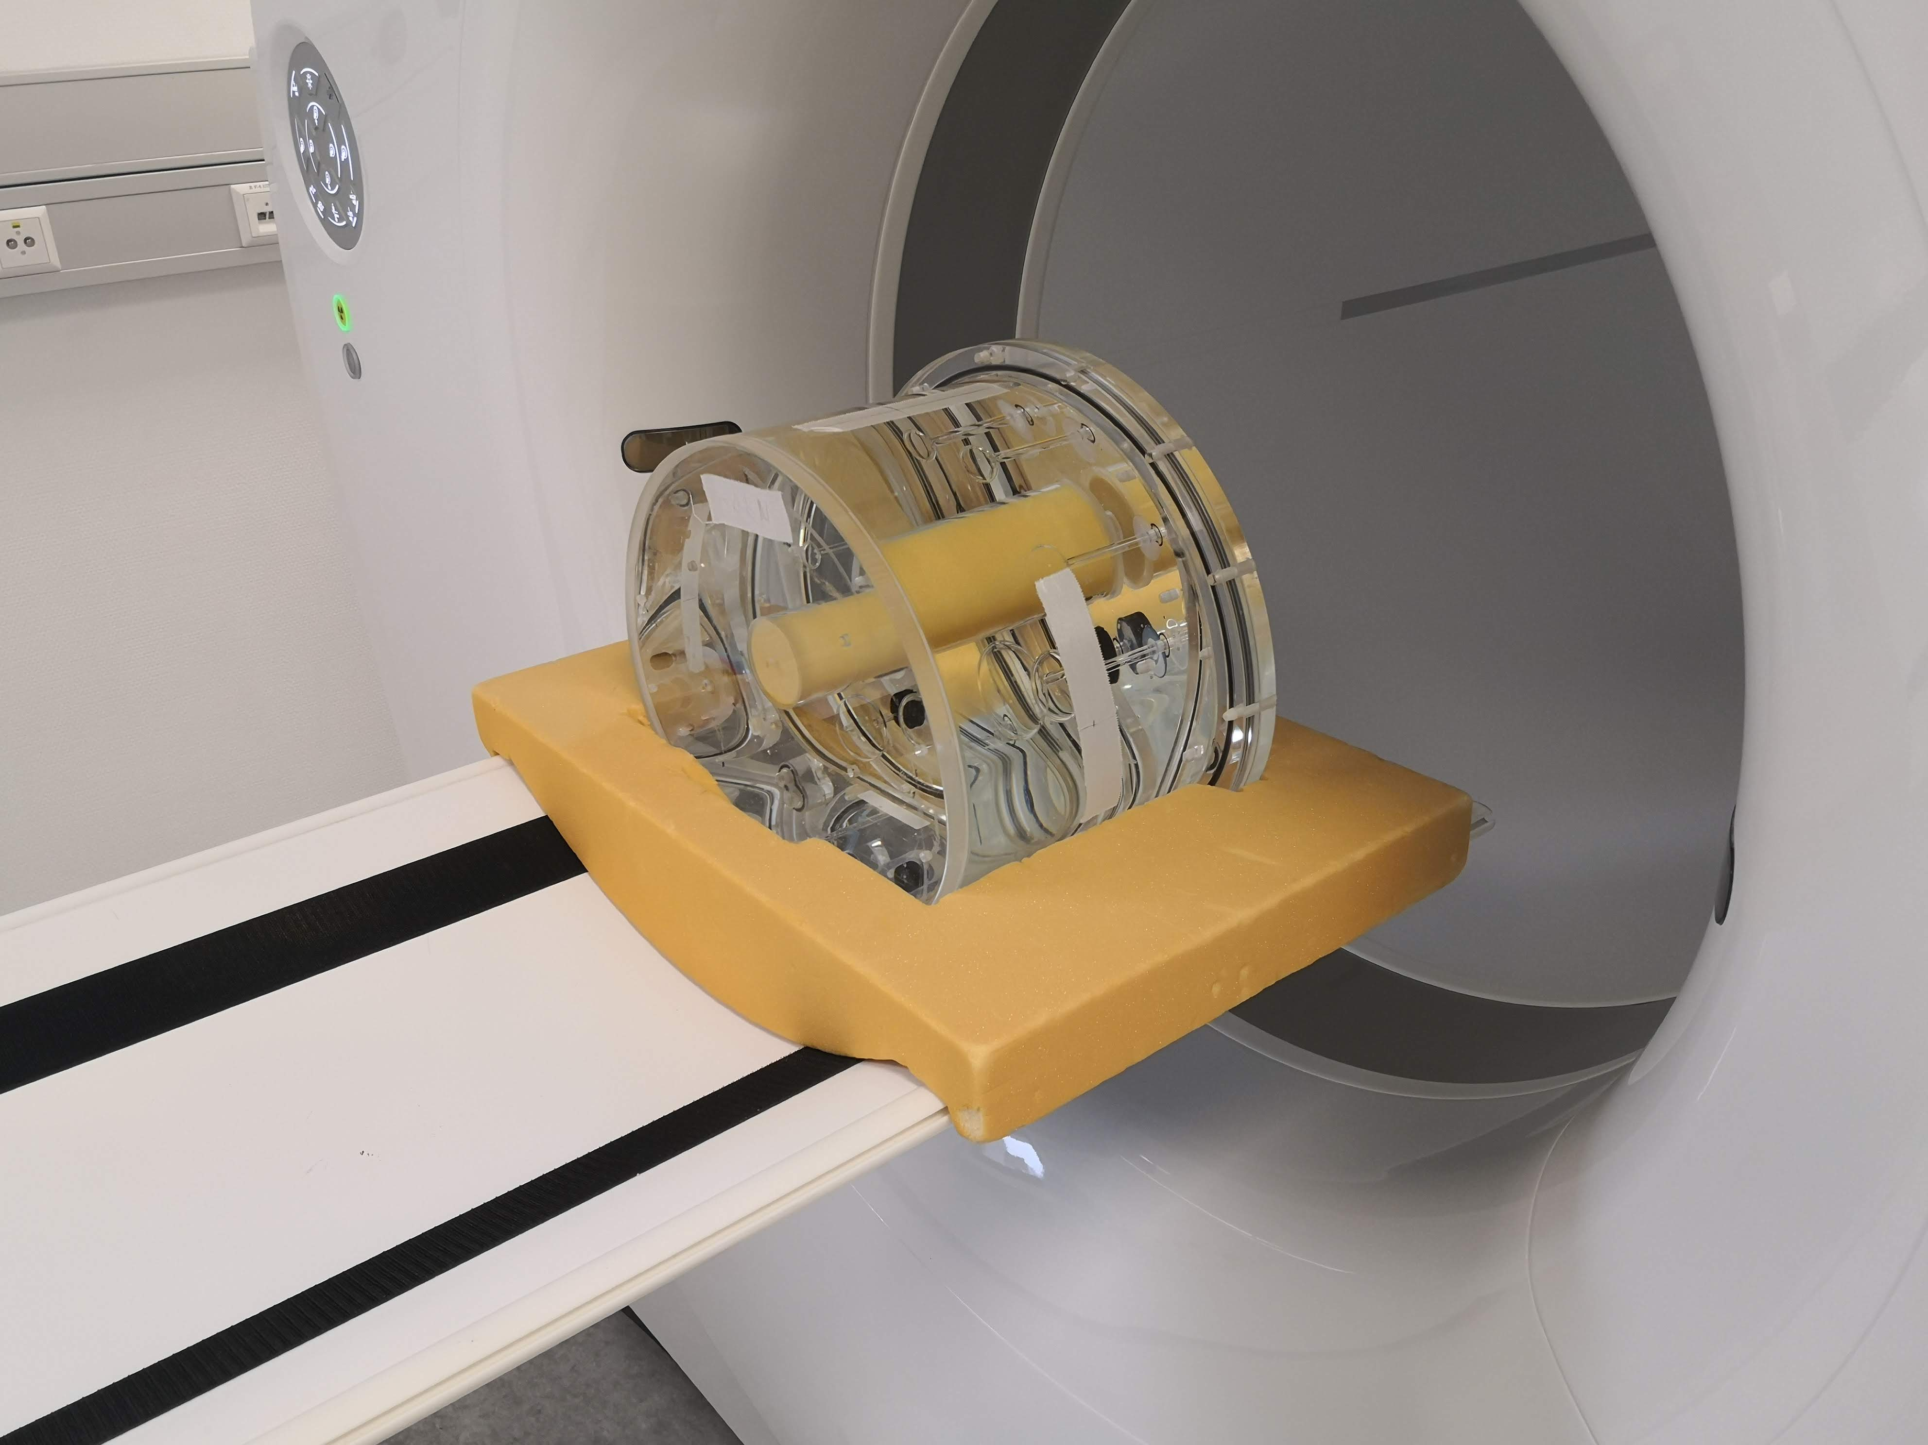
Image Quality, Noise & Contrast Recovery
Comparable IQ + image noise - CV 7.5% (Sim) 7.7% (Exp)
Comparable contrast recovery (e.g. 13 mm: 67.0% and 67.9%)

Slide 11
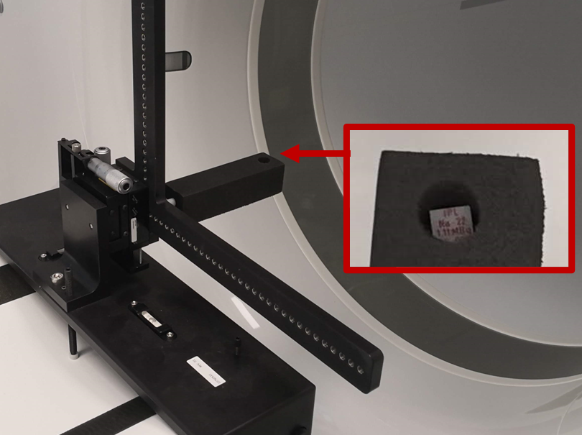
Spatial Resolution
0.3±0.3 mm (radial), 0.4±0.1 mm (tangential), 0.4±0.3 mm (axial)
Small difference in spatial resolution 0.4±0.3 mm

Slide 12
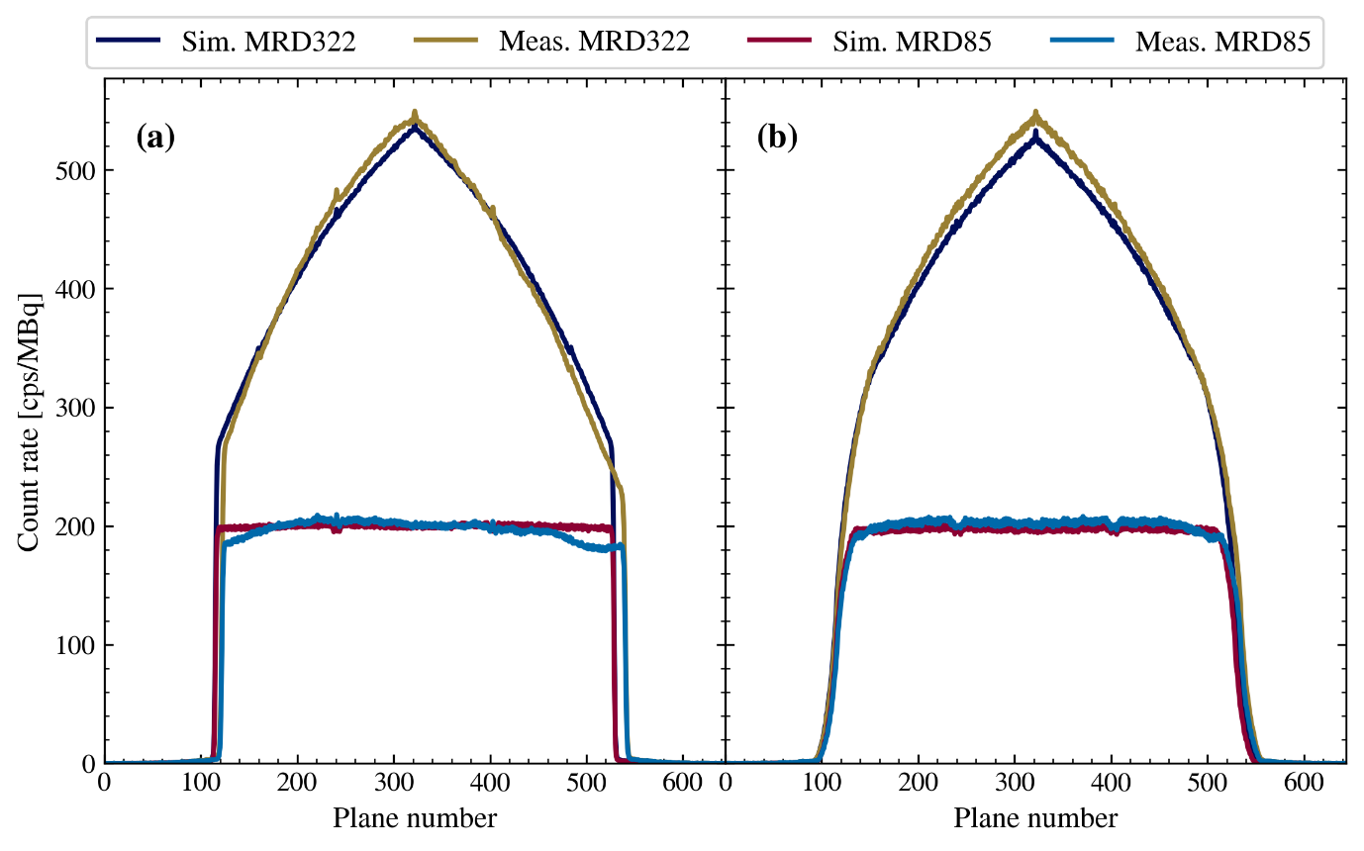
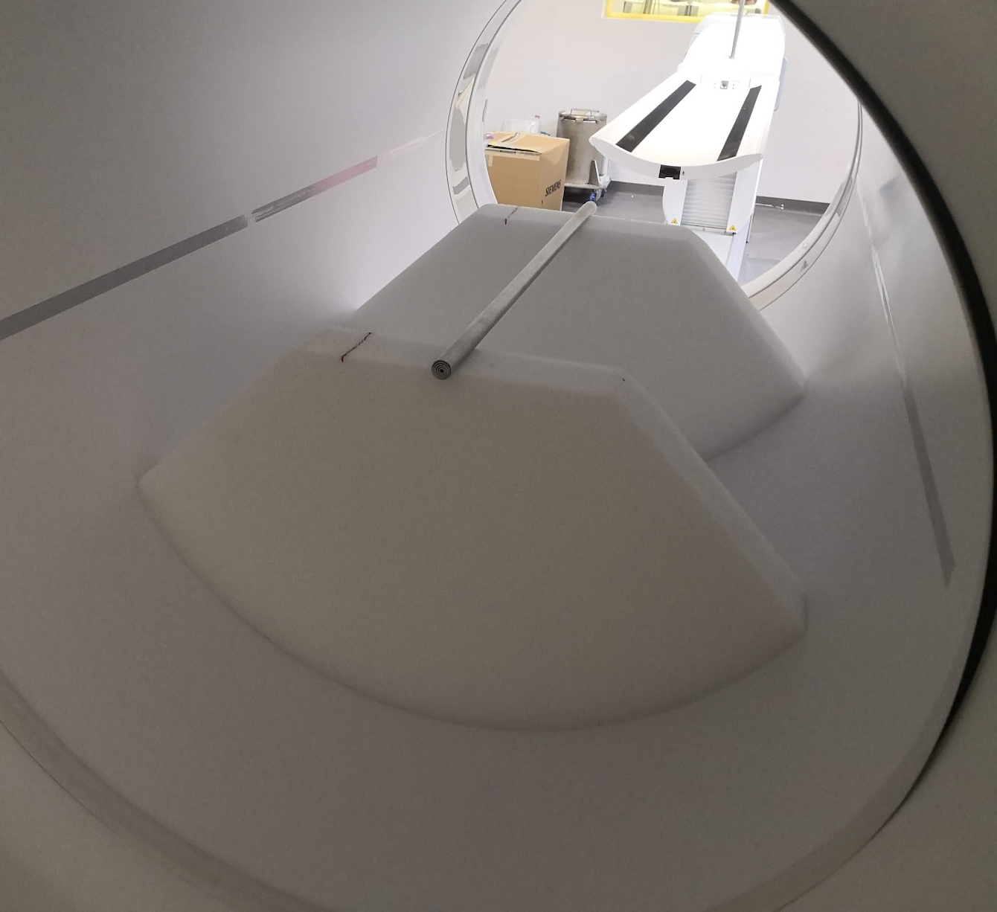
Sensitivity
MRD322: 174.6 cps/kBq (Sim) and 175.3 cps/kBq (Exp)
MRD85: 82.7 cps/kBq (Sim) and 82.6 cps/kBq (Exp)

Slide 13
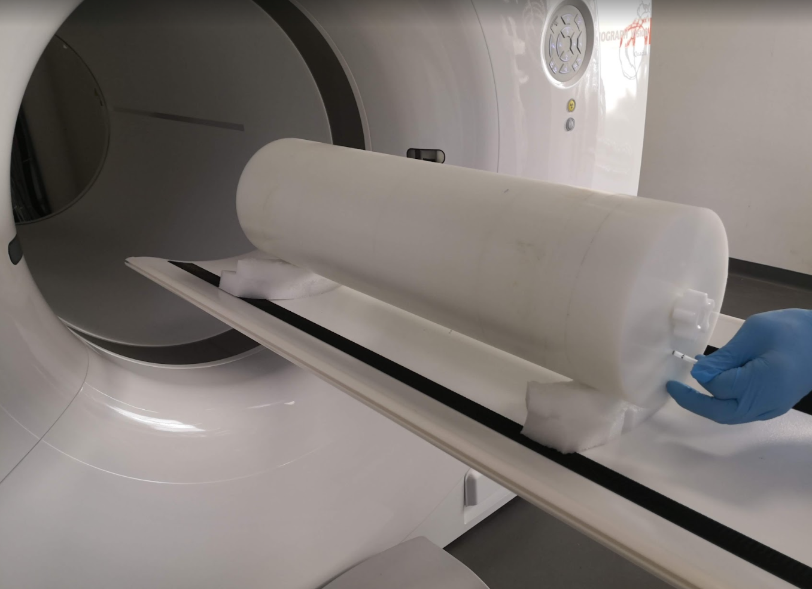
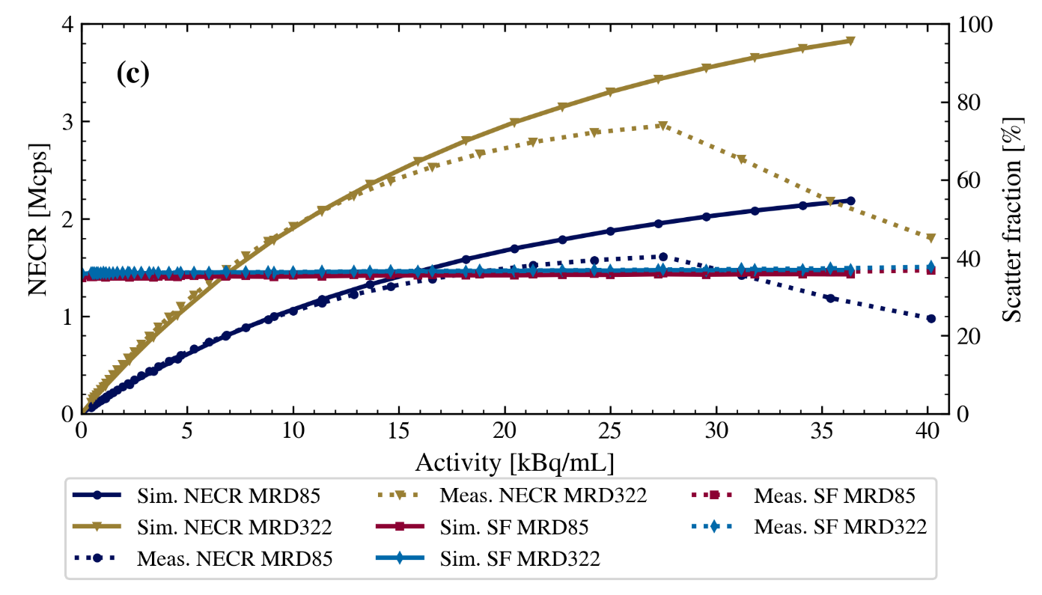
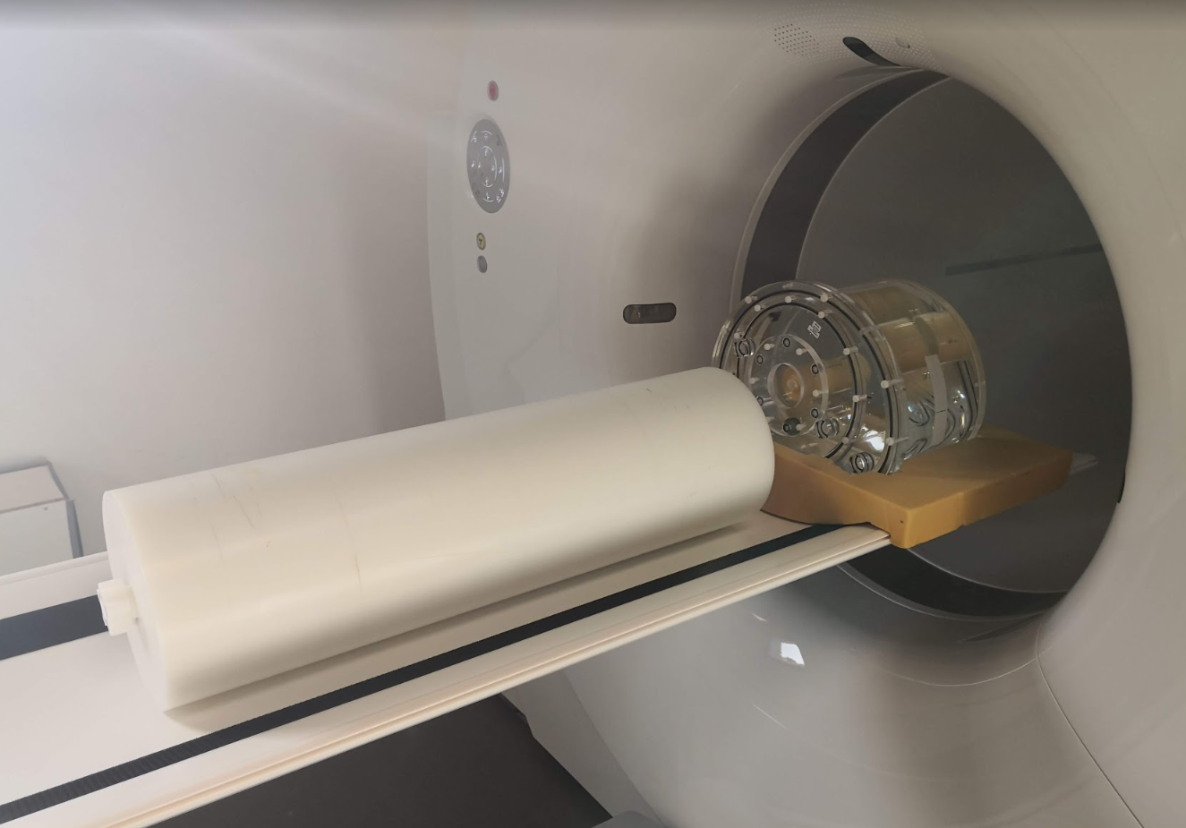
Count Rate & Scatter Fraction
Scatter fraction 36% matches experiment
NECR: max deviation of 8%/9% (MRD85/MRD322) <= 10 kBq/mL range

Slide 14
Motion Artefacts and Correction

Slide 15

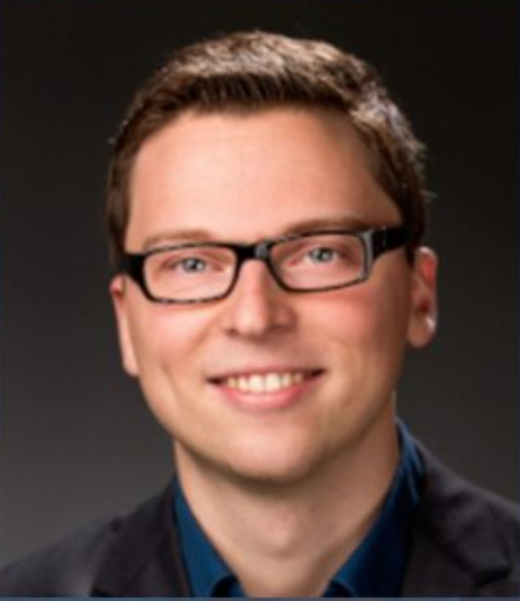
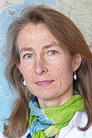

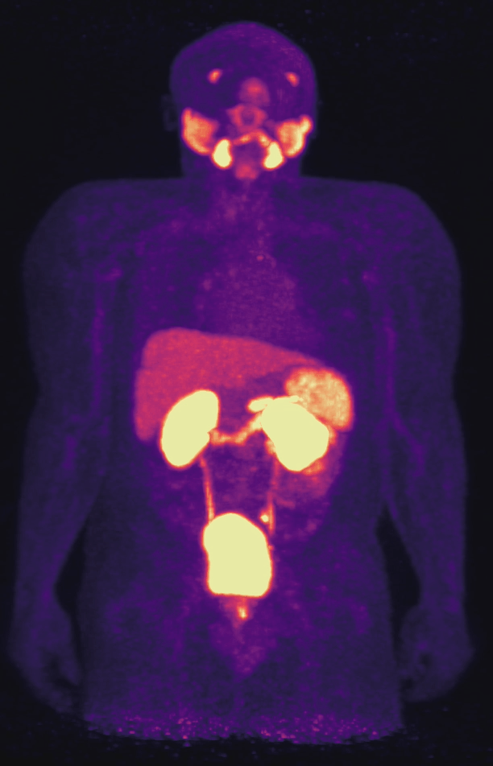
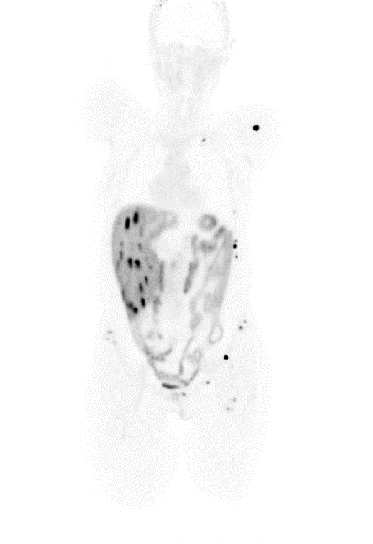
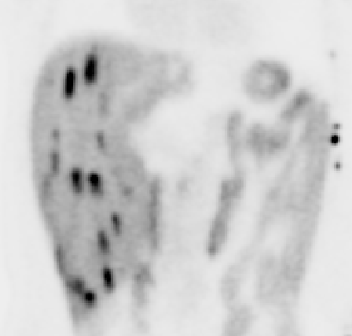
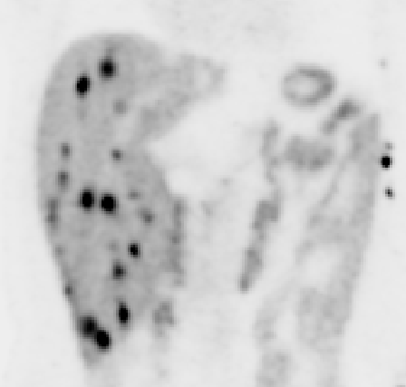
Motivation
W. Lan
H. P. Vo
E. Elmoujarkach
C. Pommranz
M. Rafecas
F. Schmidt
Uncorrected
Image Courtesy: L. Sundar
Motion Corrected
Notes:
Nicht the best sondern comparing motion derived vs data driven

Slide 16
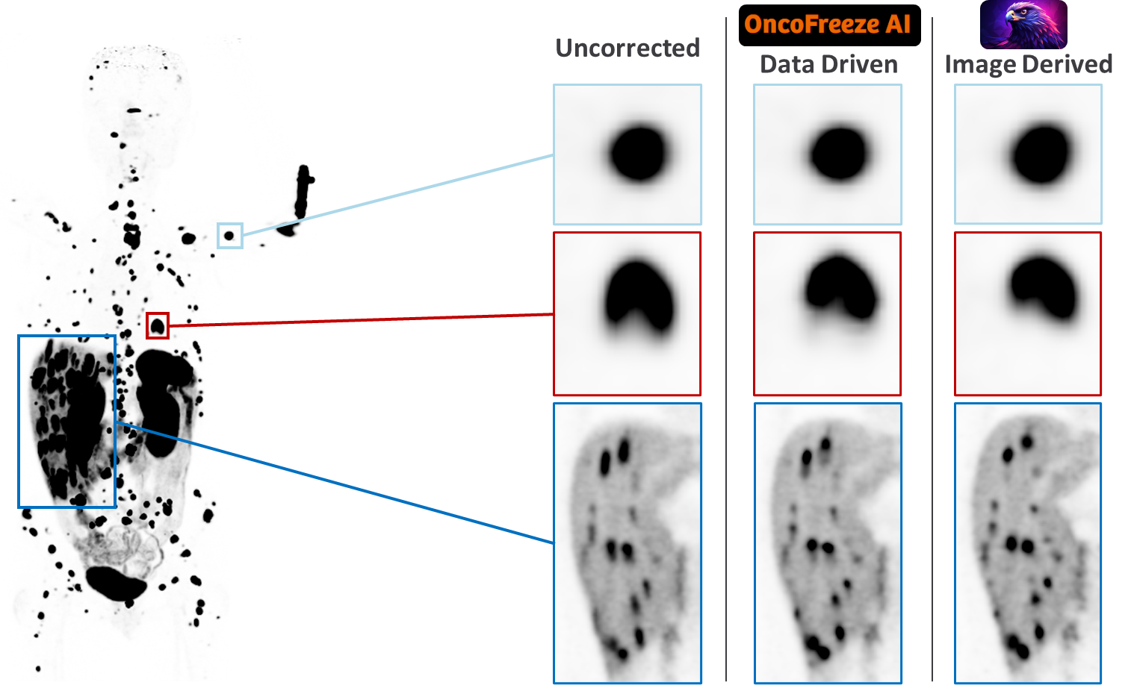
Validation and Comparison of Motion Correction Methods
Subjective improvement + relative comparison of correction methods

Slide 17
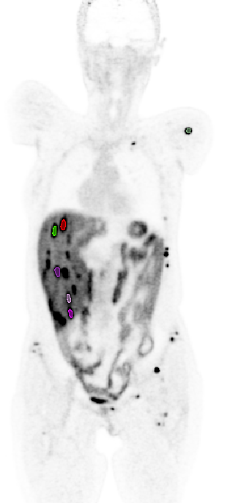
Validation and Comparison of Motion Correction Methods
 | Uncorrected | OncoFreeze AI | FALCON
SUV_{mean} | 24.2 ± 11.4 | 35.7 ± 16.7 (+ 51.5 % ± 36.9) | 34.9 ± 28.8 (+ 41.5 % ± 58.6)
SUV_{max} | 36.6 ± 16.8 | 53.6 ± 24.7 (+ 50.0 % ± 35.2) | 52.5 ± 43.7 (+ 39.9 % ± 57.2)
Lesion Volume [cm³] | 0.84 ± 0.71 | 0.42 ± 0.48 (- 48.1 % ± 25.5) | 0.68 ± 0.70 (- 17.2 % ± 28.5)
Subjective improvement + relative comparison of correction methods
Lack of ground truth (motion free) information for activity distribution

Slide 18
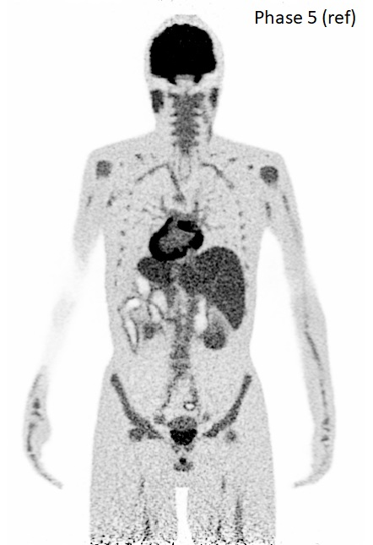
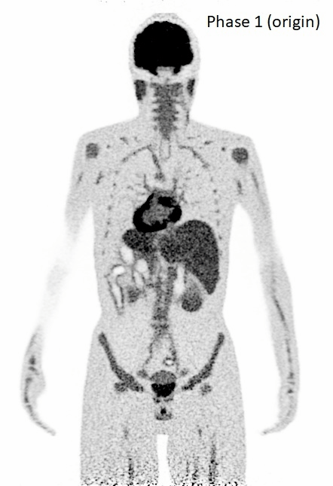
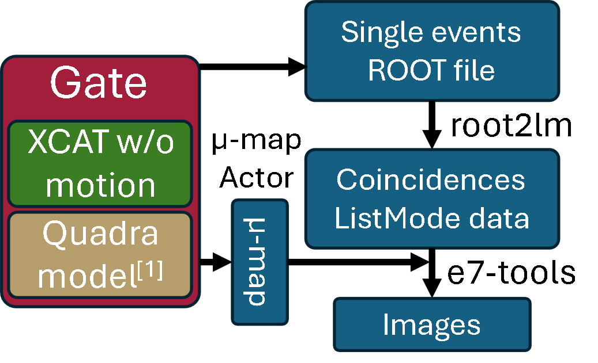
Digital Twin for Simulation Derived Motion Free Ground Truth
Motion correction
Motion free (ground truth)
Realistic Motion Model
Motion corrected
Digital Twin
Simulation without (static motion free reference) and with different motion scenarios modelled
Comparison w/wo motion to evaluate motion induced error
Apply motion correction methods and compare with motion free ground truth

Slide 19
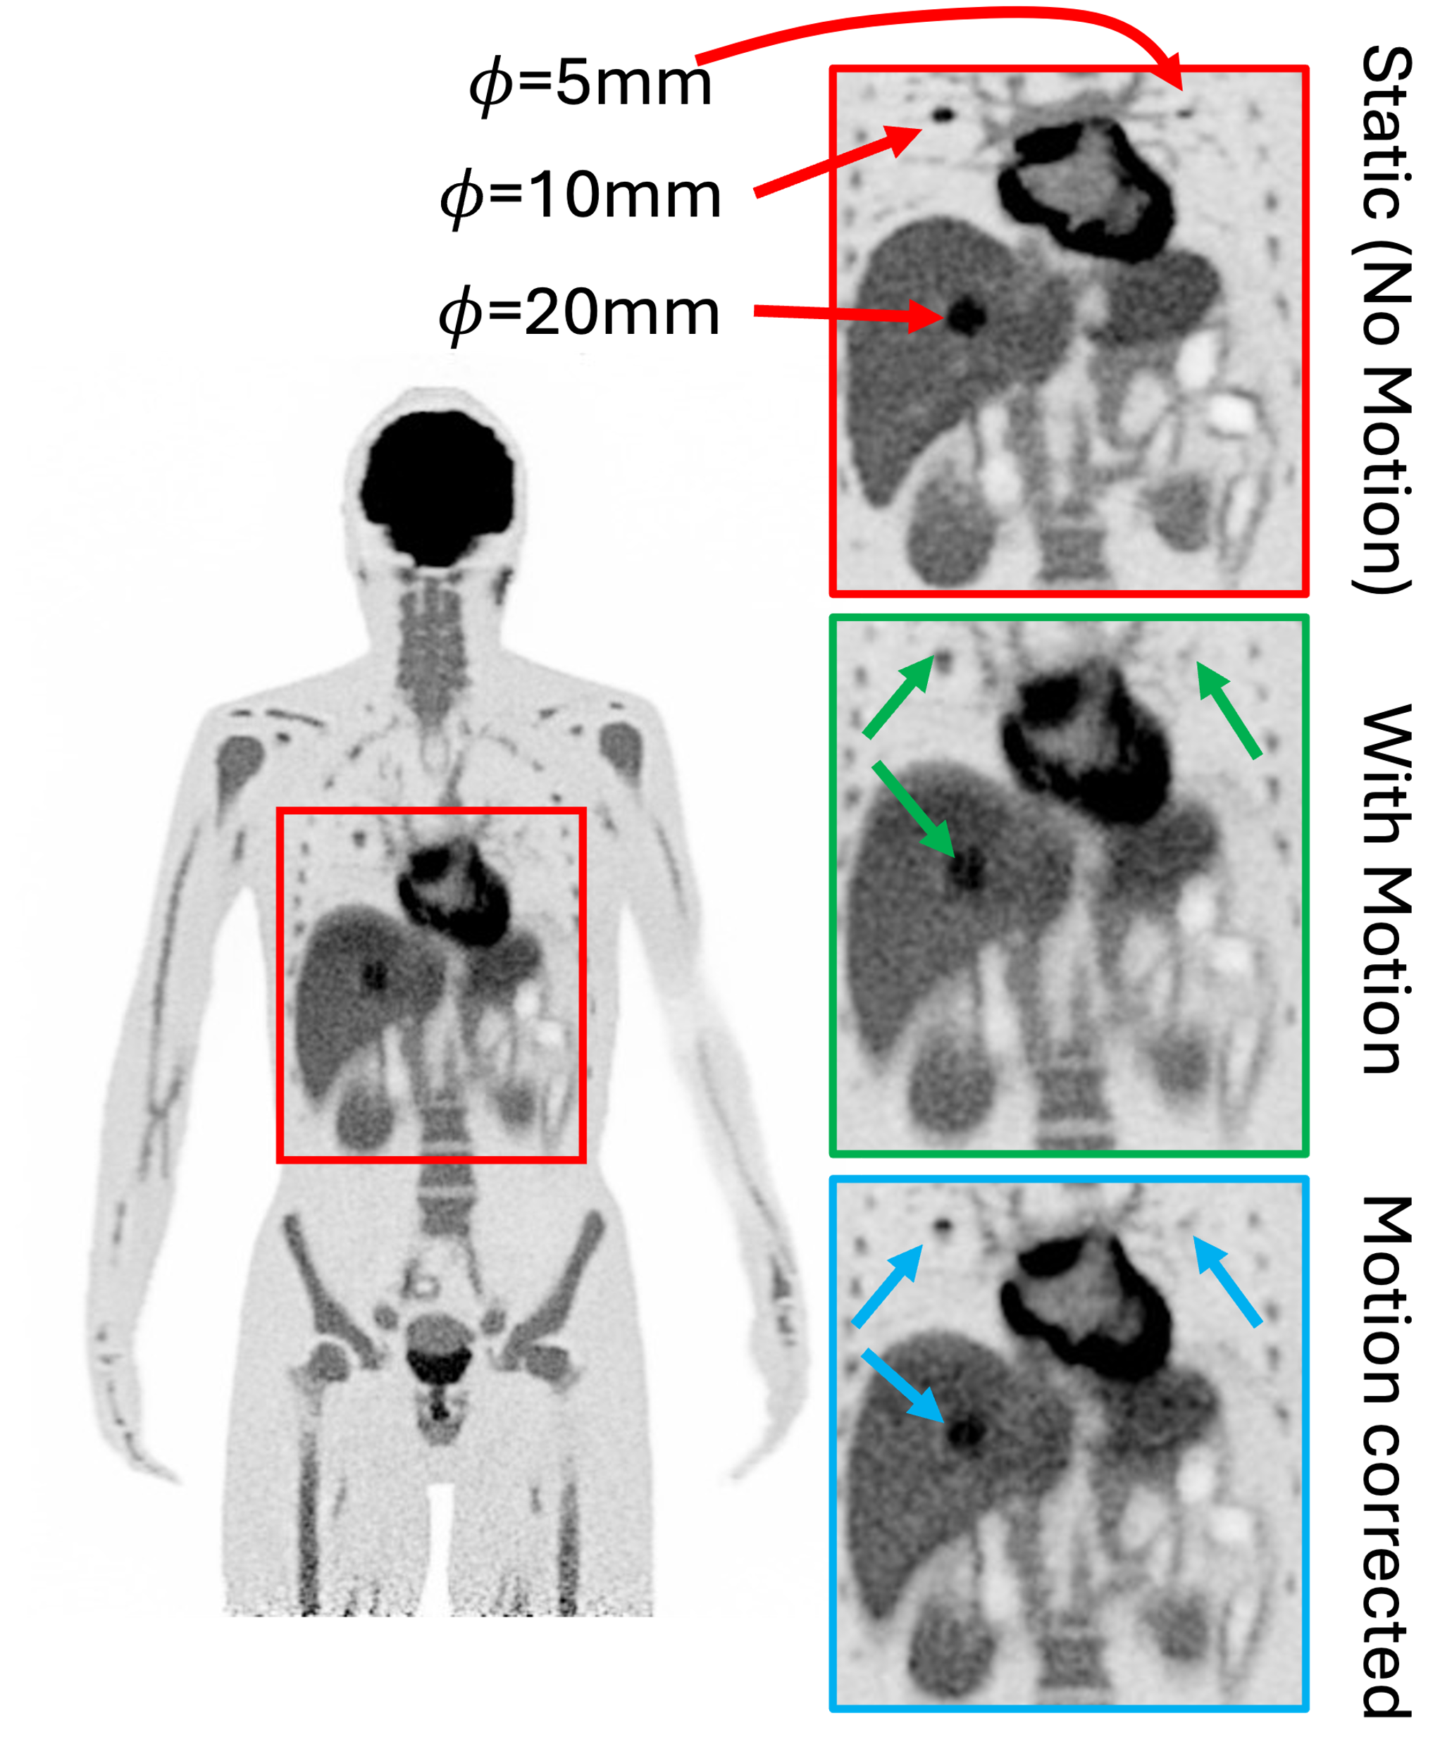
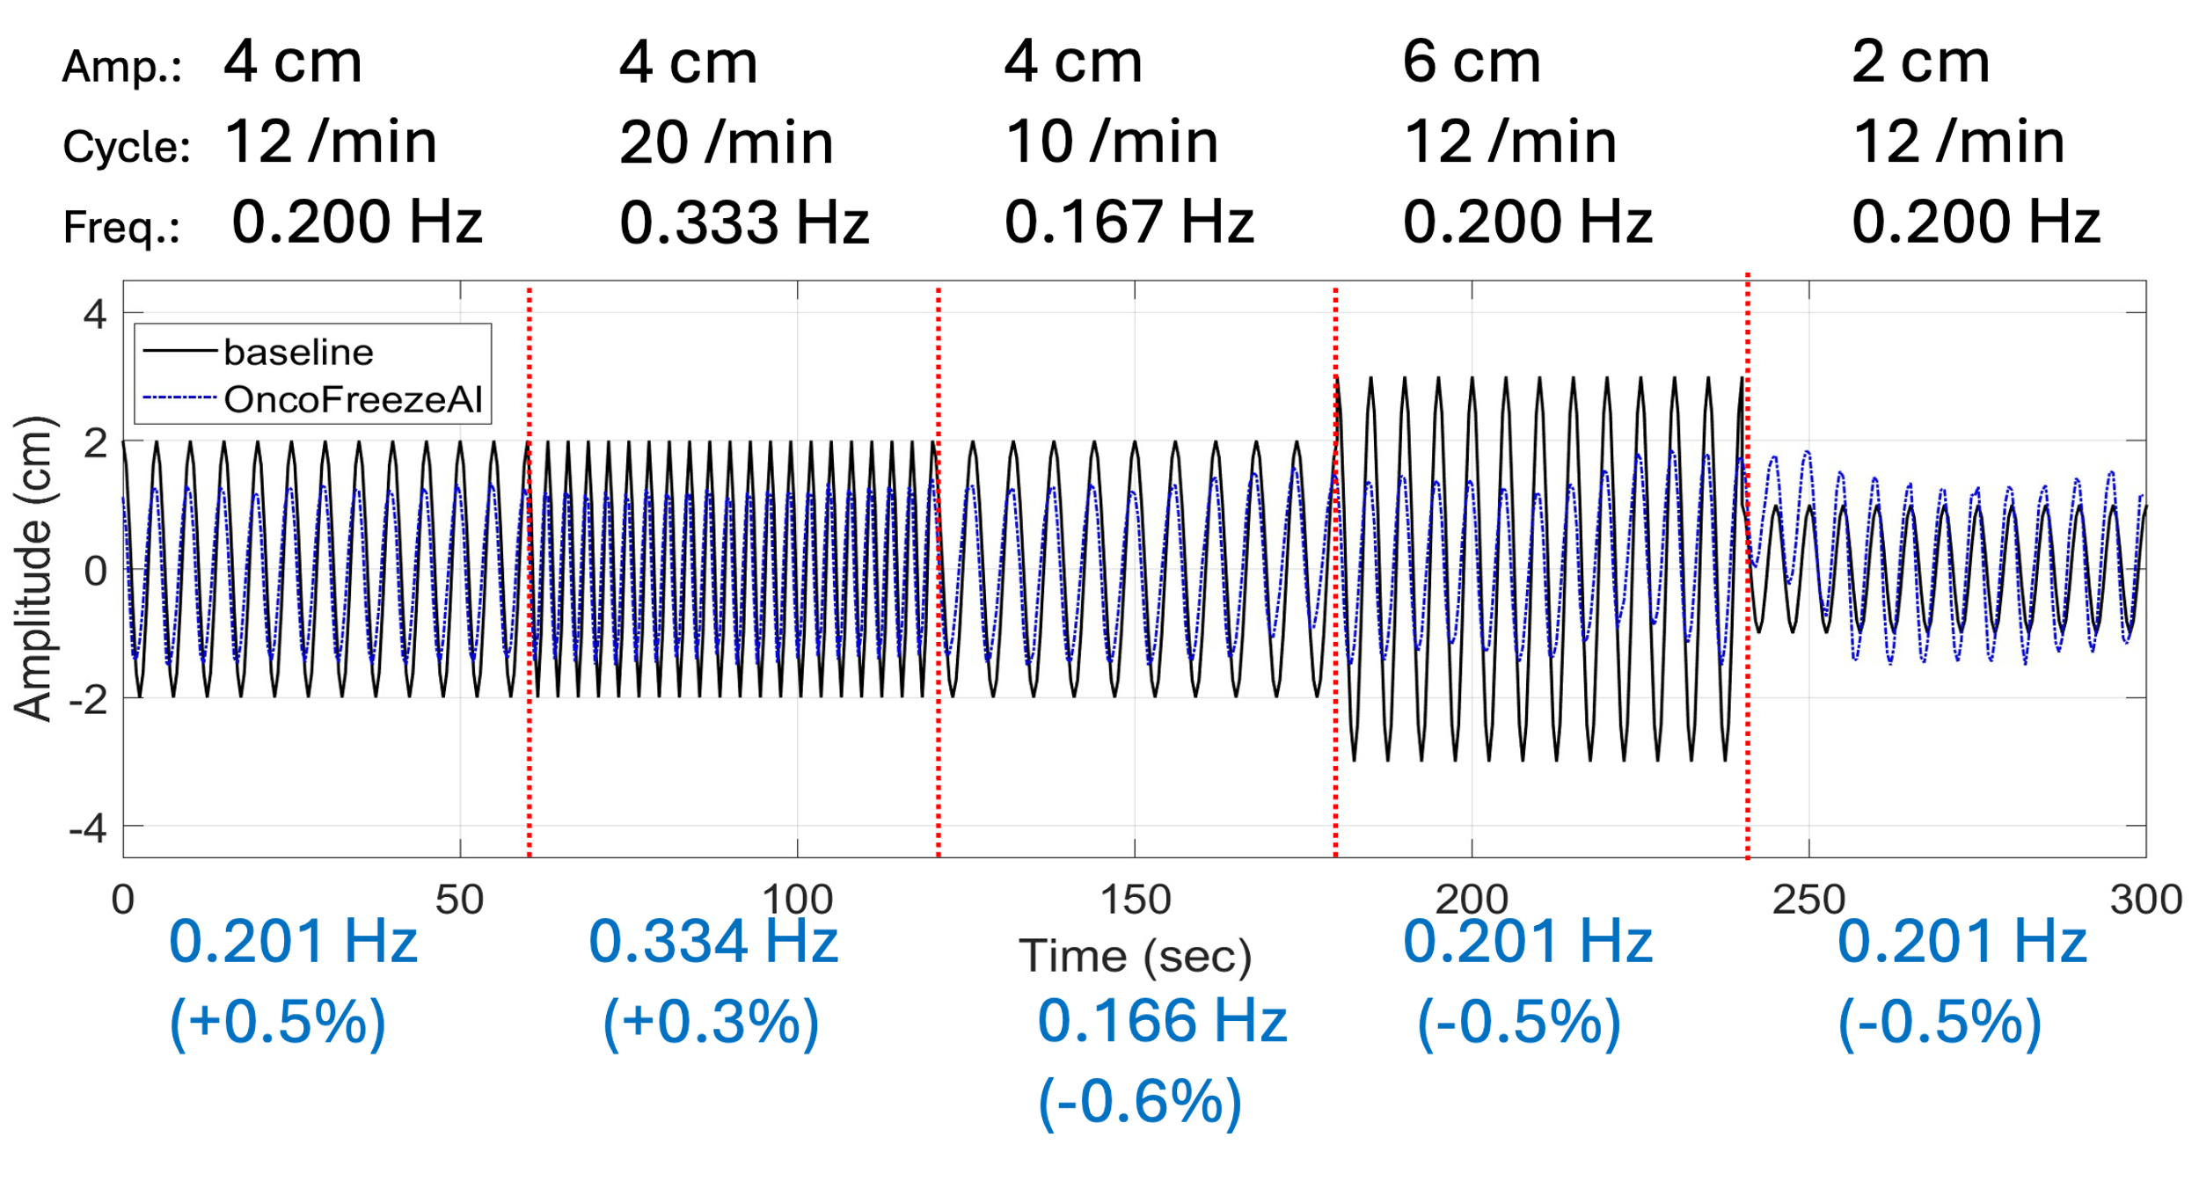
Digital Twin Motion + Correction: Results IQ
Model respiratory motion
Visual comparison w/wo motion
Apply motion correction:

Slide 20
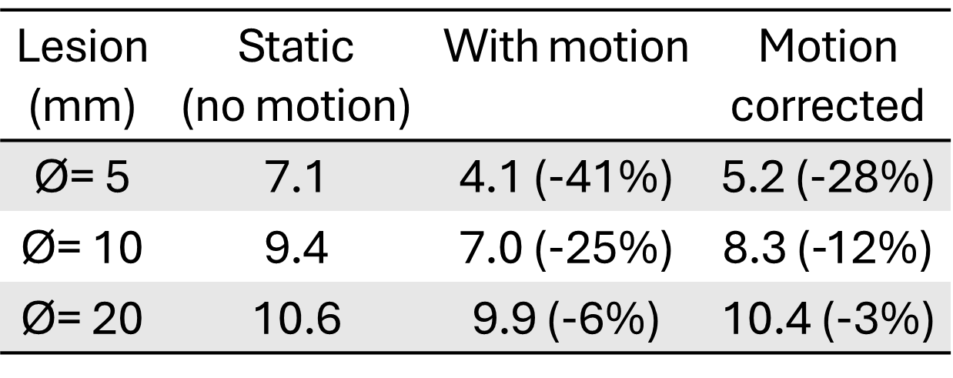
Digital Twin Motion + Correction: Results Lesion Quantification
Assess quantification changes/recovery for defined lesion size (Ø = 5, 10, 20mm) /uptake
Lesion Quantification
Table 1. Mean activity concentration (kBq/ml) of lesions
Motion correction → increase recovery of static activity concentration
Residual error lower for larger lesions (-12%) than for the smallest one (-28%) in the lung

Slide 21
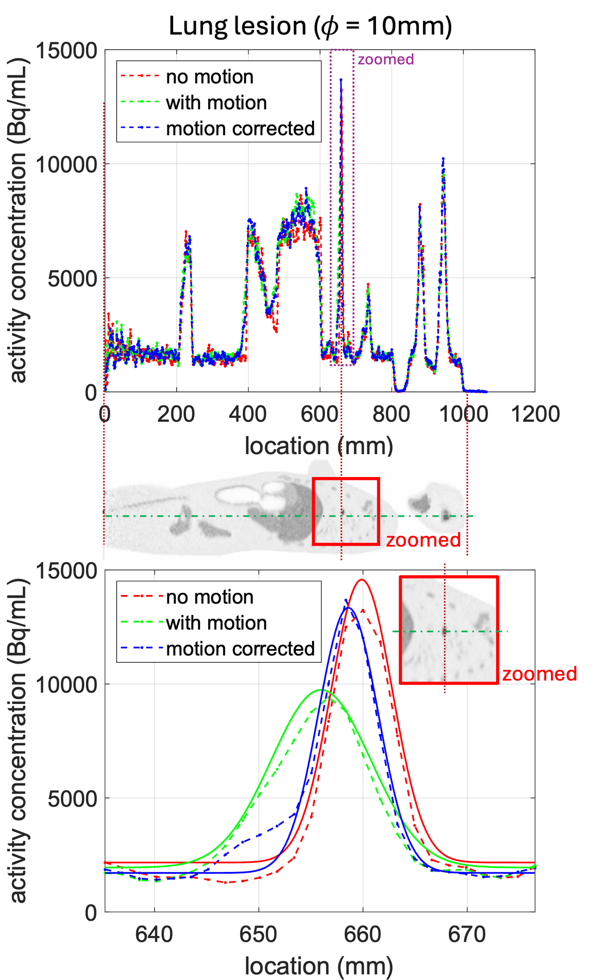
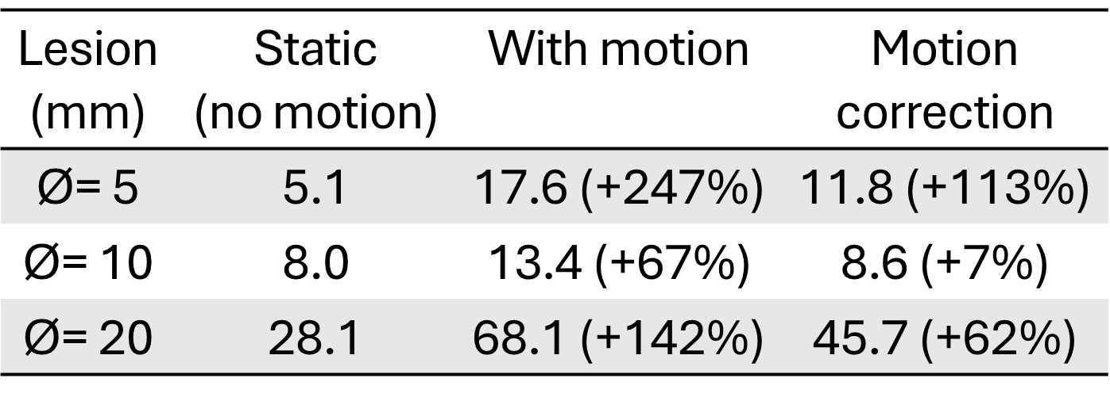
Digital Twin Motion + Correction: Results Lesion Profiles
Assess quantification changes/recovery for defined lesion size (Ø = 5, 10, 20mm) /uptake.
Lesion Line Profiles
Table 2. FWHM [mm] of line profiles (SI direction) for lesions
Excellent recovery by MoCo: Ø=10 mm, FWHM: 8.0 (static), 8.6 (MoCo) vs 13.4 mm (no MoCo)
Notes:
Picture without caption and create bulletpoint for result

Slide 22
Digital Twin Motion + Correction: Results Respiration Curve
Comparison of data derived respiratory curve (Oncofreeze AI) with input to simulation
Recovery of respiration curve with high precision (±0.5Hz) by Oncofreeze AI

Slide 23
Quadra Digital Twin – Motion Presentation
Suitability of our framework to provide ground truth information on patient motion in a total-body PET/CT scanner
Next:
Extension towards variations in scan duration, activity concentration, lesion location/size and modelling whole-body motion
Evaluation of various motion correction algorithms to identify most effective application-specific solution and optimize the corrections based on the ground truth data of our framework.
More Details, Please visit us (W. Lan) ☺
Session: M-08, MIC Poster Session
Date & Time: Thursday, 31.10.2024 - 14:00
Poster Number: M-08-068
Location: East / Central Hall

Slide 24
Y-90 Imaging and Radioembolization Dosimetry
Notes:
Delete Nils, Christian, Ezzat, add la Fougère and elisa

Slide 25
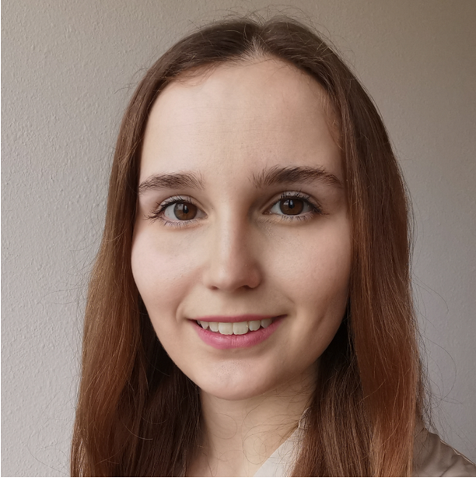
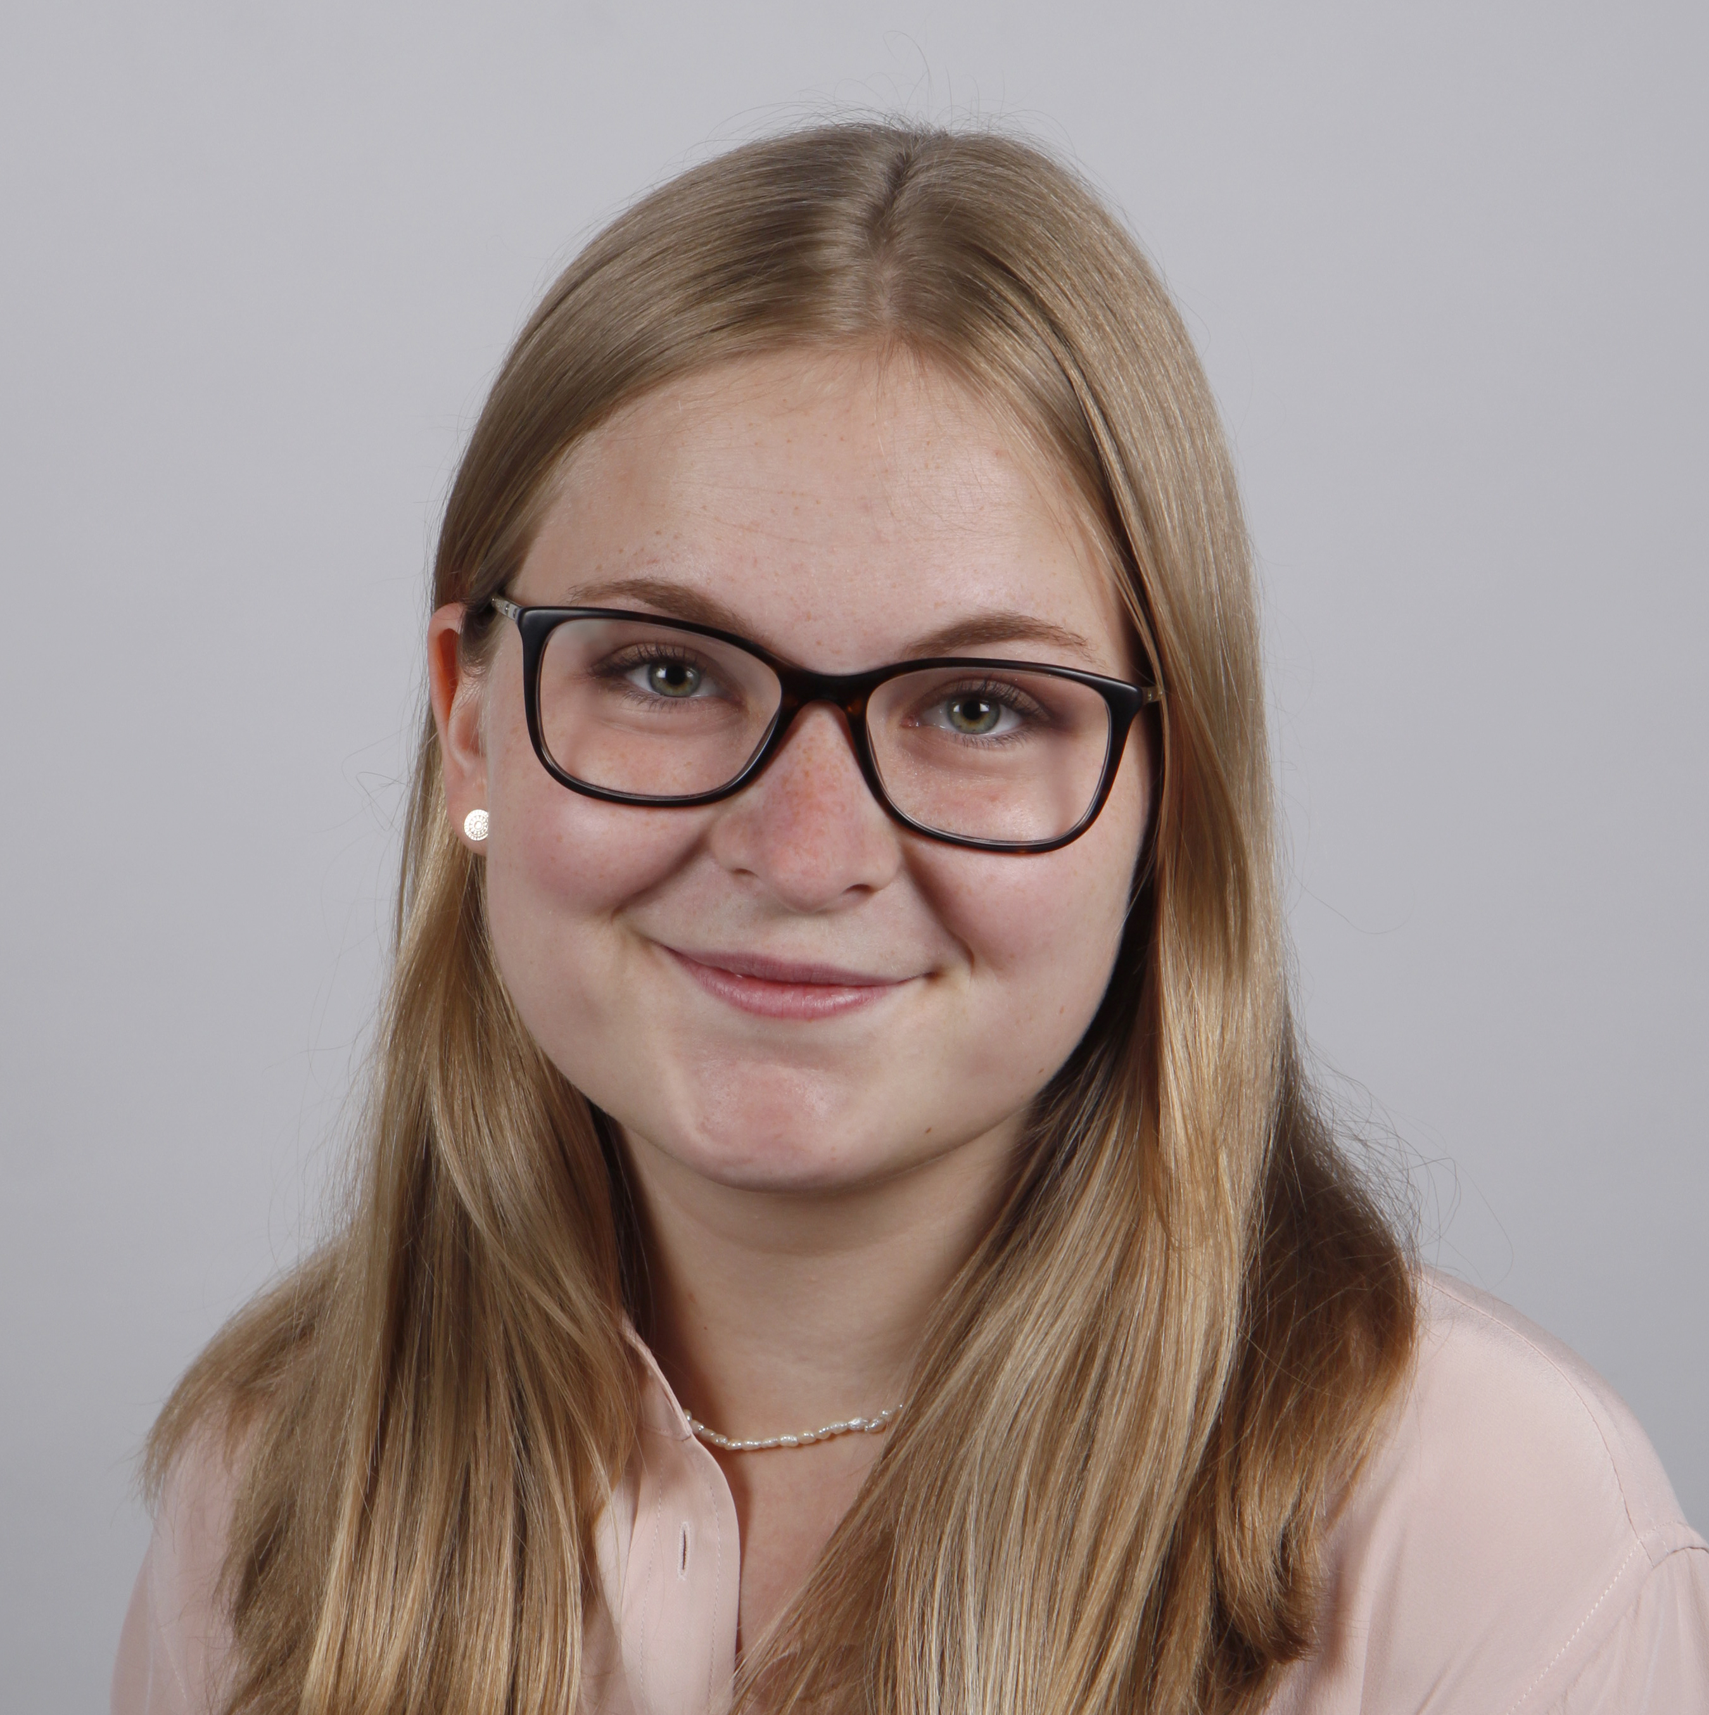

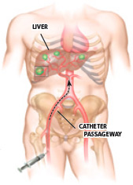

SIRT + Y-90 PET Imaging
P. Linder
E. Körner
J. Brosch-Lenz
W. Lan
C. la Fougère
F. Schmidt
Selective internal radiation therapy (SIRT) for liver tumor treatment with Y-90 microspheres
Y-90 beta emitter (99.98%) → Bremsstrahlung SPECT
0.0032% positron fraction → PET (extreme low event statistics)
→ compensate with high sensitivity TB-PET
Sensitivity: 176 kcps/MBq
Timing Resolution: 230 ps
~ ×20 Sensitivity

Slide 26













Optimization of Y-90 LAFOV PET Imaging
Objective metrics for phantom based imaging optimization
1i5s
2i5s
3i5s
4i5s

Slide 27

Optimization of Radioembolization Dosimetry?
Patient image/dosimetry subjective or relative changes
Problem no ground truth on absorbed dose

Slide 28




Dosimetry: Simulation Workflow
MC Dose Simulation
Dose map
optimum image reconstruction + residual error for dose estimation
Potential for NN trained on n>20 patients
MC Dose Simulation
Quadra Digital Twin
Emission Image
Dose map

Slide 29
Dosimetry: Simulation Ground Truth
MC Dose Simulation
Ground Truth
optimum image reconstruction + residual error for dose estimation
Potential for NN trained on n>20 patients
MC Dose Simulation
Quadra Digital Twin
Emission Image
Dose map

Slide 30
Dosimetry: Simulation Ground Truth - Application
MC Dose Simulation
Quadra Digital Twin
Emission Image
Dose map
Scatter, Motion …
optimum image reconstruction + residual error for dose estimation
Potential for NN trained on n>20 patients
Determine error introduced by scanner/imaging
Evaluate impact of different image reconstruction and correction methods

Slide 31

SIRT Dosimetry : Dosimetry: Simulation Ground Truth - Application
MC Dose Simulation
Quadra Digital Twin
Emission Image
Dose map
Kernel
Scatter, Motion …
…
optimum image reconstruction + residual error for dose estimation
Potential for NN trained on n>20 patients
Determine error introduced by scanner/imaging
Evaluate impact of different image reconstruction and correction methods
Benchmark different dose estimation methods

Slide 32

SIRT Dosimetry : Dosimetry: Simulation Ground Truth - Application
optimum image reconstruction + residual error for dose estimation
Potential for NN trained on n>20 patients
Determine error introduced by scanner/imaging
Evaluate impact of different image reconstruction and correction methods
Benchmark different dose estimation methods
Training dataset for neural network → enhance accuracy dosimetry

Slide 33
Neural Network for Low-Dose PET Denoising

Slide 34


Low Dose PET Imaging and Denoising
E. Elmoujarkach
C. Pommranz
J. Cabello
F. Schmidt
M. Rafecas
High sensitivity of TB-PET allows for dose reduction (e.g. 3MBq/kg → 0.5MBq/kg)
Neural network for denoising: further dose reduction / recover full dose images
Requires pairs of low dose and high dose scans → typically gained from reframing high dose scans
Problem: simplified, not taking into account scanner characteristics as random rate, dead time, pile up effects, ….
→ Use digital twin to assess the impact of reframing vs. actual real low dose input for a denosing NN
→
PET Listmode data: (e.g. 300s scan)
0
300s
Subset of event data to mimic low dose scan

Slide 35



Digital Twin and Denoising Network
Digital Twin Biograph Vision Quadra
XCAT phantom with different dose reduction factors (DRF) : real „injected“ and „reframed“
AI-denoising
E. Elmoujarkach, PETAL-ED: Progressive elimination of noise towards accurate ultra low dose PET images using 3D U Net, PSMR, 2024

Slide 36


Quadra Digital Twin – Training NN for Low-Dose PET Denoising
De-noised data
3 MBq/kg (ref.)
0.5 MBq/kg
0.25 MBq/kg
0.125 MBq/kg
Image quality comparable for reframed and real low dose data
Performance Metrics (PSNR, SSIM, NRMSE) showed similar values for both methods
Large difference in random fraction, e.g. DRF6 46% (true low dose) vs 9% (reframed)
Negligible difference in IQ and performance metrics for denoised data
PSNR: peak signal-to-noise ratio
SSIM: structural similarity index measure
NRMSE: normalized root mean squared error
CoR: coefficient of range
CV: coefficient of variation

Slide 37
Quadra Digital Twin – Training NN for Low-Dose PET Denoising
Re-framing high-dose PET scans provides an alternative to true low-dose data for training AI-based de-nosing.
Next:
Explore diverse activity concentrations and configurations, as well as potential differences in AI-based denoising at projection level
More Details, Please visit us (E. Elmoujarkach) ☺
Session: M-03, MIC Poster Session
Date & Time: Wednesday, 30 October 2024, 14:00 - 15:48
Poster Number: M-03-061
Location: East / Central Hall

Slide 38







Acknowledgements
I
Nuclear Medicine and Clinical Molecular Imaging
University Hospital Tuebingen
Christian la Fougère
Wenhong Lan
Pia Linder
Stefan Weigel
Werner Siemens Imaging Center, Eberhard Karls University Tuebingen
Fabian Schmidt
Julia Mannheim
Jorge Cabello
Maurizio Conti
Noah Birge
Paul Schleyer
Antonis Kalemis
Sven Zhuelsdorff
Institute of Medical Engineering, University of Lübeck
Magdalena Rafecas
Ezzat Elmoujarkach
Hong Phuc Vo
Institute for Astronomy and Astrophysics,
Eberhard Karls University Tuebingen Andrea Santangelo
Christian Pommranz
Thank you for your attention
Notes:
Some clinical applications with Simulation.

