Slide 1
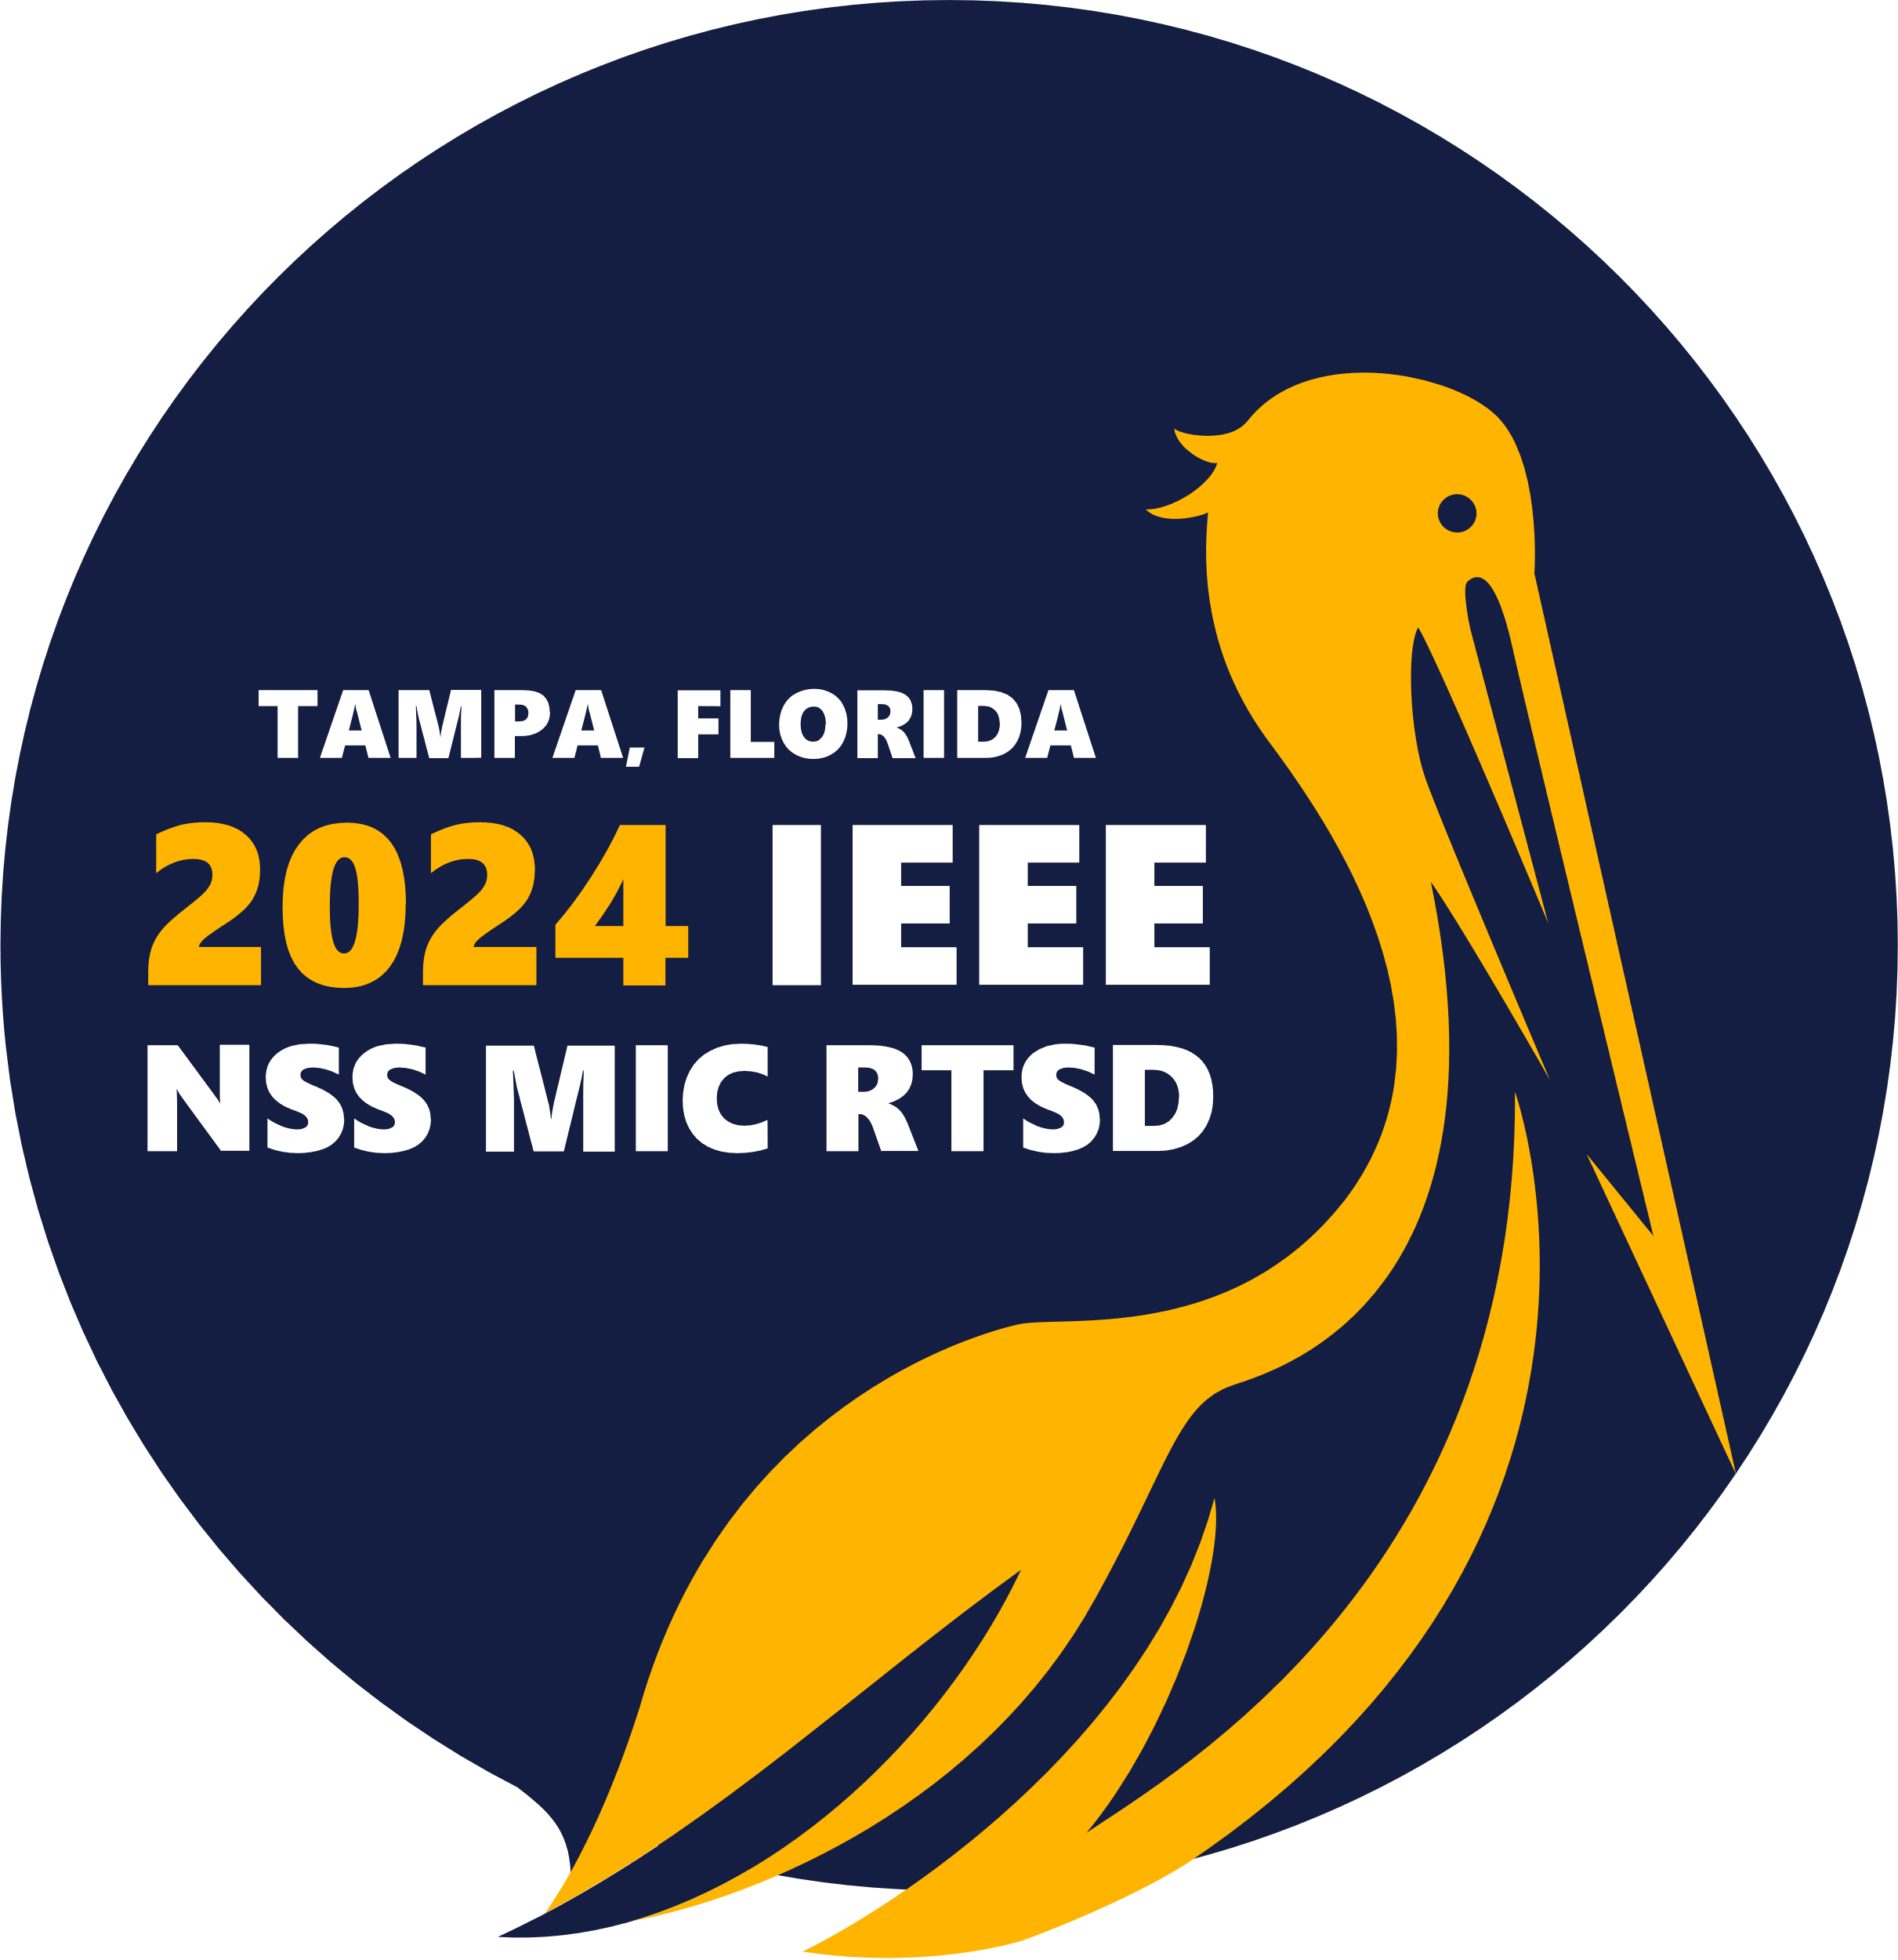


Gate User Meeting, October 31st 2024, Tampa, Florida
GATE Activities at UC Davis: optics & AI
Emilie Roncali
Associate Professor in Biomedical Engineering and Radiology, University of California Davis
Notes:
Recommended in 35% cancers (a third of all cancer deaths)

Slide 2
Outline
Expanding the suite of LUT Davis options
  Crosstalk LUTs
  PHC LUTs
  SiPM modeling
optiGAN
GATE 10 implementation

Slide 3
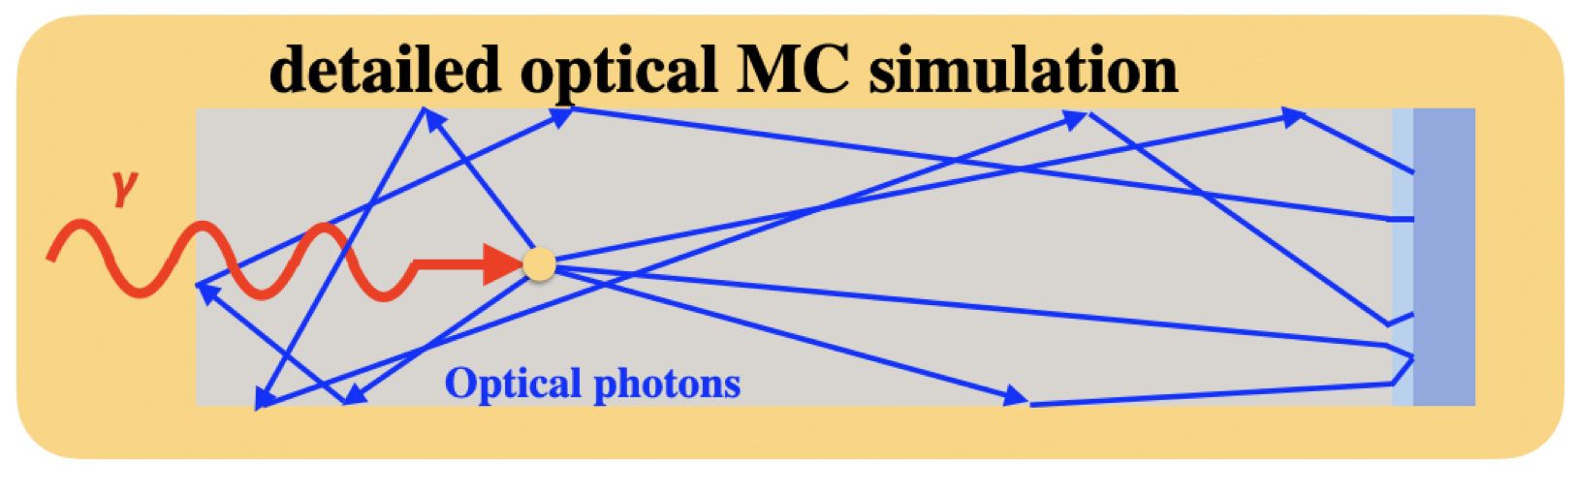
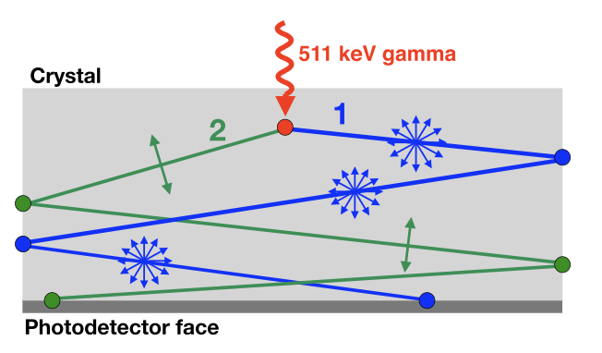
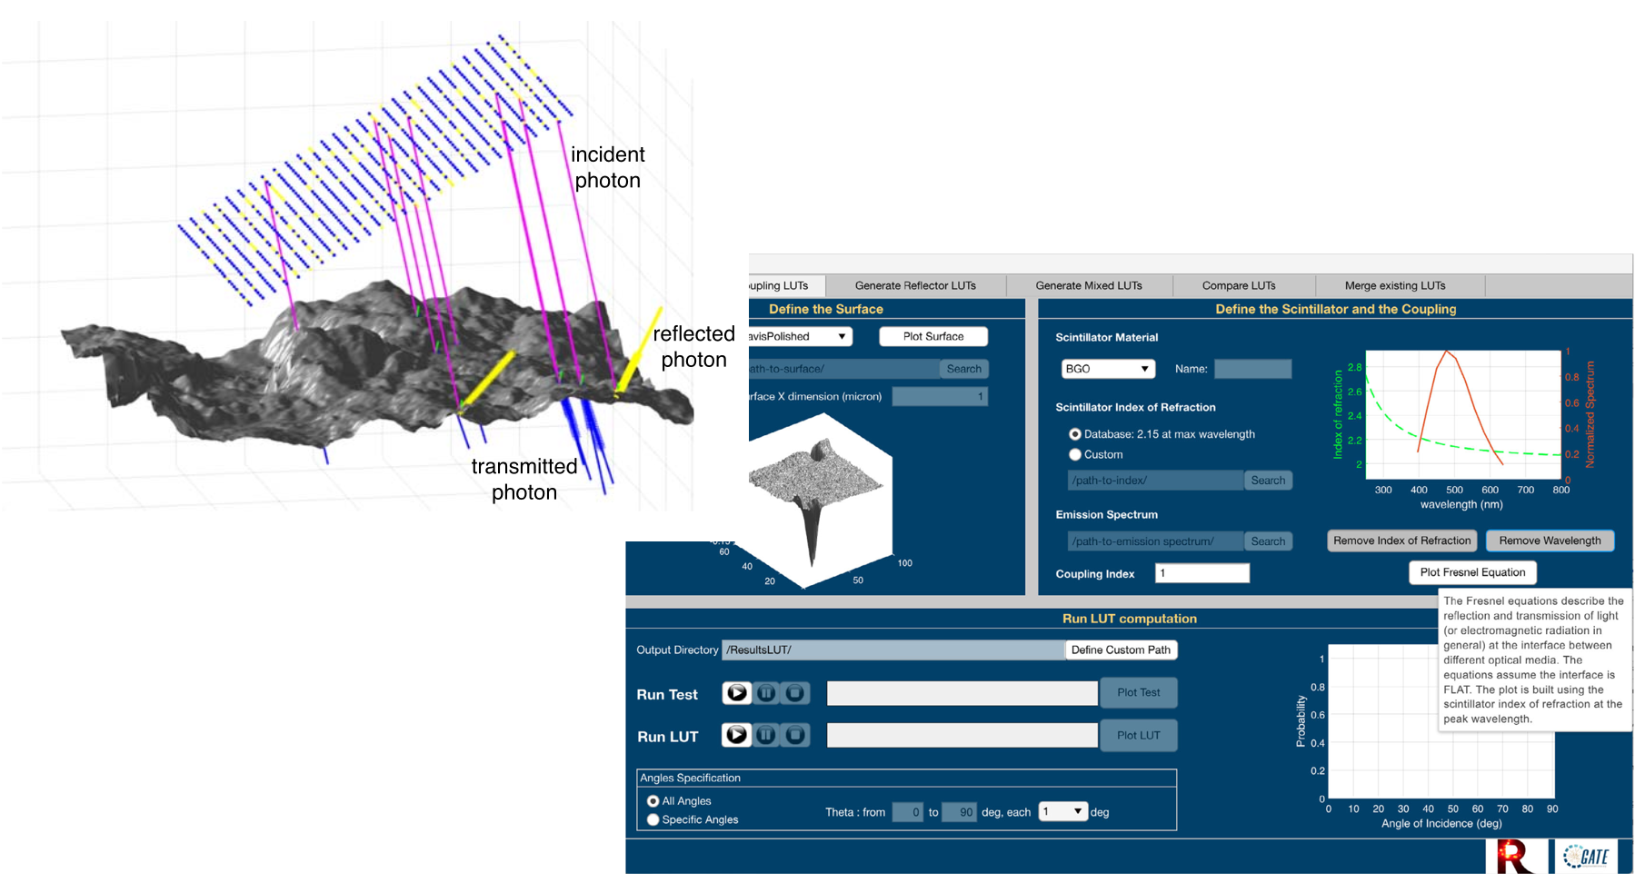
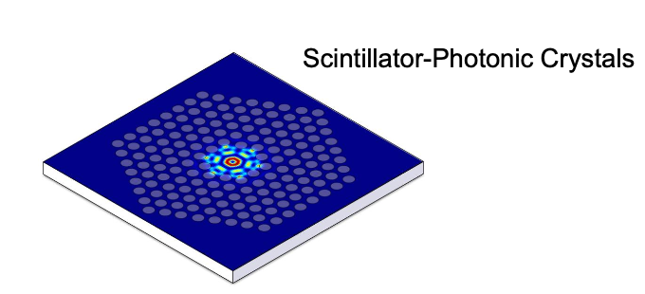
Detailed simulation of scintillation and Cerenkov photons
Optimization of scintillation and Cerenkov behavior at crystal interfaces
Cerenkov photons polarization
App to generate Look-up table for optimized simulation
of optical photon transport
Trigila C. et al., PMB (2021)
Roncali E. et al., PMB (2017)
Photonic Crystals
Trigila C. et al., Medical Physics (2021)
Trigila C. et al., Medical Physics (2022)
He X. et al., TRPMS provisionnally accepted (2024)

Slide 4
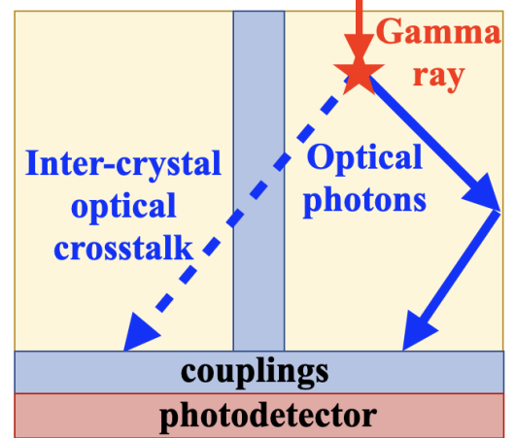
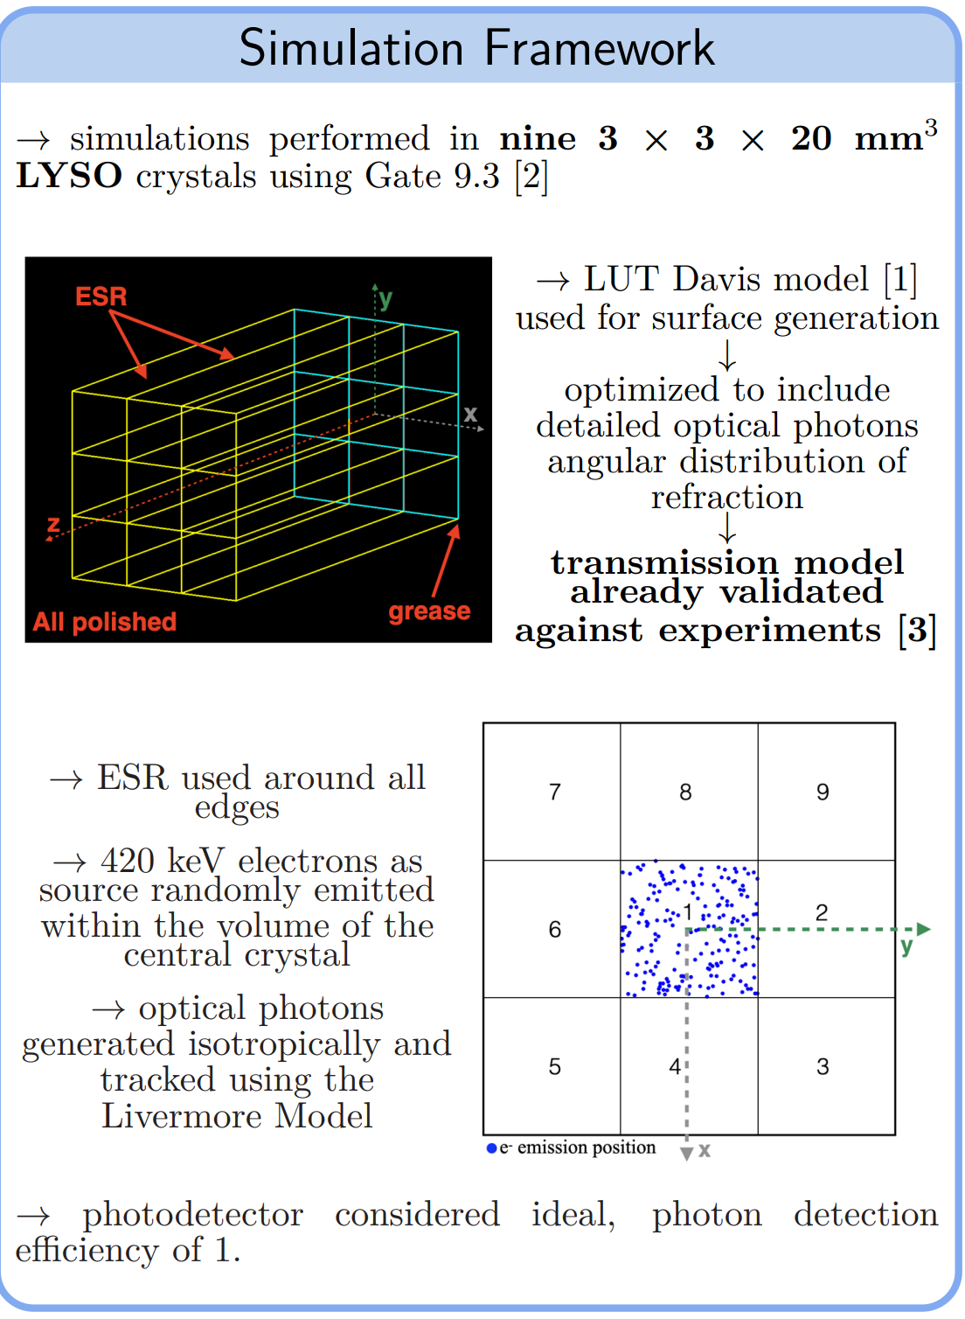
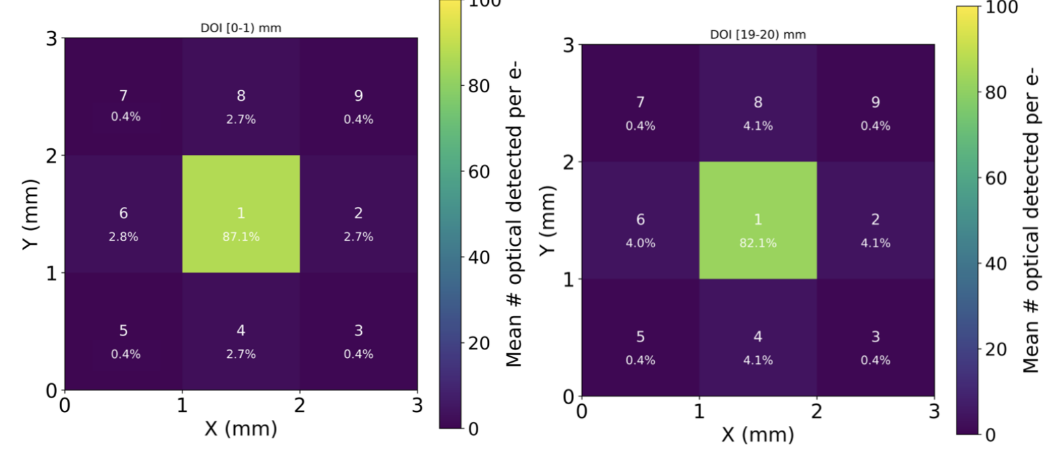
Optical crosstalk: transmission LUTs
Carlotta Trigila, M03-055 Wednesday October 30th 14:00
Notes:
→ Majority of the optical photons directly detected by the central crystal (crystal 1)
→ Less than 5% transmitted to each of the lateral neighbors of the central crystal
(crystals 2, 4, 6, 8)
→ Around 0.4% of the optical photons transmitted and detected by each corner crystal
(crystals 3, 5, 7, 9)
For larger DOI values (further from the photodetectors), the percentage of optical
photons detected in the central crystal decreased in the advantage of an increase of
photons transmitted to the neighboring crystals
→ No significant dependency of DOI position was observed in the corner crystals.

Slide 5
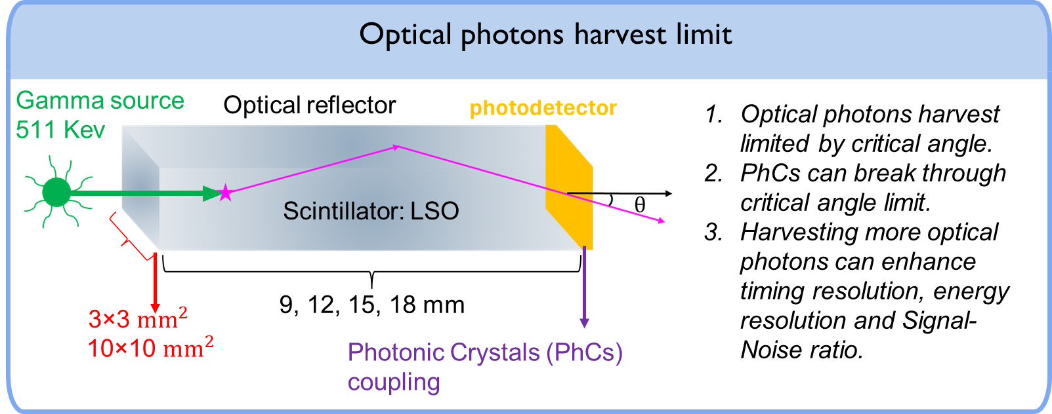
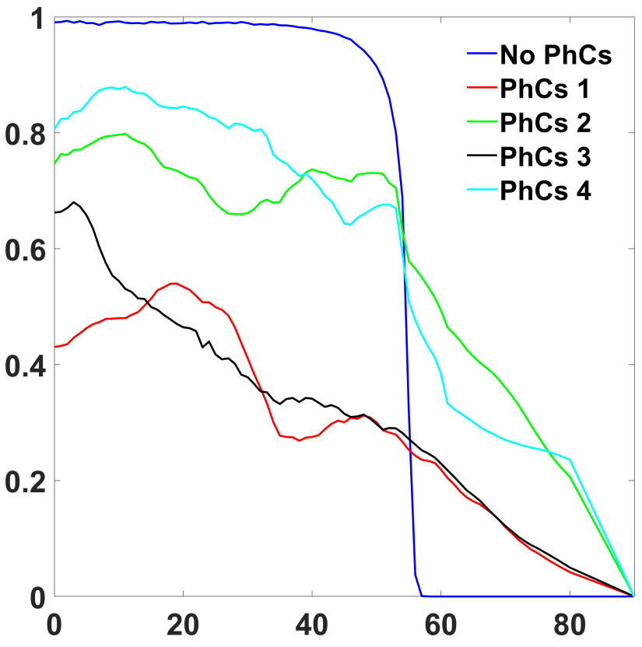
Photonic crystals modeling in GATE: new PhC LUTs
Xuzhi He, M17-042 Friday November 1st 16:20
Transmissivity vs Incident angle
Incident angle
Photonic Crystals can break through critical angle limit
He X. et al., TRPMS provisionnally accepted (2024)

Slide 6
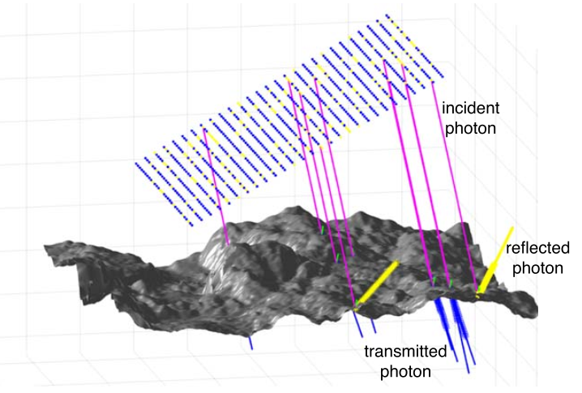
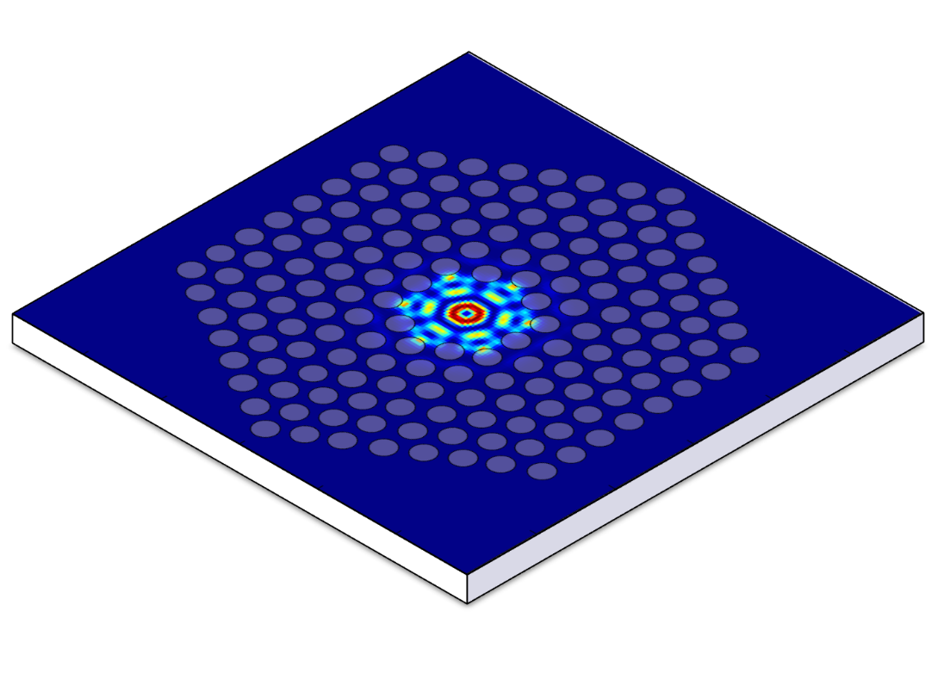
PhC LUTs to model PhC-crystal interfaces
Scintillator-optical reflector
Scintillator-optical grease
LUT DAVIS Standalone application
Does not work for photonic crystals
→ Need wave optics
Carlotta Trigila and Emilie Roncali 2021 Phys. Med. Biol. 66 21NT03
Ansys Lumerical FDTD
Scintillator-Photonic Crystals
Finite Difference Time Domain
Near Field
project
Far Field
https://optics.ansys.com/hc/en-us/articles/360041567754-Photonic-crystal-cavity
3D spatial Probability Distribution
Notes:
LUT DAVIS Standalone application follows geometry optics rule.
Ansys Lumerical FDTD: follows wave optics theory, which is used for Photonic crystals simulation. Geometric optics rules don’t apply for Photonic crystals modelling.

Slide 7
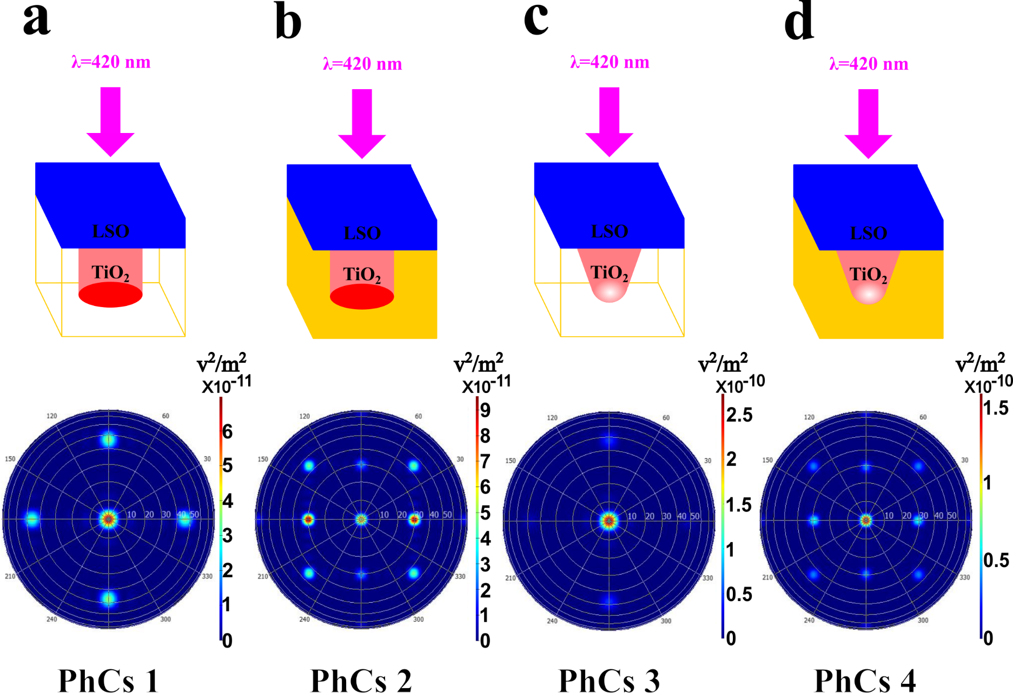
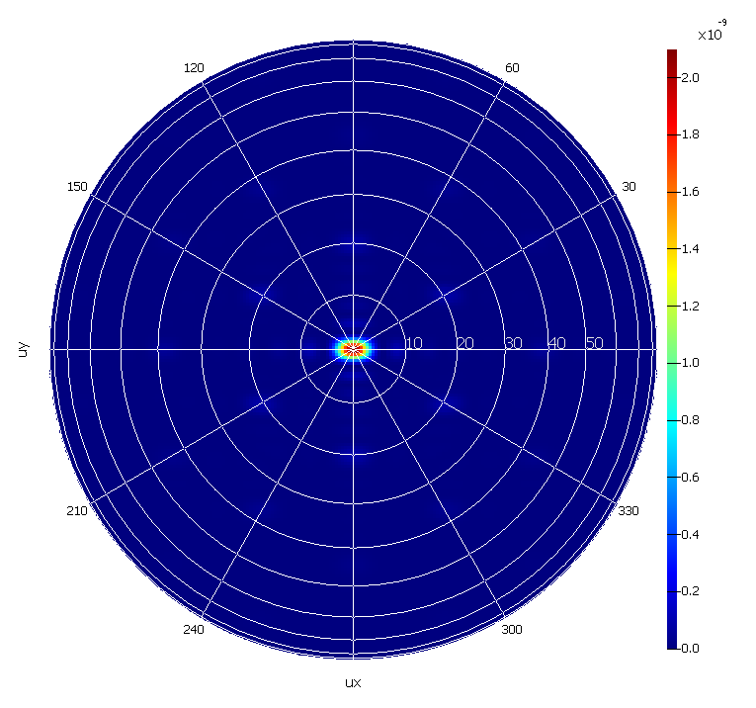


Application of PhC LUTs to optimize structure
Square lattice
580 nm
LSO
$${TiO}_{2}$$
Hexagonal lattice
$${SiO}_{2}$$
1000 nm
⇒ Use 5 new phC LUTs to run simulations in single crystal
Notes:
Make 5 LUTs, run simulation in single crystal 3x3x20 BGO and compare light output

Slide 8
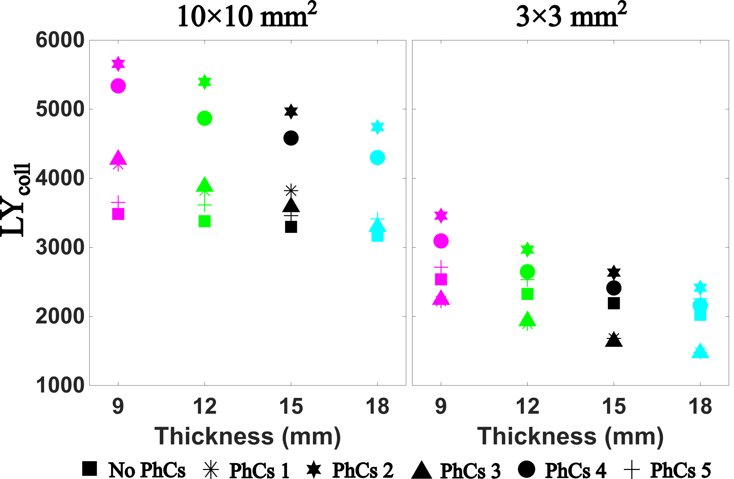
Results: Collected optical photons / gamma event
Average number of optical photons / gamma
Notes:
More light with 10x10
Thicker crystal and PhC 3 show poorer performance
New hexagonal lattice very similar to PhC 4 for small crystal and performs poorly for larger crystal?
PhC2 best for both sizes

Slide 9
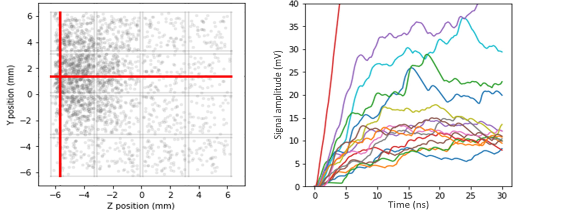
Standalone Monte Carlo simulation at micro-cell level to generate SiPM signals
Brahim Mehadji, M17-063 Friday November 1st 16:20
Initialize a signal with white noise
Generate a pulse in the signal frame
Output
signal
Input: optical simulation by user
Photon list (X,Y,Z,T,eV,µcell)
Pulse list
Simulate pulse SPTR and PDE
Simulate dark counts
(X,Y,Z,T, DCR,µcell)
Generate after-pulses and delayed crosstalk photons
Generate crosstalk photons
Simulation of SiPM-based gamma ray spectrometry and timing
Aimed at light-based where waveforms need to be simulated
Interesting for calorimetry since SiPM PDE and noise distribution affect energy resolution
Notes:
: Left: Impinging photons distribution and position of gamma ray photo-electric interaction within a Cerium Bromide monolithic crystal of 1.2 × 1.2 × 5 mm³ coupled to the SiPM array.
Right: first 30 ns of the corresponding simulated SiPMs signals that demonstrates the feasibility to simulate an SiPM array with SiPMSiM. One can also identify a signal that is both higher in intensity and has a steeper slope compared to others, which corresponds to the signal from the SiPM directly facing the interaction point of the gamma ray (in red).

Slide 10

Standalone SiPM Monte Carlo simulation toolkit available in Github
https://github.com/SiPMsim/SiPMsim
Gate or Geant4 are not needed, but also easy to incorporate in Geant4 !
Any contribution is welcomed !
bmehadji@ucdavis.edu
Notes:
Dependencies to temperature and over-voltage are being implemented.
The latest release enables simulation of SiPM arrays.
simulating inter-crystal optical crosstalk within a detector array to analyze the effects of inter-SiPM crosstalk on timing and energy resolution, using the newly released version

Slide 11
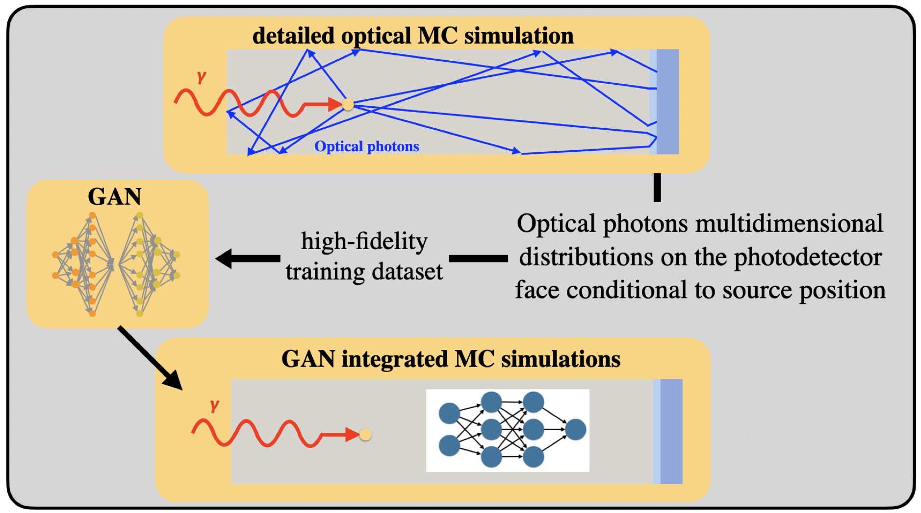
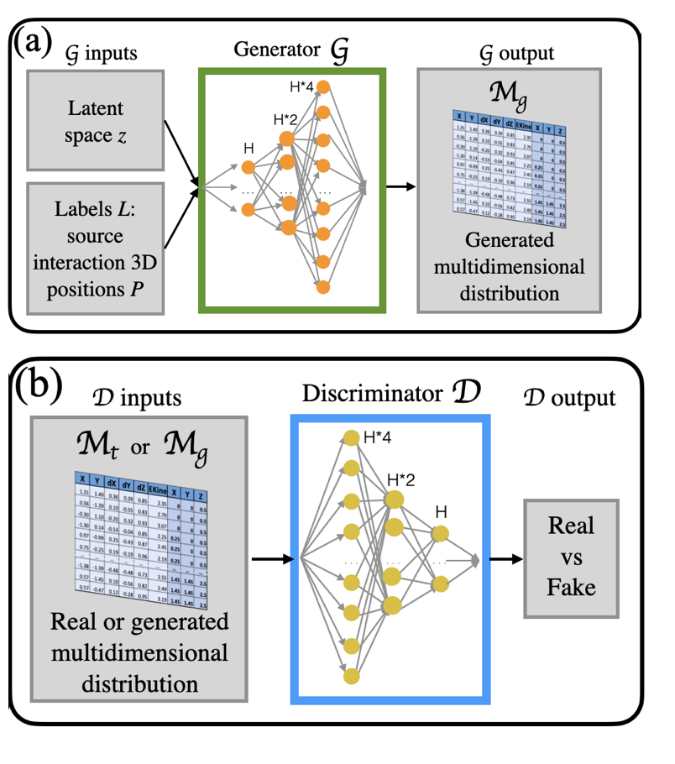
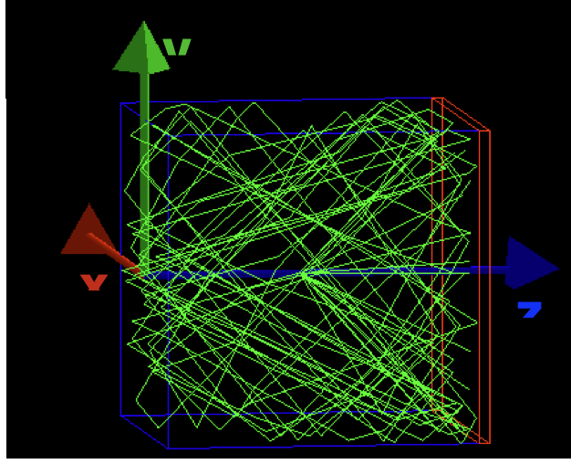
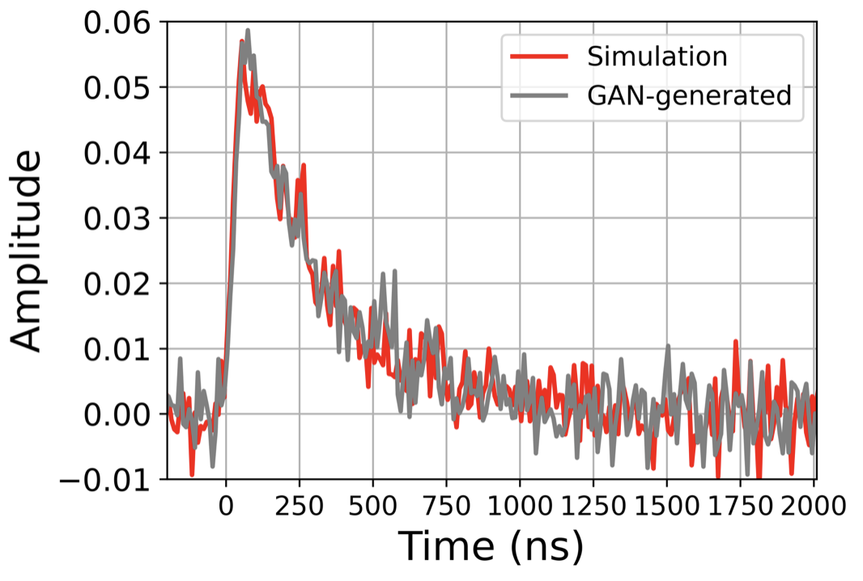
optiGAN: speed up particle transport simulation
High fidelity optical MC to build multidimentional training data
Trigila, C. et al., Machine Learning: Science and Technology (2023)
Srikanth, A., et al., Machine Learning: Science and Technology (2024)
Agreement optiGAN / Monte Carlo simulation
SiPM signal generation with GAN output to accelerate system simulations

Slide 12

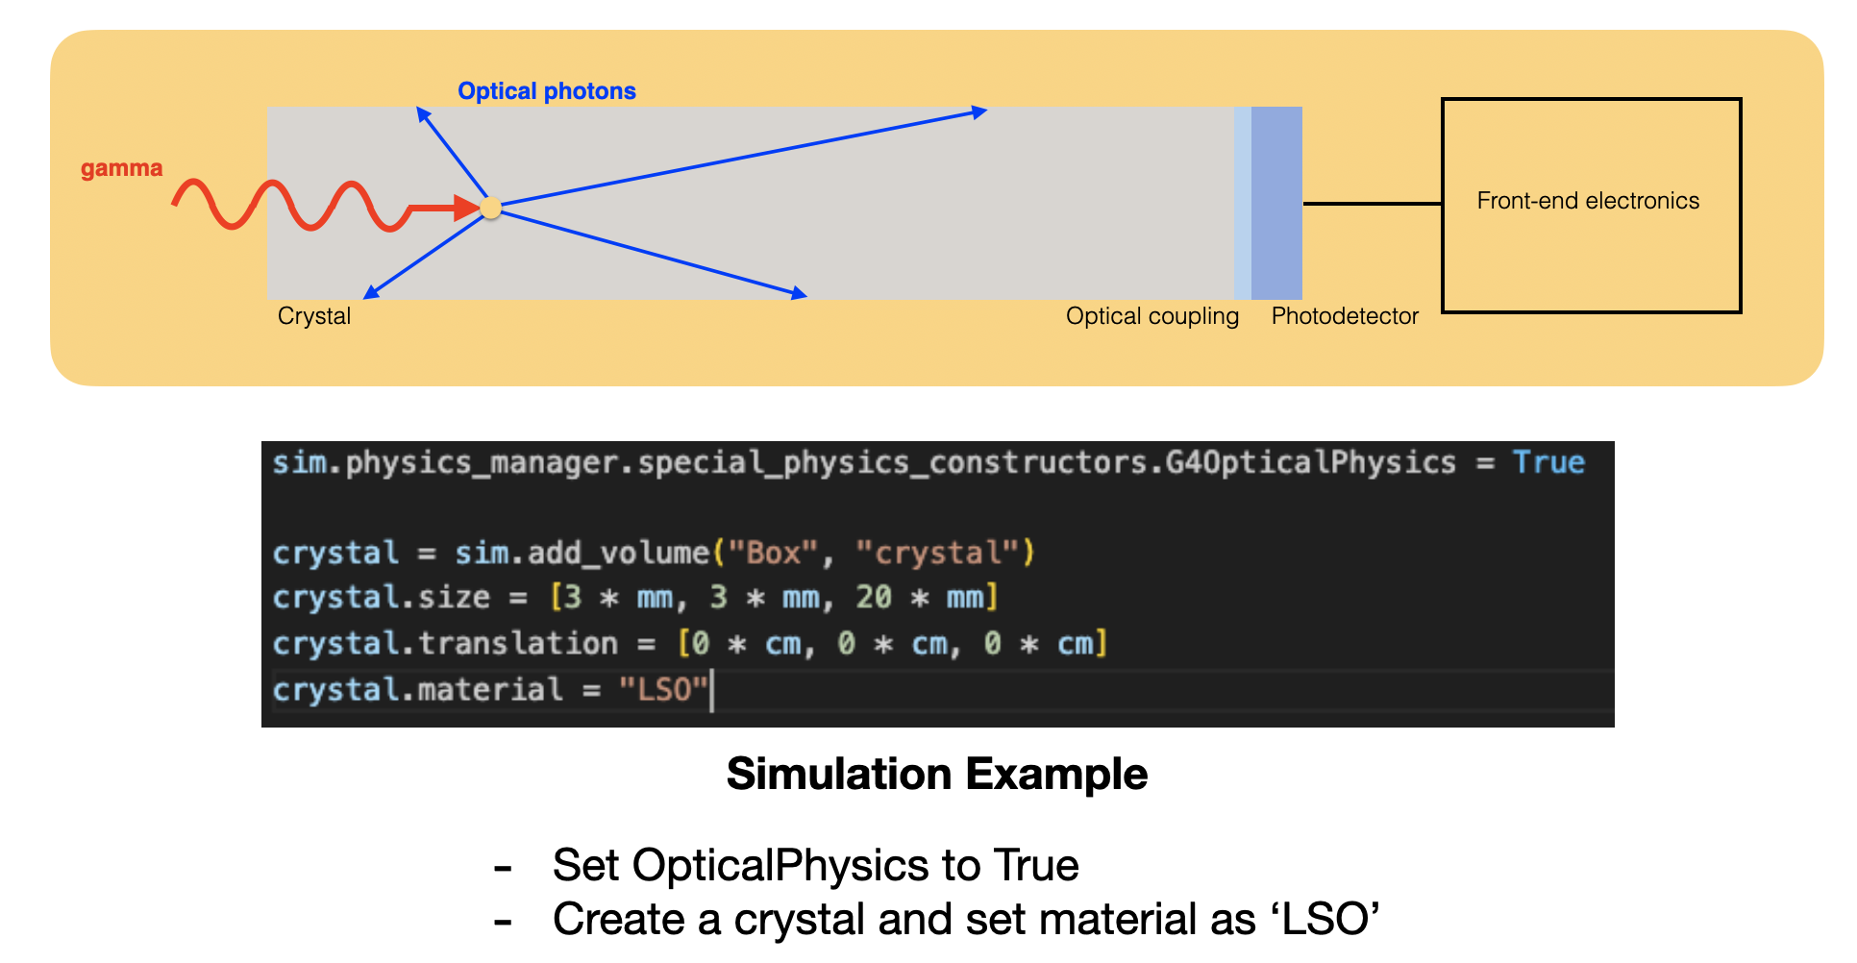
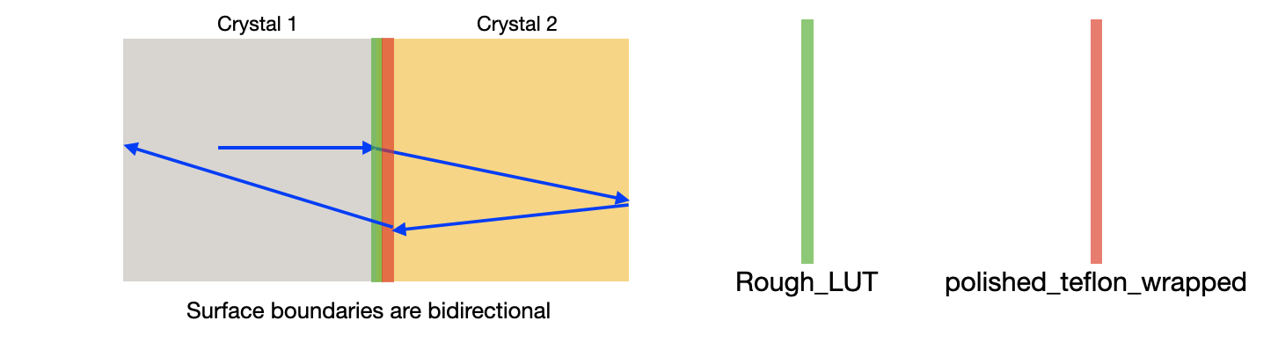
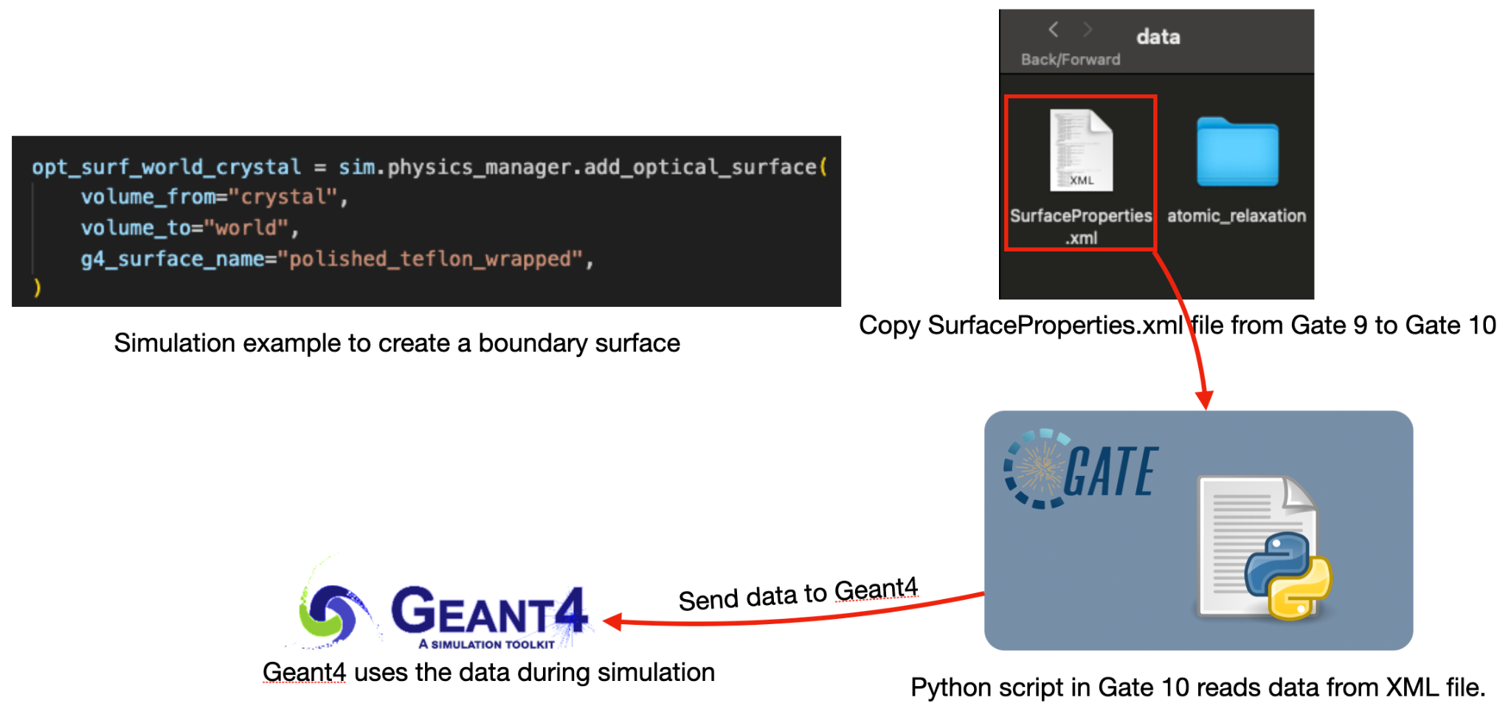
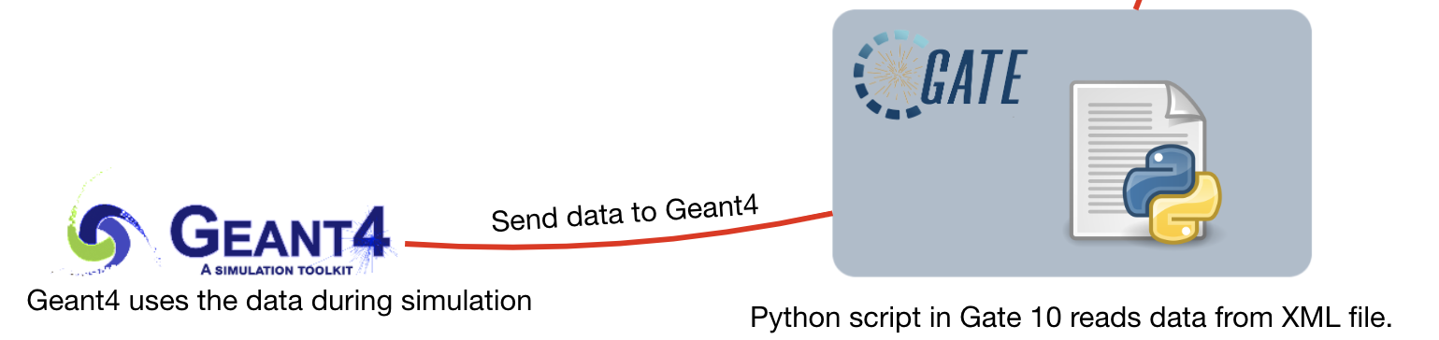
Optical models implementation in Gate 10
v10
Emission processes Optical surface boundaries
Notes:
Emission processes
Heavy collaboration with CREATIS
Guneet Mummaneni and Carlotta Trigila’s work

Slide 13
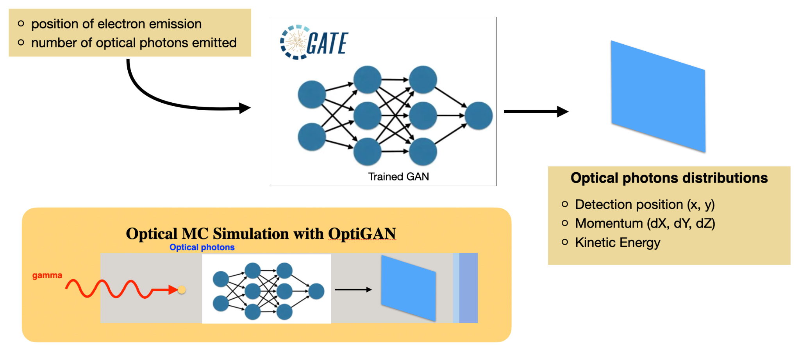
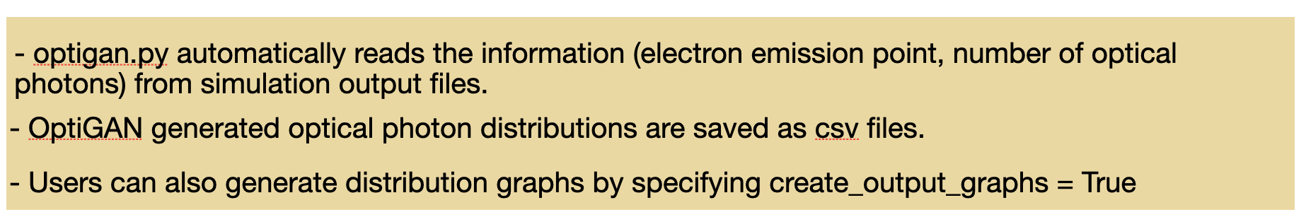
optiGAN Implementation in Gate 10
v10
Leverage the capability of integrating pytorch and GATE simulations!
test081_simulation_optigan_with_random_seed.py

Slide 14
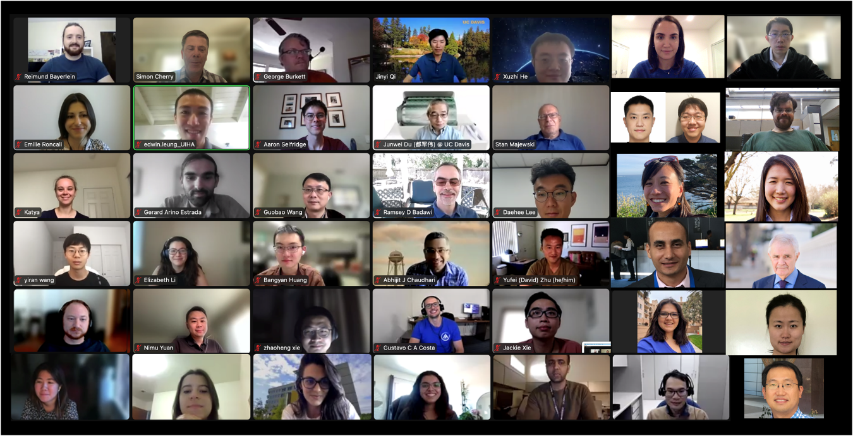
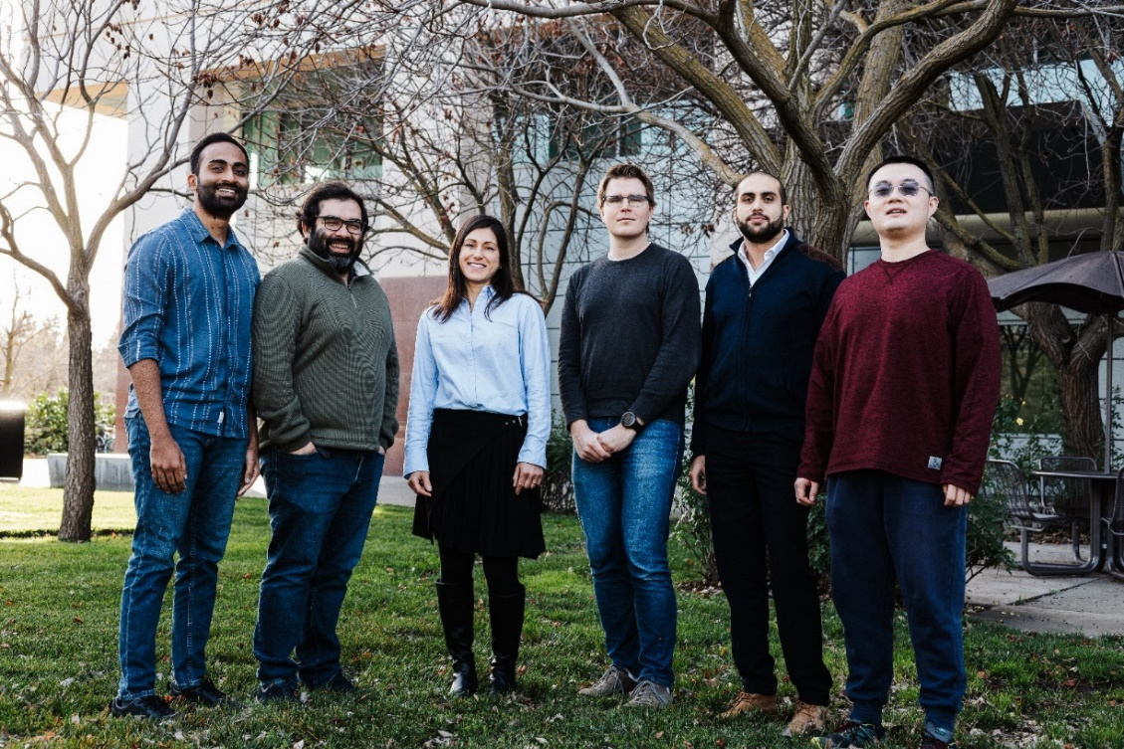

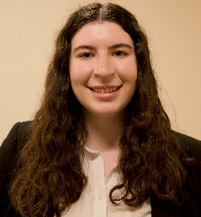



Acknowledgments
UC Davis Biomedical Engineering
Gerard Ariño-Estrada, Ph.D.
Xuzhi He
Sun-Il Kwon, Ph.D.
Brahim Mehadji, Ph.D.
Guneet Mummaneni
Carlotta Trigila, Ph.D.
Anirudh Srikanth, MSc.
PEMI group
CREATIS, Lyon France
David Sarrut, Ph.D.
Nils Krah, PhD
Thomas Baudier, PhD
R01 EB027130
R01 EB034475
U01CA289068

