Slide 1


The OpenGATE collaboration
People, software, trainings and events
Lydia Maigne, Laboratoire de Physique Clermont Auvergne
lydia.maigne@clermont.in2p3.fr

Slide 2






The OpenGATE collaboration
25 laboratories, companies, clinics developing and validating an open source platform
Europe
FH Aachen, University of Applied Sciences, Julich, Germany
Medisip, Ghent University, Belgium
Medical University of Vienna, Wiener Neustadt, Austria
MedAustron, Wiener Neustadt, Austria
Christie Medical Physics & Engineering, Manchester, UK
JPET collaboration, Poland
Institute of Nuclear Physics Polish Academy of Sciences, Poland
Univ. of Patras, Dept of Med. Phys., Greece
BioemTech, Athens, Greece
Paul Scherrer Institute (PSI), Switzerland
Elsewhere
MSKCC, New York, USA
UC Davis, Davis, USA
Sogang University, Seoul, South Korea
QST, Chiba, Japan

Slide 3

Next GATE events
Oct. 2024
Sept. 2025
November 2024
20 to 22 Remote GATE 10 training
for beginners.
Open to researchers and engineers from public or private institutions.
Last days to register!
https://cnrsformation.cnrs.fr/gate-training-on-medical-imaging-dosimetry-radiation-therapy?mc=gate

Slide 4
Next GATE events
Oct. 2024
Sept. 2025
February 2025
2.5 days GATE 10 Hackaton
Open to PhD students, postDoc, researchers or engineers willing to develop new features with GATE 10
(indico web site coming soon for registration)

Slide 5
Next GATE events
Oct. 2024
Sept. 2025
May 2025
GATE scientific meeting
Annual scientific meeting to present last R&D studies
Registration and program opening in January 2025
2 days
Previous scientific meetings:
22-23 May 2024, in Paris-Orsay (France) https://indico.in2p3.fr/e/gate2024
25-26 April 2023, in Krakow (Poland) https://indico.in2p3.fr/e/gate2023

Slide 6
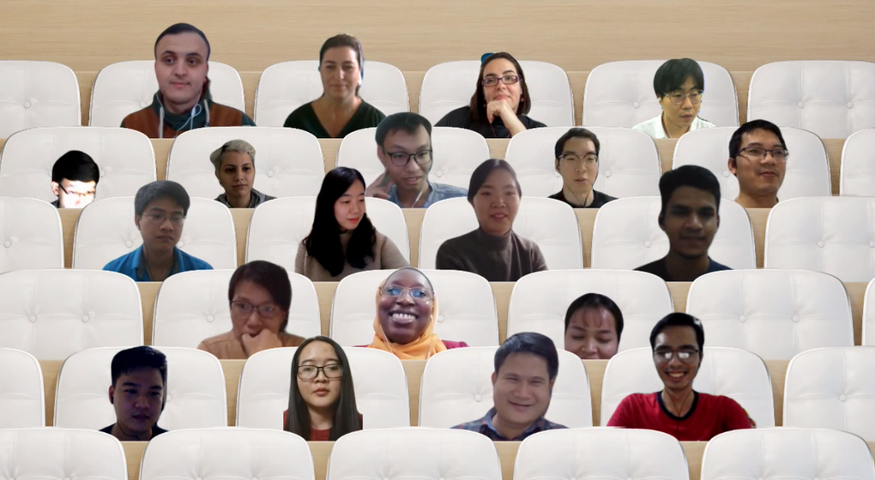


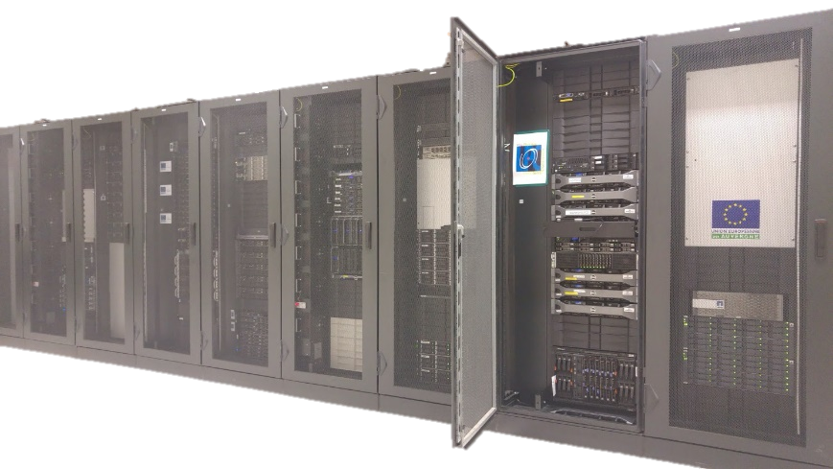
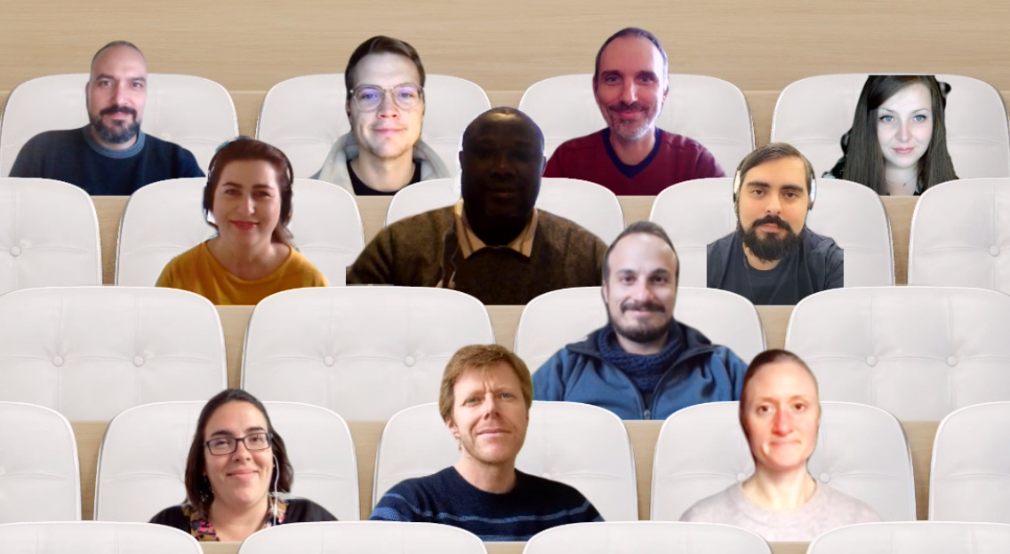
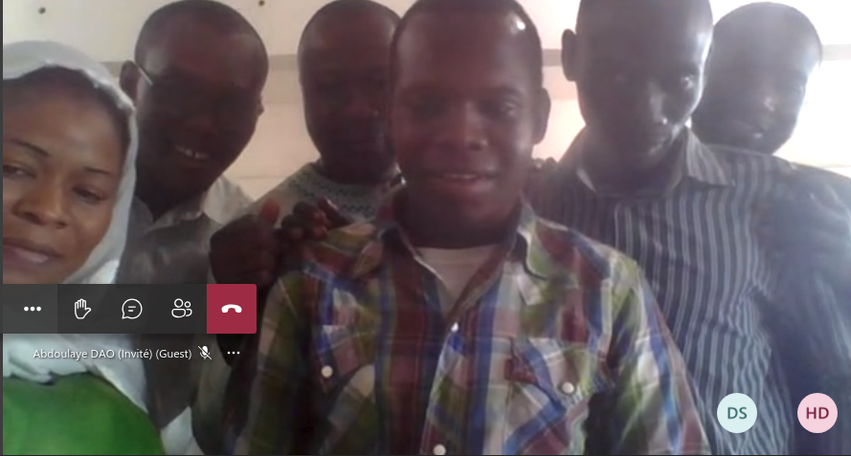
GATE training hub for students
Pacific Asia region 2022
2 servers dedicated to training
100 simultaneous connections
For on site or remote tutorials
Shared course materials
Service open since 2021
Africa 2022
Europe 2022
Mali 2021
Please contact Lydia Maigne: lydia.maigne@clermont.in2p3.fr to set up your remote training

Slide 7




GATE 10 – GATE new era
Current is 10.beta9
With Geant4 11.2.1
On Linux, Mac (Intel + Silicon), Windows*
With Python 3.9, 3.10, 3.11, 3.12
https://github.com/OpenGATE/opengate
https://github.com/OpenGATE/opengate/tree/master/opengate/tests/src

Slide 8
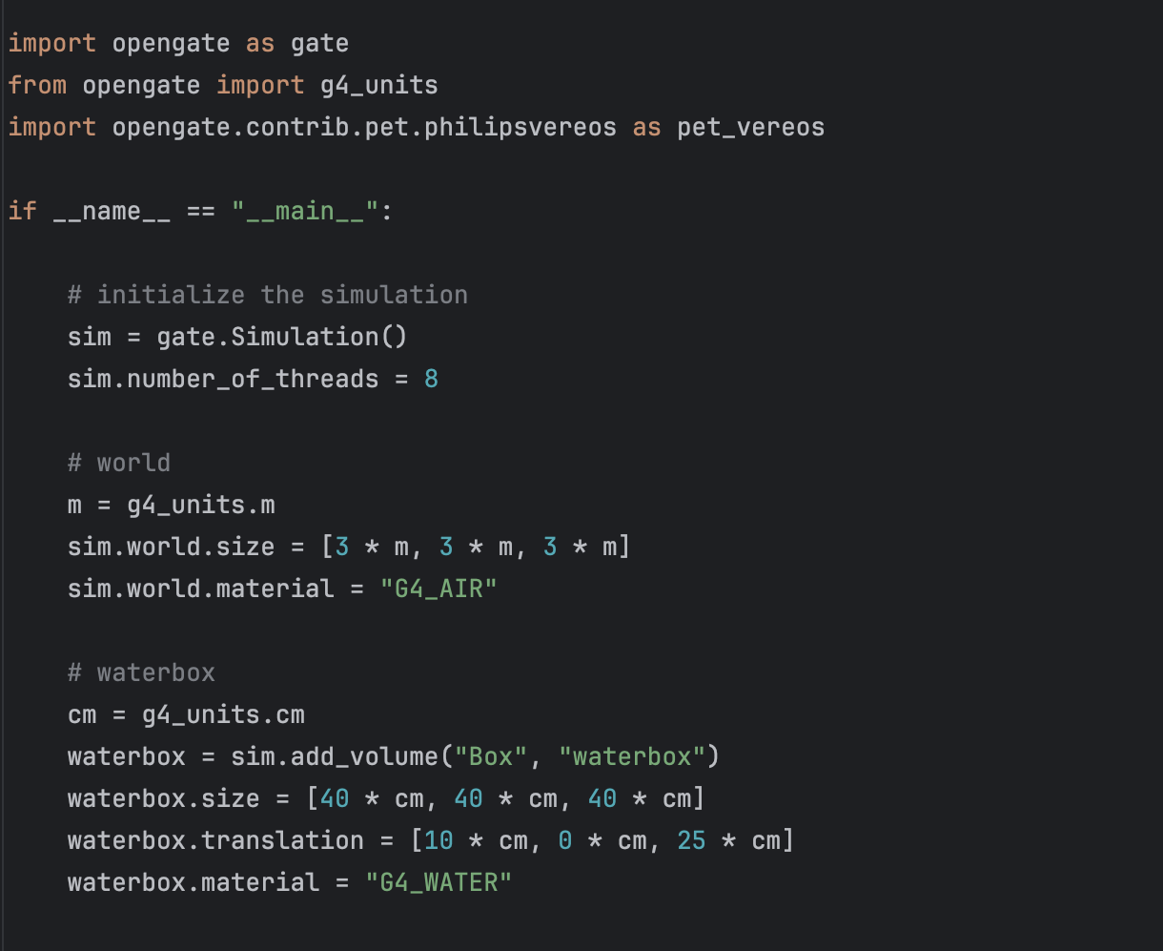
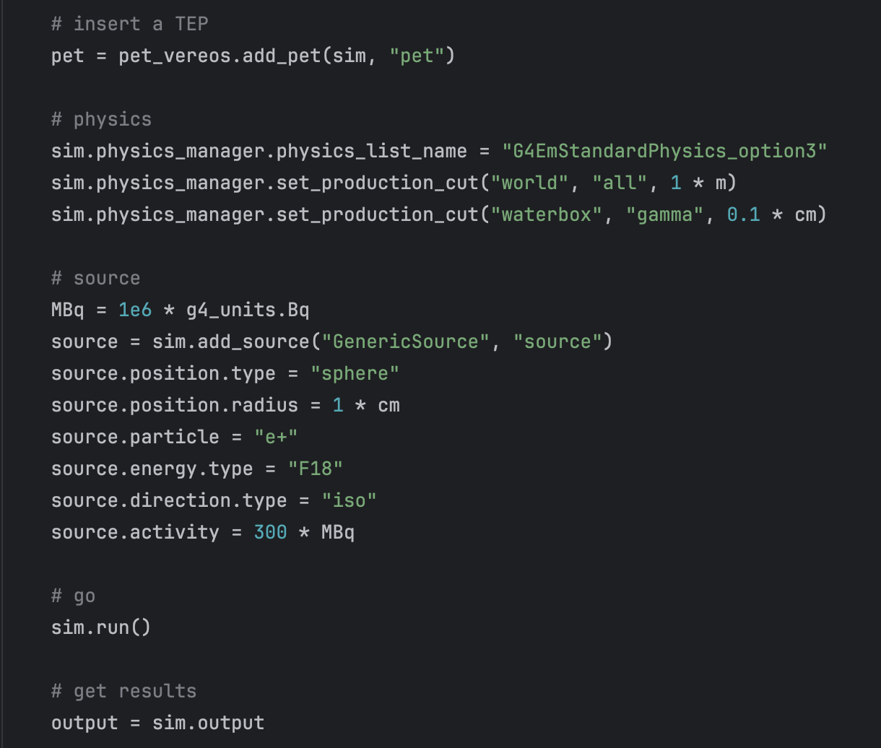
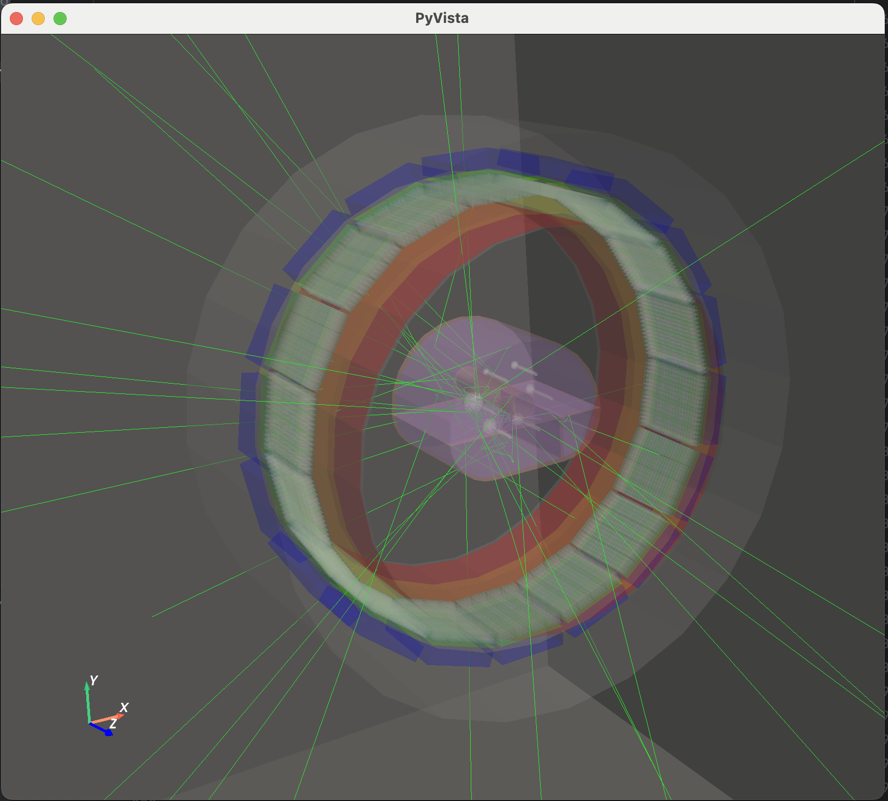
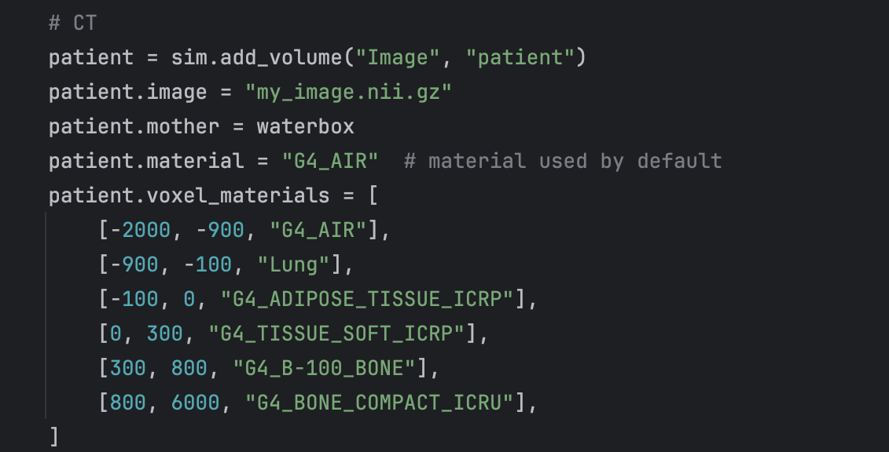
Example

Slide 9

GATE 10 - The source code
g4_bindings/ Geant4 binding from C++ to Python
(expose functions, classes) ; pybind11
opengate_lib/ Core classes (running): source, scorers etc
opengate/ User UI (initialisation)
One main object : Simulation
3 sub-main concepts: geometry sources actors
tests to help configure your scripts: tests

Slide 10

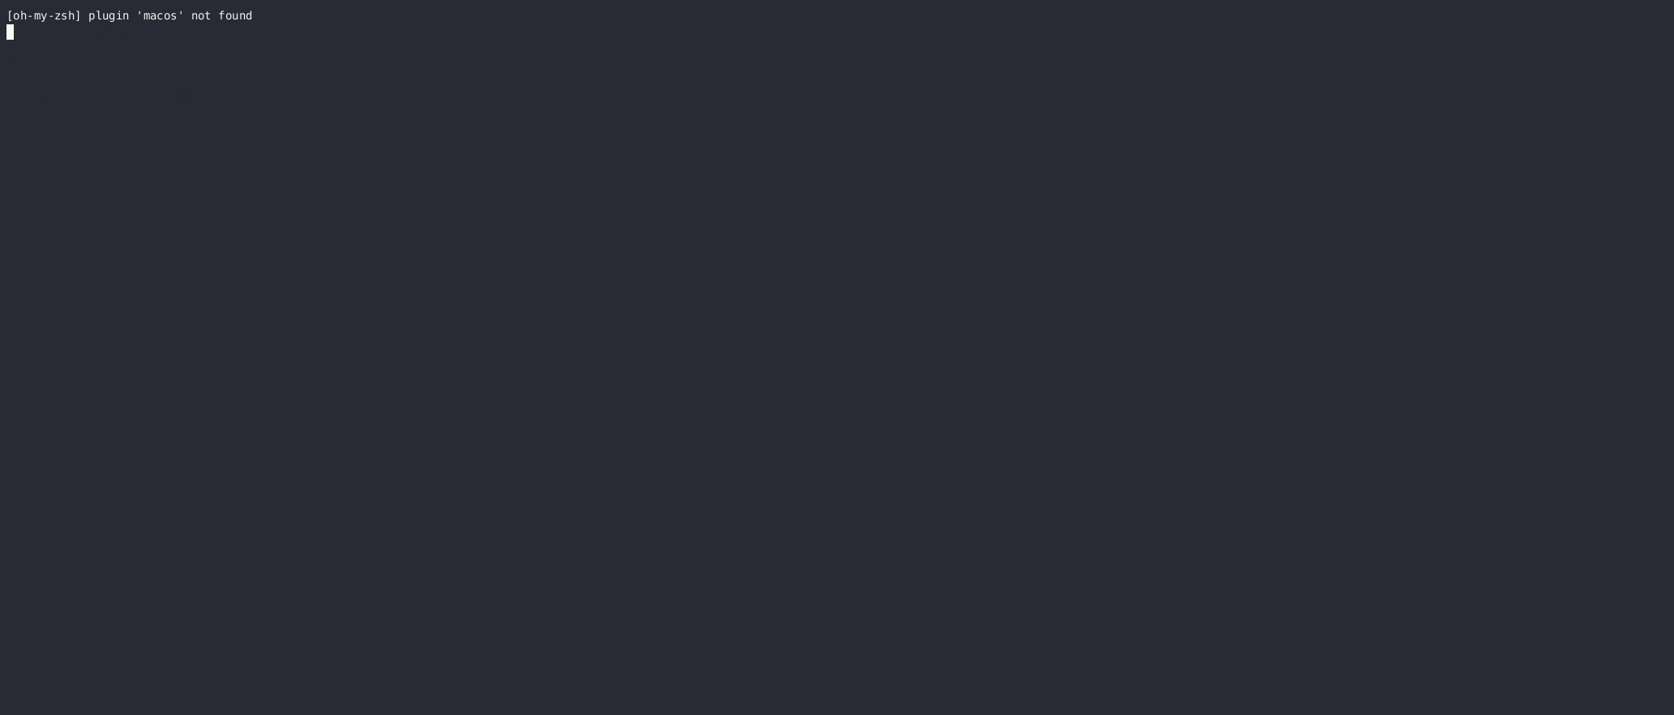


Installation
--pre only during the beta period
pip --pre install opengate
Take care of architectures and python versions
Install: GEANT4, ITK, QT, UPROOT, etc
Ready in few minutes
Download Geant4 data (10-15 min)
Download data for the tests (5 min)

Slide 11
Status
Still not equivalent to GATE 9.x serie. Estimate : 80%
Available (among others):
  General: time slicing, rnd engines, multithread
  Geom: basics volumes, voxelized, boolean, repeaters, STL, …
  Physics: all G4 physics lists, production cuts, users limits, spliting/Russian Roulette (partial), optical, DNA, …
  Sources: generic, voxelized, beta+, confine, motion, GAN source, TPS source, back to back gamma, PHID, …
  Scorers: DoseActor, Stats, PhaseSpaceActor (root), Adder, Readout (digitizer), AcceptanceAngle, LET, simple offline coincidences sorter (PET imaging)
Not yet implemented (among others):
  Polarization, Y90 source
  TLE, FFD (advanced Variance Reduction Techniques)
  EM field
  Digitizer deadtime, digitizer noise, pile-up, advanced coinc sorter
Estimation: last 5-10% will be very hard

Slide 12
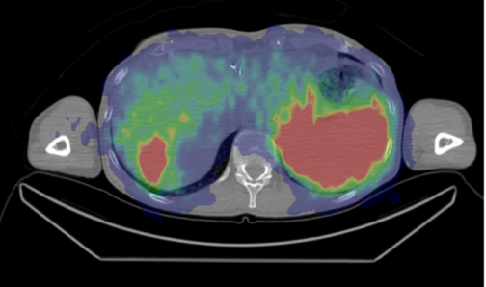

New features
Parallel worlds
  Useful when overlap object/detector
  Typically SPECT + CT volume
  Geant4 parallel world concept
    Very easy
    Maybe slower
Multithreading
  WARNINGS:
  Not all scorers support MT
  Efficiency varies (nb of threads, memory, tasks)
  Wait for threads at each run (slower when motion)
Boolean solids
  Several “solids”
  One single volume
  May slowdown the simulation
GAN, PHID sources
  New GAN sources
    Conditional GAN source for SPECT
    Conditional GAN source for PET
  New PHID source
    For alpha emitters
    Generate all gammas without
    others decay products
Detector
CT volume

Slide 13
Conclusions
GATE 9.X – maintenance at slow pace
GATE 10 – stay tuned for upcoming official first release
  Try GATE 10.beta now
GATE trainings available !
  At all levels
  Remotely or in person
We are here provide all the help needed to get started with GATE!

Slide 14
Useful links
Information
Web site http://www.opengatecollaboration.org
GATE user mailing list https://listserv.in2p3.fr/cgi-bin/wa?A0=OPENGATE-L
GATE documentation
To install GATE https://opengate.readthedocs.io/en/latest/installation.html
To use GATE https://opengate.readthedocs.io/en/latest/
Accessible through Github
Source code 9.X https://github.com/OpenGATE/Gate
Examples 9.X https://github.com/OpenGATE/GateContrib
Analysis tools 9.X https://github.com/OpenGATE/gatetools
Source code 10 https://github.com/OpenGATE/opengate
Examples 10 https://github.com/OpenGATE/opengate/tree/master/opengate/tests/src
Trainings & Workshops
1 workshop @ main conferences : IEEE NSS-MIC, AAPM, MCMA, PTCOG…
Trainings : 1/year for beginners and on demand (schools, master programs…)
  GATE training (beginner level)

Slide 15

Backups

Slide 16
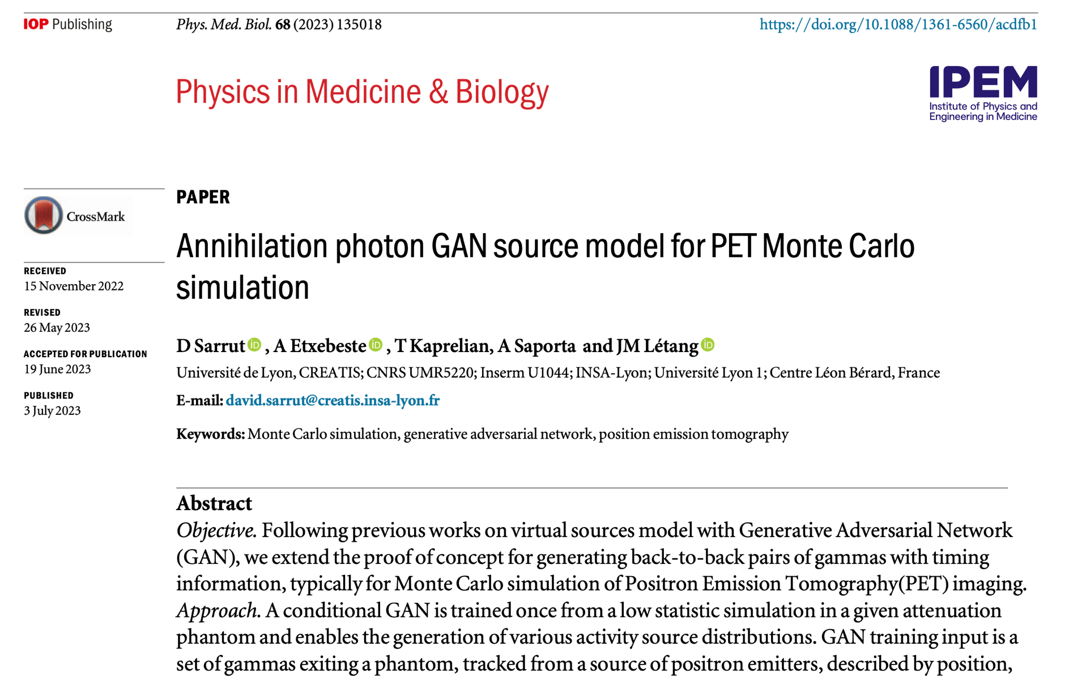
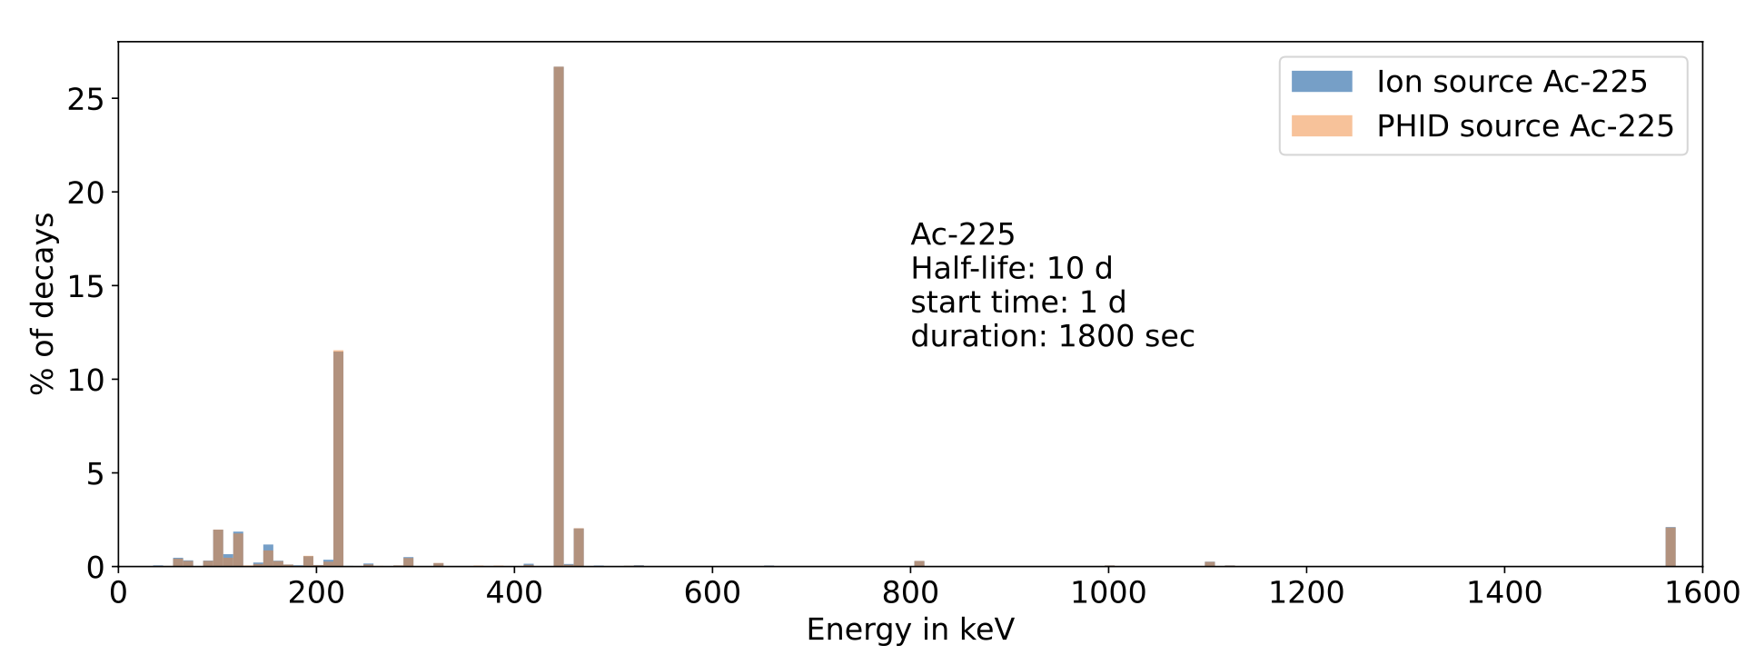
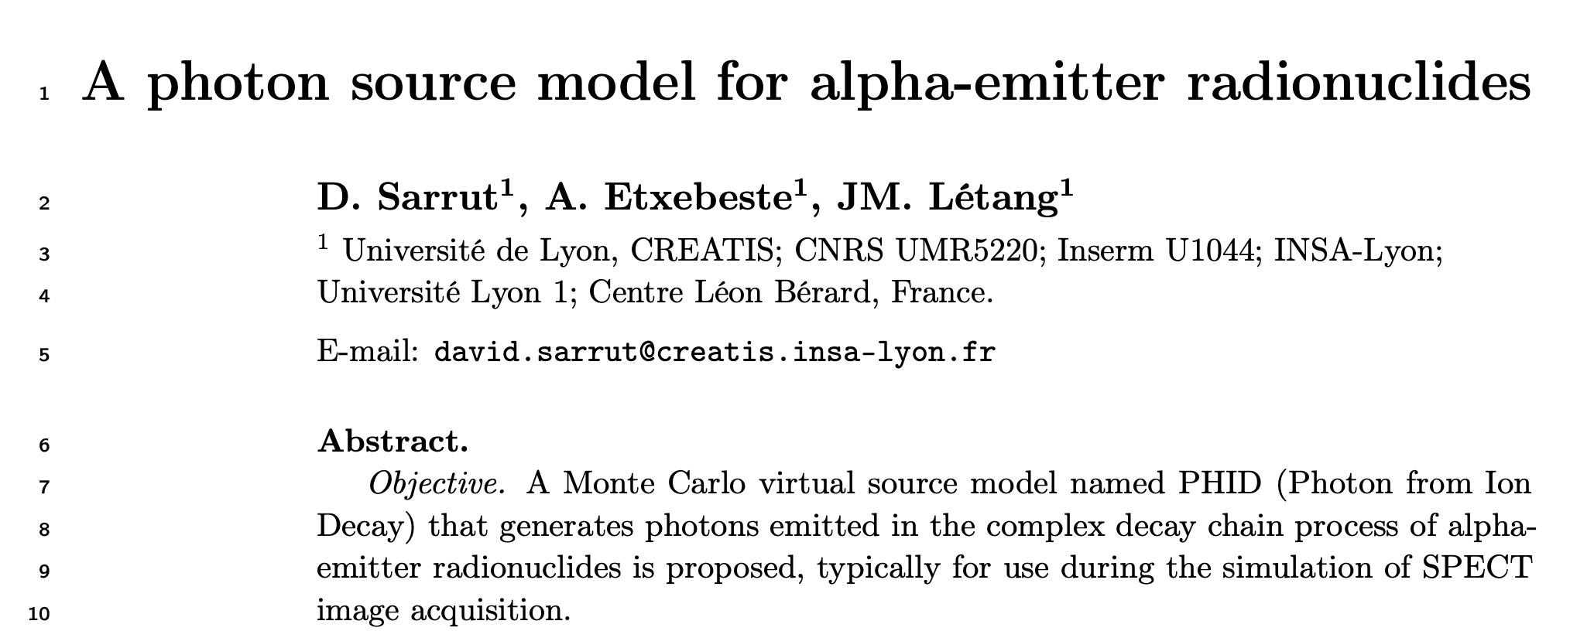
New feature: GAN, PHID sources
New GAN sources
  Conditional GAN source for SPECT
  Conditional GAN source for PET
New PHID source
  For alpha emitters
  Generate all gammas without
  others decay products
[PMB 2018]
[PMB 2019]
[PMB 2021]
[PMB 2023]
225 Ac
[PMB 2024]

Slide 17
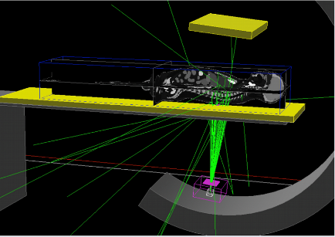
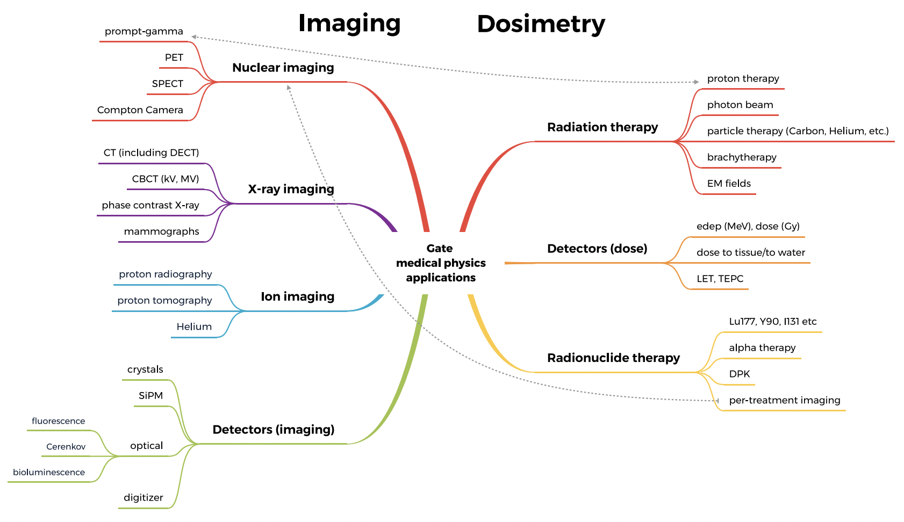
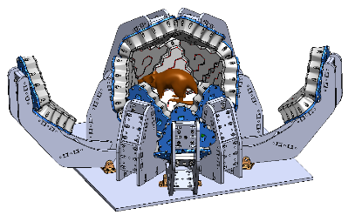
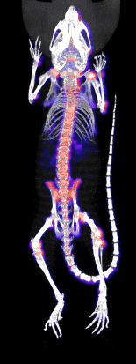
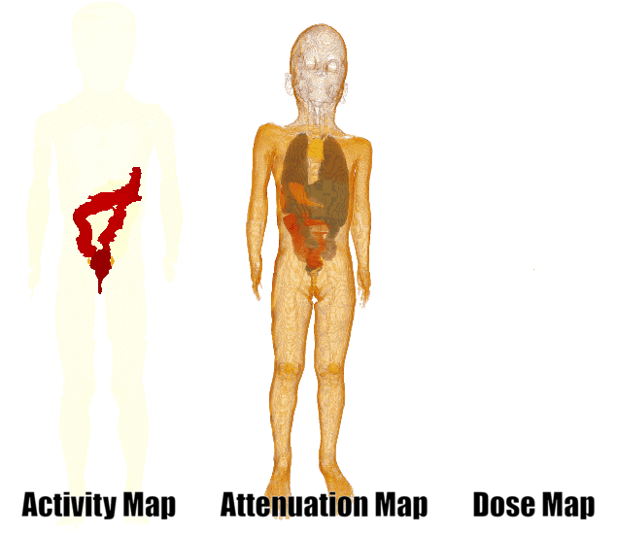
The OpenGATE ecosystem for Monte Carlo simulation in medical physics - https://doi-org.in2p3.bib.cnrs.fr/10.1088/1361-6560/ac8c83

Slide 18
GATE as a module
Gate python code
Geant4 engine: only one execution (“singletons”)
GATE deployment system
  User defines simulation in Python
  Parameters + data are packed for Geant4
  Can be dumped as json (or other file type)
  Simulation is run in a separate process (+threads)
Easy to deploy, share, etc
Can be embedded in any application
json
run
run
…

Slide 19




The OpenGATE collaboration in France
10 labs
BioMaps, CEA, Paris Orsay
IJCLab, CNRS-IN2P3, Paris Saclay
LPCA, CNRS-IN2P3, Clermont-Ferrand
IPHC, CNRS-IN2P3, Strasbourg
CPPM, CNRS-IN2P3, Marseille
CREATIS, UMR5515 CNRS, Lyon
IP2I, CNRS-IN2P3, Lyon
LPSC, CNRS-IN2P3, Grenoble
CRCT, U1037 INSERM, Toulouse
LATIM, U1101 INSERM, Brest

