Slide 1
Few words about test with fine BGO crystal
Friday 29 th November 2024
Magne Magali

Slide 2
Test setup
Cosmics flux
Oscilloscope Tektronix
BW 350MHz
Input : 50 ohms
HV - 800 V
Output file: .csv
PMT
Pmt Hamamastsu R7877
+ divider bridge
Trigger:
Signal < 5mV during minimum 15 ns
(to supress single photons / dark noise)
Fine BGO crystal
1.8cm *1.8 cm *1mm
Signal sheet read and analysed by Labview software

Slide 3
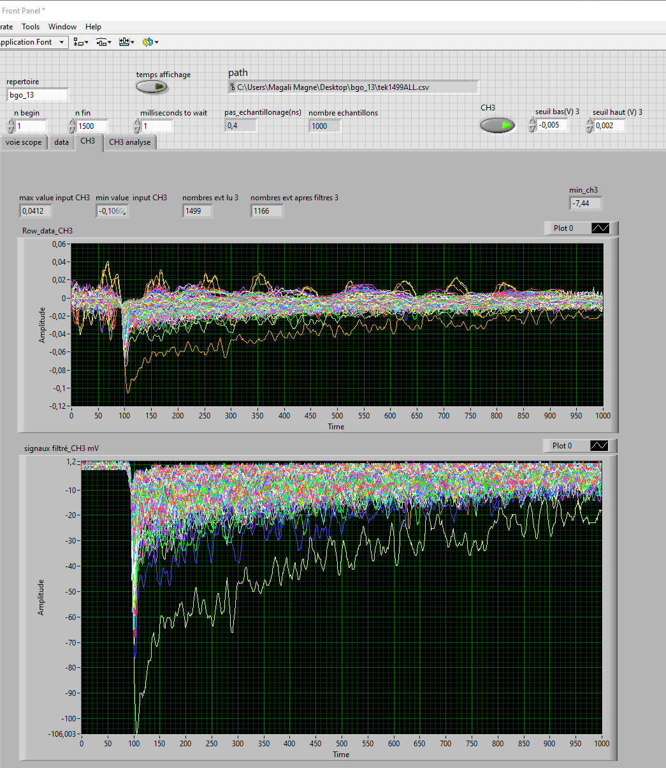
acquisition of 1day
It’s takes time to find the right trigger
With coincidence of PMT top and botom low rate and only few signal on BGO
Finaly only trig on pmt signal with more constraint in trigger selection and post selection before analysing .
With this trigger in one arround 1 day we have :
1500 signal capture by the oscilloscope
We reduce to 1106 of significant signal to be availaible for analyse

Slide 4
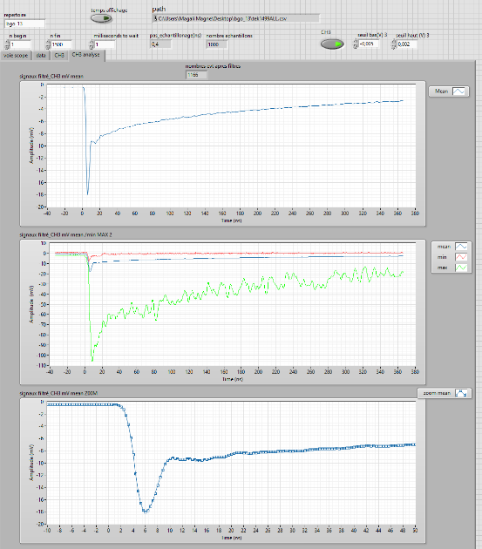
Simple Analyse
Mean signaux of the avalaible signal
Fall time = ~ 4 ns
1st peak ~6 ns (20/ 80%)
Rise time ~400ns
Zoom of the begin of the mean signal

Slide 5
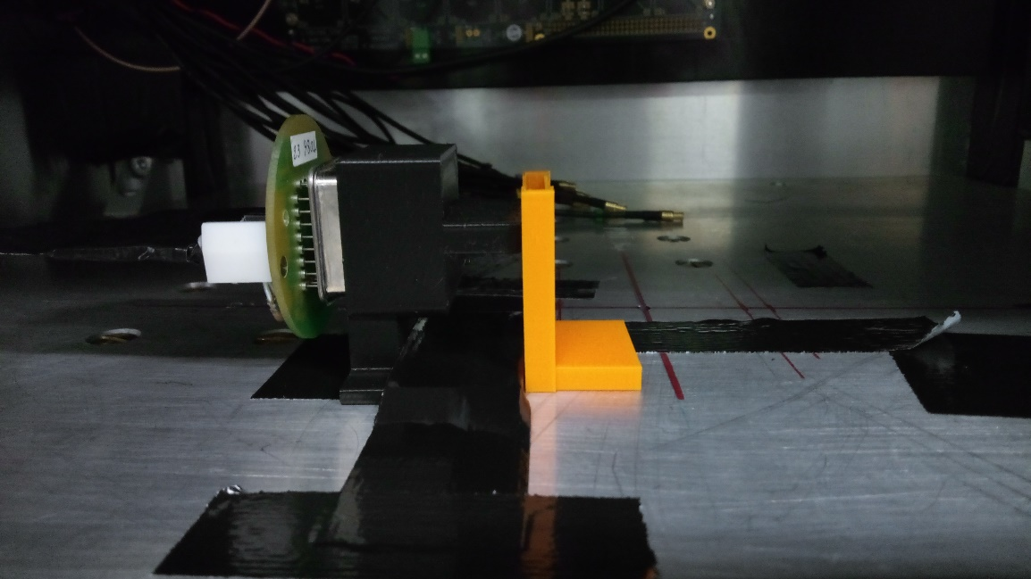
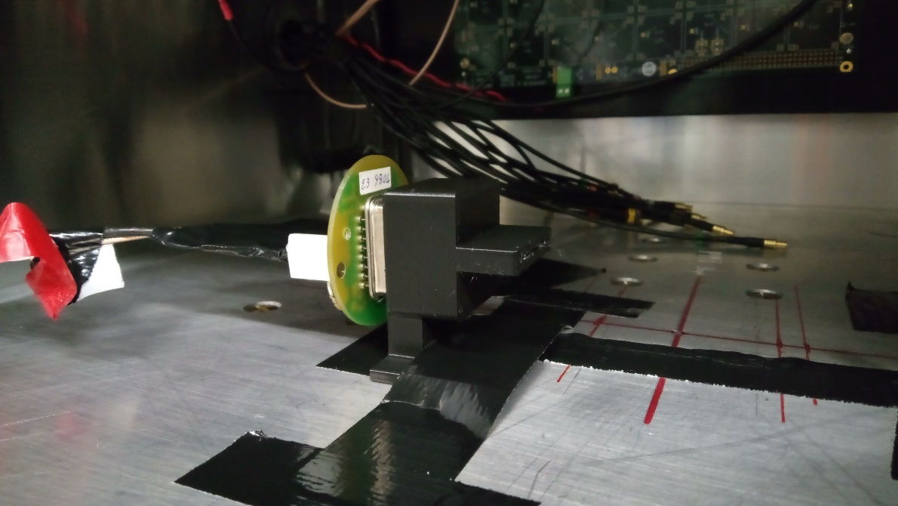

test in progress
Bgo16 in progress
Bgo crystal perpendicular to pmt with alpha souce in front of the bgo
Bgo15
Bgo crystal perpendicular to pmt
Pmt 1
Next week with pmt coincidence
Pmt 2

