Slide 1
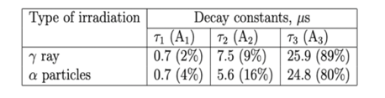
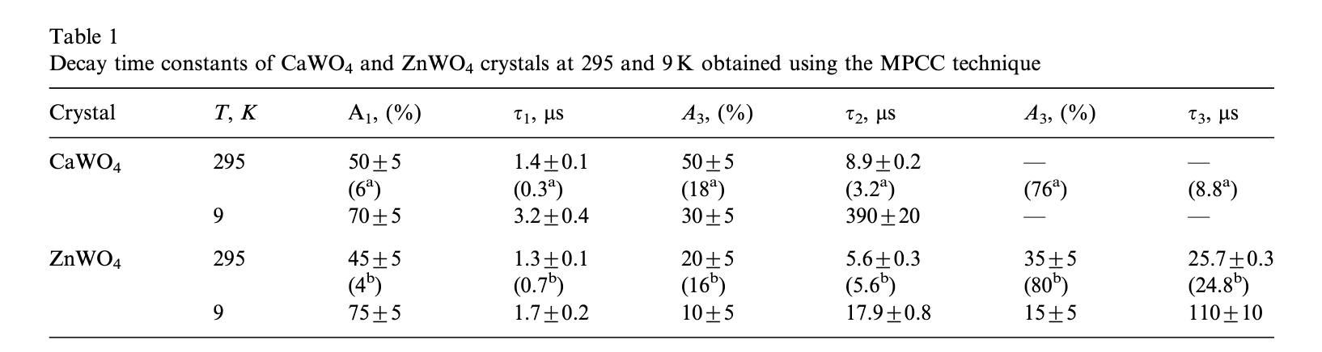
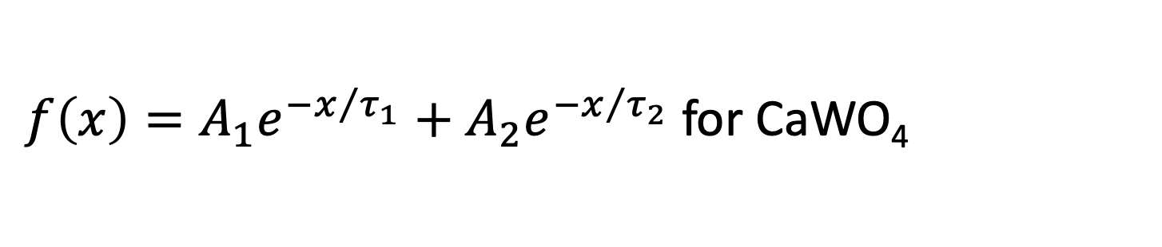
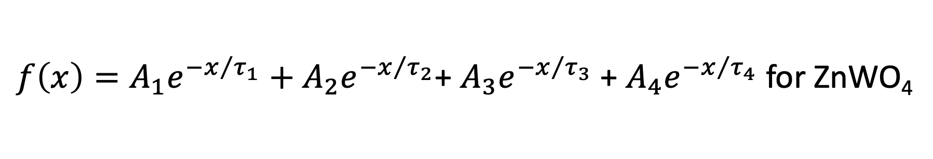
PSD Data Analysis
ZnWO₄ plate
ZnWO₄ grains
CaWO₄ grains
Acquisition in a short time range (2.5us)
Acquisition in a long time range (100us)
$f\left(x\right)=A_{1}e^{{−x}/{τ_{1}}}+A_{2}e^{{−x}/{τ_{2}}}$+ $A_{3}e^{{−x}/{τ_{3}}}$ + $A_{4}e^{{−x}/{τ_{4}}}$for ZnWO₄
$f\left(x\right)=A_{1}e^{{−x}/{τ_{1}}}+A_{2}e^{{−x}/{τ_{2}}}$ for CaWO₄
ZnWO₄

Slide 2
1. Offset correction (Voffset ~ 25-27 mV)

Slide 3
2. Shift correction (toffset ~ 5.3us for the long range WF acquisition and 0.23us for the short range WF)
3. Exponential fit on each WF, slow and fast

Slide 4
4. The mix the two waveforms
5. Exponential fit

Slide 5
There is a ~2mV discrepancy between the two WF
4. The mix the two waveforms (with a scale factor for WF slow)
5. Exponential fit with 4 decay times

Slide 6
ZnWO₄ plate
Need a scale factor of x1.03

Slide 7
ZnWO₄ plate
0.2%
1.2% (instead of 2%)
7.3% (instead of 9%)
91.3% (instead of 89%)

Slide 8
ZnWO₄ grains
No need of scale factor

Slide 9
ZnWO₄ grains
No need of scale
0.6%
1.2%
7.0%
91.3%

Slide 10
ZnWO₄ plate vs grains
Plate |  | Grains
tau (us) | % | tau (us) | %
0,06634 | 0,21 | 0,0322 | 0,55
0,597 | 1,13 | 0,508 | 1,15
3,884 | 7,14 | 3,384 | 6,96
24,67 | 91,52 | 24,25 | 91,34

Slide 11
CaWO₄ grains
Need a scale factor of x0.99

Slide 12
CaWO₄ grains
Hard to fit the mixed WF

Slide 13
CaWO₄ grains
Hard to fit the mixed WF

Slide 14
CaWO₄ grains fast WF

Slide 15
CaWO₄ grains slow WF

