Slide 1
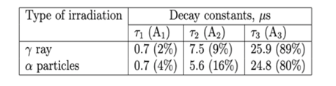
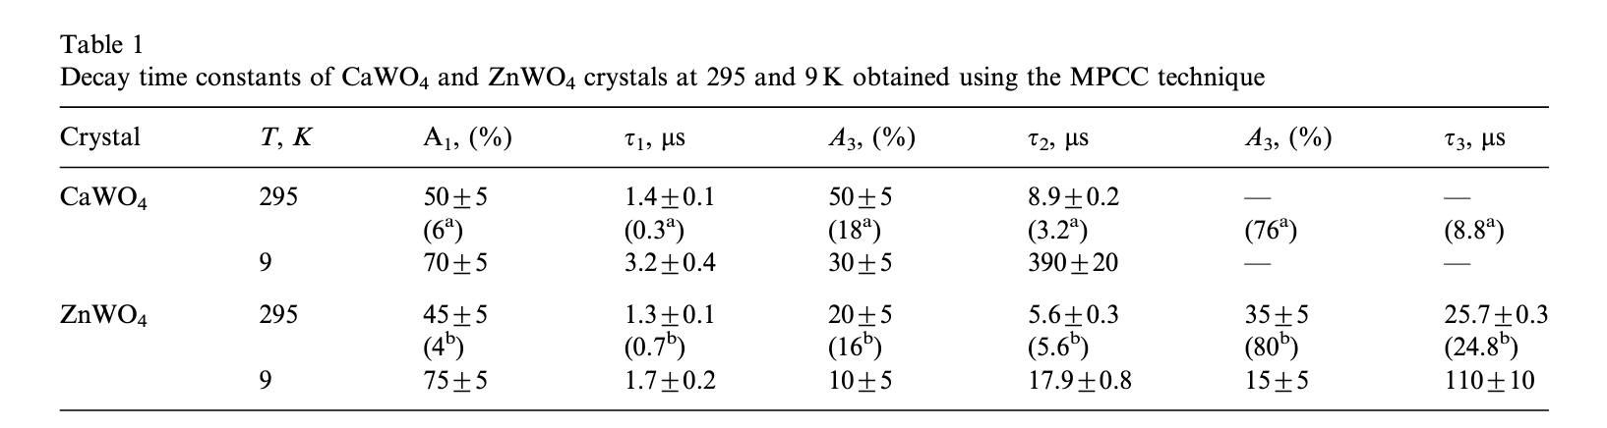
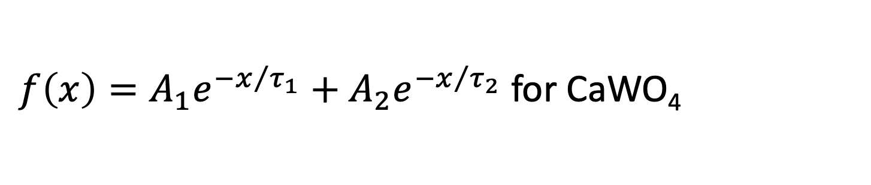
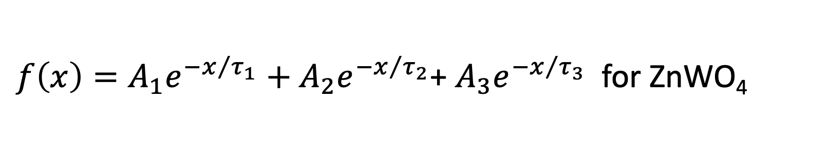
PSD Data Analysis
ZnWO₄ plate
ZnWO₄ grains
CaWO₄ grains
Acquisition in a short time range (2.5us)
Acquisition in a long time range (100us)
$f\left(x\right)=A_{1}e^{{−x}/{τ_{1}}}+A_{2}e^{{−x}/{τ_{2}}}$+ $A_{3}e^{{−x}/{τ_{3}}}$ for ZnWO₄
$f\left(x\right)=A_{1}e^{{−x}/{τ_{1}}}+A_{2}e^{{−x}/{τ_{2}}}$ for CaWO₄
ZnWO₄

Slide 2
1. Offset correction (Voffset ~ 25-27 mV)

Slide 3
2. Shift correction (toffset ~ 5.3us for the long range WF acquisition and 0.23us for the short range WF)
3. Exponential fit

Slide 4
4. Mix the two waveforms
5. Exponential fit

Slide 5
ZnWO₄ plate
1.9% (instead of 2%)
11.6% (instead of 9%)
86.5% (instead of 89%)

Slide 6
ZnWO₄ plate
1.7%
8.8%
89.6%

Slide 7
ZnWO₄ plate
Tau | %
0.239 | 0.5
2.323 | 6.1
23.8 | 93.4

Slide 8
ZnWO₄ grains
Cherenkov peak.
2.2% (instead of 2%)
13.1 % (instead of 9%)
84.7% (instead of 89%)

Slide 9
ZnWO₄ grains
Cherenkov peak.
1.3% (instead of 2%)
7.5% (instead of 9%)
91.2% (instead of 89%)

Slide 10
ZnWO₄ grains
Tau | %
0.264 | 0.6
2.17 | 5.6
23.98 | 93.8

Slide 11
ZnWO₄ plates vs grains
 | ZnWO4 plate (Voff -27.7, t off -5.3)
PLATE | tau | %
1 | 0,7 | 1,88
2 | 7,5 | 11,59
3 | 25,9 | 86,52
 | ZnWO4 plate (Voff -27.7, t off -5.3)
PLATE | tau | %
1 | 0,785 | 1,66
2 | 5,524 | 8,77
3 | 25,77 | 89,57
 | ZnWO4 grain (Voff -27.9, t off -5.3 )
GRAIN | tau | %
1 | 0,7 | 2,23
2 | 7,5 | 13,08
3 | 25,9 | 84,69
 | ZnWO4 grain (Voff -27.9, t off -5.3 )
GRAIN | tau | %
1 | 0,56 | 1,33
2 | 3,76 | 7,50
3 | 24,45 | 91,18

Slide 12
CaWO₄ grains
7.3%
92,7%

Slide 13
CaWO₄ grains
8.1%
91,9%

