Slide 1
Non-uniformity study
Denys Klekots
(Taras Shevchenko National University of Kyiv)
denys.klekots@cern.ch denys.klekots@gmail.com

Slide 2
Quick recap
1 mm
1 mm
The simulation gives the energy deposited in a strip for each simulated event.
Each strip has the dimensions of 1x1x400 mm. There are 167 by 167 such strips in the detector.
WLS fibres are located each 7 mm and the energy deposited in in grey square (see on a picture) is not recorded in the simulation output.
Fiber
y
x
Hit position
One virtual strip
Area where shower is developing as well, but the deposited energy in put to zero in simulation output.

Slide 3
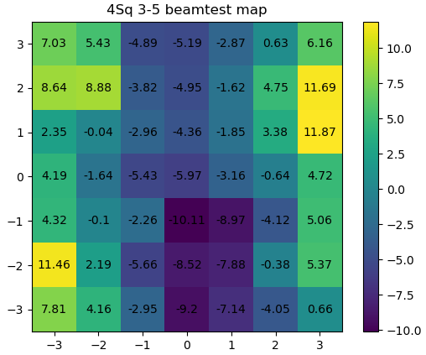
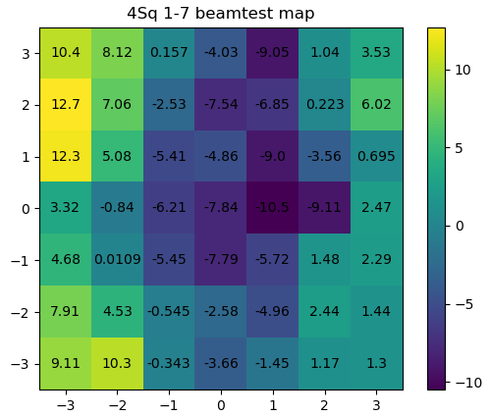
Simulation setup
The position of the primary hit was quasi-uniformly distributed in the square between fibers.
The energy deposited in each strip was multiplied by the weights from the beam test map
7 mm
Fibers
y
x
7 mm

Slide 4
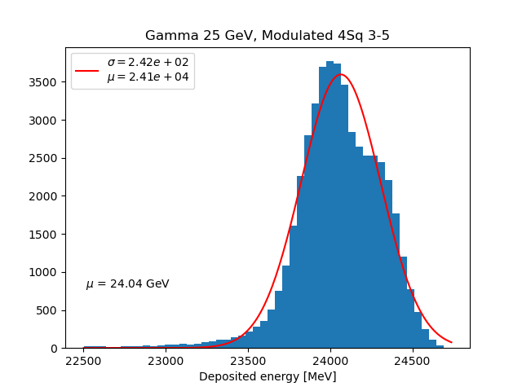
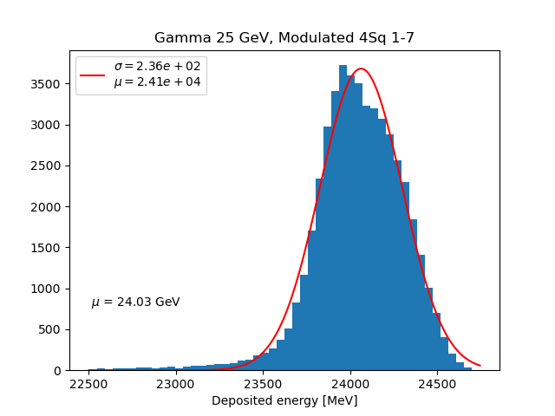
Total deposited energy gamma 25 GeV
7 mm
Fibers
Hits inside entire cell
7 mm

Slide 5
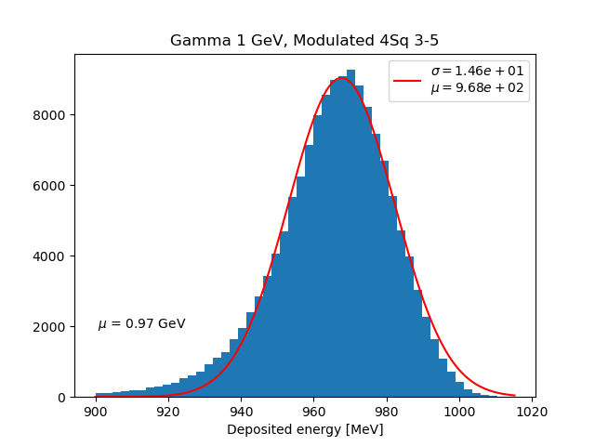
Total deposited energy gamma 1 GeV
7 mm
Fibers
Hits inside entire cell
7 mm

Slide 6
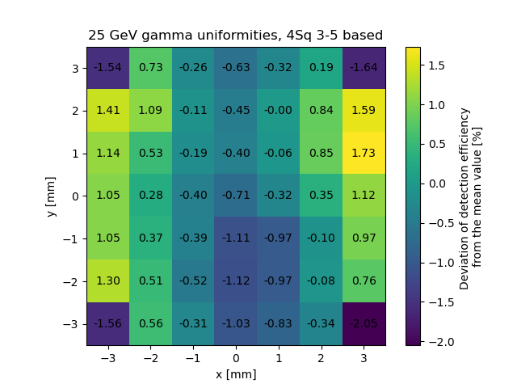
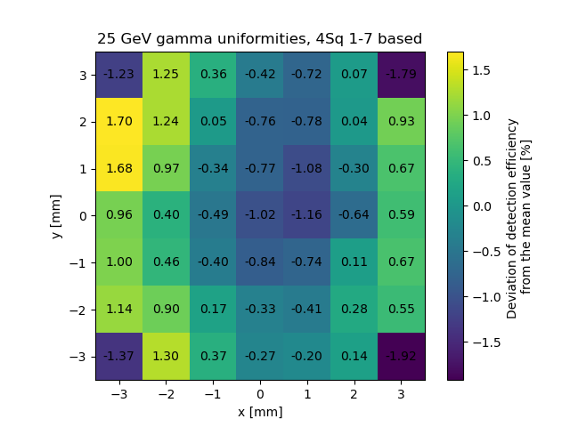
Non-uniformity map 25 GeV

Slide 7
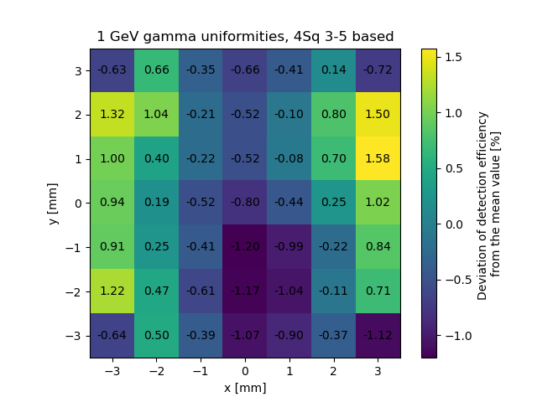
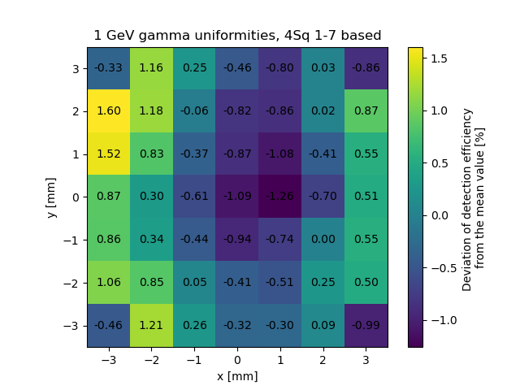
Non-uniformity map 1 GeV

Slide 8
Conclusions
Based on the result of the simulations is it possible to conclude that:
The sigma of total deposited energy (energy resolution) is about 1 % for 25 GeV gammas
The sigma of total deposited energy (energy resolution) is about 1,5 % for 1 GeV gammas
The deviation of the non-uniformity map is under about 2 % for 25 GeV gammas
The deviation of the non-uniformity map is under about 1,5 % for 25 GeV gammas
The difference in the development of the shower in the fiber affects the non-uniformity map

Slide 9
Thank you for your attention

Slide 10
Backup slides

Slide 11
Previous mesh
1 mm
Fiber
Area where shower is developing as well, but the deposited energy in put to zero in simulation output.
Hit position
One virtual strip
Frame of non-uniformity map

