Slide 1
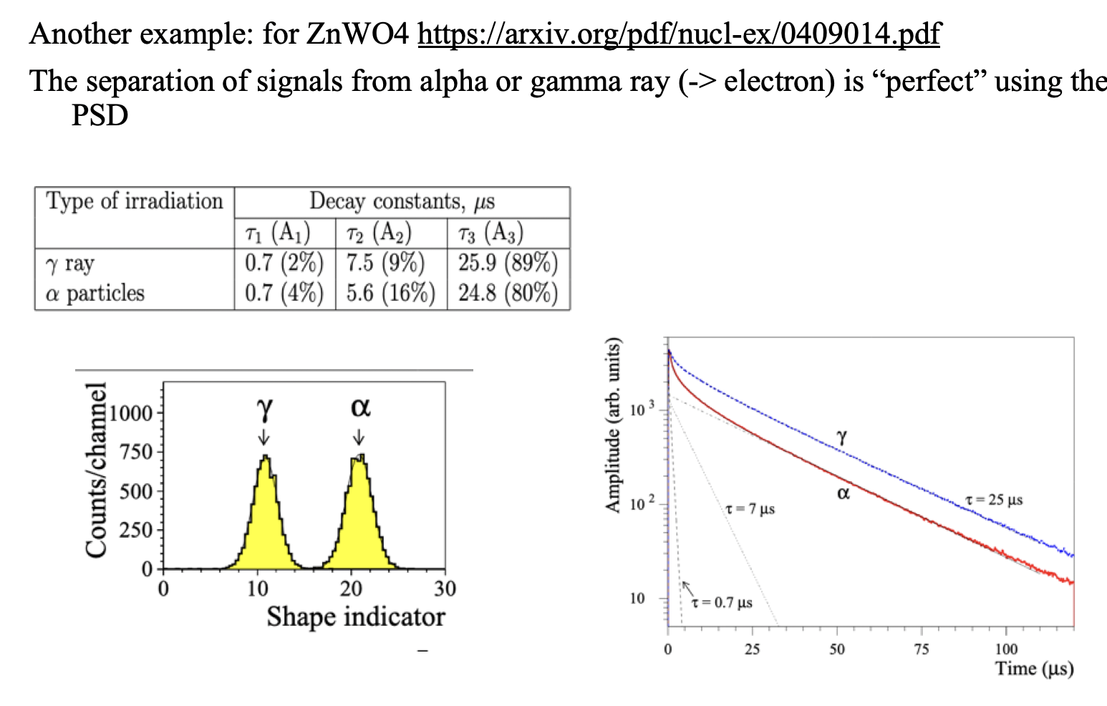
Pulse shape measurements
slide presented at FCC meeting Paris

Slide 2
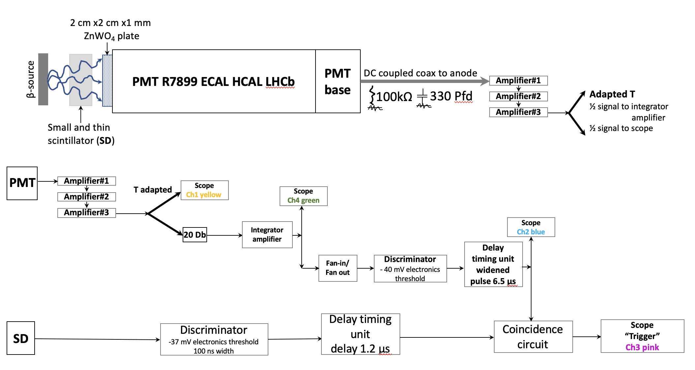
Electronics
To measure le Pulse shape with beta ray (about min ionizing) we trigger with a very thin plastic scintillator placed between the beta source (Sr90=> yttrium90 => beta 2.3 MeV) about 1000 phe => 1phe/20ns so we need to enlarge the 1phe pulse with 330pfd and 50 ohms=> 15ns RC

Slide 3
Single event with sucession of photoelectrons (sorry before one other amplifier added 5mv/cm vs 50 mv/cm)

Slide 4
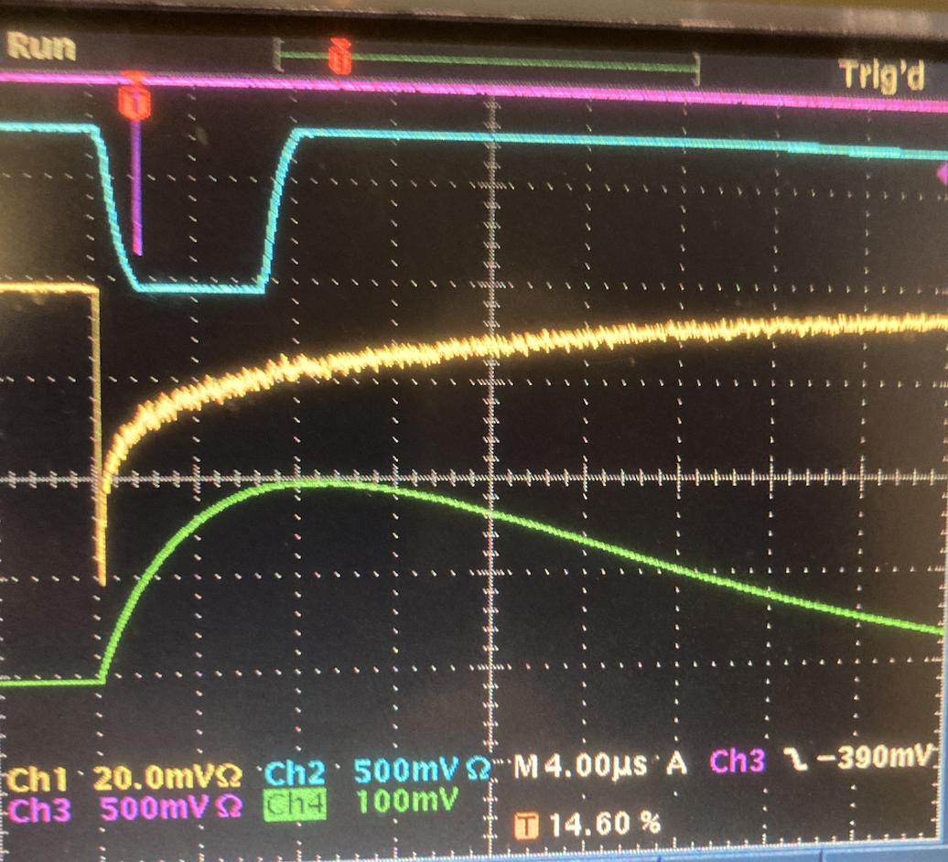
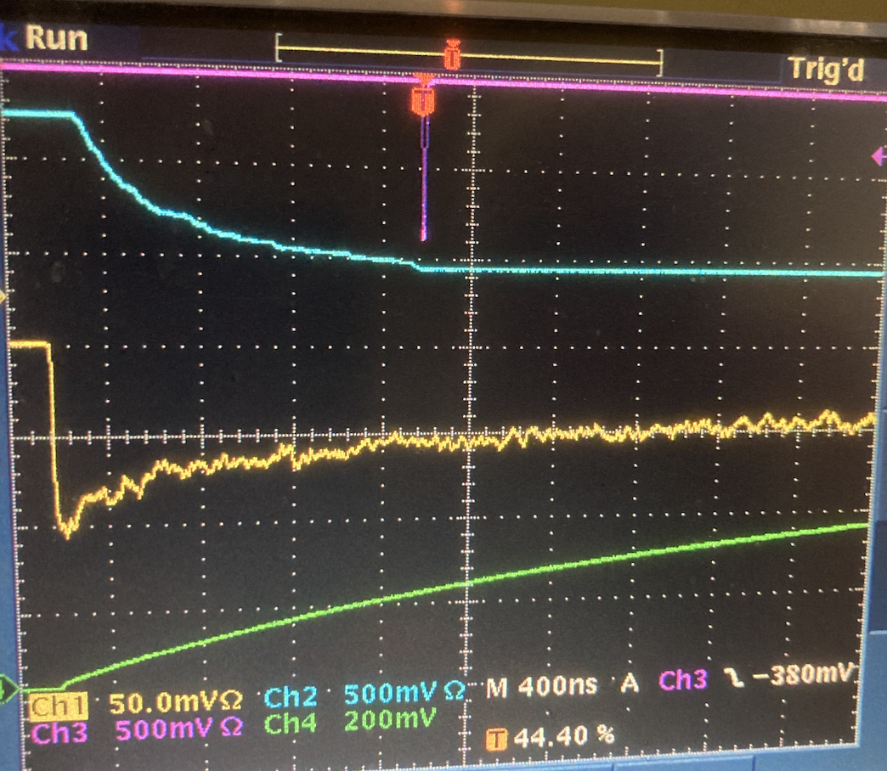
With the Tektronix one can select average pulse over 512 events
One can see the “full” pulse over 36 𝝁s or zoom to see the fast part in the first 𝝁s

Slide 5
DAQ of events
One cannot numerically acquire data from the Tektronix!
But Dominique has designed a modification of the wavecatcher to allow it to function over 50 𝝁s for the full range (or 100 𝝁s ) vs the usual 2.5 𝝁s .(Not easy! Thanks !)
One can perform average over 10000 events in about 10 minutes and then copy the average plot in an output file. One can obtain files over 50-100 𝝁s and then zoom on the first part
Data taking has started!

