Slide 1
Constant term in resolution from Z nonuniformity
From Denys simulation we have studied constant term (% independent of Egamma) from fluctuation in escape energy OK<<1%
from non uniformity vs distance to fibers => test beam at CERN
A cause observed in Leadglass or crystal calorimeter (CSI BGO) is the uniformity of light collection as function of depth (Z)
The question has not been asked by the ANR referees or in meetings … but we should prepare for it… Should we mention it in “detailed March ANR document? Not obvious!

Slide 2
Fluctuation in Z of shower development
There is an important “obvious” effect due to fluctuation in the start of the gamma shower by the first conversion gamma=>e+e- The delicate point is that very often characteristic of ECALs are tested using electron test beam, however this effect is much smaller for electrons.
For electron the probability of Brem is as function of distance x is (x/x0)Ln(Emax/Emin) where Emin is the energy where photons are “ useful in showers development” ≈ 50 MeV (?) when Ee= 5 GeV => 4.6 X/X0
However for photons of high energy the pair creation probability is much smaller = (7/9)X/X0 (PDG formula)
When integrating over 25 X0 the average first interaction is 9X0/7 and the fluctuation (rms )= (9X0/7) /sqrt(2) (if I have done my integral correctly please someone check)
In our case the rms is about 2.5 cm

Slide 3
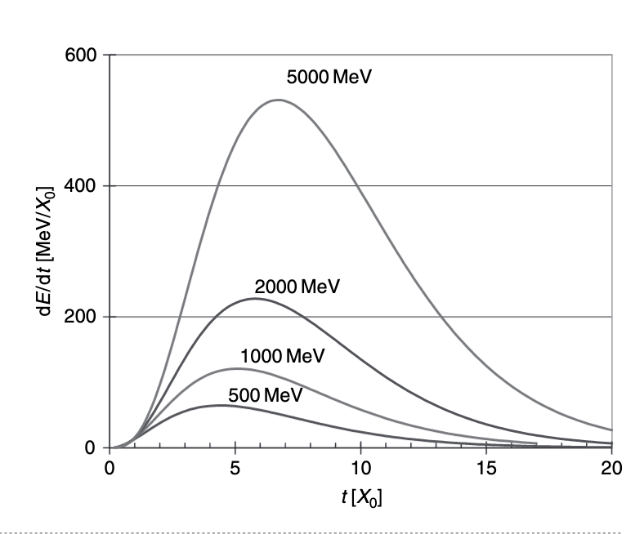
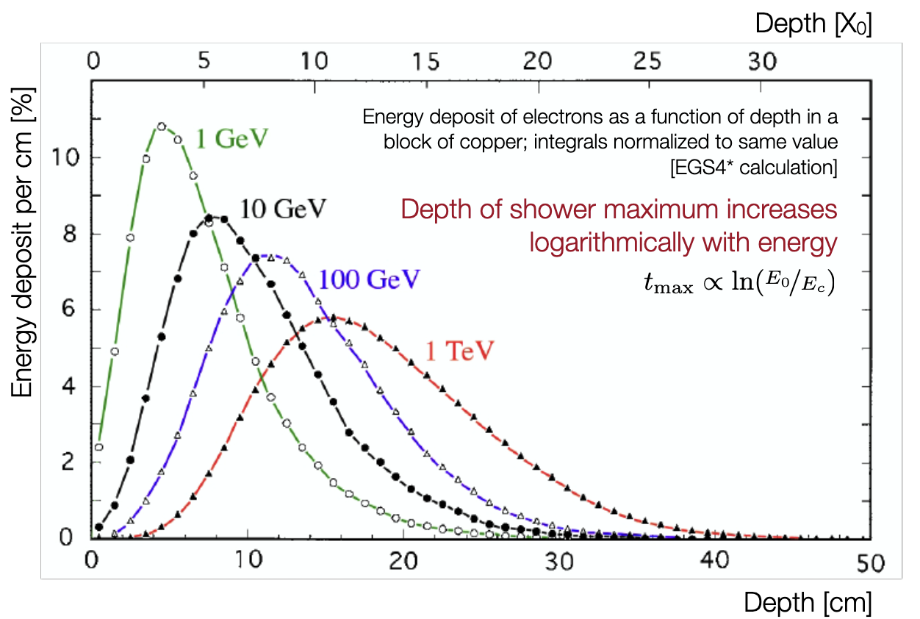
Shower shape in Z
The assumption is that the fluctuation in the average value of the shower development in Z is essentially caused by this fluctuation of the first photon conversion. This is “untuitively reasonable” because after there are N particles and the fluctuation is reduced by 1/sqrt(N) but a shower simulation is needed to be sure…
Typical shower development in Z can be found for example
https://indico.cern.ch/event/294651/contributions/671929/attachments/552041/760669/Delmastro_ESIPAP2014_3.pdf
It is clear that <Z> depends on energy … lets use 7 X0 (not too critical for next slides )

Slide 4
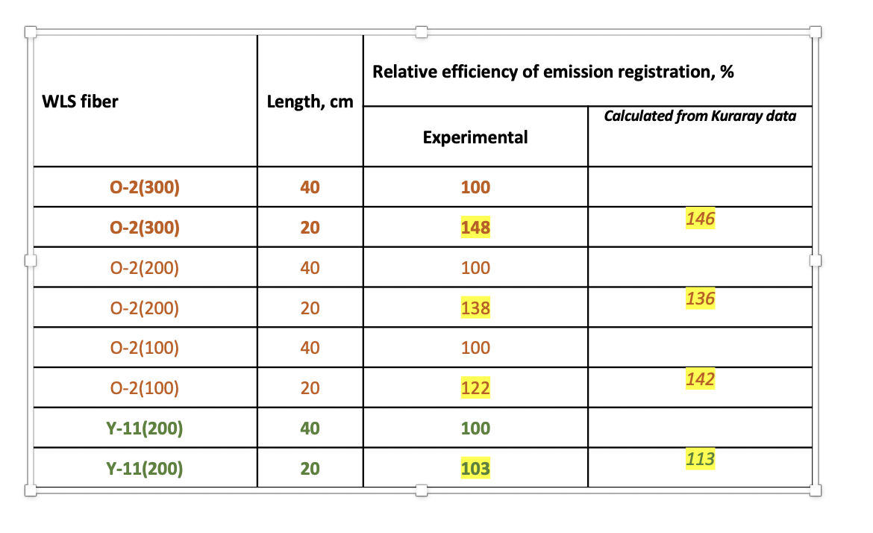
Light attenuation in WLS fibers : First order effects
For other detectors the efficiency variation vs Z can be due to light collection etc… in our case the effect is caused by light attenuation in the WLS fibers. Using Ianina’s measurements ((pptx March 10th)
For O(200) a factor 1/ 1.36 for 20cm absorption => 1.5%/cm => 2.5cm from slide 2 => 3.7% WOW!
For Y11(200) (which would have less light but perhaps possible?) the measurements are optimist but if we use the Kuraray numbers =13% for 20cm => 0.65%/cm => 2.5cm from above => 1.6%

Slide 5
Improvements after first order 😀 !
the first “obvious” improvement is the use of a mirror on the fiber at the entrance of course when the Z increases the directly collected light increases but the reflected light because of the longer path decreases however the compensation is not perfect because of the “not 100%” reflectivity of the mirror and because of the smaller fraction of light due to the path to the entrance and back
Estimate using light attenuation from the table and a mirror of 70% (optimist?) give 0.4% constant term for Y11 and 1.23% for O2(200)
2) The other possibility is the use of a preshower in front of the ECAL (4X0 !) which is often used anyhow to improve the e/h identification. Then from the ratio preshower/ECAL one can obtain the X value of the start of the shower and correct Emeasured

Slide 6
Conclusion
A solution with a contribution to constant term <1% seems possible
Clearly before starting the full module construction one should do further measurements on fiber attenuation, mirror efficiency etc… But probably not urgent in coming months ?
A priori since there were no questions on that point by referees the motivation to detail the problem and solutions in the next “detailed document” for ANR seems small
However there is the subtlety that one cannot answer objections to our ANR document using facts which are not in the ANR (if I understood correctly) … would this be dangerous?

