Slide 1
Short presentation on test done yesterday!!!
Sorry very last minute slide making
Aim see min ionising pulses in ZnWO4 averaged on “many events”
Extract the pulse shape with electrons (2MeV source) before test at ALTO with 25 MeV photons
The pulse shape should not be disturbed by a trigger so there has to be an external timing trigger at ALTO it will be the 2ns beam pulse (at 10 KHz) here the trigger is done by a thin and small scintillator placed between the beta ray source and the ZnWO4
The ZnWO4 plate 2cmx2cmx1mm thick is placed on a 1 inch PMT R7899 (the Pmt used in ECAL HCAL of LHCb)
But to do an average pulse one should only select events with a signal on PMT (for some reasons there triggers with no signals) So the trigger of the scope is a coincidence between a slow large pulse of the ZnWO4 and a delayed fast pulse from the small scintillator

Slide 2
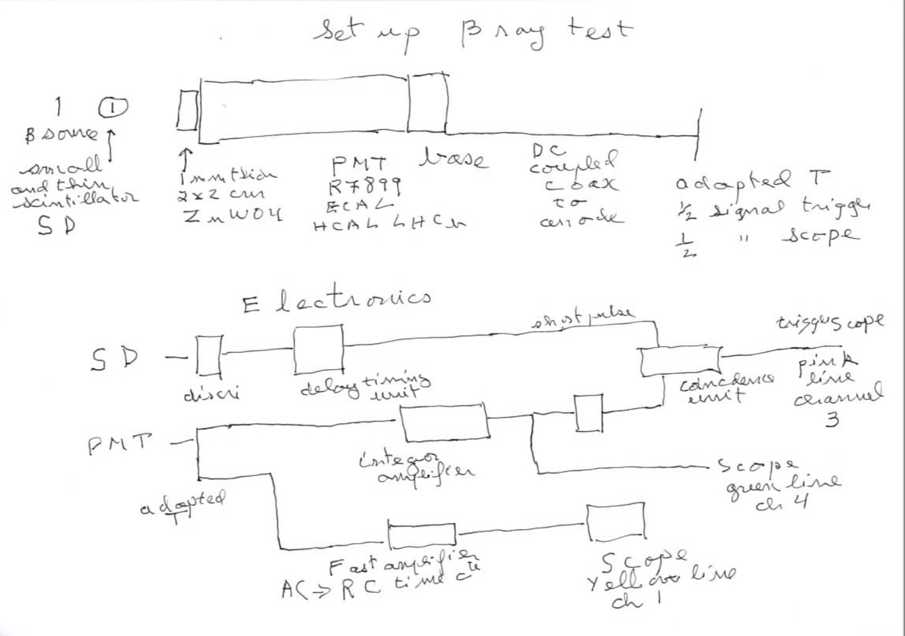
Circuit diagram (handmade sorry ;-) )

Slide 3
First plot 4 microsec/cm (averaged 512 events)
ch1 the signal PMT ch4 the integrated signal ch3 the trigger signal (coinc fast and slow) ch2 average output of discriminator on ZnWO4 signal

Slide 4
Second plot 1 microsec/div

Slide 5
Third plot 20 microsec/div

Slide 6
Some problem left ;-)
We need to solve the undershoot after 10 microsec!!!
When everything OK need to acquire data : we thought of using digital scope but “problem”
In principle new version of wavecatcher would allow to capture slower pulses :
Can acquire events or do the average
In principle if OK the method can be used in ALTO with fast scintillator replaced by trigger of 2ns ALTO pulses with 10 KHZ rate

