Slide 1
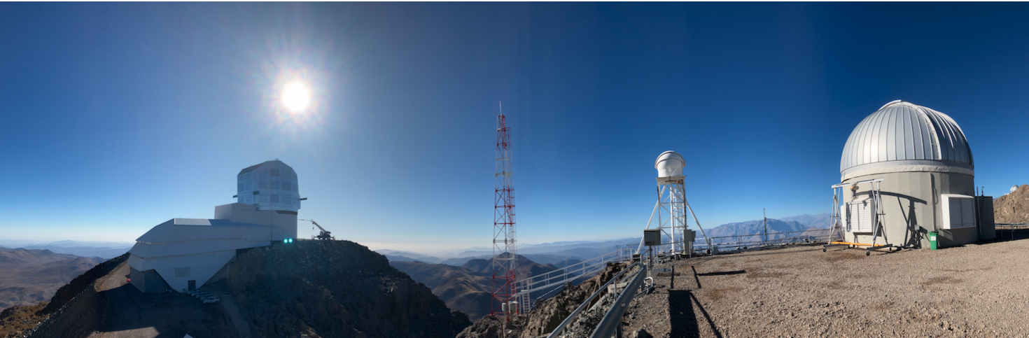
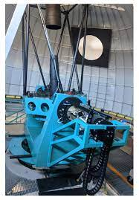
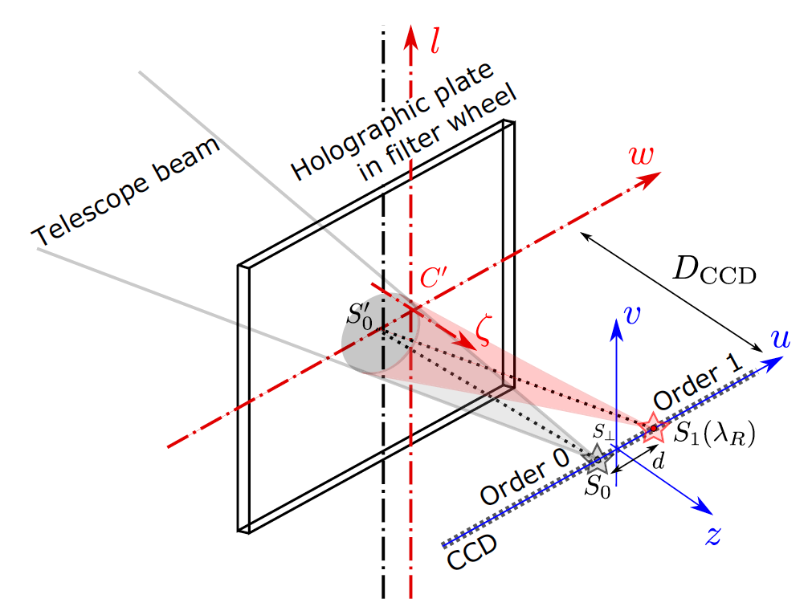
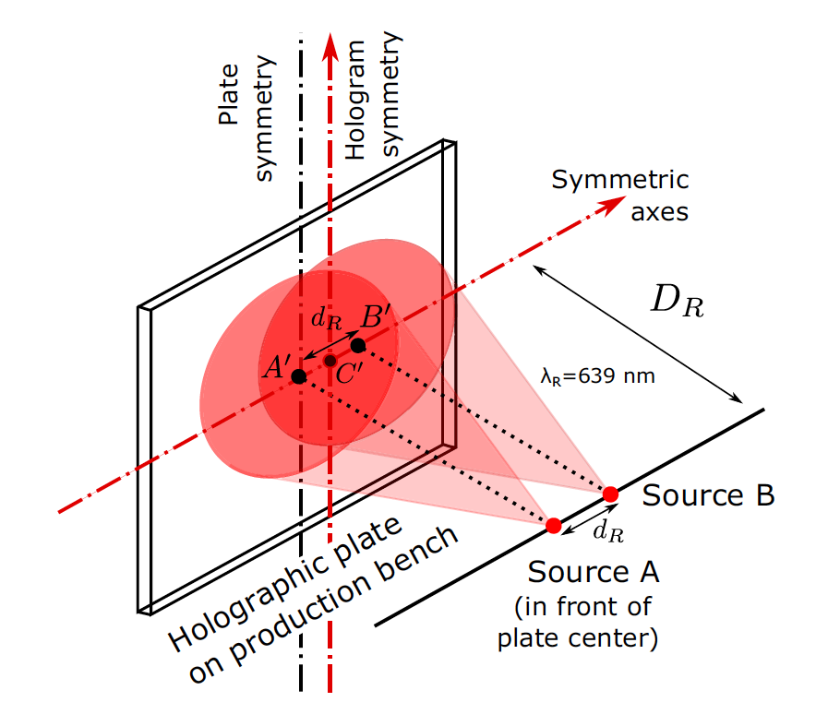
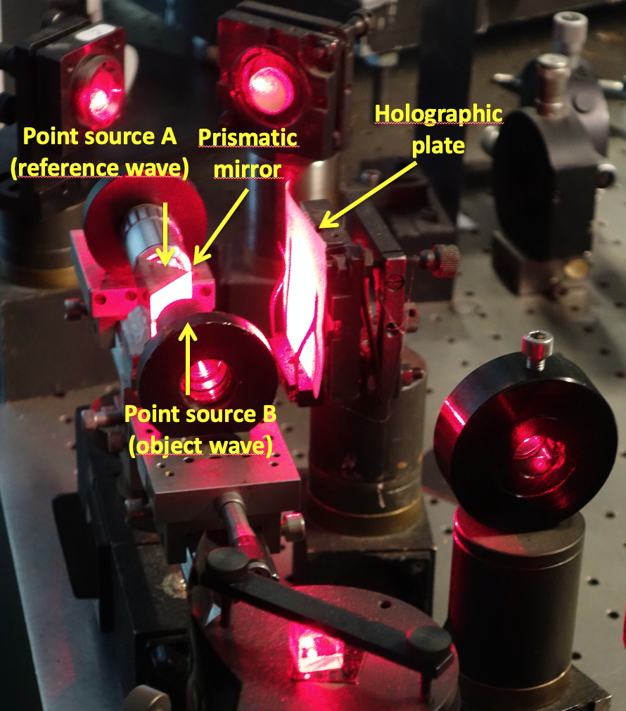
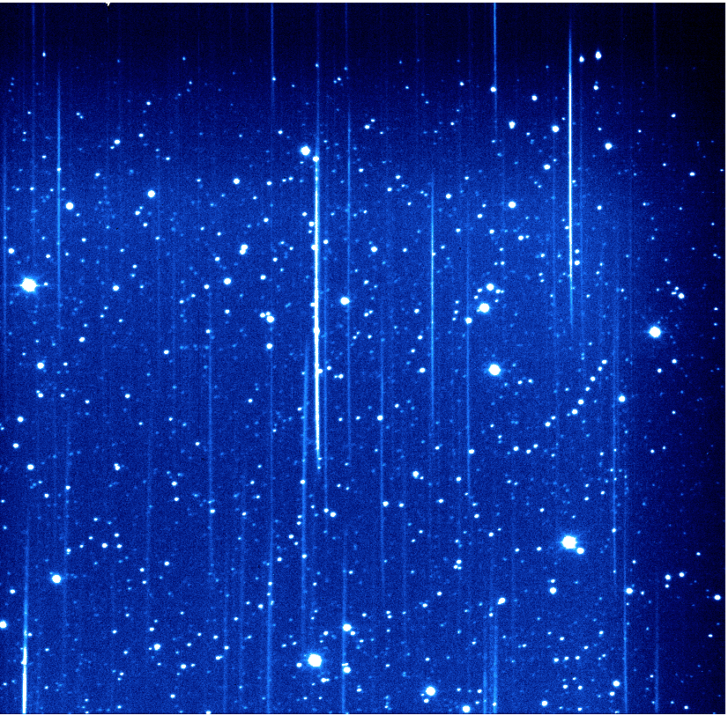
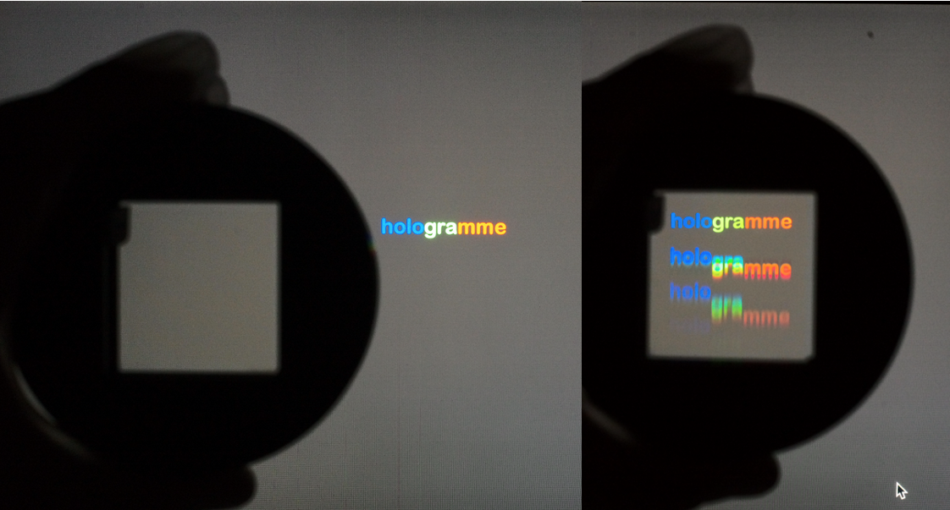
Atmospheric calibration
Auxiliary Telescope
Main Telescope
auxTel french team
Use as disperser
Hologram recording
AuxTel
Notes:
Ne pas rentrer dans les détails

Slide 2
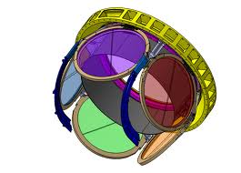
System throughput
Transmission
or efficiency
in %
Atmosphere
Optics (mirrors, lenses)
i
Detector (CCD QE)
Z
r
Throughput =
telescope transmission x
Filter transmision x
QE(detector)
g
y
Y4-Band out atm.
u
λ (nm)
- ugriZy throughputs do not include atmosphere
- But the instantaneous effective passband, which governs the quantity of photons detected, includes the transmission of the atmosphere
1 m

Slide 3
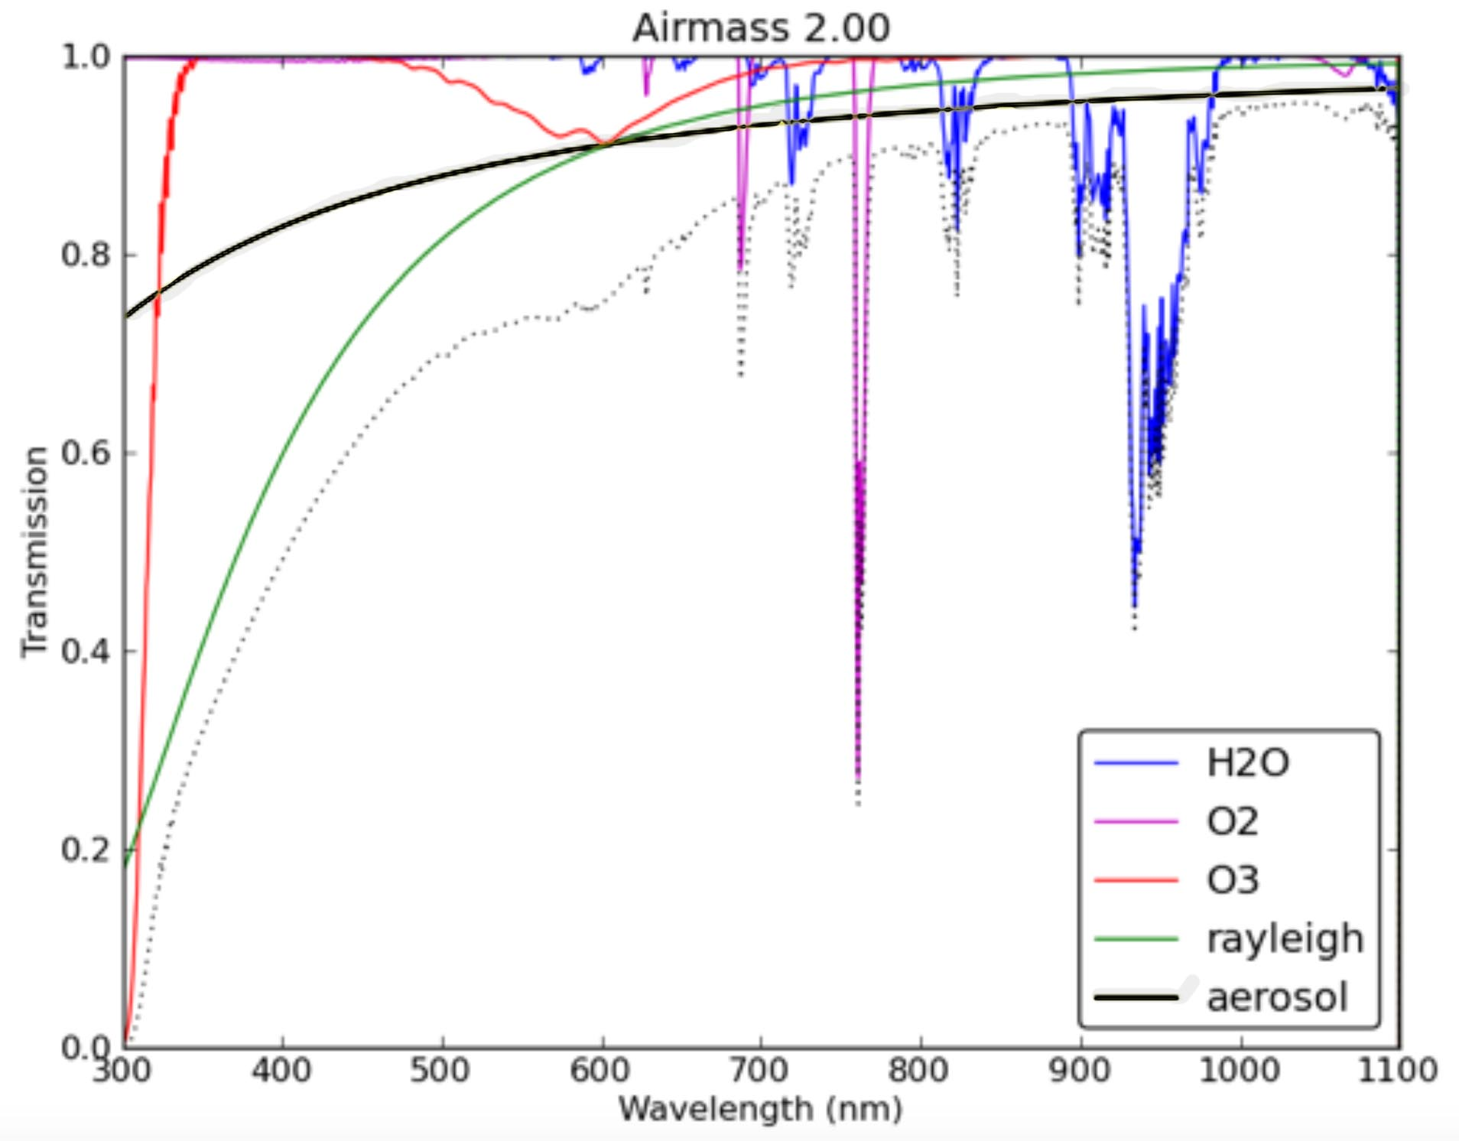
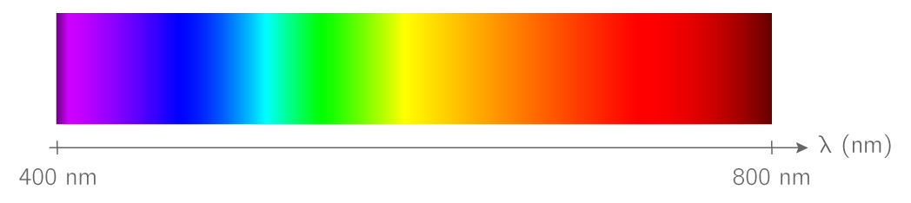
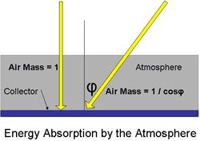
The atmospheric transmission
(Stubbs et al. PASP, 119: 1163–1178, 2007)
O₃
Photometrists use photometric quality nights and narrow band filters
  No cloud
  Low humidity
  Low aerosols
LSST wants to use all nights with wide band filters
  Few clouds (grey absorption)
  Humidity (affects I & Z)
  Aerosol (affects U & G)
aerosols
H₂O
O₂
H₂O
Rayleigh scattering α 1/λ⁴
H₂O
O₂
After correcting for Airmass:
O₂, rayleigh depends on pressure
Determine vertical H₂O, O₃ and aerosols

Slide 4
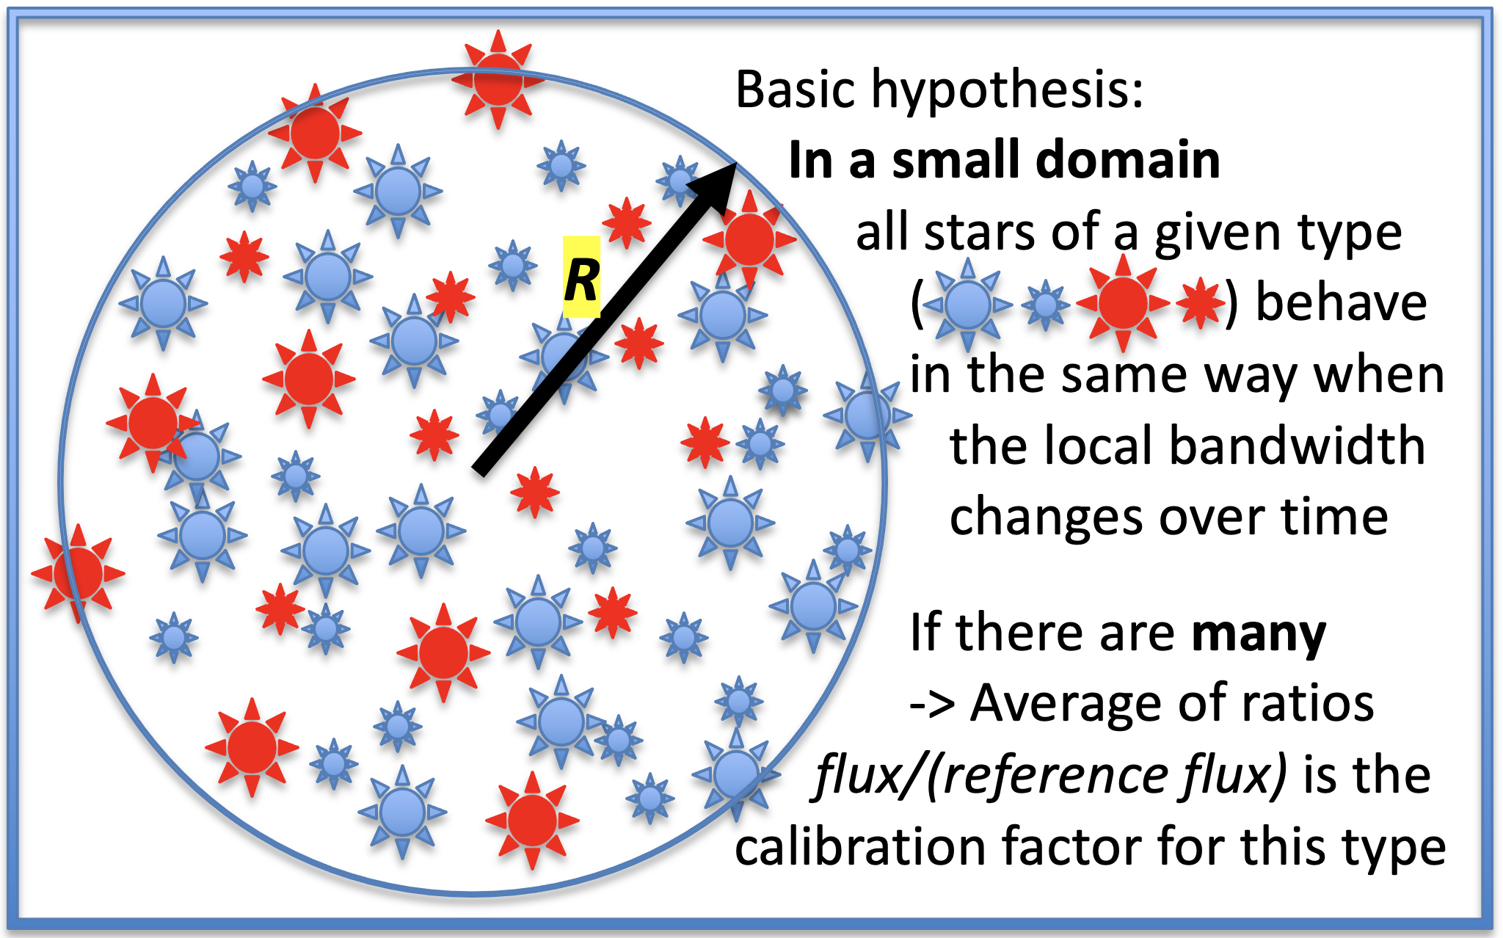
Photometric calibration
(i.e. identical colors)
General principle
The photometric estimates of similar
objects are equally affected by the
local and instantaneous transmission
Instrumental response is controlled through
- Flat-fielding : image of a uniform sky brightness
-> Showing vignetting, dust and stains on optics (slow variations) and CCD pixel-to-pixel area variations (fast).
- Variation of passband with position on detector (slow)
- Slow variations of instrument throughput with time due to reflectivity changes
-…
Atmospheric transmission
- Global transmission of atmosphere: clouds/aerosols -> grey factor
- Variation of transmission with wavelength (depends on water, ozone and aerosols)
In the last 10km of the light travel, the transmission of atmosphere can vary rapidly with time AND its impact on the photometry depends on the objects’ color
-> AuxTel spectrograph mission

Slide 5
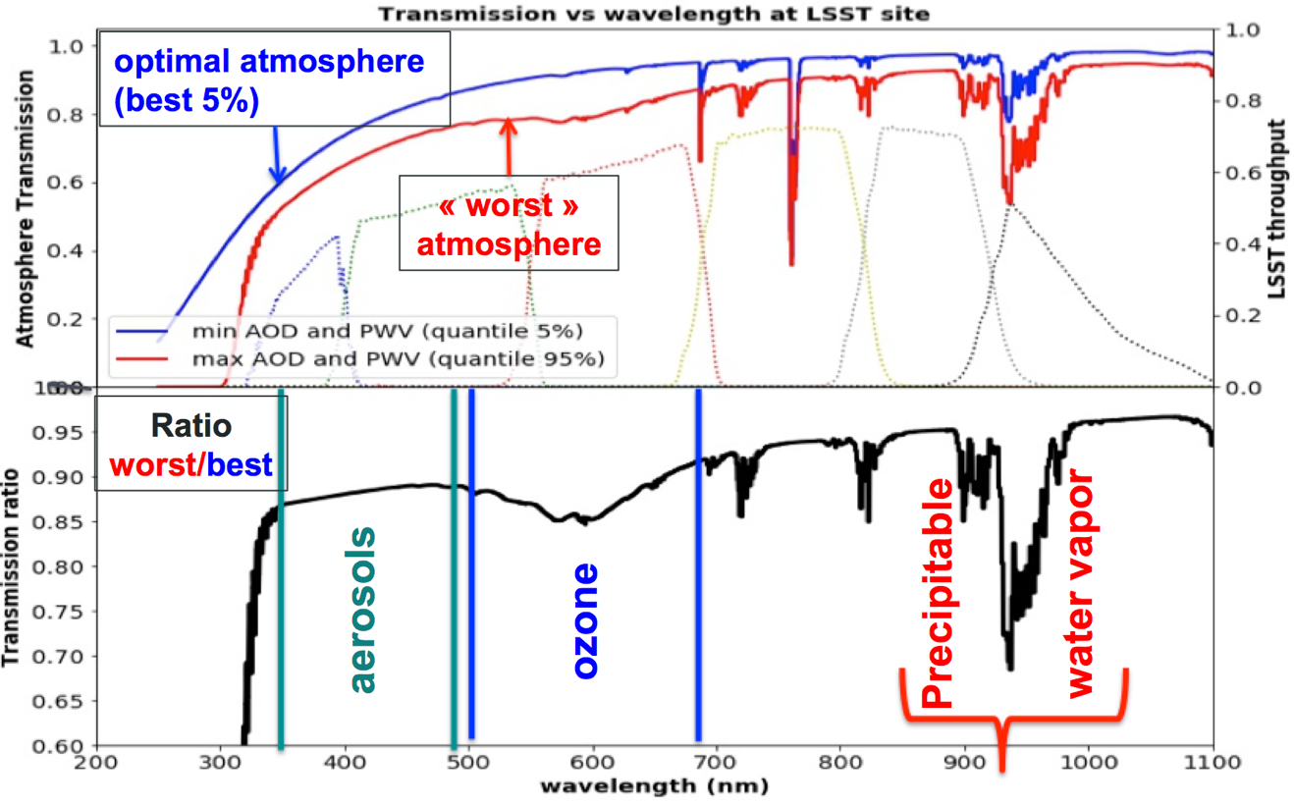
Variability of the atmospheric transmission

Slide 6
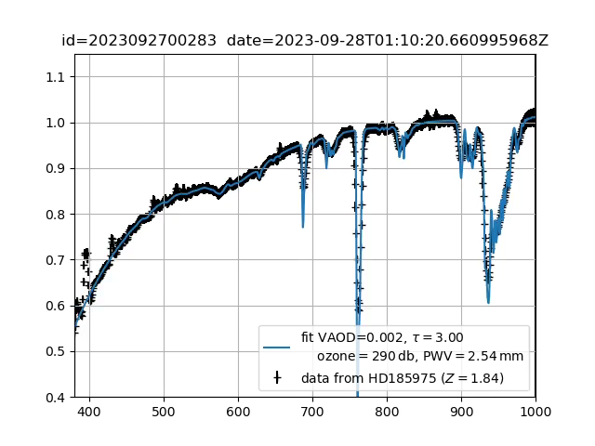
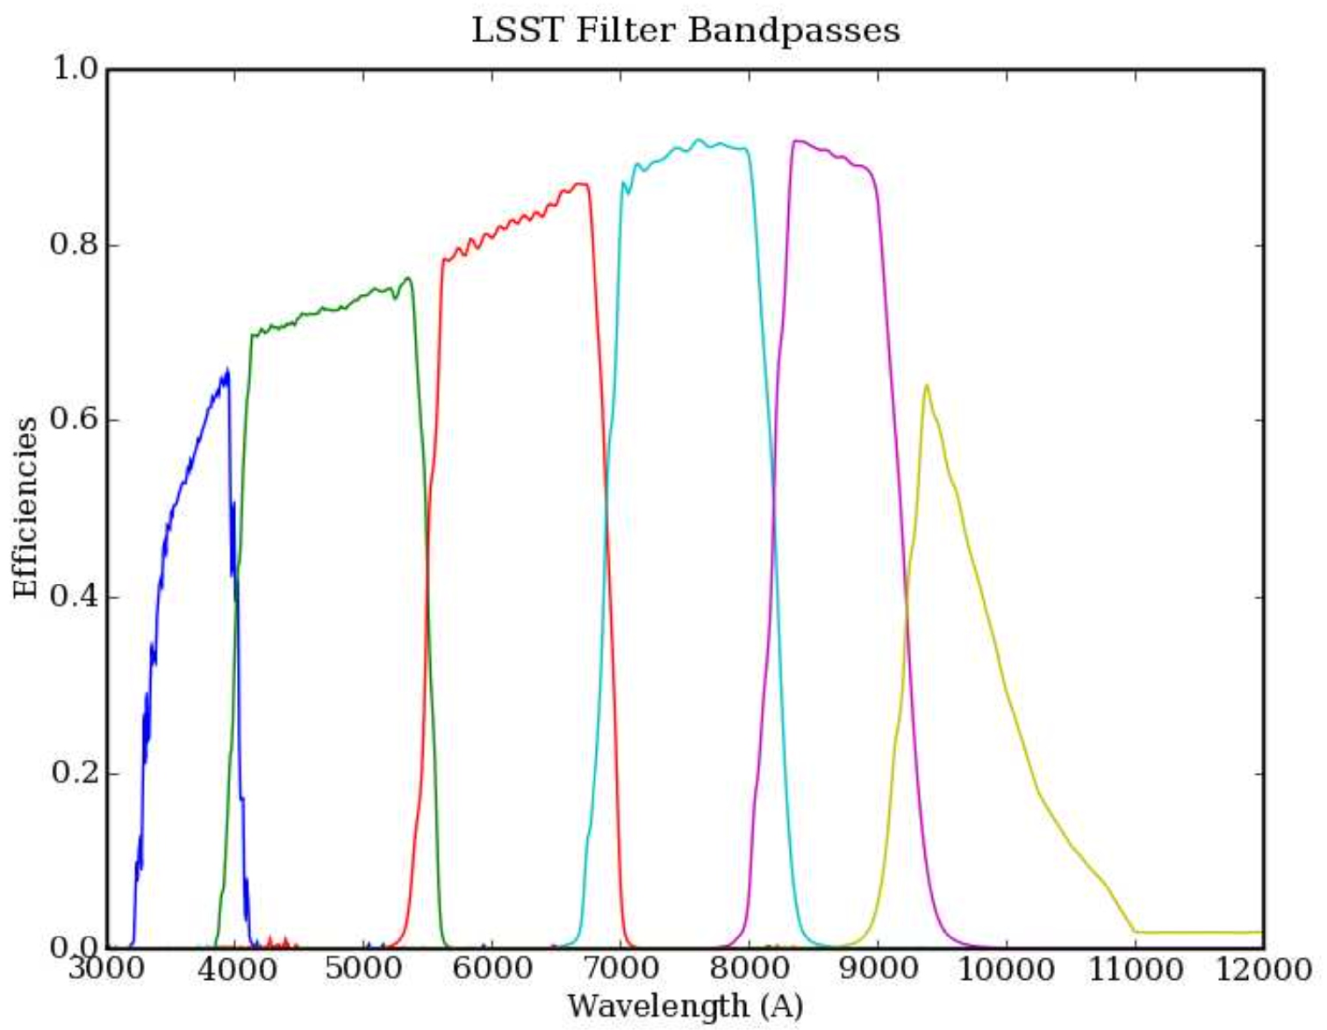
6 months of transmission measurements
Airmass
Aerosols
O₃
H₂O
H₂O
H₂O
i
Z
r
X
g
u
y
@airmass=1
Atmospheric transmision (variable)
Instrument throughput (stable)
=
effective (instantaneous) passbands

Slide 7
Atmospheric compensation
what is it? We are going to take images in all atmospheric conditions. Effective bandwidths will then vary, which will complicate comparisons. To make light curves, the ideal is to relate all measurements to a standard atmospheric situation, i.e. PWV=2mm, z=1.2.
(It would also be interesting to think about what the average atmosphere is after co-addition: otherwise winter sky regions could give a different cosmology than summer sky regions...)

Slide 8
Atmospheric compensation
The question: How can we determine the effect of the atmosphere on the photometry of a given object (so as to be able to compensate for it)?
Knowing that: it depends on the object's SED, and that we only know UGRIZY.

Slide 9
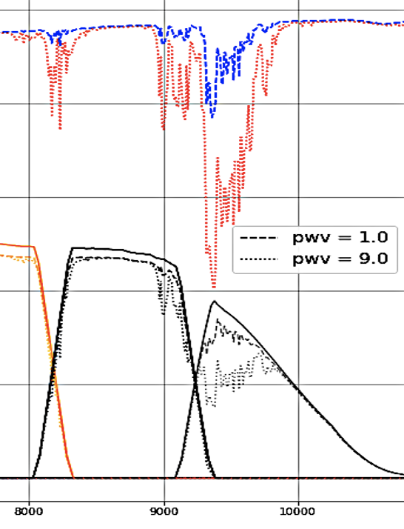
Impact of precipitable water vapor (PWV) on the integrated flux of different stars
Atmospheric
transmissions
i
Z
y
Red star spectrum
φ_{y} =
dλ
X
X
Blue star
800
1000
λ (nm)
800
900
1000
λ (nm)
y passband
y passband effective
transmissions
When PWV increases:
φ_{y} within the effective passband is more impacted for blue than red objects

Slide 10
Atmospheric compensation
The question: How can we determine the effect of the atmosphere on the photometry of a given object (so as to be able to compensate for it)?
Knowing that: it depends on the object's SED, and that we only know UGRIZY.
Ingredients
  Atmospheric absorption curve in the passband T
    Main mission of AuxTel
    An open question (axe 1)
      atmosphere model (LibRadTran) measured from CAlSPEC standards possibly far from the LSST field -> requires confidence in the model
      curve directly obtained in the same direction as LSST with a Gaia standard
  Object’s SED (axe 2): most of the time only UGRIZY_{LSST} will be known (after a few months)
    Interpolating an SED, but not always simple
    Black body thermal emission spectrum -> unrealistic
    Find the nearest object class in a library -> looks promising
With these ingredients
  Compute expected magnitudes for standard atmosphere at z=1.2 (T_{1.2}) and current atmosphere at current z (T_{z})
  Compensation to return to standard atmospheric conditions at z=1.2 is then (T_{1.2} – T_{z})

Slide 11
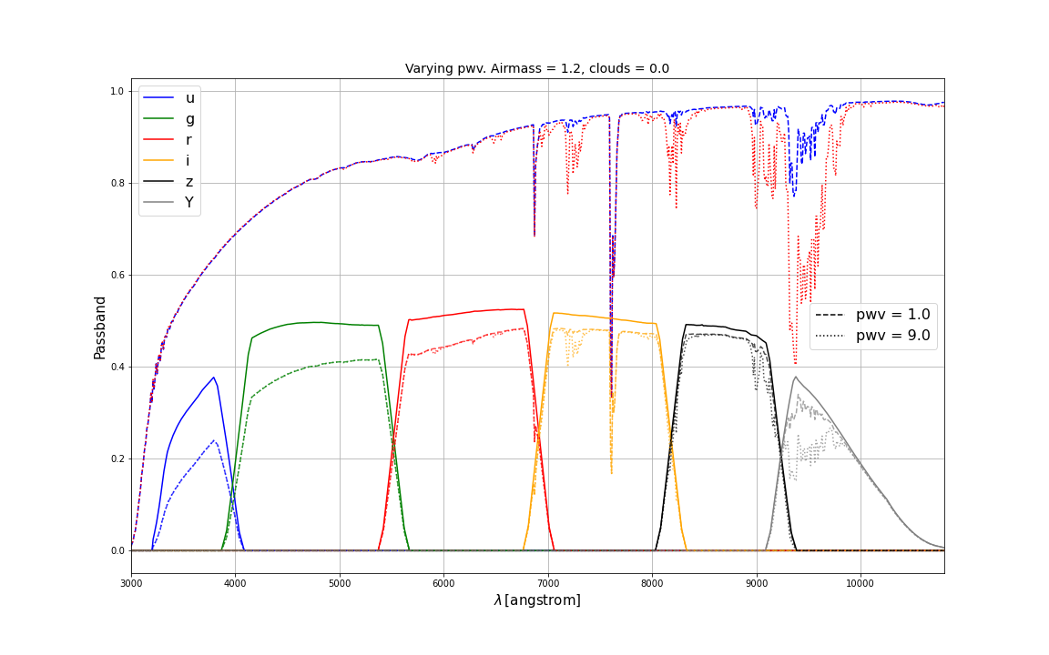
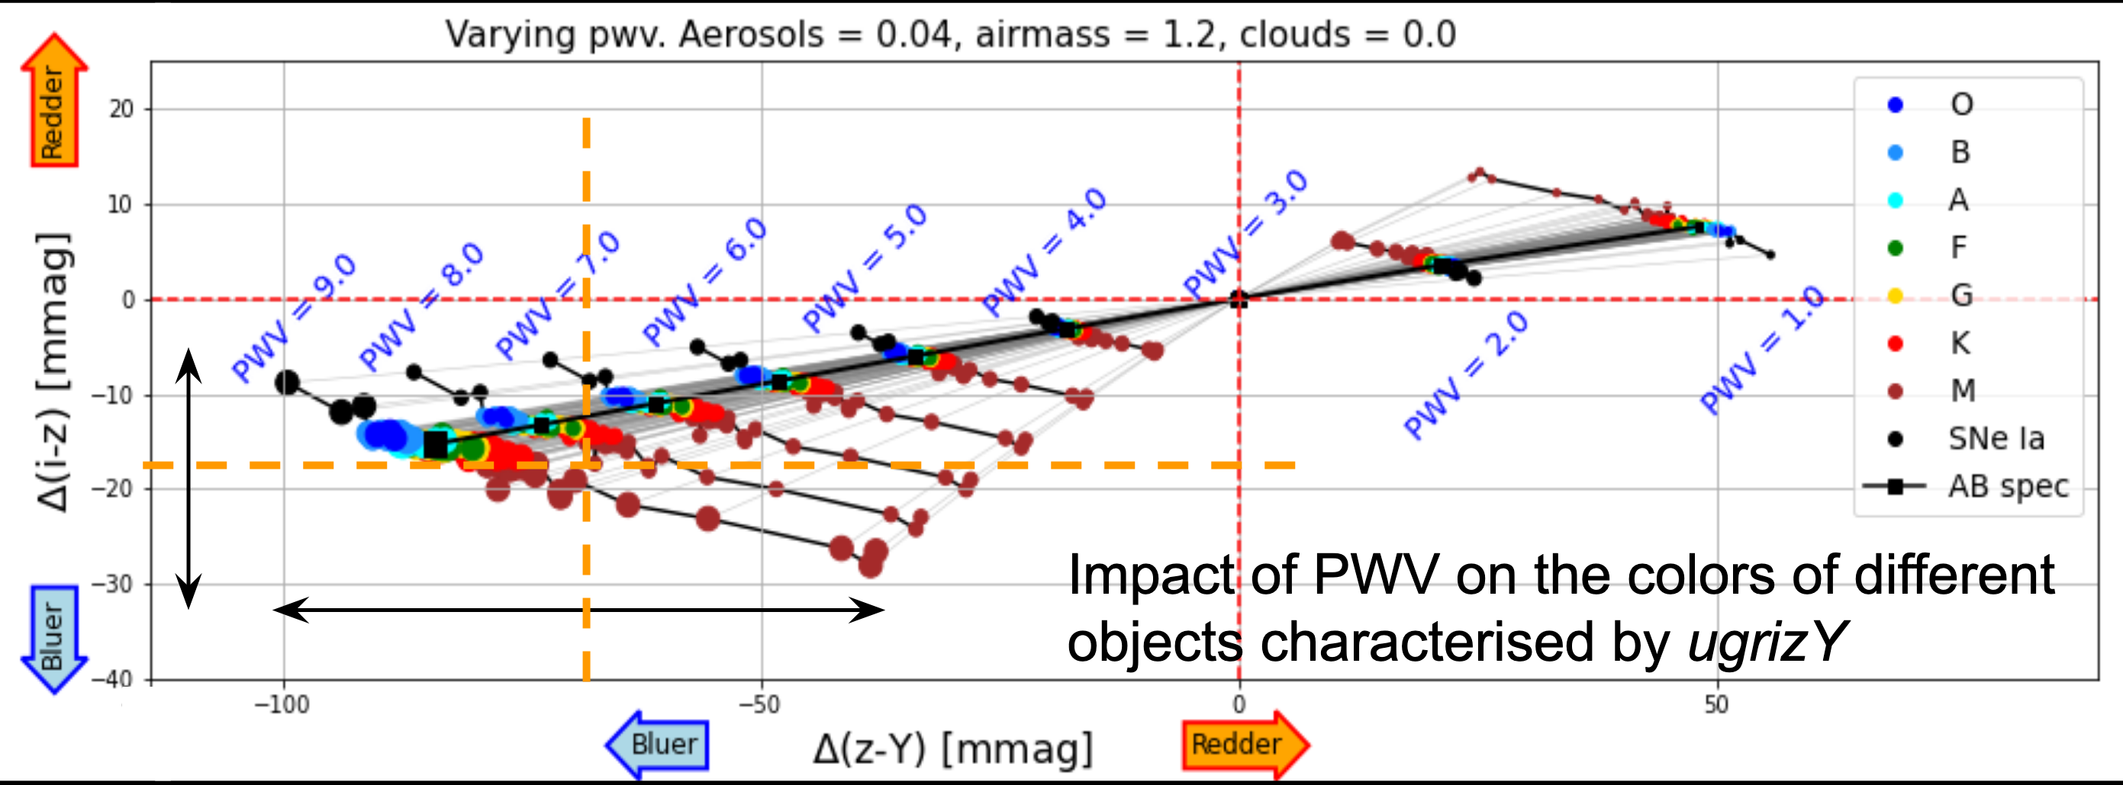
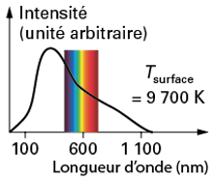
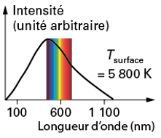
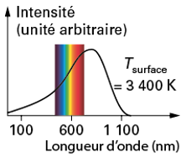
Color changes due to precipitable water vapor (PWV)
Reference atmosphere
Hot <---> cool
(Martin Rodriguez-Monroy)
- If PWV increases -> flux in Y decreases -> All objects look bluer
- If the object is hot (blue), as the flux Y decreases mainly on the blue side, it loses more light in Y than a cold object (red). It therefore turns more bluer than a red object.

Slide 12
Color changes due to precipitable water vapor (PWV)
Reference atmosphere
Hot <---> cool
(Martin Rodriguez-Monroy)
- color shift between PWV=3 and 9mm is between ~ - 40-100mmag depending on the stellar type
- Ignoring this variation means using average color shift -> object per object shift uncertainty ~20mmag
- If the stellar type is known and PWV measured with <0.5mm of precision =>
the differential shift between (K and F) or (F and O) stars is known with ~ 1mmag precision
Knowing PWV with <0.5mm allows to return to reference atmospheric conditions with 1mmag precision

Slide 13
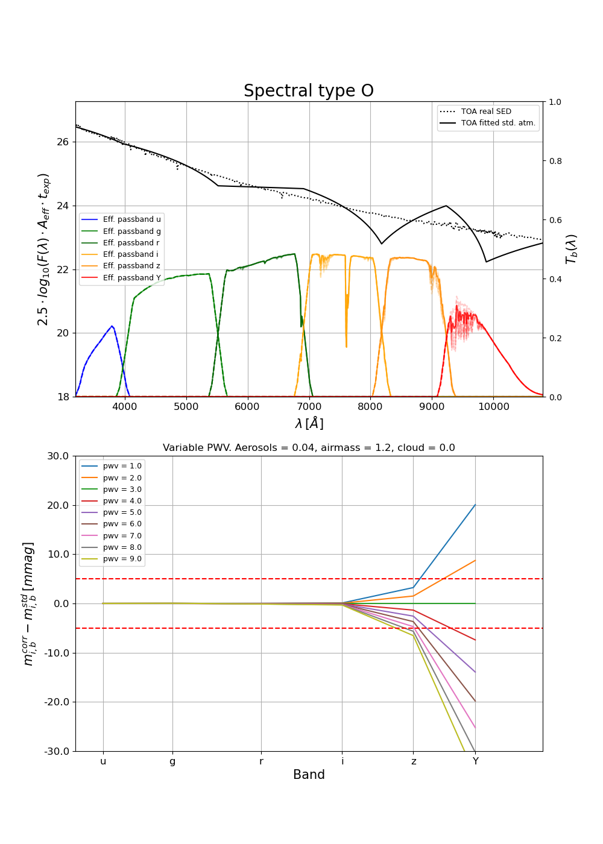
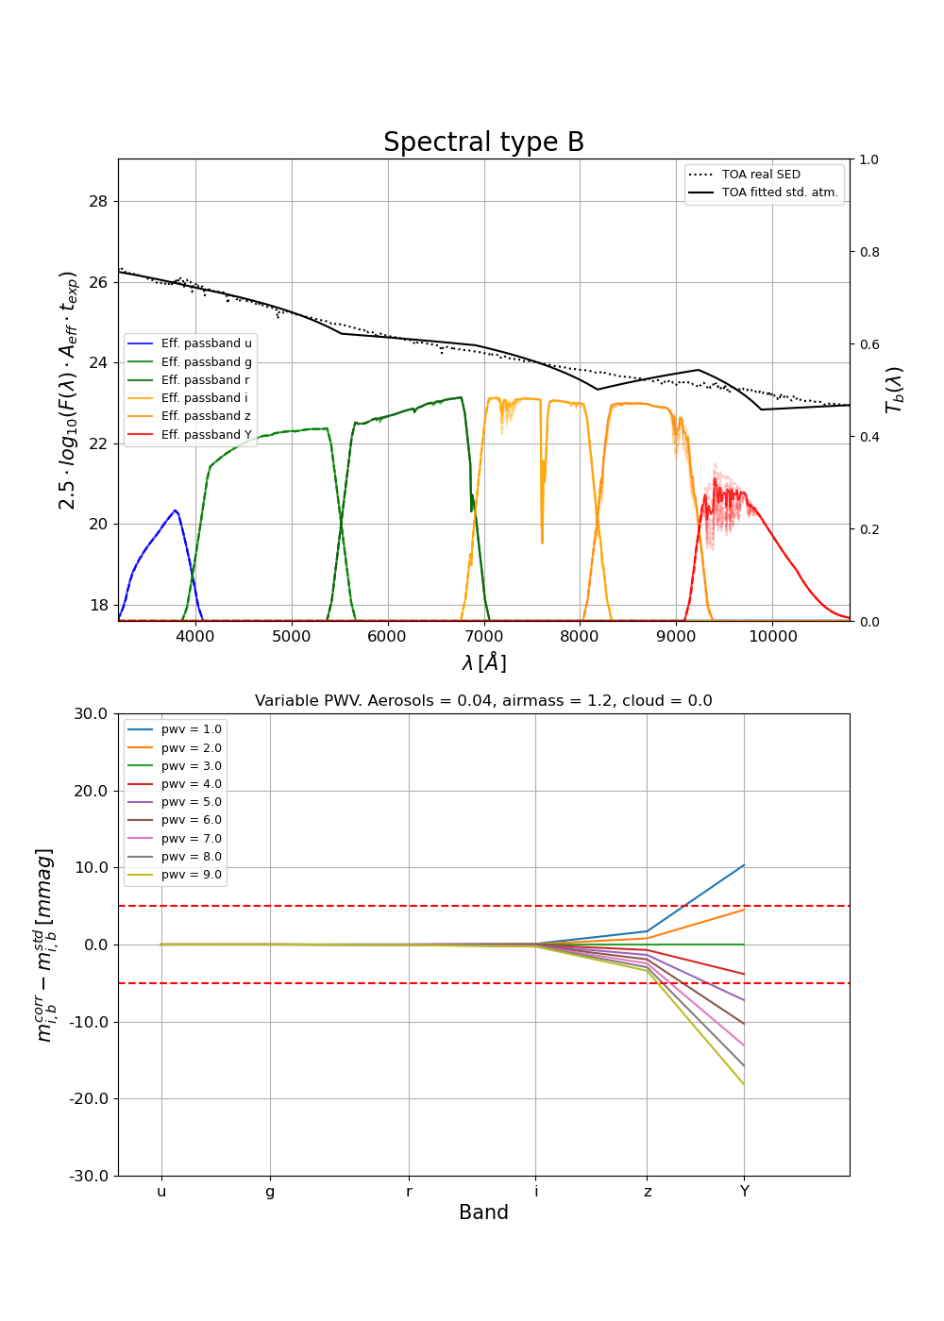
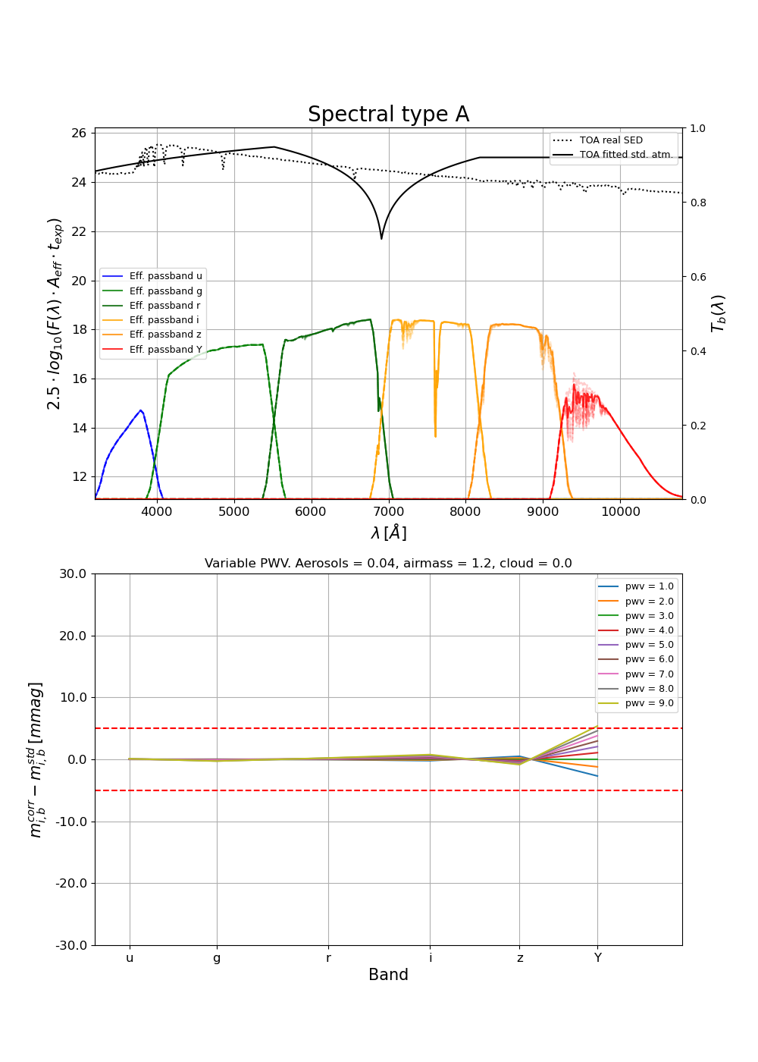
Atmospheric compensation in action
Simulated compensation process on stellar SEDs (waiting for data)
Up: dotted = true SED, full = reconstructed SED from (UGRIzY)
Down: (corrected magnitude – true magnitude) @ standard atmosphere and z=1.2

Slide 14
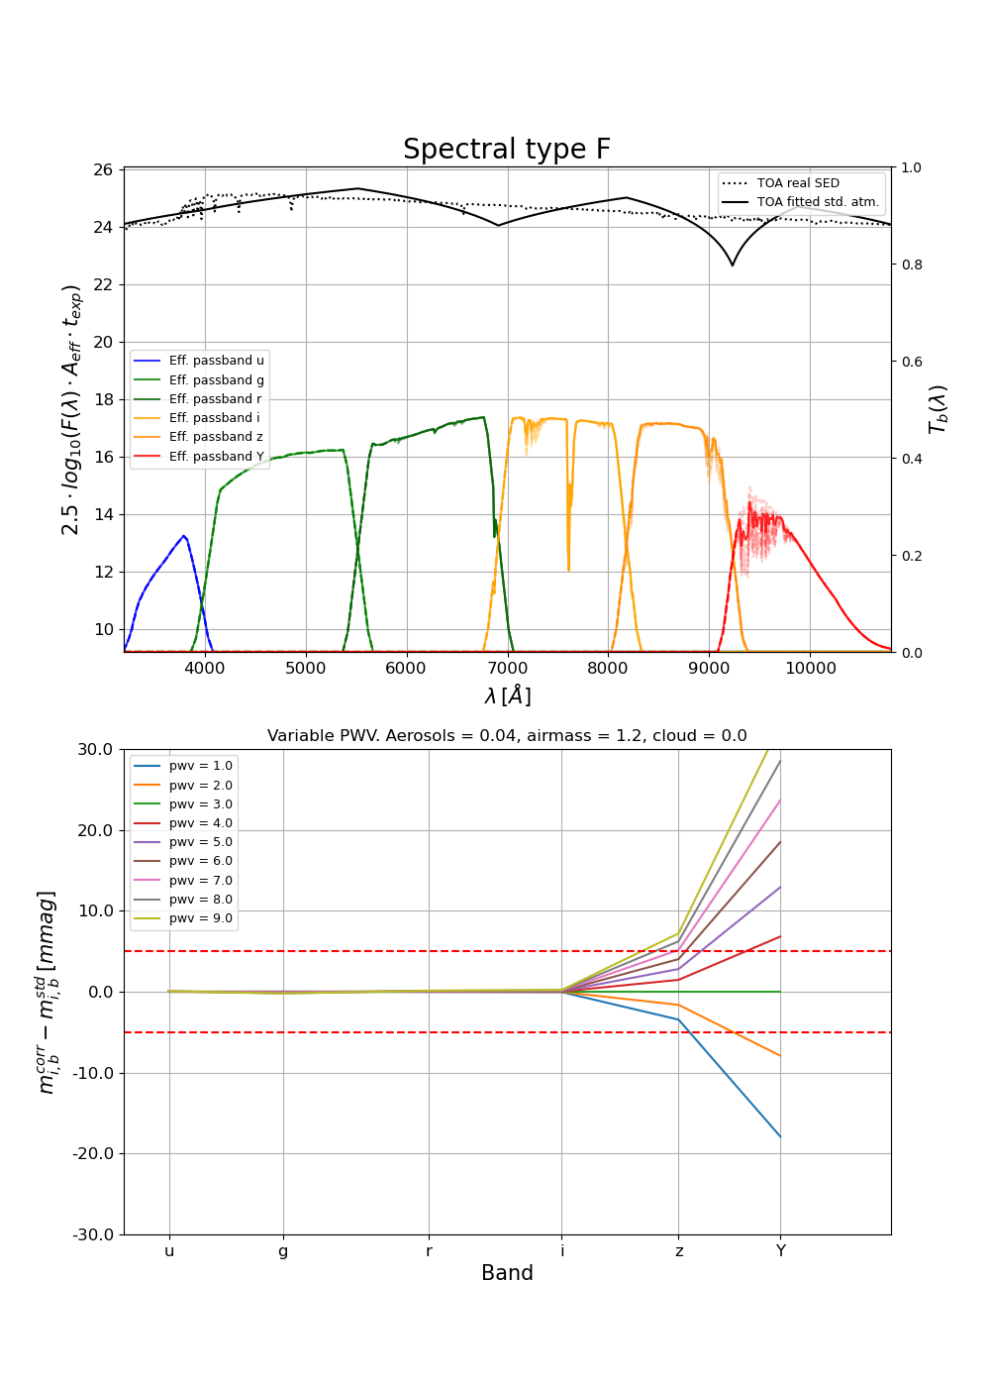
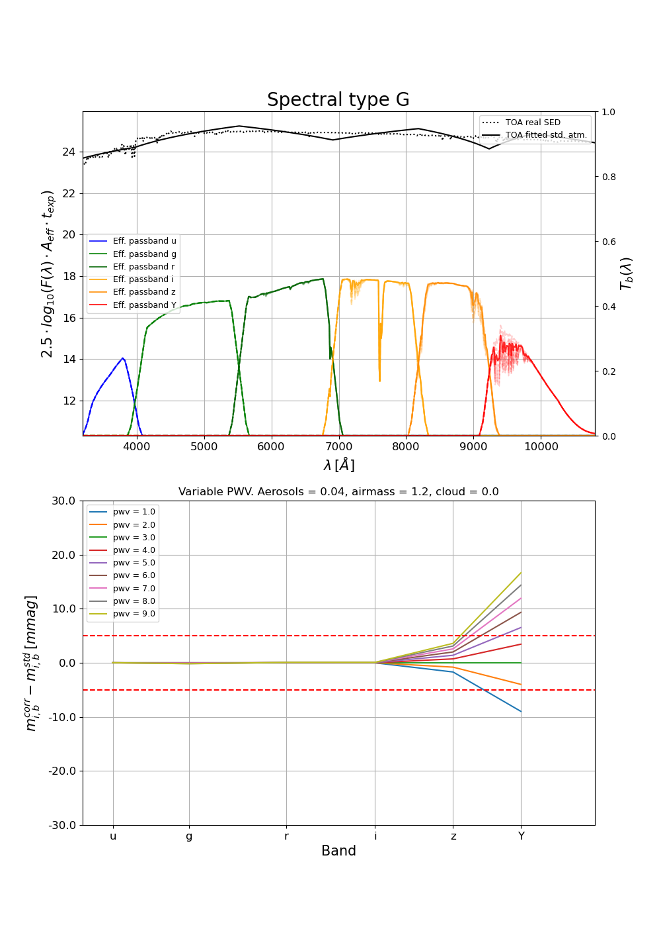
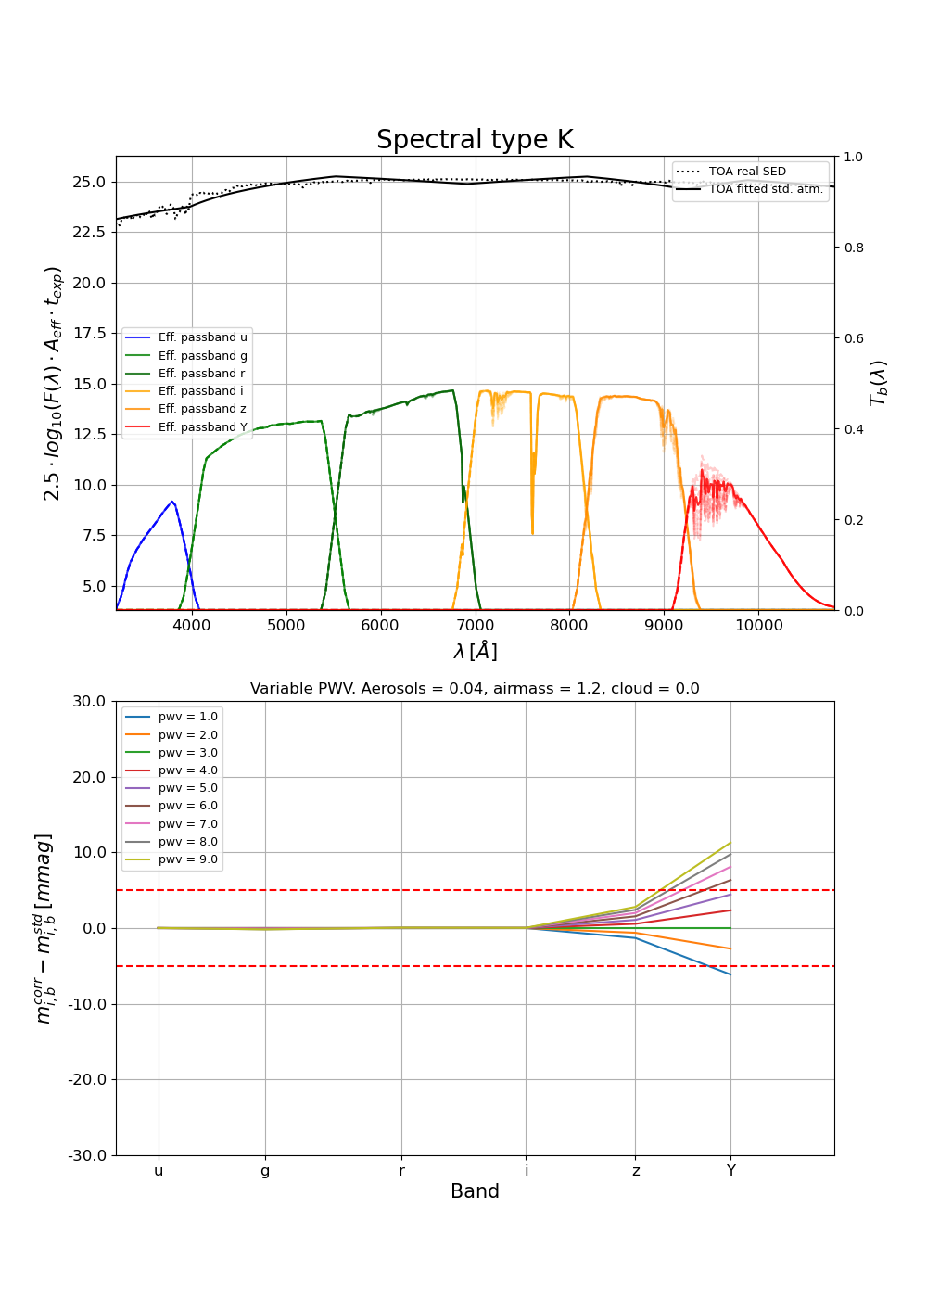

Atmospheric compensation in action
Simulated compensation process on stellar SEDs (waiting for data)
Up: dotted = true SED, full = reconstructed SED from (UGRIzY)
Down: (corrected magnitude – true magnitude) @ standard atmosphere and z=1.2

Slide 15
Current developpements
- Spectrator: gets better every day
  Transmission curve available
  PWV OK : repetability (⬄ precision?) < 0.3mm
  O₃ on the right track
  Aerosols (including clouds) in progress
- LibRadTran: to what extent are 4 parameters enough to describe the atmosphere: pression, PWV, ozone, VAOD ?
  Many absorbers do not behave linearly, i.e. t(λ,z) = t(λ,1)^{z} is often not exact (due to saturating absorbing lines).
- Estimating the best SED from (UGRIZY) alone: stars, galaxies and more…
- Catalog of stable spectrophotometric standards
  From Gaia data (out-of-atmosphere spectra)
  From AuxTel data (home-made catalog)

Slide 16
Not discussed today
- pseudo flat-fielding in spectroscopy
- Interaction with FGCM
  Provide atmospheric parameters?
  Or provide the computed compensations?
  Or compensate after FGCM… (if FGCM uses an average nightly atmosphere).
    This would be the major income of the procedure: a non-photometric night would be as good as a photometric night…
- Compensation in U for variation of aerosols and pressure
  Expect similar procedure than in Z and Y

Slide 17
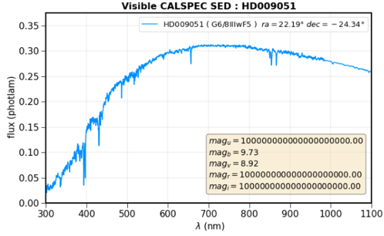
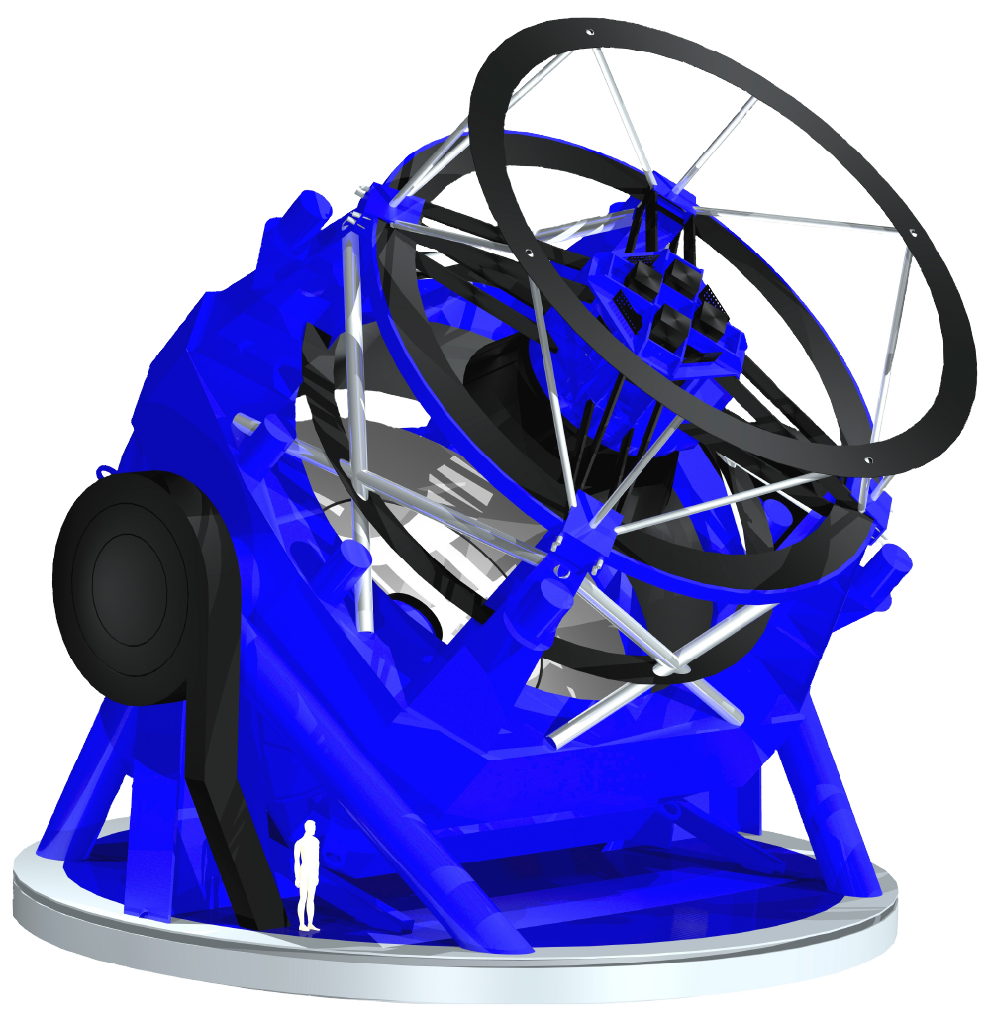
Photometry atmospheric compensation: 3 ingredients to go from (z_{cur} ,PWV_{cur}) to (z_{std} ,PWV_{std}) – case of passband Y
2-Data from LSST catalog : (UGRIZY)_{source}
-> Top of atmosphere 1rst order SED model
Current atmosphere
z_{cur} , PWV_{cur}
standard atmosphere
z_{std} , PWV_{std}
Slope within Y passband
φ^{inst}_{Y,cur}
φ^{inst}_{Y,std}
3-Data from AuxTel : current atm. transmission
1-Data: LSST current image in Y
For each source on the LSST image
- Extract current LSST instrumental flux φ^{inst}_{Y,cur.}
- Consult LSST catalog to interpolate its spectrum within passband Y
- Compute Φ^{pred}_{Y,std} predicted flux in LSST-Y with standard atmosphere
and Φ^{pred}_{Y,cur} predicted flux in LSST-Y with current atmosphere
Flux back to the standard atmosphere is then:
φ^{inst}_{Y,std} = φ^{inst}_{Y,cur} x (Φ^{pred}_{Y,std} /Φ^{pred}_{Y,cur})
Water vapor standard
absorption band
Water vapor current
absorption band
Effective passband = Throughput x
atm. transmissions
Integrate instrumental fluxes through standard and current atmospheres

Slide 18
Atmospheric compensation
Consider a source (star or galaxy) with current LSST instrumental flux in passband T (among UGRIZY) given by φ^{inst}_{T,cur.}
Procedure to obtain the estimation of this flux back to the standard atmosphere and airmass z=1.2 :
- Start with the top-of-atmosphere spectrum (toa) of the source SED_{toa}(λ)
if it is not known (general case if it is not a SN or a in a catalog of spectra):
    Modelize it from (UGRIZY)_{toa} previously measured by LSST and a black body model or interpolation
    Or from (UGR)_{toa} or (IZY)_{toa} previously known and flux interpolations
    A good first approximation is to use (IZY)_{std or cur}
- Estimate the current effective passband in LSST: T_{cur}(λ) = T_{inst} (λ) x τ^{atm}_{cur}(λ), where T_{inst} is the instrumental passband including filter + telescope throughput, and τ^{atm}_{cur}(λ) is
    deduced from the atmospheric parameters estimated with the AuxTel and Spectractor
    or directly obtained by the ratio SED(CALSPEC)_{cur}^{AuxTel} /SED(CALSPEC)_{toa}
- Compute Φ^{pred}_{T,std} (predicted flux in LSST with standard atmosphere and z=1.2)
    By integrating SED_{toa}(λ) x T_{std}(λ)
- Compute Φ^{pred}_{T,cur} (predicted flux in LSST with current atmosphere and airmass)
    By integrating SED_{toa}(λ) x T_{cur}(λ)
- Flux back to the standard atmosphere is then φ^{inst}_{T,std} = φ^{inst}_{T,cur} x (Φ^{pred}_{T,std} /Φ^{pred}_{T,cur})

Slide 19
COMPLEMENTS

Slide 20
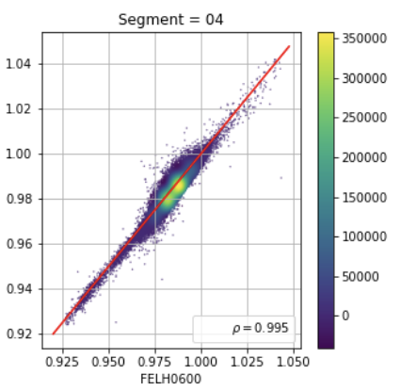
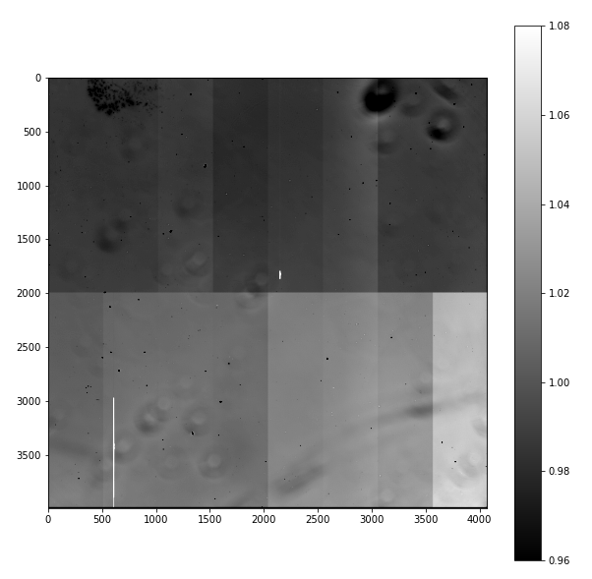
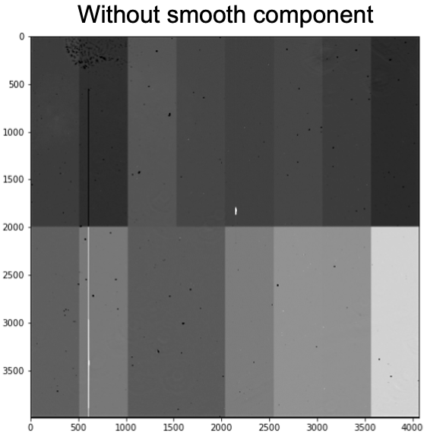

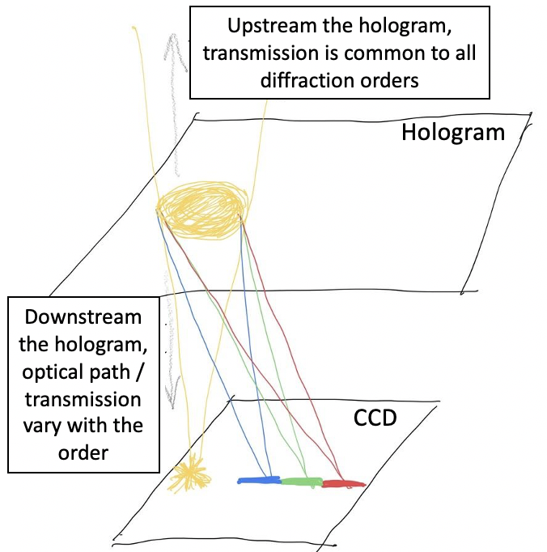
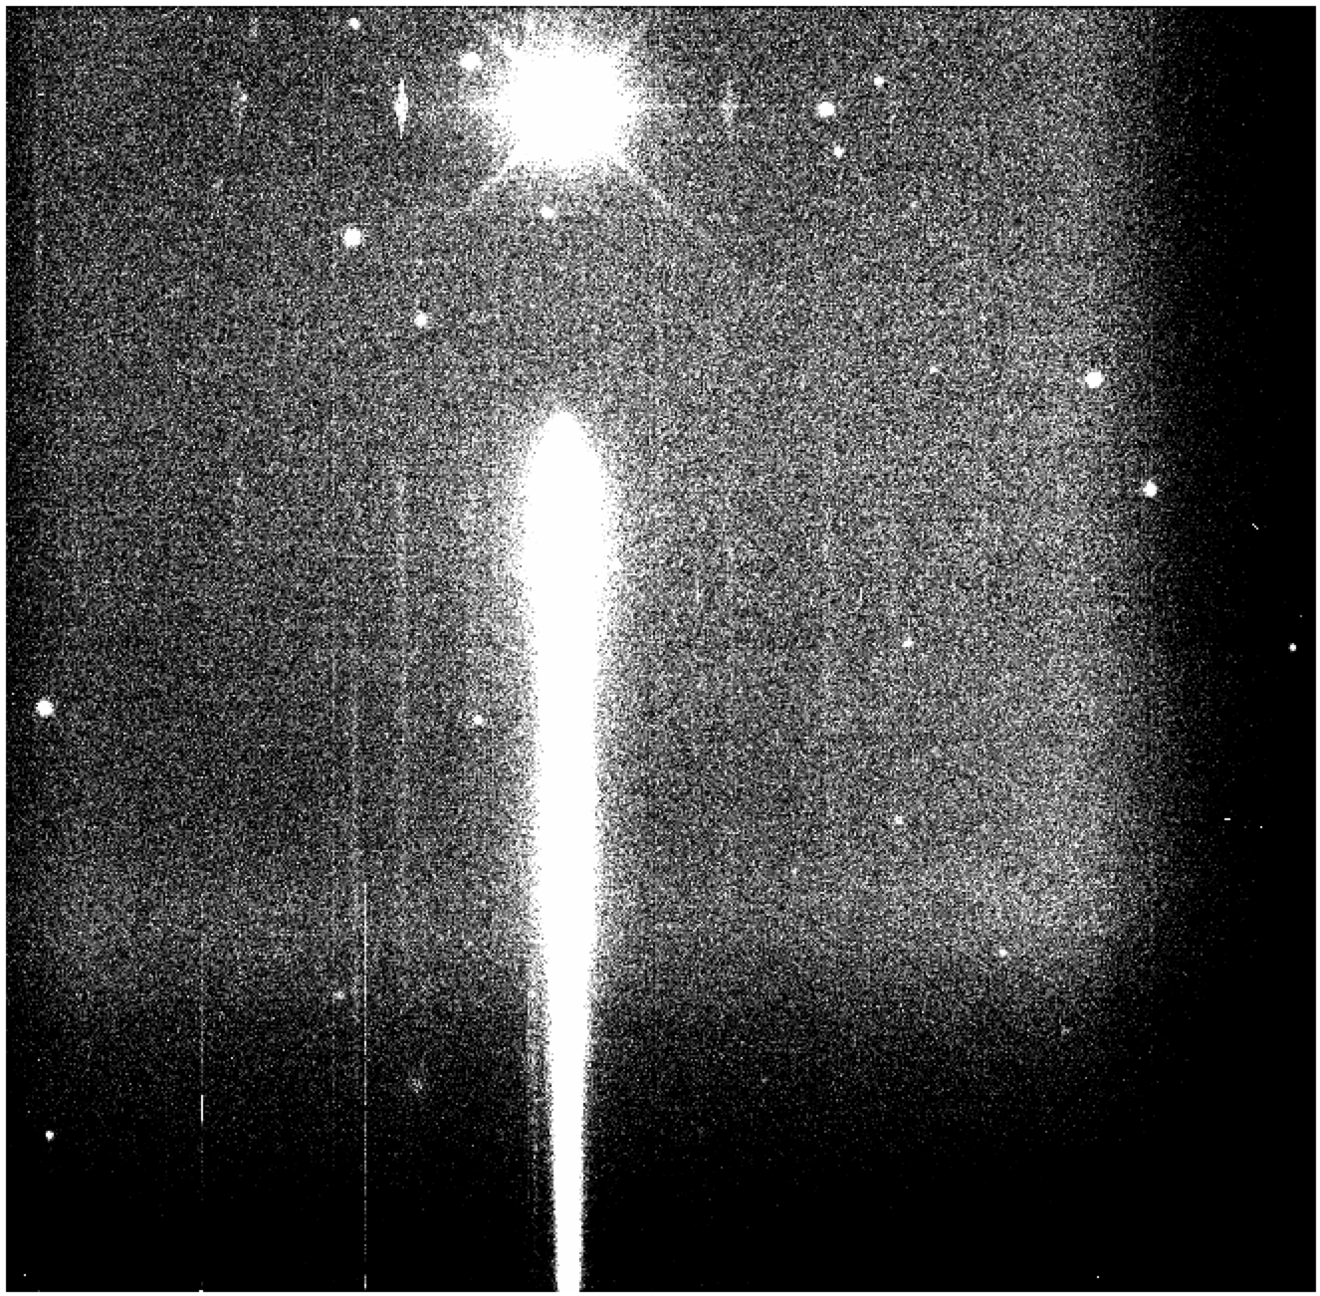
Flat-fielding in spectroscopy
Flat-fielding is not standard for spectroscopy
  Ultimately, the CBP will be the best tool
  In the meanwhile,we use approximations :
    Keep only fluctuations due to camera window + CCD (dust & pixel-to-pixel gain variations)
    spatial and wavelength efficiencies factorize
  A line of light to produce a special flat-field
Blue flat pixel value
Red flat pixel value
Normal flat FELH0600
flat after filtering slow variations due to upstream optics
Vignetting affects direct image but not spectrum

Slide 21
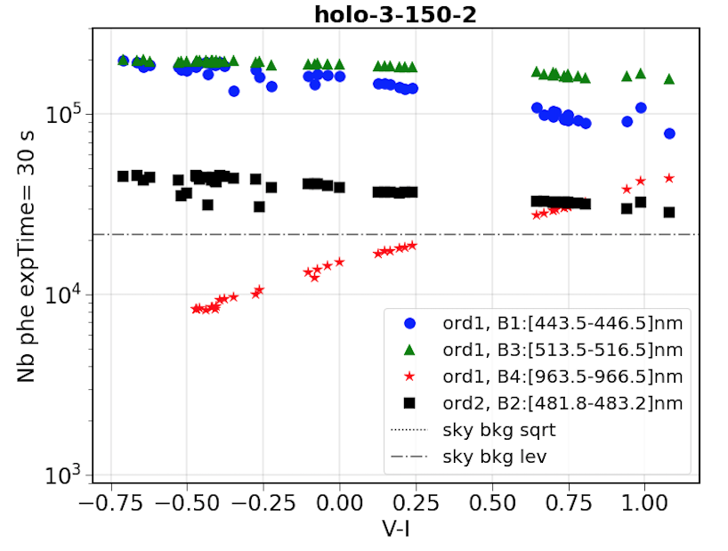
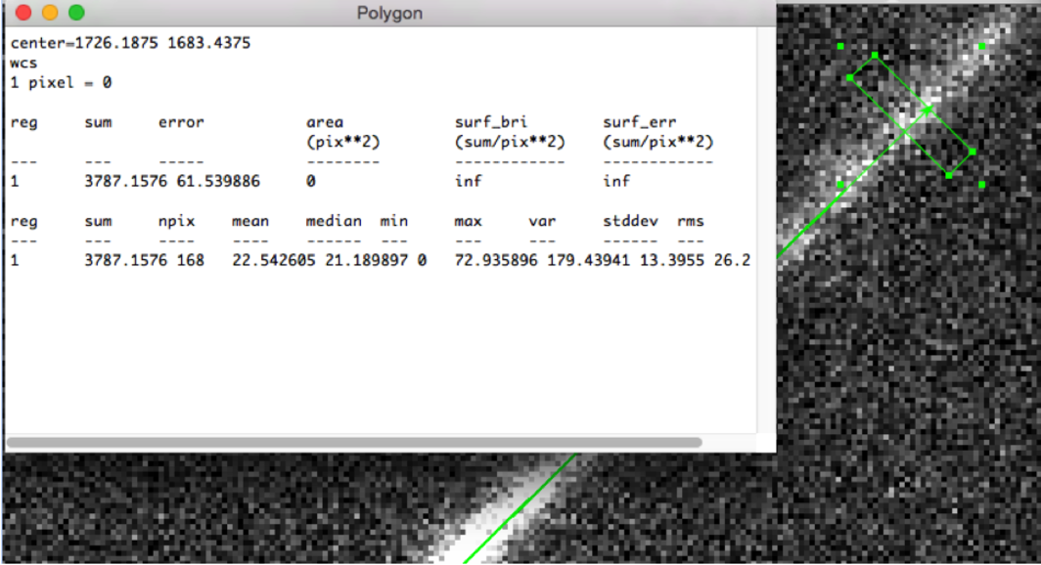
Signal from red star with V=10 (30s exposure, airmass 1)
Simulation from SDC using
AuxTel CCD QE official curve
Measured HOE transmission curves
Atmospheric absorption model
AuxTel optical throughput
The less illuminated band
965nm+/-1.5nm (1’’ seeing equivalent)
For the hologram
30s exposure
Expect > 25000γe⁻ from V=10 stars redder than V-I=0.5 (T_{eff}<7300K or F0)
Worst sky bkgd will be 23000γe⁻/(‘’)² (full moon)
-> Computation cross-checked (@10%) with the Pic-du-midi spectra obtained through holo-70
2nd order contamination
Sky bkgd/(‘’)²
hologram
965+/- 1.5nm band
First order only (with Z’ filter)

Slide 22
Compensation atmosphérique
C’est quoi? On va faire des images dans toutes les conditions d’atmosphère. Lss filtres effectifs seront variables, ce qui compliquera les comparaisons. Pour faire des courbes de lumière l’idéal est de rapporter toutes les mesures à une situation atmosphérique standard, soit PWV=2mm, z=1.2.
Il serait bon de réfléchir à ce qu’est l’atmosphère moyenne après co-addition: sinon les régions du ciel d’hiver pourraient donner une cosmologie différente des régions du ciel d’été…

Slide 23
Compensation atmosphérique
La question : Comment connaître l’effet de l’atmosphère sur la photométrie d’un objet donné? (pour pouvoir le compenser).
Sachant que: il dépend de la SED de l’objet, et qu’on ne connaît que UGRIZY.

Slide 24
Compensation atmosphérique (1)
La question : Comment connaître l’effet de l’atmosphère sur la photométrie d’un objet donné? (pour pouvoir le compenser).
Sachant que: il dépend de la SED de l’objet, et qu’on ne connaît que UGRIZY.
Ingrédients nécessaires
  Courbe de l’absorption atmosphérique dans la bande passante T
    Mission principale de AuxTel
    Question encore ouverte (axe 1)
      modèle d’atmosphère (LibRadTran) mesuré à partir de standards éventuellement loin du champ de LSST
      courbe directement obtenue dans la même direction que LSST
  SED de l’objet (axe 2): la plupart du temps on ne connaîtra que UGRIZY_{LSST} (après environ 1 an)
    Interpoler une SED, mais pas toujours simple
    Trouver la classe d’objet la plus proche dans une librairie
Avec ces ingrédients
  Calcul des magnitudes attendues pour atmosphère standard à z=1.2 (T_{1.2}) et atmosphère courante à z courant (T_{z})
  La compensation pour se rapporter à une atmosphère standard à z=1.2 est alors (T_{1.2} – T_{z})

Slide 25
Current developpements
- Spectrator: gets better every day
  Transmission curve available
  PWV OK : repetability (⬄ precision?) < 0.3mm
  O₃ on the right track
  Aerosols (including clouds) in progress
- LibRadTran: to what extent are 4 parameters enough to describe the atmosphere: pression, PWV, ozone, VAOD ?
  Beaucoup d’absorbants ne se comportent pas de façon linéaire, autrement dit t(λ,z) = t(λ,1)^{z} n’est souvent pas exact (raies saturantes);
- Estimation de la meilleure SED à partir de (UGRIZY) seul: étoiles, galaxies et autres…
- Catalogue de standards spectrophotométriques stables
  A partir de Gaia (spectres hors atmosphère)
  A partir des données AuxTel

Slide 26
Pas abordé
- equivalent du flat-field
- Amélioration throughput -> travelling CBP
- LibRadTran: jusqu’à quel point 4 paramètres suffisent pour décrire l’atmosphère: pression, PWV, ozone, VAOD ?
  Beaucoup d’absorbants ne se comportent pas de façon linéaire, autrement dit t(λ,z) = t(λ,1)^{z} n’est souvent pas exact (raies saturantes);
- Estimation de la meilleure SED à partir de (UGRIZY) seul: étoiles, galaxies et autres…
- Catalogue de standards spectrophotométriques stables
  A partir de Gaia (spectres hors atmosphère)
  A partir des données AuxTel

Slide 27
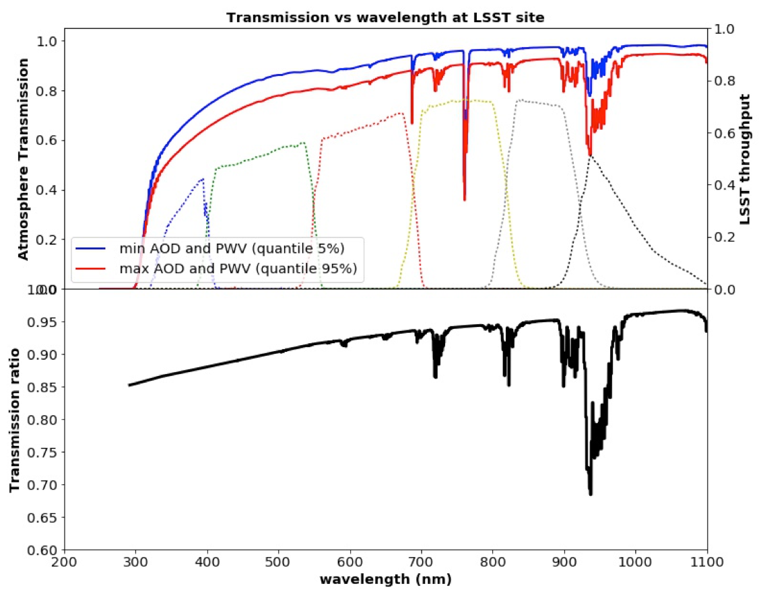
Variability of the atmospheric transmission
Same airmass
Same O₂
Same O₃
No clouds (grey)
Change
  H₂O (PWV)
  Aerosols
Aerosol /
no aerosol
Wet / dry

Slide 28
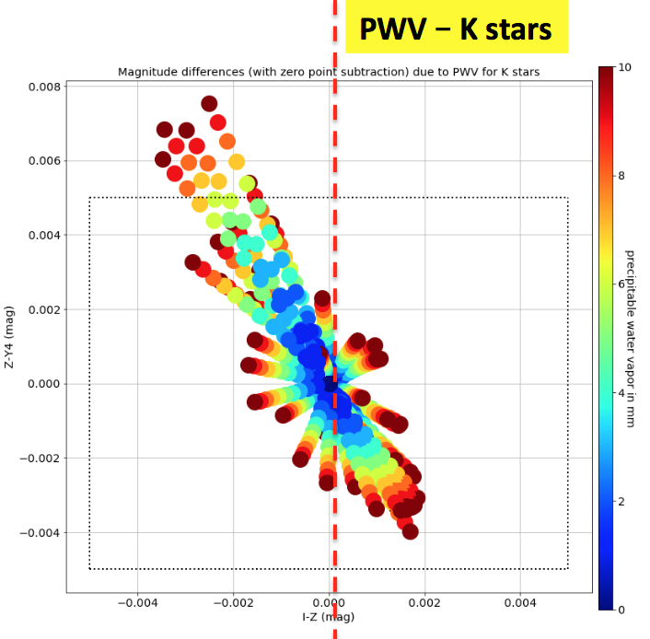
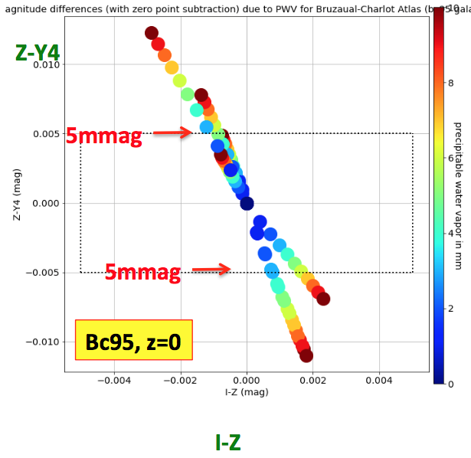
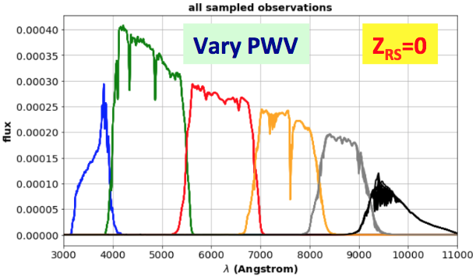

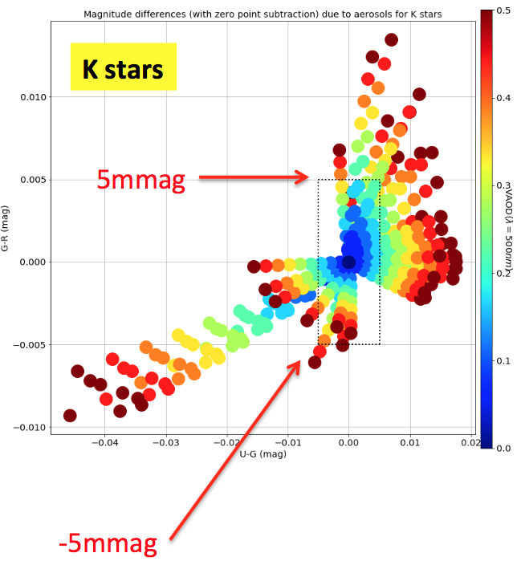
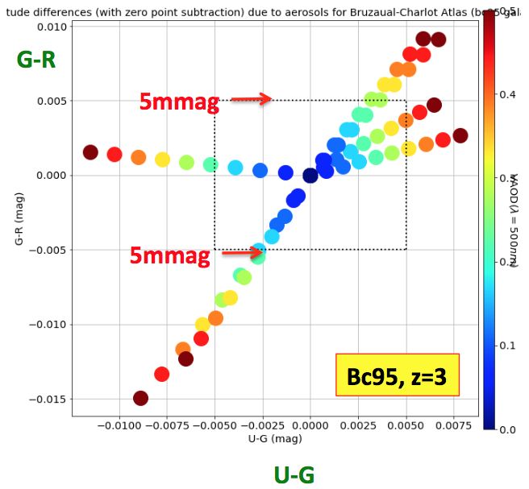
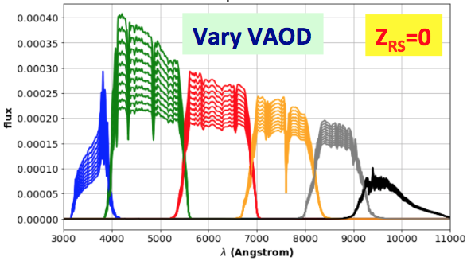

Max. expected colour changes (airmass=1)
« Worst » stellar type
« Worst » galactic types
Water vapor
1 trajectory
= 1 SED
= 1 vector
For airmass=1
@airmass=1
Aerosols

Slide 29
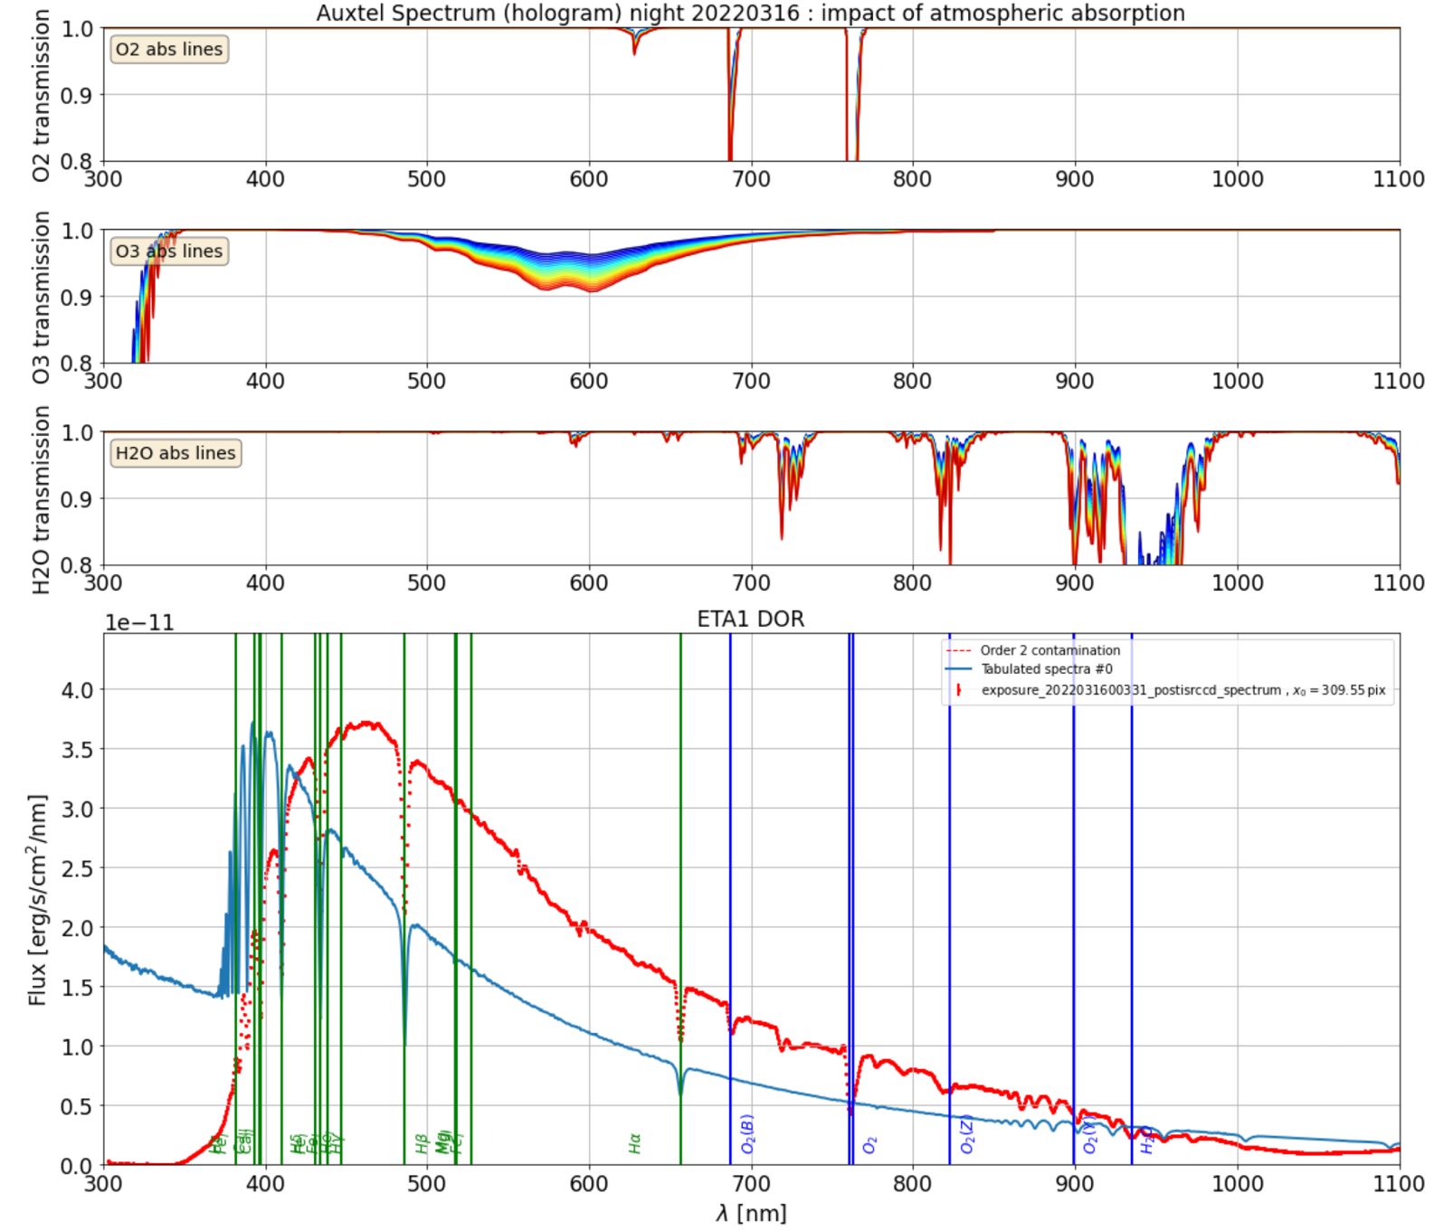
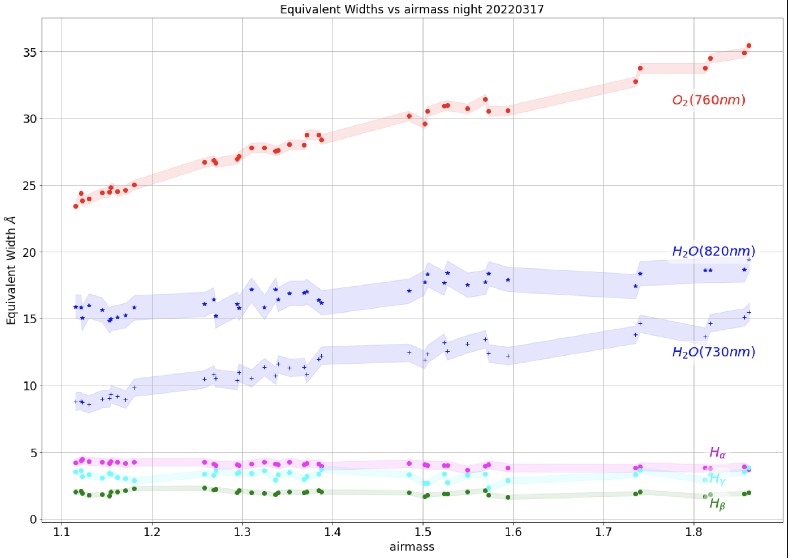
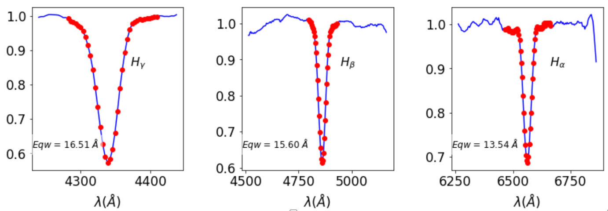
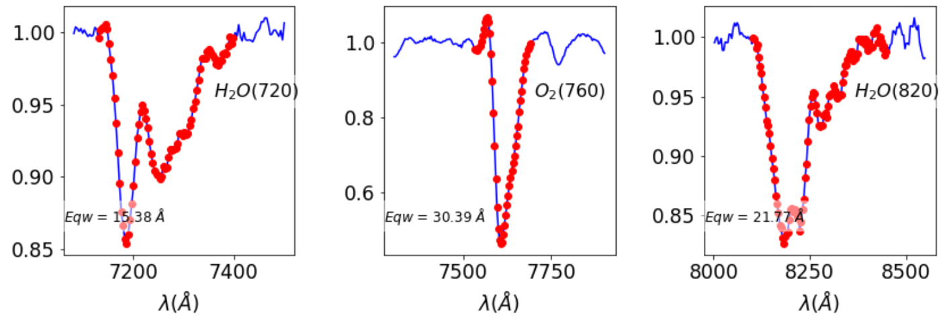
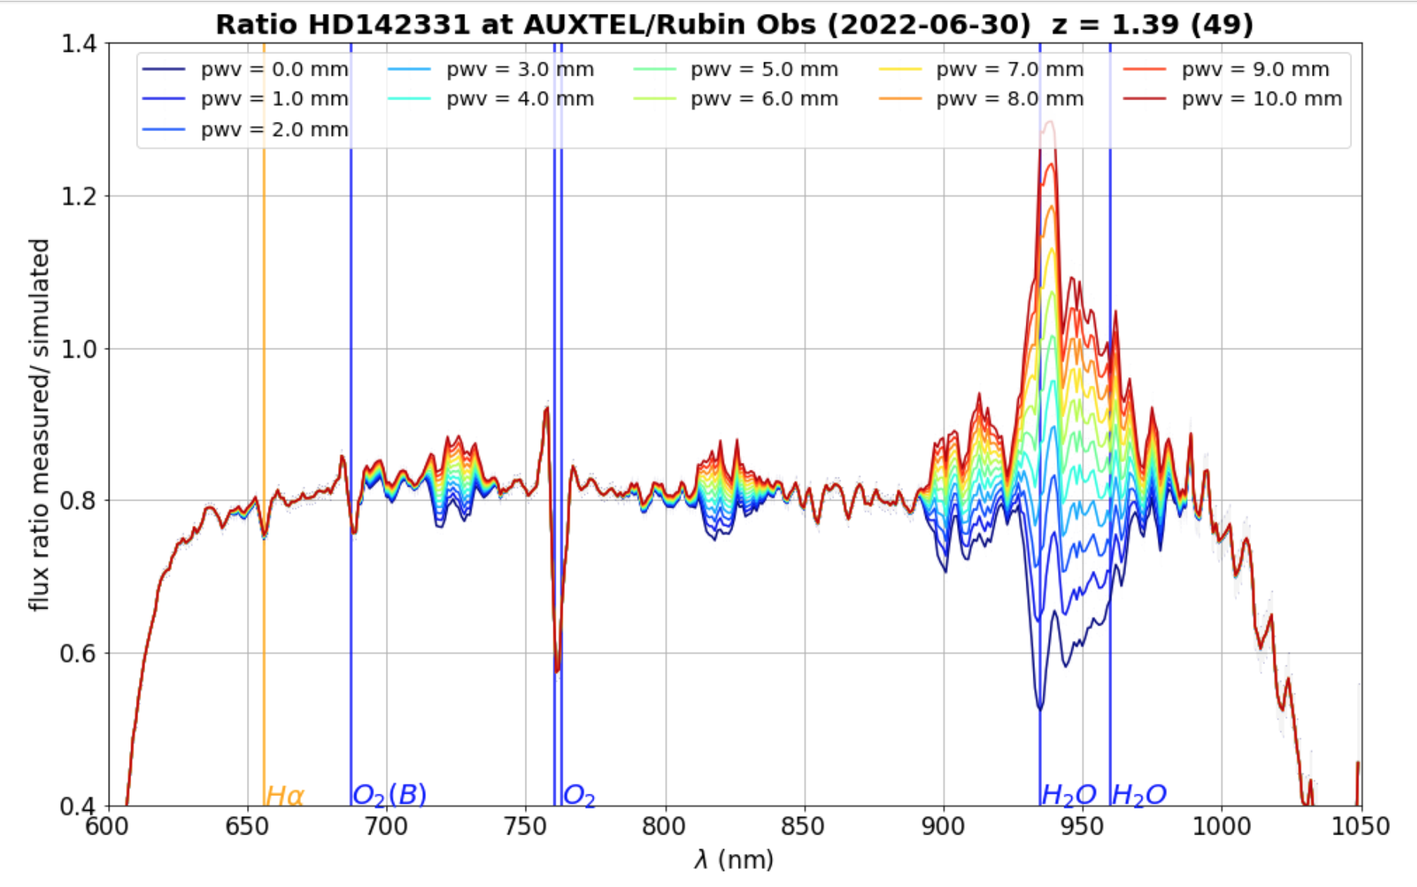
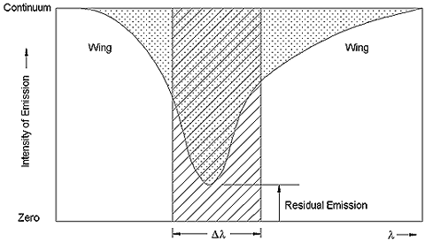
Auxtel : First estimates of atmospheric parameters
Atmospheric absorption lines
EQW depends on atmosphere
O₂ atm. absorption lines
O₃ atm. absorption bands
H₂O atm. absorption bands
Stellar lines
EQW independent on atmosphere
Variation of EQW for atmospheric lines illustrates sensitivity to atmospheric parameters (EQW)
H_{γ}
H_{β}
H_{α}
H₂O
(720nm)
O₂
(760nm)
H₂O
(820nm)
data/simu(LibRadTran) for several hypothesis (PWV)
H₂O
H₂O
H₂O
EQW definition
  ‘’fit’’ H₂O :
  PWV ~ 3.2mm

Slide 30
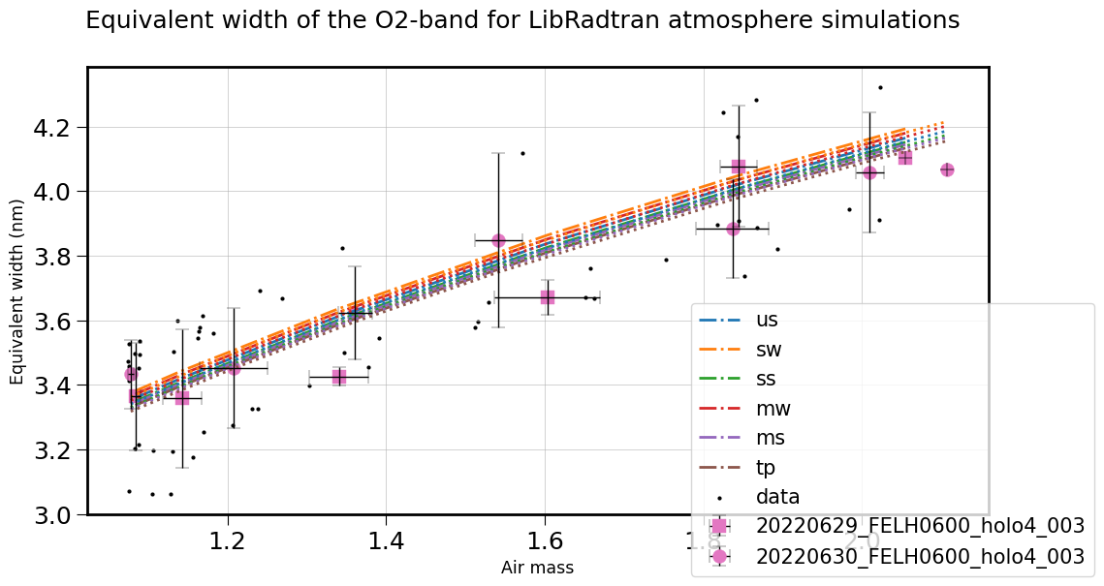
Control tool : EQW(O₂) should depend only on airmass x pressure
EQW definition
After checking EQW(O₂), we will measure
EQW(H₂O_{(A)}) and EQW(H₂O_{(B)})
H₂O_{(A)}
H₂O_{(B)}

