Slide 1



Advancements in the DESC Cluster Pipeline: Current State and Cosmological Analysis with Firecrown
Eduardo Barroso (LAPP)
LSST-France meeting
Paris
Nov. 2024

Slide 2
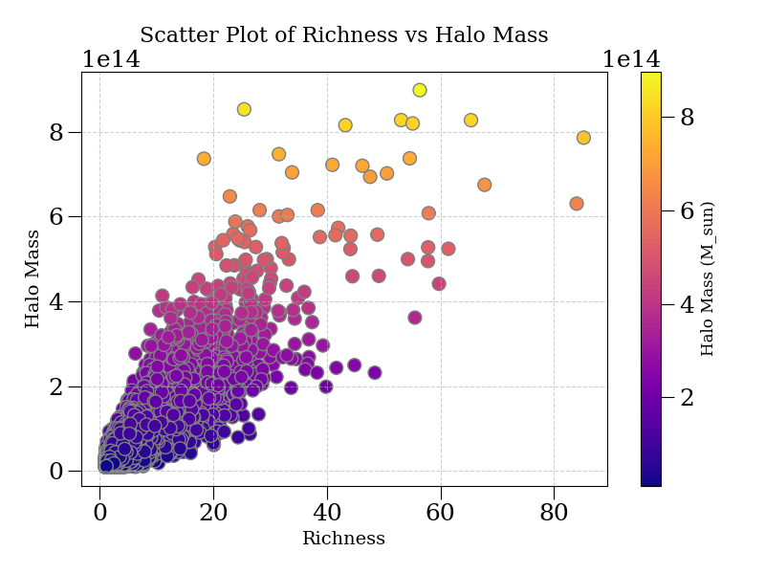
Galaxy clusters
Galaxy clusters are the biggest gravitational bounded object in the universe and thus is a good candidate for analysing Large Scale Structure Formation (LSS)
No direct detections of some of the clusters features needed for predictions (for instance, their mass)
2 probes: number of clusters in the sky and the lensing signal from source galaxies behind the cluster

Slide 3
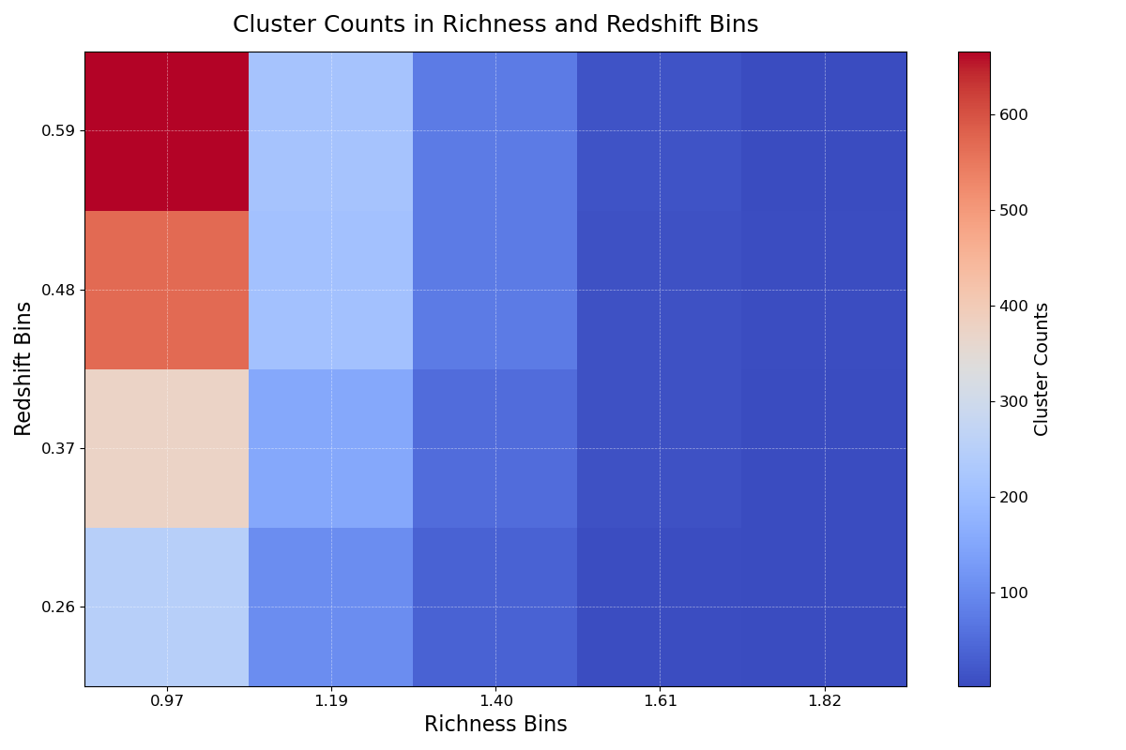
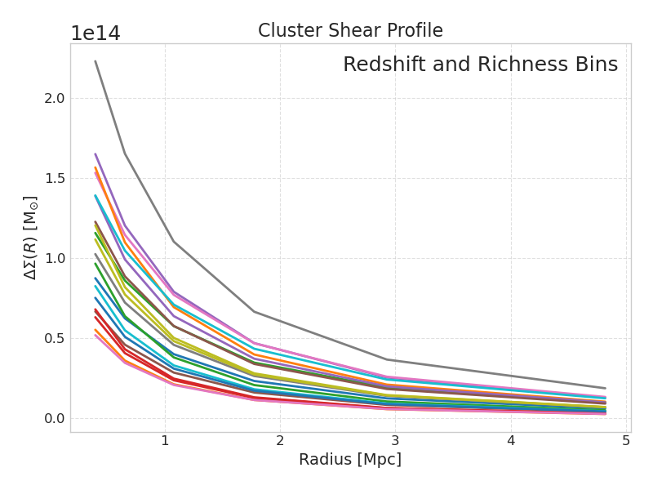
Cluster Number Counts
Cluster Shear Profile
Given a sky area, redshift and richness bins:
The number N of clusters in the bins
Given a sky area, redshift, richness and radius bins:
The stacked excess density surface mass in each bin

Slide 4
Galaxy clusters in LSST-DESC working group
A primary goal is to obtain constraints on 𝝮_{m} and 𝞼₈ from the 𝚲 - CDM
For the analysis we need:
  Data (simulations for the moment)
  Organize the data into catalogs with the needed information
  Make the theoretical predictions (counts, weak lensing, covariance)
  Implement the likelihood between data and prediction
  Run an MCMC
We need a pipeline that is able to go from a cluster catalog to the above constraints, while maintaining consistency. The catalog must have information about:
  Mass
  Redshift
  Shear signal

Slide 5
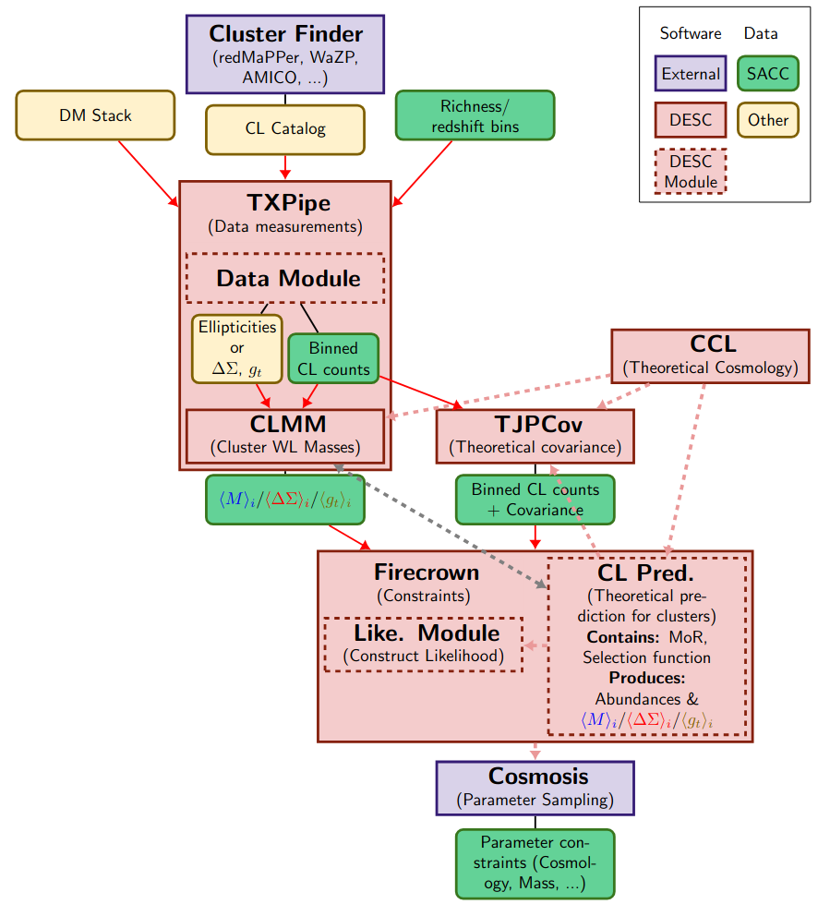
The Desc Cluster Pipeline
TXPipe processes/generates cluster catalogs.
CCL is a public, standardized library used for calculating key cosmological observables.
CLMM is designed for galaxy cluster mass reconstruction using weak lensing observables.
Firecrown is Python package that offers the DESC framework for implementing likelihood
TJPCov is a general covariance calculator developed for cluster analyses.
CL prediction module contains extra cluster calculations needed for the analysis

Slide 6
Firecrown
Python package that offers the DESC framework for implementing likelihood
Key properties | Relevant cluster codes
Dedicated likelihood implementations for 3x2 point, weak lensing, cluster counts, supernova, etc. Connection with cosmosis (MCMC) and NumCosmo. Data Reading | Cluster theory model
 | Cluster counts prediction implementation Cluster shear prediction implementation
 | Cluster Statistics FIles
 | Likelihood construction, data reading/writing for different data types.

Slide 7
Firecrown Shear Implementation
Added theory predictions to compute shear signal
Add code to read and organize new data from the SACC format
Create a recipe for theoretical prediction
Create new statistics object that will call the recipe
Uses CLMM for prediction
SACC data files will be provided by TXPipe
Recipes will be related to the Pipeline systematics

Slide 8
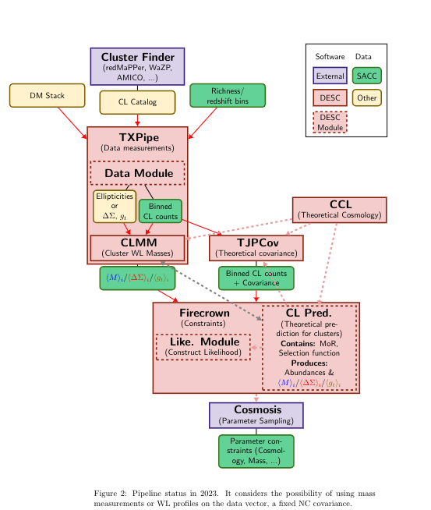
Testing the Pipeline
This analysis is using 5 different modules of the cluster pipeline: CLMM, CCL, SACC, TJPCov and Firecrown (which includes the prediction module)
Future tests will also include TXPipe

Slide 9
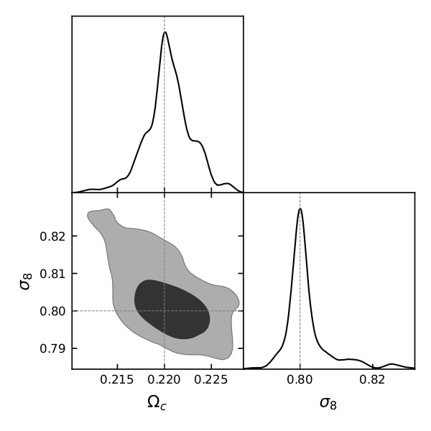
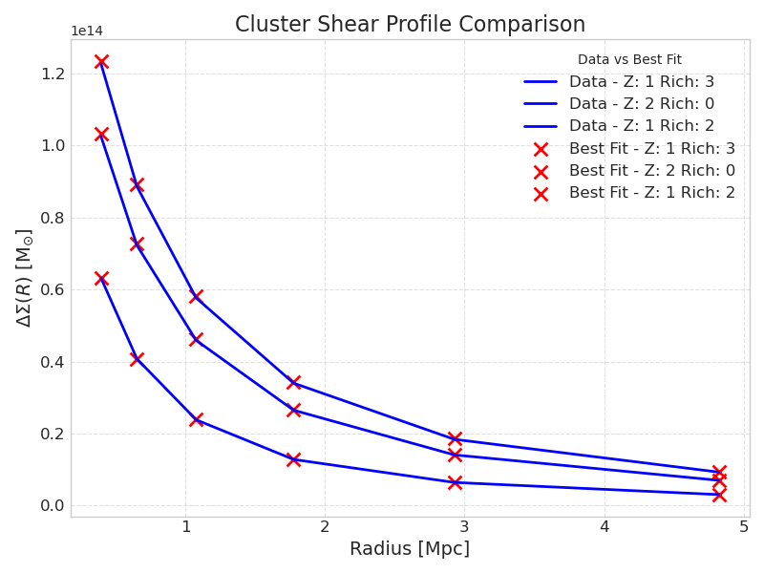
Validation with mock data: step 1
Generated only shear data with NumCosmo and CLMM
Run Firecrown with same systematics with free cosmology to be fitted
We were able to obtain the right parameters in the 2σ - region

Slide 10
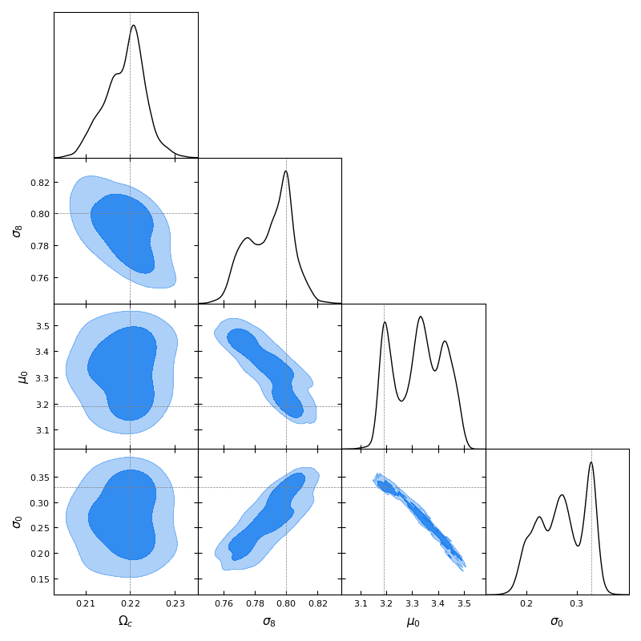
Validation with mock data: step 2
Same analysis but with counts and shear data
Run Firecrown to fit both the cosmology and the mass-richness relation
We were able to obtain the right parameters in the 2σ - region

Slide 11
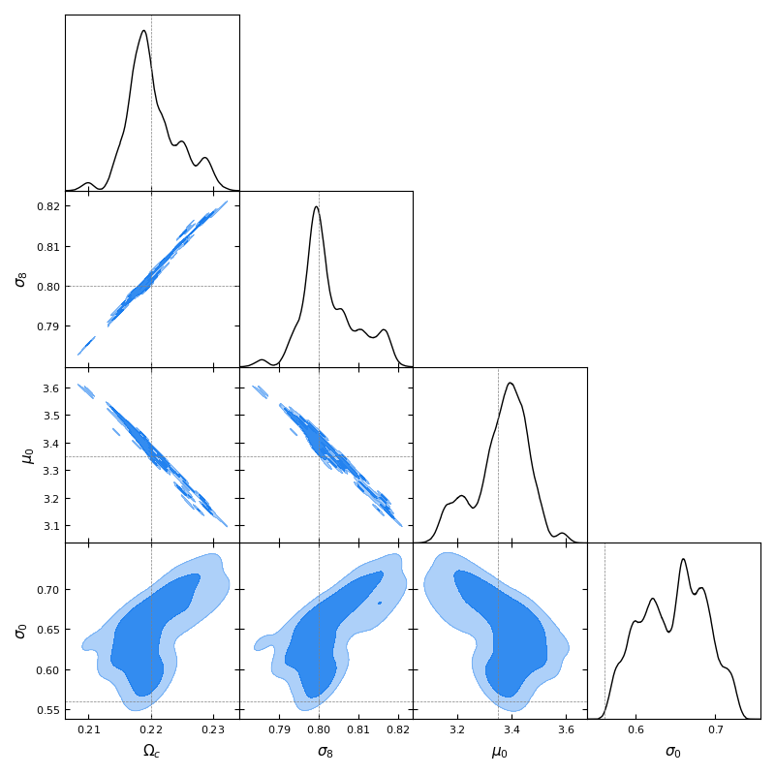
Run on cosmodc2 data
Analysis done with RedMapper cosmoDC2 catalog
Run Firecrown to fit both the cosmology and the mass-richness relation
Ongoing analysis. Computing time around 20h
We were able to obtain the right parameters in the 2σ - region

Slide 12
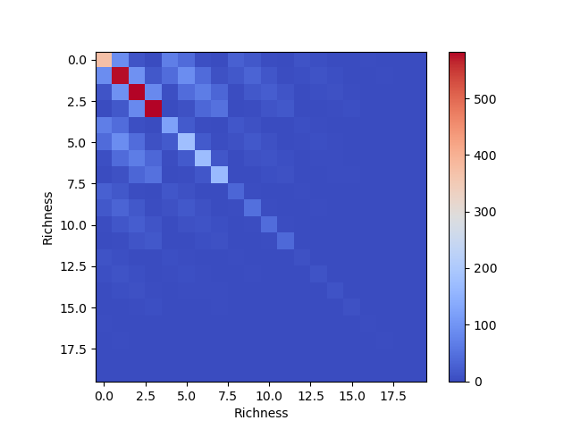
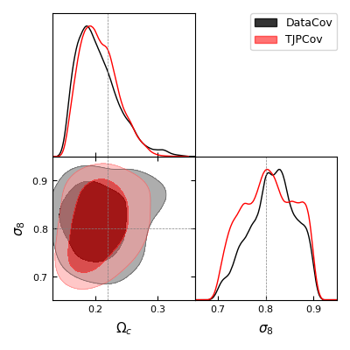
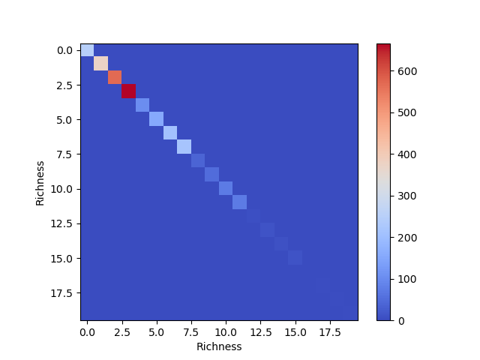
TJPCov Covariance
Counts theoretical covariance from TJPCov
Data covariance

Slide 13
Next goals
Test consistency used throughout the pipeline
Connect with TXPipe
Implement Covariance calculations for shear profile in TJPCov
Implement systematics (boost factor, selection function, misscentering)
Create a package to run different parts of the pipeline with the same configurations

