Slide 1
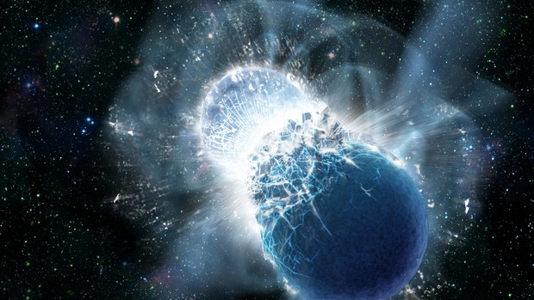
Equation of state with hyperons for neutron stars
ROCKSTAR workshop,
Trento, Italy
ASTRANUCAP, 19/11/2024, Madrid
9-13 October 2023
Hristijan Kochankovski

Slide 2
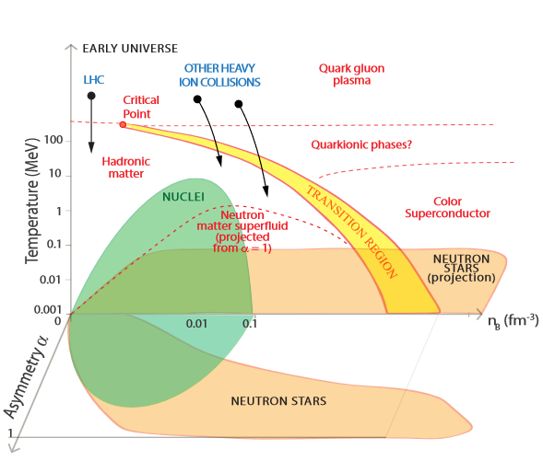
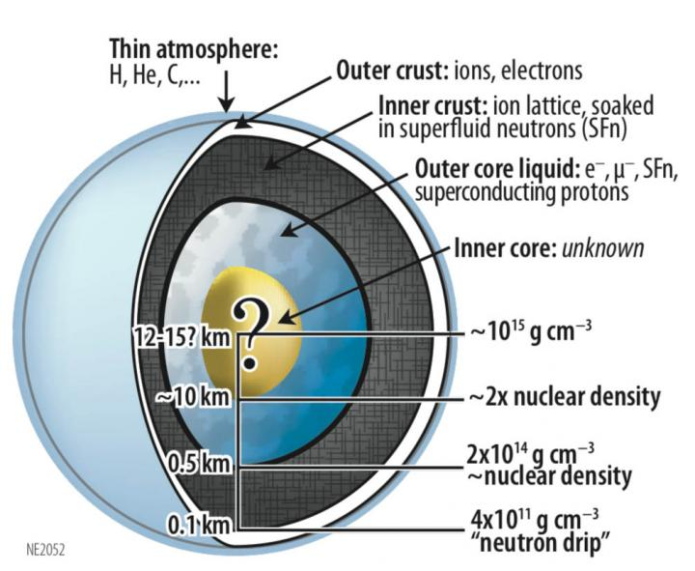
Motivation
Watts et al, PoS (AASKA14), 2014
K.C. Gendreau et al. ,SPIE, 2012

Slide 3
Hyperons in dense matter
$$E_{n}$$
$$n→Λ$$
$$n+n↔Λ+Σ^{0}$$
$$n+p↔Ξ^{0}+Σ^{+}$$
$$n+n↔p+Σ^{−}$$
$$n+n↔p+{ Ξ}^{−}$$
$$E_{Λ}$$
$$m_{Λ}$$
$$μ_{Λ}=μ_{Σ^{0}}=μ_{n}$$
$$μ_{Σ^{+}}=μ_{p}$$
$$μ_{Σ^{−}}=μ_{Ξ^{−}}={2μ}_{n}−μ_{p}$$
$$m_{n}$$

Slide 4
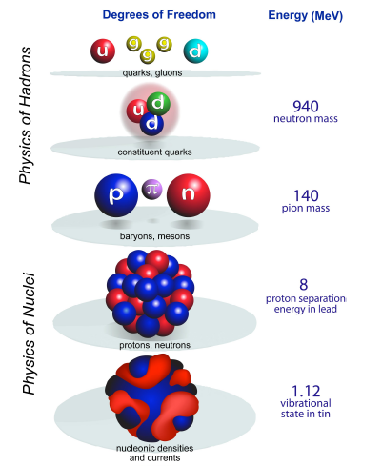
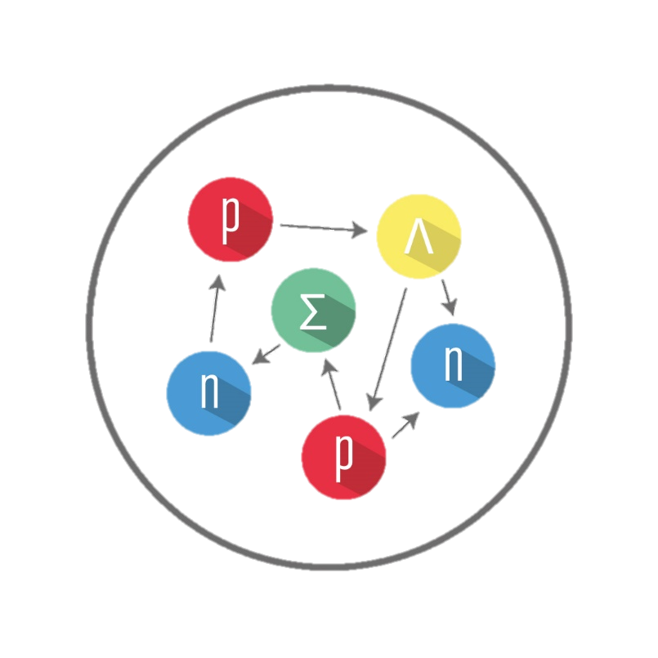
Toward a relativistic description of dense matter (I)
Microscopic models
Brueckner – Hartree Fock
Variational approach
Phenomenological models
Relativistic Mean-Field
Skyrme Potentials
Self-consistent Green Function
…
Quark meson coupling
…
$$P=P(ρ_{B},T,Y_{Q})$$

Slide 5
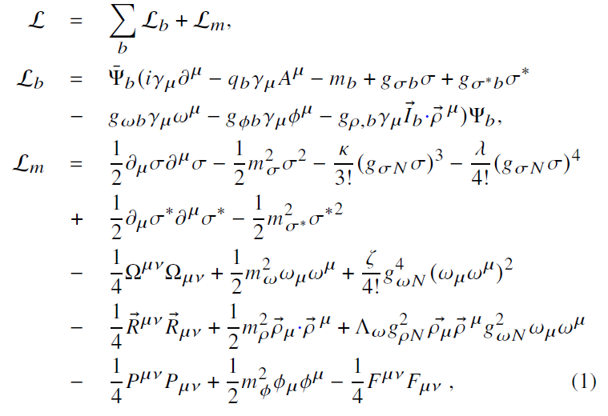
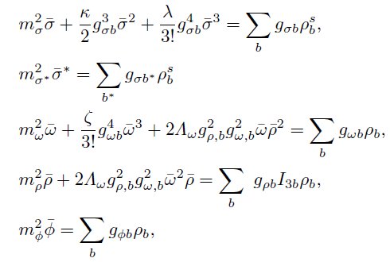
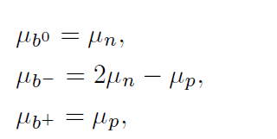
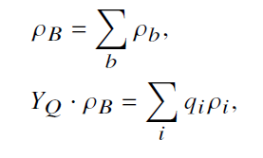
Toward a relativistic description of dense matter (II)

Slide 6
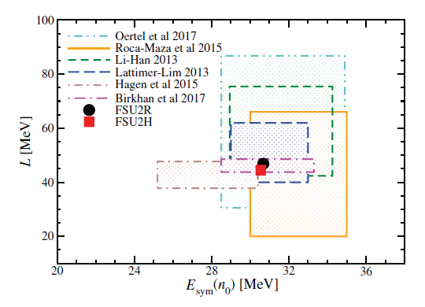
Toward a relativistic description of dense matter (III)
FSU2H* model
$$ρ_{0}$$ $$({fm}^{−3})$$ | E/A$( MeV)$ | $$K$$ $$(MeV)$$ | $$m_{N}^{∗}/m_{N}$$ | $$E_{sym}$$ $$(MeV)$$ | $$L$$ $$(MeV)$$ | $$K_{sym}$$ $$(MeV)$$
0.1505 | -16.28 | 238.0 | 0.593 | 30.5 | 44.5 | 86.4
$$U_{i}^{\left(j\right)}\left(ρ_{j}\right)=−g_{σi}{\overline{σ}}^{\left(j\right)}−g_{σi}{\overline{σ}}^{∗\left(j\right)}+g_{ωi}{\overline{ω}}^{\left(j\right)}+$$
$$+g_{ρi}I_{3i}{\overline{ρ}}^{\left(j\right)}+g_{φi}{\overline{φ}}^{(j)}$$
$$U_{Λ }^{(N)}\left(ρ_{0}\right)=−(30 −25) MeV$$
$$U_{Σ}^{(N)}\left(ρ_{0}\right)=(10−50) MeV$$
$$U_{Ξ}^{(N)}\left(ρ_{0}\right)=−\left(24−10\right) MeV$$
$$ΔB_{ΛΛ}=\left(0−6\right) MeV$$
$L[MeV]$
Tolos, Ramos & Centelles, 2017, PSASA
Gal, Hungerford & Millener, 2016, Rev. Mod. Phys
Guo, Zhou & Schulze, 2021, PRC
Friedman & Gal 2021, PLB
We will explore how this uncertainty propagates to the prediction of the properties of neutron stars!
$E_{sym}\left(ρ_{0}\right)[MeV]$

Slide 7
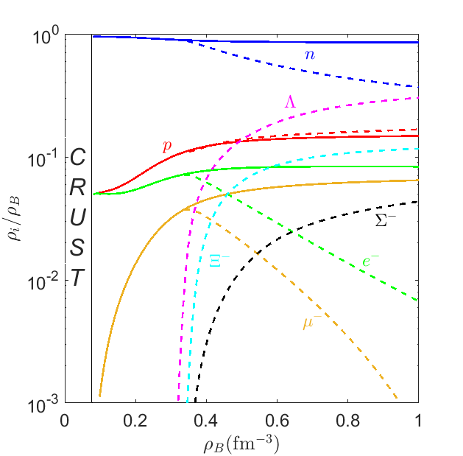
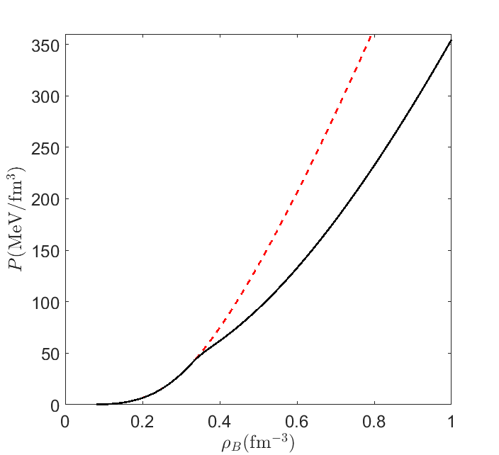
Hyperons in cold dense matter
Kochankovski et al, 2022, MNRAS
Solid lines $\left(−\right)$ N
Dashed lines $($--$)$ YN
FSU2H
FSU2H*
Hyperons artificially switched off
FSU2H*
DELEPTONIZATION OF MATTER
SOFTENING OF THE EOS

Slide 8
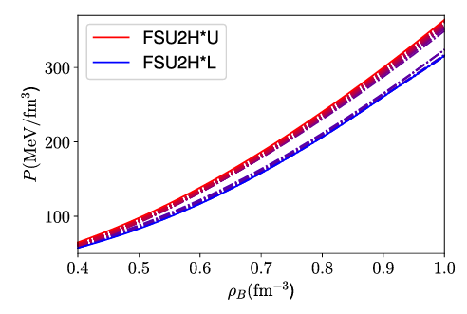
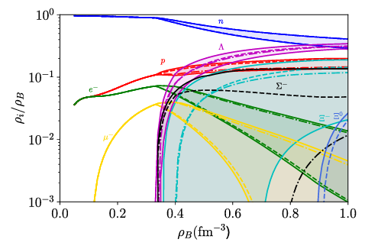
Hyperonic uncertainty in cold dense matter
-. (dashed-dotted lines) FSU2H*U
-- (dashed lines) FSU2H*L
Kochankovski et al, 2022, MNRAS

Slide 9
Mass-radius and tidal deformability of cold stars
Kochankovski, Ramos & Tolos, MNRAS, 2024

Slide 10
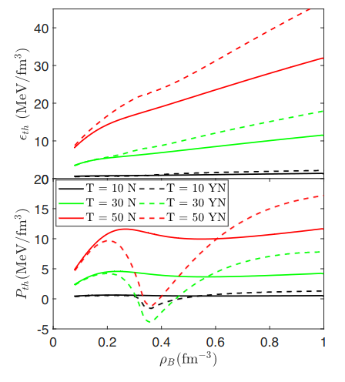
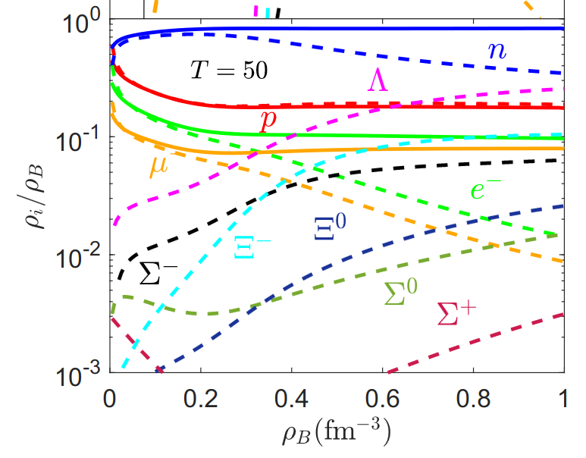
Hyperons in hot dense matter (I)
Solid lines $\left(−\right)$ N
Dashed lines $($--$)$ NY
Solid lines $\left(−\right)$ N
Dashed lines $($--$)$ NY
$$T=50 MeV$$
Kochankovski et al, 2022, MNRAS

Slide 11
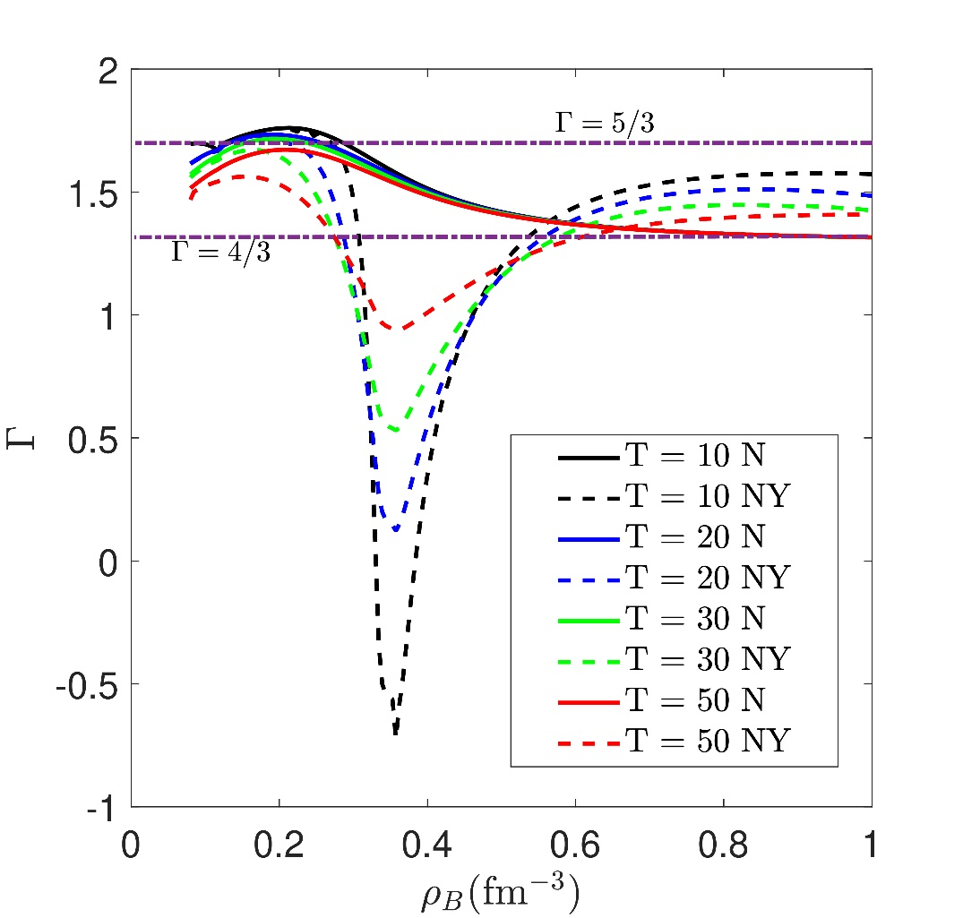
Hyperons in hot dense matter (II)
Kochankovski et al, 2022, MNRAS
Useful in complicated simulations in order to reproduce thermal effects on the EoS.
$$Γ =1+\frac{P_{th}}{ ε_{th}}=1+\frac{P\left(T\right)−P\left(0\right)}{ε\left(T\right)−ε\left(0\right) }$$
If the cold EoS is known, and one assumes that the thermal index does not depend on the composition and the temperature, the pressure can be calculated with the relation:
$$P\left(T\right)=P\left(0\right)+(Γ−1)ε\left(T\right)−ε\left(0\right)$$

Slide 12
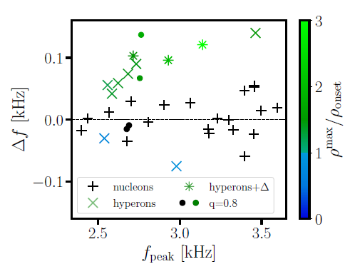
Influence of hyperons on the mergers observables (I)
We explored if different thermal behavior of hyperonic EoSs can leave imprints on observables obtained from binary neutron star merger, in particular the dominant post merger frequency.
Blacker, Kochankovski et al, PRD, 2024
Systematic study done by simulating a merger of two neutron stars with many different hyperonic and nucleonic EoSs.
$$Δf=f_{peak}−f_{peak}^{1.75}$$
FULL Temperature dependent EoS
Reference simulation
$$(Γ=1.75)$$

Slide 13
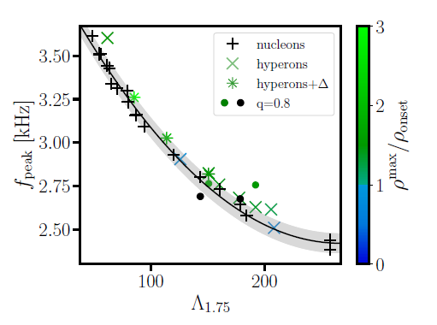
Influence of hyperons on the mergers observables (II)
Blacker, Kochankovski et al, PRD, 2024
$$f_{peak}=f_{peak}(Λ_{1.75})$$
Second order polynomial fit of the nucleonic models
Maximum deviation of the nucleonic models

Slide 14
Summary and outlooks
Exotic components like hyperons can be present in the neutron star core.
The appearance of hyperons in cold dense matter triggers a deleptonization process and makes the EoS softer.
The uncertainties that we have in the model parameters affect the cold star observables, especially the maximum neutron star mass
When hyperons are present in significant quantities at high temperature, they induce a strong non-monotonic behavior of the thermal pressure.
The different thermal behavior of hyperonic matter can leave imprints in the observables obtained from binary neutron star mergers, such as the dominant post merger frequency.

Slide 15
THANK YOU FOR YOUR ATTENTION

