Slide 1
ASTRANUCAP Workshop
Madrid, November 2024
Marcella Grasso
Scientific Director for Nuclear and Hadronic Physics
CNRS – Nucléaire et Particules
IN2P3

Slide 2
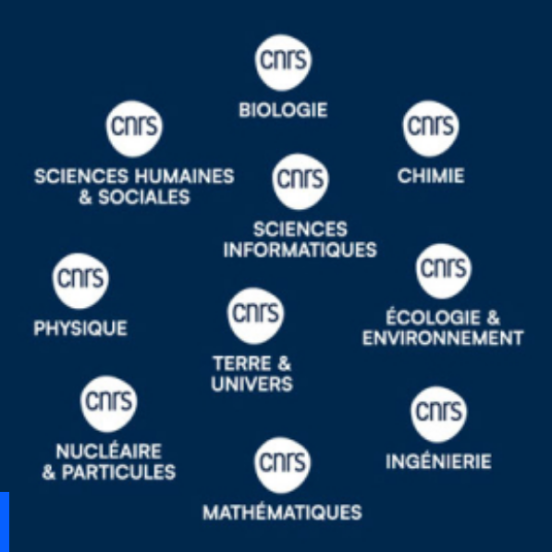
IN2P3
Institut National de Physique Nucléaire et de Physique des Particules
One of the 10 Institutes of CNRS, with a national mission

Slide 3
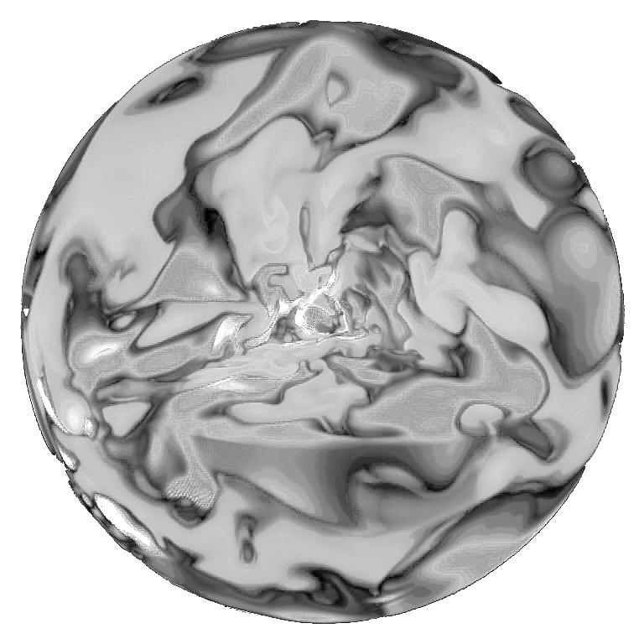
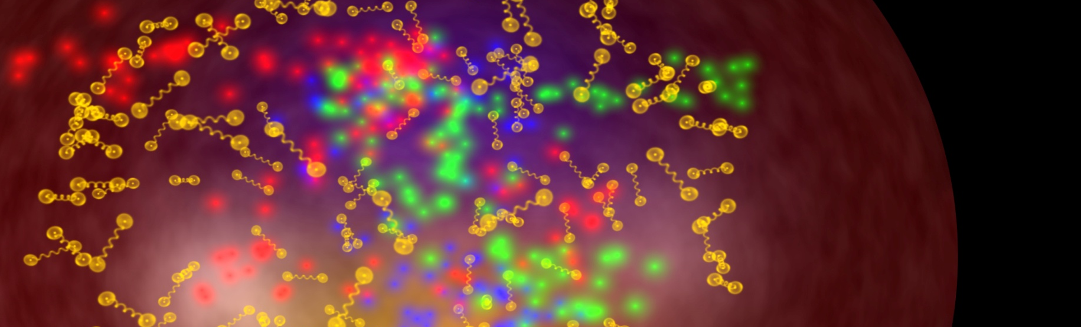
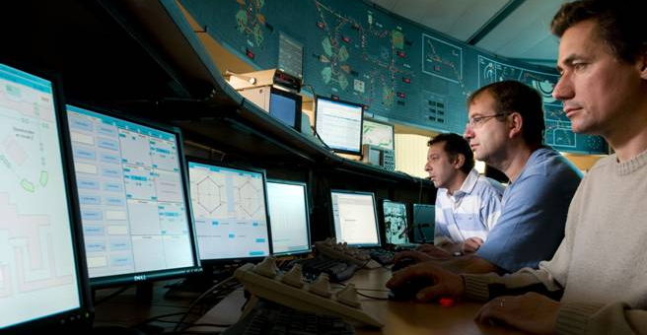
IN2P3: a national institute
al
MISSION: COORDINATING RESEARCH IN THE FIELDS OF NUCLEAR, PARTICLE and ASTROPARTICLE PHYSICS
EXPLORES
the physics of the two infinities: from elementary particles to cosmology
COORDINATES
research programs,
french involvement in facilities, projects and
international
collaborations
RUNS and OVERSEES
LINKS WITH SOCIETY
DEVELOPS
research laboratories in connection with universities and
other finding agencies
technologies, applications
of societal interest
expertise,
teaching, training
PROVIDES
15 laboratories, 9 national science & technology platforms
1000 physicists, 1500 engineers, technicians and administration staff. About 300 post-doc and 450 PhD students

Slide 4
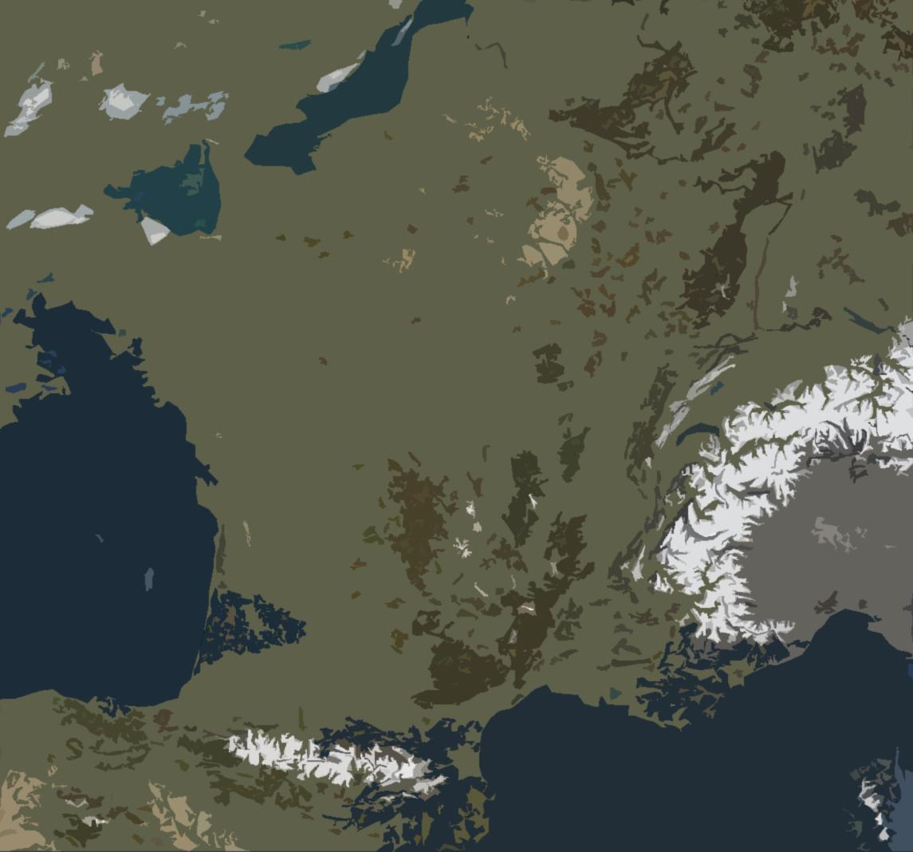
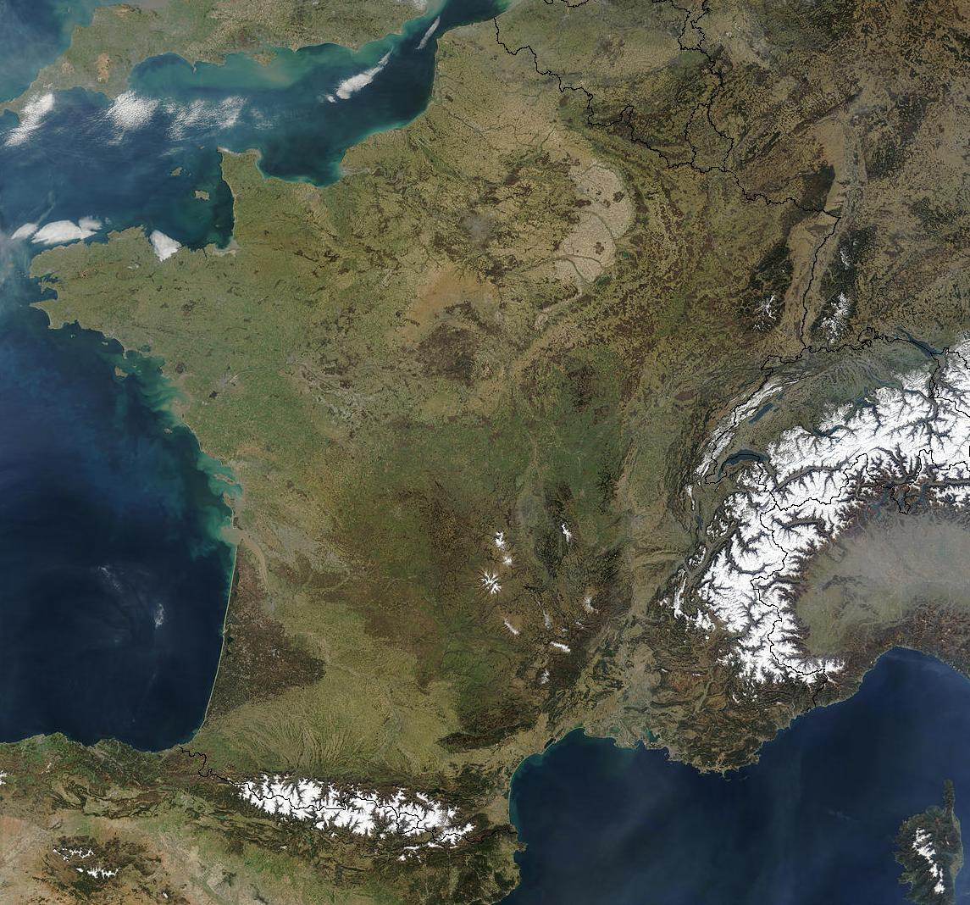
IN2P3 today, a distributed laboratory
APC, LPNHE,
Musée Curie
LNCA
GANIL
LPCC
LLR, OMEGA
IPHC
IJCLab
SUBATECH
IP2I, LMA
CC-IN2P3
Personnels permanents
LAPP
LPC
< 50
50 - 150
CENBG
LPSC, LSM
150 - 300
300 - 600
CPPM
L2IT
LUPM
LSPM

Slide 5
Nuclear and Hadronic Physics Portfolio. How it is composed today
General view of scientific communities at IN2P3 (plus engineers and technicians)
Nuclear physics and nuclear astrophysics (structure and reactions) (exp and theory) – GANIL is the national large facility in nuclear physics (with CEA)
lll
Double beta decay (neutrinoless) – CUPID –
¹⁰⁰Mo 0𝜈𝛽𝛽 decay with scintillating bolometers, under construction, planned at Gran Sasso
About 200 physicists (about 30 theorists)
About 70 PhD, 50 post-doc
10 physicists
2 PhD, 2 post-doc
ll
ll
Structure of the nucleon (today Jefferson Lab, EIC under construction)
Heavy-ion physics – recent modification –> presently in the domain of nuclear physics at IN2P3
32 ALICE,
2 CMS,
4 LHCb
About 15 PhD, 5 post-doc
7 physicists (experimentalists)
8 PhD, 5 post-doc
ll
About 10 theorists in hadronic physics
With several PhD and post-doc

Slide 6
International actions using specific CNRS tools (in addition to MoUs)
Several specific CNRS international agreements exist, for example, in nuclear physics:
International Research Networks with Italy, Spain, US
International Research laboratories (small CNRS laboratories in other countries) at Michigan State University and TRIUMF
…

Slide 7
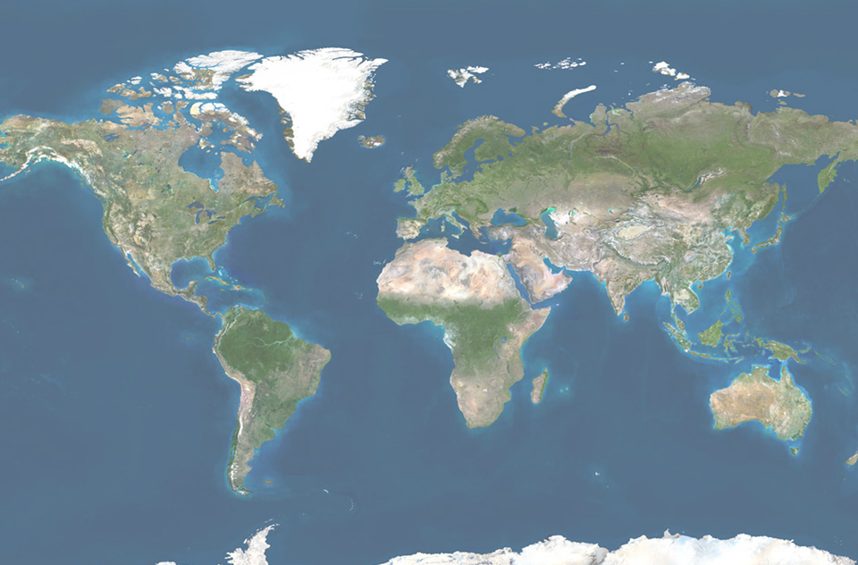
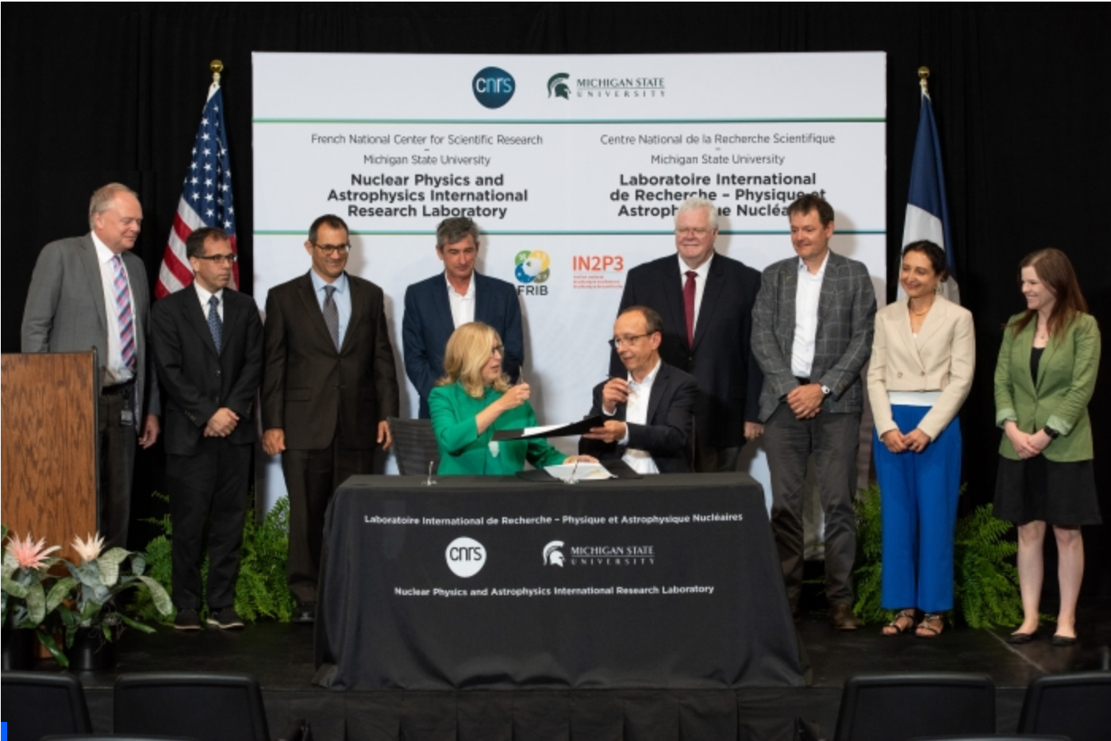
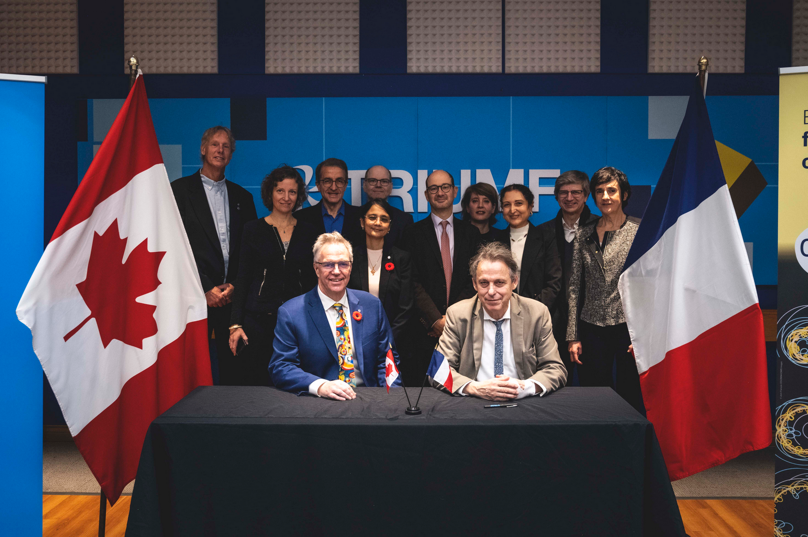
International – nuclear physics and nuclear astrophysics networks
International – nuclear physics and nuclear astrophysics international laboratories (IRL)
NPA
Inauguration ceremony,
July 2023
NPAT
(CNRS-TRIUMF)
NPA
(CNRS-MSU)
NPAT
Inauguration ceremony, November 2024
NPA, Nuclear Physics and Nuclear Astrophysics, Michigan State University
NPAT, Nuclear Physics, Nuclear Astrophysics and Accelerator Technologies, TRIUMF
7

Slide 8
International – nuclear physics and nuclear astrophysics networks (IRN)
lll
International Research Network (France, Spain)
ASTRANUCAP: Astrophysics, STructure, Reactions, and Analysis with NUClear beams and Applications, January 2021, 5 years, ending in December 2025
International Research Network (France, Italy)
FENMTO: Frontiers in Exotic Nuclei, Multidisciplinary research and TheOry, January 2024, 5 years
International Research Network (France, US)
FANPEN: France North-America Network on the Physics of Exotic Nuclei, January 2024, 5 years

Slide 9
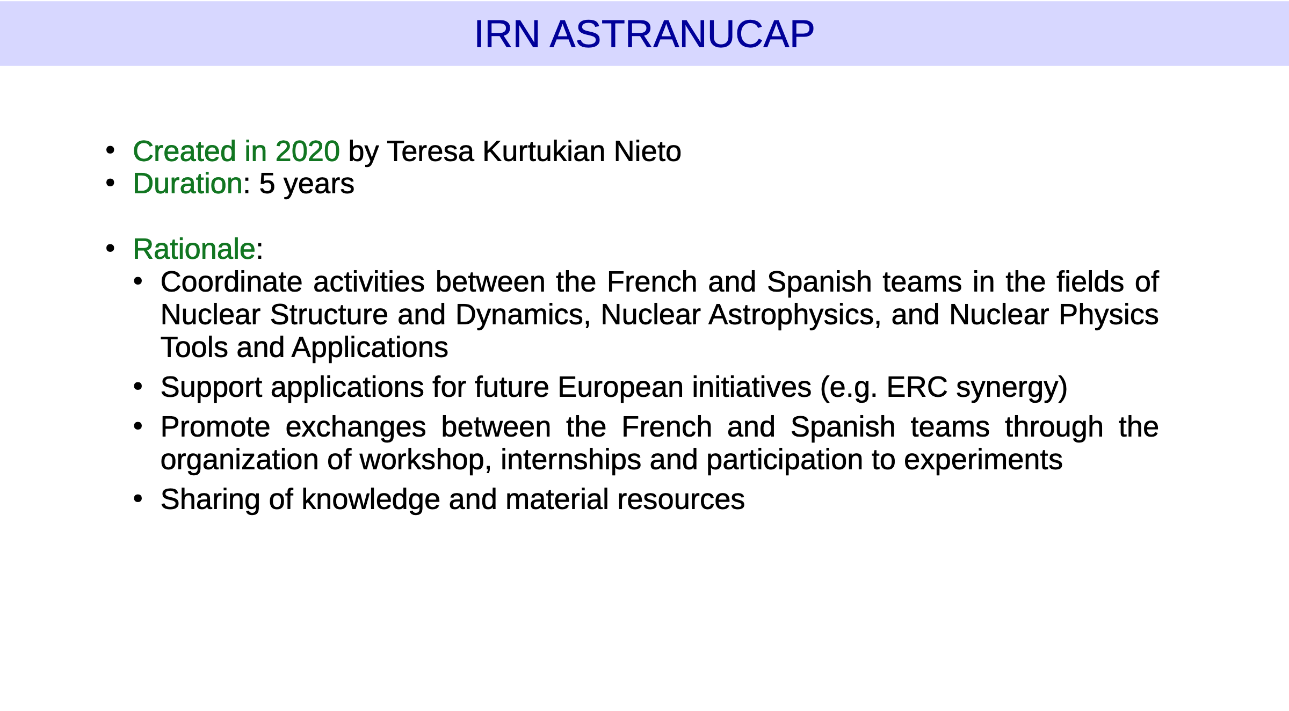
Courtesy of N. De Séréville

Slide 10
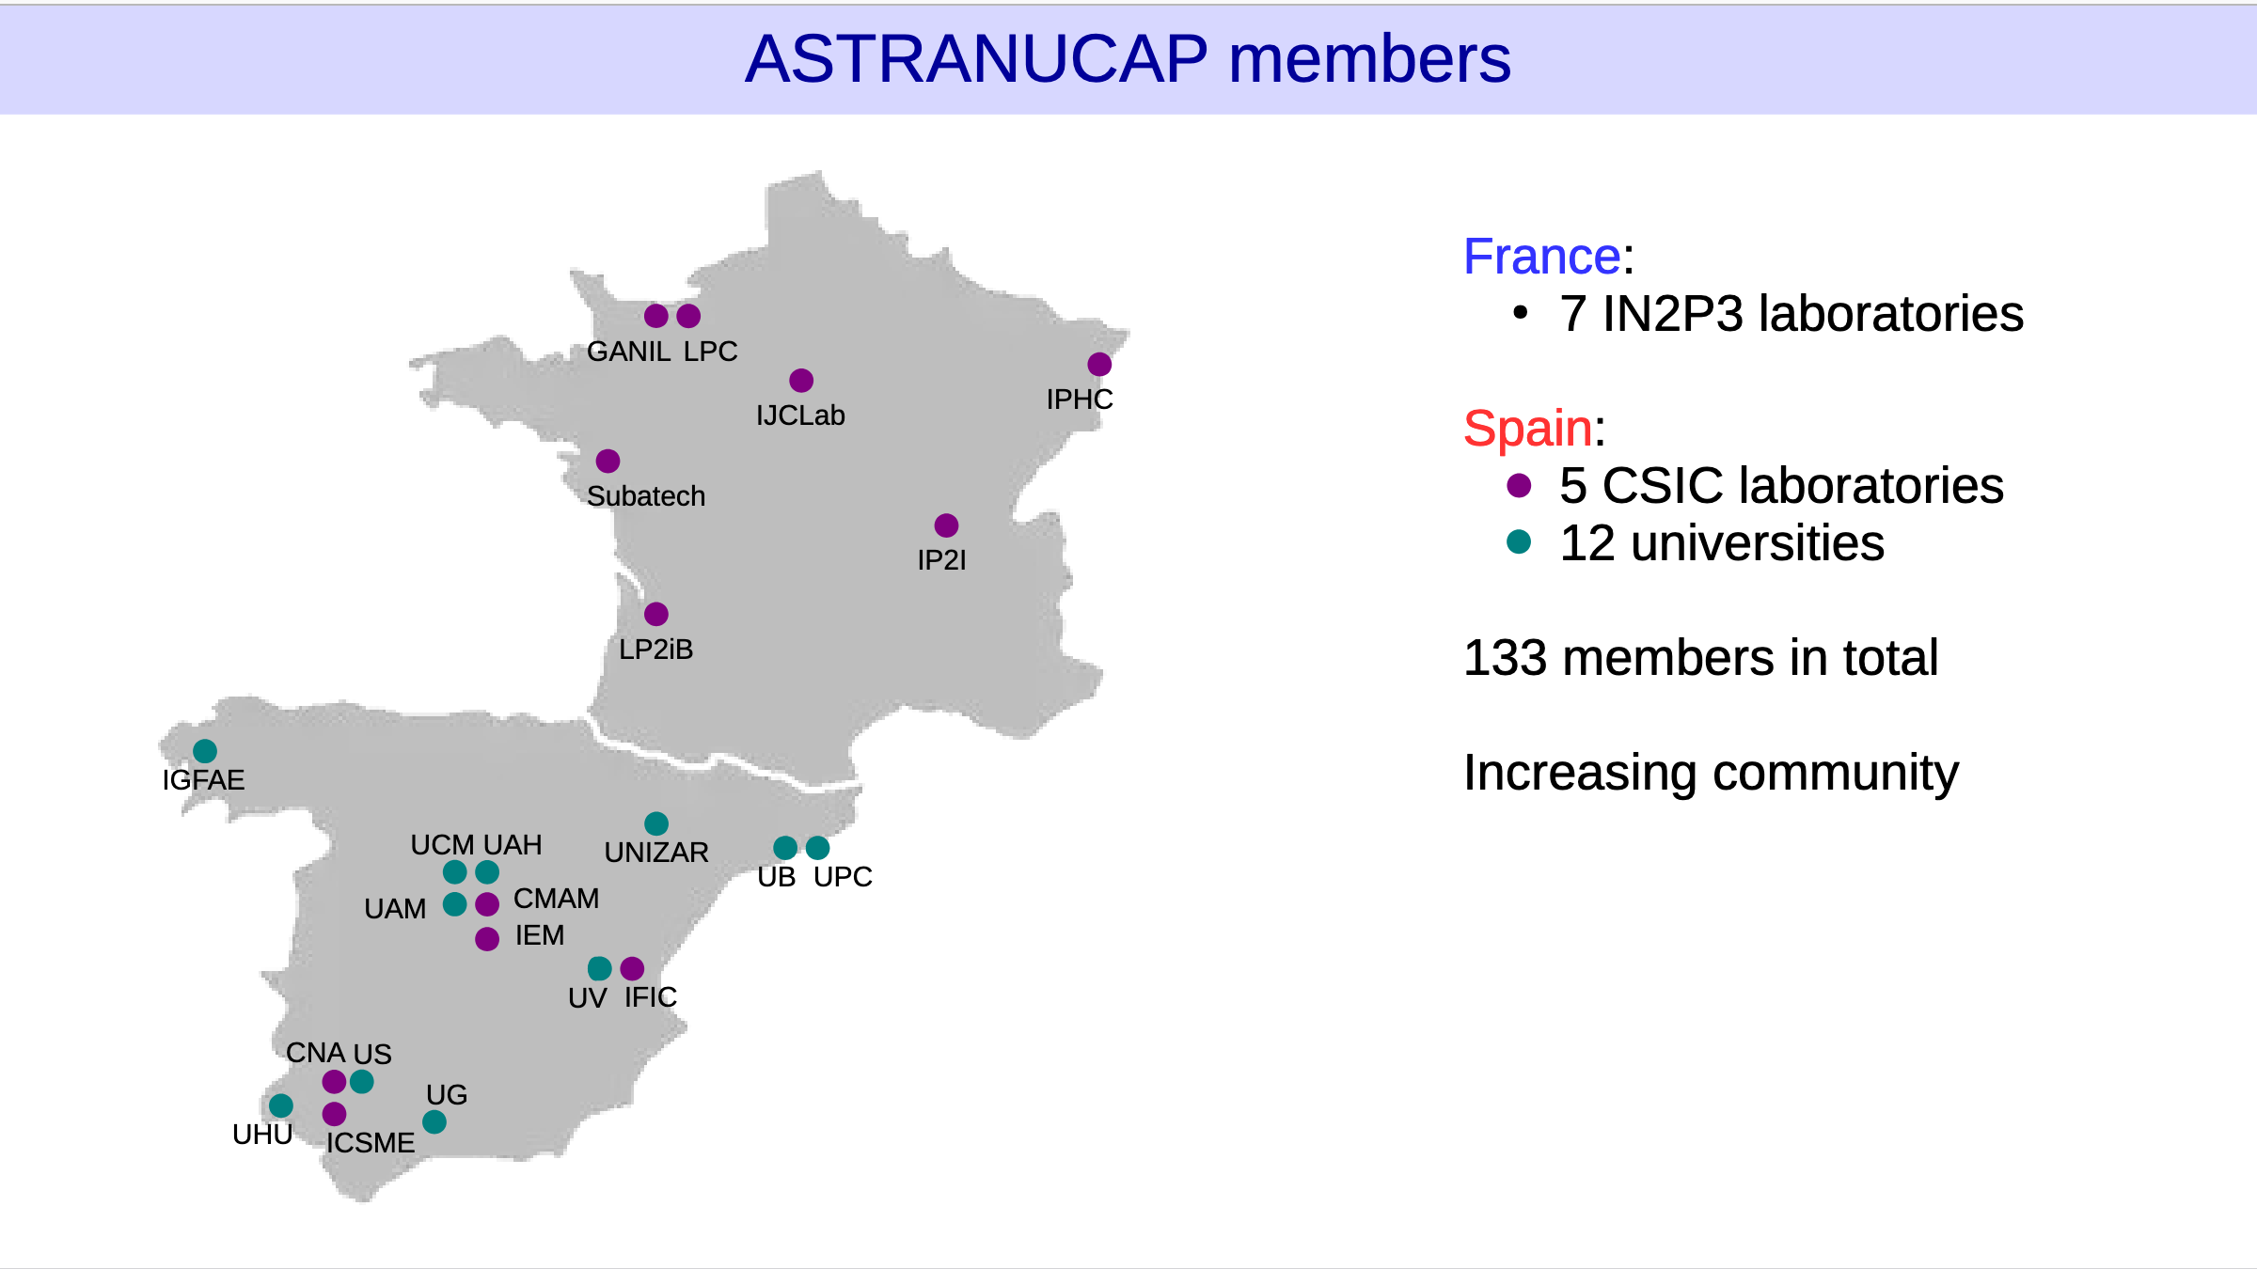
Courtesy of N. De Séréville

Slide 11
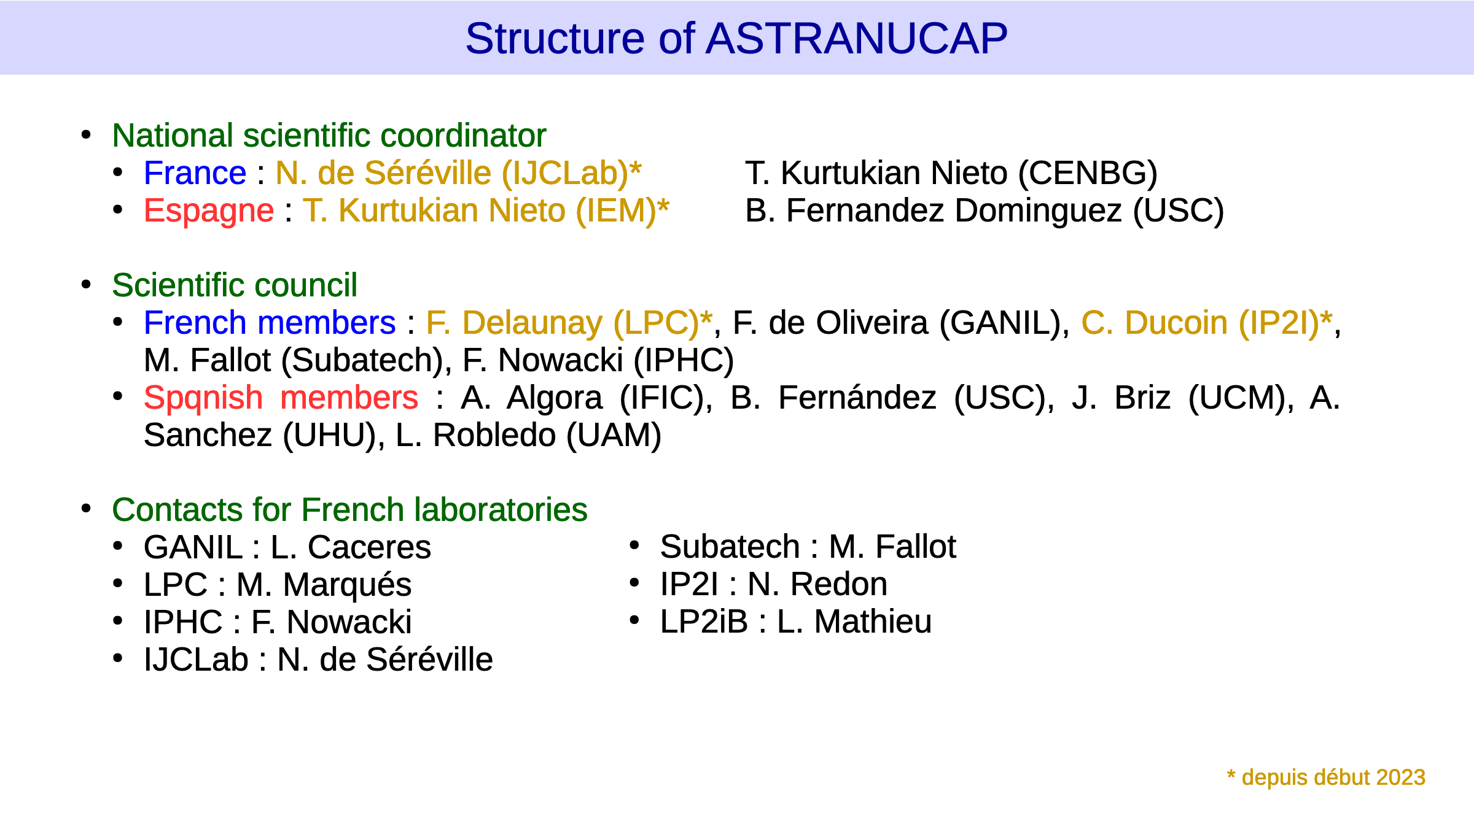
Courtesy of N. De Séréville

Slide 12
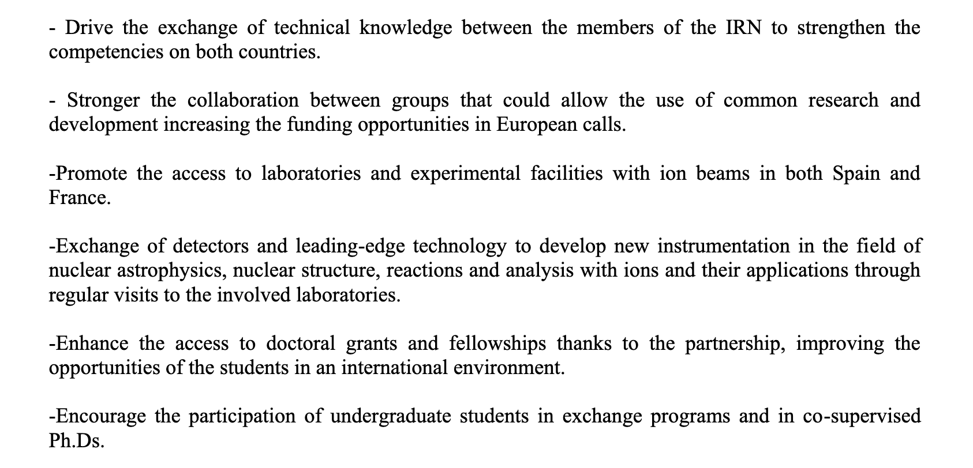
Extracted from the 2022 scientific report:

Slide 13
GANIL – SPIRAL2
Several Opportunities
Visiting Scientist Program every year

Slide 14
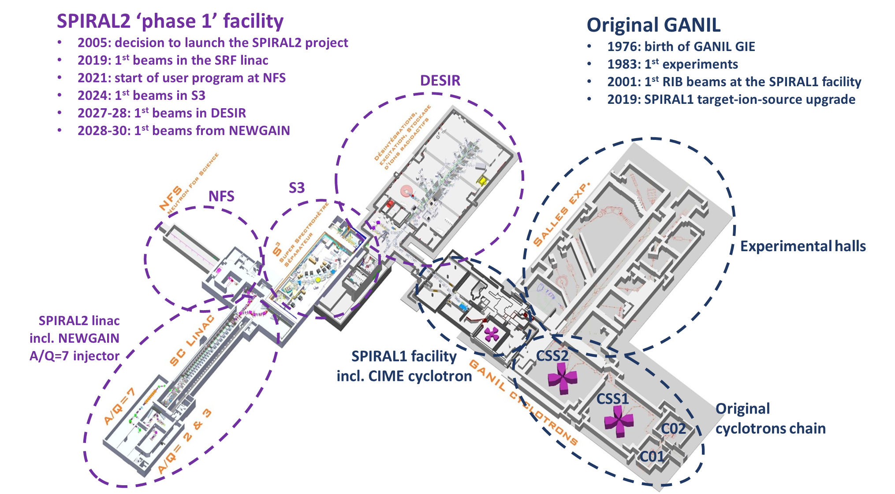
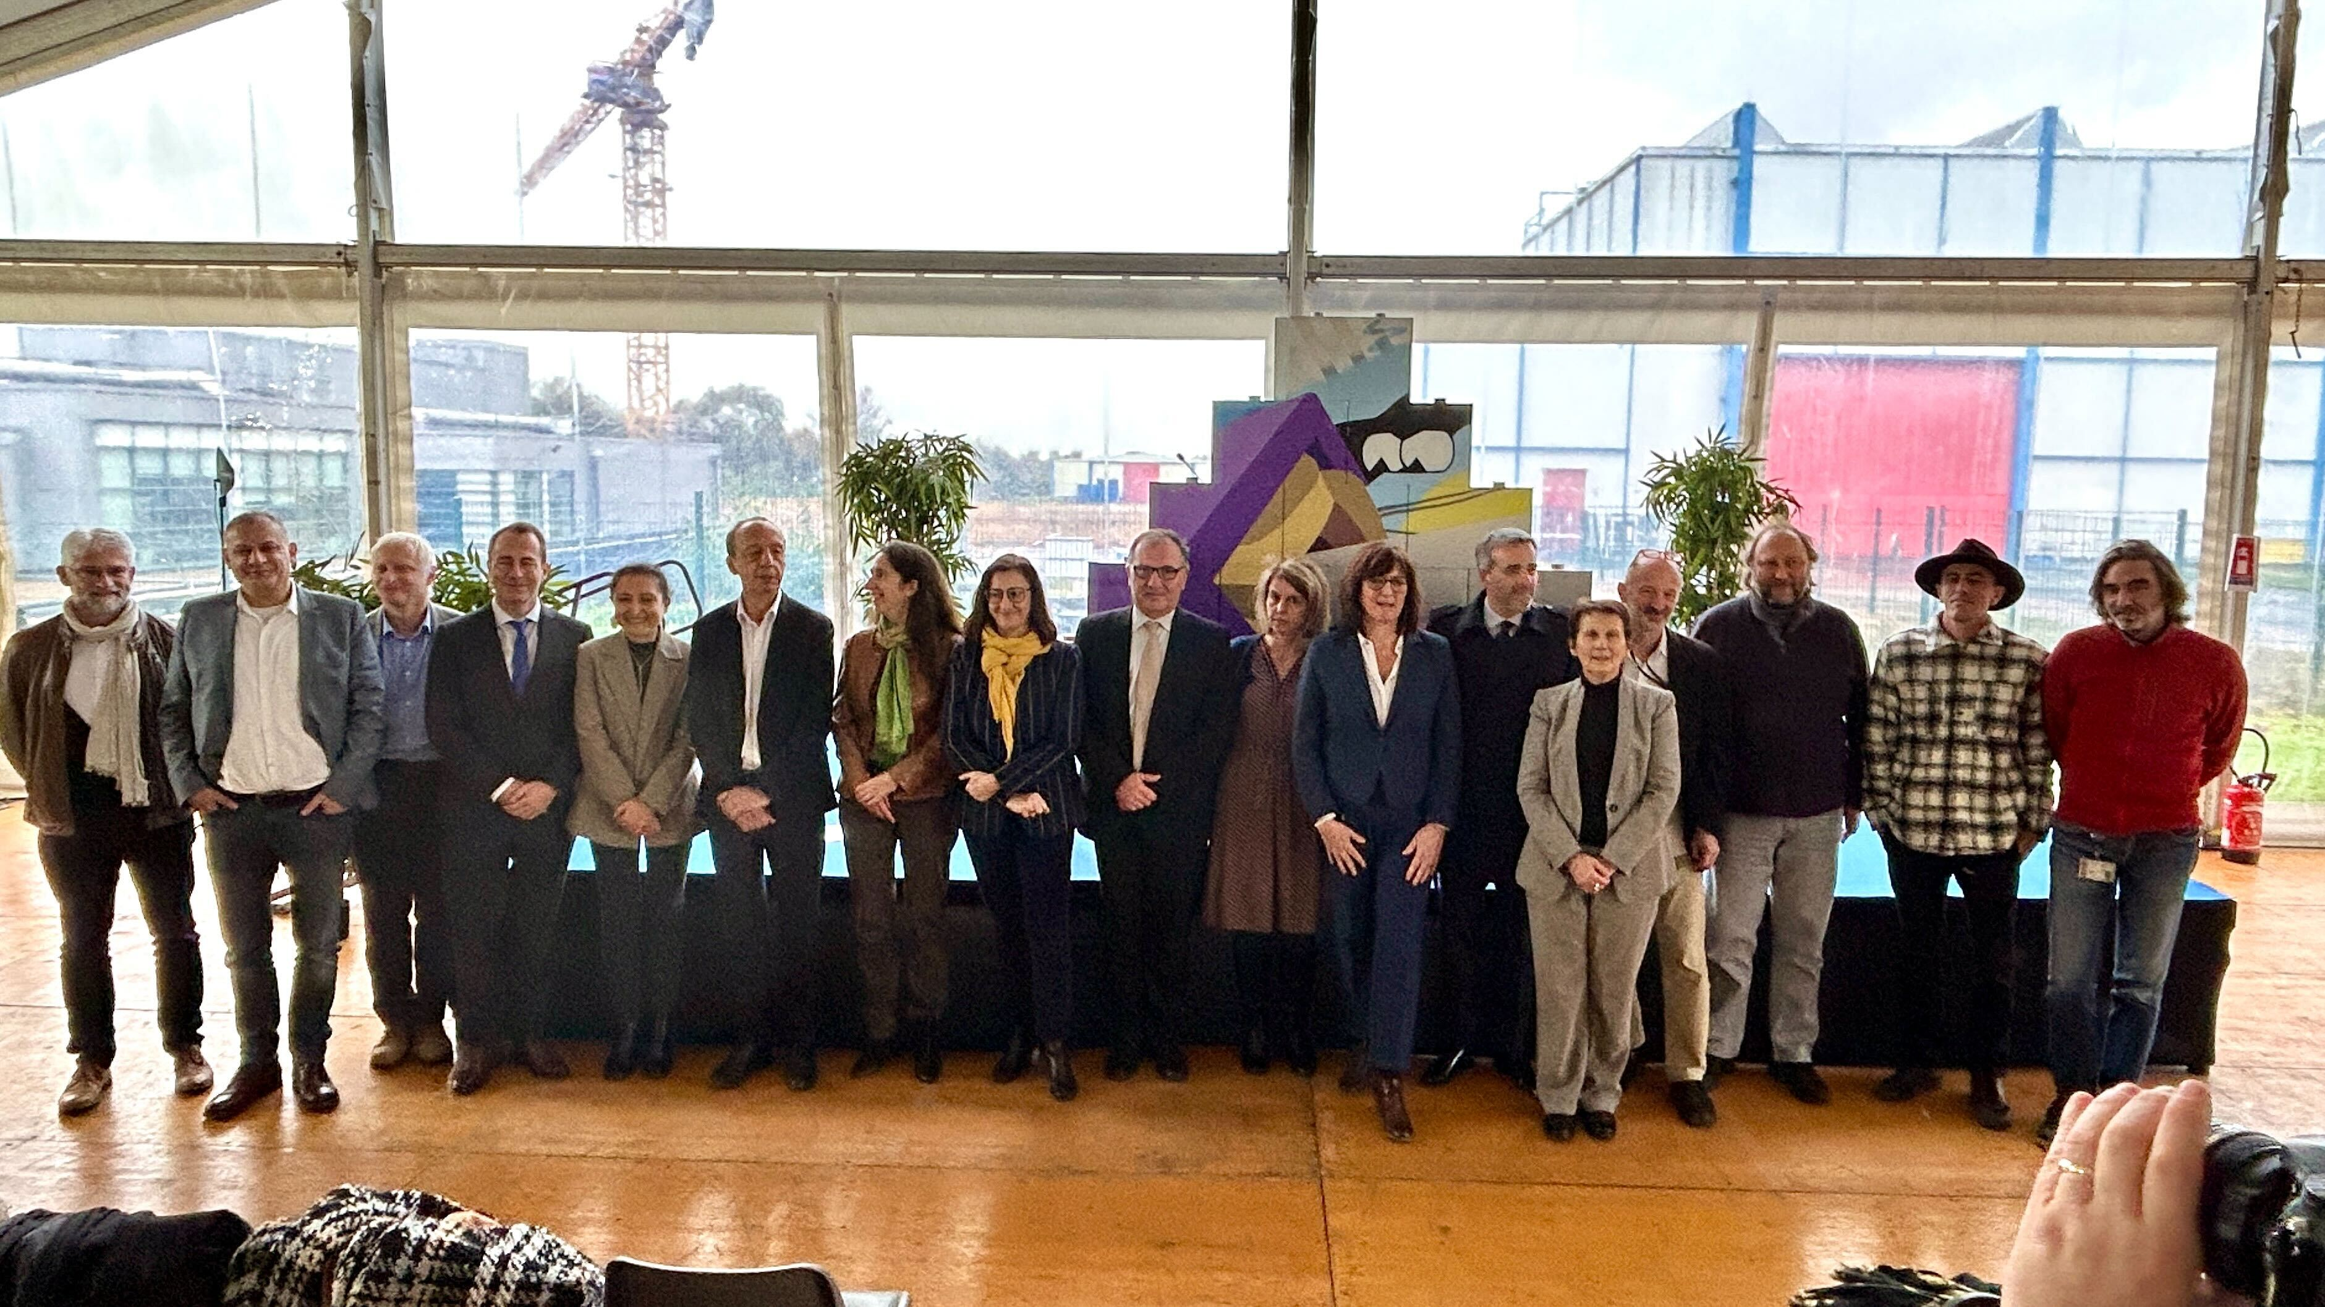
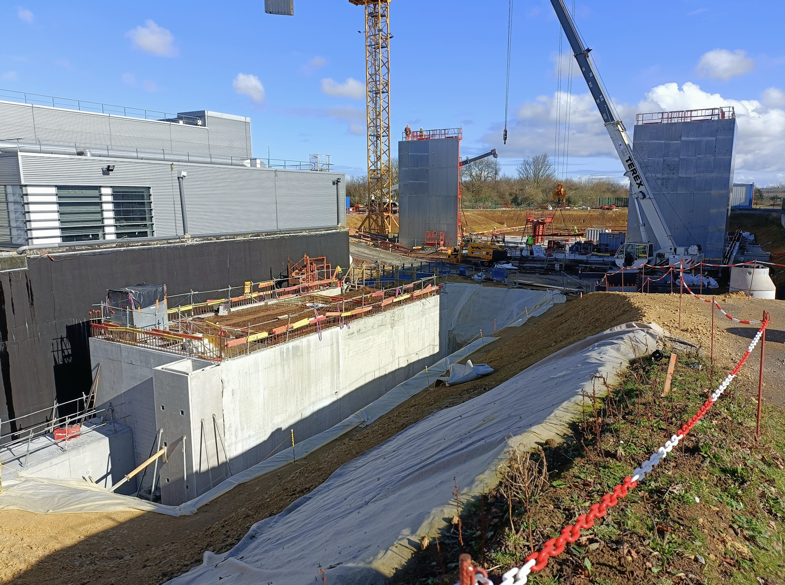
GANIL in the present decade
Neutrons for Science (NFS) started to work in 2021 (first exp).
Neutrons produced from the interaction of protons or deuterons accelerated from the LINAC with a converter
Mainly fission, but also low-energy excitations with a PARIS experiment, …
Commissioning of the Super
Separator Spectrometer (S3) planned in 2025-2026: nuclei with very low cross sections, such as
superheavy elements
neutron deficient nuclei close to the limit of stability
DESIR (Decay, excitation and storage of radioactive ions) in 2027-2028
unique opportunities in terms of selection of exotic nuclei and/or beam purity.
masses, laser spectroscopy, beta-decay spectroscopy, high-precision measurements… building construction started in 2023.
First stone ceremony on November 10, 2023
NEWGAIN, Injector 2: A/Q =3-7
Increasing beam intensities of heavy (A > 40) and very heavy (Xe, Pb, U) nuclei
Refurbishment of the cyclotrons,
by the end of the decade
Recently commissioned LINAC

Slide 15
GANIL - beyond 2030
International expert committee, chaired by Michel Spiro: vision for the future of GANIL (report provided to CNRS and CEA in December 2021)
Strategy to be defined based on different recommendations and options suggested by the expert committee:
new building for production of neutron-rich exotic nuclei
new reacceleration system -> from Coulomb barrier up to 100 MeV/nucleon
production of radioisotopes
……
Hanna Franberg and Stéphane Grevy are preparing a document (summer 2024) where a few possible scenarios and timelines are identified, with:
the description of the physics cases associated with each step
a budget estimation
CEA and IN2P3 will use this document to establish a strategy, together with the Ministry

Slide 16
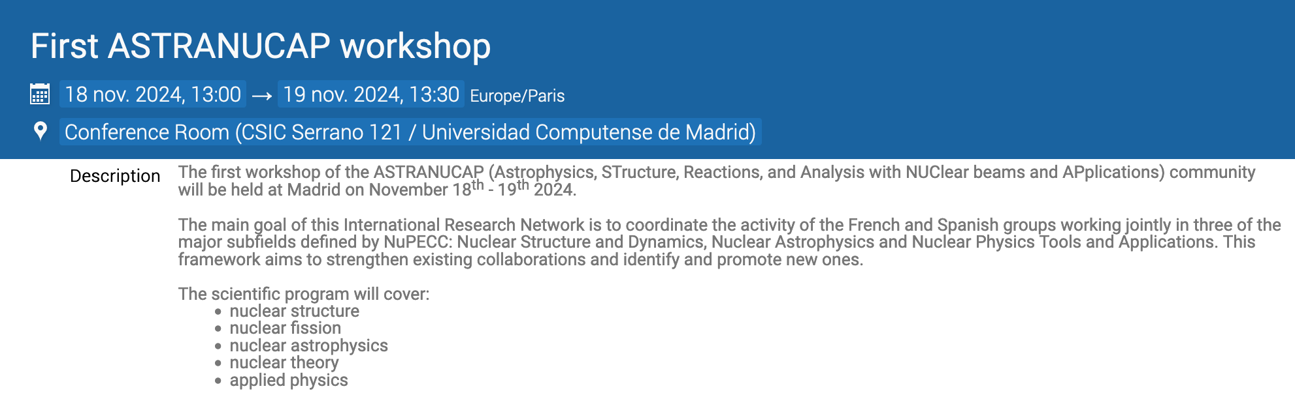
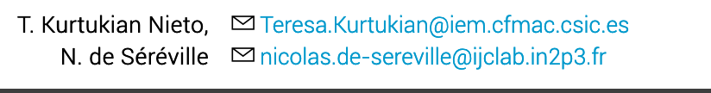
In the program, several common projects:
Detectors: MUGAST (campaigns at GANIL in 2025), GRIT (new MoU soon), ACTAR (campaign at TRIUMF in 2025), Neutrinos, Applications and Nuclear Astrophysics with a Segmented Total Absorption with higher Resolution Spectrometer (NA2STARS) (MoU soon)
Fission
Nuclear Astrophysics
Nuclear theory (there is a talk on quantum computing)
The IRN will end in December 2025. Future ?

Slide 17
Thank you for your attention

