Slide 1
Higgs @ ILC
I.Laktineh, UCBL-IP2I

Slide 2
Outline
ILC machine
Higgs studies and performances @ ILC
Higgs studies in the framework of ILC in France
Conclusion

Slide 3
ILC machine
Several staging options
To reduce the project cost a scenario with 250 GeV could be considered as the starting point.
BDS and main dumps are designed to allow running up to 1 TeV

Slide 4
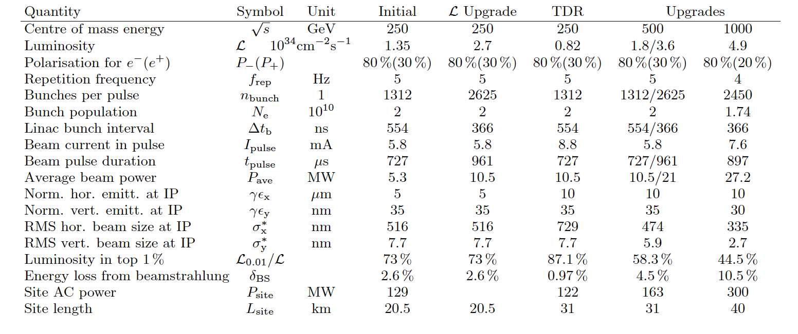

Slide 5
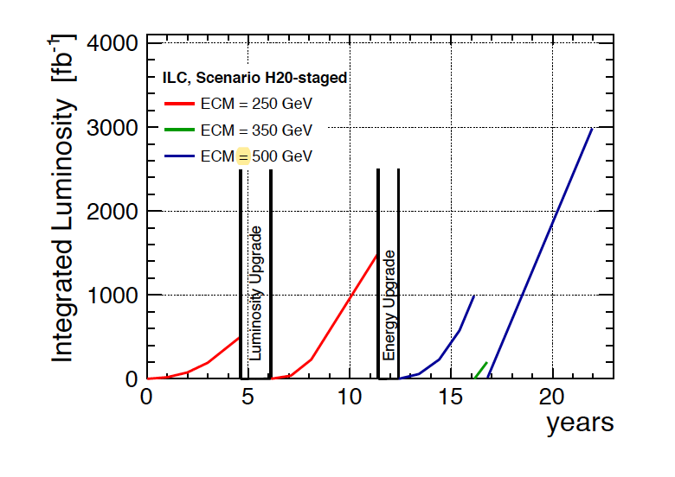
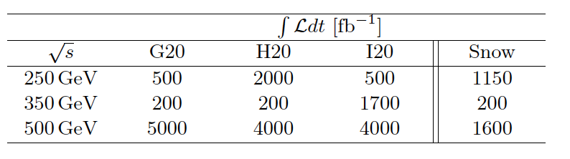
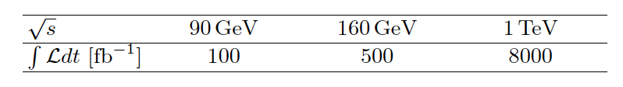

Slide 6
Electron & positron beam @ILC
Electron source is based on the SLC polarized source scheme.
TI:saphhire laser impinging on photocathode made of GaAa/GaAsP strains
85% polarized electrons
Positron source:
baseline: Hard circularly polarized photons are produced by the electron beam of the main Linac in a helical undulators. They are converted into electrons-positrons on a rotating target. Positrons are at 30% longitudinally polarized.
cons: Target heating, photon dumping..
pros: up to 10 Hz (determined by the damping time)
Electron driven scheme. An independent electron beam of 3 GeV is
used on rotating target to produce the positrons.
cons: limited to 5 Hz (positron time production)
pros: limited target heating, less risky
30% positron polarization is reachable at 250 GeV and up to “60%” at 500 GeV.

Slide 7
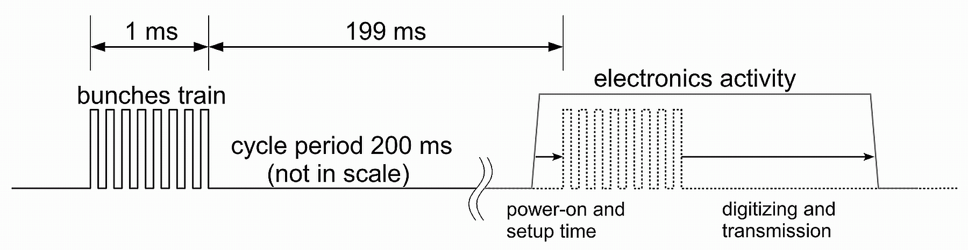
Bunch Crossing structure @ iLC
Train of 1ms duration every 200 ms (5 Hz), 1312 BC/train
Readout electronics is conceived to read out all the events (triggerless mode) during the bunch crossings, store them and then transfer them just after.
Electronics is switched off inbetween trains
(a factor 100 of power reduction)
→ almost no cooling →low material budget

Slide 8
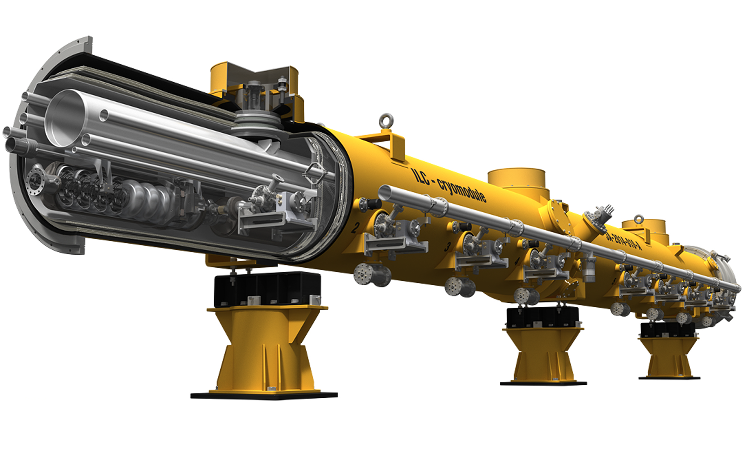
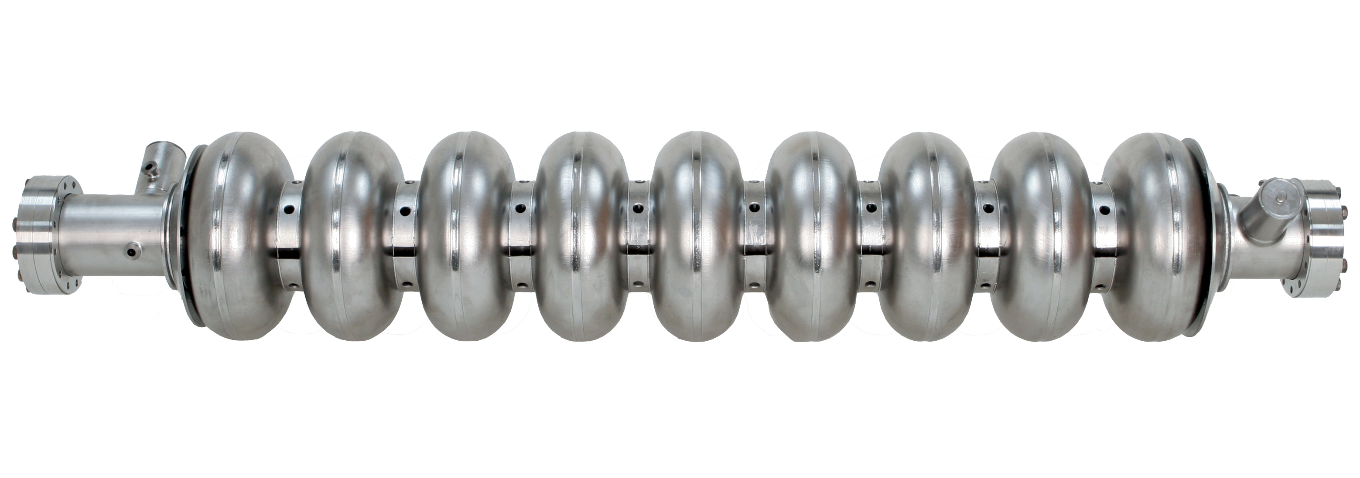
Main Linac is made of X cryomodules equipped with RF Klystrons:
Each cryomodules is made of 9 cavities or 8 cavities+ QP/corrector.
Each cavity is a 1.3 GHz nine-cell niobium one operated at 2 K (>31.5 MV/m)

Slide 9
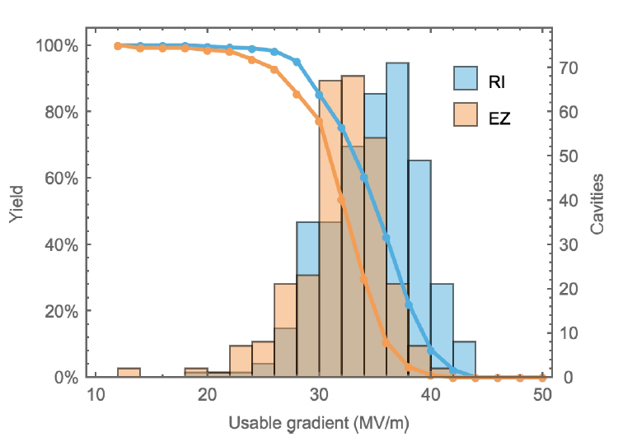
Main Linac is made of cryomodules equipped with RF Klystrons
Each cryomodules is made of 9 cavities or 8 cavities+ QP/corrector.
Each cavity is a 1.3 GHz nine-cell niobium one operated at 2 K (>31.5 MV/m)
Cavity performance for XFEL
XFEL best value is 44.6 MV/m (not far from the expected theoretical value of 48).
Ongoing improvement on cavities:Nitrogen infusion at 120°C could
Improve Q0
Reach ILC required value
Simplify the cavity production and reduce the cost.

Slide 10
Luminosity upgrade scenario:
1312 BC/train → 2624/train
5 Hz→ 10 Hz
This will increase the luminosity
by a factor of 4
A possible increase to 15 Hz is
under study to get an increase of a factor 6.
The ILC luminosity increases by a factor of 6 has a moderate cost increase
5.5 B→ 5.5+1.9 B€$
Cost increase is due to additional klystrons and cryo modules
By using more cavities (3000) with improved Q= 2 x 10¹⁰
380 GeV scenario is possible with additional 1.5 B$

Slide 11
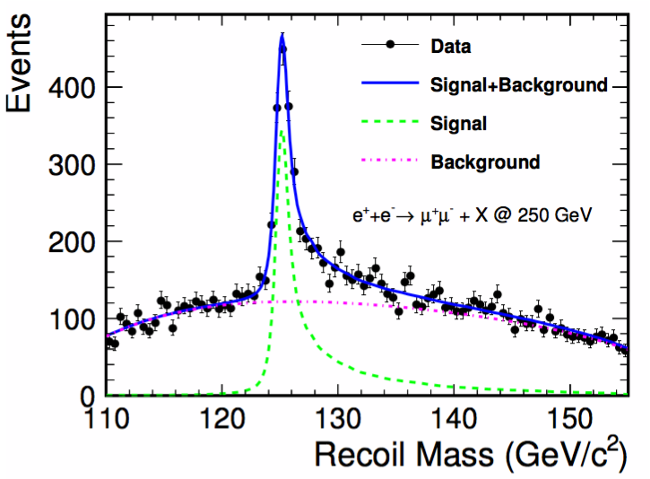
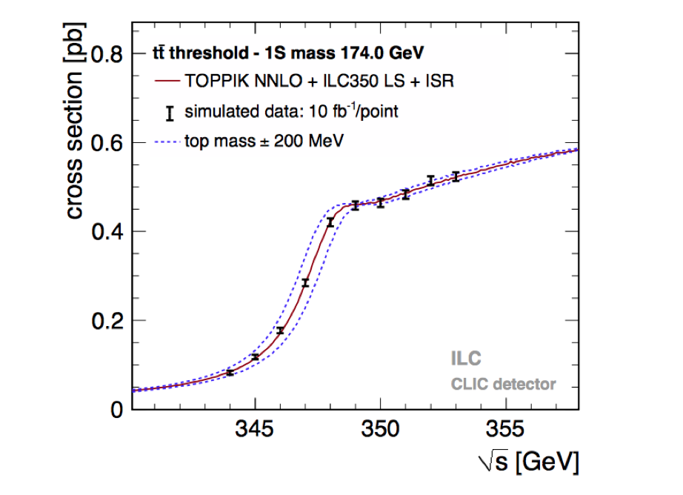
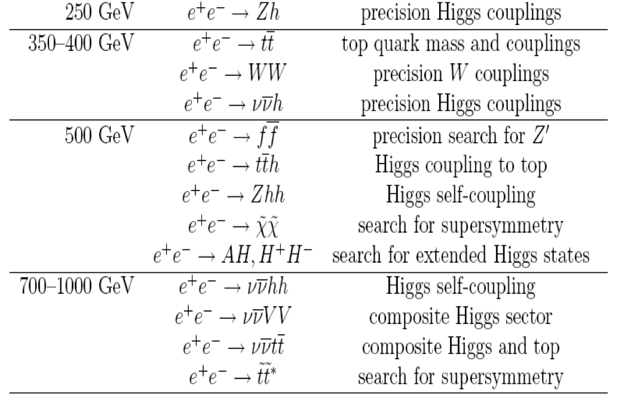
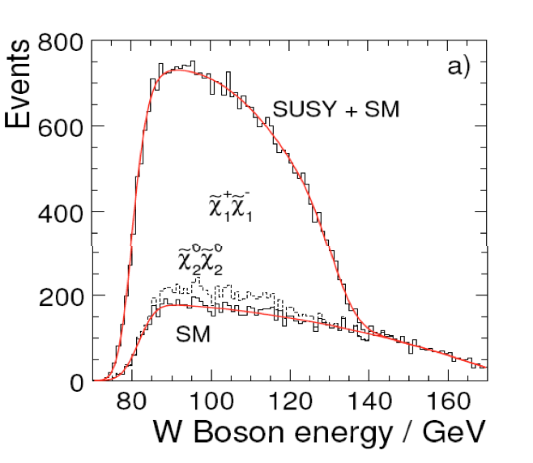
Philosophy of the ILC detectors
Detectors should be a precision and discovery
tool beyond the LHC scope.
Relevant Physics phenomena in the TeV energy range
are associated to multi jet final states
→ Jet flavour & 4-momentum measurements are of prime importance

Slide 12
Decoupling theorem:
If new particles are present beyond the SM with masse M then their impact on the Higgs coupling will be of the order of
F = a m²_{H}/M²
with a of the order of 1.
For instance models with first-order electroweak phase transition predict a mixing between the Higgs and a heavy scalar particle S. The model predicts
g(HWW) ≈2m²_{W}/v (1-1/2 m²_{H}/m²_{S})
Since the new particles are not seen at LHC in the mass range up to 1 TeV
F is of a few % at most. Testing the SM requires measuring the Higgs coupling constants with a precision of the order of 1% to test the BSM.

Slide 13

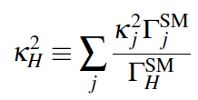
The Kappa framework:
Study deviation of Higgs coupling constants through Br with respect to the expected SM.
Allow the extension to invisible Higgs decay (Br_{inv}) as well as untagged process (Br_{unt}).
Higgs boson total width is determined in this framework from:

Slide 14
Higgs couplings study:
Hbb, H𝜏𝜏 are sensitive to models with two-Higgs-doublets (SUSY,..)
Hbb sensitive to the presence of heavy SUSY particles
HWW, HZZ are sensitive to composite Higgs or mixing with a singlet
Hgg, H𝛾𝛾 are sensitive to models with vector-like fermions (« Little Higgs »,..)
Htt is sensitive to composite Higgs and top quarks

Slide 15
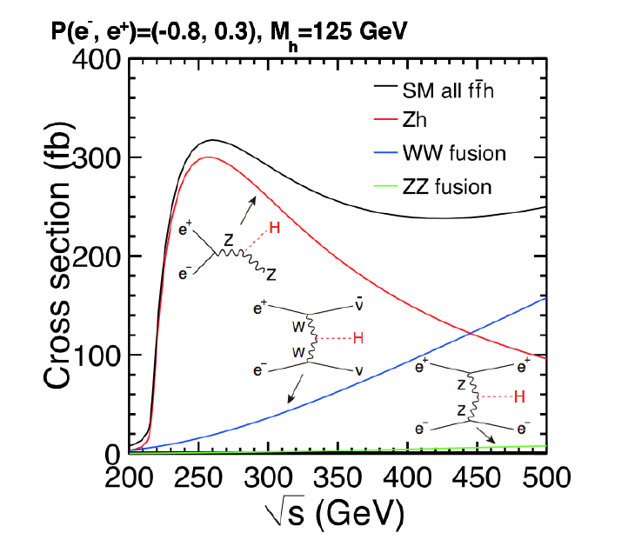
Higgs study@ILC

Slide 16
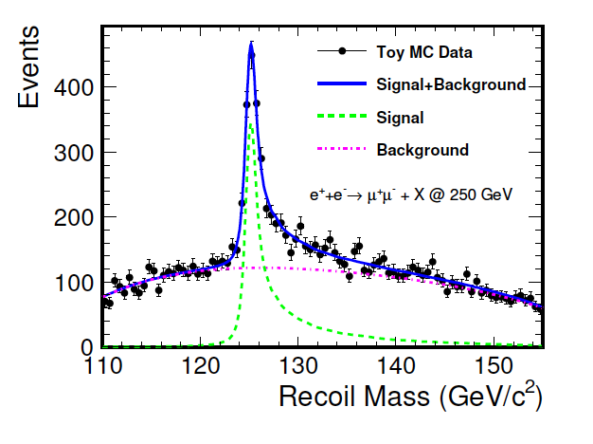
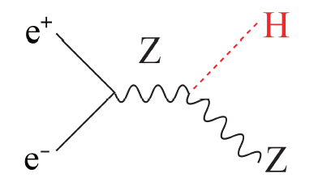
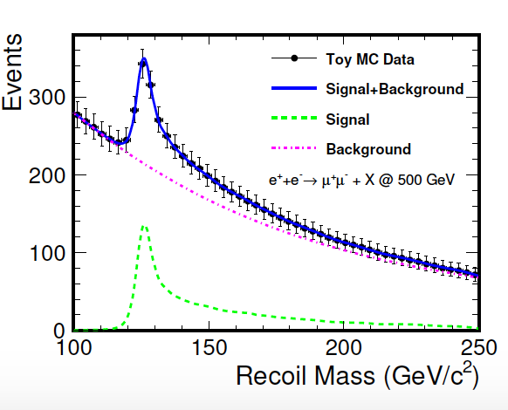
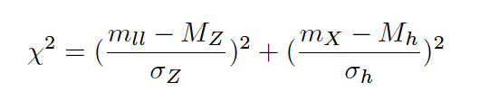
e e → Z H
This is the principle process. Using the recoil mass
technique. One can measure the Higgs mass
Z → µ µ/ e e: golden channels allowing
studying Higgs branching rations in
model independent ways.
σ_{tot} = σ_{vis} + σ_{inv}
The background ( e e → Z Z, W W, ϒ Z) can be reduced to less than 0.1% (0.2%)
At ILC250 by requiring 2 isolated muons (electrons) with opposite charge with invariant mass compatible with Z mass with additional cuts on E_{vis} and P^{ll}_{T} and using
Z→ qq,ττ is more challenging due to jets confusion but better at ILC500

Slide 17
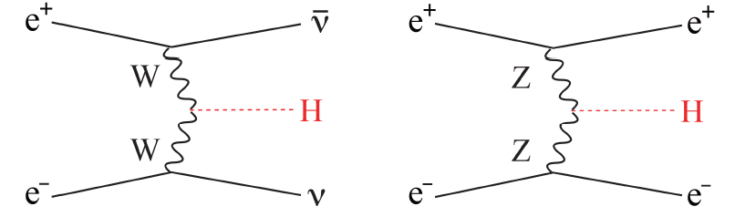
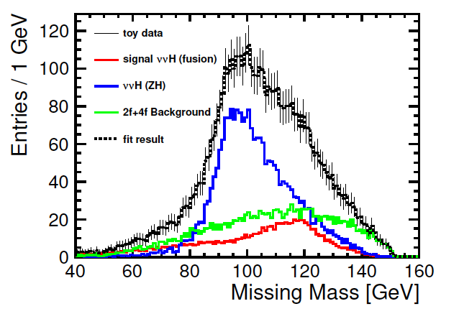
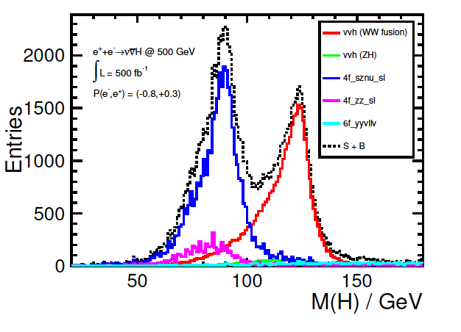
e e → ν ν H, e e H
Small cross sections (14, 0.7 fb resp.)
but provide precious and direct
information on HWW, HZZ coupling constants.
For the ν ν H, selection is based on looking for two b-tagged jets (H→ b b) and
missing mass > 20 GeV
Remaining background are ν ν Z and ϒ Z with Z→ bb but also Z H.
MVA techniques: the dijet polar angle + the angle between the two jets
Efficiency of the selection is around 36% and S/B≈ ¼ → resolution on σ . Br(bb) is 8.1%
250 GeV
For the e e H even with a ridiculous cross section one expects at least a significance
of 9 at ILC250 and 60 at ILC500

Slide 18

Using the e e → Z H with Z→ ll, qq and νν, the different H decay modes are then determined:
H → bb/ cc/ gg
For Z→ µµ, ee
H→ bb and H→ cc will benefit from the excellent precision provided by the ILC detectors to tag b and c quarks → g_{Hbb}, g_{Hcc}
H→ gg is complementary to LHC
For the Z→qq the dominating background is the qqqq from WW, ZZ. A χ² is used to select one configuration after applying angular cuts.
Z→ νν sensitivity is much higher than Z→ qq even though its BR is 3 times less

Slide 19
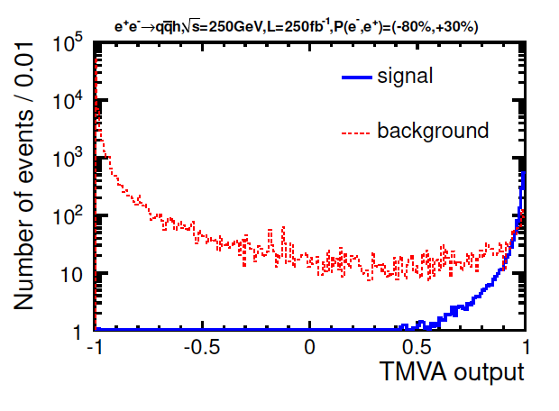

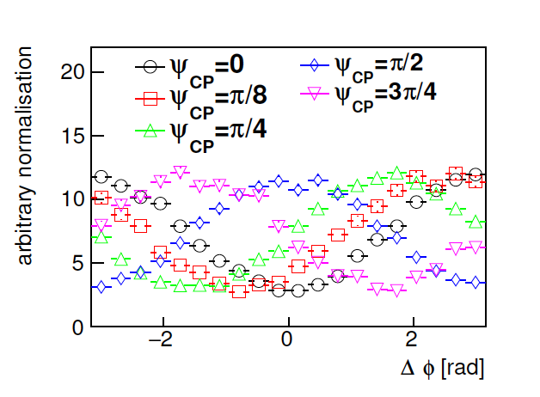
Using the e e → Z H with Z→ ll, qq and νν, the different H decay modes are then determined:
B) H → τ τ
This channel is expected to be the most
precise thanks to its relatively large Br and
limited Bkg (e e → Z Z→ q q τ τ).
Efficiency of 36% and S/B around 2 are expected.
This channel is also interesting to study the Higgs CP proprieties.
The τ polarization could be determined,
in τ→ leptons and πν/ρν
The angle between the transvers spin of the
two τ will indicate if the Higgs is a pure CP-even
or a mixed with a resolution on Ψ_{CP} down to 4.3°

Slide 20
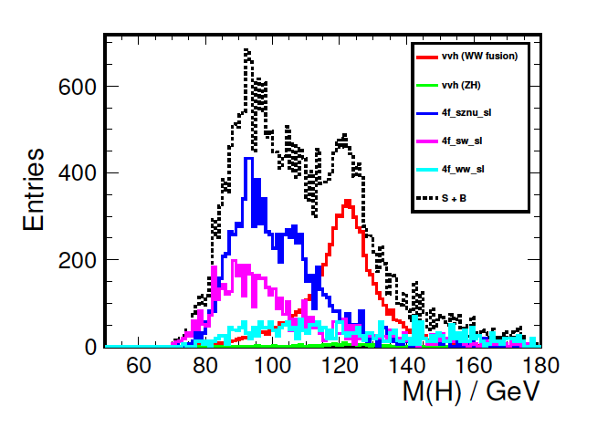
Using the e e → Z H with Z→ ll, qq and νν, the different H decay modes are then determined:
C) H → WW* , ZZ*
These decays can also be studied from the ν ν H and e e H production modes.
For the W W* mode with many possible configurations the major background contribution comes from e e → W W in both ν ν H and Z H (Z→ ν ν)
Using right-handed beams reduces significantly this contribution.
ILC500 provides better measurement than ILC250 thanks to the e e → ν ν H
For the Z Z* the same strategy of combining many analyses will be used but the small cross section of e e → ee H and the small branching ratio of H→ Z Z* makes it difficult to have a good resolution at 250 and 500 GeV.

Slide 21
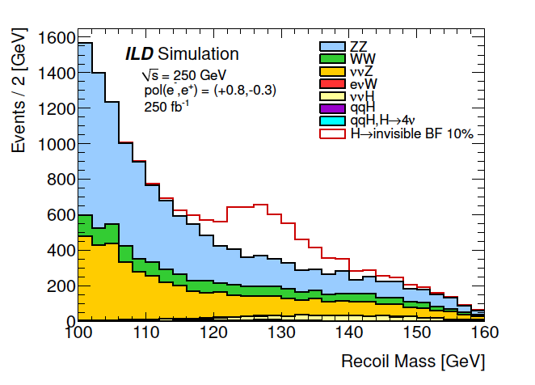
Using the e e → Z H with Z→ ll, qq and νν, the different H decay modes are then determined:
D) H →µ µ, ϒϒ, ϒ Z
ILC measurements of the associated coupling constants is not competitive with the expected measurements from HL-LHC.
E) H → invisible/exotic
This study is possible thanks to the recoil technique used in e e → Z H
The main backgrounds are from ZZ→ νν q q and WW → qqlν
Using right-handed beams could
improve the sensitivity to this mode
by a a factor of 1.4
Other exotic decays could also be
studied using the excellent
Performance of the ILC detectors

Slide 22
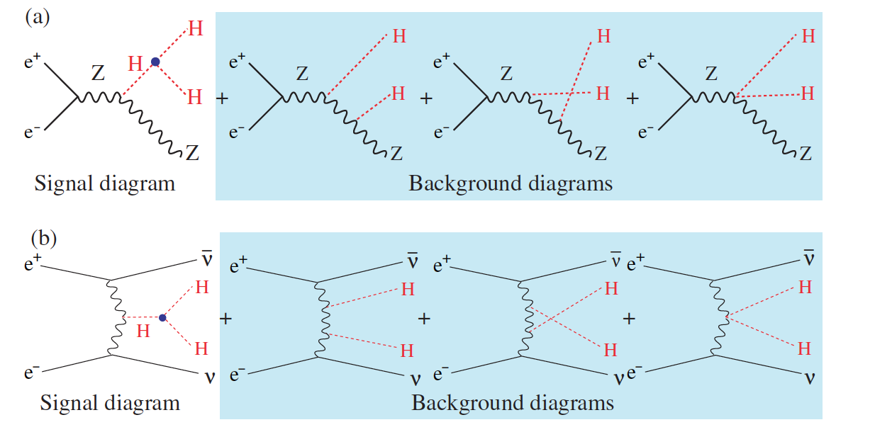
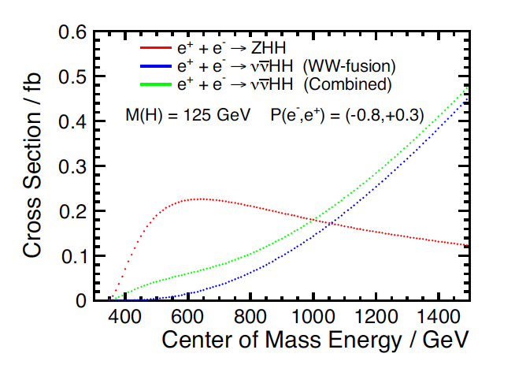
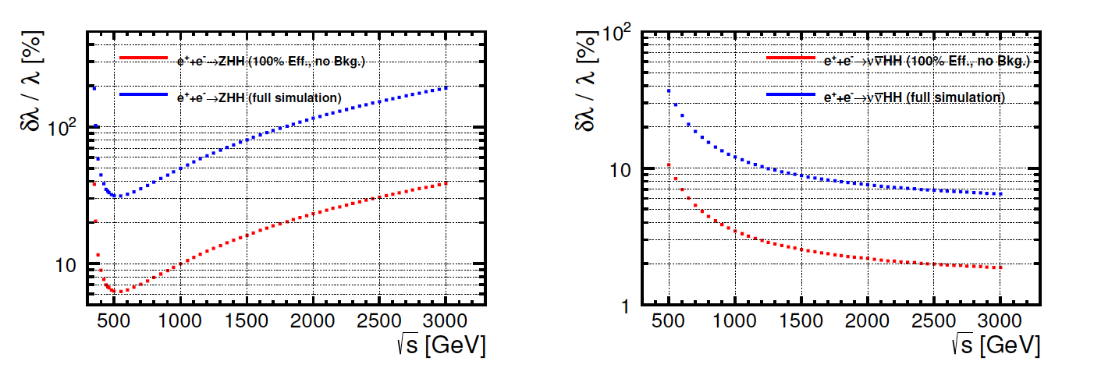
Trilinear Higgs coupling
Measurement of the trilinear Higgs coupling is important to determine the shape of the Higgs potential and thus to provide a clue on its origin

Slide 23
Beam polarization impact
Polarized beam is of interest only for lepton beams
Only linear e⁺ e⁻ colliders could provide adequate longitudinal polarization
Using polarized beams brings substantial improvement in:
Measurement of helicity-dependent constants
Suppression of backgrounds
Systematic studies

Slide 24
Beam polarization impact
P_{e-}, P_{e+} being the electron and positron polarization with
P_{e} = -1 for left handed and 1 for right-handed beam
σ_{O} is the unpolarized cross-section

Slide 25
Beam polarization impact
e e → H Z
For P_{e-} =-80% and P_{e+}= + 30% and using A_{LR}=-0.151 (asymmetry of the interaction)
P_{eff} = 90% → L_{eff}/L_{eff0} ≈ 1.4
e e → f f
By using different beam polarization configurations one can separate ϒ and Z s-channel contributions and then measure the different couplings more efficiently.
e e → WW
is a background for several process but for this process
σ_{LR}/σ_{RL} ≈ 30 By using (e⁻_{R},e⁺_{L}) beam configuration this background
is almost turned off
Systematic uncertainties could be reduced by measuring the same quantity with independent configurations

Slide 26
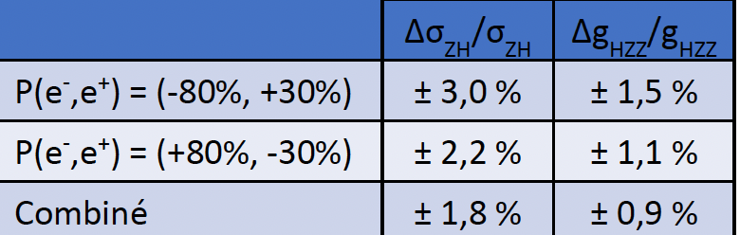
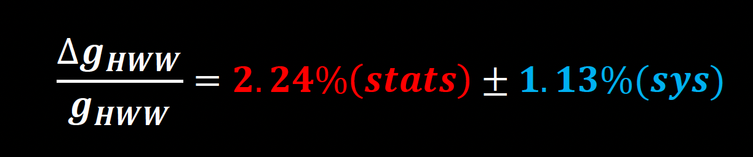
Higgs studies in the framework of ILC in France:
Two studies were conducted at IP2I with full simulation. Both were intended to exploit the Semi-Digital Hadronic Calorimeter (SDHCAL) developed in CALICE under Lyon leadership.
PhD thesis of G. Garillot:
- Production of e⁺ e⁻ → ZH → q q q q and measurement of g_{HZZ}
PhD thesis of Bing Liu:
- Production of of e⁺ e⁻ → ν ν H → ν ν W W* → ν ν qqqq and measurement of g_{HWW}

Slide 27
Conclusion
ILC is a mature project
Well-known acceleration technology with expertise in large scale cavities production
All of the detectors proposed for ILC have their prototypes and many their technological/engineering ones
The physics case is clear. First to test the SM and then to investigate beyond it. With the H20 its performance is similar to the most ambitious project.
The luminosity can be enhanced in a cost-effective way. An increase of up to a factor of 4-6 is feasible at affordable cost so its performance should outperform the other projects at lower cost.
Having polarized beam is a big asset not only to increase the effective luminosity (≈2) but to reduce the systematics substantially

Slide 28
Personal point of view
HL-LHC may be not have been the best choice for HEP but it is very useful and its input is very important.
For the future, three possible scenarios should be envisaged:
ILC followed by FCChh. This scenario is the optimal one. It gets benefit from the readiness of ILC. It exploits the results from HL-LHC. It keeps CERN as the reference lab for at least 30 years ahead.
FCCee followed by FCChh : CERN will continue to be the HEP world leader but a decision needs to be taken soon and construction to start immediately but be aware the CEPC may start before.
CEPC followed by SPPC : This may be the most realistic scenario and we should continue to collaborate with our Chinese partners.

Slide 29
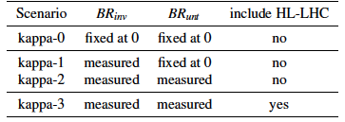
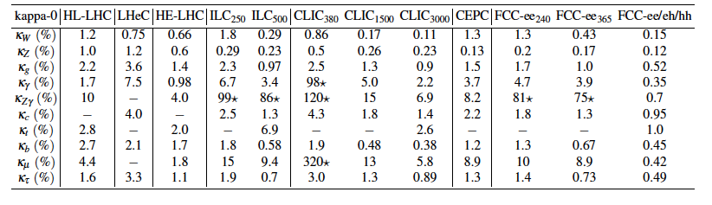
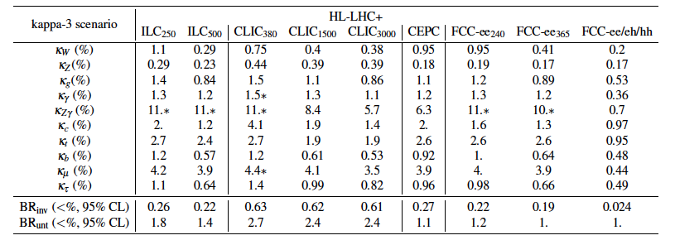

Slide 30
Effective Field Theory (EFT):
A Lagrangian with all the terms respecting the SU_{c}(3)x SU_{L}(2) X U(1) symmetry
Only even terms remain when baryonic and leptonic numbers are conserved independently.
The advantage of such framework is the possibility to:
Go beyond the decay rate measurements and use additional variables such as
the angular distribution and polarization asymmetry in e e → Z H
Associate deviation of Higgs couplings in e e → Z H and other processes such
e e → WW, ZZ to the nature of the associated operators and thus to the BSM
physics models.
Operator contributions have different energy-dependence. Some increase substantially with energy. Runs at different energy is very useful.

