Slide 1
Ulrich Ellwanger
Universally gifted
Jean Orloff, LPClermont-Auvergne, IRN Terascale Lyon, 13 November 2024

Slide 2
An incredibly broad
scientific expertise
with many facets
159 papers, 63 single-authored, >17.000 citations

Slide 3
The insatiable theory explorer
1978: 1st paper (alone!) in Heidelberg: Baryon Mass Splitting by the Strong Hyperfine Interaction and SU(3) Breaking; cites and is cited by his PhD advisor, D. Gromes, a specialist in quark potential models ( and that’s all ! )
1979-81: PhD Heidelberg. 4 papers (alone!), on partons & jets transverse spread
1981-83: Postdoc Oxford. 6 papers (alone!) on composite field condensation, Sugra & Susy breaking, renormalisation group (RG)
1983-86: Postdoc CERN. 11 papers with W.Buchmueller, N.Dragon, M. Schmidt, on Susy $σ$-models and radiative emerging scales in mSugra
1986-90: Assistant PR Heidelberg. Supergravity from superstrings, string field theory from beta functions and RG-flows
1990-94: Professor Heidelberg. Major papers on Exact RG-flows for bound states and condensates, for Yang-Mills; and on Susy with a gauge singlet (with M. Rausch, and C. Savoy)
1994-2019: Professor Orsay. (→ NMSSM see C. Hugonie)
Cosmological constant and branes in extra dimensions
Quark-hadron transition with RG-flows
Confinement, mass gap and monopole condensation

Slide 4
The (BSM) phenomenologist
1987: The Production of Charginos of the SU(N,1) mSUGRA Model in e+e− Annihilation and pp Collider Experiments (with H. Konig & M. Schmidt)
1990: The Spin Structure of the Proton and the Axial U(1) Current (with B. Stech)
1992: Constraints on new physics from the Higgs and top masses (with M. Lindner)
2009: Bottomoniom spectroscopy with mixing of $η_{b}$ states and a light CP-odd Higgs (with F. Domingo & M.A. Sanchis-Lozano)
Many other with NMSSM, eg:
2010: Light dark matter in the NMSSM: upper bounds on direct detection cross sections (with D. Das)
2013: Testing the higgsino-singlino sector of the NMSSM with trileptons at the LHC
2015: Excessive Higgs pair production with little MET from squarks and gluinos in the NMSSM (with A. Teixeira)

Slide 5
The careful data listener
2009: CDF Multi-Muon Events and Singlet Extensions of the MSSM
2013: Higgs Bosons at 98 and 125 GeV at LEP and the LHC
2015: Possible explanation of excess events in the search for jets, missing transverse momentum and a Z boson in pp collisions
2016: Possible Explanation of the Electron Positron Anomaly at 17 MeV in ⁸Be Transitions Through a Light Pseudoscalar (with S. Moretti)
2022: MW, dark matter and a${}_{μ}$ in the NMSSM (with F. Domingo & C. Hugonie)

Slide 6
The gifted
and playful musician

Slide 7
Musical experiments: Moriond22
Discovering the viola (while preparing the summary…)

Slide 8
Musical experiment: GdR Susy 07
The violin leader, ahead of the band… (J.-L. Kneur & J.O.)

Slide 9
We are missing Ulrich
27 years later, this meeting in Lyon is our first IRN/GdR one without Ulrich… we will miss
his musical talents
an incredibly rich scientific expertise
a respected and incredibly productive colleague, till the end
cheerful and creative interactions
a sharp critical and constructive look
But we have to move on… so to introduce this afternoon session:

Slide 10
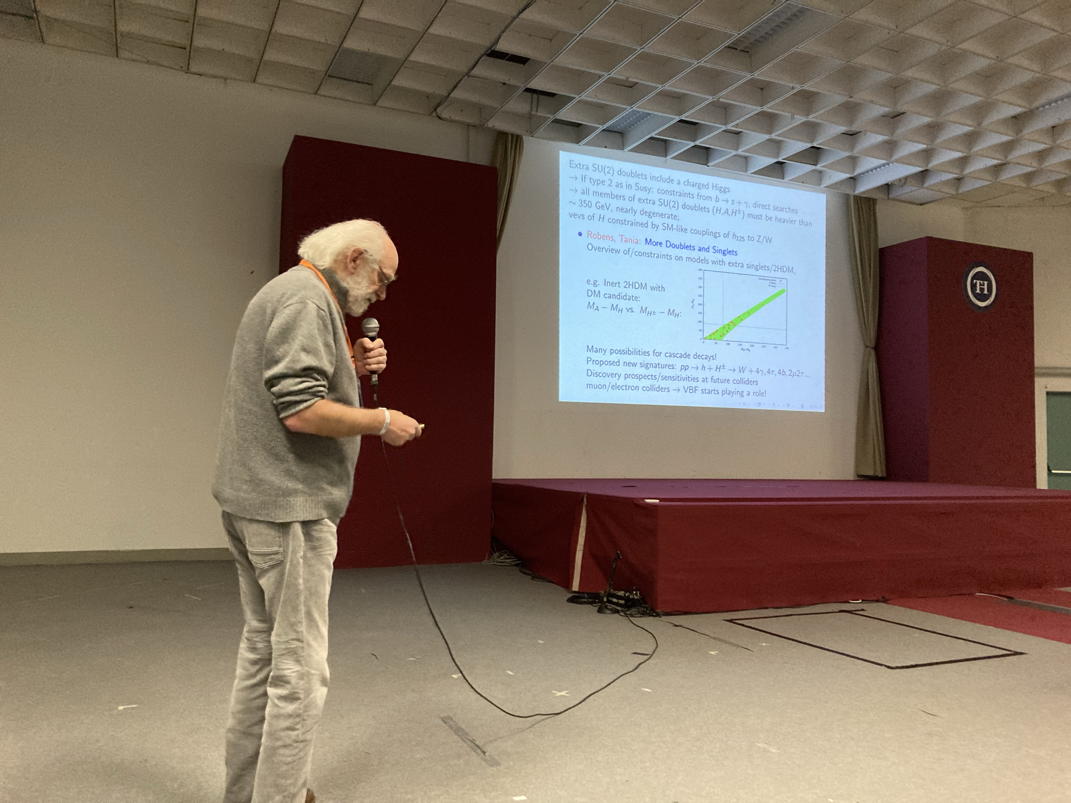

Slide 15
===========
ESPPU discussion

