Slide 1
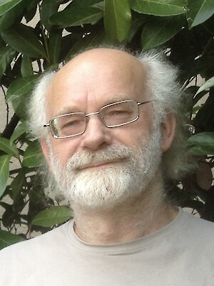
In memoriam Ulrich Ellwanger
*8.4.1953 - †7.8.2024
Cyril Hugonie, LUPM Montpellier
IRN Terascale, Lyon 13/11/2024

Slide 2
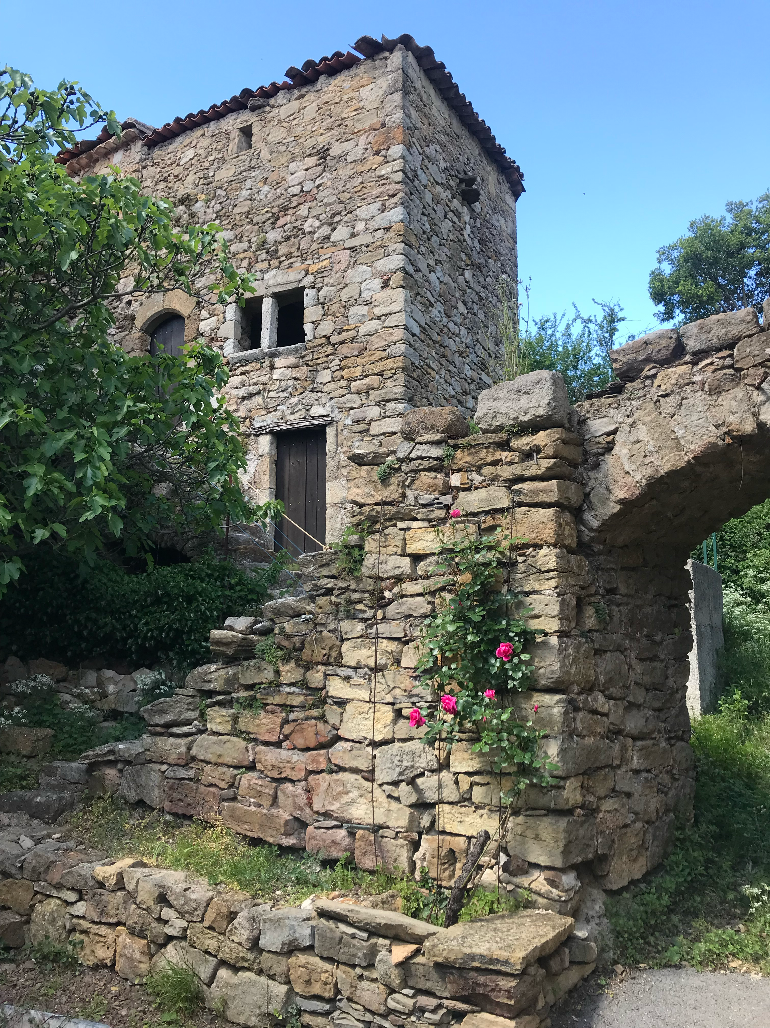
Ulrich’s career
1978-1981: PhD Heidelberg (supervisor: D. Gromes)
1981-1983: Postdoc in Oxford
1983-1986: Fellow at CERN
1986-1990: Assistant Professor, Heidelberg
1990-1994: Full Professor, Heidelberg
1994-2019: Full Professor, Orsay
2019-2024: Emeritus Professor
1974-2024: Owner of a house in Pailhès, in the Cévennes region (south of France):

Slide 3
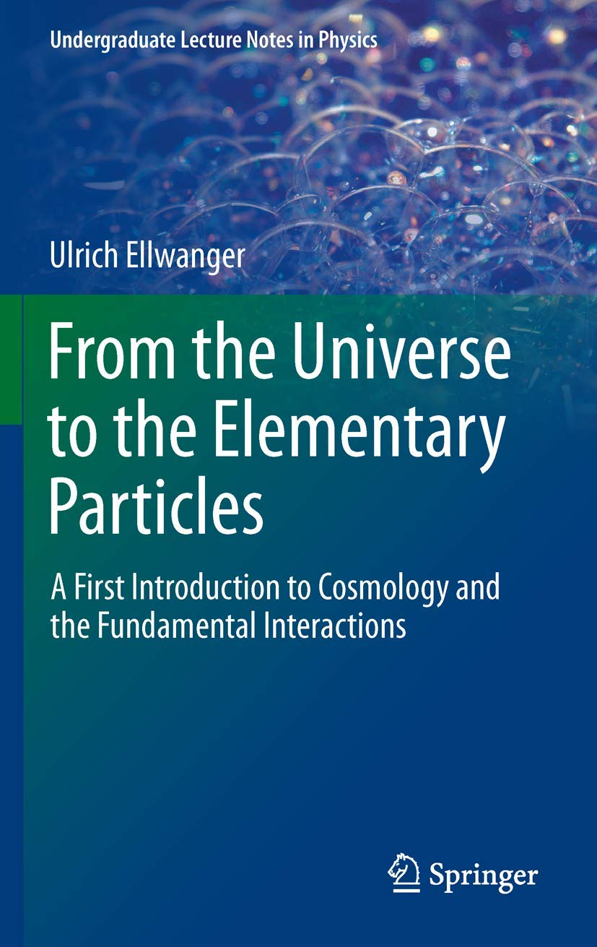
Ulrich’s students
Teaching at all levels, from undergraduate to Master students
Introductory book for undergraduate students from his lectures:
Many PhD students:
Mariano Cadoni (Cagliari University, Italy)
Lautaro Vergara (Santiago University, Chile)
Axel Weber (Michoacan University, Mexico)
Manfred Hirsch (left physics)
Cyril Hugonie (Montpellier University)
Nicolas Wschebor (Montevideo University, Uruguay)
Florian Domingo (Bonn, left physics)
Christian-Charles Jean-Louis (Antilles, left physics)
Pantelis Mitropoulos (left physics)
Florian Nortier (IP2I, Lyon)
Matias Rodriguez-Vazquez (left physics)
…

Slide 4
Ulrich’s scientific production
Citesummary: 159 papers published on many topics, 17600 citations
First paper:
Baryon mass splitting by the strong hyperfine interaction and SU(3) breaking, Nucl. Phys. B, 1978 (Heidelberg)
First paper on the Renormalisation Group:
Composite field condensation and the RG, Nucl. Phys. B, 1982 (Oxford)
First paper on supersymmetry:
On negative norm states in SUSY theories, Z. Phys. C, 1983 (Oxford)
First collaborative papers:
On the Structure of Composite Goldstone Supermultiplets, with W. Buchmuller, Nucl. Phys. B, 1984 (CERN)
Sliding scales in Minimal SUGRA, with N. Dragon and M. Schmidt, Phys. Lett. B, 1984 (CERN)
First collider paper:
Constraints on SUSY models from LEP, Z. Phys. C, 1990 (Heidelberg)

Slide 5
Ulrich and the NMSSM
Natural range of Higgs masses in supersymmetry, with M. Rausch, Z. Phys. C, 1991 (Heidelberg)
Radiative corrections to the neutral Higgs spectrum in supersymmetry with a gauge singlet, Phys. Lett. B, 1993 (Heidelberg)
Particle spectrum in supersymmetric models with a gauge singlet, with M. Rausch and C. Savoy, Phys. Lett. B, 1993 (Heidelberg)
Higgs phenomenology of the supersymmetric model with a gauge singlet, with M. Rausch & C. Savoy, Z. Phys. C, 1995 (Orsay)
Neutralino cascades in the (M+1)SSM, with C. H., Eur. Phys. J. C, 1997
Constraints from charge and color breaking minima in the (M+1)SSM, with C. H., Phys. Lett. B, 1999
Masses and couplings of the lightest Higgs bosons in the (M+1) SSM, with C. H., Eur. Phys. J. C, 1999

Slide 6
Ulrich and NMSSMTools
Establishing a no-lose theorem for NMSSM Higgs discovery at the LHC, with J. Gunion & C. H., Les Houches, 2001
NMHDECAY: A Fortran code for the Higgs masses, couplings and decay widths in the NMSSM, with J. Gunion & C. H., JHEP, 2004
NMSPEC: A Fortran code for the sparticle and Higgs masses in the NMSSM with GUT scale boundary conditions, with C. H., CPC, 2006
Since 12/2006: NMSSMTools public code which also contains
NMGMSB: for GMSB models, with C.C. Jean-Louis
NMHDECAY_CPV: for CP violating Higgs sector, with F. Domingo
NMSDECAY: for sparticle decays, with A. Teixeira and D. Das
Adapted version of micrOMEGAs, with G. Bélanger and A. Pukhov
Adapted version of SmodelS for LHC constraints, with S. Kraml

Slide 7
Ulrich and NMSSMTools

Slide 8
His most cited and last papers
The most cited papers:
The Next-to-Minimal Supersymmetric Standard Model, with C. H. & A. Teixeira, Phys. Rev. 2009 → 1232 citations
Brane cosmological evolution in a bulk with cosmological constant, with P. Binetruy, C. Deffayet & D. Langlois, Phys. Lett. B, 1999 → 1121 citations
The last papers:
Benchmark Lines and Planes for Higgs-to-Higgs Decays in the NMSSM, with M. Muehlleitner & al, March 2024
NMSSM with correct relic density and an additional 95 GeV Higgs boson, with C. H., March 2024
NMSSM explanation for excesses in the search for neutralinos and charginos and a 95 GeV Higgs boson, with C. H., S. Moretti and S. King, April 2024 (accepted for publication on August, 6th)

Slide 9
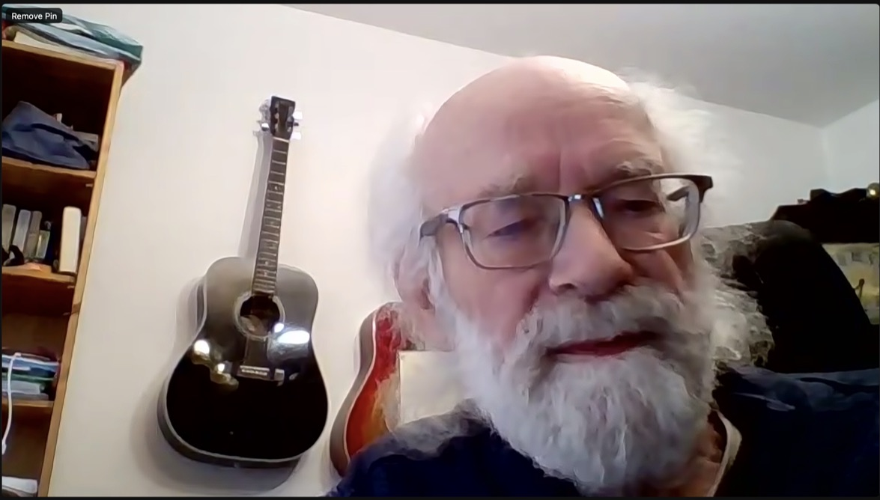
His last talk

Slide 10
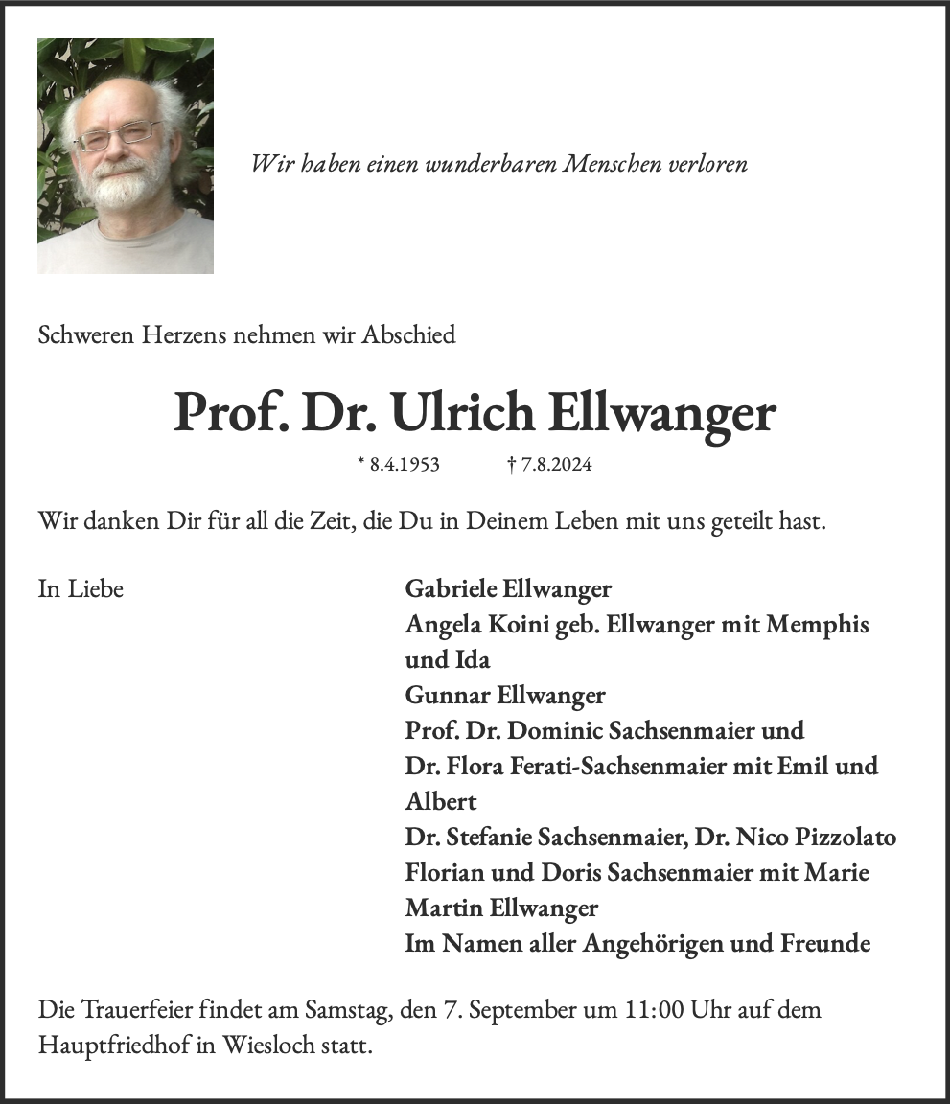
In memoriam Ulrich Ellwanger
Ulrich had an encyclopaedic knowledge of physics, covering a large spectrum from particle physics to cosmology, with a marked interest in phenomenology at colliders.
He played an essential role in various working groups joining theoretical physicists with experimentalists.
But Ulrich was not only a great physicist, he was also an exceptional human being, always open for discussion, always with a smile.
He will be deeply missed by his friends and family and by the whole community of physicists.
https://traueranzeigeonline.de/verzeichnis/baden-wuerttemberg/prof-dr-ulrich-ellwanger/

Slide 11
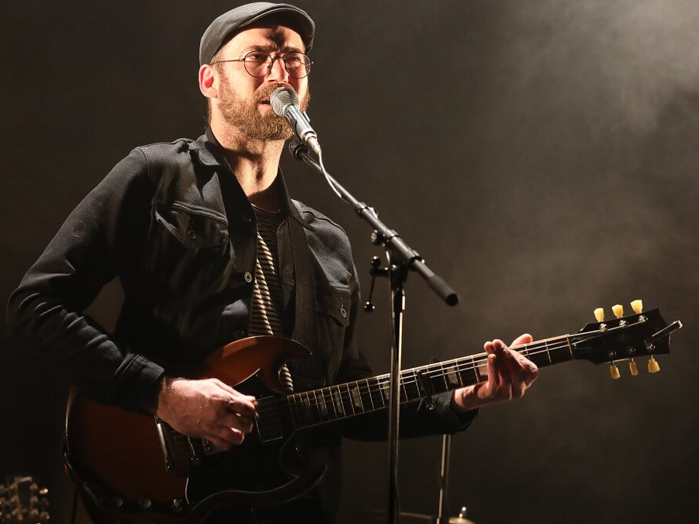
Ulrich and music
Ulrich was playing guitar, banjo, violin (or fiddle) and singing. He played in various groups in France and Germany (Folk and Celtic music, bluegrass…) and gave concerts in pubs.
His son Gunnar is a renowned musician:
Four albums with his group Gunwood
A collaboration with Ben L’Oncle Soul
They played together for Ulrich’s 70th birthday a bluegrass classic called Orange Blossom that I suggest we listen to now as a last tribute to Ulrich:
We will miss you Uli!

