Slide 1
Fundamental symmetries
with novel technologies
Image by Sandbox Studios
LPC Prospectives 2025
Leendert Hayen

Slide 2
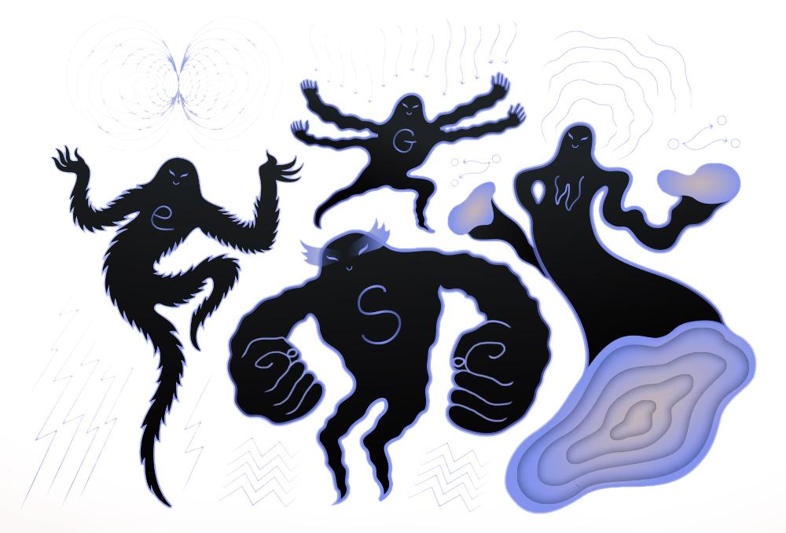
Standard Model tests and Beyond
Symmetry tests in the electroweak sector at low Energy
Parity violation
CP violation
Lorentz structure
CKM & PMNS unitarity
Neutrino mass
Sterile 𝜈
…
all can be probed with (nuclear) 𝛽 decay
Image by Sandbox Studio

Slide 3
MPBE Activities
World-leading experiments in all categories
& logo-less experiments
nEDM
JYFLTRAP
several posters, but today focus on cryogenic quantum sensors

Slide 4
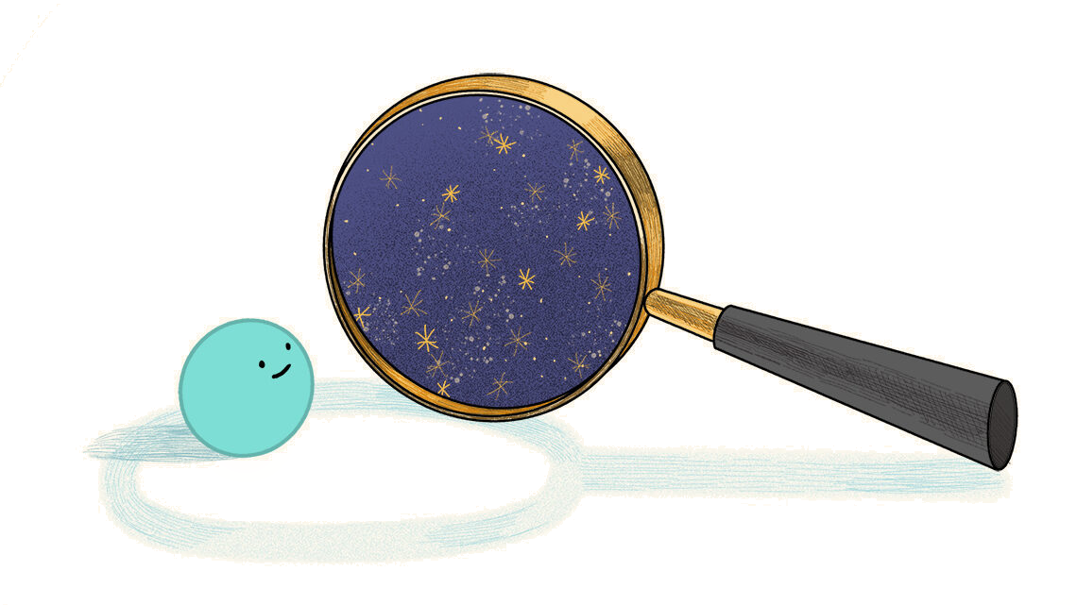
Why cryogenic quantum sensors
Semiconductor era is limited to >keV radiation, but unexplored world below
Dark matter
Foundations of quantum mechanics
Largely unexplored neutrino sector
…
low temperature (mK)
France: Ricochet (ILL), LNHB, Edelweiss, Manoir, …

Slide 5
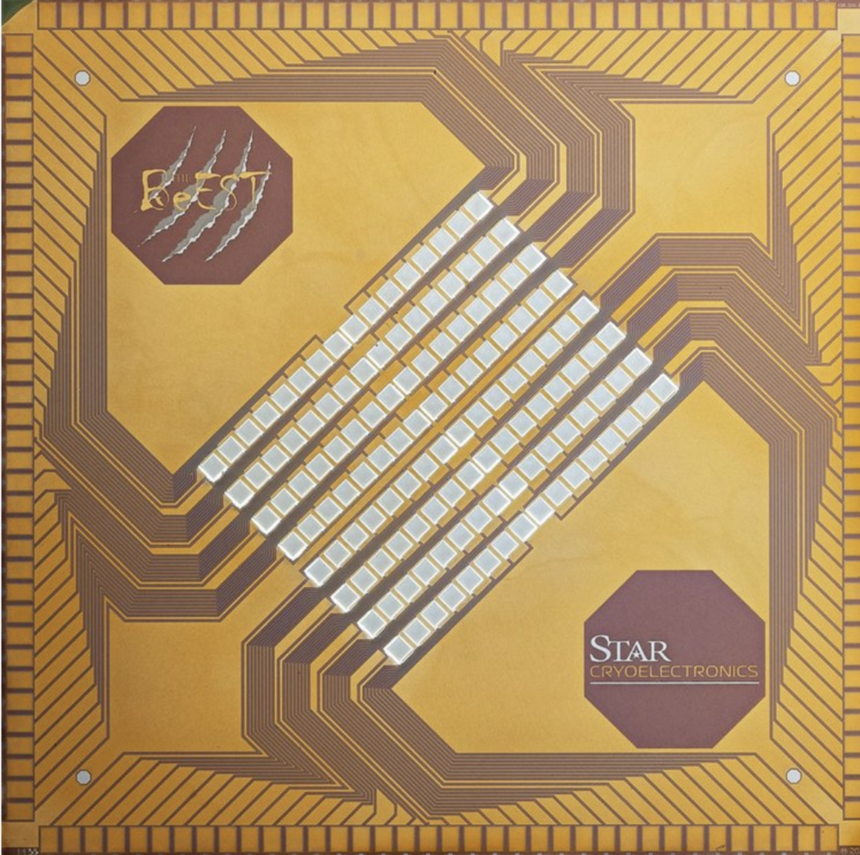
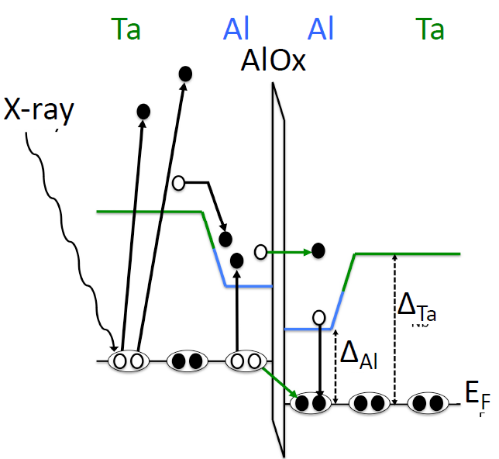
Superconducting Tunnel Junctions: BeEST
Josephson junction, measure tunneling current of broken cooper pairs ( 1 meV)
Unique properties:
High resolution (~ 2 eV)
Low threshold (~ 1 eV)
Fast (up to kHz)
ideal for measurement of short-lived radioactivity

Slide 6
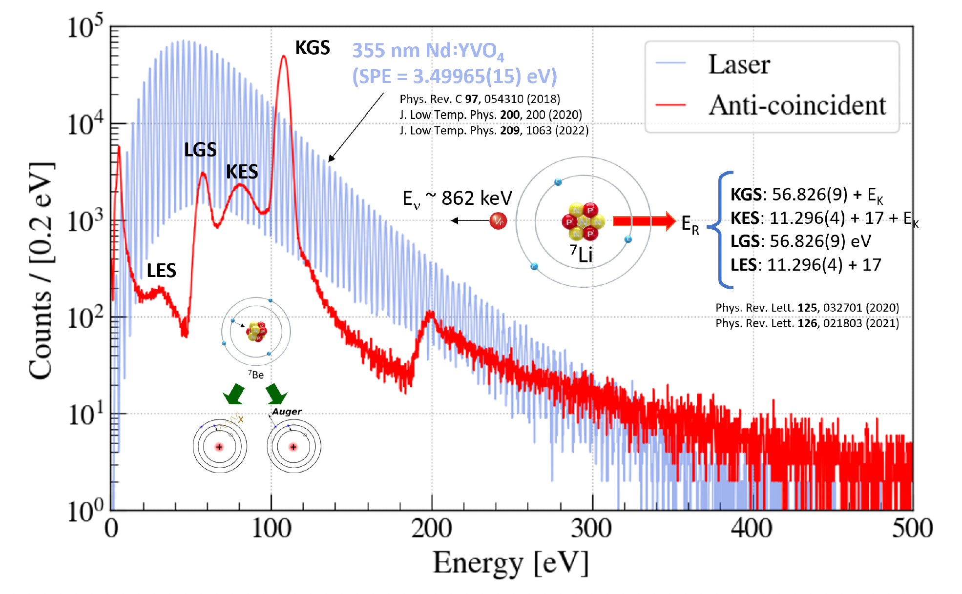
The BeEST experiment
First spectroscopy of ⁷Be recoil + cascade
Competitive sterile neutrino searches
Tests of quantum mechanics!
PRL 126 (2021) 021803; PRL 125 (2020), 032701
Nature 638 (2025) 640

Slide 7
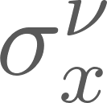
Immediate high impact: ‘low hanging fruit’ with BeEST
Recoil nucleus is broadened due to get
See also PRD 111 (2025) 052010

Slide 8
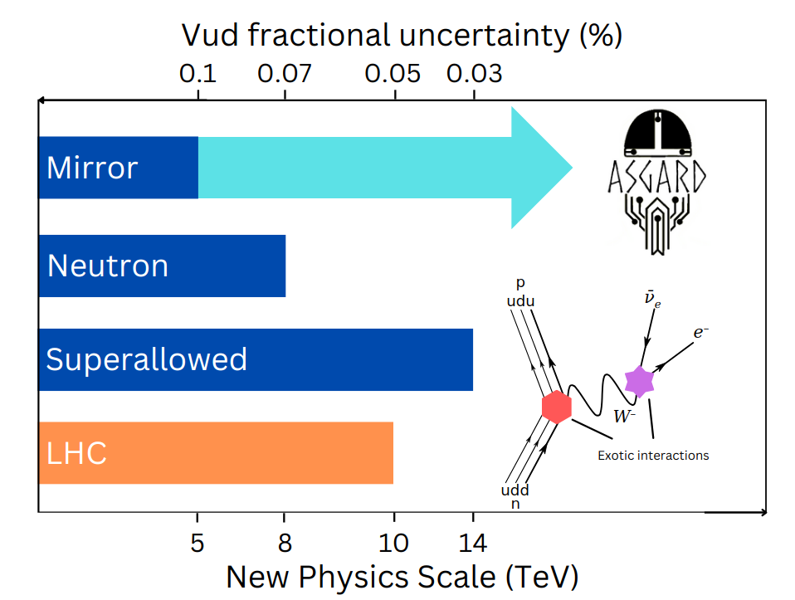
Experimental opportunities with recoil spectroscopy
Competitive with LHC ( )
TeV-scale new currents
Extra flavour components
High precision at low energy probes new physics at high energy
but plateau due to systematics
Recoiling ion has wealth of information, but technologically inaccessible and requires broad theory understanding
LH, ARNPS 74 (2024) 497
LH et al., RMP 90 (2018) 015008

Slide 9
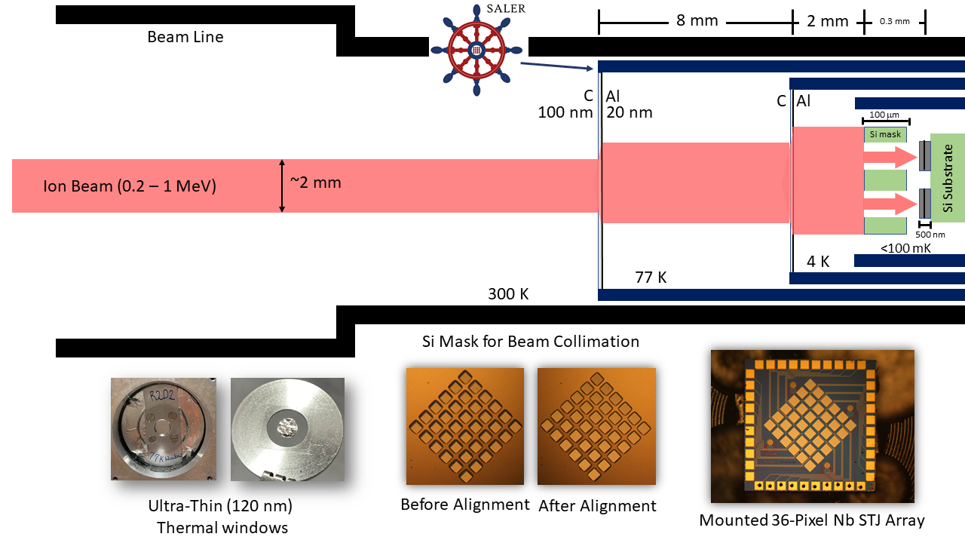
SALER: First short-lived measurements at FRIB
First-of-its-kind
but
closed fridge
significant scattering
no precise implantation
limited isotopes
Commissioning underway + First data taking soon!

Slide 10
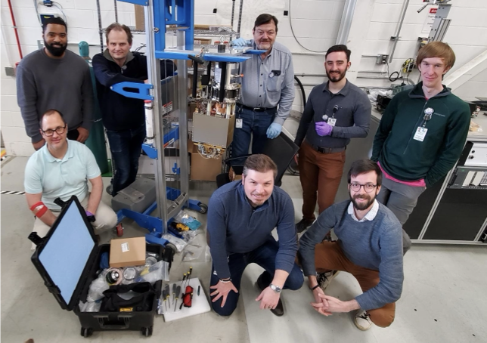
SALER commissioning: First light April 2024

Slide 11
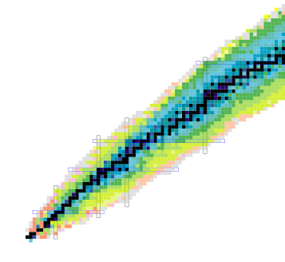
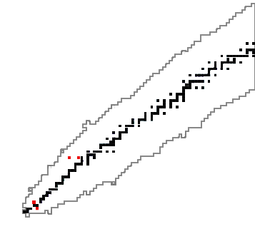
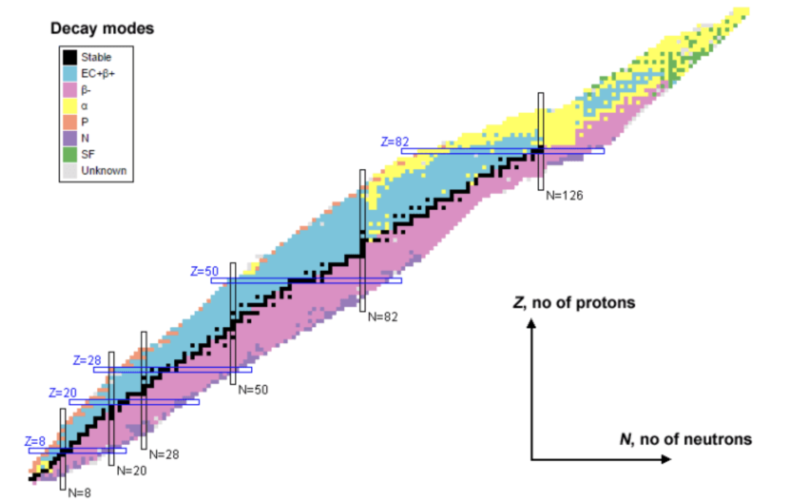
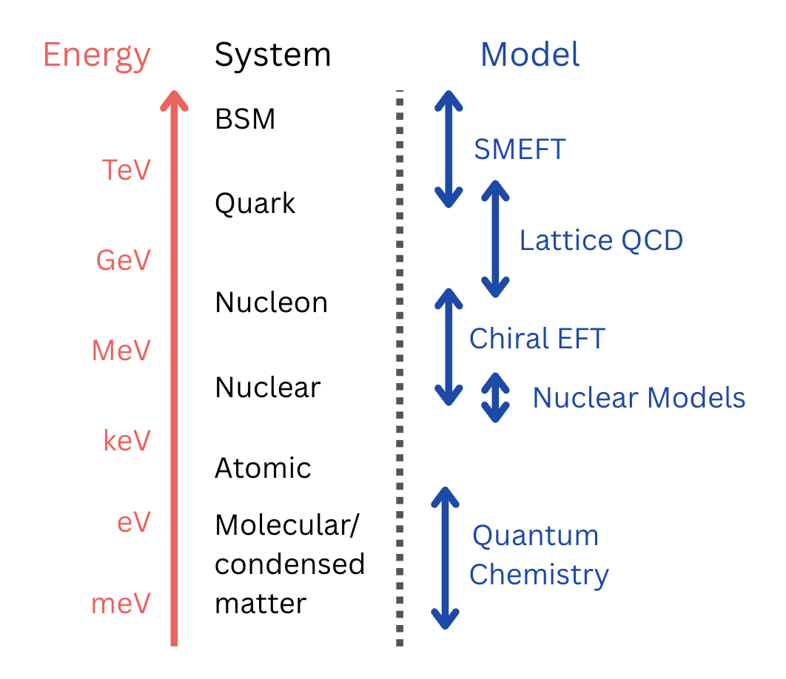
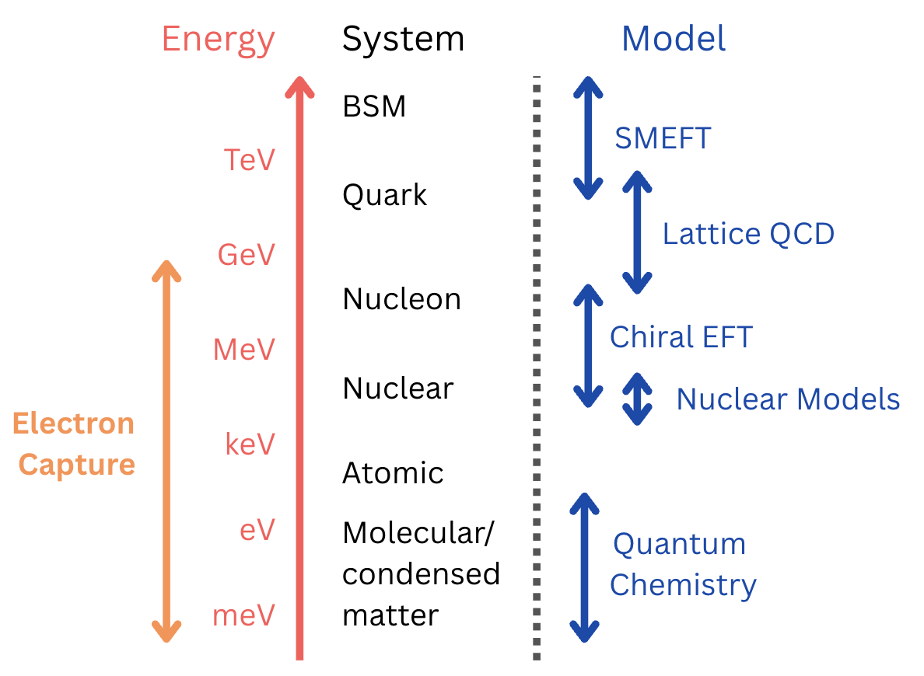
Recoil spectroscopy: broader scope
Out of thousands of known radioactive transitions,
only handful measured recoiling nucleus
Out of thousands of known radioactive transitions,
only handful measured recoiling nucleus
Coherent multi-scale framework
(QCD Chemistry) is crucial, but missing
Recoil: Access to electron capture &
electronic environment

Slide 12
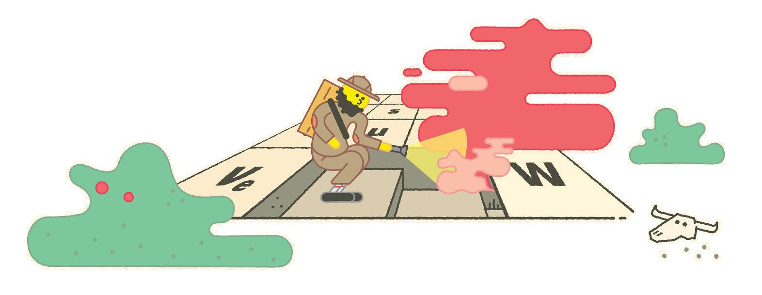
ASGARD: Tabletop experiment for particle physics
Direct collider searches don’t see new physics, but
tabletop experiments probe wealth of operators and energy scales
ASGARD will perform precise eV-scale spectroscopy on short-lived isotopes with superconducting quantum sensors
Novel TeV-scale new physics searches
New directions in nuclear physics
ASGARD will be a precision device
at DESIR@GANIL
Artwork by Sandbox Studio, Chicago

Slide 13
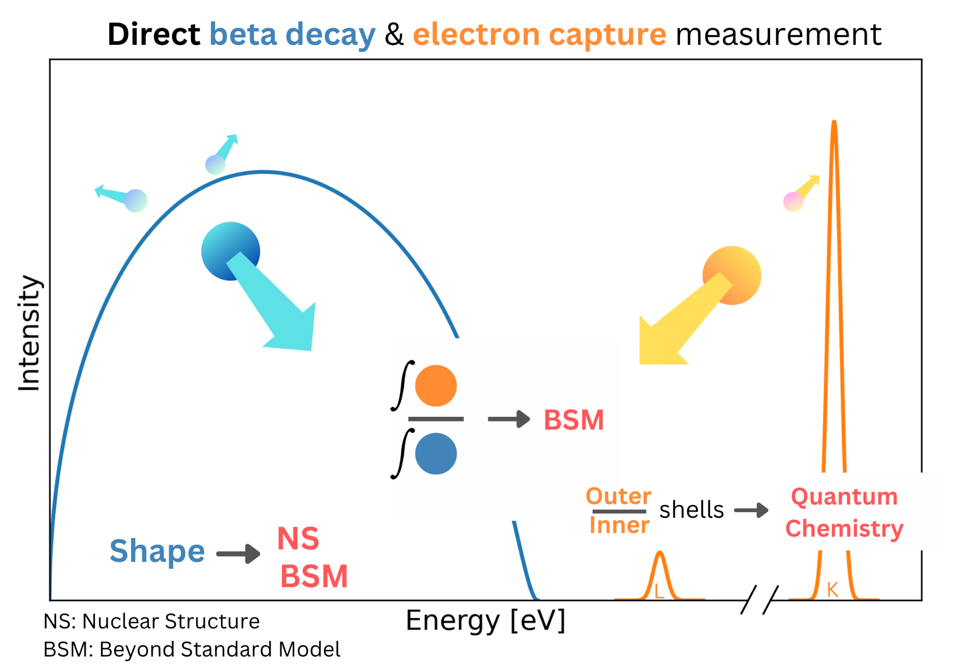
ASGARD: Principle
Perform full spectroscopy of short-lived isotopes with quantum sensors
Two novel measurement schemes:
I: EC/B+ Branching ratio
II: B+ shape
probe new physics at tens of TeV in completely new way

Slide 14
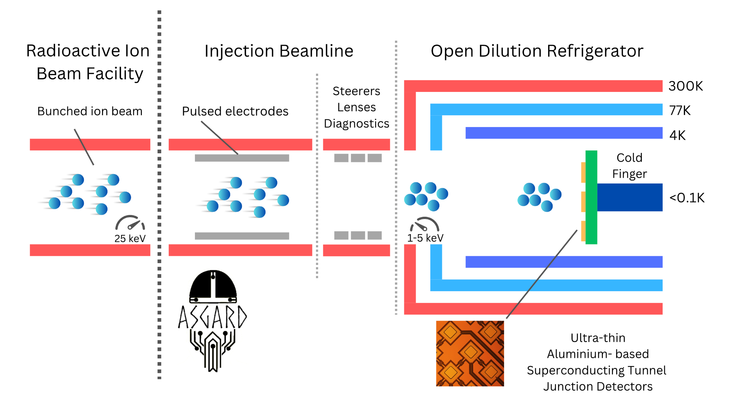
ASGARD: Methodology
Combination of expertise in beta decay and technical innovations
Orders of magnitude improvement in systematic effects and efficiency

Slide 15
ASGARD: Methodology
Key #1: Windowless dilution fridge
Full access to nuclear chart
Key #2: Ultrathin Al-STJs
x100 reduced scattering
Key #3: Injection beam line
Extremely precise implantation
Together world-first precision device

Slide 16
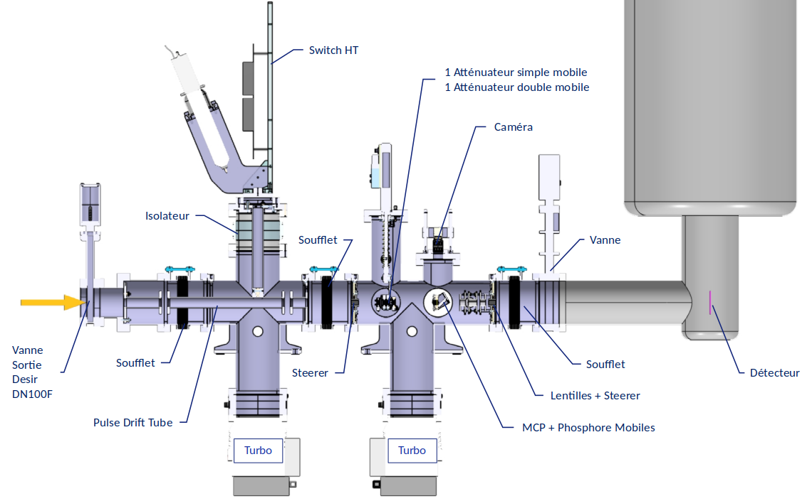
Setup geometry
Relatively compact
(~3m length, 2.5m height)
Closed cooling circuits
Besides PDT, all at ground potential

Slide 17
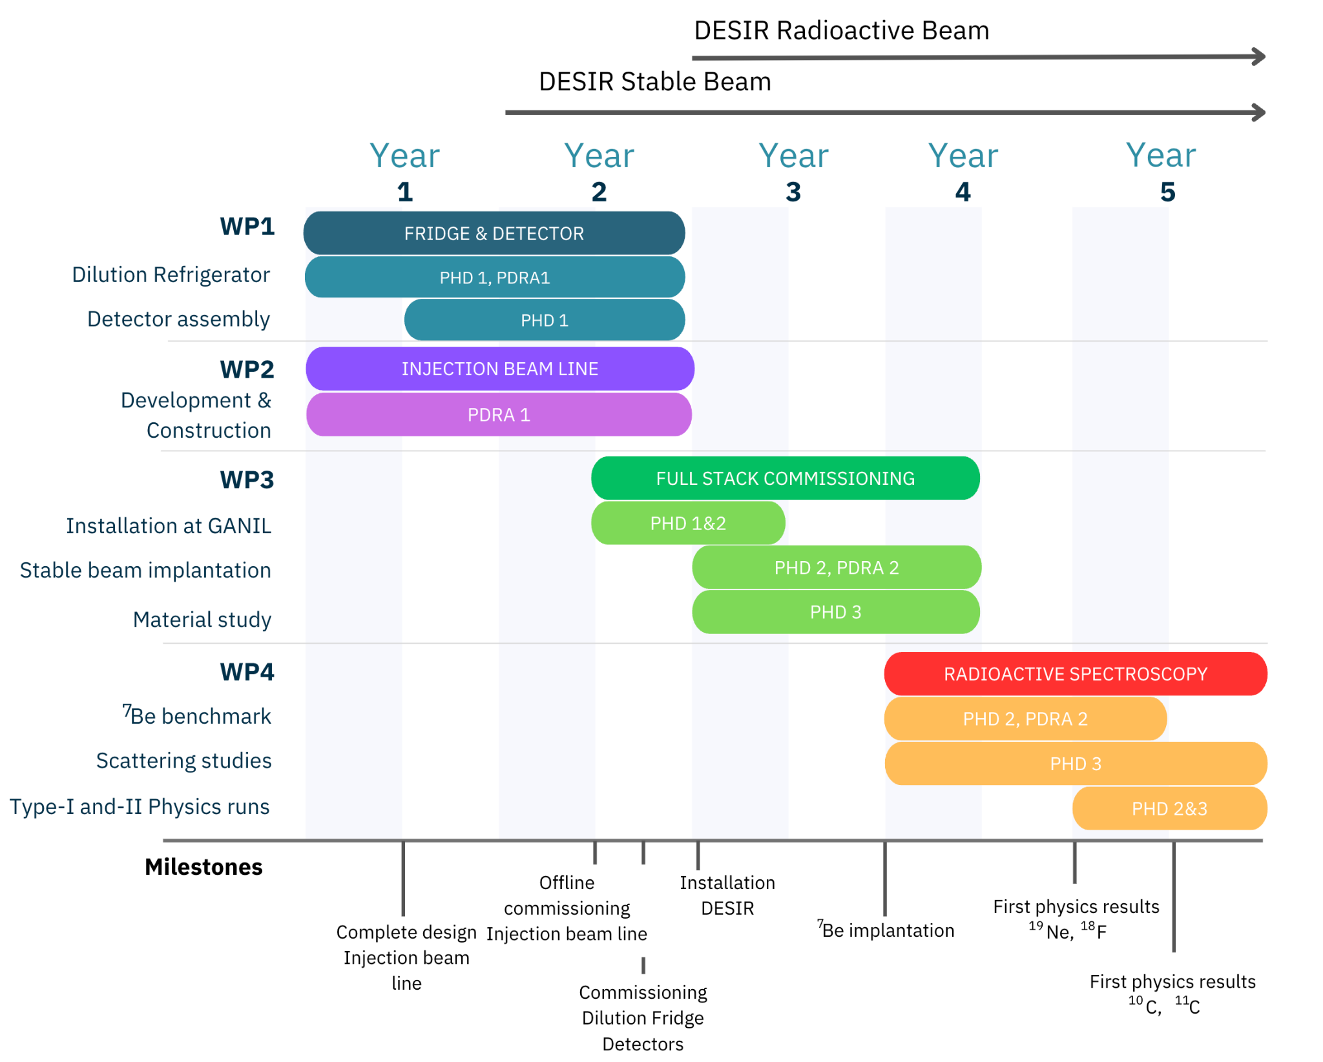
Timeline
ERC Starting Grant
submitted October 2024
Final Stage interview
May 2025
Decision August

Slide 18
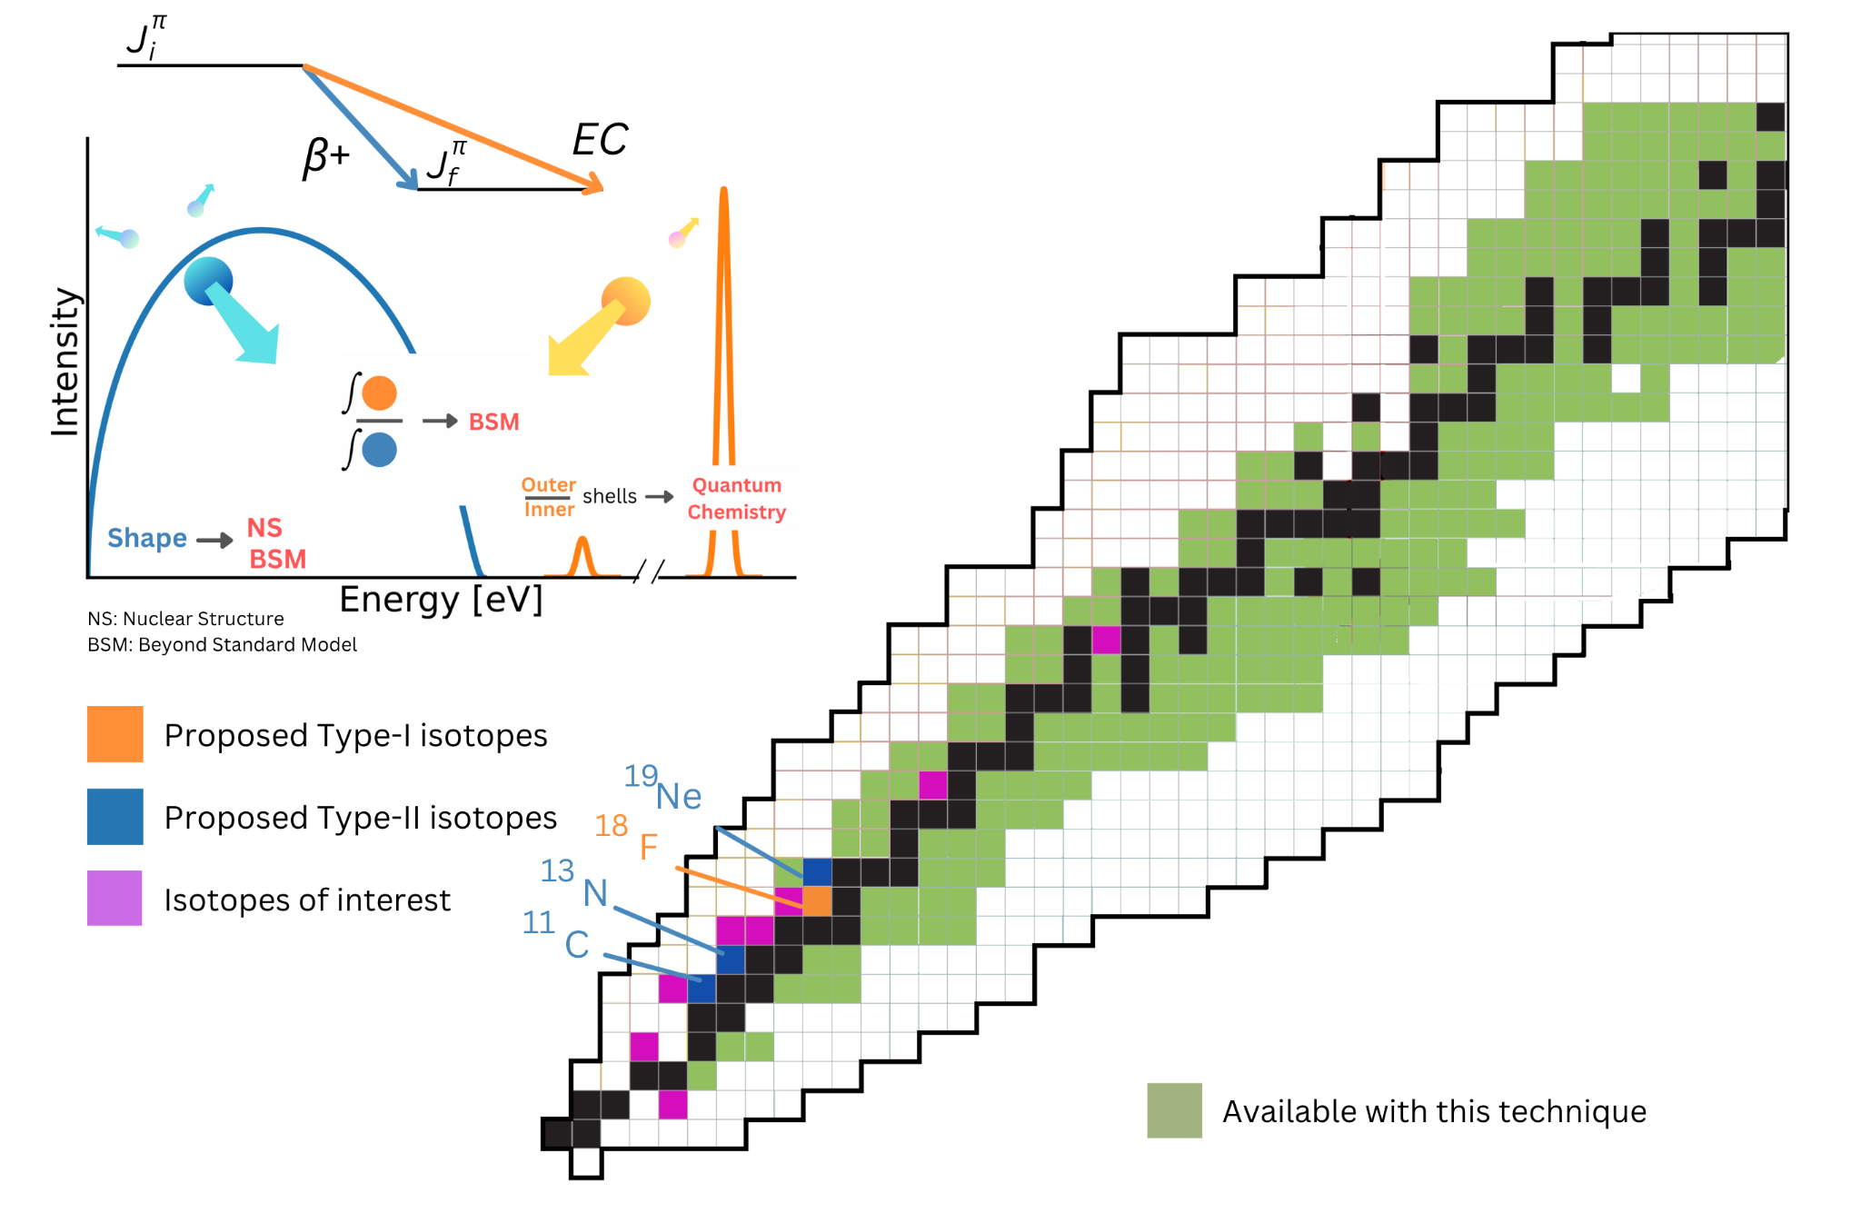
ASGARD: Reach
Complementary high-impact isotopes for BSM
Unlock hundreds of isotopes for study
Nuclear structure
Auger spectroscopy
Completely unexplored variable

Slide 19
Backup

Slide 20
Novel nuclear structure methods
Total absorption recoil spectroscopy
branching ratio measurements
Lifetimes?
essentially tip of the iceberg

Slide 21
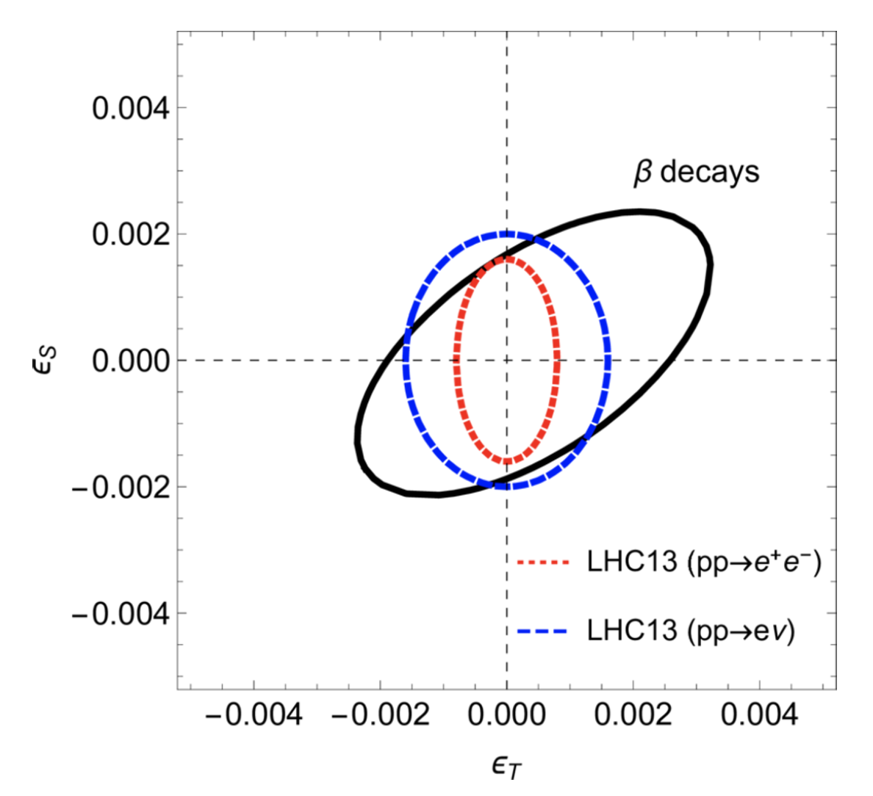
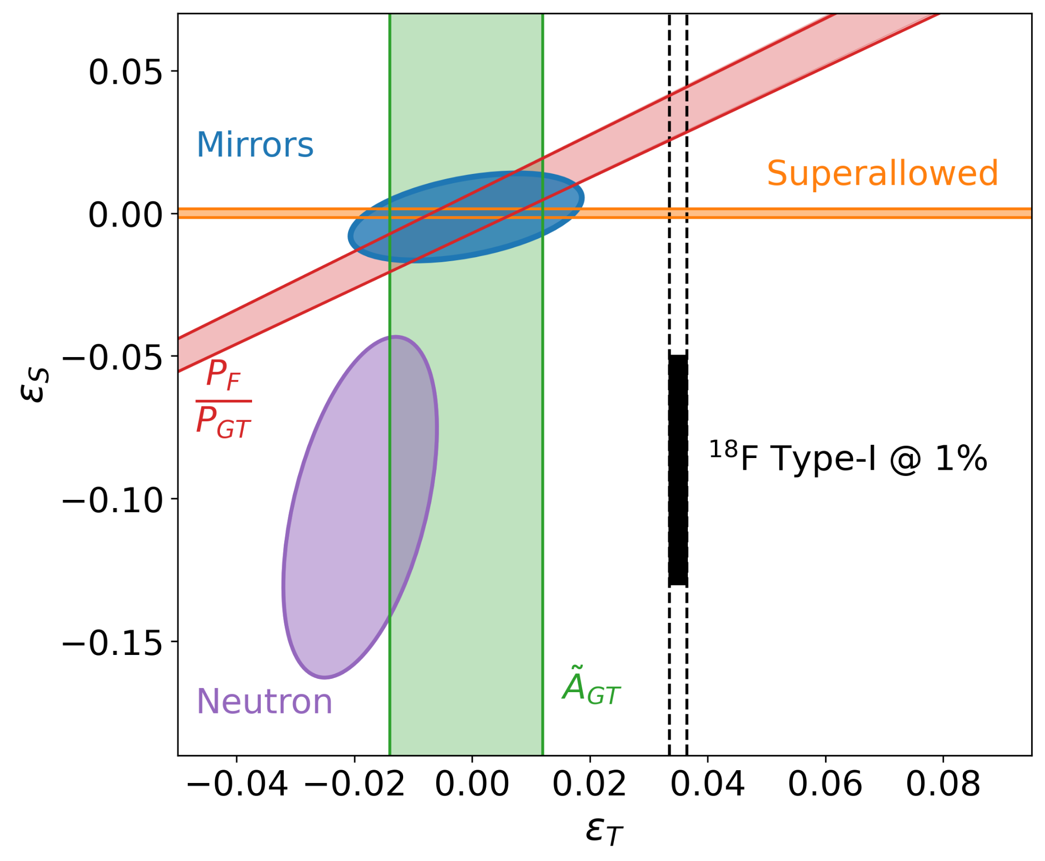
Exotic current constraints

Slide 22
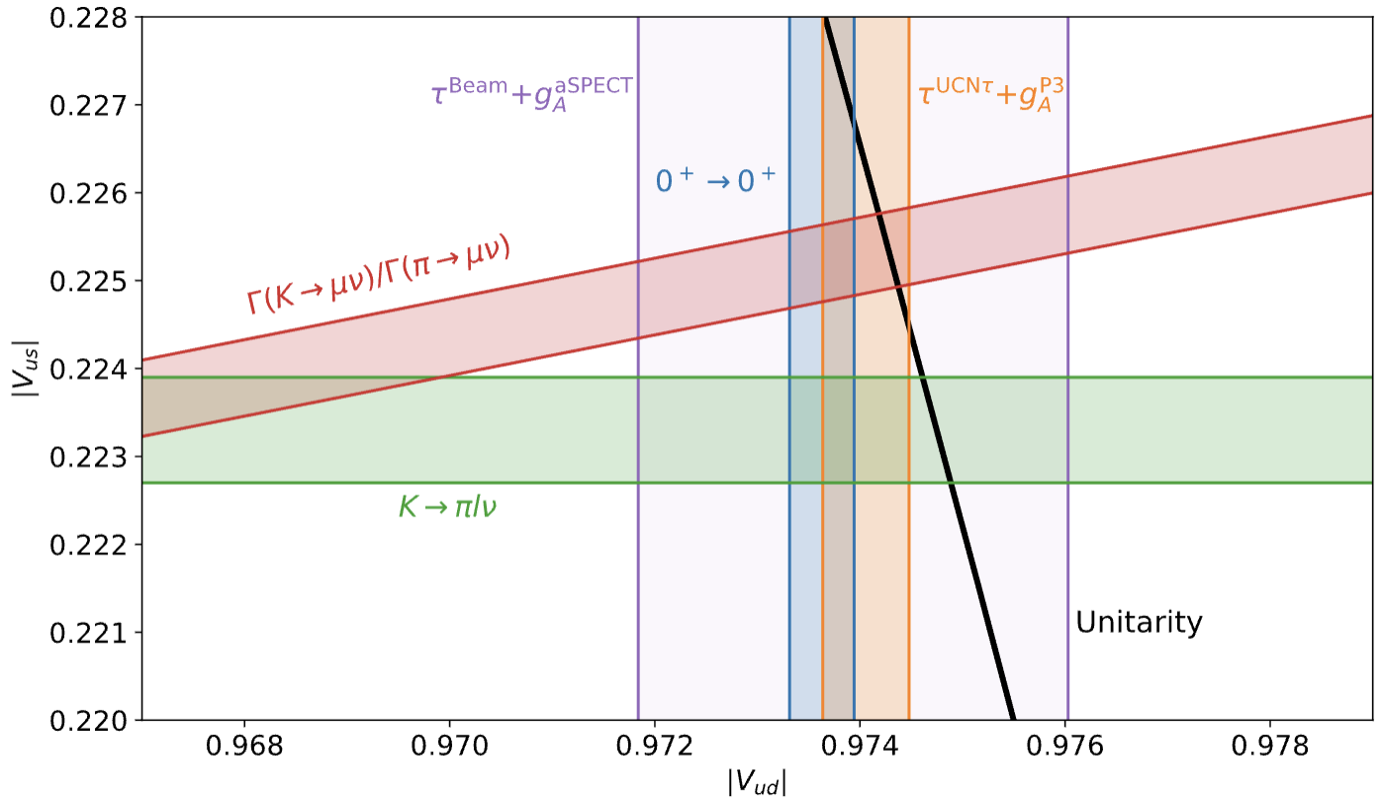
CKM unitarity in the Standard Model
Quark mixing means
and unitarity requirement
is an independent probe for BSM
Situation right now is ‘complicated’:
talks by Alejandro Garcia, John Behr, Leah Broussard, …
LH, ARNPS 74 (2024) 497
LH et al., RMP 90 (2018) 015008

Slide 23
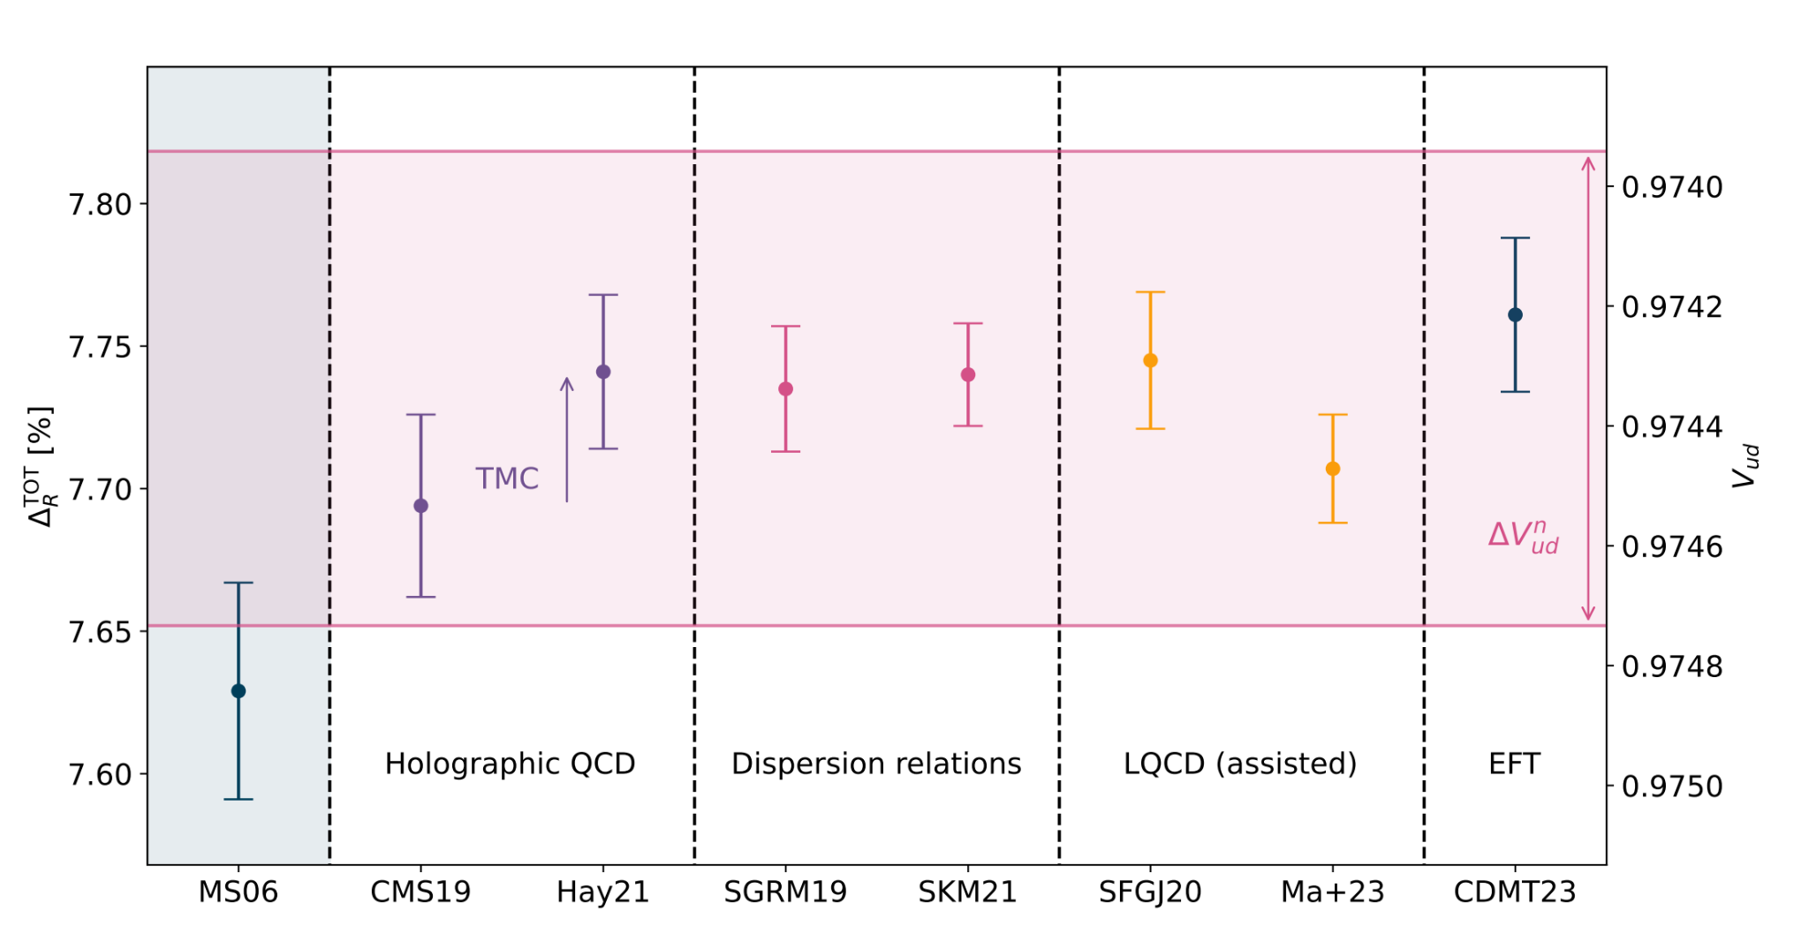
CKM unitarity in the Standard Model: Theory progress
Theory has undergone enormous change in last 10 years
Much work to be done, but path forward on nuclear side
LH, ARNPS 74 (2024) 497

Slide 24
Vud constraints

Slide 25
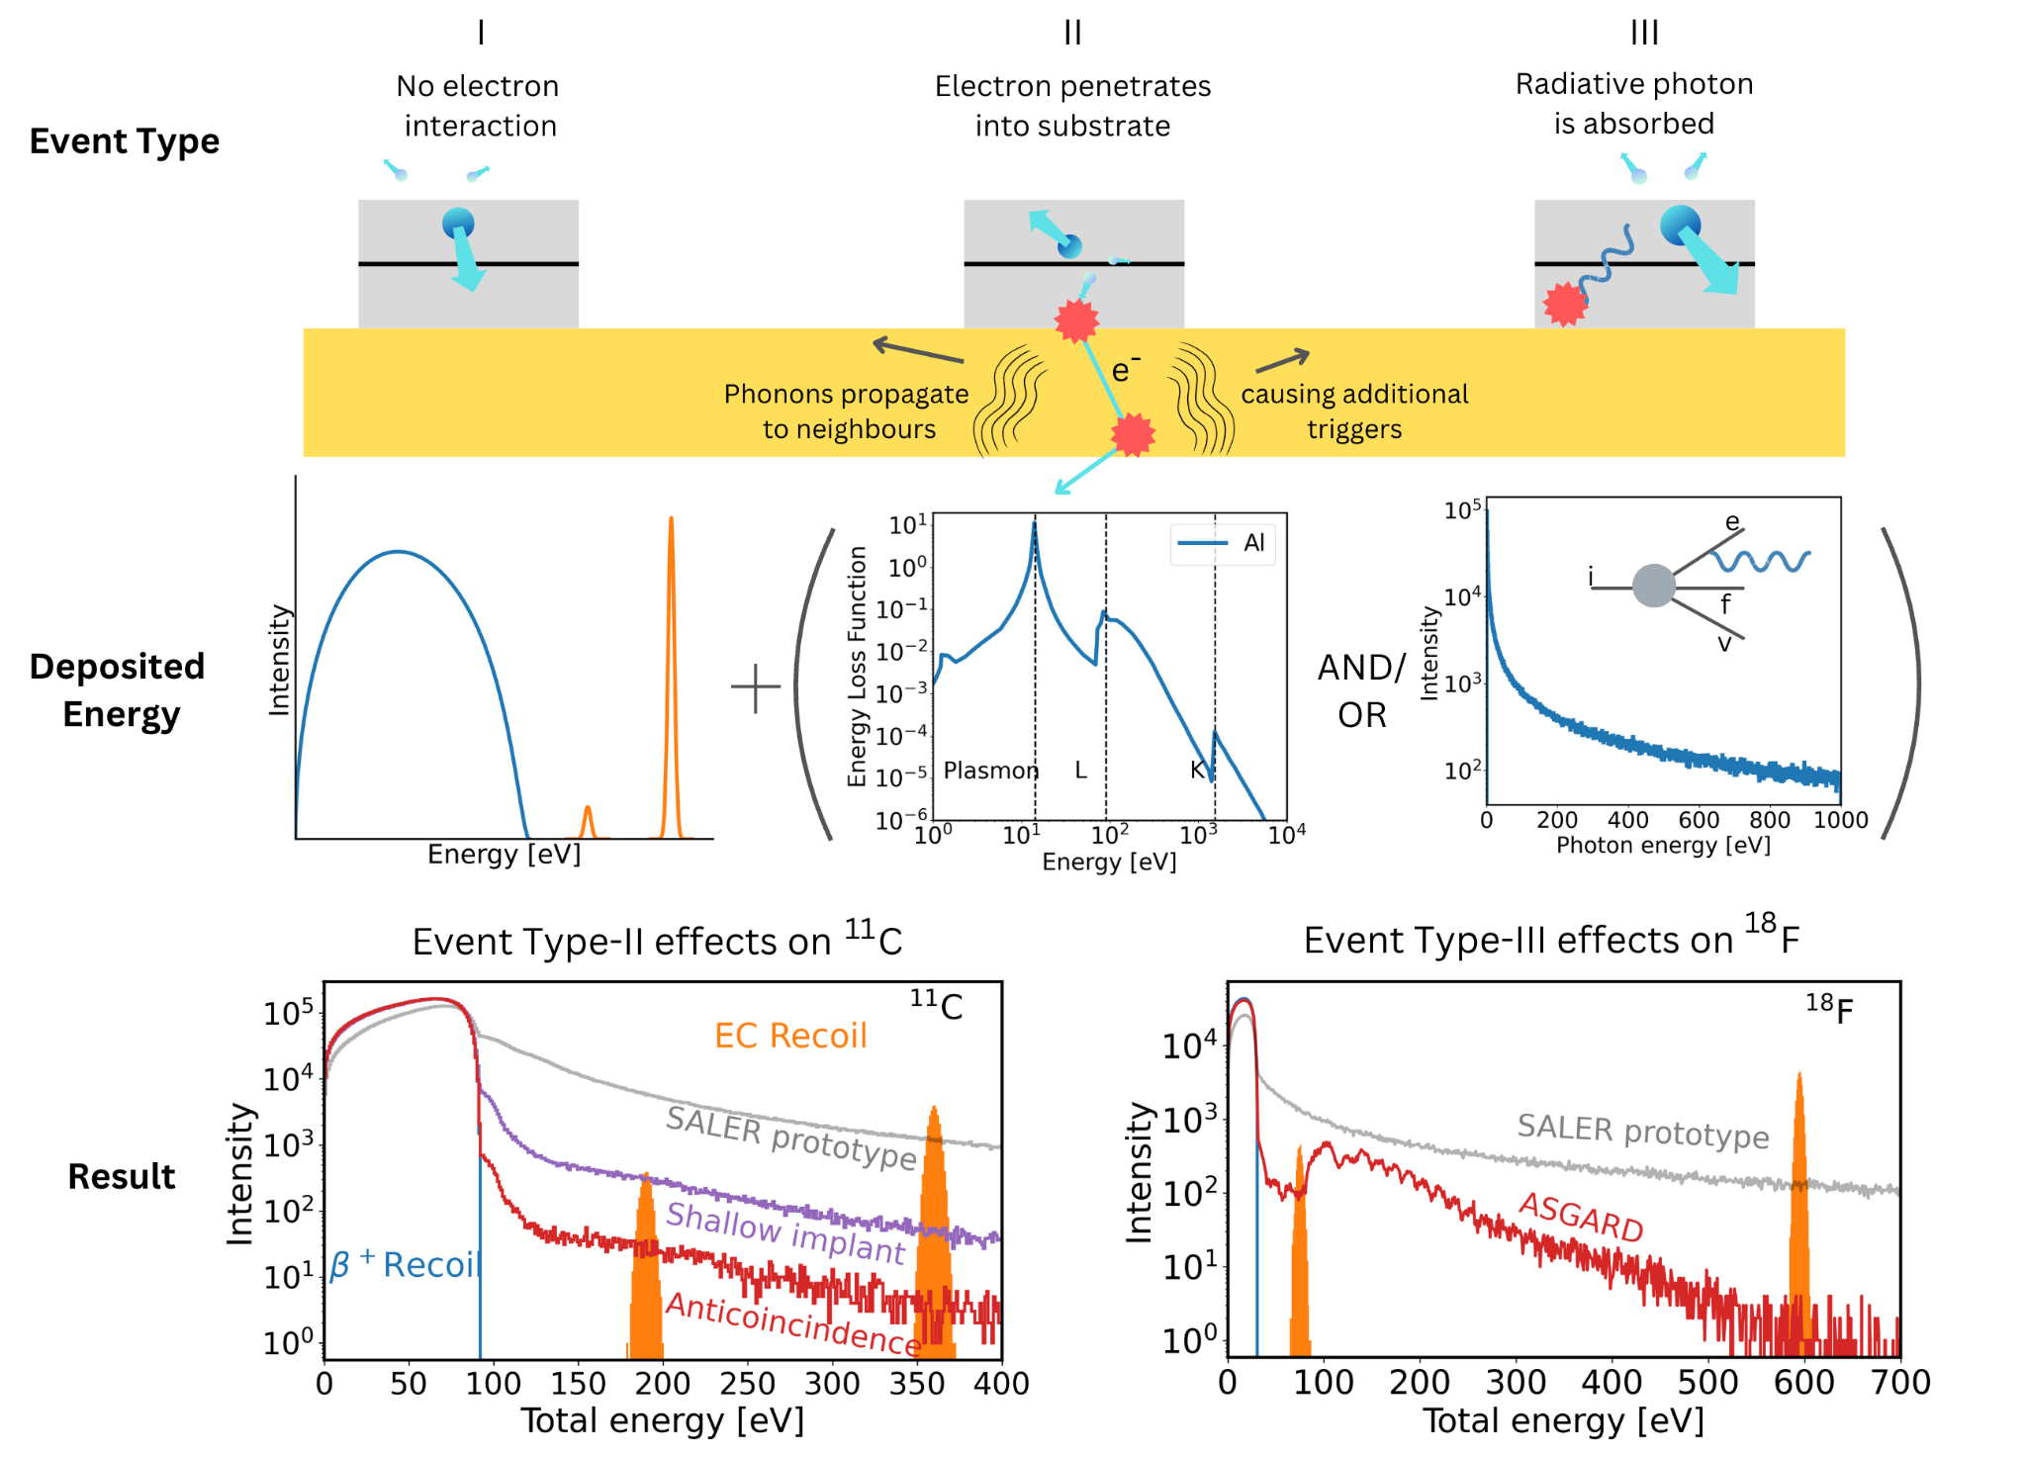
Systematics improvement
Anticipated systematic uncertainties on at or below 0.01% due to scattering

