Slide 1

ISB activities
Edwige Tournefier
ET France meeting
October 9th, 2024

Slide 2
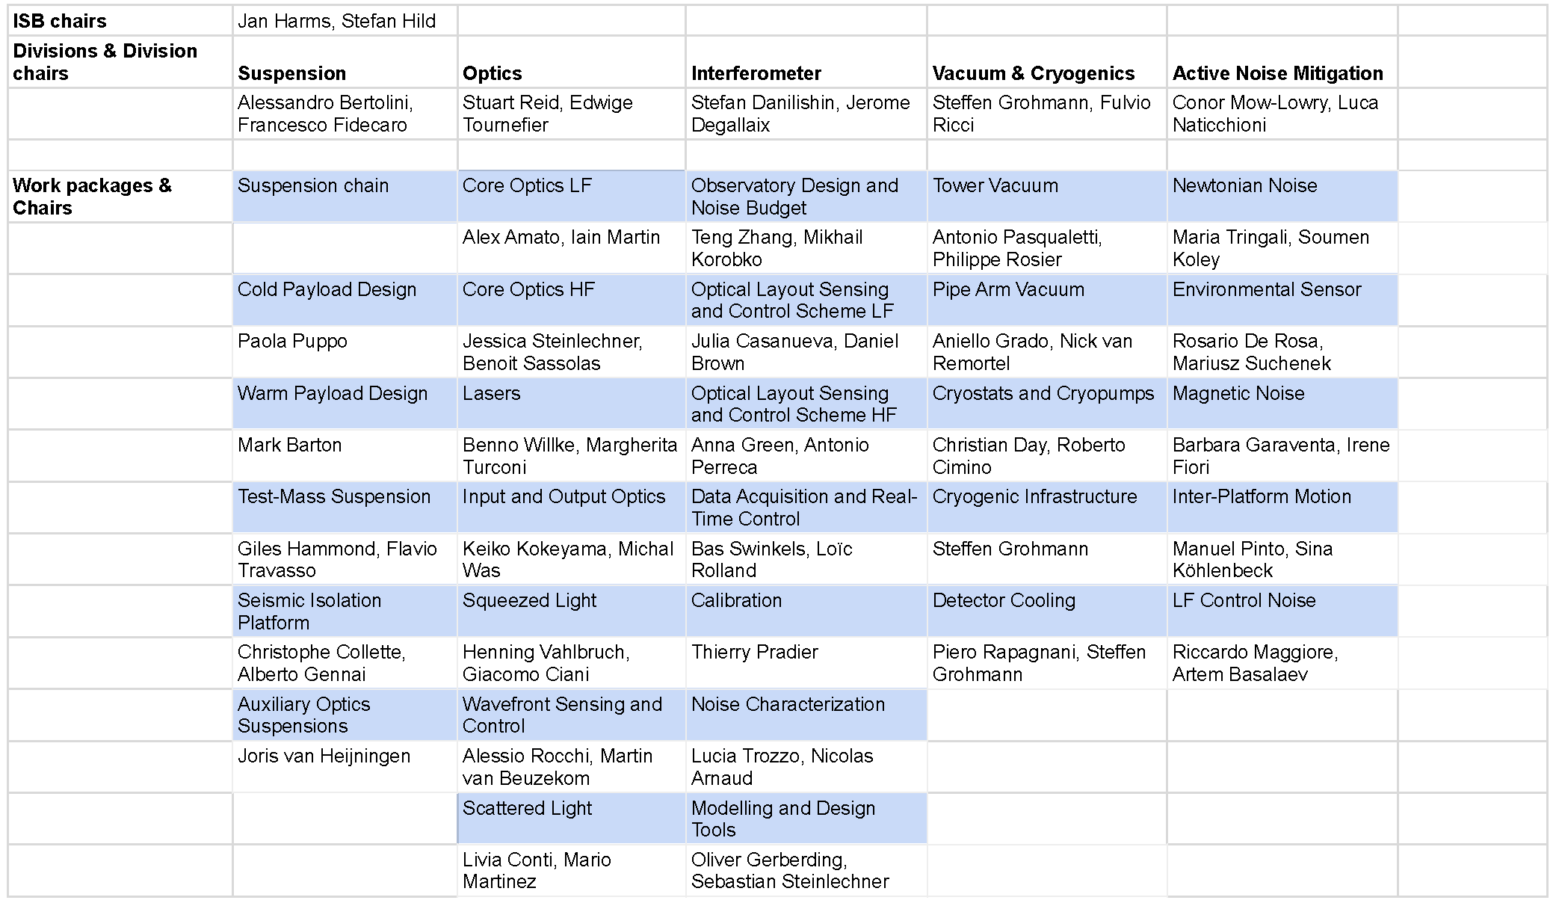
Interferometer Science Board (ISB) divisions

Slide 3
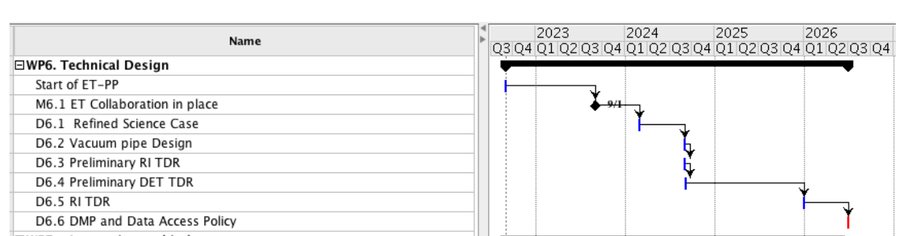
ET Detector design
One of the aims of the ISB is to provide the ET detector design
Original plan from ET preparatory phase (ET-PP): preliminary design by Q3 2024
Postponed to 2025?
Will be based on the Product Breakdown Structure (PBS)?
From ET-PP proposal

Slide 4
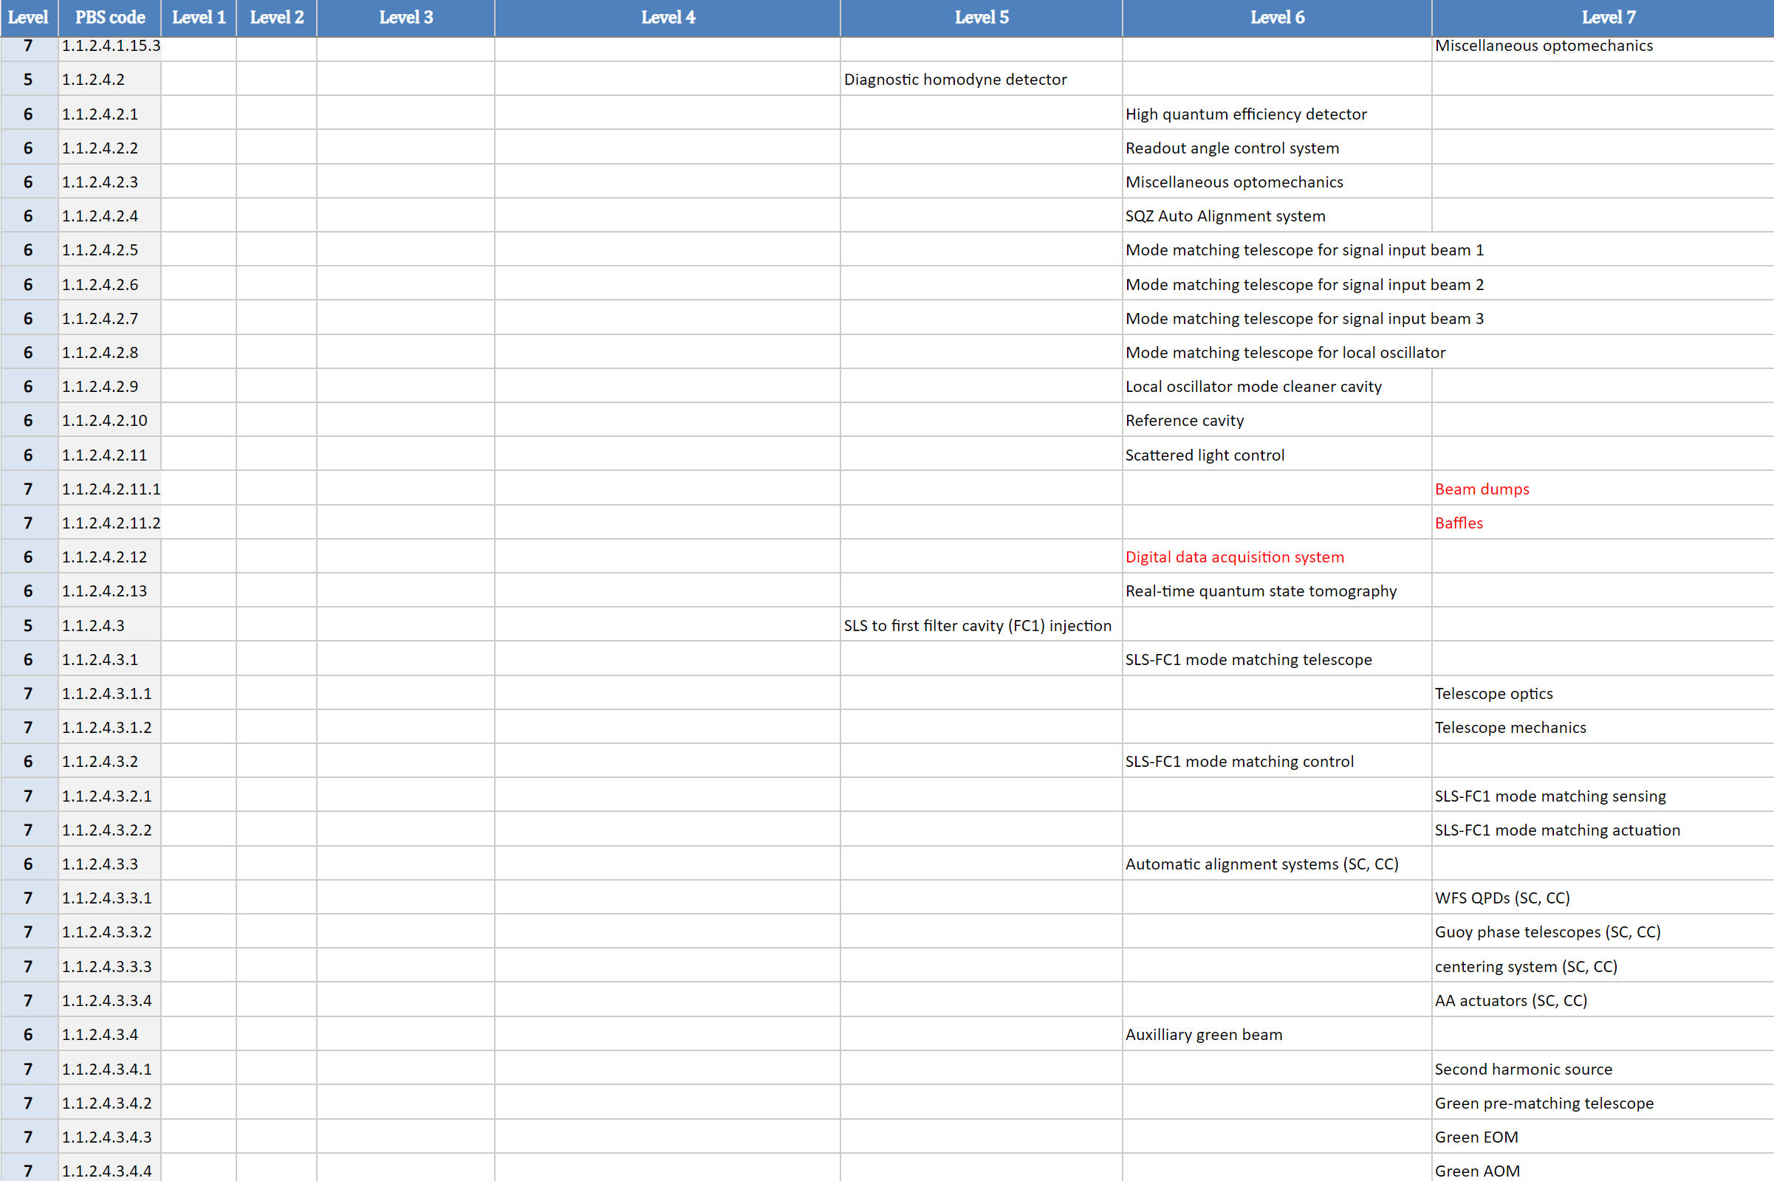
The detector PBS
ISB 2024 activity focused on the production and review of the PBS
PBS contains all the detector elements to be produced
Each PBS element is described by a parameter’s file including specifications, interfaces, dimensions,... but only few numbers yet
~1000 lines (elements) submitted
Reviews of the PBS lines going on
(2-4 days meeting in Roma for each Division)

Slide 5
ET optical layout
The optical layout is the starting point for the design of the detector
The is the other major activity of 2024: triangular + 2L configurations
See Jérôme’s presentation

Slide 6
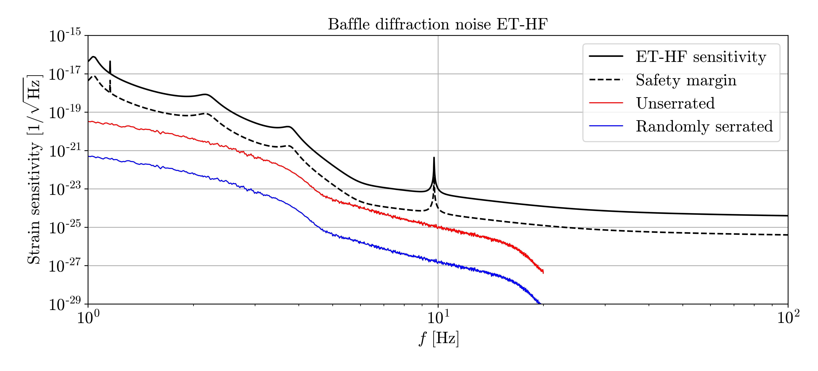
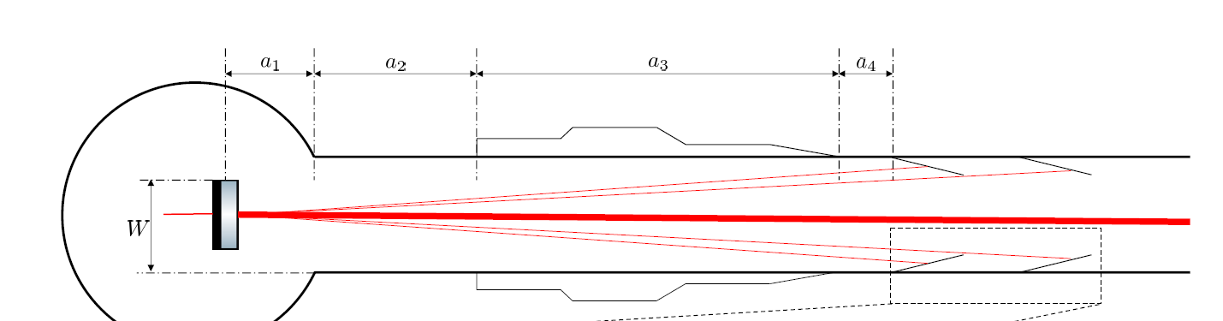
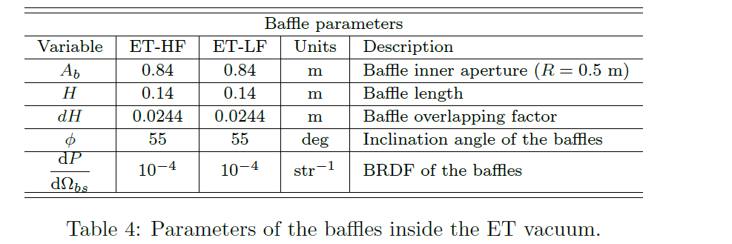
Beam pipe requirements
CERN is coordinating the writing of the vacuum beam pipe TDR (see presentation by Alexandre Lacroix)
ISB is defining the beam pipe requirements from noise studies:
  Scattered light: baffles and dust particules
  Residual gas
  Magnetic noise due to magnetic properties of the tube
  ...
ET-0385A-24

Slide 7
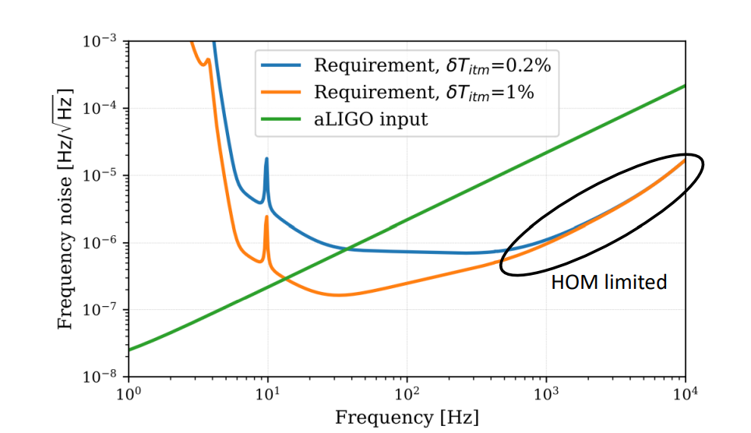
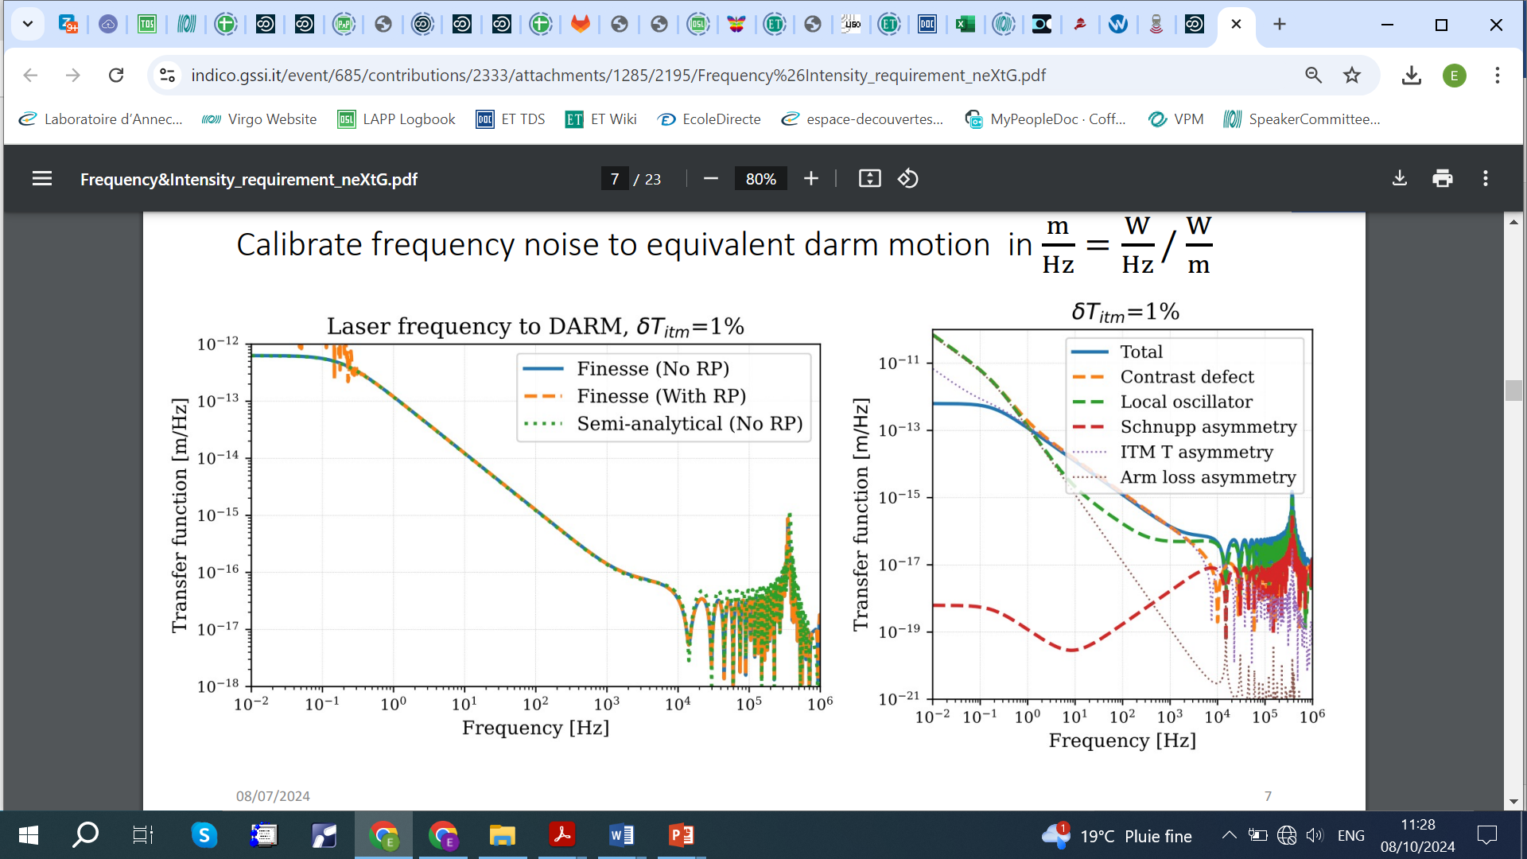
NeXt Generation Collaborative Design (XCGD)
Regular XGCD meetings (forum for discussion) with Cosmic Explorer (CE) on detector design topics: https://indico.gssi.it/e/xgcd
  January 2024: Optical design
  March 2024: Stray light control (1)
  April 2024: Sray light control (2)
  June 2024: Laser and noise couplings
  October 28th: Suspensions design
Michal Was and Teng Zhang studies on laser noise requirements

Slide 8
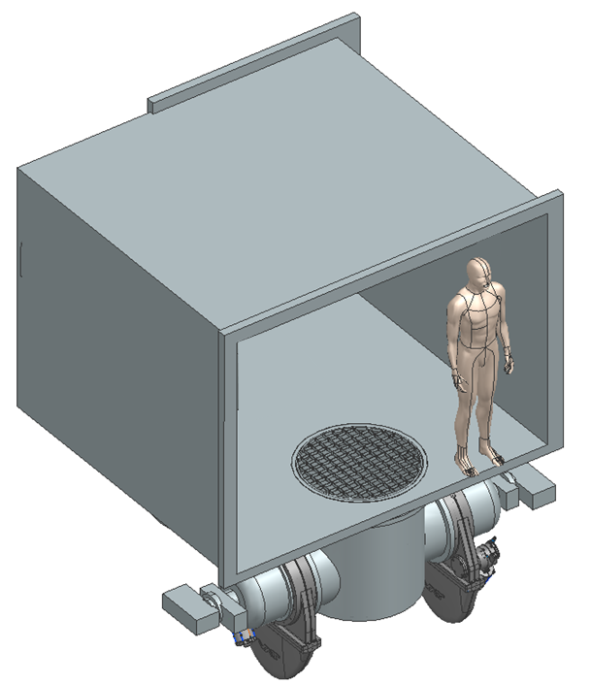
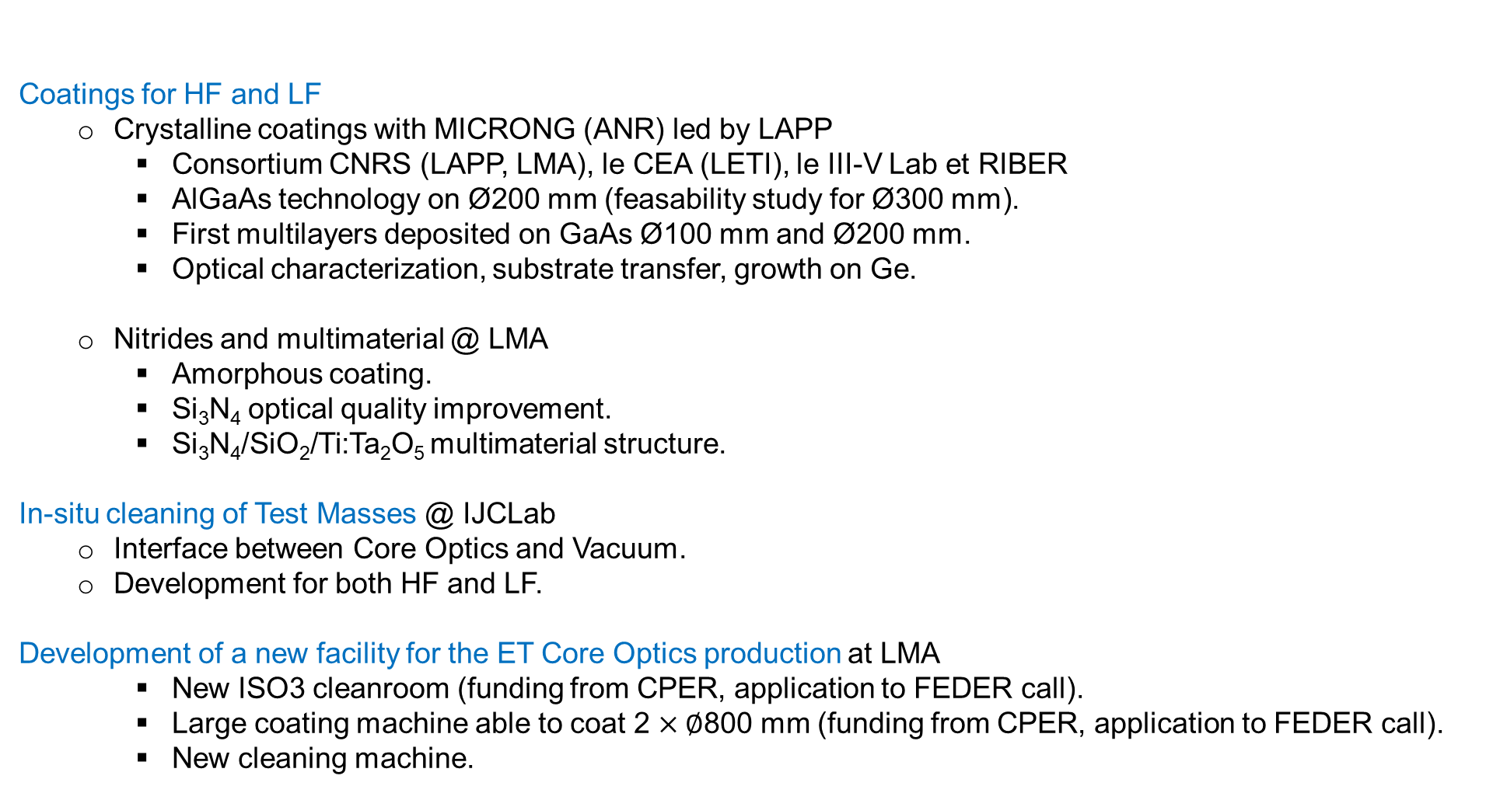
Activities in France: coatings
Coatings for HF and LF
  Crystalline coatings with MICRONG (ANR) led by LAPP
    Consortium CNRS (LAPP, LMA), le CEA (LETI), le III-V Lab et RIBER
    AlGaAs technology on Ø200 mm (feasability study for Ø300 mm).
    First multilayers deposited on GaAs Ø100 mm and Ø200 mm.
    Optical characterization, substrate transfer, growth on Ge.
  Nitrides and multimaterial @ LMA
    Amorphous coating.
    Si₃N₄ optical quality improvement.
    Si₃N₄/SiO₂/Ti:Ta₂O₅ multimaterial structure.
      In-situ cleaning of Test Masses @ IJCLab
        Interface between Core Optics and Vacuum.
        Development for both HF and LF.
      Development of a new facility for the ET Core Optics production at LMA
        New ISO3 cleanroom (funding from CPER, application to FEDER call).
        Large coating machine able to coat 2 $×∅$800 mm (funding from CPER, application to FEDER call).
        New cleaning machine.
Rendering of the new coating machine under design @ LMA.

Slide 9
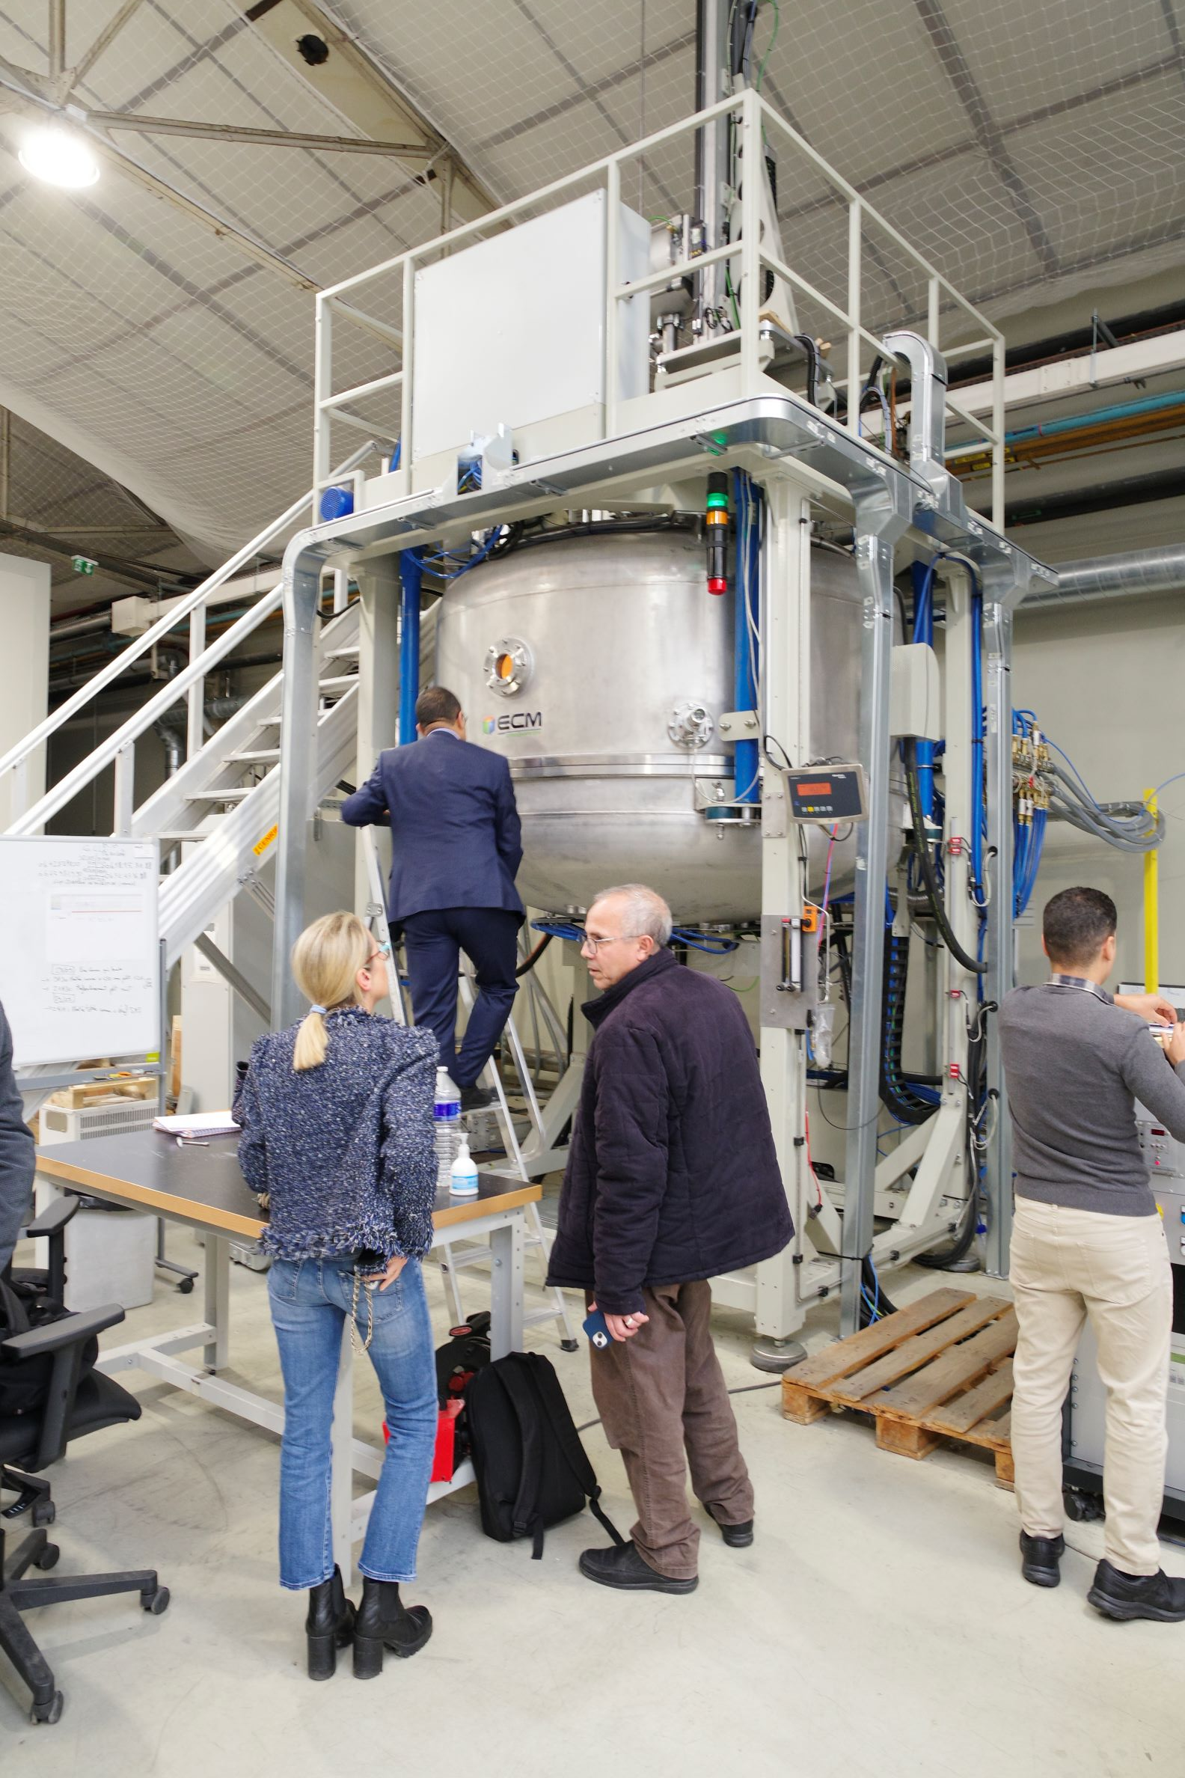
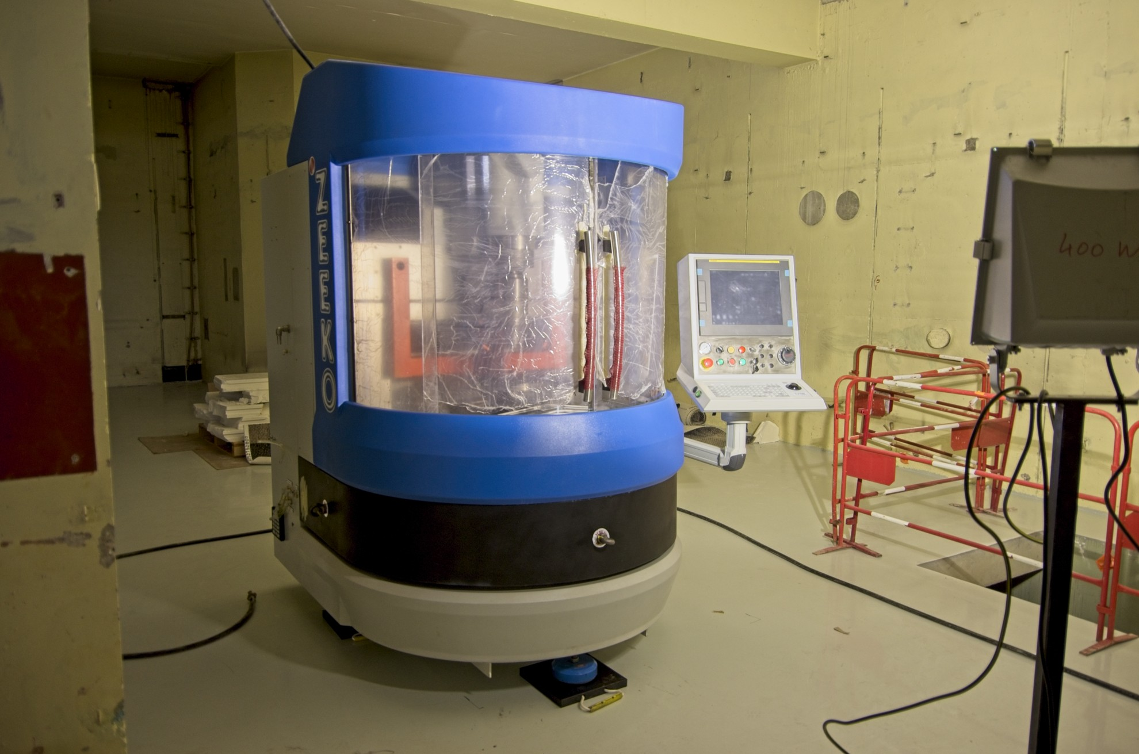
Activities in France: substrates for ET_LF
Sapphire substrate
Motivation and strategy detailed during the R&D Workshop in Marseille (link)
Progress :
Ingot of 150 kg, Ø 320 mm produced at ILM. Still cutting issues to overcome.
Optical absorption measurements to be done in the short term.
Assembly of an optical bench to measure the bulk birefringence over a large diameter.
Polishing machine delivered at LMA. Commissioning and process optimization should start shortly.
Growth furnace
Polishing robot

Slide 10

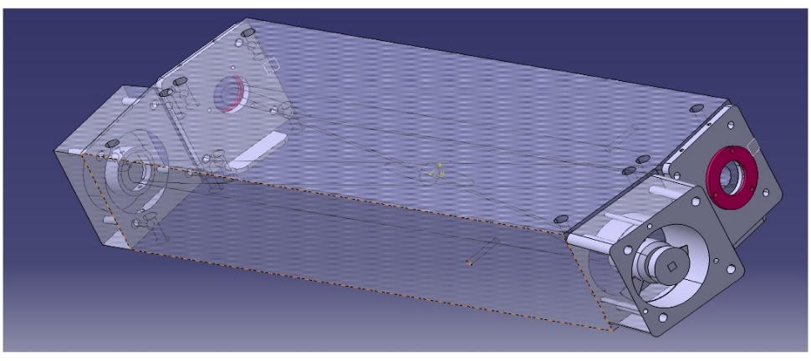
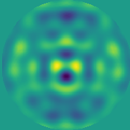
Activités en France: R&D pour les lasers
Lasers:
High Power fibre Laser R&D
(exploratory program)
High power laser stabilization
Member of ET Laser WP inside the ISB (as participants and coordinator)
Tapered fibers + pump free injection
Higher finesse pre-mode- cleaner cavity
ET Lasers Technical Design
Parametric Instability:
Development of an active damping device based on radiation pressure
Laser
AOM
AOM
Horizontal
Vertical
T. Harder et al. Optics Express Vol. 31, Issue 2, pp. 1486-1500 (2023)

Slide 11
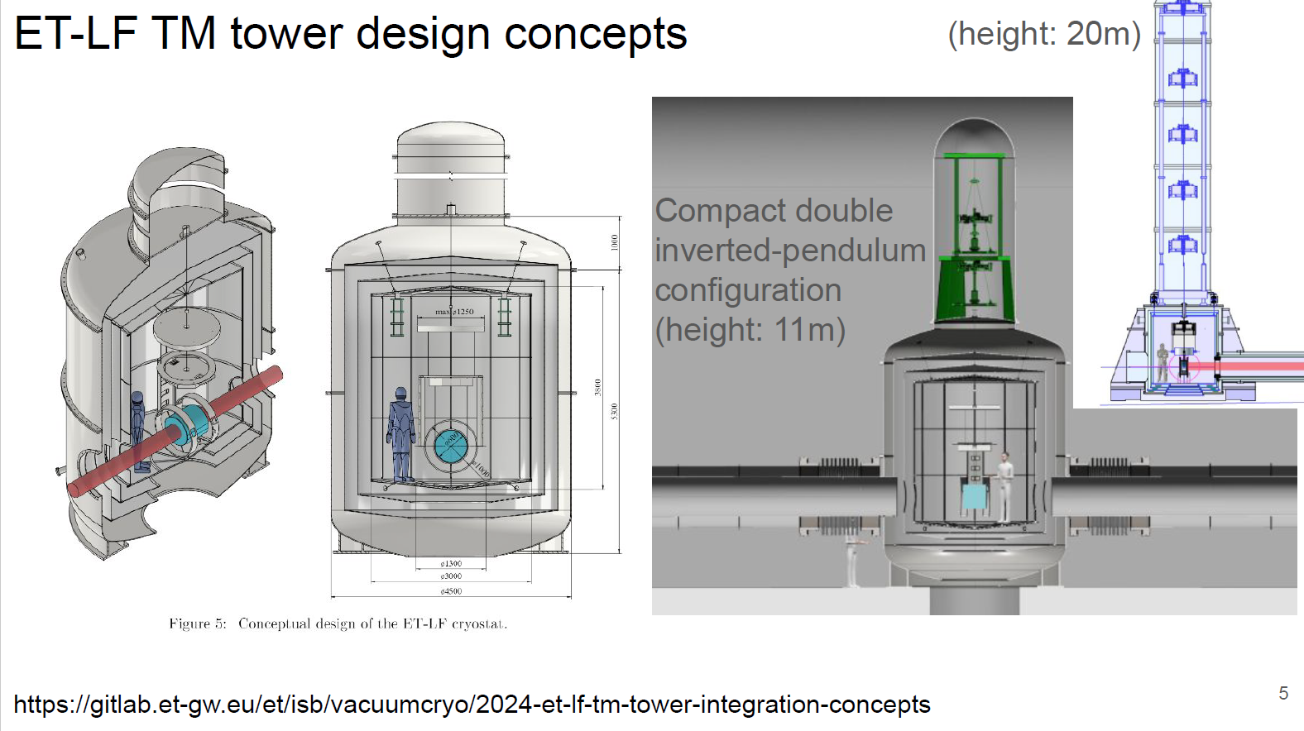
Other ISB activities: ET_LF tower and suspension design
See presentation by Grégory Laquaniello

Slide 12
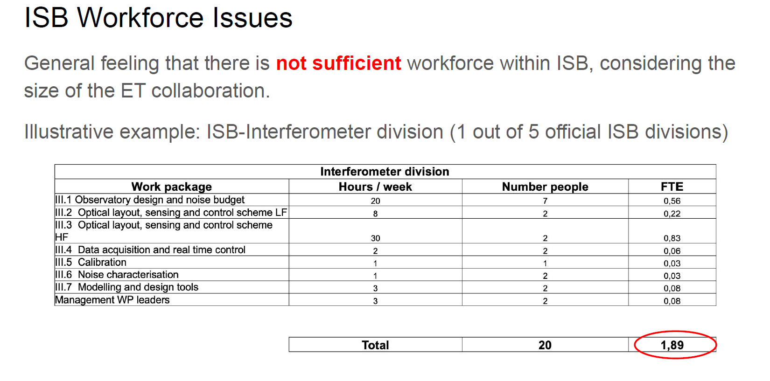
Workforce issues

Slide 13
Conclusions
ISB in charge of the design of the detector (TDR)
Activity started with the production of the PBS in parallel with the optical design
Not clear what will contain the preliminary TDR / when it has to be delivered
French ISB activities concentrated on Optics and Interferometer Divisions + Vacuum – R&Ds started
Exchanges with CE colleagues (XGCD meetings)

Slide 14
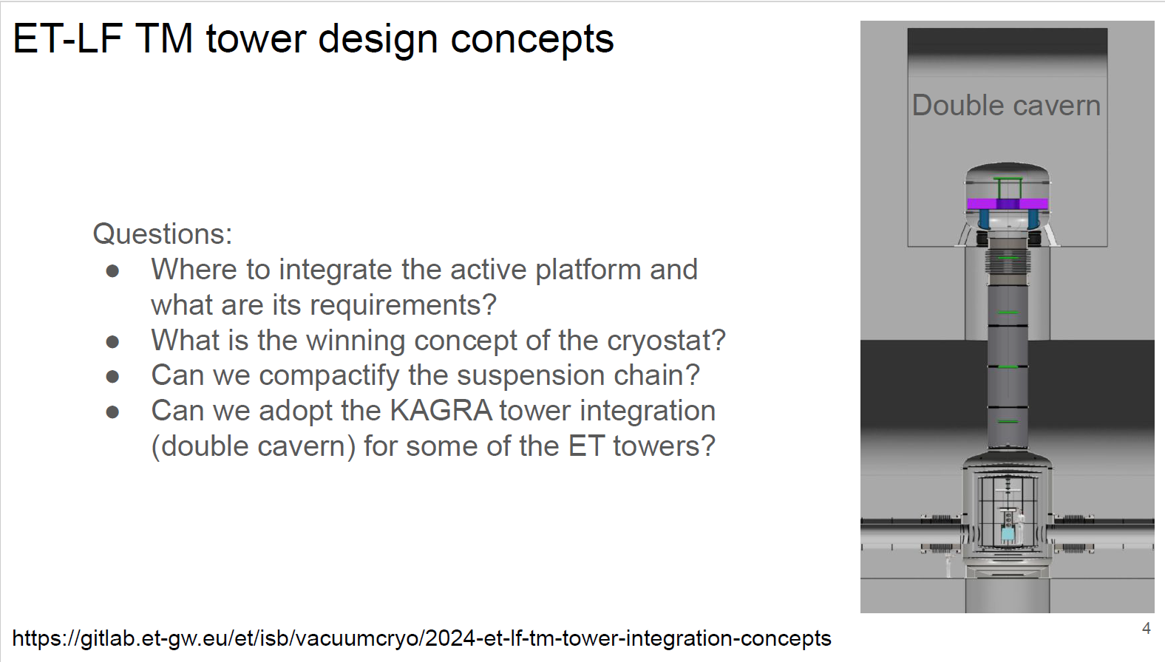
Other ISB activities: ET_LF tower and suspension design

