Slide 1
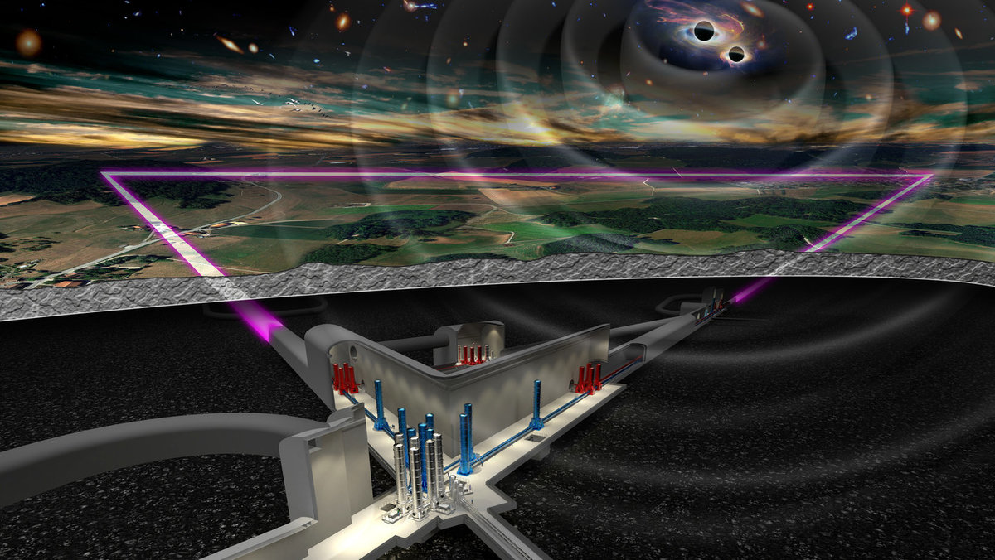
Risk Management
Ghada Mahmoud - ET Project Office
ghada.mahmoud@apc.in2p3.fr

Slide 2
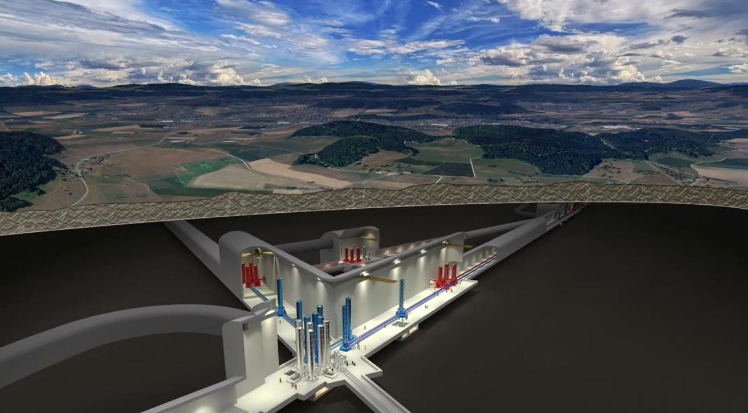
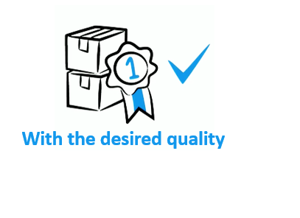
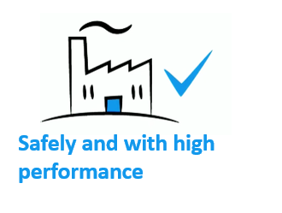
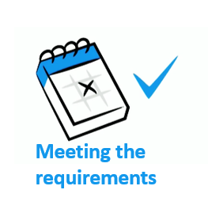
Why we do Risk Analysis

Slide 3
Why we do Risk Analysis

Slide 4
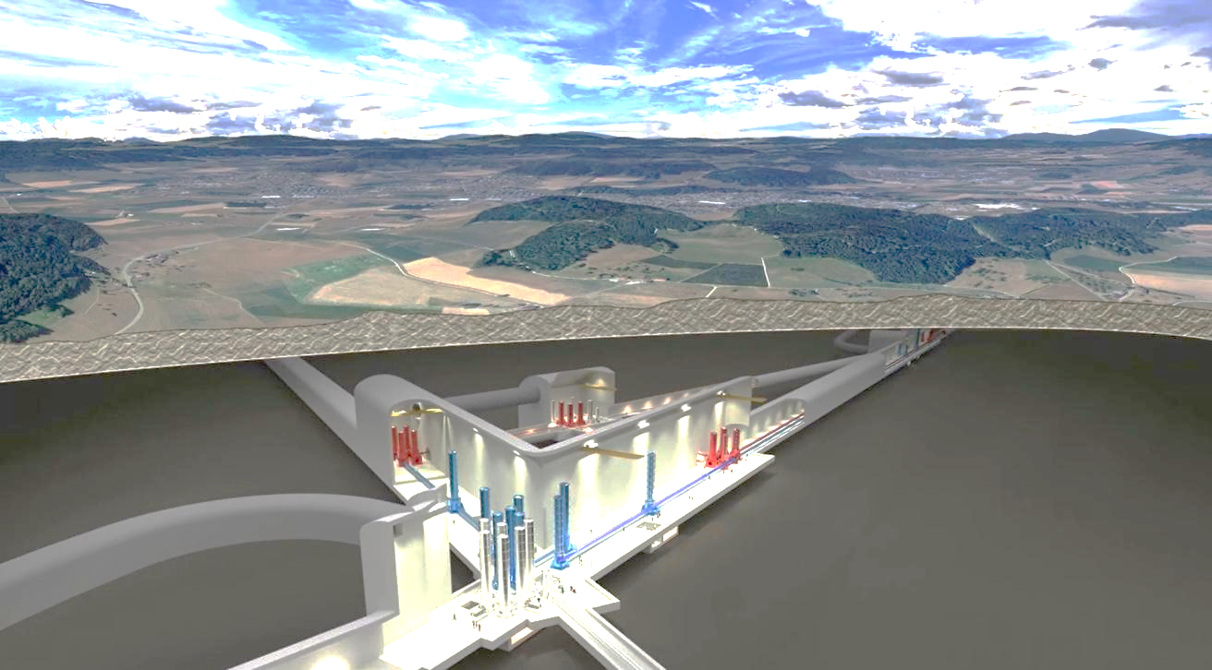
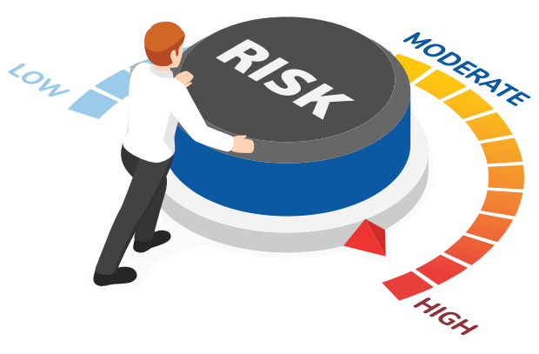
Why we do Risk Analysis
Risk arises from the potential occurrence of specific hazard during a project's lifecycle.
This Hazard can affect the project, leading to impacts on cost, schedule, technical performance, safety, and other critical areas….
Risks are defined by their Criticality = Likelihood * Severity
- Likelihood Represents the chance this particular hazard will occur
- Severity quantify the impact of this hazard occurrence on a project ….

Slide 5
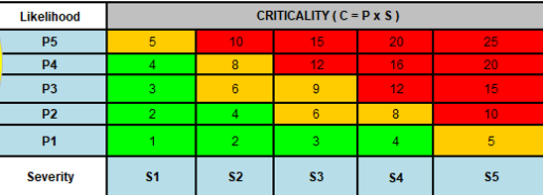
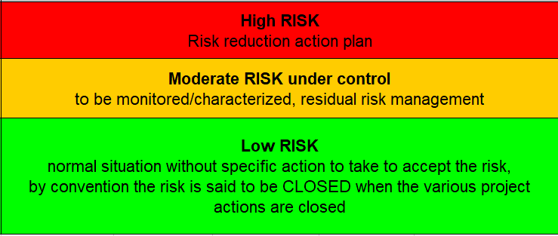
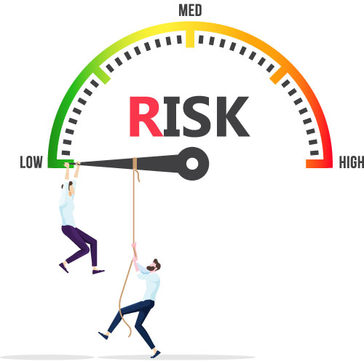
Why we do Risk Analysis
Risk Planning
Risk Planning
Risk Identification
Risk Assessment
Plan Risk Responses: Accept/ Close / Avoid / Transfer / Mitigate
Monitor and control
Implement Risk Responses
Monitor and control
Risk Identification
Implement Risk Responses
Risk Assessment
Plan Risk Responses: Accept/ Close / Transfer / Mitigate

Slide 6
Why we do Risk Analysis

Slide 7
ET Risk Domains
Risk Domain
Technical
Financial
Schedule
Environmental
Political
Communication
Super-attenuator Operational Failures
Sudden increase in some materials prices affecting the cost
Some design Approval Delays
High energy use by the cryogenic systems raising concerns about carbon footprint
Organizational
Safety
Scope
A change in government leading to shifts in science funding priorities.

Slide 8
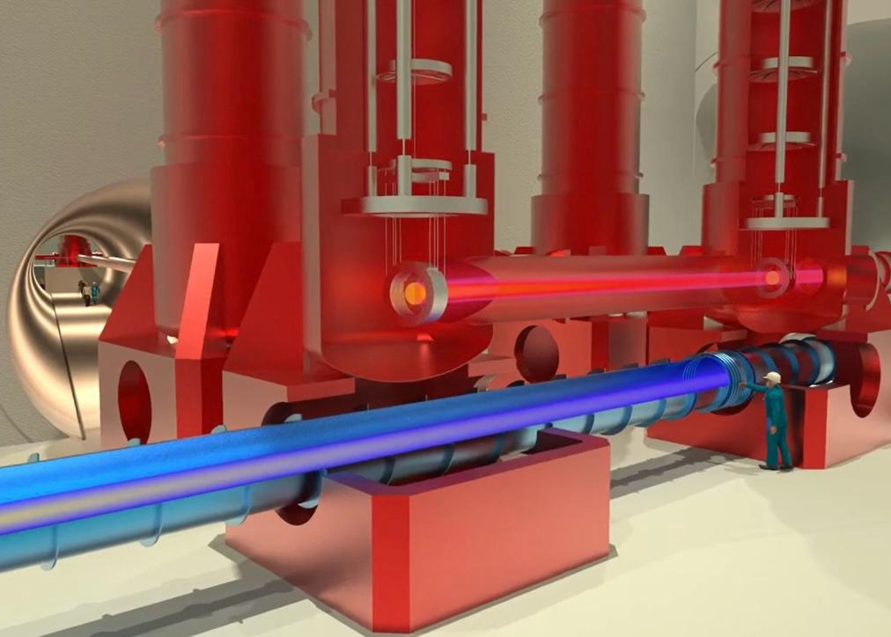
1st Risk Campaign
Vacuum & Cryogenics Group :
vacuum system to maintain an ultra-low pressure environment within the interferometer arms.
Cryogenic systems to keep the mirrors and suspensions cooled to these low temperatures, reducing thermal noise…
Suspension Group :
Designs and builds the suspension systems that hold the massive mirrors in place, isolating them from ground vibrations and seismic activity ….
Interferometer Group :
designs the layout of the interferometer arms and ensures that the detector meets the required sensitivity​.
integrate mirrors, lenses, beam splitters, and other optical elements …
Civil Engineering Department :
ensures that all facilities (tunnels, caverns, access points, and Technical infrastructure (electrical , cooling …) are stable, secure, and operational for the other systems.
ANM Group :
identifies and characterizes all sources of noise ..
Performance Optimization: Works closely with other groups to suggest improvements in the layout and design regarding the improvement of the sensitivity …
Optics Group :
Design and manage the core optics,
Develops technologies to reduce quantum noise (e.g., squeezed light techniques)
Scattered Light Control….

Slide 9
1st Risk Campaign
We are currently conducting an ongoing Risk Campaign with each of the Groups/Divisions within the Einstein Telescope Group to:
Identify, assess, and respond to the risks associated with each Group.
Analyze interface risks between Groups/Subsystems.
Address all project risks at this stage.
We are initially using Excel sheets to collect data.
By the end of the First Risk Campaign:
This data will be transferred into a Requirement/Risk Management Tool, along with the Requirements and the PBS (Product Breakdown Structure)…
The tool will be accessible in read-only mode at first, allowing easier interaction between subsystems, between subsystems and the ETO, and among the various stakeholders of the project later on.
The results of this First Risk Campaign will be compiled into a Final Risk Management Document.

