Slide 1
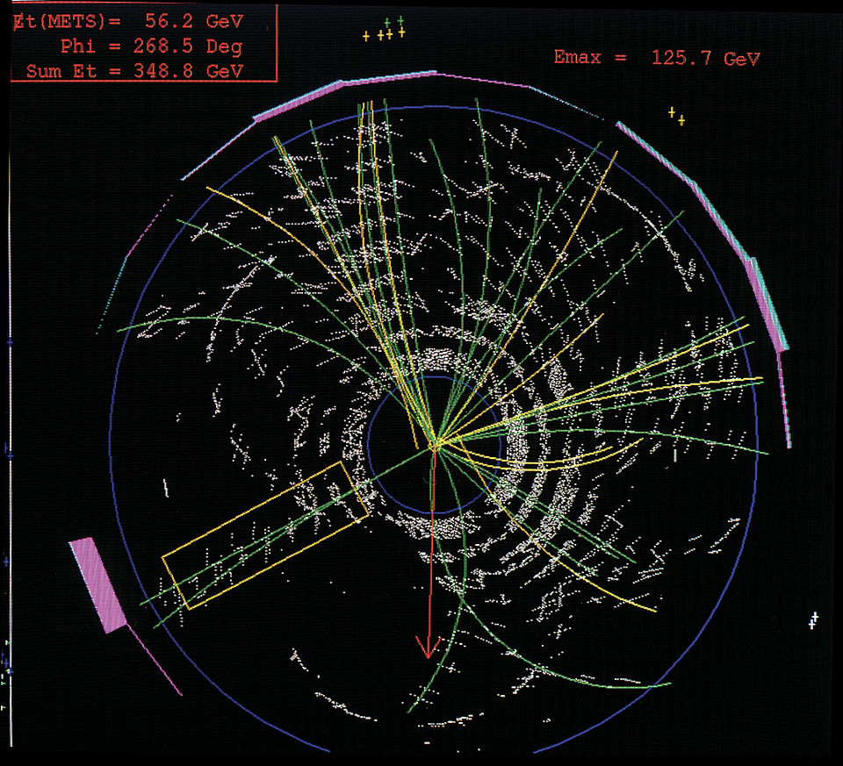
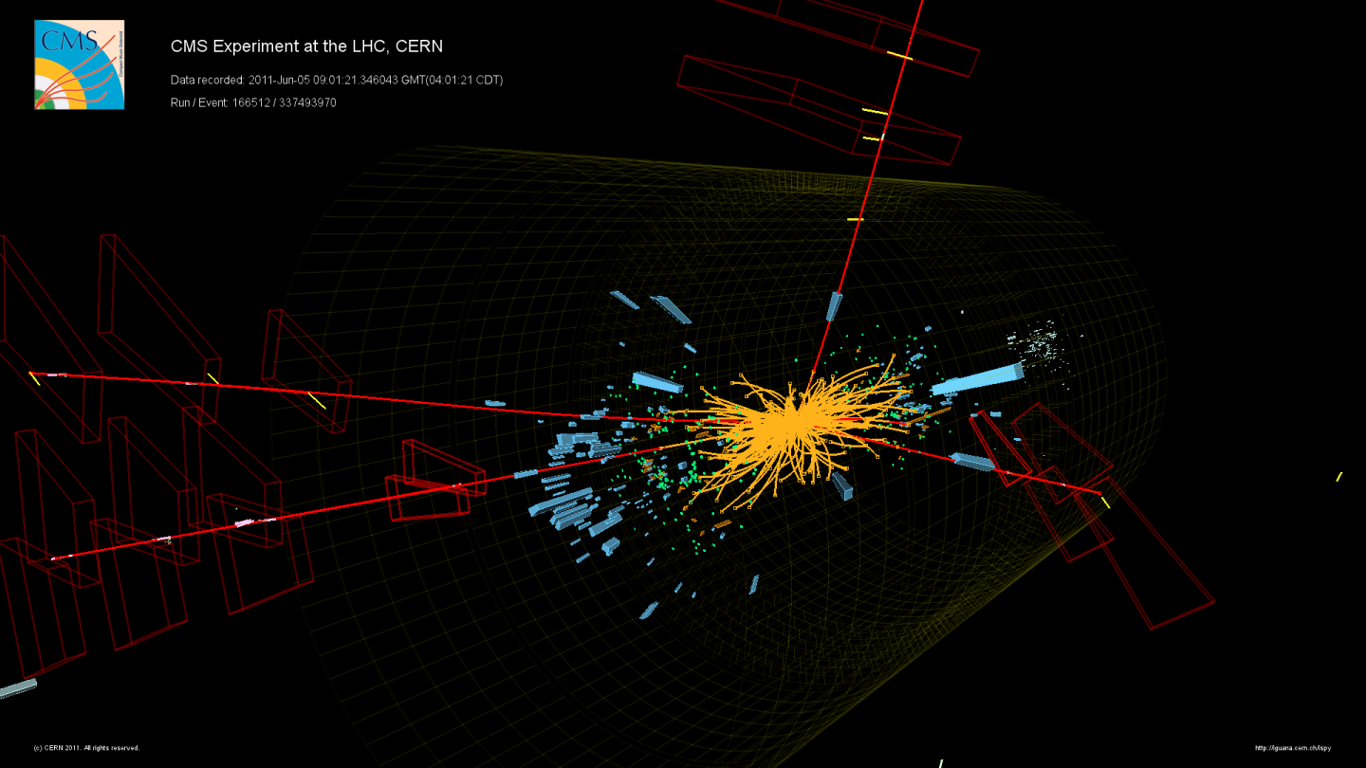
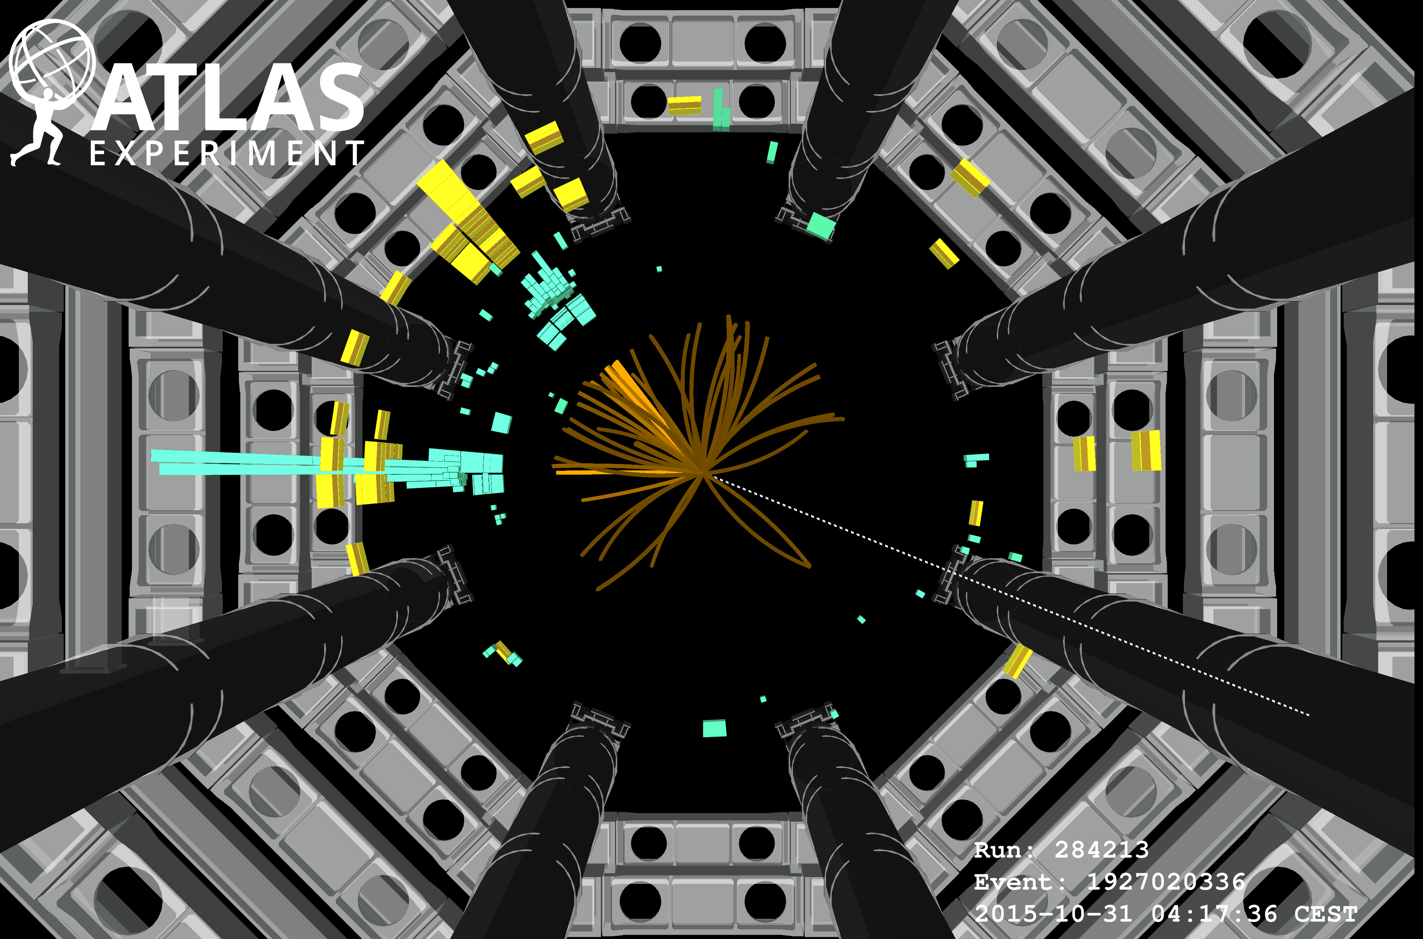
Enabling Discovery:
Advancing Instrumentation and Physics Analysis in Particle Physics
Daniela Bortoletto
07 July 2024

Slide 2
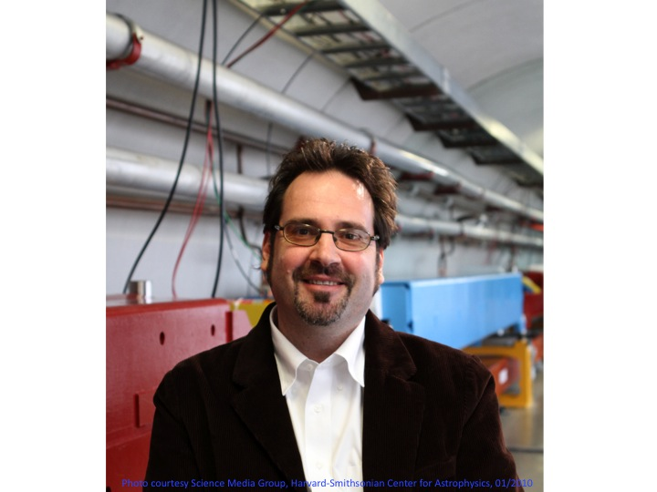
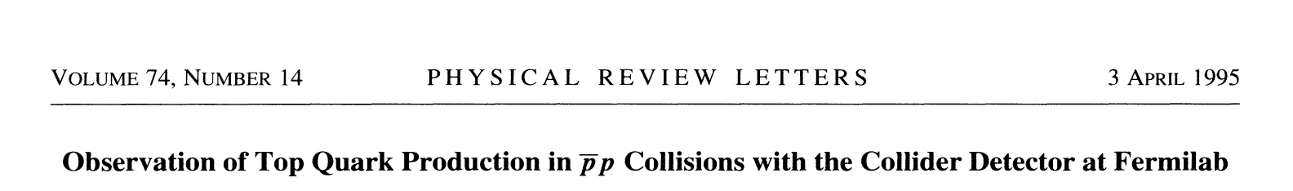
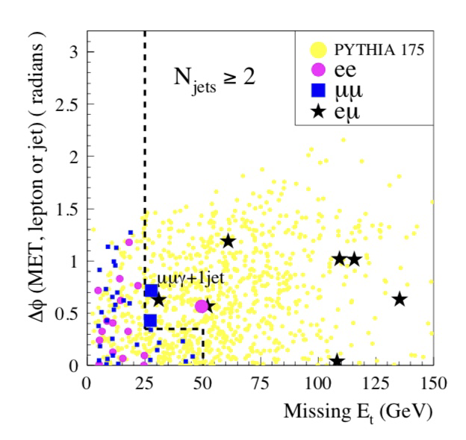
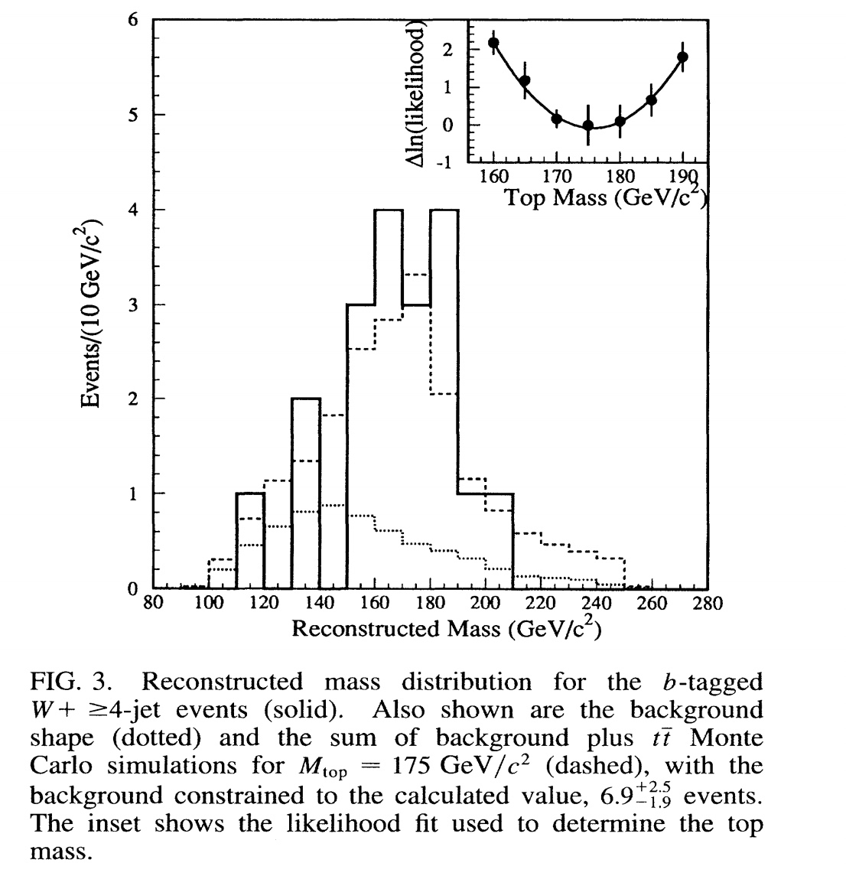
Top discovery
Mark Kruse

Slide 3
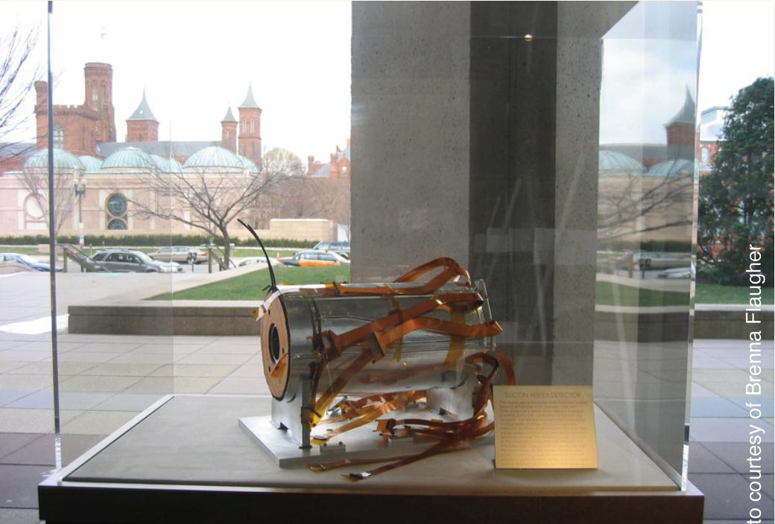
Top discovery
Enabling power of silicon detectors: SVX and SVX ‘
Aldo Menzione
Karl Haber
Nicola Bacchetta
Luciano Ristori
Mark Shaw
Joe Incandela
and many others

Slide 4
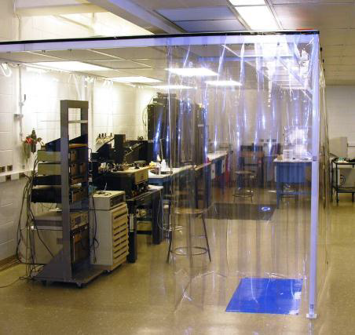
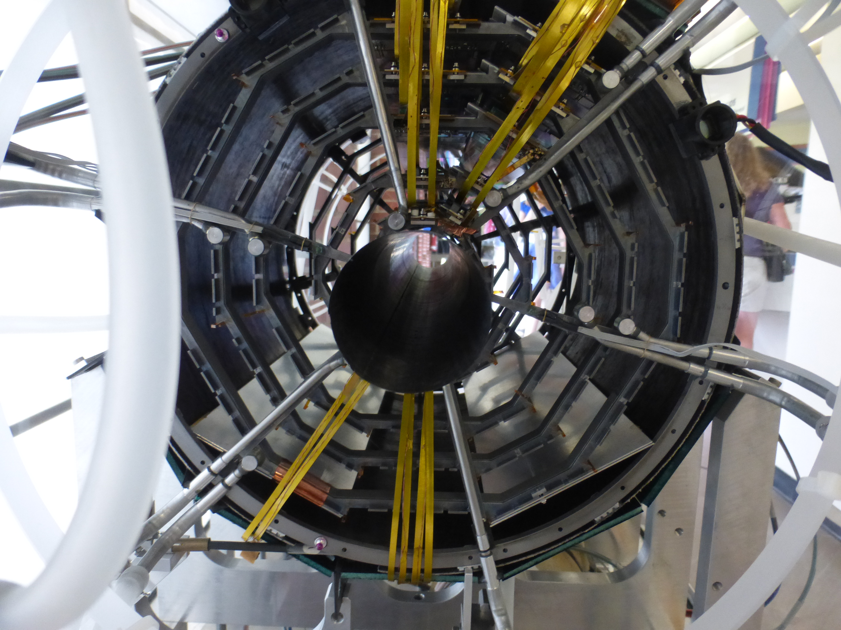
CDF SVX II detector
P3MD lab at Purdue University: used to build SVX II and the CMS FPIX
▪

Slide 5
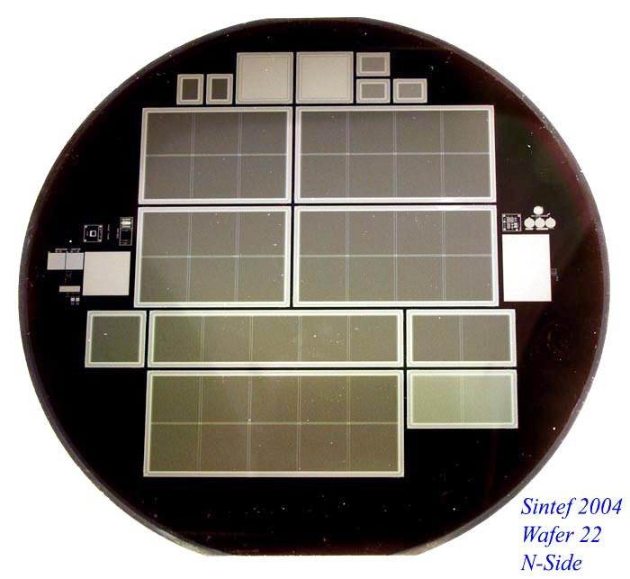
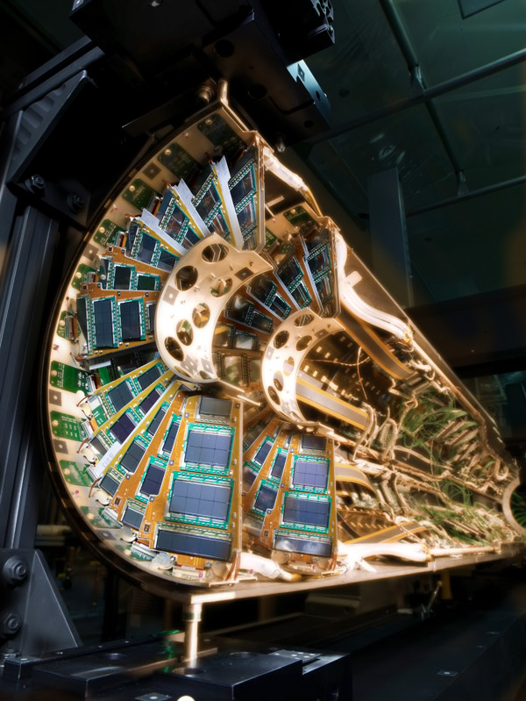
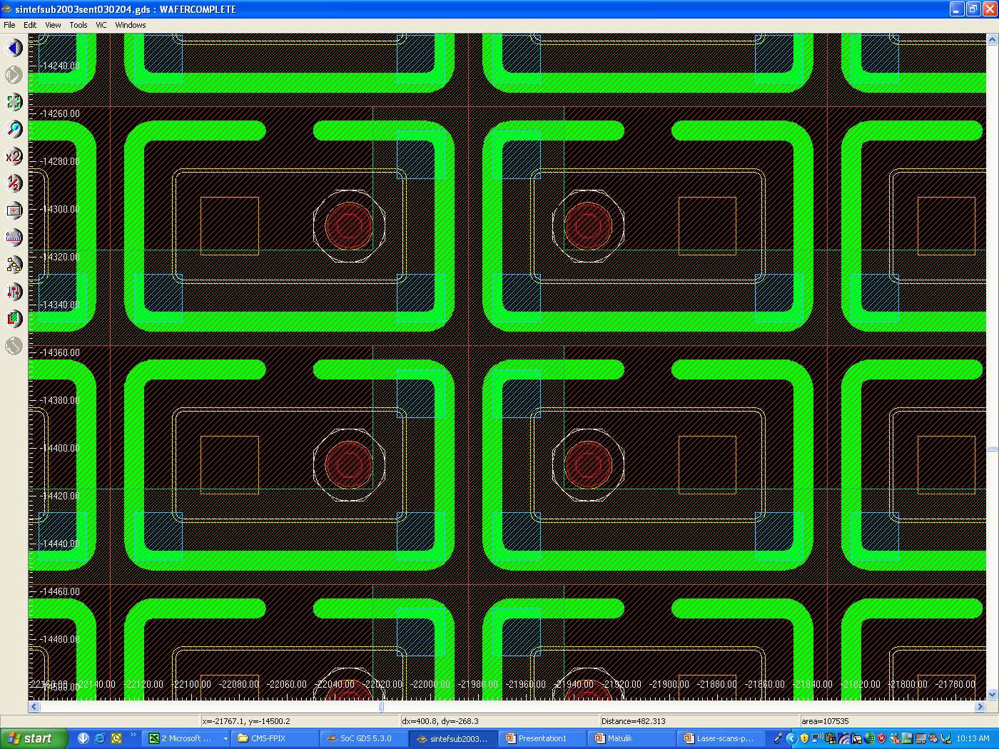
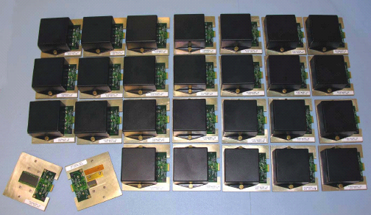
CMS FPIX
Sensor Development
Matching the LHC requirements
Radiation hardness
  Up to 100 Mrad
  Up to 6×10¹⁴ cm⁻²
Production of the plaquette
First pixel detector operating at a hadron collider

Slide 6
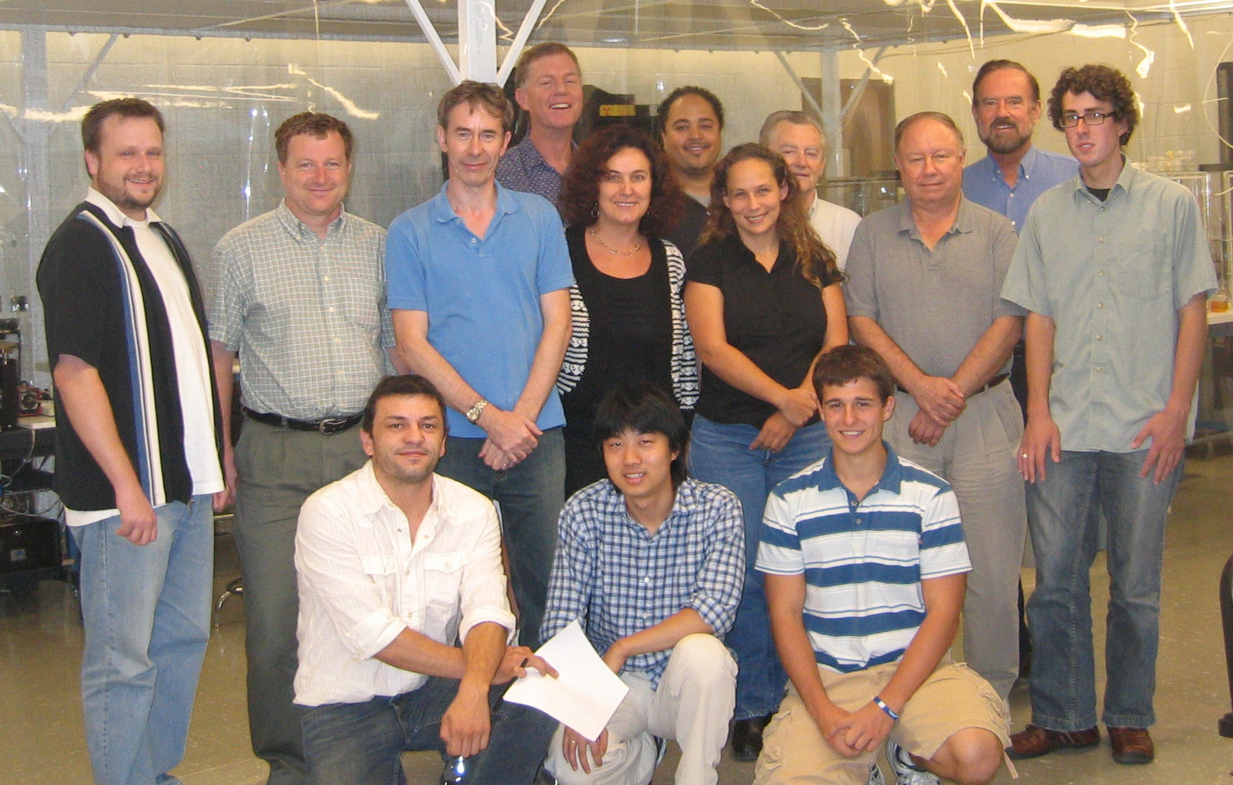
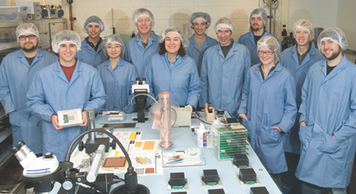
P3MD: the people
Kirk Arndt
Gino Bolla
Petra Merkel
Ian Shipsey
Anadi Canepa
Artur Apresyan

Slide 7
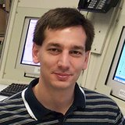
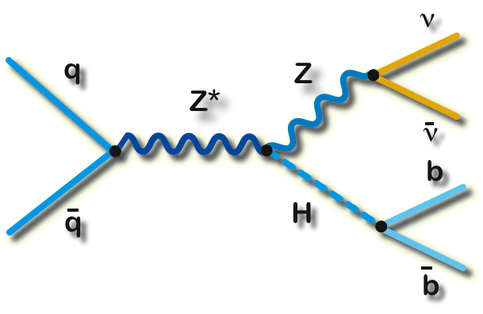
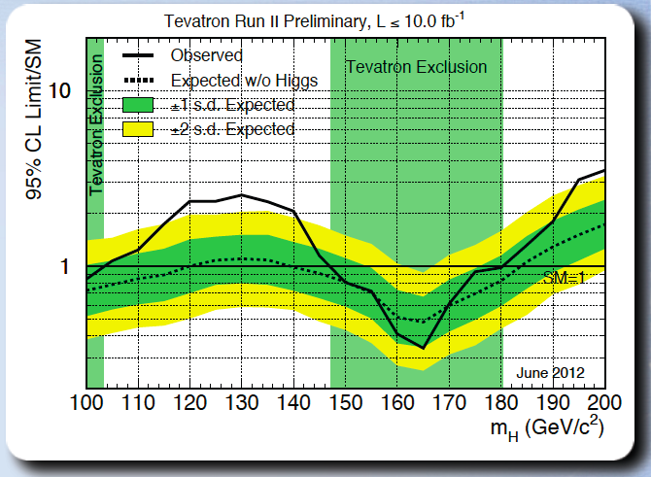
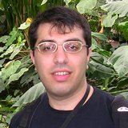
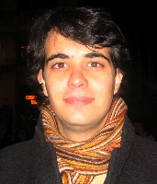
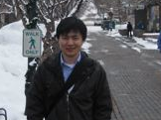

Searching for the HIGGS@ CDF
V. Veszpremi Ph. D. 2007
ZH→ννbb
A. Apresyan, Ph. D. 2009
Leading the ZH$→$bb$ν\overline{ν} −$considered very challenging at the time.
Introduced many improvements including Machine Learning to improve b-tagging and signal over background
K. Potamianos, Ph. D 2011
Q. Li, Ph. D 2012

Slide 8
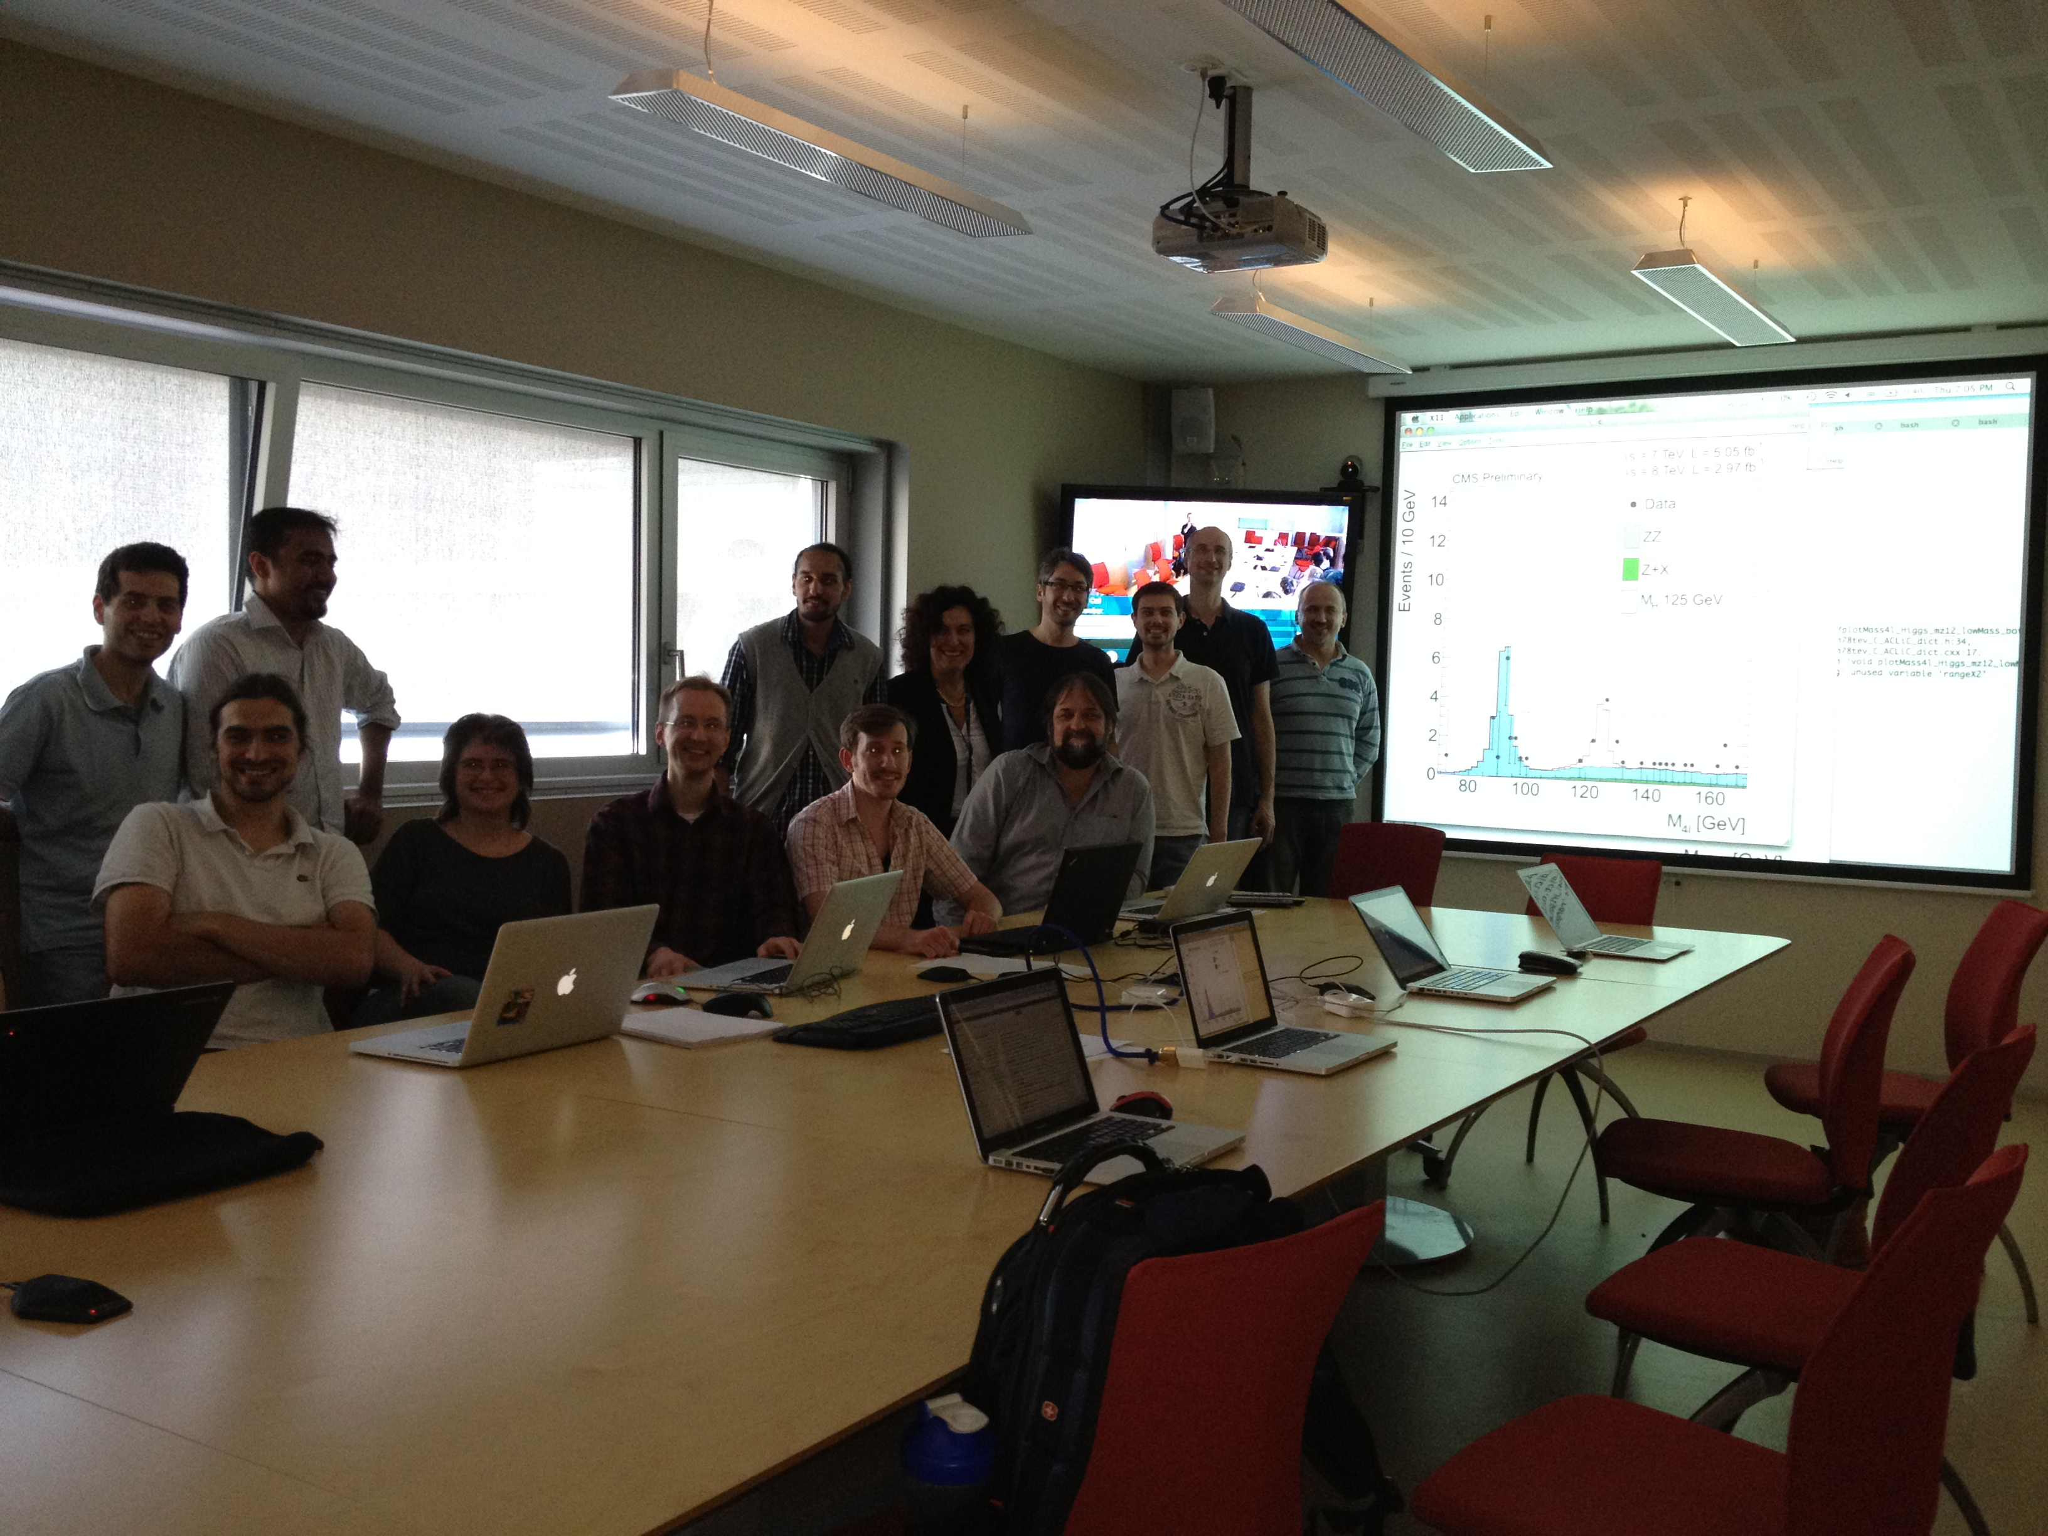
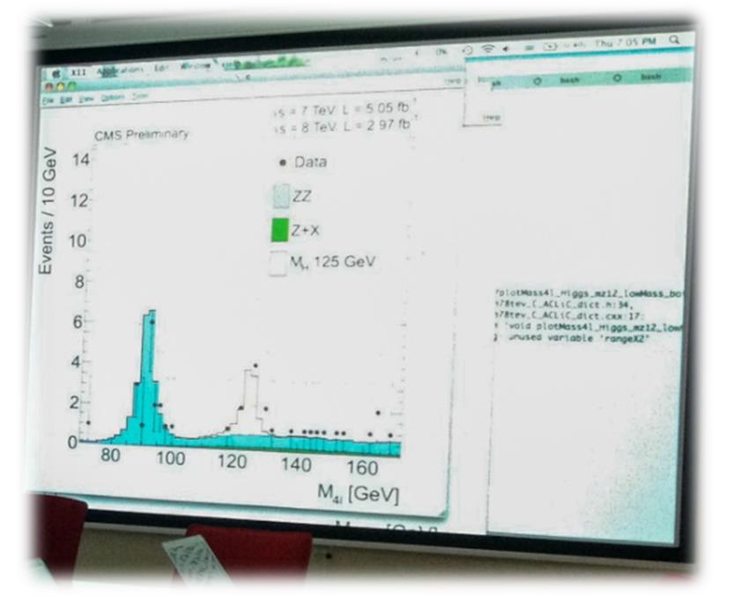
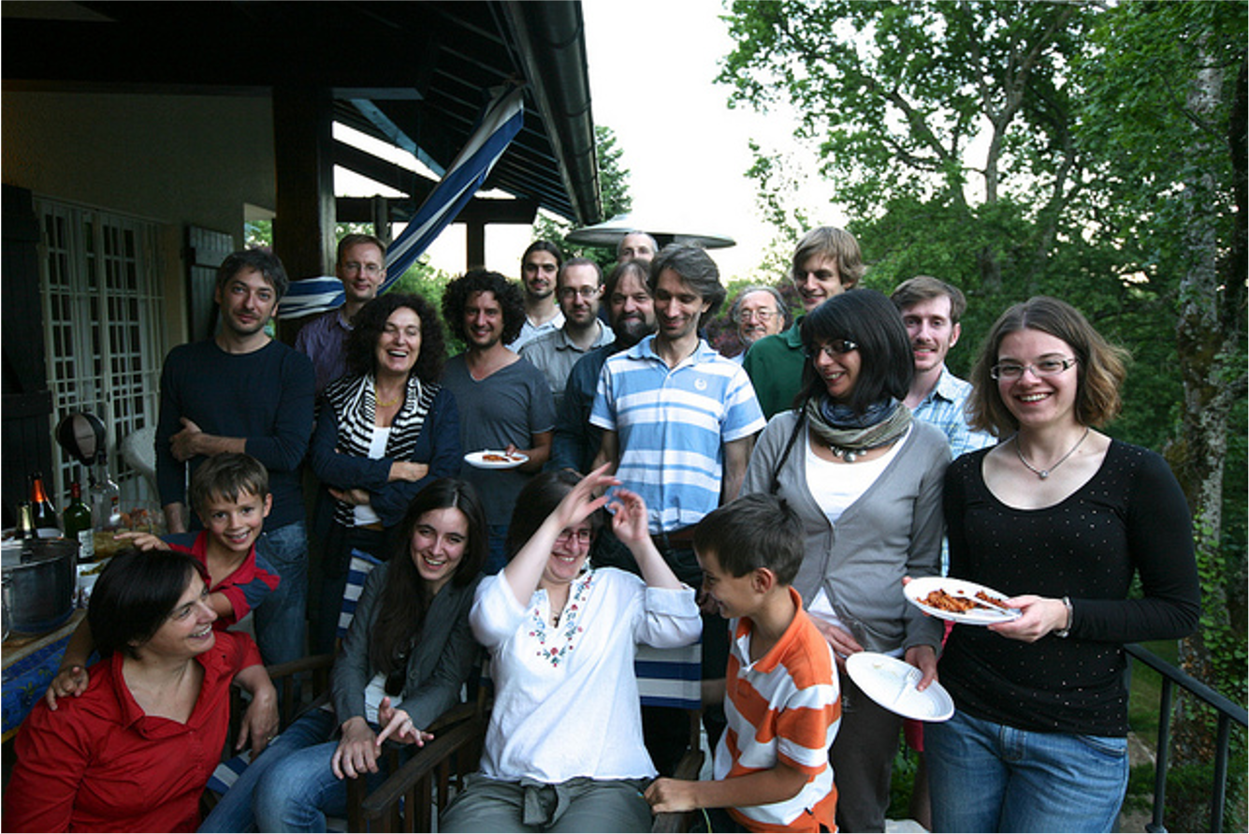
Higgs @ CMS
Daniele Benedetti
Petra Merkel
Three recipients of the Emmy Noether distinction!!!

Slide 9
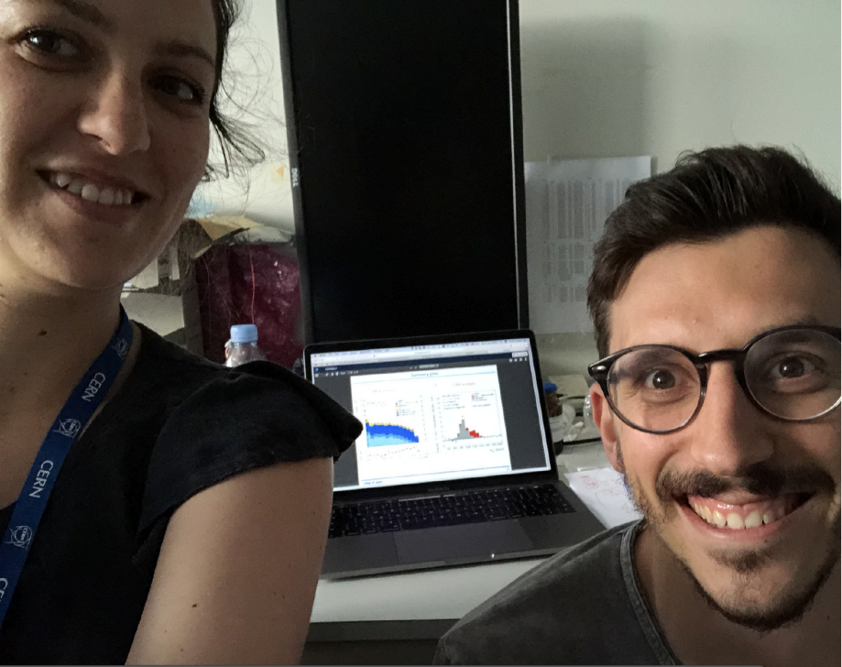



H $→$bb @ ATLAS
More contributions to Higgs physics:
H$→bb$ and H$→cc$ Maria Mironova, Windishhofer, Draguet, Elisabeth Schopf, Weitao Wang
H$→$µµ with Chunhao Tian, Eleonora Rossi
H$H→bbττ$ with Haslbeck, Moser
Cecilia Tosciri and Luca Ambroz (with Elisabeth Schopf) unblinded the H$→bb analysis$ in 2018

Slide 10
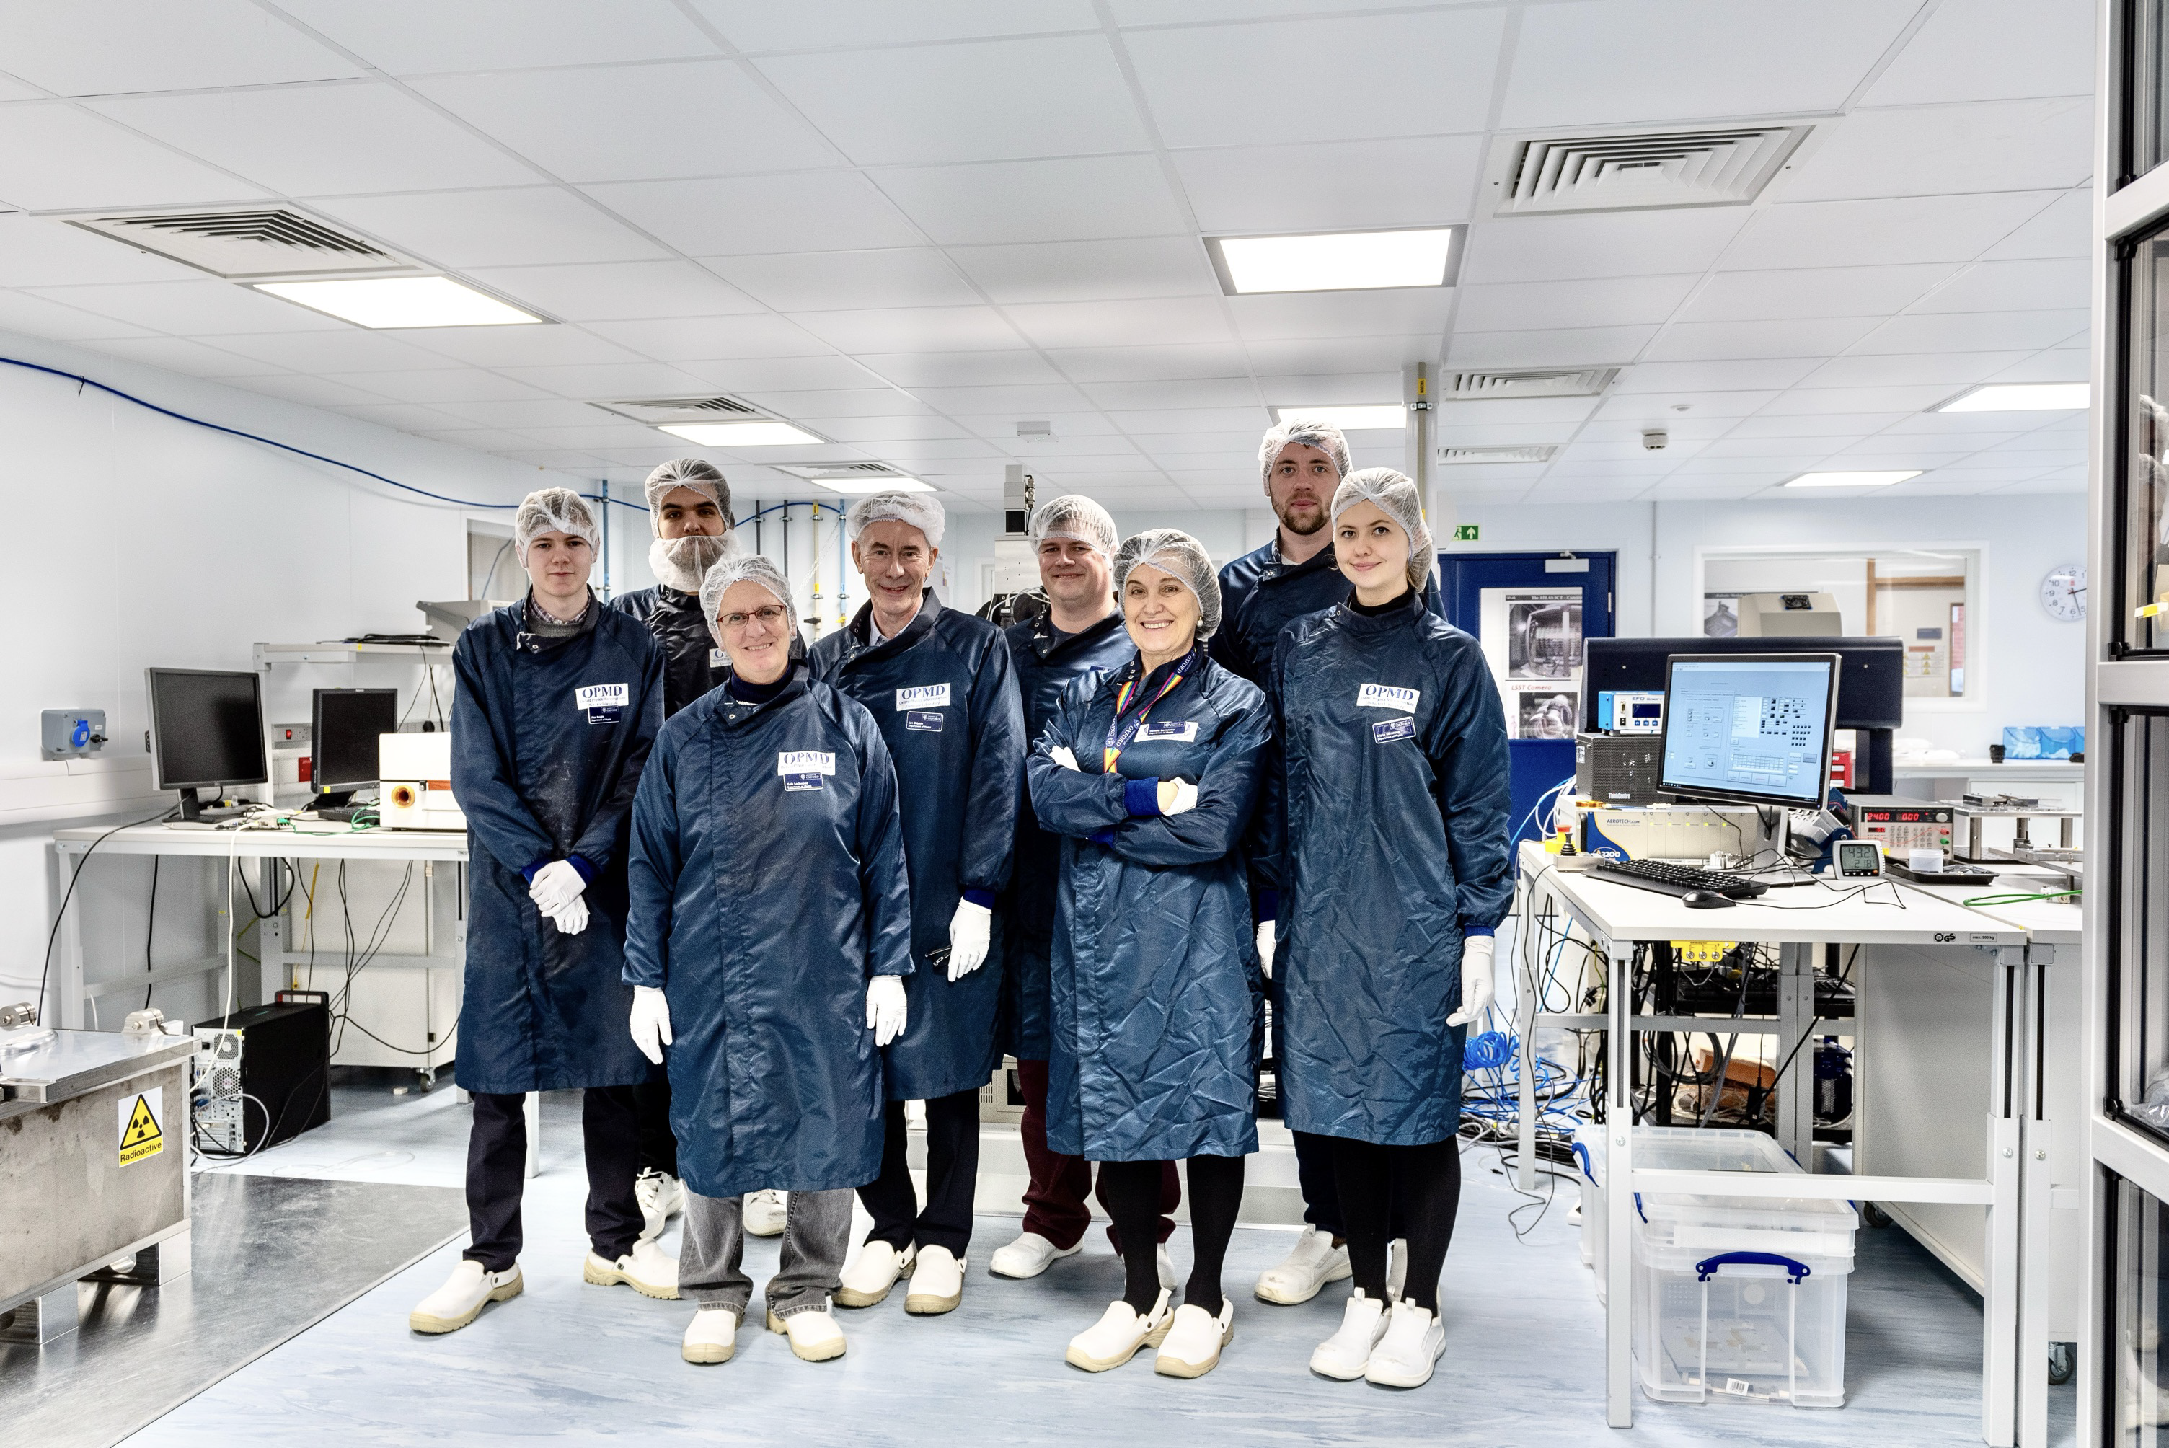
OPMD
Richard Plackett
Daniel Hynds
Umberto Molinatti
Maria Mironova
Abhi Sharma
Simon Koch
Alex Knight
Ashely McDougal
Jon Spiers
Adam Lowe
Morgan Larner-Smith
Maryam Akhtar
Jonathan Spiers

Slide 11
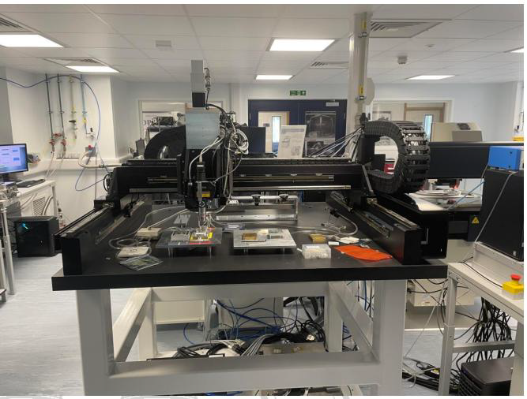
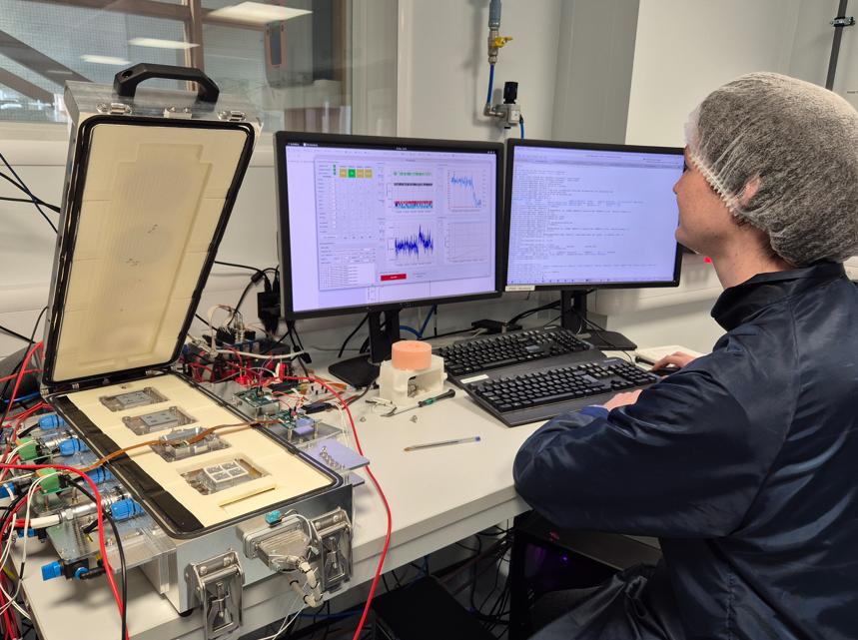
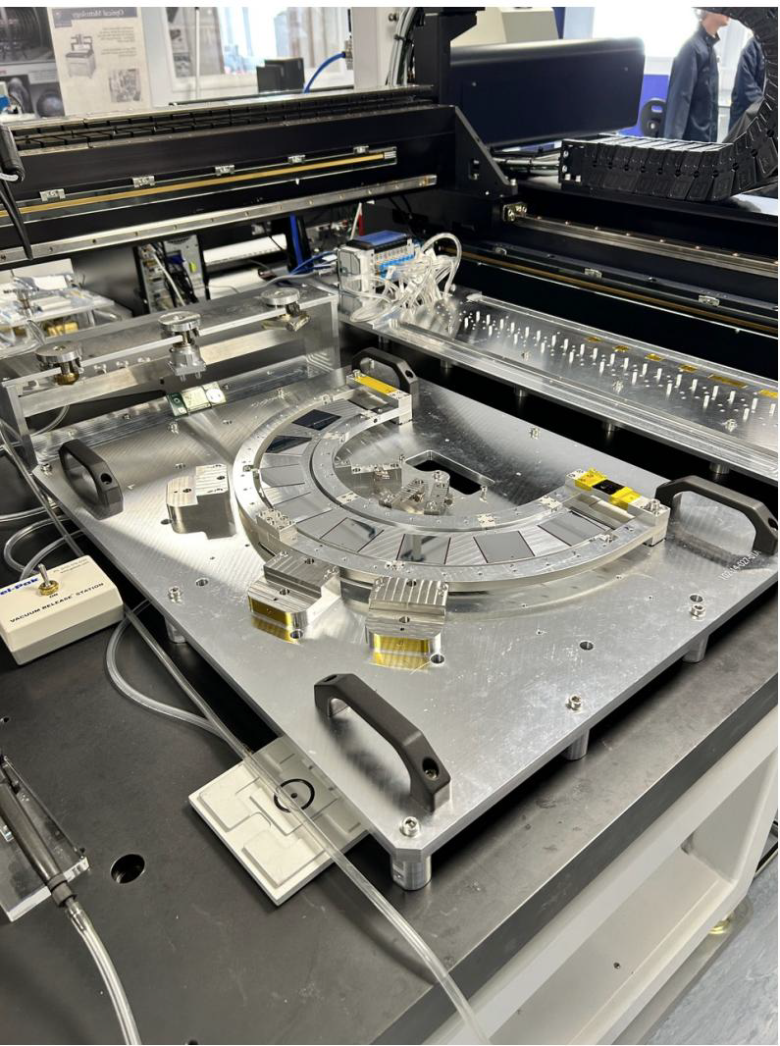
ATLAS ITK Pixel
ITk Modules
ITk Rings
Largest Pixel Detector ever built

Slide 12
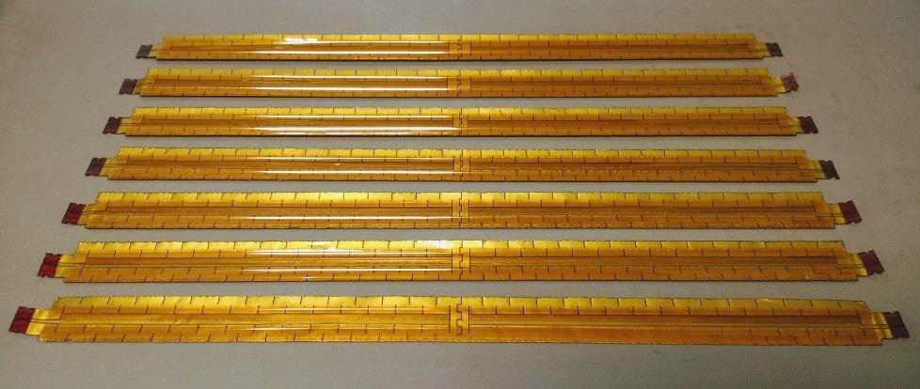
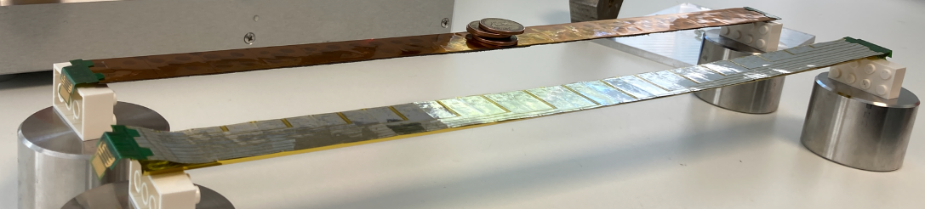
Mu3e
Mupix11 chips based on HV-CMOS technology (KIT- Heidelberg)
Thinned to 50 μm (Vertex) and 70 μm (Tracker)
80 Ωcm resistivity (380 Ωcm for first prototype modules)
Kapton-Aluminum flexes produced by LTU (Kharkiv)
  Chips glued on Al/Kapton flex supported by a Kapton tape with a v-fold (vertex) or by 25 µm Carbon-fibre support structure (tracker) to achieve 0.1% X₀/layer
Oxford
One of the lightest pixel detector

Slide 13
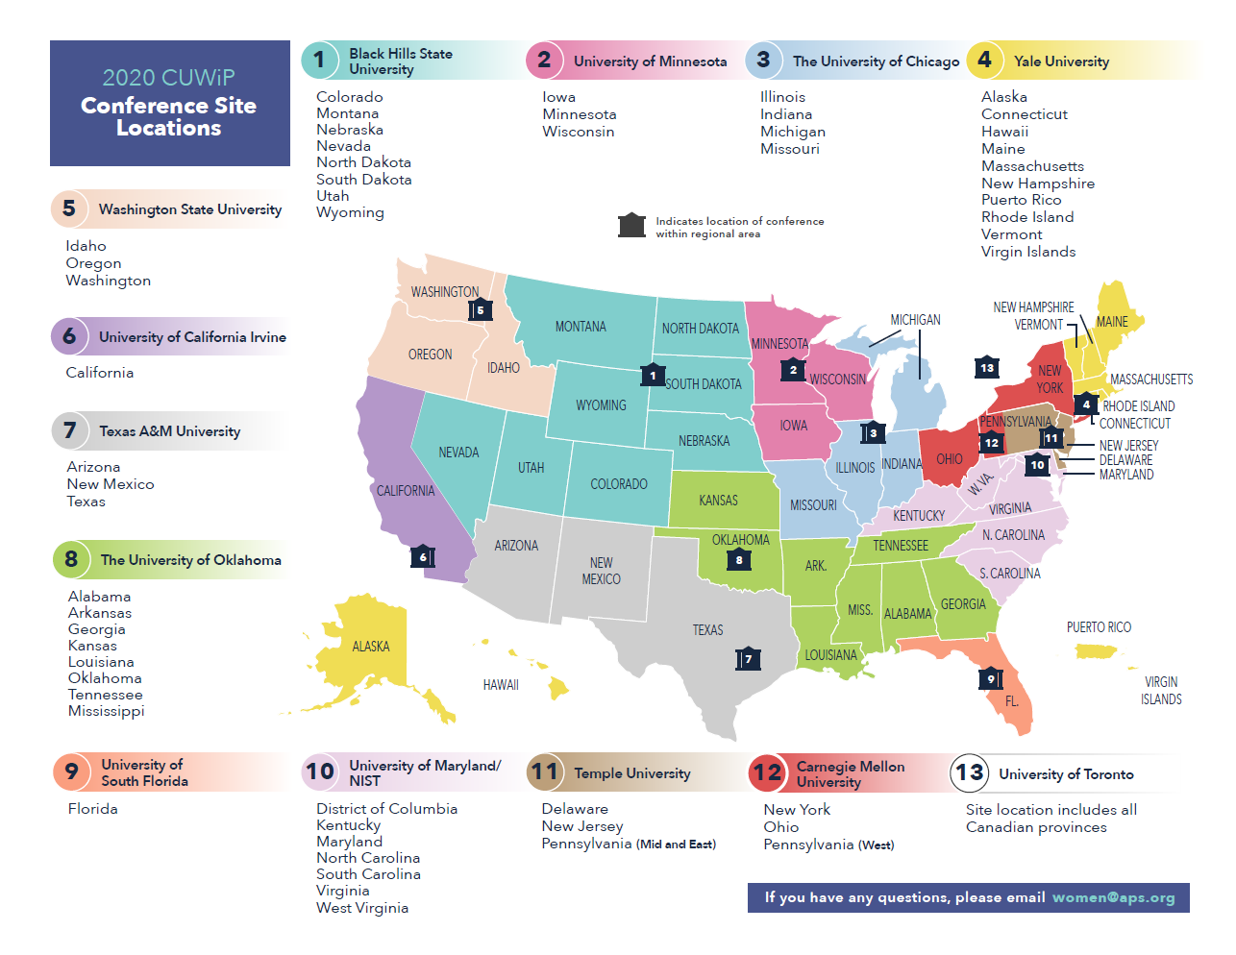
APS CUWIP 2020

Slide 14
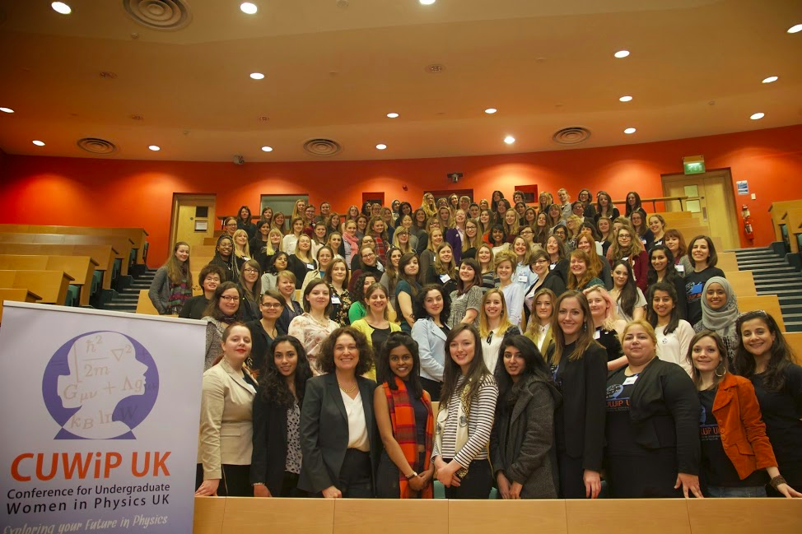

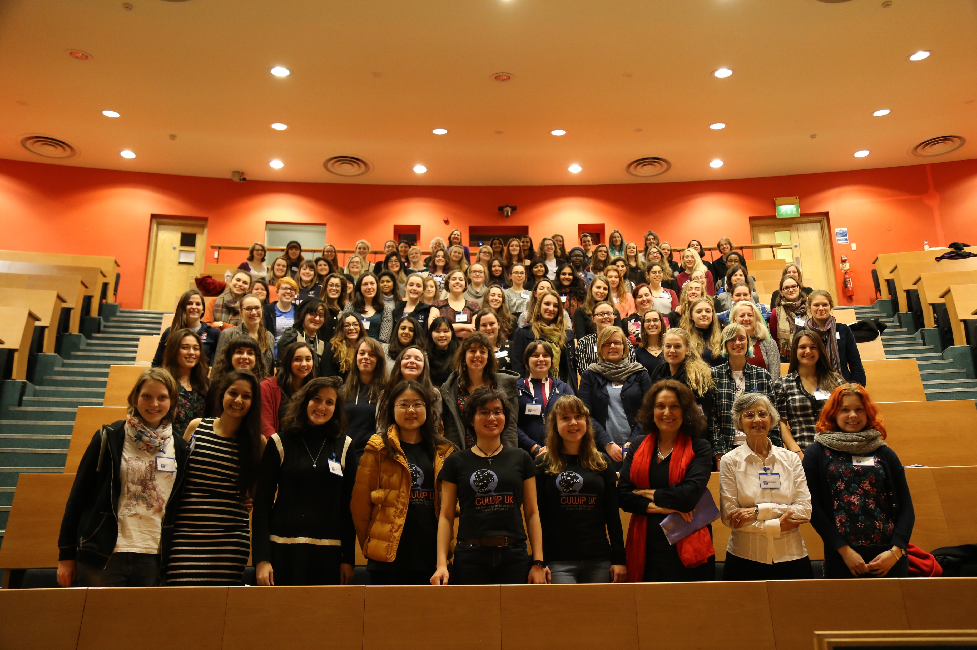
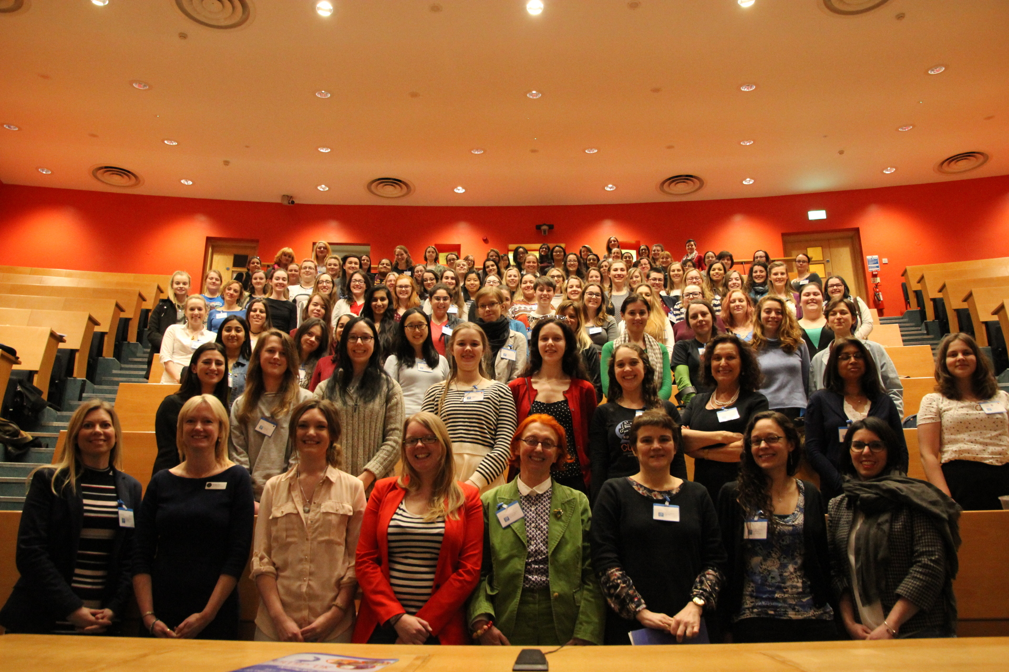
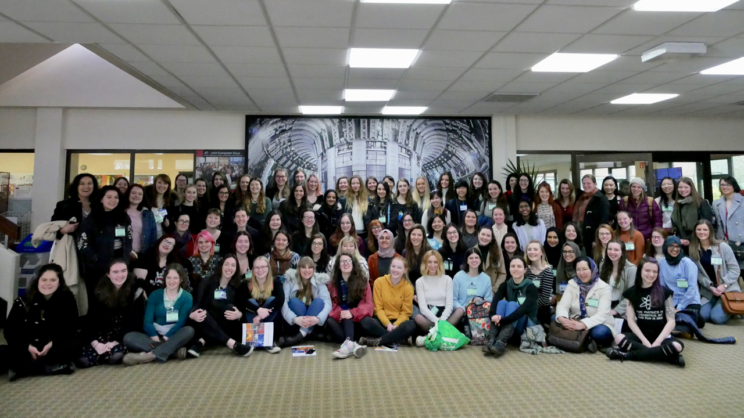
CUWiP UK
2016
2015
2017
2018
Daniela Bortoletto CUWiP UK 2025
14

