Slide 1
AWAKE: Towards high-energy electrons for particle physics experiments
EPS-HEP 2025
10/07/2025
Michele Bergamaschi for the AWAKE collaboration

Slide 2
Contents
Introduction to AWAKE
  Plasma Wakefield Acceleration
  AWAKE program
Recent Results from Run 2
  Development of discharge plasma source
  Development of Self-Modulator vapor plasma source
  Physics studies during Run 2b
Ongoing preparation for Run 2c
Summary

Slide 3
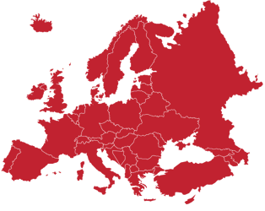
AWAKE Collaboration: 19 Institutes World-Wide
CERN, Geneva, Switzerland
University of Manchester, Manchester, UK
Cockcroft Institute, Daresbury, UK
Lancaster University, Lancaster, UK
Oxford University, UK
Max Planck Institute for Physics, Garching/Munich, Germany
Max Planck Institute for Plasma Physics, Greifswald, Germany
UCL, London, UK
UNIST, Ulsan, Republic of Korea
Philipps-Universität Marburg, Marburg, Germany
Heinrich-Heine-Universität of Düsseldorf, Düsseldorf, Germany
University of Liverpool, Liverpool, UK
ISCTE – Instituto Universitéario de Lisboa, Lisbon, Portugal
GoLP/Institutode Plasmas e Fusao Nuclear, Instituto Superior
Téchnico, Universidade de Lisboa, Lisbon, Portugal
Ludwig-Maximilians-Universität, Munich, Germany
University of Wisconsin, Madison, US
Uppsala University, Uppsala, Sweden
Wigner Institute, Budapest, Hungary
Swiss Plasma Center group of EPFL, Lausanne Switzerland
Korea
Madison
Lancaster
Daresbury
Manchester
Uppsala
Liverpool
Greifswald
Oxford
London
Marburg
Dusseldorf
Lausanne
Munich
Budapest
CERN
Lisbon
Notes:
International

Slide 4
Plasma wakefield acceleration
RF accelerators have limited acceleration gradient because of RF cavities maximum field. The limit on the order of 100 MV/m due to electrical breakdown in resonant cavities
Use of plasma, already ionized i.e. conductor and gradients above 100 GeV/m have been demonstrated

Slide 5
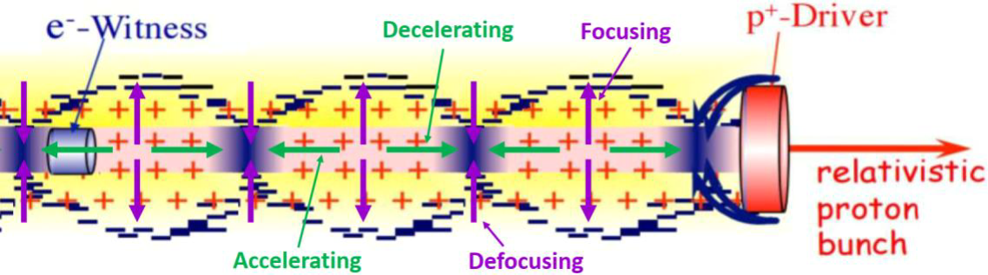
Plasma wakefield acceleration
A laser pulse or a charged particle bunch that travel in the plasma can induce a modulation of the plasma electron density that sustains longitudinal and transverse field which are called wakefield
Wakefield can be used to accelerate particles
AWAKE:
SPS proton bunch as driver of wakefields
Accelerate externally injected electron witness bunch

Slide 6
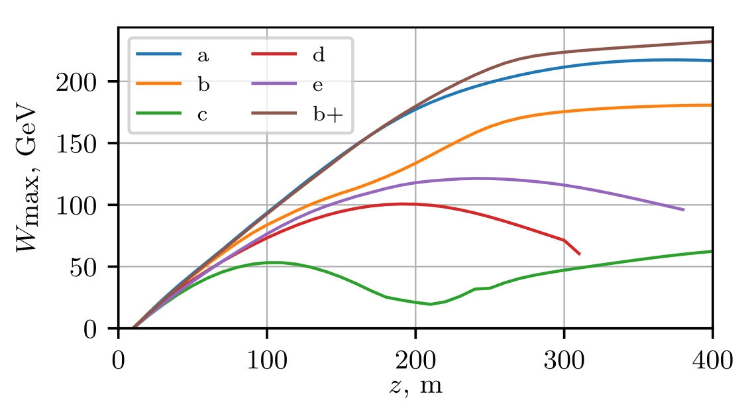
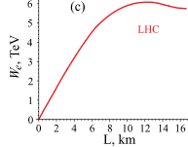
AWAKE is a plasma wakefield acceleration experiment using a proton driver
2D numerical simulation results
Why a proton plasma wakefield accelerator?
SPS
19 kJ
PW laser ≈ 40J/Pulse
FACET (electron PWFA) ≈ 30J/Pulse
SPS 19 kJ/bunch
LHC 112kJ/bunch
K. V. Lotov & P. V. Tuev, Plasma wakefield acceleration beyond the dephasing limit with 400 GeV proton driver, Plasma Phys. and Control. Fusion, 63, 125027 (2021)
Very large energy gain with a single driver in a single plasma
Energy gain LHC bunch
TeV in km ≈ GeV/m
A. Caldwell & K. V. Lotov. Plasma wakefield acceleration with a modulated proton bunch, Physics of Plasmas, 18(10), 103101, (2011)
Notes:
Simulation showed

Slide 7
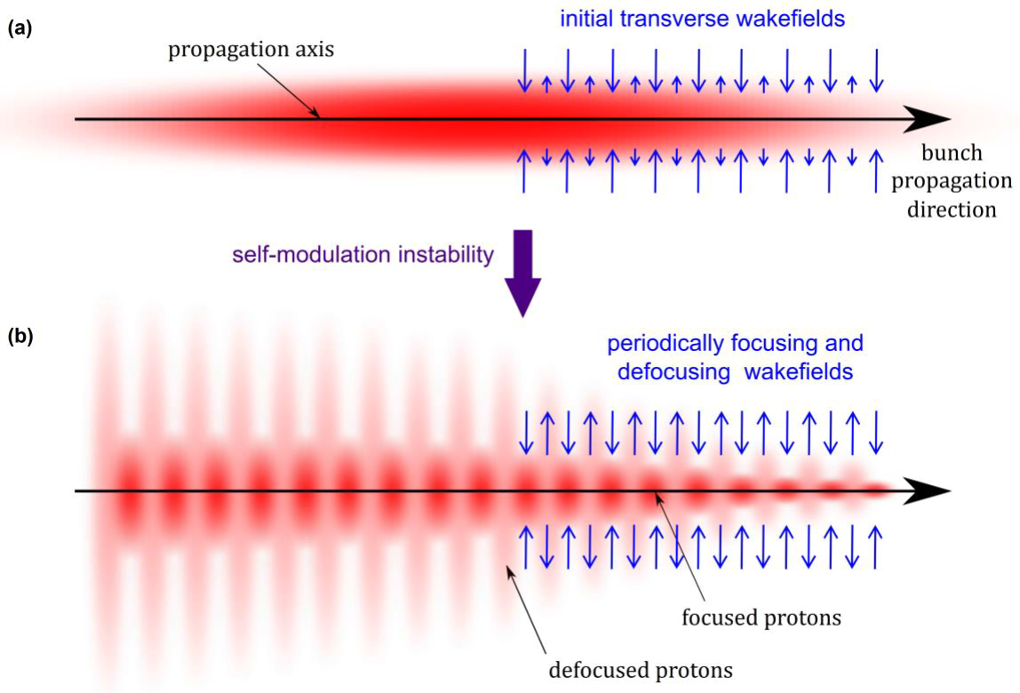
Self-modulation to reach ≈ 1 GeV/m
The SPS proton bunch length too long to drive efficiently
Self-Modulation Instability (SMI)
The process of Self-Modulation (SM) proposed in * to drive E_{wb}= 1 GV/m. Needed to drive effectively wakefields, proton microbunches are formed and the self-modulated proton bunch resonantly excite wakefields
Simulations shows that development of Self-Modulation saturate within the plasma length of awake
* N. Kumar, A. Pukhov, and K. Lotov, Phys. Rev. Lett. 104, 255003 (2010)
Image from F. Batch PhD thesis
Notes:
places an upper limit on the plasma densities and corresponding accelerating fields that can be driven by these single bunches, i.e., E_{wb}= 37–75 MV/m when $σ_{z}/(c/ω_{pe})≈\sqrt{2}$

Slide 8

AWAKE is a plasma wakefield acceleration experiment using a proton driver
SPS Driver (19 kJ):
~ 200 GeV in ~200 m
~ 10⁹ e⁻

Slide 9

AWAKE Run 1 (2016-2018)
Awake Run 1 goals:
Demonstrate and study the seeded self-modulation (SSM) of the long SPS proton bunch in a dense plasma:
Accelerate externally injected electrons to the GeV energy level
$$σ_{z}≫λ_{pe}∝{n_{e}}^{−1/2}$$

Slide 10
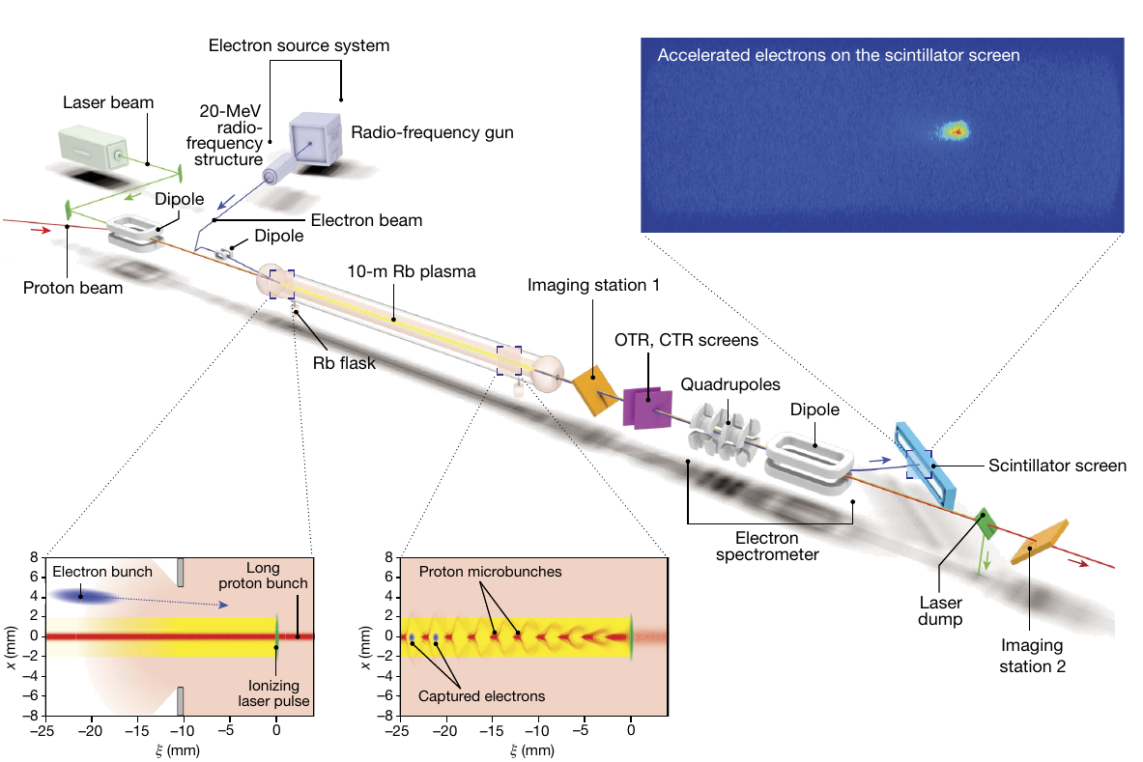
AWAKE Run 1 (2016-2018)
AWAKE collaboration, Acceleration of electrons in the plasma wakefield of a proton bunch, Nature 561, 363–367 (2018)

Slide 11
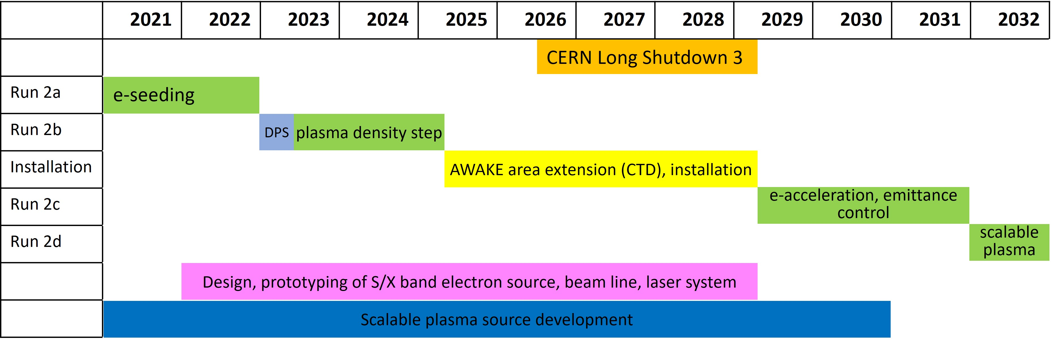

Clear Timeline Towards an Accelerator
(2016-2018)
Run 1
Proof-of-principle
Possible particle physics applications
now
AWAKE Run 2: → transition from proof-of-principle to applications
  Run 2a: Demonstrate the seeding of the self-modulation of the entire proton bunch with an electron bunch
  Run 2b: Maintain large wakefield amplitudes over long plasma distances by introducing a step in the plasma density
  Run 2c *: Demonstrate electron acceleration and emittance control of externally injected electrons
2029
  Run 2d *: Development of scalable plasma sources to 100s meters length with sub-% level plasma density uniformity.
2032
  Possible first applications for particle physics experiments with 10-100 GeV electron bunches
* AWAKE Run 2c and 2d has been approved in last year’s CERN MTP
Notes:
. Mention updated version with LS3 shifted

Slide 12
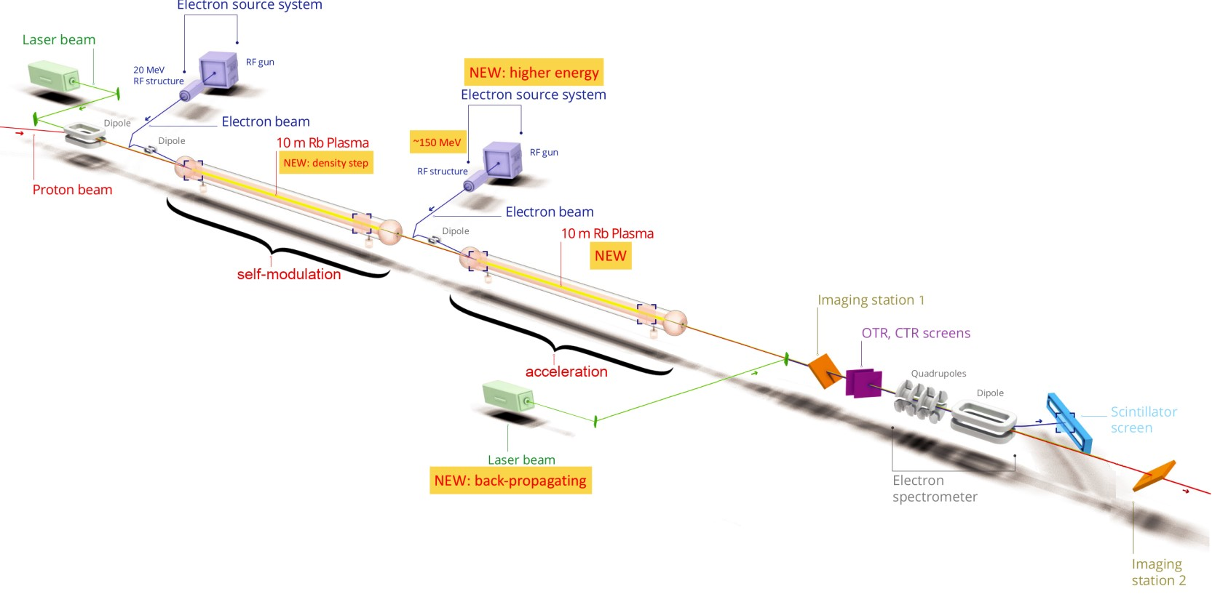
AWAKE Run 2 (2021 - )

Slide 13
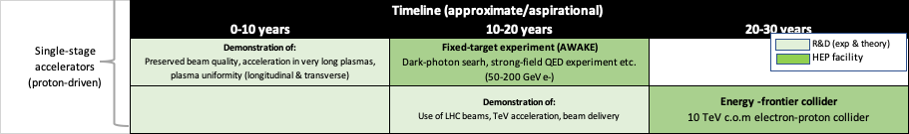


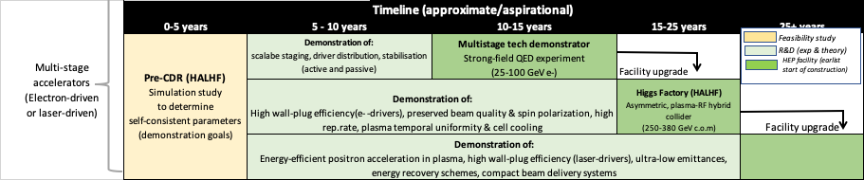
ESPP Roadmap
Advanced Accelerator Community
R. Pattathil,
presented at EAAC 2023
AWAKE is part of the ESPP process

Slide 14
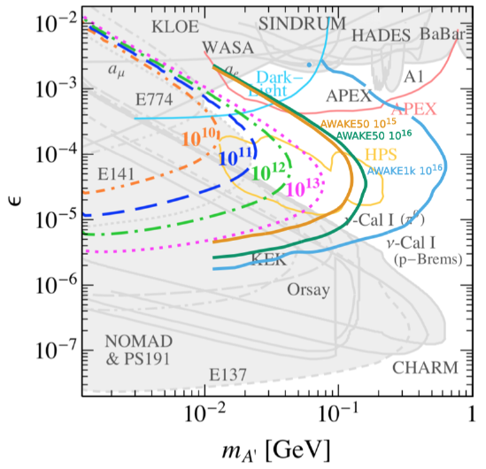
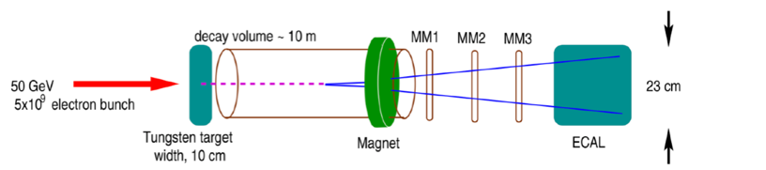
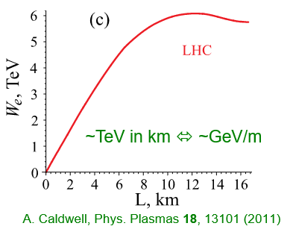
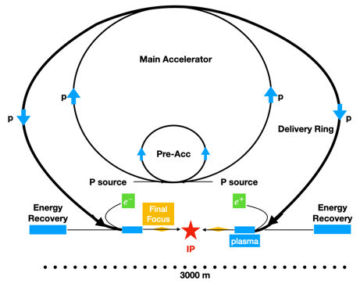
Possible applications
E. Gschwendtner, et al. (AWAKE Coll.), Symmetry 2022, 14(8), 1680 (2022)
First application: SPS driver
➔ Requirements on emittance are moderate for fixed target experiments → first experiments in not-too far future!
Search for dark photons
50-100GeV e⁻ bunch
Decay of dark photon into visible particles (e.g. e⁺e⁻)
10¹⁶ e⁻ on target with AWAKE-like beam (1000 more than NA64)
Deep inelastic scattering
Strong field QED
Experimental conditions modeled on NA64 experiment.
Collider Applications: LHC driver
Collision of TeV-range e⁻ with an LHC p⁺ bunch: lower luminosity measurements in e⁻ /p⁺ or e⁻ /ion collisions
Strong field QED
Proton-driven Higgs factory (ALiVE): e⁺/e⁻ collider 250 GeV CoM
A. Caldwell et al. arXiv:2503.21669 (2025)

Slide 15
Results from Run 2

Slide 16
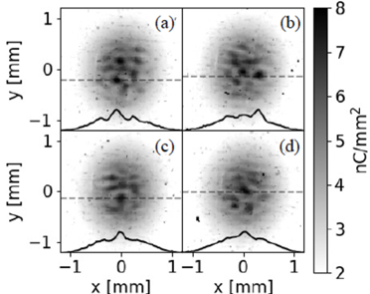
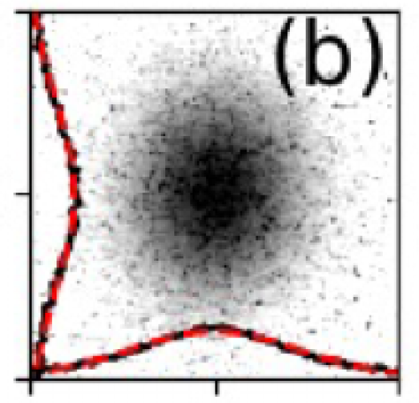
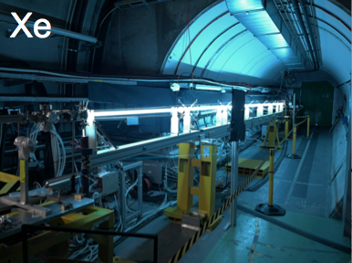
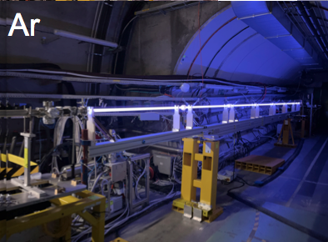
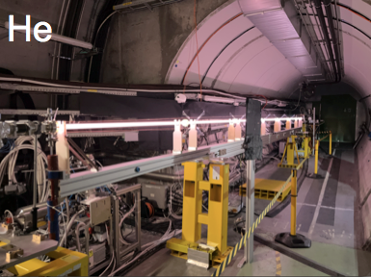


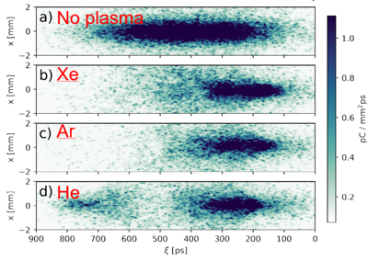
Development of discharge plasma source
L. Verra et al. (AWAKE Coll.), Phys. Rev. E 109, 055203 (2024)
n_{e0}=9.38x10¹⁴cm⁻³
No Plasma , σ_{r0}=500μm
-
-
N_{p+}=2.8x10¹¹
n_{e0}=4.810¹⁴cm⁻³
M_{Xe}=131 amu
M_{Ar}=40 amu
M_{He}= 4amu
M. Turner et al. (AWAKE Coll.), Phys. Rev. Lett. 134, 155001 (2025)

Slide 17
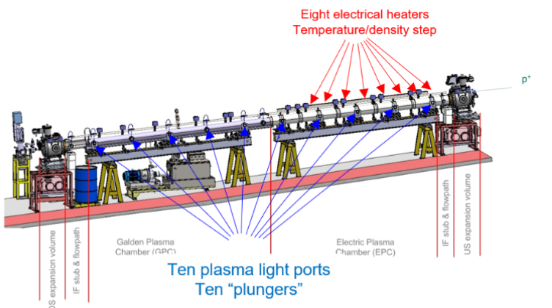
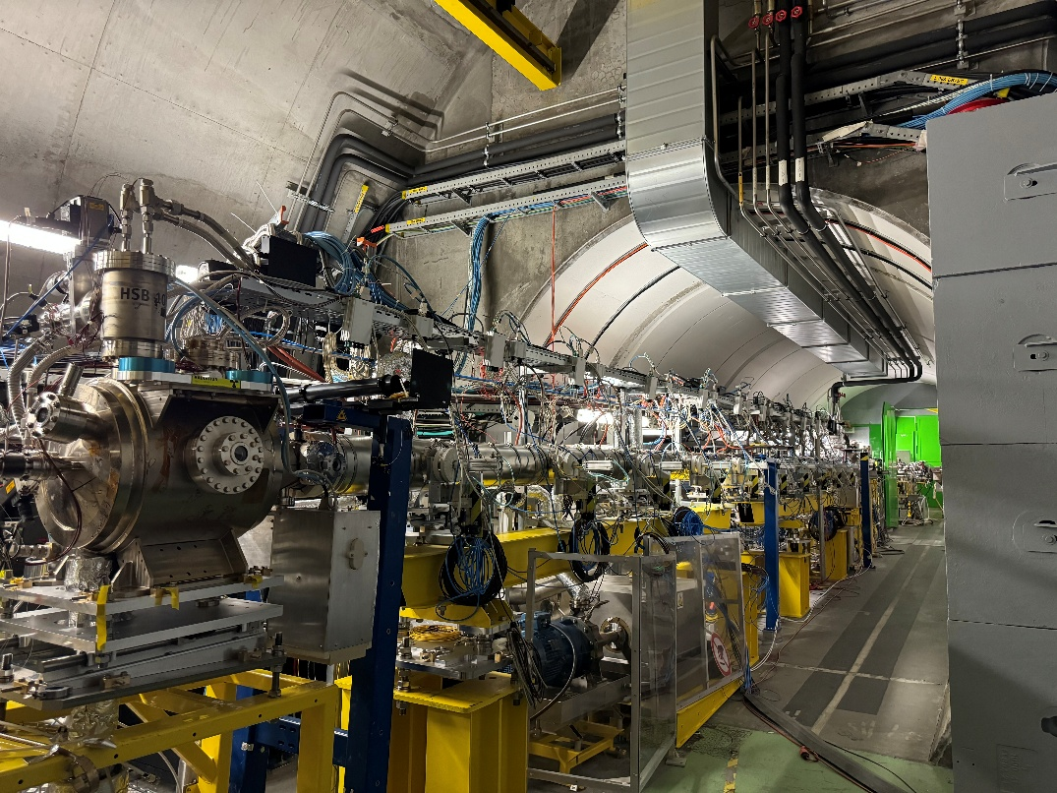
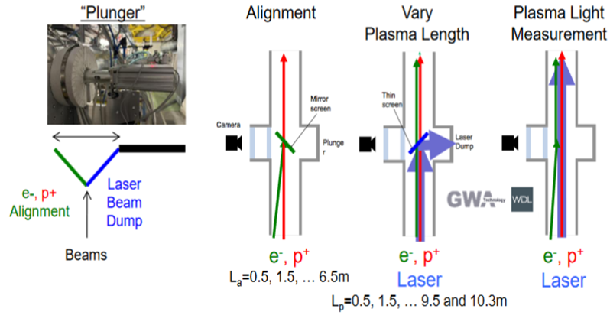
Development of self-modulator vapor source
  Align e⁻ and p⁺ beams inside plasma source for :
    Acceleration, side injection
    e⁻ Seeding of Self-Modulation (e⁻ SSM)
    e⁻ Seeding of hosing
  Vary plasma length to perform:
    Acceleration gradient measurements
    Growth of the wakefields
    Growth of hosing

Slide 18
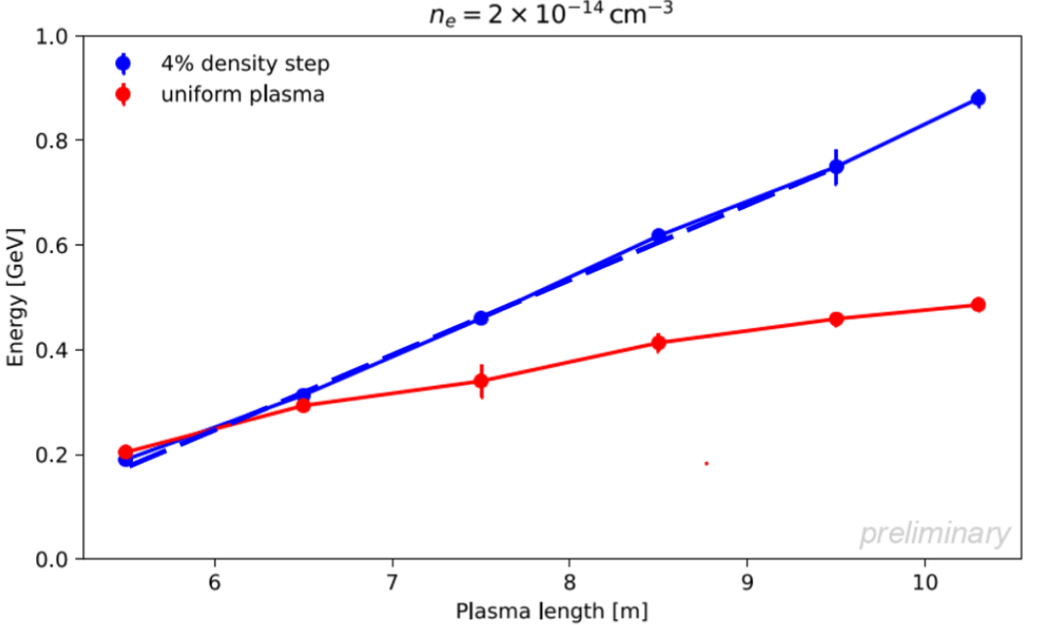
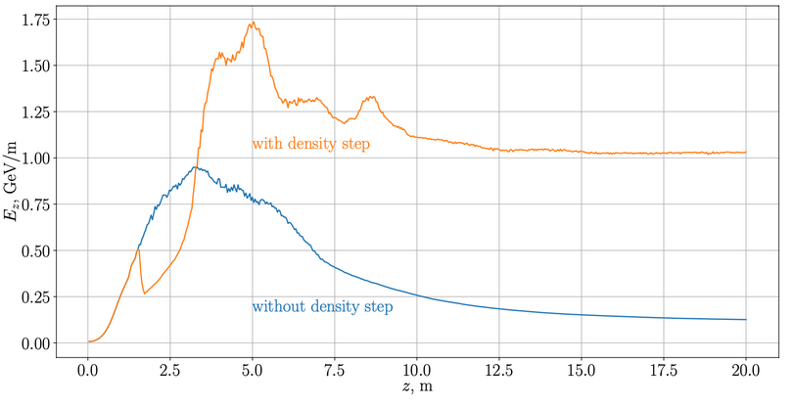
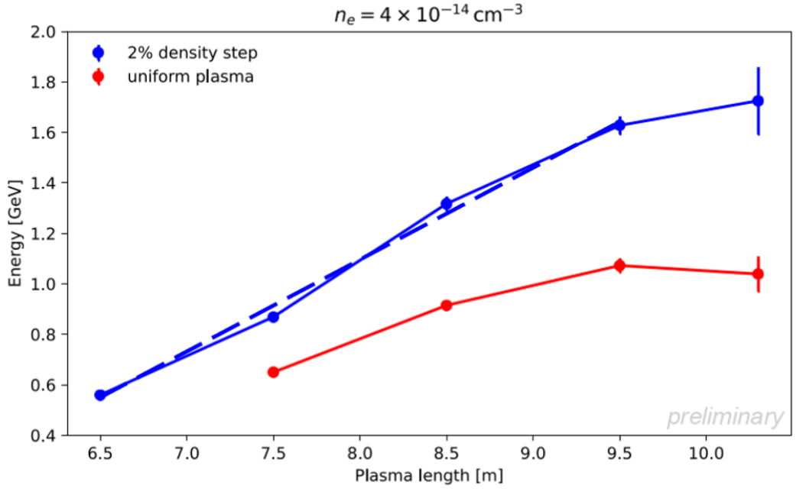


Physics studies in Run 2b
Plasma density step increases energy gain, constant acceleration gradient
Plasma density (up) step to make E_{z} and acceleration constant past the SM saturation point
$$n_{e}={2∙10}^{14}{cm}^{−3}$$
880MeV
n_{e0}=7x10¹⁴cm⁻³
Step-up
142MeV/m
486MeV
~63MeV/m
AWAKE status report 2024, https://cds.cern.ch/record/2917426/files/SPSC-SR-356.pdf
$$n_{e}={4∙10}^{14}{cm}^{−3}$$
1.73GeV
Clear increase in final energy (L_{p}=10.3m): 1.04 → 1.73GeV
Clear increase in accelerating gradient: ~211 → 365MeV/m
Step-up
365MeV/m (324)
1.04GeV
~211MeV/m
Notes:
Measurements at low density only (n_{e0}<7x10¹⁴cm⁻³), as capture with side-injection decreases with increasing n_{e0}
Optimization, long and tedious process in large phase-space:
Step position and height (thermal system), injection angle and location, RIF timing along the p⁺ bunch, delay between the e-bunch and the RIF

Slide 19
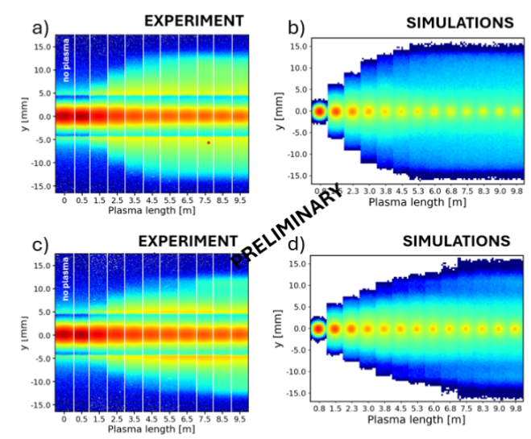
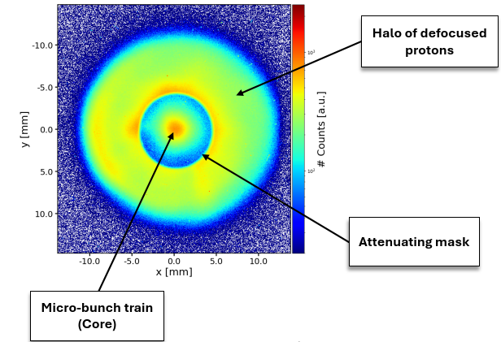
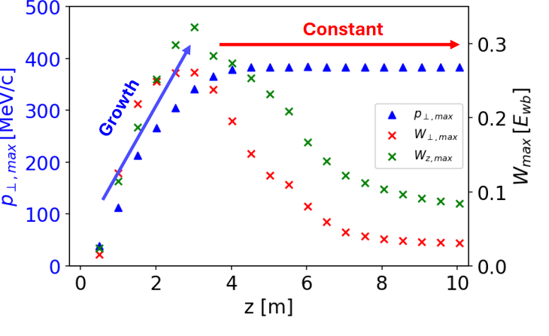
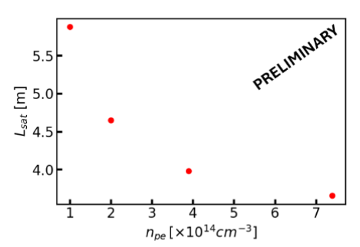
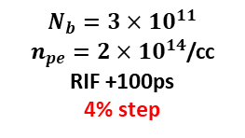
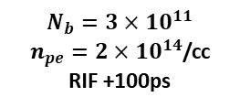
Physics studies in Run 2b
Growth of the wakefields: SM saturates in less than 10m => Self-modulator for Run 2c
Constant density plasma
$$N_{b}=3×{10}^{11}$$
$n_{pe}=2×{10}^{14}$/cc
RIF +100ps
Halo radius shows Self-Modulation saturation length
Plasma with density step
$$N_{b}=3×{10}^{11}$$
$n_{pe}=2×{10}^{14}$/cc
RIF +100ps
4% step
Dependency of saturation length on plasma density
A. Clairembaud et al., NIMA, 1073, 170265 (2025)
Notes:
As said in slide 6, show saturation is shorter then 10m

Slide 20
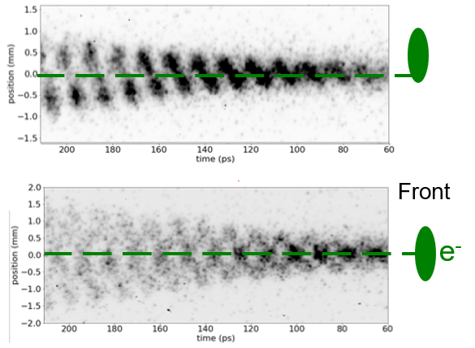
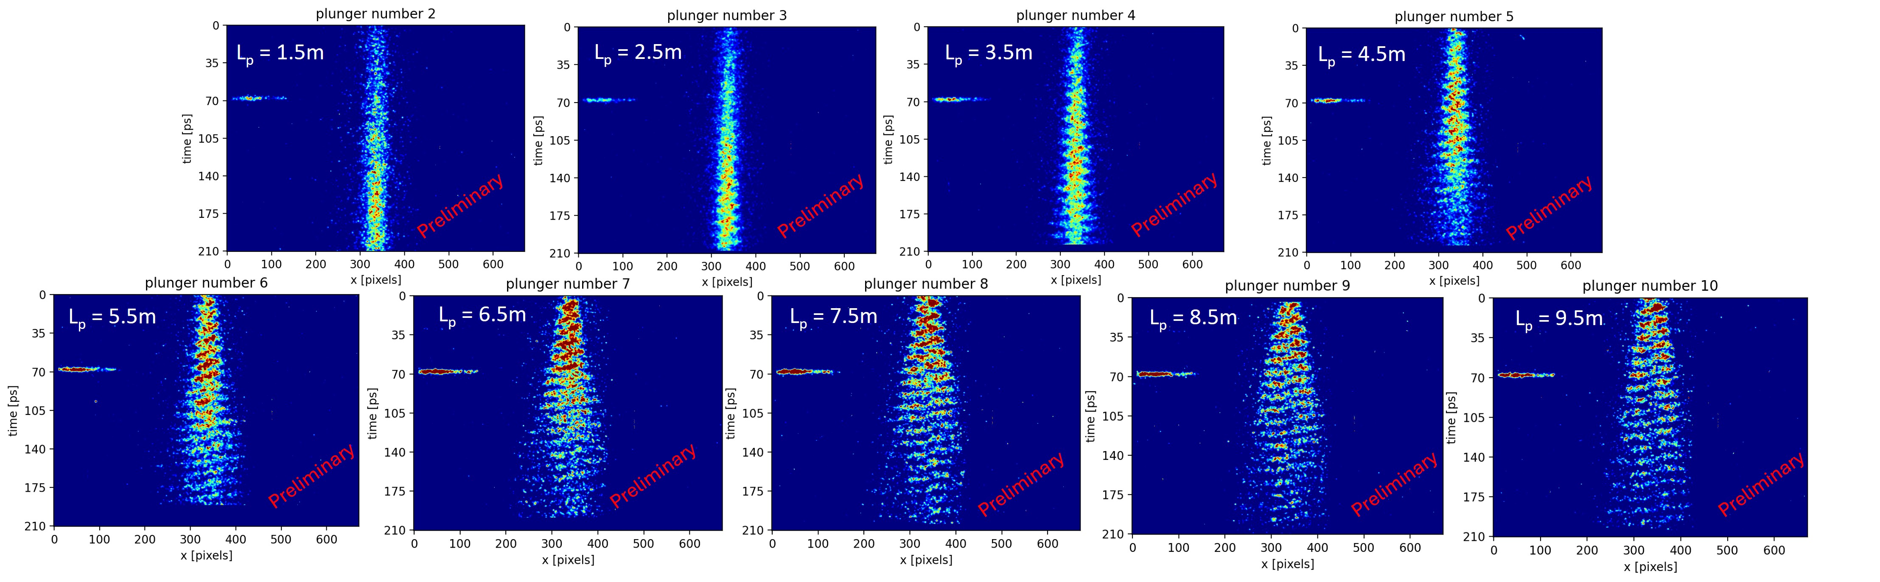
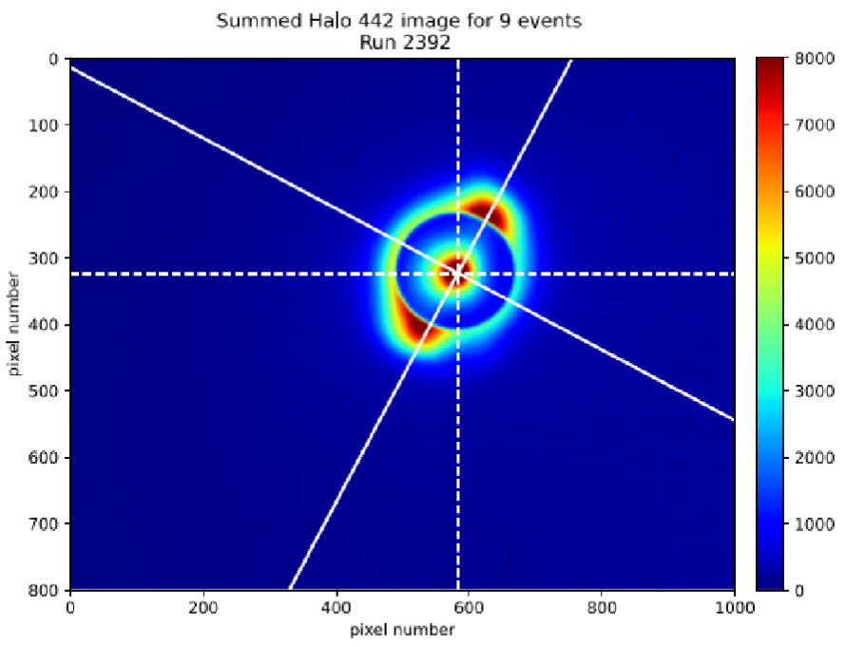
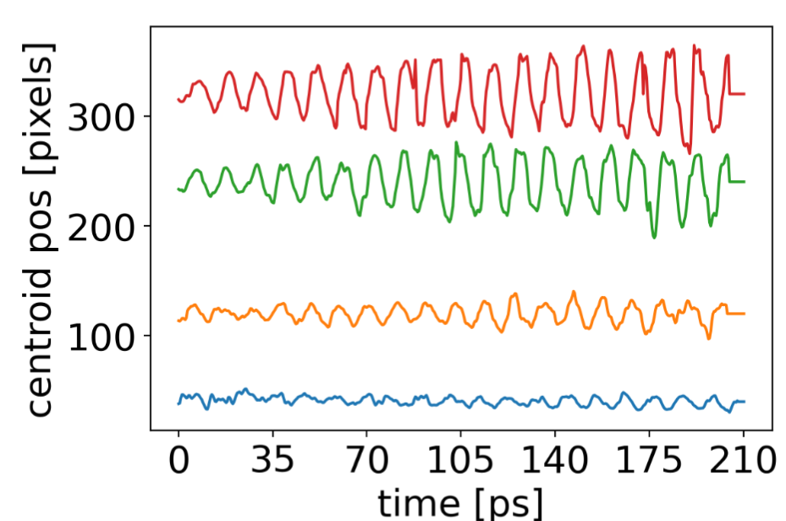
Physics studies in Run 2b
Growth of hosing: understand and control as it must be suppressed
Hosing grows along the plasma, seeded by misaligned e-bunch
n_{e0}= 1x10¹¹cm⁻³
L_{p}=9.5m
Clear growth: time-resolved images
Hosing in the plane of misalignment: time-integrated images
  Plane of the streak camera slit
Streak Camera Slit
L_{p}=7.5m
L_{p}=4.5m
L_{p}=1.5m

Slide 21
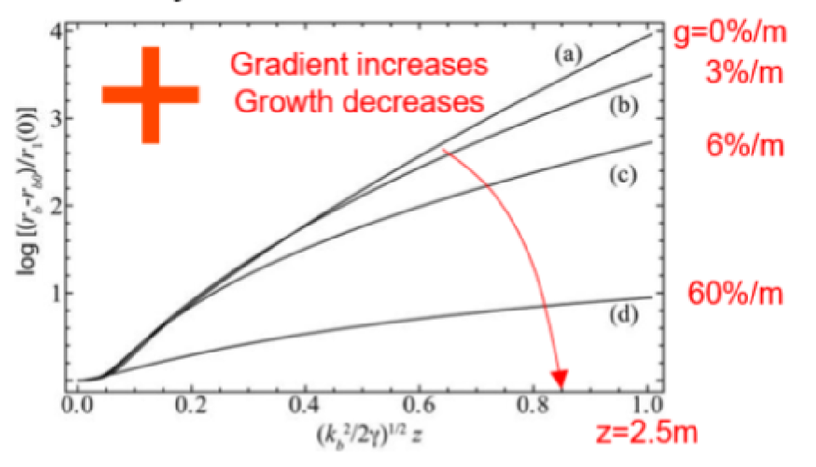
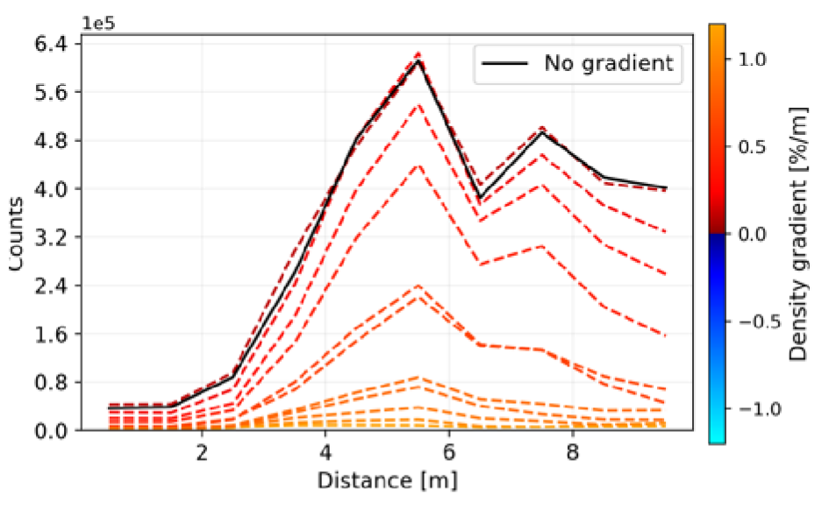
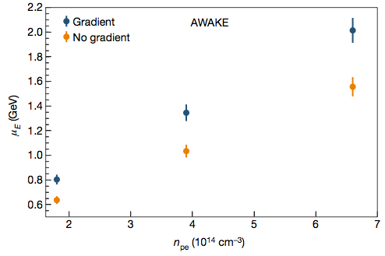
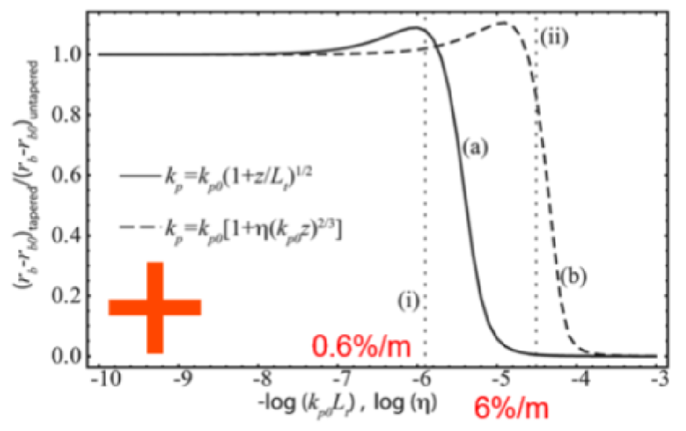
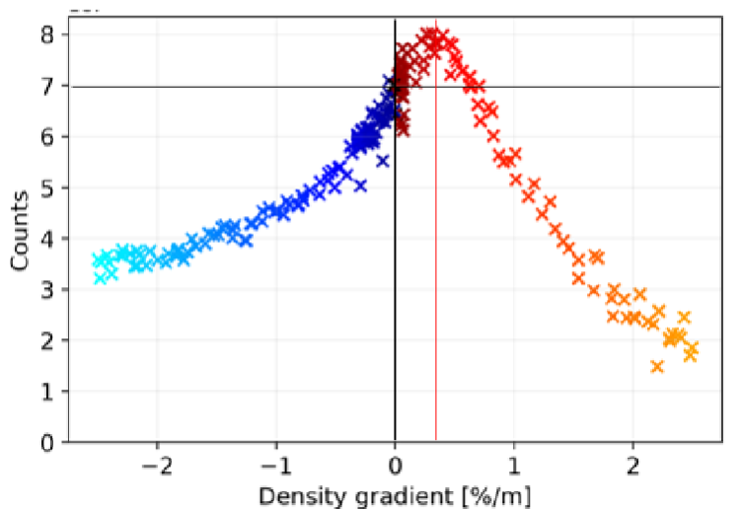
Physics studies in Run 2b
Effect of density gradient on Seeded Self-Modulation
SM can be detuned and suppressed by (linear) density gradients
Theory predictions
Plasma Light Measurements
n_{e0}= 2x10¹¹cm⁻³
preliminary
Acceleration results (Run 1)
preliminary
C. B. Shroeder et al., Phys. Plasmas 19, 010703 (2012)
Clear observation of SM suppression: light, halo and time-resolved (not shown) diagnostics
Asymmetry positive/negative gradients
Higher fields with small positive gradient consistent with higher energy gain observation
Notes:
Control of self-modulation, 0.2%/m

Slide 22
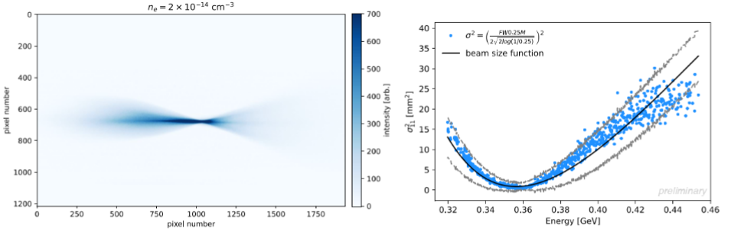
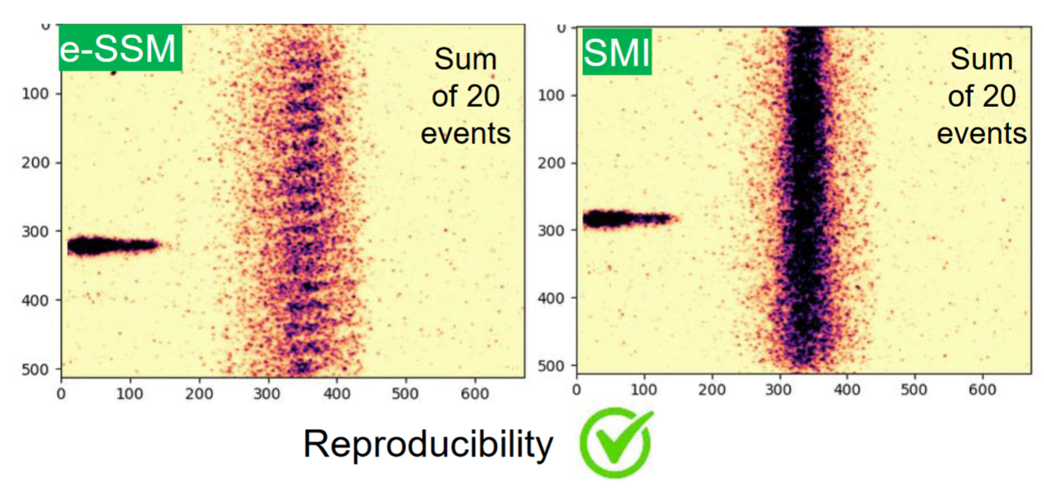
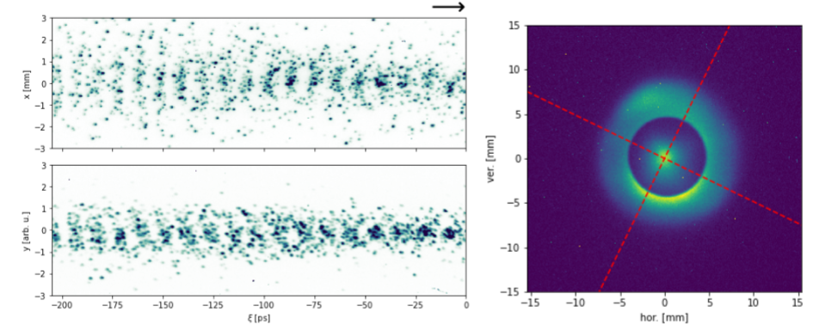
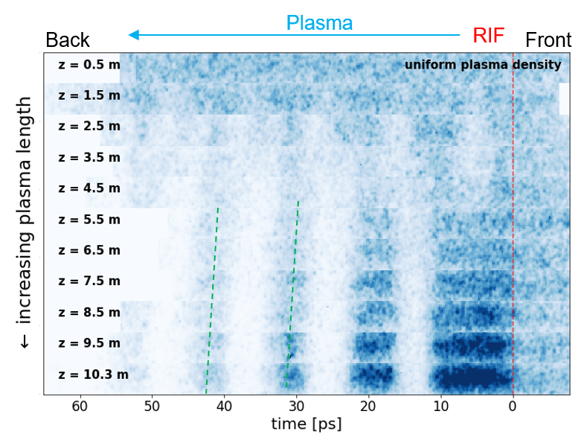
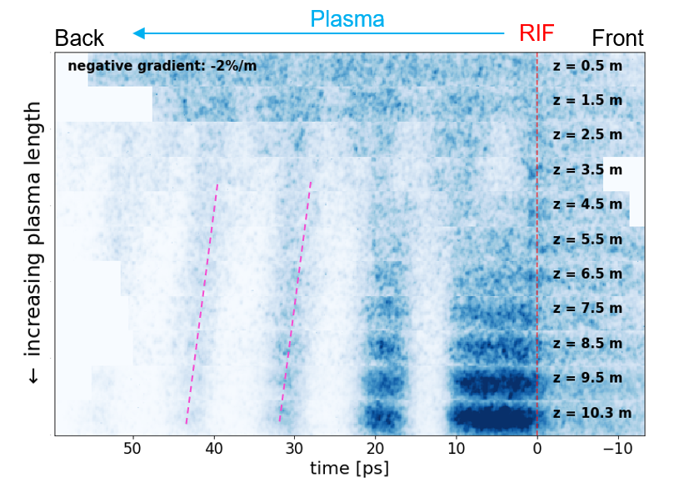
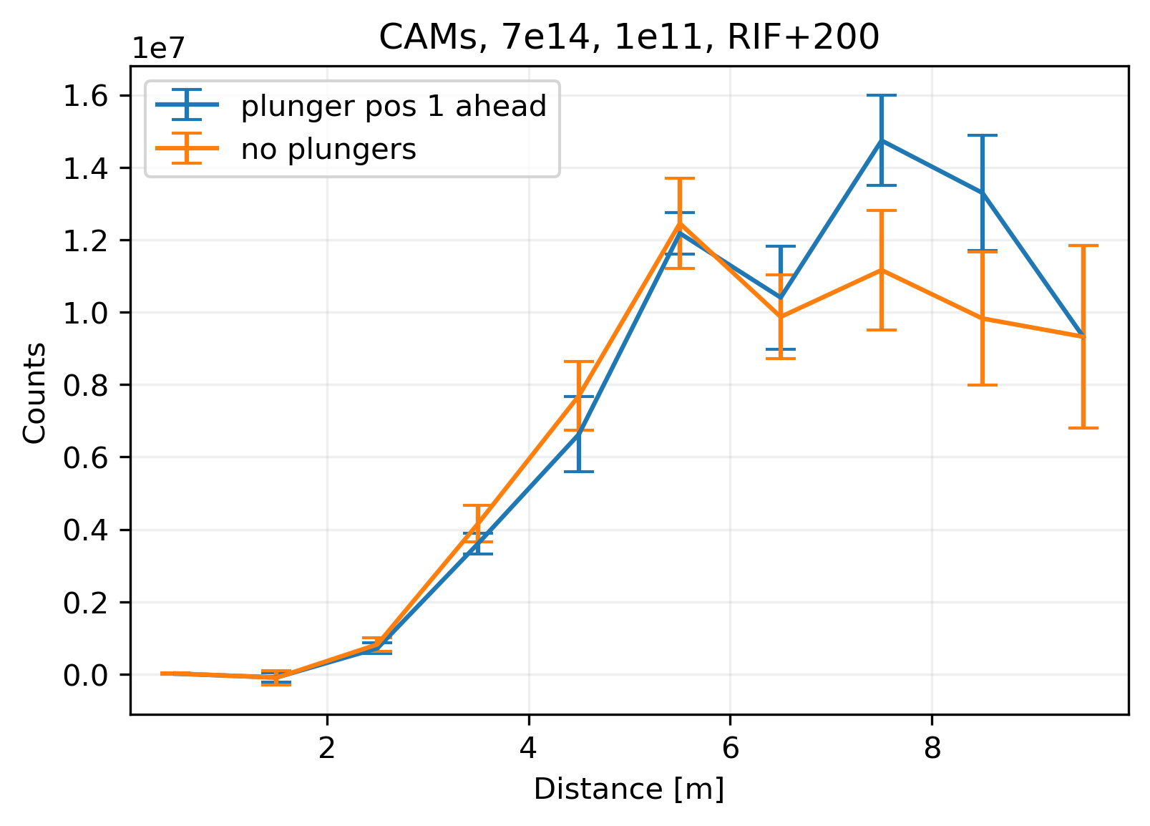

Physics studies in Run 2b
Several other measurements were possible
Proof-of-principle of single-shot emittance measurement
e⁻ Seeding SM with n_{e0}=7x10¹⁴cm⁻³ and N_{p+}=1x10¹¹ possible
$$n_{e}={2∙10}^{14}{cm}^{−3}$$
preliminary
preliminary
First micro-bunch evolution along the plasma
e⁻ Seeding SM at high density without hosing, possible at n_{e0}=1x10¹⁴cm⁻³
N_{p+}=10¹¹
n_{e0}=10¹⁴cm⁻³
preliminary
preliminary
Plasma light emission along the plasma
No plasma density gradient:
Large slope green dotted lines: v_{Φ} close to v_{p+}
Negative plasma density gradient, g=-2%/m
Smaller slope pink dotted lines: v_{Φ} slower than v_{p+}
preliminary
preliminary
preliminary

Slide 23
Ongoing preparation for Run 2c
e- bunch quality
Scalability of acceleration: 10m -> 20m

Slide 24
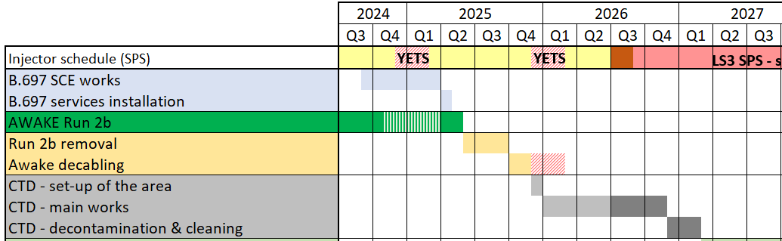
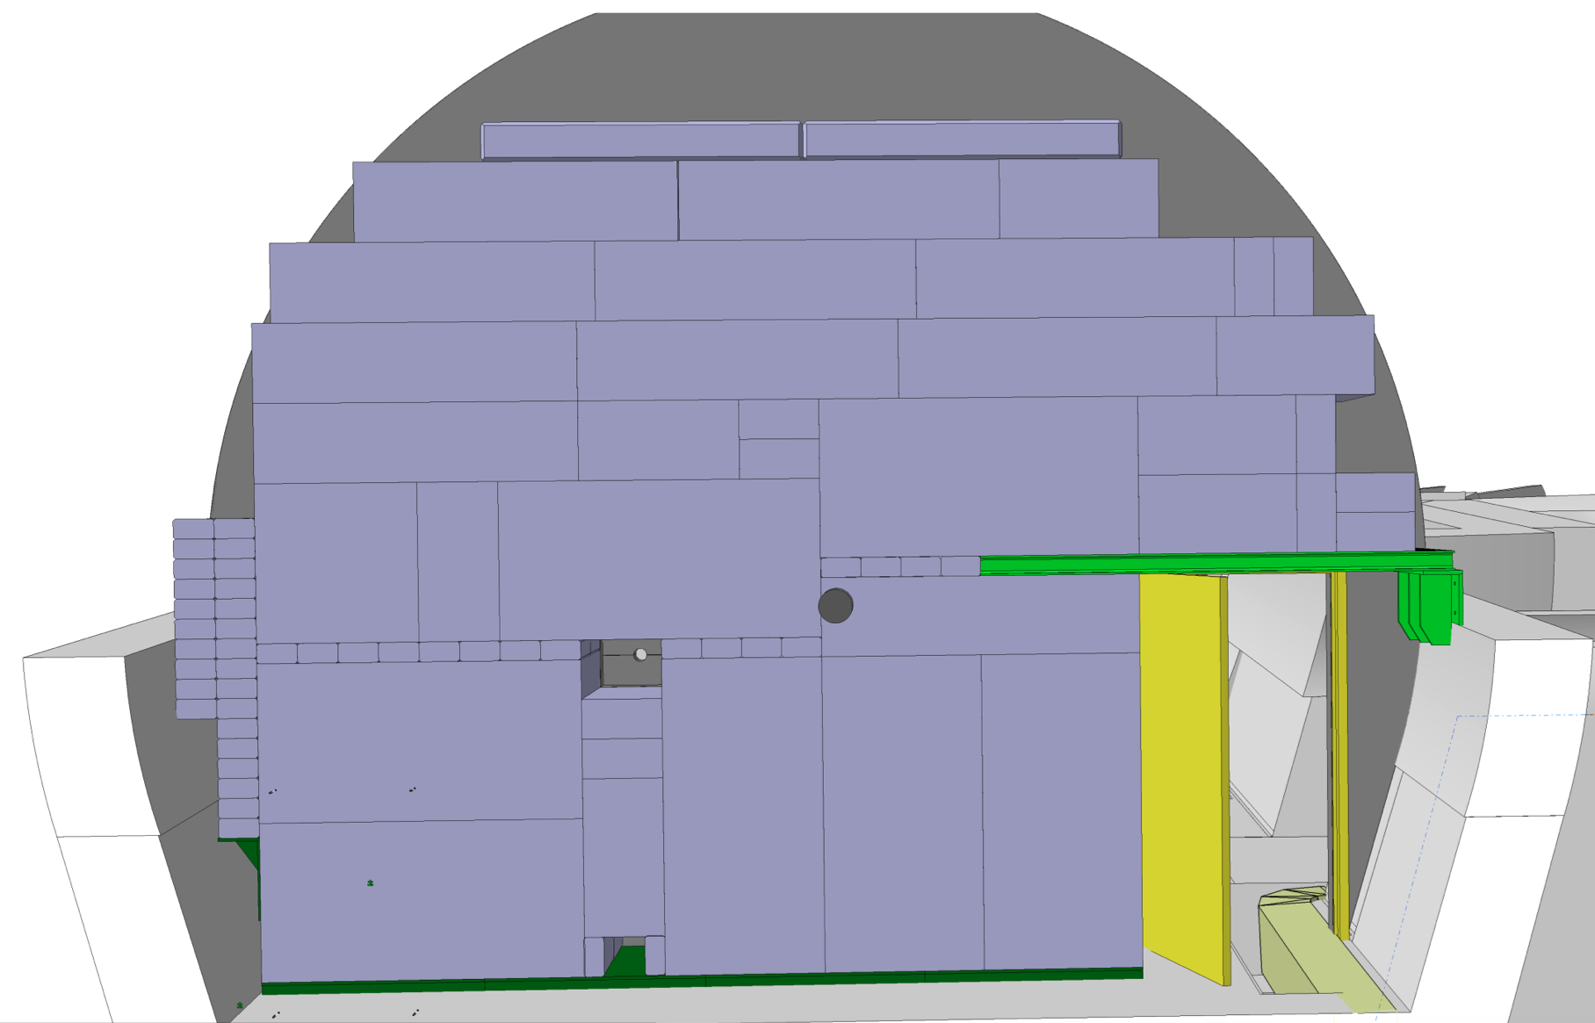
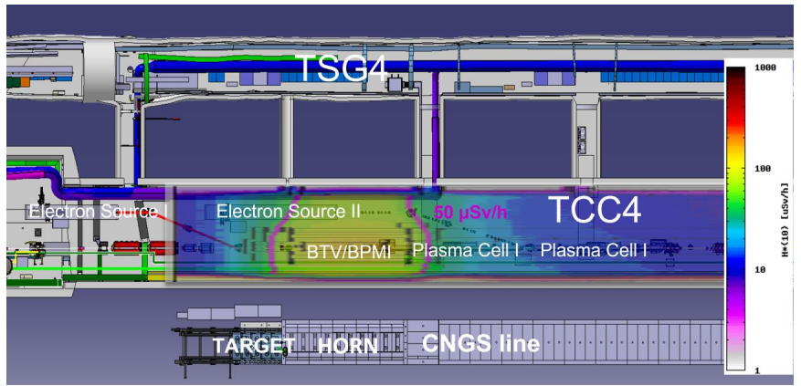

CNGS target area dismantling (CTD)
CNGS target area dismantling (CTD)
Set-up of work area
Corridor equipment
Target area
Horn area
Helium tank 1 area
Reflector area
Helium tank 2 area
Cleaning & decontamination
Checking all requirement are met (evacuation sirens, temporary wifi, etc.)
SAS installation
Protection of TCC4 (floors, walls, etc.)
Removing AWAKE-CNGS separation wall
Separation wall
CNGS main beam line assemblies to be removed
SAS concept
Expected remnant dose rate after CTD
Notes:
Overlay a pic from building praparation

Slide 25




Additional Run 2c, 2d Preparations
New electron source
  Successful commissioning of the prototype RF-gun with beam for 150MeV e⁻ beamline
Beam instrumentation upgrade
  Collaboration with institutes
Beam transport line upgrades
  Electron, laser and proton
Simulation studies
Scalable plasma source R&D
  Collaboration with institutes
Discharge Plasma
Helicon Plasma Source

Slide 26
Summary

Slide 27
Summary
Highly successful installation and commissioning of the upgraded self-modulator
  Improved operations efficiency and precision for e⁻ beam/proton alignment
  Many physics measurements performed
  Observed clear effect of density step, stabilization of acc. gradient at higher level and energy gradient increased
  Studied directly the growth of self-modulation along plasma
Continue with a clear plan towards applications to particle physics in 2030’s
Clear scientific program
    Run 2b: plasma density step
    Run 2c: external injection of e-bunch in second plasma, quality
    Run 2d: operation with acceleration in scalable plasma source

Slide 28
Thank you for your attention

