Slide 1



K. Long, on behalf of the collaboration; 10 July, 2025

Slide 2
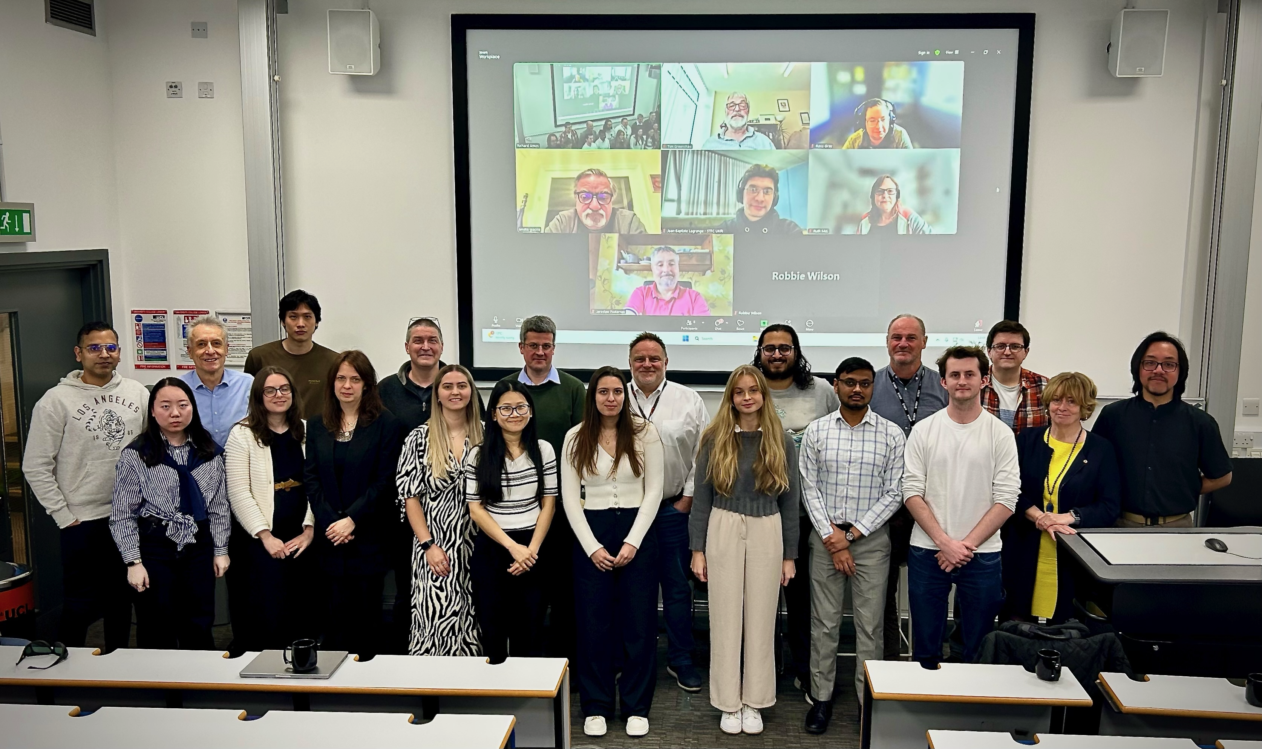
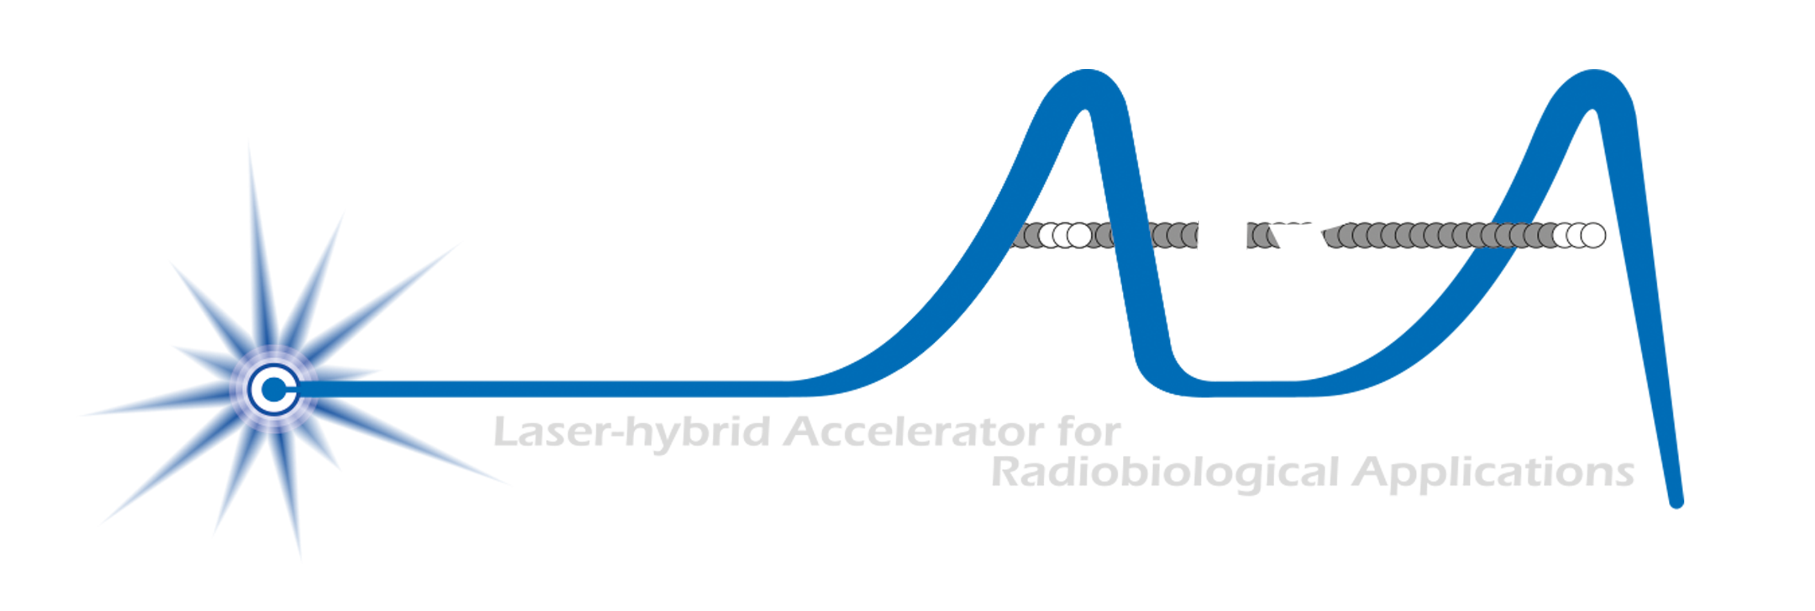
Acknowledgements

Slide 3
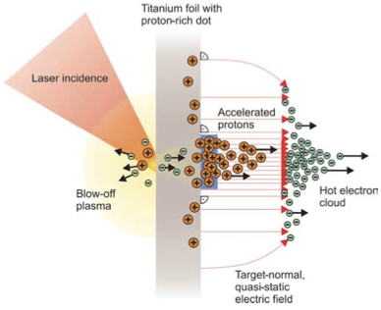
Our mission to:
Deliver a systematic and definitive radiation biology programme
Prove the feasibility of laser-driven hybrid acceleration
Lay the foundations for the transformation of particle beam therapy
  Automated, patient-specific proton and ion beam therapy
Spin back into fundamental science and innovation

Slide 4
What is LhARA?
A novel, hybrid, approach:
Laser-driven, high-flux proton/ion source
  Overcome instantaneous dose-rate limitation
    Capture at >10 MeV
  Delivers protons or ions in very short pulses
    Bunches as short as 10—40 ns
  Triggerable; arbitrary pulse structure
Novel “electron-plasma-lens” capture & focusing
  Strong focusing (short focal length) without the use of high-field solenoid
Fast, flexible, fixed-field post acceleration
  Variable energy
    Protons: 15—127 MeV
    Ions: 5—34 MeV/u
Front. Phys., 29 September 2020; DOI: 10.3389/fphy.2020.567738

Slide 5
Stage 1

Slide 6
Stage 1
Standardised TNSA source
Stage 1 baseline
7 Gabor lens adopted
Greater flexibility
Drifts longer:
  Diagnostics
  Shielding
Gabor lens/solenoid focusing optics equivalent

Slide 7
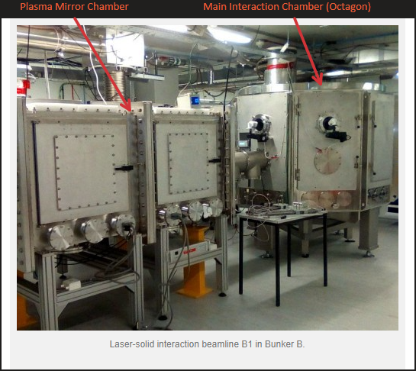
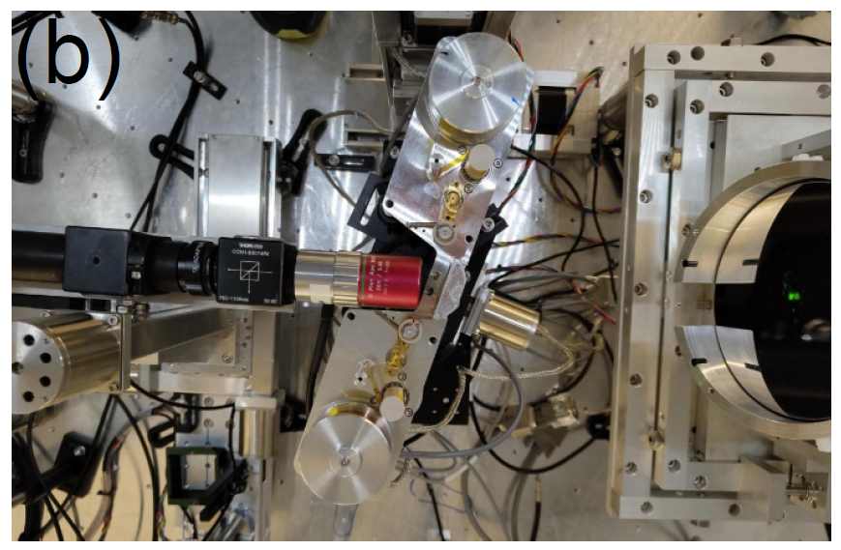
Source development

Slide 8
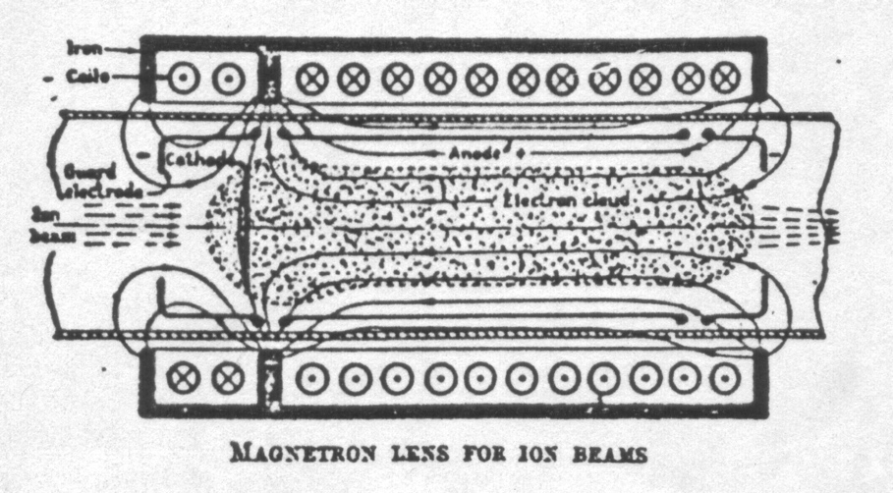
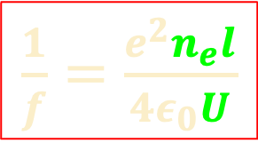
Gabor lens
“Electron-plasma” (Gabor) lens:
  Strong focusing exploiting electron
  gas in “Penning/Malmberg” trap
Focal length:
Gabor
1957
$\frac{1}{f}=\frac{e^{2}n_{e}l}{4ε_{0}U}$
8

Slide 9

Plasma confinement

Slide 10
Stage 2

Slide 11
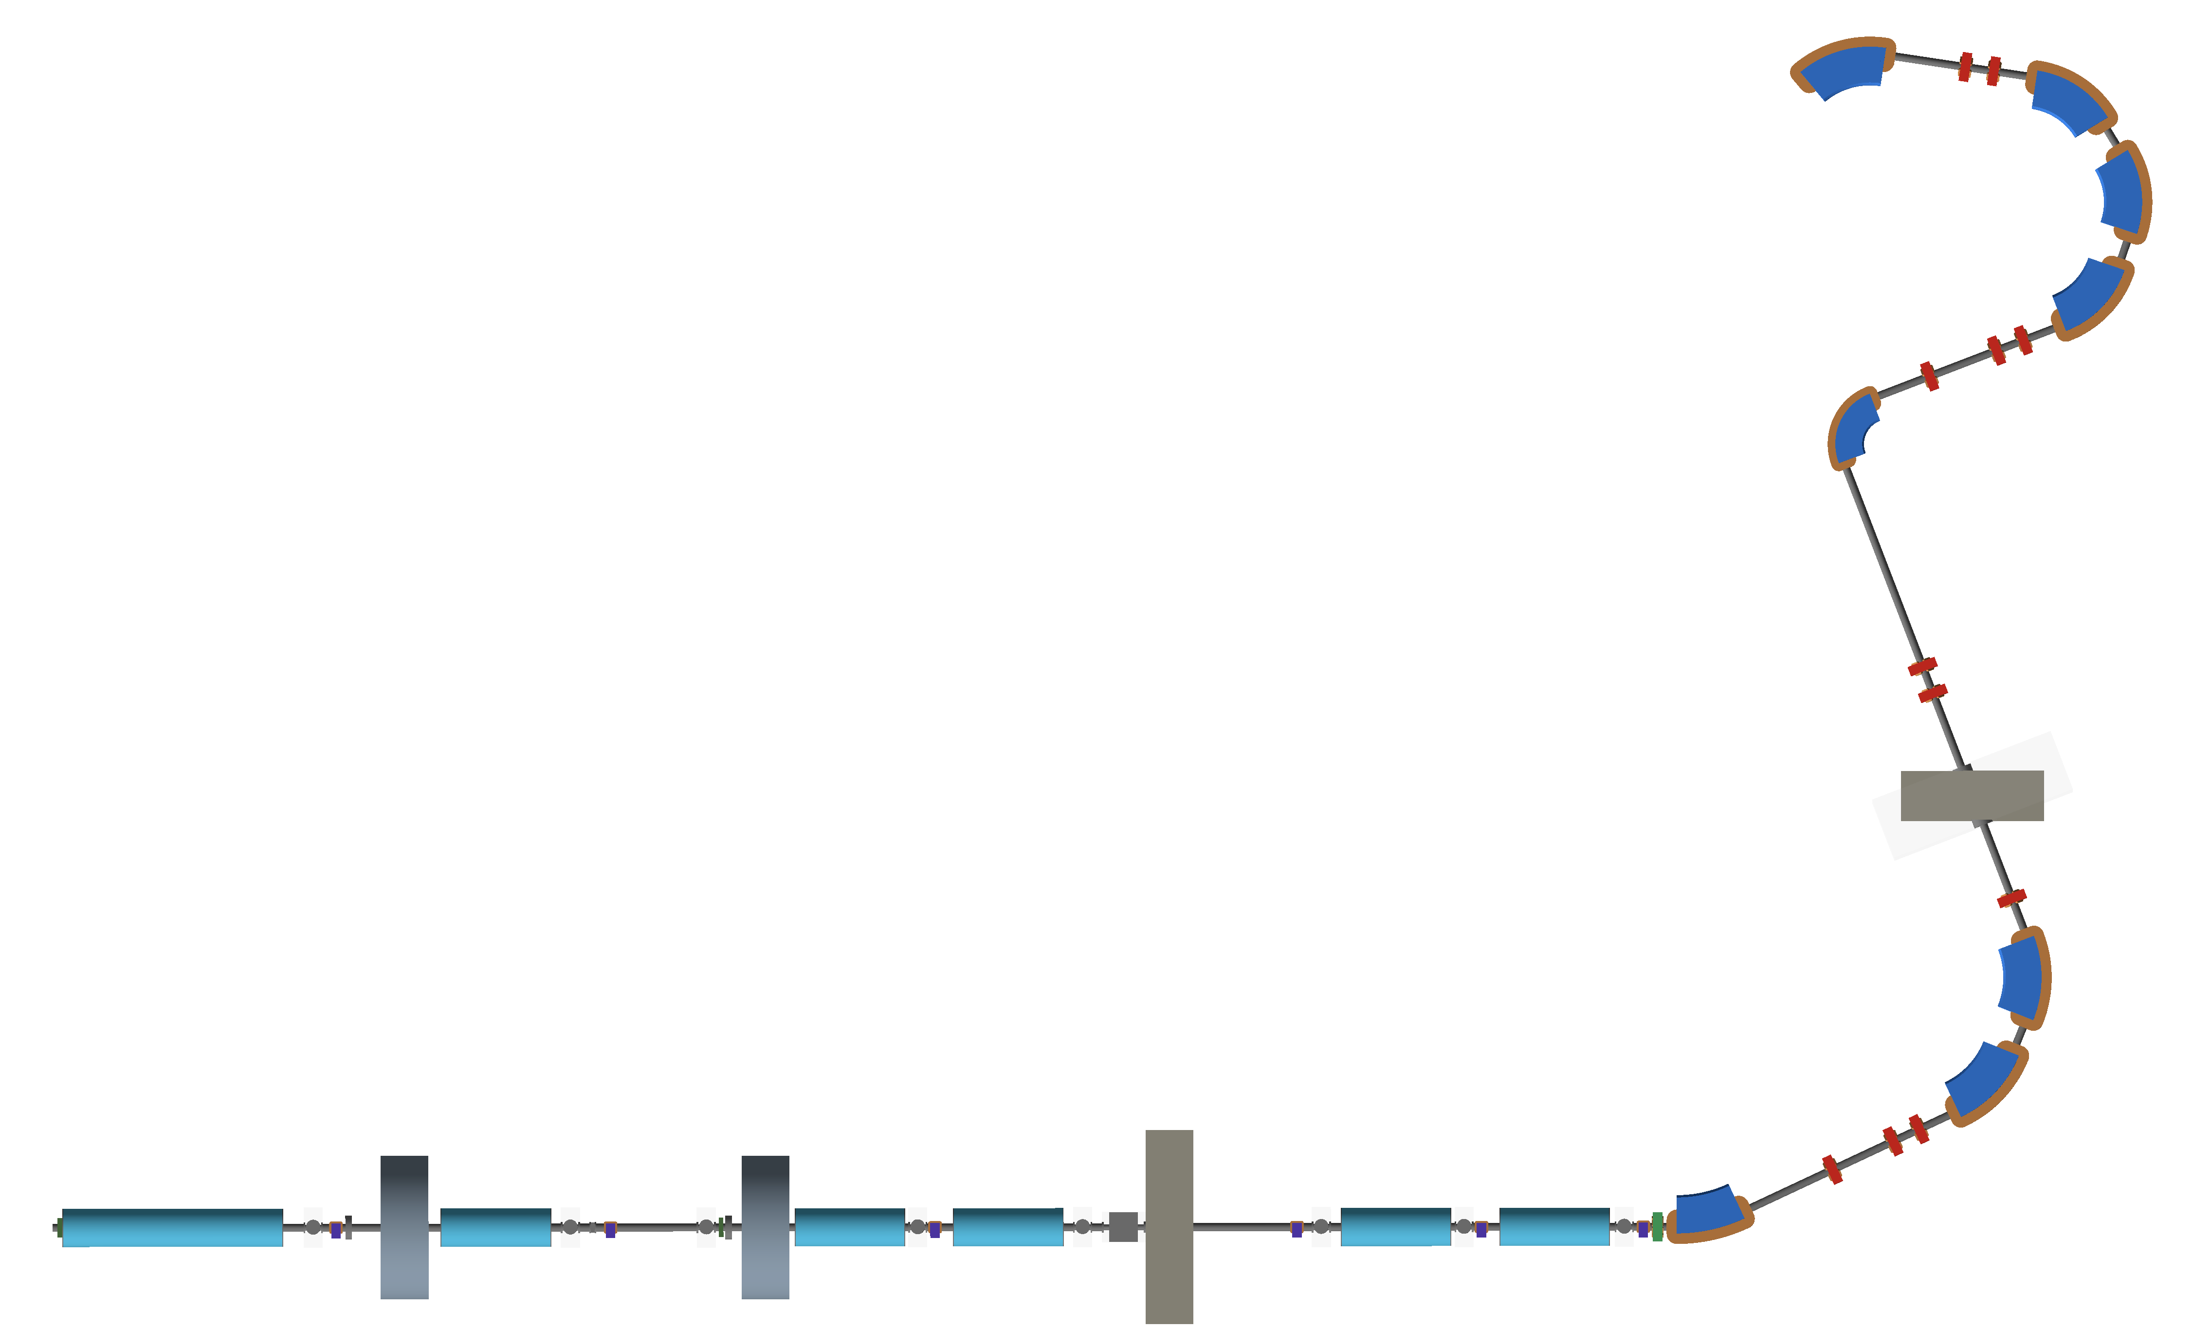
Optimised injection to FFA
Injection
septum
FFA
crossing
Collimation
Switching
dipole

Slide 12
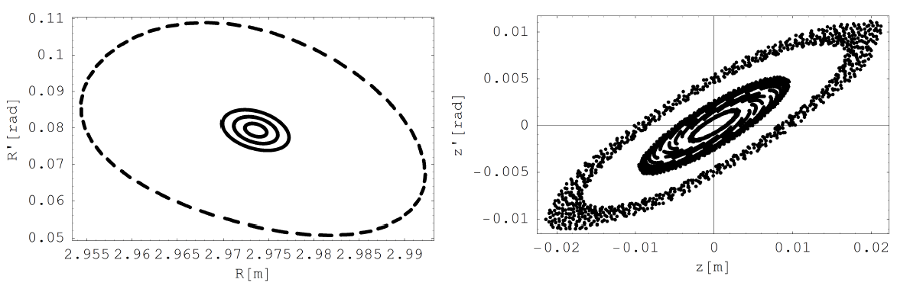
FFA optimised
Variable-energy FFA
Multi-ion capability
Single spiral design
Max field ~1.4 T
  Tunable
3D tracking:
  1, 2, 3 and 5σ

Slide 13
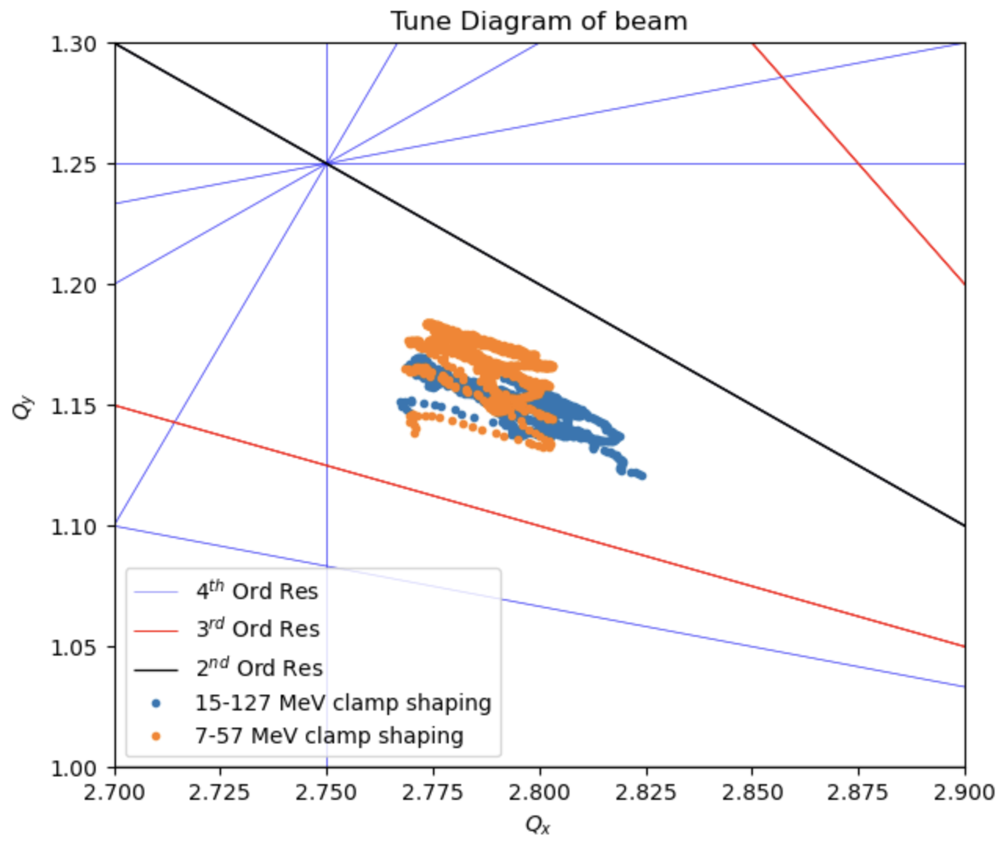
Tunes

Slide 14
Radiobiology programme and proof-of-principle experiment
Systematic comparison:
  Radiobiology with conventional (cyclotron) and laser-driven beams
MC40 cyclotron (Brm)
Laser-driven@ SCAPA (Strathclyde)

Slide 15
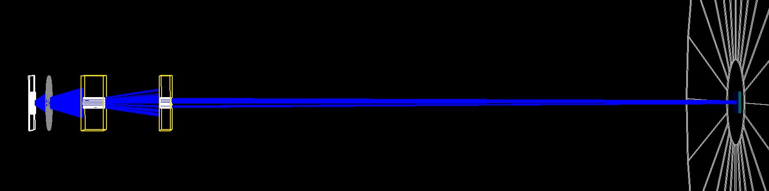
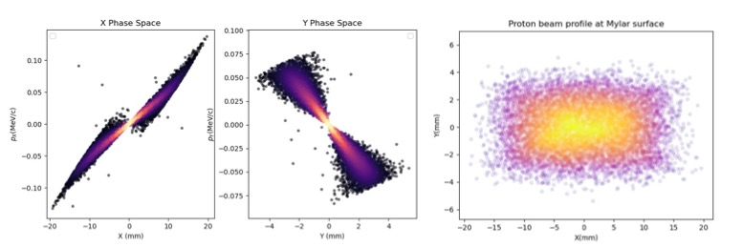
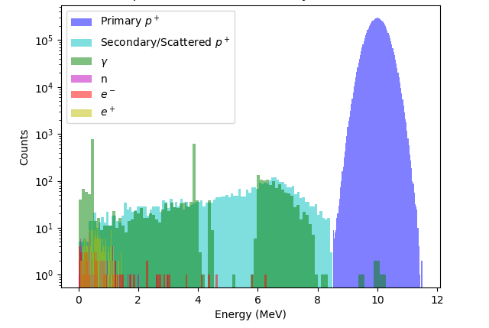
PoPLaR @ SCAPA

Slide 17
PoPLaR programmatic approach
First:
  Quad-doublet
    Qualify source
    First radiobiology
  Starting summer 2025
Incremental development:
  2 quad doublet:
    Better capture
    More uniform dose distribution
  To be defined:
    Dipole for momentum selection and to “shoot into sample”
    Instrumentation
  Systematic studies …
  LhARA test bed!

Slide 18
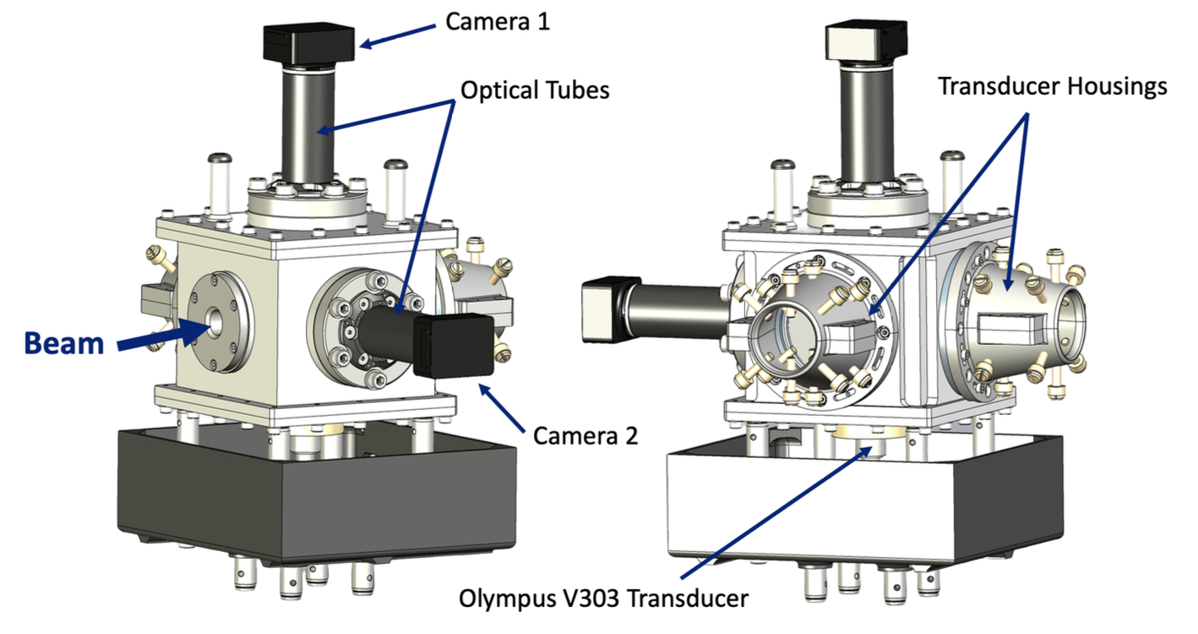
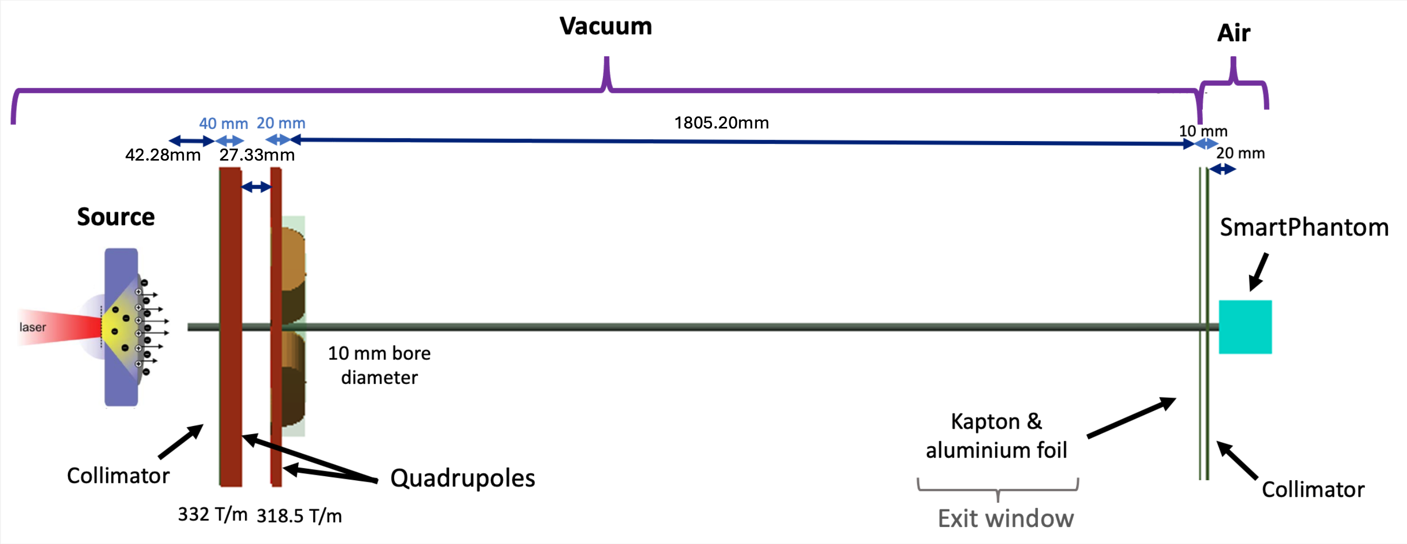
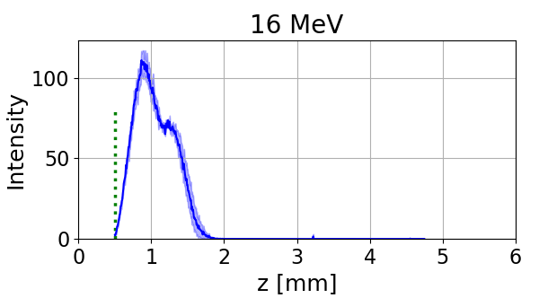
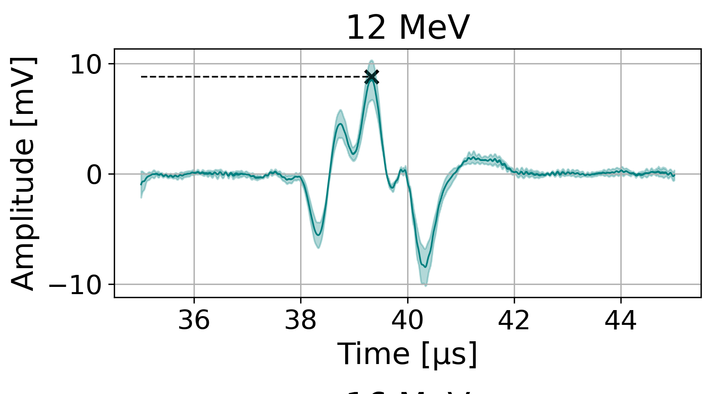
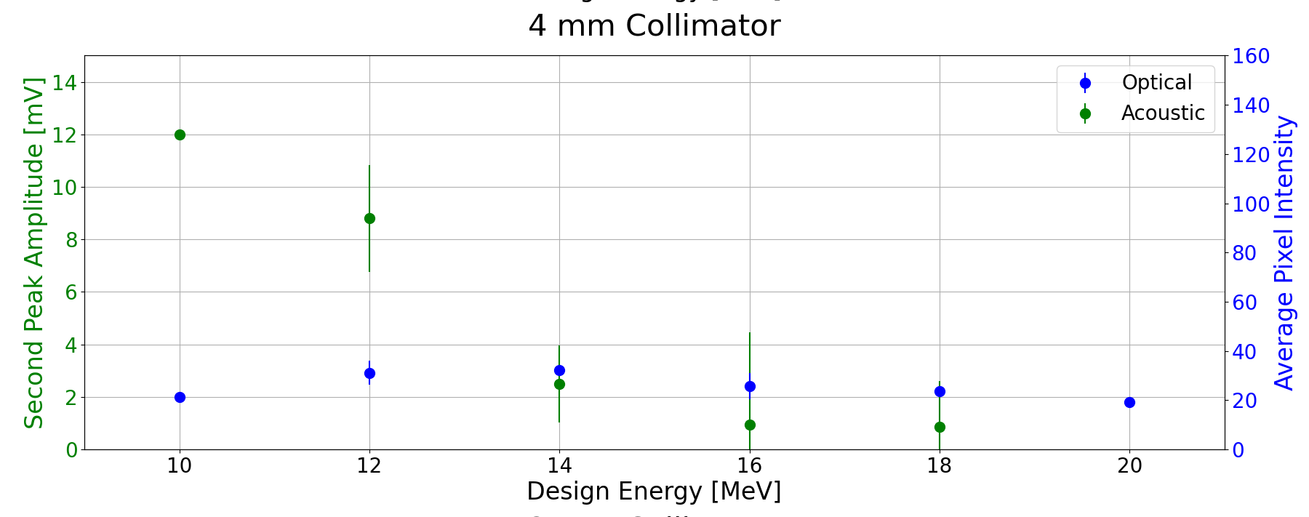
Real-time acoustic dose-profile measurement
Maxouti
Test exposure on LION at LMU:
Correlation: liquid scintillator and acoustic signal

Slide 19
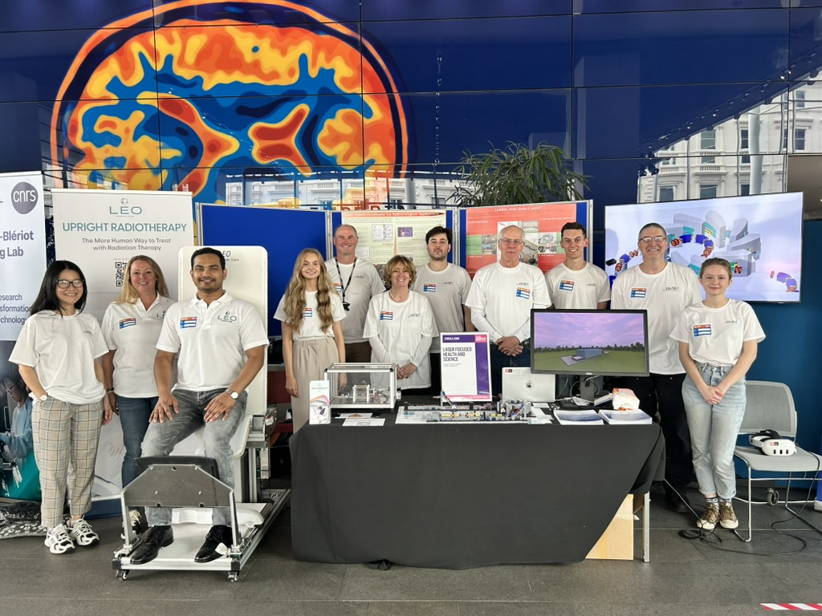
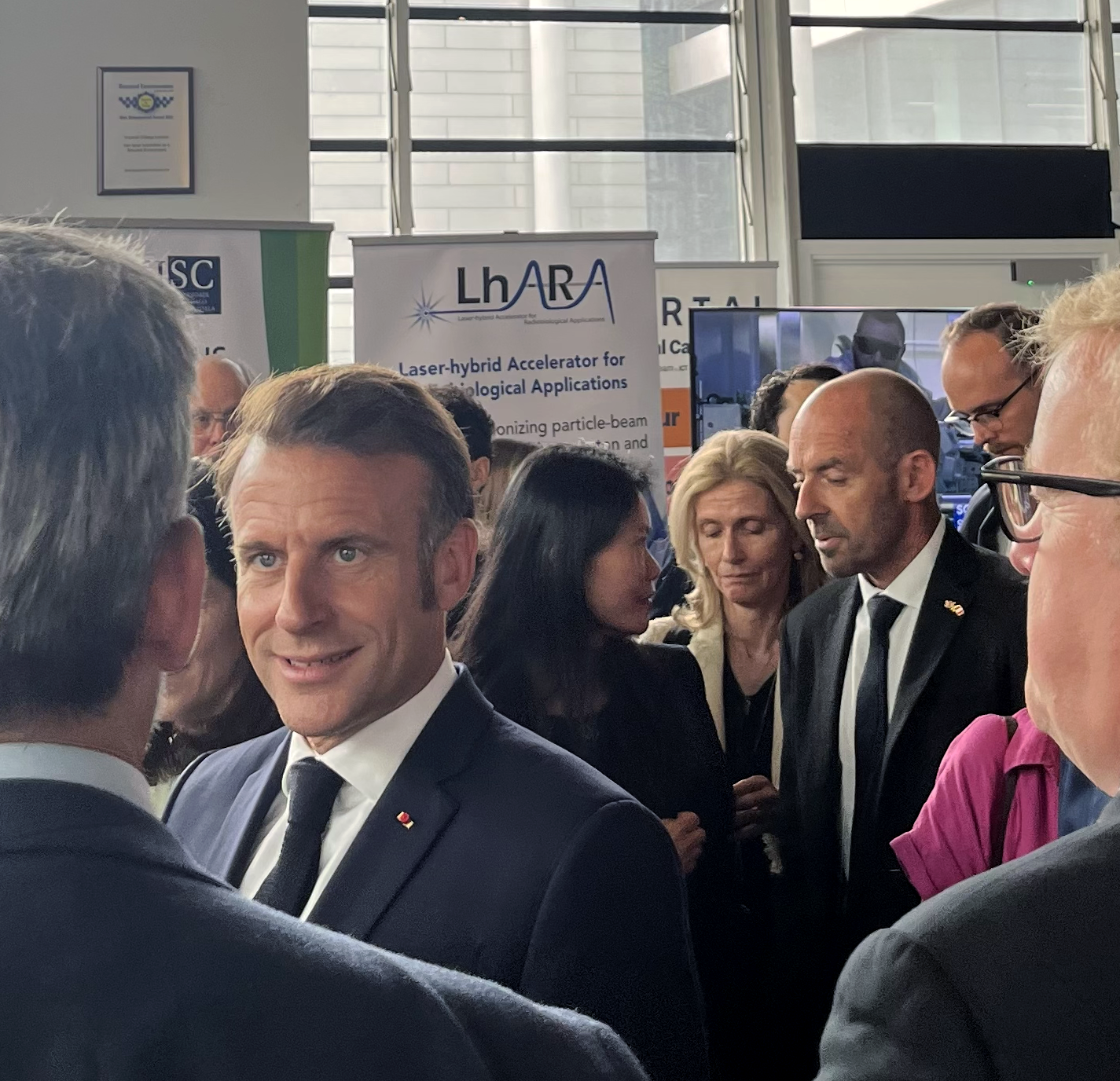
09Jul25; Imperial
Co-creation
ab initio!

Slide 20
Collaboration committed to realising the opportunity to:
Deliver a systematic and definitive radiation biology programme
Prove the feasibility of laser-driven hybrid acceleration
Lay the foundations for the transformation of particle beam therapy
  Automated, patient-specific proton and ion beam therapy
Spin back into fundamental science and innovation

Slide 23
Plasma confinement test beam line

Slide 25
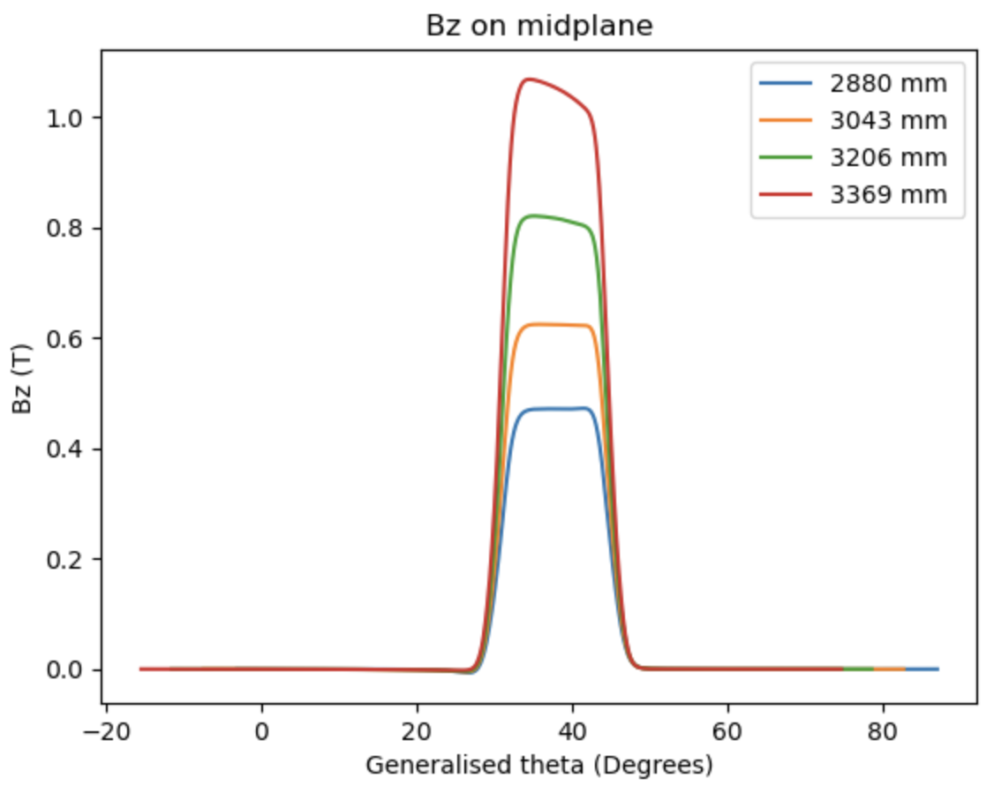
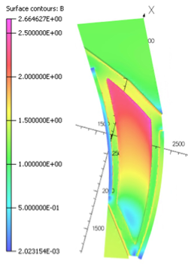
FFA magnet
Magnet:
Satisfies scaling
requirement
Field in straights 60G
Tracking:
No tune crossing up to fourth order

Slide 26
Detailed simulation of beamline …
Simulation required to interpret optical and acoustic measurements

