Slide 1
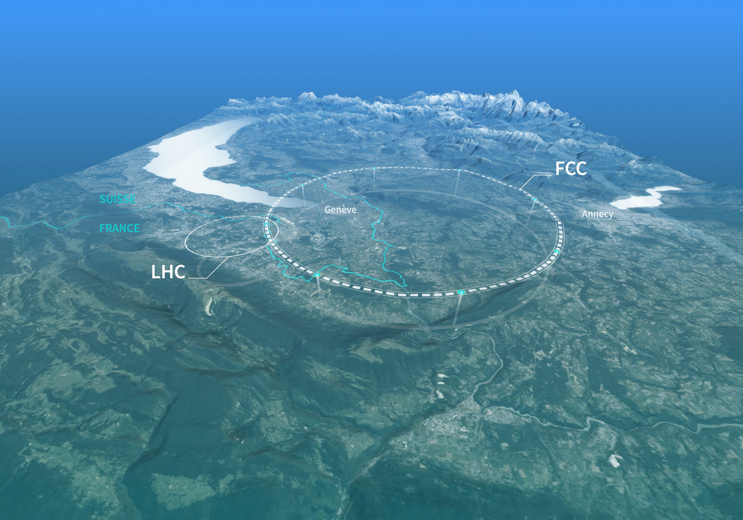

FCC-ee: A High-Luminosity Lepton Collider at CERN
Sofia Kostoglou, CERN
on behalf of the FCC collaboration
EPS-HEP Marseille, 7 July 2025

Slide 2
Motivation
LHC currently in Run 3 with 2 operational years remaining (2025 & 2026). Next phase: High-Luminosity LHC from 2030 to 2041:
  → Expected total integrated luminosity from Run1-6: ~3000 fb⁻¹

Slide 3
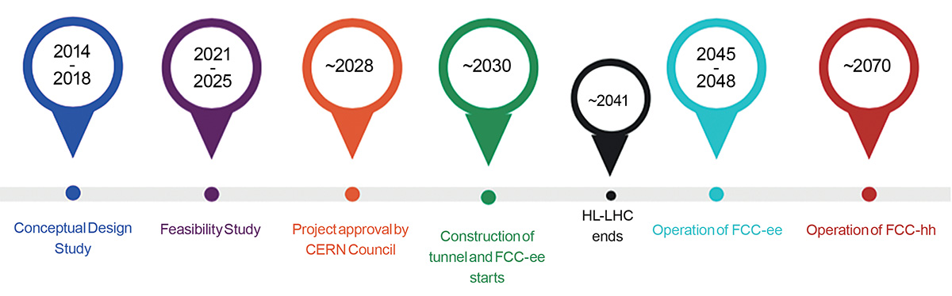
Motivation
LHC currently in Run 3 with 2 operational years remaining (2025 & 2026). Next phase: High-Luminosity LHC from 2030 to 2041:
  → Expected total integrated luminosity from Run1-6: ~3000 fb⁻¹
Next potential collider at CERN post-LHC with unparallel physics reach: Future Circular Collider (FCC):
  FCC Feasibility study completed in 2025 to assess viability of project.
  Entering next phase: “pre-TDR” focusing on detailed R&D, engineering design, cost, integration and environmental impact studies.

Slide 4
Motivation
LHC currently in Run 3 with 2 operational years remaining (2025 & 2026). Next phase: High-Luminosity LHC from 2030 to 2041:
  → Expected total integrated luminosity from Run1-6: ~3000 fb⁻¹
Next potential collider at CERN post-LHC with unparallel physics reach: Future Circular Collider (FCC):
  FCC Feasibility study completed in 2025 to assess viability of project.
  Entering next phase: “pre-TDR” focusing on detailed R&D, engineering design, cost, integration and environmental impact studies.
Two stages: FCC-ee and FCC-hh.
Design and operation of FCC-ee build on experience from current and past machines such as SuperKEKB, DAFNE, LEP, PEP-II: Crab-waist collision scheme, Top-up injection, nm-scale emittances, energy calibration via Resonant Depolarization, etc.

Slide 5
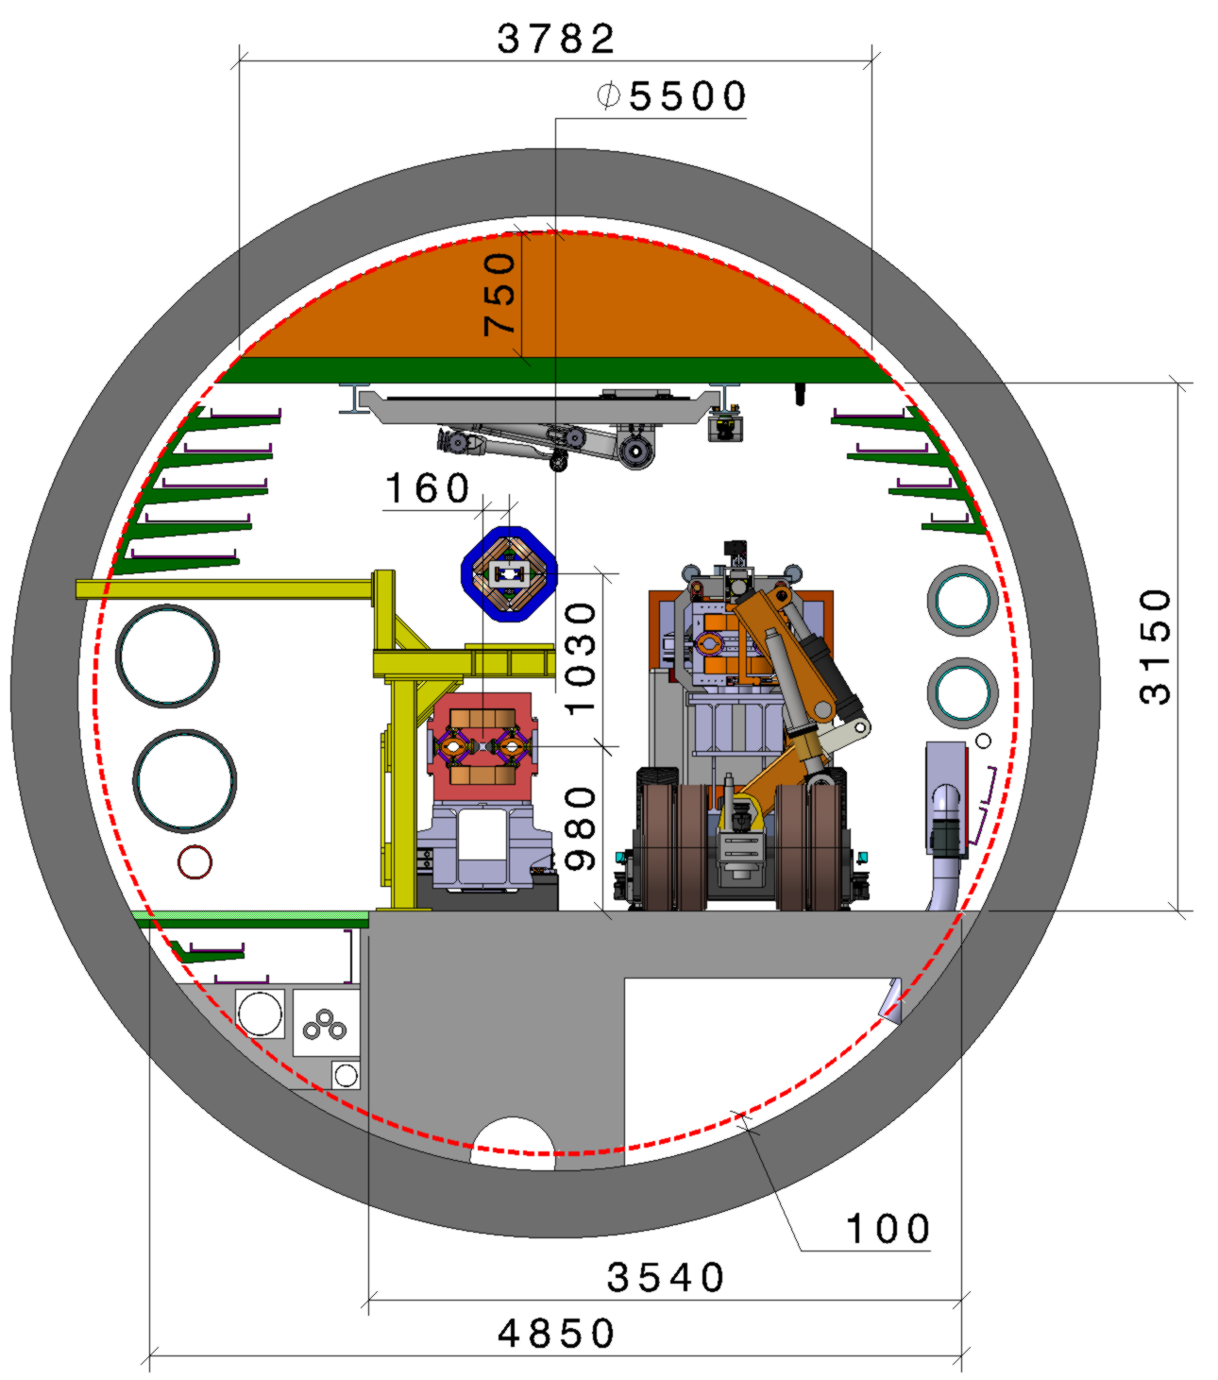
FCC overview
FCC will consist of two stages:
  FCC-ee: Electron-positron collider for high-luminosity Higgs, top & electroweak precision measurements.
  FCC-hh: proton-proton collider.
FCC-ee will operate at 4 energies:
  Z-pole: 45.6 GeV
  WW pair production threshold: 80 GeV
  ZH production peak: 120 GeV
  ttbar production threshold: 182.5 GeV
Common 91 km tunnel for both stages, with 5.5 m tunnel diameter.
~15 years of FCC-ee operation, including 1 year of shutdown for ttbar upgrade. Sequence of Z, WW, ZH is flexible and feasibility of fast switching between modes is being explored.

Slide 6
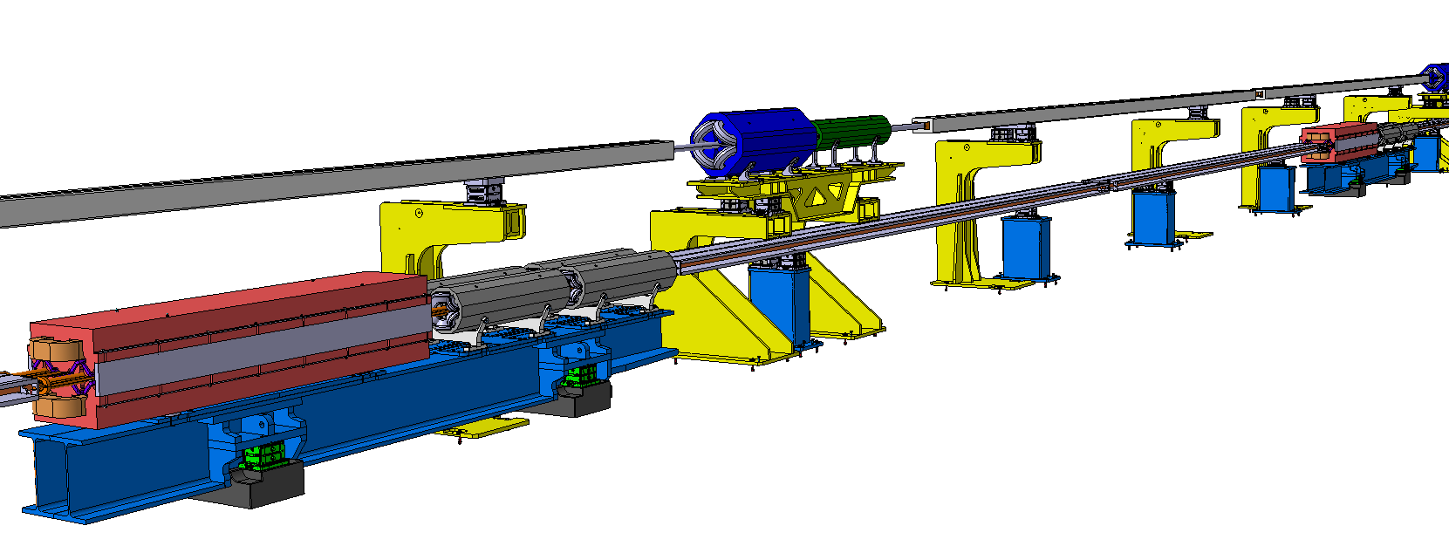
FCC-ee complex
F. Carra et al.
Injector complex:
  Electron & positron source, linacs for e⁻ and e⁺, damping ring, high-energy linac to 20 GeV.
  Beam transferred towards Booster through transfer line.
  On CERN Prevessin site.
High Energy Booster (HEB):
  Installed on top of the Collider, 1.03 m vertical separation.
  Same circumference with Collider.
  Synchronized with Collider for top-up injection.
Collider
2025 DESIGN
SSS Booster girder
SSS Collider girder
BOOSTER
Quadrupole
BOOSTER
Sextupoles
Booster dipole supports
COLLIDER
Sextupoles
COLLIDER
Quadrupole
BOOSTER
Dipole
Collider dipole supports
COLLIDER
Dipole
Magnets supports design are drafts !
Still work in progress !
Shielding are not represented
SSS Booster girder supports
SSS Collider girder supports

Slide 7
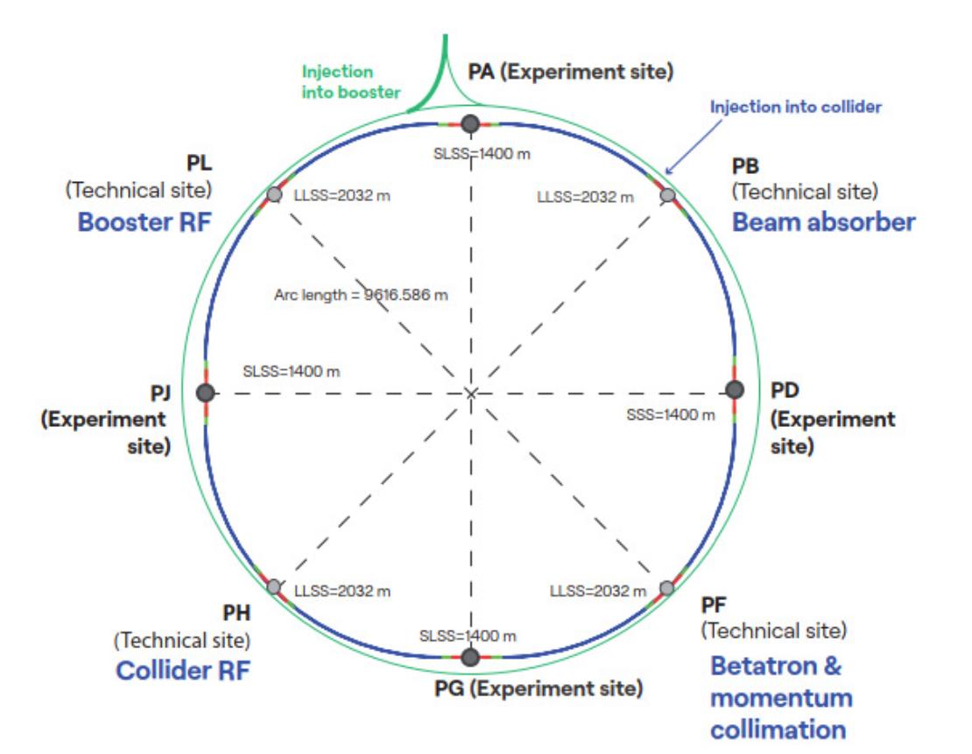
FCC-ee Collider Layout
Electron-positron collider.
~91 km circumference.
8 arcs of ~9.6 km each and 8 long straight sections (insertions).
4 experimental insertions of ~1.4 km (PA, PD, PG, PJ), with experimental cavern sizes meeting the detector needs for both FCC-ee and FCC-hh.
4 technical insertions of 2 km:
  Injection & Extraction (PB)
  Collimation (PF)
  RF (PH)
  Booster RF (PL)

Slide 8
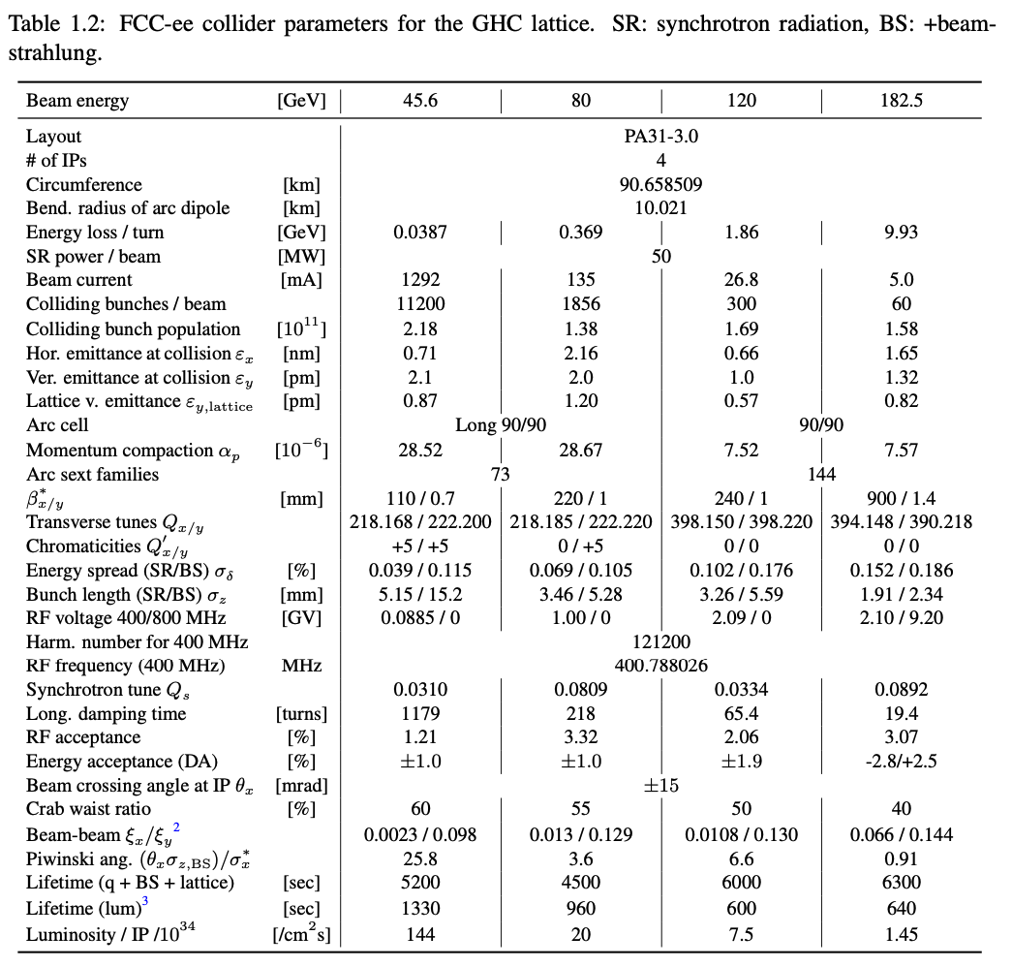
FCC-ee Collider parameters
4 years
5 x 10¹² Z
LEP x 10⁵
2 years
> 10⁸ WW
LEP x 10⁴
3 years
2 x 10⁶ H
5 years
2 x 10⁶ ttbar pairs
Reference layout chosen, 7 sites in France, 1 site in Switzerland.
Synchrotron Radiation power limited to 50 MW per beam for all operation modes.
Number of bunches ranges from 11200 (Z) down to 60 (ttbar).
Bunch intensity 1.4-2.2e11 ppb.
Horizontal emittances in ~nm range, vertical emittances in ~pm range.
Vertical β* function 0.7-1.4 mm.
400 MHz RF cavities for Z/WW/ZH, additional 800 MHz RF cavities for ttbar.
Horizontal crossing in IPs with 30 mrad.
Luminosity target 144 x 10 ³⁴ Hz/cm² (Z) to 1.45 x 10 ³⁴ Hz/cm² (ttbar).

Slide 9
Optics
Two optics options currently under consideration:
Global Hybrid Correction (GHC) as baseline by K. Oide
Local Chromaticity Correction (LCC) as alternative by P. Raimondi
Several common features (4-fold symmetry, crab waist scheme, superconducting quadrupole doublet for final focusing) but also important difference (chromaticity correction, arc structure, polarity of twin aperture quadrupoles for e- and e+).
  → Based on different principles and require different hardware implementation. Different chromaticity correction strategies that result in different requirements.
One of the key milestones in the pre-TDR phase is to select the final optics design based on several criteria such as performance, cost, integration, availability, tuning flexibility, tolerances, hardware.

Slide 10
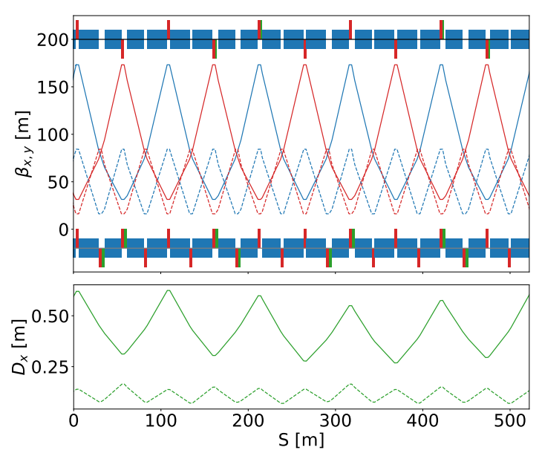
Arc layout
350 mm separation between e+ and e- beams
Twin aperture dipoles and quadrupoles.
Dedicated SR shielding required: Dipoles equipped with photon stoppers and SR absorbers, bunkered electronics underneath for radiation shielding.
- I
GHC:
FODO cell length varies with beam energy, fixed 90° phase advance. Requires magnet reconfiguration. Currently studying options to minimize hardware changes across energy stages.
Sextupoles arranged in –I transform pairs, powered independently.
Twin aperture structure quadrupoles with QF/QD polarity for the two beams.

Slide 11
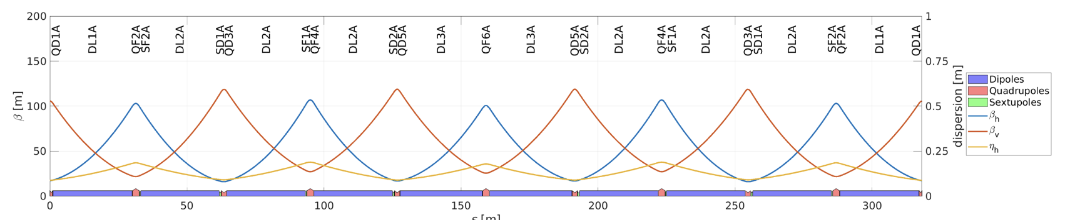
Arc layout
LCC:
Magnet layout remains fixed across all energies, only FODO cell phase advance is adjusted with energy
Designed to be anharmonic and achromatic.
Uses nested sextupole pairs and fewer sextupole families.
Longer dipoles and fewer quadrupoles and sextupoles with non-uniform lengths.
Same polarity QF/QF or QD/QD quadrupoles for e+/e- beams.

Slide 12
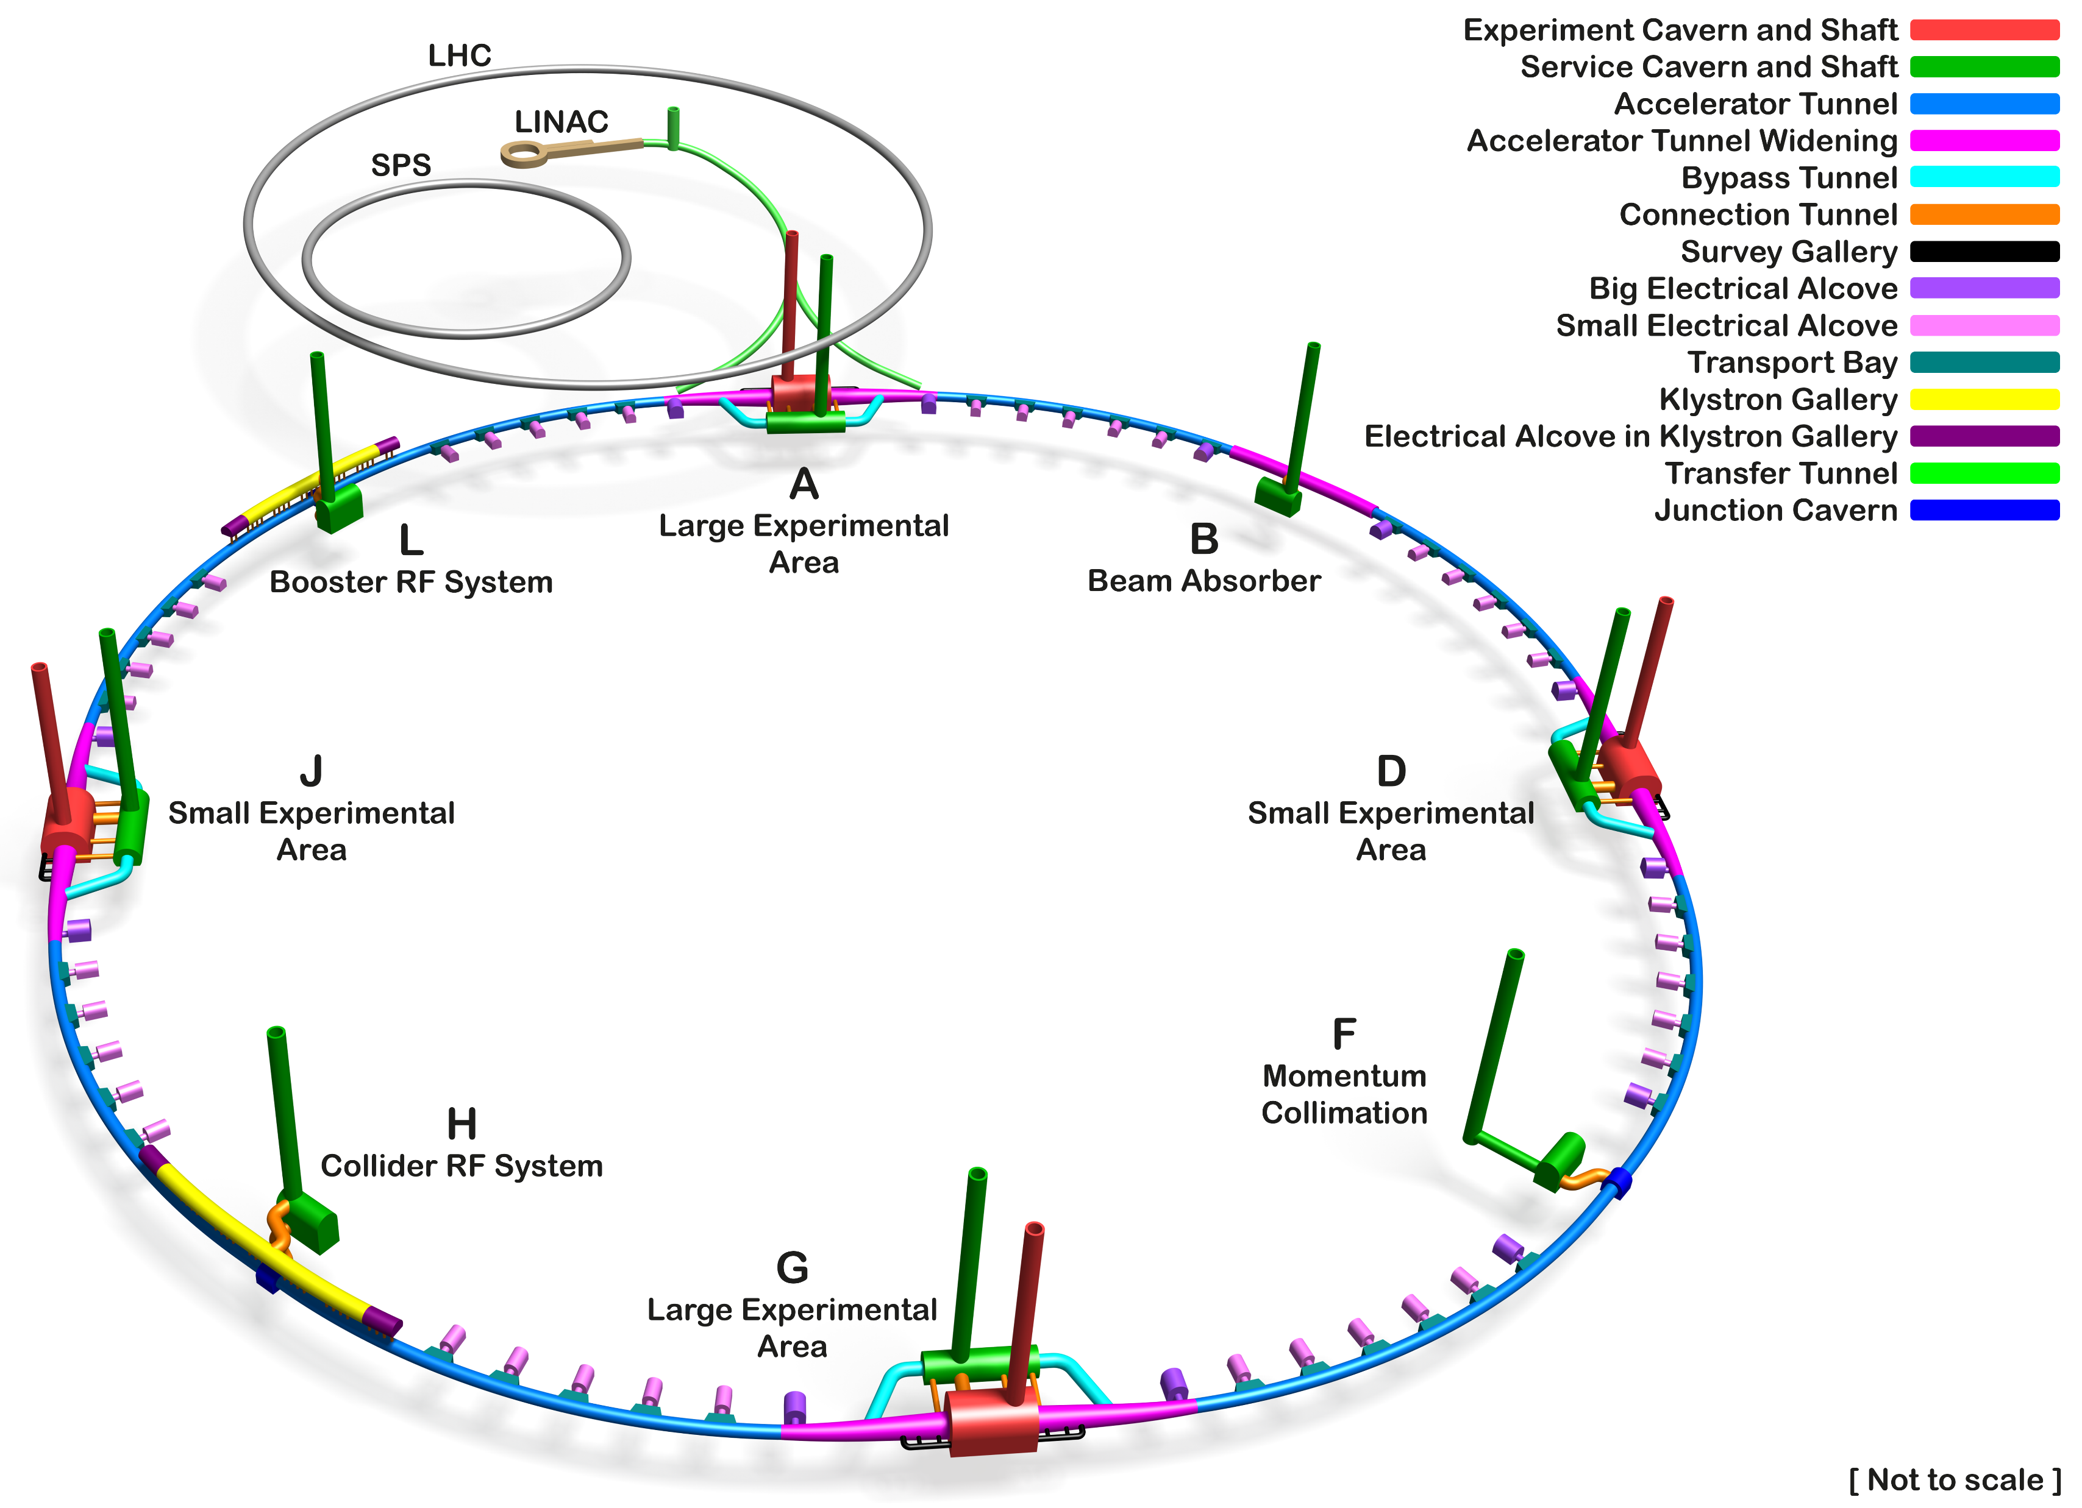
Technical insertions
Advantage to maintain 4-fold super-periodicity of the lattice:
  “Universal” insertions: Current efforts to integrate similar insertions for all functionalities.
Injection & extraction:
  Top-up injection: Short beam lifetime and high luminosity require continuous refilling of the circulating bunches
    Every 3s, up to 10% of bunch intensity & 1120 bunches (Z).
    On-axis injection with 1% momentum deviation, estimated injection efficiency of 90% in simulations.
    Bootstrapping to avoid instabilities with intensity asymmetries & beam-beam (3D flip flop).
  Extraction:
    Extremely small vertical emittances, high energy density.
    Several protection elements required at precise phase advances to safely absorb and extract the beam.
    Large beta functions and dispersion to maximize beam size and reduce energy density on the dump.

Slide 13
Technical insertions
Collimation:
  Protect machine against unavoidable beam losses and reduce background in the experiments.
  17.5 MJ for most critical Z mode, 0.3 MJ for ttbar.
  2 stage collimation system (primary & secondary).
  Momentum and betatron collimation.
  Additional collimation in experimental areas (synchrotron radiation collimation system, tertiary collimators) and injection areas.

Slide 14
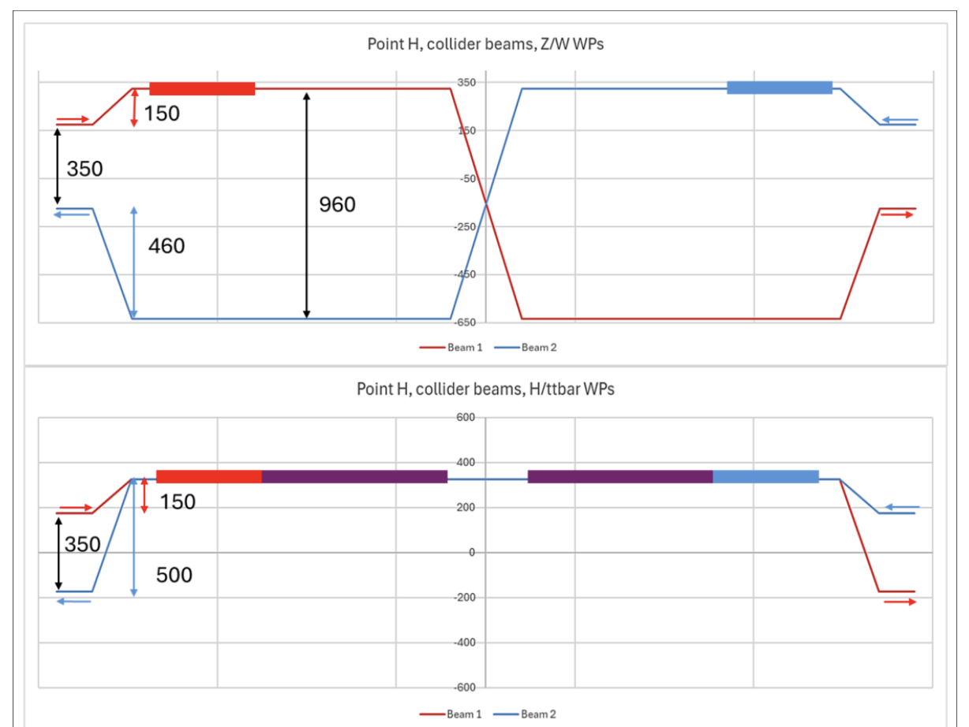
Technical insertions
RF:
  Same 2-cell 400 MHz superconducting RF system for Z, WW and ZH operation thanks to Reverse Phase Operation (RPO) at Z, entire system installed at operation start
  6-cell 800 MHz for ttbar.

Slide 15
Experimental insertions
Highly complex region of the machine, exposed to major radiation sources such Beamstrahlung radiation, radiative Bhabha and synchrotron radiation.
Key points:
  Final doublet: Superconducting final focusing quadrupoles (QC1 and QC2).

Slide 16
Experimental insertions
Highly complex region of the machine, exposed to major radiation sources such Beamstrahlung radiation, radiative Bhabha and synchrotron radiation.
Key points:
  Final doublet
  Solenoid compensation schemes: Designed to mitigate the 2 T detector solenoid field on the beam:
      “Local” scheme: compensating solenoid placed close to the IP.
      “Non-local”: compensating solenoid placed meters from IP, after final quadrupoles.

Slide 17
Experimental insertions
Highly complex region of the machine, exposed to major radiation sources such Beamstrahlung radiation, radiative Bhabha and synchrotron radiation.
Key points:
  Final doublet
  Solenoid compensation schemes
  Polarization: Need for energy calibration within ~100 keV
    Average energy can be extracted from spin tune measurements, method used in LEP.
    Baseline is to polarize pilot bunches in collider.
    Wigglers: enhance polarization buildup for pilot bunches.
    Compton polarimeters: measures beam polarization for resonant depolarization.
    Considering option of injecting pre-polarized bunches.

Slide 18
Experimental insertions
Highly complex region of the machine, exposed to major radiation sources such Beamstrahlung radiation, radiative Bhabha and synchrotron radiation.
Key points:
  Final doublet
  Solenoid compensation schemes
  Polarization
  Crab waist scheme: Maximizes luminosity and suppresses synchro-betatron resonances
    Achieved via sextupoles near IP: either dedicated crab-waist sextupoles (LCC) or “virtual” crab waist using IR chromatic sextupoles (GHC) .

Slide 19
Experimental insertions
Highly complex region of the machine, exposed to major radiation sources such Beamstrahlung radiation, radiative Bhabha and synchrotron radiation.
Key points:
  Final doublet
  Solenoid compensation schemes
  Polarization
  Crab waist scheme
  Chromaticity correction: Depends on optics choice, in GHC vertical is corrected locally and horizontal globally, while in LCC both planes corrected locally at each IP.

Slide 20

FCC-ee simulation framework
Goal: Demonstrate performance feasibility under realistic machine conditions using accurate and consolidated simulation framework.
  Benchmarking of simulation tools against existing operational accelerators & ensure reliable modeling of important FCC-specific effects.
Powerful simulation framework developed at CERN: Xsuite
  Full chain of simulations: lattice optics, Synchrotron Radiation, Injection and top-up, Collisions, Beam-beam (weak-strong, strong-strong), Polarization & many other effects.
  Performance studies: Emittance evolution, Dynamic Aperture, Momentum Acceptance, Frequency Map Analysis, Luminosity.
  Tolerance studies for alignment, imperfections, magnetic field errors, power supply ripple, noise effects, ground motion.
  Optics tuning and correction strategy.
  Define hardware specifications such as BPM resolution, power converter specifications, orbit and tune control etc.
  → Crucial to guide hardware specifications & building confidence that predicted performance can be achieved.

Slide 21
Conclusions
FCC-ee is one of the leading candidates for the next generation lepton collider at CERN, first stage of broader FCC program.
Will operate at four energies with unprecendented luminosity and precision.
Builds on the experience of past and present machines with novel optics and beam dynamics strategies: Ultra-low emittance optics, crab waist collision scheme, top-up injection, energy calibration and resonant depolarization
Focusing on flexible transition between energy modes and maximizing operational efficiency.
Design and performance studies rely on simulation tools: Xsuite currently under development at CERN. Results guide hardware specifications, machine operation and performance.
Next steps include:
Final optics selection: GHC vs LCC decision during pre-TDR.
Integration studies, mock-up validations & prototype developments.
Complete pre-TDR phase and feed into full TDR preparation.

