Slide 1
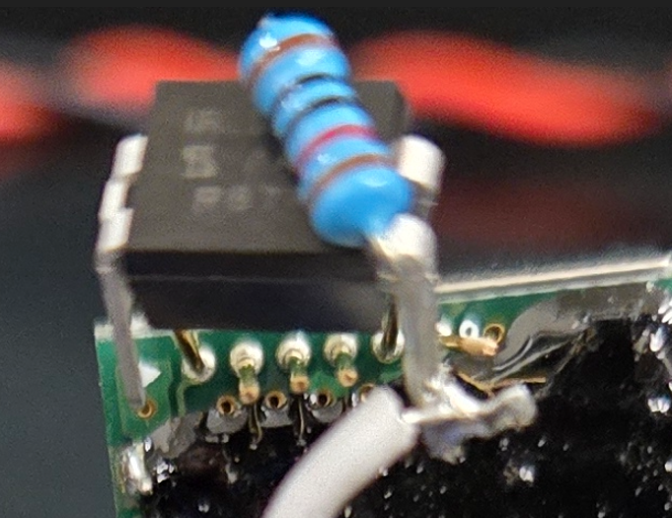
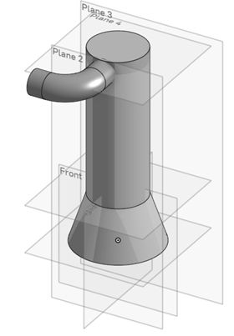
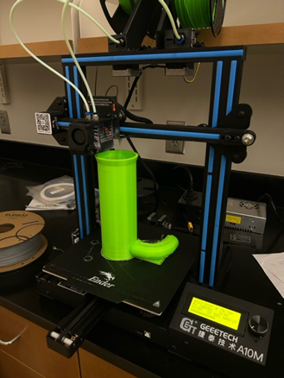
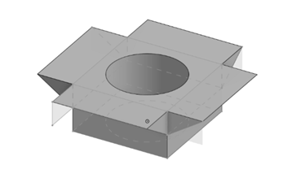
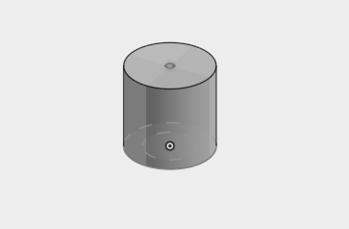
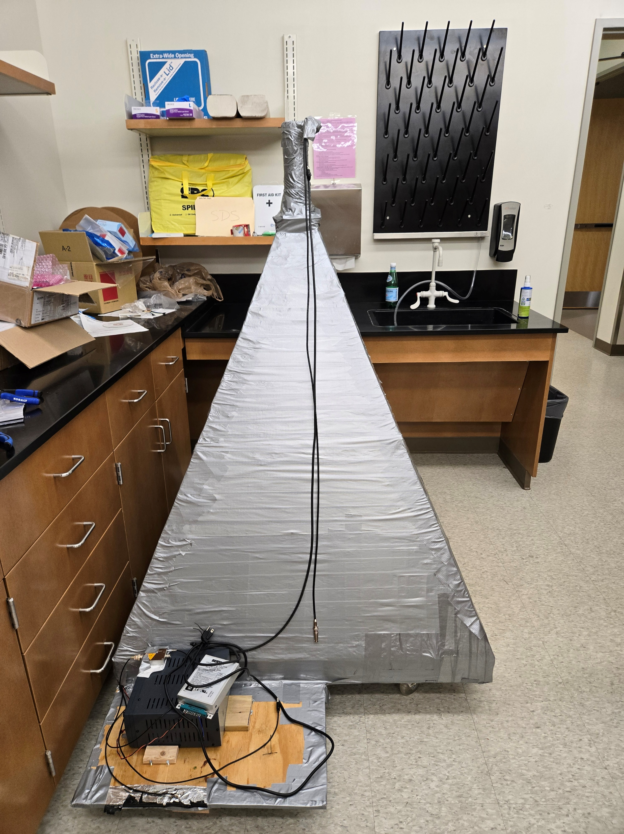
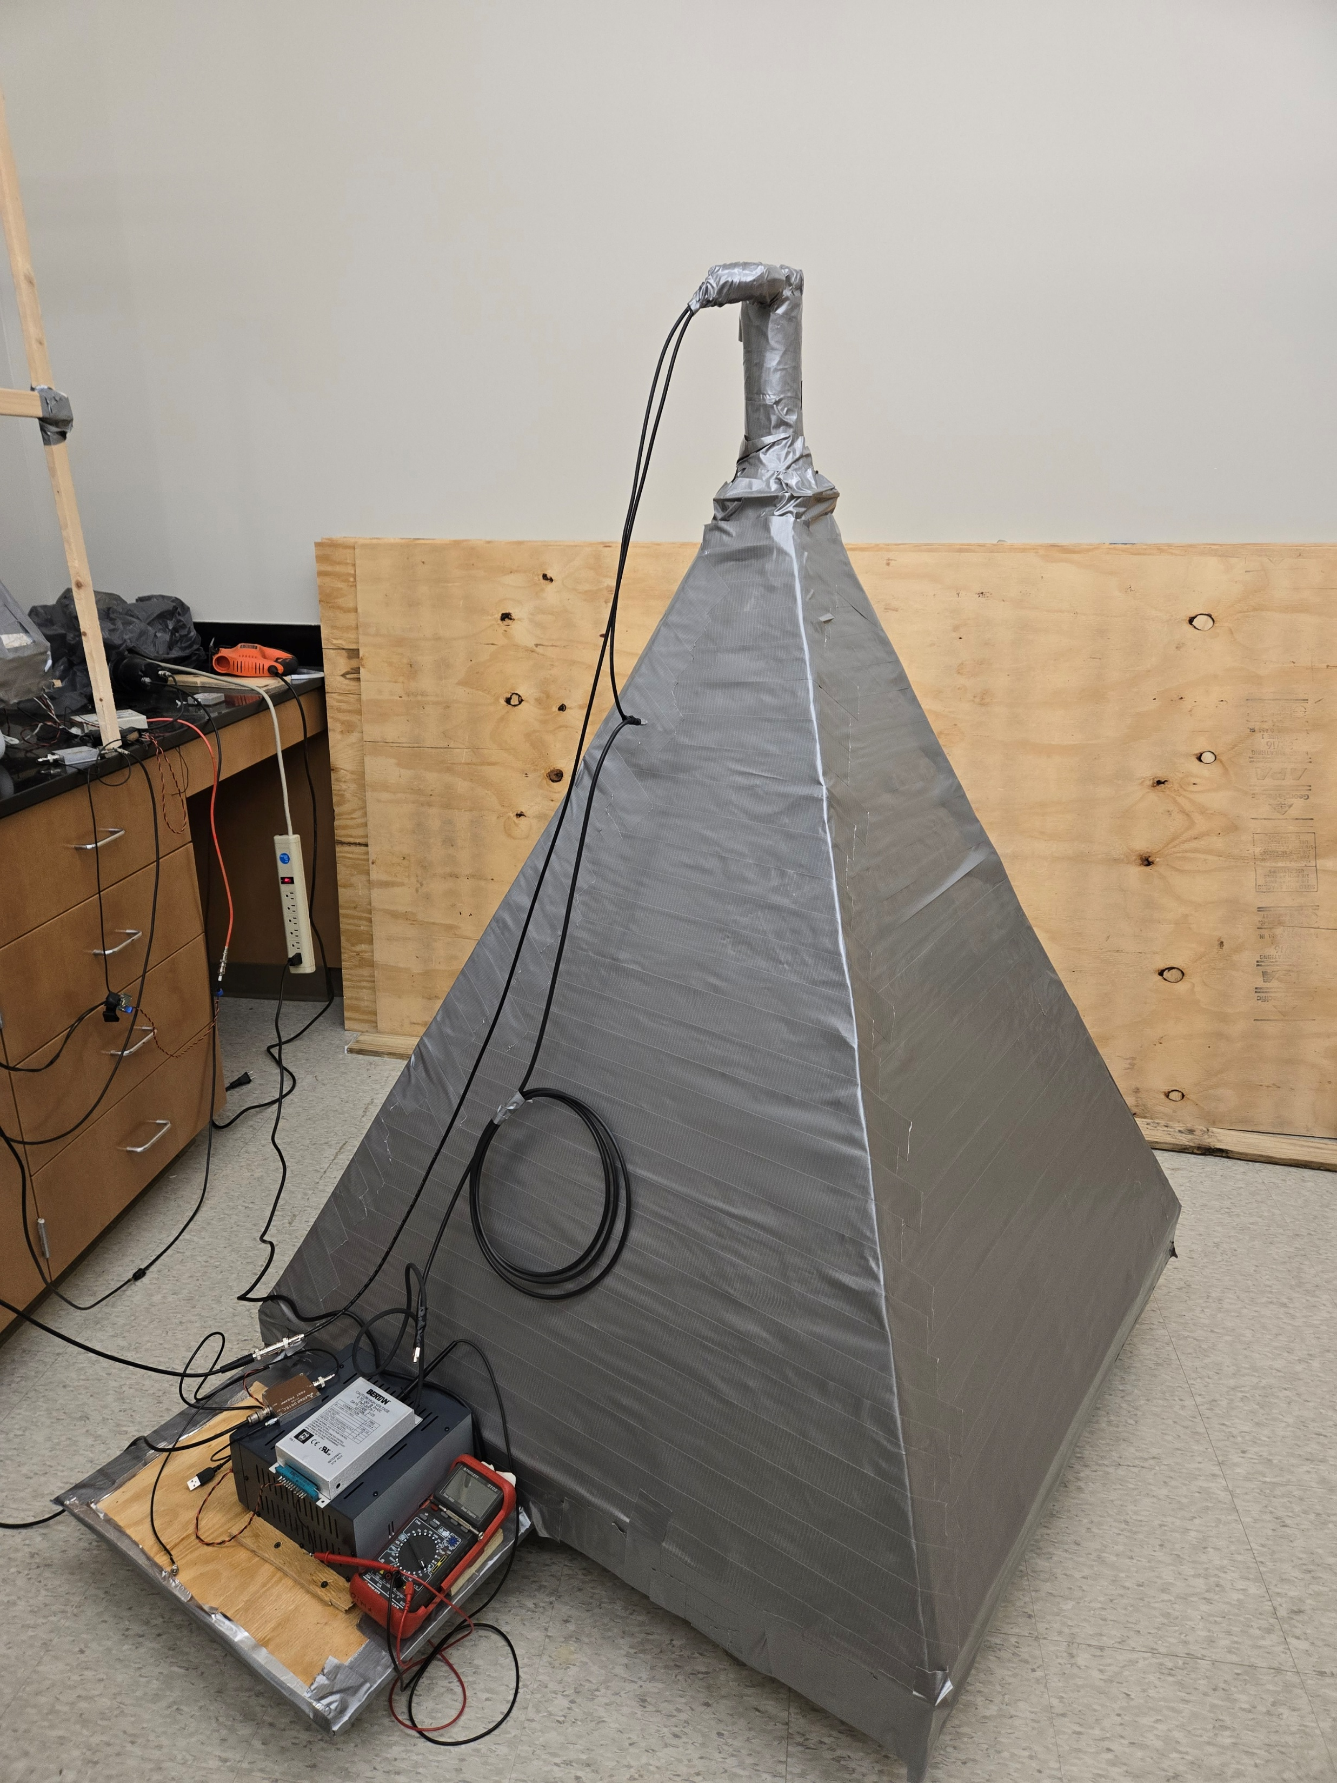
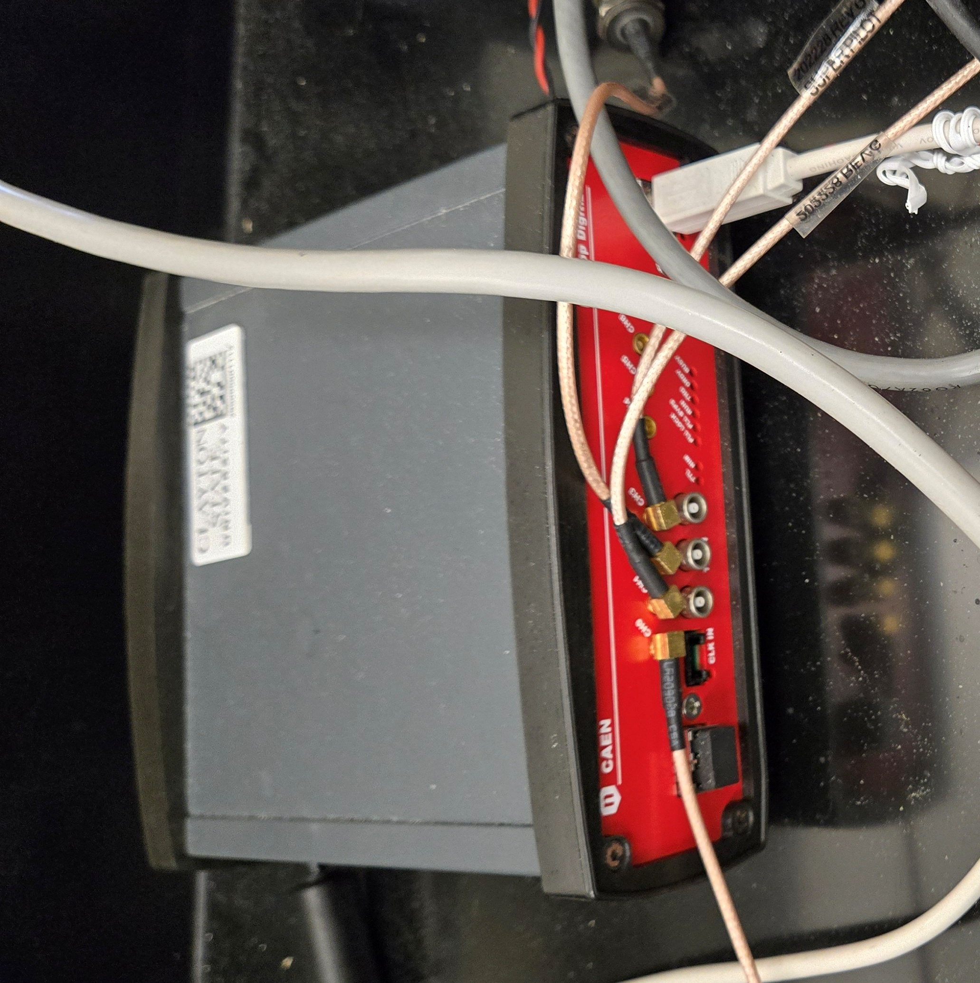
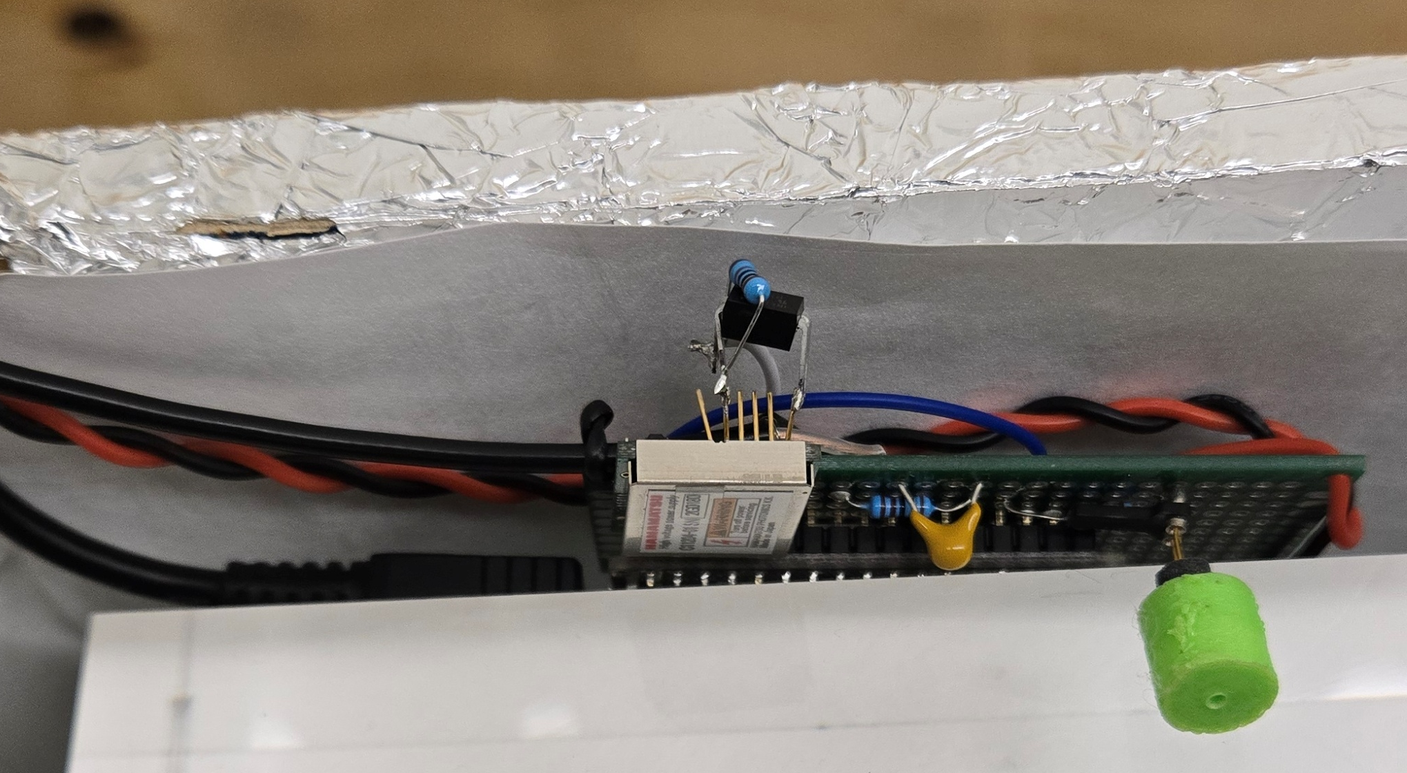
Construction and calibration of the DUCK (Detector of Unusual casKades) system modules By: Dmitriy Beznosko* for DUCK Collaboration EPS-HEP 2025 *Presenter. dmitriybeznosko@clayton.edu
ABSTRACT: In the High-Energy Physics field there is an active search of the origin and the nature of the Ultra-high energy cosmic rays. These are messengers that carry information from far into the Universe, and they might also hint on direction towards new physics. This talk presents the overall hardware and software design, and the construction and calibration of DUCK (Detector system of Unusual Cosmic-ray casKades) main modules. DUCK is a new cosmic-rays detector that is being constructed at the Clayton State University campus that has resolution at the ns-level. The main scientific direction for the DUCK project is to contribute to the approach of cosmic ray event analysis using the full waveform and detector response width. Additionally, it aims to provide an independent verification of the detection of the ‘unusual’ cosmic ray events that were reported by the Horizon-T detector system that may be indicating direction towards the novel physics possibilities.
Introduction
High Energy Physics (HEP) is a field that has still has many mysteries that need to be solved. An open question is about the origin and composition of the Ultra-high Energy Cosmic Rays (UHECRs). These cosmic rays originate well outside our planet, may be even outside of the galaxy. They are messengers that could help us better understand the universe around us and provide insight into the fundamental building blocks of our universe.
The primary goal of the DUCK system [1] is to detect and verify the existence of unusual cosmic events [2, 3]. Moreover, it can help innovate EAS (Extensive Atmospheric Shower) analysis methods. This poster aims to highlight development and construction of the detector system, instrument calibrations and other activities conducted at Clayton State University.
H11284-30 (former R7723) PMT from Hamamatsu is used as primary photosensor (one of the best PMTs arguably)
Great/robust C9619-01 power supply
Figure 8 is the DT5730 ADC used
Figure 9 is the Hamamatsu [4] Power supply C11204-01 for the MPPC photosensor. In- 5V, out - <90V, covers MPPC range needed.
Issues:
COM-port communication, on power loss – loses last setting, starts with default of 40V – Arduino controller to monitor
Old protocol, slow speed. Unnecessarily complicated commands.
Needs to be ‘reset’ when loaded: short NC pin to ground, undocumented.
No overload/short protection
Worst product by Hamamatsu ever?
ROOT-based file format
The data acquisition (DAQ) method is implemented using the CERN ROOT analysis framework. ROOT’s built-in file-writing tools are used to save the data as .root files. These ROOT files are binary and are designed to prioritize easy retrieval of information while maintaining a compact file size. They use a hierarchical structure for data organization, with data stored in tree-like structures that help track complex systems. The file consists of three parts: header, body, and footer. Each part contains a data tree (TTree), and each tree can hold multiple events. In practice, the header and footer typically contain a single event [5].
Header: The header’s primary purpose is to define the parameters by which the DAQ was conducted. Parameters include: sampling frequency, readout speed, trigger type, trigger polarity, etc.
Data: The body of the file contains ‘events’ - data from a detected cosmic event. The data recorded notes the size of a given event and data from each each individual channel within the DAQ time window. The data is written after each trigger, this is done to reduce data loss in the event of malfunction.
Footer: The footer of the file is written at closing the file and contains important information for quality assurance. The footer notes the total number of cosmic events during a physics run across all files.
ADC-DAQ Software
A specialized software was developed for the purposes of controlling DT5730 ADC, and data collection [6]. The software was designed to consider the speed, data readability, ADC control function, and real time display (with priority on data collection). The software uses TBB (threading blocks) library to delegate and handle task operation [5, 7].
The current version of the software offers a real time display where the controls are adjusted, and data can be observed.
Figure 1. PMT holder shell .
Figure 2. PMT holder printing.
Figure 3: PMT base holder
Figure 4. Optic Fiber ferule for MPPC.
3D Hardware Design
Using OnShape CAD, the PMT Upper Shell (Figure 1), Holder (Figure 3) and Optic Fiber ferule (Figure 4) for Module 1 were designed and 3Dprinted.
Notes taken about “CAD-ing”:
Use Planes to manipulate where objects originate
Splicing using UltiMaker Cura 5.3 or similar after downloading the .stl file.
Operating a 3D printer (Figure 2) and troubleshooting problems.
Use fine mode for stl file, units in mm. Adjust other parameters as needed.
Project Progress Report
Modules #1 and #2 has been fully built, and all hardware components are now operational. (Figures 5 and 6)
Several new hardware additions were designed and implemented, including the PMT holder and mount, as well as PMT cable management. (See 3D hardware design section)
Two more modules are under construction. (Figure 7)
Initial calibrations were conducted.
Future Plans
Software:
Adapt new methods for better and more robust ADC-DAQ control.
Addition of detailed software documentation.
Development of command-line interface for more dynamic interaction.
Hardware
Complete construction of Module 3 and 4
Complete calibration of all modules through various tests
Analyze data from Module 1 and 2 and start tests such as separation curve
Command-Line Interface Program:
The current software only allows for the execution of commands through the GUI. The purpose of the new command-line interface (CLI) is to enable the execution of ADC and DAQ controls within a terminal, while maintaining the ability to execute commands through the GUI.
The program will be written in Python 3 and will utilize task queuing as the primary method of task execution. It will run a main control method and use Python's subprocess library to manage ADC-DAQ software execution.
Figure 5. Module #1
Figure 6. Module #2
Figure 7. Modules 3 and 4
References
[1] Dmitriy Beznosko, Valeriy Aseykin, Alexander Dyshkant, Fernando Guadarrama, Alexander Iakovlev, Oleg Krivosheev, Tatiana Krivosheev, Alexander Ramirez, Vladimir Shiltsev, Xuong Minh Tran, and Valeriy Zhukov. "Construction progress of Detector of Unusual Cosmic-ray casKades", Proceedings of 4th Annual College of STEM Symposium, PROC(04ACSS2025)002, 03/2025 https://sos.clayton.edu/proceedings/004/PROC(04ACSS2025)002.pdf
[2] Dmitriy Beznosko, Valeriy Aseykin, Alexander Dyshkant, Alexander Iakovlev, Oleg Krivosheev, Tatiana Krivosheev, Valeriy Zhukov, ‘Design Considerations of the DUCK Detector System’, Quantum Beam Sci. 2023, 7(1), 6; https://doi.org/10.3390/qubs7010006
[3] Beznosko, D.; Aseykin, V.; Dyshkant, A.; Iakovlev, A.; Krivosheev, O.; Krivosheev, T.; Shiltsev, V.; Zhukov, V. "Prototype Setup Hardware Choice for the DUCK System". Quantum Beam Sci.2024, 8, 17. https://doi.org/10.3390/qubs8030017
[4] HAMAMATSU PHOTONICS K.K., Electron Tube Division, 314-5, Shimokanzo, Iwata City, Shizuoka Pref., 438-0193, Japan, http://www.hamamatsu.com
[5] Dmitriy Beznosko, Farid Gasratov, Fernando Guadarrama, Alexander Iakovlev, “Scripting data acquisition operations and choice of data format for the data files of the DUCK ultra-high energy cosmic rays detector”, arXiv:2501.08235, 2025/1/14, https://doi.org/10.48550/arXiv.2501.0823
[6] Dmitriy Beznosko, Valeriy Aseykin, Kanat Baigarin, Elena Beisembaeva, Turlan Sadykov, Marina Vildanova, Valery Zhukov. ‘Continuous detection points calibration at Horizon-T experiment and the status update’, 38th International Cosmic Ray Conference (ICRC2023), PoS(ICRC2023)195, DOI: https://doi.org/10.22323/1.444.0195, 2023/7/25
[7] Beznosko, Dmitriy, Valeriy Aseykin, Alexander Dyshkant, Alexander Iakovlev, Oleg Krivosheev, Tatiana Krivosheev, Vladimir Shiltsev, and Valeriy Zhukov. 2024. "Prototype Setup Hardware Choice for the DUCK System" Quantum Beam Science 8, https://doi.org/10.3390/qubs8030017
Figure 8. ADC
Figure 9. Secondary photodetector (MPPC) installation

